Slide 1
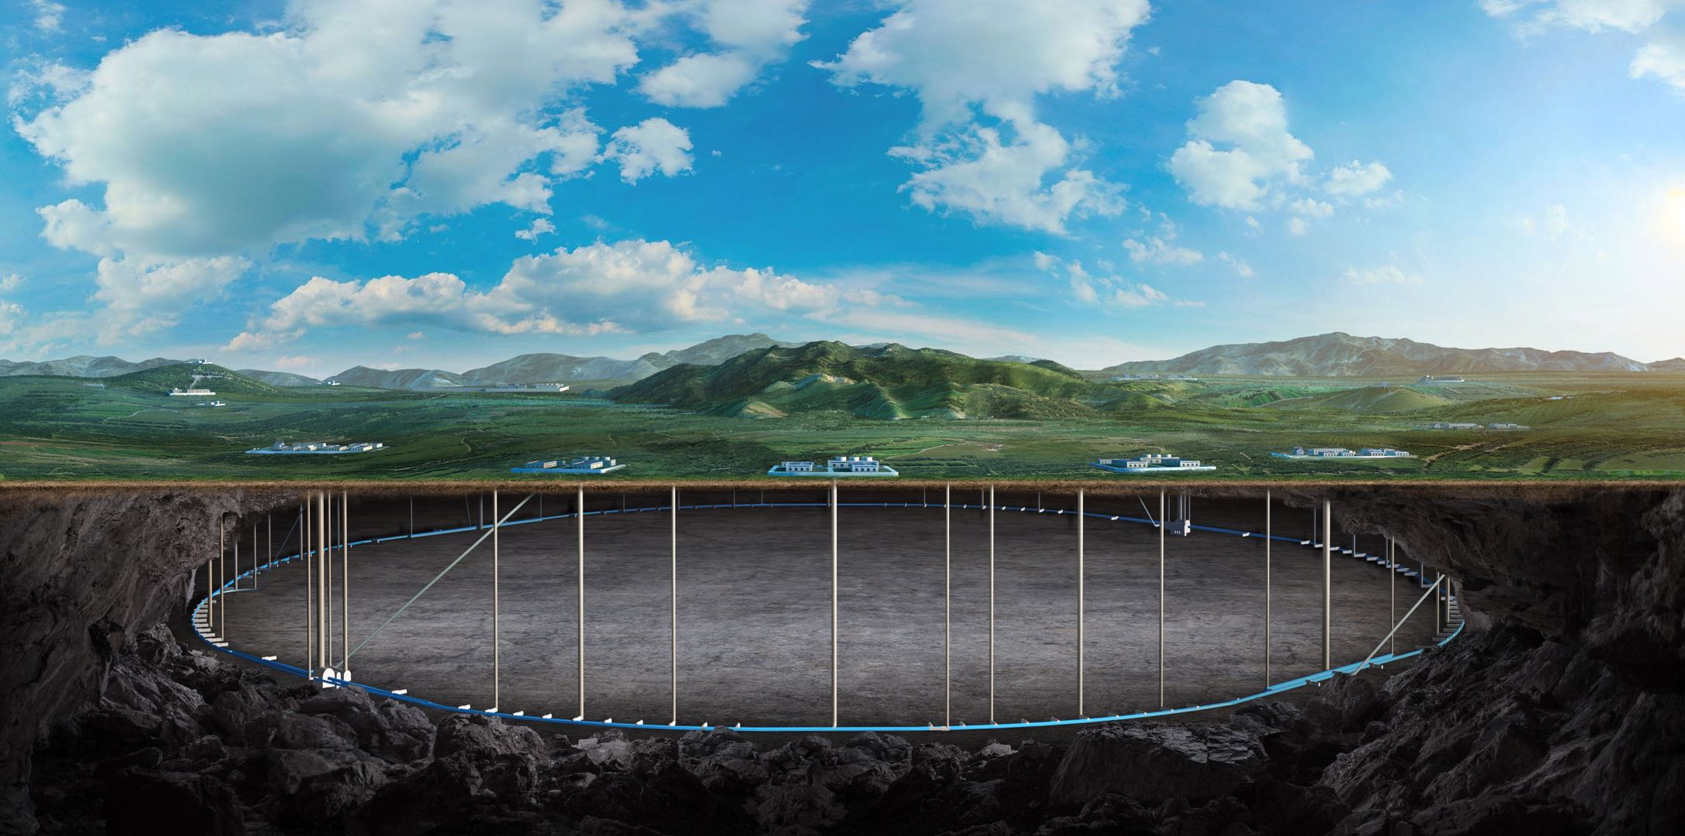


CEPC vertex Detector
Zhijun Liang

Slide 2
CEPC Vertex: Schedule to Address IDRC Recommendations (2026-2027)
Editable PPT
Year
Main goals
IDRC recommendation addressed
Deliverables / milestones
2026
Finalize the SK hynix HL 90L CIS sensor strategy; define stitching scheme, readout partitioning, epi-layer and resistivity options; start dummy-wafer mechanical studies; build first cooling/thermal mock-up platform; define laser-alignment demonstrator concept.
Technology update after TDR; realistic sensor properties; cooling validation; laser alignment.
HL 90L CIS first-generation design strategy; stitching layout definition; dummy-wafer prototype plan; initial cooling/thermal test platform; laser-alignment demonstrator design.
2027
Submit first HL 90L CIS prototype tape-out; perform basic sensor-function tests; develop low-mass ladder, readout board, DAQ, cabling, and RSU routing prototypes.
Sensor prototype validation; RSU power/data routing; low-mass ladder development.
First HL 90L CIS prototype tape-out; sensor basic test report; ladder/readout/DAQ prototype; preliminary cabling and RSU routing scheme.
Source basis: 2022 BOE / IDRC vertex prototype structure, updated with current HL 90L CIS route and IDRC follow-up items.

Slide 3
CEPC Vertex: Schedule to Address IDRC Recommendations (2028-2030)
Editable PPT
Year
Main goals
IDRC recommendation addressed
Deliverables / milestones
2028
Perform beam and irradiation tests of first-generation sensor; validate radiation tolerance; prepare next sensor-design iteration; integrate sensor, ladder, readout, cooling, and alignment into detector-unit prototypes.
Radiation tolerance at about 2 x 10^14 neq/cm^2; realistic detector-unit demonstrator; cooling and alignment validation.
Beam-test report; irradiation-test report; second design iteration plan; detector-unit prototype with cooling/readout/alignment elements.
2029
Conduct system-level tests combining sensor, readout, cooling, cabling, shielding, and mechanical support; validate RSU shielding and electromagnetic-pickup mitigation; perform stability and integration tests.
Power/data shielding; electromagnetic pickup; system-level integration.
System integration test report; RSU shielding validation; stability-test results; updated full-scale VTX prototype design.
2030
Complete full-scale VTX prototype; demonstrate realistic sensor performance, laser alignment, validated cooling with non-uniform heat dissipation, controlled routing/shielding, radiation tolerance, and full detector integration.
Full response to IDRC recommendations; full-scale demonstrator with realistic sensor, mechanics, cooling, alignment, and readout.
Full-scale VTX prototype; final validation data package; technical summary and next-stage implementation plan.
Goal: complete an integrated response to the IDRC recommendations with realistic sensor, mechanics, cooling, alignment, routing and system validation.

Slide 4
CEPC
e
CEPC Vertex: BOE Sub-items and Current Updates
Original BOE / IDRC 2022
Updated Project Scope
1)
Pixel sensor R&D
SK hynix HL 90L CIS stitched MAPS
2)
Full-size CMOS sensor
large-area stitched CIS sensor prototype
3)
Low-mass ladder
ultra-thin support and dummy-wafer studies
4)
Readout electronics and DAQ
HL 90L readout, cabling, RSU routing
5)
Detector layout optimization
sensor size, services, material budget, MDI constraints
6)
Mechanical structure
cooling, deformation, laser-alignment compatibility
7)
Detector integration and test
full VTX prototype, beam, irradiation, cooling, alignment tests
Main update since TDR:
technology route changed to SK hynix HL 90L CIS with stitching feasibility.

Slide 5
Backup :Reminder of IDRC review recomandation
The committee commends the inclusion of a laser alignment system, which will enable continuous monitoring of mechanical deformations of the vertex detector. It is recommended to construct an early demonstrator that incorporates this feature and reflects the realistic properties of the sensors. → need large detector system
The calculations for cooling performance (required flow rate and pressure drop) should be revisited, taking into account the non-uniform nature of heat dissipation. Building a detailed and realistic thermal mock-up will be essential. → need to develop thermal detector system to validate the cooling performance
The design of power and data lines across the Readout Support Units (RSUs) must ensure sufficient shielding to minimize electromagnetic pickup. → need almost final stitching design
Finally, the expected radiation fluence of approximately 2 × 10¹⁴ nₑ_{q}/cm² is significant for unbiased substrates relying on diffusion charge collection and could strongly impact operation. Since the ITS-3 project faces nearly an order of magnitude lower requirement, dedicated irradiation studies should be undertaken without delay. If substrate biasing proves necessary, the power-service design—particularly at the front-end boards—will need to be adapted accordingly. → this have been validated with TJ180 CIS technology

