Slide 1
HCAL next Plan
Yuekun Heng
On behalf of HCAL team
June 3rd，2026

Slide 2
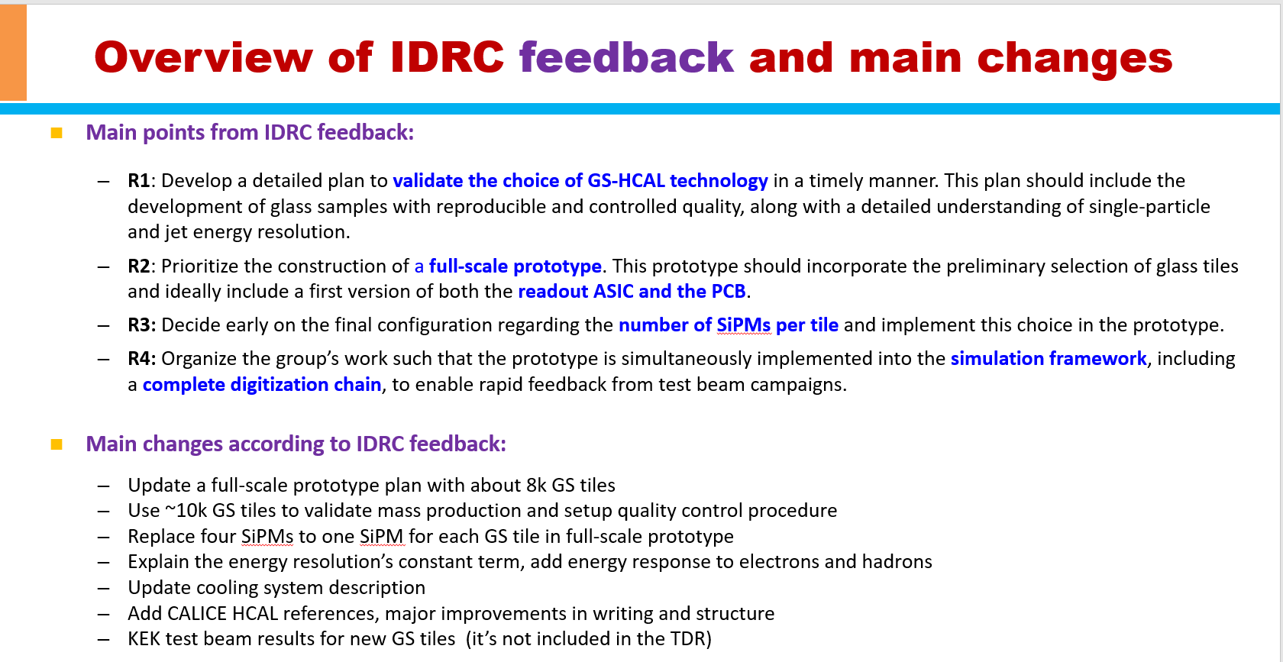

Slide 3
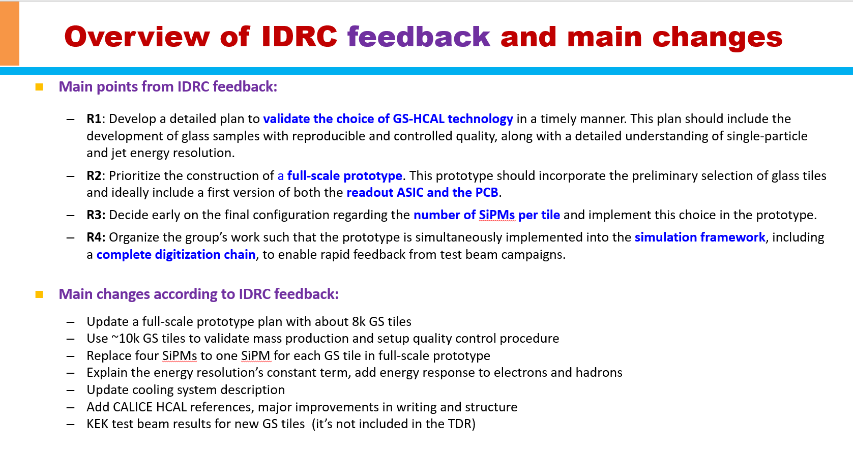

Slide 4
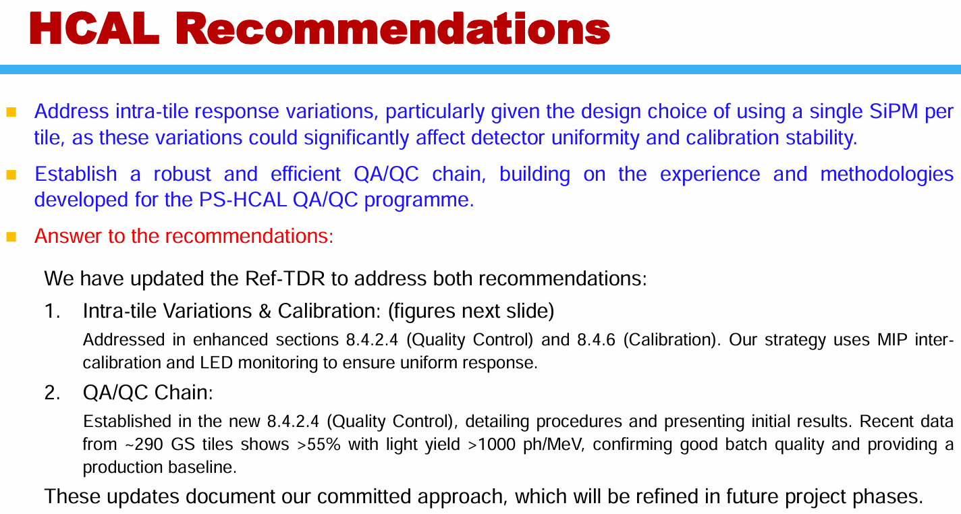
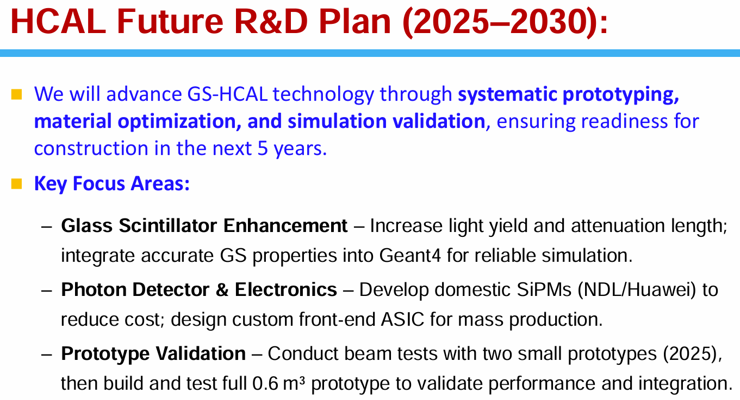
Recommendations and replying in Dec. 2025

Slide 5
Updates on HCAL plan
Optimization of design in 2026, continuing iterative refinement.
  Homogeneous ECAL and HCAL: E and H shower, SiPM, FEE, ME, cooling, etc.
  Optimization of longitudinal and transverse granularity: with considerations including Δθ(η)×Δφ, shower separation, cost and other constraints.
  Optimization of sampling fraction：shower separation, energy reso., e/h, etc.
  Update requirements on GS, SiPM, FEE, ME, Cooling, CAL, etc.
GS R&D more
  Besides density and light yield
  Achieve attenuation length >10 cm
  Improved response uniformity
  Peak emission wavelength: red-shifted some if feasible
Parts, module and prototype tests in 2026, 2027 and 2028
  GS and SiPM tests: establish the baseline for QA/QC procedures in 2026 and 2027
  Light collection and guide R&D in 2026
  Module tests: CR tests for MIP and source tests in 2027
  Prototype construction and tests: in 2027 and 2028 if with funds
    Construction: GS/SiPM/ME/FEE/DAQ/CAL
    Tests: CR, e, p, π± ,n
Engineering designs in 2027, 2028, maybe to 2029
  Iterate alongside design optimization, including barrel and endcap
  Integrate GS tiles, SiPM, FEE, CAL, ME and Cooling subsystems, including interfacing with sibling subdetectors.
  Give the QA/QC plan

Slide 6
Backup and some updates

Slide 7
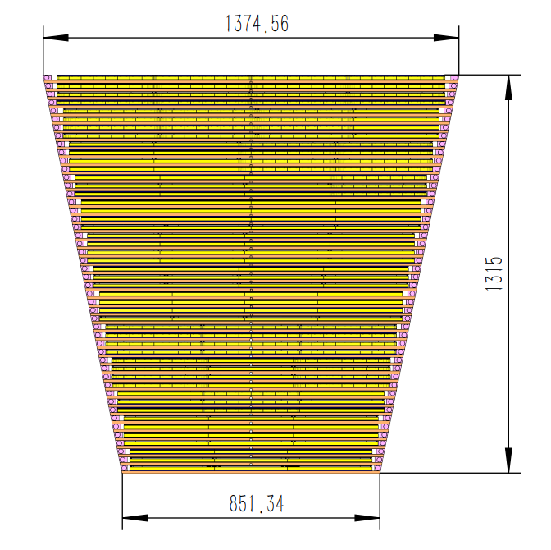
Layer settings of HCAL
CEPCSW current settings,
30% sampling fraction, using in ref-TDR
Steel (2mm) (cassette)
PCB (3.1mm)
GS (10mm) + ESR (2*0.065mm) + air (0.07mm) = 10.2mm
Steel (2mm) (cassette)
Steel (9.9mm) (Absorber)
Incident particle
50% sampling fraction
70% sampling fraction
90% sampling fraction
Steel (6.25mm)
PCB (3.1mm)
GS (18.2mm) +
ESR (2*0.065mm) +
air (0.07mm) =
18.4mm
Steel (6.25mm)
Steel (3.65mm)
PCB (3.1mm)
GS (25.5mm) +
ESR (2*0.065mm) +
air (0.07mm) =
25.7mm
Steel (3.65mm)
Steel (1.1mm)
PCB (3.1mm)
GS (32.8mm) +
ESR (2*0.065mm) +
air (0.07mm) =
33.0mm
Steel (1.1mm)

Slide 8
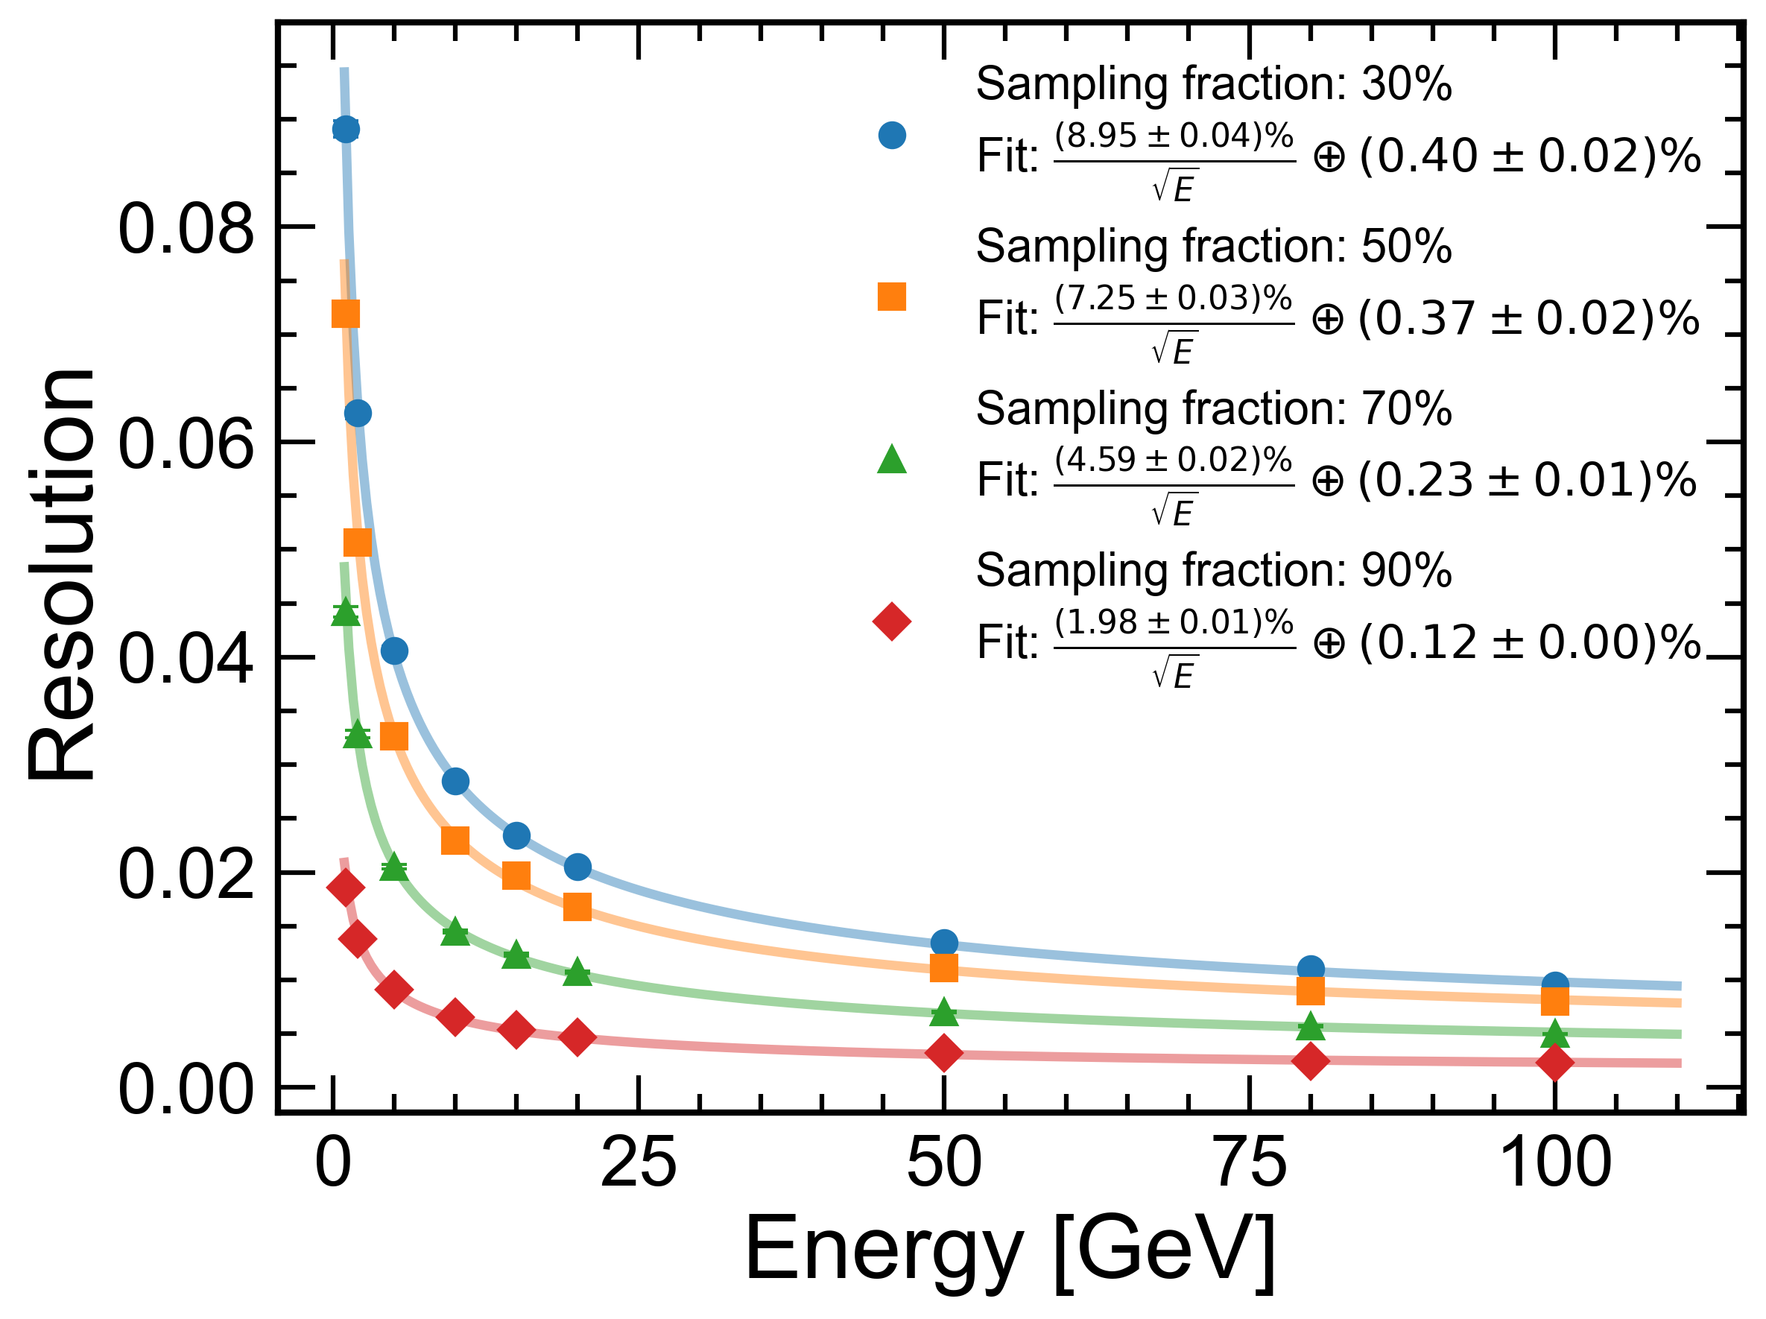
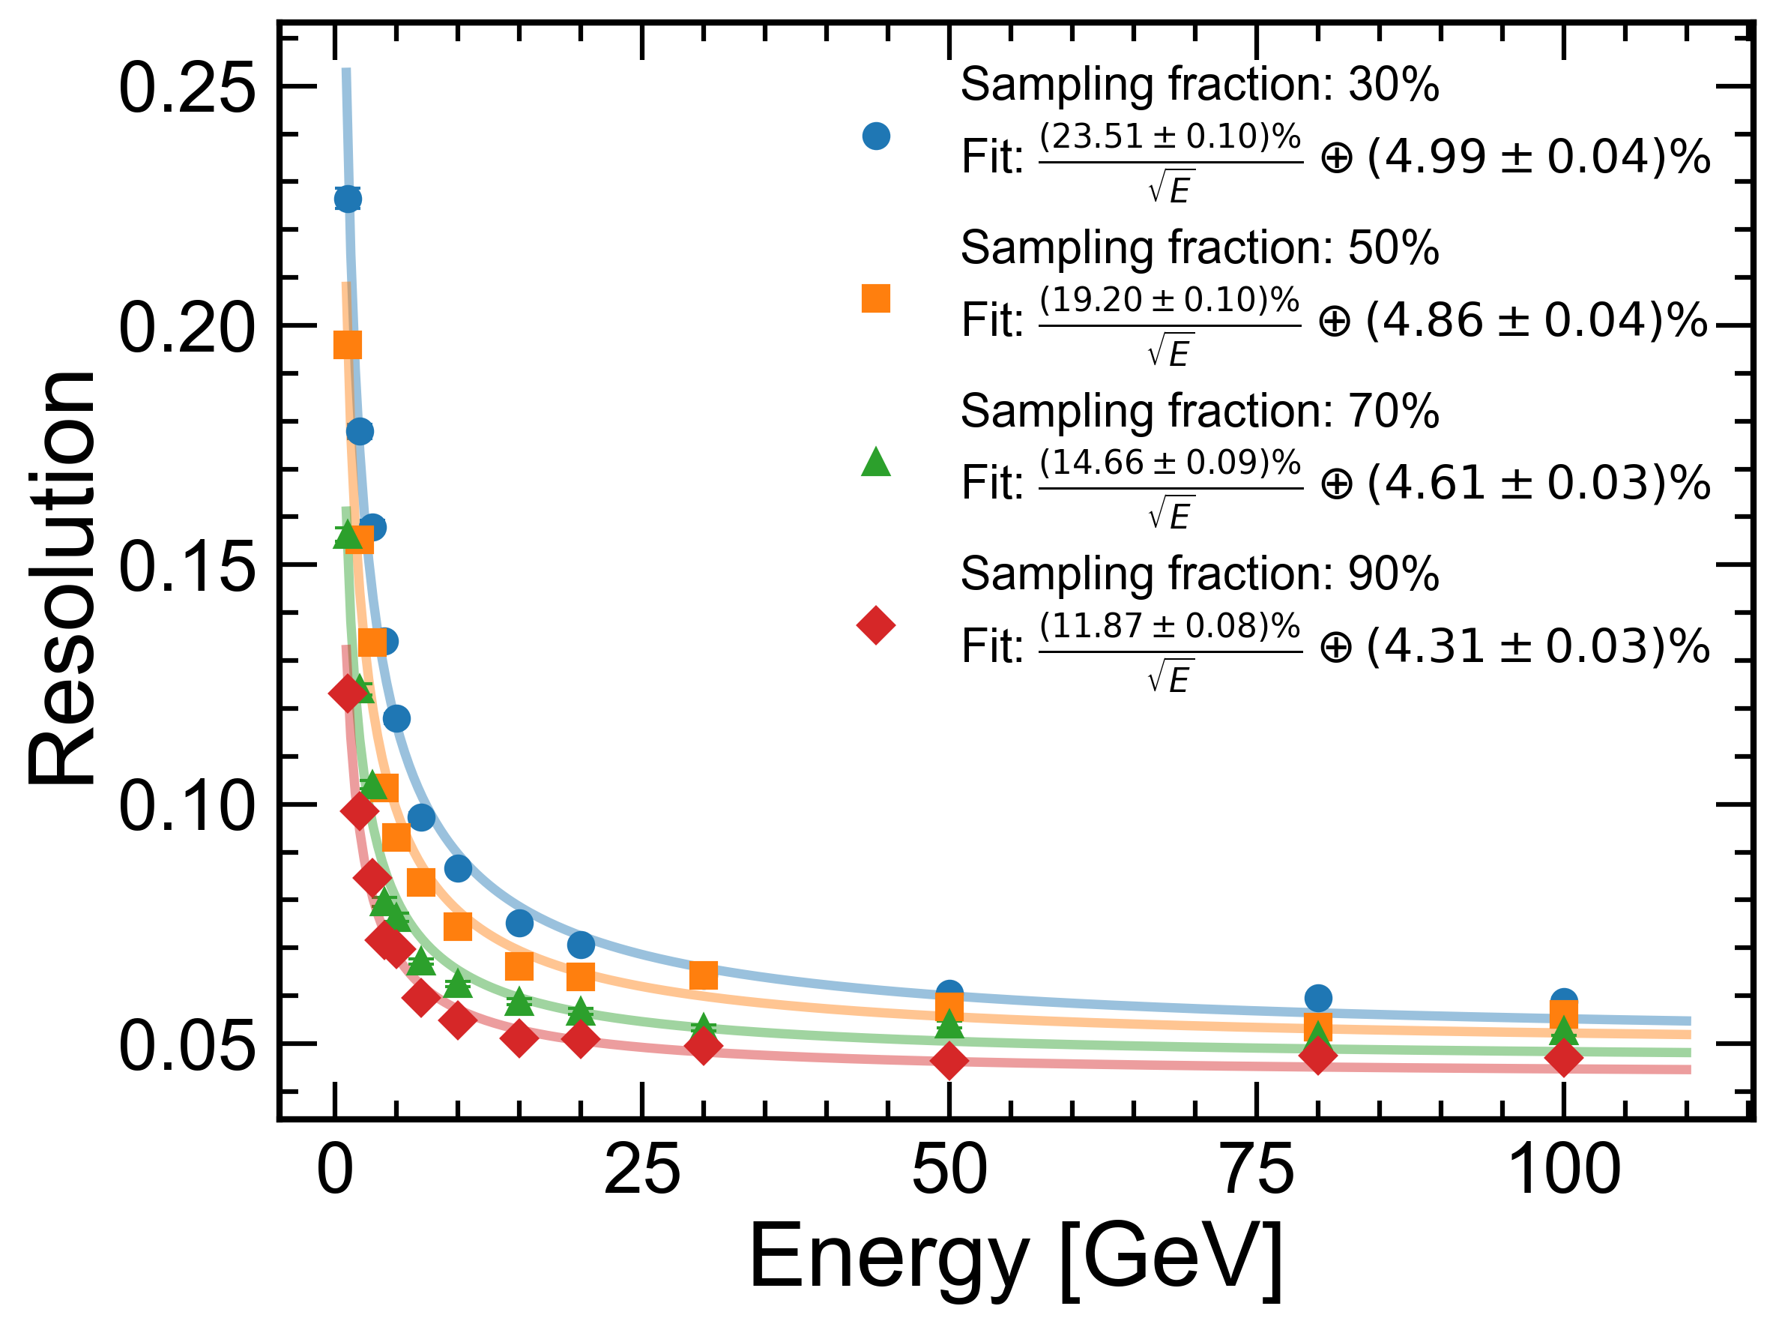
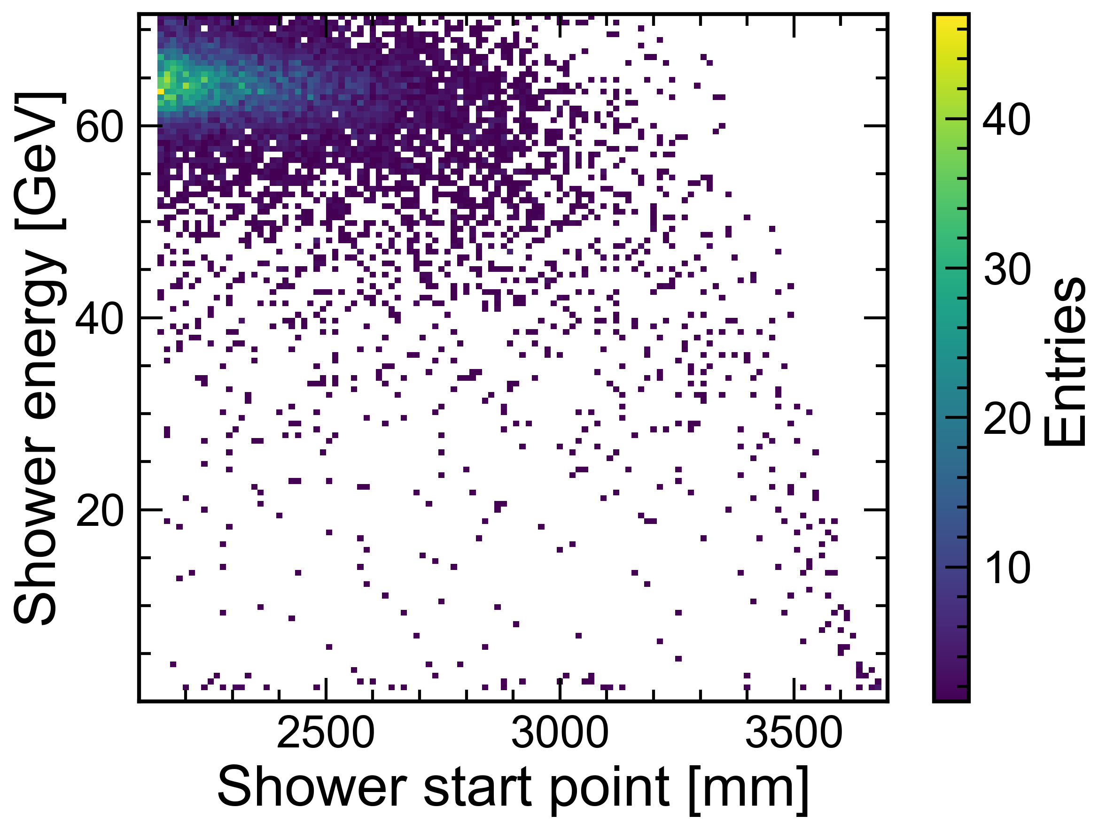
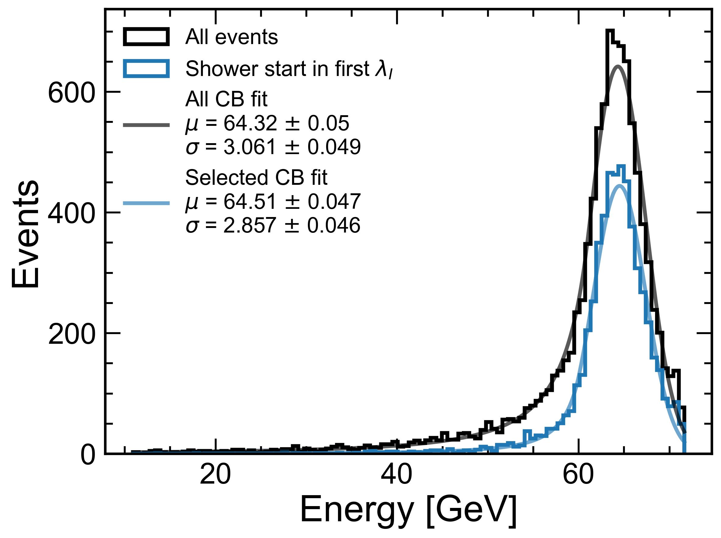

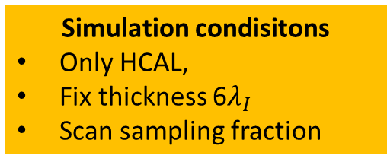
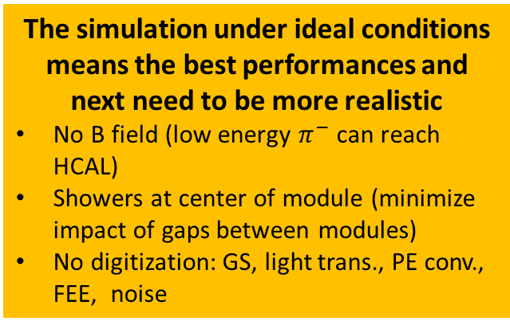


Hadronic & EM Energy Resolution
Simulation condisitons
Only HCAL,
Fix thickness 6$λ_{I}$
Scan sampling fraction
EM resolution
Hadronic resolution
Incident particle: $γ$
Incident particle: $π^{−}$
The simulation under ideal conditions means the best performances and next need to be more realistic
No B field (low energy $π^{−}$ can reach HCAL)
Showers at center of module (minimize impact of gaps between modules)
No digitization: GS, light trans., PE conv., FEE, noise
80 GeV $π^{−}$

Slide 9
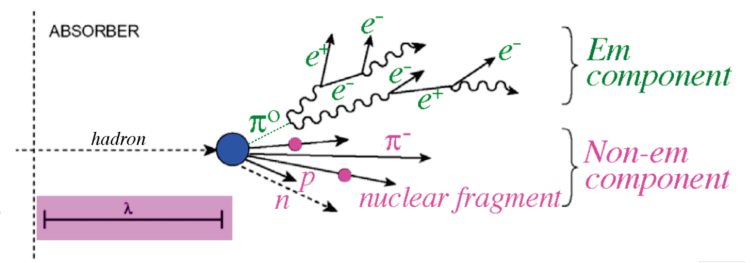
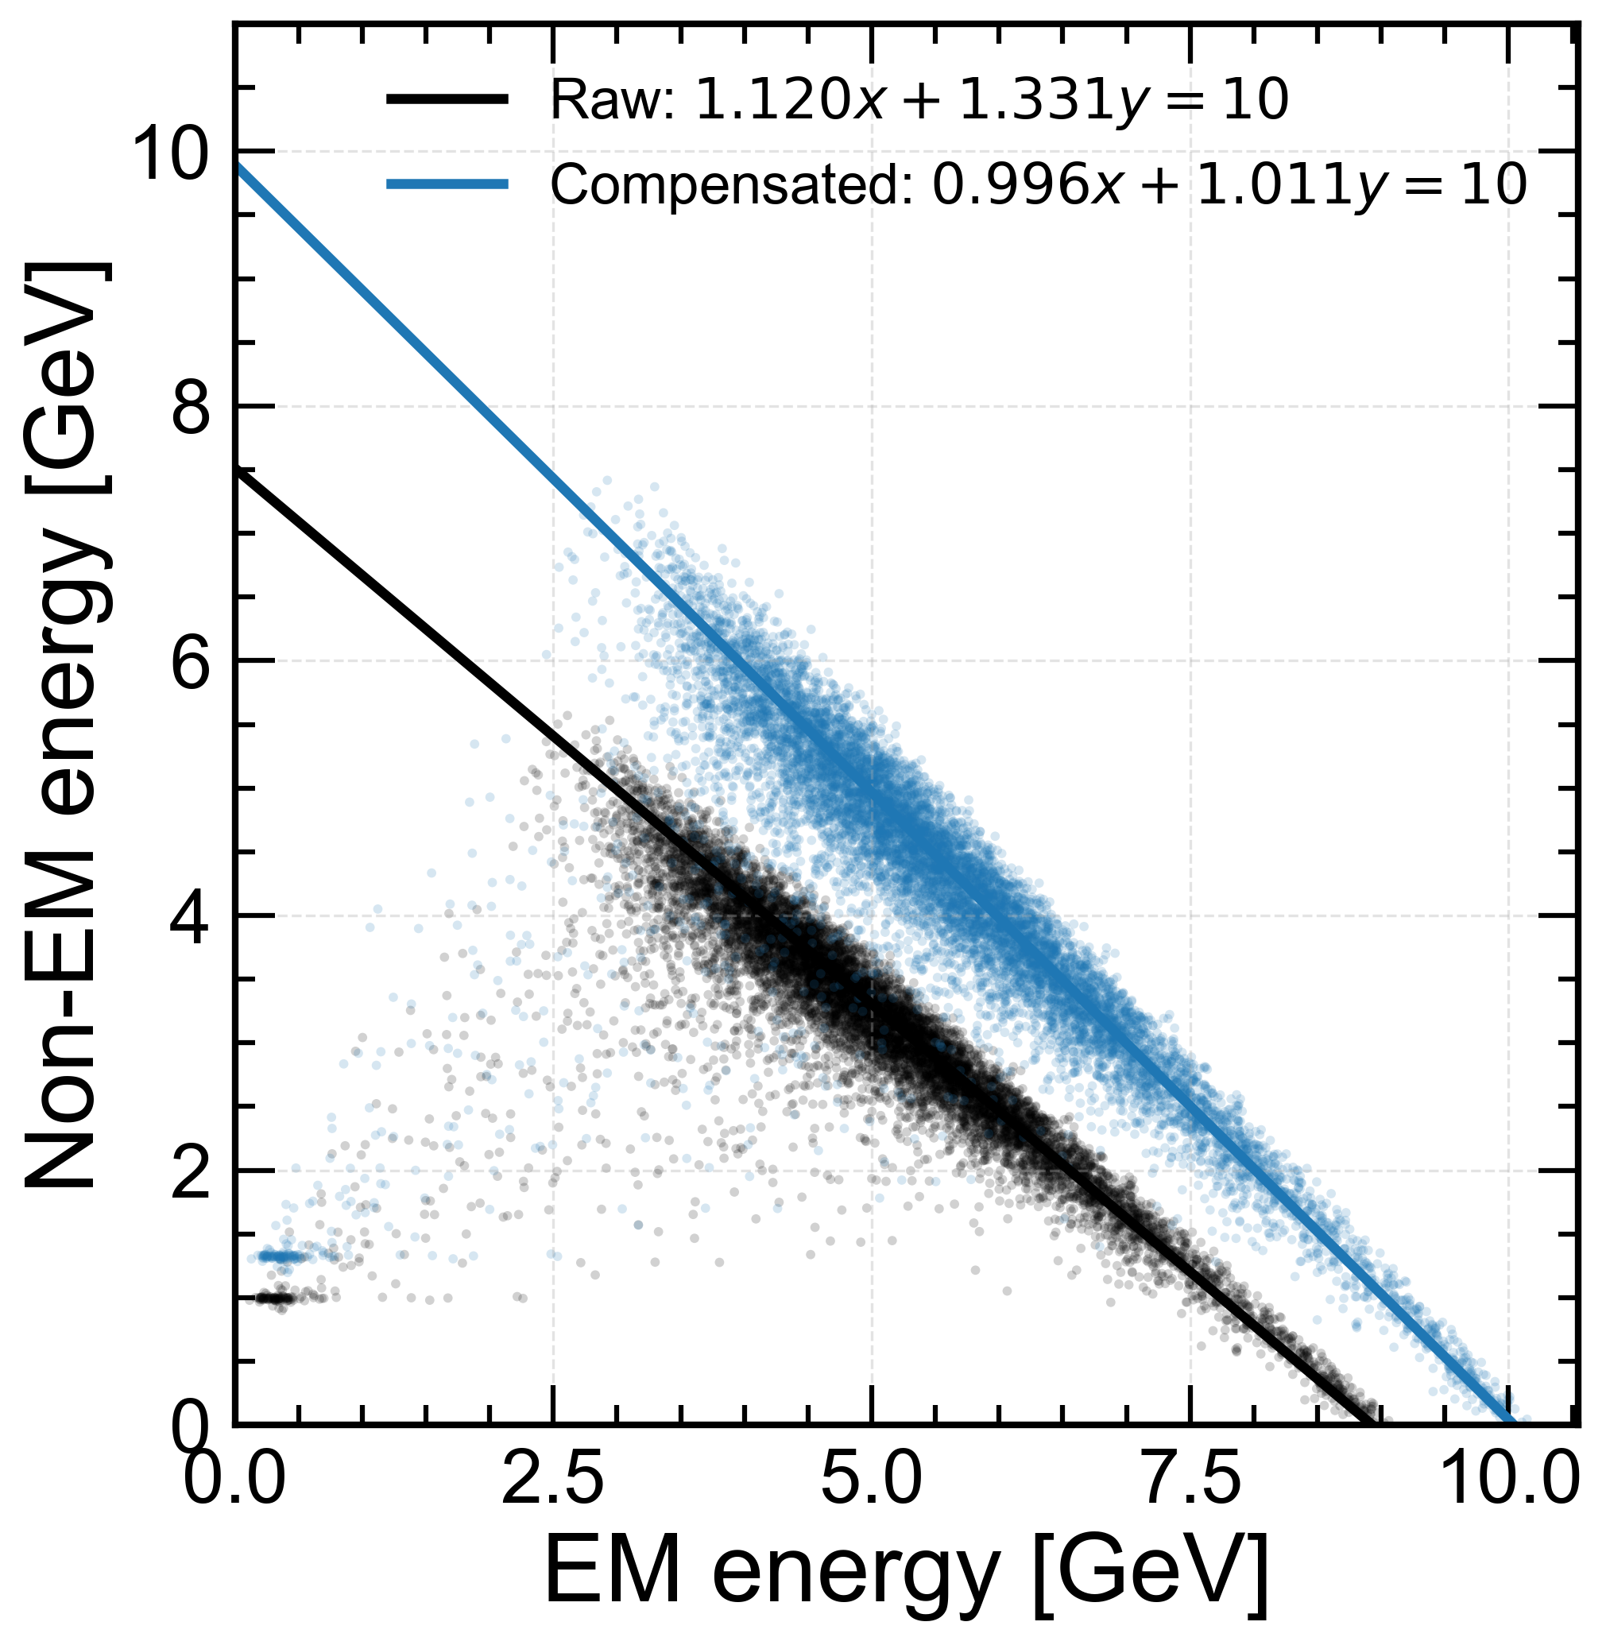
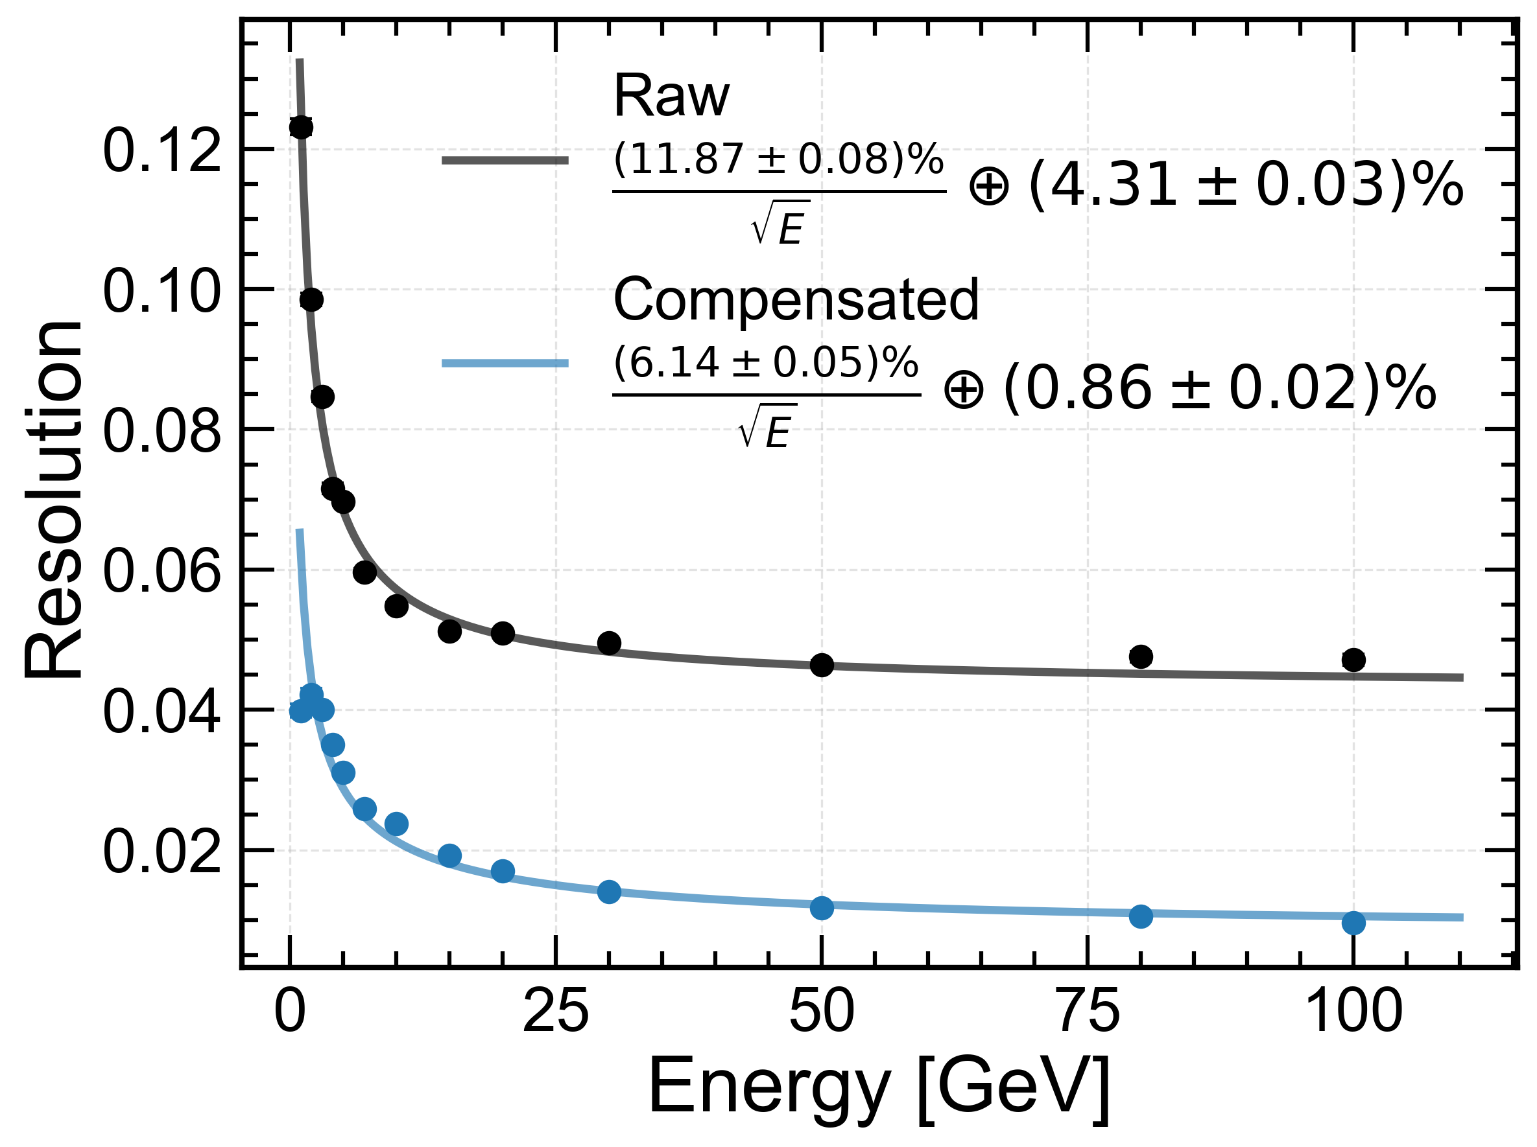
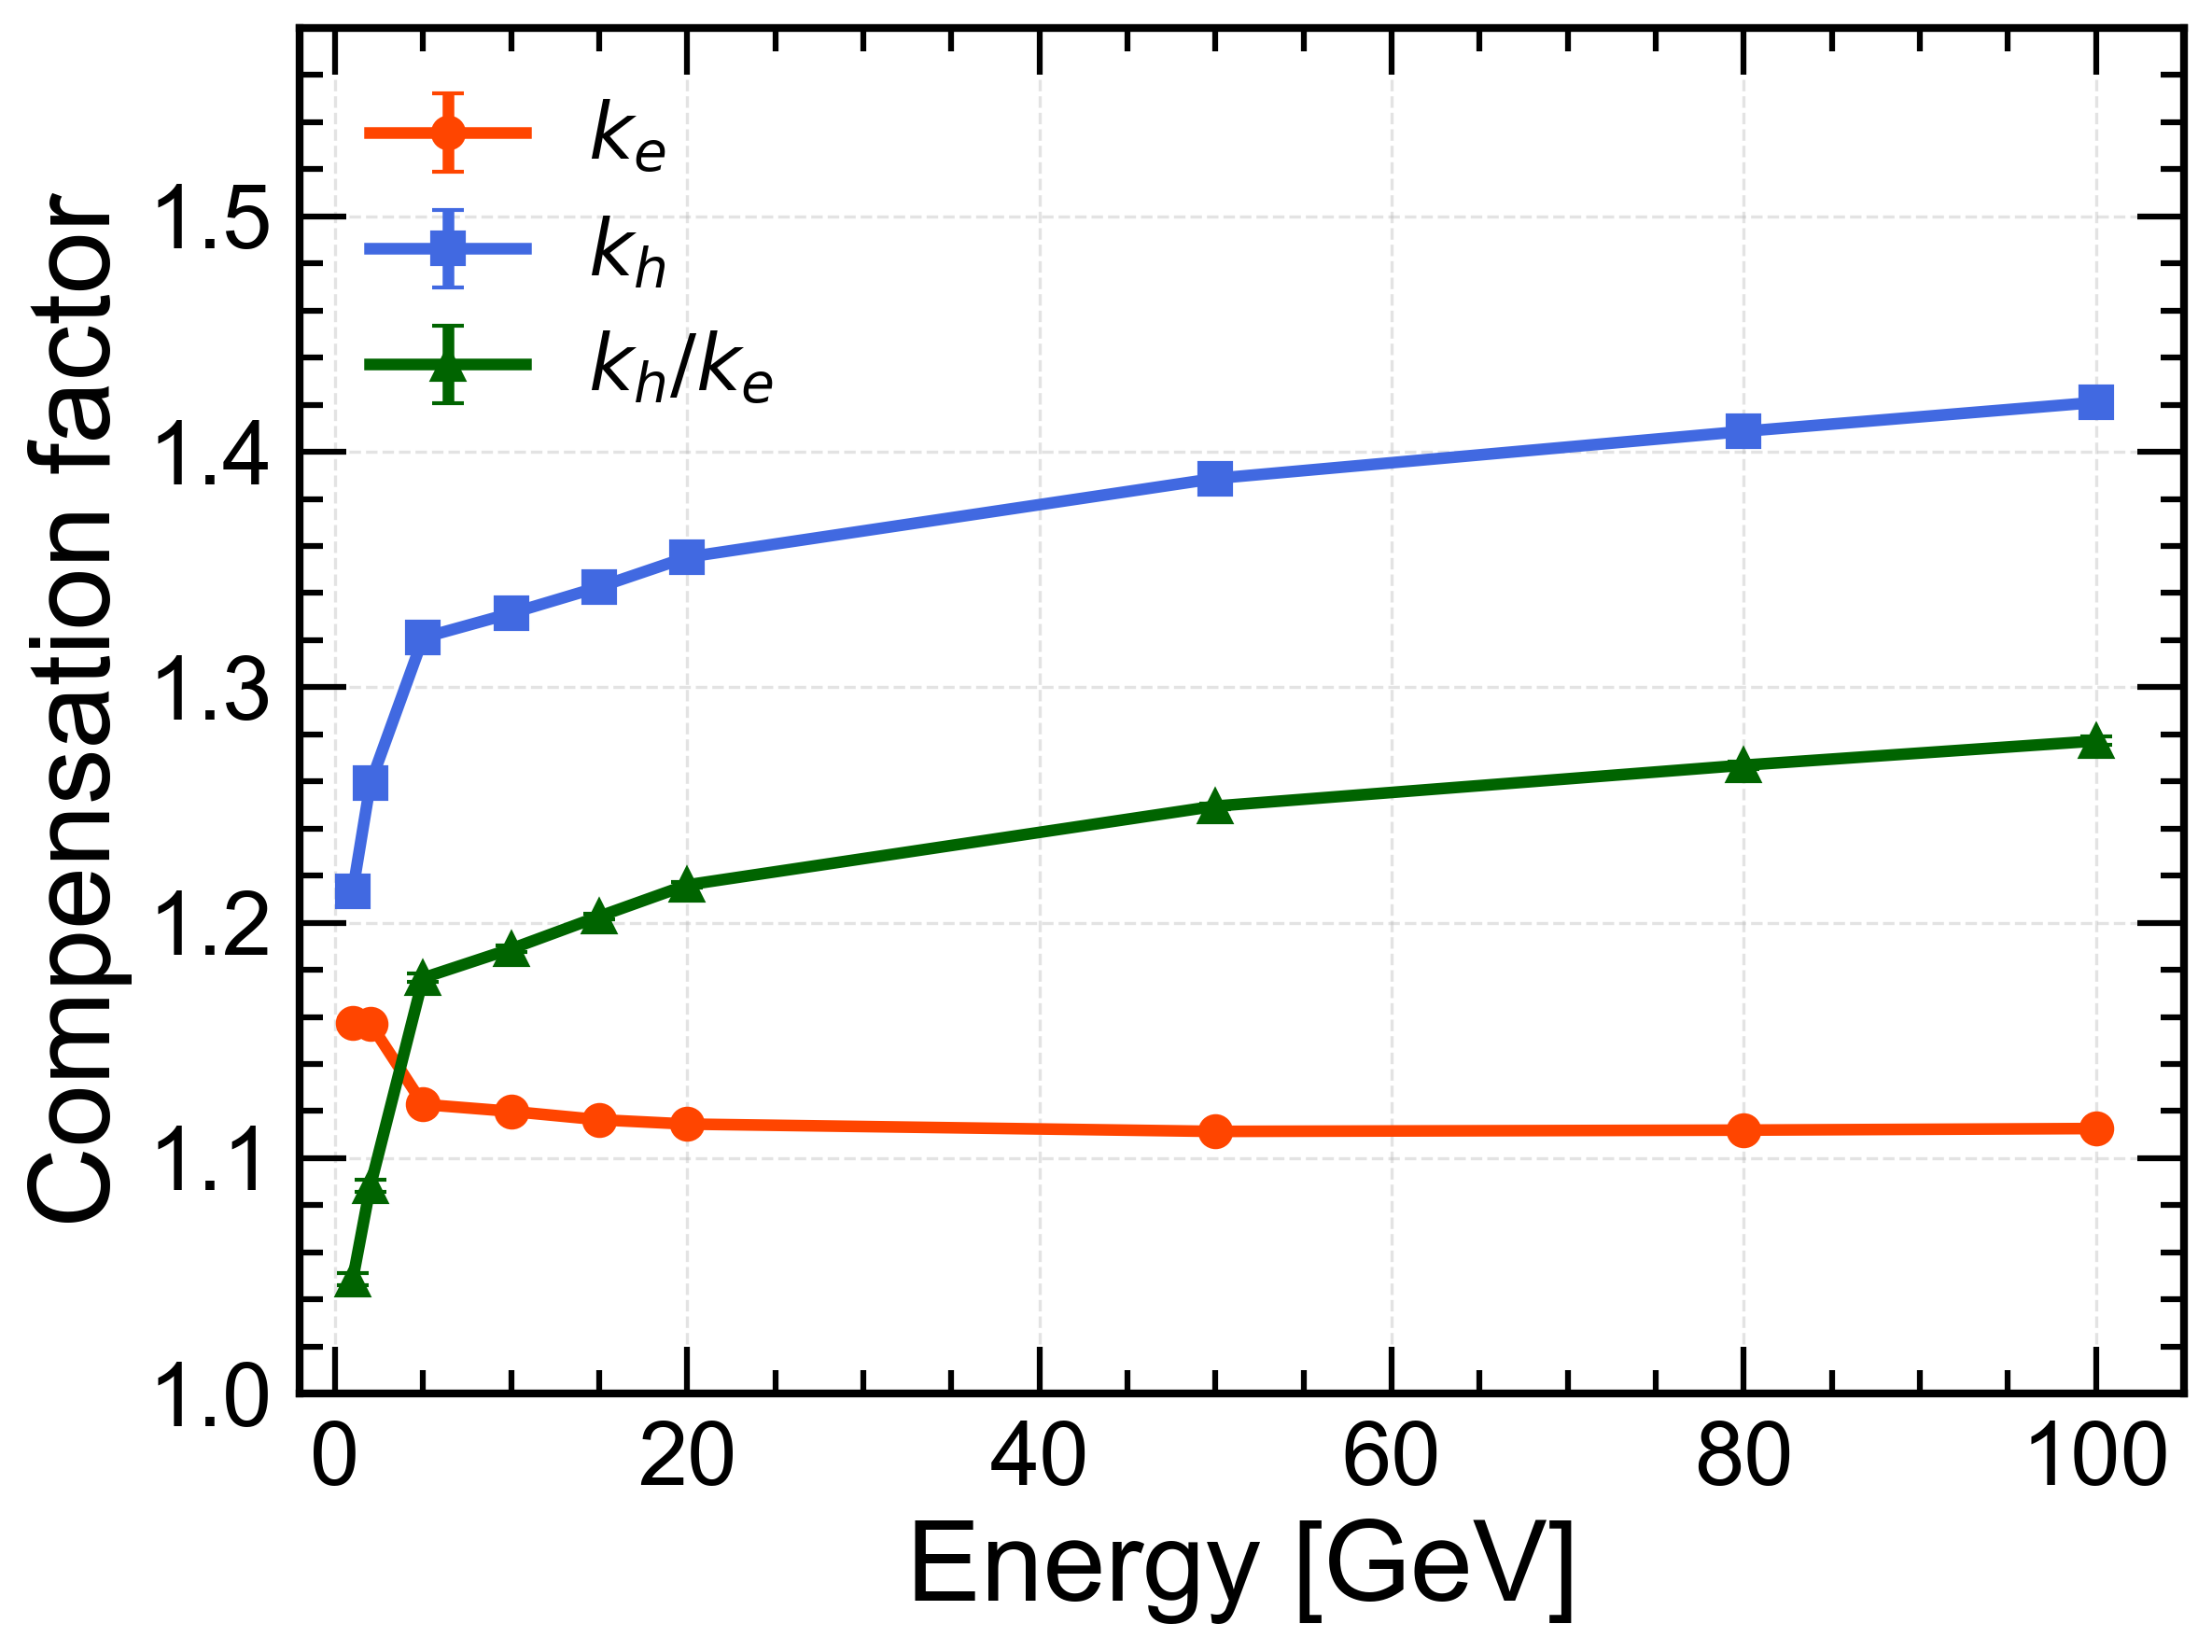
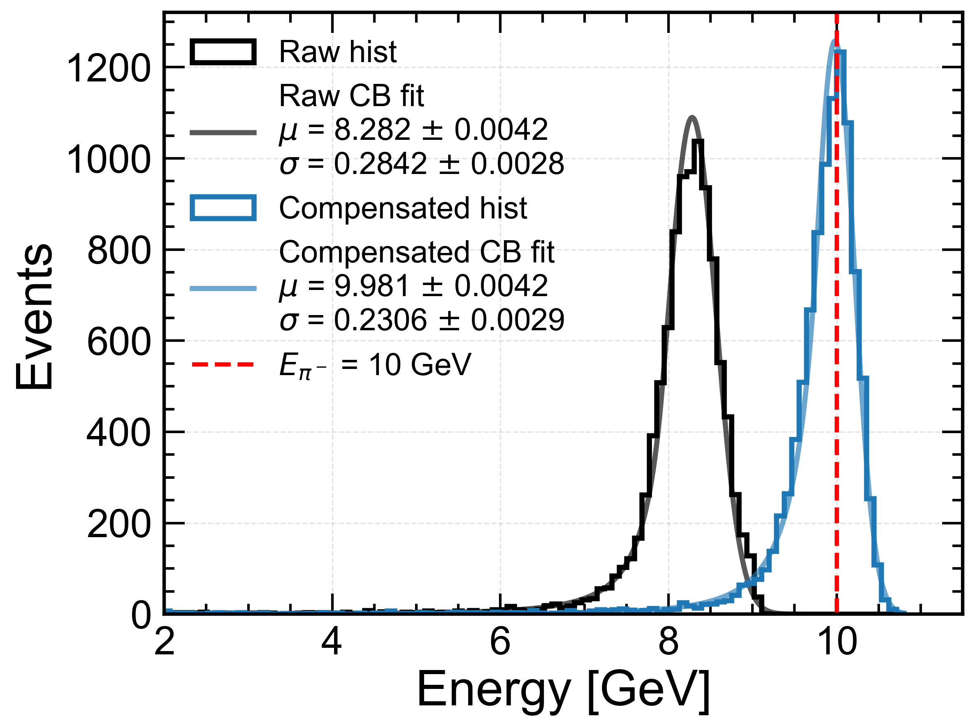
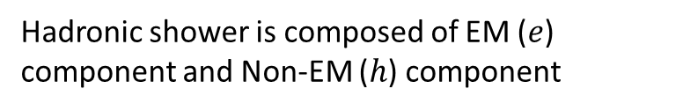
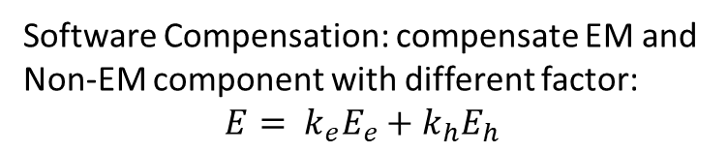
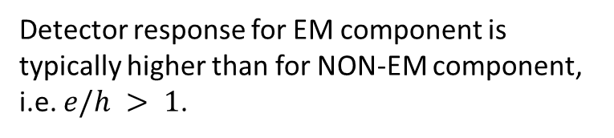
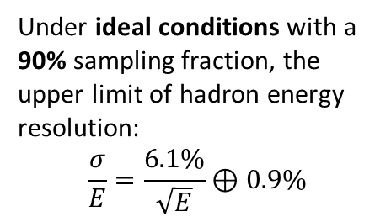
Software Compensation
Detector response for EM component is typically higher than for NON-EM component,
i.e. $e/h > 1$.
Software Compensation: compensate EM and Non-EM component with different factor:
$$E= k_{e}E_{e}+k_{h}E_{h}$$
Hadronic shower is composed of EM ($e$) component and Non-EM ($h$) component
Under ideal conditions with a 90% sampling fraction, the upper limit of hadron energy resolution:
$$\frac{σ}{E}=\frac{6.1\%}{\sqrt{E}}⊕0.9\%$$
The software compensation based on truth information
Real one depends on reconstruction and the shower separation power.
Next to do including more real simulation and reconstruction.

