Slide 1
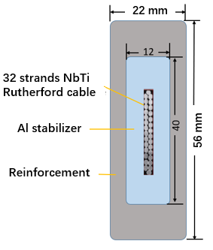
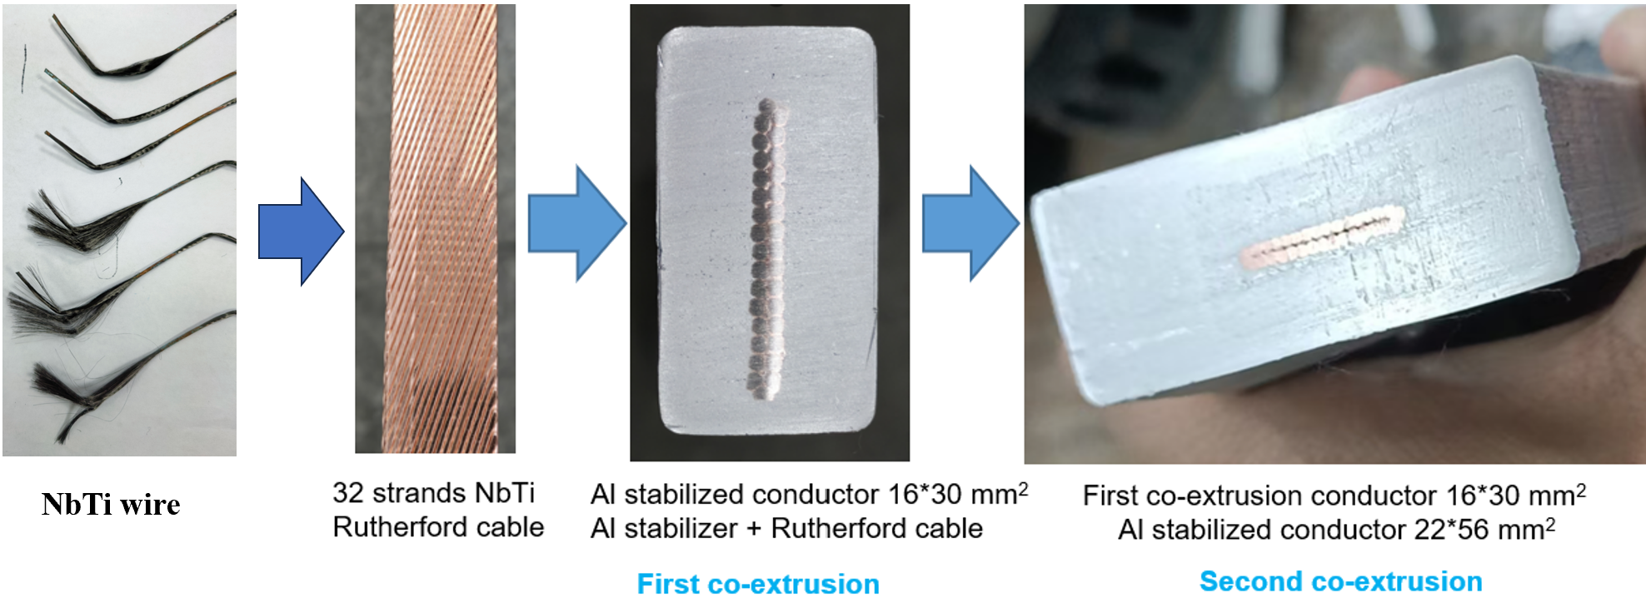
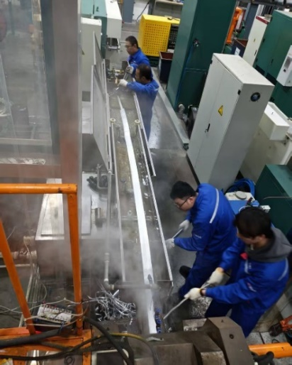
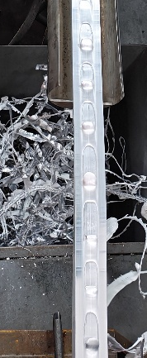
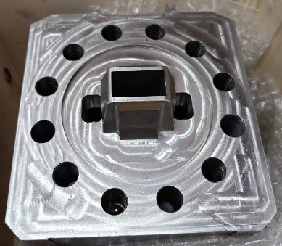
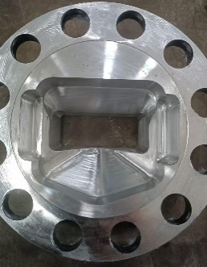
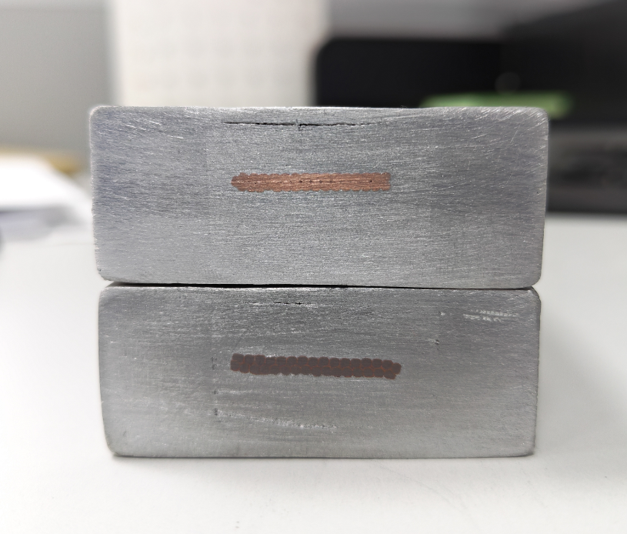
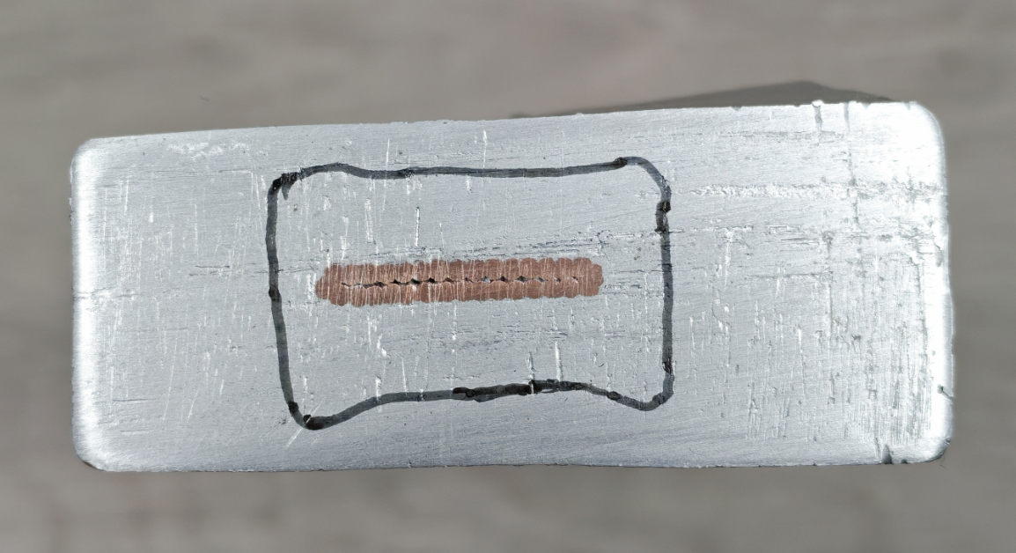
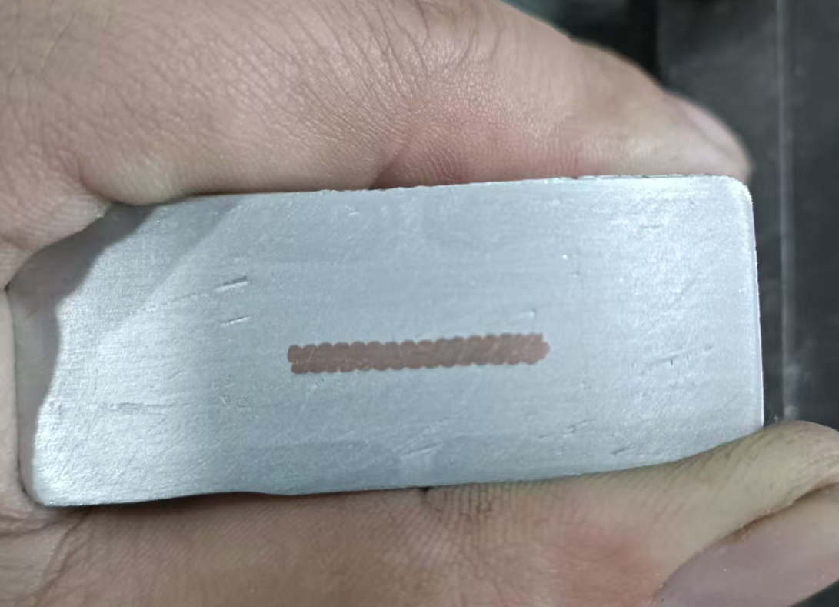
Current status
CEPC Detector Magnet System
The Full-size cable development.
We are finding the balance between over-extrusion with the old mold and the gap in the new one.
Continuously improving the process, such as core wire preheating, size adjustment and mold optimization.
Box type conductor
Improvement: mold
replaced;
Continuous production achievable (6m);
Surface voids occurred.
2026.4
New mold
2026-1-04
Improvement: Mold design updated.
Upper/lower cladding improved;
Core breakage reoccurred;
2026.3
2025-11-22
Old mold
Old mold
2026-1-09
2025-12-13

Slide 2
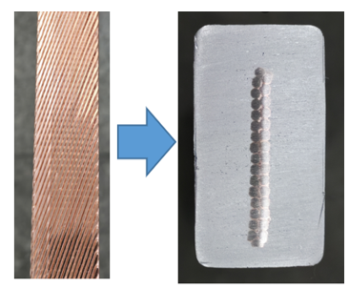
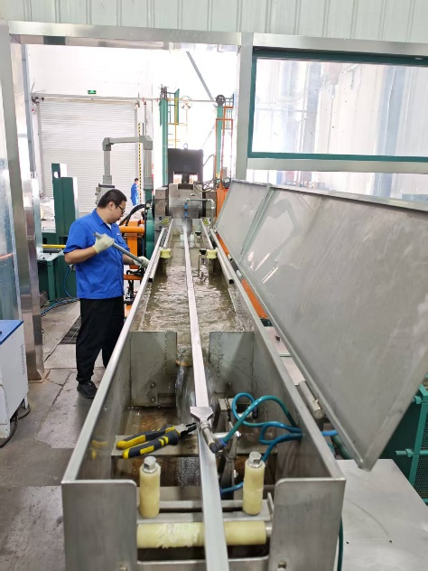
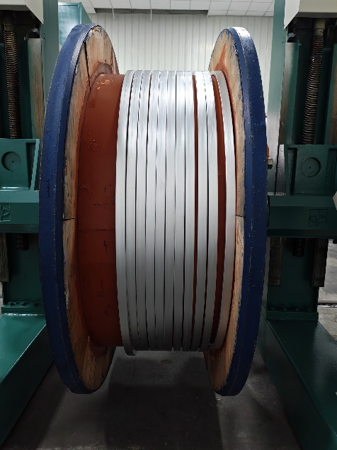

Current status
Full size Box-type Super-conductor sample was developing.
The first co-extrusion aluminum-coated cable 16 × 30 mm²
We have a mature first aluminum coating processing technology. Recently produced a 45-meter-long cable in 55 minutes, with a production speed of 0.9-1 m/min.

Slide 3
Plan
CEPC Detector Magnet System
The Full-size cable development.
We have produced the full-size short-sample (5~10 meters) cable development, and also need to do:
Research on performance optimization;
  Overall performance testing
  Research on Performance Degradation Mechanism
  Optimize cable processing technology
Development of Hundred-Meter-Level Long Cables.
  Research on Process Consistency of Long Cable
R&D on High Temperature Superconducting (HTS) plan
Aluminum stabilized Stacked REBCO Tape Conductor development
Quench Detecting and Protecting Research
Performance test.

