Slide 1
Mechanics and integration

Slide 2
Status and planning
CO2 cooling system: (IDRC)
Progress: Several talks about cooling system at the mechanical weekly meeting
Cooling system preliminary design for CEPC: 2026
Critical component design and test: 2027
Small prototype to verify function of system: 2027~2028
Beam pipe: (DRD8)
Progress: Simulation about aluminum beam pipe is being done, result show almost no difference with Be pipe
Aluminum beam pipe prototype design: 2026
Prototype manufacturing and cooling test: 2027
Be pipe manufacturing and welding: 2026~2028
Research on Be Corrosion and Surface Anti-corrosion Coating: 2027~2028
Vertex cooling: (IDRC)
Progress: Flat model is designed and under fabricated, air plant is purchased and assembled in the lab
Prototype test(flat model and single layer): 2026~2027
Muti-layer model prototype cooling: 2027
Cooling plate research (Capillary titanium tubes or stainless steel tubes for research) : (IDRC)
Could be use in TPC, ITK, HCAL and so on
Progress: mold is under design, candidate powders to increasing thermal conductivity: Boron nitride(BN), aluminum nitride(AlN)
Mold design, manufacturing and preliminary test: 2026
Process optimization to increasing thermal conductivity

Slide 3
Robot inspection: (DRD8)
Progress: positioning sensor has been purchased and test
Further test: 2026
Investigation about different robots: 2027~2028
AI-assisted design (Structure parameter design according to computer learning)
Progress: Yoke structure design: Parameter optimization by providing AI some FEA results
Beam pipe structure design: 2026~2027
Service study：(IDRC)
Routing prototype test(if necessary and enough funding)
Installation related：2026~2030
Continue optimize the installation scheme
Design the tooling the fixture
Layout of underground EH and auxiliary hall
Surface assembly building
Survey , alignment, monitoring
Sub-detector structure design: 2026~2030
Keep on designing according to each sub-detector requirement
HCAL new structure design, Consideration of ITK supporting。。。

Slide 4
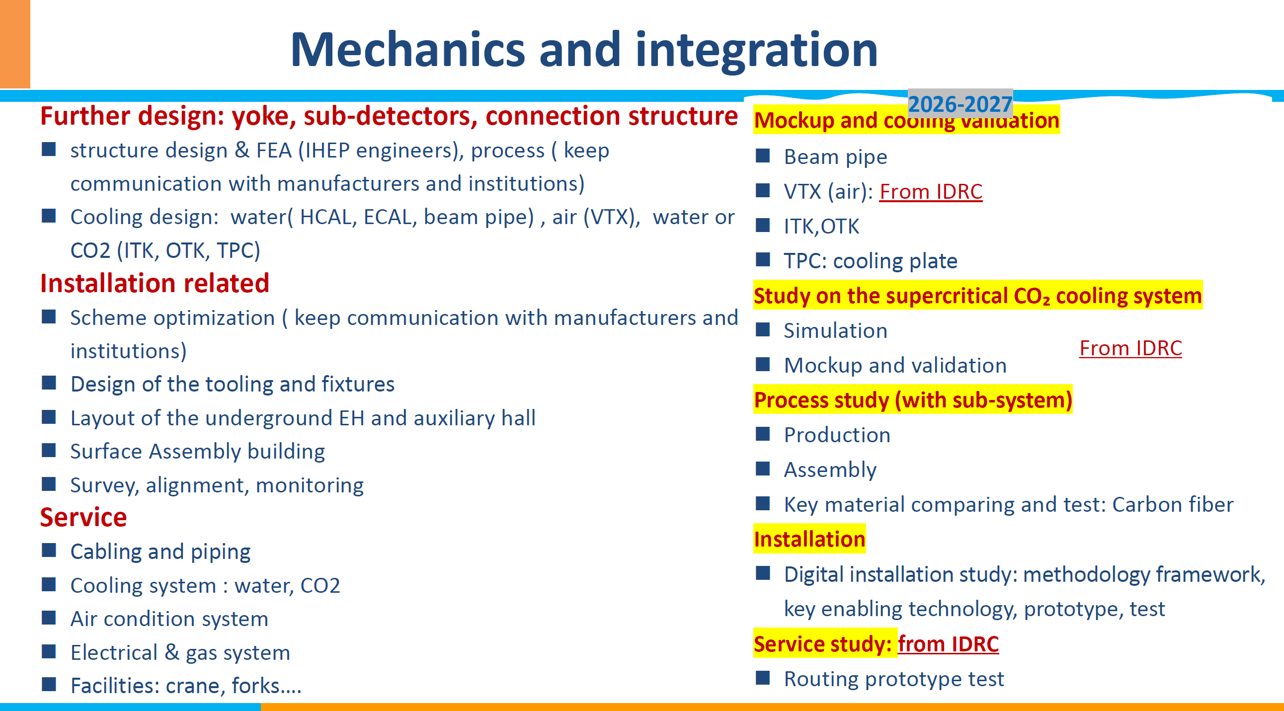
CEPC day on December 18

