Slide 1
Development Progress of Aluminum Stabilizer Superconductor
Ling Zhao
On behalf of the magnet team
2026.5.20

Slide 2
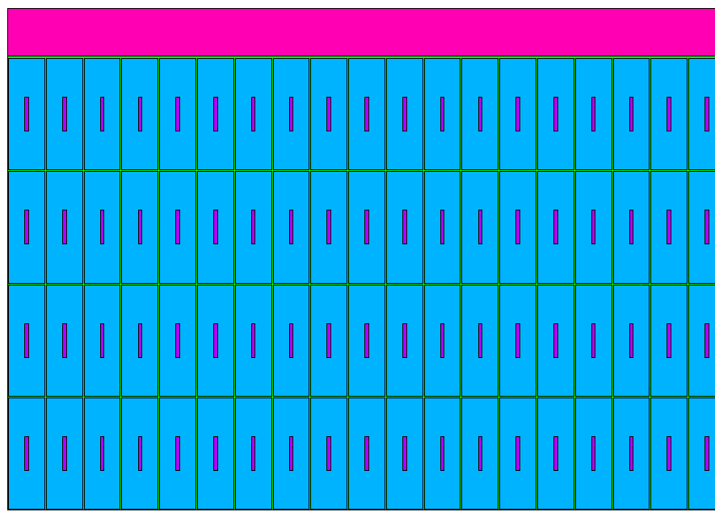
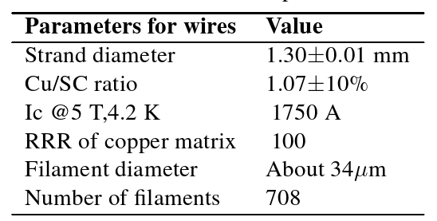
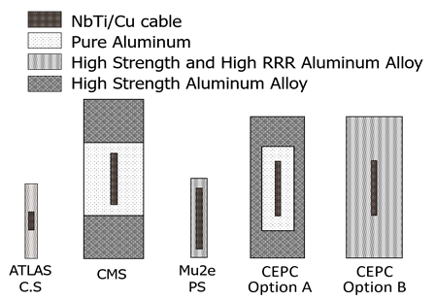
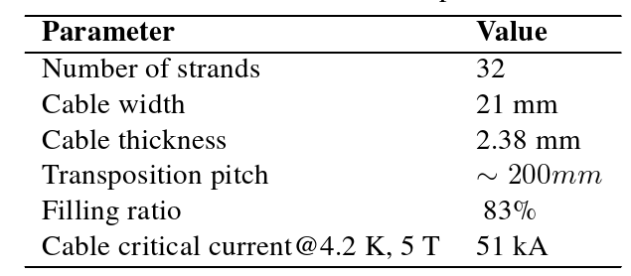
Superconductor design
Cross section of the Coil
Ref-CDR: Study of Two Cable Technology Options
Option A: Small-size conductor (4.7 mm × 15 mm) + 6061 Aluminum alloy
Overall dimensions: 56 mm × 22 mm
Option B: Developed doped aluminum material + 32-strand Rutherford cable
Overall dimensions: 56 mm × 22 mm
Parameters Value
Nominal design current 17kA
Critical current@4.2K，5T 51kA
Total length of conductor 33km
Overall dimension(without insuluation) 56mm*22mm
Superconducting cable overall area 2.2mm*20.5mm
Al stabilizer area 12mm*40mm

Slide 3
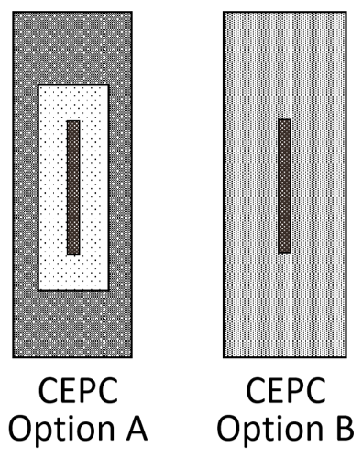

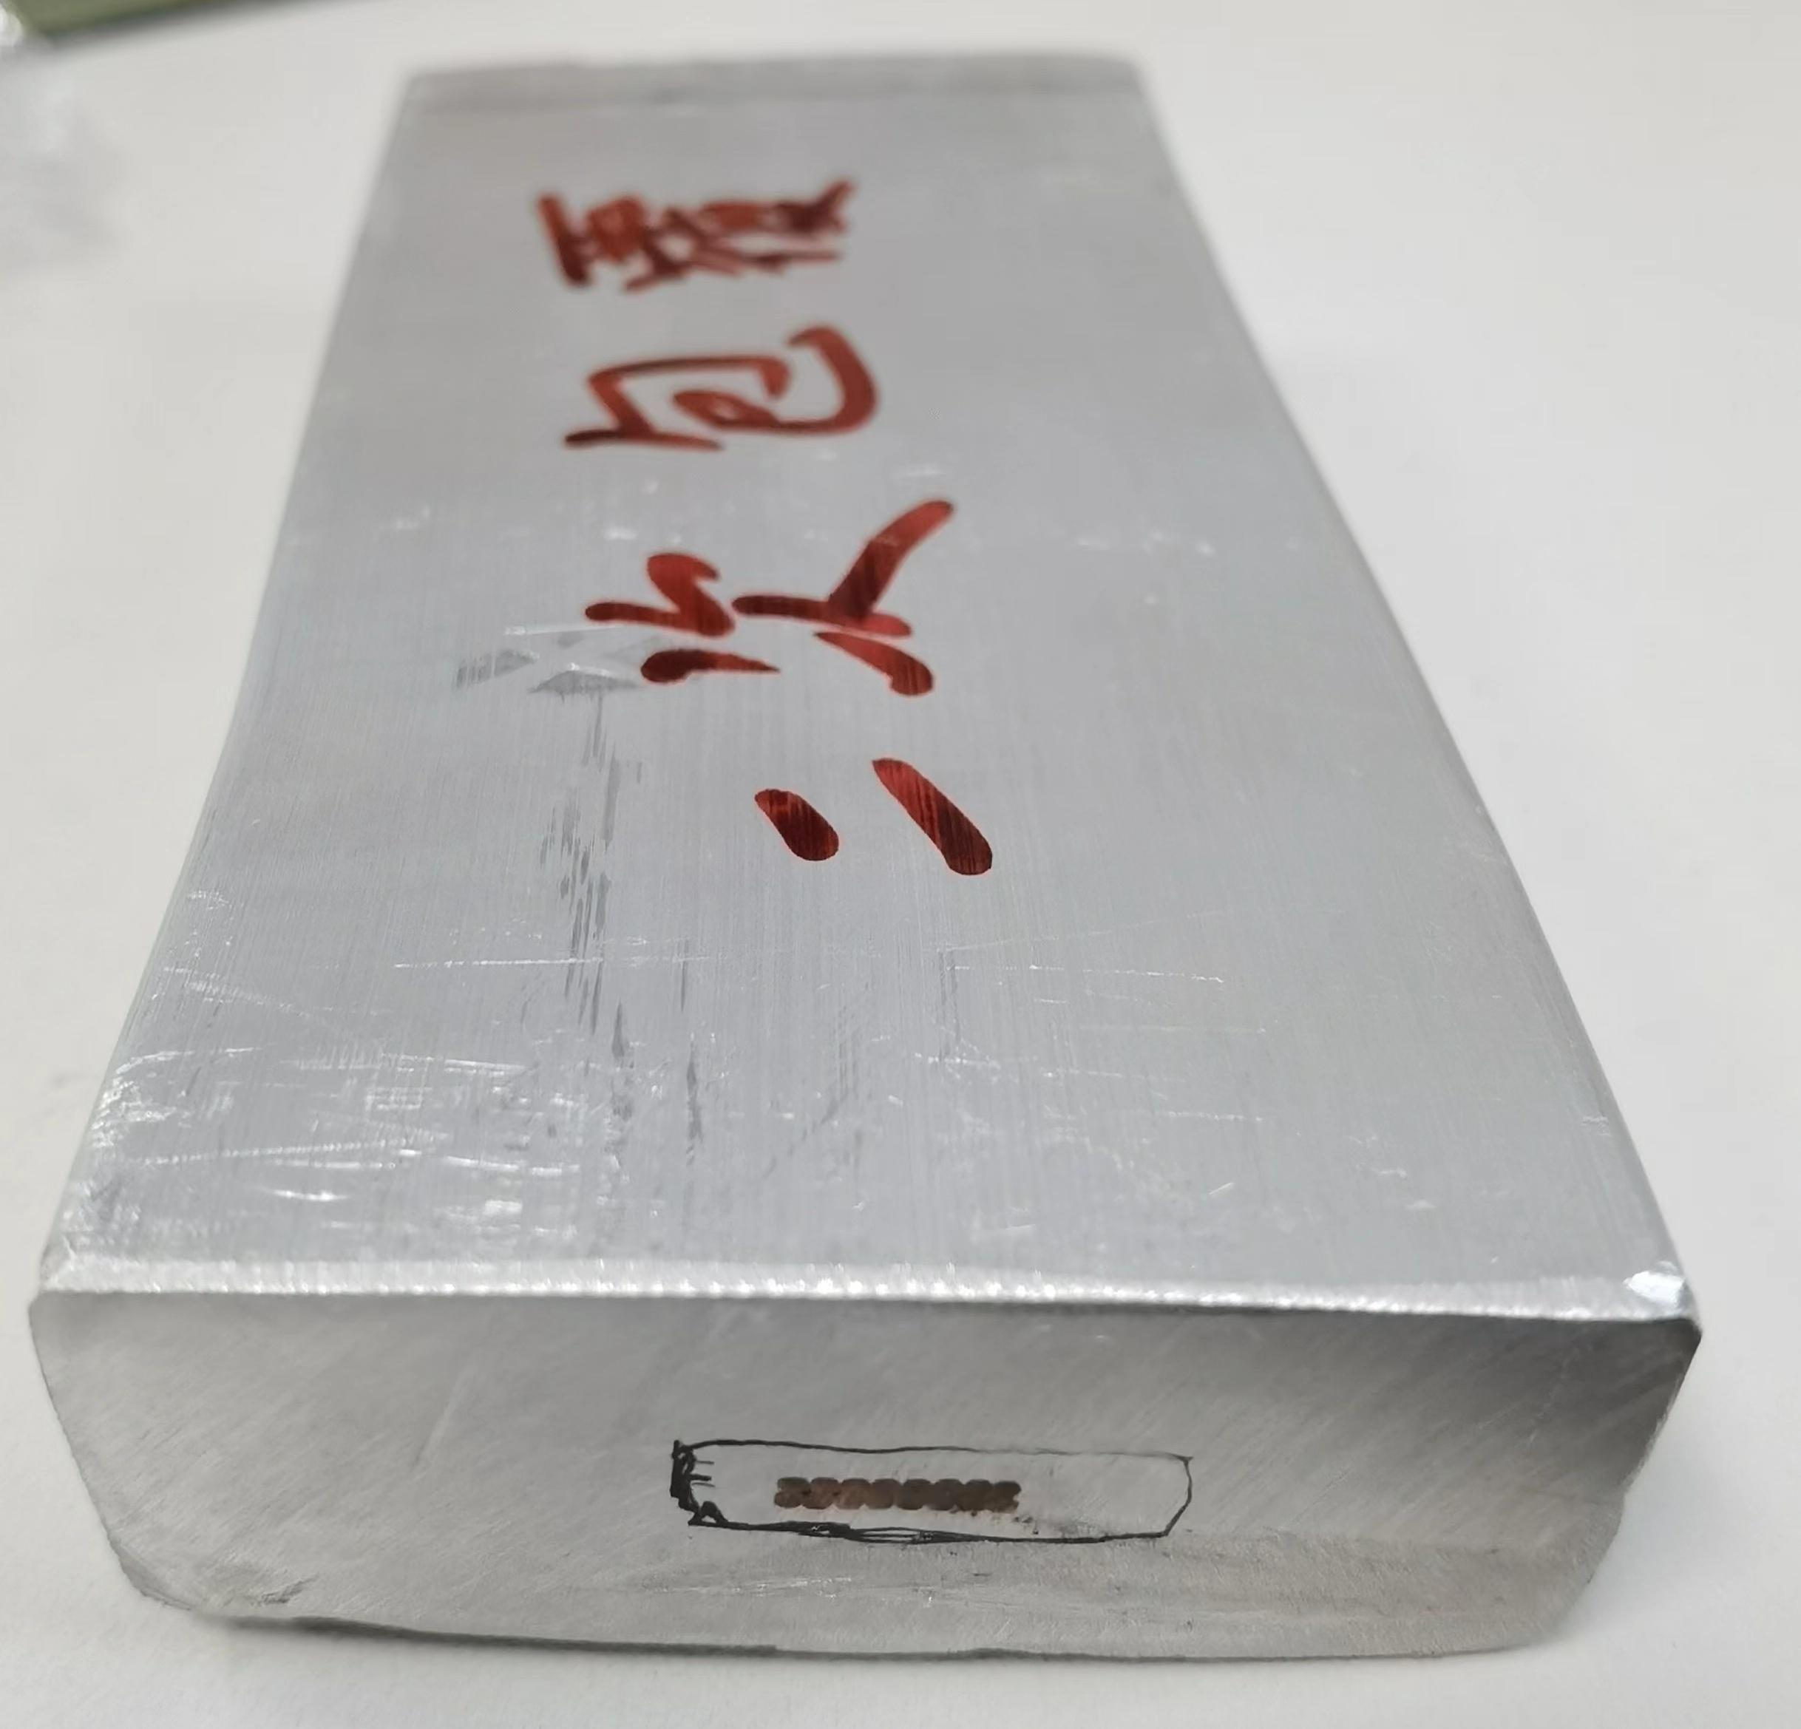
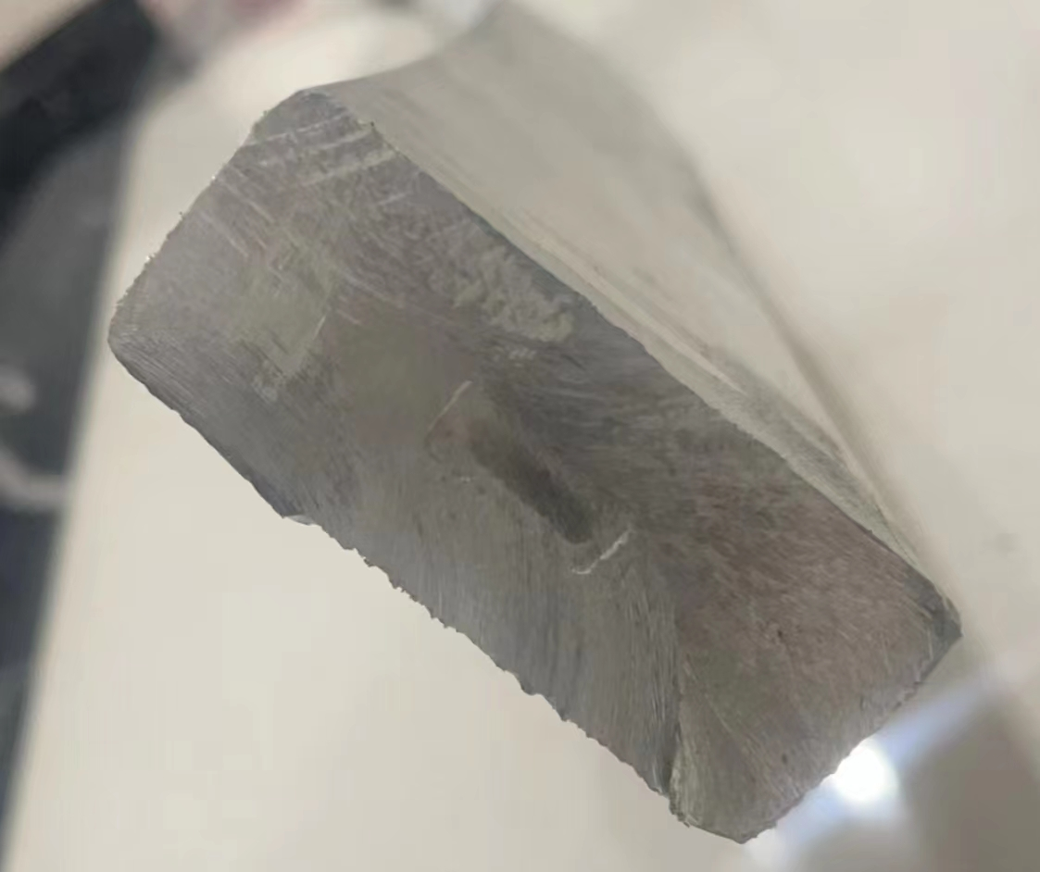
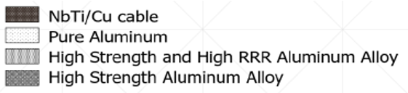
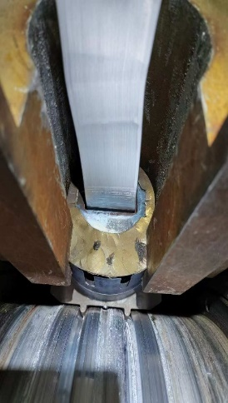
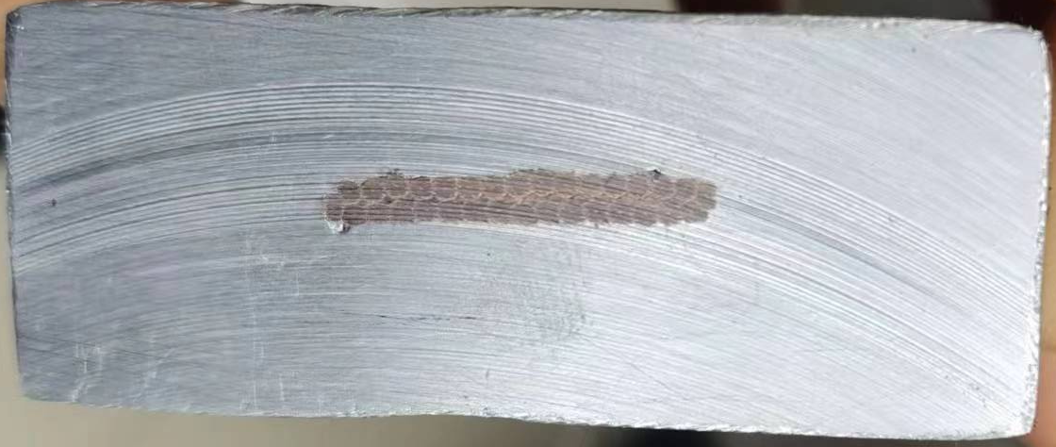
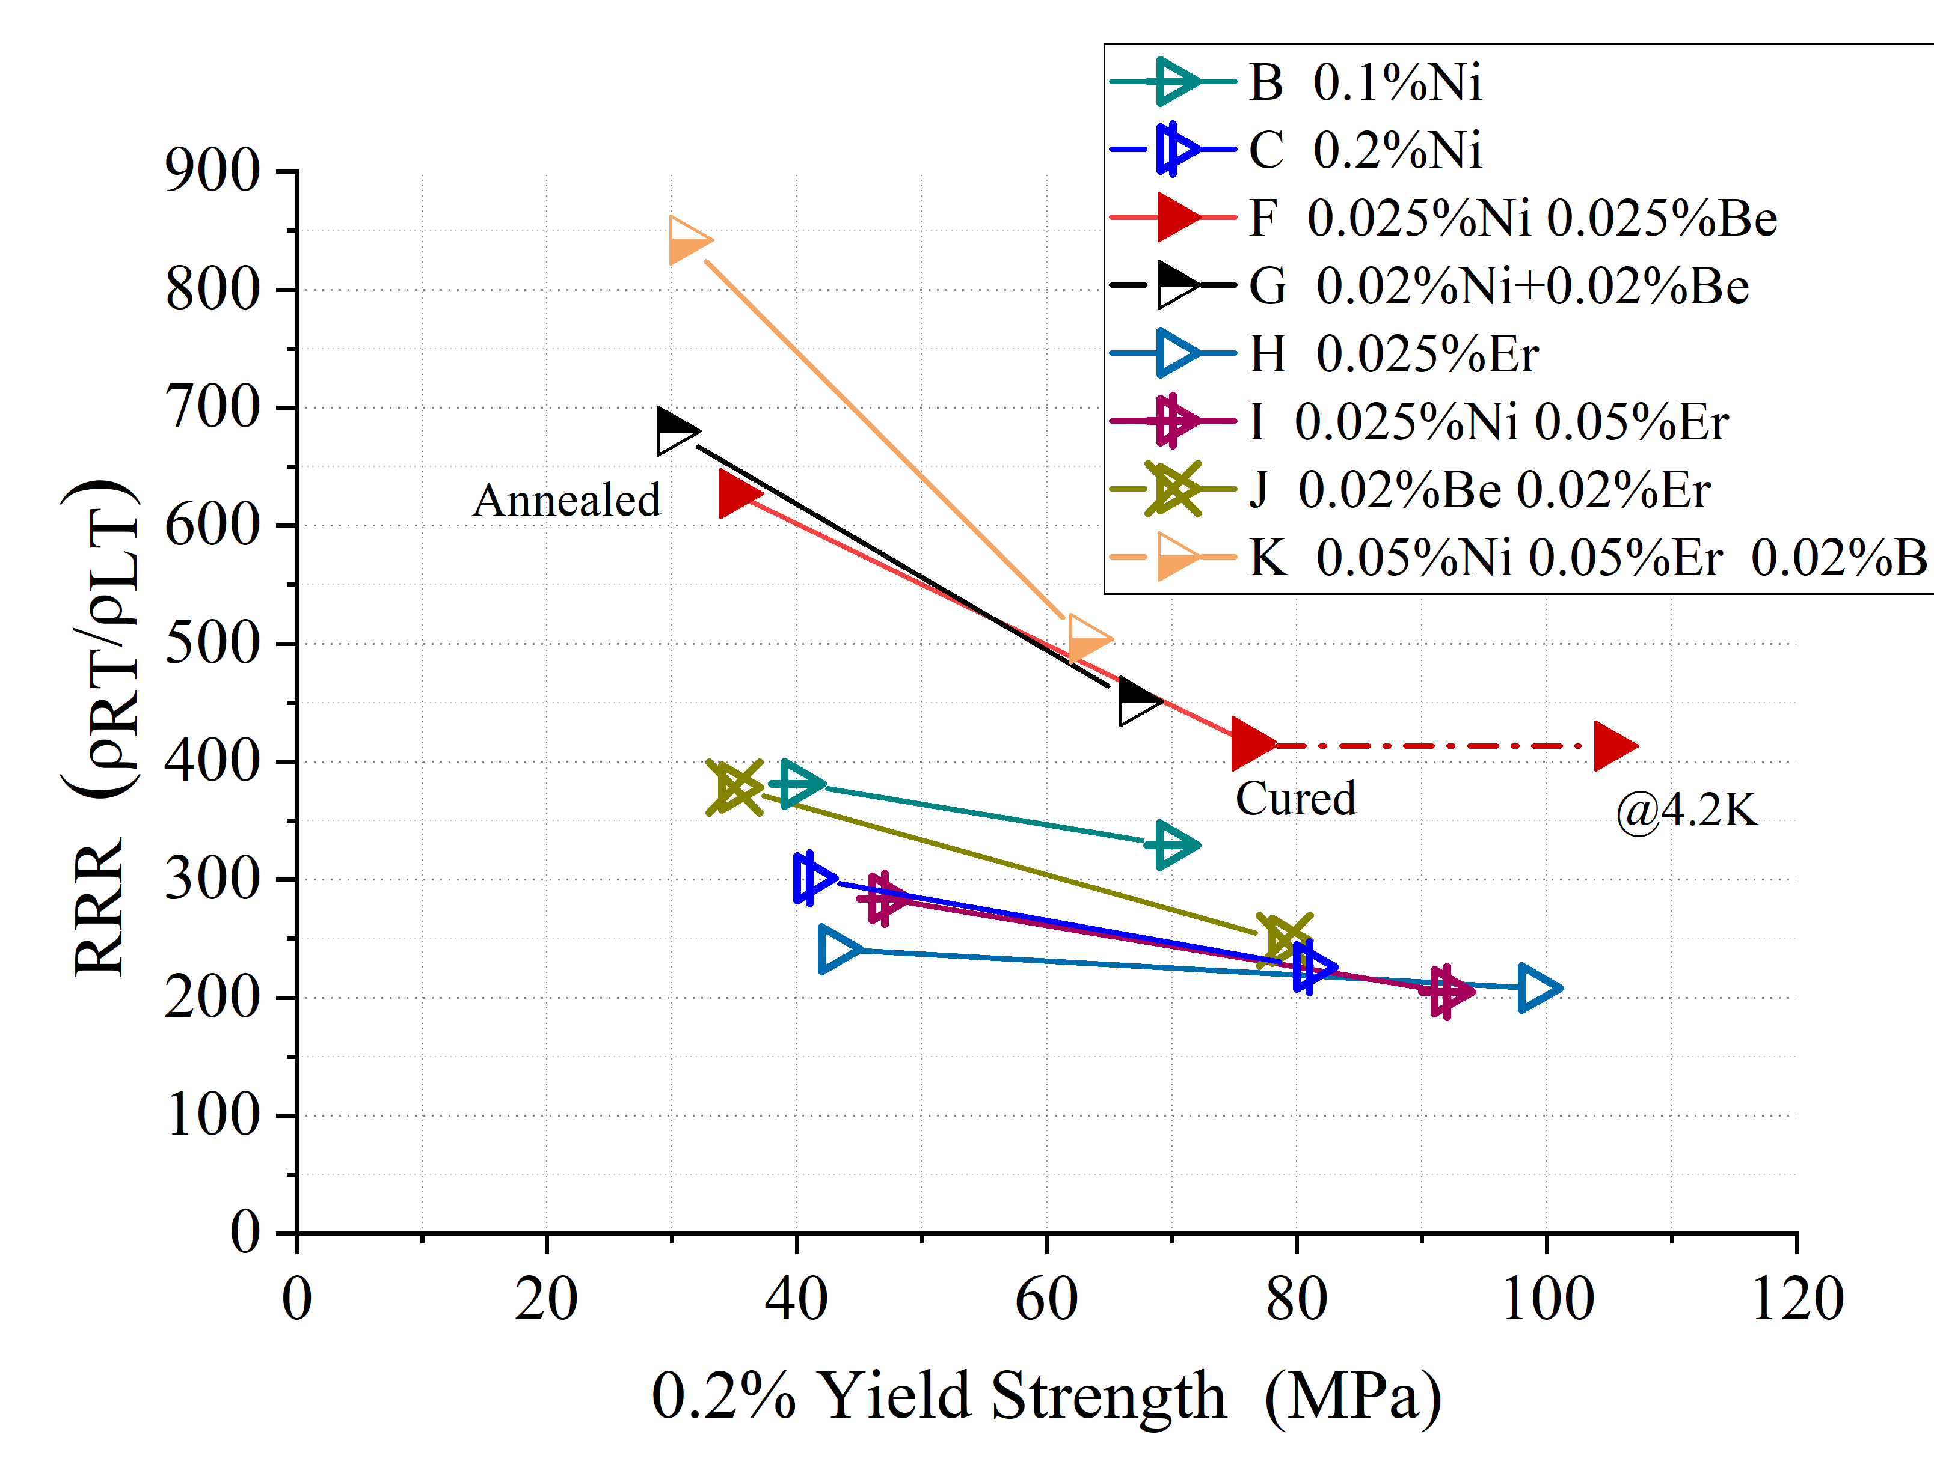
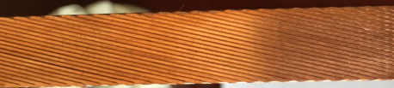
Development of the Two Cable Options
Plan A
Box-type conductor with Aluminum alloy (6061)
16 strands Rutherford cable as the first co-extrusion step, and developed the secondary co-extrusion dummy cable at the year 2022，5 meter long box-type sample was achieved at 2025.4.
Aluminium stabilized cable
Dummy cable 56*22mm
Aluminum alloy + Copper cable
Box superconductor 56*22mm
Pure aluminum + NbTi cable
Plan B
Single co-extrusion with high-strength and high RRR aluminum（adoped aluminum）
Box superconductor 56*22mm
6061 Alloy + NbTi cable（2025.4 5meter）
Rutherford cable
32 strands
Pure aluminum+NbTi cable

Slide 4
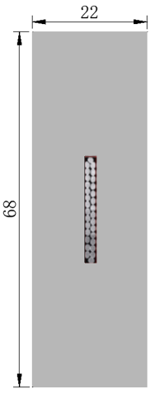
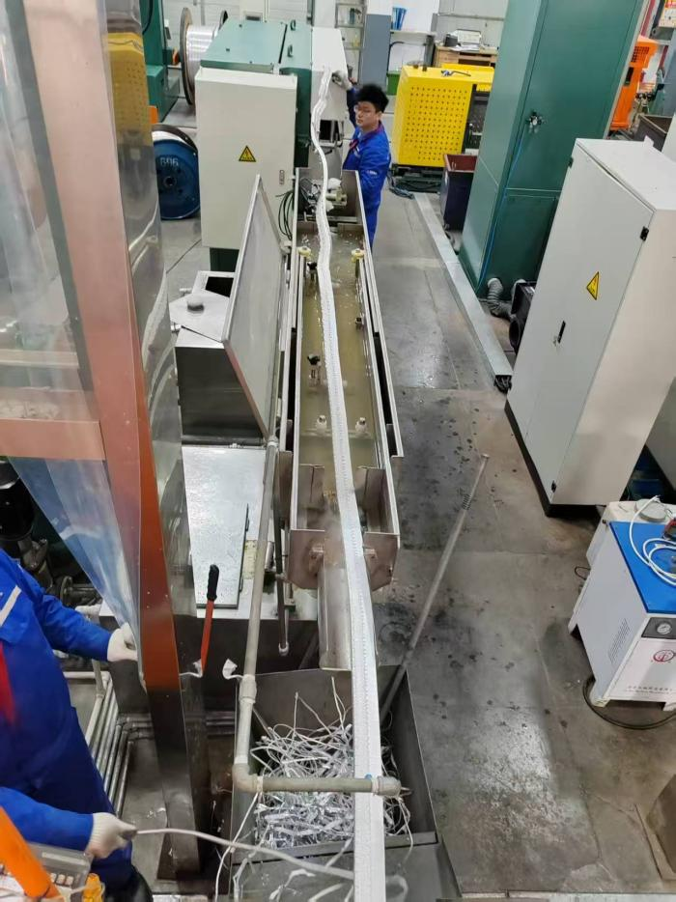
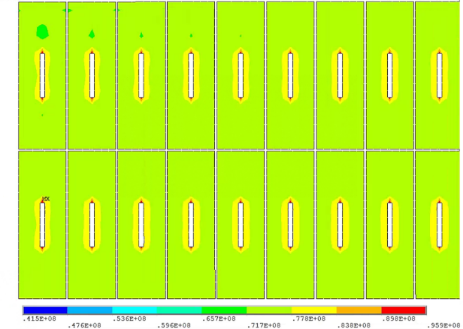
Why choose Box-type superconductor？
IDRC comments: The maximum von mise stress on the aluminum stabilizer (96MPa) is close to the yield strength of the material (105MPa). The safety margin is less than 1/3 of 0.2% yield strength.
The maximum conductor width producible by Wuxi Toly’s aluminum cladding equipment is less than 70 mm.
Option B: Currently facing major obstacles — cannot continue.
NbTi Rutherford cable
Material | Von Mises stress (MPa)
Coil at 4.2 K
Aluminum stabilizer | 4.4-86.1
SC cable | 174-243
Al alloy support | 4.6-36.2
Coil at 4.2 K, energized
Aluminum stabilizer | 41.5-95.9
SC cable | 54.9-221
Al alloy support | 43.2-87.4
Option A :(April 2025): First 5 m sample achieved via secondary cladding using small-size core conductor (4.7 mm × 15 mm).
High strength and High RRR Al stabilizer
Next R&D focus: Box-type superconductor

Slide 5
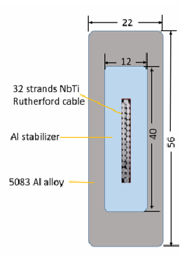
Box-type superconductor
Dimensions：
  Rutherford cable：2.2mm*20.5mm
  Pure Al：12mm*40mm
  superconductor：22mm*56mm
RRR of Pure Al | 1000 | 800 | 700 | 600 | 500
coil temperature/K | 50.83 | 55.76 | 60.56 | 66 | 74.34
coil voltage/V | 886.8 | 895.16 | 898.53 | 905.05 | 915.08
voltage between layers/V | 36.61 | 53.91 | 75.88 | 112.46 | 213.58
time/s | 173 | 167 | 162 | 155 | 141
Pure Al | 22.5 MPa
Rutherford cable | 246 MPa
Al Alloy | 137MPa
Insulation（剪切） | 10.6 MPa
Insulation（等效） | 65 MPa
support | 127MPa
Box-type cable: All component stresses satisfy allowable limits.
Aluminum stabilizer RRR analysis: Minimum RRR of 500 is acceptable.

Slide 6

Key R&D of Aluminum-stabilized Superconducting Cables
2024-12
2025-02
2025-03
2025-06
2025-09
2025-07 to now
Signed full-scale R&D contract
Re-ordered NbTi wire
Integrated preheating fixture into production line
Continue secondary cladding process development with existing small-size cable.
32-strand dummy Mg-Cu cable: stranding completed.
Proceeded with the stranding of a 32-strand Rutherford superconducting cable.
excrusion mold（16mm*30mm） in place
co-excrusion experiments using dummy copper cables+pure Al
Complete fabrication of ten-meter sample cables（16mm*30mm）
Continue secondary co-extrusion（56mm*22mm）
Notes:
大家好，这张PPT展示了我们铝稳定体超导电缆研发项目的关键时间轴。项目自2024年12月启动以来，我们按计划完成了多项重要工作。从最初的合同签订和工艺摸索，到2025年上半年完成关键的电缆绞制和包覆实验准备。目前，二次包覆实验正在持续进行中，而一次包覆工艺已于去年9月成型，并成功制作出十米级样缆。整个项目进展顺利，接下来我们将继续推进后续工作。

Slide 7
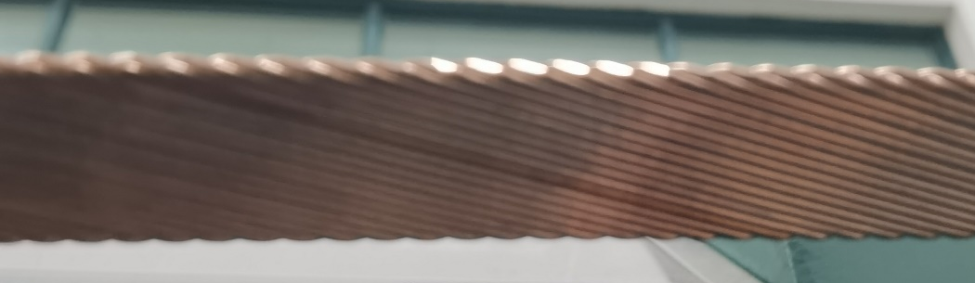
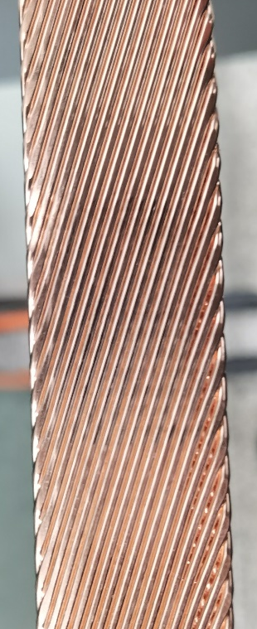
Rutherford Superconducting Cable Stranding
Niobium-titanium wire diameter: 1.3 mm
Copper-to-superconductor ratio: 1.07
Cable core number: 32 cores
Difficulties: The elastic modulus of NbTi wire is much higher than that of copper wire with the same diameter, resulting in:
Springback and strand jumping during cabling;
Excessively high void fraction between wires.
Solutions: Adjust the width and length of cabling mandrel, and extend compaction length.
In June 2025, the stranding of 30-meter Rutherford superconducting cable was successfully completed.

Slide 8
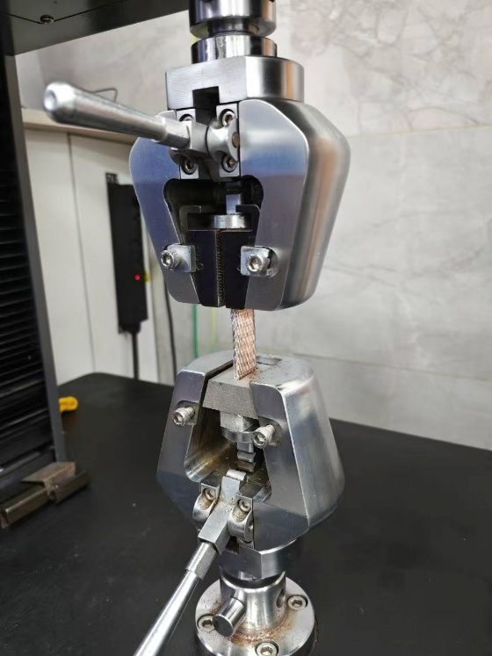
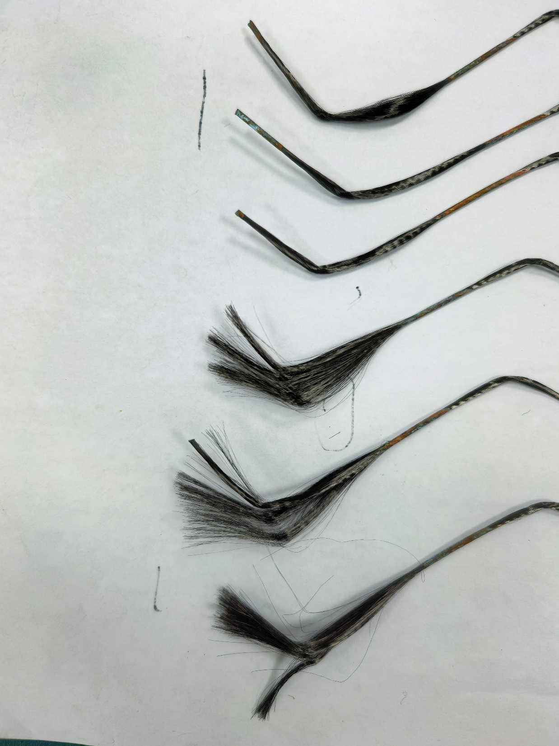
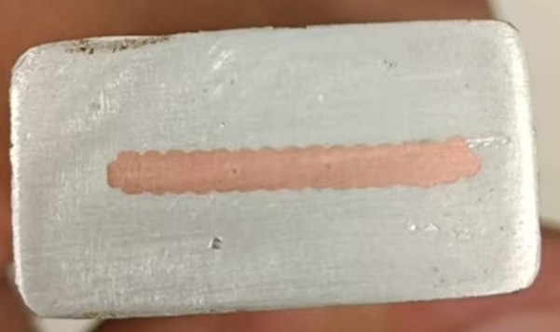
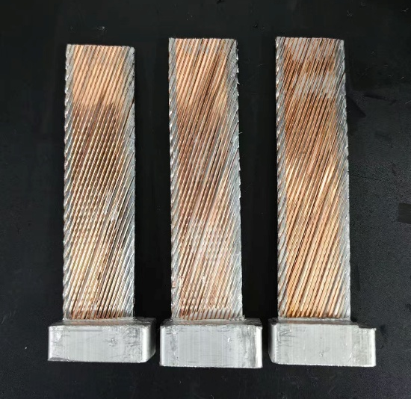
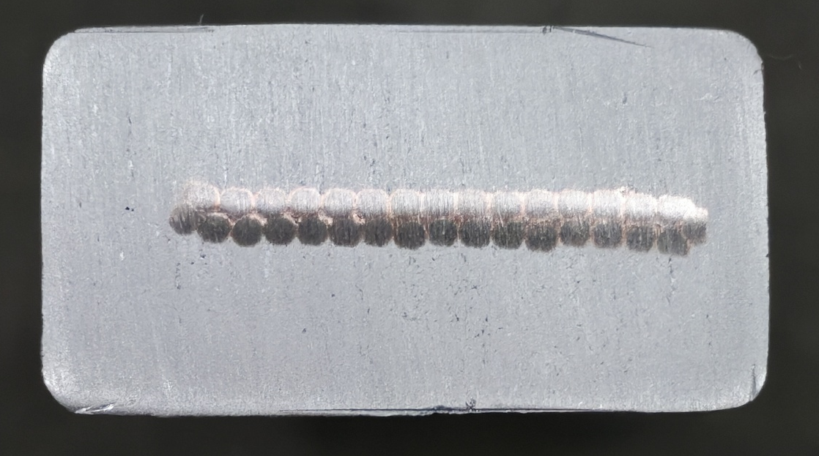
Insert（24meter,16mm*30mm）
Dummy copper cable + pure aluminum（2025.8）
Rutherford cable plus pure aluminum（2025.9）
NbTi filament inspection: no broken filaments were found. Current-carrying capacity test is in progress.
Banding ：The shear strength is 28.59 MPa, 29.18 MPa and 29.15 MPa, which meets the requirements.
Smooth appearance without defects

Slide 9
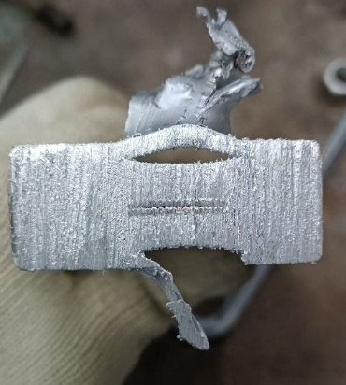
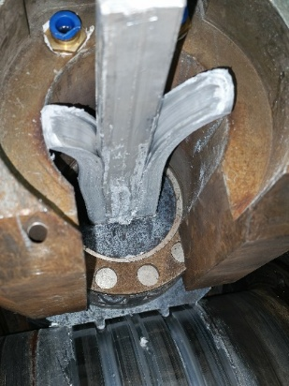
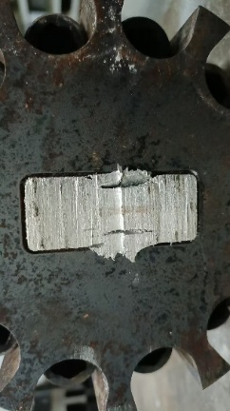
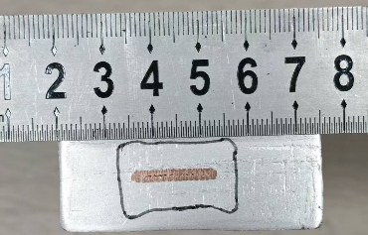
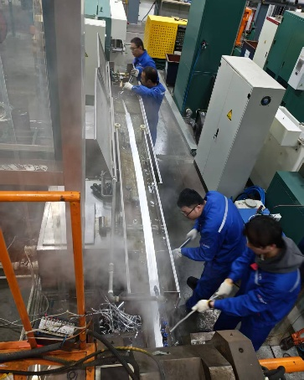
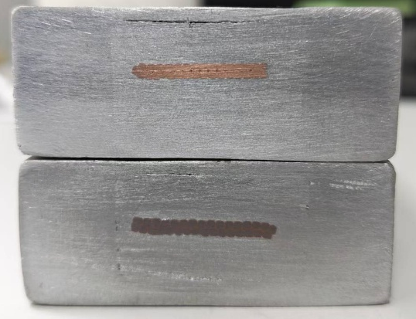
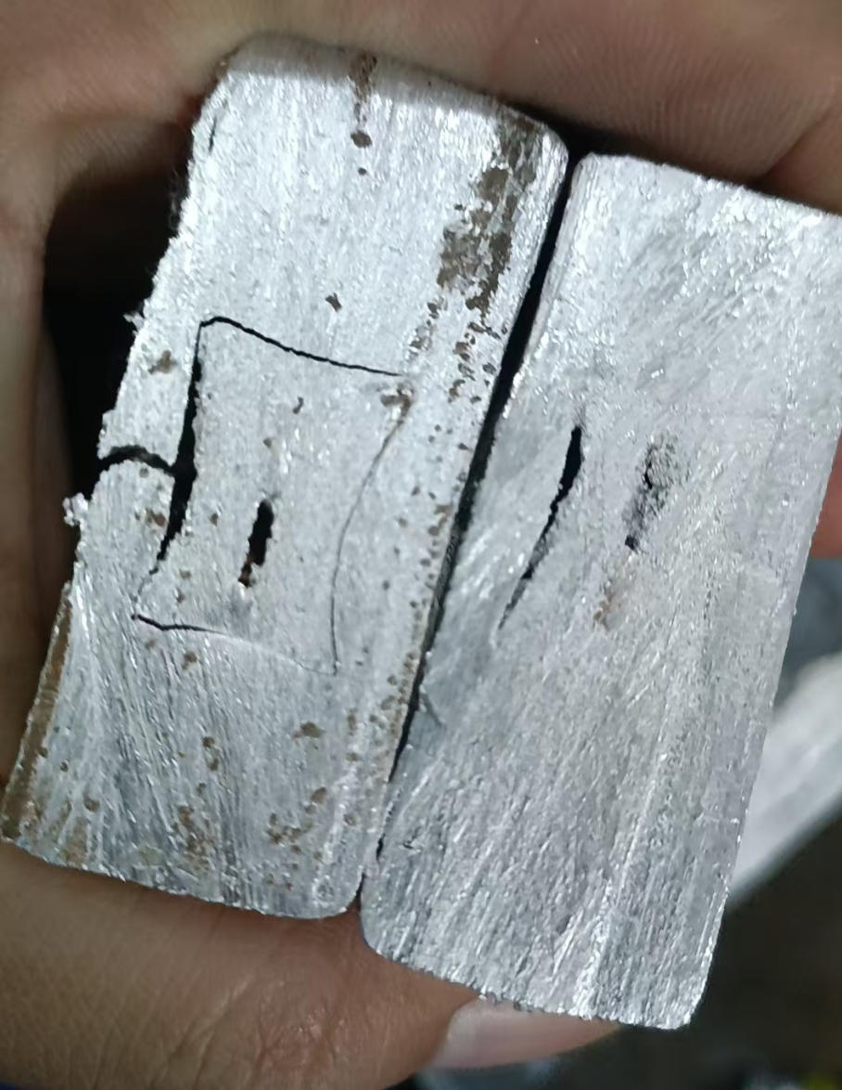
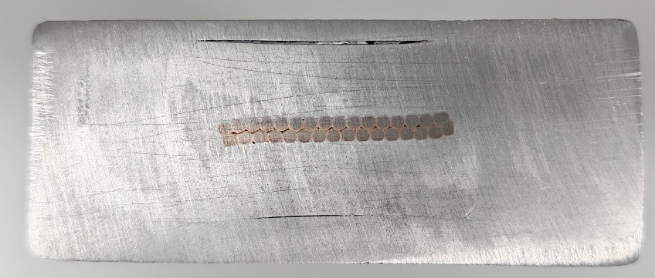
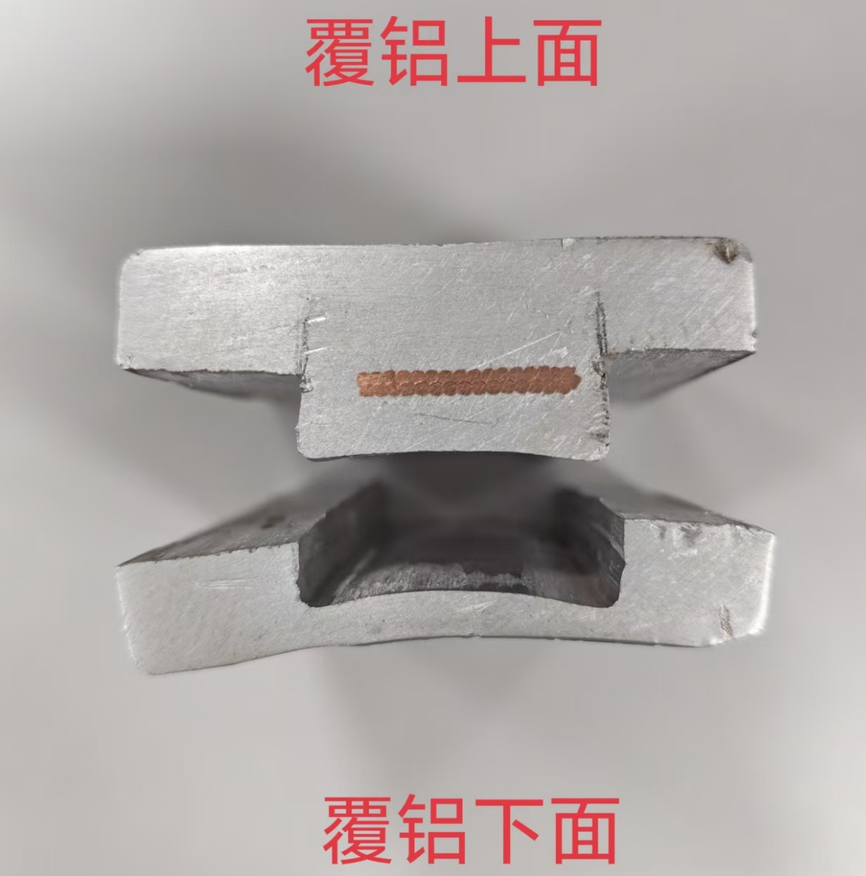
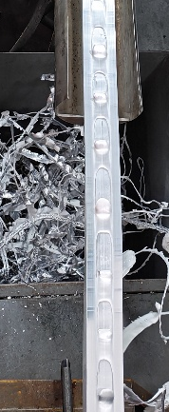
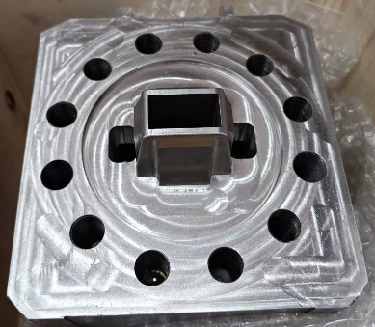
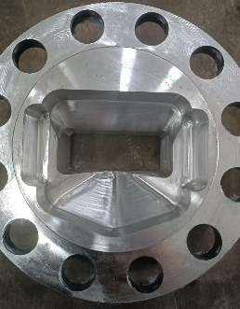
R&D of Box-type Conductor
2026.1.4
2025.12
Split mold: continuous production, incomplete upper/lower cladding, excessive flash，2025.10
Improvement: Mold gap adjusted → No significant improvement. 2026.01
Improvement: Milled insert thickness by 2mm → still incomplete cladding on upper/lower surfaces2025.11；
Improvement: Mold modified.
cladding basically complete;
Excessive flash after 1m production；
insert deformation
2025.11
Improvement: Mold modified.
Completed 5m dummy cable;
Obvious gaps still on upper/lower surfaces.
Al-Al bonding strength only 4.5MPa
2025.12
Improvement: mold
replaced;
Continuous production achievable (6m);
Surface voids occurred.
2026.4
Improvement: Replaced worn extrusion wheels + adjusted mold gap → No significant improvement.
2026.01.09
Improvement: Mold design updated.
Upper/lower cladding improved;
Core breakage reoccurred;
2026.3

Slide 10
R&D of Box-type Conductor
2026.1.4
2025.12
Split mold: continuous production, incomplete upper/lower cladding, excessive flash，2025.10
Improvement: Mold gap adjusted → No significant improvement. 2026.01
Improvement: Milled insert thickness by 2mm → still incomplete cladding on upper/lower surfaces2025.11；
Key Point: How to find the optimal cladding tightness between aluminum alloy and pure aluminum，and continuous efforts on this point.
Improvement: Mold modified.
cladding basically complete;
Excessive flash after 1m production；
insert deformation
2025.11
Improvement: Mold modified.
Completed 5m dummy cable;
Obvious gaps still on upper/lower surfaces.
Al-Al bonding strength only 4.5MPa
2025.12
Improvement: mold
replaced;
Continuous production achievable (6m);
Surface voids occurred.
2026.4
Improvement: Replaced worn extrusion wheels + adjusted mold gap → No significant improvement.
2026.01.09
Improvement: Mold design updated.
Upper/lower cladding improved;
Core breakage reoccurred;
2026.3

Slide 11
others
In May 2026, 45m insert cables produced for secondary cladding process verification.
Cooperated with Hunan Qianlong to develop Al-doped materials; two batches of samples finished. ButRRR values unqualified, parameters under adjustment.

Slide 12
Summary
32-core Rutherford cable stranding process verified, 50m sample cable accomplished.
Primary extrusion process validated, banding strength qualified; current-carrying test ongoing, 45m sample completed.
Secondary extrusion process adjusted repeatedly, improvement scheme confirmed, mold under repair, verification expected in June.
Next: Complete secondary extrusion verification & performance tests, achieve production of 100m-long usable cables.

