Slide 1
GS calorimeter R&D progress
Yuekun Heng
On behalf of Calorimeter team
June 10，2026

Slide 2
Updates on HCAL plan
Optimization of design in 2026, continuing iterative refinement.
  Homogeneous ECAL and HCAL: E and H shower, SiPM, FEE, ME, cooling, etc.
  Optimization of longitudinal and transverse granularity: with considerations including Δθ(η)×Δφ, shower separation, cost and other constraints.
  Optimization of sampling fraction：shower separation, energy reso., e/h, etc.
  Update requirements on GS, SiPM, FEE, ME, Cooling, CAL, etc.
GS R&D more
  Besides density and light yield
  Achieve attenuation length >10 cm
  Improved response uniformity
  Peak emission wavelength: red-shifted some if feasible
Parts, module and prototype tests in 2026, 2027 and 2028
  GS and SiPM tests: establish the baseline for QA/QC procedures in 2026 and 2027
  Light collection and guide R&D in 2026
  Module tests: CR tests for MIP and source tests in 2027
  Prototype construction and tests: in 2027 and 2028
    Ecal：1024(8x8x16) channels, Hcal：~12960 (18x18x40) channels
    Construction: GS/SiPM/ME/FEE/DAQ/CAL
    Tests: CR, e, p, π±
Engineering designs in 2027, 2028, maybe to 2029
  Iterate alongside design optimization, including barrel and endcap
  Integrate GS tiles, SiPM, FEE, CAL, ME and Cooling subsystems, including interfacing with sibling subdetectors.
  Give the QA/QC plan
Dimensional Optimization & Gradation
Ecal cublic side: 1.5/17/2 cm ?
Hcal squire side: 3.5/4/4.5/5 cm ?
Optimization depends on algorithms
Software contribute much!

Slide 3
Prototypes
Ecal：
  2x2x2 cm³ ，Channel: 1024(8x8x16)
  Ecal prototype firstly to do in 2027, then Hcal prototype
Hcal：
  The horizontal detection probability is 95% for a radius of 1.3-1.5 λ_{I}.
  If the horizontal radius is set at 32cm, then the cell number equals 16x16x40=10240.
SiPM
  Suppliers: IHEP, NDL, Hamamatsu, etc
  Tests and optimization for calorimeter
FEE
  Suppliers: IHEP ASIC and PCB
  Commercial like Caen or 宇称电子
GS
  Density, light yield, attenuation length, response uniformity
  B field effects
  Radiation hardness
  ME performances like tensile strength bending strength
H shower Horizontal probability | 60-65% | 90% | 95%
Horizontal radius | 2/3λ_{I}(16cm) | 1λ_{I}(24cm) | 1.5λ_{I}(36cm)
Cell number | 8x8x40=2560 | 12x12x40=5760 | 18x18x40=12960

Slide 4
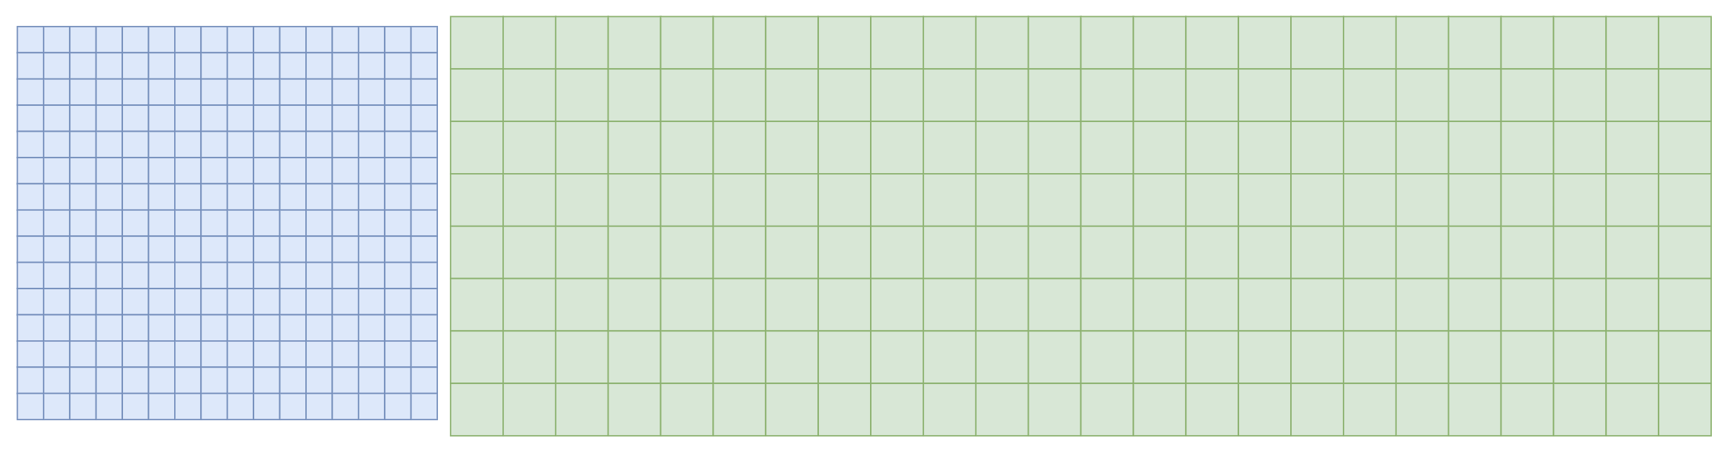


GS ECAL-HCAL Longitudinal Thickness
ECAL
HCAL
Incident particle
32 cm/20 $X_{0}/$1.3 $λ_{I}$
~150 cm/6$λ_{I}$
Table Properties of BGO and scintillating glass
Ecal: may not thick enough
  Hcal to compensate it
  Need the material be small between them
  Total thickness ~40 cm from 30 cm
Hcal: total 7.3𝝀_𝑰 adopting Ecal
Property | BGO | Scintillating Glass
Density ρ (g/cm³) | 7.13 | 6.0
Effective atomic number Z | 72.9 | 56.9
Radiation length X₀ (cm) | 1.12 | 1.59
Molière radius R_M (cm) | 2.23 | 2.50
Nuclear interaction length λ_I (cm) | 22.7 | 24.1
λ_I / X₀ | 20.27 | 15.16
Refractive index | 2.15 | 1.74
Light yield (photons / MeV) | 7400 | 1500
Attenuation length (cm) | ~ 1000 | ~ 6 → 10,20
Cost (CHF / cm³) | 3.88 | 0.5

Slide 5
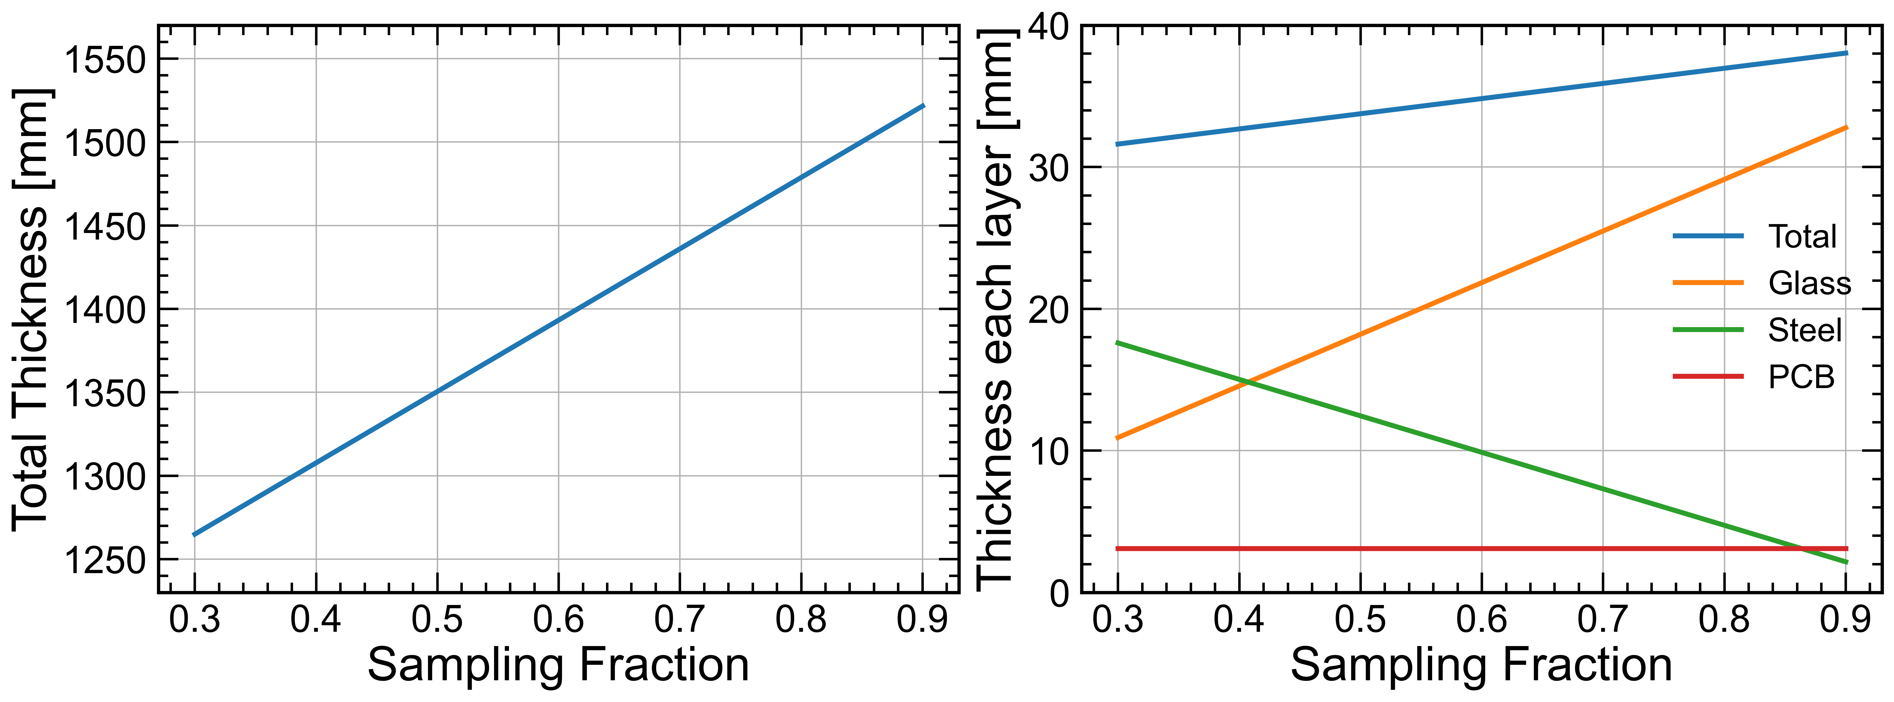
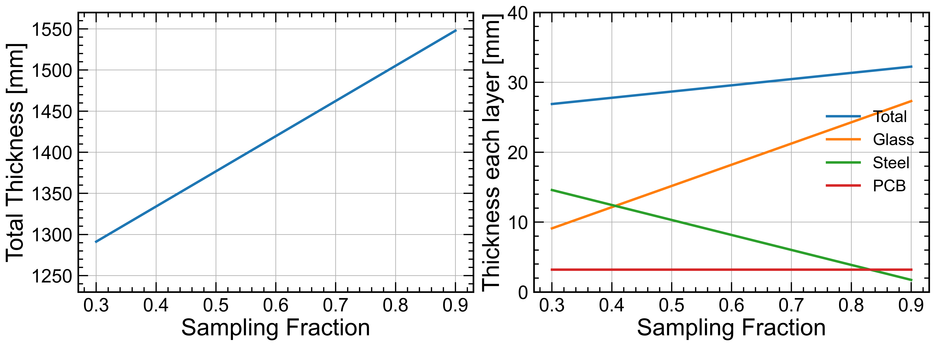
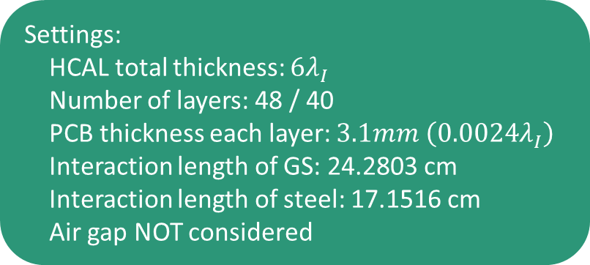
HCAL fraction
Settings:
HCAL total thickness: $6λ_{I}$
Number of layers: 48 / 40
PCB thickness each layer: $3.1mm \left(0.0024λ_{I}\right)$
Interaction length of GS: 24.2803 cm
Interaction length of steel: 17.1516 cm
Air gap NOT considered
Sampling fraction | HCAL total thickness (mm) | Layer thickness (mm) | GS thickness /layer (mm) | Steel thickness /layer (mm)
50% | 1351 | 33.8 | 18.2 | 12.5
70% | 1436 | 35.9 | 25.5 | 7.3
90% | 1522 | 38.0 | 32.8 | 2.2
48 layers
40 layers with 42mm support structural thickness
Hcal thickness increasing about 25 cm from 1314 in Ref-TDR

Slide 6
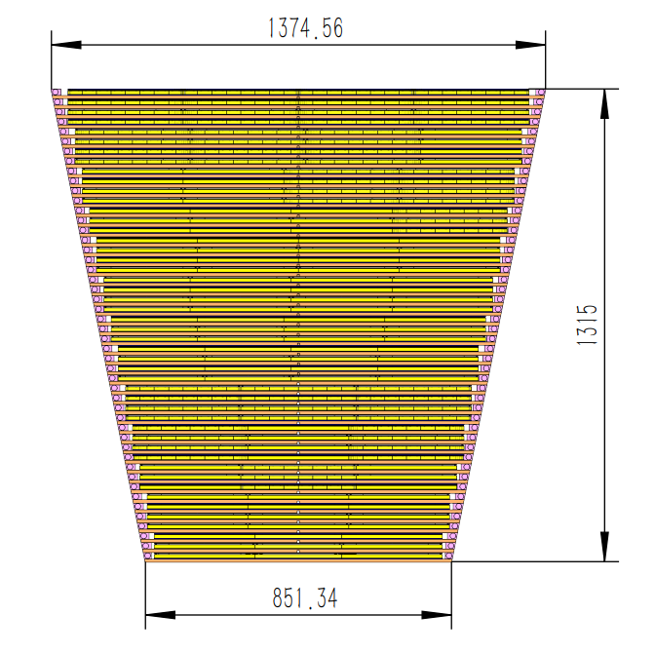
Layer settings of HCAL
CEPCSW current settings,
30% sampling fraction, using in ref-TDR
Steel (2mm) (cassette)
PCB (3.1mm)
GS (10mm) + ESR (2*0.065mm) + air (0.07mm) = 10.2mm
Steel (2mm) (cassette)
Steel (9.9mm) (Absorber)
Incident particle
50% sampling fraction
70% sampling fraction
90% sampling fraction
Steel (6.25mm)
PCB (3.1mm)
GS (18.2mm) +
ESR (2*0.065mm) +
air (0.07mm) =
18.4mm
Steel (6.25mm)
Steel (3.65mm)
PCB (3.1mm)
GS (25.5mm) +
ESR (2*0.065mm) +
air (0.07mm) =
25.7mm
Steel (3.65mm)
Steel (1.1mm)
PCB (3.1mm)
GS (32.8mm) +
ESR (2*0.065mm) +
air (0.07mm) =
33.0mm
Steel (1.1mm)

Slide 7
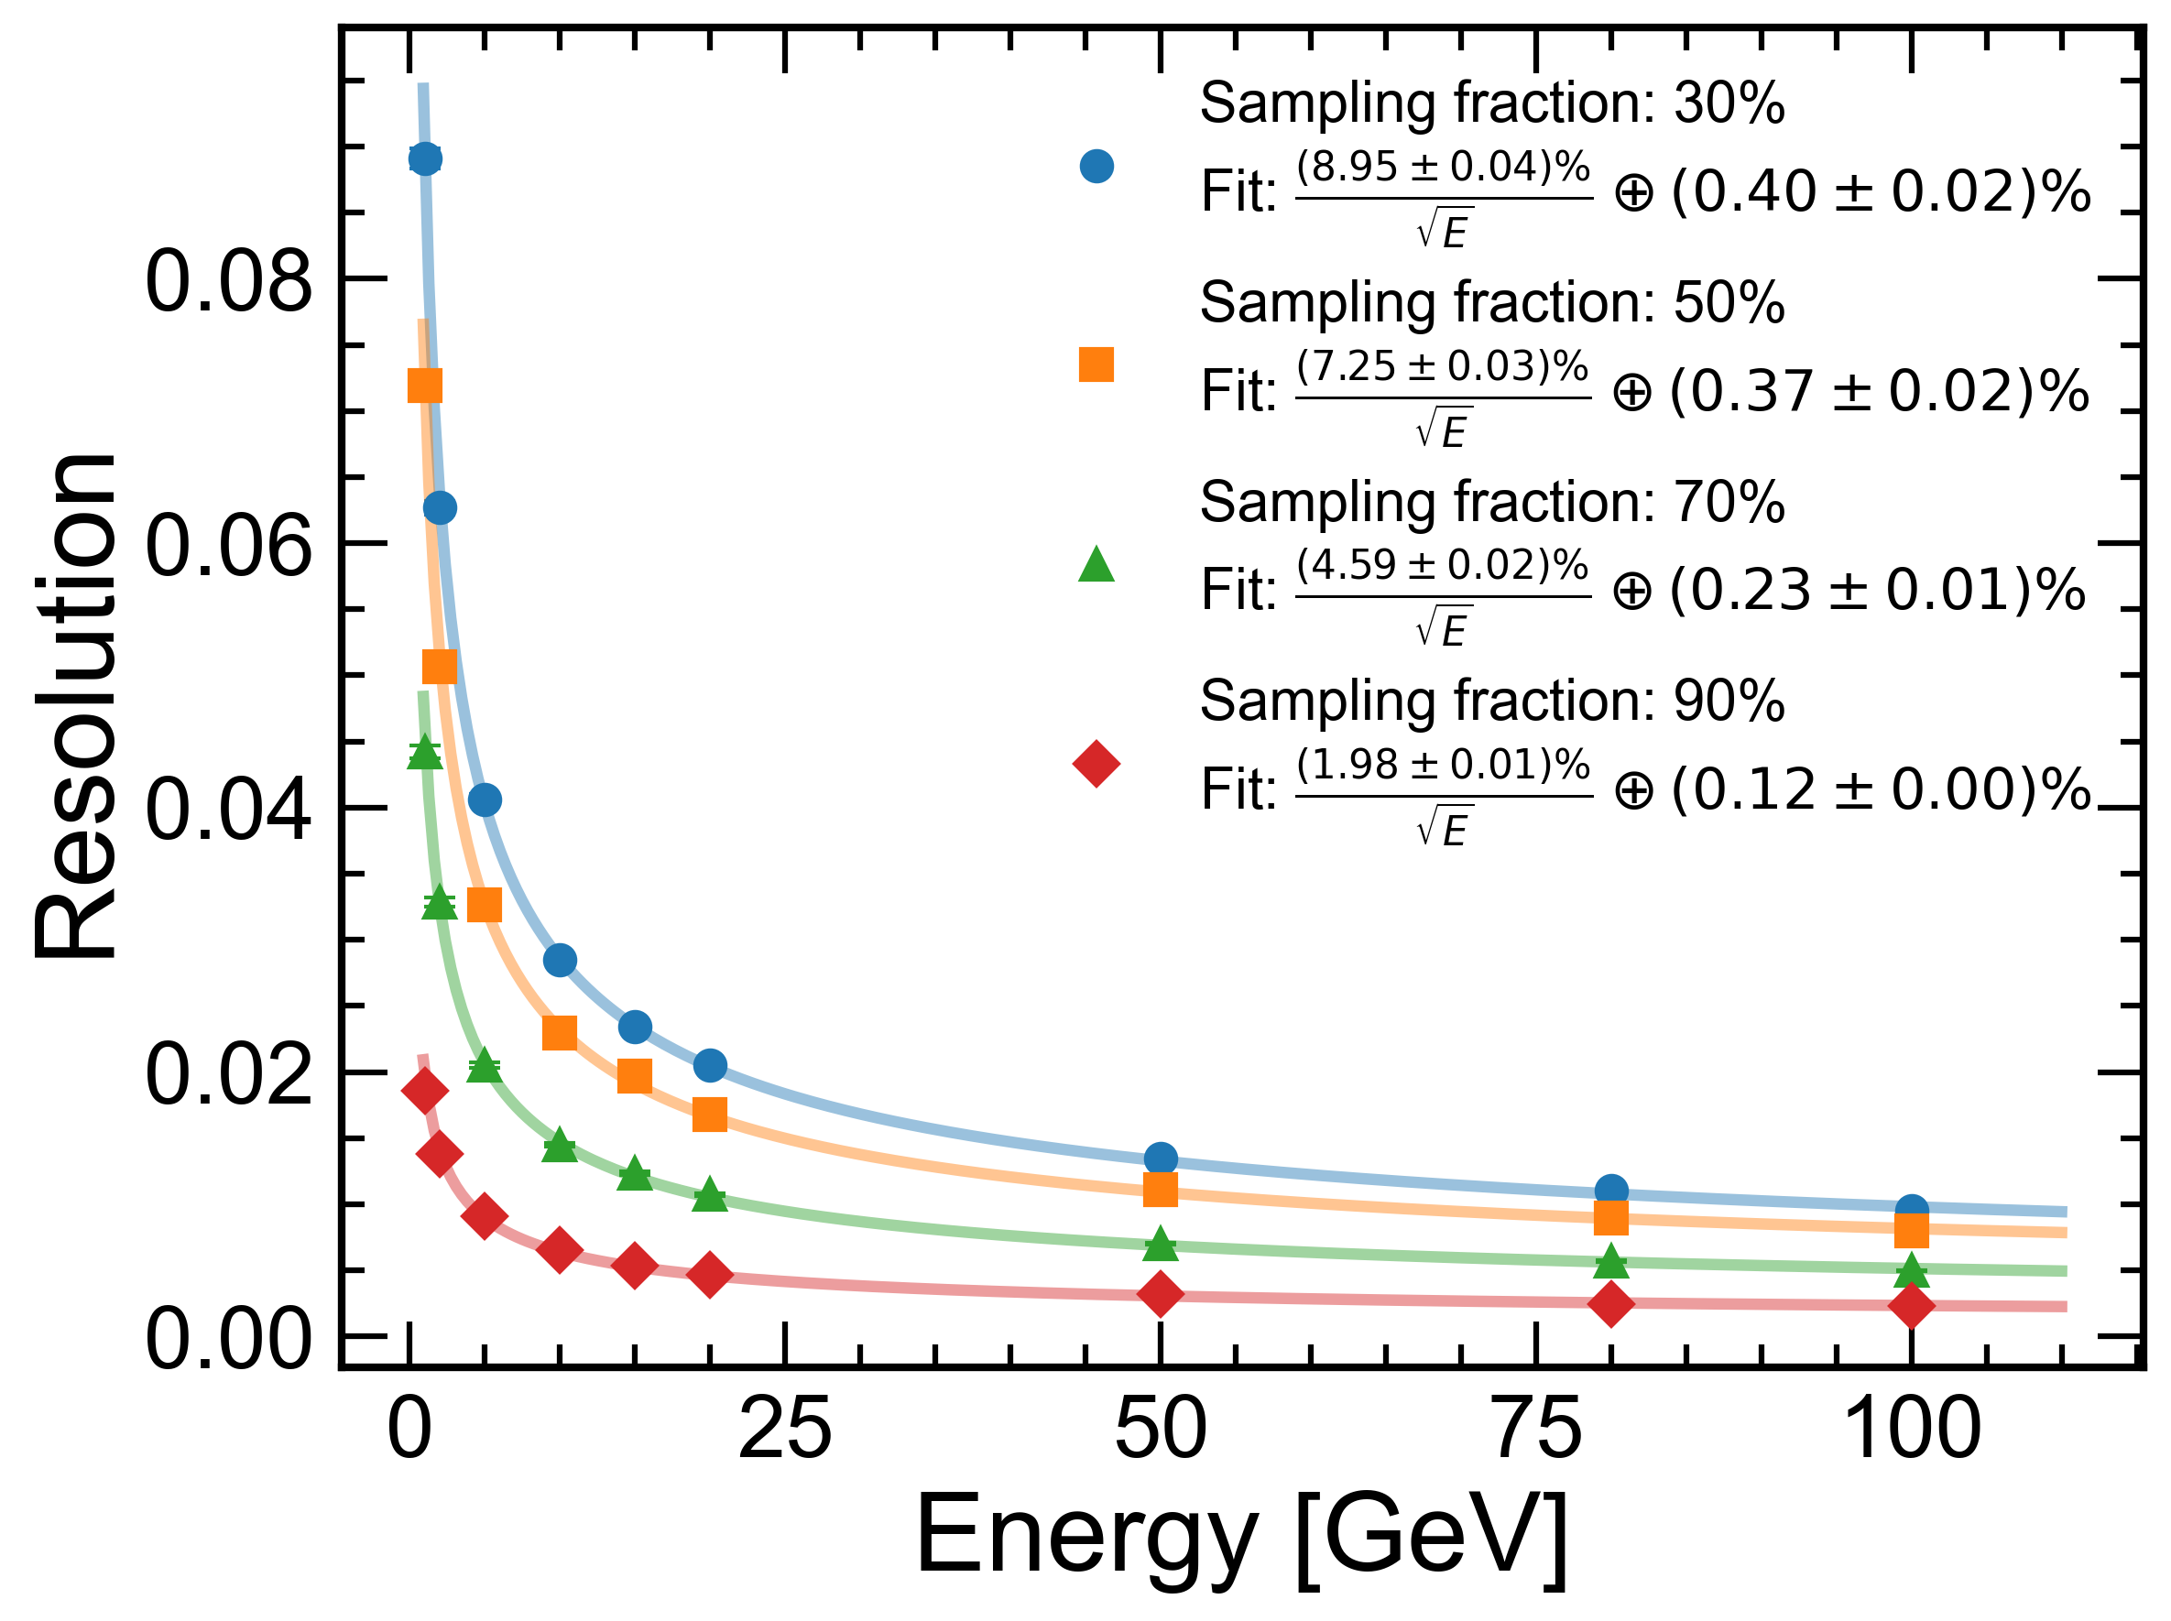
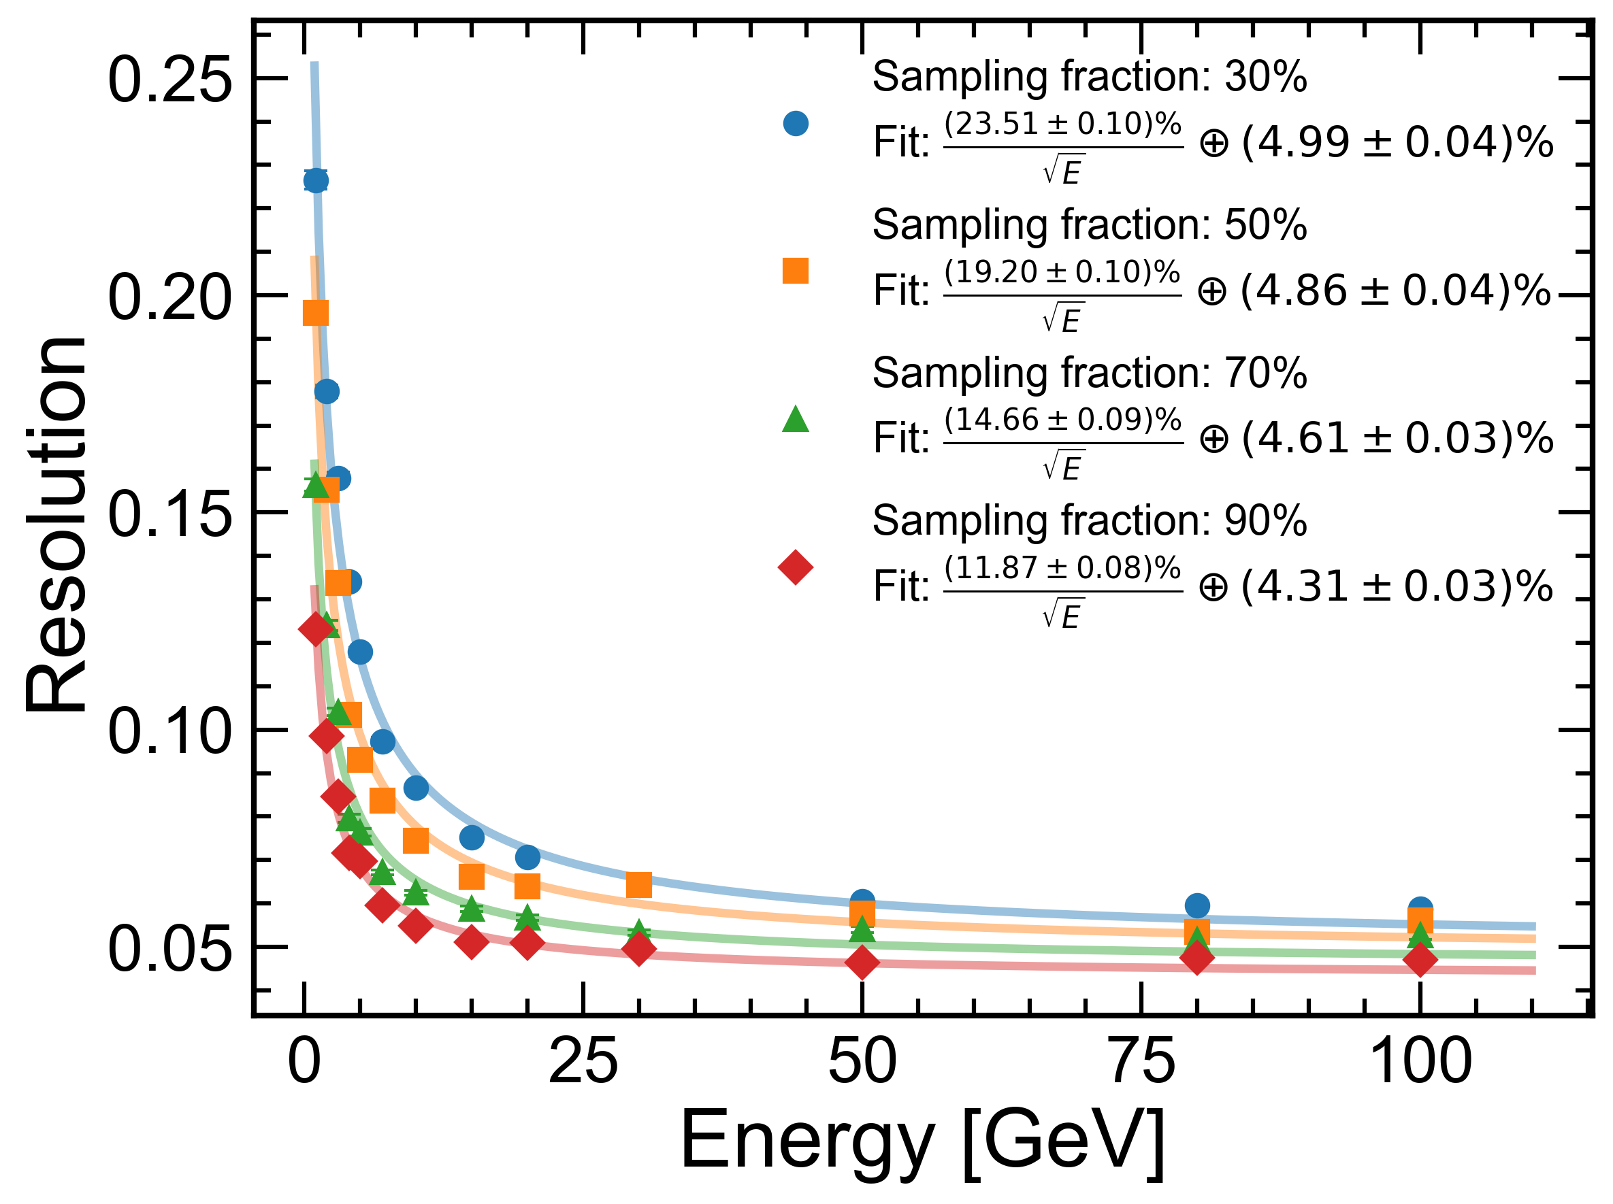
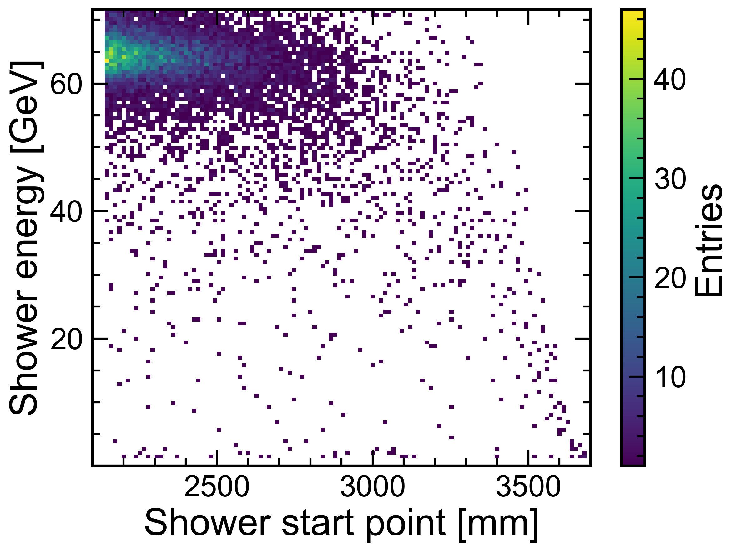
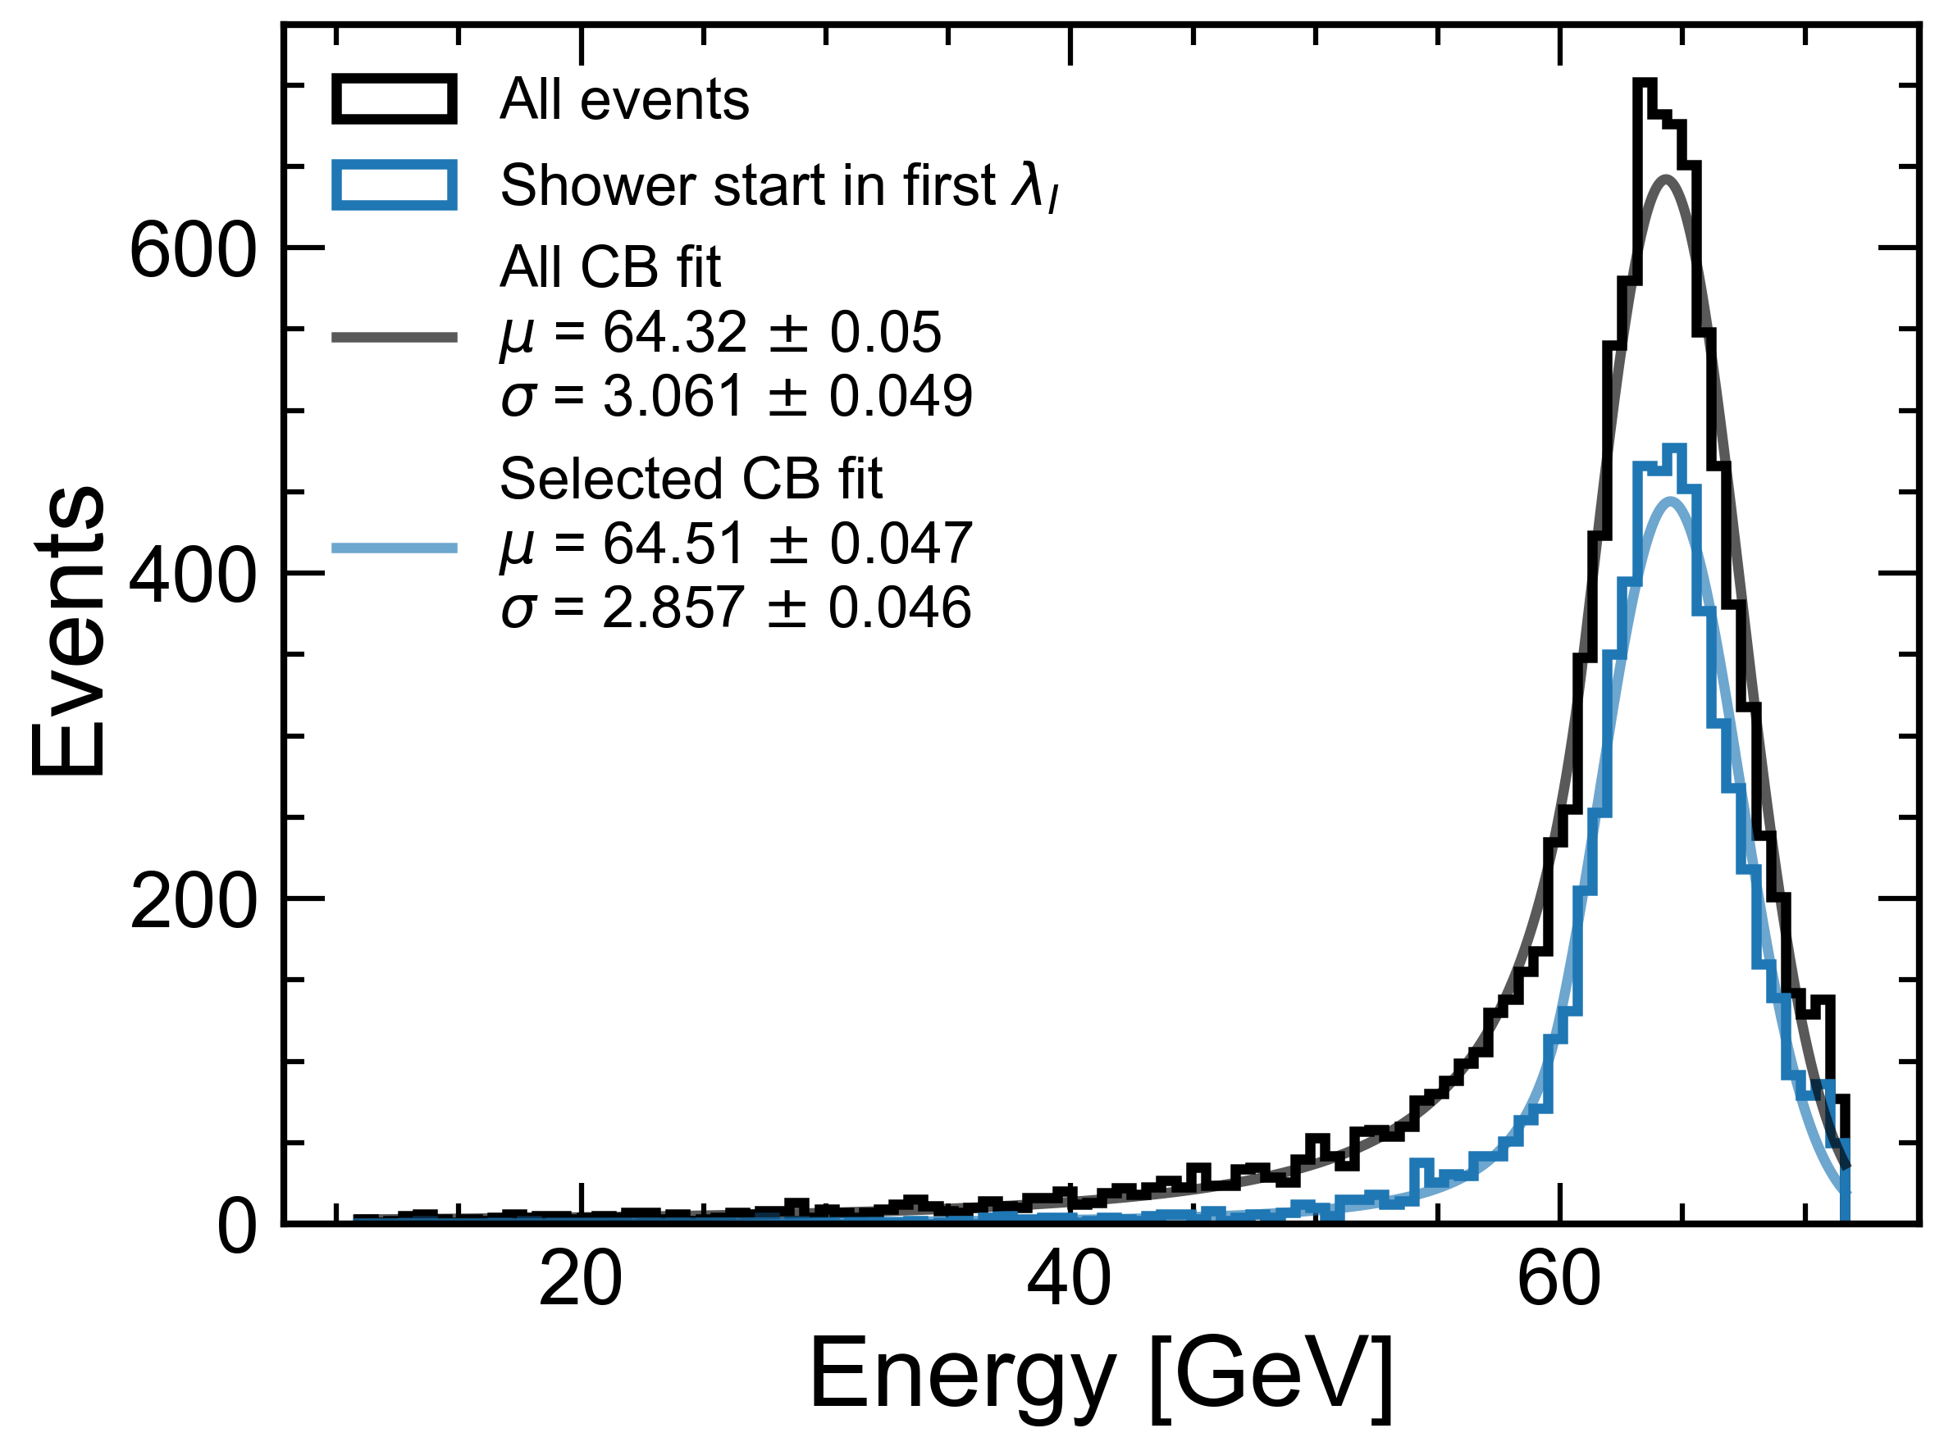

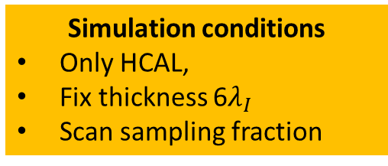
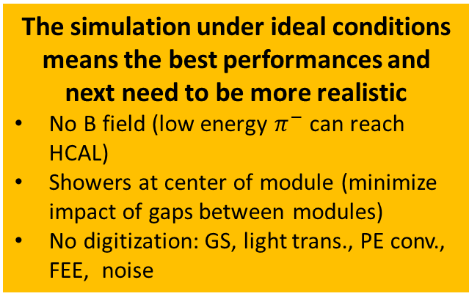


Hadronic & EM Energy Resolution
Simulation conditions
Only HCAL,
Fix thickness 6$λ_{I}$
Scan sampling fraction
EM resolution
Hadronic resolution
Incident particle: $γ$
Incident particle: $π^{−}$
The simulation under ideal conditions means the best performances and next need to be more realistic
No B field (low energy $π^{−}$ can reach HCAL)
Showers at center of module (minimize impact of gaps between modules)
No digitization: GS, light trans., PE conv., FEE, noise
80 GeV $π^{−}$

Slide 8
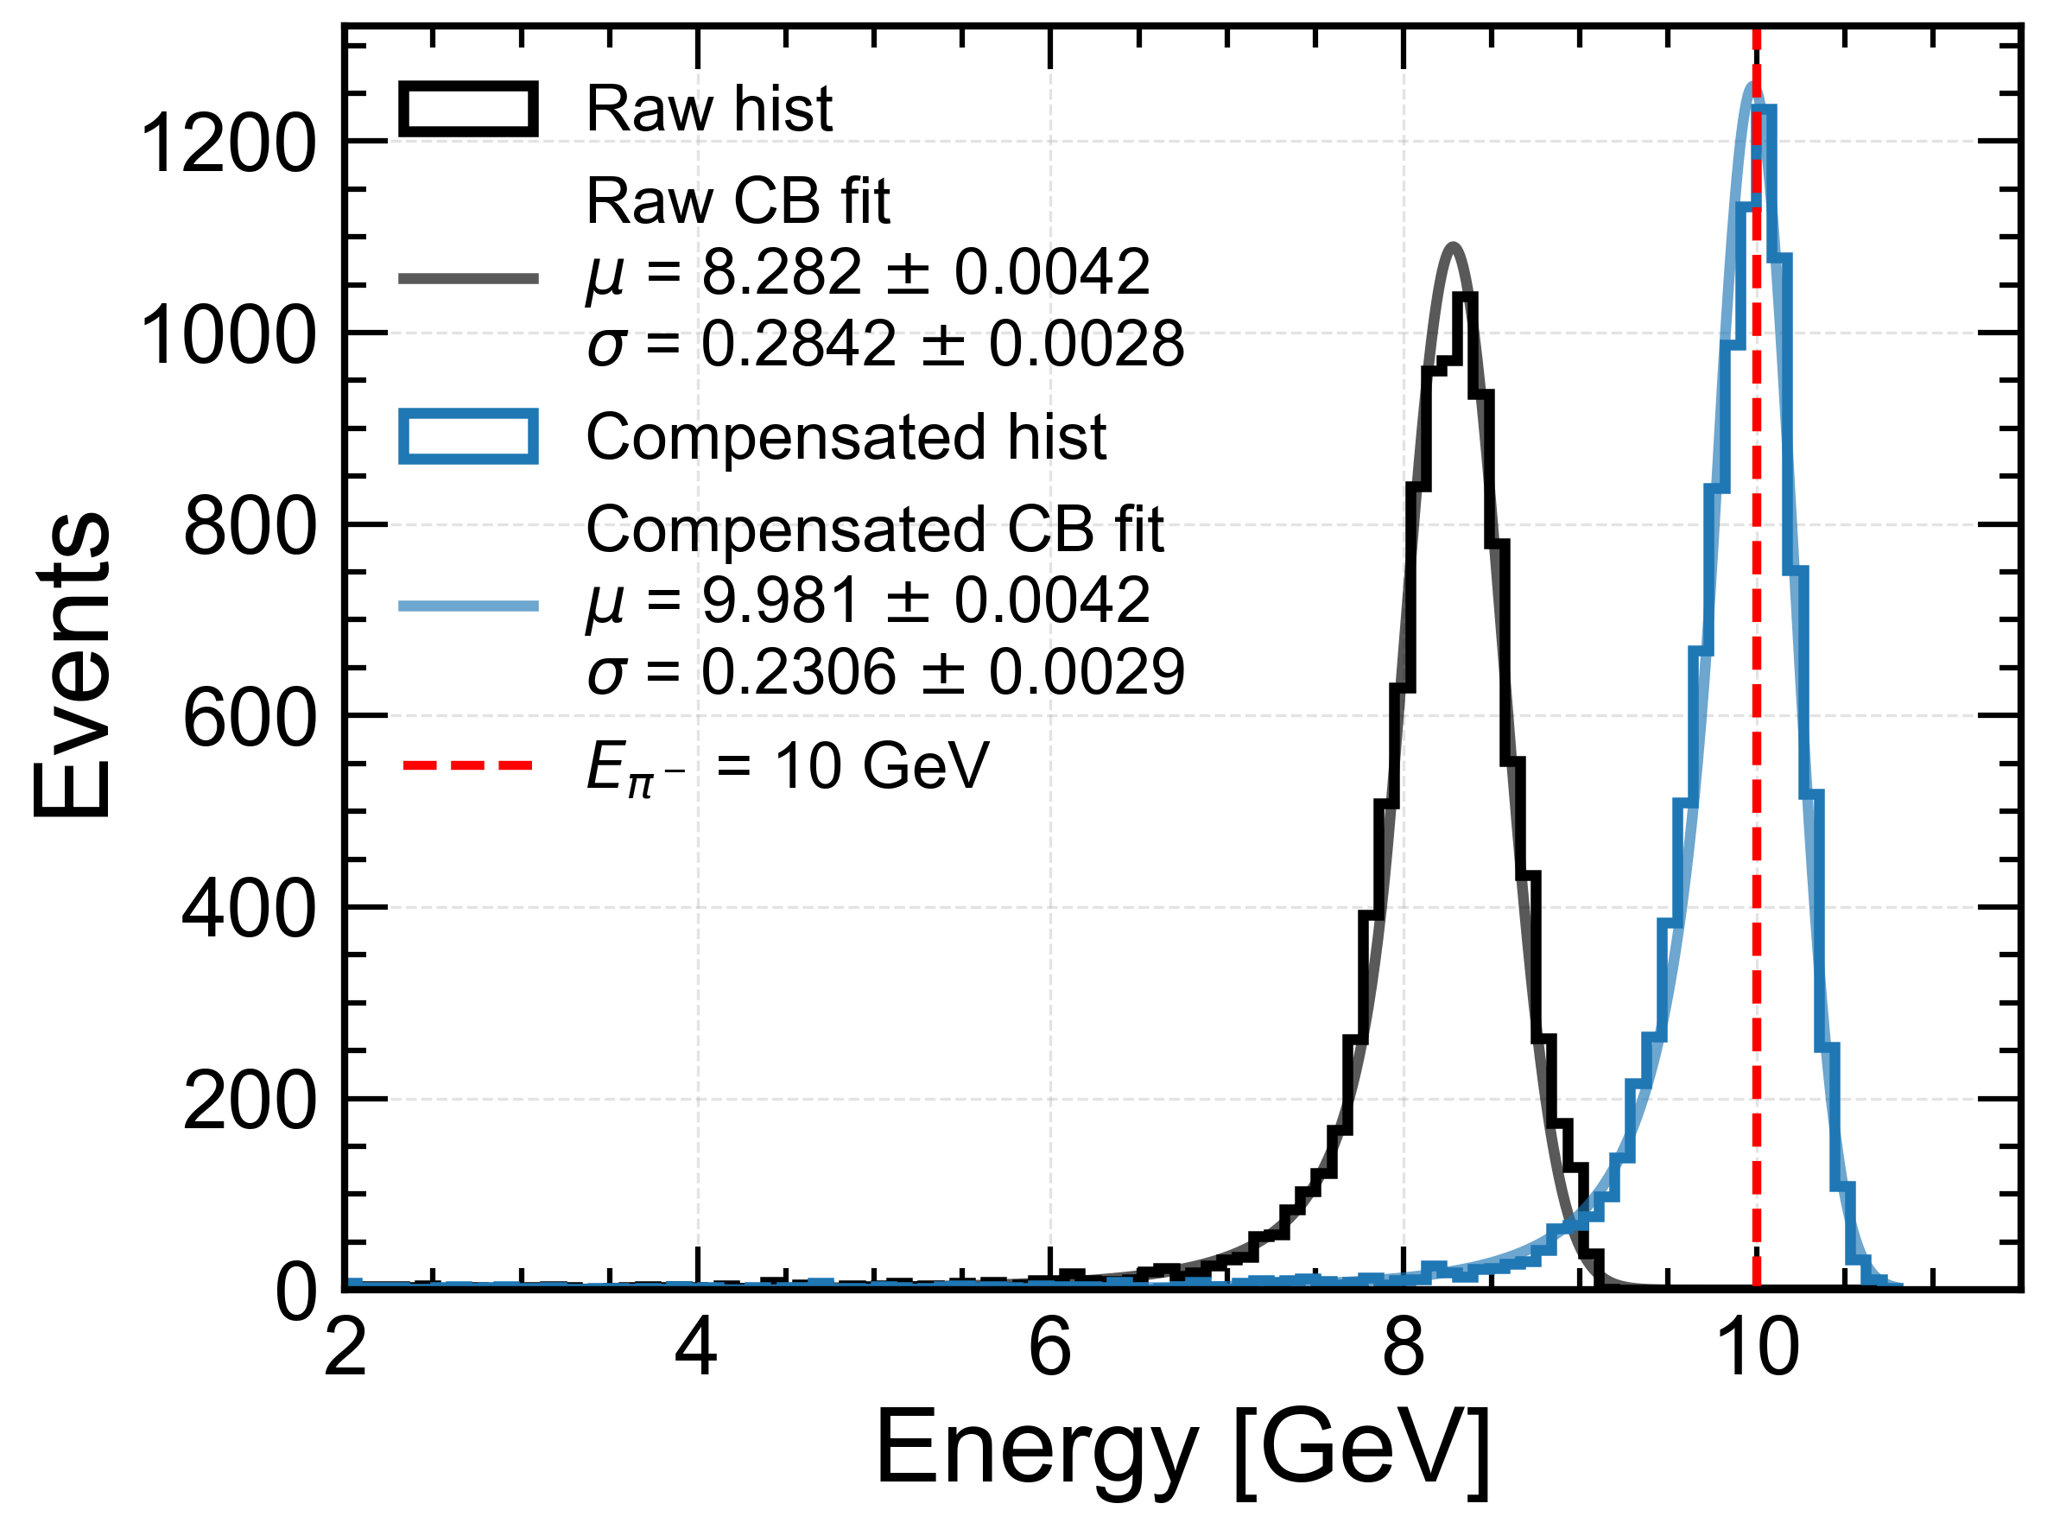
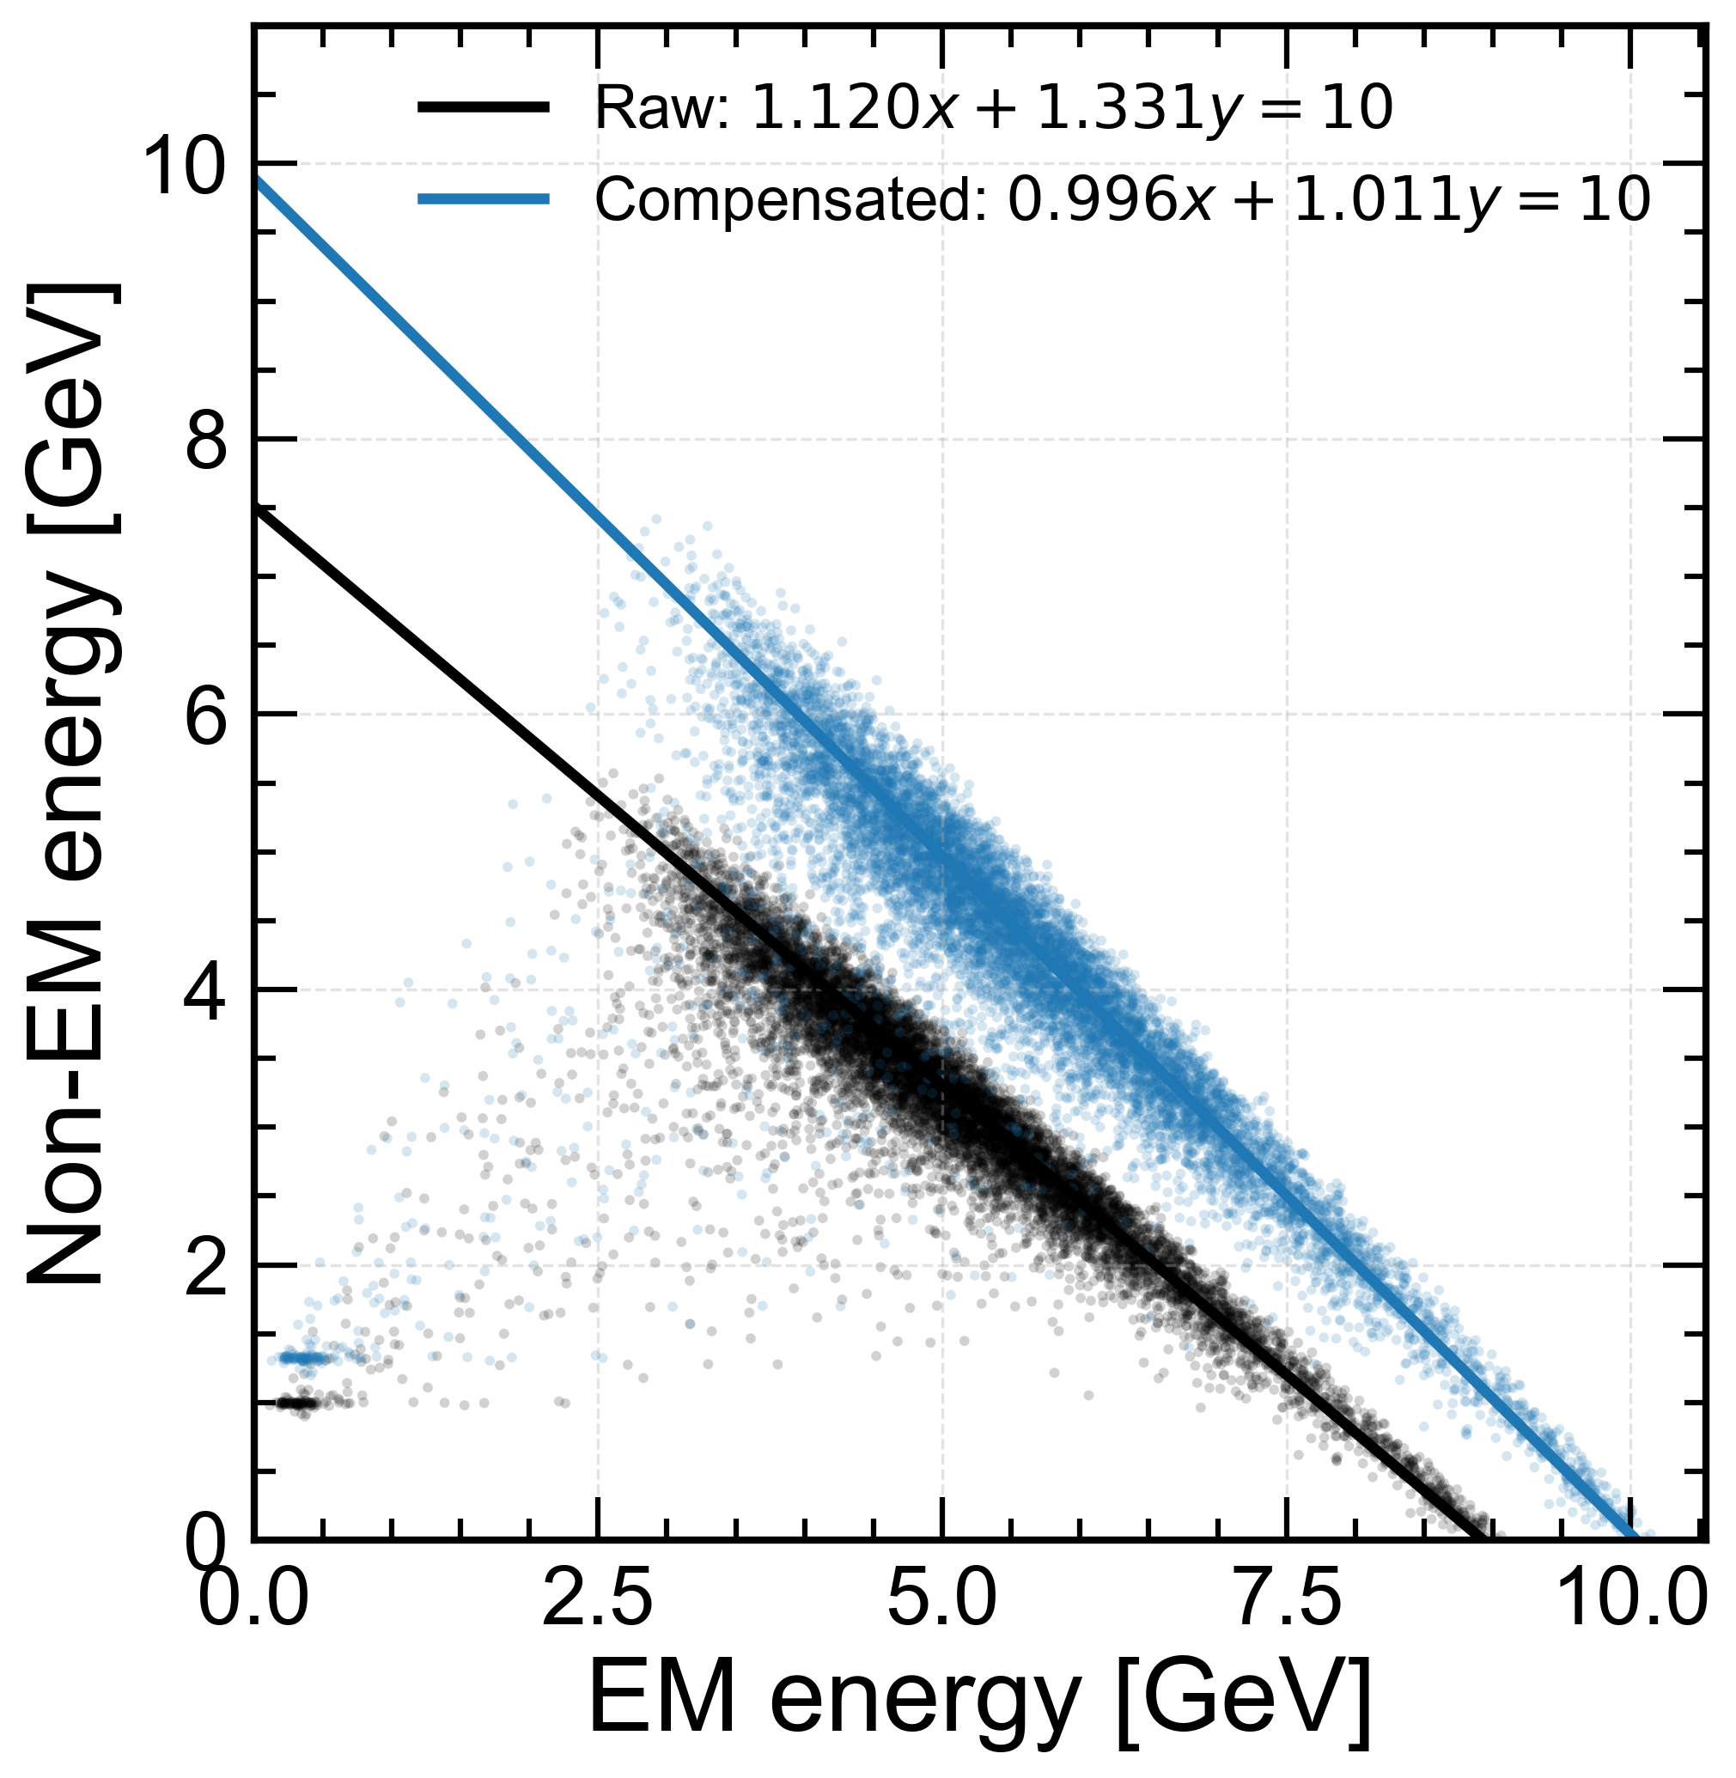
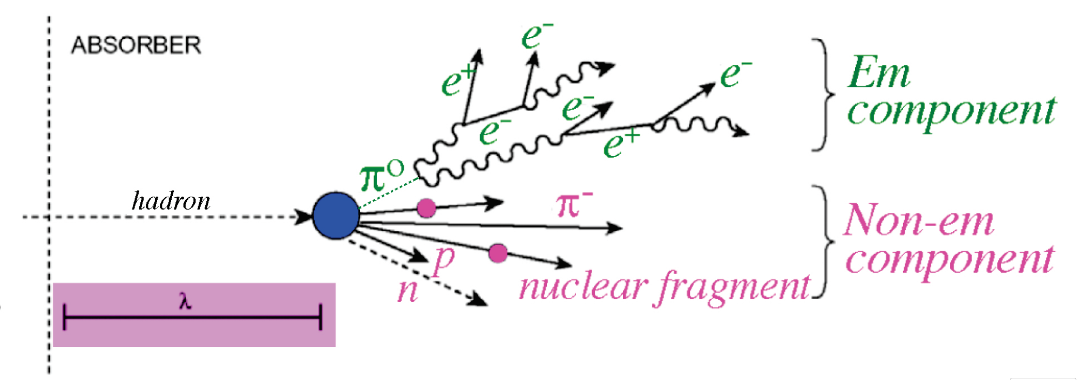
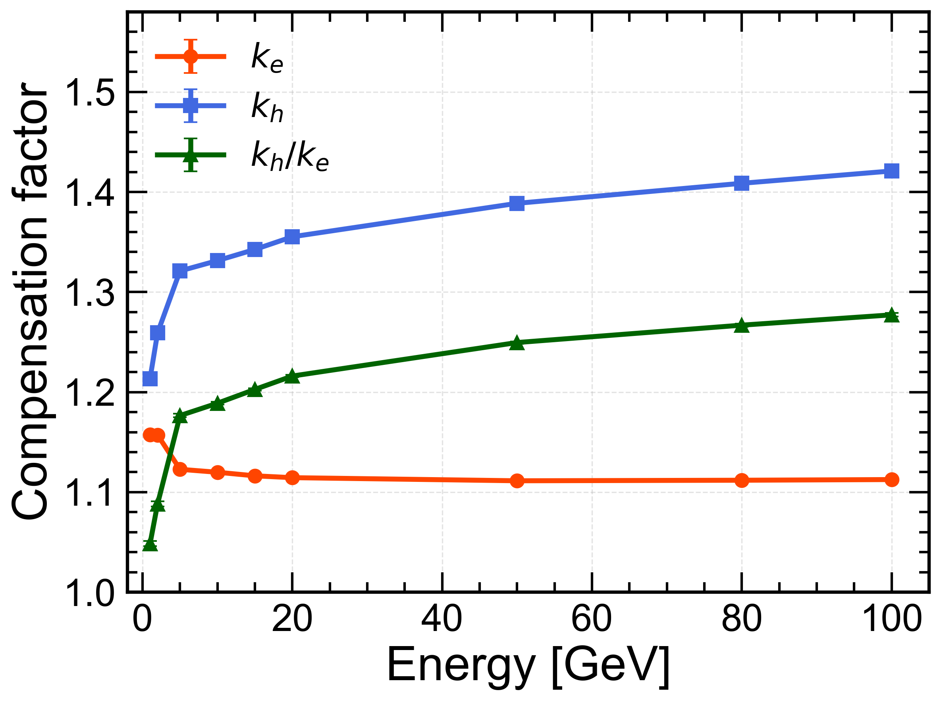
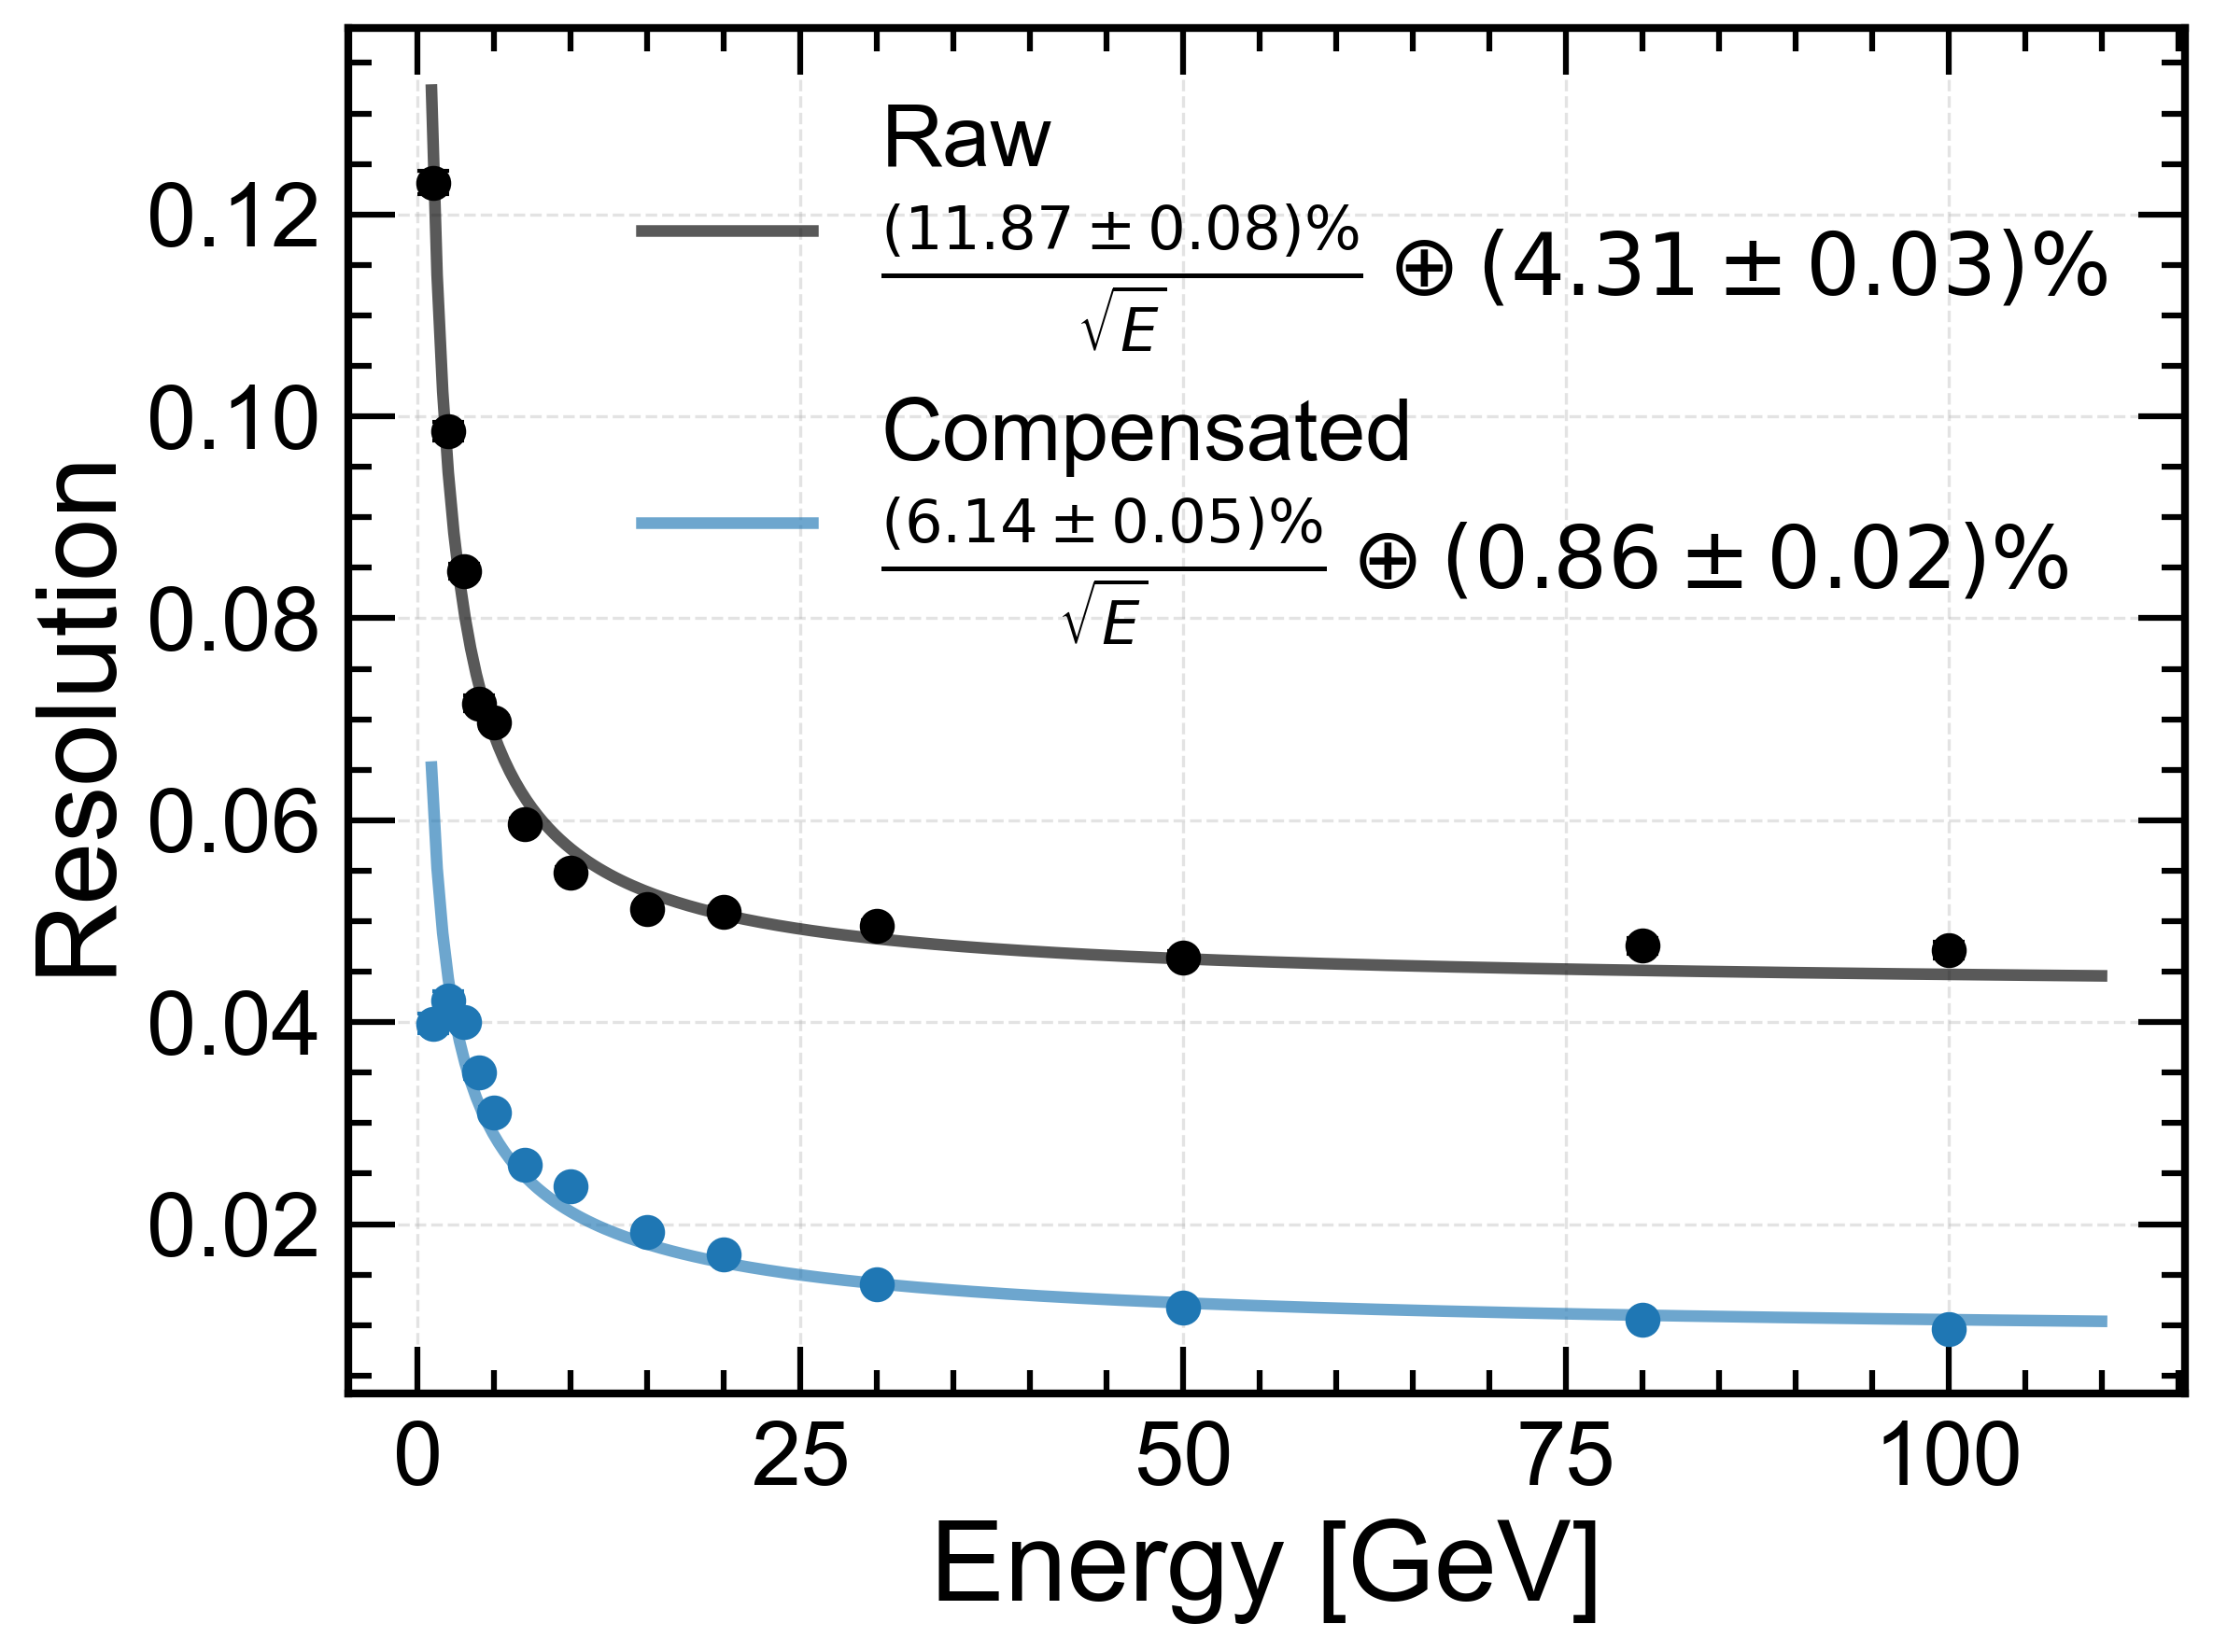
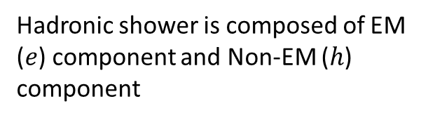
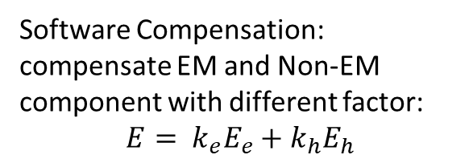
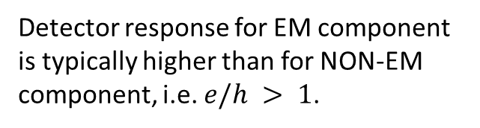
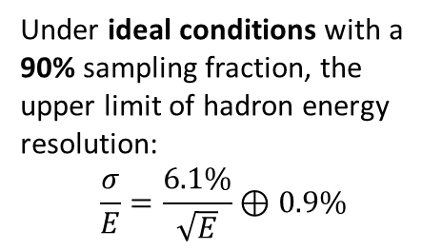
Software Compensation
Detector response for EM component is typically higher than for NON-EM component, i.e. $e/h > 1$.
Software Compensation: compensate EM and Non-EM component with different factor:
$$E= k_{e}E_{e}+k_{h}E_{h}$$
Hadronic shower is composed of EM ($e$) component and Non-EM ($h$) component
Under ideal conditions with a 90% sampling fraction, the upper limit of hadron energy resolution:
$$\frac{σ}{E}=\frac{6.1\%}{\sqrt{E}}⊕0.9\%$$
The software compensation based on truth information
Real one depends on reconstruction and the shower separation power.
Next to do including more real simulation and reconstruction.

Slide 9
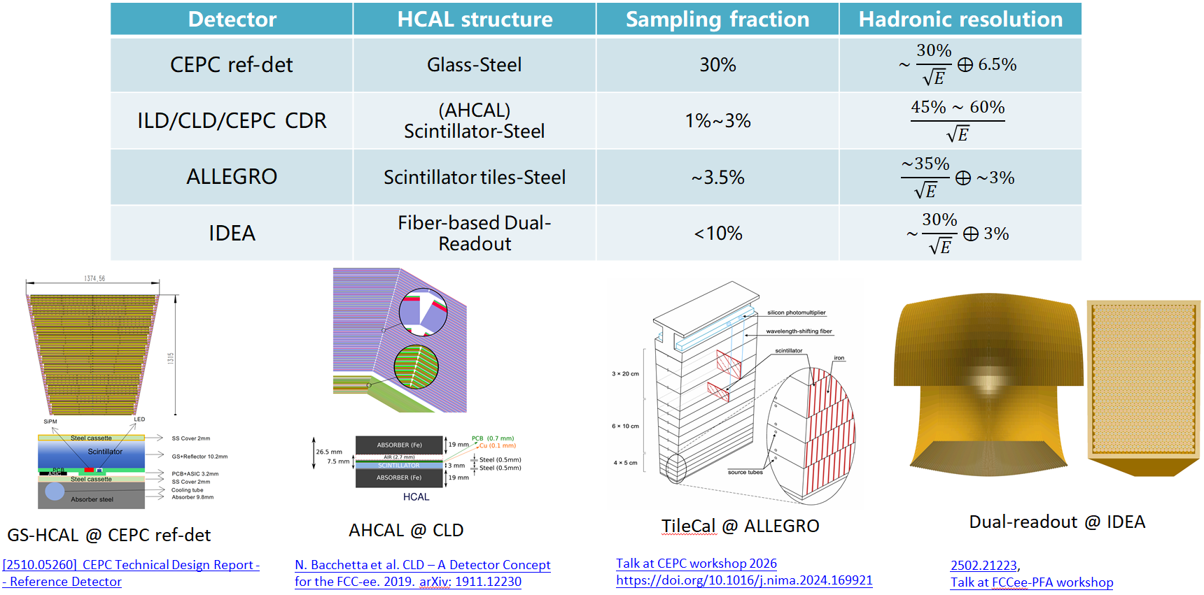
HCAL performance target
Stochastic term
  Ideal 12%→~18% guessed considering light/PDE/FEE etc.
Constant term
  Ideal 0.9%，no compensation 4.3%

Slide 10
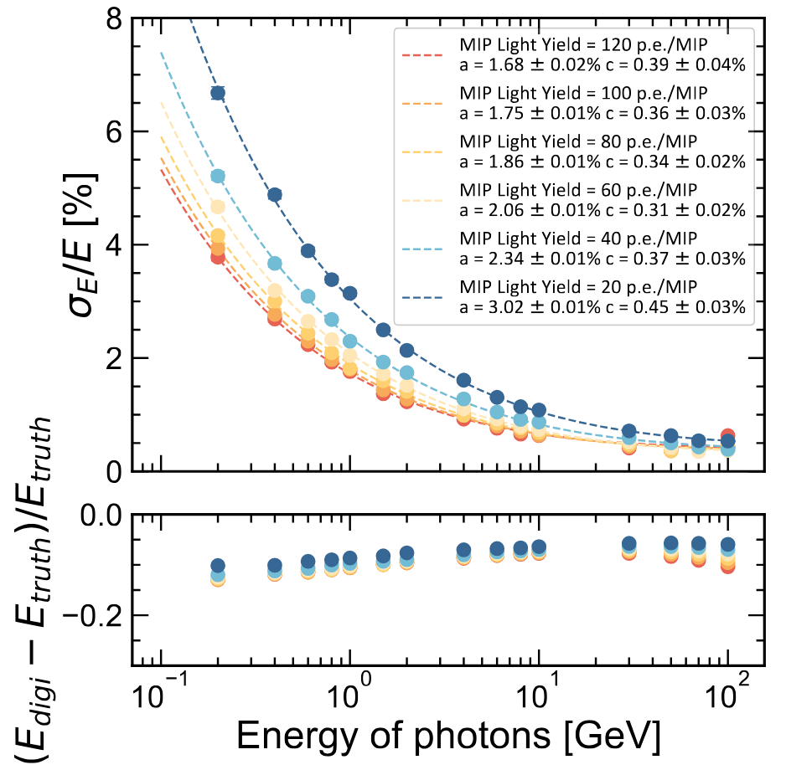
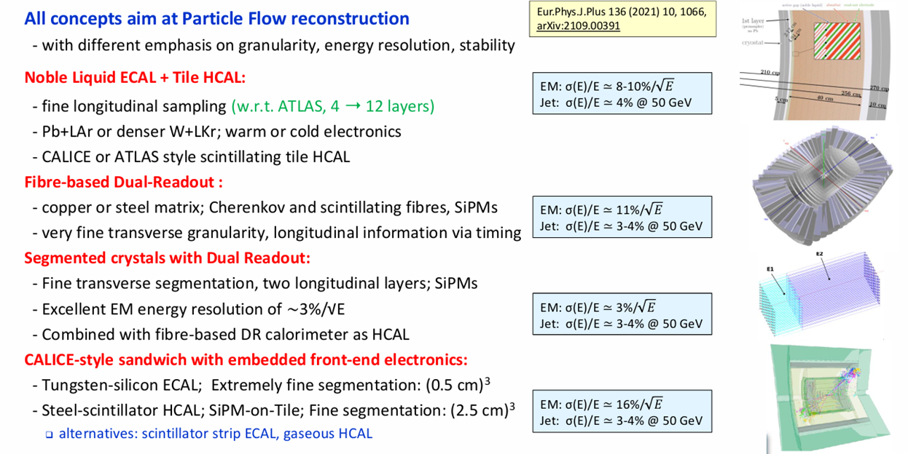
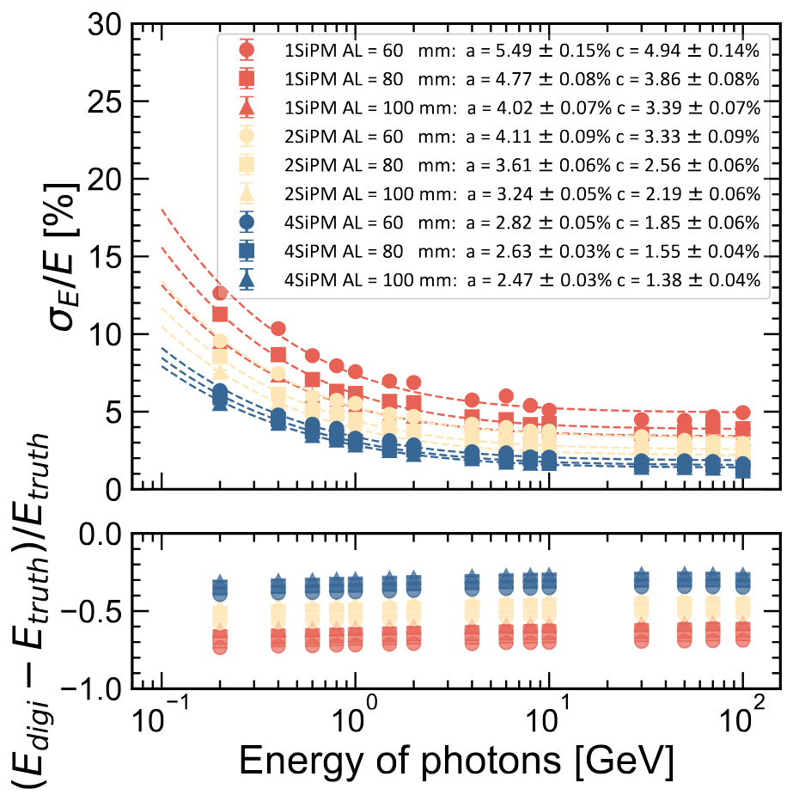

Ecal performance target
Our preliminary simulation
$\frac{σ}{E}=\frac{3\%}{\sqrt{E}}⊕1\%$ is our target
FCC-ee Ecal candidates performances

Slide 11
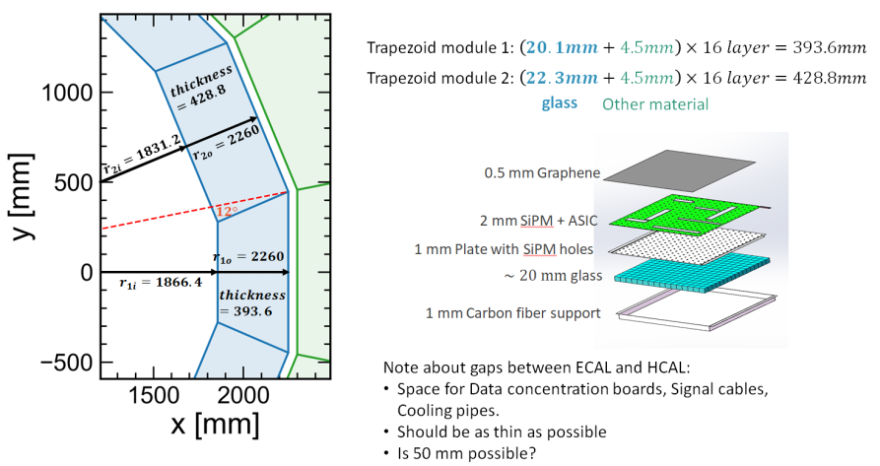
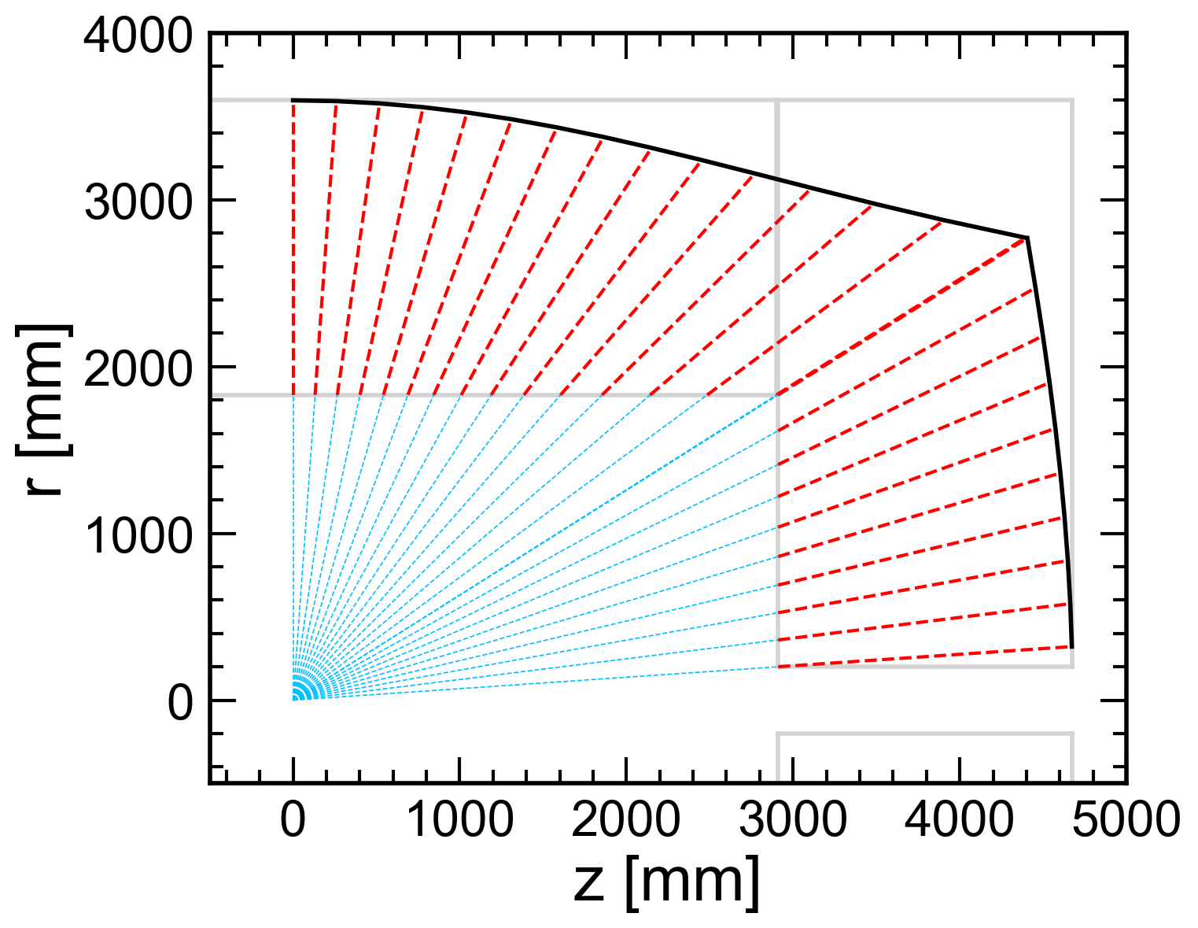
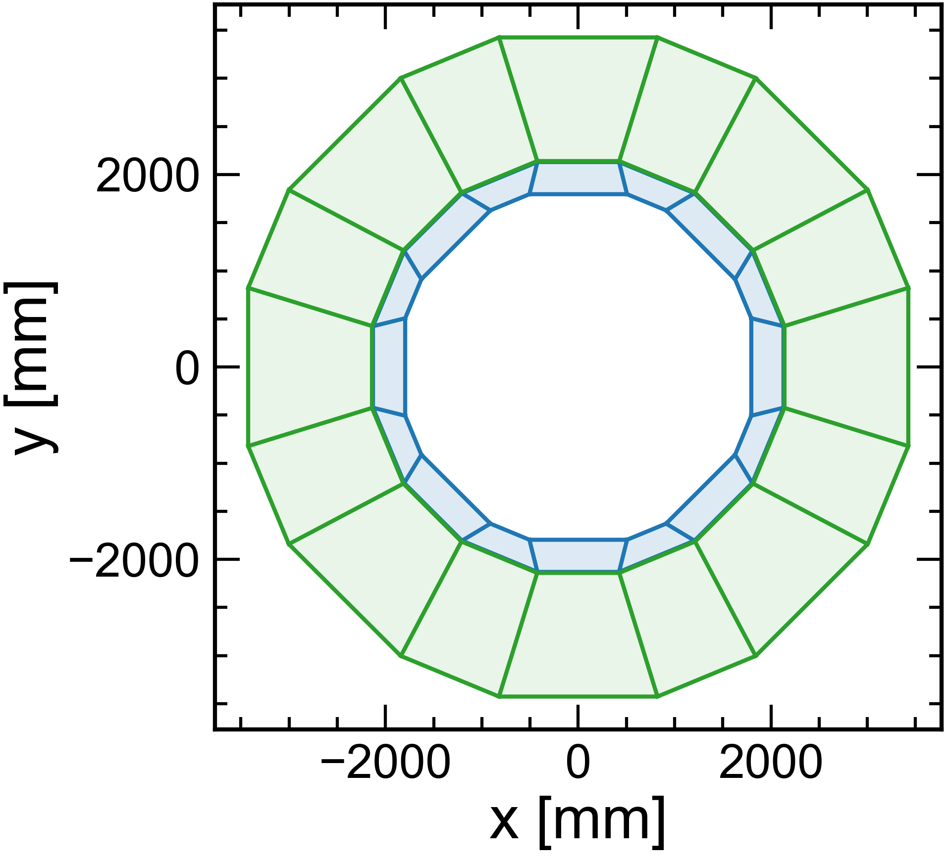
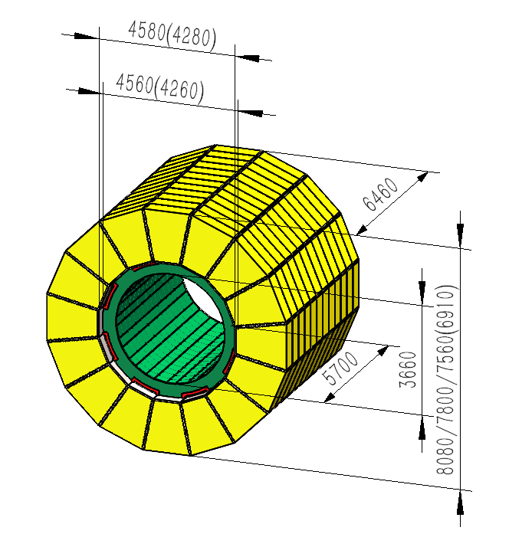

Integrated ME design of ECAL + HCAL
Integrated Design
Φ: 16 sectors Z: 15 sectors (odd)
Curved Design
Burdens for superconducting field?
Cooling：
one like ref-TDR, another like the right
ECAL+HCAL profile in TDR
6$λ_{I}$

Slide 12
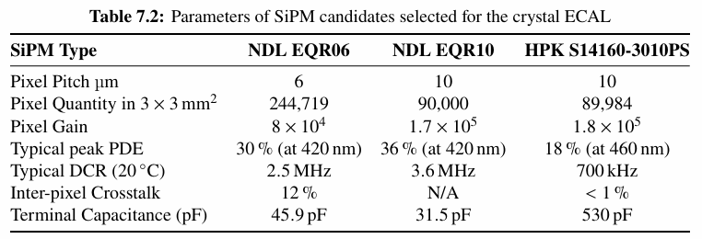
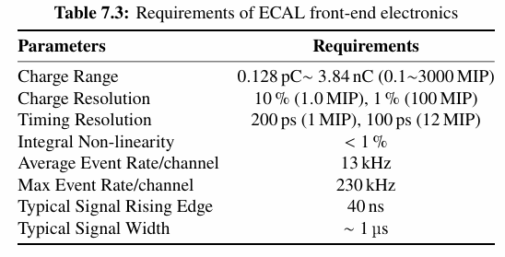
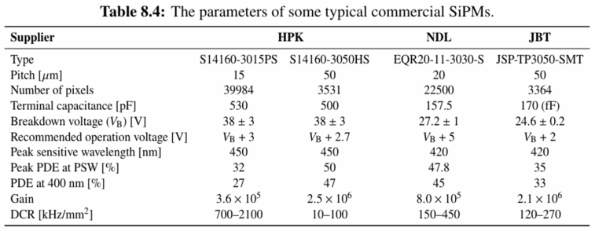
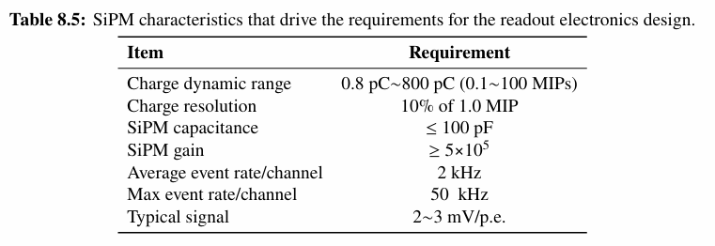
SiPM and FEE
SiPM
  Crucial items: PDE, Pixel quantity, DCR, cross talk, capacitance, timing etc
  Suppliers:
FEE
  Dynamic ranges become close: 3-7 times
  Timing both required
  ASIC
Calorimeter | Sensitive size (cm) | MIP energy | High End
Ref-TDR ECAL | 1.5x1.5x40 BGO | 13.4 MeV | 3000 MIP (high energy electron)
Ref-TDR HCAL | 1x4x4 GS | 7.3 MeV | 100 MIP (high energy π± )
GS ECAL | 2x2x2 GS | 2 x 7.3 MeV | ~1400 MIP (high energy electron)
GS HCAL (new consideration) | 1.0x4x4 2.1x4x4 2.9x4x4 3.75x4x4 | N x 7.3 MeV | ~200-500 MIP may needed, need more simulation

Slide 13
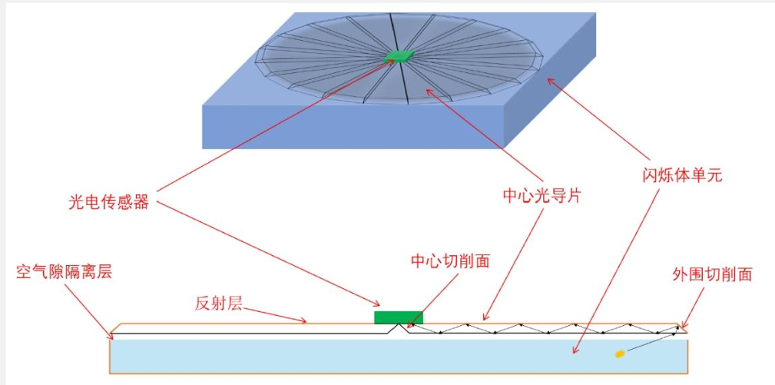
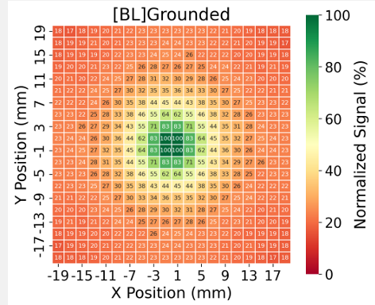
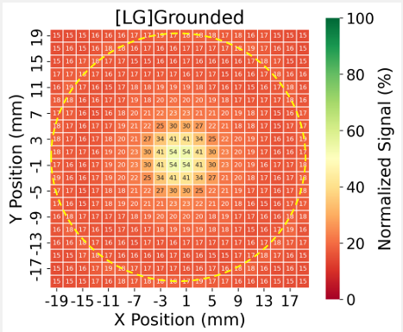
_{Light collection studies}
Light guide
  Improve the uniformity
  More photons
  Simulation and tests is underway
By Mingzheng Yang, Xilei Sun, Jingbo Ye, etc

Slide 14
Backup and some updates

Slide 15
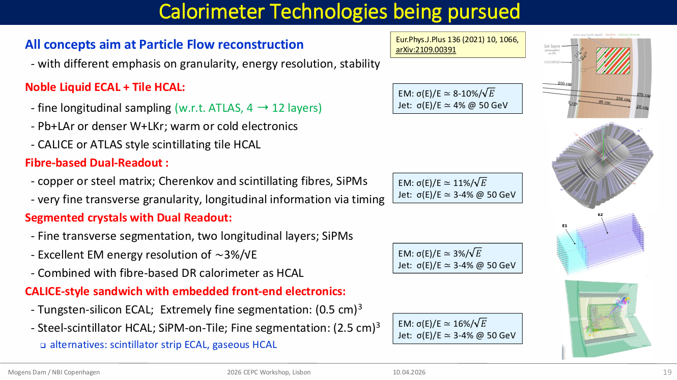

Slide 16

Thickness and ME consistency of ECAL + HCAL
ECAL+HCAL profile in TDR
6$λ_{I}$
Fixed thickness profile

Slide 17
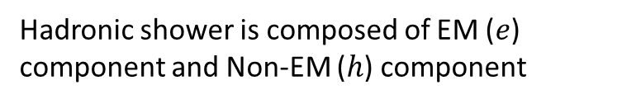
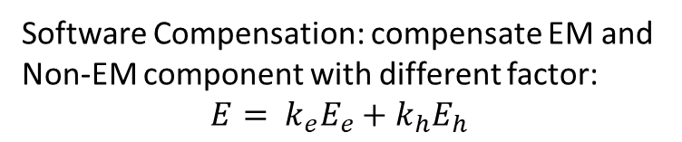
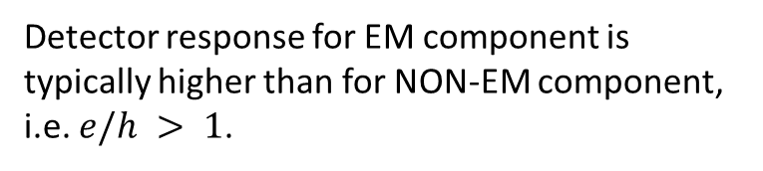
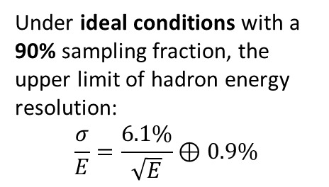
Software Compensation
Detector response for EM component is typically higher than for NON-EM component,
i.e. $e/h > 1$.
Software Compensation: compensate EM and Non-EM component with different factor:
$$E= k_{e}E_{e}+k_{h}E_{h}$$
Hadronic shower is composed of EM ($e$) component and Non-EM ($h$) component
Under ideal conditions with a 90% sampling fraction, the upper limit of hadron energy resolution:
$$\frac{σ}{E}=\frac{6.1\%}{\sqrt{E}}⊕0.9\%$$
The software compensation based on truth information
Real one depends on reconstruction and the shower separation power.
Next to do including more real simulation and reconstruction.

Slide 18
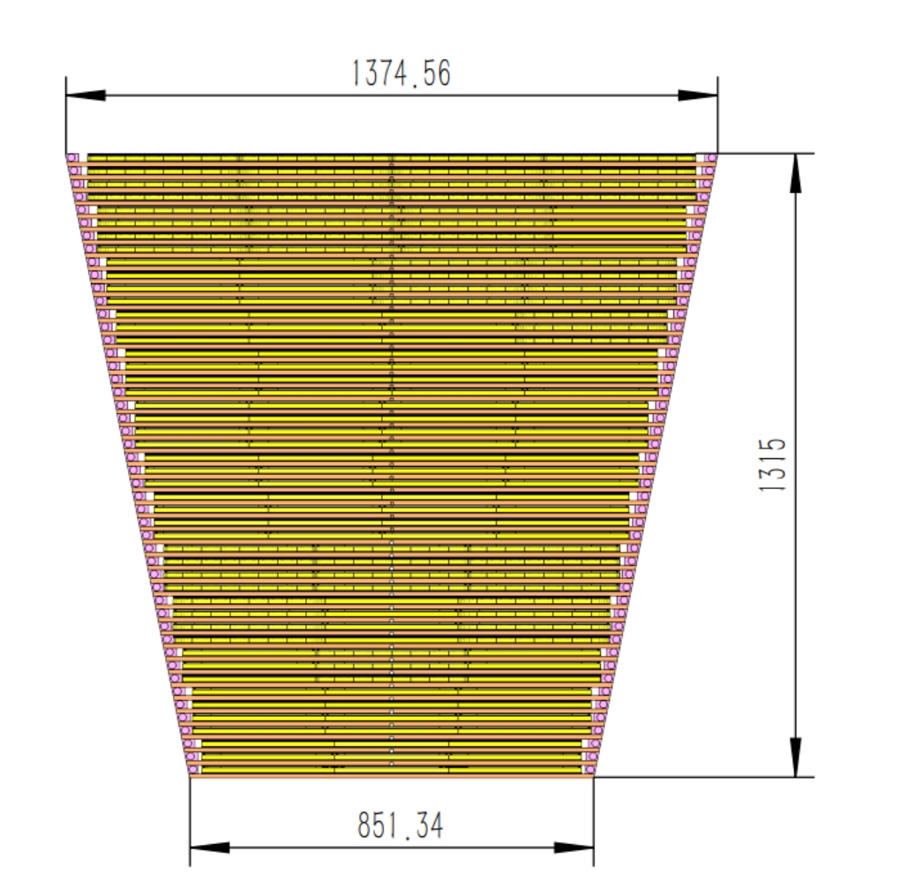
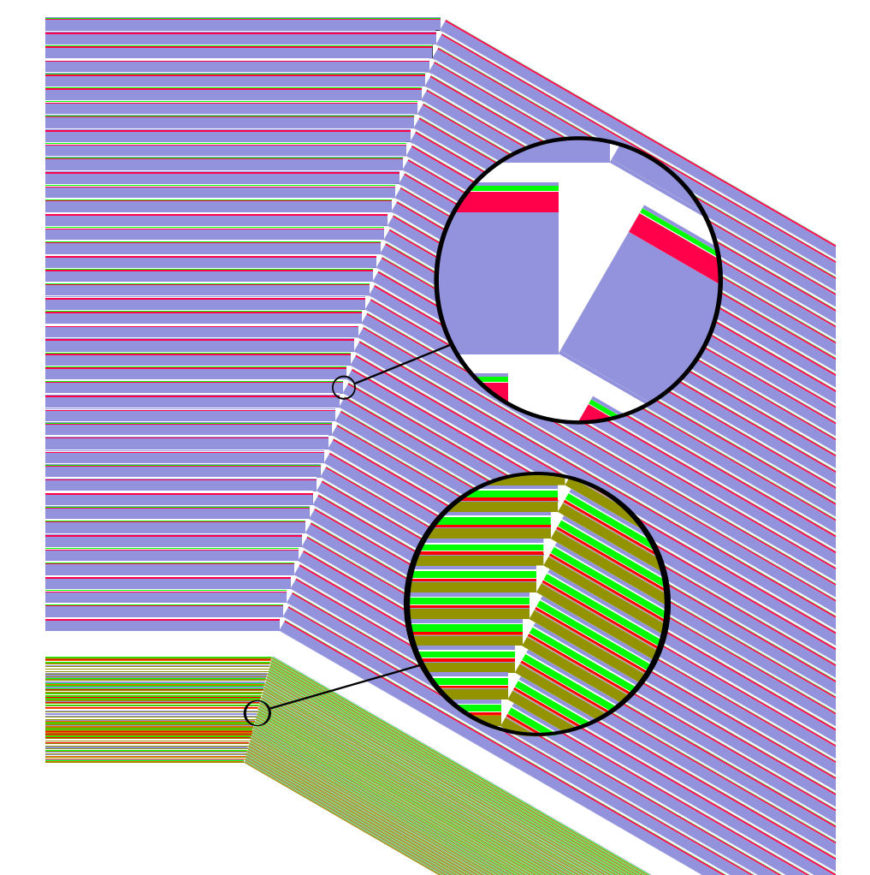
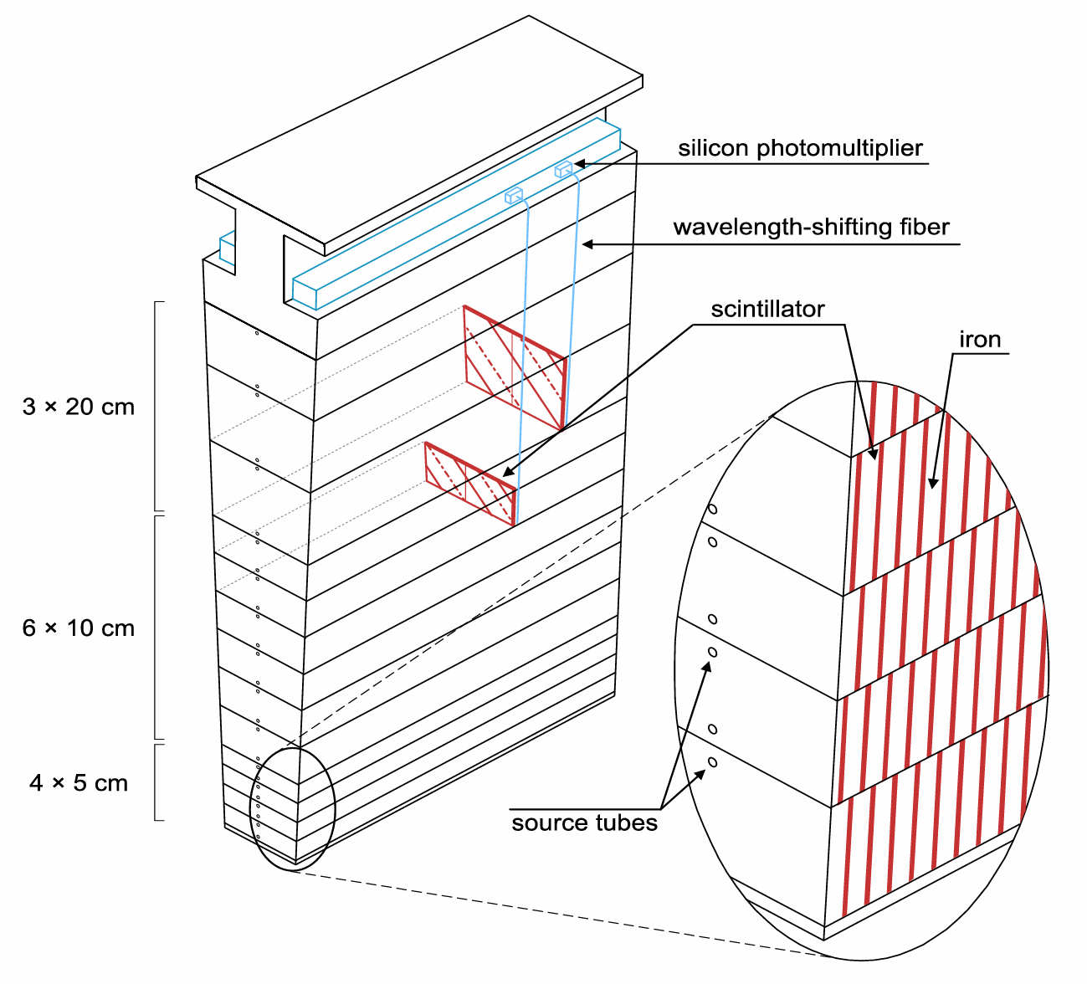
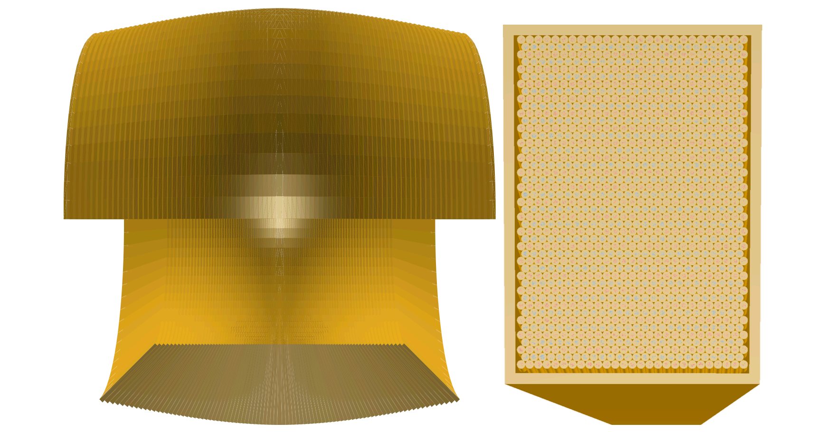
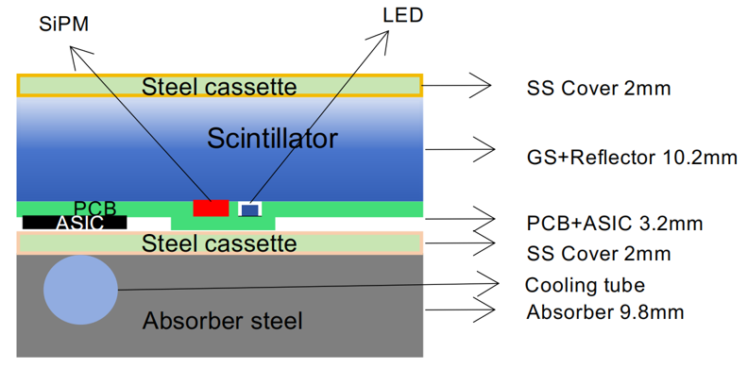
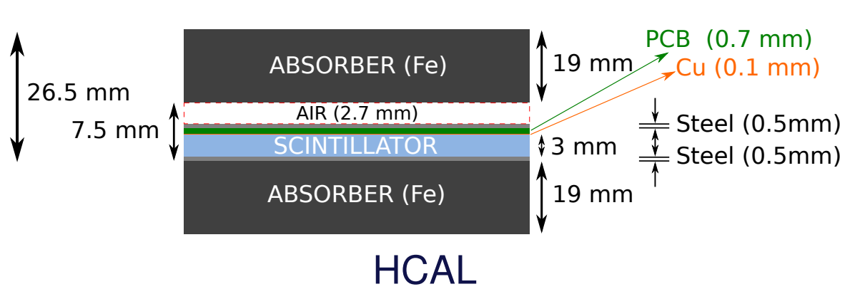
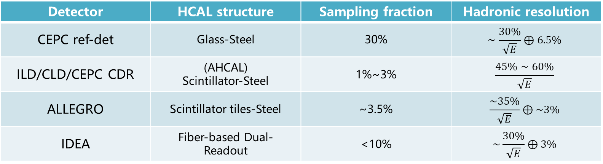
Comparison of HCAL in different detectors
Detector | HCAL structure | Sampling fraction | Hadronic resolution
CEPC ref-det | Glass-Steel | 30% | $$∼\frac{30\%}{\sqrt{E}}⊕6.5\%$$
ILD/CLD/CEPC CDR | (AHCAL) Scintillator-Steel | 1%~3% | $$\frac{45\%∼60\%}{\sqrt{E}}$$
ALLEGRO | Scintillator tiles-Steel | ~3.5% | $$\frac{\sim 35\%}{\sqrt{E}}⊕\sim 3\%$$
IDEA | Fiber-based Dual-Readout | <10% | $$\sim \frac{30\%}{\sqrt{E}}⊕3\%$$
GS-HCAL @ CEPC ref-det
AHCAL @ CLD
TileCal @ ALLEGRO
Dual-readout @ IDEA
[2510.05260] CEPC Technical Design Report -- Reference Detector
N. Bacchetta et al. CLD – A Detector Concept for the FCC-ee. 2019. arXiv: 1911.12230
Talk at CEPC workshop 2026
https://doi.org/10.1016/j.nima.2024.169921
2502.21223,
Talk at FCCee-PFA workshop

Slide 19
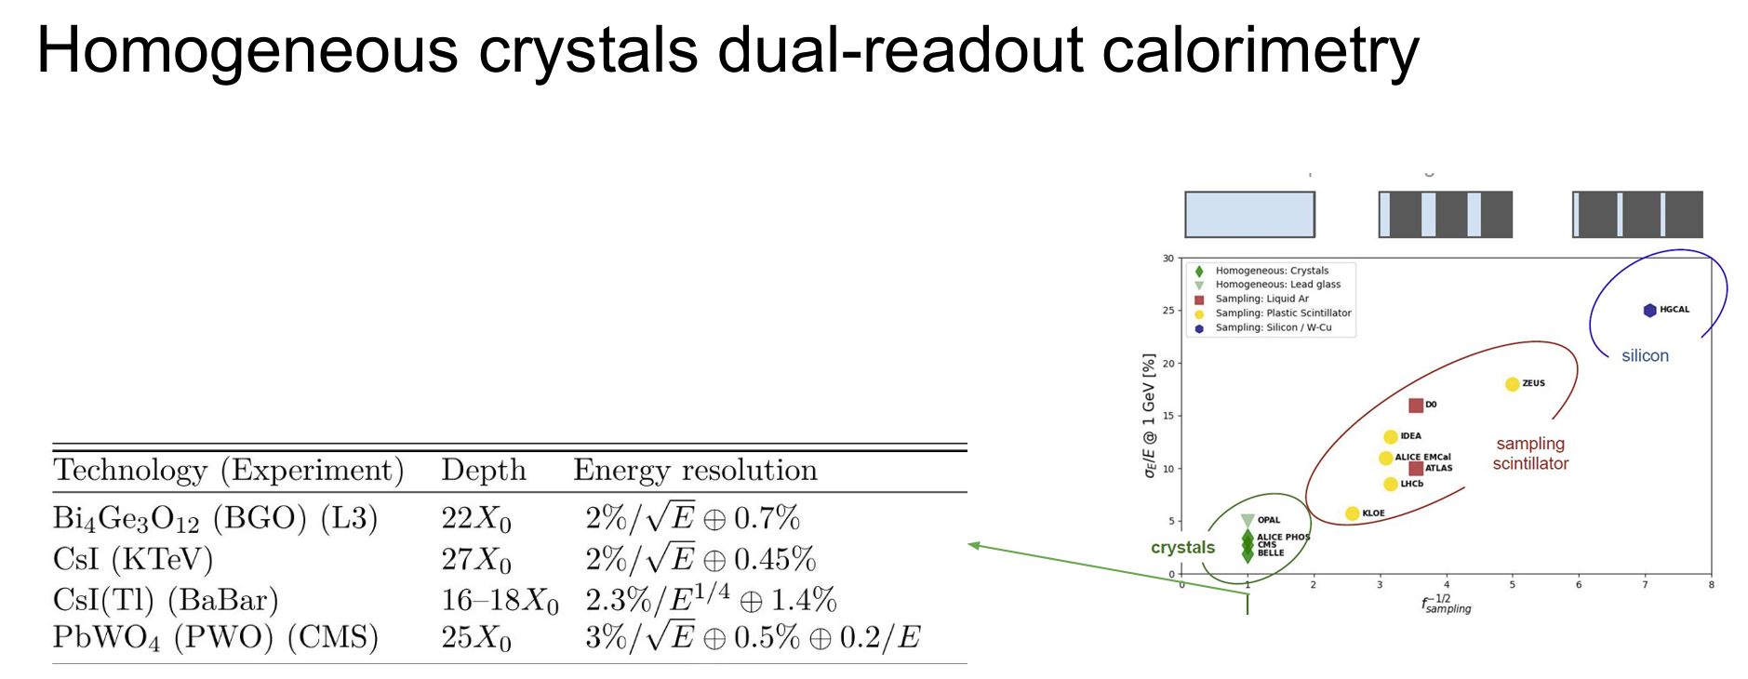

Slide 20
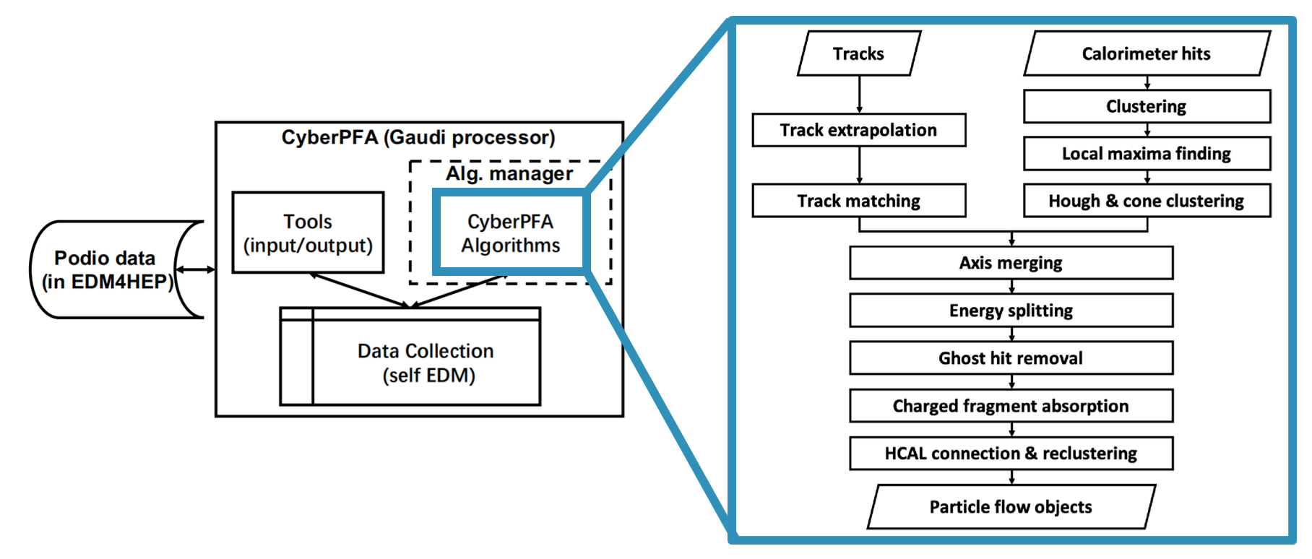

Slide 21
Comparison of ECAL detectors

Slide 22
Comparison of HCAL in different detectors
Detector | HCAL structure | Sampling fraction | Hadronic resolution
CEPC ref-det | Glass-Steel | 30% | $$∼\frac{30\%}{\sqrt{E}}⊕6.5\%$$
ILD/CLD/CEPC CDR | (AHCAL) Scintillator-Steel | 1%~3% | $$\frac{45\%∼60\%}{\sqrt{E}}$$
ALLEGRO | Scintillator tiles-Steel | ~3.5% | $$\frac{\sim 35\%}{\sqrt{E}}⊕\sim 3\%$$
IDEA | Fiber-based Dual-Readout | <10% | $$\sim \frac{30\%}{\sqrt{E}}⊕3\%$$
GS-HCAL @ CEPC ref-det
AHCAL @ CLD
TileCal @ ALLEGRO
Dual-readout @ IDEA
[2510.05260] CEPC Technical Design Report -- Reference Detector
N. Bacchetta et al. CLD – A Detector Concept for the FCC-ee. 2019. arXiv: 1911.12230
Talk at CEPC workshop 2026
https://doi.org/10.1016/j.nima.2024.169921
2502.21223,
Talk at FCCee-PFA workshop

