Slide 1
Cygnus X-3: The first Variable PeV Gamma-ray Source
Cong Li， Zhen.Cao, J.S Wang, J.N Zhou, F. Aharonian
licong@ihep.ac.cn
LHAASO Collaboration

Slide 2
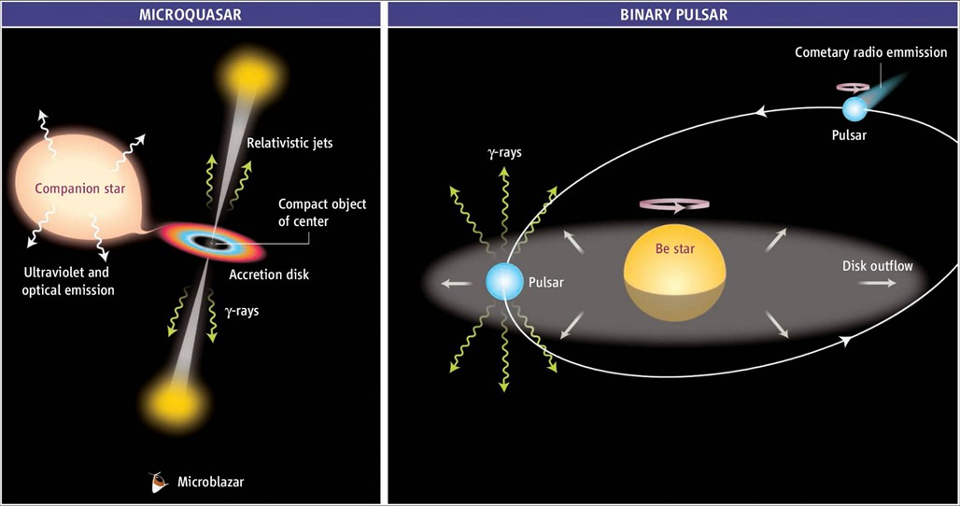
TeV Binary
Binary is a very important kind of TeV source, characterized with unique properties .
colliding-wind binary system

Slide 3
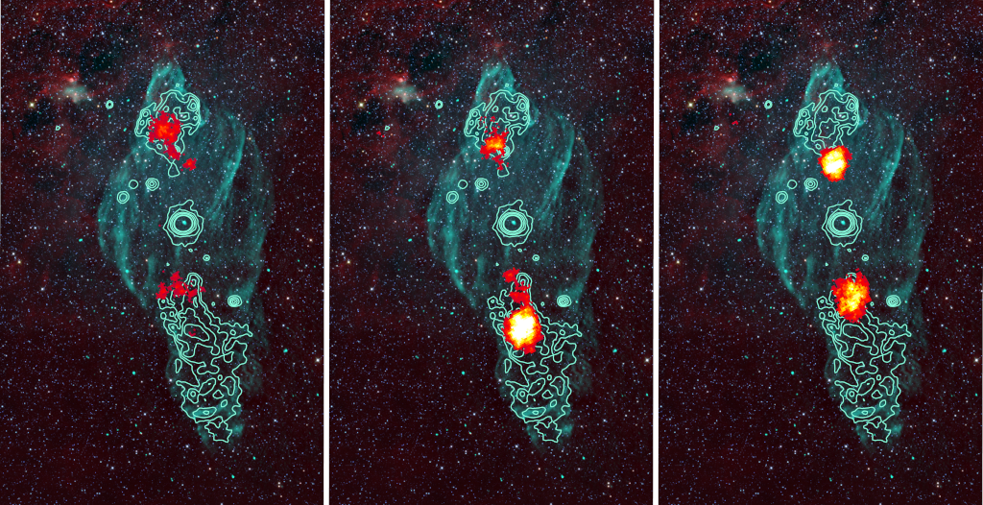
Microquasar “halo”
UHE(>100TeV) emission associated with microquasar was detected recently;
Gamma-ray from center system?

Slide 4
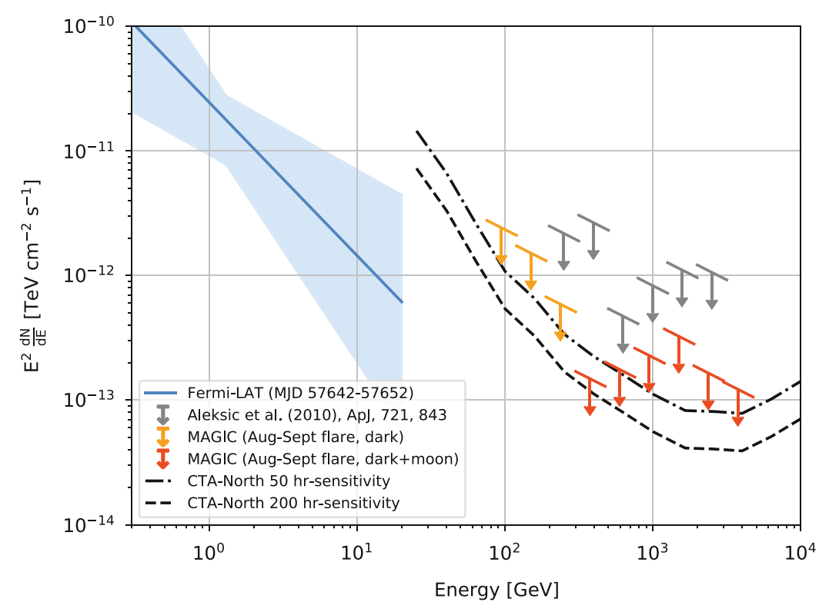
Historical puzzle: Cygnus X-3
1.PeV signals were declared by many experiments at 1980s;
2.Not confirmed by future more sensitive detectors;
1983 APJ

Slide 5
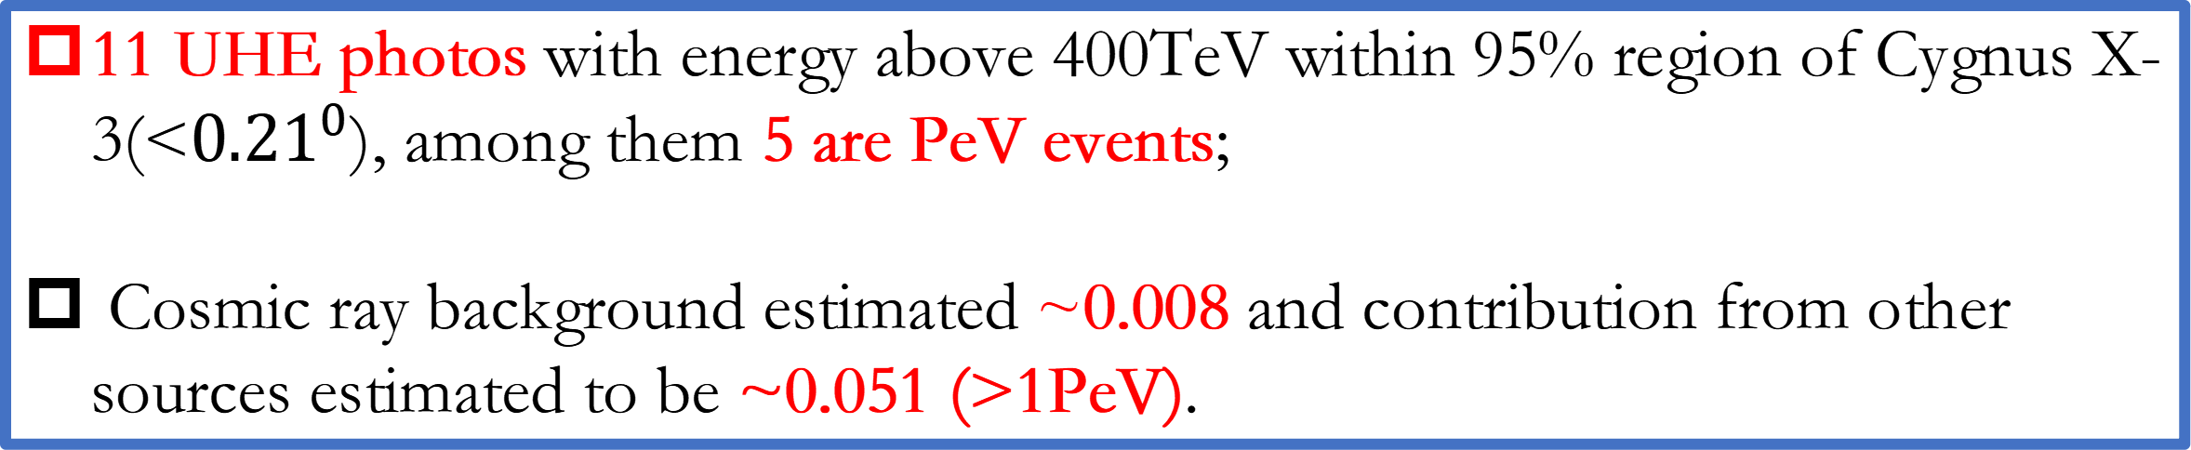
First PeV gamma-ray source ( Accepted by NSR )
A point source is detected positionally coincident with Cygnus X-3 at a significance of 9.6 sigma assuming stable flux;
11 UHE photos with energy above 400TeV within 95% region of Cygnus X-3(<${0.21}^{0}$), among them 5 are PeV events;
Cosmic ray background estimated ~0.008 and contribution from other sources estimated to be ~0.051 (>1PeV).

Slide 6
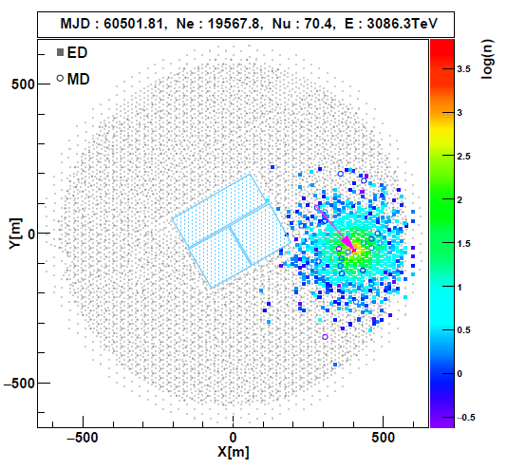
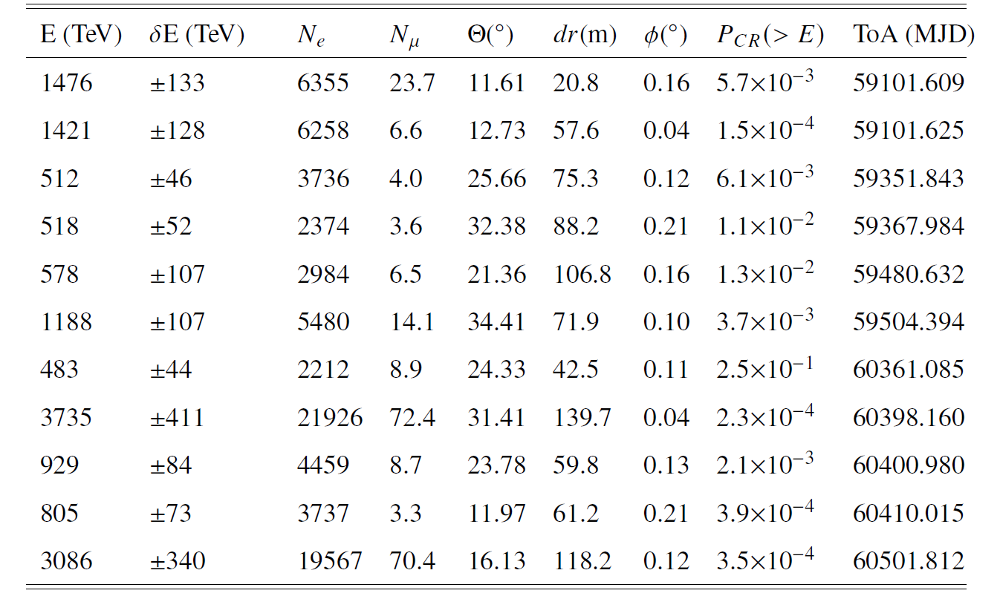
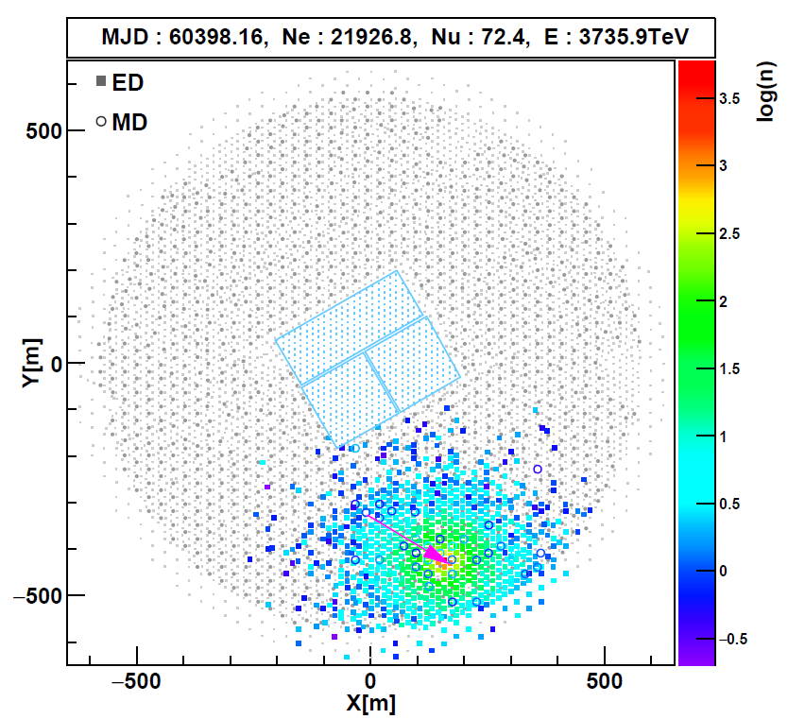
UHE Photons (>400TeV)

Slide 7
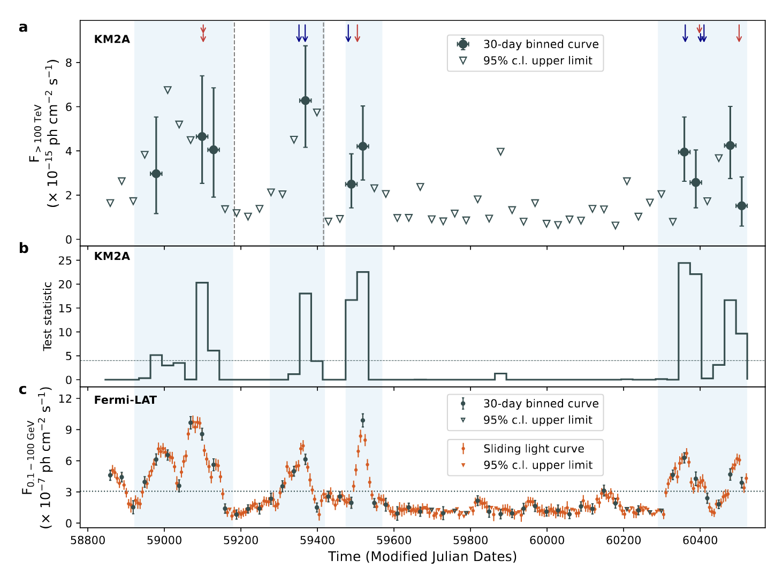

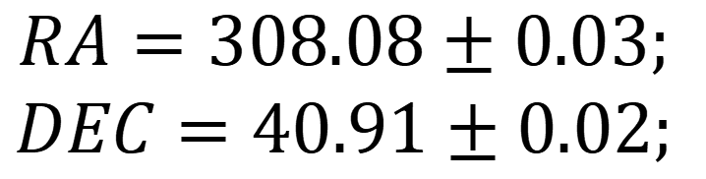
UHE Flares
$$RA=308.08±0.03;$$
$$DEC=40.91±0.02;$$
Divide the data into two parts according to GeV states. Ratio of exposure time: 1:1.6.
$$∆TS=75\sim 8.6 σ$$
Variability test:
H0: Constant flux;
H1: Change of flux at two states.
Flaring UHE emission with time coincidence with GeV flares.
3. Firmly identification of source.

Slide 8
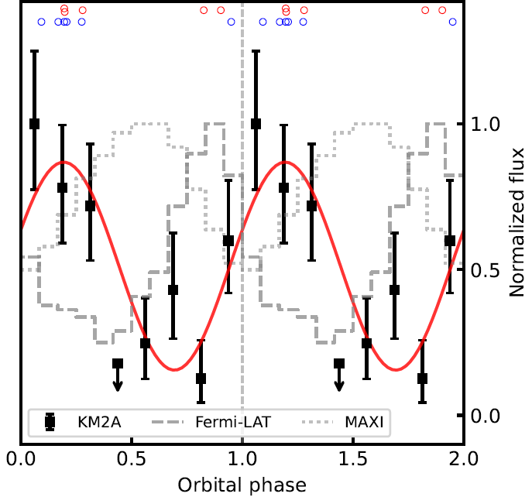
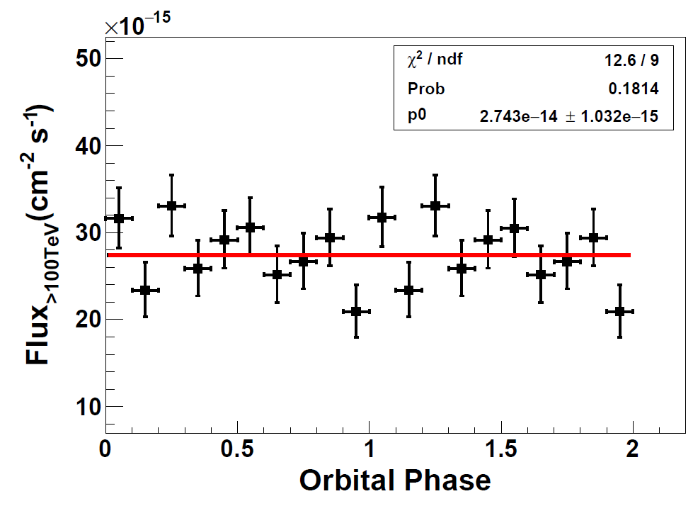

Modulation with orbital phases
The significance for variability: $3.5σ\sim 3.2σ$(post trials).
Comparison between cosine function and constant function. $∆TS=15.24σ\sim 3.3σ$.

Slide 9
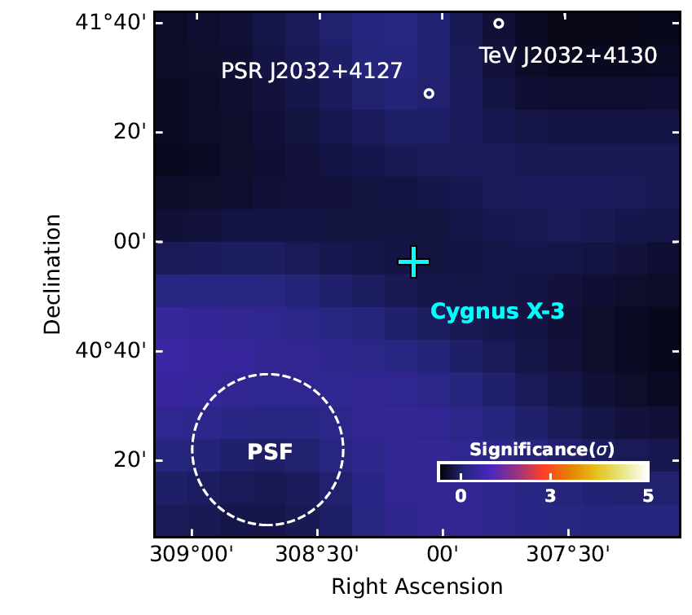
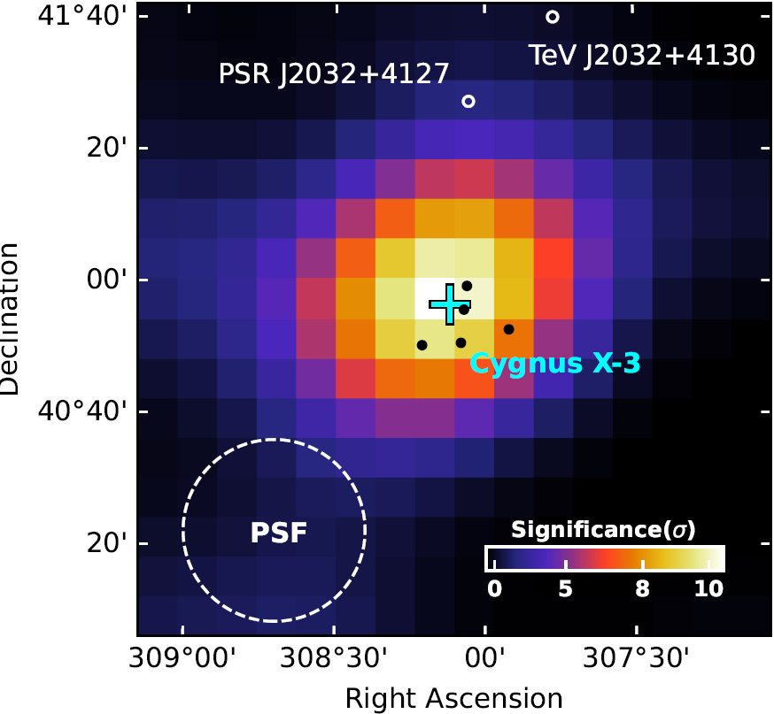
Significance Map
No residual signal at quiescent state verifies the reliability of background model.
Difference between quiescent and active states demonstrates the variability nature.

Slide 10
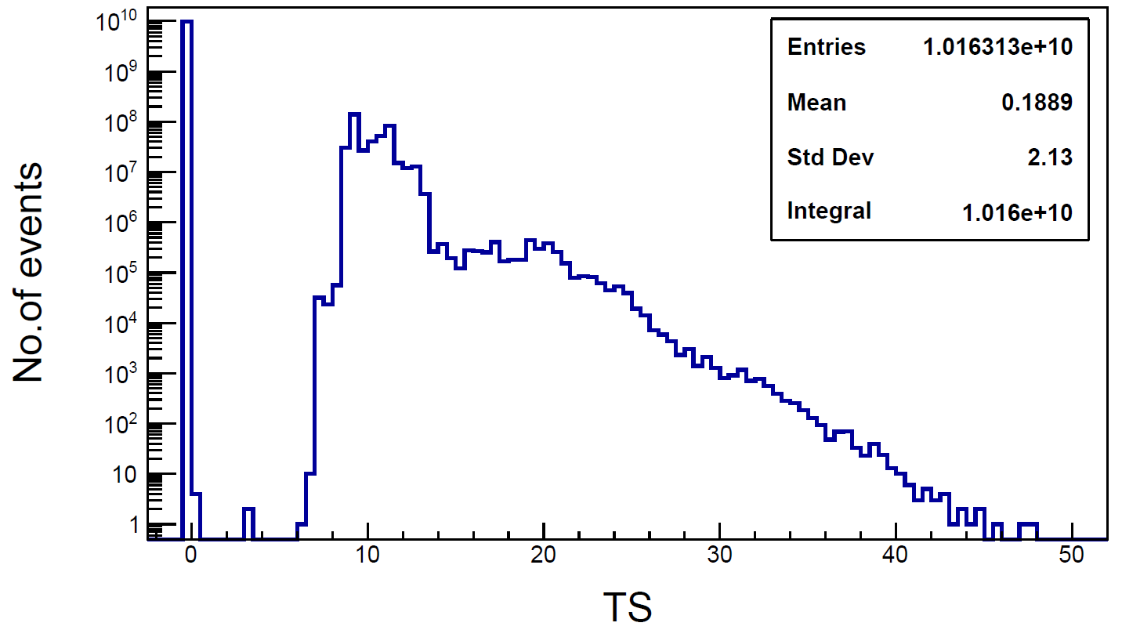
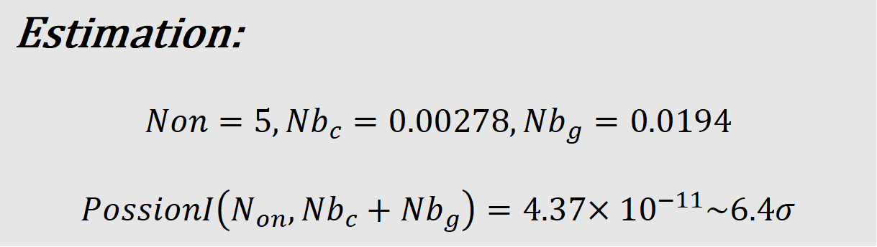
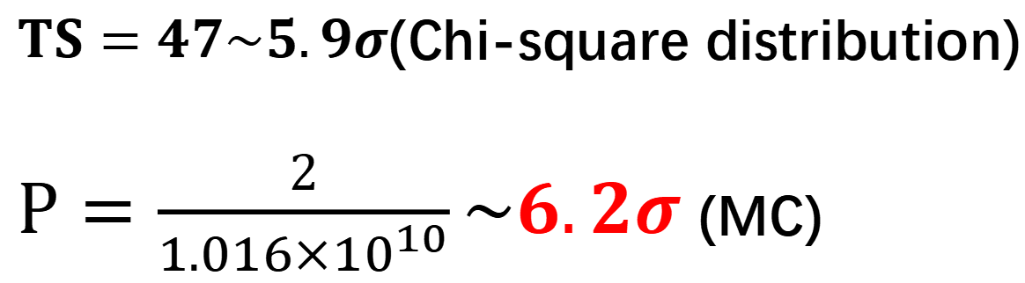
First PeV Gamma-Ray Source
$TS=47\sim 5.9σ$(Chi-square distribution)
$P=\frac{2}{{1.016×10}^{10}}\sim 6.2σ$(MC)
Estimation:
$$Non=5,{Nb}_{c}=0.00278,{Nb}_{g}=0.0194$$
$$PossionI\left(N_{on},{Nb}_{c}+{Nb}_{g}\right)=4.37{×10}^{−11}\sim 6.4σ$$

Slide 11
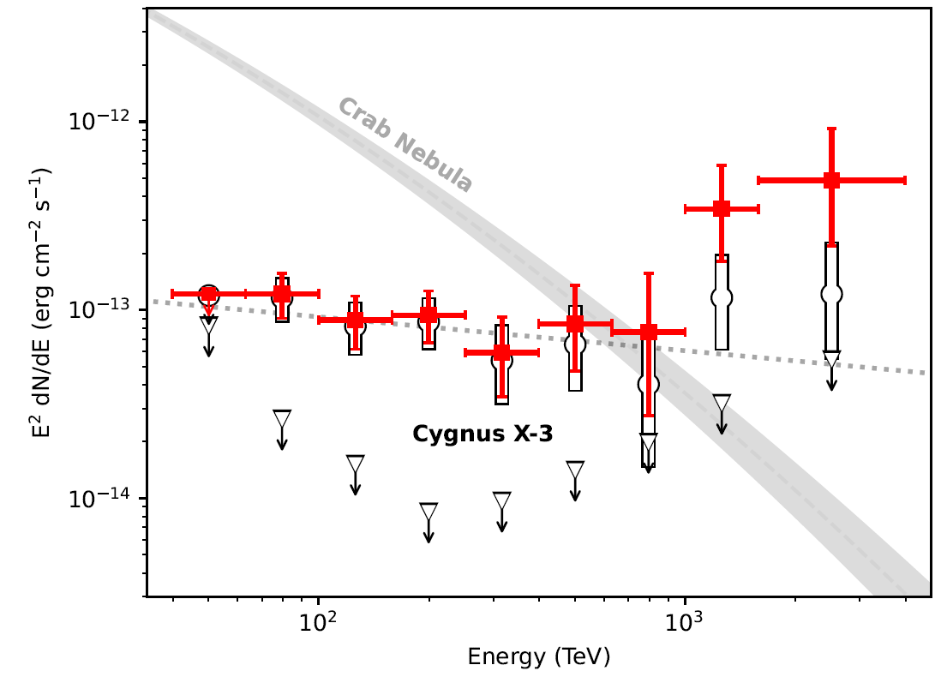
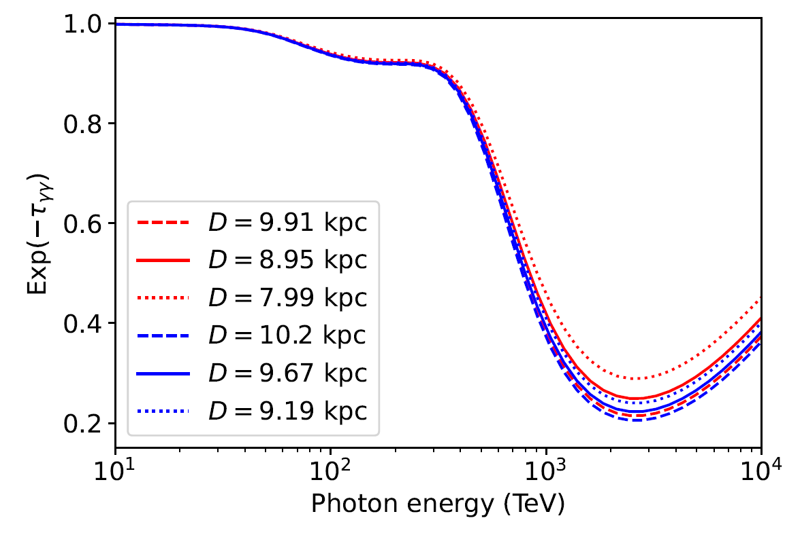
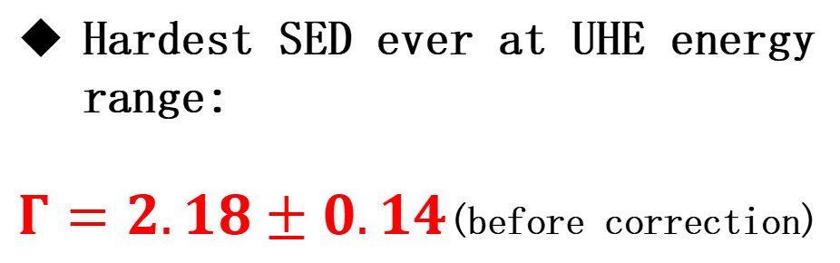
Spectrum
Hardest SED ever at UHE energy range:
$Γ=2.18±0.14$(before correction)

Slide 12

Leptonic or Hadronic?
Hillas criterion:
It is impossible for electrons to be accelerated to PeV within binary system, and protons are allowed to be accelerated to 100 PeV.
Synchrotron cooling limit:
Combine synchrotron cooling and the Hillas criterion

Slide 13
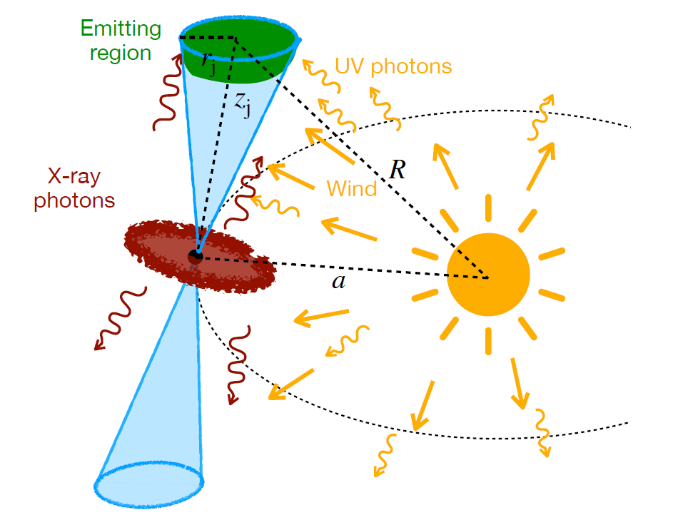
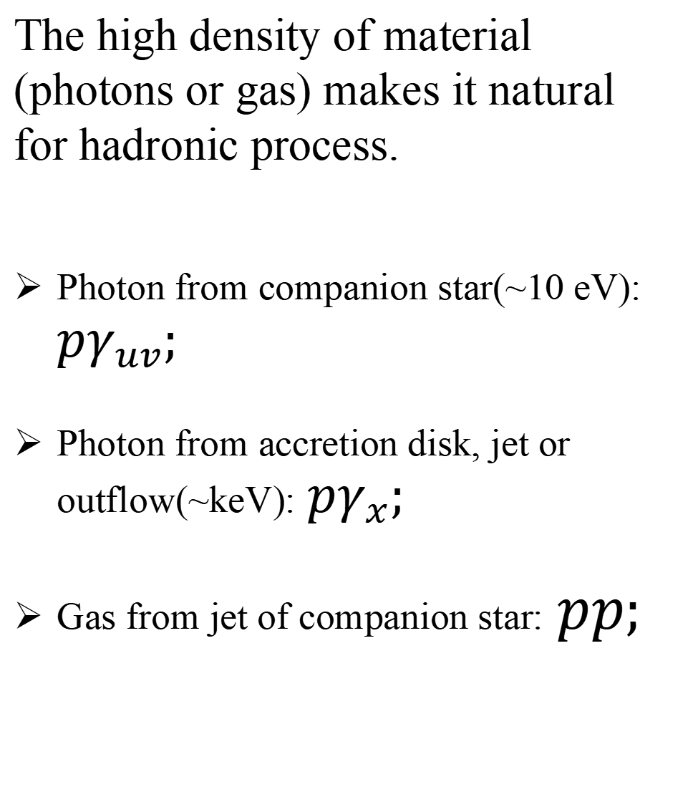
Physical Scenario
The high density of material (photons or gas) makes it natural for hadronic process.
Photon from companion star(~10 eV): $pγ_{uv};$
Photon from accretion disk, jet or outflow(~keV):$pγ_{x};$
Gas from jet of companion star:$pp;$

Slide 14
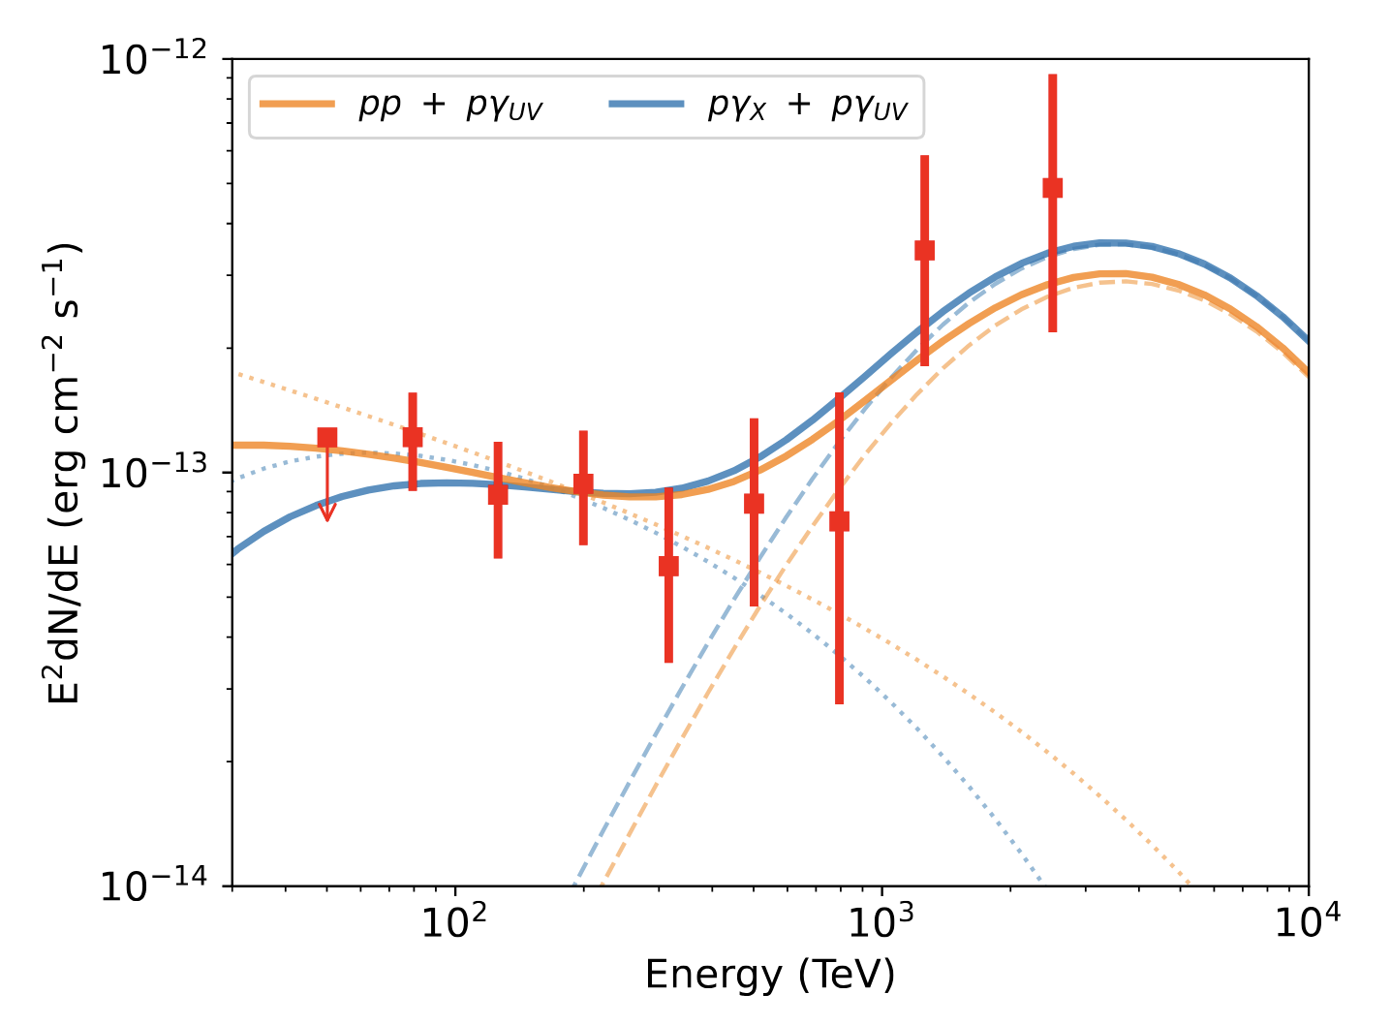
Model Fitting
$E_{t}\sim 10eV,\text{interaction} \text{angle} \text{θ} \text{= }\text{90}\text{◦},E_{p}\sim 10PeV,E_{γ}\sim 1PeV$
Proton needs to be accelerated at least to 10 PeV.

Slide 15
Conclusion
Identification of first variable UHE gamma-ray source, suggesting the gamma-ray is from the central system ;
Identification of first PeV gamma-ray source, with energy up to to 3.7 PeV;
Almost rule out the leptonic model and favors a hadronic scenario.

Slide 16
欢迎批评指正！
李骢
licong@ihep.ac.cn

