Slide 1
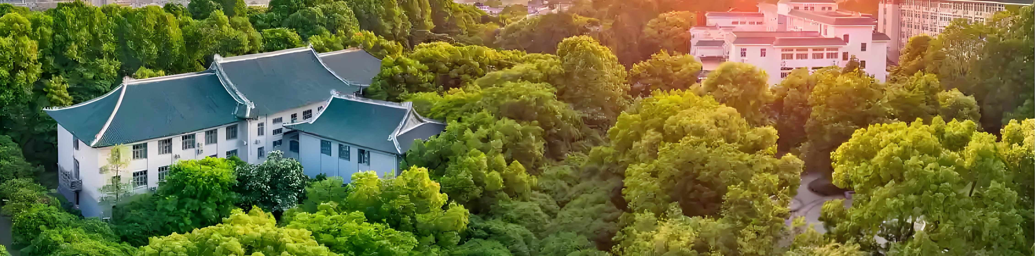

An Introduction to Huada QCD School and C3NT
Xin-Nian Wang
Central China Normal University

Slide 2
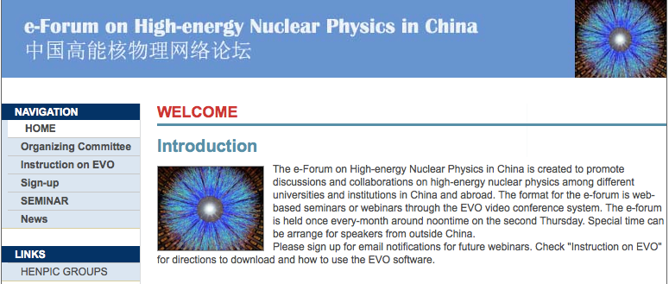
中国高能核物理网络论坛
255th
HENPIC: High-energy Nuclear Physics in China
June 7, 2012 -- present
Biweekly EVO video conference, and Zoom video conference (since 2019)
An e-forum to promote discussions and collaboration on high-energy nuclear physics among different universities and institutes in China and abroad

Slide 3
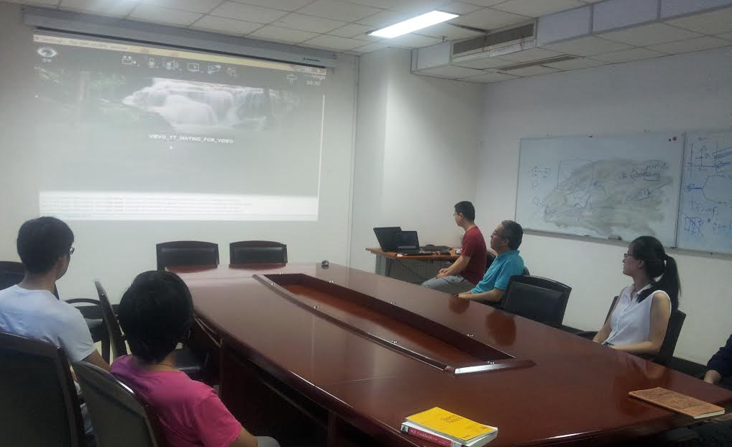
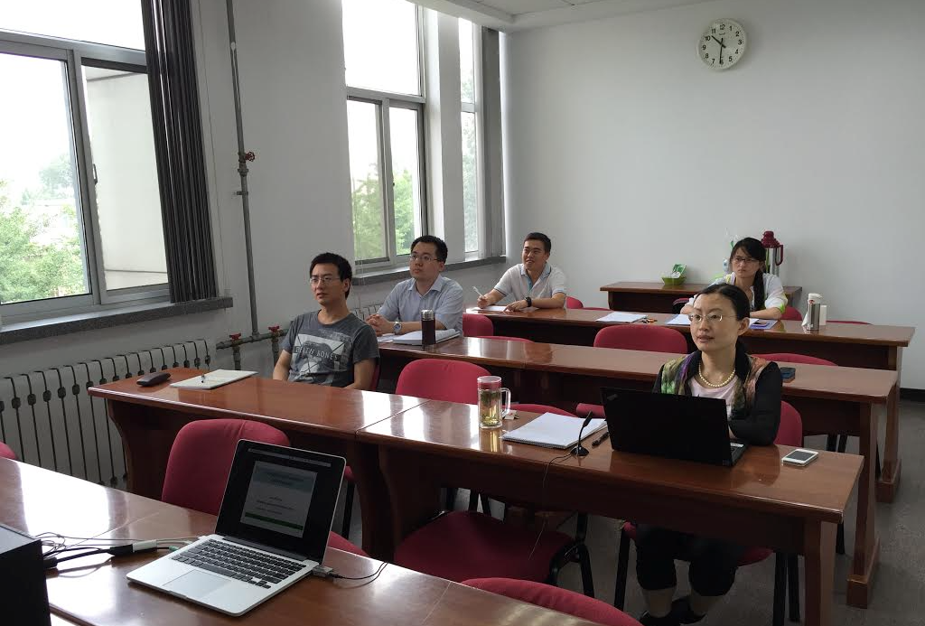
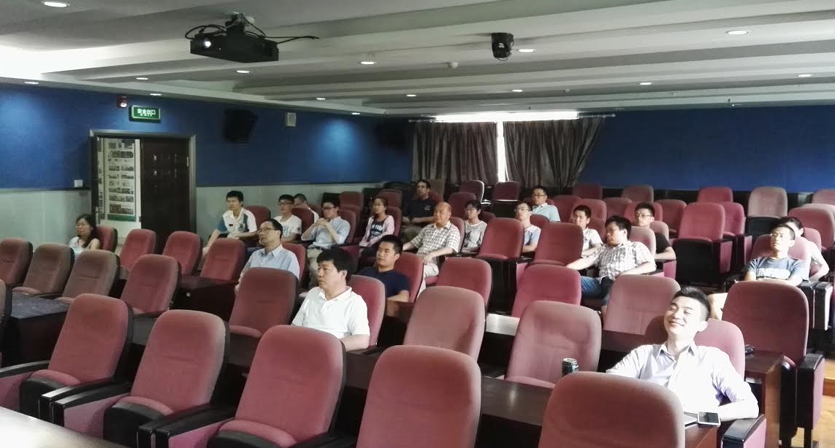
中国高能核物理网络论坛
HENPIC: High-energy Nuclear Physics in China
First 10 HENPIC talks
Longgang Pang (6.7.2012),
Xuan Li (6.21.2012),
Shi Pu (7.12.2012),
Guo-Liang Ma (8.9.2012),
Danning Li (9.13.2012),
Frithjof Karsch (10.10.2012),
Chun Shen (10.27.2012),
Yuhui Zhu (11.8.2012),
Xuguang Huang (12.13.2012),
Yifei Zhang (1.10.2013)
USTC
IHEP
CCNU

Slide 4
Huada QCD School 华大QCD讲习班
(2012 – 2026)
The 1st HuaDa QCD School (2012): Perturbative QCD （Jeff Owens)
The 2nd HuaDa QCD School (2013): Finite Temperature Field Theory (Charles Gale and Joseph Kapusta)
The 3rd HuaDa QCD School (2014): QCD under high energy and density (Al Mueller)
The 4th HuaDa QCD School (2015): Lattice QCD
The 5th HuaDa QCD School (2016): QCD in the EIC Era
The 6th HuaDa QCD School (2017): Chiral anomaly and strong magnetic fields in heavy-ion collisions
The 7th HuaDa QCD School (2018): Jet-medium interaction and jet quenching in high-energy heavy-ion collisions
The 8th HuaDa QCD School (2019): Nuclear astrophysics and dense QCD
The 9th HuaDa QCD School (2021): Deep learning for particle and nuclear physics
The 10th HuaDa QCD School (2022): Topics in high-energy nuclear physics
The 11th HuaDa QCD School (2023): Quark Matter and Particle Detection
The 12th HuaDa QCD School (2024): Practical Theory Tools for the Electron-Ion Collider Physics
The 13th HuaDa QCD School (2025): QCD out of equilibrium
The 14th Huada QCD School (2026): Spin and polarization in QCD

Slide 5
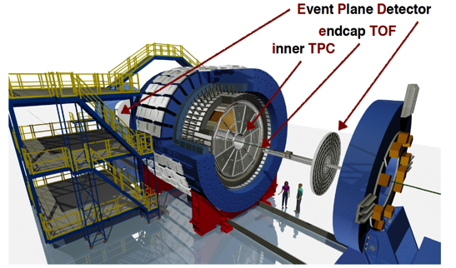
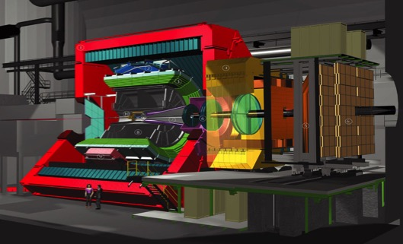
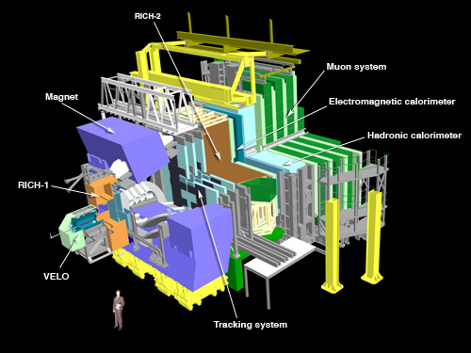
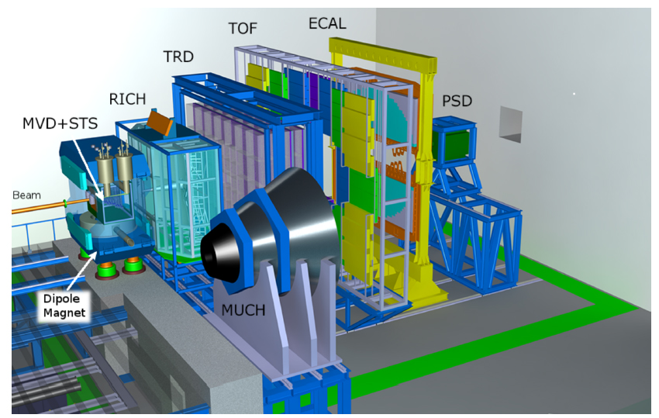




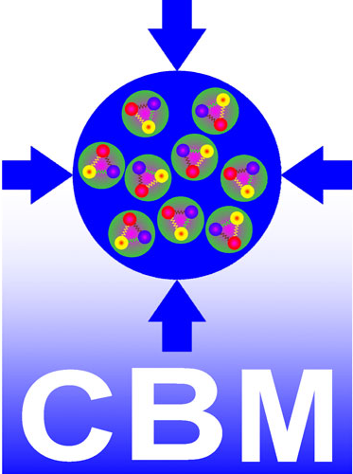
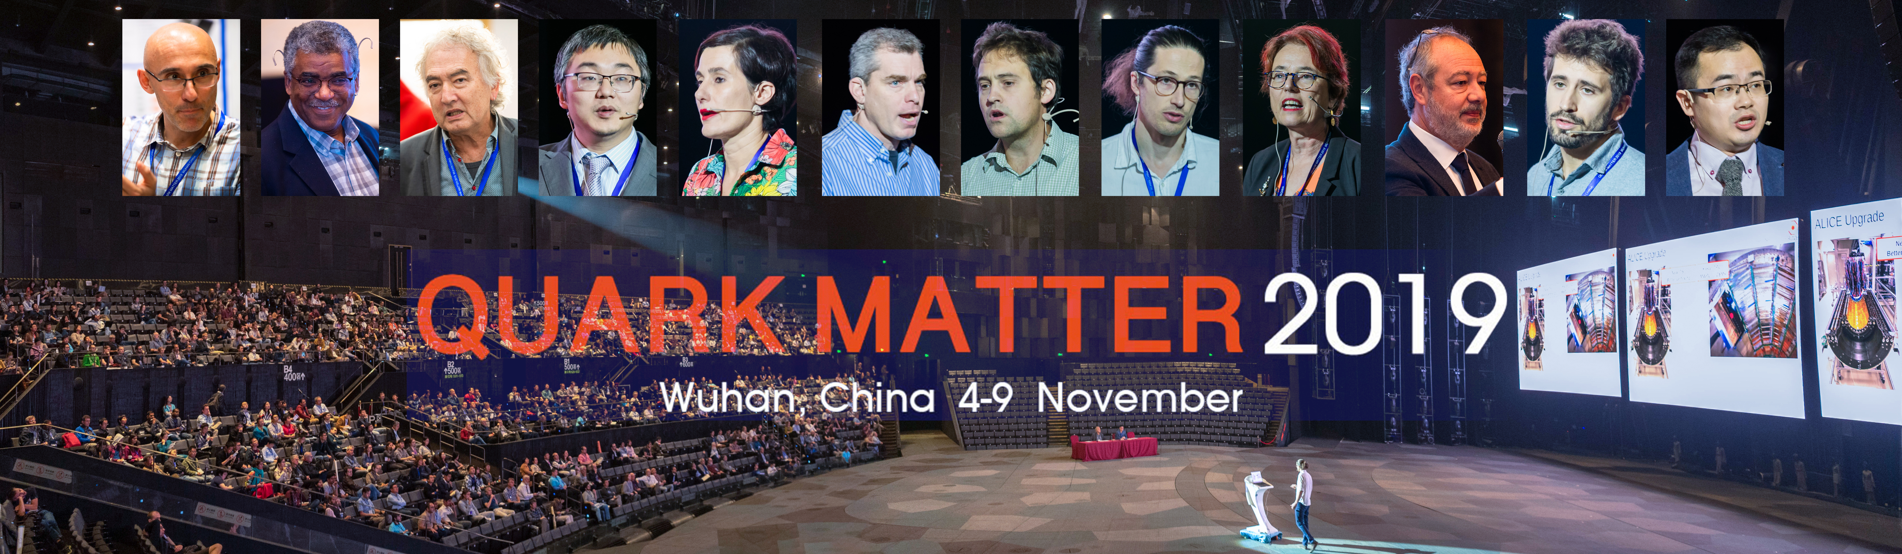
Part of the international nuclear physics community
Notes:
We have done all of these through internation collaboration
Our international collaboration culminated in a climax in 2019 at the memeroable quark matter 2019
Then came the pandemic

Slide 6
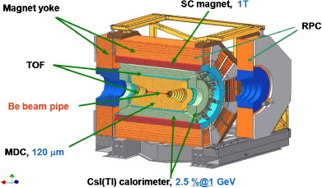

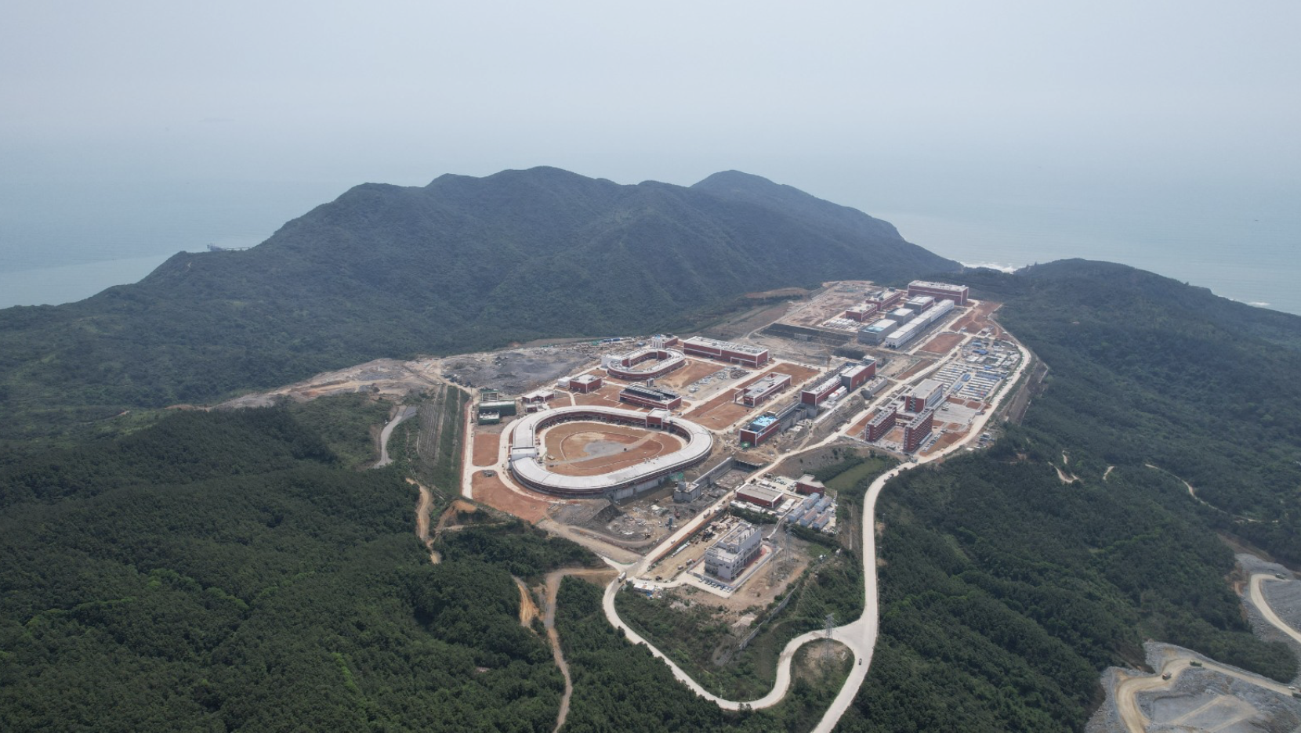
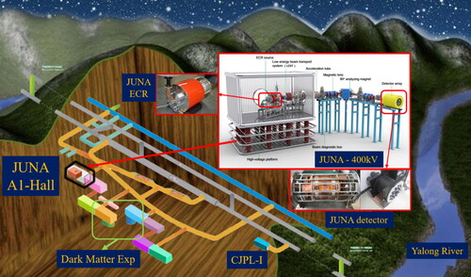
Advances in nuclear physics in China
The world needs to know and engage China to benefit Science
HIAF=High Intensity heavy-ion Accelerator Facility
JUNA=Jinping Underground Nuclear Astrophysics experiment
Notes:
A lot things has happened in the last five years,

Slide 7

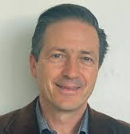
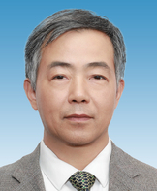
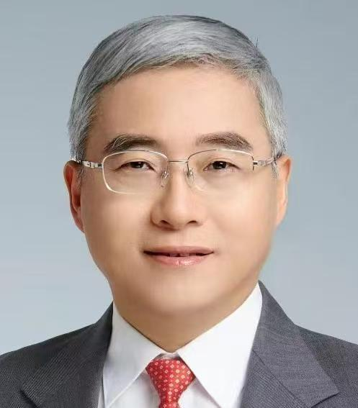
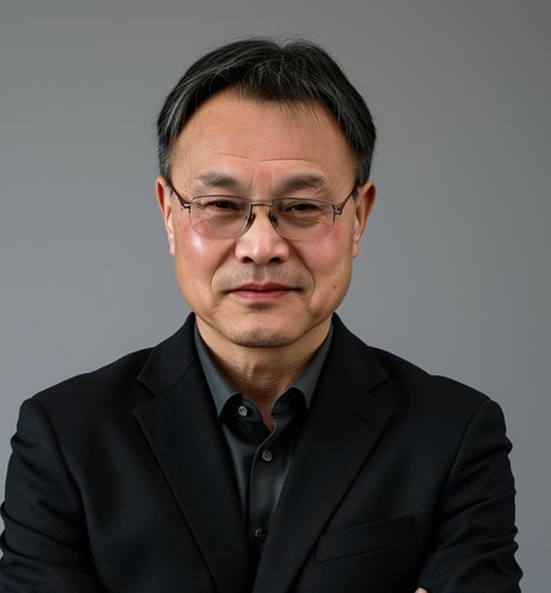
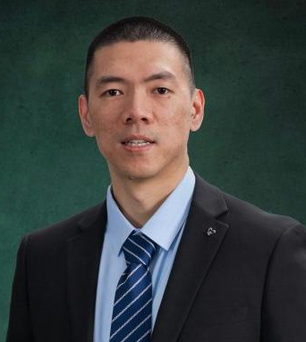

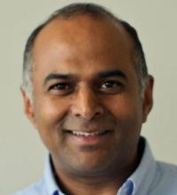
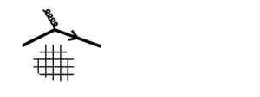

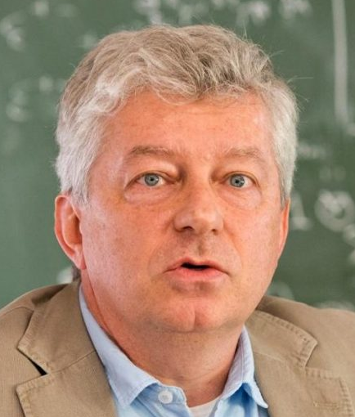
Board of Directors
(Chair: Urs Wiedemann)
Scientific Advisory Committee
(Chairs: Yugang Ma, Qun Wang)
Regional Committee
Director: Xin-Nian Wang
Deputy Directors: Weiyao Ke,
Longgang Pang
Sanjay Reddy
Ubirajara van Kolck
Notes:
This is why we want to establish C3NT

Slide 8
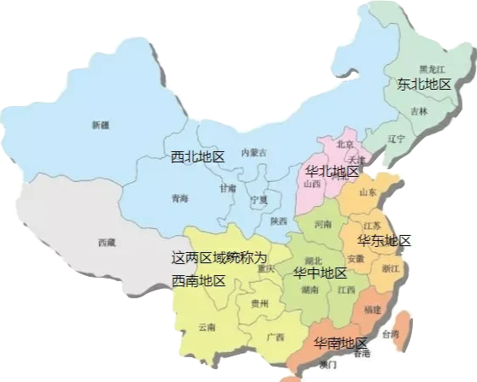
Nuclear Physics Groups in Central China
Univ of Science and Technology of China
Anhui University
Anhui Univ of Science and Technology
Zhengzhou University
Henan Univ of Technology
Central China Normal Univ
Huazhong Univ of Science and Technology
China Univ of Geosciences, Wuhan
Hunan Normal University
Univ of South China
Hunan University
Central South University
…..
5 hrs
Notes:
Wuhan is geologically center of China, with networks of rivers, railroads run through the city and connect to the rest of China and the world

Slide 9
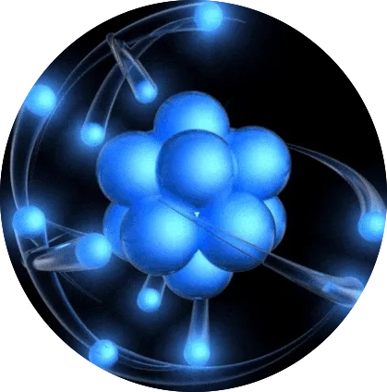
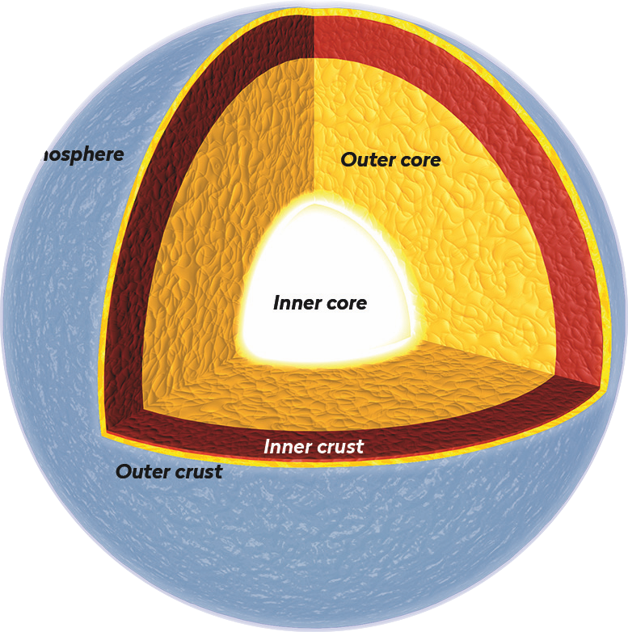
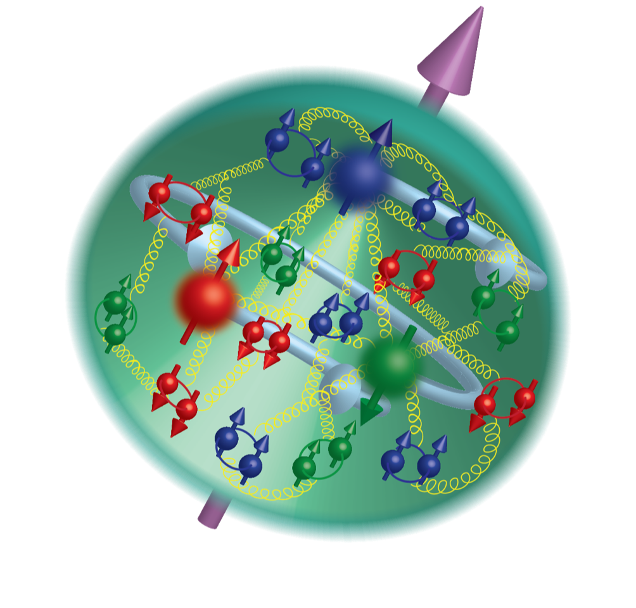
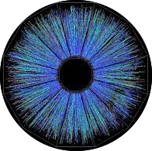

C3NT: Missions & Programs
Nuclear structure
Nuclear matter under extreme conditions
Hadron physics
Nuclear astrophysics and fundamental symmetry
Quantum computing and AI in nuclear physics
Provide an open environment that is conducive to cutting-edge research and collaboration at the forefront of nuclear theory and phenomenology with close contact with experiments.
Long workshops
Collaboration
Short workshops
Info exchange
Regional meetings
Networking
Huada QCD Schools
Training

Slide 10
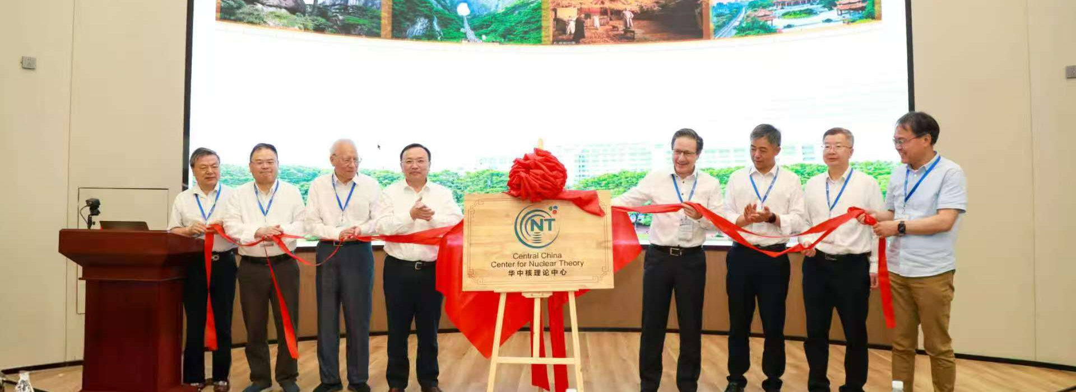
Inaugural Symposium of C3NT, May 17-18,2-25

Slide 11
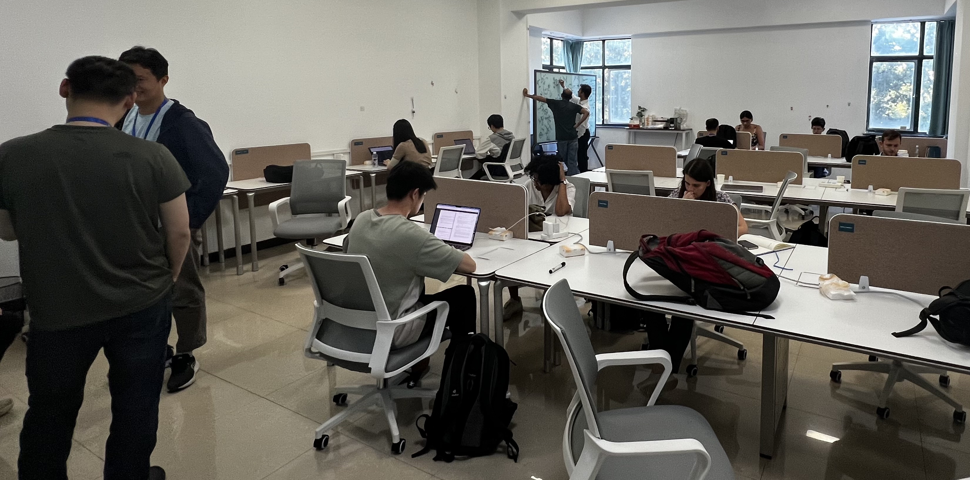
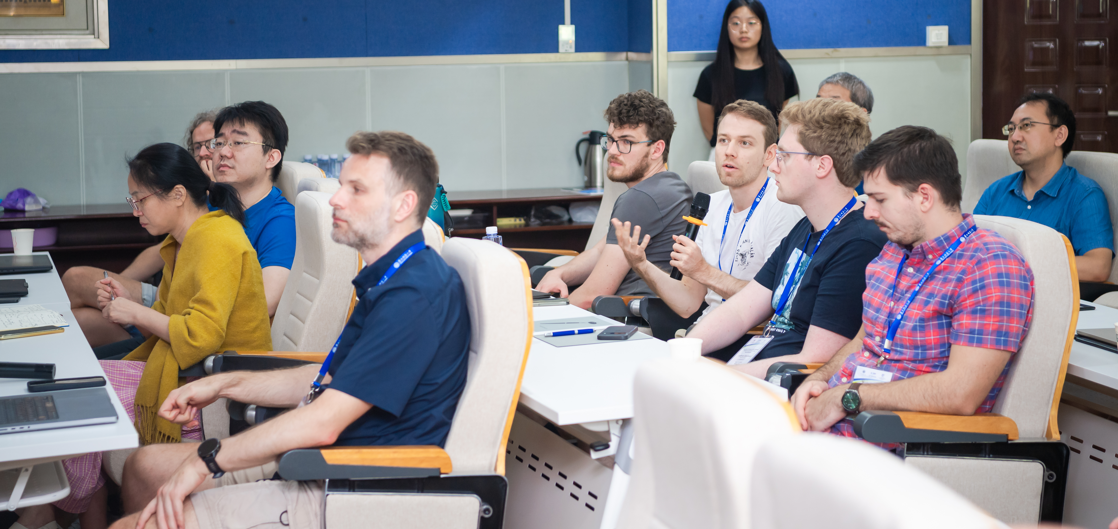
Timeline of C3NT programs during May 2025 – April 2026
New opportunities in particle
and nuclear physics with
energy correlators
13th Huada QCD
School on QCD out
of equilibrium
Workshop on Nuclear physics
across energy scales
2025
May 17-18
September 1-12
May 6-17
August 25-29
September 19-21
Inaugural Symposium on
Frontiers of Nuclear Theory
Precision Frontiers of QCD
Matter: Inference and uncertainty
quantification
1st workshop on Jet and
Heavy Quark Physics (JAQ2026)
Jet-Soft Dynamical Interaction in
High-energy heavy-ion collisions
CEP & EFT
January 6-17
June 15 -19
Sept 20-24
November 22– Dember 5
2026
January 6-17
March 22-April 4
October 19 - 22
Workshop on Global
Constraints of QGP properties
QIS - HENP
14th Huada QCD School on
Spin and polarization in QCD
Frontiers of ab initio
Nuclear Theory

Slide 12
Programs in 2026-2027
Long1: Connecting Theory to Collider Data in the Era of Precision Saturation Physics （2027.3.8-19)
Long2: Nuclear Physics under Extreme Cosmic Conditions (2027.5.30-6.11)
Long3: Strangeness across Scales: linking QCD, dense matter and fundamental symmetries. (2027.9.20-30)
Short 1: QCD CEP and EFT (2026.10.19-22)
Short 2: AI for Nuclear Modeling: from ab initio to DFT (2027.11.5-8)
Short 3: AI in nuclear and high-energy physics (2027.9.6-10)

Slide 13
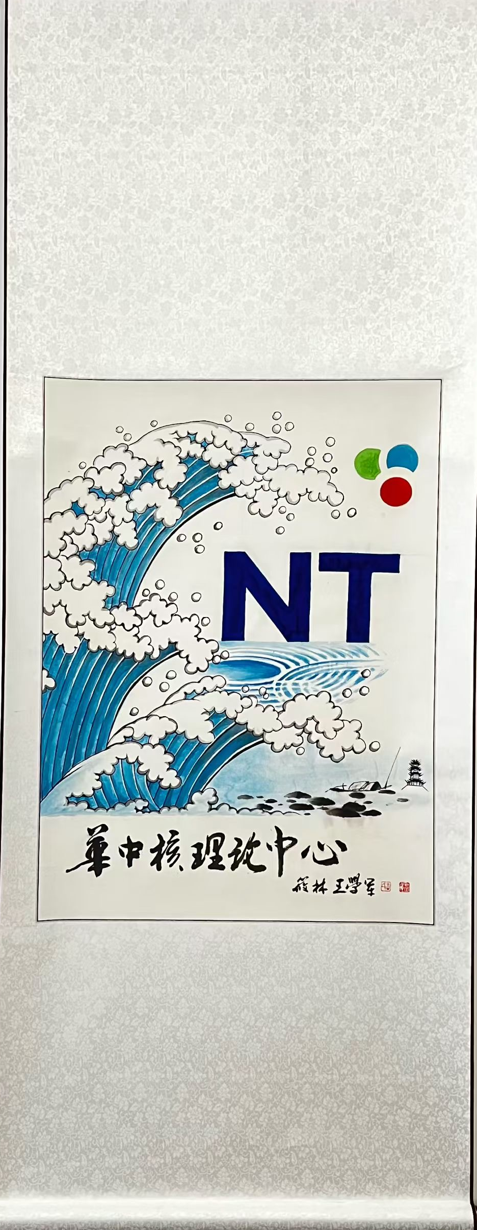
Welcome to 14th Huada QCD School
C3NT @CCNU

