Slide 1
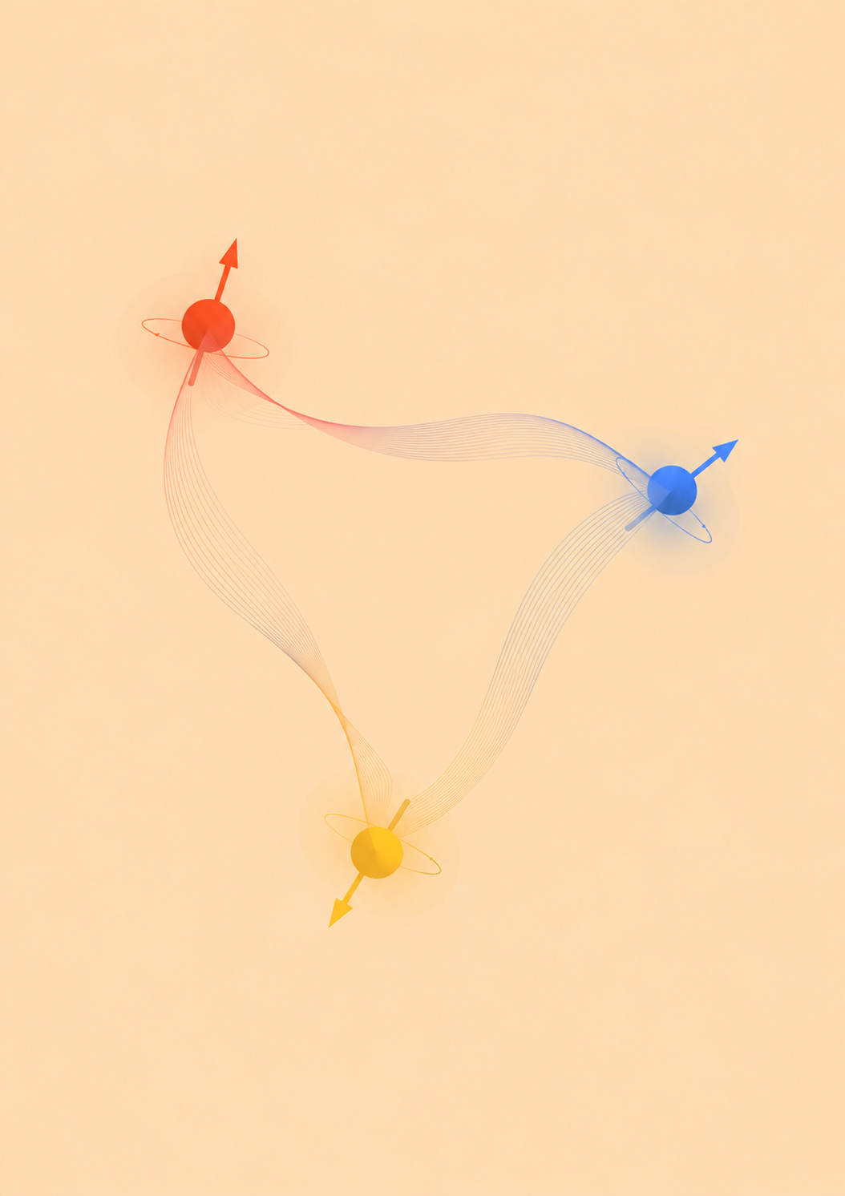
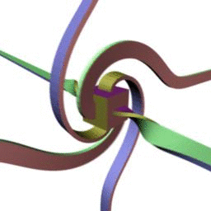

The 14th HuaDa QCD School
Spin & Polarization in QCD
Spin in hadron structure
Prof. Xiangdong Ji (SJTU)
Spin in non-equilibrium systems
Prof. Qun Wang (USTC)
Spin physics and nuclear/collider expt.
Prof. Takafumi Niida (U. of Tsukuba)

Slide 2
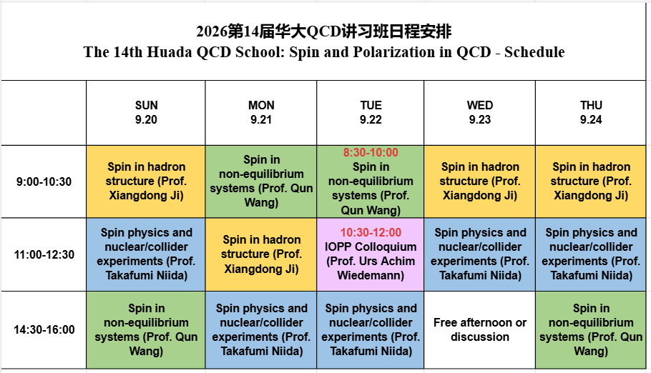

Slide 3
Announcements:
We will take a group photo during the first coffee break today.
Group dinner: Tuesday at 6:00 p.m., 小官园 on the CCNU campus.
Dining cards are available in limited numbers to non-CCNU registrants Nos. 1–51. They can be used at the campus cafeterias.
Please return your dining card to the registration table, the secretary, any volunteer, or me before you leave.
Alipay (支付宝), WeChat Pay (微信支付) are also accepted at the cafeterias.
There are convenience stores and supermarkets on campus. They are several shopping malls nearby.

Slide 4
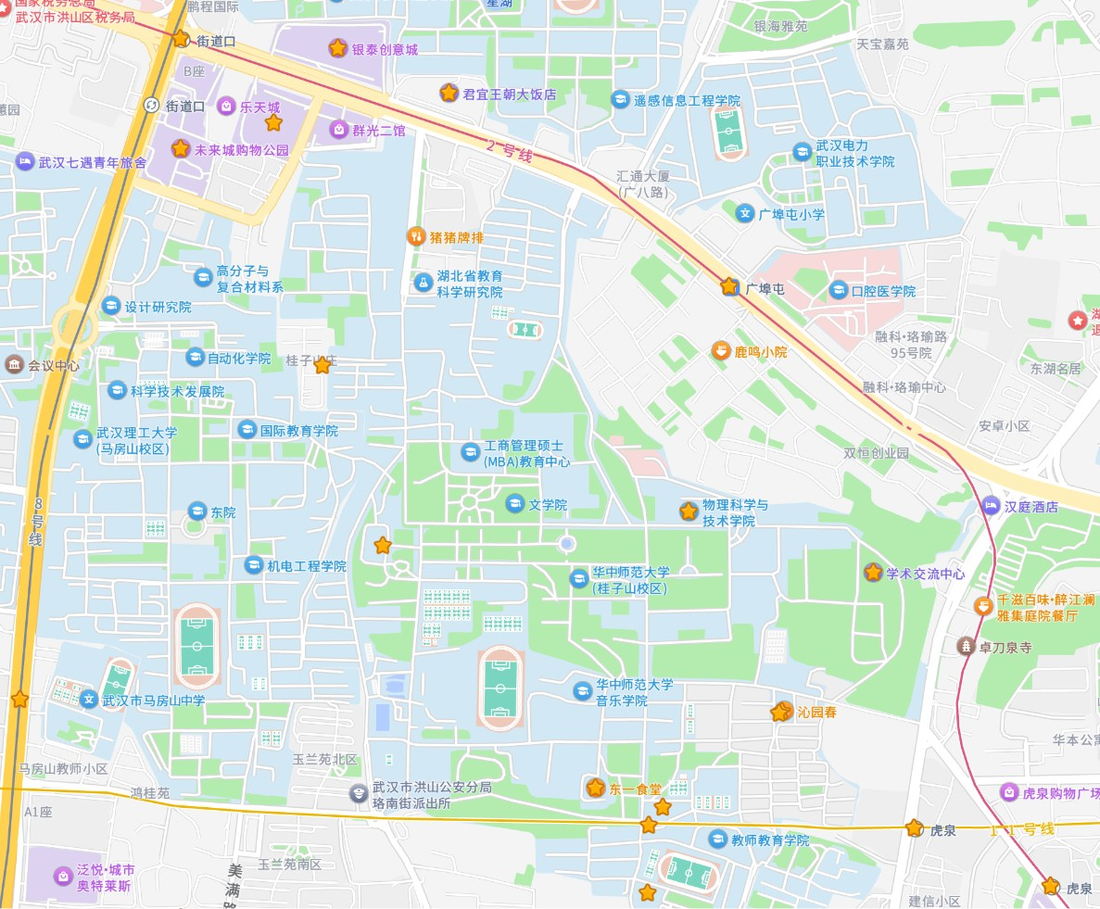
Jiedaokou, Subway Line 2/8
Junyi Dynasty Hotel
Shopping Malls
Guangbutun, Subway Line 2
About 20mins walk
Physics Building
7mins walk
Guiyuan Hotel
Cafeteria
Group dinner
Cafeteria
& Market
Cafeteria &
Convenience stores
Huquan, Subway Line 2/11

