Slide 1

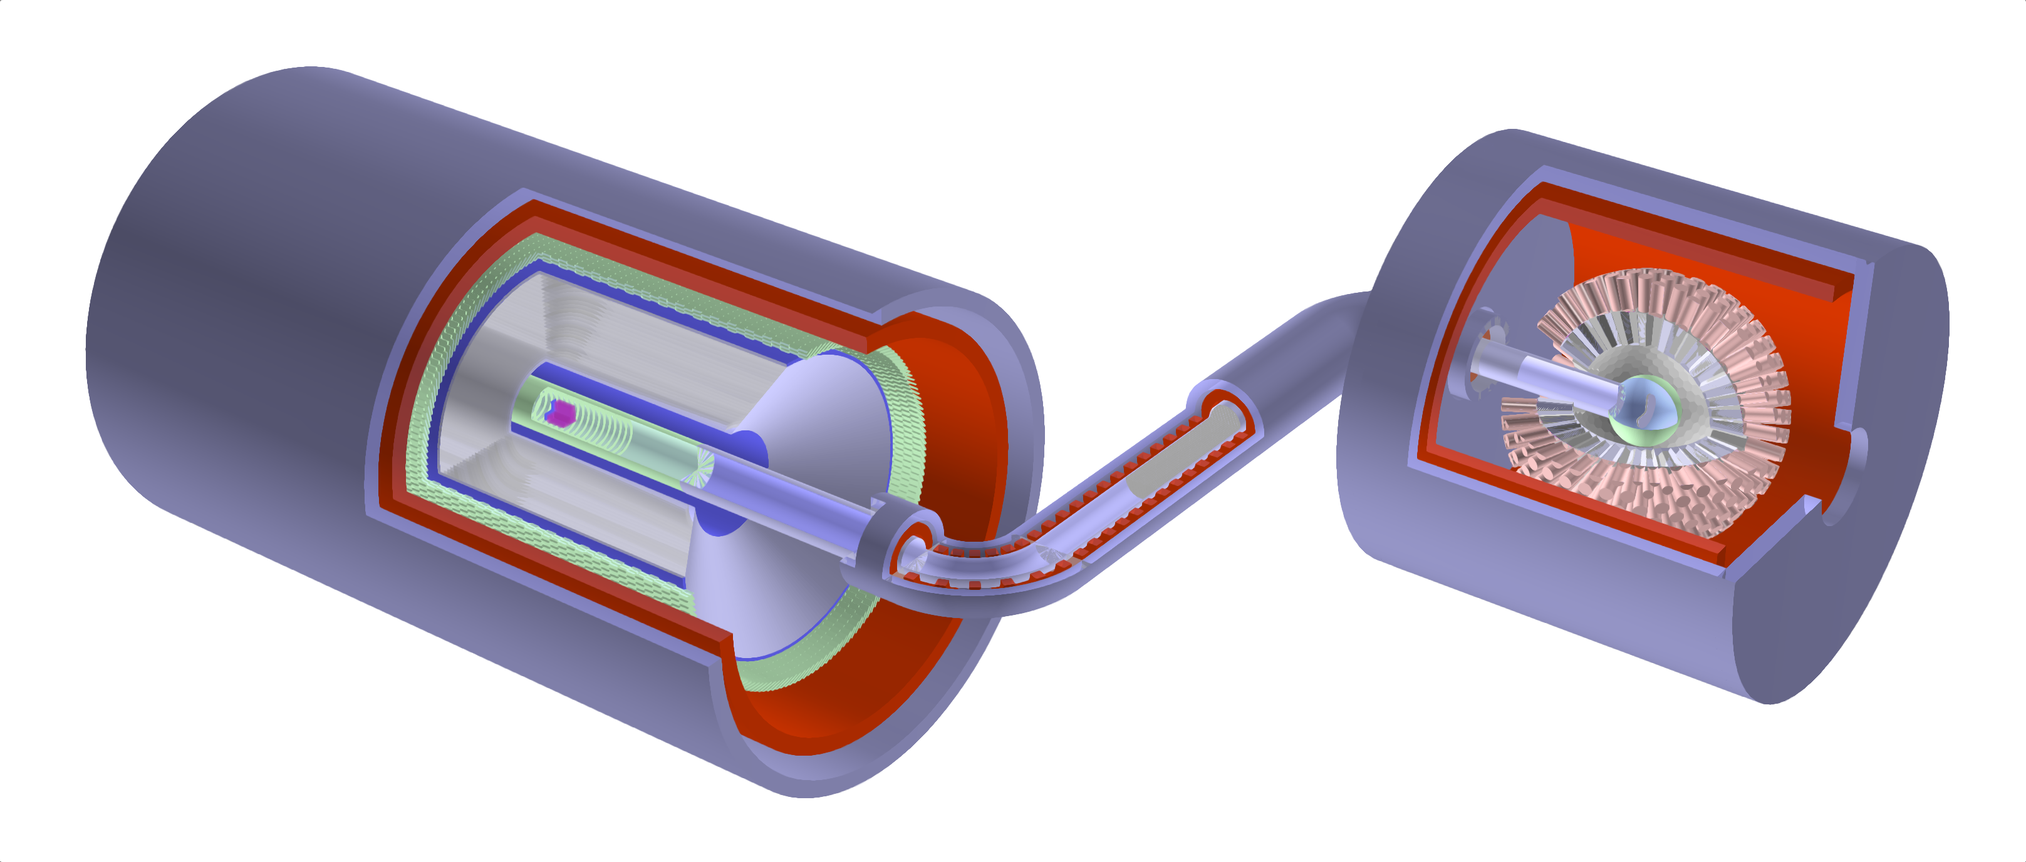
Progress of Muonium to Antimuonium Conversion Experiment (MACE)
Jian Zhang (张健)
zhangjianphy@nankai.edu.com
粒子物理天问论坛
2026-08-28 广西 桂林
Ai-Yu Bai, Hanjie Cai, Chang-Lin Chen, Siyuan Chen, Xurong Chen, Yu Chen, Weibin Cheng, Ling-Yun Dai, Rui-Rui Fan, Li Gong, Zihao Guo, Yuan He, Zhilong Hou, Yinyuan Huang, Huan Jia, Hao Jiang, Han-Tao Jing, Xiaoshen Kang, Kim Siang Khaw, Hai-Bo Li, Jincheng Li, Yang Li, Shulin Liu, Guihao Lu, Han Miao, Jun Kai Ng, Yunsong Ning, Jianwei Niu, Huaxing Peng, Alexey A. Petrov, Yuanshuai Qin, Mingchen Sun, Jian Tang, Jing-Yu Tang, Ye Tian, Rong Wang, Xiaodong Wang, Zhichao Wang, Chen Wu, Tian-Yu Xing, Weizhi Xiong, Yu Xu, Baojun Yan, De-Liang Yao, Tao Yu, Ye Yuan, Yi Yuan, Jian Zhang, Yao Zhang, Yongchao Zhang, Zhilv Zhang, Guang Zhao, and Shihan Zhao
(MACE working group)
Conceptual Design of the Muonium-to-Antimuonium Conversion Experiment (MACE),
Nucl. Sci. and Tech. 37, 57 (2026), cover story

Slide 2
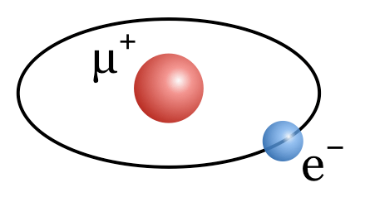
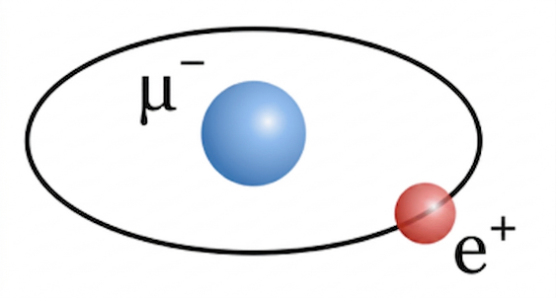
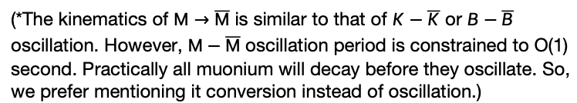
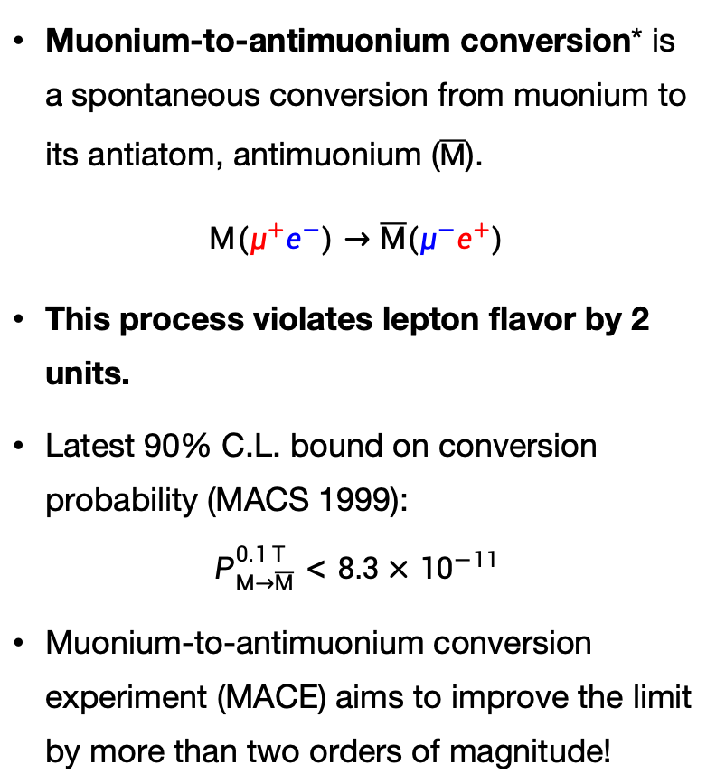
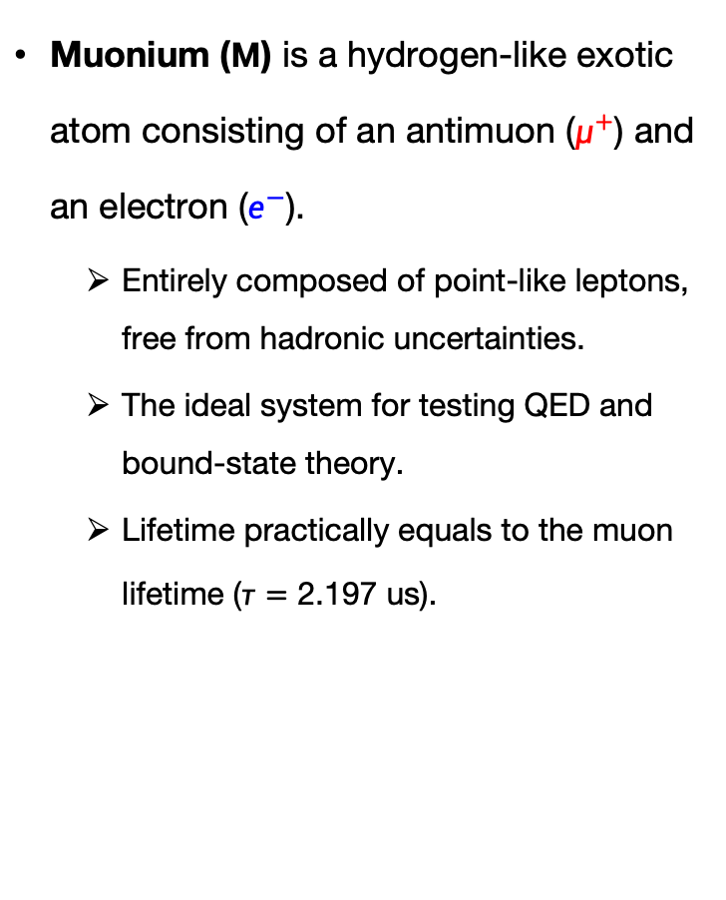
Muonium and muonium-to-antimuonium conversion
Muonium ($M$) is a hydrogen-like exotic atom consisting of an antimuon ($μ^{+}$) and an electron ($e^{−}$).
  Entirely composed of point-like leptons, free from hadronic uncertainties.
  The ideal system for testing QED and bound-state theory.
  Lifetime practically equals to the muon lifetime ($τ=\text{2}\text{.}\text{197}$ us).
Muonium-to-antimuonium conversion* is a spontaneous conversion from muonium to its antiatom, antimuonium ($\overline{M}$).
$$M(μ^{+}e^{−})→\overline{M}(μ^{−}e^{+})$$
This process violates lepton flavor by 2 units.
Latest 90% C.L. bound on conversion probability (MACS 1999):
$$P_{M→\overline{M}}^{0.1 T}<8.3×{10}^{−11}$$
Muonium-to-antimuonium conversion experiment (MACE) aims to improve the limit by more than two orders of magnitude!
Muonium
?
L. Willmann, PRL 82 (1999), 49-52
 | Hydrogen | Muonium
Nucleus | Proton | Antimuon
Mass | 938.3 MeV/c² | 106.2 MeV/c²
Reduced mass | 0.9995 m_{e} | 0.9952 m_{e}
Bohr radius | 52.9 pm | 53.2 pm
1S energy | 13.598 eV | 13.540 eV
Lifetime | Stable | 2.197 μs
Antimuonium
(*The kinematics of $M→\overline{M}$ is similar to that of $K−\overline{K}$ or $B−\overline{B}$ oscillation. However, $M−\overline{M}$ oscillation period is constrained to O(1) second. Practically all muonium will decay before they oscillate. So, we prefer mentioning it conversion instead of oscillation.)

Slide 3
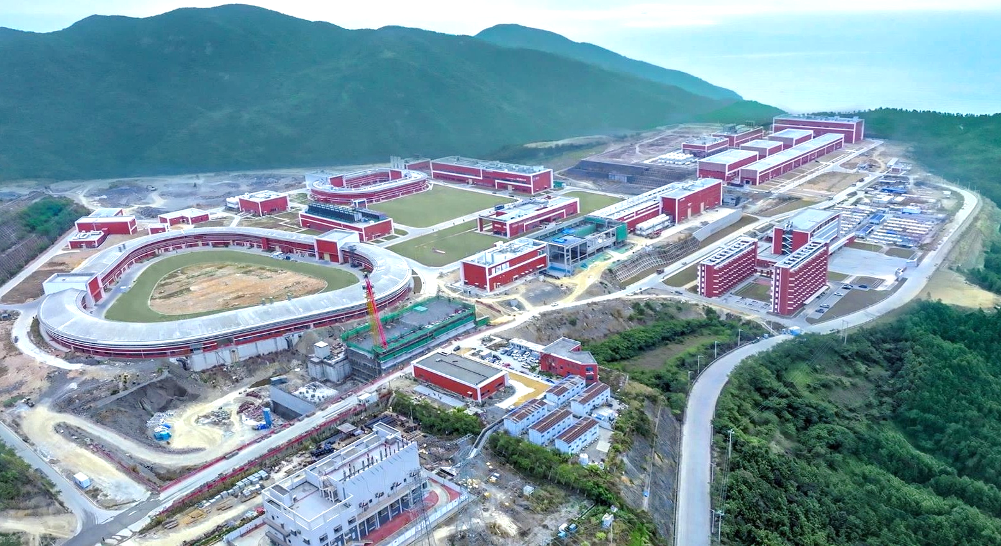
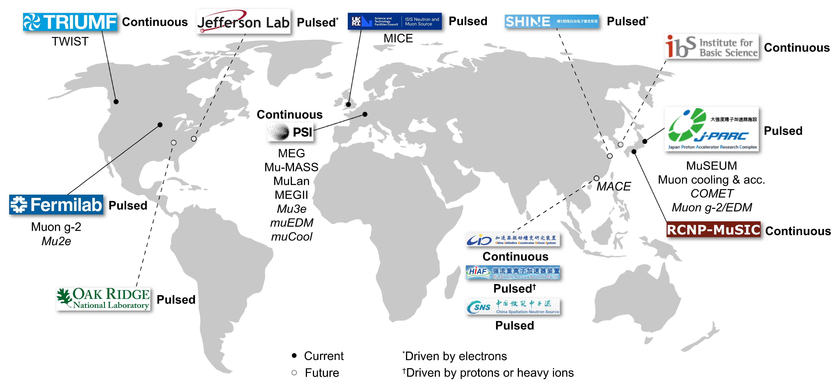
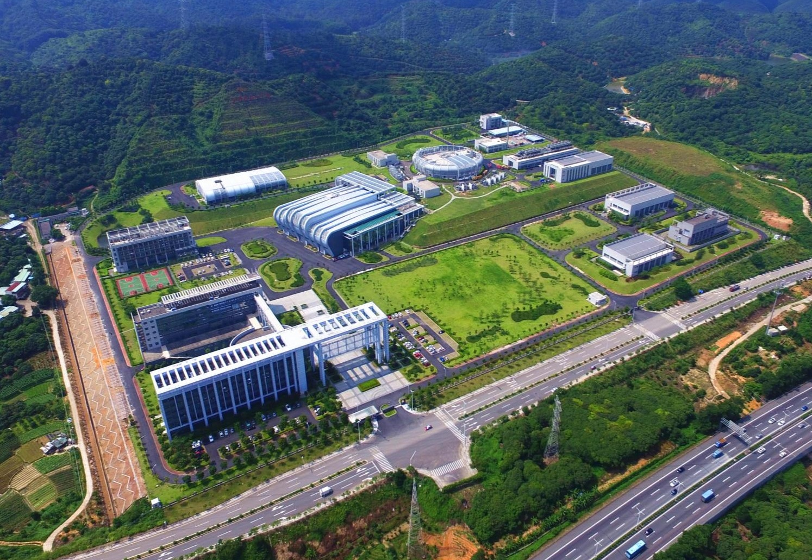
Status of muon sources
CiADS & HIAF, Huizhou, China
(under construction)
CSNS, Dongguan, China
Global facilities: PSI (Switzerland), J-PARC (Japan), ISIS (UK), TRIUMF (Canada), FNAL (USA).
First high-intensity muon source in China, to be built in the Greater Bay Area: CiADS/HIAF/CSNS.
Notes:
The UK, Switzerland,.. have all built their own muon beamlines, and became important centers of muon physics.
On the other hand
Three major
Guangdong

Slide 4
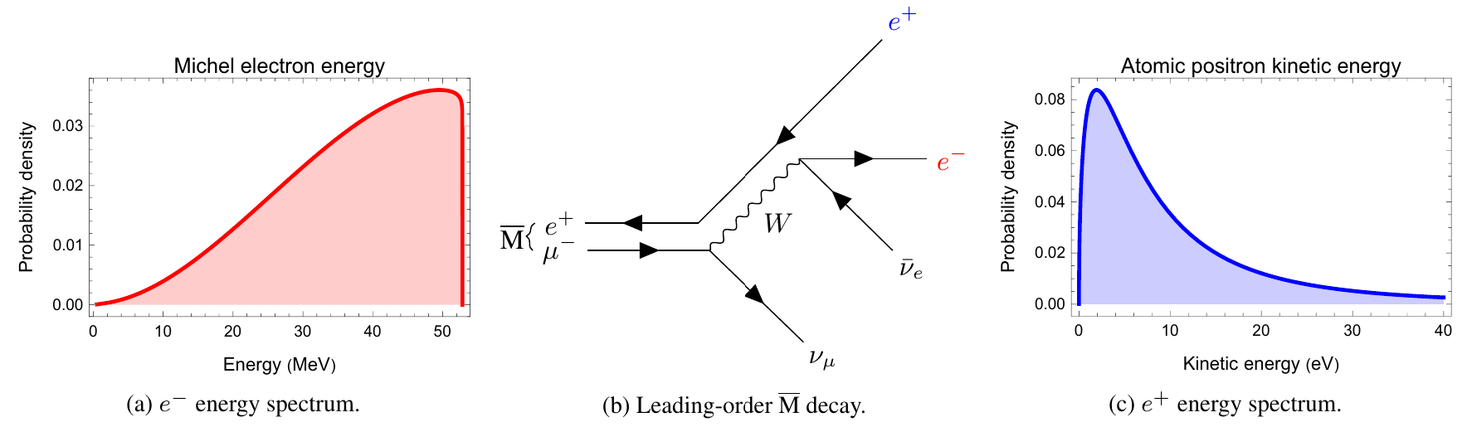
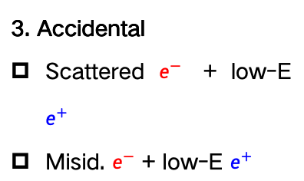
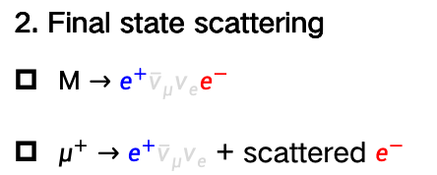
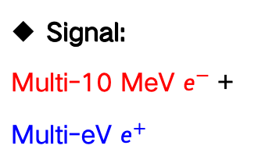
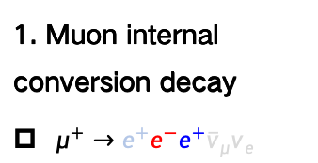
Signal and background
Signal:
Multi-10 MeV $e^{−}$ + Multi-eV $e^{+}$
1. Muon internal conversion decay
$μ^{+}→e^{+}e^{−}e^{+}{\overline{ν}}_{μ}ν_{e}$
3. Accidental
Scattered $e^{−}$ + low-E $e^{+}$
Misid. $e^{−}$ + low-E $e^{+}$
2. Final state scattering
$M→e^{+}{\overline{ν}}_{μ}ν_{e}e^{−}$
$μ^{+}→e^{+}{\overline{ν}}_{μ}ν_{e}$ + scattered $e^{−}$
e⁻ (26MeV avg.)
e⁻
e⁻
e⁻
μ⁺
e⁺
e⁺ (miss)
e⁺
(13.5eV avg.)
e⁺
μ⁺
μ⁺
μ⁺
M
e⁺
M
e⁺ (miss)
ν
ν
ν
ν
ν
ν
ν
ν
ν
e⁻
e⁻ (误鉴别)
μ⁺
e⁺
μ⁺
e⁺
ν
ν
ν
ν

Slide 5
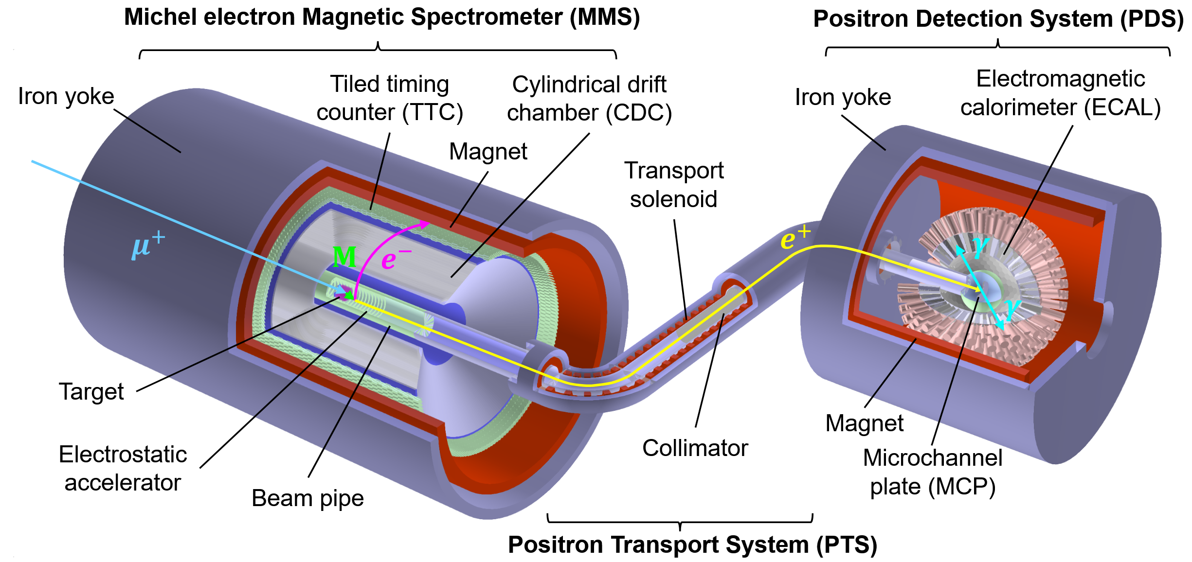
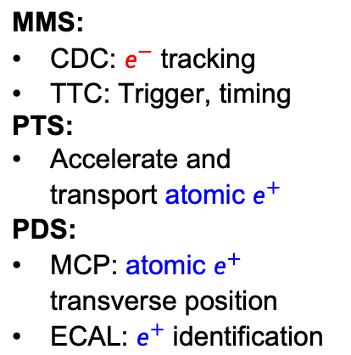
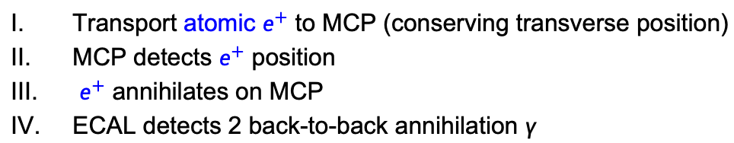


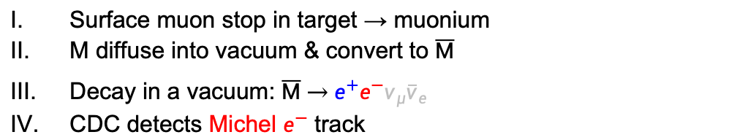
Conceptual design of MACE detector system
More details in backup slides.
MMS:
CDC: $e^{−}$ tracking
TTC: Trigger, timing
PTS:
Accelerate and transport atomic $e^{+}$
PDS:
MCP: atomic $e^{+}$ transverse position
ECAL: $e^{+}$ identification
Triple coincidence:
MMS + MCP + ECAL
Michel $e^{−}$
Atomic $e^{+}$
Surface muon stop in target → muonium
M diffuse into vacuum & convert to $\overline{M}$
Decay in a vacuum: $\overline{M} \underset{→}{ } e^{+}e^{−}ν_{μ}{\overline{ν}}_{e}$
CDC detects Michel $e^{−}$ track
Transport atomic $e^{+}$ to MCP (conserving transverse position)
MCP detects $e^{+}$ position
$e^{+}$ annihilates on MCP
ECAL detects 2 back-to-back annihilation $γ$

Slide 6
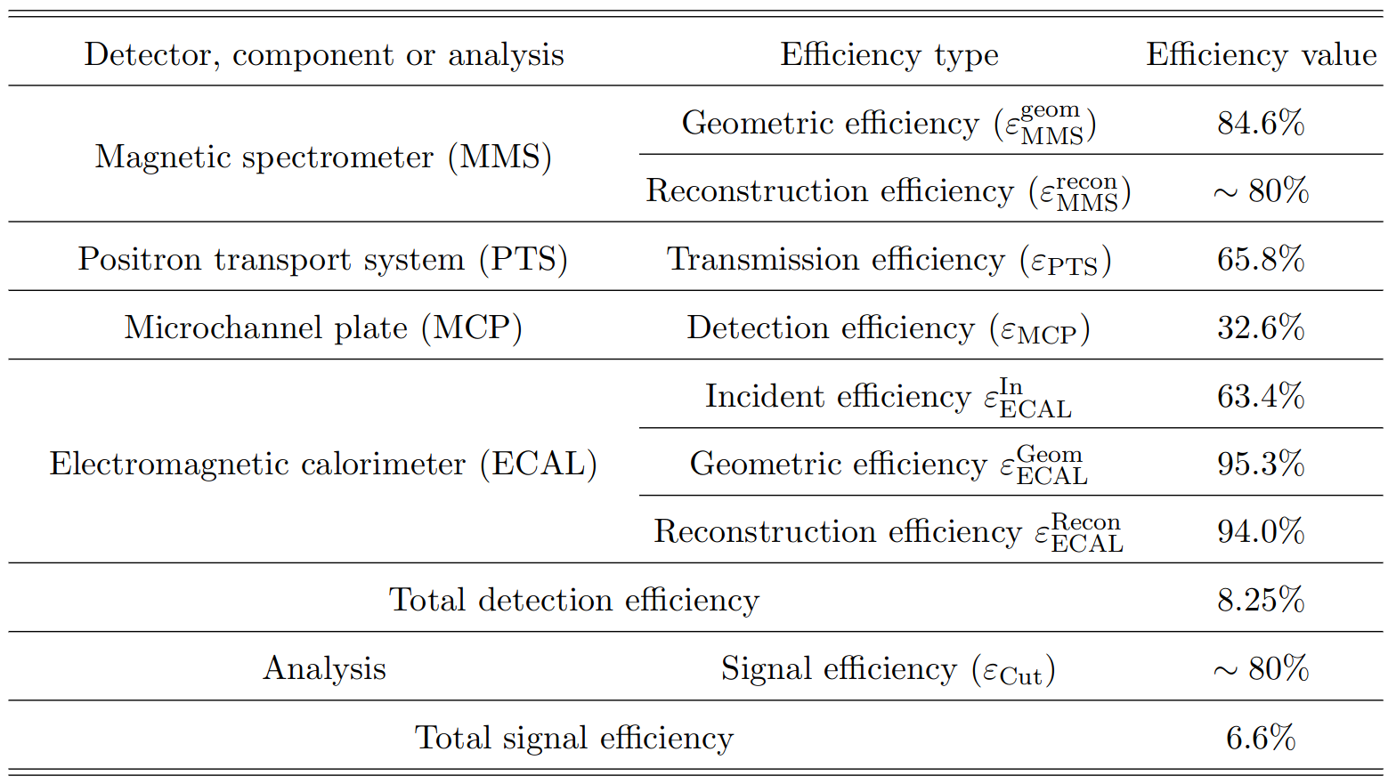
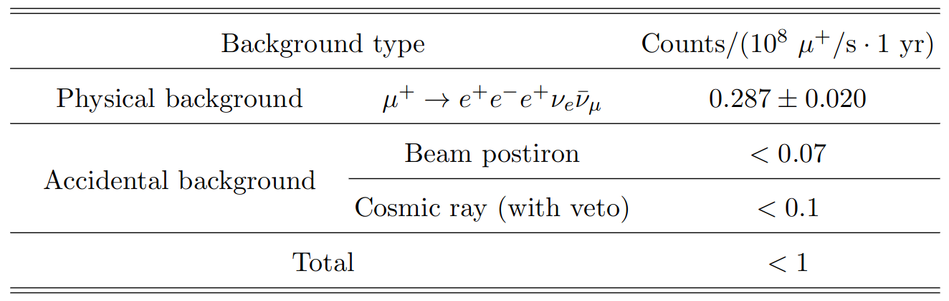
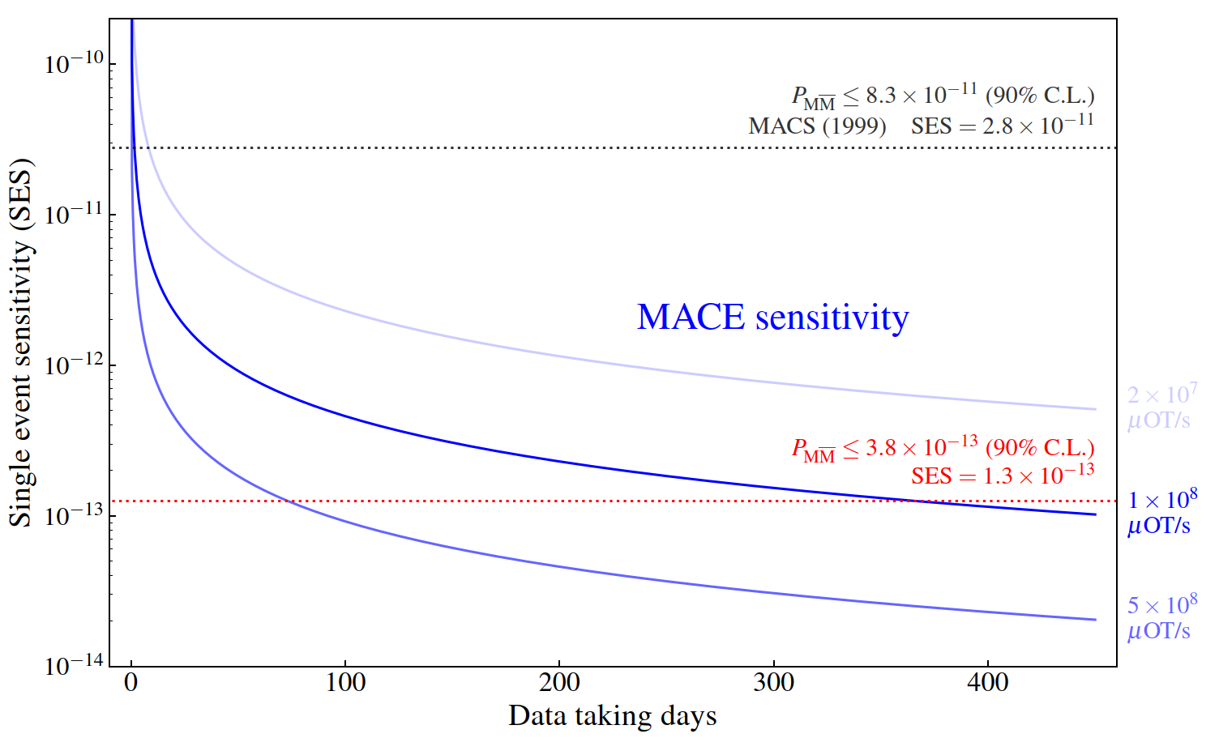
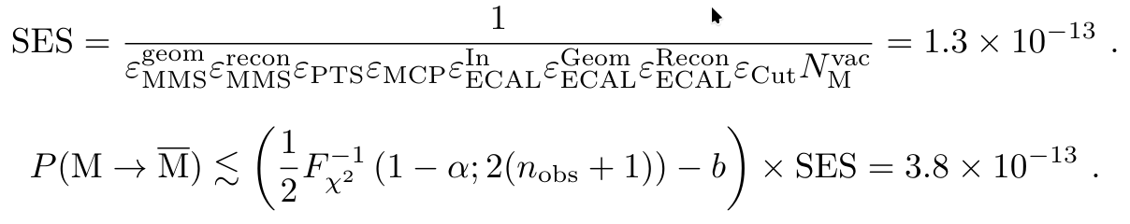
Experimental sensitivity
Summary of simulation results:
$𝓞\left({10}^{−13}\right)$ single event sensitivity is expected:
(90% C.L.)
Notes:
We estimated the sensitivity of MACE by detailed simulations
Left side table: each type of backgrounds and their levels
Right side table: the detailed efficiency of each subdetectors
For the muonium to antimuonium conversion, we can expect a single event sensitivity of

Slide 7
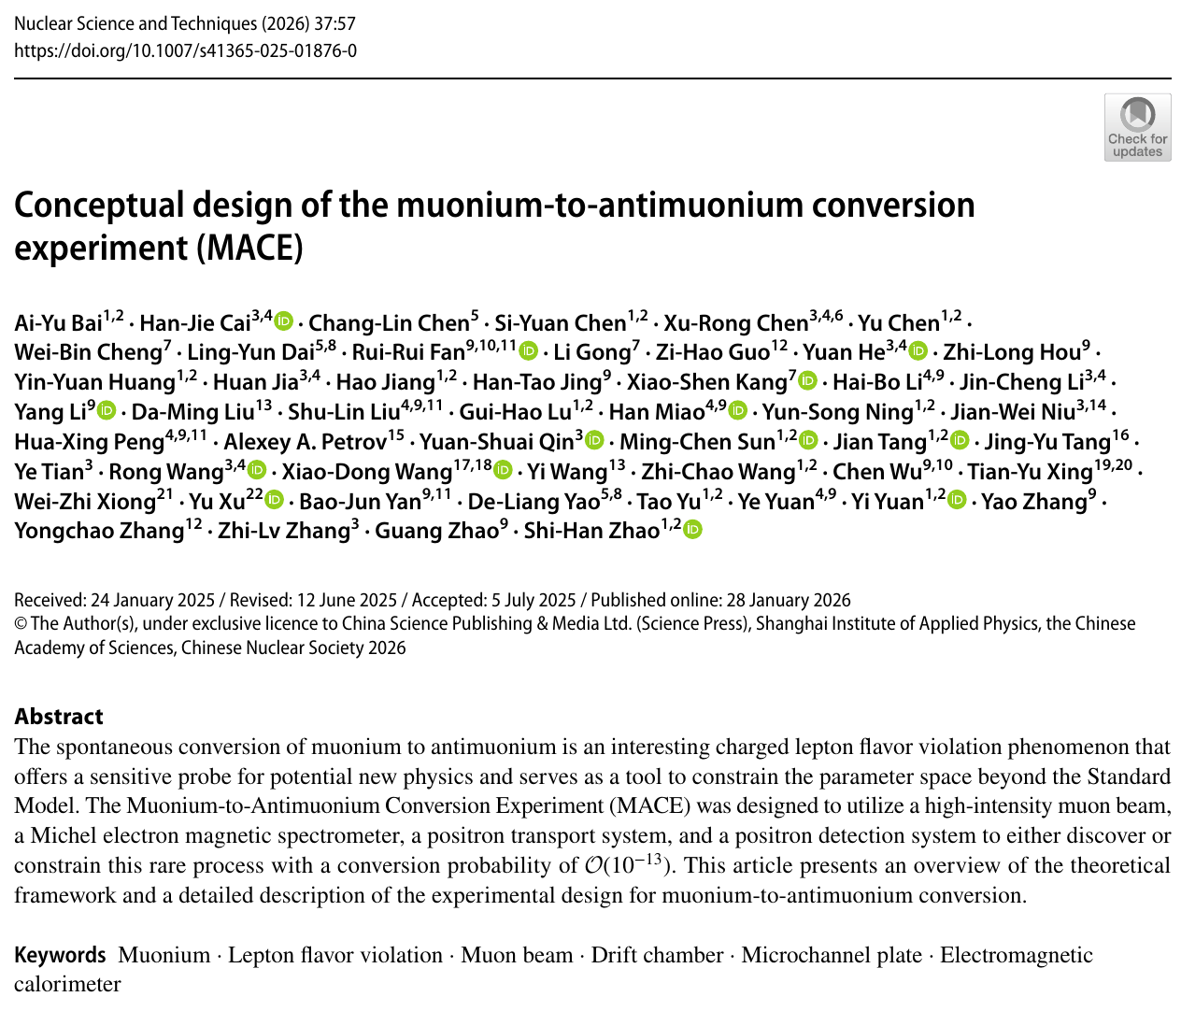
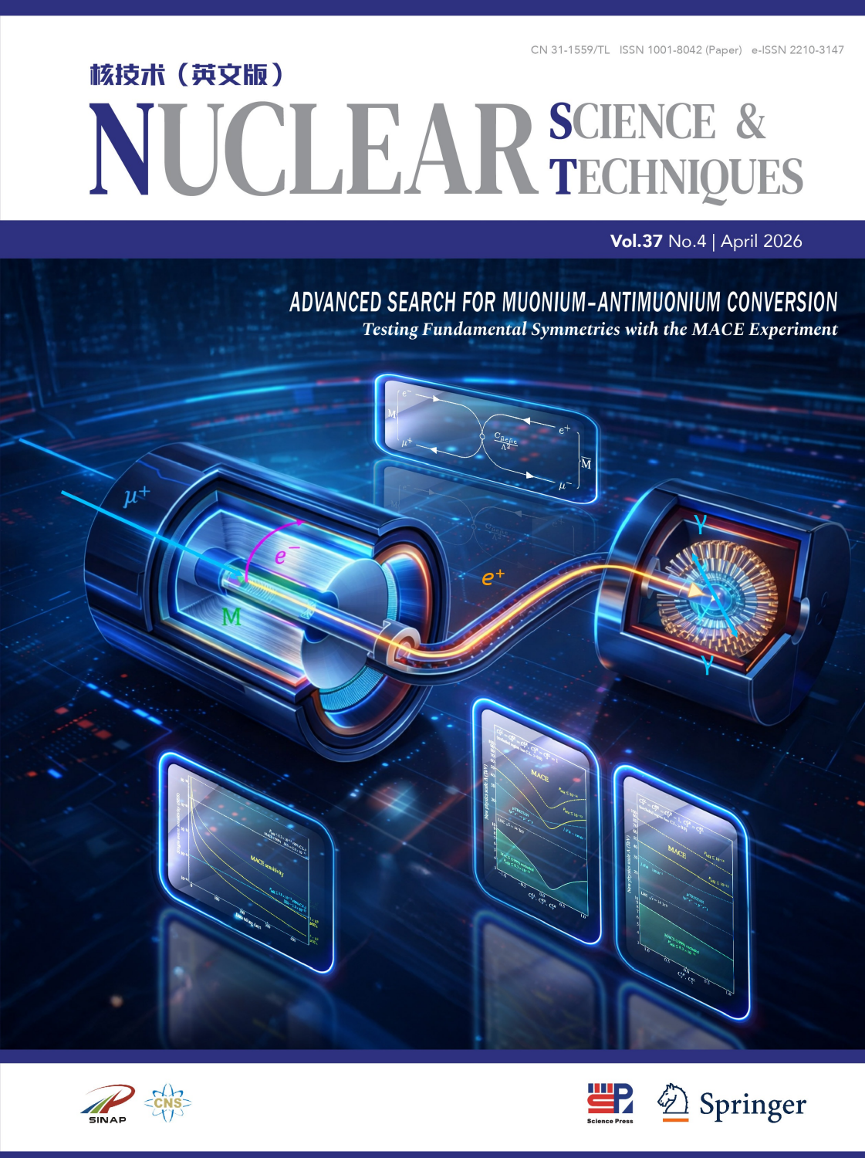
MACE conceptual design report
Nucl. Sci. and Tech. 37, 57 (2026), cover story

Slide 8
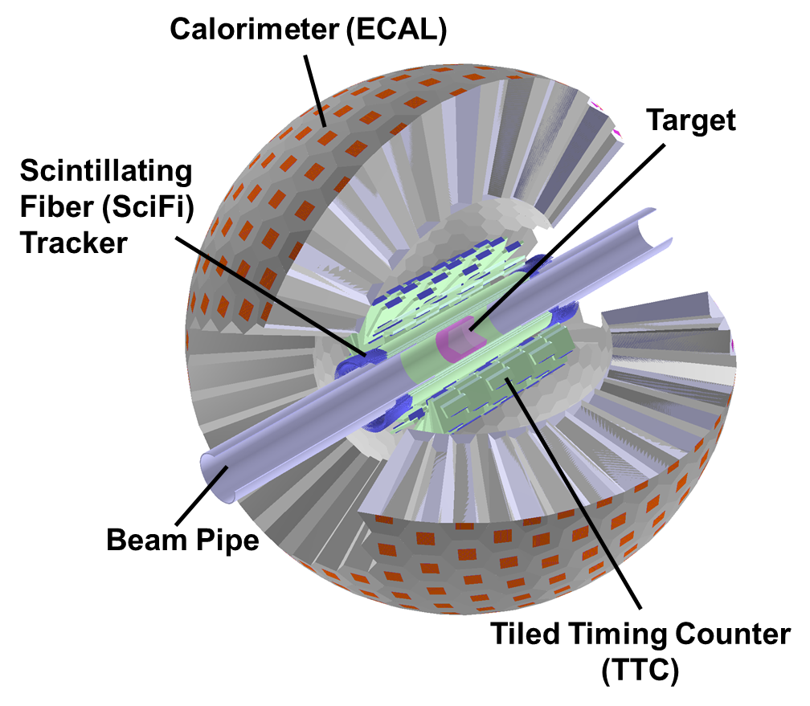




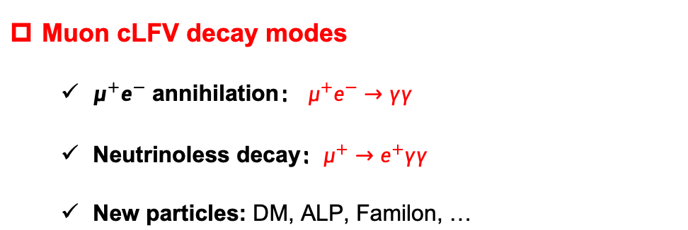
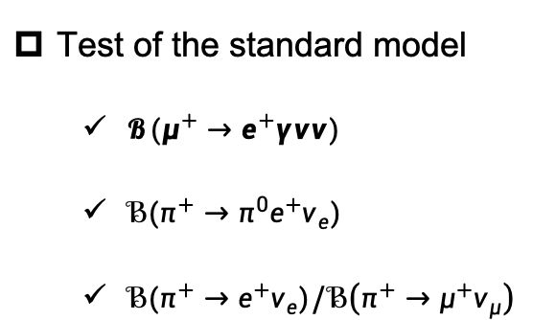
MACE Phase-I
Muon cLFV decay modes
  $μ^{+}e^{−}$ annihilation： $μ^{+}e^{−}→γγ$
  Neutrinoless decay：$μ^{+}→e^{+}γγ$
  New particles: DM, ALP, Familon, …
More in backup slides.
$𝒪\left({10}^{−5}\right)$, 1959
$𝒪({10}^{−11})$, 1988
Crystal Box、MEG
PRL, 1959, 3: 288-291
PRD 38 (1988) 2077
EPJC 80 (2020) 9, 858
Test of the standard model
  $𝓑(μ^{+}→e^{+}γνν)$
  $ℬ(π^{+}→π^{0}e^{+}ν_{e})$
  ${ℬ(π}^{+}→e^{+}ν_{e})/ℬ\left(π^{+}→μ^{+}ν_{μ}\right)$
$𝒪\left({10}^{−8}\right), E_{e}>45, E_{γ}>40$ MeV, 2016
$𝒪({10}^{−8})$, 2004
$𝒪({10}^{−4})$, 2015
EPJC 76 (2016) 3, 108
Int.J.Mod.Phys.A 20 (2005) 472-481
PRL. 115 (2015) 7, 071801
arXiv:2203.01981
PIONEER CDR, 2022

Slide 9
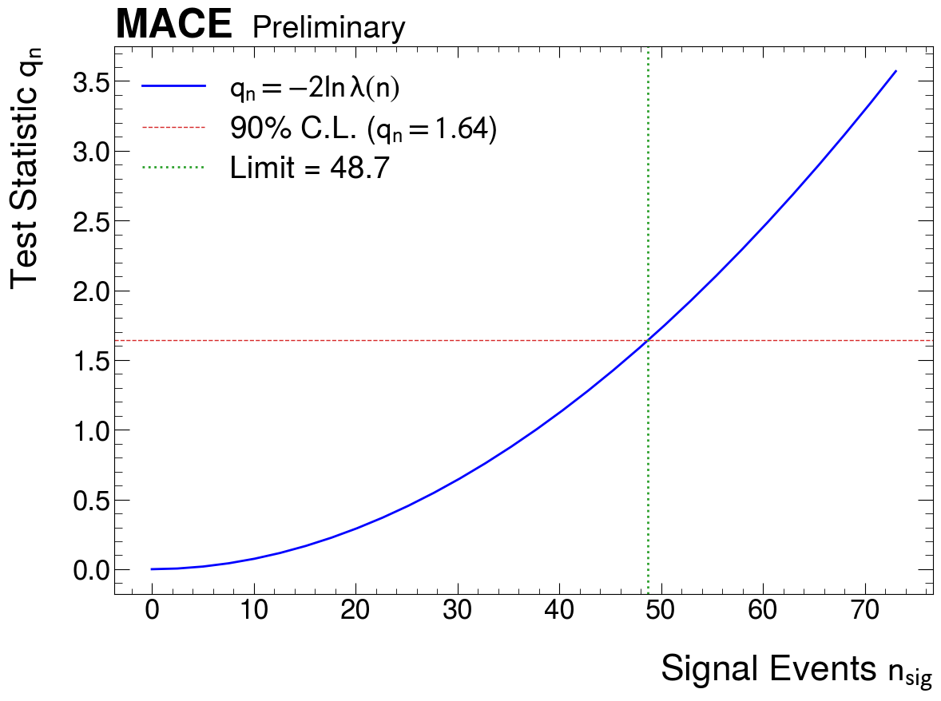
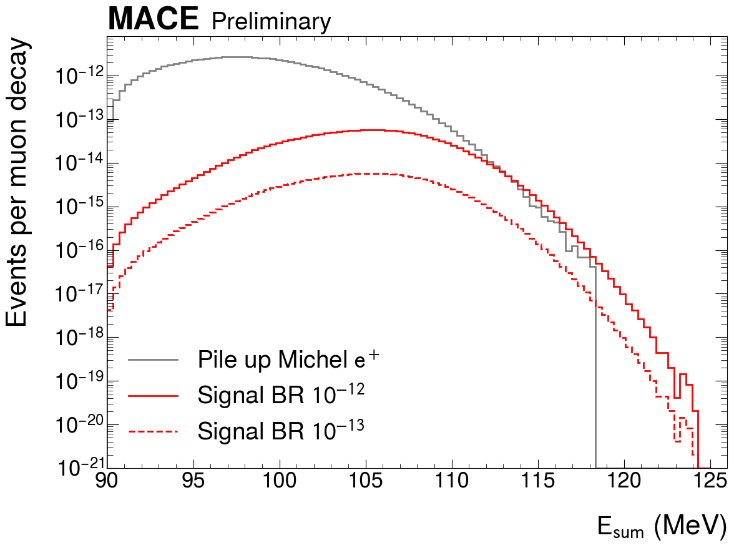





MACE Phase-I sensitivity to $M→γγ$
Signal: Double collinear 53 MeV gamma-rays.
$$γ$$
Non-response in tracker
Double tracks reconstructed by ECAL
$$μ^{+}$$
M
$$γ$$
Background: Accidental coincidence of “pileup” positrons.
$$e^{+}$$
Asimov dataset (signal & bkg)
Profile likelihood ratio test
5% systematics error included
$$μ^{+}$$
$$μ^{+}$$
M
$$e^{+}$$
Upper limit of BR: $5.2×{10}^{−13}$ (90% C.L.)
$𝒪({10}^{−5})$ in 1959
PRL, 1959, 3: 288-291

Slide 10
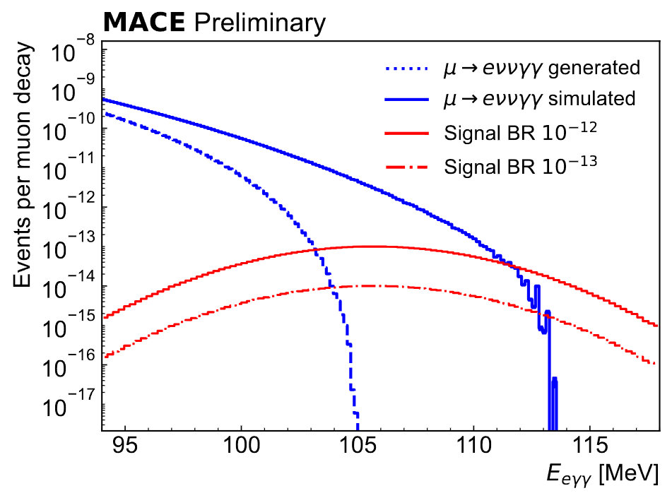

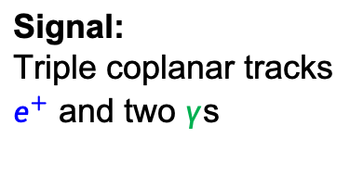



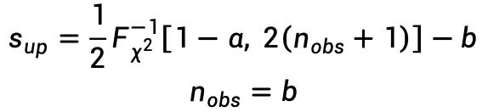
MACE Phase-I sensitivity to $μ^{+}→e^{+}γγ$
Event selection criteria:
Time coincidence
Single track in Tracker, Triple tracks in ECAL
Energy-momentum conserved
Signal:
Triple coplanar tracks
$e^{+}$ and two $γ$s
Background:
Double radiative muon decay
SciPost Phys. 9, 027 (2020)
$$s_{up}=\frac{1}{2}F_{χ^{2}}^{−1}\left[1−α, 2\left(n_{obs}+1\right)\right]−b$$
$$n_{obs}=b$$
$$γ$$
$$γ$$
$$e^{+}$$
$$μ^{+}$$
$$e^{+}$$
$$μ^{+}$$
$$ℬℛ\left(μ^{+}→eγγ\right)=\frac{s_{up}}{ε_{signal}Φ_{μ}T}$$
$$ν_{e}$$
$${\overline{ν}}_{μ}$$
$$γ$$
$$γ$$
Upper limit of BR: $3.5×{10}^{−13}$ (90% C.L.)
More solid simulations and refined data analyses to be updated!
$𝒪({10}^{−11})$ in 1988
PRD 38 (1988) 2077

Slide 11
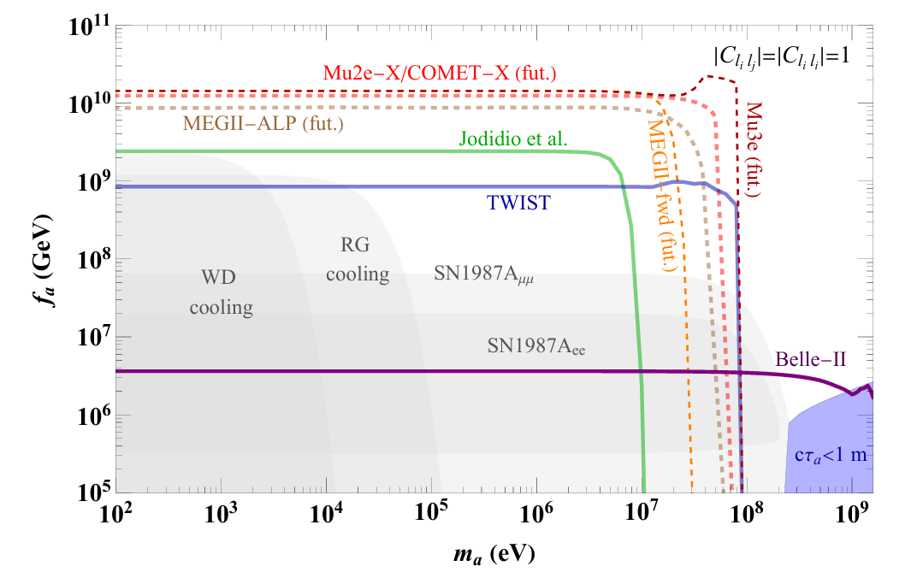
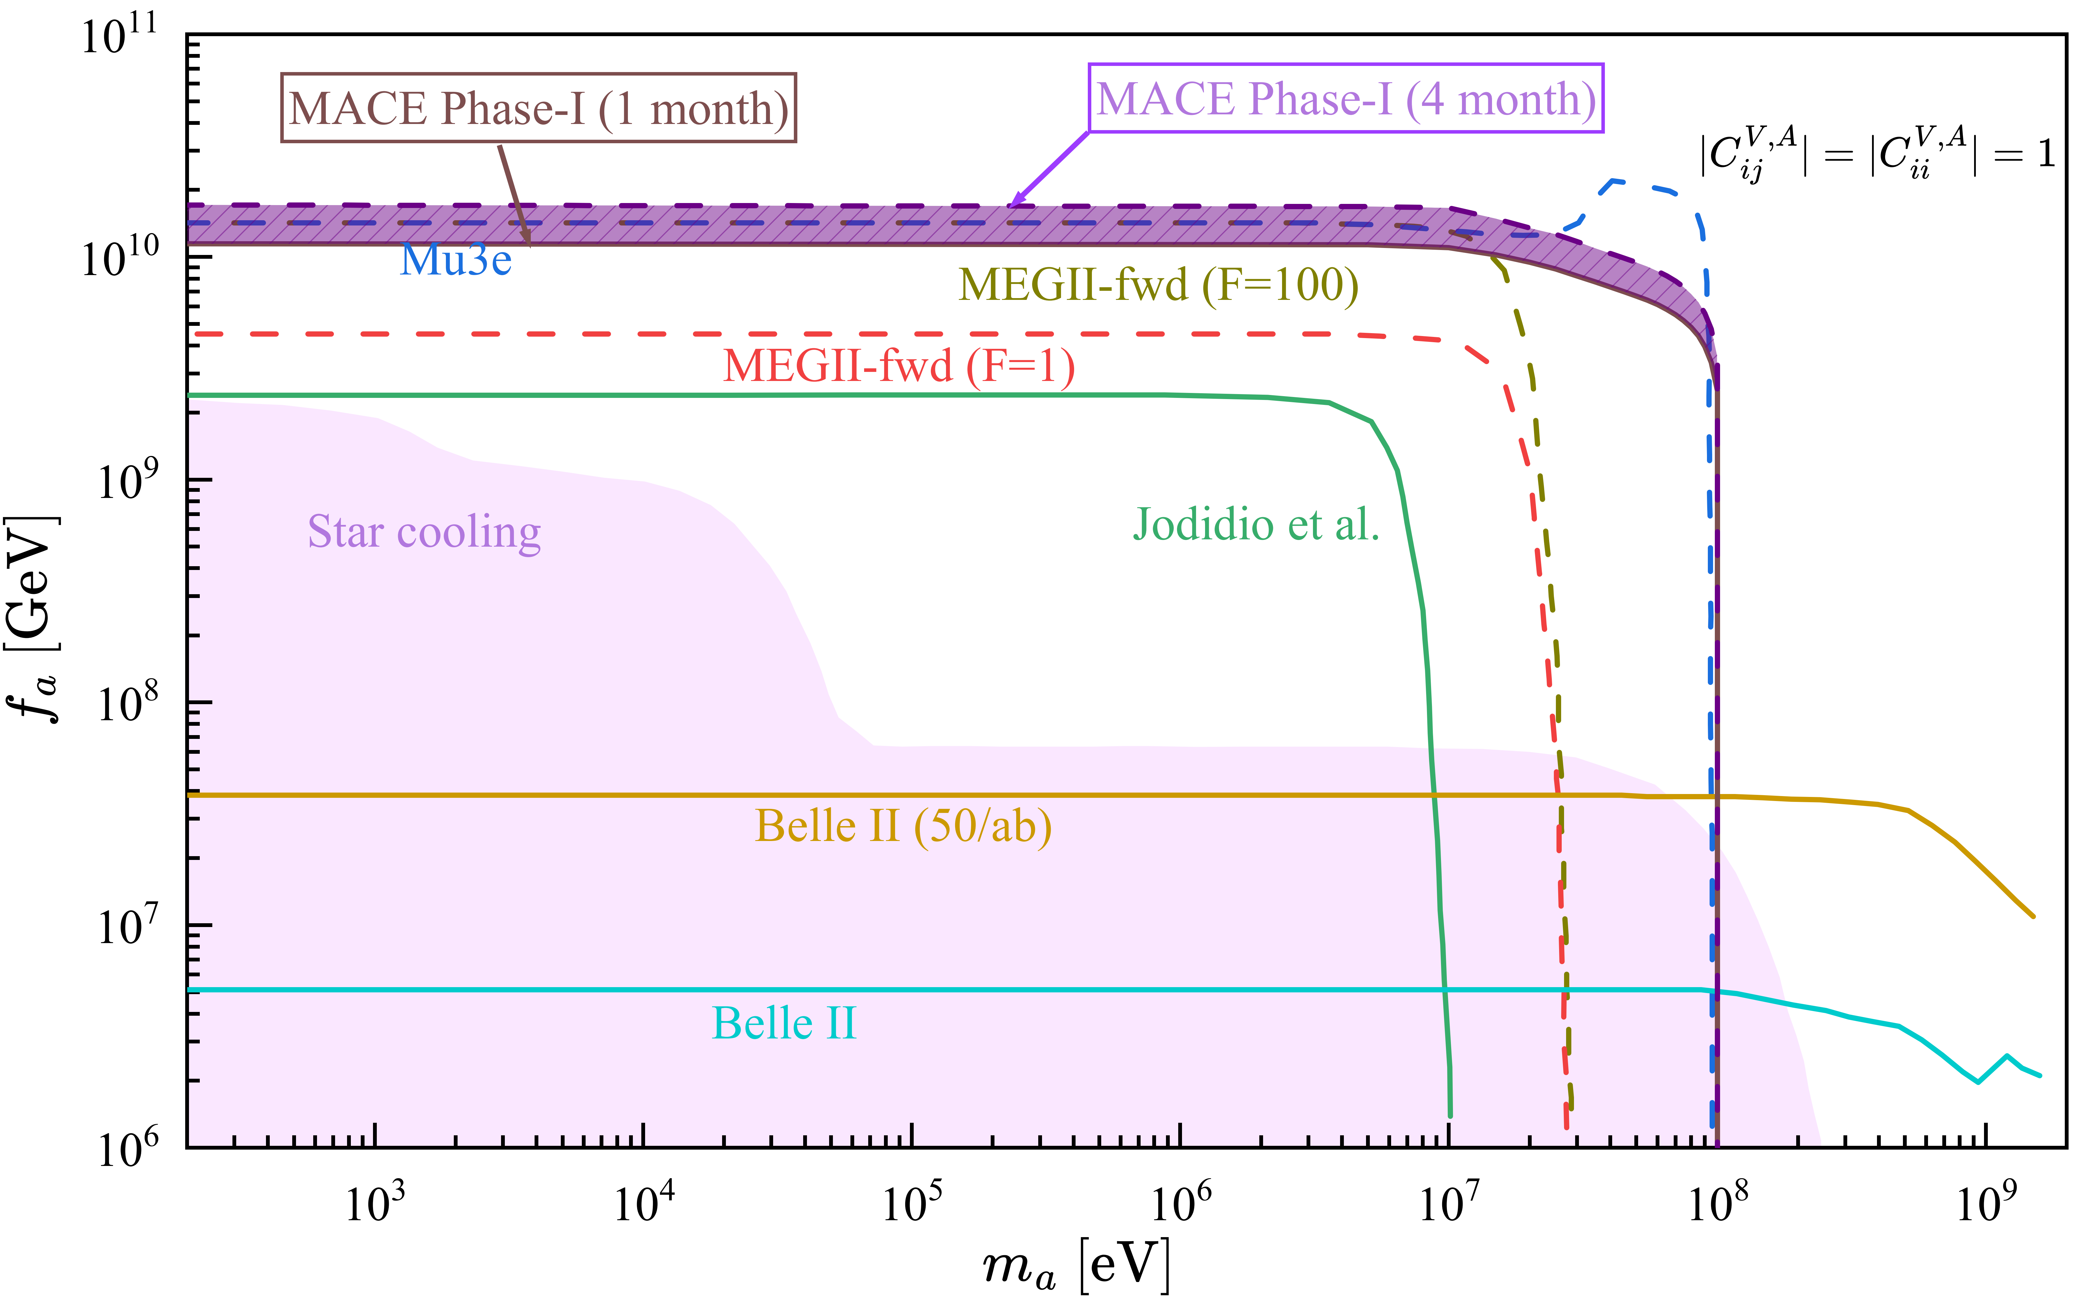
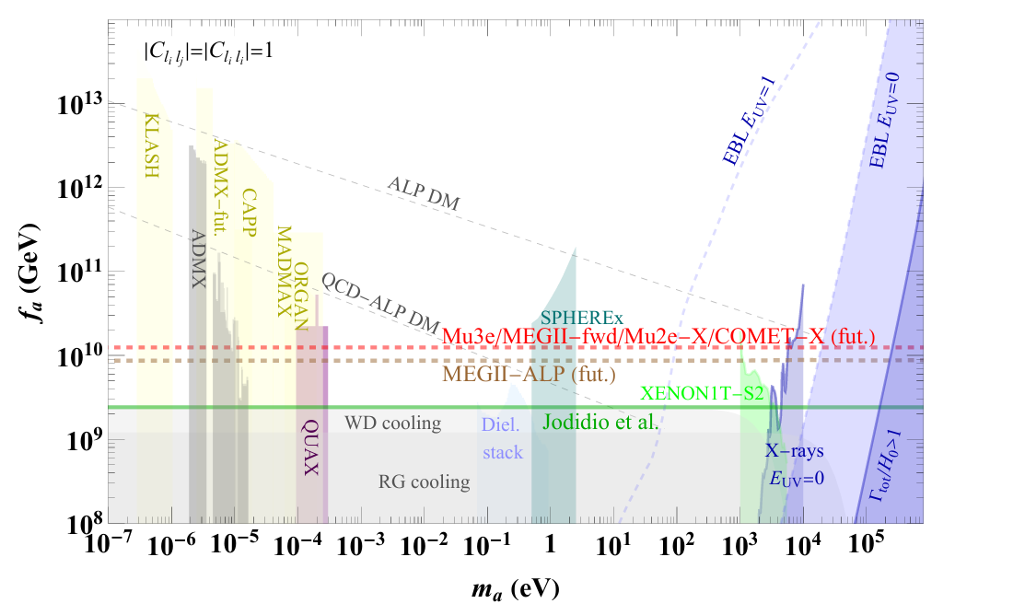
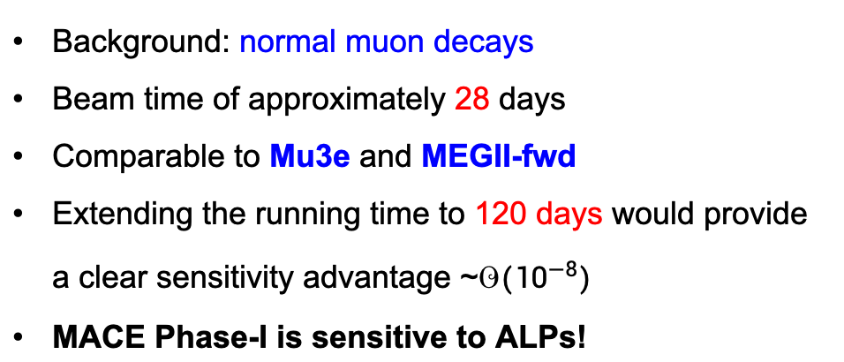
MACE Phase-I sensitivity to $μ^{+}→e^{+}a$
Background: normal muon decays
Beam time of approximately 28 days
Comparable to Mu3e and MEGII-fwd
Extending the running time to 120 days would provide a clear sensitivity advantage ~$𝒪({10}^{−8})$
MACE Phase-I is sensitive to ALPs!
Preliminary
MACE Phase-I?
PRD 109, 035025 (2024)

Slide 12
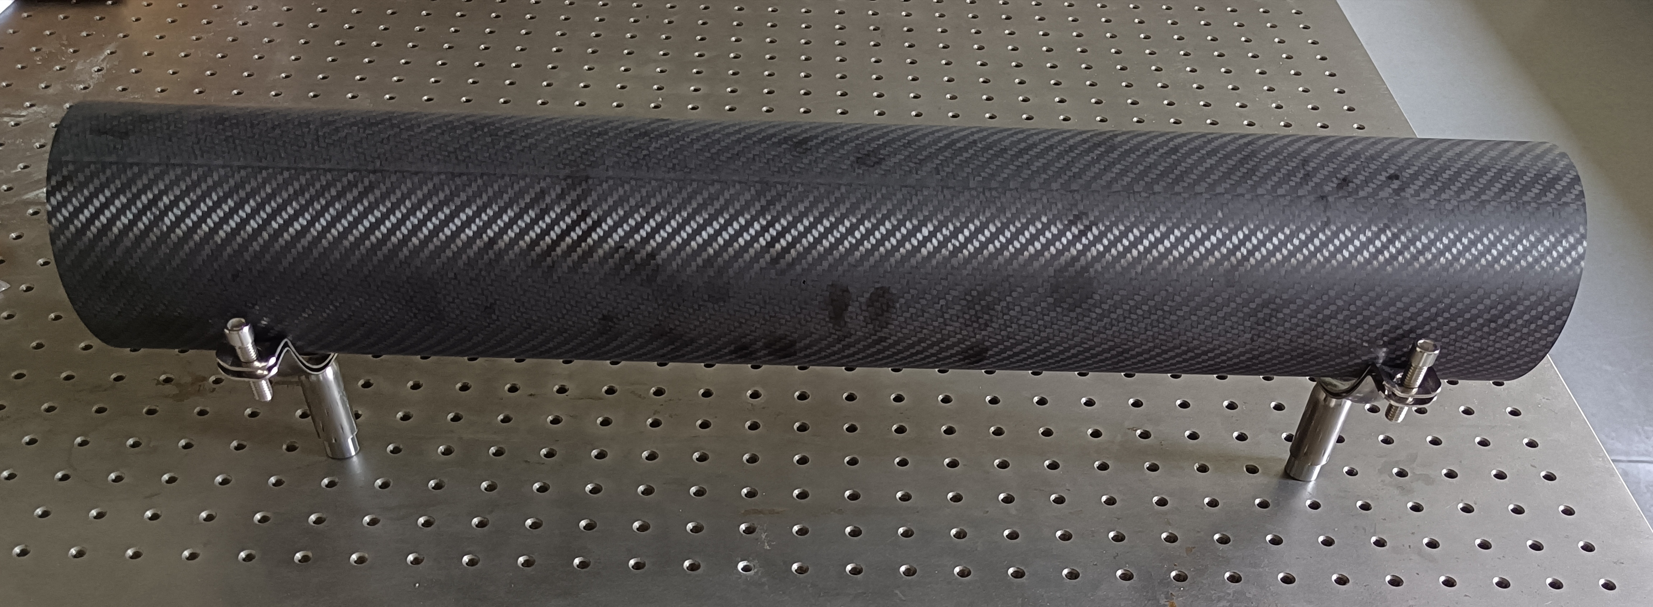
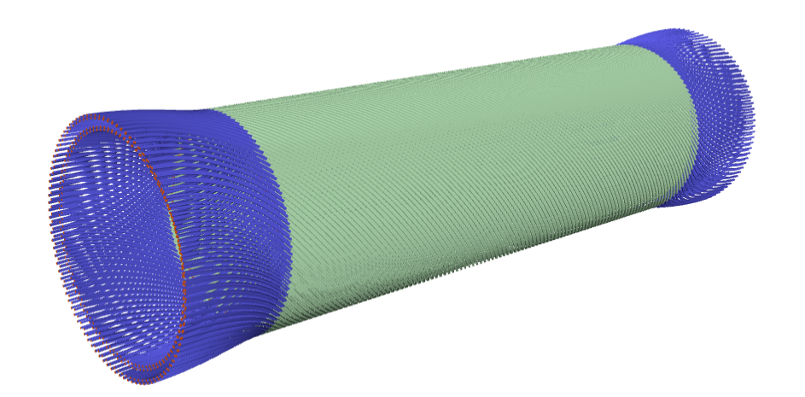
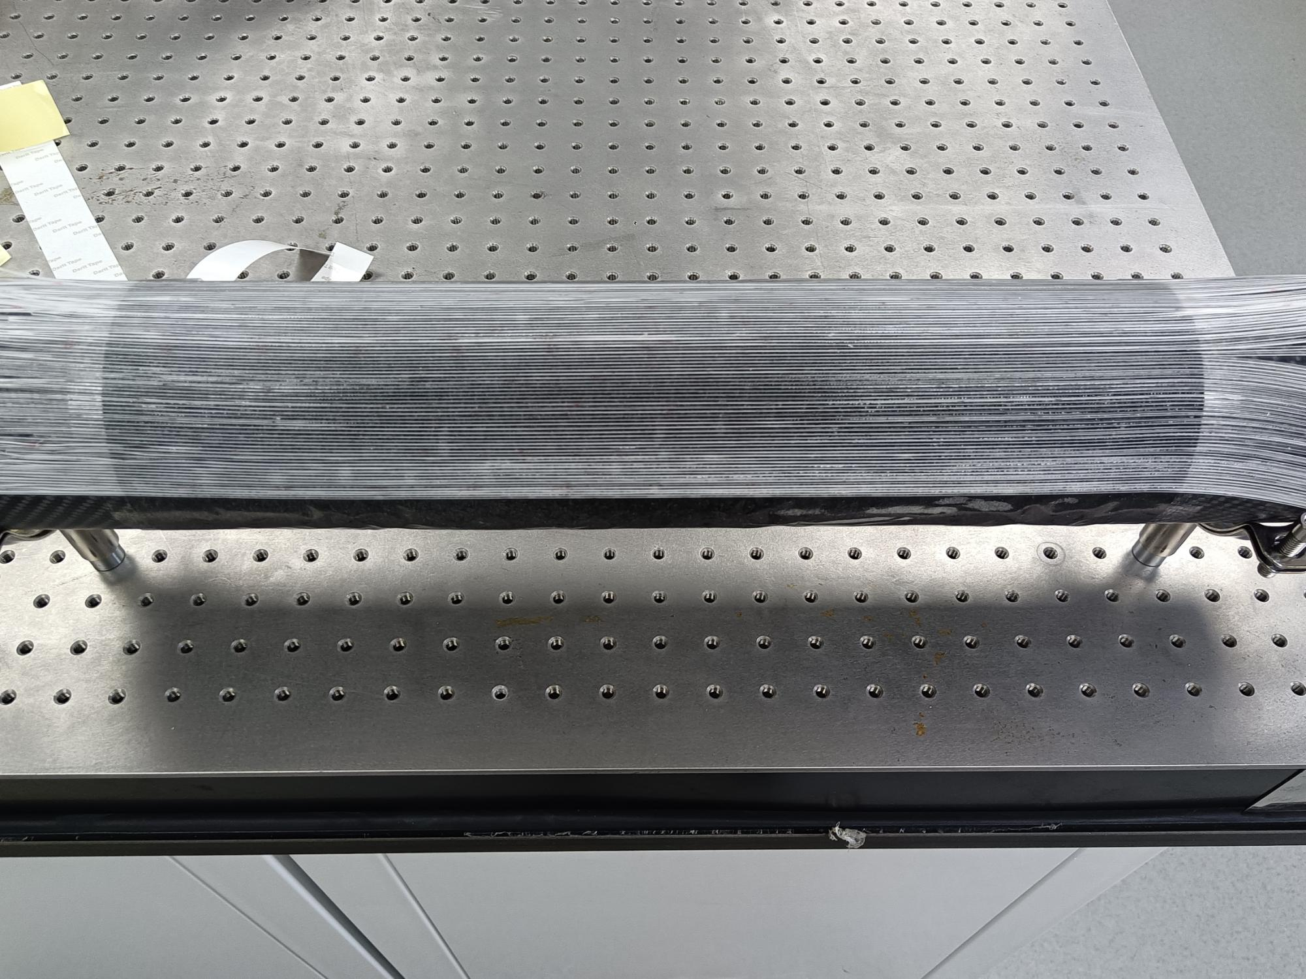
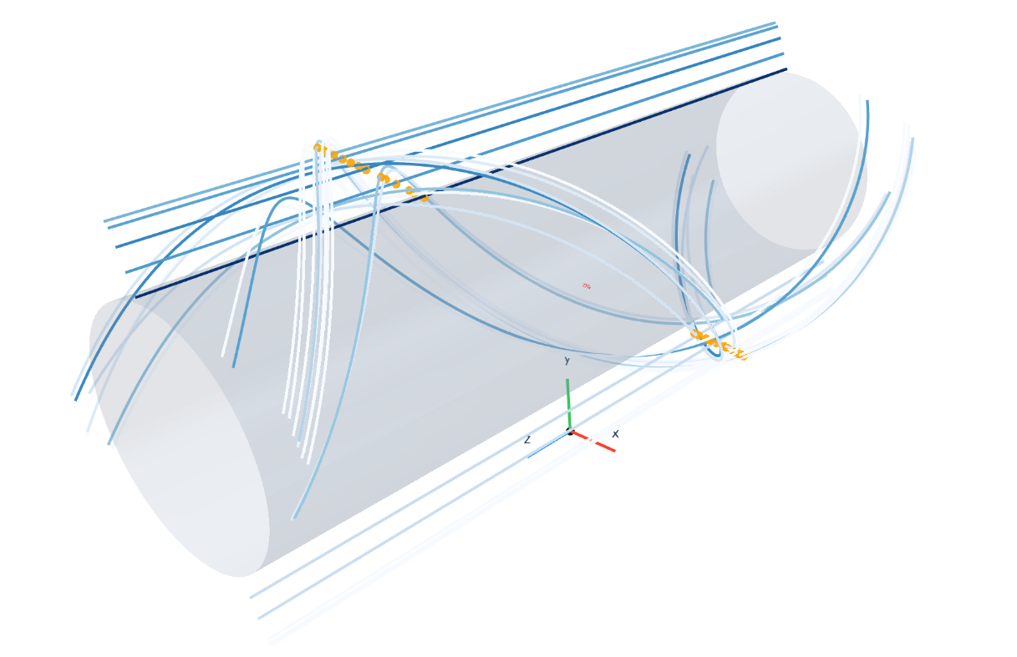
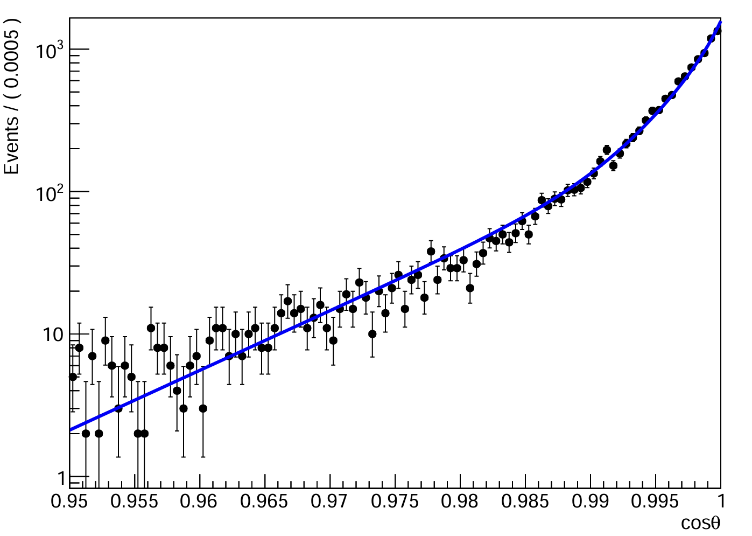
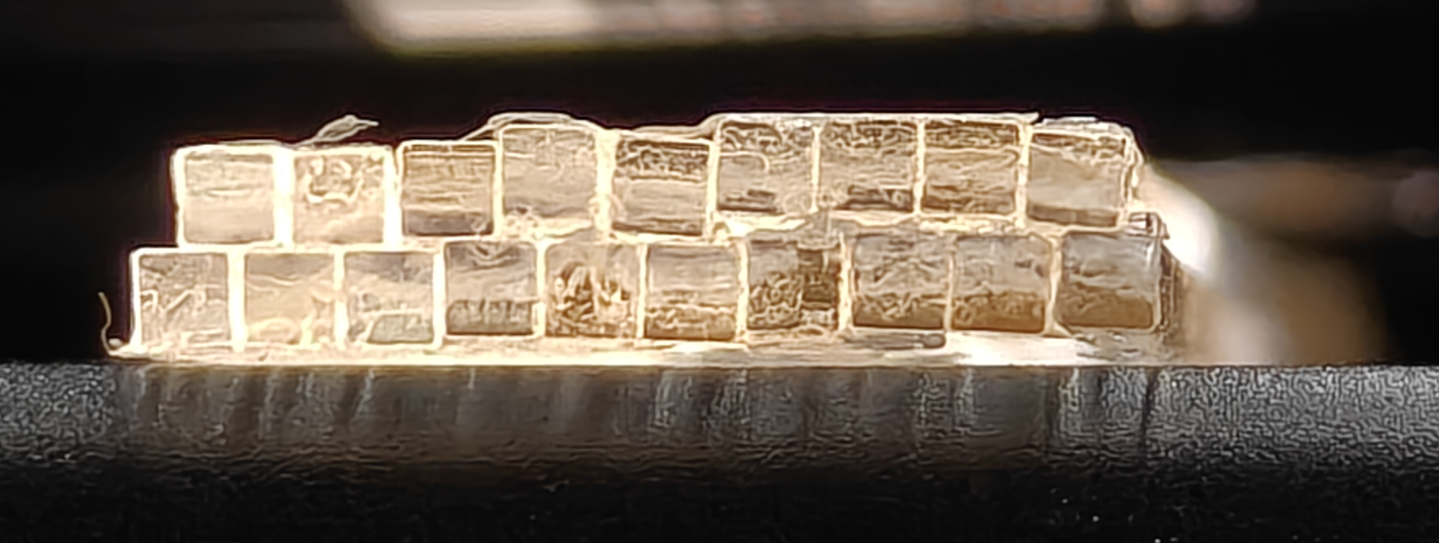

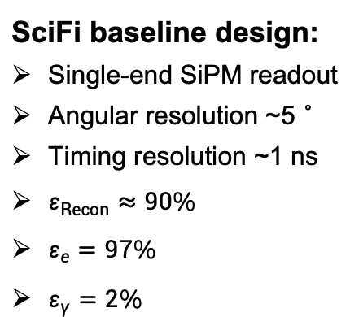
SciFi tracker in MACE phase-I
SciFi baseline design:
Single-end SiPM readout
Angular resolution ~5°
Timing resolution ~1 ns
$ε_{Recon}≈90\%$
$ε_{e}=97\%$
$ε_{γ}=2\%$
Credit: Yinyuan Huang
Design schematic
Inner CFRP tube
Simulated angular resolution (RMS): 4.5$°$
Preliminary
Prototype assembly in progress.
Simulated
event display
Notes:
The SciFi tracker will detect positron tracks while ttc provide precise timing information to ECAL.
Must have low ensure ECAL resolution
another mission
Stop more e than
Independent crossing fiber crosstalk

Slide 13
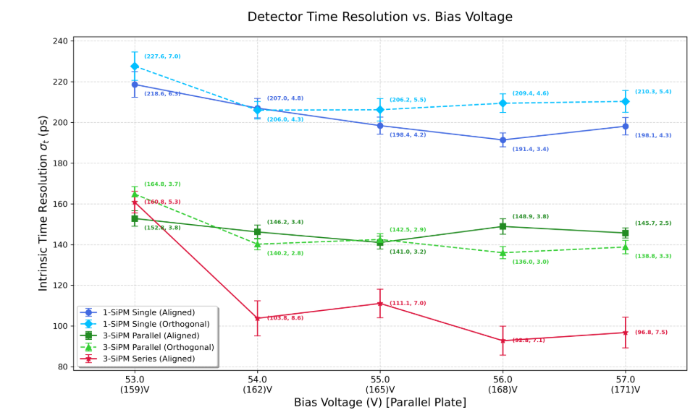
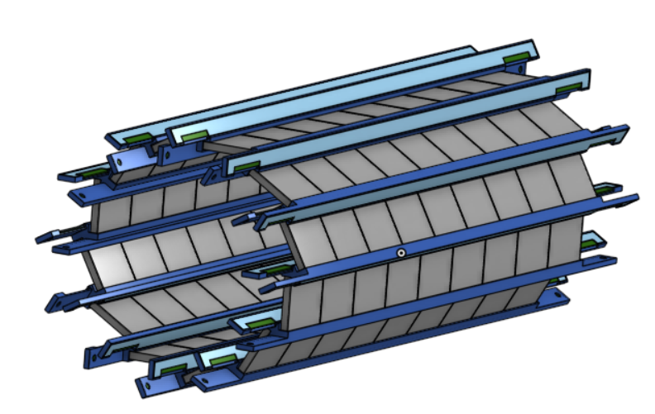
Tiled timing counter (TTC) for MACE Phase-I
A single tile:
Credit: Changlin Chen & Hao Jiang
Tiled timing counter (TTC):
Thin plastic scintillator
Double-end SiPM readout
3 SiPM in series per end
50 mm
Single SiPM, 3 SiPM serial / parallel readout tested.
Timing performance: 3-serial > 3-parallels > single.
100 ps time resolution achieved.
52 mm
SiPM
Plastic
scintillator
Preliminary
Support & PCB

Slide 14
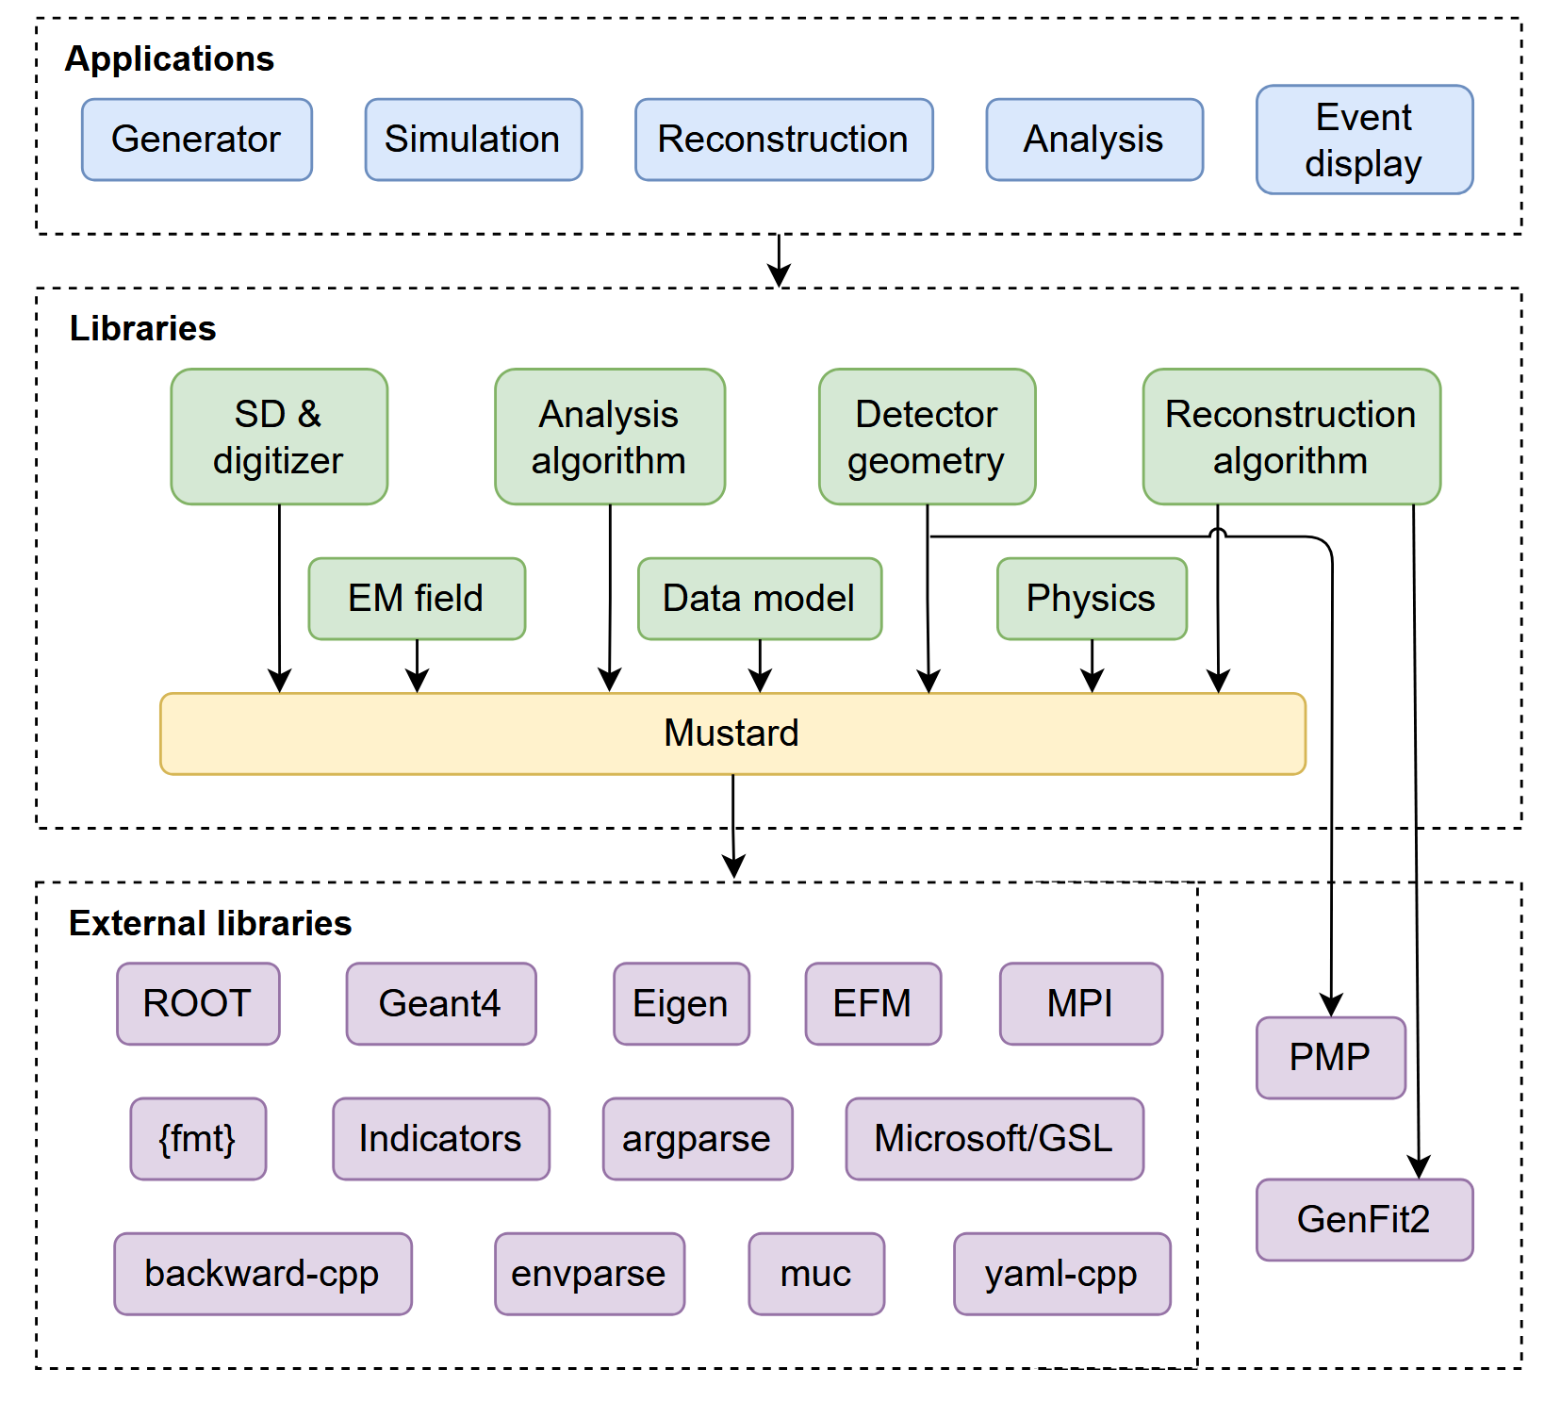
MACE offline software and Mustard framework
https://github.com/zhao-shihan/MACESW
More in backup slides.
MACE offline software
Event generation, detector simulation, offline reconstruction and data analysis framework.
Based on Mustard framework and HEP toolkits.
Mustard framework
A modern, high-performance offline software framework for non-collider experiment.
Natively support large scale distributed computing.
Framework for data model definition, event generation, detector geometry management, application interface and other utilities.
Applications: MACESW, MusAirS (an air shower simulation tool), CRMuSR offline software, muon tomography simulation and analysis software.
https://github.com/zhao-shihan/Mustard

Slide 15
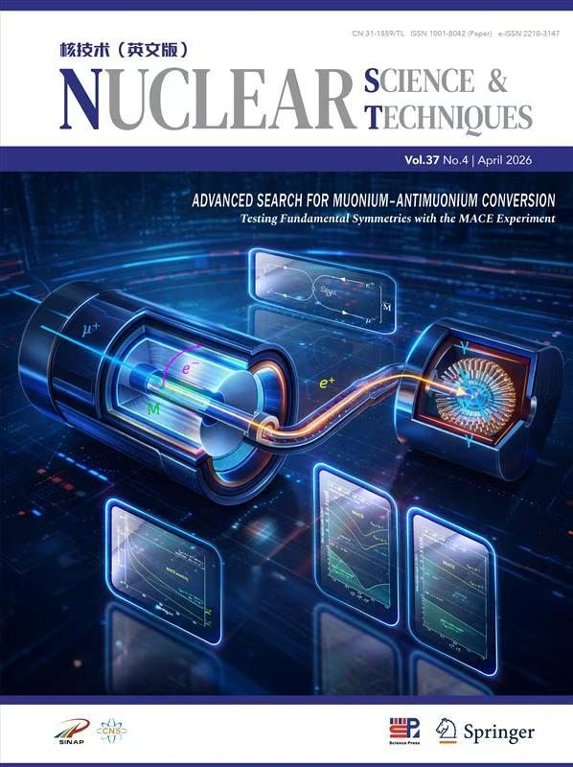
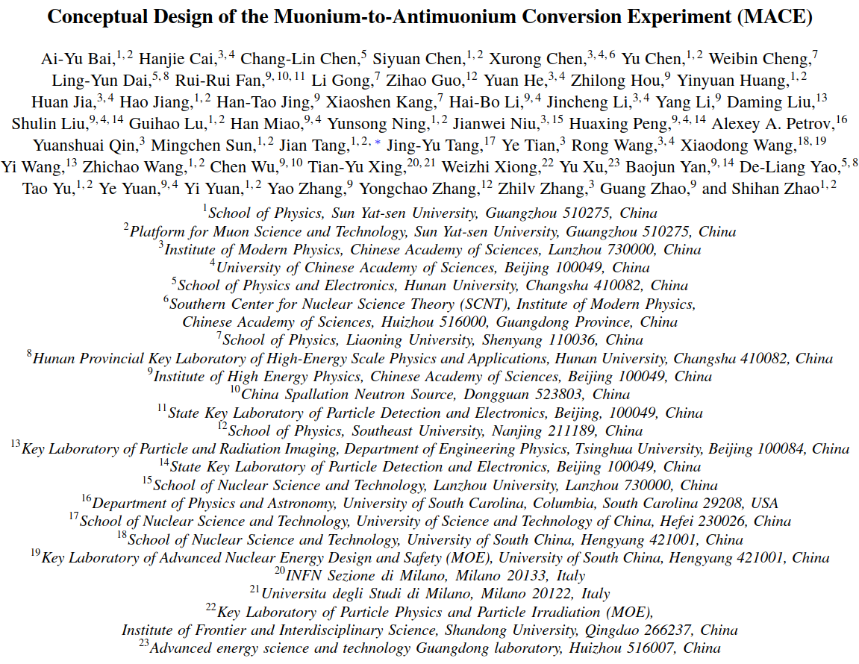


Summary
Rich new physics in muonium-to-antimuonium conversion!
Next-generation muon cLFV experiment — MACE aims at two orders of magnitude improvement in $M$-to-$\overline{M}$ conversion probability. MACE Phase-I: Forerunner of MACE. A search for batches of muon(ium) cLFV decay, also aiming at broader physics programs.
$𝒪\left({10}^{−13}\right)$ sensitivities are expected.
Welcome to joining the high-intensity muon physics experiment MACE!
Contact person:
Prof. Jian Tang (tangjian5@mail.sysu.edu.cn)
Thank you!

Slide 17
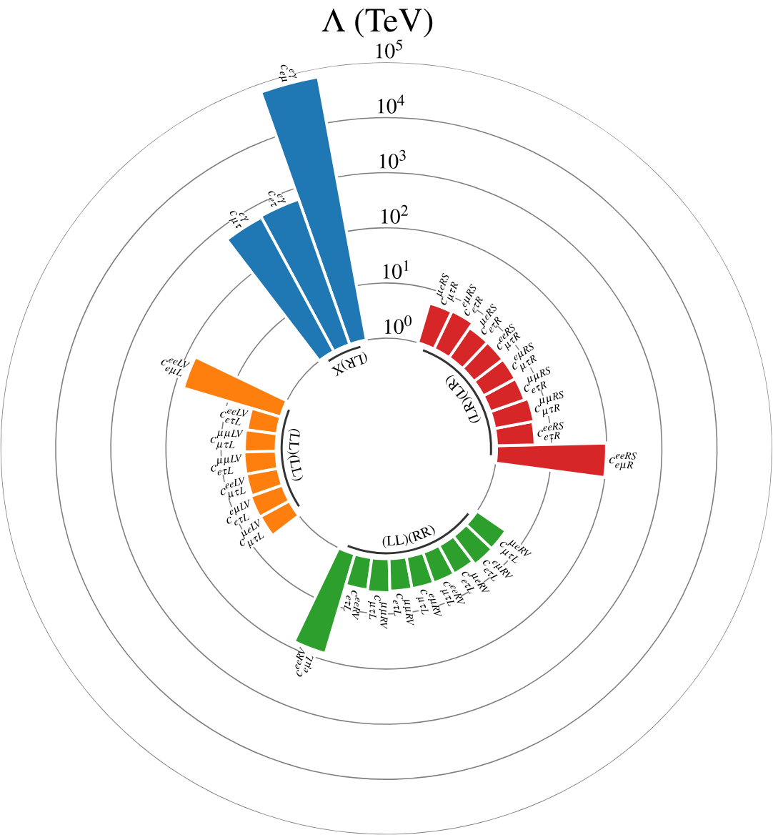
High-intensity frontier and cLFV
How to search for new physics beyond SM?
High-intensity frontier:
  Provide indirect constrains with precision measurement or search for forbidden processes.
Advantages of cLFV with muon:
  Clear signals. cLFV is forbidden in SM, no irreducible SM backgrounds.
  High statistics. High-intensity muon beam → large samples within a short period.
  Well motivated. Scalable cLFV in new physics models including SUSY, seesaw, ALP, U(1)_{B-L} .
Enrique Fernández-Martínez et al, Global lepton flavour violating constraints on new physics. Eur. Phys. J. C 84 (2024) 666
Significant cLFV signals → clear evidence for new physics;
Negative result → strong limit on new physics models.

Slide 18





Muonium science and application
缪子素
由正缪子（$μ^{+}）$和电子（$e^{−}）$组成的原子，基本性质类似氢原子，但质量较轻且会自发衰变。
缪子素在前沿科学研究中有重要价值
缪子素是精确检验基础物理定律的重要体系
  精确测量缪子素能级 → 精确检验量子电动力学
  寻找正反缪子素转化过程 → 寻找超越标准模型的新物理
  测量缪子素重力 → 研究反物质重力及检验广义相对论
缪子素是交叉学科前沿的重要窗口
  缪子素自旋谱学 → 研究材料内禀磁学性质
  缪子素化学 → 研究化学反应机理
缪子素示意图
正反缪子素转化实验
Ai-Yu Bai et al (MACE working group). Conceptual Design of the Muonium-to-Antimuonium Conversion Experiment (MACE). arXiv: 2410.18817, 2024.
缪子素研究铁氢酶催化机理
Joseph A. Wright. Muonium Chemistry at Diiron Subsite Analogues of [FeFe]-Hydrogenase. Angewandte Chemie International Edition, 55, 47, 14471, 2016
缪子素 $1S$ 态的 Breit-Rabi 能级
Tanaka K S, Iwasaki M, Kamigaito O, et al. PTEP, 2021, 2021(5): 053C01.
缪子素是前沿科学研究的理想对象
缪子素重力测量实验
Anna Soter and Andreas Knecht, Development of a cold atomic muonium beam for next generation atomic physics and gravity experiments, SciPost Phys.Proc. 5, 031, 2021

Slide 19






Muonium-to-antimuonium conversion
$M−\overline{M}$ conversion is a coherent process,
The off-diagonal term induces the conversion,
The effective Hamiltonian can be written by the combination of 5 dim-6 effective operators,
Time evolution of the state and conversion probability
Work out the time evolution: $Γ_{M→\overline{f}}\left(t\right)∝e^{−Γt}{\left(Γt\right)}^{2}$ ,
Normal muonium decay: $Γ_{M→f}\left(t\right)∝e^{−Γt}$ .
Define the conversion probability: $P_{M\overline{M}}\left(t\right)=\frac{Γ_{M→\overline{f}}\left(t\right)}{Γ_{M→f}\left(t\right)}∝t^{2}$
Insight: probability evolves quadratically over time → longer travel time of muonium in vacuum leads to higher probability → search for muonium conversion in vacuum (instead of in material).
Details in e.g. R. Conlin, A. A. Petrov, Phys. Rev. D 102 (2020) 9, 095001

Slide 20

























Muonium-to-antimuonium conversion in EFT
Muonium conversion can specifically probe $μμee$ effective coupling (which cannot be directly constrained by $μ→eγ$, $μ→eee$ and $μ−e$ conversion).
The effective Hamiltonian can be written by the combination of 5 dim-6 effective operators,
$$μ^{−}$$
$$e^{−}$$
$$e^{−}$$
$$γ$$
$$μ^{+}$$
$$e^{+}$$
$$μ^{+}$$
$$e^{+}$$
$$q$$
$$q$$
$$e^{+}$$
$μ−e$ conv.
$μeqq$ contact
$${\left|M\right|}^{2}∝C_{μeqq}^{2}$$
$$μ→eee$$
$μeee$ contact
$${\left|M\right|}^{2}∝C_{μeee}^{2}$$
$$μ→eγ$$
$μeγ$ dipole
$${\left|M\right|}^{2}∝C_{μeγ}^{2}$$
$μμee$
contact
operators
$$e^{−}$$
$$e^{−}$$
$$e^{+}$$
$$μ^{−}$$
$$e^{−}$$
$$μ^{+}$$
$$M$$
$$\overline{M}$$
$M→\overline{M}$is the only low-energy process that can directly constrain $μμee$ effective coupling.
$$e^{+}$$
$$μ^{+}$$
$$μ^{−}$$
$μμee$ contact
$$q$$
$$q$$
$$e^{+}$$
$μeee$ contact
$μ−e$ conv.
$μeγ$ dipole
$${\left|M\right|}^{2}∝αC_{μeγ}^{2}$$
$$μ→eee$$
$μeγ$ dipole
$${\left|M\right|}^{2}∝αC_{μeγ}^{2}$$
$$M→\overline{M}$$
$μμee$ contact
$${\left|M\right|}^{2}∝C_{μμee}^{2}$$
$μeγ$ dipole
$μeqq$ contact

Slide 21



Muonium-to-antimuonium conversion in EFT
Muonium conversion can specifically probe $μμee$ effective coupling (which cannot be directly constrained by $μ→eγ$, $μ→eee$ and $μ−e$ conversion).
The effective Hamiltonian can be written by the combination of 5 dim-6 effective operators,
$μμee$
contact
operators
MACE can probe TeV-scale new physics and provide unique constrain.
See also R. Conlin, A. A. Petrov, Phys. Rev. D 102 (2020) 9, 095001

Slide 22




MACE physics motivation
Rich physics in muonium conversion.
  Stringent bound on maximally LFV ALP, doubly charged Higgs, bilepton, and more.
Muonium conversion is unique.
  Provide direct constrain to a set of unique EFT operators;
  The only low-energy observable in certain flavor structure.
MACE is well-motivated and can complement other low-energy experiments and future colliders.
C.C. Han et al, PRD 103, 055023 (2021)
MACE could probe doubly-charged Higgs beyond the reach of LHC
g_{ee}=0
L. Calibbi et al, PRD 110, 115009 (2024)
g_{ee}=10⁻¹⁰
A. A. Petrov, arXiv2604.07481
MACE could constrain LFV ALP parameter space comparable to future eμ collider

Slide 23



MACE physics motivation
Rich physics in muonium conversion.
  Stringent bound on maximally LFV ALP, doubly charged Higgs, bilepton, and more.
Muonium conversion is unique.
  Provide direct constrain to a set of unique EFT operators;
  The only low-energy observable in certain flavor structure.
MACE is well-motivated and can complement other low-energy experiments and future colliders.
$M→\overline{M}$is even the only low-energy observable in certain flavor structure
(L. Calibbi et al, PRD 112, 075031 (2025))
MACE can probe bileptons
comparable to future colliders
(T. Li and M. Schmidt, PRD 100, 115007 (2019))

Slide 24

Muon beam
From Hanjie Cai
(MIP2026)

Slide 25

Muon beam
From Hanjie Cai
(MIP2026)

Slide 26







Muonium production target
Intensity of in-vacuum muonium source: $I_{M}^{vac}=I_{beam}Y_{μ→M}$
$Y_{μ→M}$ can be improved by utilizing porous materials, ideally perforated silica aerogel.
A simulation method is developed to accurately simulate muonium production and diffusion.
The simulation is validated by muonium yield data measured in TRIUMF.
Optimize $Y_{μ→M}$ in perforated bulk target by scanning parameters, it can achieve
  Max $Y_{μ→M}={N_{M}^{vac}}/{N_{μ}^{total}}=1.134\%$, with 2mm hole depth, $p_{beam}=28 MeV/c$ and $\frac{σ_{p_{beam}}}{p_{beam}}=2.5\%$.
J. Beare et al., PTEP. 2020, 123C01 (2020)
2 times larger than the yield in 1999
$${N_{M}^{vac}}/{N_{μ}^{beam}}$$
$${N_{M}^{vac}}/{N_{μ}^{beam}}$$
$${N_{M}^{vac}}/{N_{M}^{total}}$$
$${N_{M}^{vac}}/{N_{M}^{total}}$$
Zhao, Shihan, and Jian Tang. "Optimization of muonium yield in perforated silica aerogel." Physical Review D 109.7 (2024): 072012.

Slide 27







Tiled timing counter (TTC)
Tilt design, signal track hits 2-3 scintillator tiles.
Azimuth spacing $φ=2.951°$, tilt angle $α=46°$.
Full simulation result:
  Geometry efficiency: $ε_{geom}=83.7\%$
  Detection efficiency (amp. > 3 p.e.): $ε_{thr}=99.6\%$
Contributed by Hao Jiang, SYSU
Test with cosmic-ray muons:
Fitted time resolution:
  Double-tile: $σ_{t}=(513±17) ps$
  Single-tile: $σ_{t}=(362±12) ps$
Credit: Hao Jiang

Slide 28


Positron transport system
The component of positron transport system (PTS)
  I. Electrostatic accelerator
  II. Solenoid system
  1. MMS solenoid
  2. TS solenoid
  3. ECAL solenoid
PTS performance
I. Transmission efficiency: 65.8%.
II. Flight time: 322 ns.
III. Flight time FWHM: 6.9 ns.
IV. Spatial resolution: 0.088 mm $×$ 0.102 mm
Suppress the IC decay bkg. by a level of ${10}^{−7}$
Lu, Guihao, et al. "Positron Transport System for Muonium-to-Antimuonium Conversion Experiment." arXiv preprint arXiv:2508.07922 (2025).

Slide 29





PTS prototyping progress
PTS validation
  Testing with TS solenoids and accelerator module
Credit: Guihao Lu
Detector Chamber
Ionization Vacuum Gauge
Venting Valve
Validation
prototype
Particle Source
Roughing Valve
Accelerator module prototype
  Multi-layer PCB
  High voltage > 2 kV
Thermocouple Vacuum Gauge
High Vacuum Gate Valve
Dry Mechanical Pump
Foreline Valve
Molecular Pump

Slide 30




Electromagnetic Calorimeter
Design scheme：
High acceptance and granularity
Symmetrical structure
Class-I GP(8,0) Goldberg polyhedron
Crystal scintillators coupled with SiPM arrays
PEN detector
pCsI + PMT
MACE ECAL
pCsI + SiPM
LYSO
30000 ph/MeV
40 ns
Radiation hard
Not hygroscopic
Emits at 420 nm
CNY ￥300/cm³
BGO
8000 ph/MeV
300 ns
Not hygroscopic
Emits at 480 nm
CNY ￥100/cm³
Pure CsI
3500 ph/MeV
40 ns
Slight hygroscopic
Emits at 310 nm
Adopted by Mu2e and PIBETA
CNY ￥30/cm³
Baseline design
NUV SiPM readout
Sensors 19 (2019) 2, 308
Notes:
The key component of phase-I detector is the ECAL
Adopt inspired
Store dreaming supreme
High event rate
Cesium iodide
PDE

Slide 31






Phase-I ECAL performance
Second Neighbor
Baseline requirement based on full simulation:
  Full optical physics: scintillation, transportation, collection
  Coincidence timing resolution better than 200 ps
  Energy resolution better than 5% @ 53 MeV
  Angular resolution better than 5°
Energy-weighted
clustering
Seed
First Neighbor
Credit: Siyuan Chen
γ beam
$$\frac{σ}{E}=\sqrt{{\left(\frac{a}{\sqrt{E}}\right)}^{2}+{\left(\frac{b}{E}\right)}^{2}+c^{2}}$$
Calibrated ADC spectrum
fitted by Crystal Ball function
$𝒪\left(50\right)$ p.e. electronic noise considered
Energy resolution
1.5% nonlinear correction considered
Angular resolution
Events isotopically emitted from the target
Notes:
Based on the full simulation by geant4, the performance of ECAL is studied.
Reconstruction
Baseline in reality

Slide 32


并行计算架构研发进展
分布式并行计算框架
Mustard 原生支持基于 MPI 的分布式并行计算，基于 Mustard 开发的软件可在超级计算机（HPC）或高通量计算机（HTC）上开展大规模并行计算。
基于统一的执行器架构实现并行事例生成、模拟和数据处理。
框架可感知运行情况和环境，自动优化并行效率。
设计为最大化计算与通信的重叠，可获得最优并行效率。
先前在“天河二号”超算上开展了千核规模加速比测试，实现了线性加速比，可满足目前需求，且远未触及性能边界。
后续可在新一代超算上开展万核规模的测试。

Slide 33

数据 I/O 与管理框架研发进展
数据模型框架
已在 Mustard 中实现了统一的数据模型定义和管理框架。
除提供一部分预定义模型外，可根据实验需求定义所需的模拟。
数据模型采用展平结构以提高兼容性和改善 I/O 性能。该架构下产生的数据不依赖于字典，可在外部开展独立分析，有利于开放数据的使用。
数据 I/O 框架
Mustard 原生支持为 HL-LHC 升级而开发的 RNTuple（接替 TTree 作为新一代数据格式）。数据大小减小~30%，读取速度提升~50%。
Mustard 基于一套统一的 Reader / Writer 架构开展数据 I/O，后端数据格式可无缝切换，保障兼容性。

Slide 34

事例生成框架研发进展
事例生成框架
Mustard 提供一套易用的事例生成框架，用于计算相空间积分和生成树图阶事例。
针对新物理实验对高效抽样稀有事例的需求，设计为可自由施加重要性抽样分布并可快速采样稀有事例，可高效生成非加权事例。
为满足该设计，底层使用马尔科夫链蒙特卡洛（MCMC）实现，基于迭代式相空间生成器和多次尝试 Metropolis 算法采样。
实现了全同粒子对称化提议分布，解决了 MCMC 导致末态全同粒子分布不一致的问题。
为克服 MCMC 固有的样本自相关问题，实现了对样本自相关时间的计算以及一套自适应去关联算法，从而获取近独立样本。
框架中已提供几种缪子衰变过程。接口定义友好，只要计算出矩阵元即可新增新的过程。

Slide 35

Continuous Integration
Challenges in Parallel Development
  Merge conflicts
  Tedious code review
  Hidden risks
Practice of Continuous Integration
  Frequently integrate code into main.
  Automated builds and tests.
CI/CD
  Configure pipeline via config file.
  Runners execute automated test scripts.
  Regression tests.
Credit: Zhichao Wang

Slide 36
MACE Phase-I sensitivity to $M→γγ$
Signal: Double collinear 53 MeV gamma-rays.
$$γ$$
Non-response in tracker
Double tracks reconstructed by ECAL
$$μ^{+}$$
M
$$γ$$
Background: Accidental coincidence of “pileup” positrons.
$$e^{+}$$
Asimov dataset (signal & bkg)
Profile likelihood ratio test
5% systematics error included
$$μ^{+}$$
$$μ^{+}$$
M
$$e^{+}$$
Upper limit of BR: $5.2×{10}^{−13}$ (90% C.L.)
$𝒪({10}^{−5})$ in 1959
PRL, 1959, 3: 288-291

Slide 37
MACE Phase-I sensitivity to $μ^{+}→e^{+}γγ$
Event selection criteria:
Time coincidence
Single track in Tracker, Triple tracks in ECAL
Energy-momentum conserved
Signal:
Triple coplanar tracks
$e^{+}$ and two $γ$s
Background:
Double radiative muon decay
SciPost Phys. 9, 027 (2020)
$$s_{up}=\frac{1}{2}F_{χ^{2}}^{−1}\left[1−α, 2\left(n_{obs}+1\right)\right]−b$$
$$n_{obs}=b$$
$$γ$$
$$γ$$
$$e^{+}$$
$$μ^{+}$$
$$e^{+}$$
$$μ^{+}$$
$$ℬℛ\left(μ^{+}→eγγ\right)=\frac{s_{up}}{ε_{signal}Φ_{μ}T}$$
$$ν_{e}$$
$${\overline{ν}}_{μ}$$
$$γ$$
$$γ$$
Upper limit of BR: $3.5×{10}^{−13}$ (90% C.L.)
More solid simulations and refined data analyses to be updated!
$𝒪({10}^{−11})$ in 1988
PRD 38 (1988) 2077

Slide 38
MACE Phase-I sensitivity to $μ^{+}→e^{+}a$
Background: normal muon decays
Beam time of approximately 28 days
Comparable to Mu3e and MEGII-fwd
Extending the running time to 120 days would provide a clear sensitivity advantage ~$𝒪({10}^{−8})$
MACE Phase-I is sensitive to ALPs!
Preliminary
MACE Phase-I?
PRD 109, 035025 (2024)

