Slide 1

Research on the properties of baryons at LHCb
俞洁晟（湖南大学）
第八届粒子物理天问论坛
2026年8月28日
广西师范大学

Slide 2

Outline
Introduction
Doubly charmed baryons
CPV of $Λ_{b}^{0}$ decays
Baryonic decays of B meson

Slide 3
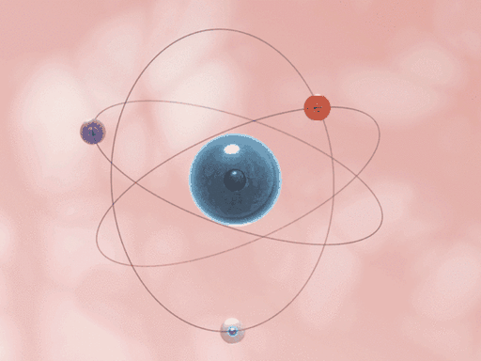
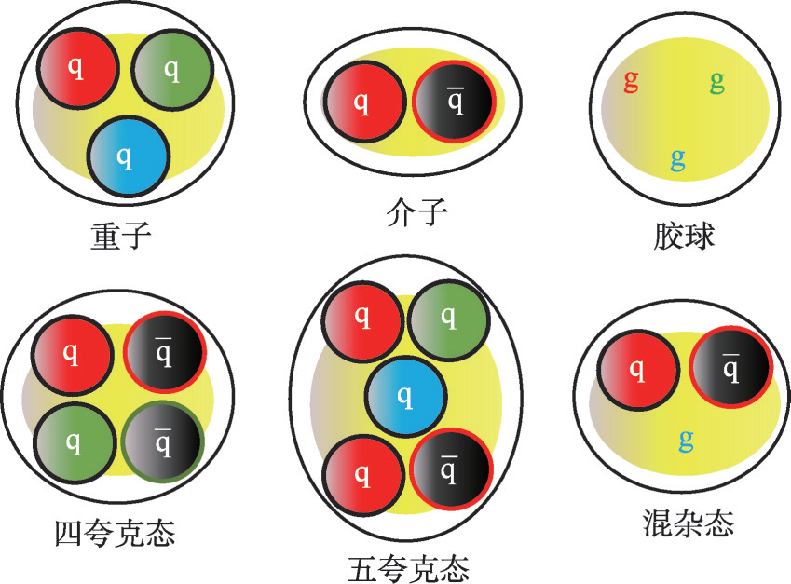
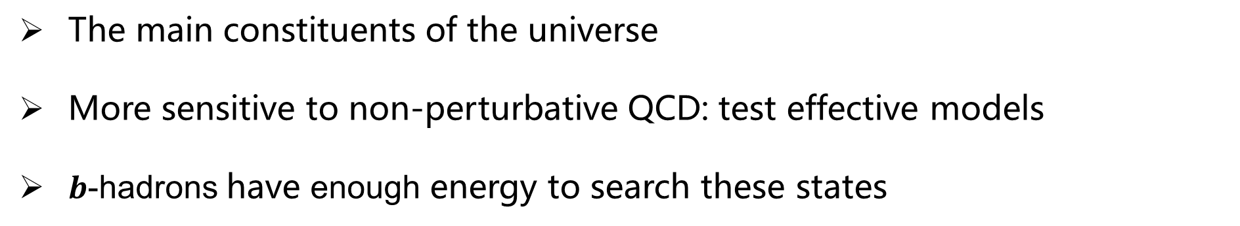
Why baryons?
  The main constituents of the universe
  More sensitive to non-perturbative QCD: test effective models
  $b$-hadrons have enough energy to search these states

Slide 4
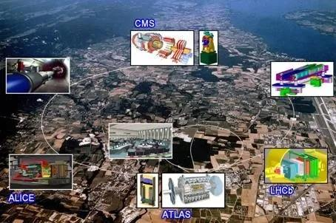
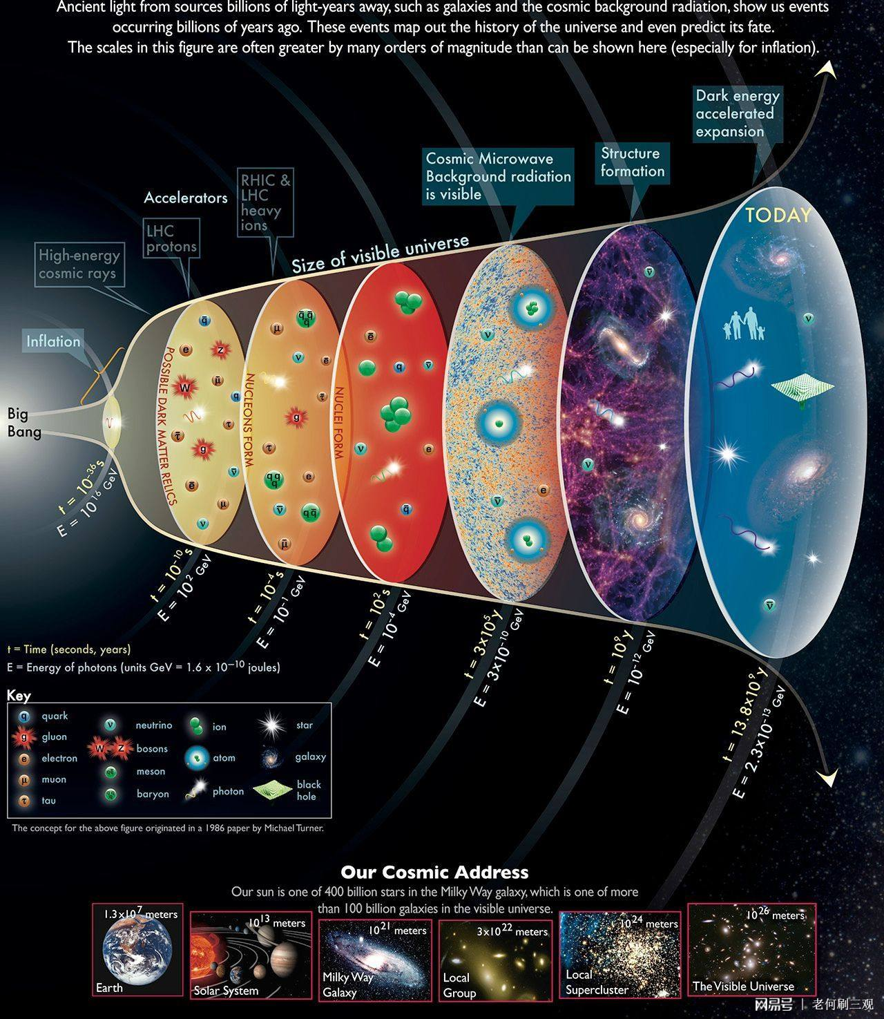
LHC is the forefront of high energy physics
LHC
Design energy 14 TeV. Four main experiments: ATLAS, CMS, LHCb, ALICE
The LHC recreates conditions of the universe at 10⁻¹⁰ seconds

Slide 5
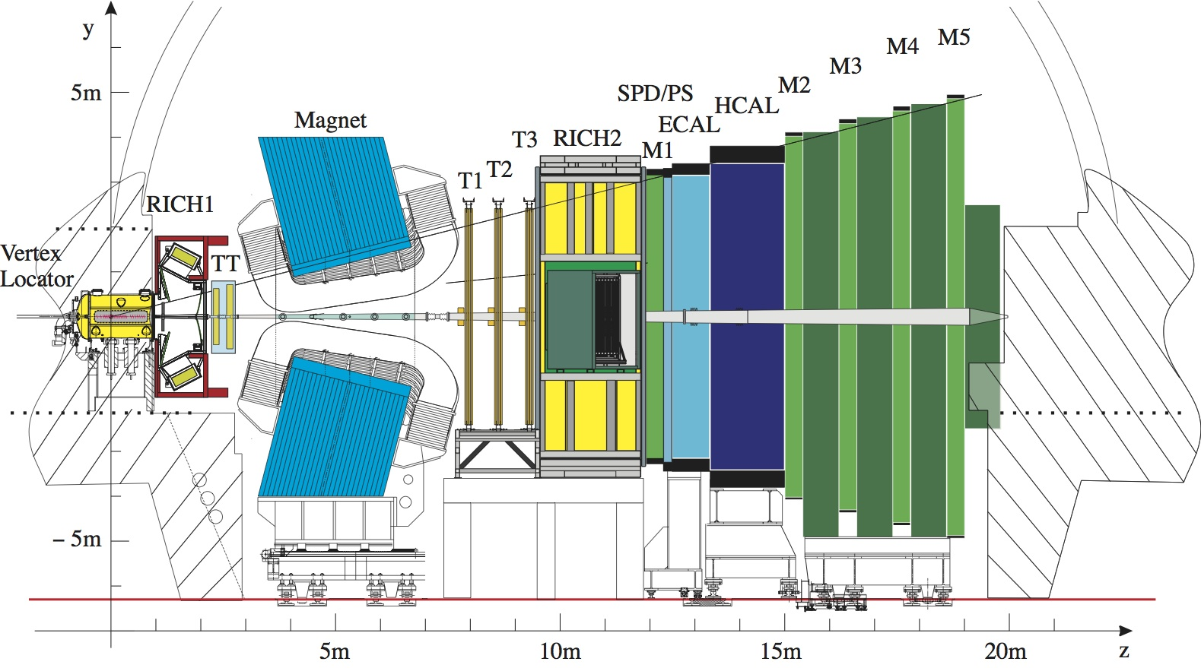
LHCb experiment
LHCb collaboration： 21 counties, 96 institutes, 1600 members
中国单位(12个)：
清华大学
华中师范大学
中国科学院大学
武汉大学
高能物理研究所
华南师范大学
北京大学
湖南大学
兰州大学
西北工业大学
河南师范大学
中国科学技术大学
Understand matter-antimatter imbalance (CP violation)
Search for new physics (Rare decays)
Explore and understand QCD (Hadron properties, exotic hadrons)

Slide 6
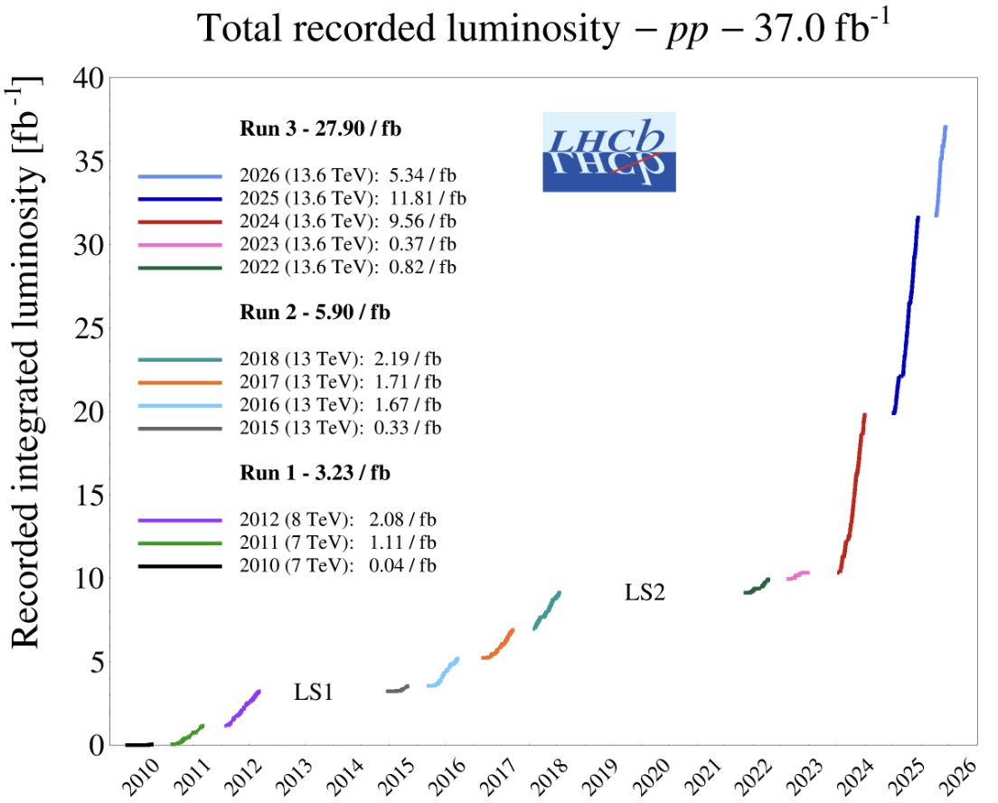
LHCb data
Run 1:
  2011 (7 TeV): 1 fb⁻¹
  2012 (8 TeV): 2 fb⁻¹
Run 2:
  2015-2018 (13 TeV): 6 fb⁻¹
Run 3:
  2024 alone (13.6 TeV): 9.56 fb⁻¹
  2025 (13.6 TeV): 11.81 fb⁻¹
  2026 (13.6 TeV): 5.34 fb⁻¹
A new LHCb detector for Run 3 operates at $×5$ higher instantaneous luminosity
Similar performance, while efficiency for hadron final states increased by a factor of 2

Slide 7
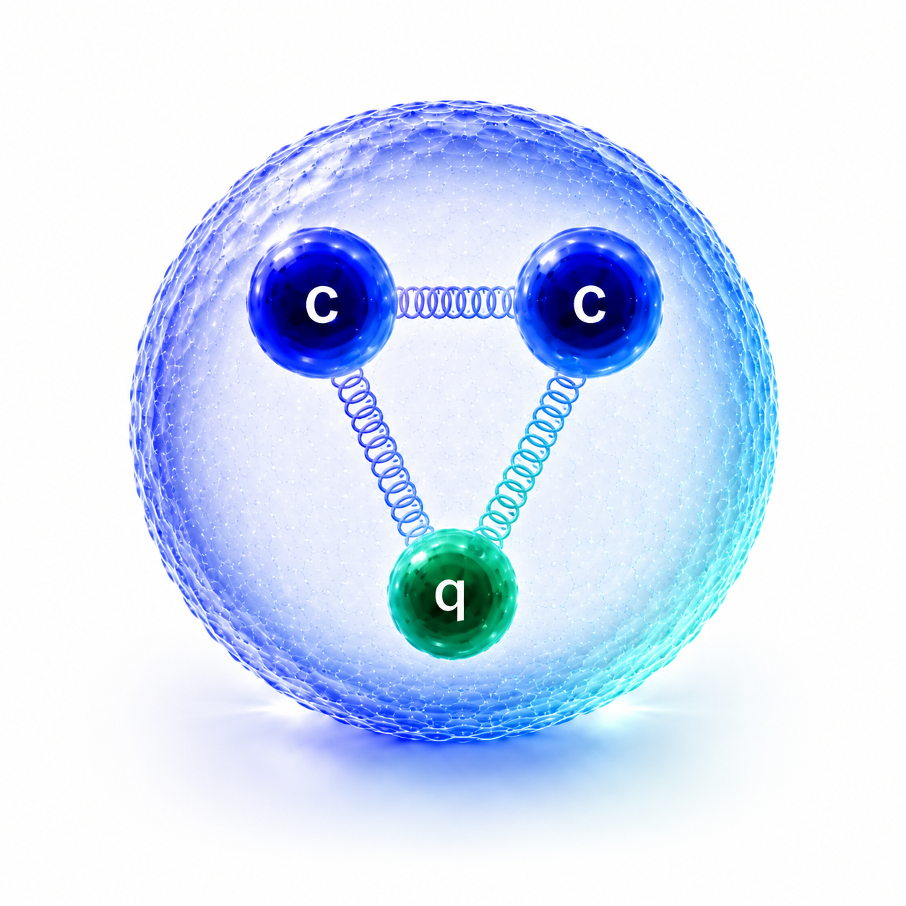
Doubly charmed baryons

Slide 8
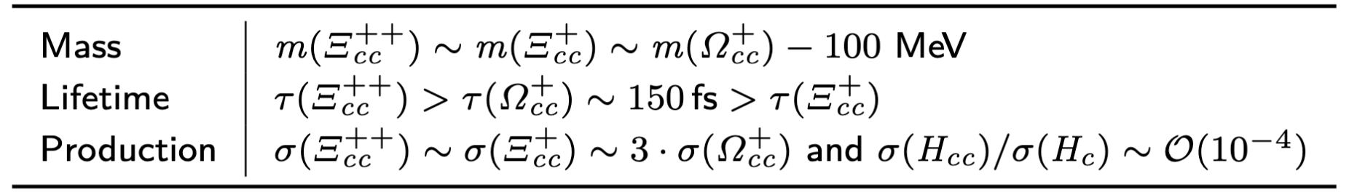
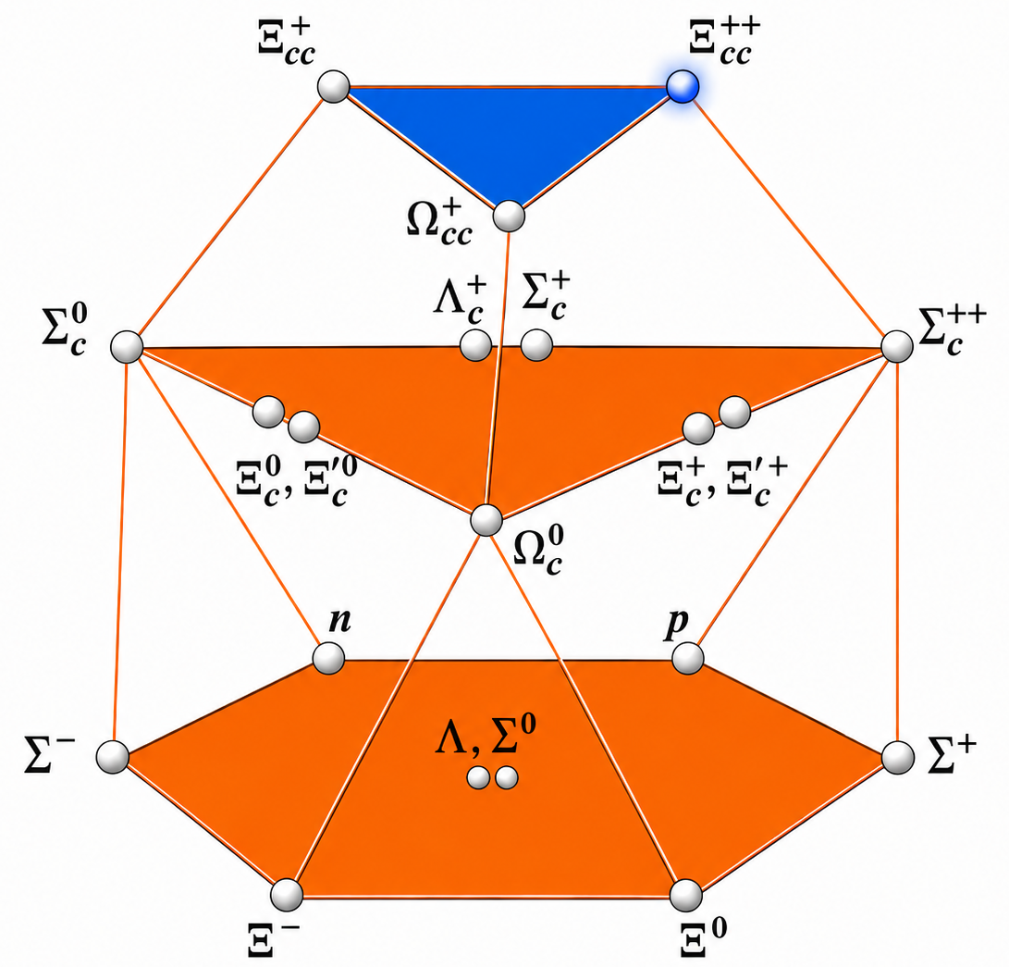
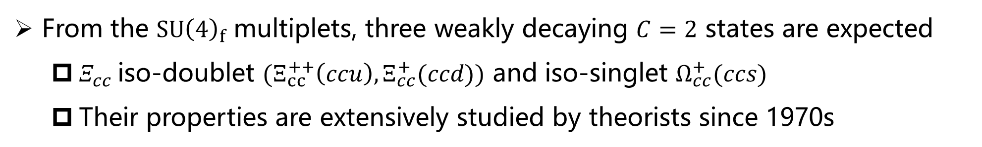
Theories of doubly charmed baryons
From the $SU{\left(4\right)}_{f}$ multiplets, three weakly decaying $C=2$ states are expected
  $Ξ_{cc}$iso-doublet $(Ξ_{cc}^{++}\left(ccu\right), Ξ_{cc}^{+}(ccd))$ and iso-singlet $Ω_{cc}^{+}(ccs)$
  Their properties are extensively studied by theorists since 1970s
[JHEP 07 (2023) 061]
[PRD 102 (2020) 054513]
[PRD 83 (2020) 034026]

Slide 9
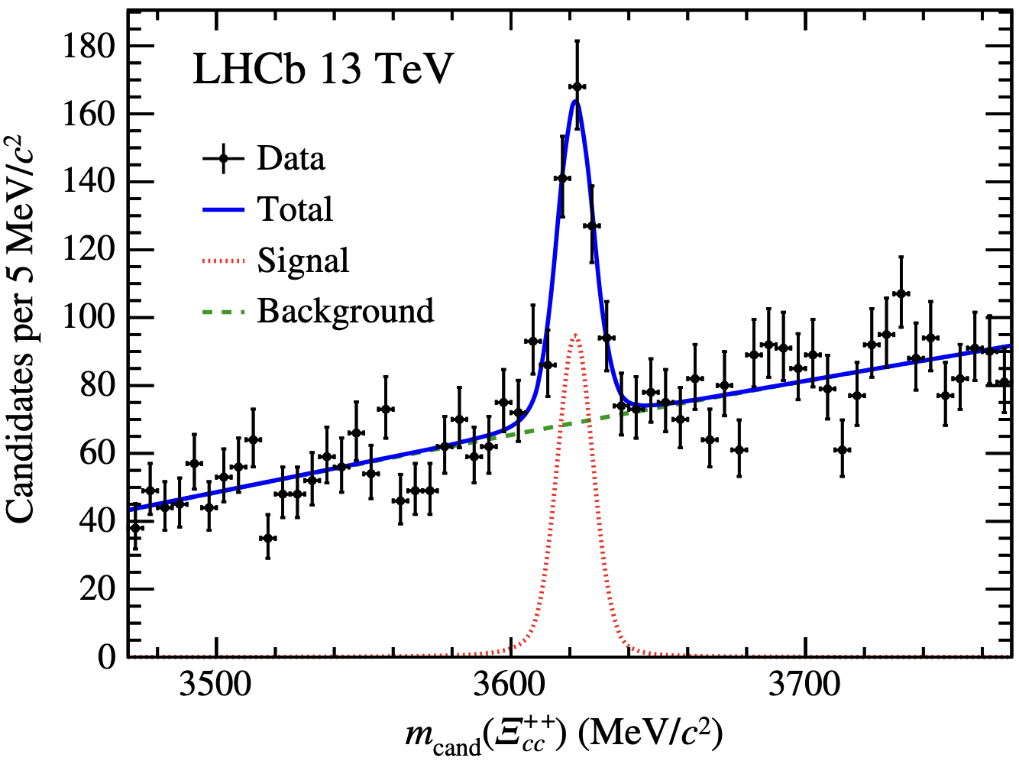
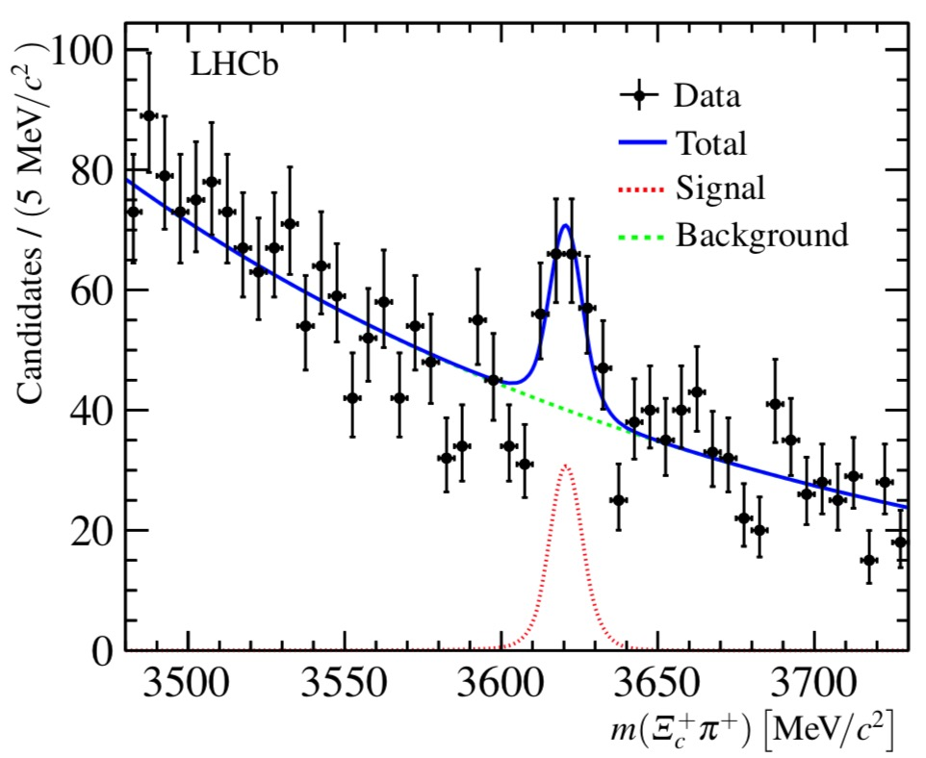
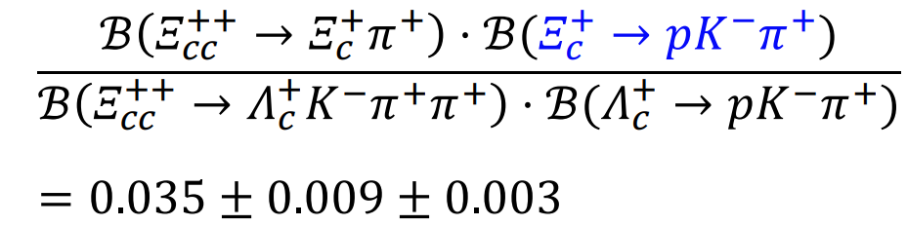
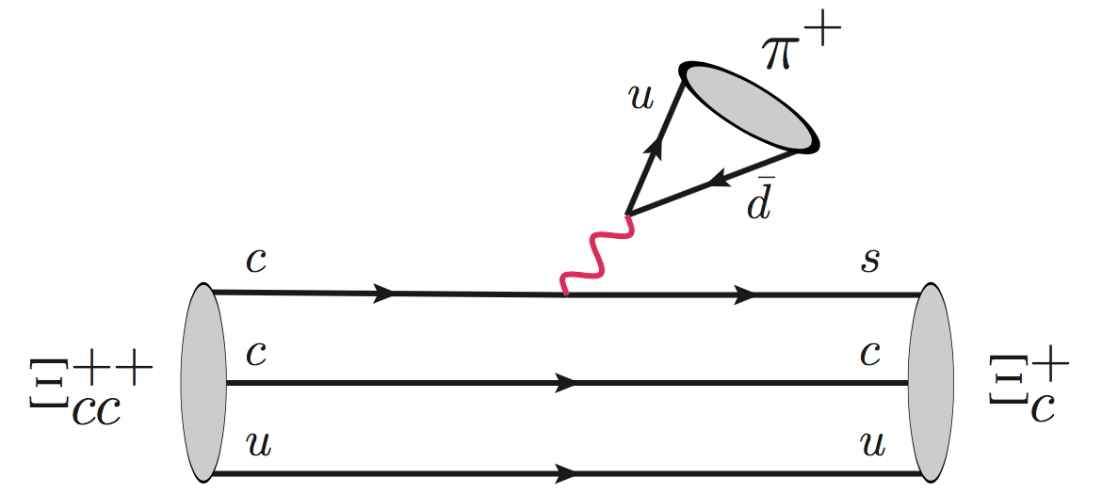
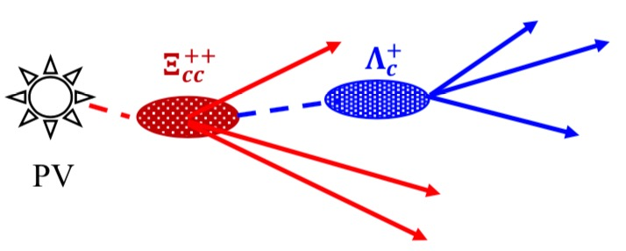
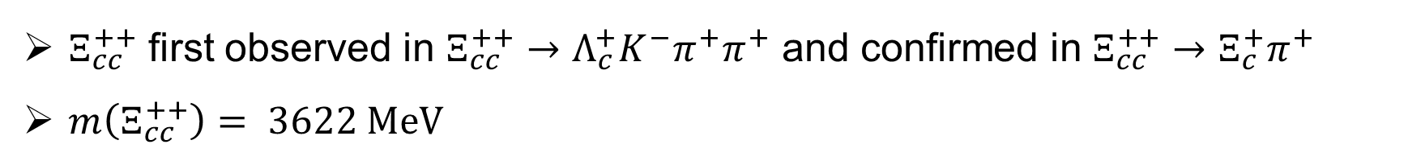


First observation of the $Ξ_{cc}^{++}$baryon
$Ξ_{cc}^{++}$ first observed in $Ξ_{cc}^{++}→Λ_{c}^{+}K^{−}π^{+}π^{+}$ and confirmed in $Ξ_{cc}^{++}→Ξ_{c}^{+}π^{+}$
$m\left(Ξ_{cc}^{++}\right)= 3622 MeV$
F.-S. Yu et al., CPC 42 (2018) 051001
313$±$33
$$91±20$$
PRL 119 (2017) 112001
PRL 121 (2018) 162002

Slide 10
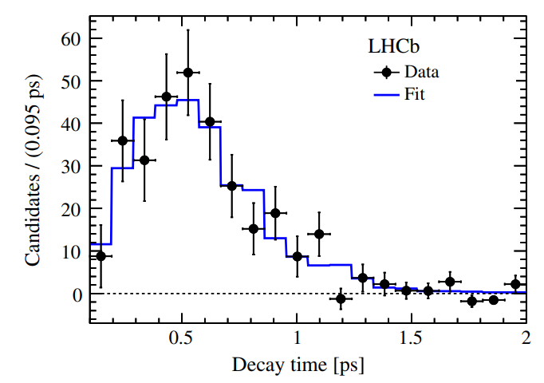
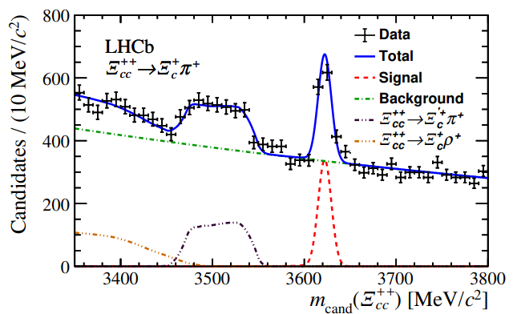
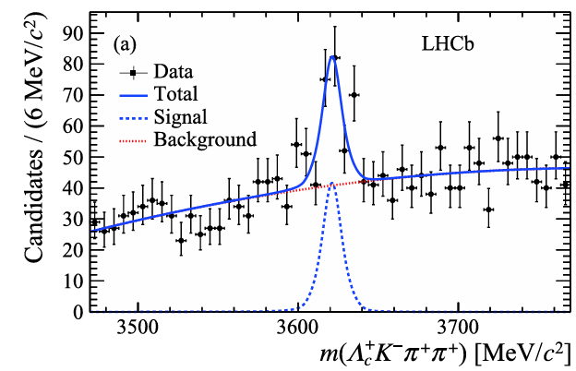
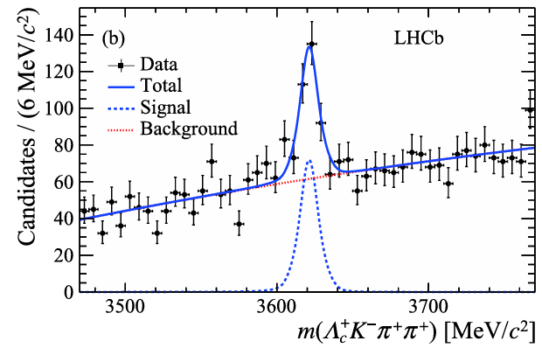
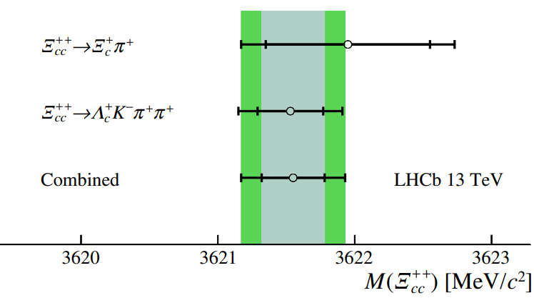
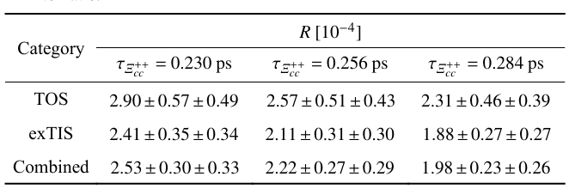
Lifetime, mass and production of $Ξ_{cc}^{++}$
PRL 121 (2018) 052002
JHEP 02 (2020) 049
CPC 44 (2020) 022001

Slide 11
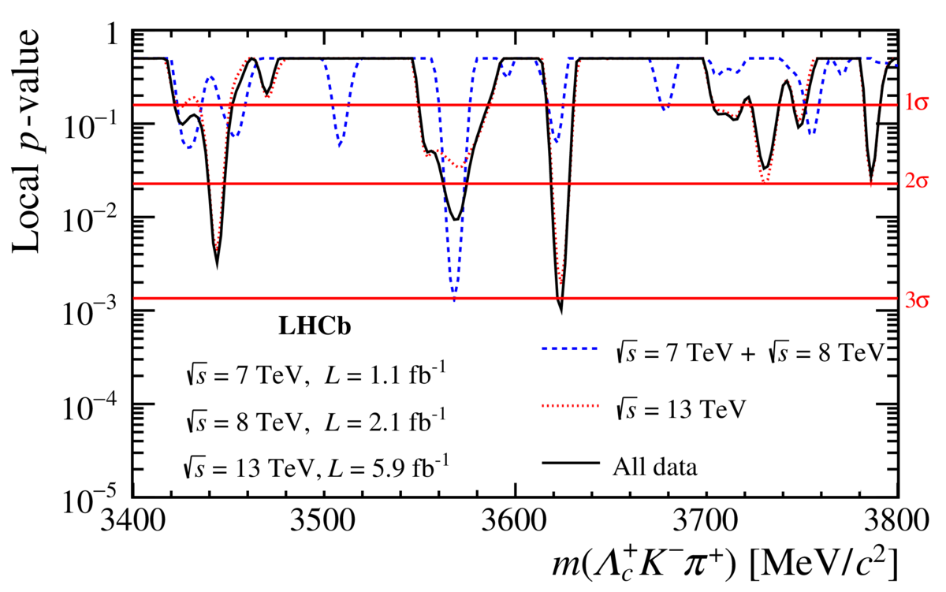
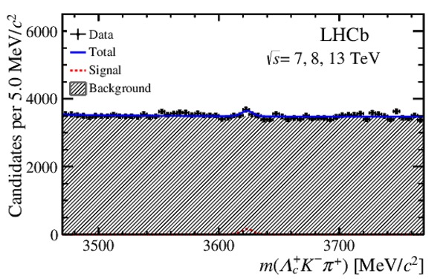

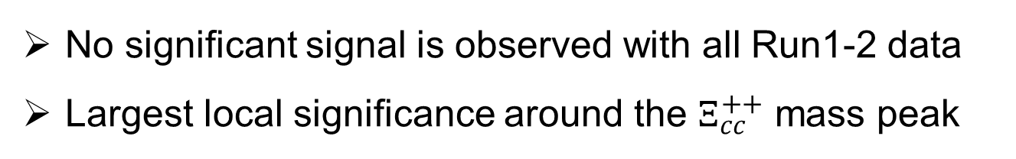
Search for $Ξ_{cc}^{+}$ in $Ξ_{cc}^{+}→Λ_{c}^{+}K^{−}π^{+}$
No significant signal is observed with all Run1-2 data
Largest local significance around the $Ξ_{cc}^{++}$ mass peak
$$343±121$$

Slide 12
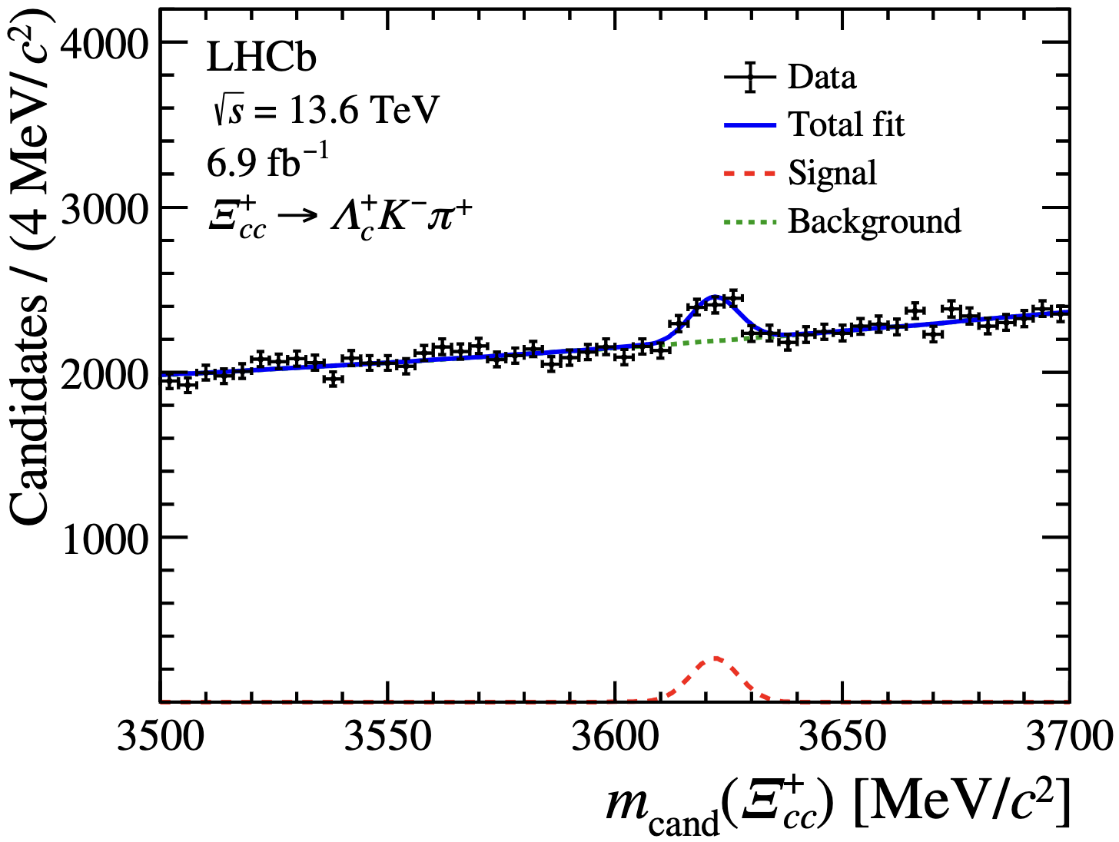
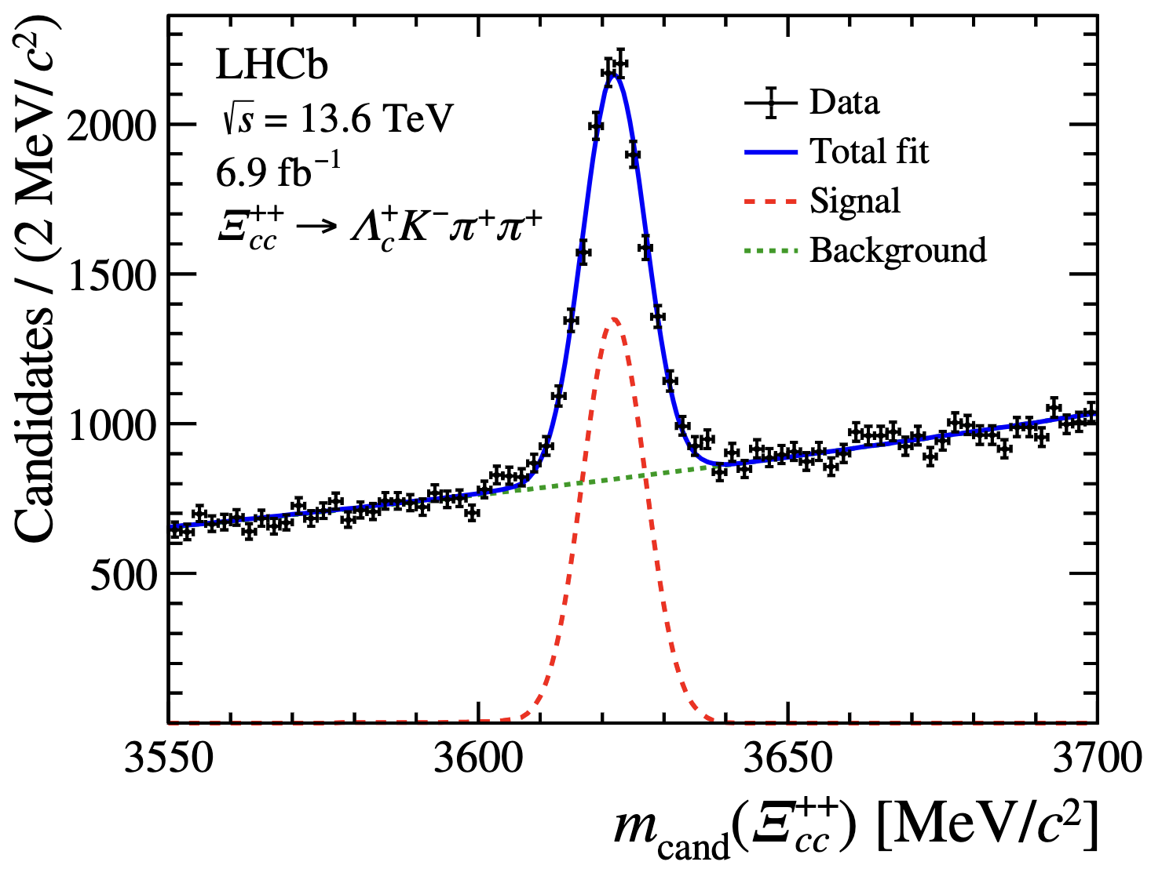
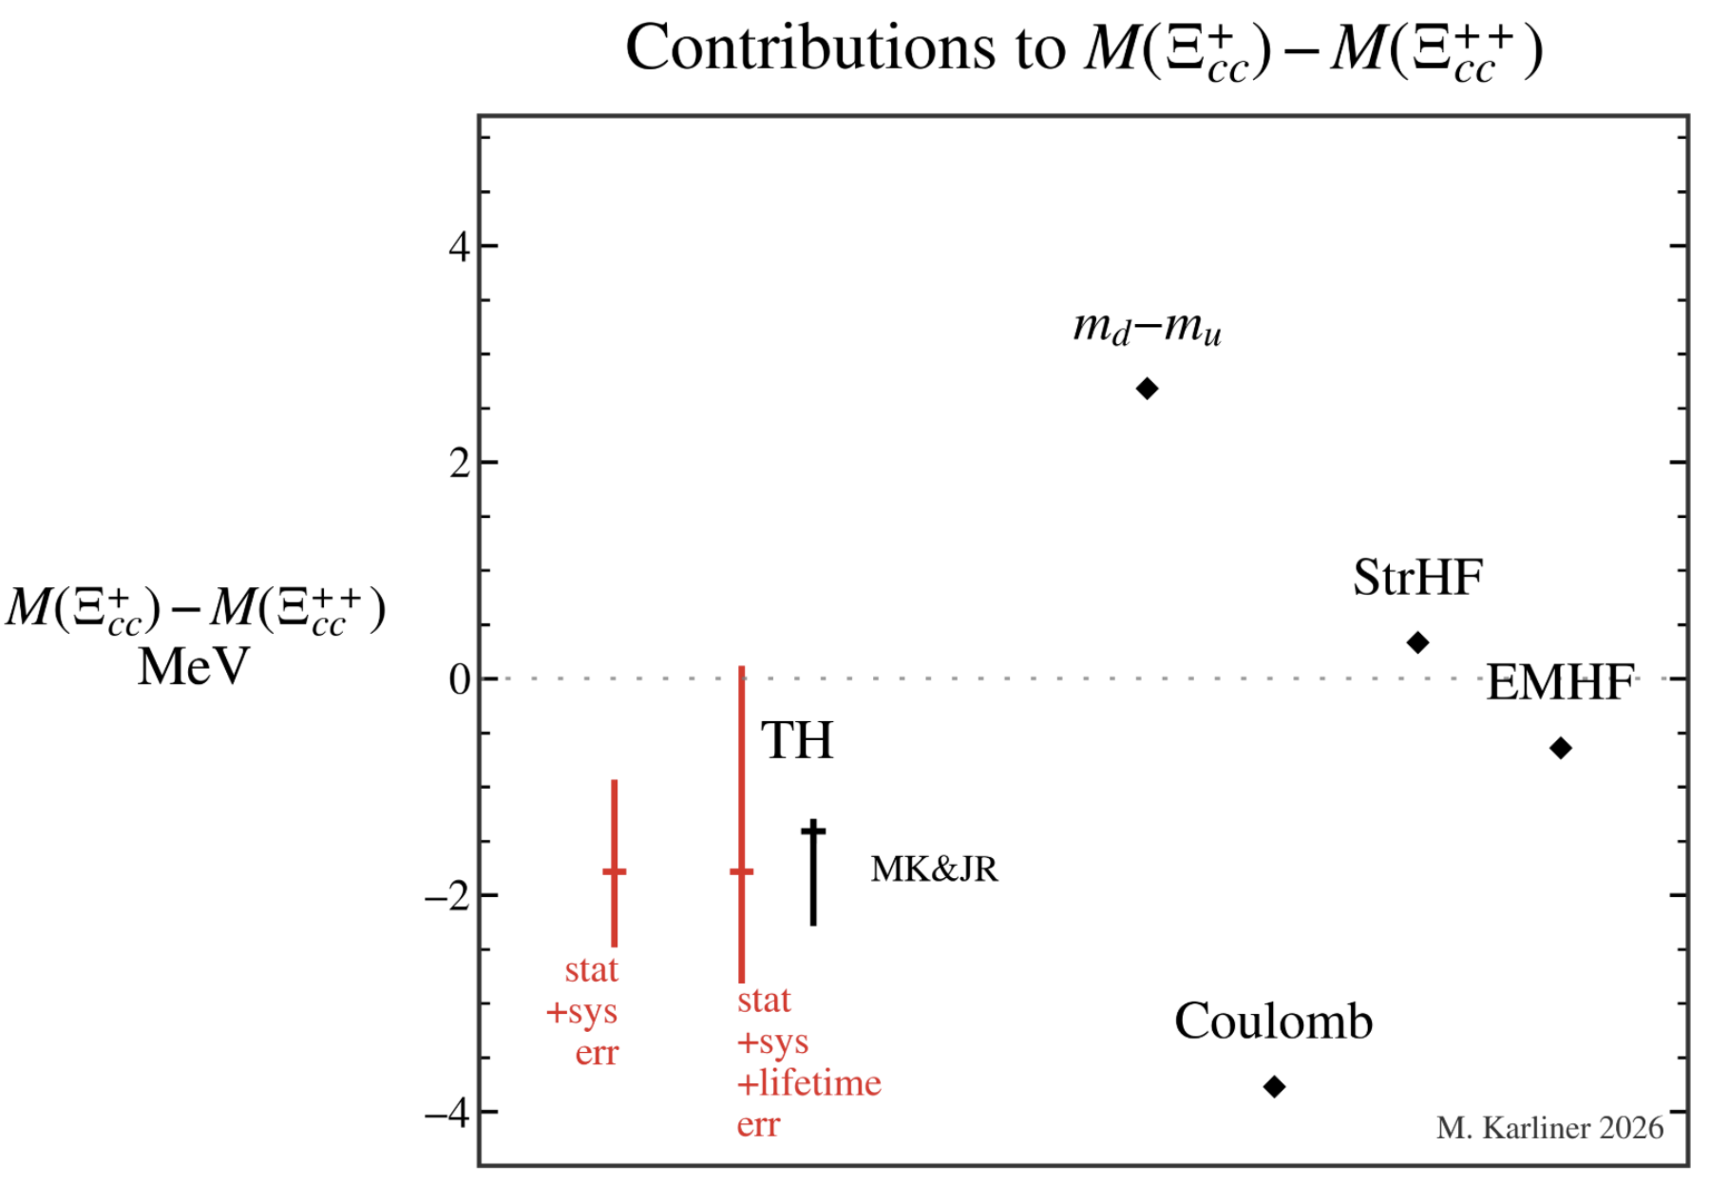

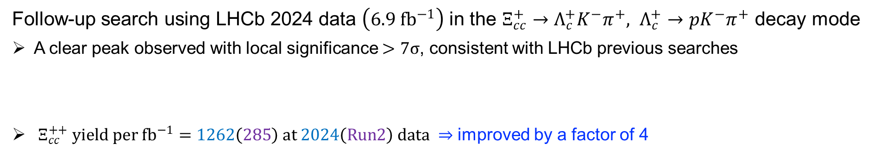

First observation of $Ξ_{cc}^{+}$
Follow-up search using LHCb 2024 data $\left(6.9 fb^{−1}\right)$ in the $Ξ_{cc}^{+}→Λ_{c}^{+}K^{−}π^{+}, Λ_{c}^{+}→pK^{−}π^{+}$ decay mode
A clear peak observed with local significance $>7σ$, consistent with LHCb previous searches
$Ξ_{cc}^{++} yield per fb^{−1}=1262\left(285\right) at 2024\left(Run2\right) data ⇒$ improved by a factor of 4
$$N_{sig}=915±121$$
$$N_{sig}=8712±155$$
Phys. Rev. Lett. 137, 021902
The first particle observed with LHCb upgrade I detector

Slide 13

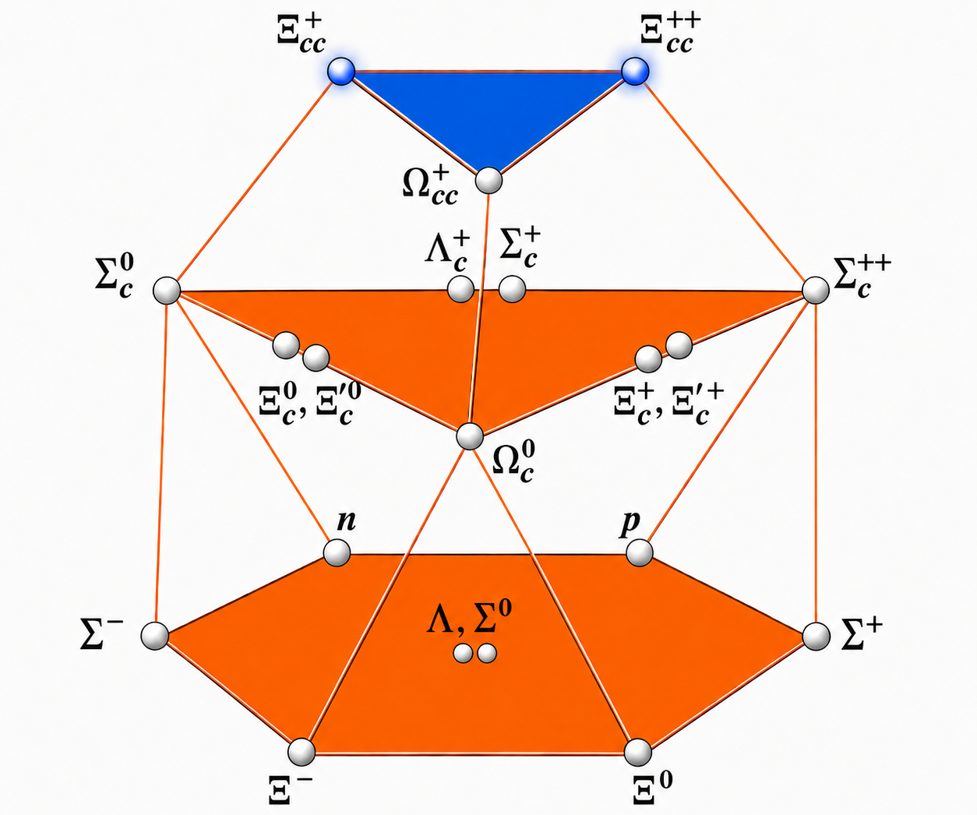
The last missing doubly charmed baryon, $Ω_{cc}^{+}$

Slide 14
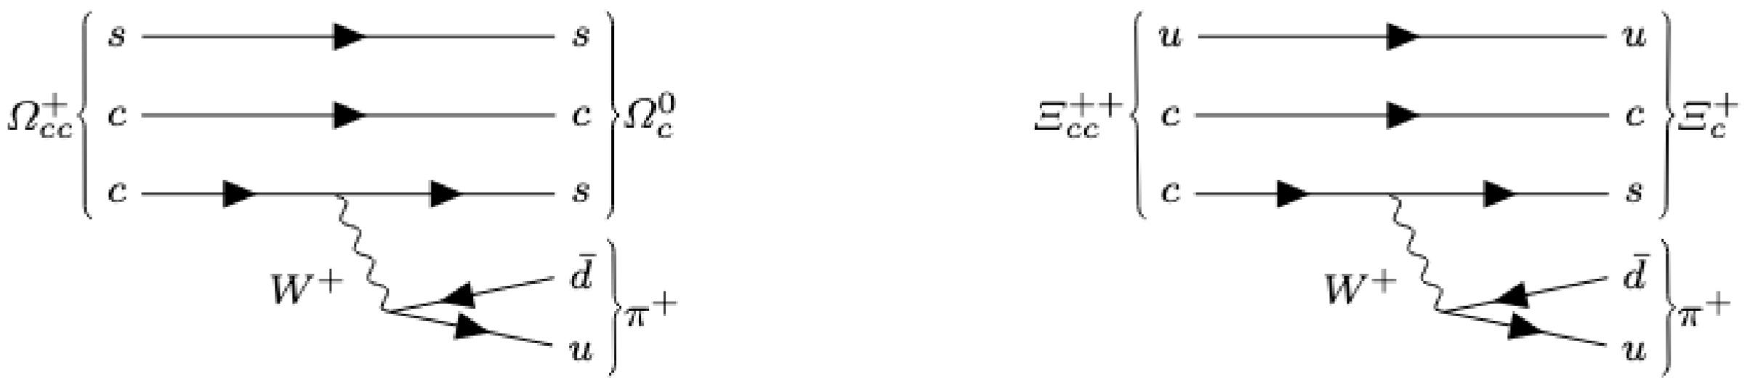
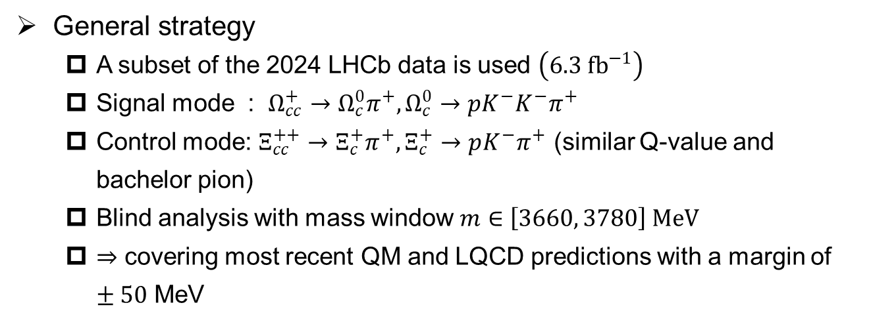
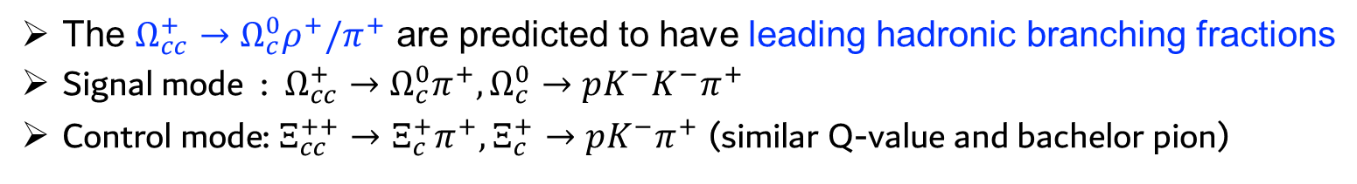
Search for the $Ω_{cc}^{+}$ baryon in the $Ω_{c}^{0}π^{+}$ final states
The $Ω_{cc}^{+}→Ω_{c}^{0}ρ^{+}/π^{+}$ are predicted to have leading hadronic branching fractions
Signal mode : $Ω_{cc}^{+}→Ω_{c}^{0}π^{+}, Ω_{c}^{0}→pK^{−}K^{−}π^{+}$
Control mode: $Ξ_{cc}^{++}→Ξ_{c}^{+}π^{+}, Ξ_{c}^{+}→pK^{−}π^{+}$ (similar Q-value and bachelor pion)
General strategy
  A subset of the 2024 LHCb data is used $\left(6.3 fb^{−1}\right)$
  Signal mode : $Ω_{cc}^{+}→Ω_{c}^{0}π^{+}, Ω_{c}^{0}→pK^{−}K^{−}π^{+}$
  Control mode: $Ξ_{cc}^{++}→Ξ_{c}^{+}π^{+}, Ξ_{c}^{+}→pK^{−}π^{+}$ (similar Q-value and bachelor pion)
  Blind analysis with mass window $m∈\left[3660, 3780\right] MeV$
  $⇒$ covering most recent QM and LQCD predictions with a margin of $±50$ MeV

Slide 15
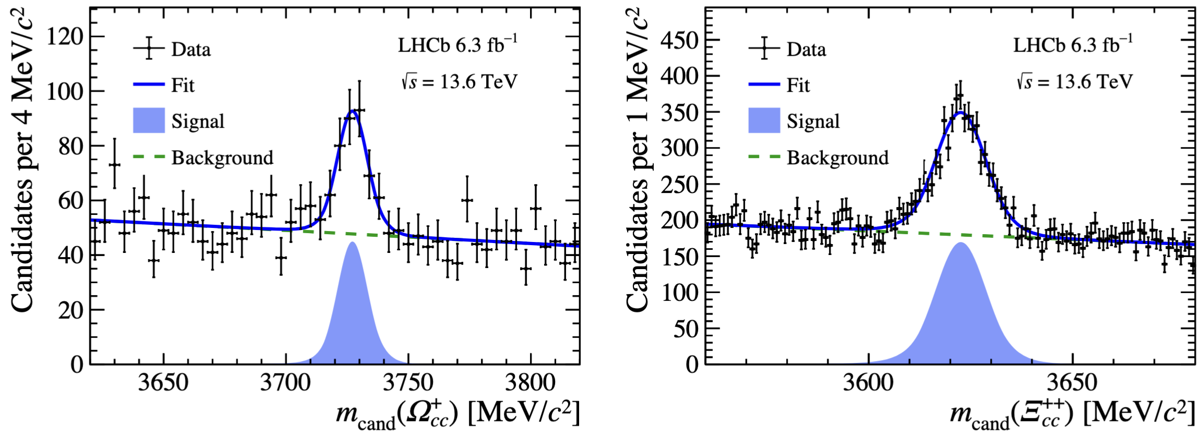
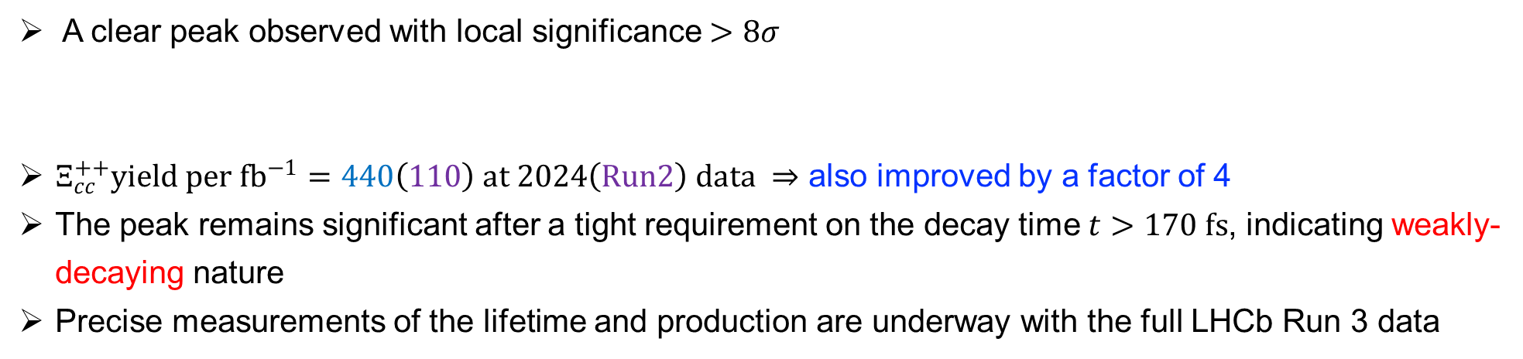

Observation of doubly charmed baryon $Ω_{cc}^{+}$
A clear peak observed with local significance $>8σ$
$Ξ_{cc}^{++}yield per fb^{−1}=440\left(110\right) at 2024\left(Run2\right) data ⇒$ also improved by a factor of 4
The peak remains significant after a tight requirement on the decay time $t>170 fs$, indicating weakly-decaying nature
Precise measurements of the lifetime and production are underway with the full LHCb Run 3 data
LHCb-PAPER-2026-022

Slide 16
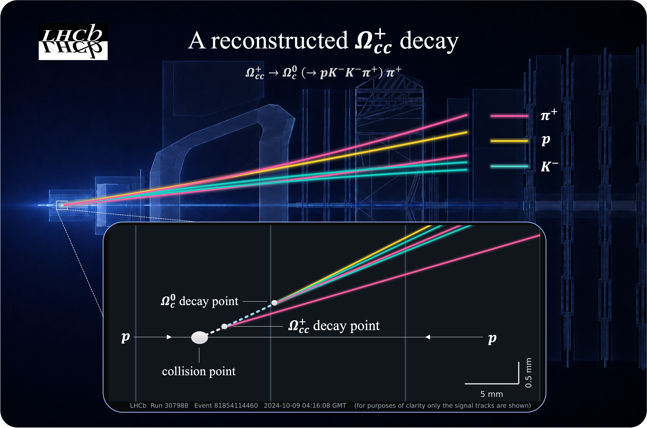
Example event display for $Ω_{cc}^{+}→Ω_{c}^{0}π^{+}$

Slide 17
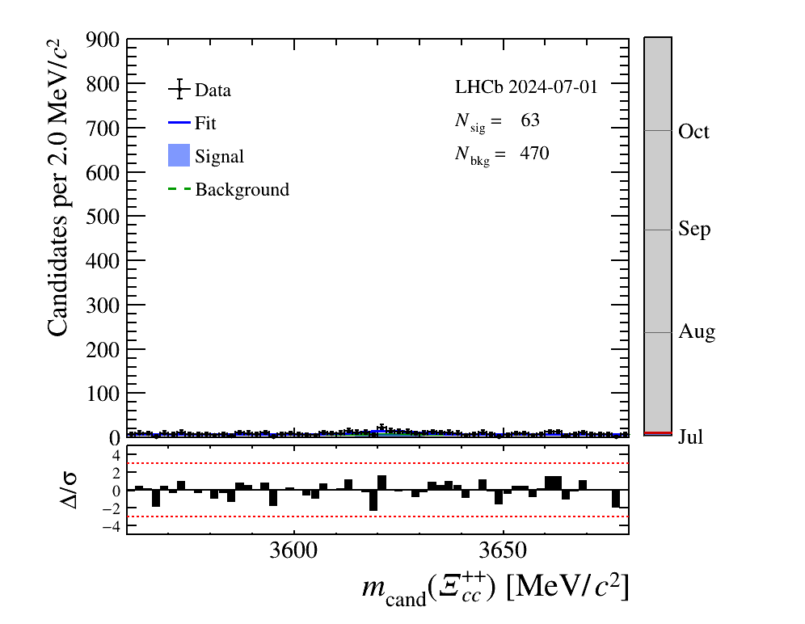
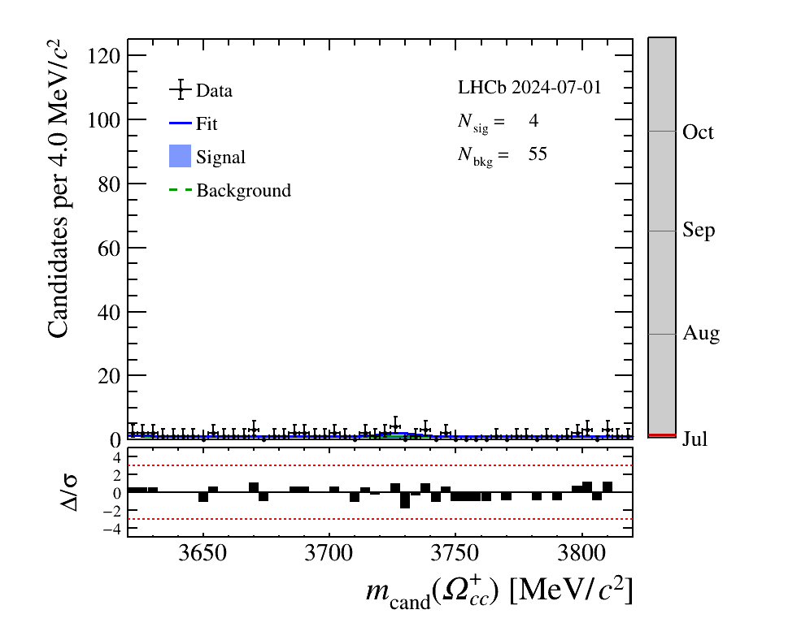


Display for $Ω_{cc}^{+}→Ω_{c}^{0}π^{+}$
$$Ξ_{cc}^{++}$$
$Ω_{cc}^{+}$

Slide 18
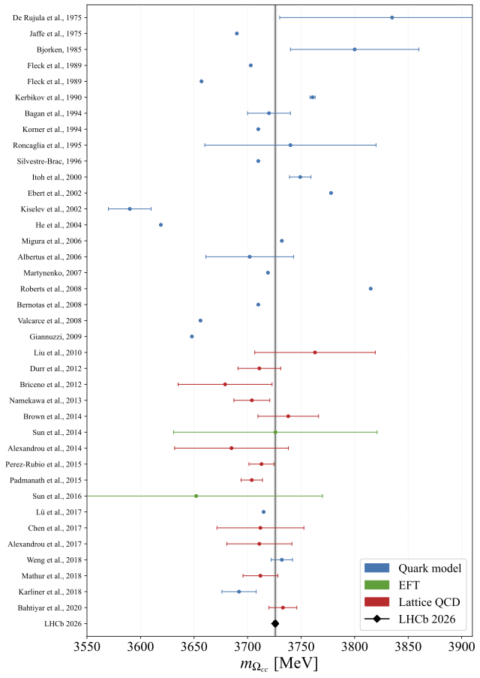
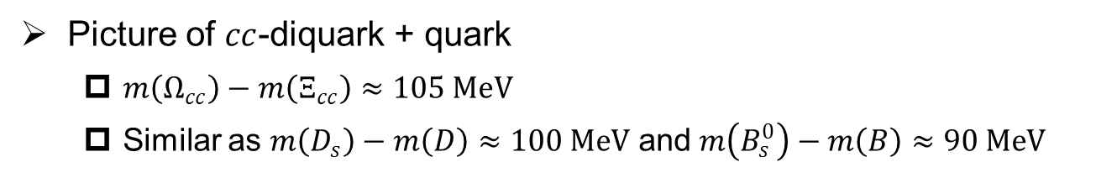
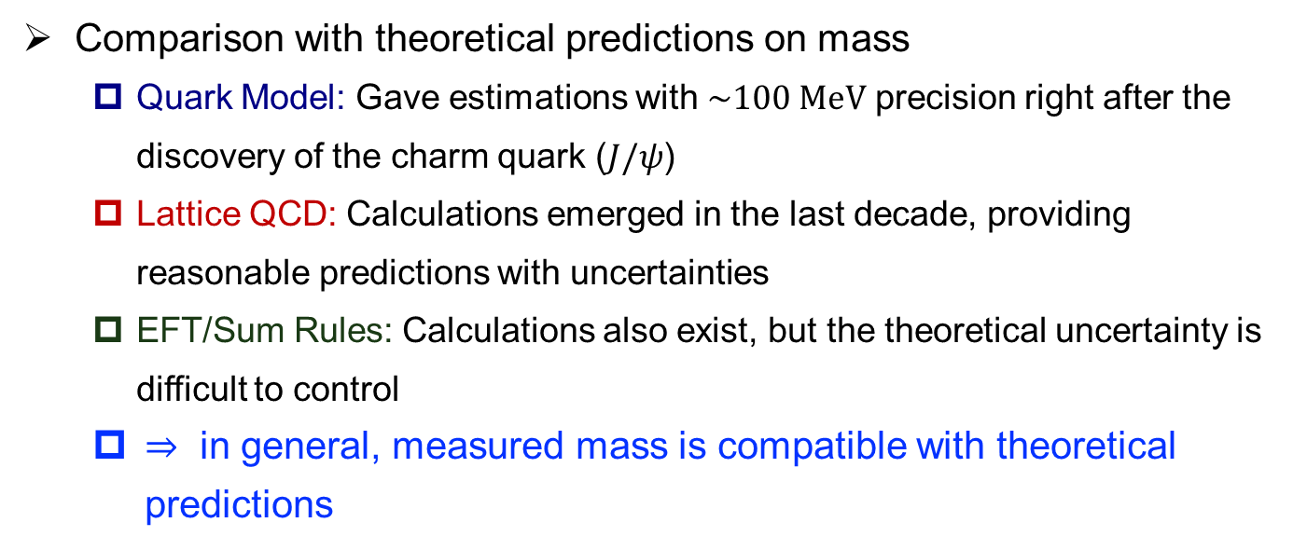
Observation of doubly charmed baryon $Ω_{cc}^{+}$
Picture of $cc$-diquark + quark
  $m\left(Ω_{cc}\right)−m\left(Ξ_{cc}\right)≈105 MeV$
  Similar as $m\left(D_{s}\right)−m\left(D\right)≈100 MeV$ and $m\left(B_{s}^{0}\right)−m\left(B\right)≈90 MeV$
Comparison with theoretical predictions on mass
  Quark Model: Gave estimations with $\sim 100 MeV$ precision right after the discovery of the charm quark ($J/ψ$)
  Lattice QCD: Calculations emerged in the last decade, providing reasonable predictions with uncertainties
  EFT/Sum Rules: Calculations also exist, but the theoretical uncertainty is difficult to control
  $⇒$ in general, measured mass is compatible with theoretical predictions
All members of the $SU{\left(4\right)}_{f}$ spin$−\frac{1}{2}$ 20-plet of ground-states baryons has now been established

Slide 19
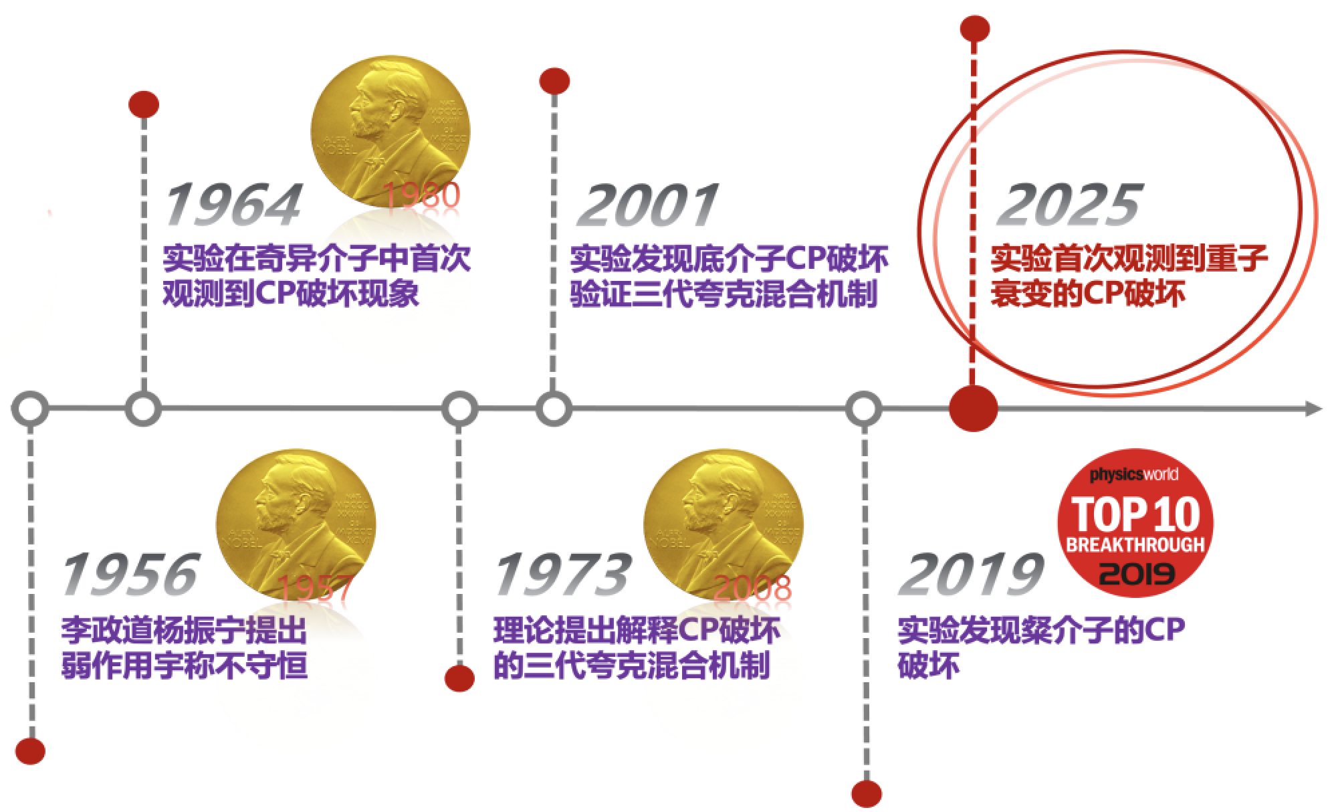

CPV of $Λ_{b}^{0}$ decays

Slide 20
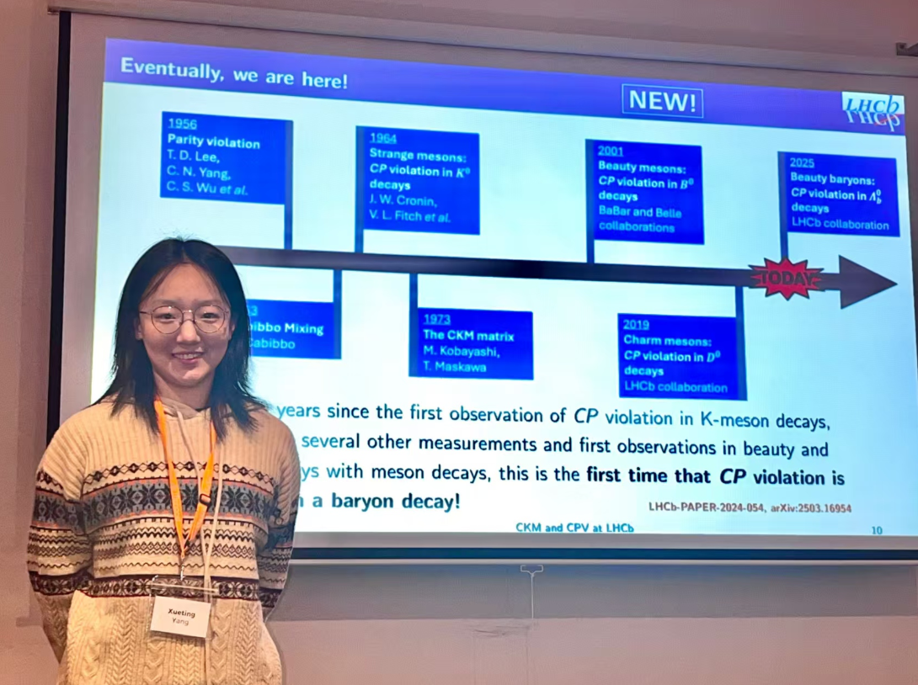
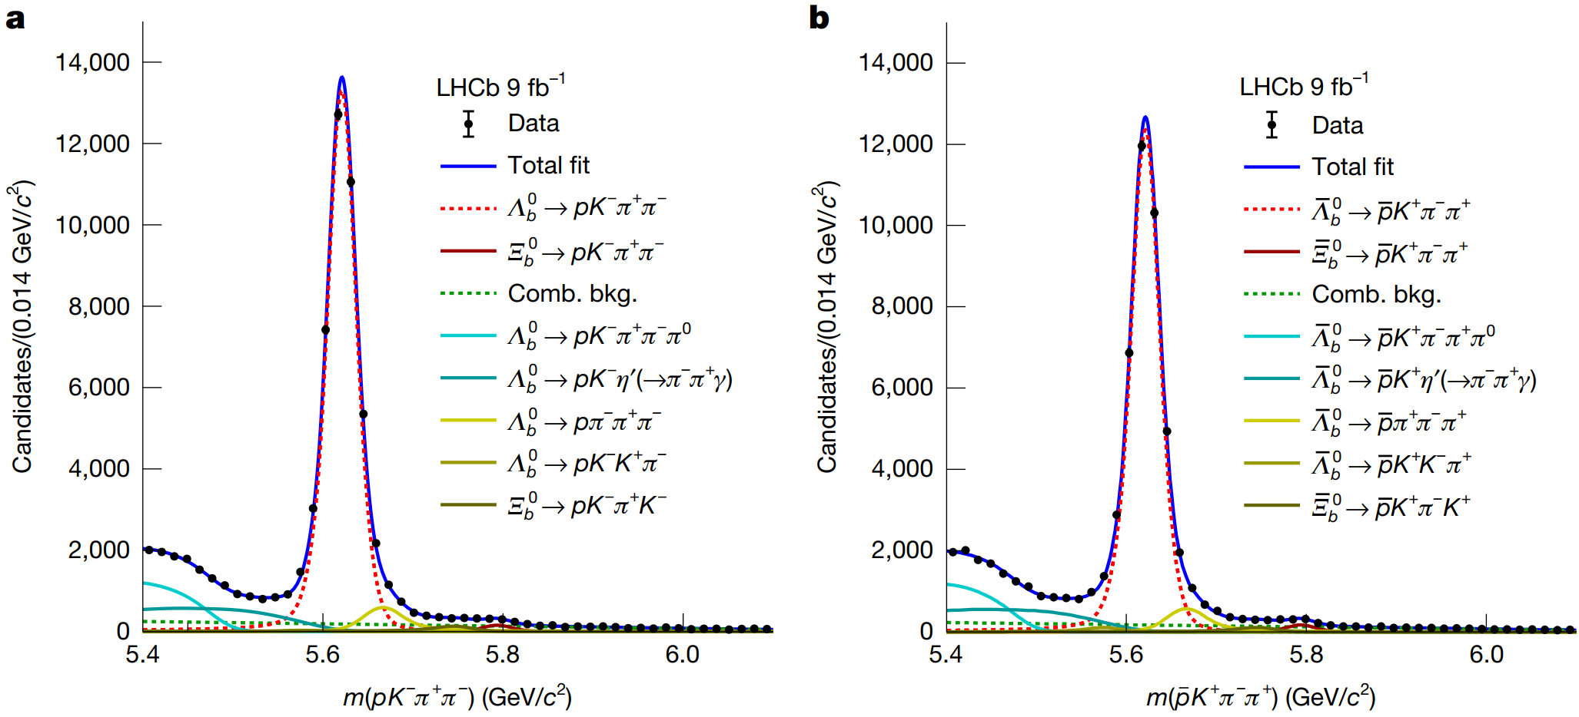

First observation of baryon CP violation
Nature 643 (2025) 1223
$Λ_{b}^{0}→pK^{−}{π^{+}π}^{−} (5.2σ)$
第59届国际电弱相互作用和统一理论会议

Slide 21
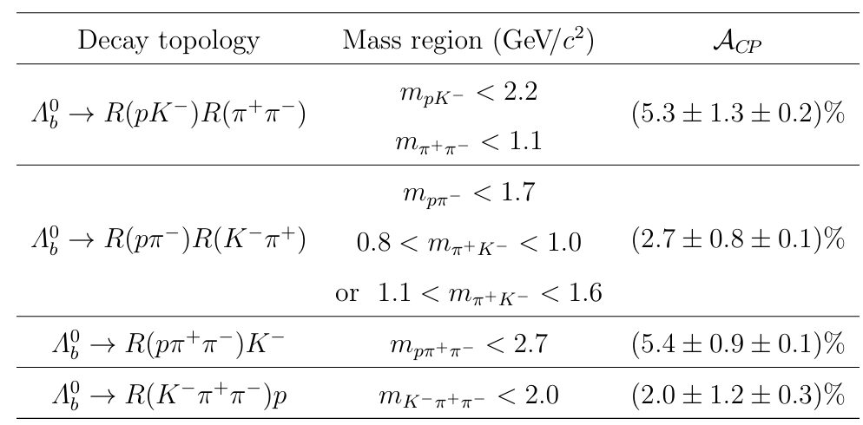
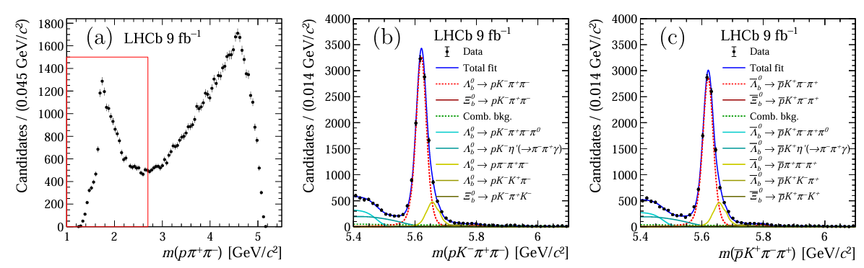


Local CP violation in selected regions of the phase space
$$6.0σ$$
$N^{∗+}$resonance region

Slide 22
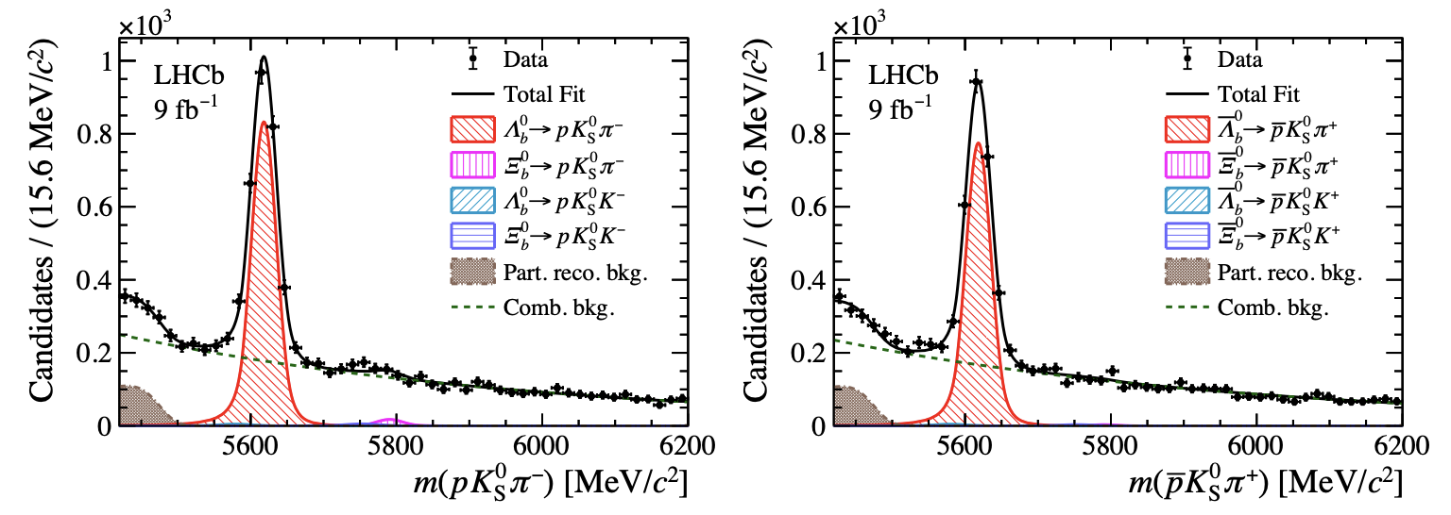
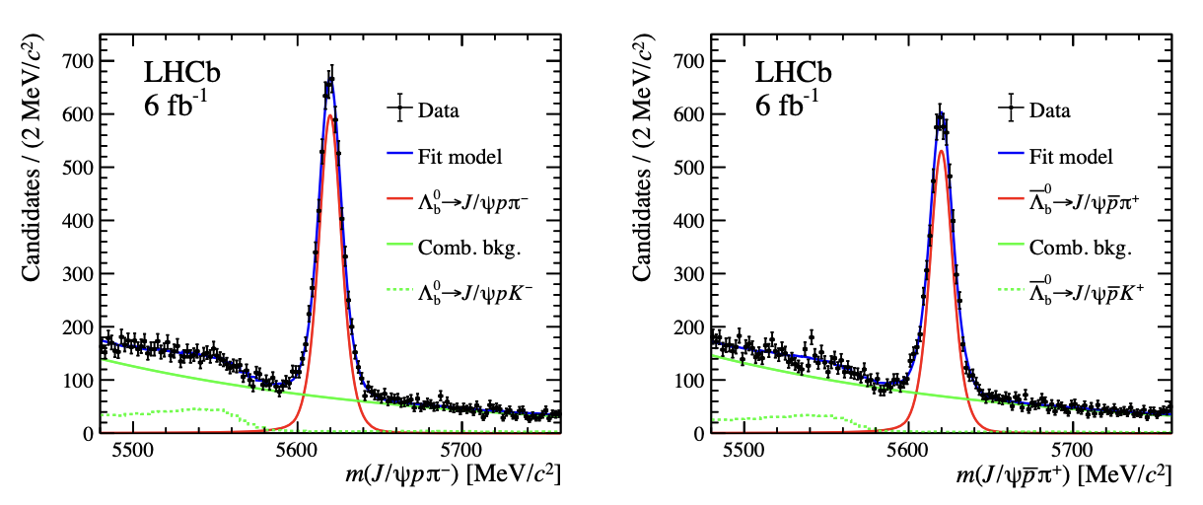





CPV of other $Λ_{b}^{0}$ decays
No CPV
JHEP10(2025)169
$$A^{CP}\left(Λ_{b}^{0}→pK_{S}^{0}π^{−}\right)=\left(3.4±1.9±0.9\right)\%$$
Science Bulletin 71 (2026) 547-557
3.3$σ$ evidence of CPV
Evidence of CPV in pentaquark decays
3.1$σ$ evidence of CPV
PRL 134 (2025) 101802
$$ΔA_{CP}(Λ_{b}^{0}→ΛK^{+}K^{−})=0.083±0.023±0.016$$

Slide 23




Baryon vs meson
CPV in some B-meson decays are 10%，but b-baryon CPV only reach 1%
Dynamics more complex than mesons
Possible cancellation of S and P amplitudes
Favoring multiple body decays
arXiv:2409.02821

Slide 24
Baryonic decays of $B$-meson

Slide 25









$\text{Two}\text{−}\text{body baryonic decays of }B$ meson
Provides information on the dynamics of $B$ decays and tests QCD based models of the hadronization process
Baryonic $B$ decays are also interesting in the study of CP violation
tree
penguin
tree
penguin
annihilation
W-exchange
annihilation
Pure penguin modes are expected to be sensitive to new physics contributions
electroweak penguin
penguin annihilation
Phys. Rev. D 95, 096004 (2017)

Slide 26




$$\text{The }\text{f}\text{eature}\text{ of} B \text{baryonic decays}$$
Two-body baryonic decays suppressed with respect to multibody decays
Two-body
Multi-body
Decays of $B$ mesons into multiple baryons still far from being fully understood
Charmless baryonic $B^{+}$and $B^{0}$ modes branching fractions reported by HFLAV

Slide 27













Threshold enhancement
Many channels have the special feature: baryon-antibaryon pair peaks near threshold
PRD 88, 052015 (2013)
Phys. Rev. Lett. 119 (2017) 041802
$$B^{+}→p\overline{p}K^{+}$$
$$B^{+}→p\overline{p}π^{+}$$
$B^{0}→p\overline{Λ}π^{−}$
$B_{s}^{0}→p\overline{Λ}K^{−}$
Phase space
Phase space
$$B^{0}→p\overline{p}K^{+}π^{−}$$
$$B_{s}^{0}→p\overline{p}K^{+}K^{−}$$
$$B^{0}→p\overline{p}π^{+}π^{−}$$
Phys. Rev. D 96 (2017) 051103

Slide 28


CP asymmetry
CPV in some B-meson decays are 10%，but b-baryon CPV only reach 1%
Provide a crucial bridge to understanding this puzzle
CPV of multi-body decays: richer interference structures, more precise constraints on strong phases, more efficient utilization of statistics, and higher sensitivity to new physics
$$∆A_{cp}\sim 4.7σ$$
PRL 113, 141801 (2014)

Slide 29






First Observation of the $B_{s}^{0}→Λ_{c}^{+}{\overline{Λ}}_{c}^{−}$ decay
$$19 ± 5$$
$$4.3 σ$$
$$25 ±7$$
$$6.2 σ$$
PRL 136, 061802 (2026)
JHEP11(2023)117
The first experimental verification of the W-exchange process
Consistent with theoretical predictions
Such effects may be important for improving predictions of CP -violating

Slide 30




Search for $B^{−}→Λ\overline{p}$ decay
$${13.0}_{−4.3}^{+5.1}$$
$$4.1 σ$$
JHEP04(2017)162
CP-violation of $B_{s}^{0}→K^{+}K^{−}$ and $B^{0}→K^{+}π^{−}$ $\sim 10\%$
Why $A_{cp}\left(Λ_{b}^{0}→pK^{−}\right)=\left(−1.14±0.17\right)\%$
Theoretical studies for $A_{cp}\left(B^{−}→Λ\overline{p}\right)$ could reach $10\%$, but S-wave and P-wave amplitudes cancellation could suppress CPV
LHCb have searched this decay mode with Run I data

Slide 31





First observation of the $B^{+}→p\overline{Λ}$ decay
$$88 ± 12$$
$$>7 σ$$
PRL 136, 051802 (2026)
Consistent with available theoretical predictions
$α_{B}≠0$ indicates a strong interference between the competing S-wave and P-wave amplitudes
$ℬ\left(B^{+}→p\overline{Λ}\right)\sim 10×ℬ\left(B^{0}→p\overline{p}\right)→$like mesonic two-body B-meson decays
CPV of $B^{+}→p\overline{Λ}$ will become feasible

Slide 32





Four-body baryonic decays：$B_{(s)}^{0}→p\overline{p}p\overline{p}$， $B^{+}→\overline{Λ}p\overline{p}p$
Physics Letters B 845 (2023) 138158

Slide 33


Search for $B_{(s)}^{0}→p\overline{p}p\overline{p}$
$B$ meson decay to 4 baryons was never observed
  $B^{0}→pppp (2.9σ)$ Phys. Rev. D 98, 071102 (2018)
$B_{s}→pppp$ (no study reported) is expected to be further suppressed with respect to $B^{0}$
  Hadronisation fraction $f_{s}/f_{d}\sim 25\%,$and ${\left|\frac{V_{us}}{V_{ud}}\right|}^{2}\sim 5\%$

Slide 34


First observation of $B_{s}^{0}→p\overline{p}p\overline{p}$
PRL 131, 091901 (2023)
$B^{0}→J/ψ\left(→p\overline{p}\right)K^{∗0}(→K^{+}π^{−})$ and $B_{s}^{0}→J/ψ\left(→p\overline{p}\right)φ(→K^{+}K^{−})$ as normalization channel
$ℬ\left(B^{0}→p\overline{p}p\overline{p}\right)=\left(2.2±0.4±0.1±0.1\right)×{10}^{−8}$
$ℬ\left(B_{s}^{0}→p\overline{p}p\overline{p}\right)=\left(2.3±1.0±0.2±0.1\right)×{10}^{−8}$
$B_{s}^{0}→p\overline{p}p\overline{p}$ is not consistent with expected Cabibo suppression: ${\left|\frac{V_{us}}{V_{ud}}\right|}^{2}\sim 5\%$
Expect other theoretical explanations

Slide 35



$$\text{Mass distributions of }p\overline{p}$$
Tight selection
Very Tight selection
Data above the red-dashed line are excluded by the $c\overline{c}$ veto.
To avoid $J/ψ→p\overline{p}$, require $m\left(p\overline{p}\right)<2.85GeV/c^{2}$
Branching fractions with $c\overline{c}$ veto (only stat. uncertainty)
  $ℬ(B^{0}→p\overline{p}p\overline{p}) = (1.6±0.4)×{10}^{−8}$
  $ℬ(B_{s}^{0}→p\overline{p}p\overline{p}) = (2.2±1.2)×{10}^{−8}$

Slide 36







First observation of $B^{+}→\overline{Λ}p\overline{p}p$
$$m\left(\overline{Λ}p_{1}\right)<m(\overline{Λ}p_{2})$$
$$78 ± 12$$
$$>5 σ$$
$$m\left(\overline{p}p_{1}\right)<m(\overline{p}p_{2})$$
PRL 135, 261901 (2025)
LHCb result:
Theoretical result:
A clear double-threshold enhancement in both baryon-antibaryon invariant-mass distributions

Slide 37







Evidence for the rare decay $B^{+}→p\overline{Λ}μ^{+}μ^{−}$
$$15.5 ±5.5$$
$$3.5 σ$$
$B^{+}→J/ψΛp$ as normalization mode
Phys. Rev. Lett. 137, 051801
Compatible the SM within 2σ
J. Phys. G: Nucl. Part. Phys. 41 065002

Slide 38



Prospects
Opportunities with Run 3 (~30 $fb^{−1}$)
  Wider scope for exploitation
  Improvement on understanding natures of baryon

Slide 39
Thank you

