Slide 1


第八届粒子物理天问论坛
From Topologies to Rescattering
in Charmed Baryon Decays
报告人：王 迪
单 位：湖南师范大学
合作者：骆金凤，赖颖鑫

Slide 2
第八届粒子物理天问论坛
Contents
1
Motivation
2
From topologies to rescattering
3
Phenomenological analysis
4
Summary

Slide 3
第八届粒子物理天问论坛
Contents
1
Motivation
2
From topologies to rescattering
3
Phenomenological analysis
4
Summary

Slide 4

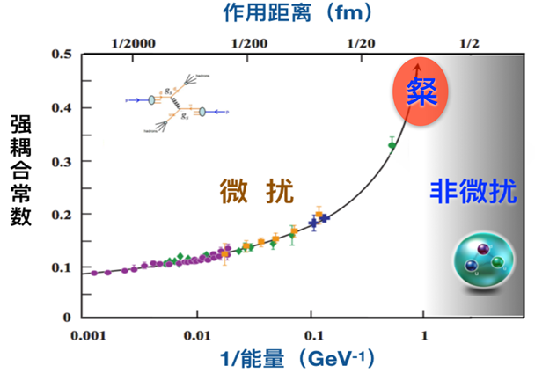
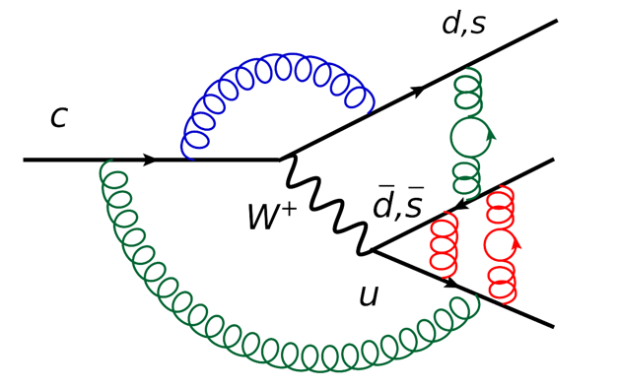
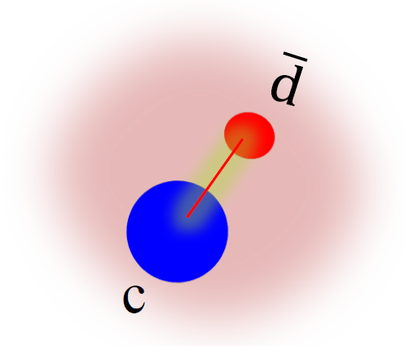
第八届粒子物理天问论坛
Charmed baryon weak decay
Charm physics: test SM and search for NP
Non-perturbative
Three quarks, complex system
Meson .vs. Baryon
4

Slide 5
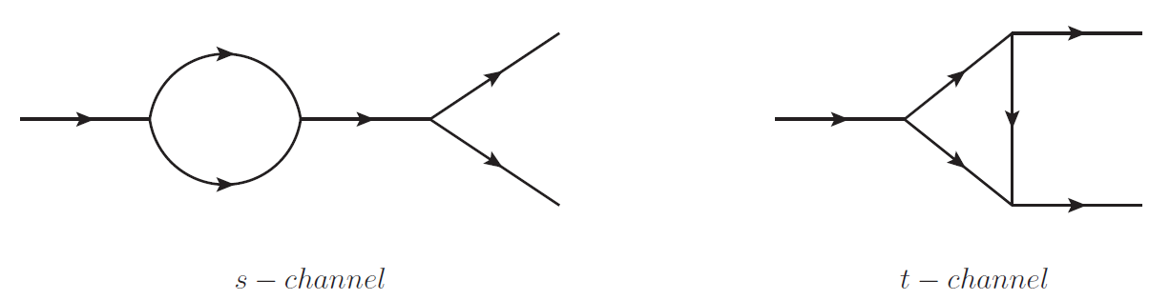
第八届粒子物理天问论坛
Rescattering Mechanism
The non-perturbative QCD effects are modeled as an exchange of one particle between the two particles generated from short-distance tree emitted process.
Discovery channel of doubly charmed baryon in 2017/Predicting direct CPV of bottom baryon decay in 2025.
F. S. Yu, H. Y. Jiang, R. H. Li, C. D. Lu, W. Wang and Z. X. Zhao, Chin. Phys. C 42, no. 5, 051001 (2018).
J. P. Wang and F. S. Yu, Chin. Phys. C 48, no.10, 101002 (2024).
5

Slide 6
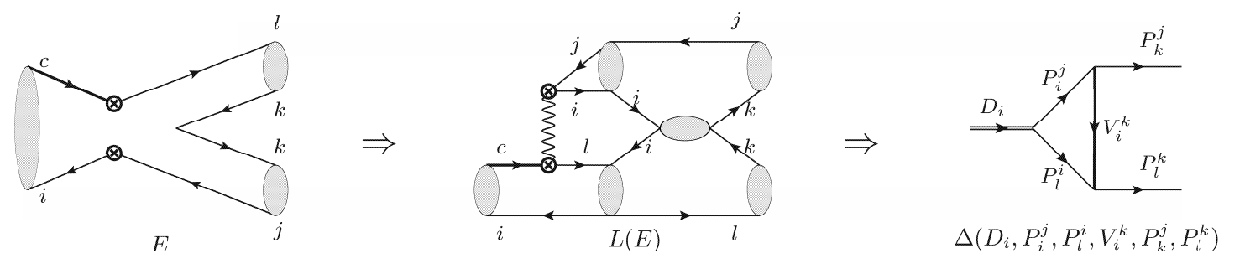

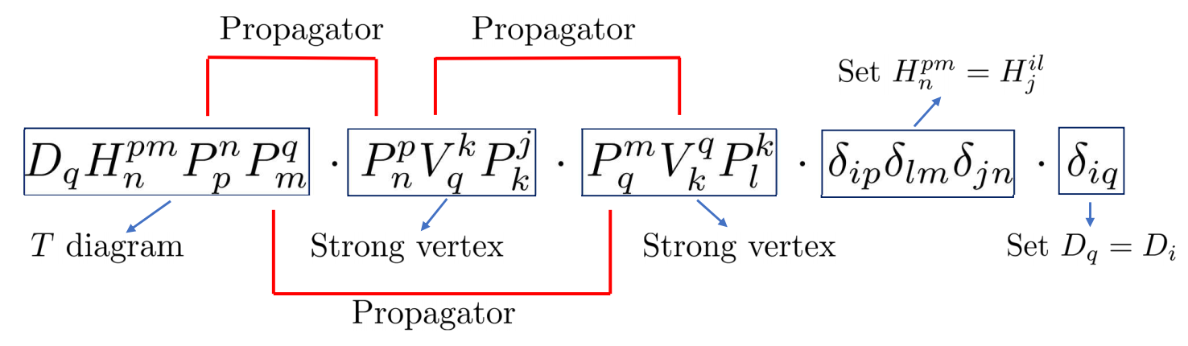

第八届粒子物理天问论坛
From topology to rescattering – meson decays
Di Wang, JHEP 03, 155 (2022).
R. Aaij et al. [LHCb Collaboration], Phys. Rev. Lett. 122, no. 21, 211803 (2019).
H. Y. Cheng and C. W. Chiang, Phys. Rev. D 86, 014014 (2012).
6
?

Slide 7
第八届粒子物理天问论坛
Contents
1
Motivation
2
From topologies to rescattering
3
Phenomenological analysis
4
Summary

Slide 8
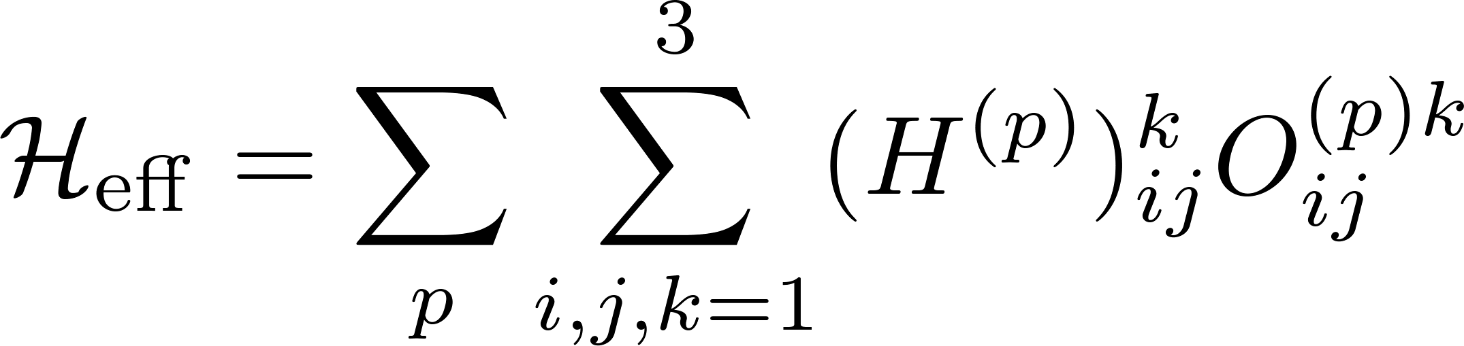
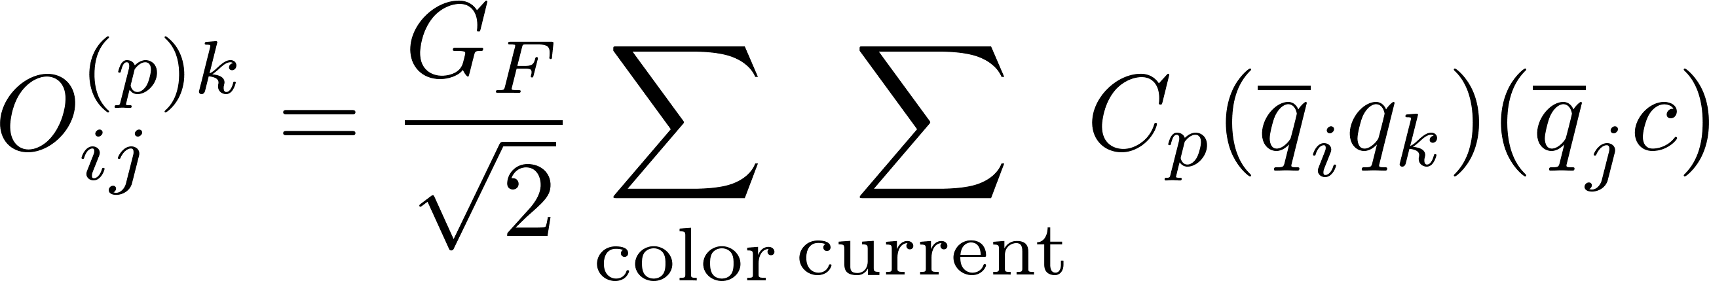
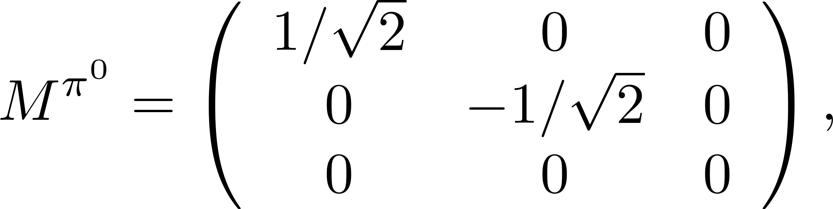

第八届粒子物理天问论坛
Topologies of charmed baryon decays
Effective Hamiltonian
CKM
Operator
Hadrons
…
D. Wang, C. P. Jia and F. S. Yu, JHEP 09, 126 (2021).
8

Slide 9
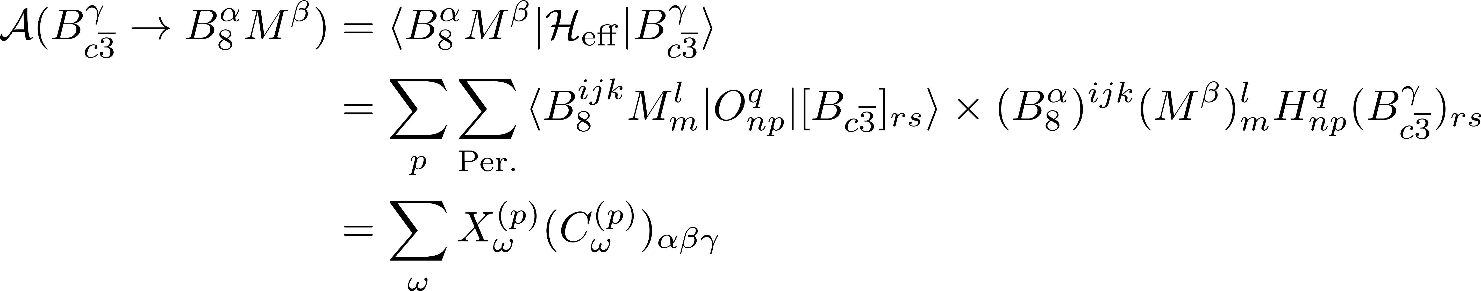
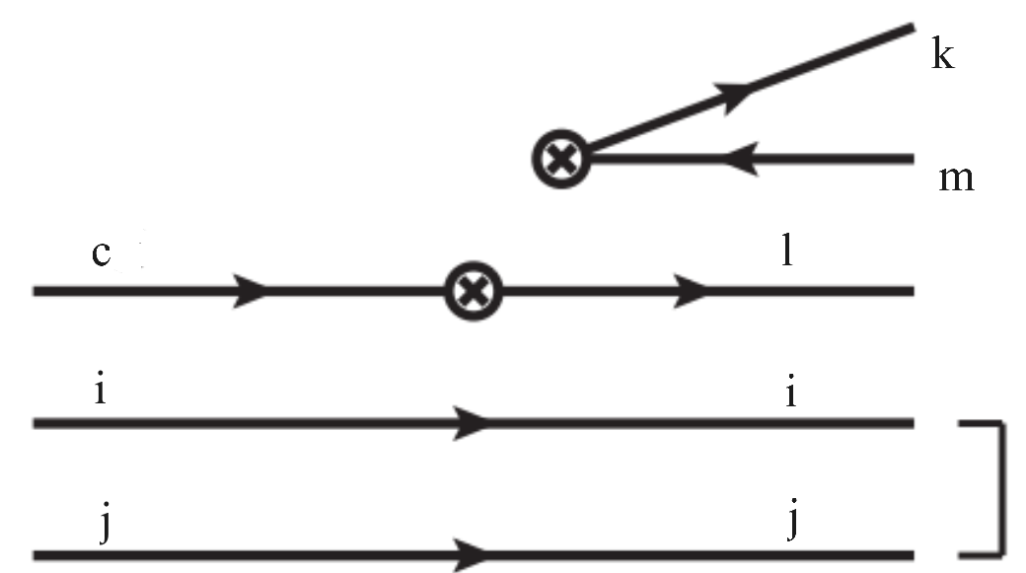
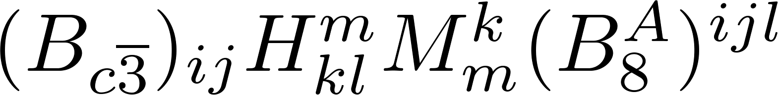
第八届粒子物理天问论坛
Topology Invariant Tensor
CG coefficient, mode-dependent
Reduced matrix element, mode-independent
Wigner-Eckart theorem
Index-contraction Quark flowing
D. Wang and J. F. Luo, Phys. Rev. D 110, no.9, 093001 (2024).
9

Slide 10
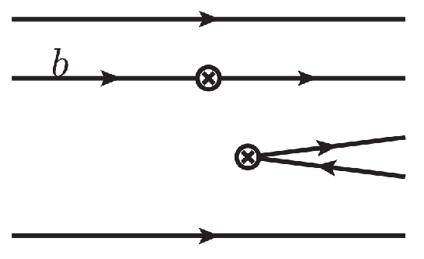

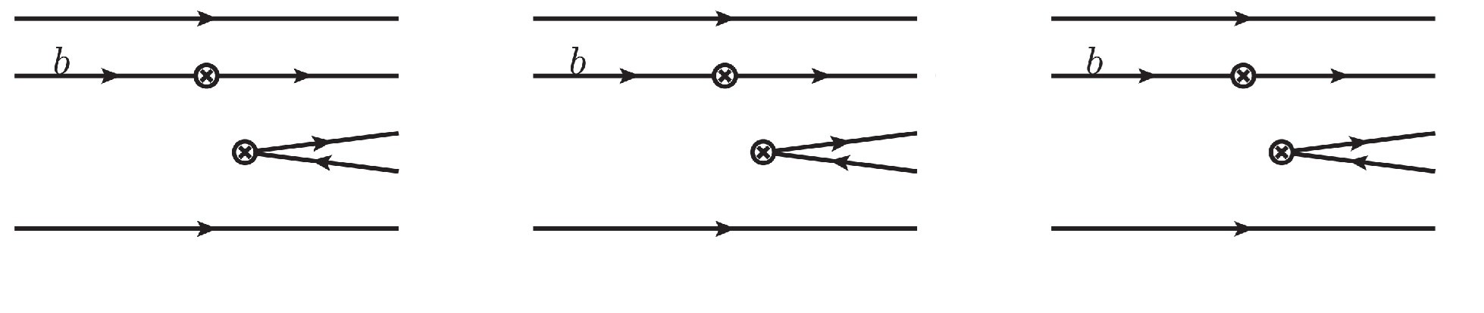
第八届粒子物理天问论坛
Topologies of heavy baryon decays
Wavefunction
10

Slide 11
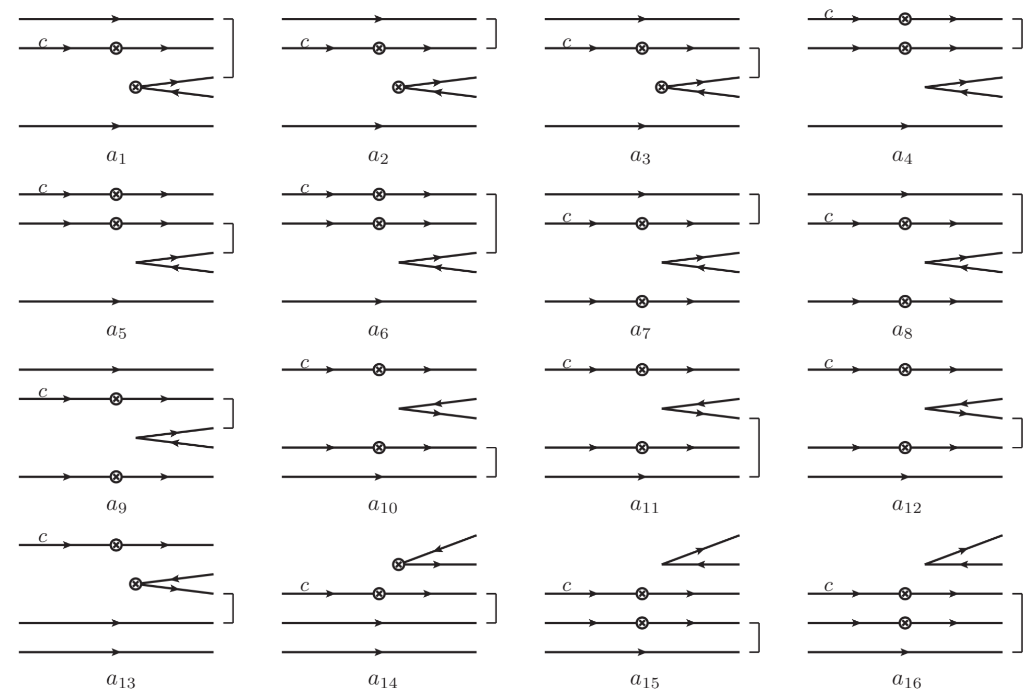
第八届粒子物理天问论坛
Topologies in charmed baryon decays
11

Slide 12
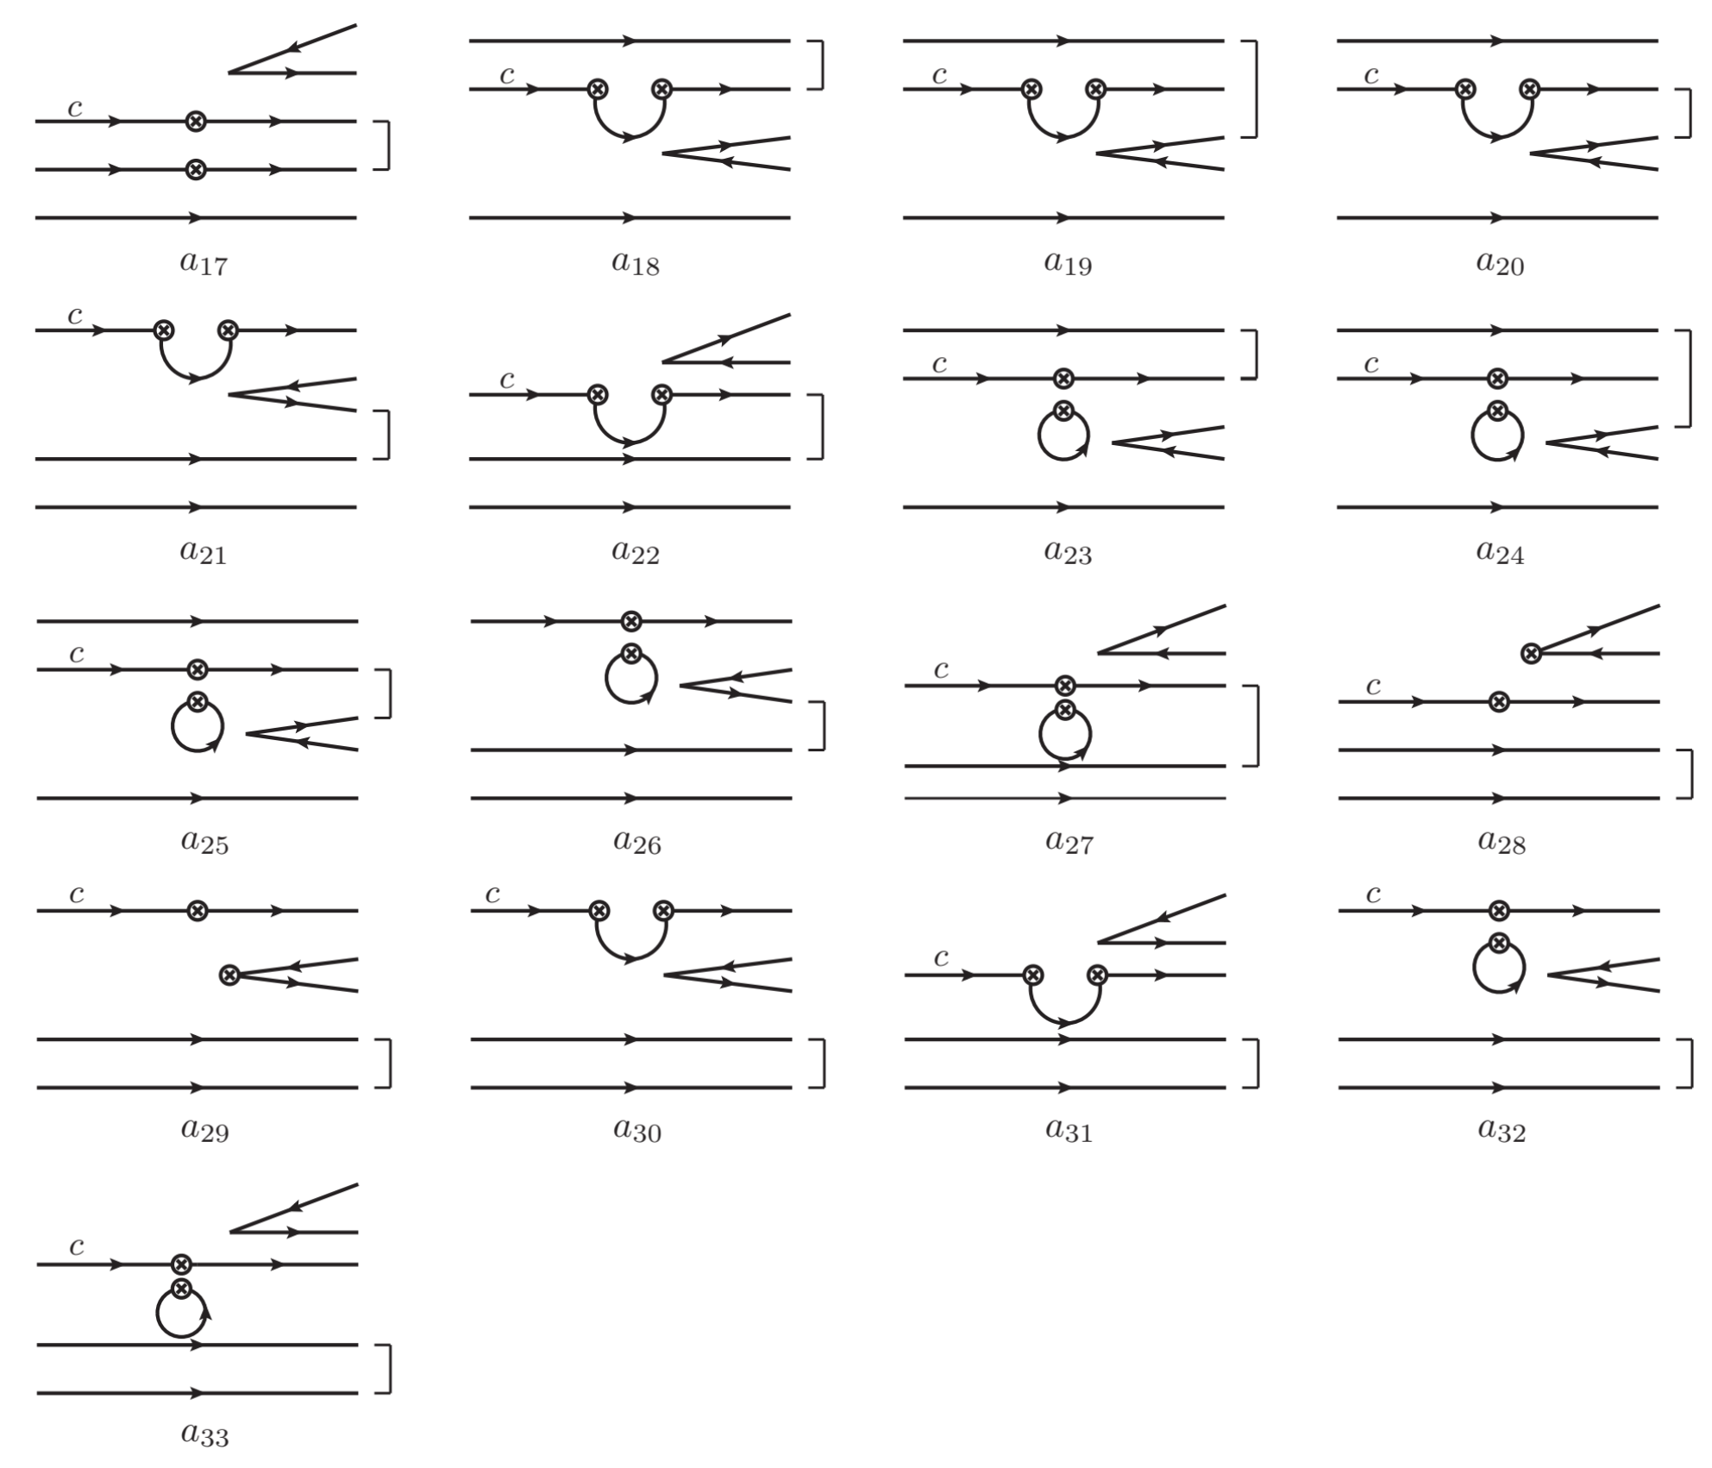
D. Wang and J. F. Luo, Phys. Rev. D 110, no.9, 093001 (2024)
12

Slide 13
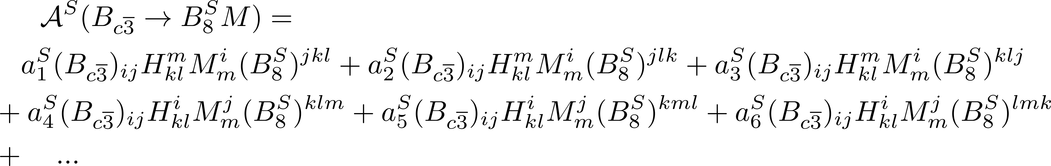
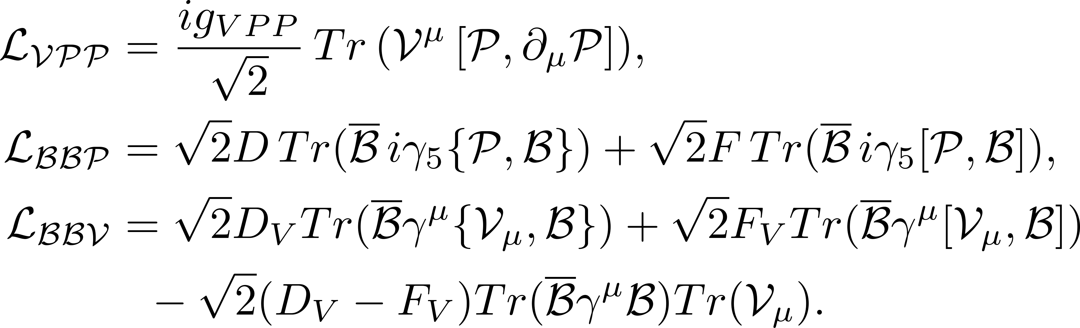
第八届粒子物理天问论坛
TDA and ChPT
TDA: constructed via third-rank octet tensors
ChPT: constructed via (1,1)-rank octet tensors
?
13

Slide 14
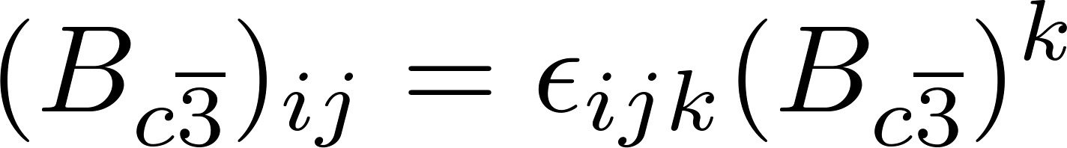
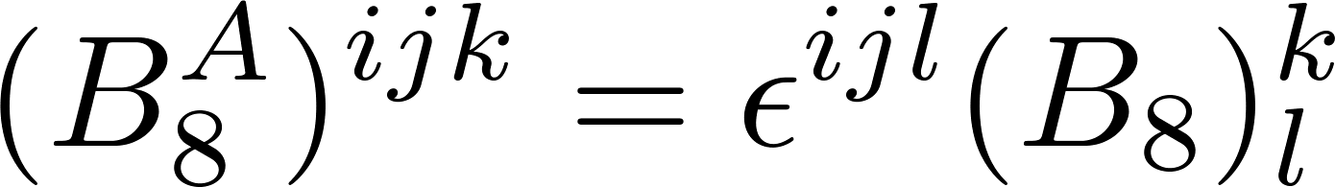
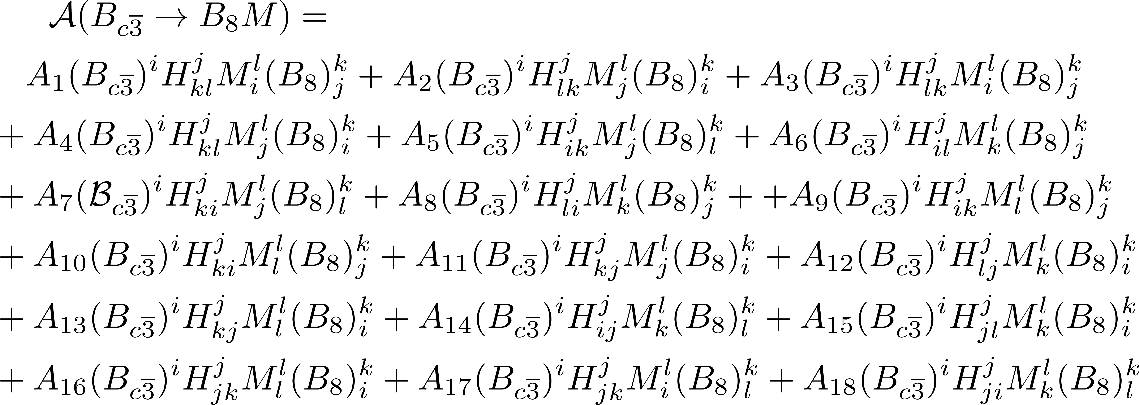
第八届粒子物理天问论坛
Three indices Two indices
Reducing indices by Levi-Civita tensor
D. Wang and J. F. Luo, Phys. Rev. D 110, no.9, 093001 (2024)
14

Slide 15
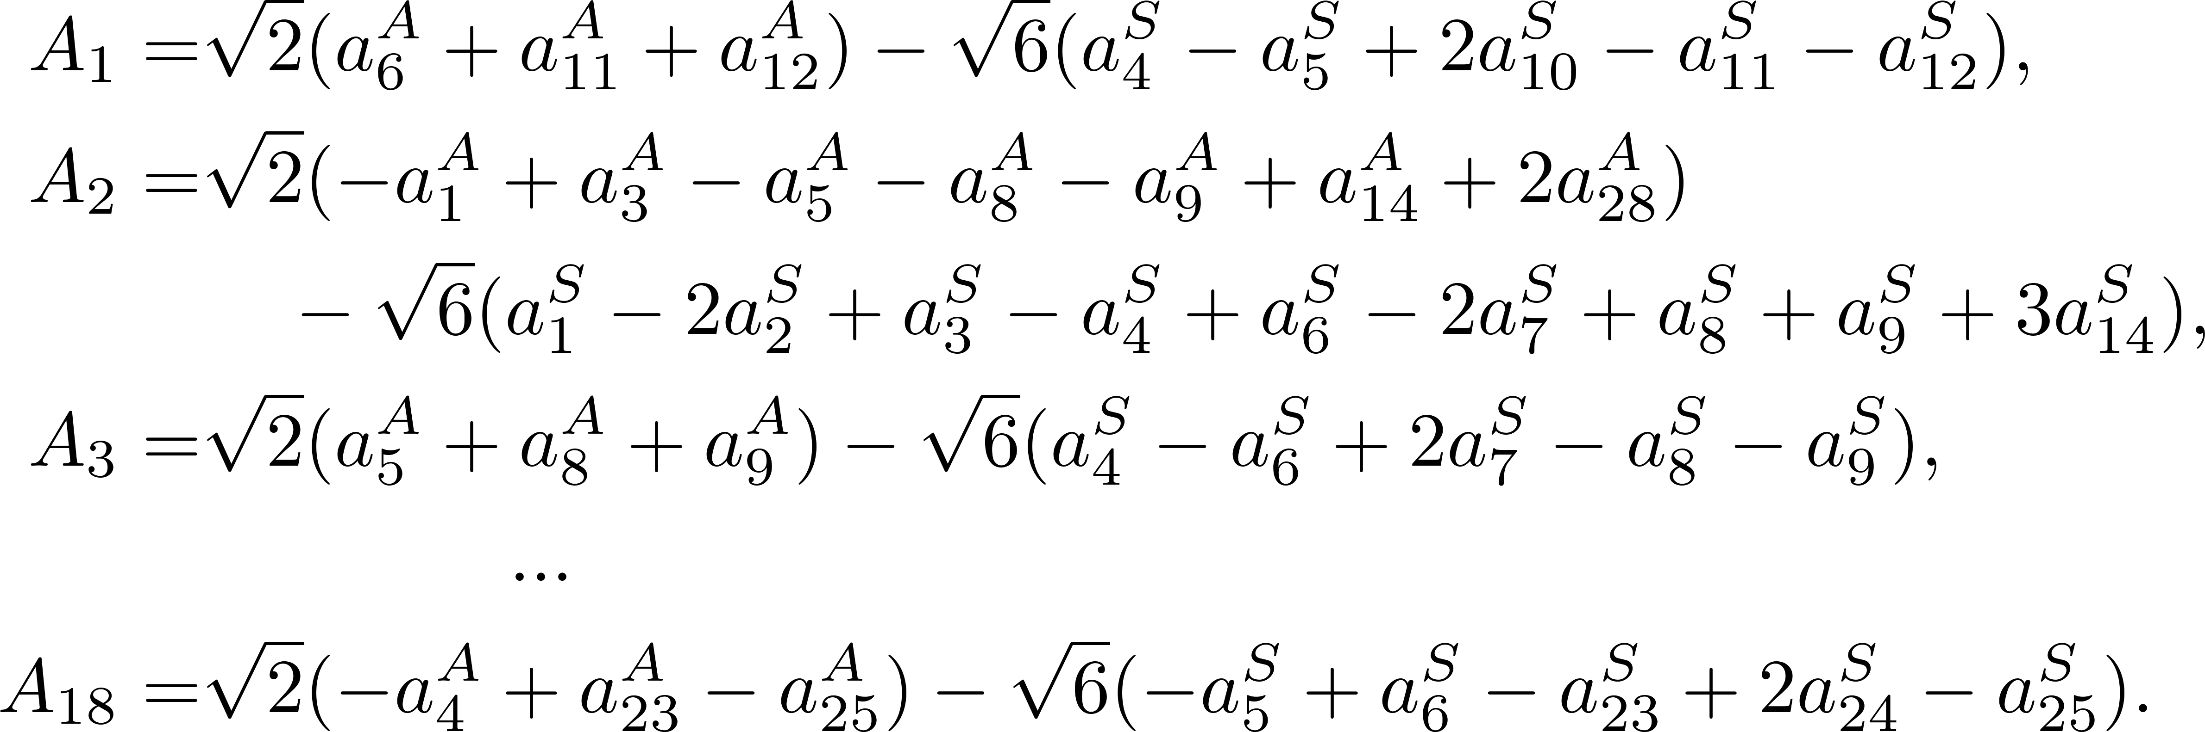

第八届粒子物理天问论坛
Relations between 3- and 2-rank amplitudes
D. Wang and J. F. Luo, Phys. Rev. D 110, no.9, 093001 (2024)
15

Slide 16

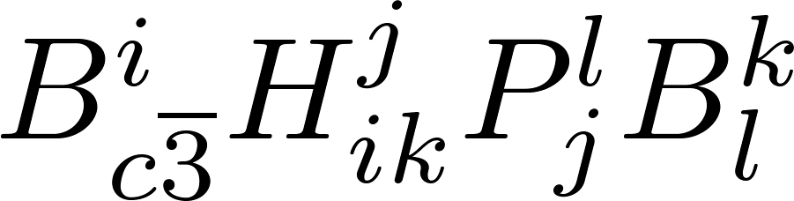
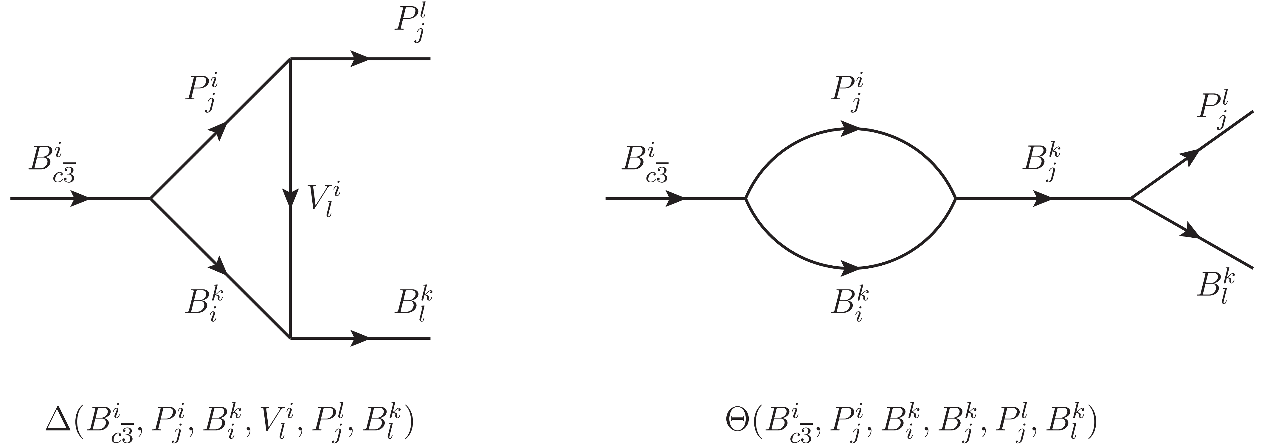
第八届粒子物理天问论坛
From topologies to re-scattering
U- and S-channels
16

Slide 17
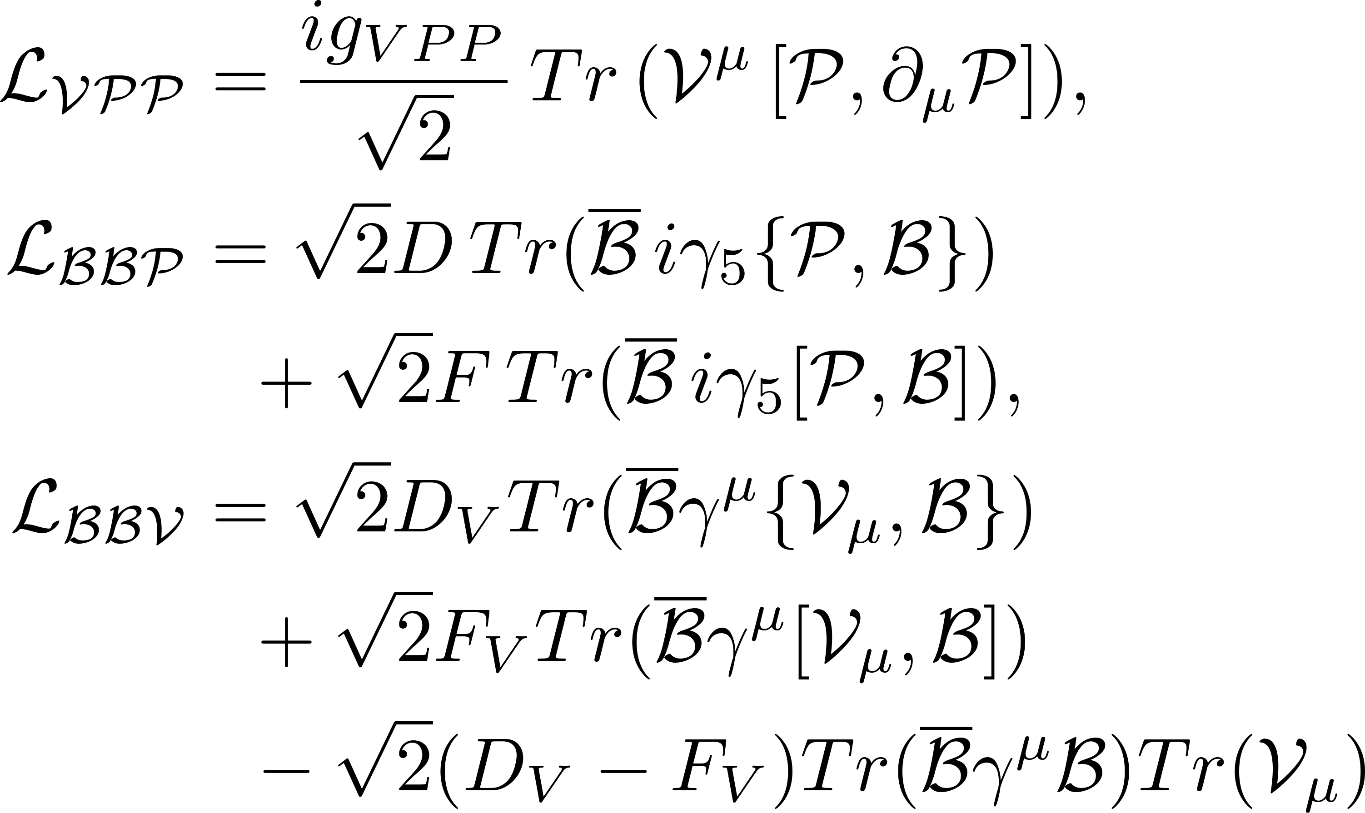
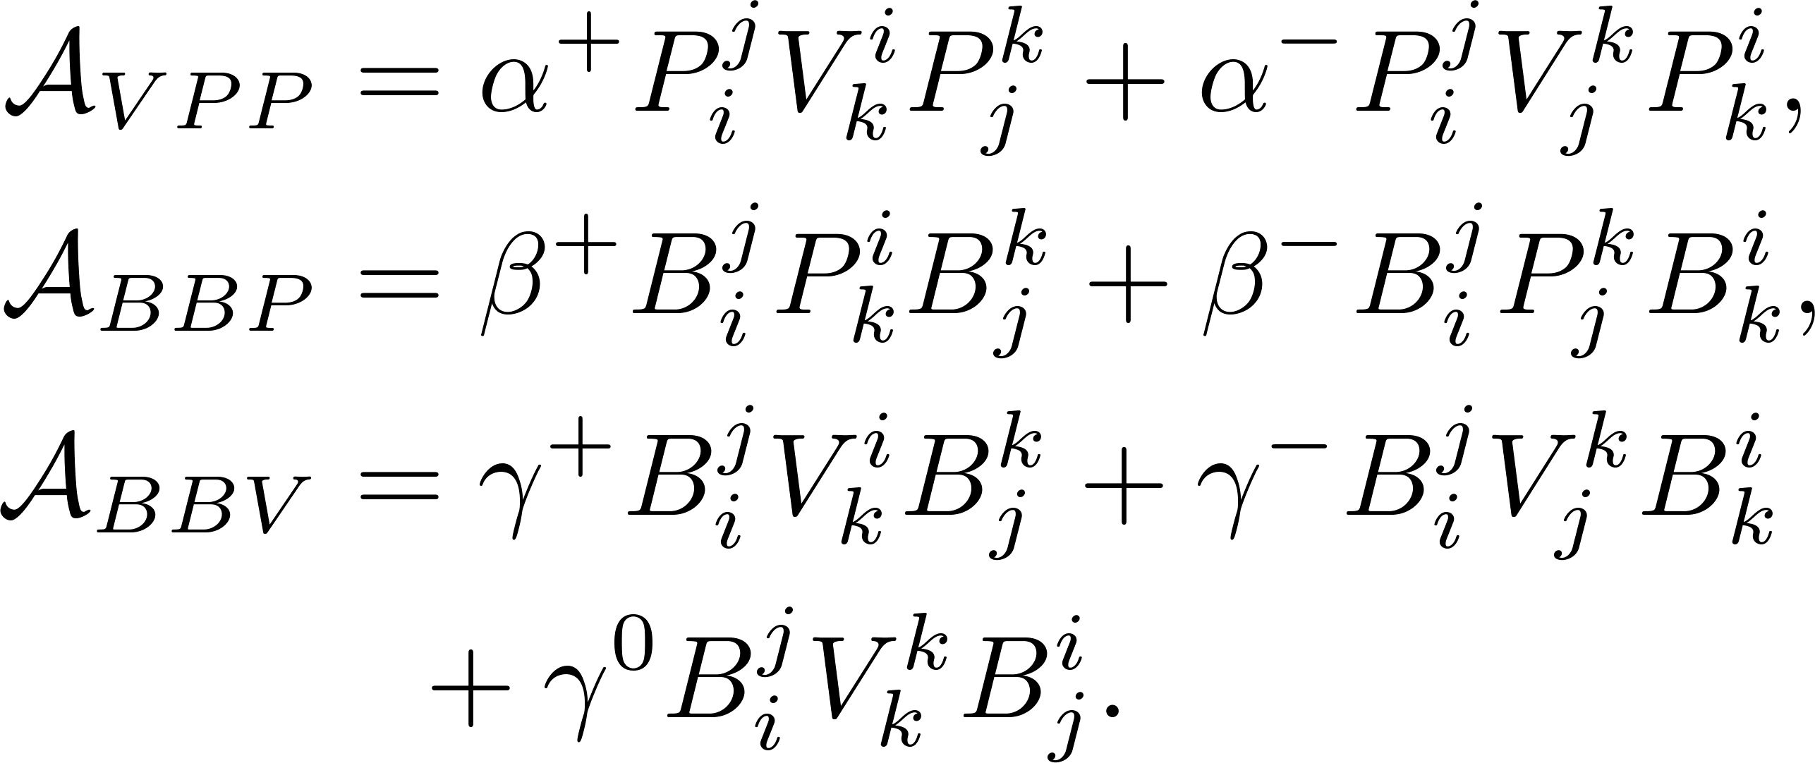
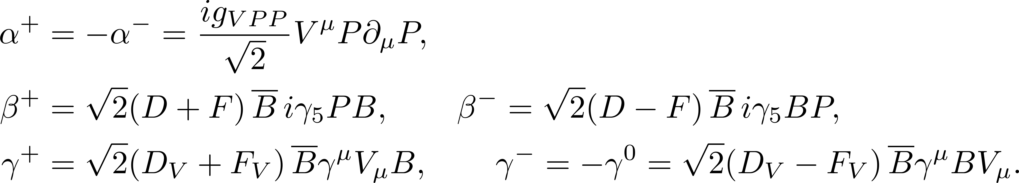
第八届粒子物理天问论坛
Strong coupling
Strong coupling in tensor
Chiral Lagrangian
Y. X. Lai and D. Wang, [arXiv:2507.06914 [hep-ph]].
17

Slide 18

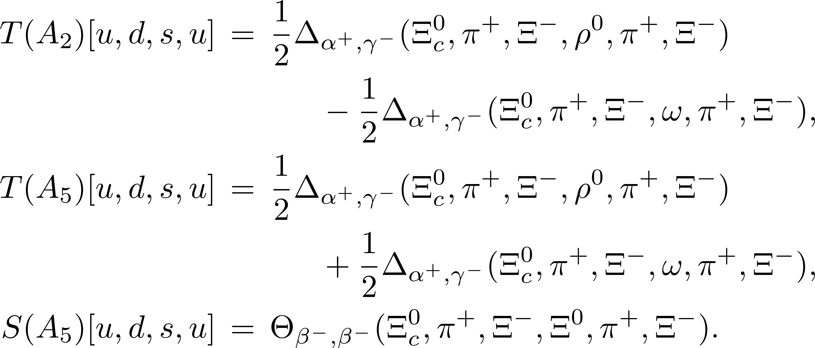
第八届粒子物理天问论坛
Examples
system
Consistent with the rescattering diagrams derived from Chiral Lagrangian directly !
C. P. Jia, H. Y. Jiang, J. P. Wang and F. S. Yu, JHEP 11, 072 (2024).
18

Slide 19
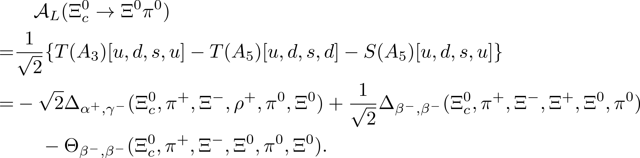
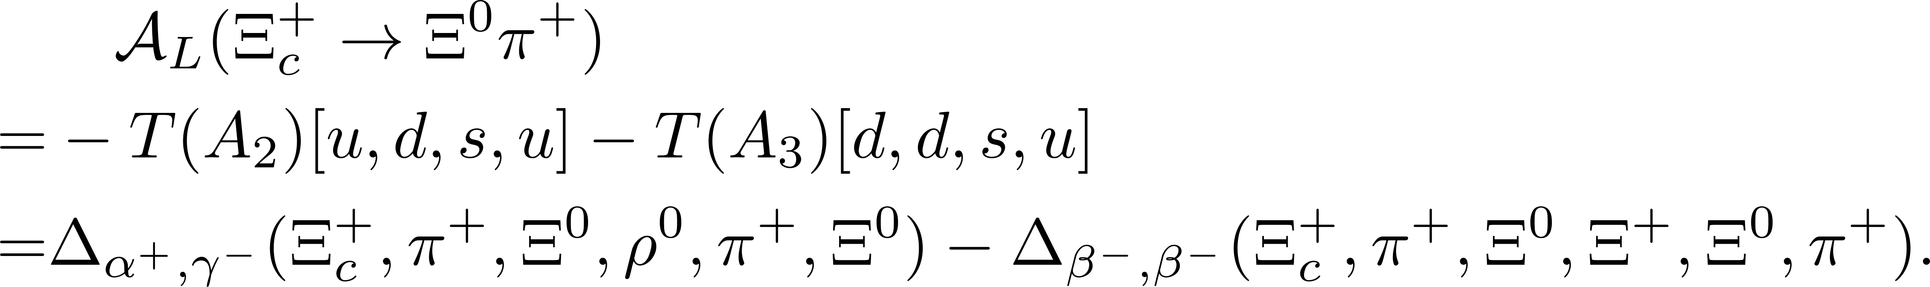
第八届粒子物理天问论坛
Examples
Isospin:
19

Slide 20
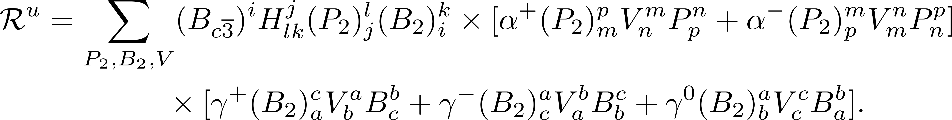
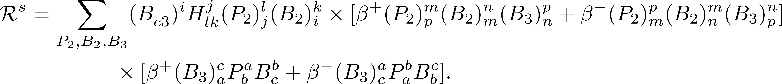
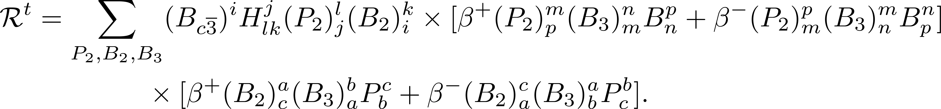
第八届粒子物理天问论坛
Flavor SU(3) limit
Tensor structures of u-, s-, and t-channels
Completeness relations
20

Slide 21
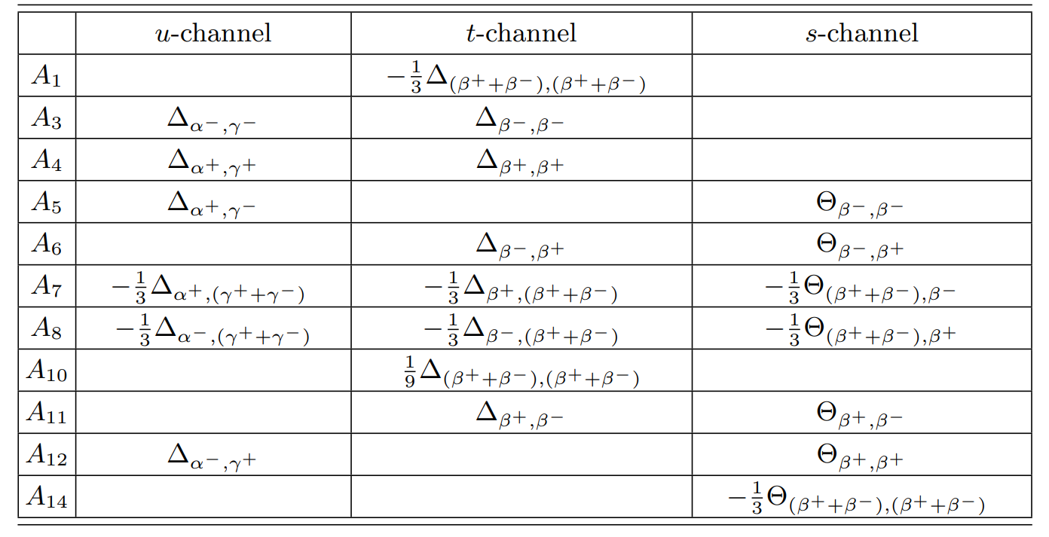
第八届粒子物理天问论坛
Flavor SU(3) limit
Y. X. Lai and D. Wang, [arXiv:2507.06914 [hep-ph]].
21

Slide 22
Contents
1
Motivation
2
From topologies to rescattering
3
Phenomenological analysis
4
Summary

Slide 23


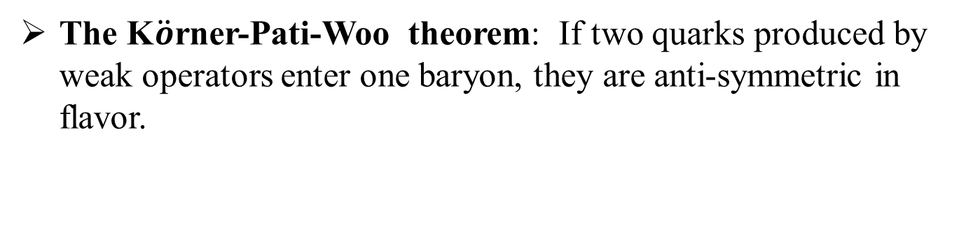

第八届粒子物理天问论坛
The K$\ddot{o}$rner-Pati-Woo theorem
The K$\ddot{o}$rner-Pati-Woo theorem: If two quarks produced by weak operators enter one baryon, they are anti-symmetric in flavor.
J. G. Korner, Nucl. Phys. B 25, 282-290 (1971).
J. C. Pati and C. H. Woo, Phys. Rev. D 3, 2920-2922 (1971).
Decay amplitudes: 9 5
Parameters:
Isospin symmetry + KPW theorem
C. Q. Geng, C. W. Liu and T. H. Tsai, Phys. Lett. B 794, 19-28 (2019).
23

Slide 24
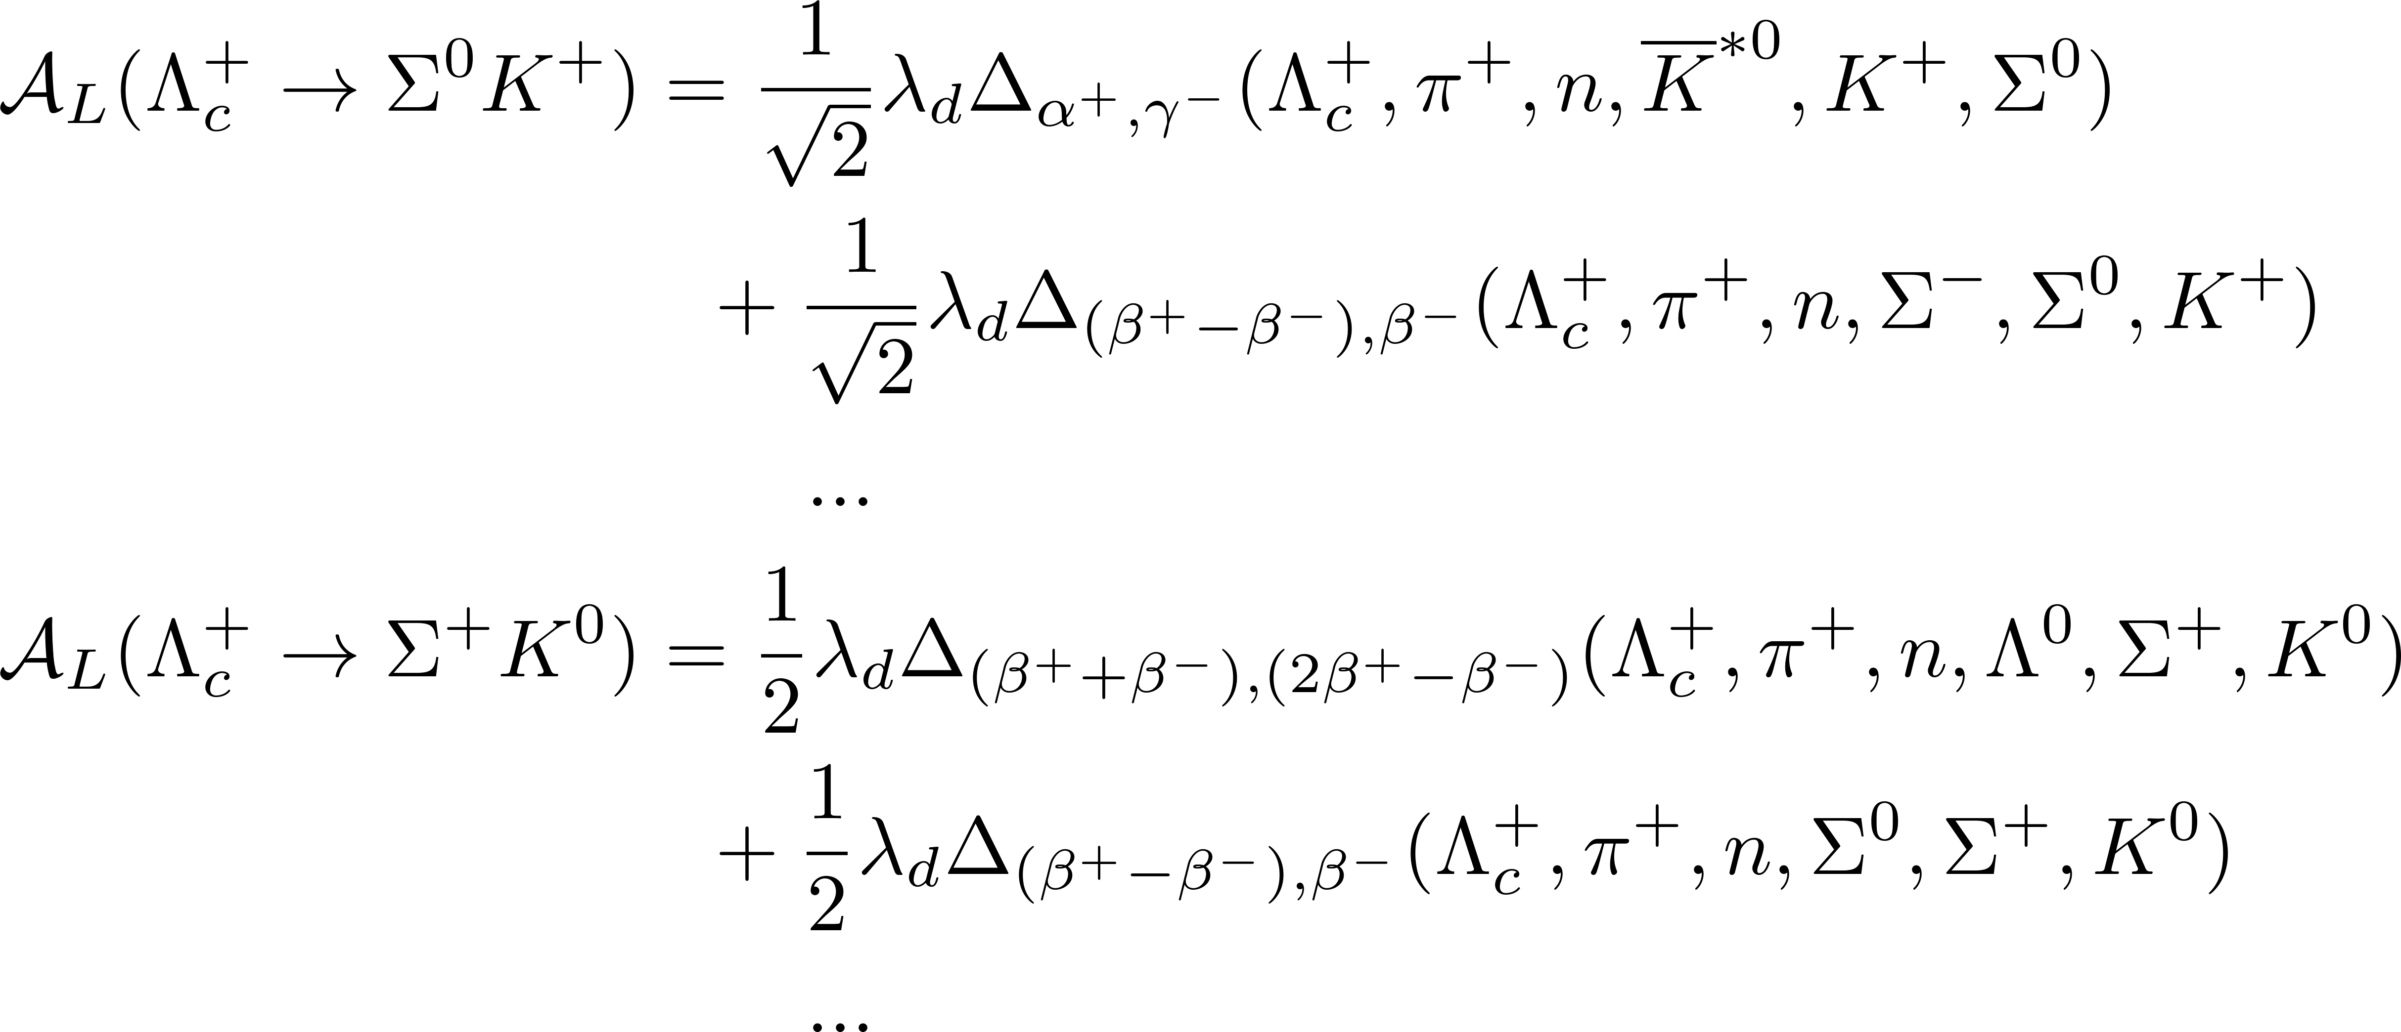
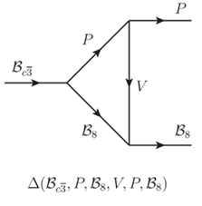
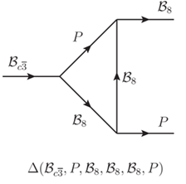
第八届粒子物理天问论坛
Final-state rescattering
Y. X. Lai and D. Wang, [arXiv:2507.06914 [hep-ph]].
24

Slide 25




第八届粒子物理天问论坛
Global fit
Fitting decay amplitudes: A₁, A₂, A₃, A₄, A₅, A₆, A₇, A₈, A₁₀=A₁/3
48 points,
31 parameters,
$$χ^{2}/.dnf=2.9$$
Y. X. Lai and D.Wang, [arXiv:2507.06914 [hep-ph]].
$$χ^{2}/.dnf=3.3$$
H. Y. Cheng, F. Xu and H. Zhong, Phys. Rev. D 112, no.5, 054022 (2025).
$$χ^{2}/.dnf=4.8$$
C. Yang, X. G. He and C. W. Liu, JHEP 09, 193 (2025).
25

Slide 26
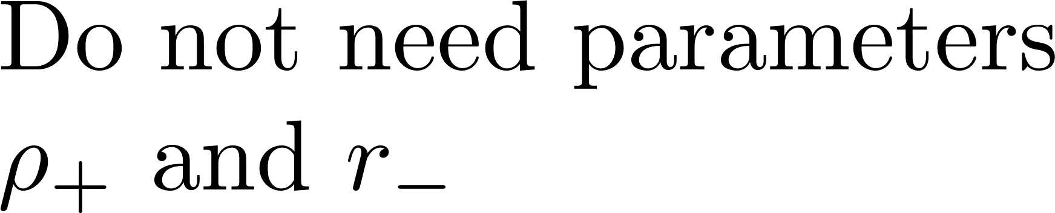
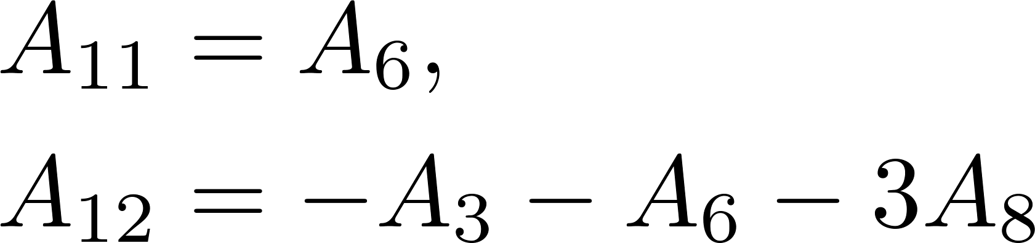
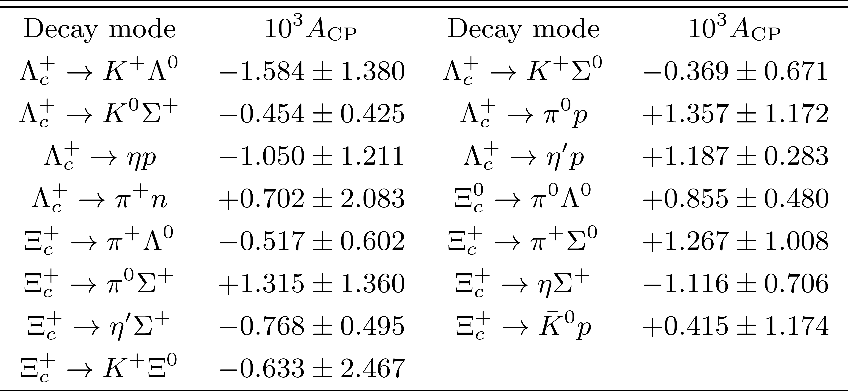
第八届粒子物理天问论坛
CP asymmetries
Amplitude relations
C. Yang, X. G. He and C. W. Liu & H. Y. Cheng, F. Xu and H. Zhong
26

Slide 27
第八届粒子物理天问论坛
Contents
1
Motivation
2
From topologies to rescattering
3
Phenomenological analysis
4
Summary

Slide 28
第八届粒子物理天问论坛
Summary
The correlation between topologies and rescattering in the charmed baryon decays is studied.
The rescattering amplitudes derived from topological diagrams are consistent with those derived from the ChPT.
CP asymmetries in charmed baryon decays are predicted.
Thanks for your attention!
28

