Slide 1
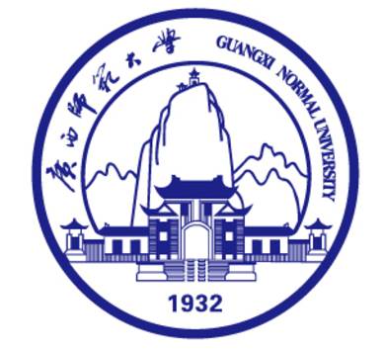
CP violation in charm decays into
neutral kaons
报告人： 赖颖鑫
单 位： 湖南师范大学
Cooperate with Di Wang
arXiv:2605.14899 [hep-ph]
arXiv:1707.09297 [hep-ph]

Slide 2
Contents
1
Motivation
2
CPV in charm decays into neutral kaons
3
Phenomenological analysis
4
Summary

Slide 3
Contents
1
Motivation
2
CPV in charm decays into neutral kaons
3
Phenomenological analysis
4
Summary

Slide 4
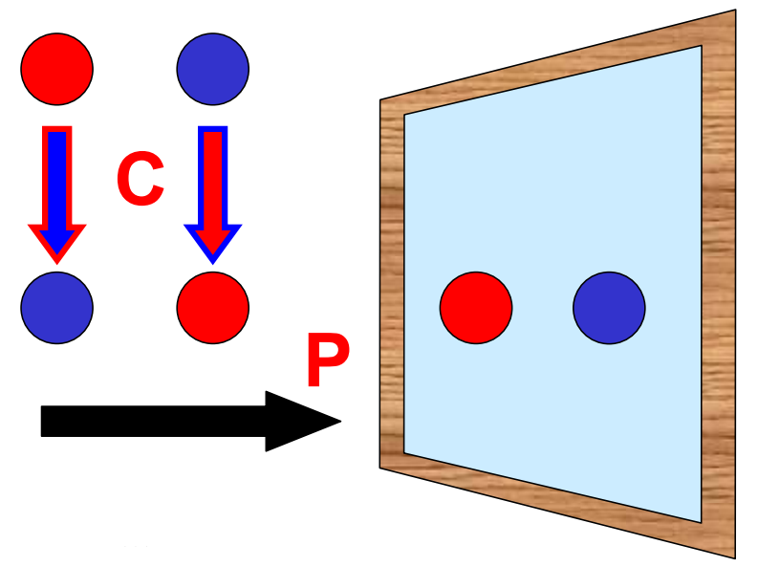
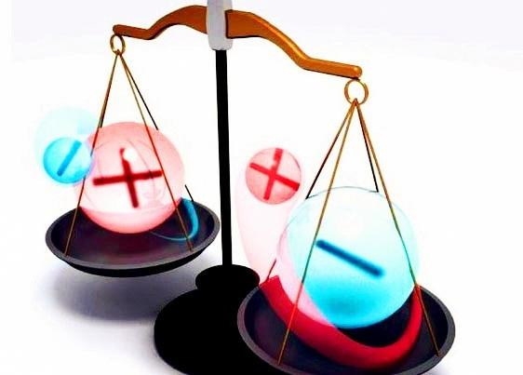
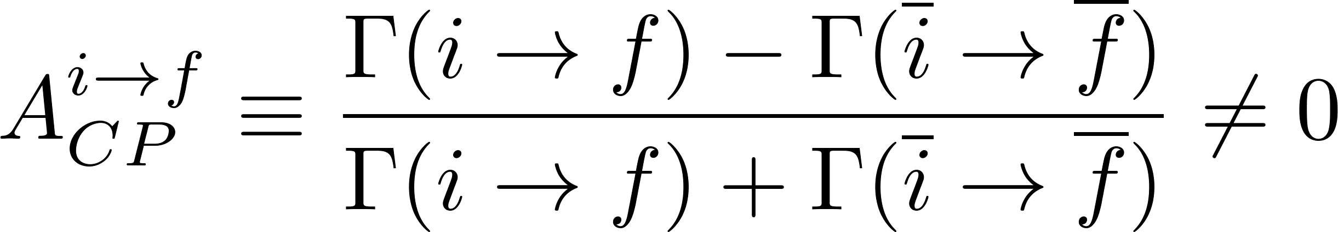

1
Motivation
CP Violation
Parity transformation:
Left-handed⟷ Right-handed
Charge conjugation transformation:
Particle ⟷ Antiparticle
CP violation:
CP is a crucial element in interpreting the matter-antimatter asymmetry in the Universe and serves as a window for new physics.

Slide 5
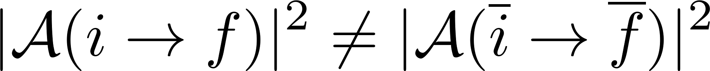
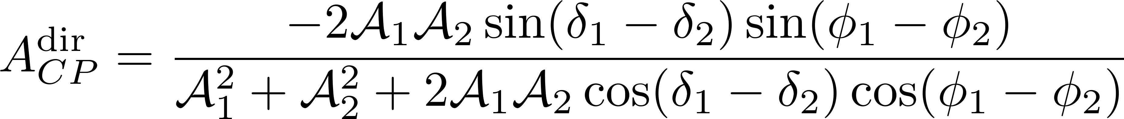
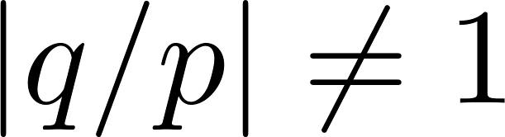
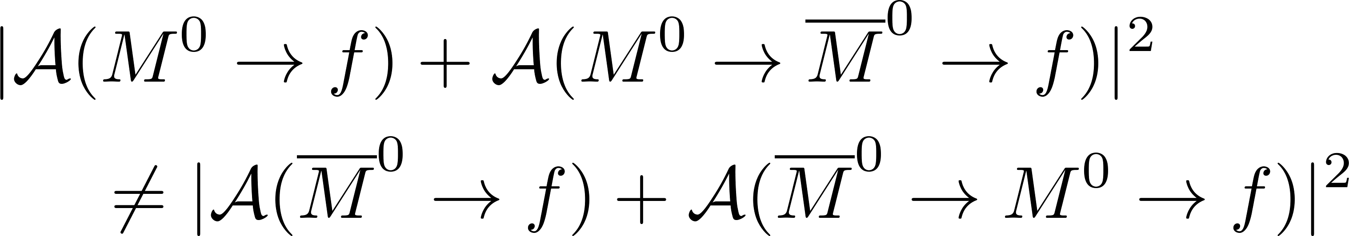
1
Motivation
Classification of CP Violation
Direct CP violation in particle decays
Indirect CP violation in neutral meson mixing
PDG
CP
CP violation in the interference between decay and mixing

Slide 6
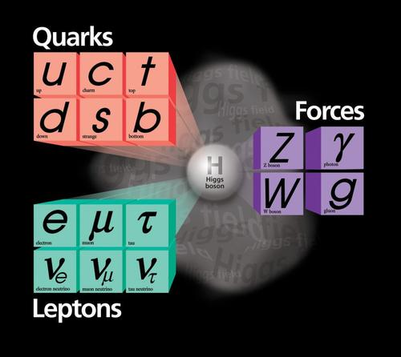
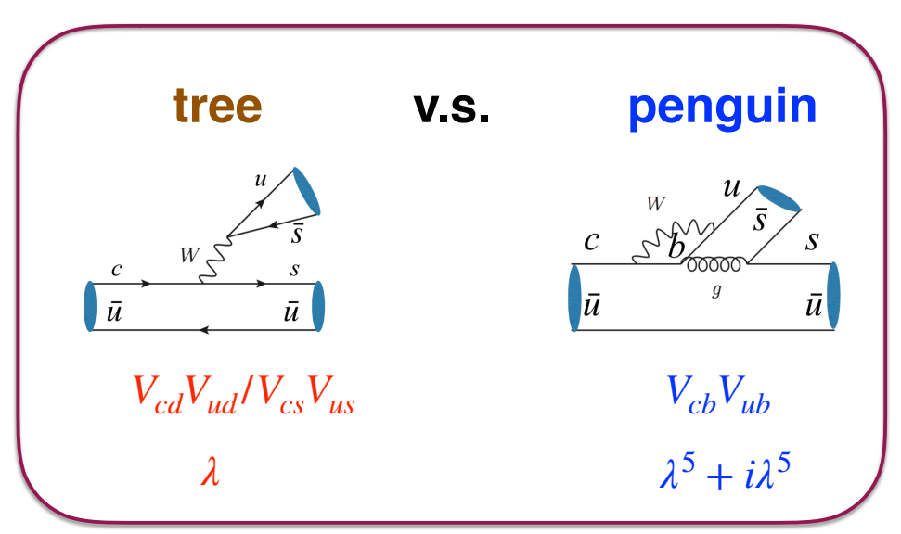
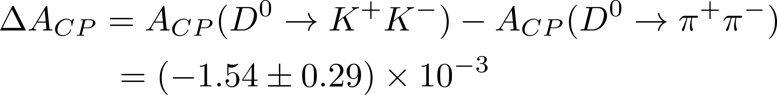
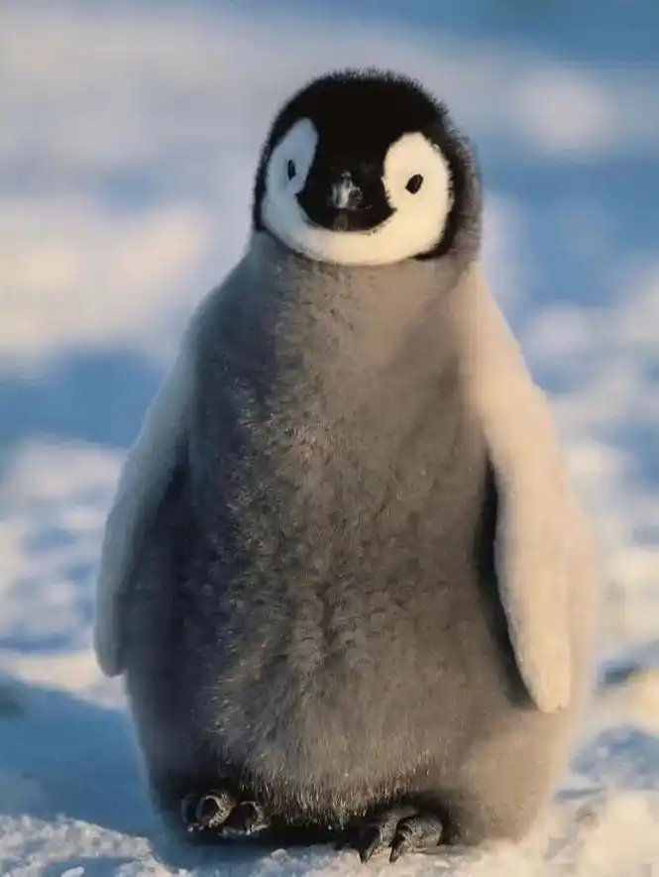
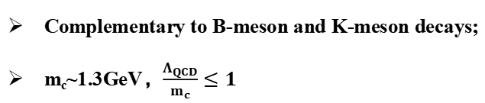
1
Motivation
D-meson decays
D mesons:
Complementary to B-meson and K-meson decays;
m_{c}~1.3GeV，$\frac{Λ_{QCD}}{m_{c}}≤1$
CP violation in SCS processes:
R.Aaij et al. [LHCb], Phys. Rev. Lett. 122, no.21, 211803 (2019).
Large Penguin or New physics ?

Slide 7
Contents
1
Motivation
2
CPV in charm decays into neutral kaons
3
Phenomenological analysis
4
Summary

Slide 8
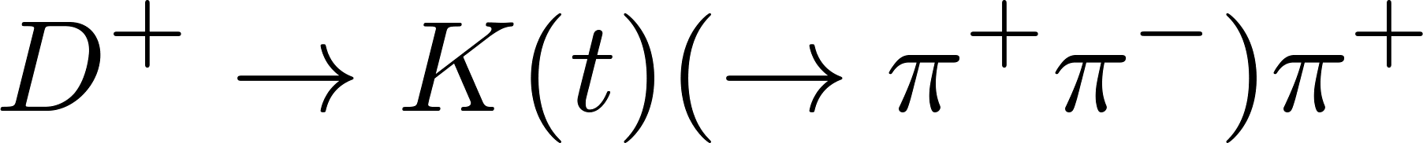
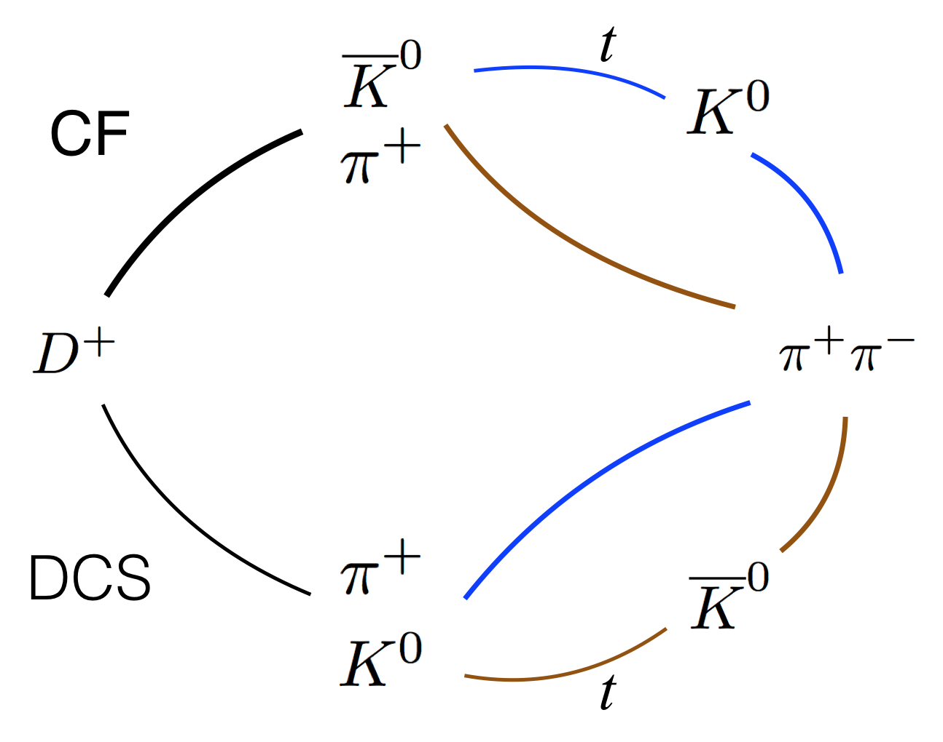
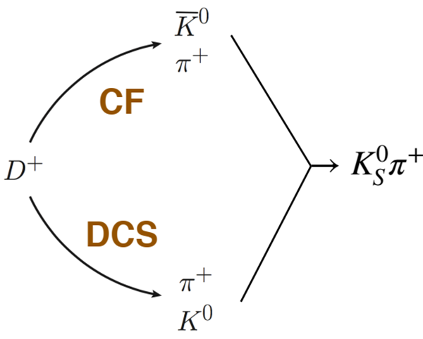


2
CPV in charm decays into neutral kaons
Complete decay chain
$$×$$
$$√$$
Neutral Kaon is reconstructed from its decay final states; what is observed in experiments is a decay chain.
The flight time (t) of the neutral Kaon must be considered.

Slide 9
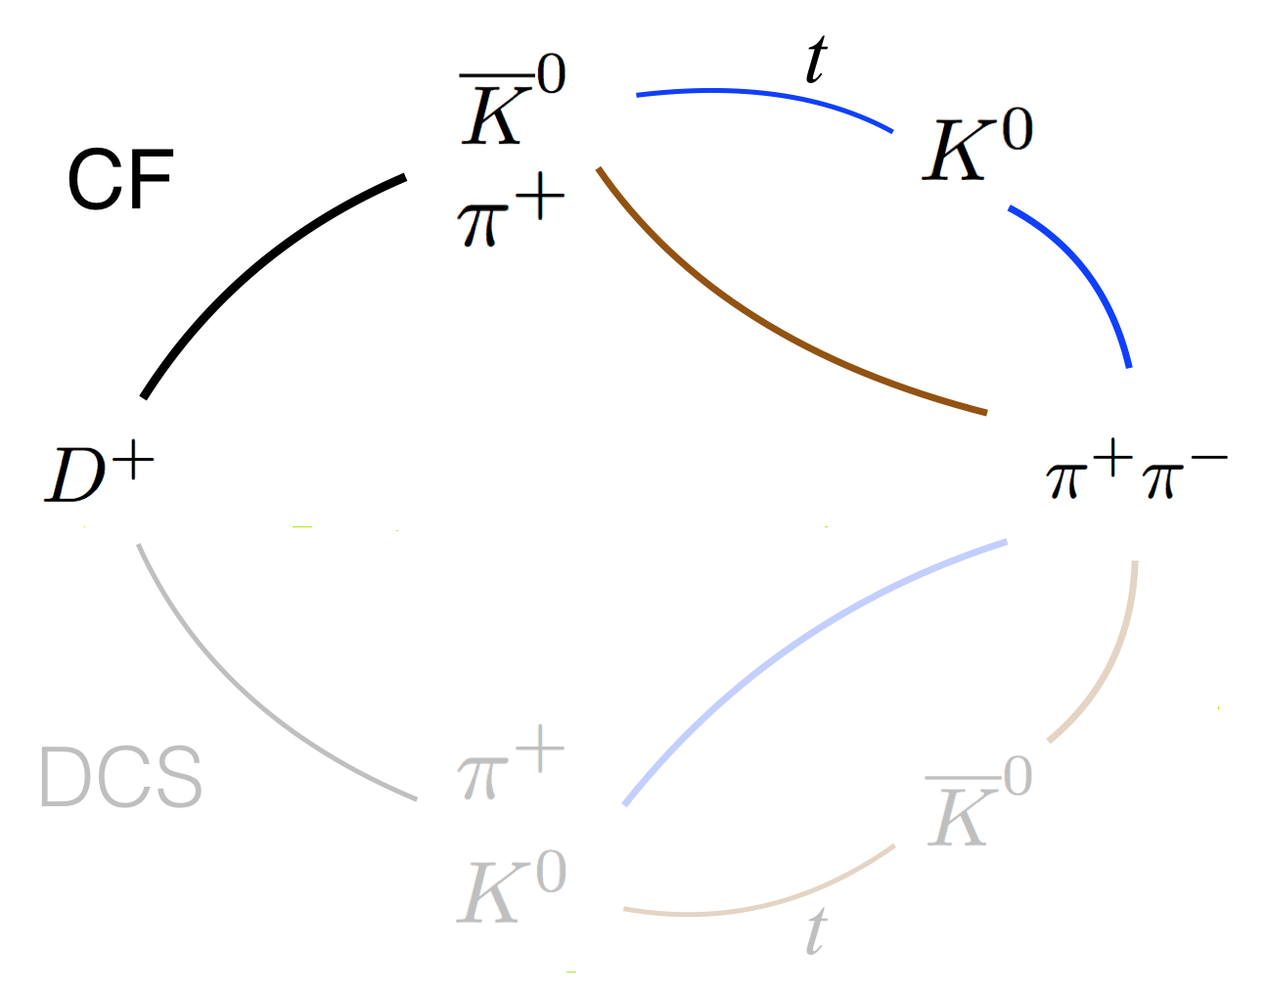
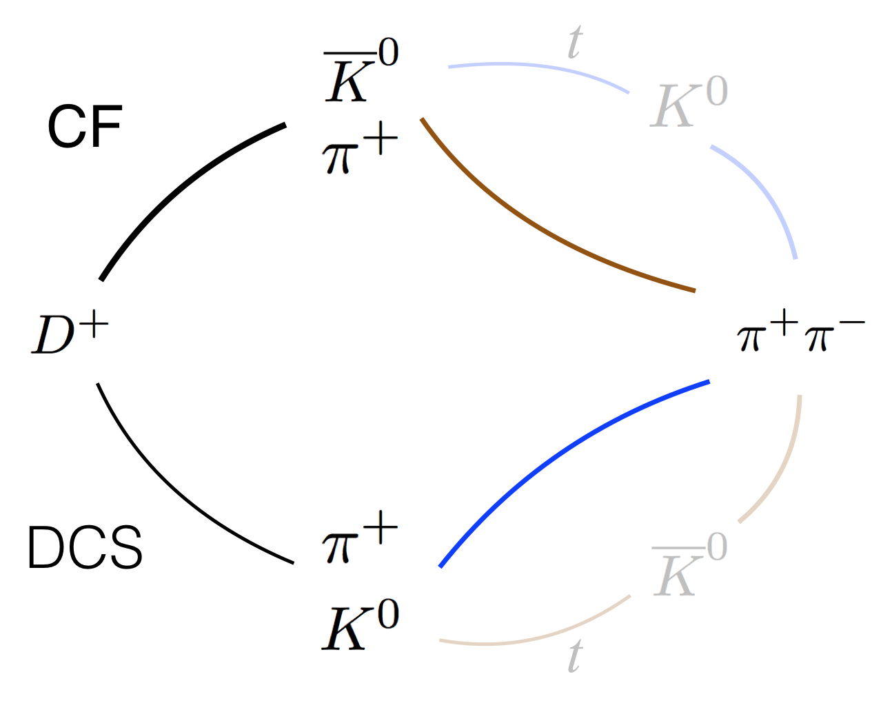
CP violation in
neutral Kaon mixing
Direct CP violation in D meson decays
Z.z. Xing, ’95
Bigi, Yamamoto, ’95

Slide 10
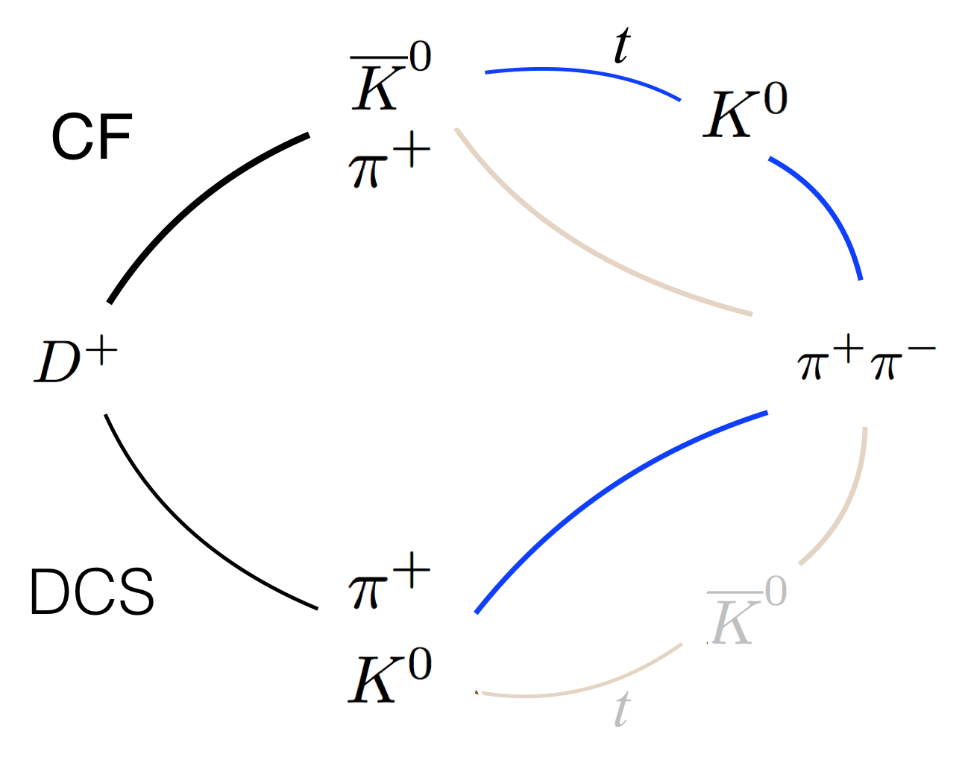
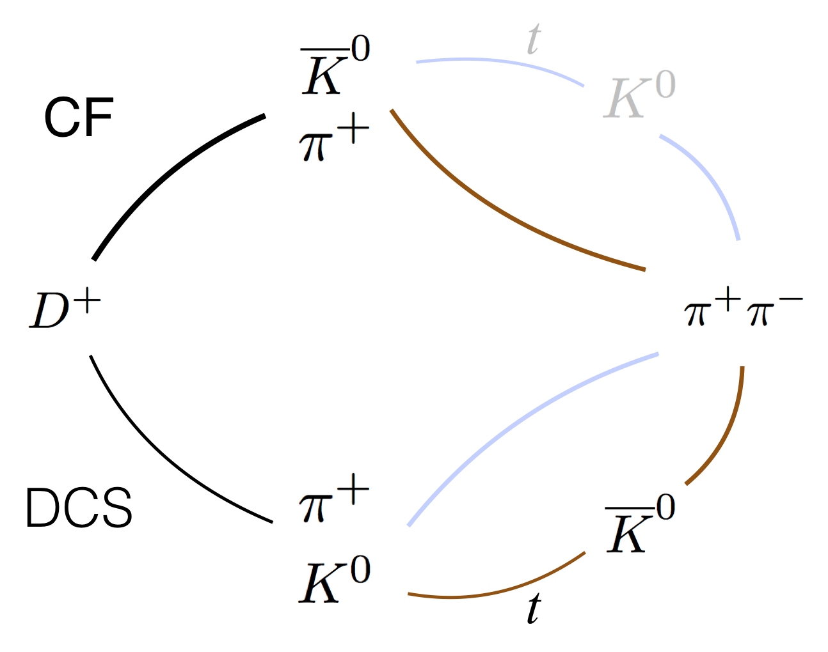
Interference between mother particle decay
and daughter particle mixing
D.Wang, F.S.Yu, H.n.Li, Phys.Rev.Lett 119, 181802 (2017).

Slide 11
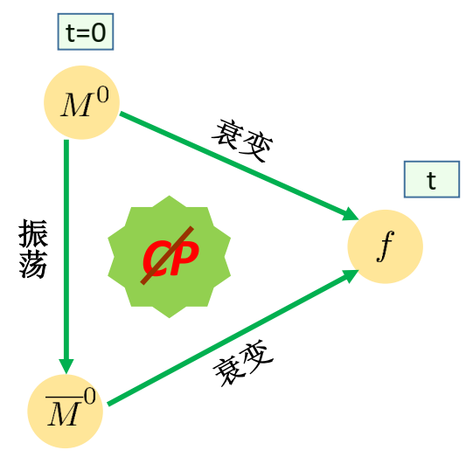
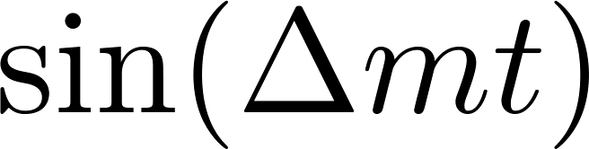
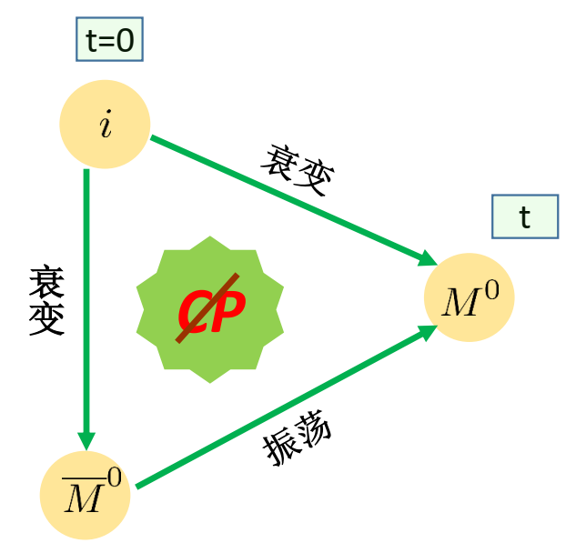
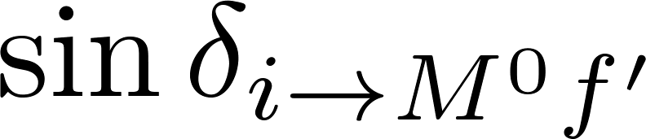
2
CPV in charm decays into neutral kaons
Novel CP violation
Direct CP violation in particle decays
Indirect CP violation in neutral meson mixing
CP violation in the interference between decay and mixing
Weak phase: Mixing of the neutral mother meson
Strong phase：
Interference between mother particle decay and daughter particle mixing
Weak phase: Mixing of the neutral daughter meson
Strong phase:
D.Wang, F.S.Yu, H.n.Li, Phys. Rev. Lett 119, 181802 (2017).

Slide 12
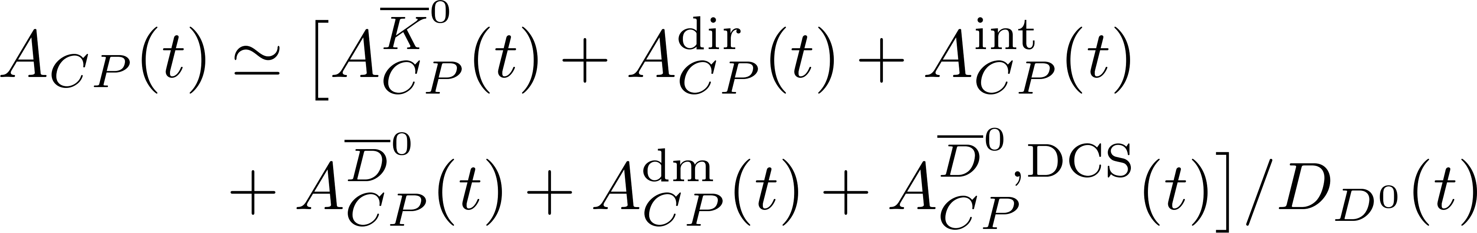
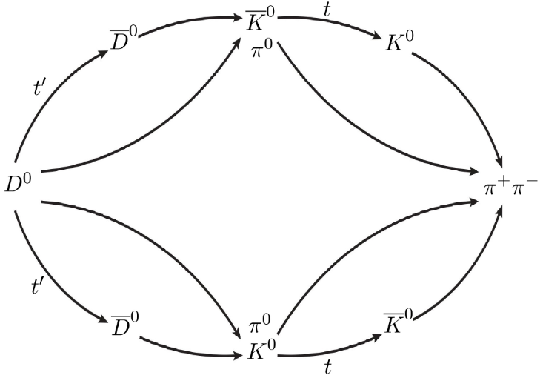
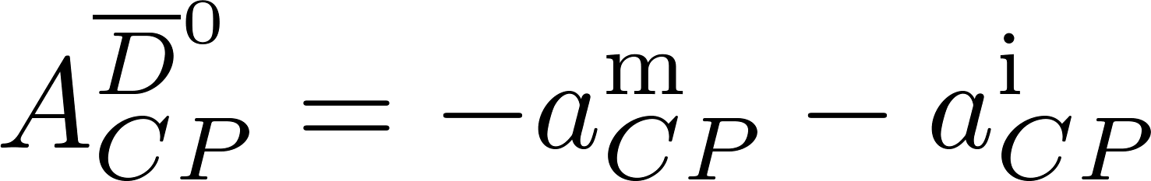
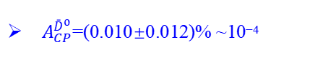
2
CPV in charm decays into neutral kaons
$D^{0}−{\bar{D}}^{0}$ Mixing
For neutral D meson decay modes, corrections from
$D^{0}−{\bar{D}}^{0}$ mixing are be considered:
Y. F. Shen, W. J. Song, Q. Qin, Phys.Rev.D 110, L031301 (2024)
$A_{CP}^{{\bar{D}}^{0}}$=(0.010±0.012)% ~10⁻⁴
HFAG

Slide 13
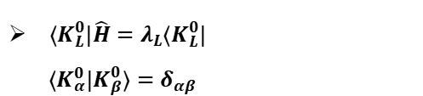
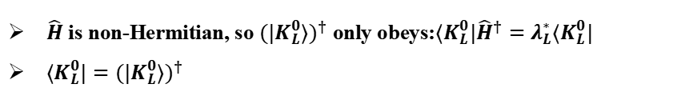

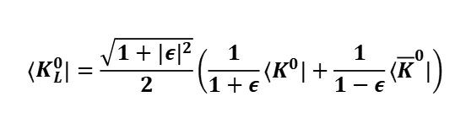
2
CPV in charm decays into neutral kaons
CP violation in $K_{L}^{0}$ modes
Time-integrated detection: $K_{L}^{0}$ is established as a mass eigenstate via direct detection (e.g. KLM detector at Belle)
Effective Hamiltonian: $\hat{H}=\hat{M}−\frac{i}{2}\hat{Γ}$
$\hat{H}$ is non-Hermitian, so $(|K_{L}^{0}⟩)^{†}$ only obeys:$⟨K_{L}^{0}|{\hat{H}}^{†}=λ_{L}^{∗}⟨K_{L}^{0}|$
$⟨K_{L}^{0}|=(|K_{L}^{0}⟩)^{†}$
Reciprocal basis method:
$$⟨K_{L}^{0}|=\frac{\sqrt{1+|ε|^{2}}}{2}\left(\frac{1}{1+ε}⟨K^{0}|+\frac{1}{1−ε}⟨{\overline{K}}^{0}|\right)$$
$⟨K_{L}^{0}|\hat{H}=λ_{L}⟨K_{L}^{0}|$
$⟨K_{α}^{0}|K_{β}^{0}⟩=δ_{αβ}$
The total CP asymmetry is approximately opposite to $K_{S}^{0}$
$$A_{CP}(D→K_{L}^{0}f)≈−\left[A_{CP}^{{\overline{K}}^{0}}+A_{CP}^{dir}+A_{CP}^{int}\right]/D′$$

Slide 14
Contents
1
Motivation
2
CPV in charm decays into neutral kaons
3
Phenomenological analysis
4
Summary

Slide 15
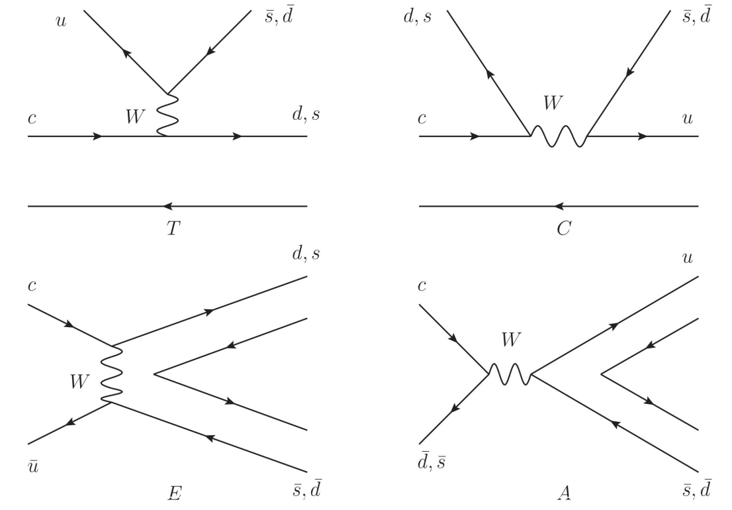


3
Phenomenological analysis
Topological Diagram Approach
Classified by quark flow
topologies in weak decays.
Absorb all perturbative &
non-perturbative strong effects.
Model-independent;
extracted from experimental data.
D→PP : Fitting T, C, E, and A;
CF + DCS modes, 17 branching fractions
D→PV : Fitting T_{P,V}, C_{P,V}, E_{P,V}, and A_{P,V};
CF + DCS modes, 26 branching fractions
$$χ^{2}/.dnf=2.2$$
$$χ^{2}/.dnf=3.1$$

Slide 16
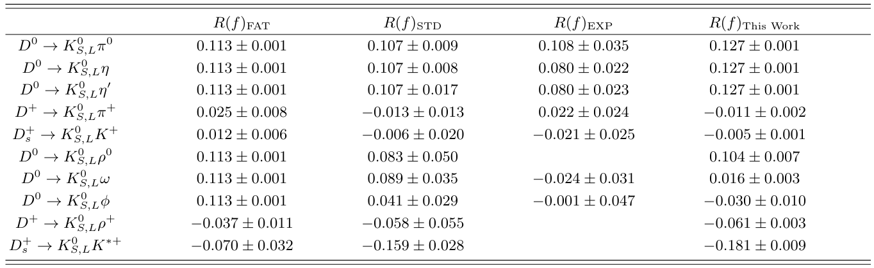
3
Phenomenological analysis
$K_{S}^{0} −K_{L}^{0}$ asymmetry
D. Wang, F. S. Yu, P. F. Guo and H. Y. Jiang, Phys. Rev. D 95, 073007 (2017).
H. Y. Cheng and C. W. Chiang, Phys. Rev. D 109, 073008 (2024).
Q. He et al., Phys. Rev. Lett. 100, 091801 (2008).
M. Ablikim et al., Phys. Rev. D 99, 112005 (2019).
M. Ablikim et al., Phys. Rev. D 105, 092010 (2022).

Slide 17
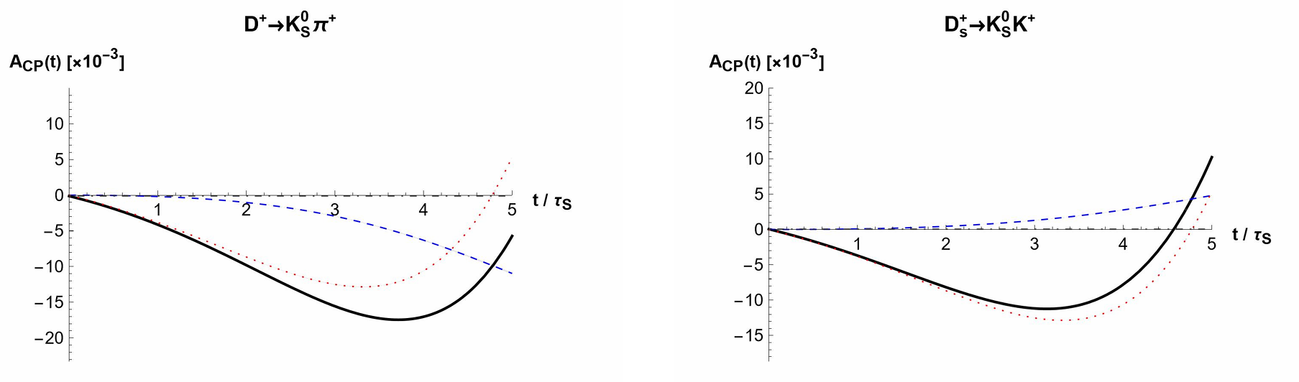
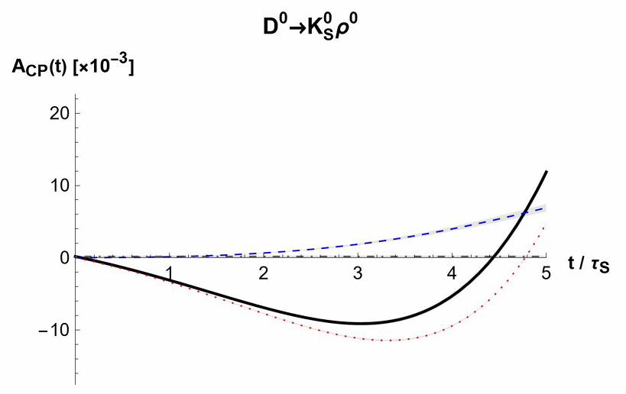
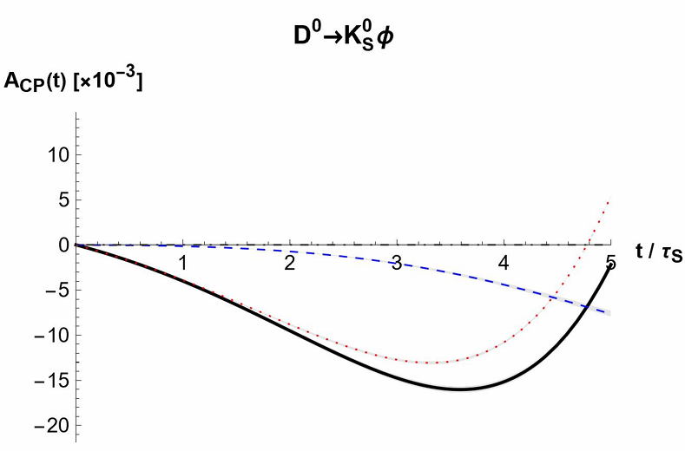
3
Phenomenological analysis
Time-dependent CP asymmetries

Slide 18
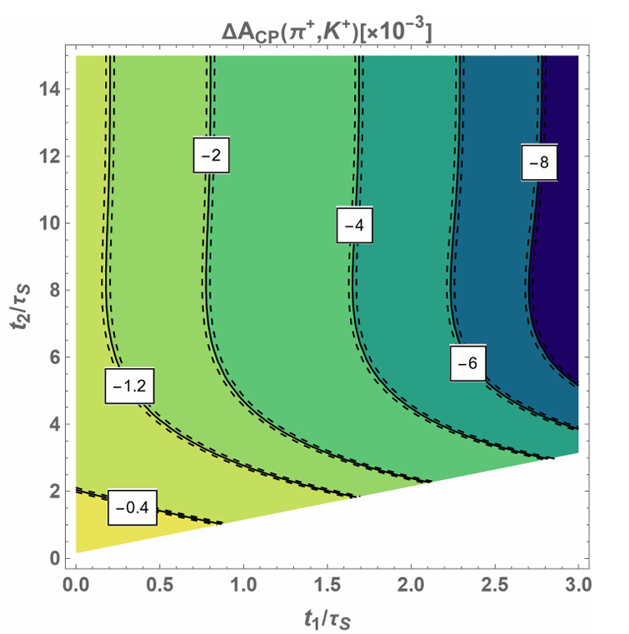
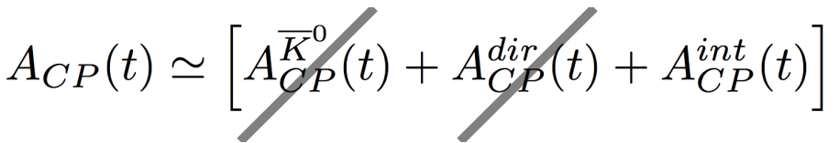
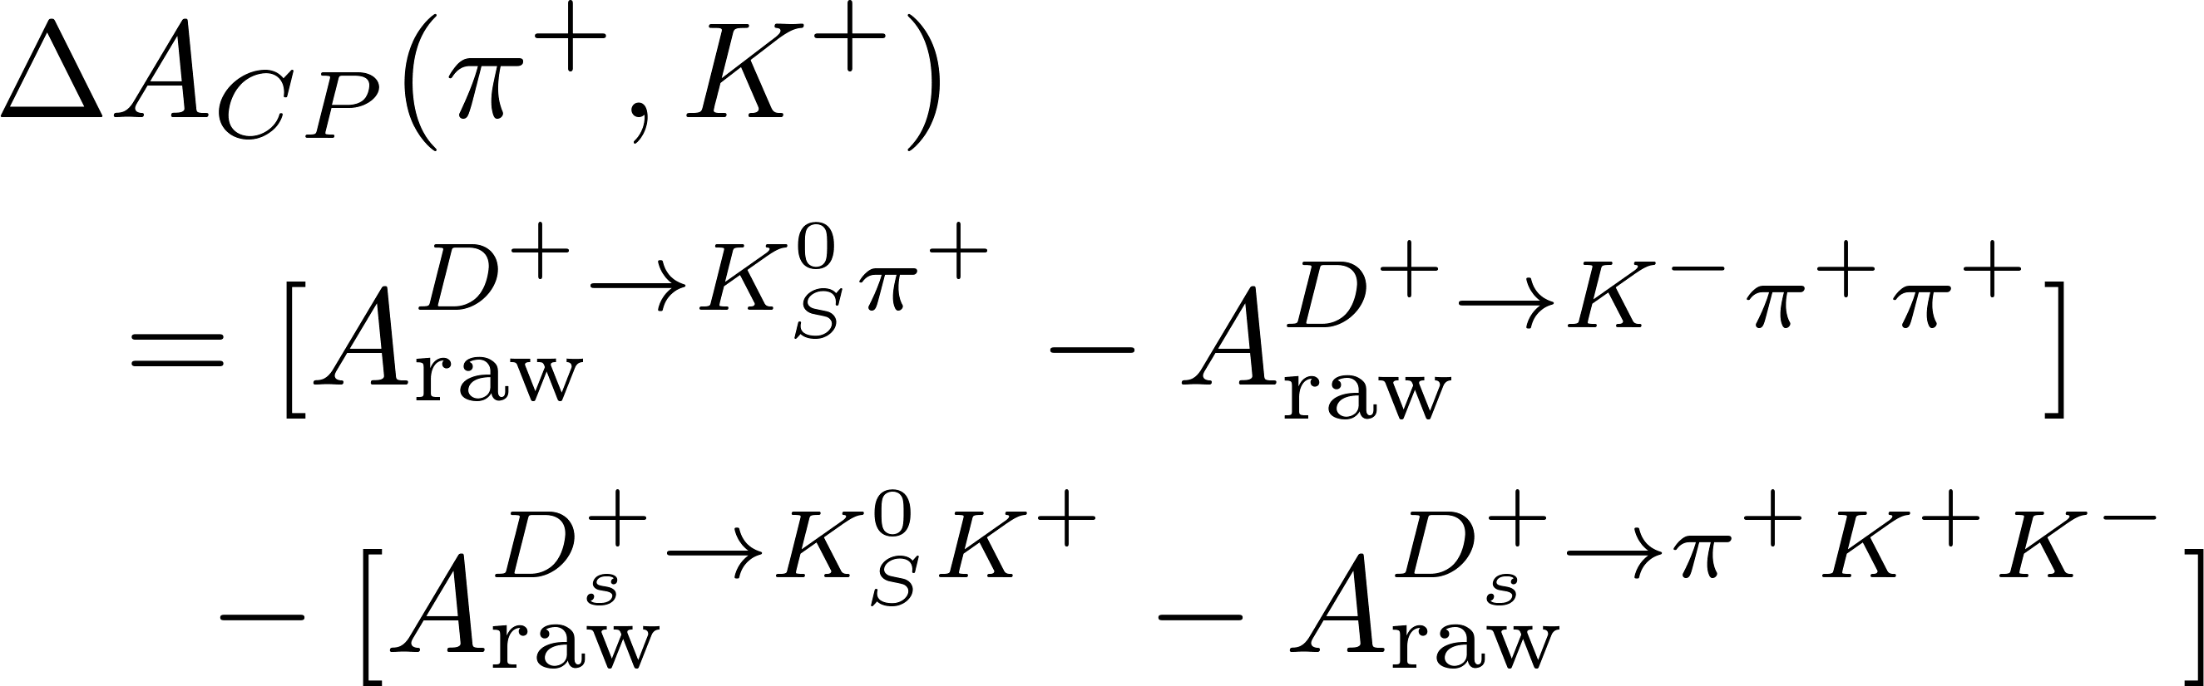
3
Phenomenological analysis
Observable
U-spin symmetry
Constructive
Cancel systematic uncertainties

Slide 19
Contents
1
Motivation
2
CPV in charm decays into neutral kaons
3
Phenomenological analysis
4
Summary

Slide 20

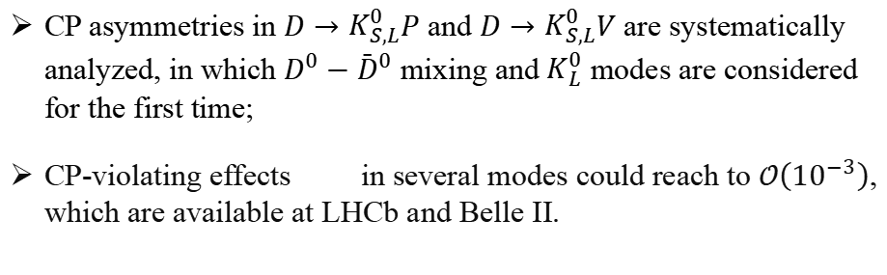
Summary
CP asymmetries in $D→K_{S,L}^{0}P$ and $D→K_{S,L}^{0}V$ are systematically analyzed, in which $D^{0}−{\bar{D}}^{0}$ mixing and $K_{L}^{0}$ modes are considered for the first time;
CP-violating effects in several modes could reach to $𝒪\left(10^{−3}\right)$, which are available at LHCb and Belle II.
Thanks for your attention!

