Slide 1


第八届粒子物理天问论坛—广西师范大学
U-spin sum rules for two-body decays of bottom baryons
报告人： 闻思佳
单 位：湖南师范大学
Cooperate with Di Wang，Wei-Chen Fu
arXiv:2508.09763v3 [hep-ph]

Slide 2
第八届粒子物理天问论坛—广西师范大学
Contents
1
Motivation
2
U-spin sum rules
3
Phenomenological analysis
4
Summary

Slide 3
第八届粒子物理天问论坛—广西师范大学
Contents
1
Motivation
2
U-spin sum rules
3
Phenomenological analysis
4
Summary

Slide 4
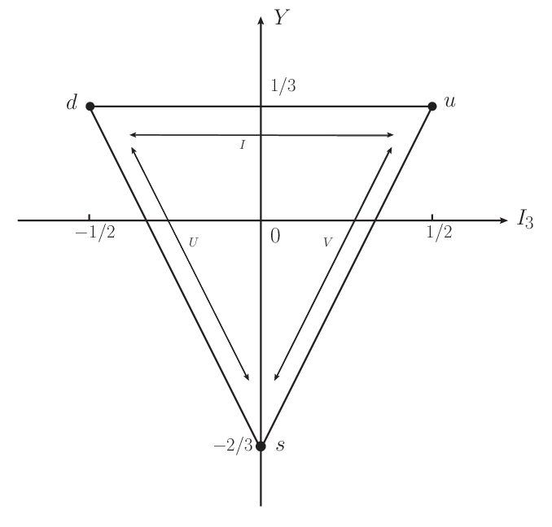
第八届粒子物理天问论坛—广西师范大学
U-spin symmetry
SU(3) symmetry
U-spin: d and s quarks
Connecting the weak phase and CP violation in decays
More powerful than isospin and V-spin
4

Slide 5
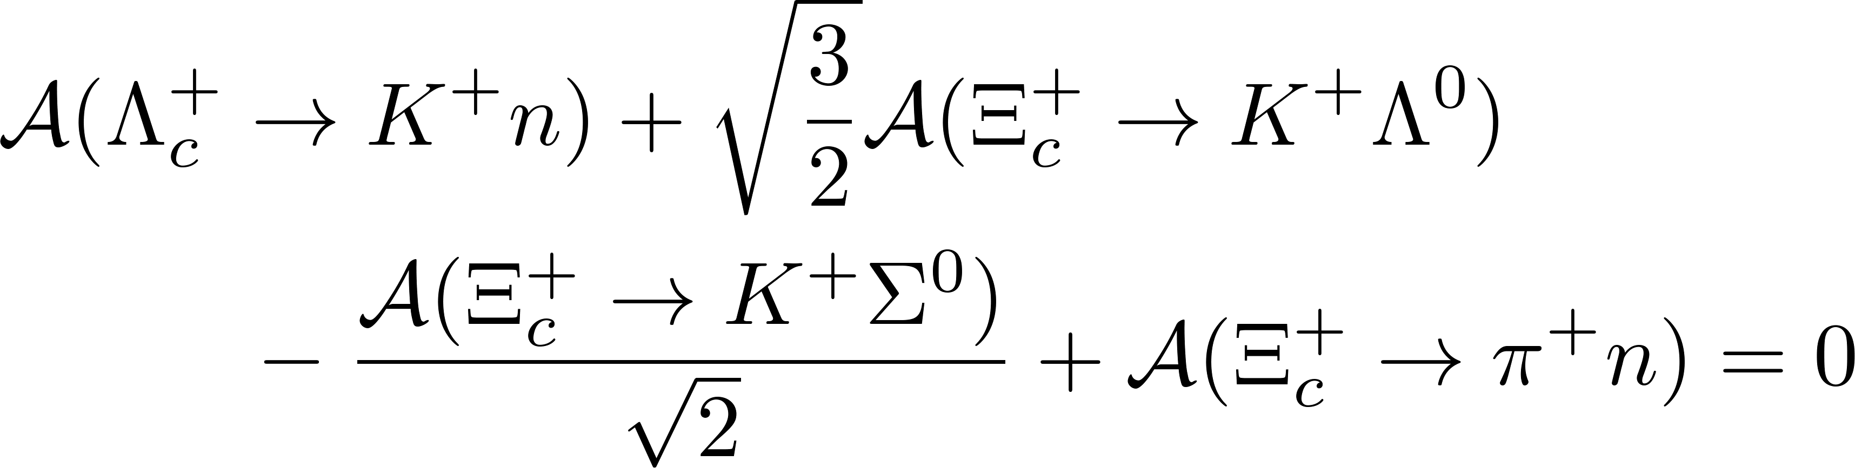
第八届粒子物理天问论坛—广西师范大学
U-spin sum rules
U-spin sum rules
Testing U-spin symmetry
Estimating branching fraction
Analyzing CP asymmetry
How to get U-spin sum rules effectively?
5

Slide 6
第八届粒子物理天问论坛—广西师范大学
Contents
1
Motivation
2
U-spin sum rules
3
Phenomenological analysis
4
Summary

Slide 7
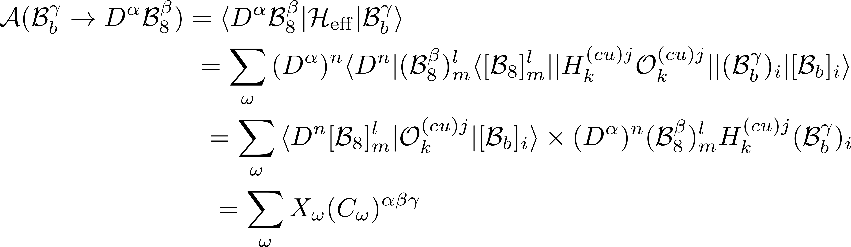
第八届粒子物理天问论坛—广西师范大学
Decay amplitudes and Flavor sum rules
If there exists an operator T, under which the Hamiltonian is invariant, TH = 0, the decay amplitude is zero under T.
D. Wang, JHEP 05, 064 (2023).
7

Slide 8
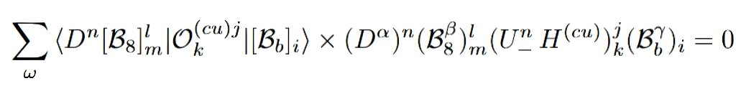
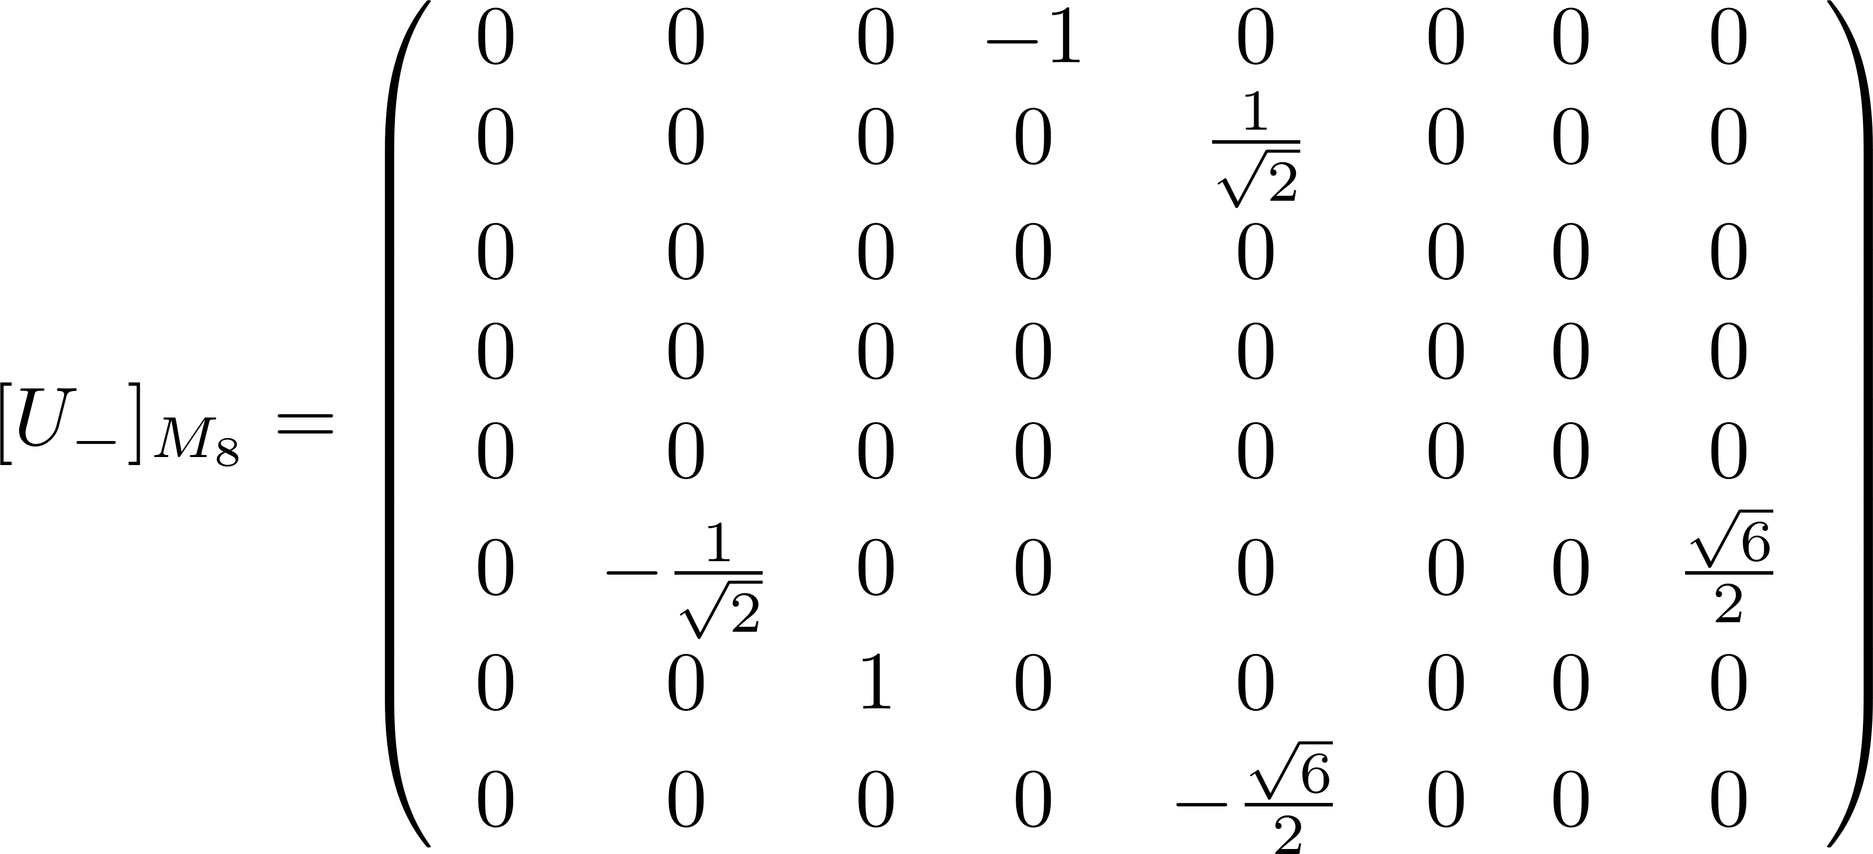
第八届粒子物理天问论坛—广西师范大学
U-spin sum rules - 1
To obtain U-spin sum rules, we apply operator U₋ to the initial/final states and compute coefficients expanded by the initial/final states
Basis
Apply I₋ to the initial/final states
8

Slide 9
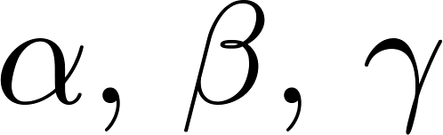
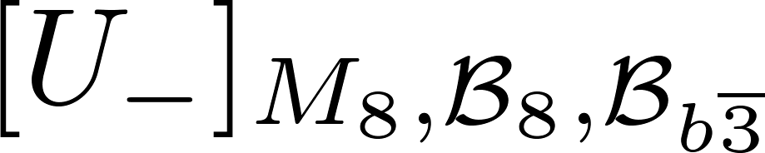
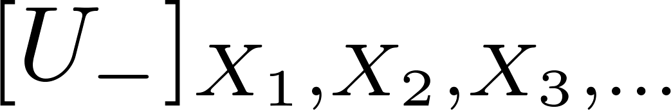
第八届粒子物理天问论坛—广西师范大学
U-spin sum rules - 1
U-spin sum rules are generated if appropriate are selected
Other decay modes:
S. J. Wen, W. C. Fu and D. Wang, [arXiv:2508.09763 [hep-ph]].
9

Slide 10
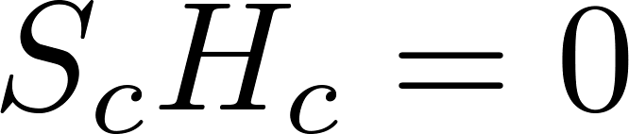
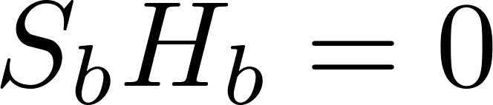
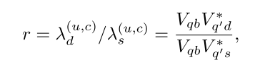
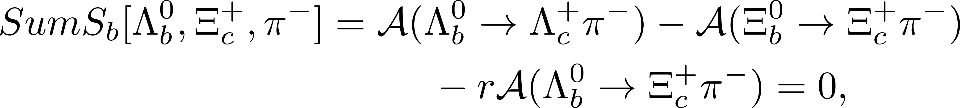
第八届粒子物理天问论坛—广西师范大学
U-spin sum rules - 2
The U-spin sum rules generated by U₋ involve only the CF, SCS, or DCS transition ( ) transition.
U-spin sum rules involve two or three decay types
Y. Grossman and D. J. Robinson, JHEP 04, 067 (2013).
S. J. Wen, W. C. Fu and D. Wang, [arXiv:2508.09763 [hep-ph]].
10

Slide 11
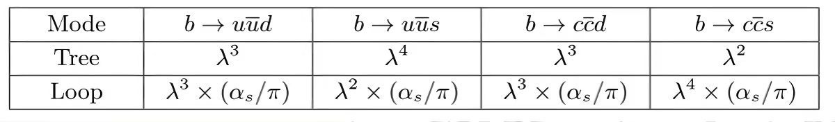


第八届粒子物理天问论坛—广西师范大学
U-spin sum rules - 2
Comparison of the magnitudes of tree contributions and quark-loop contributions
Quark-loop diagrams in the modes is larger than the U-spin breaking ×
Quark-loop diagrams in the modes is of the same order as or smaller than the U-spin breaking
11

Slide 12


第八届粒子物理天问论坛—广西师范大学
U-spin sum rules
Not all the U-spin sum rules are independent.
For a U-spin system, the number of independent U-spin sum rules is equal to the number of decay channels minus the number of U-spin amplitudes.
Six decay channels, two U-spin amplitudes
Four independent U-spin relations
12

Slide 13
第八届粒子物理天问论坛—广西师范大学
Contents
1
Motivation
2
U-spin sum rules
3
Phenomenological analysis
4
Summary

Slide 14



第八届粒子物理天问论坛—广西师范大学
Branching fractions
Use the U-spin sum rules together with experimentaldata to predict the branching fractions and Lee-Yang parameters of unobserved decay modes.
Use the branching fractions for two decay channels to estimate branching fraction for the third decay channel
14

Slide 15

第八届粒子物理天问论坛—广西师范大学
Sum rules beyond U-spin limit
U-spin breaking: ~ 30%
Direct use of limit rules → large theoretical uncertainty
Goal: Construct higher-precision sum rules
Why go beyond the limit?
Four decay channels are related by a single amplitude
Introduce the breaking parameter ϵ
Take modulus squared + Sum two U-spin conjugate channels → all ϵ terms cancel
✅ Uncertainty reduced from 30% to ~9%
15

Slide 16
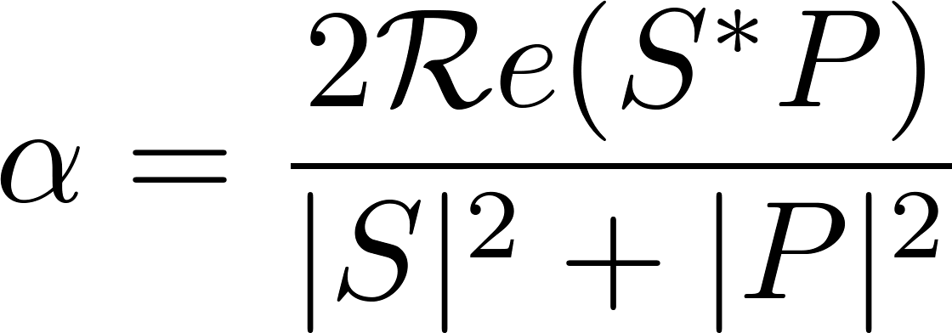
第八届粒子物理天问论坛—广西师范大学
Sum rules beyond U-spin limit
Generalization to decay parameters
similarly
Other decay modes
16

Slide 17
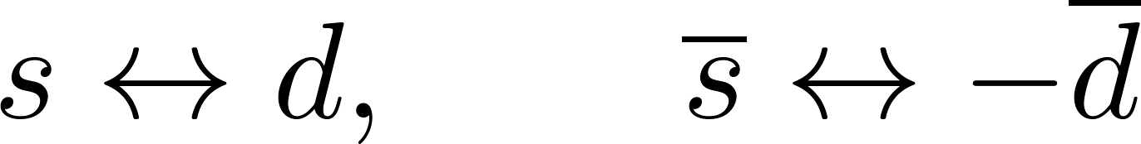
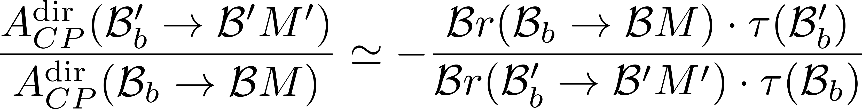
第八届粒子物理天问论坛—广西师范大学
Direct CPV
M. Gavrilova, Y. Grossman and S. Schacht, JHEP 08, 278 (2022).
U-spin conjugate modes
Example:
CPV relation:
M. Gronau, Phys. Lett. B 492, 297-302 (2000);
D. Wang, Eur. Phys. J. C 79, no.5, 429 (2019);
W. Wang, Z. P. Xing and Z. X. Zhao, Phys. Rev. D 111, no.5, 053006 (2025), …
17

Slide 18
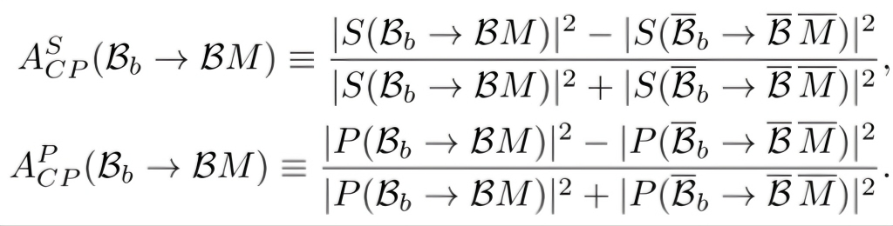
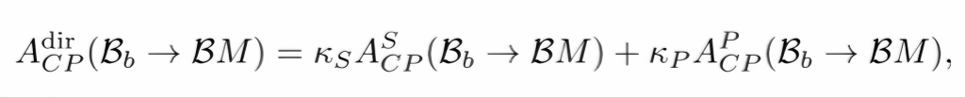
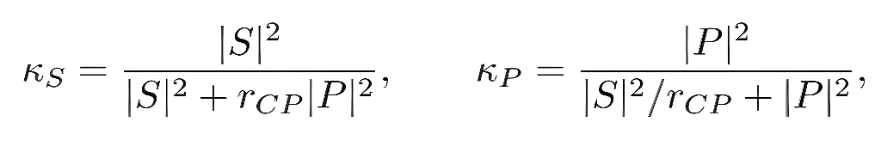
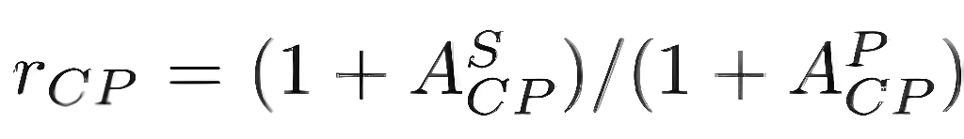
第八届粒子物理天问论坛—广西师范大学
CP asymmetries
S-wave and P-wave have different strong phases in baryon decays
Their contributions to CP violation are different
Why partial-wave analysis?
Partial-wave CP asymmetries
Total CP asymmetry = weighted sum
where
J. J. Han, J. X. Yu, Y. Li, H. n. Li, J. P. Wang, Z. J. Xiao and F. S. Yu, Phys. Rev. Lett. 134, no.22, 221801 (2025).
18

Slide 19
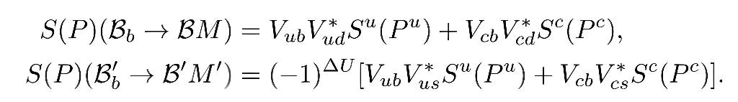
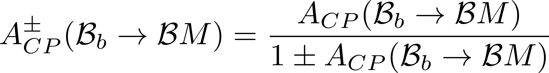
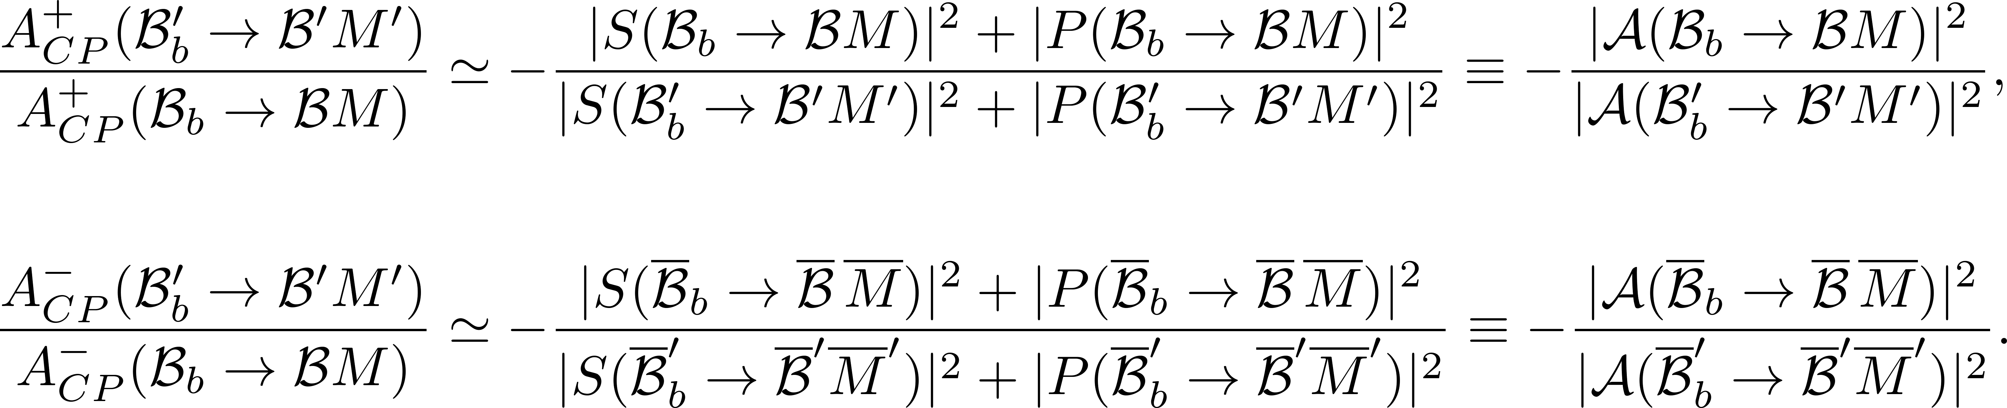
第八届粒子物理天问论坛—广西师范大学
CP asymmetries
Partial-wave U-spin amplitude relations
Final CPV relation
valid for large CP violation
19

Slide 20
第八届粒子物理天问论坛—广西师范大学
Contents
1
Motivation
2
U-spin sum rules
3
Phenomenological analysis
4
Summary

Slide 21
第八届粒子物理天问论坛—广西师范大学
Summary
Generating U-spin sum rules without decay amplitudes.
Sum rules beyond U-spin limit with percent-level precision.
Universal CP asymmetry relations for U-spin conjugate modes, valid for large CP violation.
Thanks for your attention!
21

