Slide 1




ATLAS High Granularity Timing Detector
Zhijun Liang
(The Institute of High Energy Physics, the Chinese Academy of Sciences)
梁志均 （中国科学院高能物理研究所）

Slide 2
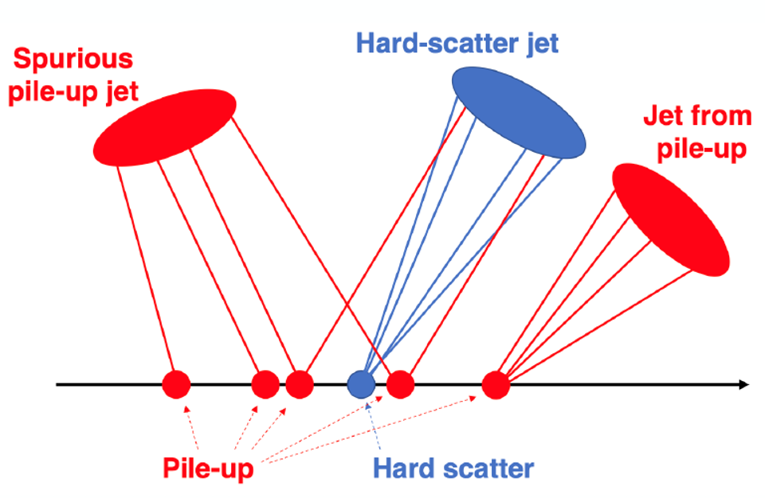
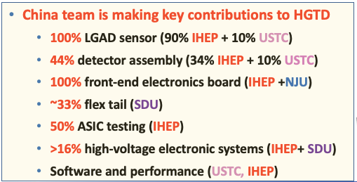
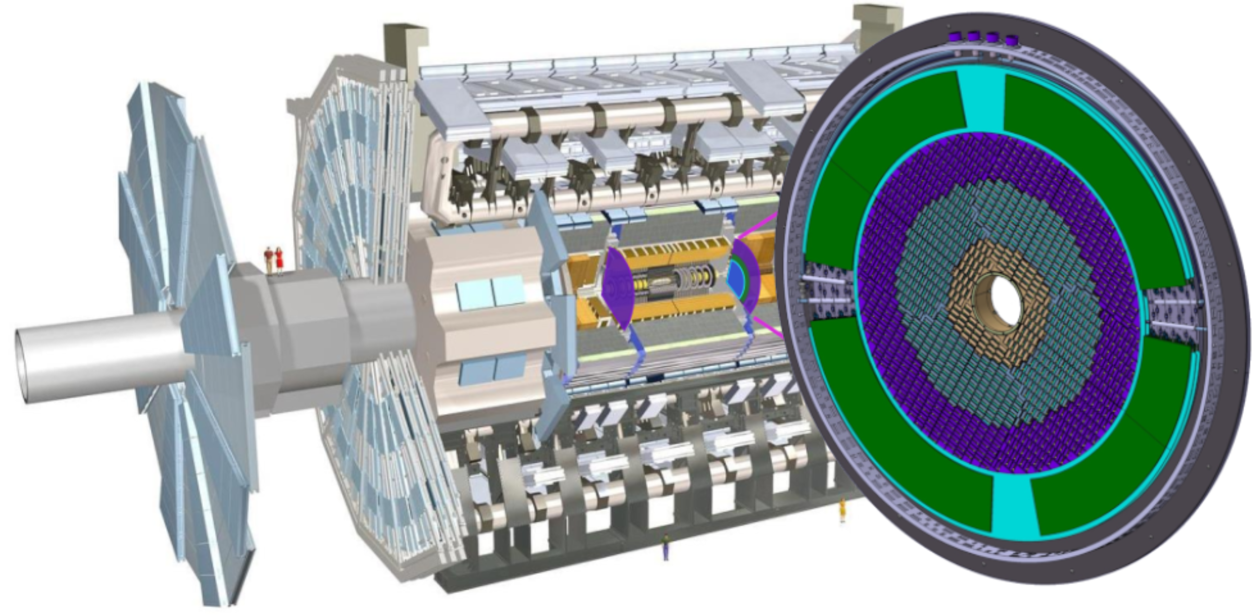
High Granularity Timing Detector (HGTD)
HGTD aim to reduce pileup contribution at HL-LHC
  Timing resolution is better than 30 ps (start) - 50 ps (end) ps per track
  6.4 m² area silicon detector and ~ 3.6 × 10⁶ channels
第一个用于对撞机实验的硅基高精度时间探测器
First silicon-based timing detector in particle physics

Slide 3
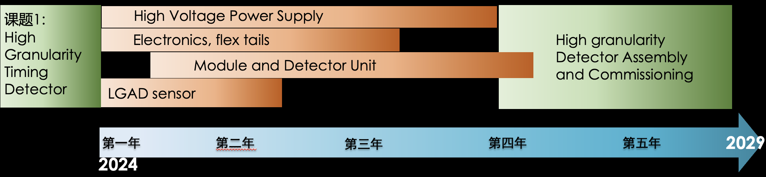
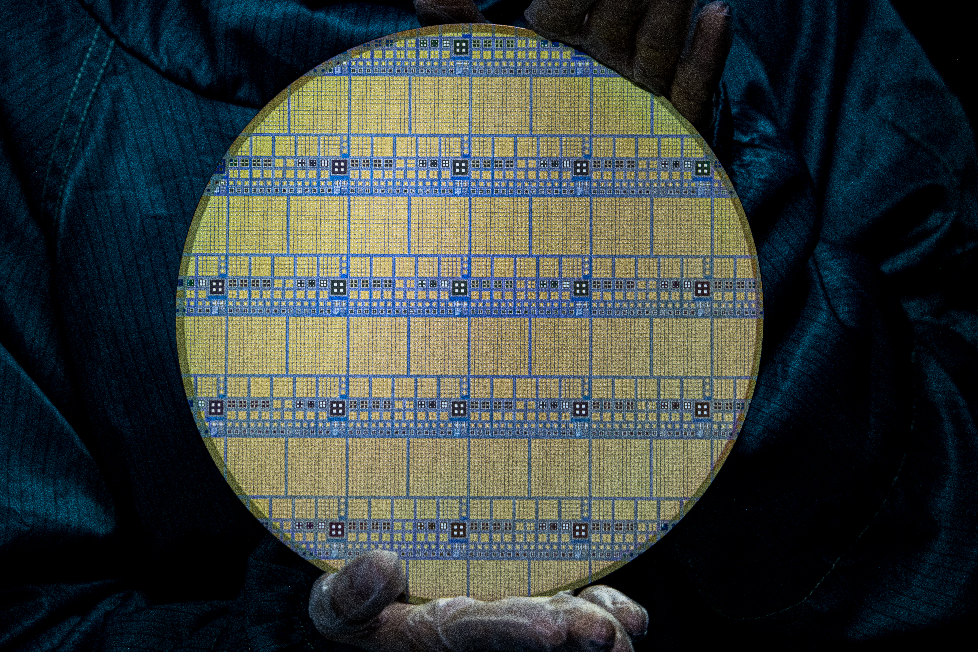
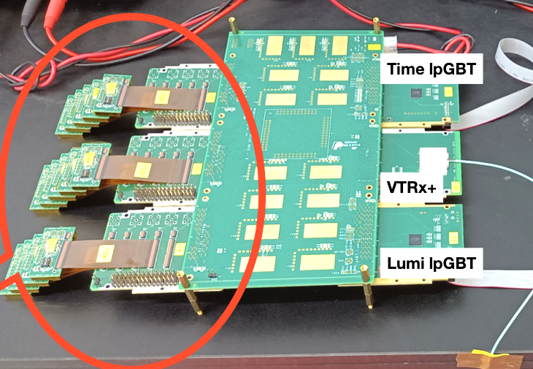
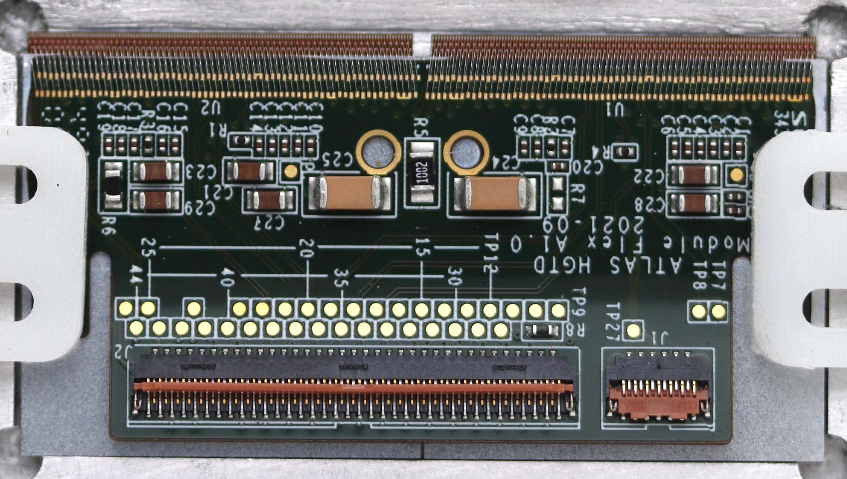
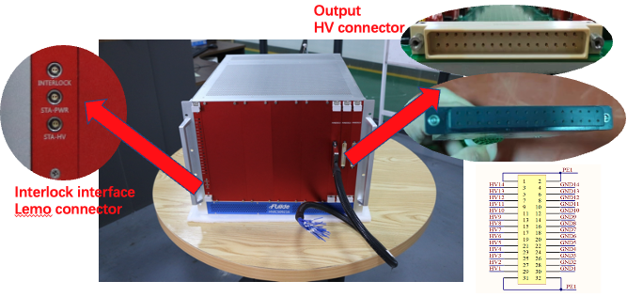
Research Content, Assessment Index (考核指标，研究内容)
研究内容： Develop all key components for the Timing Detector
  Developed radiation hard LGAD silicon sensor
  Build large-area ASIC+Sensor Module with robot
  Develop Front-end electronics, high voltage system, flexible cable
LGAD sensor
Electronics
Modules
High Voltage supply
ATLAS Experiment
Higgs discovery @ ATLAS

Slide 4
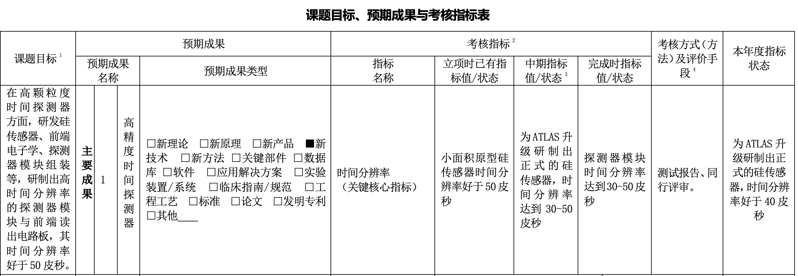
Assessment index status （考核指标）:
Midterm goal （中期指标）:
  (pre-)production sensor timing resolution reach 30 - 50ps
  ATLAS升级研制出正式的硅传感器，时间分辨率达到30-50皮秒
Final goal:
  Final production sensor and detector module time resolution 30-50 ps

Slide 5
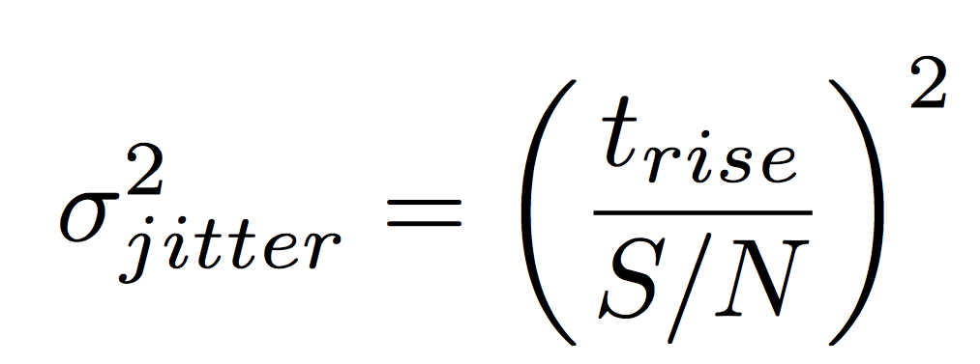
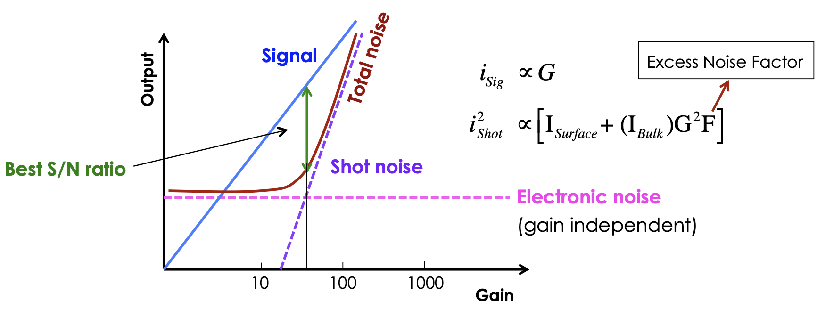
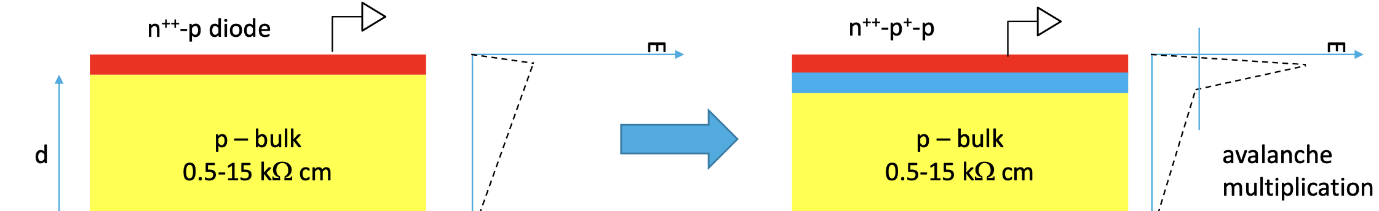
Innovation: Low Gain Avalanche Diodes (LGAD)
  Key technology developed in HGTD: LGAD sensor
  Innovation: high-granularity Radiation-hard LGAD developed for Collider
  LGAD has modest gain (~50), optimized to get the best S/N and fast timing
  Modest gain to increase S/N
  Thin detector to reduce t_{rise}
LGAD: P+ gain layer on top of PIN diode
Conventional PiN diode
E
E

Slide 6
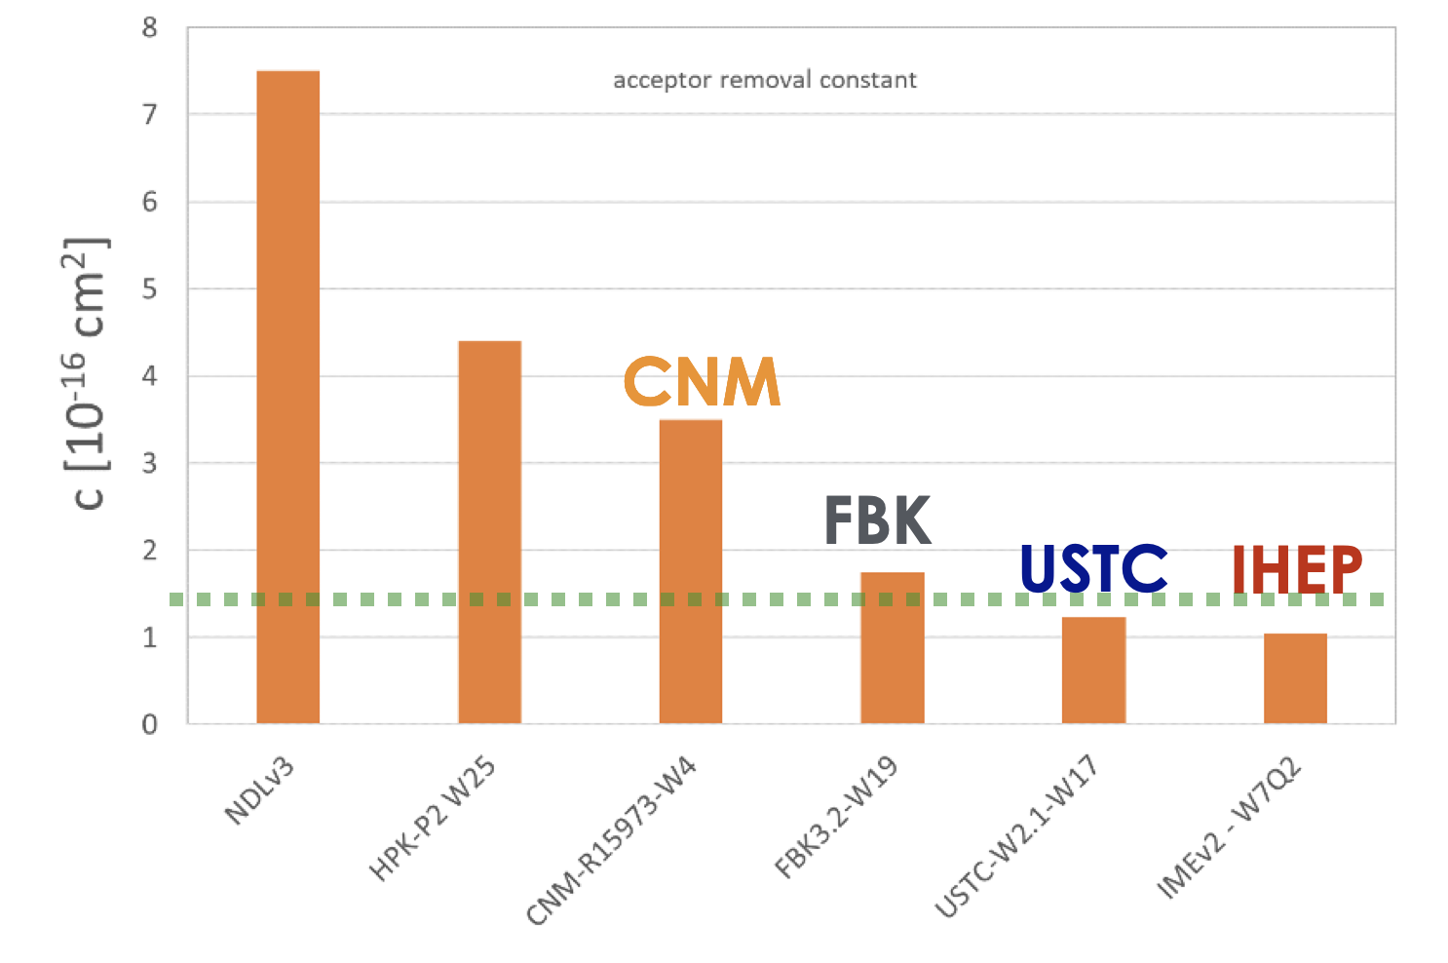
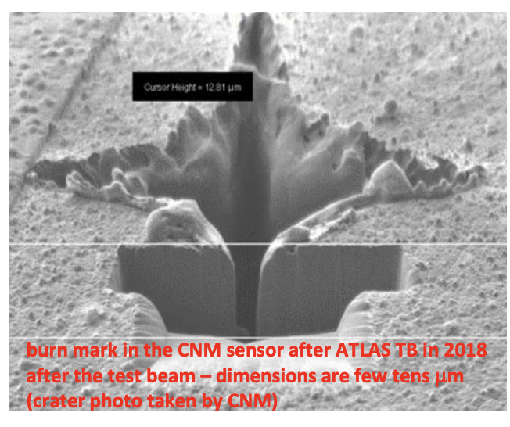
Innovation: LGAD sensor after Irradiation
IHEP and USTC developed IHEP-IME and USTC-IME LGAD with carbon doping independently
  Increased radiation hardness, met HGTD requirement, survive at fluence 2.5×10¹⁵ n_{eq}/cm²
After 2.5×10¹⁵ n_{eq}/cm² , IHEP LGADs can operated much below 550 V
  Avoid single event burnout
Acceptor Removal Ratio
Lower ratio, more radiation hard
Single Event Burnout (SEB) effect
CNM LGAD

Slide 7
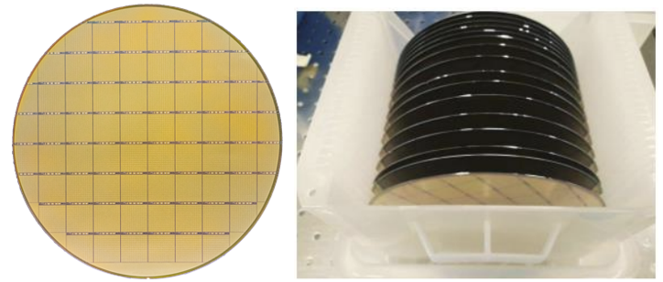
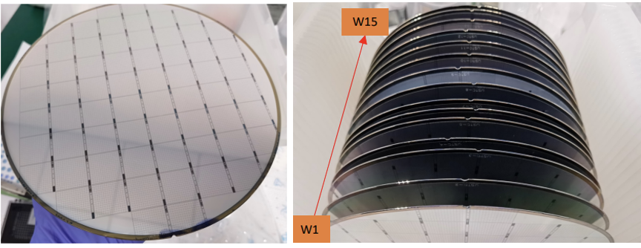
LGAD sensors pre-production and production
Passed CERN review at 2024. The sensor production will be 100% done by China
  First time domestic silicon sensor was used by CERN
  IHEP-IME: 90% (66% from CERN tendering+24% in-kind contribution) : ~8 m²
    CERN chosen IHEP-IME sensor in tendering, contract signed in Feb 2025
  USTC-IME: 10% in-kind contribution (~0.8 m² )
Production status
  IHEP
    Pre-production: ~1700 sensor fabricated
    Production: ~6000 sensor fabricated (~30% of total)
    To do: complete remaining 60% of LGAD in one year.
  USTC
    pre-production: ~270 sensor fabricated
    Production ~2300 sensor fabricated (~10% of total)
    USTC finished its share in production
    Next step is to finish the testing
IHEP-IME LGAD
USTC-IME LGAD

Slide 8
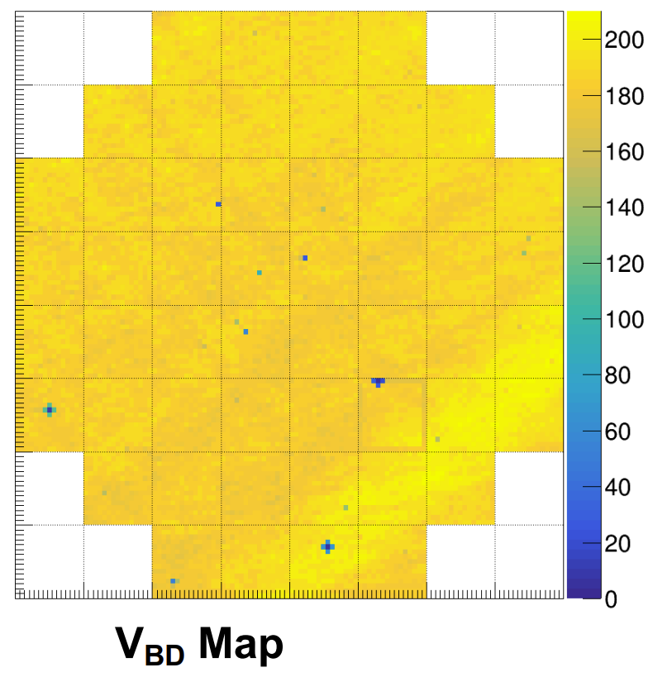
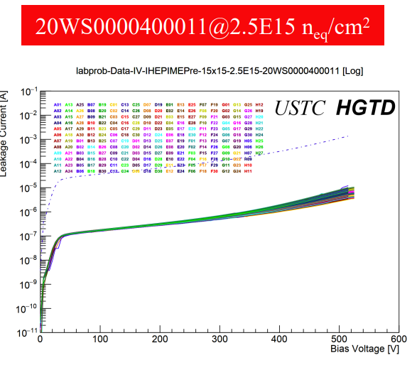
LGAD sensors pre-production and production
Good uniformity of leakage current and breakdown voltage

Slide 9
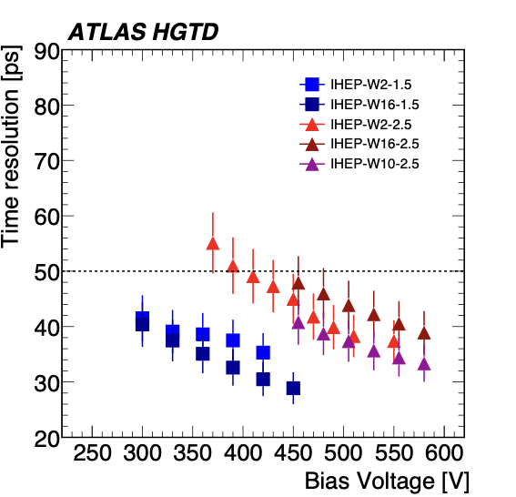
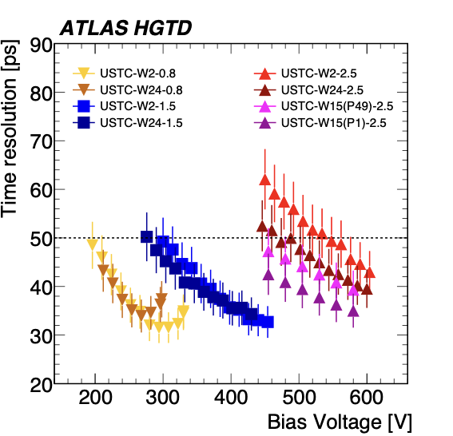
LGAD sensors performance at testbeam
Pre-production sensor performance
  Timing resolution measured at test beam at CERN and DESY
  Better than 40ps after irradiation for both IHEP-IME and USTC-IME sensor
  Reach the goal of midterm:
    (pre-)production sensor timing resolution reach 30 - 50ps at operational voltage
  达到中期指标： ATLAS升级研制出正式的硅传感器，在工作电压下时间分辨率达到30-50皮秒
JINST 21 (2026) P03021.

Slide 10
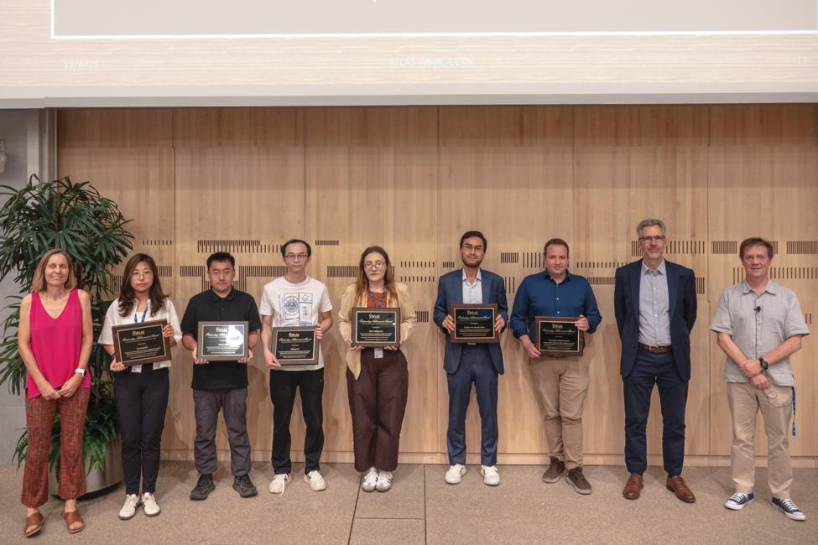

ATLAS Outstanding Achievement Award
IHEP and USTC members won the 2025 Outstanding Achievement Award
  for their development of the LGAD sensor in HGTD project
  The list of ATLAS award for HGTD project: Bojan Hiti (Ljubljana), Alissa Howard (Ljubljana), Xuewei Jia (Munich MPI), Mengzhao Li (Beijing IHEP), Chihao Li (Michigan), Kuo Ma (Hefei), Theodoros Manoussos (CERN), Weiyi Sun (Beijing IHEP), Guilherme Tomio Saito (Sao Paulo), Iskra Velkovska (Ljubljana), Xiao Yang (CERN), Mei Zhao (Beijing IHEP)

Slide 11

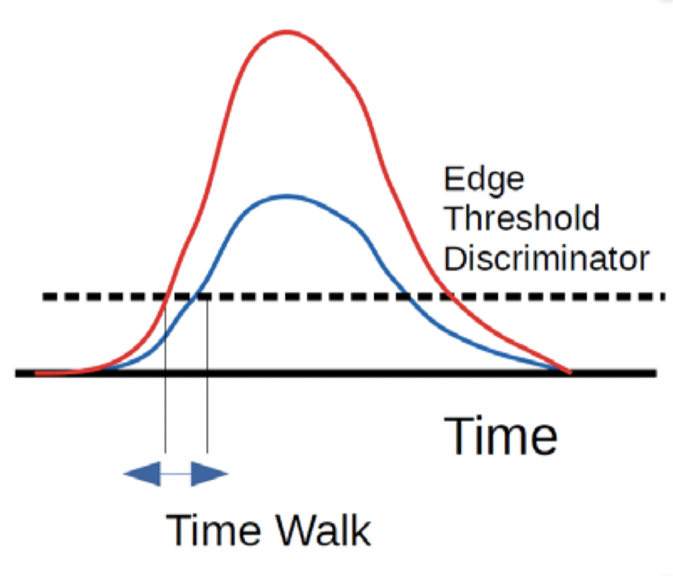
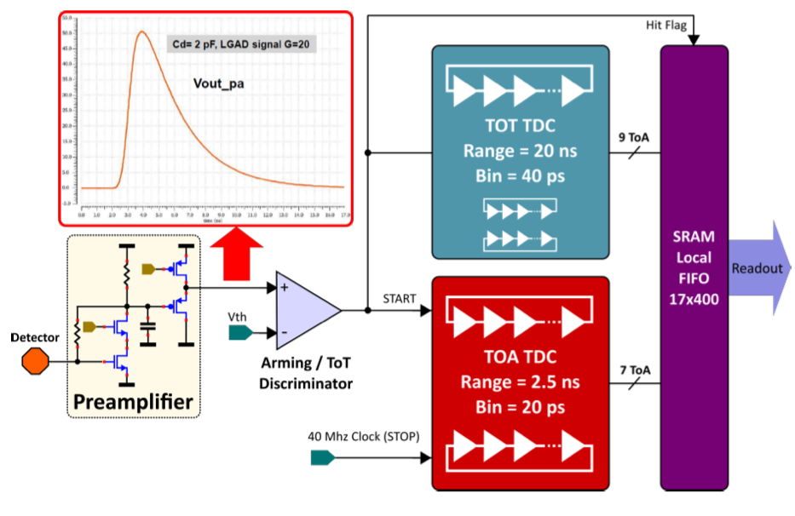
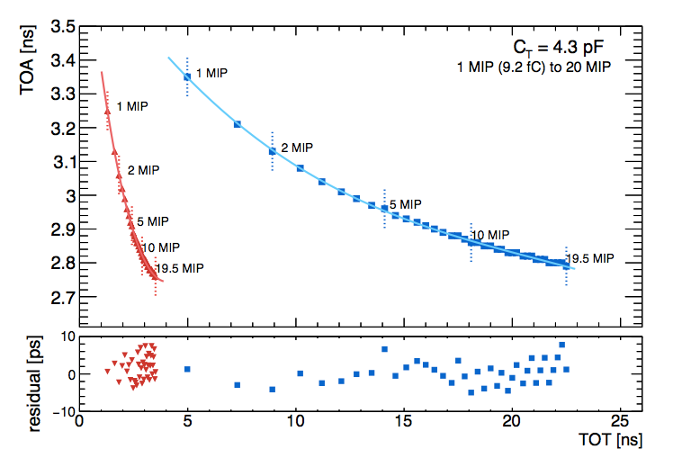
ALTIROC : Fast Timing ASIC
225 front-end channels in ALTIROC, each channel has
  A preamplifier followed by a discriminator:
  Two TDC (Time to Digital Converter) to provide digital Hit data
    Time of Arrival (TOA) : Range of 2.5 ns and a bin of 20 ps (7 bits)
    Time Over Threshold (TOT) : range of 20 ns and a bin of 40 ps (9 bits)
  Local memory: to store the 17 bits of the time measurement until L0/L1 trigger (~ 1 MHz)
Time walk
ALTIROC timing ASIC in nutshell
Time walk correction with TOT

Slide 12
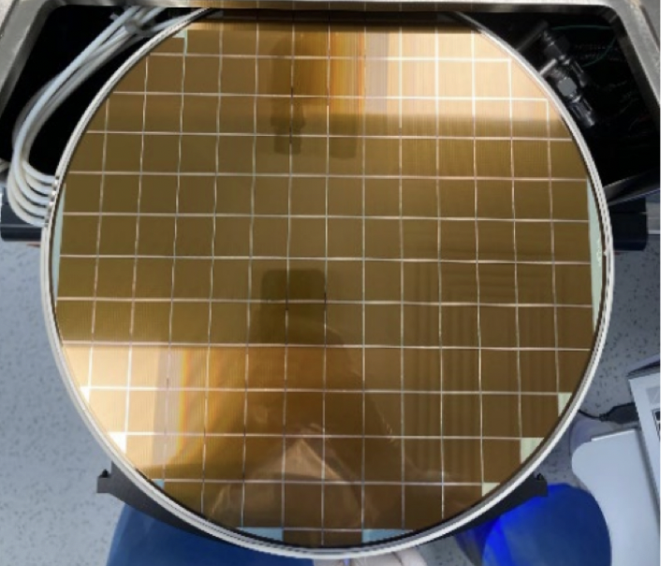
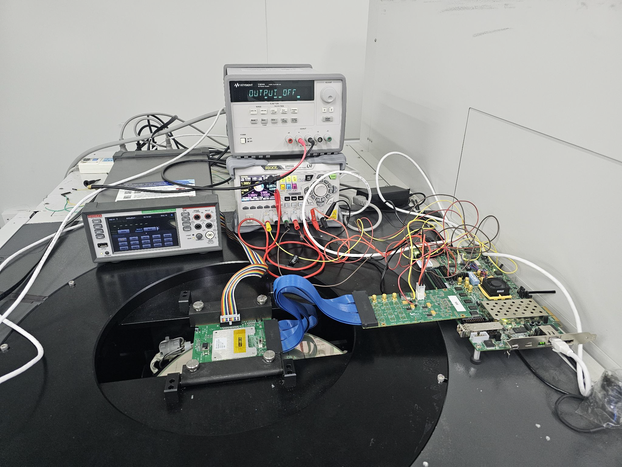
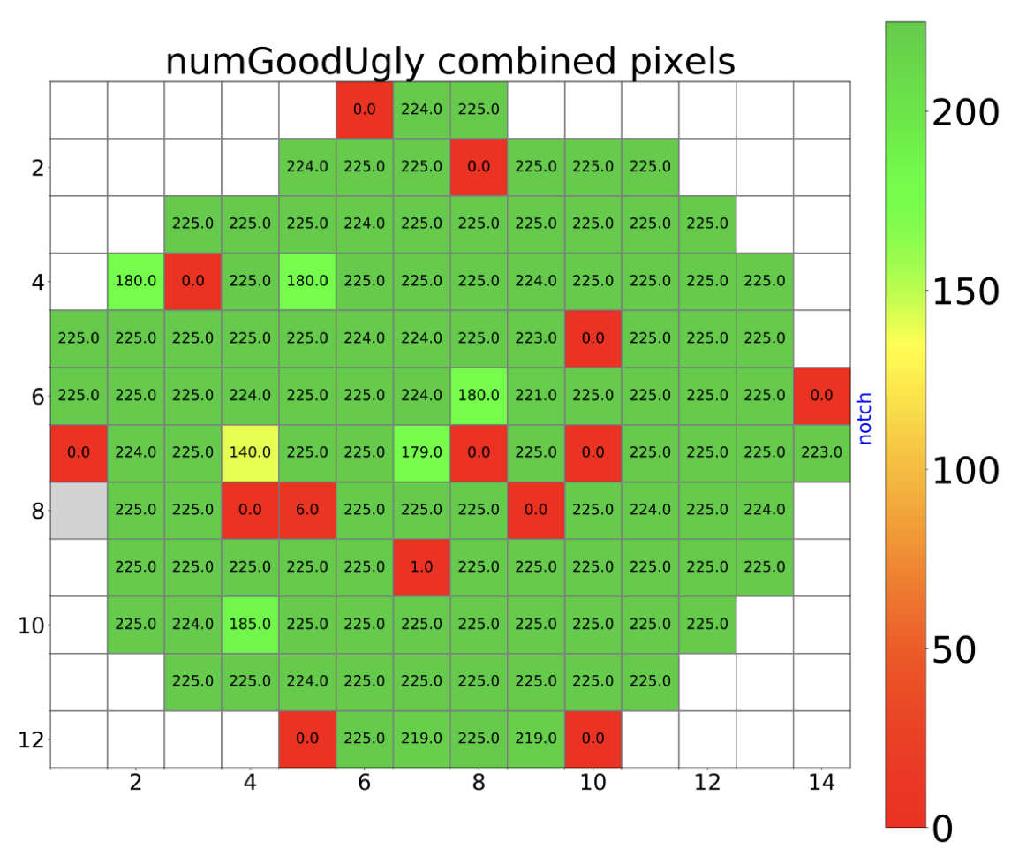
ASIC production and testing
China and IJClab/Omega share 50% of wafer probe test（~225 wafers )
  Agreements was probe cards, and evaluation criteria should have been defined by IJCLab
  IHEP is now much advanced, IJClab gave up testing in France at the end of 2025, will move to China for testing
Update:
  ASIC wafer testing has been the bottle neck for the project for sometime (in critical path)
    PRR was scheduled at Oct 2024, passed PRR July 2025
    TSMC finished production, probe testing just started in May 2026
  Risk: Probe testing delays, the yield may be lower than expected.
ASIC Yield is 70 ~ 80%

Slide 13
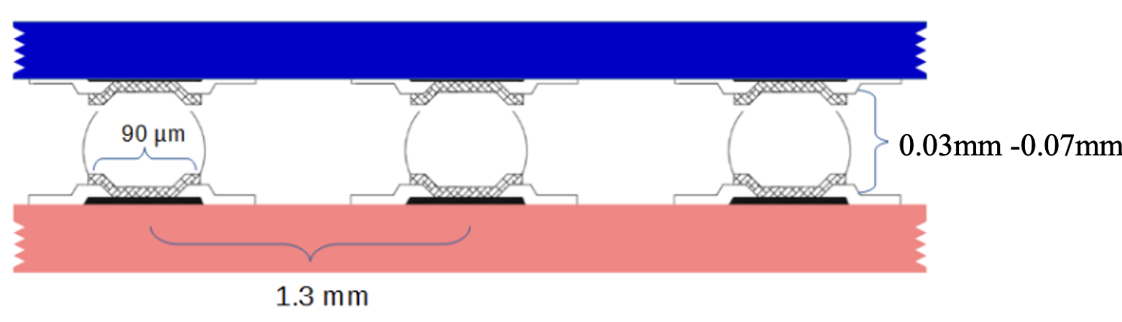
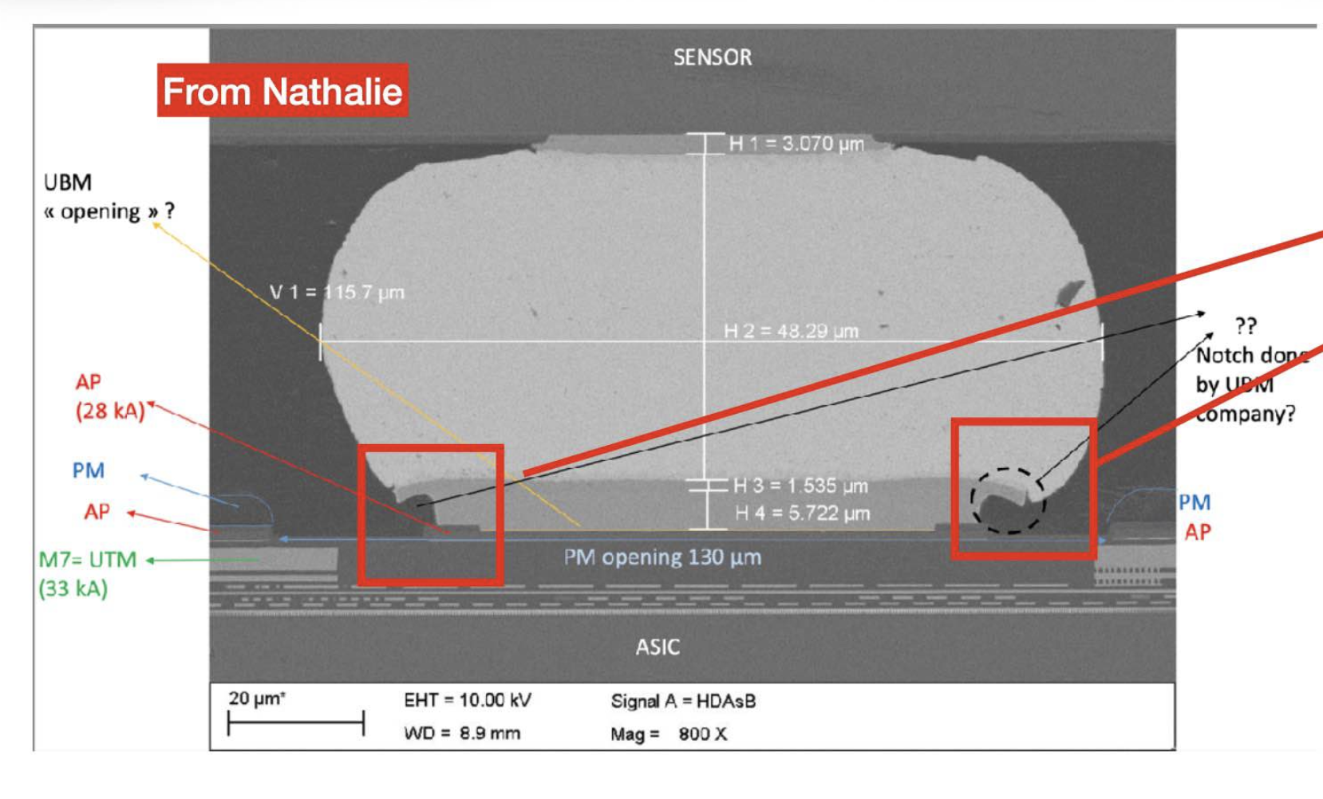
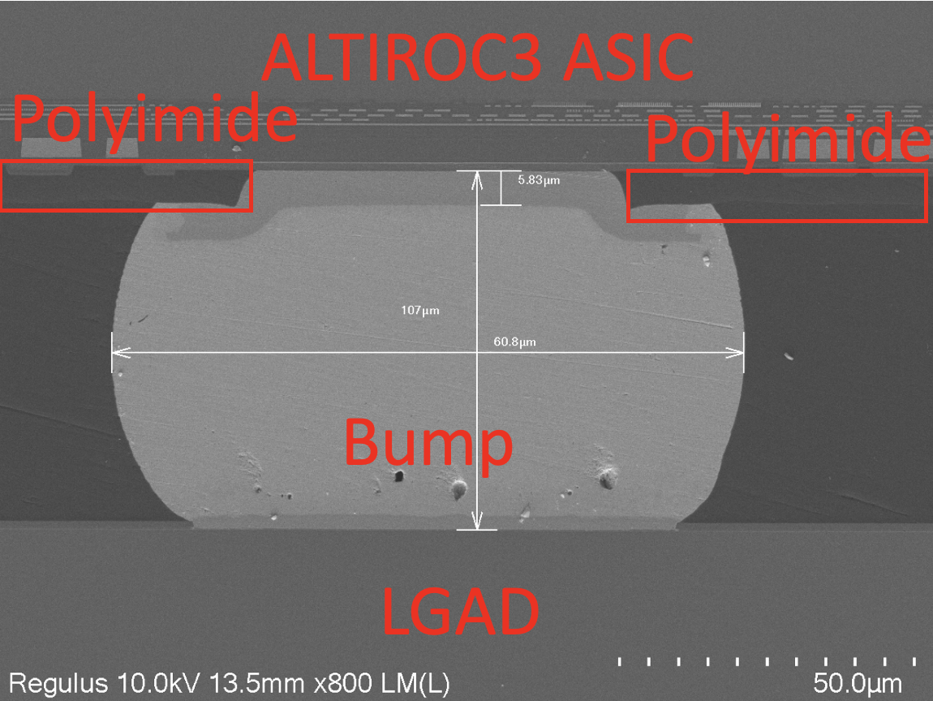
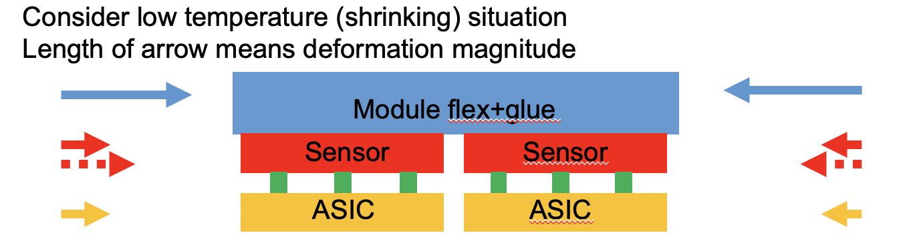
Sensor + ASIC Hybrid
IHEP is in charge of 50% of hybrids assembly
挑战：ATLAS ITK pixel has hybrid bump delamination issue, was delaying HL-LHC
IHEP solved the bump delamination issue in old ALTIROC2 hybrids, addressed by
  Softer Polyimide layer; Thicker sensors …
Passed CERN review, Good stability after improvement, published in JINST
ALTIROC2 hybrid incorrect Polyimide
by TSMC
ALTIROC3 hybrids with
correct Polyimide by IHEP/NCAP
JINST 20 (2025) P11003.
Notes:
Check Polyimide

Slide 14
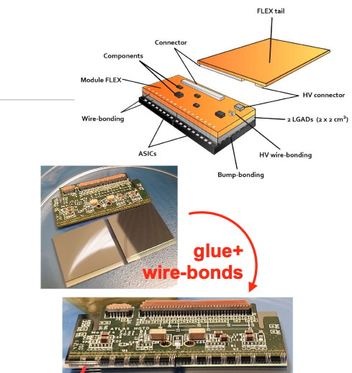
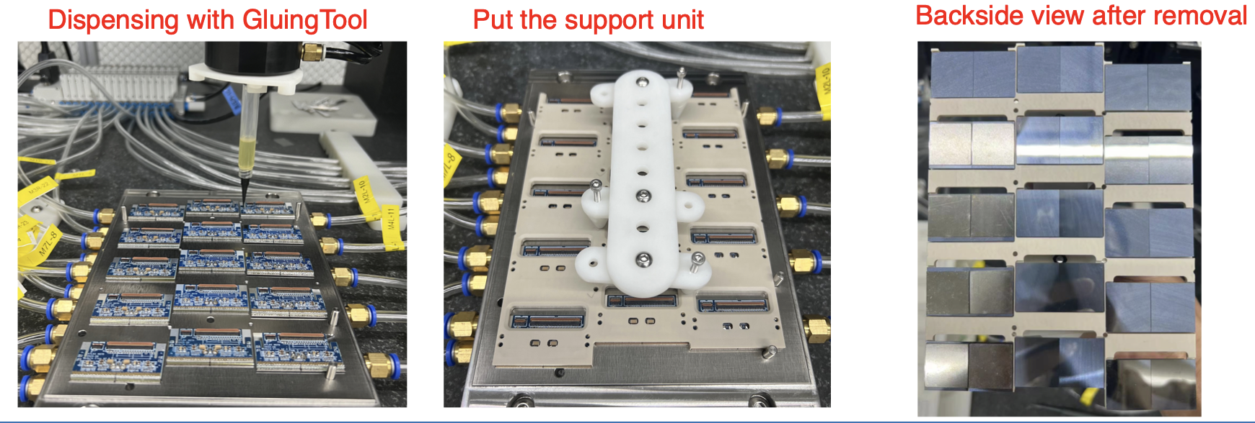
HGTD detector unit prototyping
The team led the first modules and detector unit prototyping
  Develop automatic robot for module assembly and glue dispending
Module prototype
Detector unit prototype

Slide 15
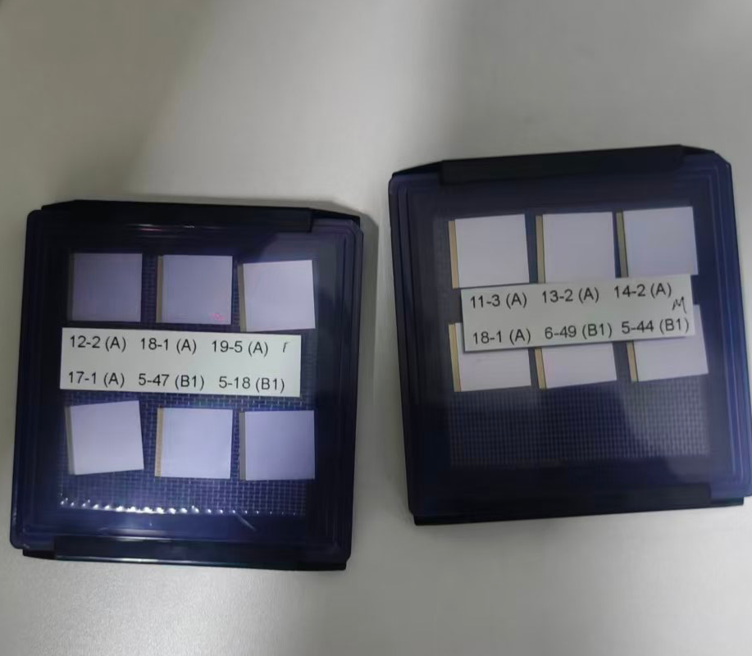
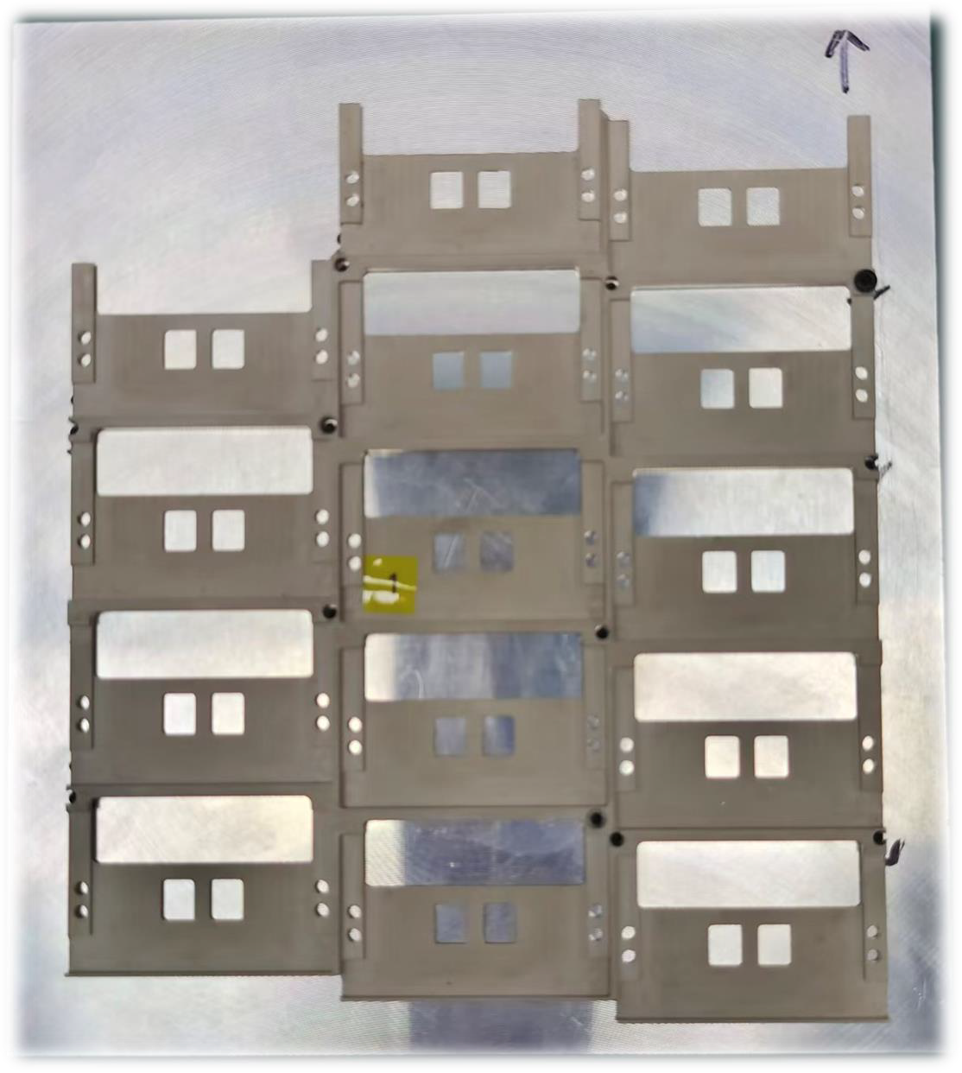
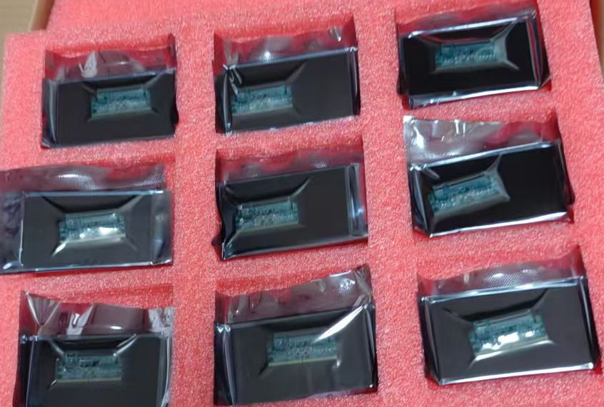
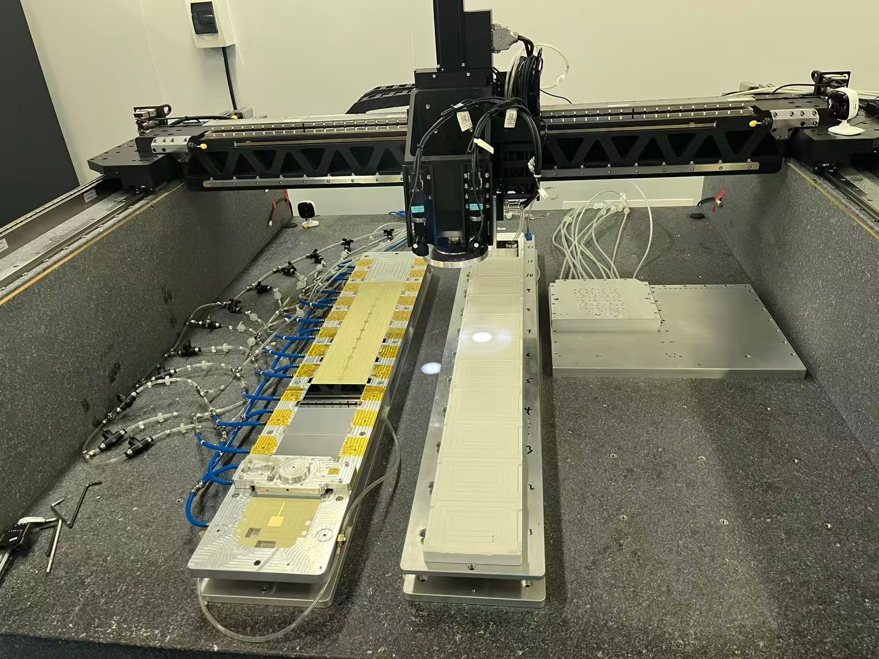
Module and detector units
5 production site at HGTD (China, Mainz (Germany), France, IFAE(Spain), Morocco )
  China is largest site, will assemble 44% of the module ( ~4000 modules)
    China module team included IHEP/USTC/SDU/SJTU/Nankai, assembly lab is in IHEP
  Pre-production: 100% ASIC wafer bumping, 50% ALTIROC-A Hybrids flip-chip
  IHEP and USTC sites merged
    USTC team explored using AMS gantry in IHEP hall 3 for module loading
    Two dummy detector unit loaded
  Supported unit prototyped and metrology, ready for pre-production
    Both IHEP/USTC did metrology for support unit
Module flex pre-production
ALTIROC-A Hybrids
Support units
Gantry robot @IHEP hall 3

Slide 16
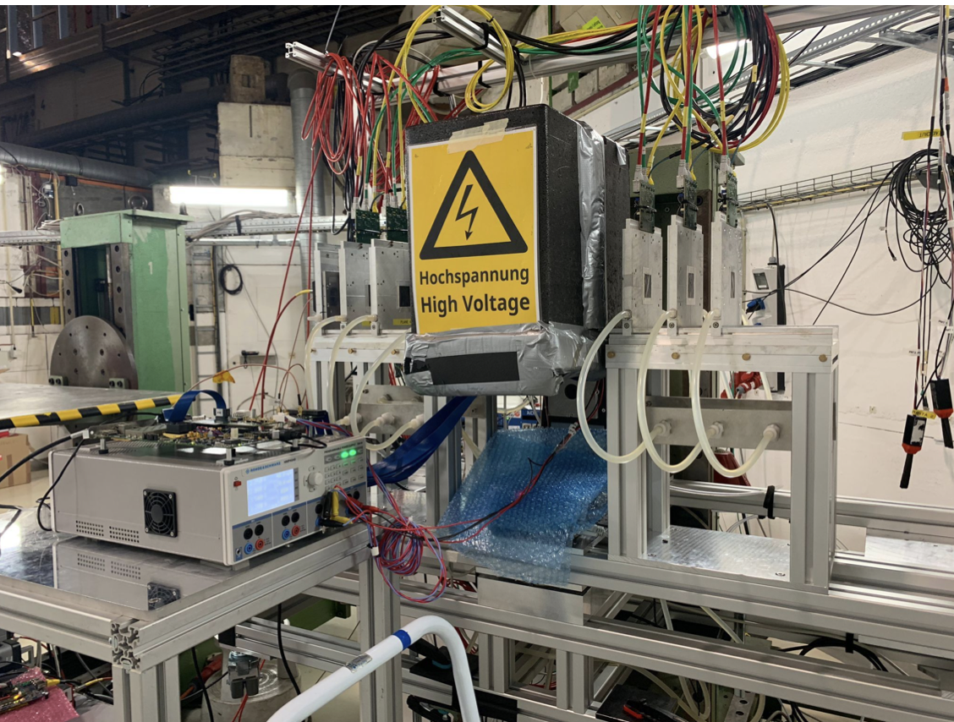
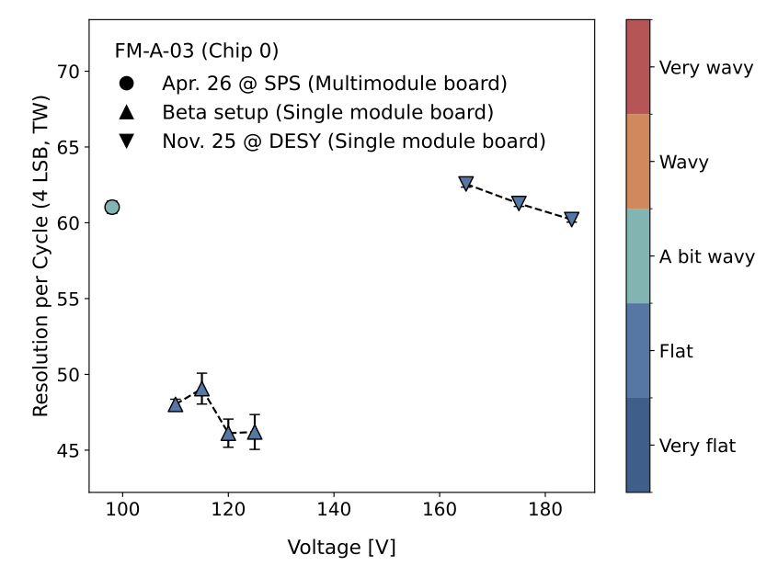
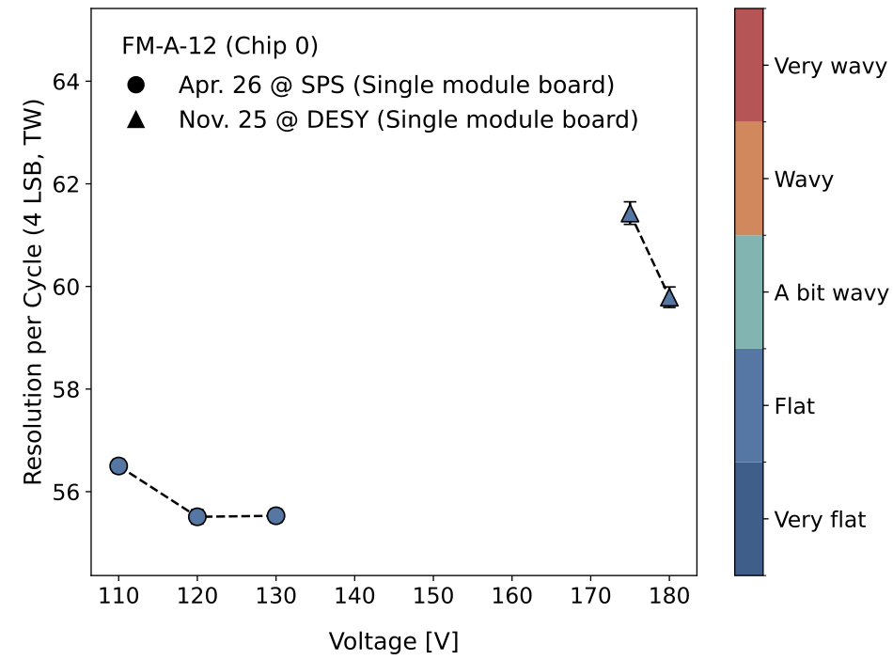
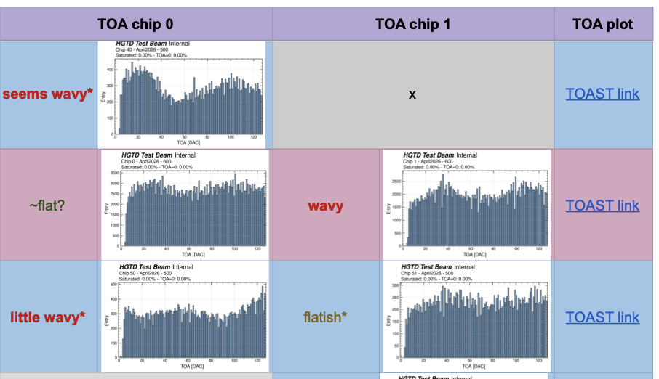
Module performance in test beam
Module performance in testbeam is under study
  Some modules and some setup have better performance
  Large fraction of modules has non-flat “time of arrival” (TOA) distribution
    Giving impact to final timing resolution of the modules
  Understand the TOA behavior and try to calibrate them using data

Slide 17
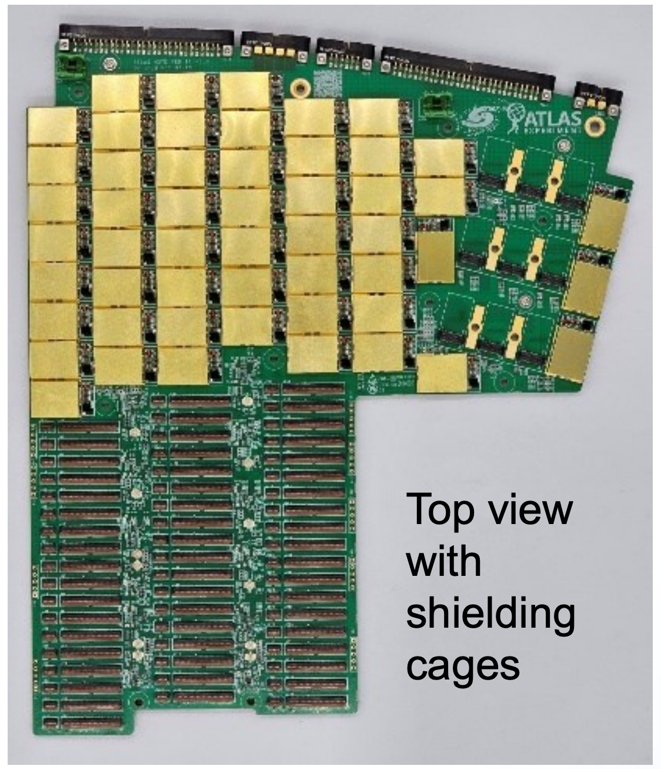
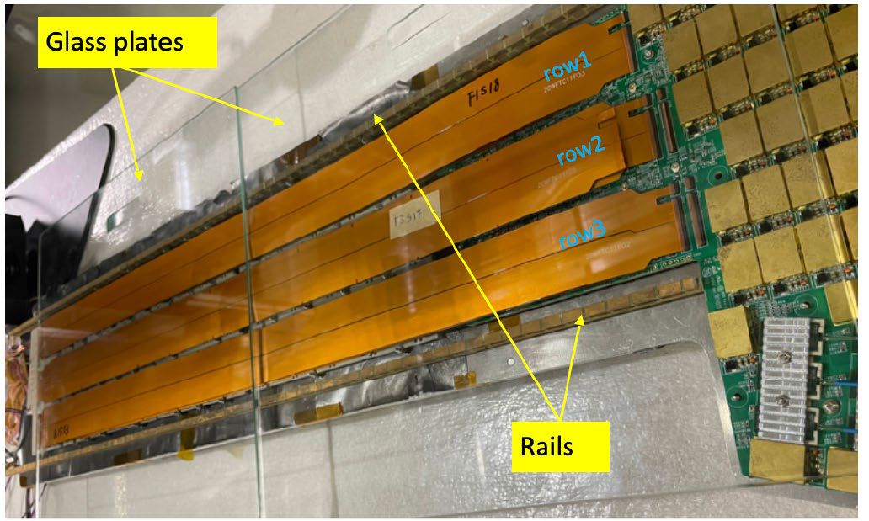
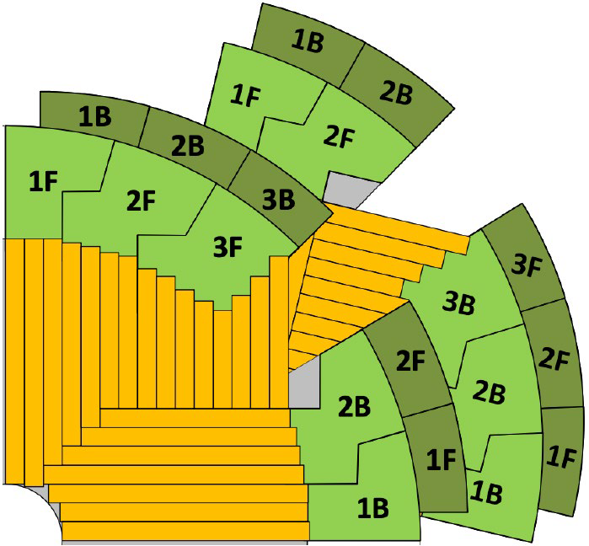
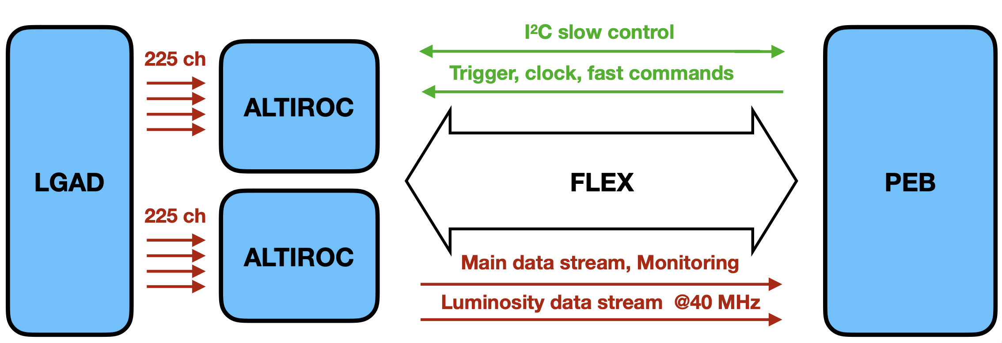
Peripheral Electronics Board (PEB)
China (IHEP/NJU) will design and produce 100% PEB (PCB fabrication)
Challenge: fast communication with 55 modules, 24 metal layers in PCB
  Comments in CERN review: Comparable with the most difficult boards for HEP projects
Update :
  IHEP and NJU developed 1st Peripheral Electronics Boards at 2024
  2nd Peripheral Electronics Boards designed in 2026
    Delayed due to Bpol chip radiation hardness issue by CERN
    Keep in touch with CERN team to avoid any risk
PEB1F prototype
6 types of PEB

Slide 18
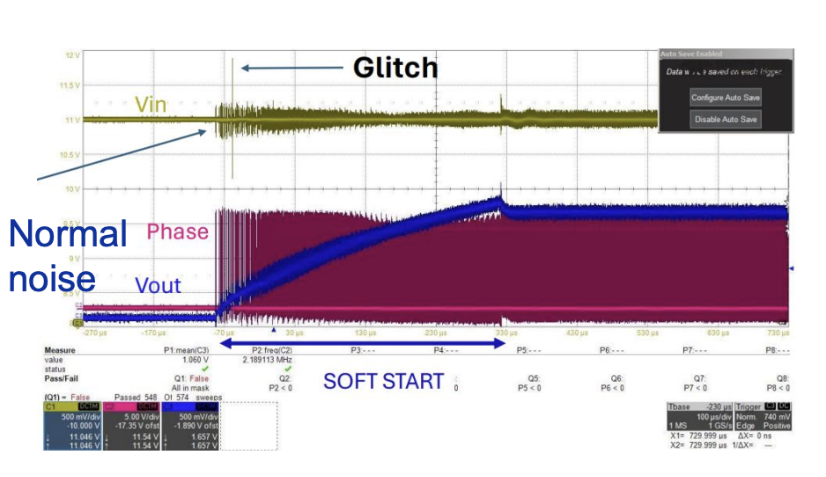
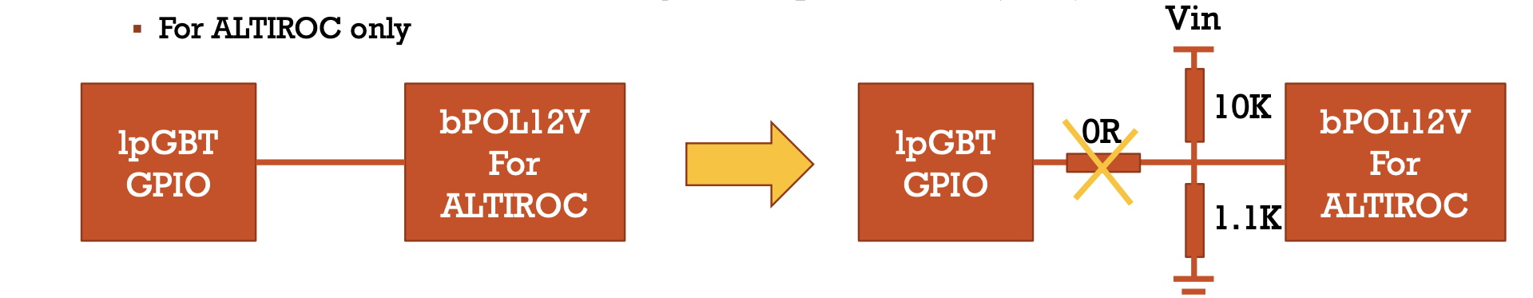
Peripheral Electronics Board (PEB): issue
People found CERN BPOL chip irradiation hardness issue in 2025
  Output voltage is too high (glitch) after irradiation
  Impact to the whole LHC upgrade project.
  Need to use voltage divider solution to re-design the PEB board

Slide 19
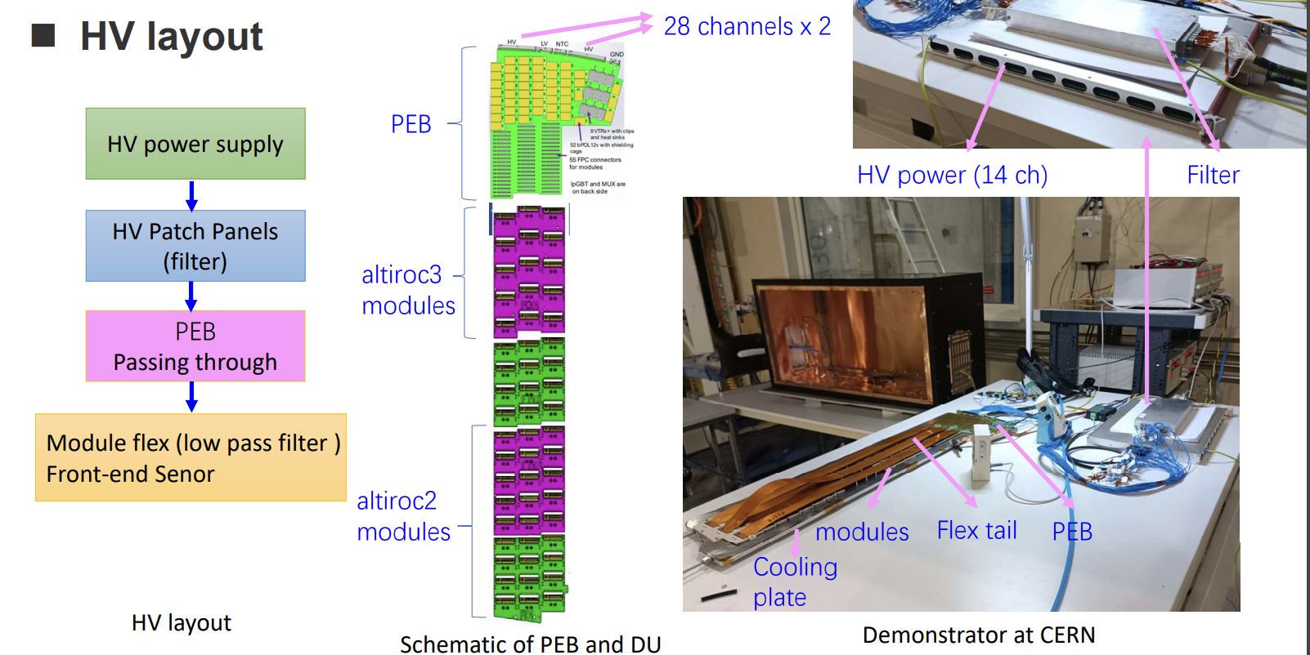
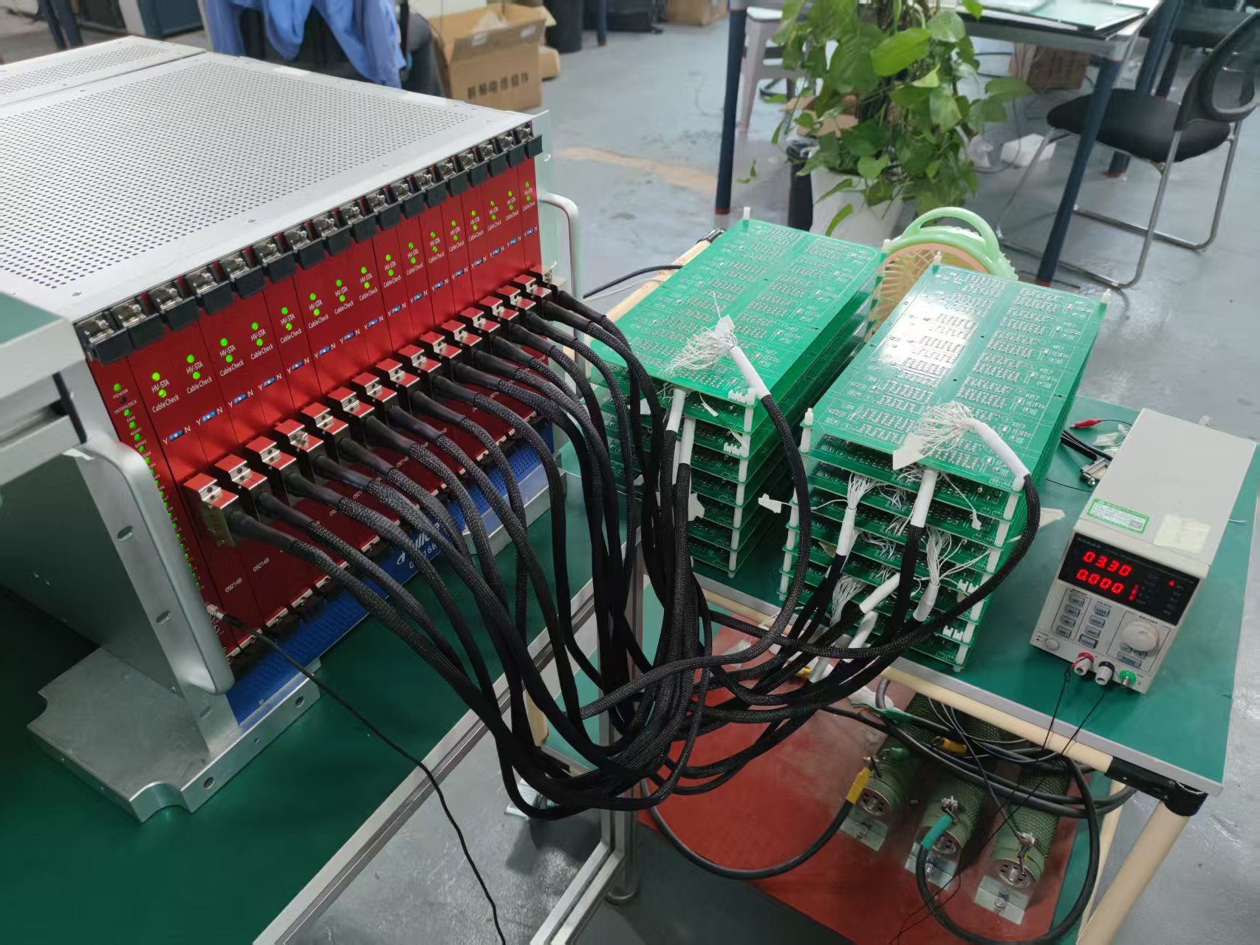
High voltage (HV) power supply
China (IHEP/SDU) prototyped and oversee HV supply production and do quality tests
Challenge: 1000V voltage, 100nA precision in current measurement
Latest update : pre-production finished in 2025.
  IHEP/SDU team in FULLDE company for quality assurance tests
  Two HV crates delivered to CERN in Sep. 2025. SDU student did reception tests.
HV pre-production quality tests

Slide 20
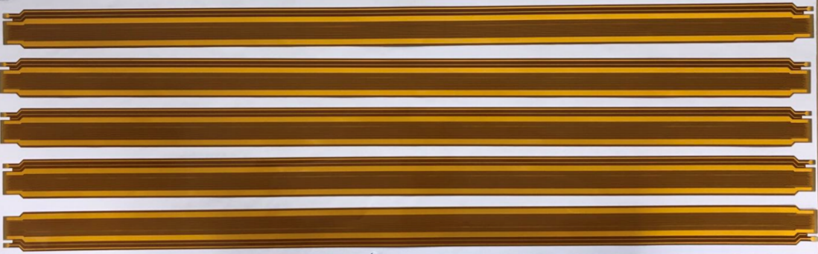




Flex tails（柔性电子学尾板）
SDU is responsible for 33% of flex tails production
Prototype has been made, and satisfied the requirement, Ready for pre-production
caliper
micrometer
High power BC1 adjustable sliding resistor
B
A
~ 46 mΩ for vdda and ~22 mΩ for gnda.
Flex tail
C
D
gnda
Adapter
board v1
Simple Test board

Slide 21


Demonstrator system
The China team played key role testing demonstrator system at CERN
  System level testing with 54 modules
  1st time to demonstrate silicon timing detector in a large-scale system
ATLAS phase 2 upgrade review
HGTD lab visit @CERN
Demonstrator system

Slide 22
Innovation points summary
IHEP-IME and USTC-IME LGAD performance reach world class level
  The most radiation hard LGAD sensors, passed CERN review
  Timing resolution Better than 40ps after irradiation
  First time domestic silicon sensor was used by CERN
    HGTD sensor 100% by China. (90% from IHEP-IME, 10% from USTC-IME)
China team played a major in demonstrator timing detector system
  1st time to demonstrate silicon timing detector in a large-scale system
  China team provide key components
    Detector units, PEB boards, HV supply, flex tails …

Slide 23


International landscape of this task in HGTD project
The primary objective of this project is to support the successful construction, integration, and commissioning of the ATLAS High Granularity Timing Detector.
Enables the China team play a key role in cutting-edge HGTD detector development
ATLAS HGTD is international project

Slide 24


Project management
Project has both internal meeting and international meeting for management.
ATLAS China team played an important role in HGTD management team
  Mar. 2021- Feb 2025 , Joao was HGTD project leader, 1st PL in China LHC community
  Mar 2025 - Feb 2027, Zhijun is serving as deputy project leader
  6 person as L2 conveners (Jie Zhang, Mei Zhao, Zhaoru, Zhijun,Yusheng,Lailin)
  3 person as Level-3 convener （Yunyun,Jie, Lei Fan ）
  2 person as speaker committee (Yanwen, Lailin)
HGTD management

Slide 25
Project management : schedule
HGTD is an international project, not all the schedule can be determinized by the project team
LGAD sensor
  IHEP-IME Production will completed in one year. (30% finished, 60% of LGAD still needs to produce)
  USTC-IME Production is finished, in the middle of testing
Module assembly
  Delayed about 1 year due to ALTIROC-A ASIC performance.
  Will speed up the production, has done R & D to increase capability
Electronics
  PEB delayed about 1 year, due to CERN Bpol power chip radiation hardness issue. Re-design PEB to avoid the risk.
High voltage power supply
  Ready for production since Sep. 2025. Waiting for HV filter provided by international collaborator.

Slide 26
Project management: Risk
PEB Electronics boards
  CERN Bpol chip technical risk, may cause over voltage and damage the device after irradiation
    Solution: Re-designed PEB board board electronics using voltage-divider solution
  CERN Bpol chip policy risk (US foundry), The license for importing it to China expired.
    Collaborate with CERN to request for new license from US.
    Look for PEB board assembly site in EU if new license is not available
Module assembly
  ALTIROC-A ASIC performance may lower than expected.
  Time of arrival (TOA) bin was not flat, meaning the bin size of TDC was not uniform.
  Difficult to reach 50ps in module level
    Try to explore the TDC calibration method
    Work with HGTD community to understand and improve module performance

Slide 27
Publication list
Yimin Che et al., Comprehensive full-power testing of demonstrator system for the High Granularity Timing Detector, JINST 21 (2026) C03026.
A. Aboulhorma, G. Di Gregorio, K. Tariq et al., Beam-test evaluation of pre-production Low Gain Avalanche Detectors for the ATLAS High Granularity Timing Detector, JINST 21 (2026) P03021.
Thermal cycling reliability of hybrid pixel sensor modules for the ATLAS High Granularity Timing Detector, JINST 20 (2025) P11003.
ATLAS HGTD Collaboration, Evaluation of the prototype Peripheral Electronics Board for the High Granularity Timing Detector, JINST 19 (2024) C12012.
Low Gain Avalanche Detectors for the ATLAS High Granularity Timing Detector: Laboratory and test beam campaigns, NIMA 1063 (2024) 169237.
Zhenwu Ge et al., An FPGA-based front-end module emulator for the High Granularity Timing Detector, JINST 19 (2024) C03055.
C. Wang et al., Radiation tolerance of the MUX64 for the High Granularity Timing Detector of ATLAS, JINST 19 (2024) C03044.
ATLAS HGTD Collaboration, HGTD DC/DC converter in low temperature and magnetic field operation, JINST 19 (2024) C02006.

Slide 28
Funding Status
The expenditures are mainly concentrated in labor costs, indirect costs, meeting/travel/international cooperation expenses, material costs, and testing/processing fees. Overall, these expenditures support sensor, module, electronics, and testing work, as well as CERN/ATLAS collaboration activities, experimental material procurement, and key component testing and validation.
Reason for low rate in USTC: When paying for the LGAD sensor production, the project funds were insufficient, so the cost was temporarily advanced using other funds. The sensors have now been produced and entered the testing stage. After testing is completed, RMB 1.60 million will be paid from this project fund.
 | Task 1 | Task 1 | Task 1 | Task 1 | Task 1
 | Sum | IHEP | USTC | NJU | SDU
Total Budget | 1135.00 | 500.00 | 255.00 | 130.00 | 250.00
Received funds | 908.14 | 400.25 | 203.95 | 103.97 | 199.97
Pending to allocated | 226.86 | 99.75 | 51.05 | 26.03 | 50.03
Implementation rate % | 45.16% | 59.19% | 17.12% | 54.06% | 41.07%
Total Expense | 512.57 | 295.97 | 43.66 | 70.27 | 102.66
1 Direct fee | 314.56 | 276.43 | 15.56 | 46.42 | 58.95
1) Device fee | 1.22 | 2.69 | 0.00 | 0.00 | 0.00
2) Business fee | 150.23 | 155.81 | 15.56 | 22.42 | 47.55
3) Labor fee | 140.87 | 117.94 | 0.00 | 24.00 | 11.40
2 Indirect fee | 88.82 | 19.54 | 28.10 | 23.85 | 43.72

Slide 29
Summary and plan
Reach the goal of midterm:
  (pre-) production sensor timing resolution is better than 40ps
  达到中期指标： ATLAS升级研制出正式的硅传感器，时间分辨率达到40皮秒
  Finalized Module, PEB readout board, flex tails, HV power supply prototyping.
Next Milestones
  Sensor production finished in one year
  Electronics boards, flex tails and HV power supply to be completed in 2027
  Module and detector unit to be completed in 2028
  Detector assembly and Commissioning at CERN (2026 -2028 )

Slide 30
Backup

Slide 31
Research team
Awards :
ATLAS Outstanding award 2025 (HGTD LGAD)
Talents:
Yunyun Fan, IHEP, CAS “100 talents” project
Francois Lagarde, USTC, Special Professor
....
Graduated Postdocs :
Tianya Wu, IHEP → Nanchang University
Bo Liu, IHEP → Nankai University
Xuan Yang, IHEP → SINAP
……
PhD and Master: more than 20
 |  | Staffs in project | Other Staffs | Postdoc | Students
Task 1 | Sum | 11 | 15 | 5 | 25
Task 1 | IHEP | 7 | 3 | 4 | 6
Task 1 | NJU | 1 | 5 | 1 | 5
Task 1 | USTC | 1 | 6 | 1 | 8
Task 1 | SDU | 2 | 1 | 0 | 6

Slide 32
International conference
梁志均，ATLAS HGTD module overview，ATLAS HGTD Week in Rabat， 摩洛哥，2026.5.18-22.
周展航，IHEP/USTC status in HGTD module assembly，ATLAS HGTD Week in Rabat， 摩洛哥，2026.5.18-22。
Yimin Che，Comprehensive Full-Power Testing of Demonstrator System for the High Granularity Timing Detector，TWEPP2025，2025.10.6–10。
梁志均，ATLAS HGTD module overview，ATLAS HGTD Week in Clermont，法国，2025.6.30。
黄鑫辉，ATLAS HGTD module assembly at IHEP，ATLAS HGTD Week in Clermont，法国， 2025.6.30。
Joao Guimaraes da Costa，HGTD Update Project，ATLAS-China Faculty Meeting 2025，2025.4.25。
梁志均，The High-Granularity Timing Detector for ATLAS at HL-LHC，Pixel2024，2024.11.18–22，法国斯特拉斯堡。
Yinmin Che，HGTD status report，ATLAS Upgrade Week，2024.11.14。
Tests of the Prototype Peripheral Electronics Board for the High Granularity Timing Detector，Topical Workshop on Electronics for Particle Physics 2024（TWEPP2024），2024.9，Glasgow, Scotland，Poster。
HGTD Status Overview，ATLAS Week，2024.6，Thessaloniki, Greece，Plenary Session。
Zhenwu Ge，HGTD status overview，ATLAS Week，2024.6.20。
Zhijun Liang，Module assembly in HGTD，ATLAS Week，2024.2.10–14，Geneva, Switzerland。
Low Gain Avalanche Detectors for the ATLAS High Granularity Timing Detector: laboratory and test beam campaigns，PSD2023，2023.12.3–8，大会报告。
Jingbo Ye，Overview of the ATLAS High-Granularity Timing Detector: project status and result，HSTD2023，2023.12.3–8，Vancouver, Canada.

Slide 33
ALTIROC : Fast Timing ASIC
225 front-end channels in ALTIROC, each channel has
  A preamplifier followed by a discriminator:
  Two TDC (Time to Digital Converter) to provide digital Hit data
    Time of Arrival (TOA) : Range of 2.5 ns and a bin of 20 ps (7 bits)
    Time Over Threshold (TOT) : range of 20 ns and a bin of 40 ps (9 bits)
  Local memory: to store the 17 bits of the time measurement until L0/L1 trigger (~ 1 MHz)
Time walk
ALTIROC timing ASIC in nutshell
Time walk correction with TOT

Slide 34

ASIC production and testing
China and IJClab/Omega share 50% of wafer probe test（~225 wafers )
  Agreements was probe cards, and evaluation criteria should have been defined by IJCLab
  IHEP is now much advanced, IJClab gave up testing in France at the end of 2025, will move to China for testing
Issue:
  ASIC wafer testing has been the bottle neck for the project for sometime (in critical path)
    PRR was scheduled at Oct 2024, now passed PRR July 2025 ( delayed by ~10 months)
    TSMC finished production
    ~10% ASIC short issue → use new dicing scheme. →expect to be resolved
  Tax free import ASIC wafers to China → resolved in 2026
ASIC Yield is 70 ~ 80%
new dicing scheme
old dicing scheme

Slide 35
Schedule
  2025 年11 月—2026 年5月
  探测器模块、柔性电路板尾板的正式生产研制；（module, flex tails production)
  电子学外围电路板的测试；(PEB production and testing )
  高压电源的正式生产研制 (HV power supply production)
2026 年6 月—2026 年11 月
  探测器模块正式生产研制；(module production)
  电子学外围电路板在欧洲核子中心开始总体组装；( PEB assembly at CERN )
  高压电源的正式生产研制 (HV power supply production)

