Slide 1





The status of ITk for
ATLAS Phase-II upgrade
Xin Shi (IHEP)
史欣 (中国科学院高能物理研究所)
On behalf of subtask 2 Team
28 May 2026
MOST ATLAS Detector Upgrade Project Midterm Review Meeting

Slide 2
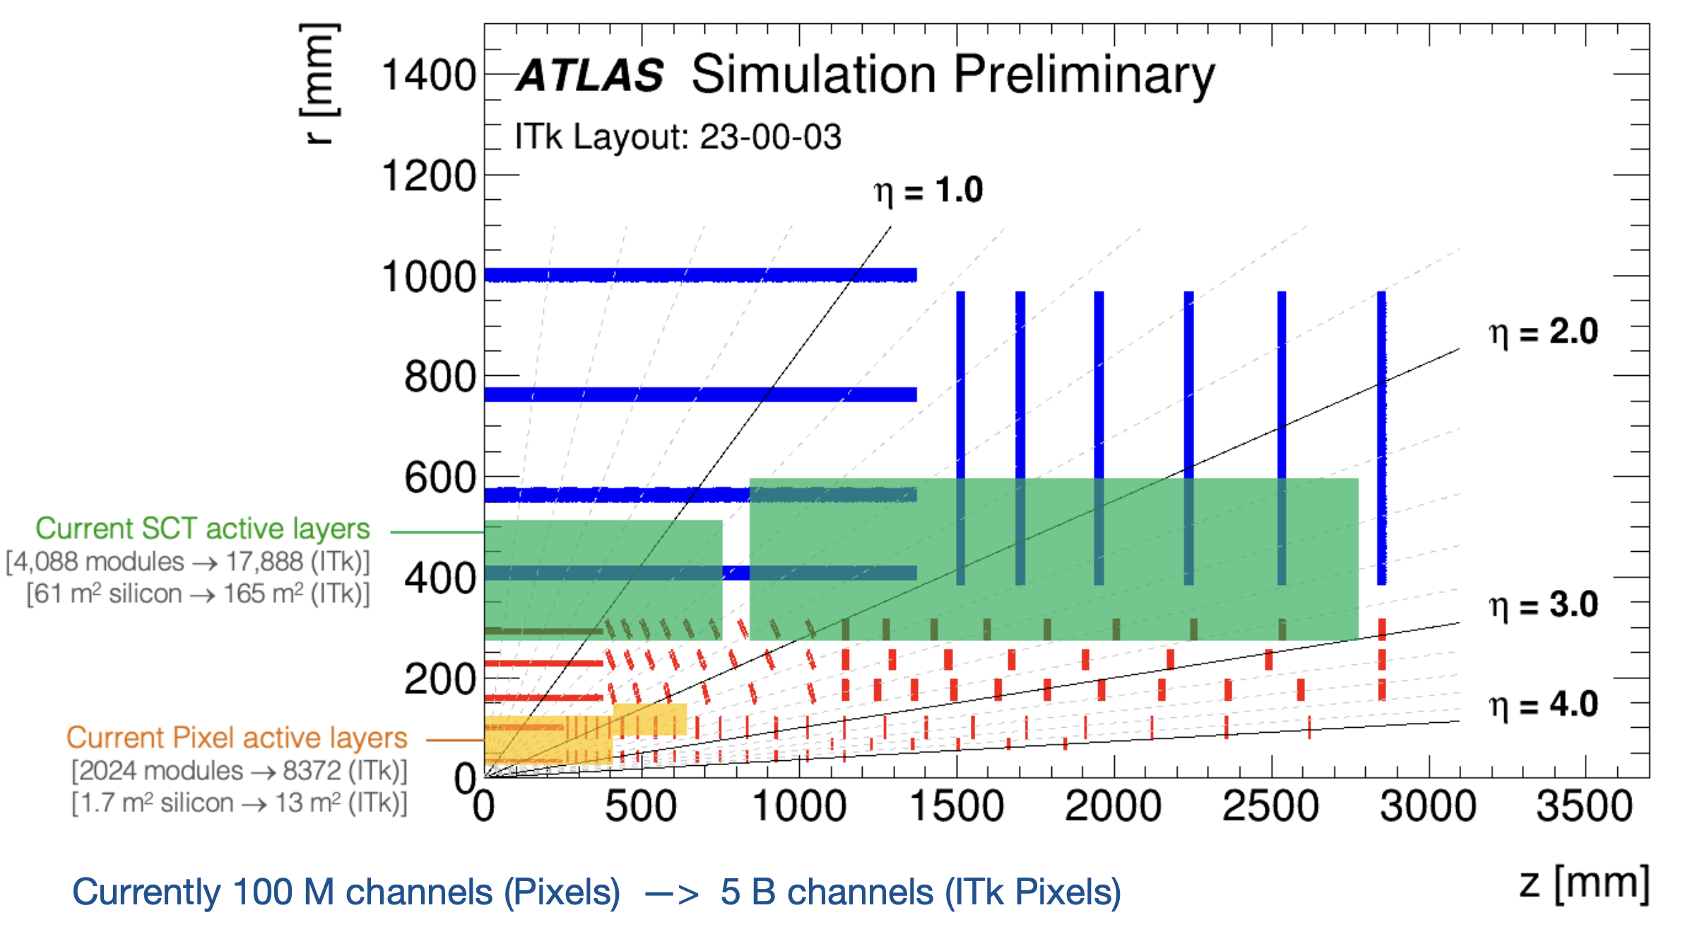
ATLAS New Inner Tracker (ITk)

Slide 3
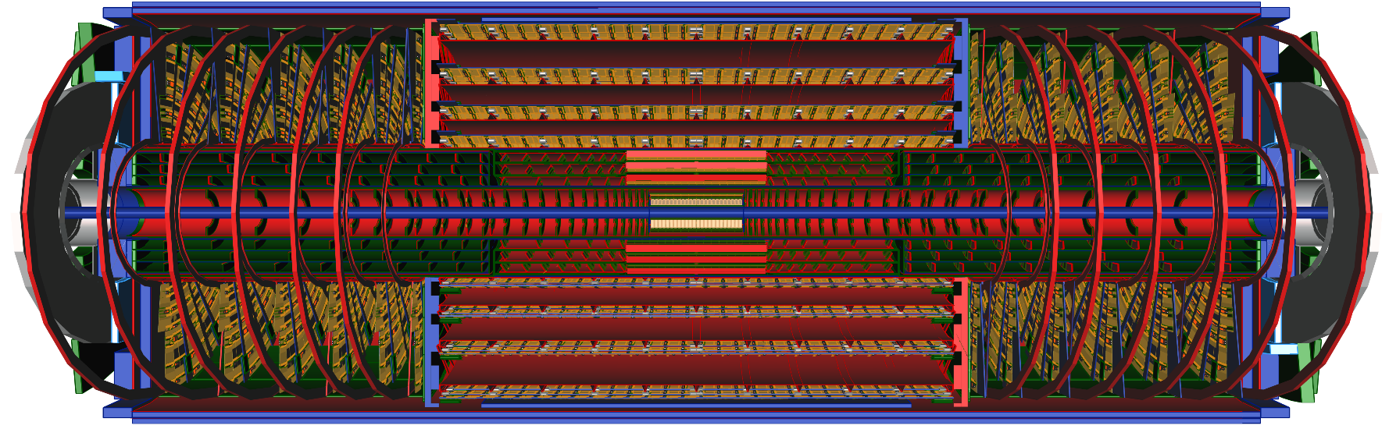
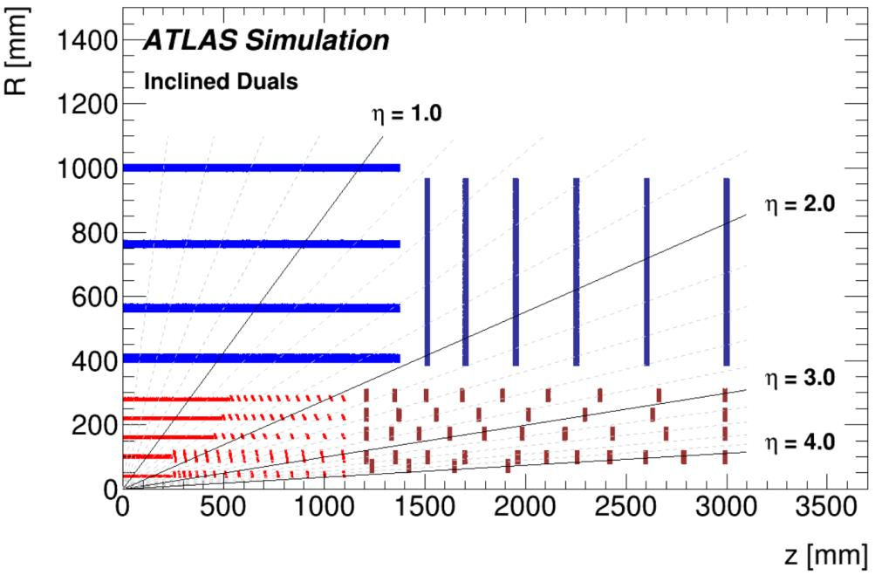
Subtask 2: Inner Tracker (ITk) Upgrade
2.1 ITk Strip Barrel Detector
Radiation hard sensor and ASIC study
Strip detector module production
Complex silicon tracker system integration
2.2 Timing Pixel Detector
Pixelated LGAD sensor R&D
Fast front-end electronics R&D

Slide 4
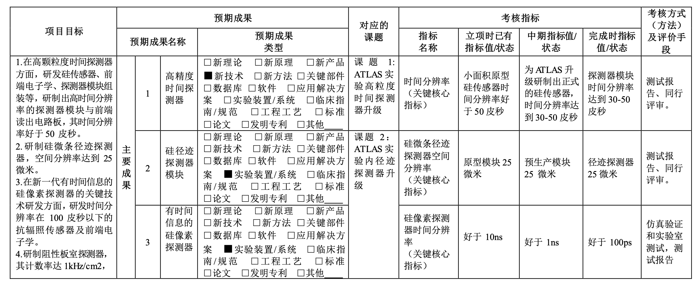


Task 2 – Overall Indicator

Slide 5
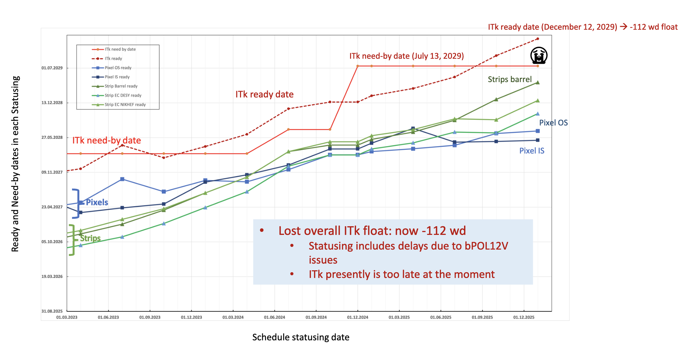
ATLAS ITk Strip schedule
ITk ready : 12 Dec 2029
(-112 wd float)
Mainly driven by
strip barrel
Does not include potential
delays due to bPOL12V
issues
ITk Strips Barrel ready for installation: 12 Sep 2029
ITk Strips Barrel need-by date: 13 July 2029

Slide 6
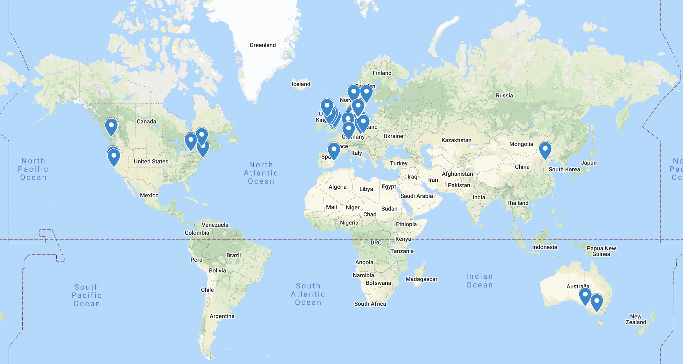




ATLAS ITk Strip Project World Wide
16 Funding Agencies and 50 Institutes
UK/China Cluster
50% Barrel Strip Detector
China: IHEP, THU, SYSU, TDLI, SDU
1000 Modules（10m² Silicon Surface Area）
Xin Shi as UK/China Cluster Manager since 2022

Slide 7
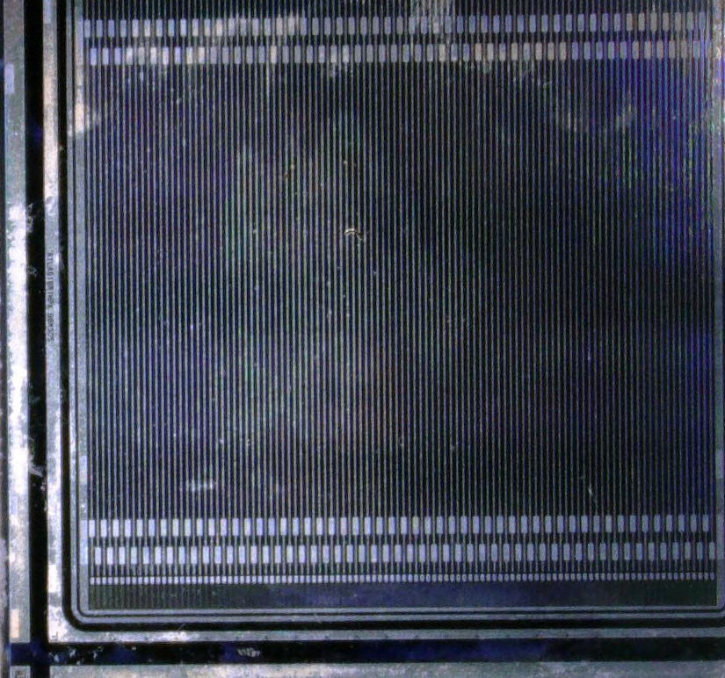
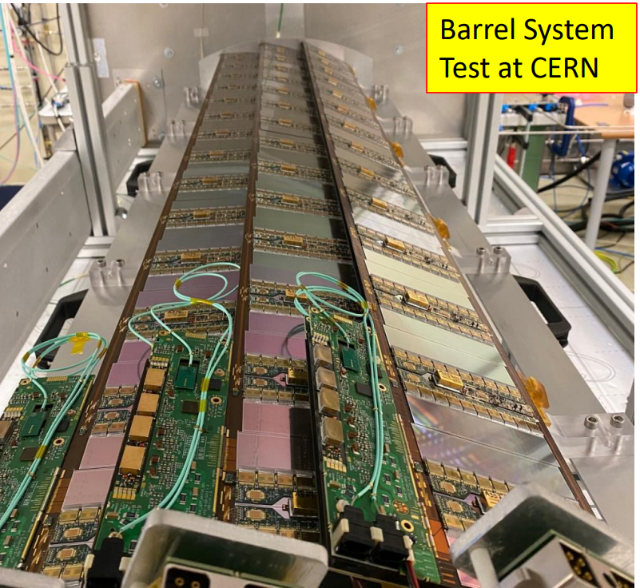
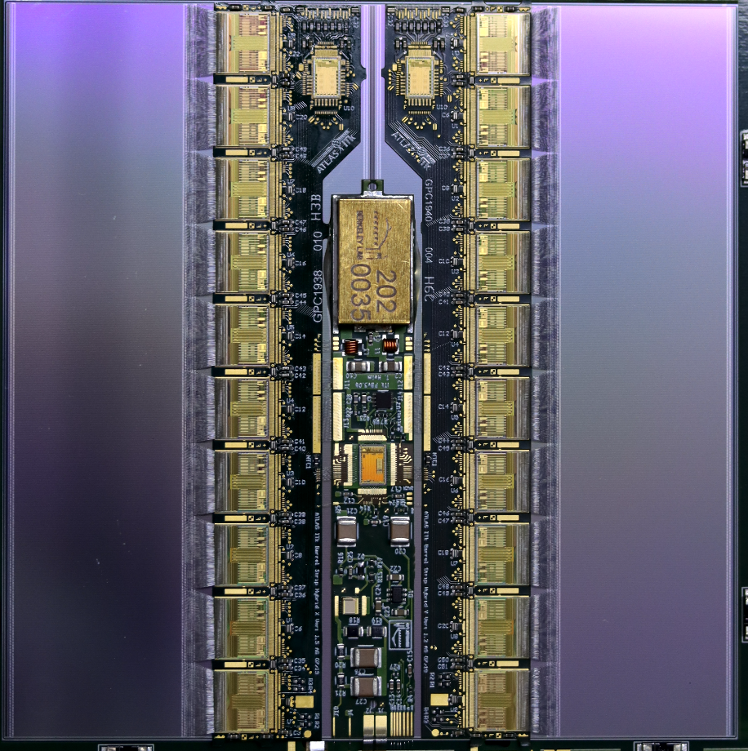
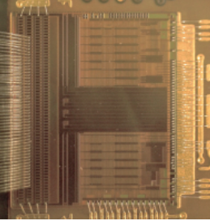
2.1 ITk Strip Barrel Detector
Deliverables
Complete strip barrel detector with 25µm spacial resolution
Provide strip module spacial resolution evaluation report
Contents
Radiation hard sensor and readout ASIC study
High performance strip detector module production
Complex silicon detector system integration
Mini Sensor
Strip Module
Strip Barrel Detector
ASIC

Slide 8
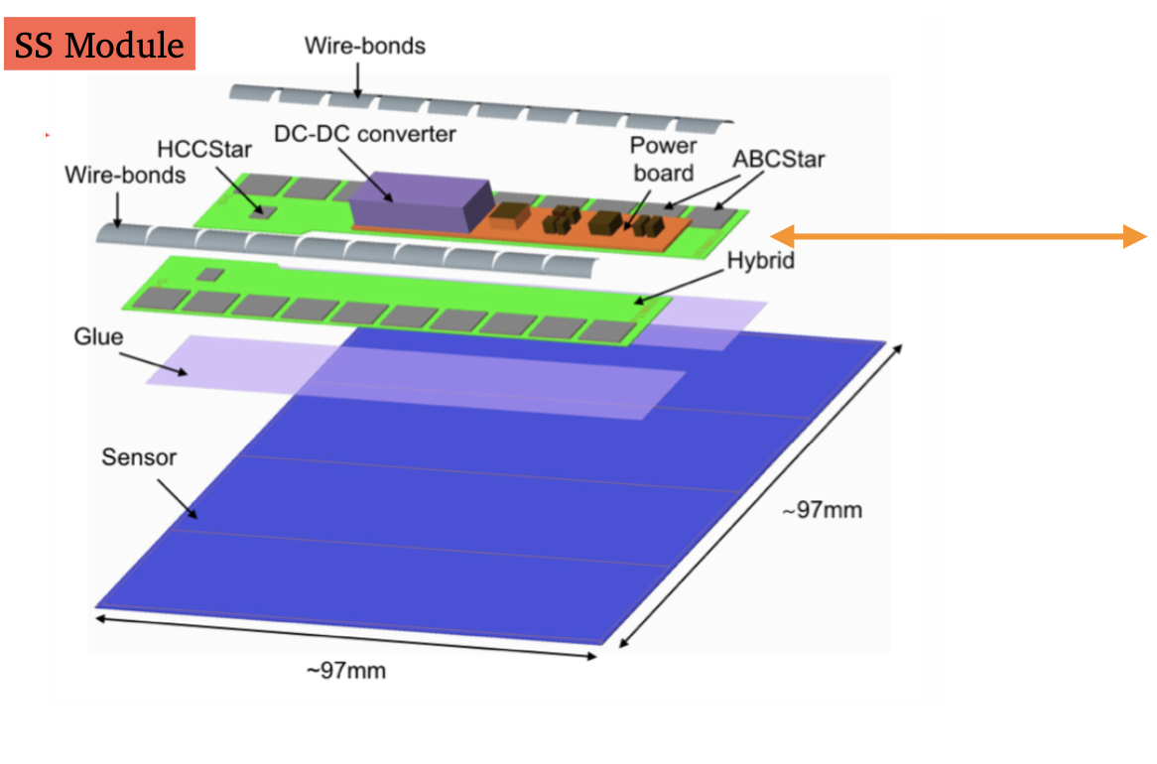
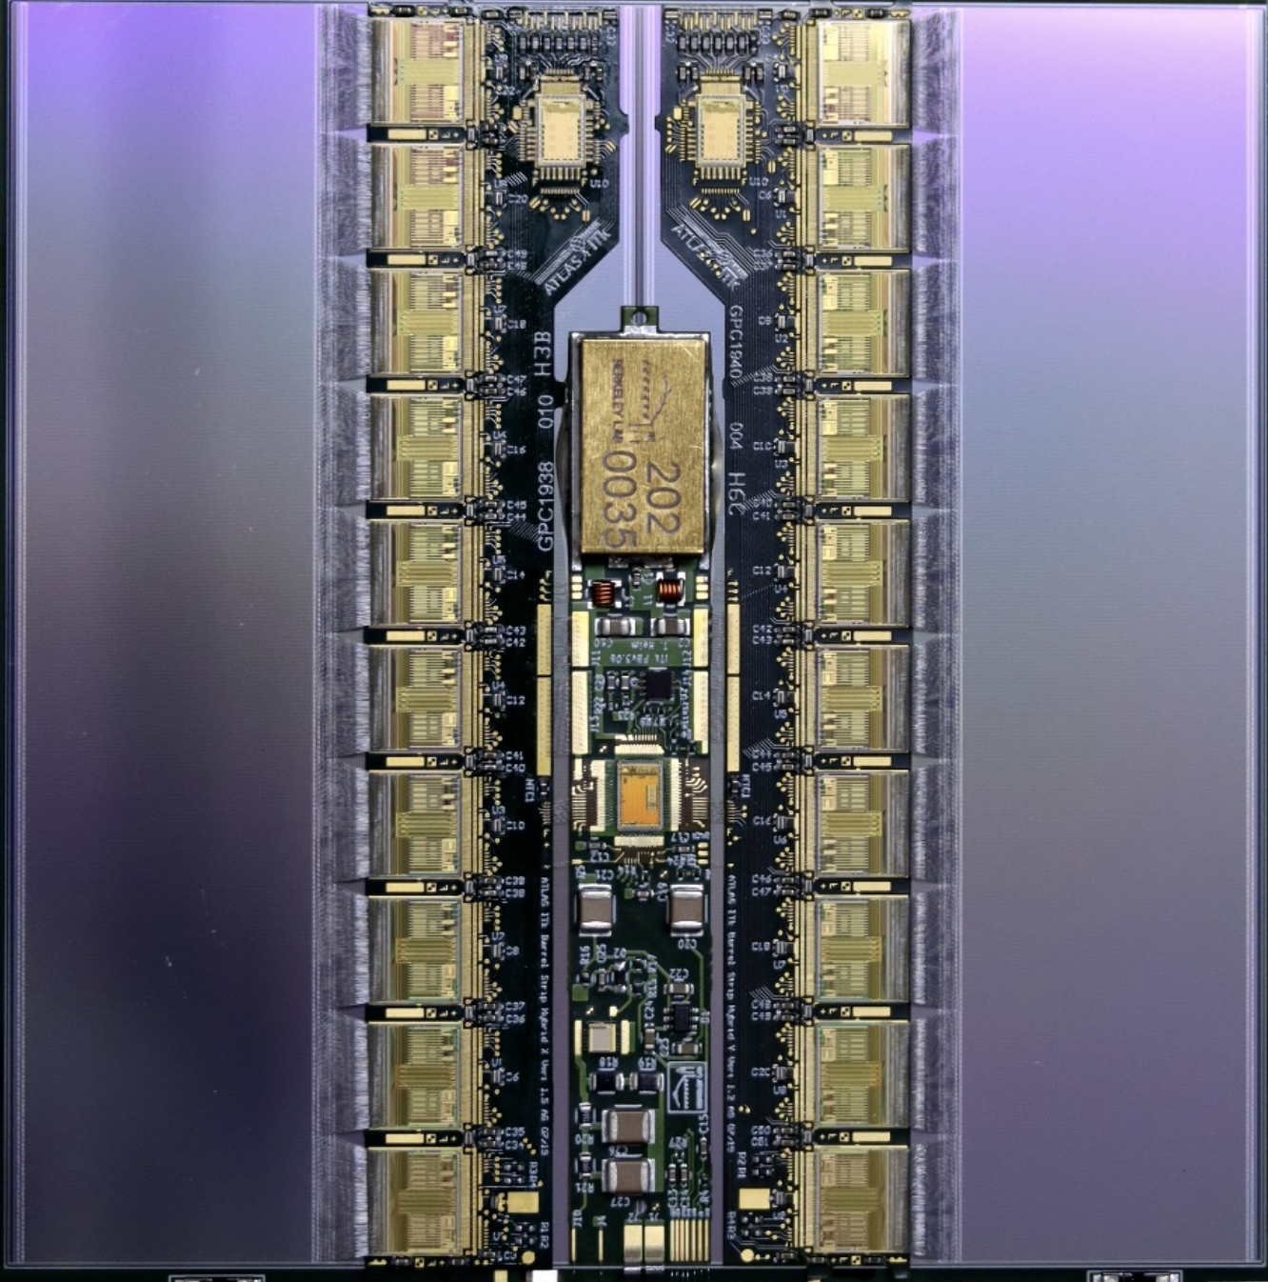
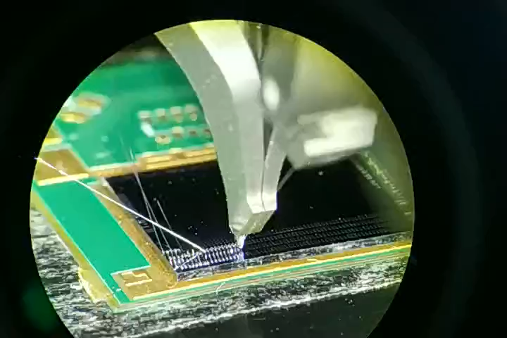
Strip Module Component
Short Strip Module

Slide 9
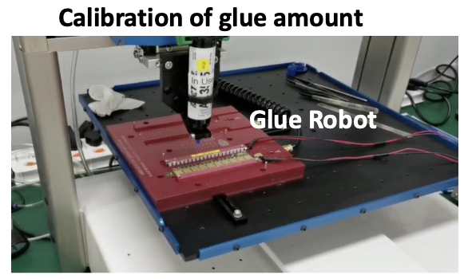
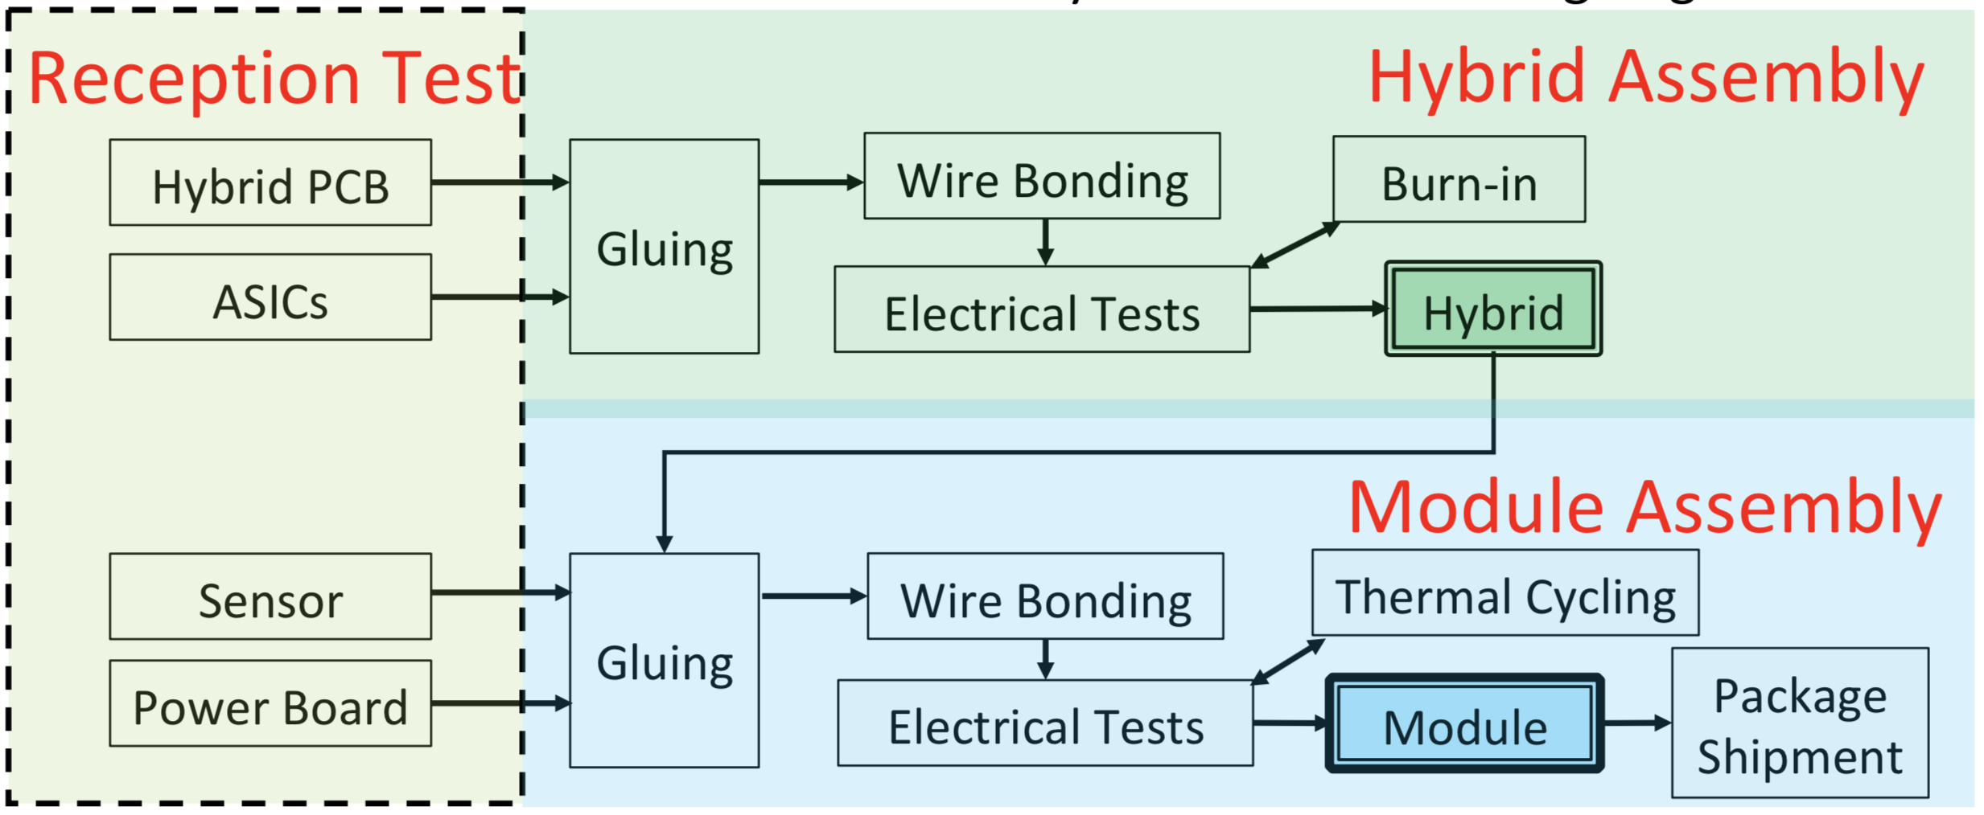
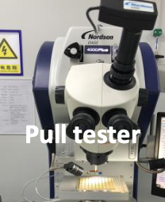
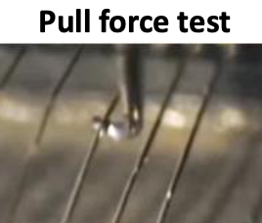
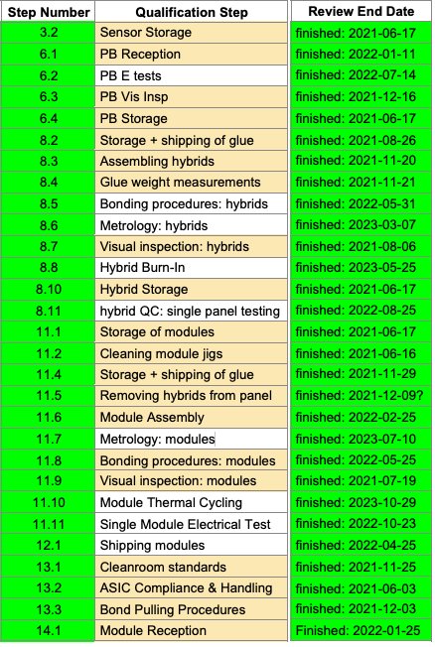
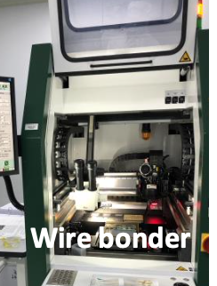
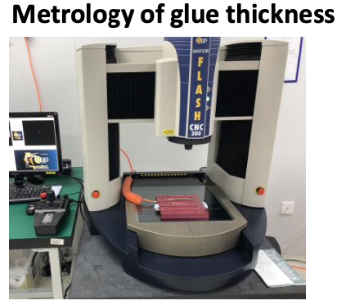
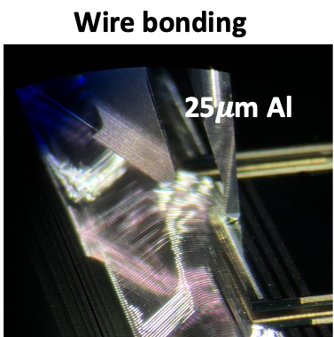
ITk Strip Module Production Procedure
Well defined module production steps to ensure High Quality Modules
29 Steps

Slide 10
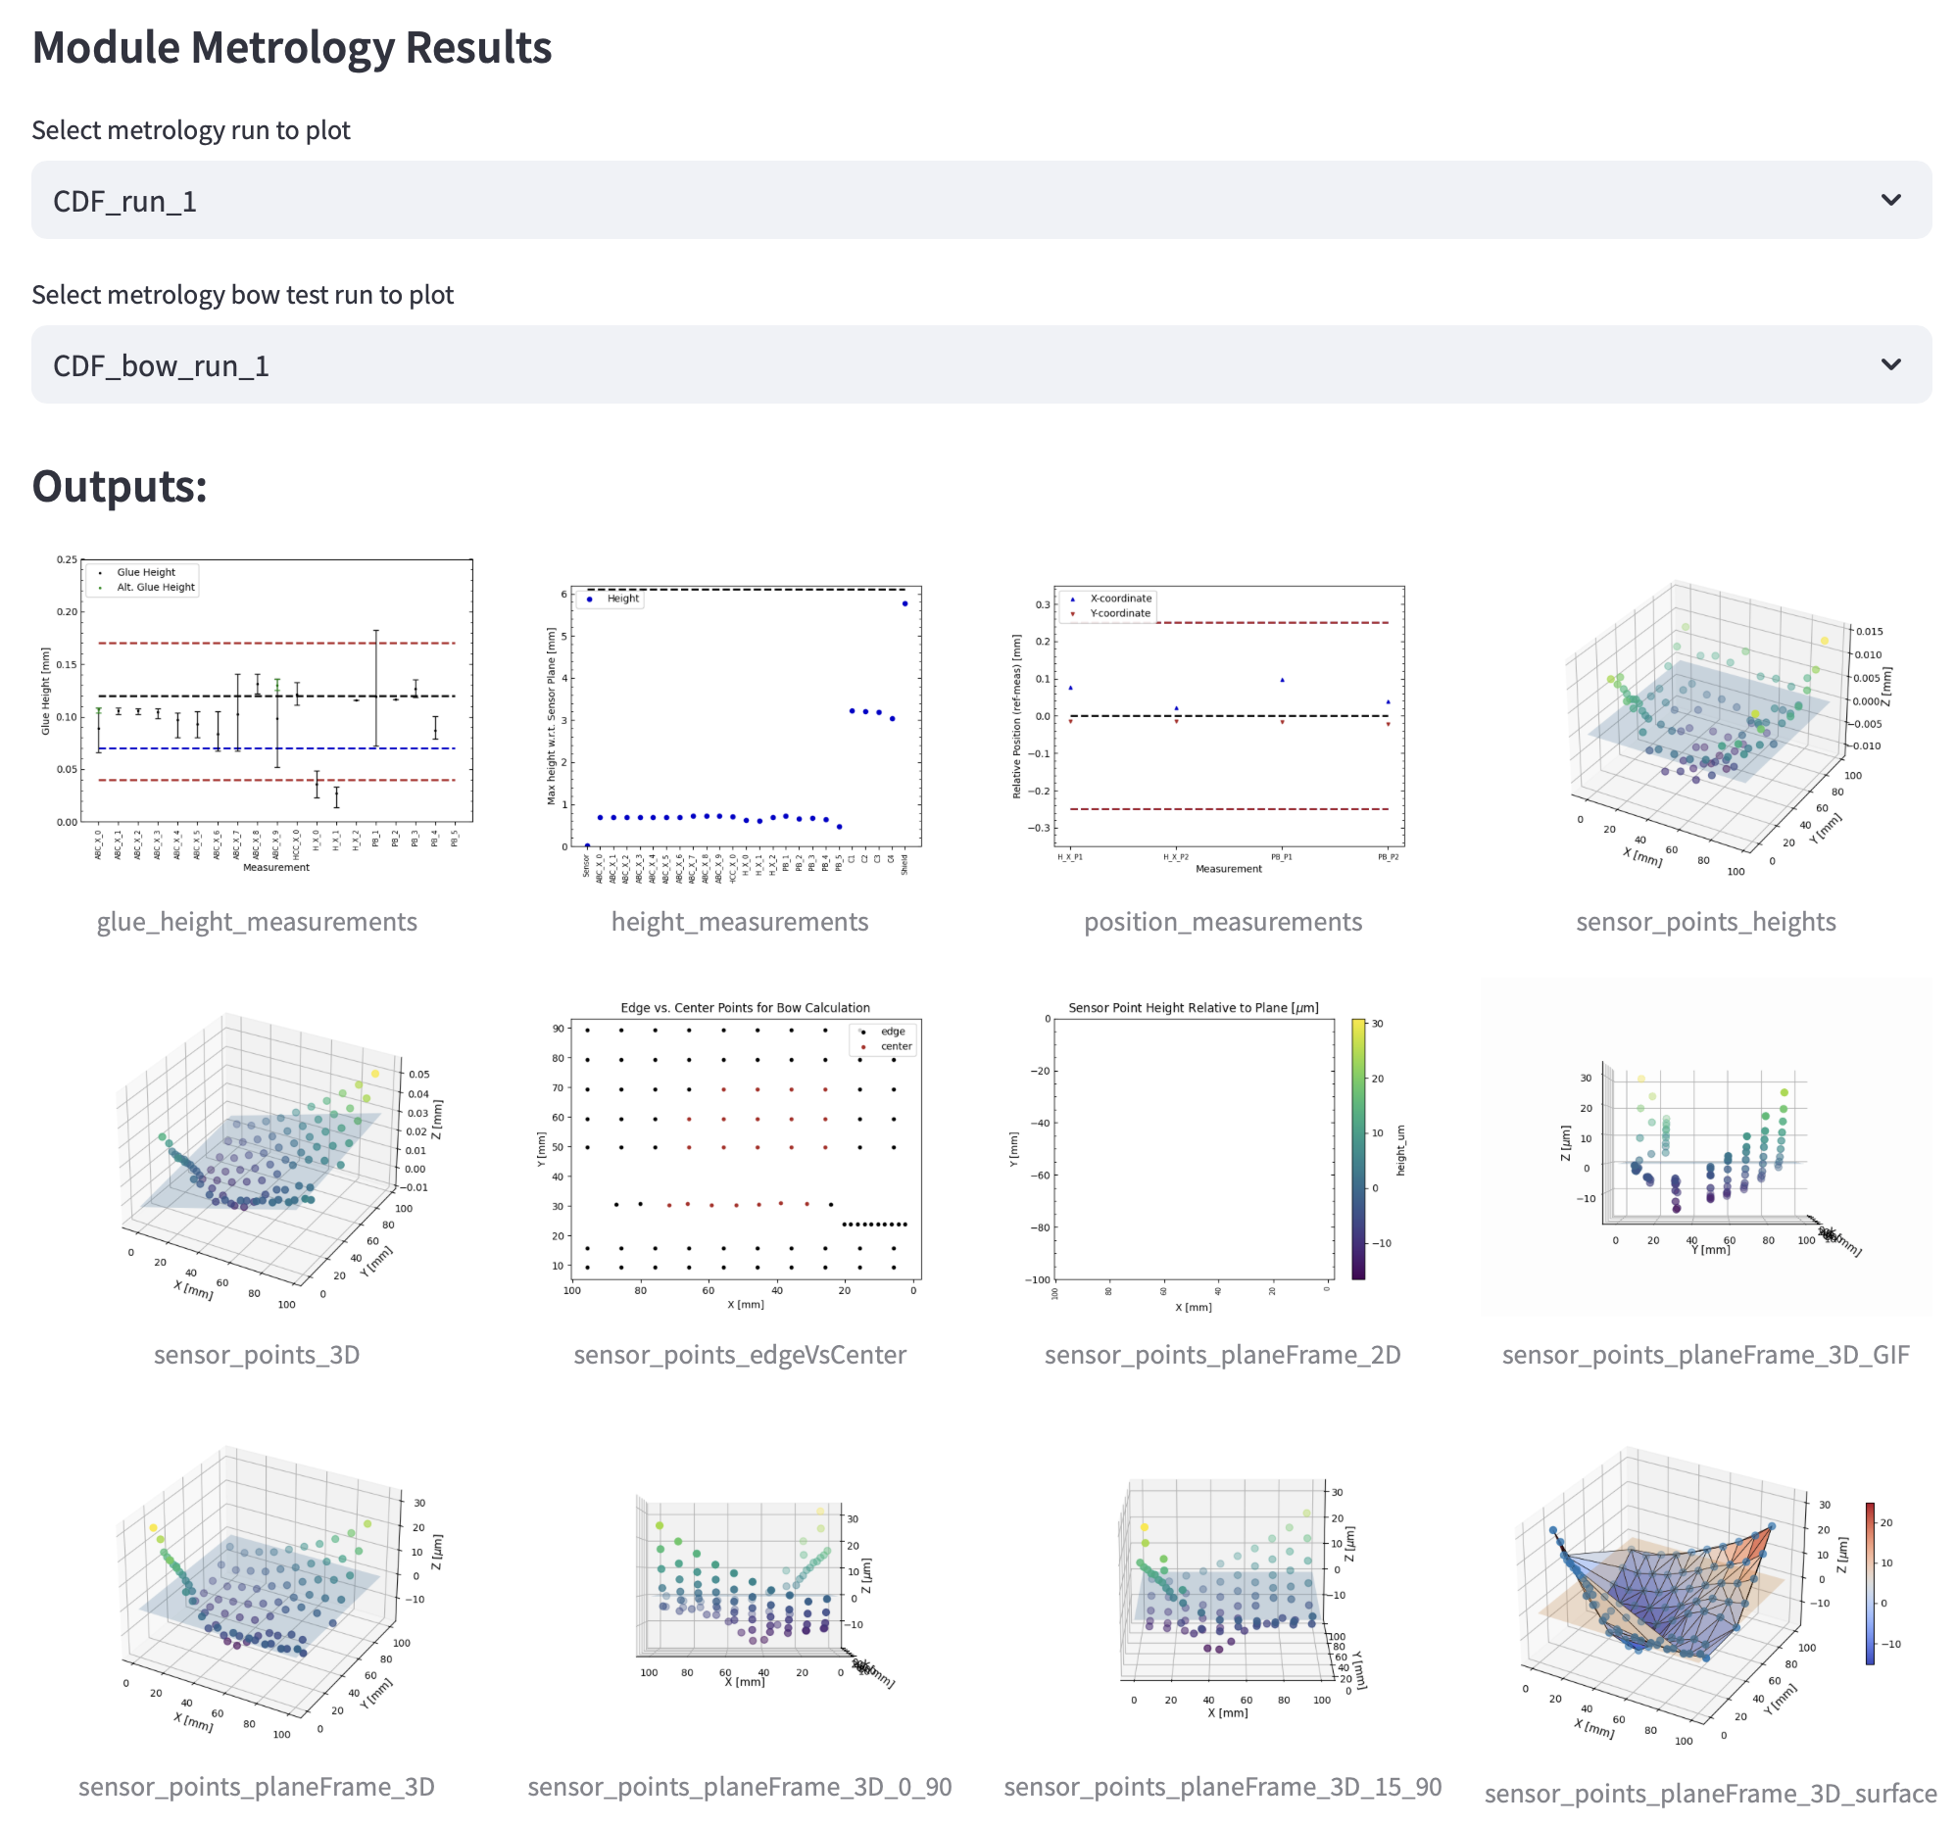
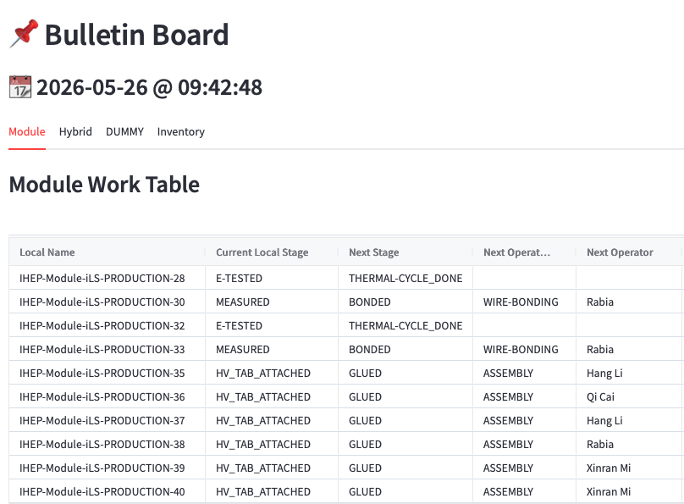
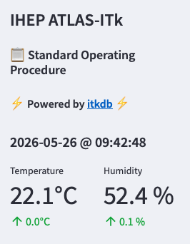
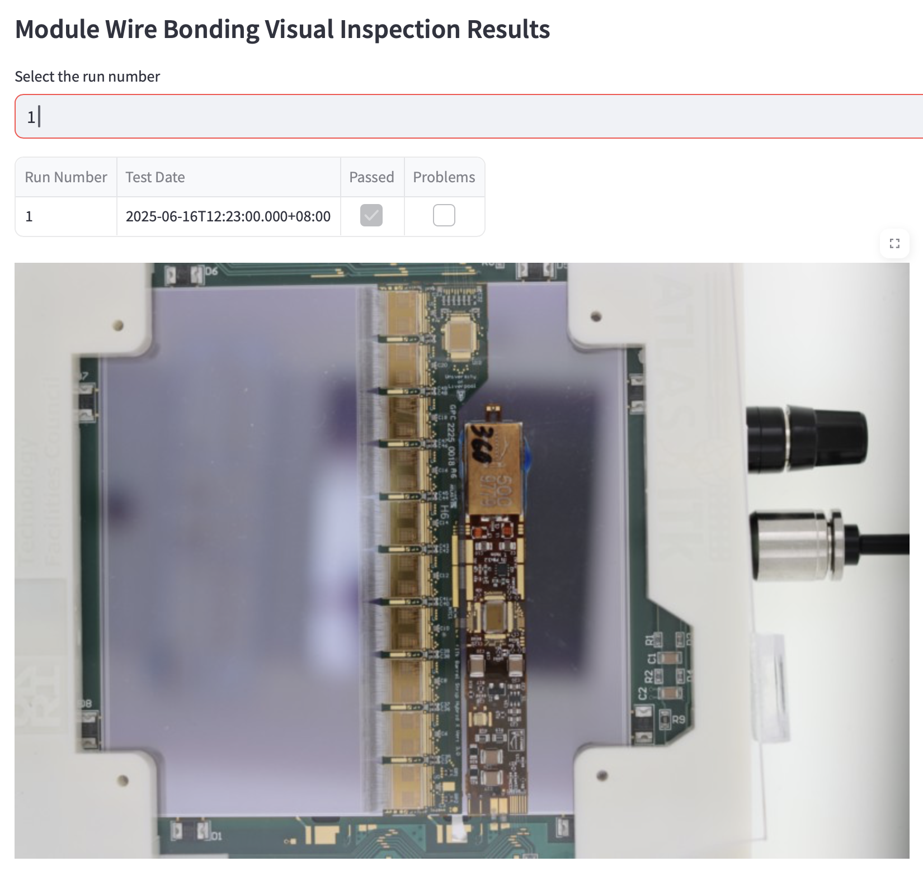
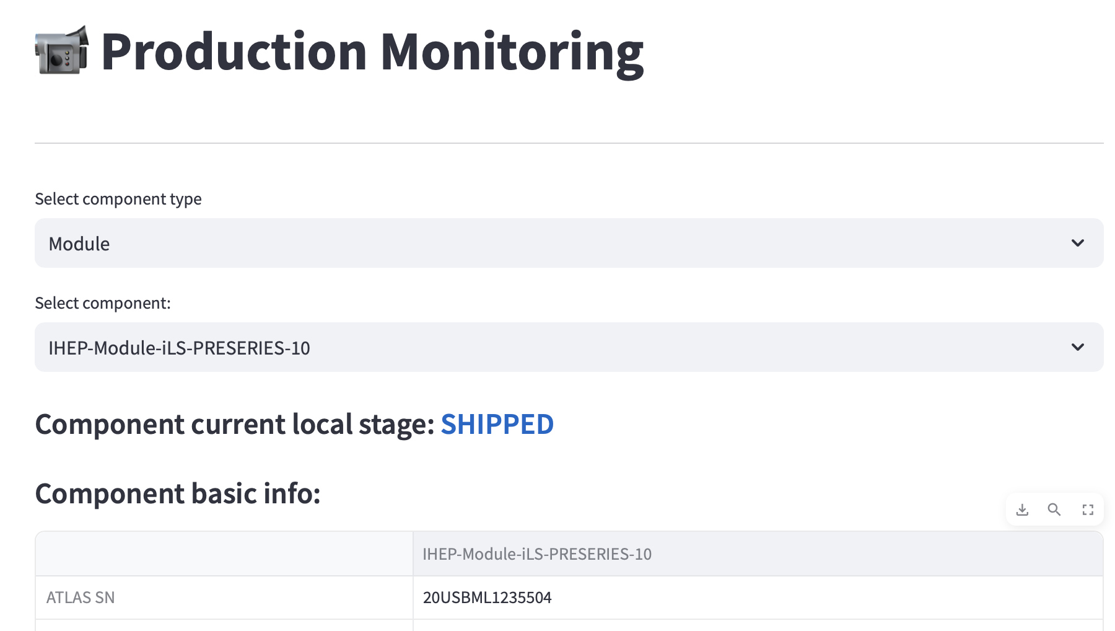
Standard Operating Procedure (SOP)
Developed at IHEP for local production
  All SQ 29 steps have been implemented in SOP
  Interact with ITk central Production Database
http://atlasitk.ihep.ac.cn
Connect to ITk Production Database

Slide 11
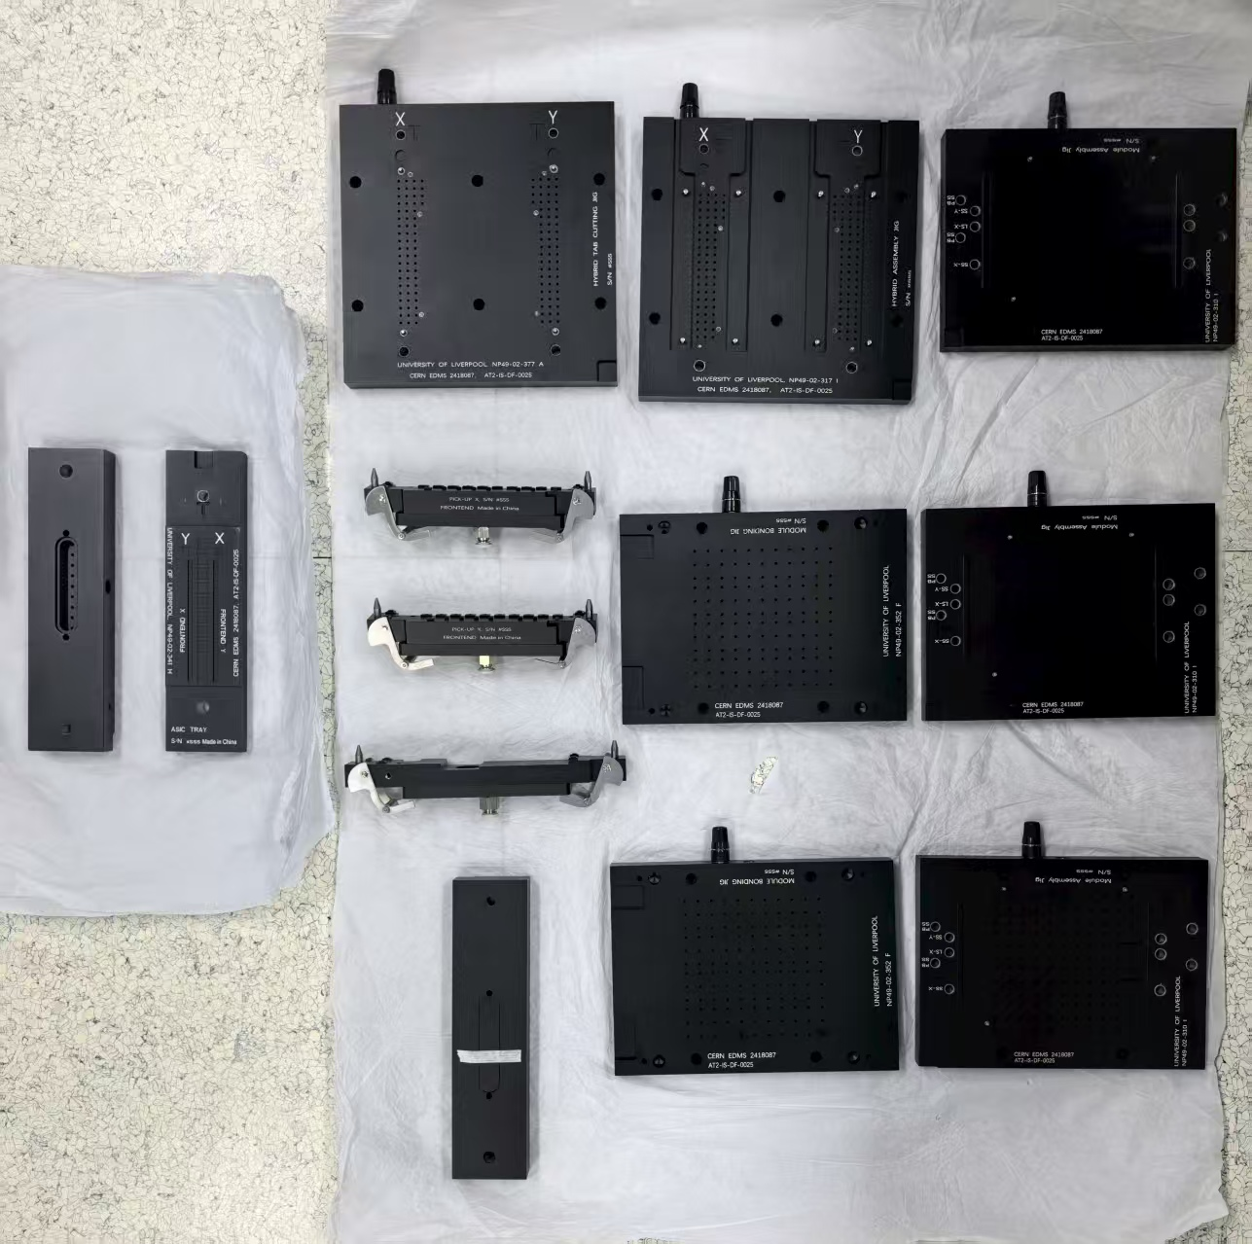
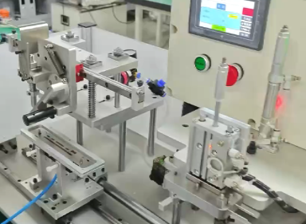
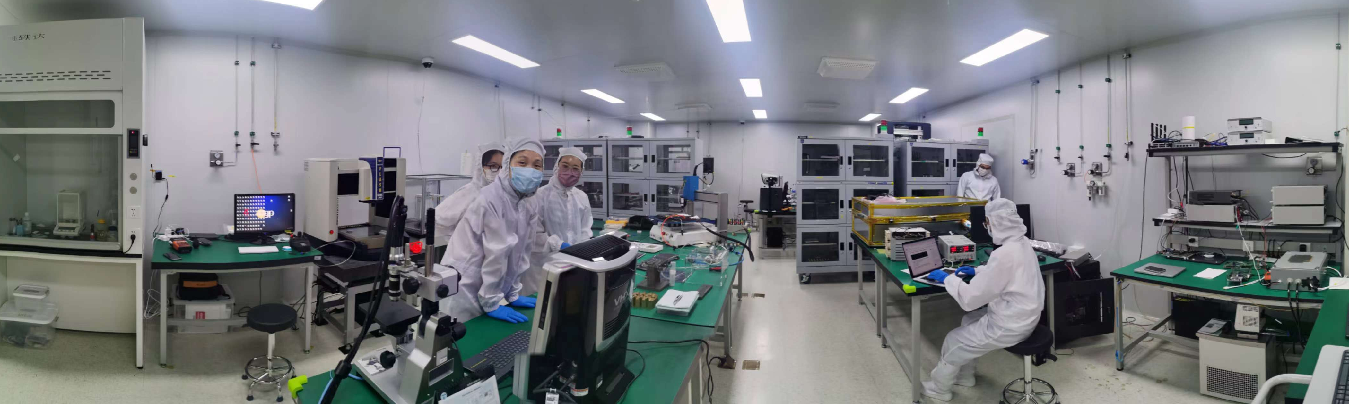
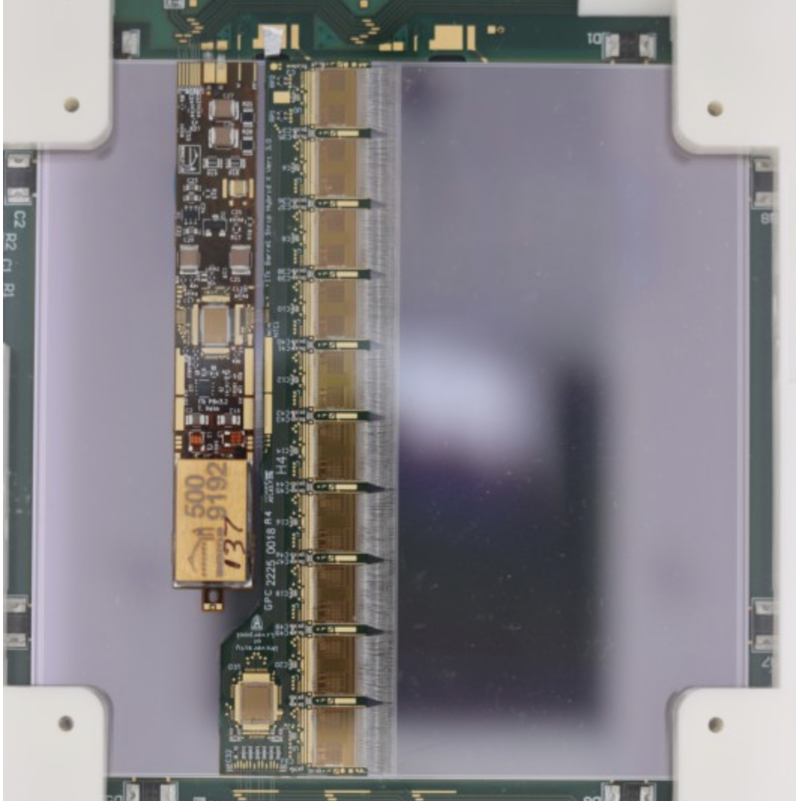
IHEP Site Module Production Status
Passed PRESERIES stage for Module production
  Produced 75 PRESERIES modules
  (15@IHEP / ~ 50@ RAL)
  Produced ~134 PRODUCTION modules
  (34 @IHEP / ~100@RAL)
Manufactured 11 production tooling set and one automatic machine in China
Automatic Tool at IHEP
New tools made in China
IHEP Site for ITk Strip Module
Cabinet
Pull Test
Wire Bonder
Weight
Probe Station
Dry Box (x4)
Electrical Test
Metrology
Thermal Cycling
Glue Robot
Scope
PRODUCTION
Module (x25)
Hybrid Burn-in
Scope
Chiller

Slide 12
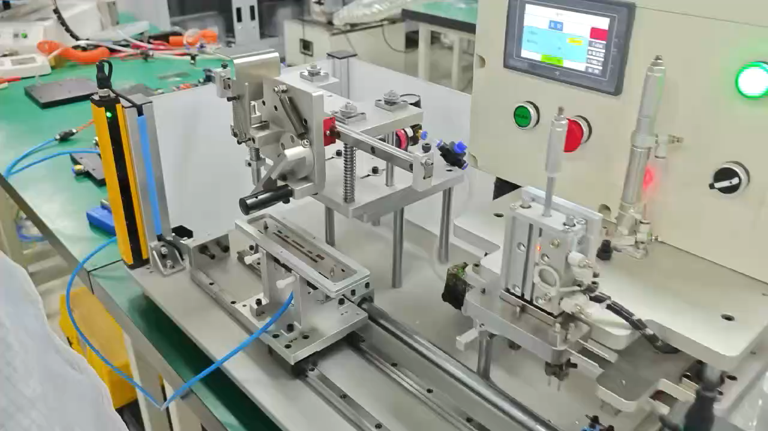
Automatic Module Asseble Machine at IHEP
Steamline the lifting procedure after apply the glue
Improve the uniformity between different operators

Slide 13
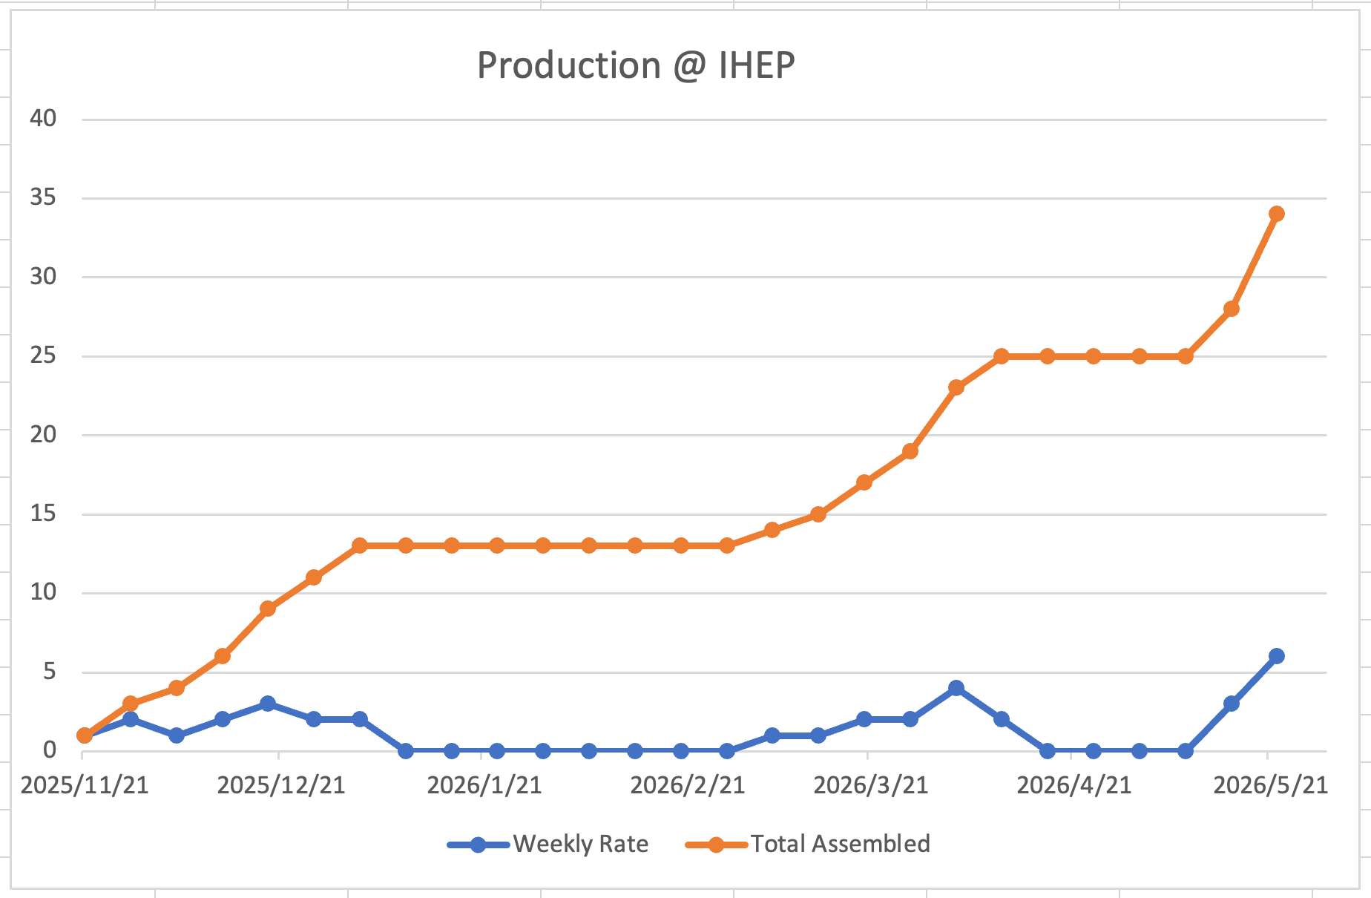
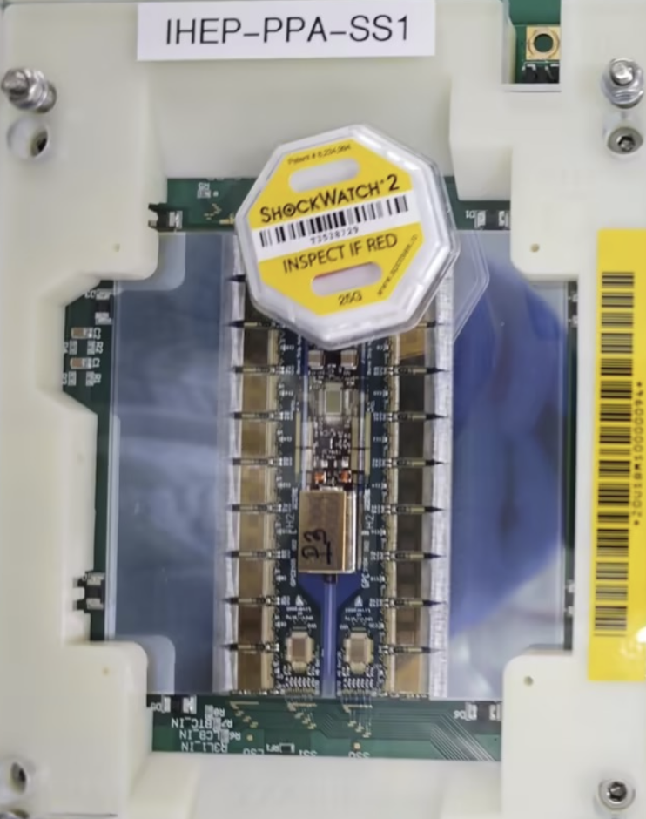
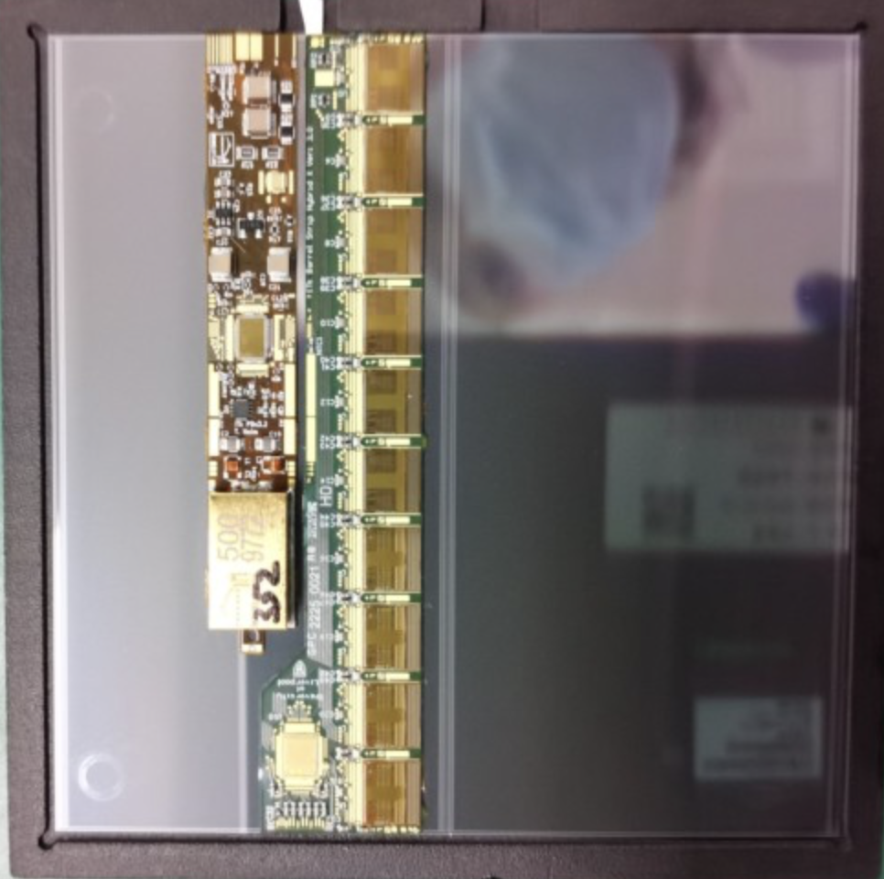
Modules @ IHEP
16 Pre-Production Modules
15 PRESERIES modules
34 PRODUCTION modules @ IHEP
  Yield > 95 %
  Reached peak rate 6 modules/week (current expect for IHEP: 3)
Reached peak rate!
IHEP-LS-1
Flat due to lack of sensors from UK

Slide 14
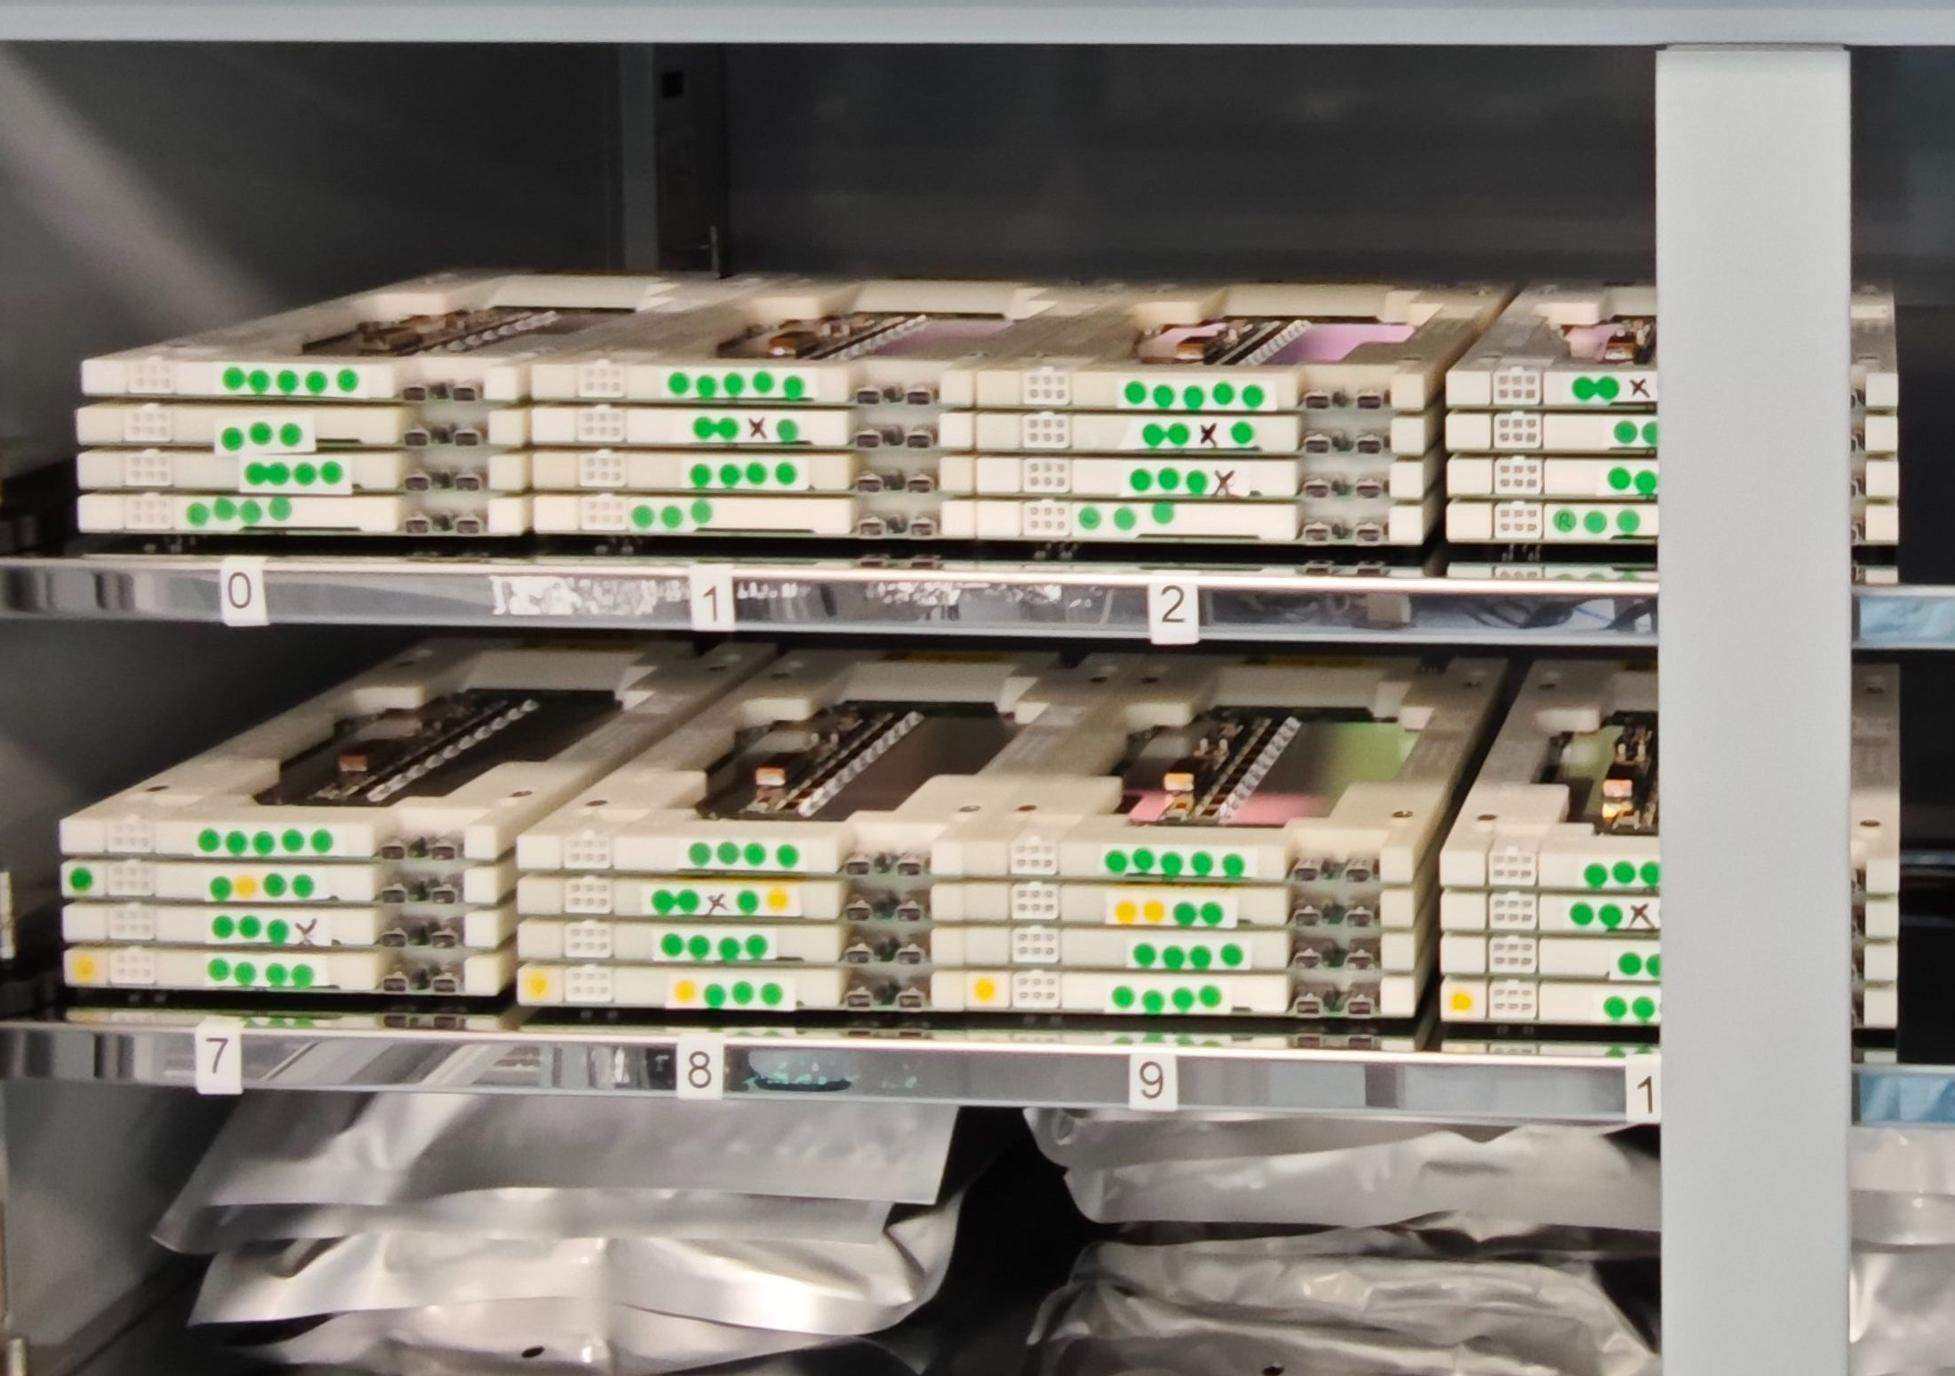
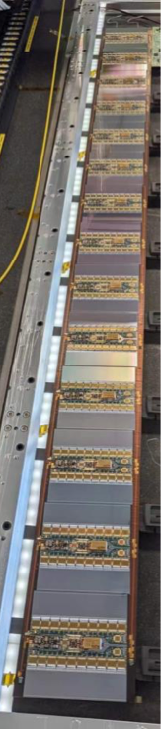
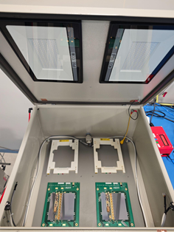
China ITk @ RAL
Two FTEs from China based at RAL
Assembled ~100 modules for China share
Participated in stave loading activities
Assist in logistics for IHEP and UV light setup for module recovery
2 UV lights

Slide 15
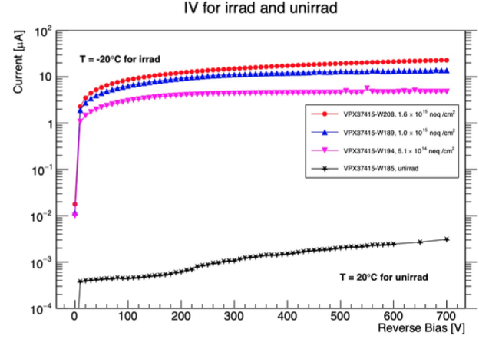
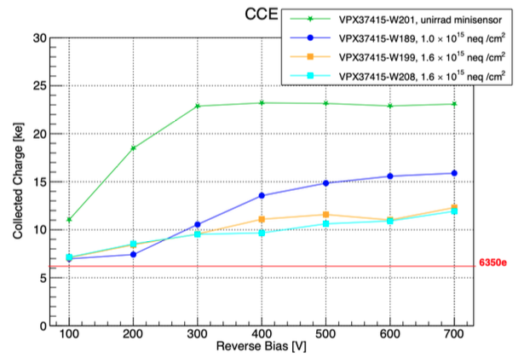
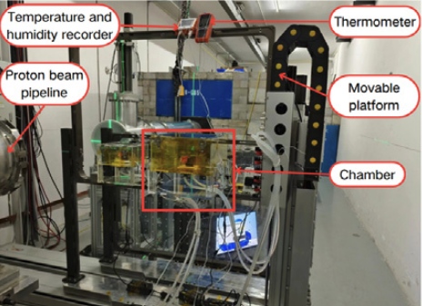
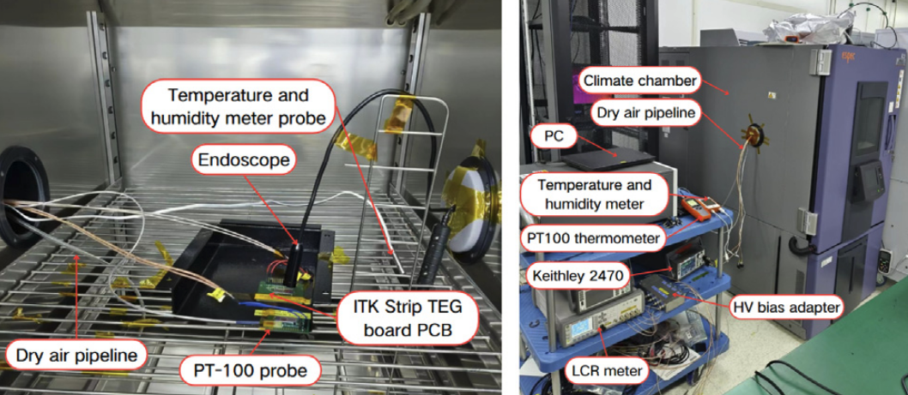
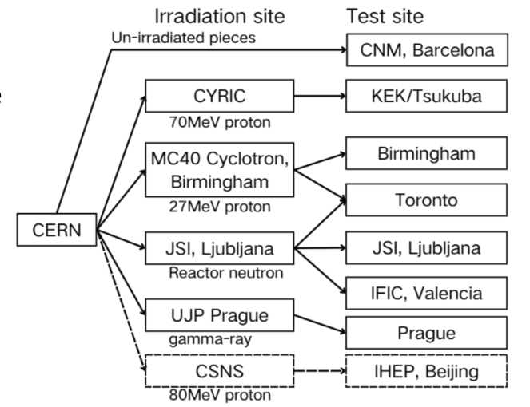
Strip Sensor Irradiation Study
Proton irradiation of strip mini-sensor at CSNS
Sensor characterization at IHEP
Qualified as Sensor Qualification Assurance (QA) site (CSNS as irradiation site / IHEP as sensor testing site)
Received 10 batches of sensor samples for irradiation
CSNS
IHEP

Slide 16
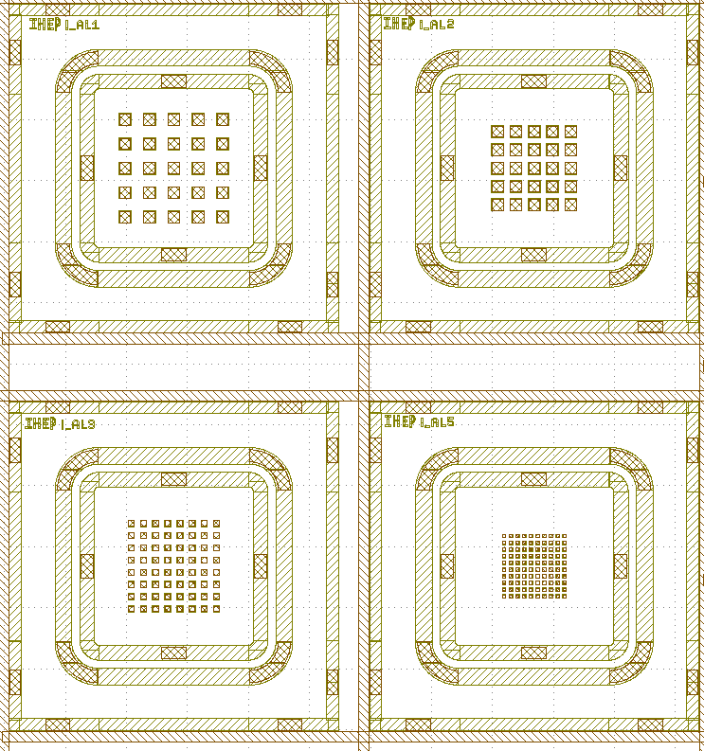
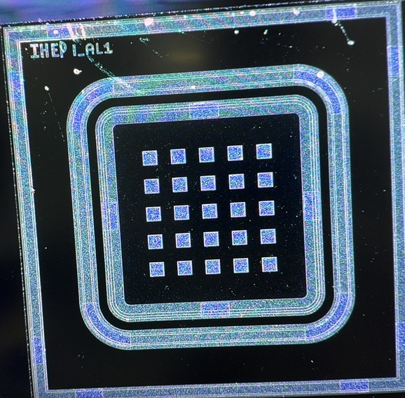
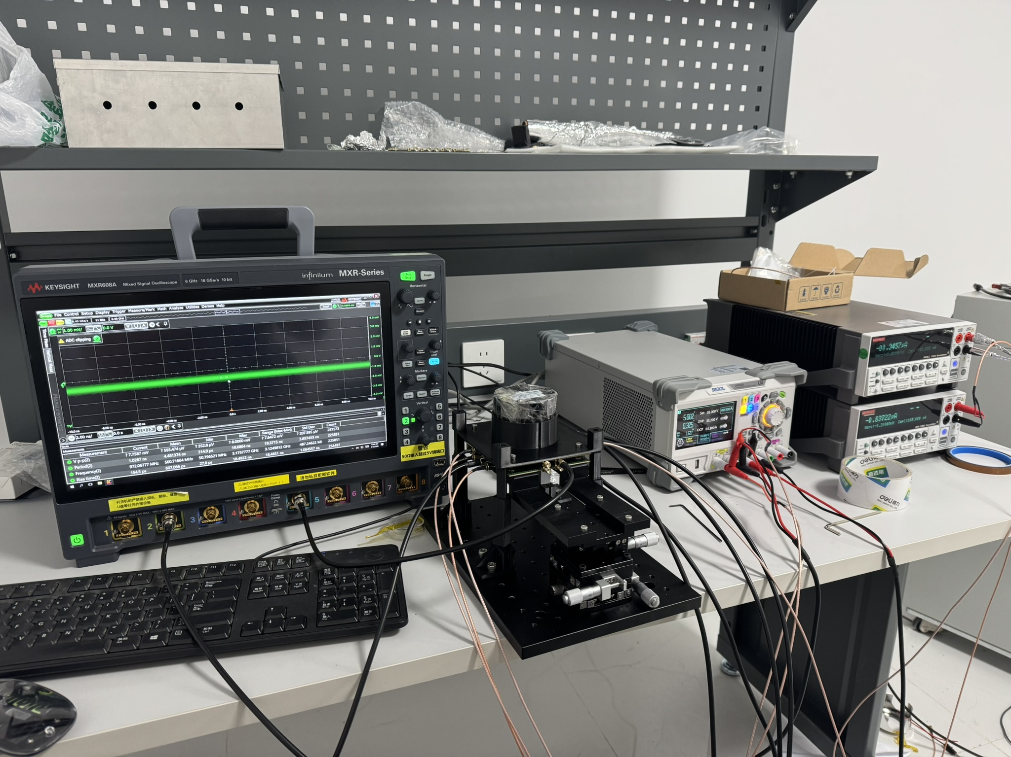
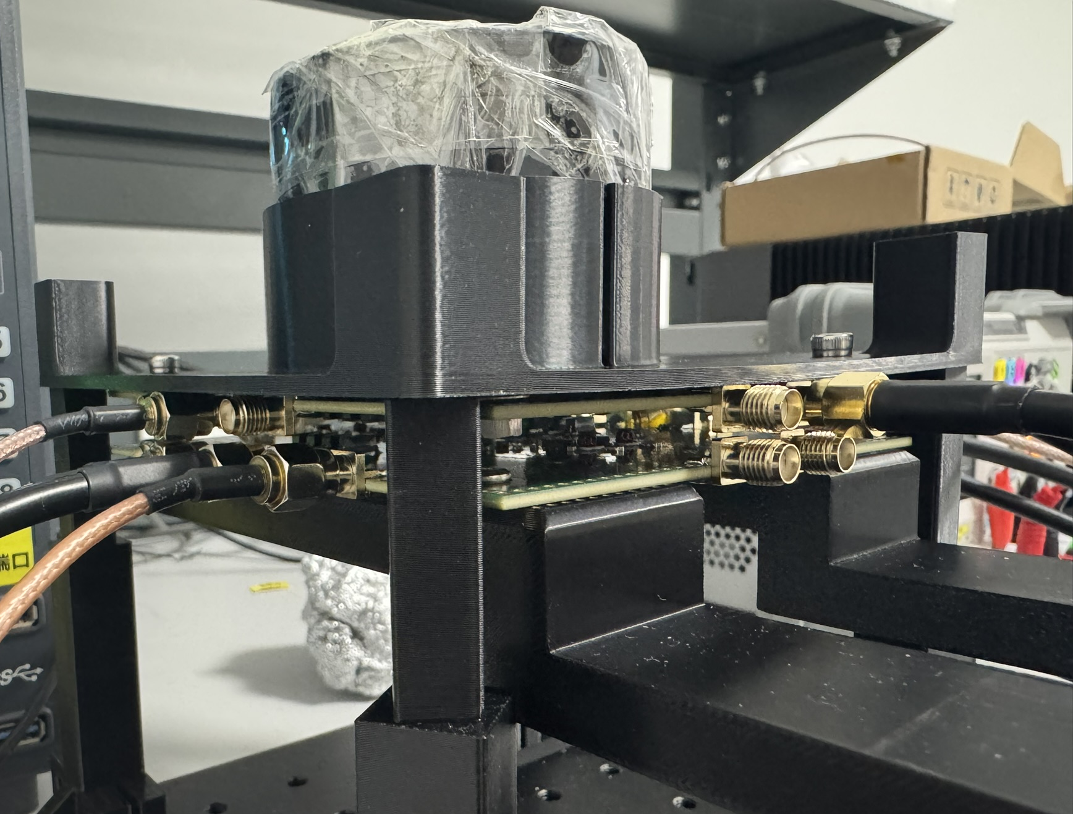
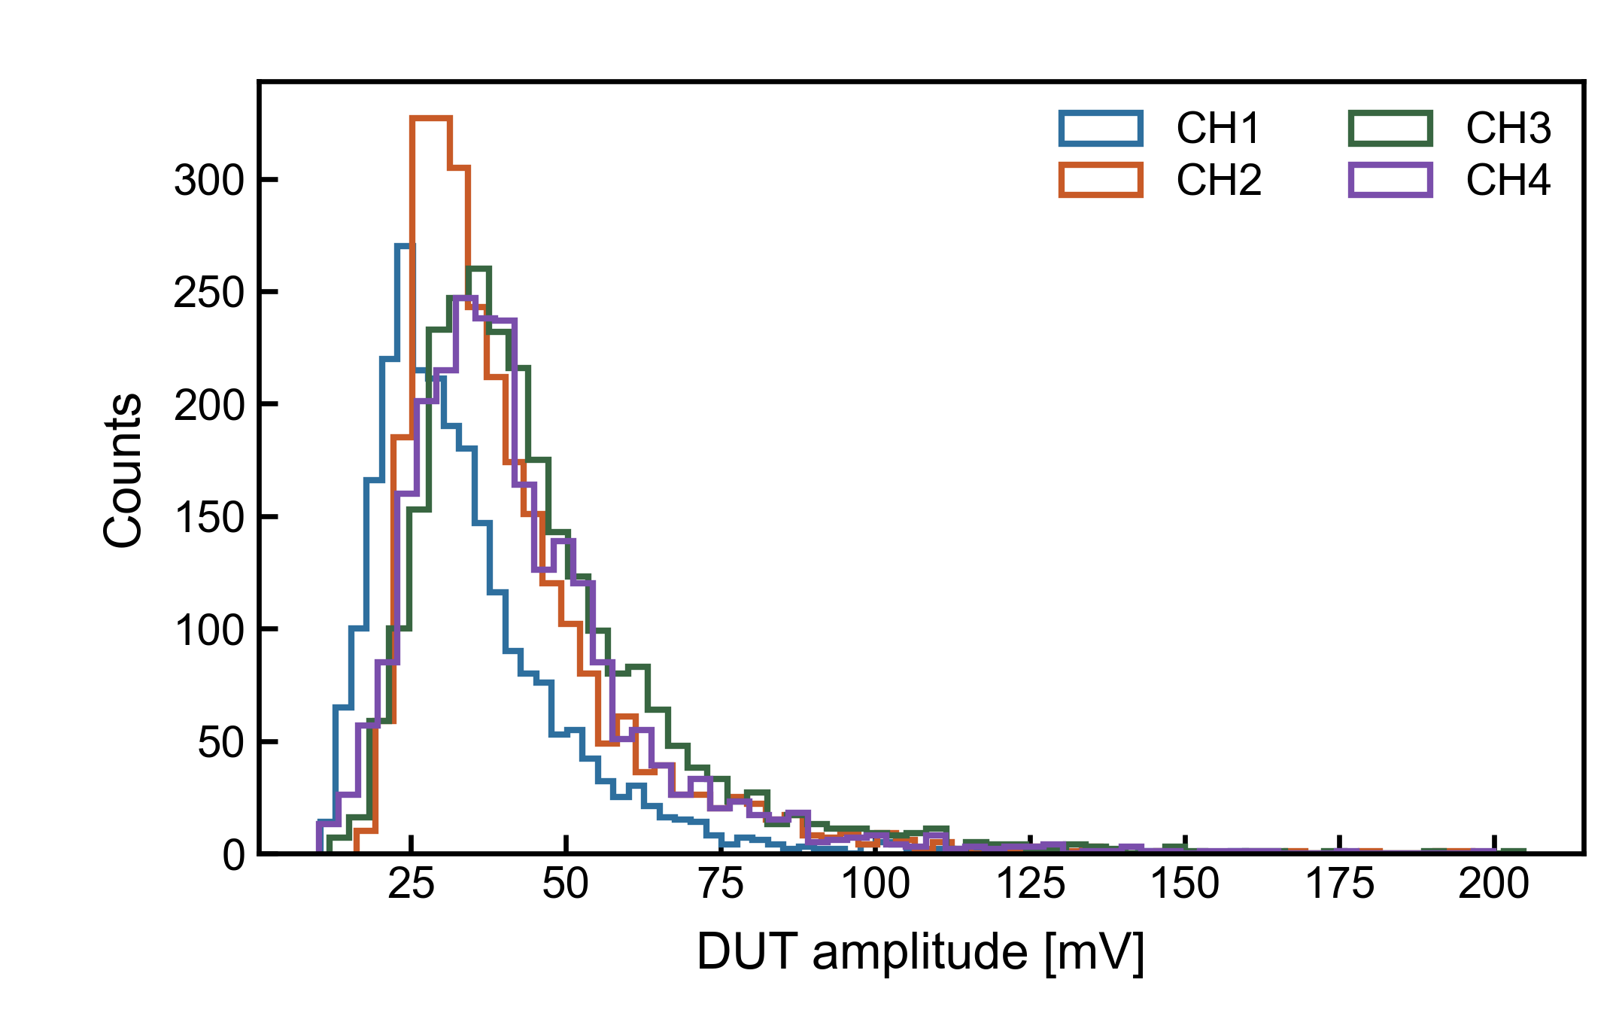
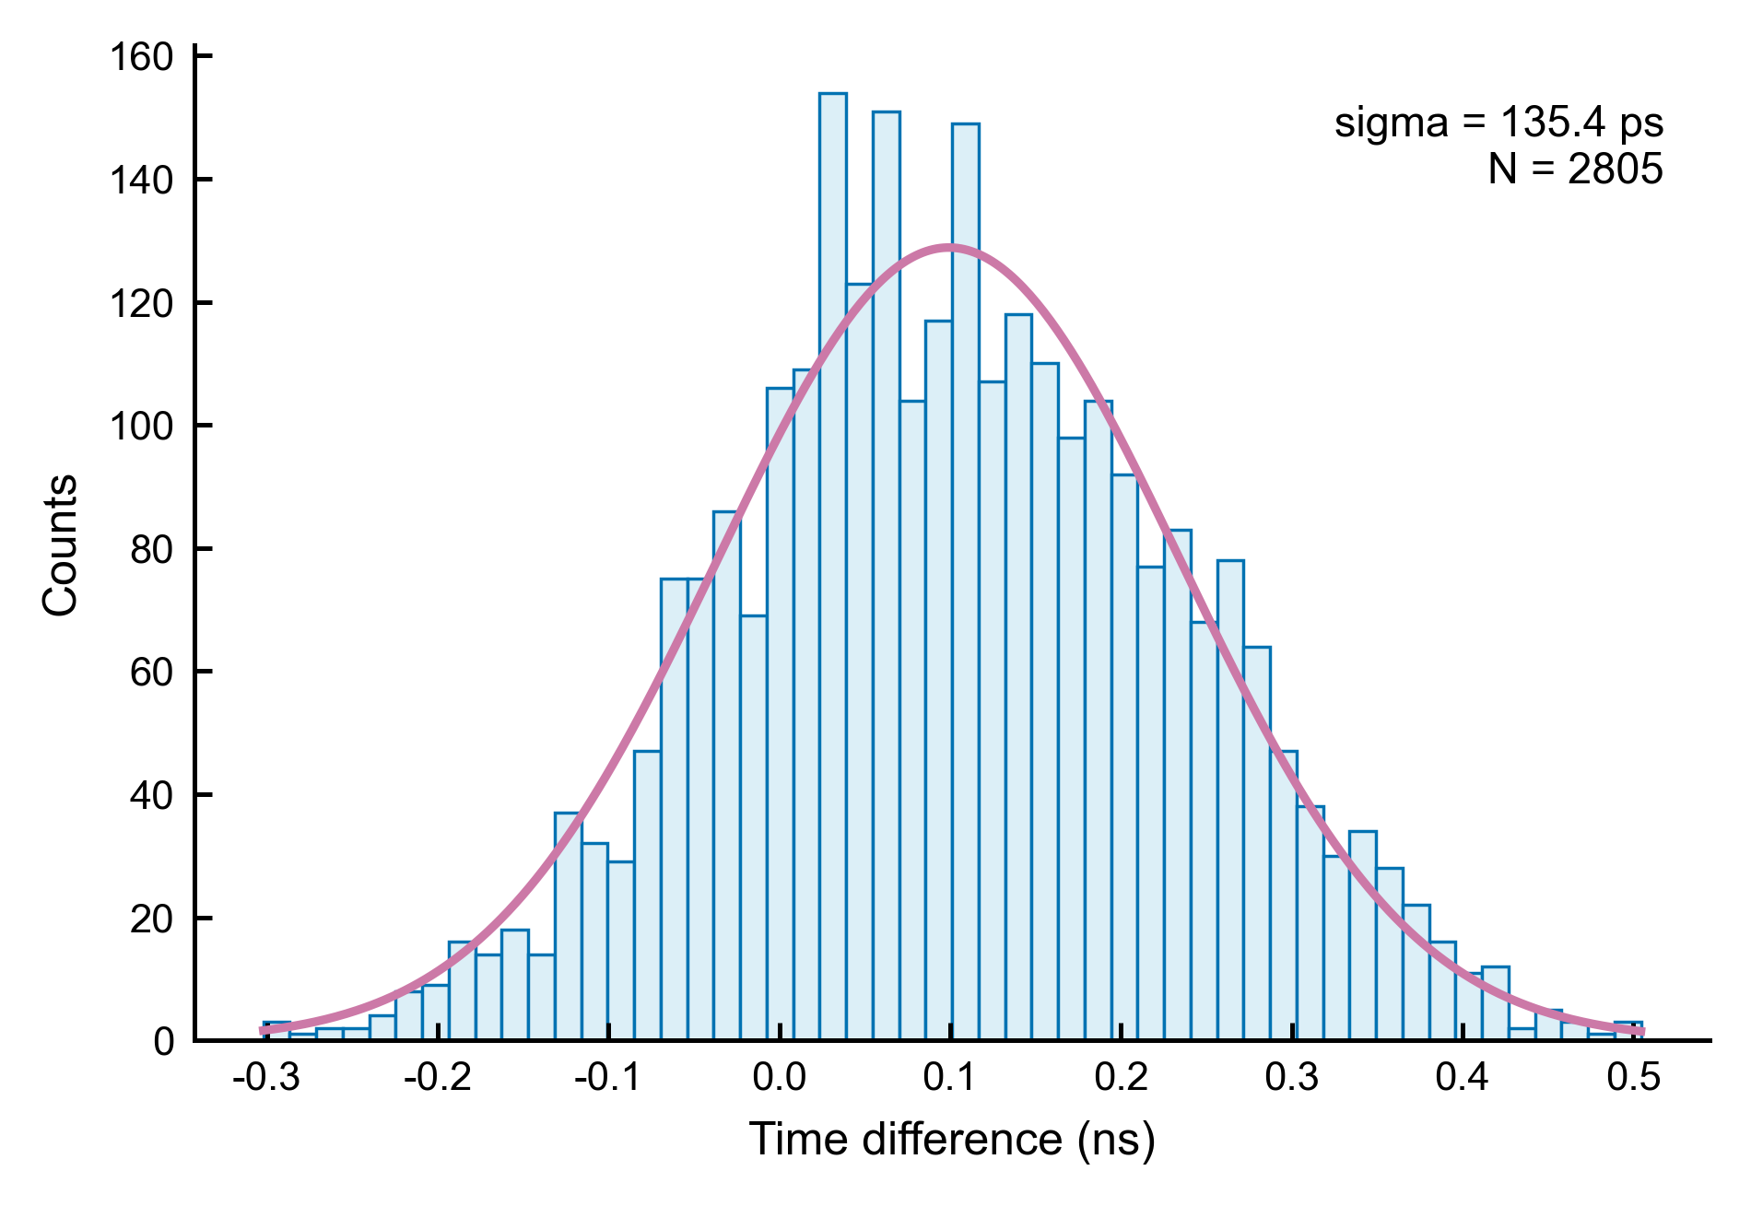
2.2 Timing Pixel Sensors – Si AC-LGAD R&D
200 µm
Pixelated AC-LGAD R&D
New design with different pad-pitch size
  55um, 100um, 150um, 200um
  Received the first batch at the beginning of 2025
  4-pixel from 200um tested with 136 ps
~136ps

Slide 17
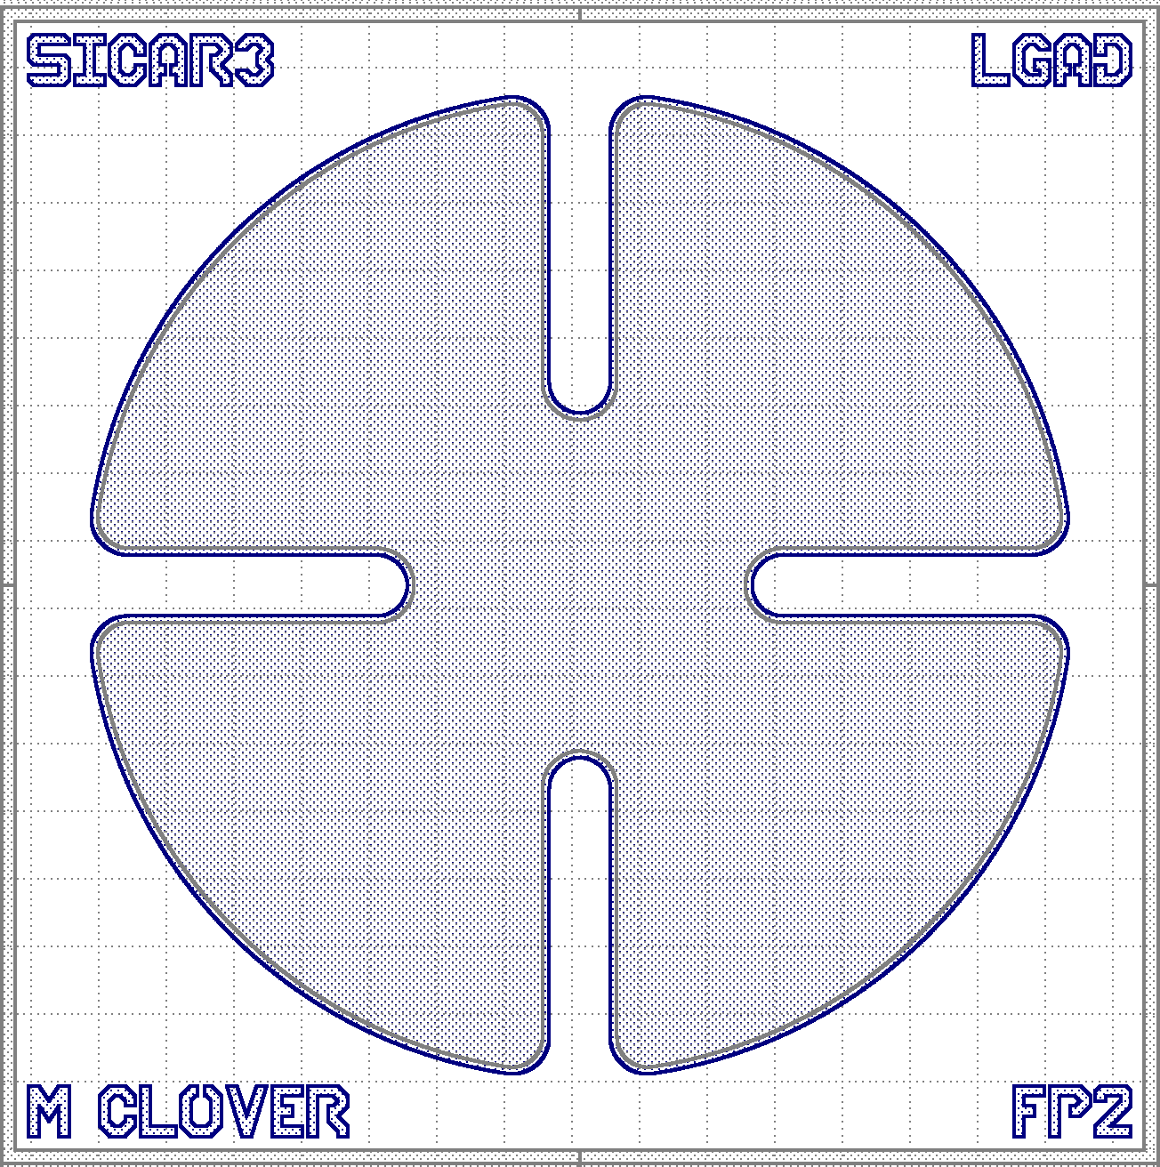
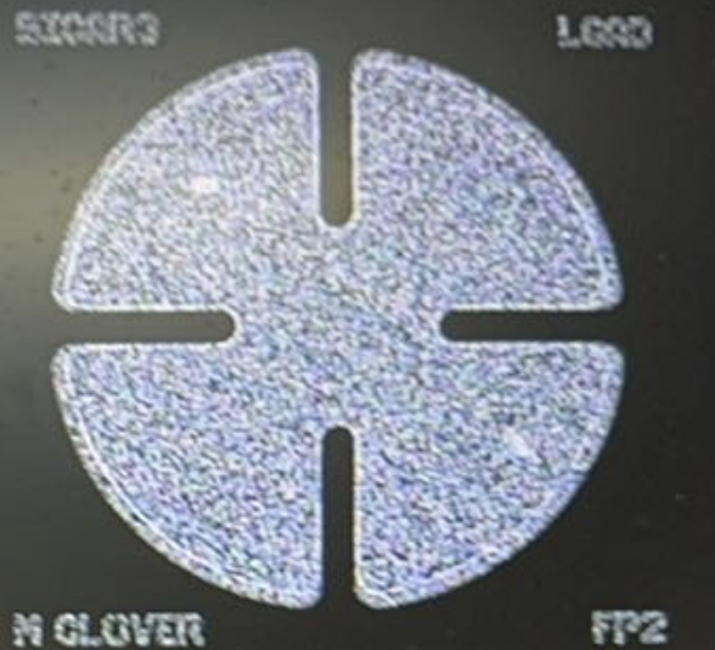



SiC AC-LGAD R&D
SiC-LGAD R&D
  Designed SiC AC-LGAD SICAR3
  Received first batch in May 2026
  LGAD/PIN with 1.4mm diameter pad tested
  Reached time resolusion ~60ps @400V
~ 60 ps

Slide 18

2.2 Timing Pixel Readout Electronics
Timing Pixel Modules for the Readout ASIC (<100 ps):
Total precision: $\sqrt{jitter_{Amp}^{2}+jitter_{Disc}^{2}+jitter_{TDC}^{2}}=\sqrt{80^{2}+50^{2}}≈94 ps<100 ps$
  Analog Front-end: Amplifier, Discriminator (< 80 ps)
  Time-to-digital Converter (< 50 ps)
  Digital readout circuit：Core Array (8×8 pixels), End of Column, Chip Bottom.
Pixel Circuit
Core Array
Periphery

Slide 19



Layouts for the readout ASIC
Pixel Array + Digital readout circuit
Layout of analog island
Layout of pixel array
Layout of digital circuit

Slide 20



Verification based on discrete devices
FPGA TDC test: bin size (90.6 ps)
Precision of FPGA TDC two ch~ 46.3 ps
Electronics module:
  Three-stage Amplifier
  Discriminator
  FPGA TDC: delay line
Precision of discrete devices : $\frac{68}{\sqrt{2}}≈48.1 ps$
Discrete devices
Test system
FPGA TDC Bins’ Size
Distribution for Two Channel’s Delay

Slide 21
Overall timing pixel ASIC
Electronics Design:
  Analog Front-end (Two stage Amp. + Discriminator) (< 80ps)
  TDC (Delay line + Loop counter) (Bin size 80~110 ps)
  Digital readout circuits (Shared memory)
  Total precision < 100 ps
Verification based on discrete devices
  time precision < 55ps
  Only FPGA TDC ~33 ps

Slide 22
Completion of R&D Tasks – All DONE
2023.12-2024.5: Testing silicon sensor, master module assembly. Investigate timing pixel design
2024.6 - 2024.11: test ASICs, start asemble long strip module, test stave at RAL, build the stave reception at CERN. Complete timing pixel sensor and ASICs design
2024.12 – 2025.5: test irradiated sensor and ASICs, assemble long strip module. Complete timing pixel sensor gain layer desing and readout electronics functional level design.
2025.6– 2025.11: mass production stable test for long strip modules, sending modules to CERN. Mask desgin for timing pixel sensor, readout electronics register design.
2025.12-2026.5: production for long strip module, mount the IHEP modules at RAL stave; first batch of pixel sensor returned, desing the main verification electronics program.

Slide 23

Completion of Assesment Indicators – all DONE
Mid-Term goal have been achieved
  Strip Module Pre and PRODUCTION have started at IHEP with 25 µm spacial resolution
  Timing pixel sensor reached better than 1ns for Si/SiC LGAD
  Timing pixel ASICs finished design and verified better than 1ns

Slide 24
Orgnization and Management Performance
IHEP hold weekly meeting, including all tasks with RAL and CERN
  Mainly discuss strip modules
  Occationally invite timing pixel report progress
USTC hold bi-weekly meeting for timing pixel readout electronics
  Discussion with US colleagues
IHEP hold weekly sensor discussion with Si and SiC LGAD activities
  Joint effort from Task 1 & Task 2

Slide 25
Potential Issues
Strip Module Assembly & Test
  ASICs export license from US may get delayed
  bPOLV12 issue to reduce the production rate

Slide 26


Benifical to society
SiC sensors to be used for fusion reactor and proton beam monitor
CSNS Phase 2 Upgrade

Slide 27
Research Team
Members listed in task book
  IHEP: Xin Shi, Peilian Liu, Xiyuan Zhang, Weiguo Lu
  THU: Yibao Chen
  USTC: Zhe Cao
Other contributors
  IHEP: Xinchou Lou, Yiming Li, Yanping Huang, Zijun Xu, Xuai Zhuang
  Mei Zhao, Yinhong Zhang
  THU: Xin Chen
  USTC: Hongtao Yang, Jiajun Qin, Lei Zhao, Kairen Chen
  SDU: Kun Hu, Peilian Liu
  SJTU: Kun Liu
  SYSU: Yang Liu

Slide 28
Papers
1. Simulation of radiation damage effect on silicon detectors using RASER, JINST 20 (2025) P12009
2. Irradiation study using QA test pieces of ATLAS18 ITk strip sensors with 80 MeV protons, NIMA, 1080 (2025) 170707.
3. Radiation Tolerance of Epitaxial 4H-SiC LGAD Under 80-MeV Proton Irradiation，IEEE TNS 73 (2026) 157
4. Mechanisms of proton irradiation-induced defects on the electrical performance of 4H-SiC PIN detectors, JINST 21 (2026) P03010
5. Temperature-dependent performance characterization of 4H-SiC PIN detectors for alpha-particle detection (25–90 ◦C), NIMA 1084 (2026) 171178
6. A simulation-based design of the CEPC fast luminosity monitor detector using 4H-SiC, JINST 21 (2026) T02009

Slide 29
Task2: Domestic conference talks
1. 陆卫国，ATLAS硅微条探测器升级进展，第四届半导体探测器研讨会，2024年5月23日–26日。
2. 张希媛，4H-SiC 粒子探测器的研究潜力及其器件研发，第四届半导体探测器研讨会，2024年5月23日–26日。
3. 王成伟，Development of ATLAS ITk strip module，第十届中国LHC物理会议，2024年11月13日–17日。
4. 周研、陆卫国，Radiation effects of ASICs for ATLAS ITk strip upgrade，第十届中国LHC物理会议，2024年11月13日–17日。
5. 黄英峻，ATLAS ITk Strip Sensor Irradiation at CSNS，第十届中国LHC物理会议，2024年11月13日–17日。
6. 蔡孟珂, The ATLAS ITk Strip Detector for the HL-LHC Upgrade，第五届半导体辐射探测器研讨会，2025年4月17-20日
7. 史欣, ATLAS ITk Strip Module Status in China，第十一届中国 LHC 物理会议，2025年10月29日-11月2日
8. 李瞻, ATLAS ITk Strip Sensor Quality Assurance，第十一届中国 LHC 物理会议，2025年10月29日-11月2日
9. 杨林, ATLAS ITk Strip Module Testbeam，第十一届中国 LHC 物理会议，2025年10月29日-11月2日
10.王延祺Progress on ACTS-based 4D tracking and a design of timing pixel digital chip 第十一届中国LHC物理会议（CLHCP2025）2025年10月31日
11. 陆卫国，ATLAS 内径迹硅微条探测器升级进展与挑战，第六届半导体辐射探测器研讨会，2026年4月16日–4月19日。
12. 张希媛，强辐照环境的 4H-SiC 传感器研发进展，第六届半导体辐射探测器研讨会，2026年4月16日–4月19日。

Slide 30
Task2: International conference talks
1. 彭少刚，Irradiation test of HCCStar ASICs in CSNS，Topical Workshop on Electronics for Particle Physics 2024，2024年9月30日–10月4日。
2. 陆卫国，Irradiation test for BETSEE at CSNS for ATLAS ITk strip upgrade，Topical Workshop on Electronics for Particle Physics 2024，2024年9月30日–10月4日。
3. 史欣，SiC AC-LGAD Timing Pixel Detector，1st DRD3 Week on Solid State Detectors R&D，2024年6月17日–21日。
4. 史欣，Prototype of SiC-LGAD Detector, 2nd DRD3 Week on Solid State Detectors R&D, 2024年 12 月2 日-6 日。
5. 张希媛，Fabrication Progress and Performance Characterization of SiC detectors, 3rd DRD3 Week on Solid State Detectors R&D, 2025年 6 月 2 日- 6 日。
6. 符晨曦， RASER - A python package for solid-state radiation detector simulation, 3rd DRD3 Week on Solid State Detectors R&D, 2025年 6 月 2 日- 6 日。
7. 史欣，Status and Plans for the DRD3 collaboration, The 2025 International Workshop on the High Energy Circular Electron Position Collider, 2025年 11 月 5 日-10 日。
8. 周嘉奇，Radiation hardness of 4H-SiC detectors for the CEPC Fast Luminosity Monitor Detector, The 2025 International Workshop on the High Energy Circular Electron Position Collider, 2025年 11 月 5 日-10 日。
9. 符晨曦， RASER simulation of 4D tracking detectors, 4th DRD3 Week on Solid State Detectors R&D, 2025年 11 月 10 日- 14日。
10. 张希媛，Update on SICAR, 4th DRD3 Week on Solid State Detectors R&D, 2025年 11 月 10 日- 14日。

Slide 31
Funding Status
Task 2 expenditures are mainly concentrated in labor costs, meeting/travel/international cooperation expenses, and indirect costs, while material costs and testing/processing fees account for a relatively small share. Overall, the expenditures mainly support silicon strip detector module R&D and testing, sensor irradiation tests, readout chip and timing pixel detector R&D, international collaboration activities, and personnel input, which is generally consistent with the current R&D and testing stage of the task.
Low rate for USTC:
The delay in the production schedule of the application-specific integrated circuit (ASIC). Once the production schedule for the first multi-project wafer (MPW) run is confirmed, the related funds will be spent in a concentrated manner and are expected to be implemented by mid-2026.
 | Task 2 | Task 2 | Task 2 | Task 2
 | Sum | IHEP | USTC | THU
Total Budget | 600.00 | 350.00 | 100.00 | 150.00
Received funds | 480.00 | 274.07 | 82.37 | 123.56
Pending to allocated | 120.00 | 75.93 | 17.63 | 26.44
Implementation rate % | 48.70% | 50.54% | 30.97% | 56.23%
Total Expense | 292.18 | 176.87 | 30.97 | 84.34
1 Direct fee | 212.11 | 156.41 | 7.13 | 48.57
1) Device fee | 0.00 | 0.00 | 0.00 | 0.00
2) Business fee | 90.06 | 86.76 | 3.30 | 0.00
3) Labor fee | 94.62 | 69.65 | 3.83 | 21.14
2 Indirect fee | 80.08 | 20.46 | 23.84 | 35.77

Slide 32
Summary and Plan
Mid-Term goal have been achieved
  Strip Module Pre and PRODUCTION have started at IHEP with 25 µm spacial resolution
  Timing pixel sensor reached better than 1ns for Si/SiC LGAD
  Timing pixel ASICs finished design and verified better than 1ns
Plan
  Complete the modules assembly and participate in the CERN integration
  Complete the assessment of timing pixel detector combined test once the ASICs are ready

