Slide 1
Development of RPC detector for ATLAS Muon Phase-II upgrade
-- Mid-term progress report
Yongjie Sun (孙勇杰)
On behalf of the ATLAS China Muon team
University of Science and Technology of China

Slide 2
Introduction – towards HL-LHC
Higgs. discovery
LHC construction
1998-2008
Run-1
2009-2012
LS-1
2013-2014
Run-2
2015-2018
7,8 TeV
30 fb⁻¹
13 TeV
190 fb⁻¹
13.6 TeV
450 fb⁻¹
13.6-14 TeV
3000-4000 fb⁻¹
LS-2
2019-2021
Run-3
2022-2026
LS-3
2026-2029
Run-4，5
2030-2040
*Latest schedule released in Oct. 2024
LHC will upgrade to HL-LHC with 5 - 7.5 times higher luminosity.
ATLAS will collect 90% of its physics data during the HL-LHC period
→ Unprecedented opportunities to search for new physics at energy frontier and measurement of the SM, e.g. Higgs boson properties
ATLAS detector is undergoing Phase-II upgrades accordingly.

Slide 3
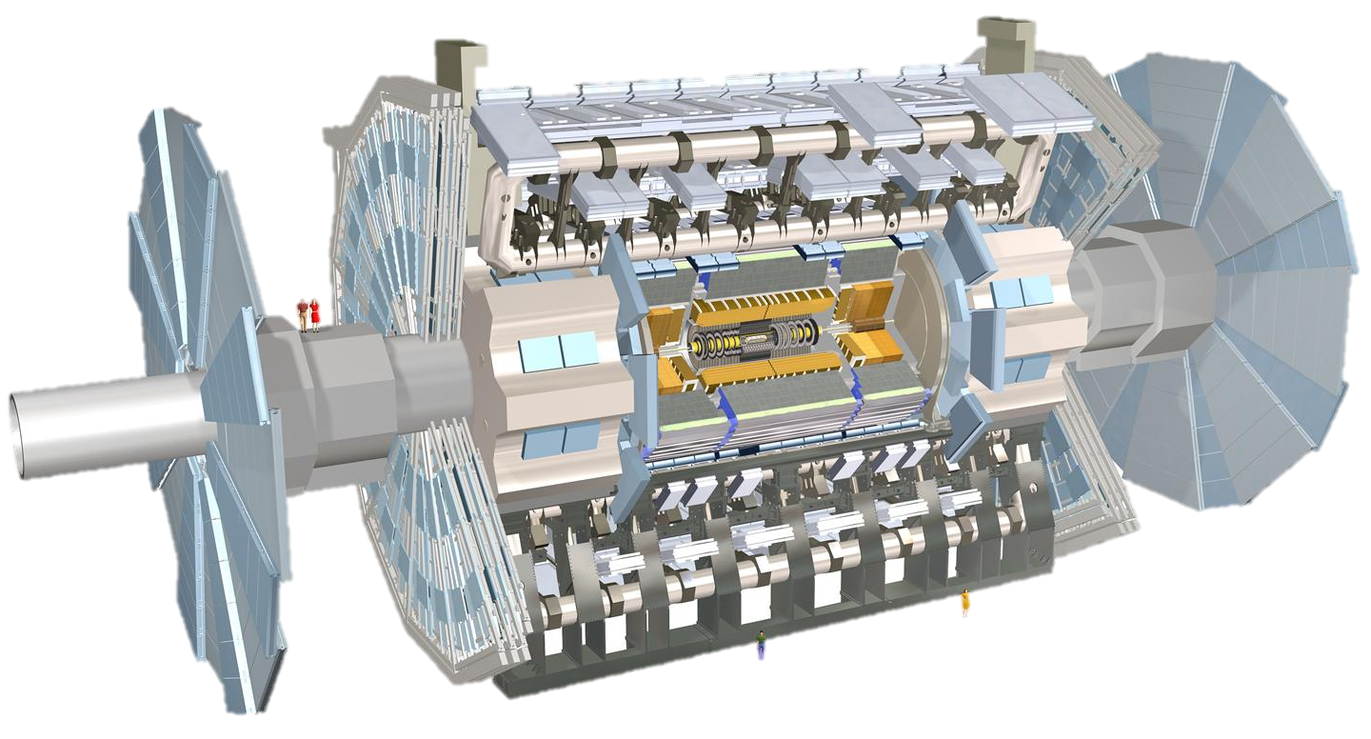
Upgrade of the ATLAS detector
Phase-I upgrade
New Small Wheel (NSW)
Phase-II upgrade
Silicon Inner Tracking system
Main goals:
Higher radiation hardness/rate capability
Higher spatial/time resolution
Faster response time
Higher data acquisition rate
Phase-II upgrade
Trigger and Data Acquisition - TDAQ
Phase-II upgrade
High Granularity Timing Detector HGTD
Phase-II upgrade
Thin-gap RPC (barrel muon trigger, very crucial for physics) ,
sMDT, electronics

Slide 4
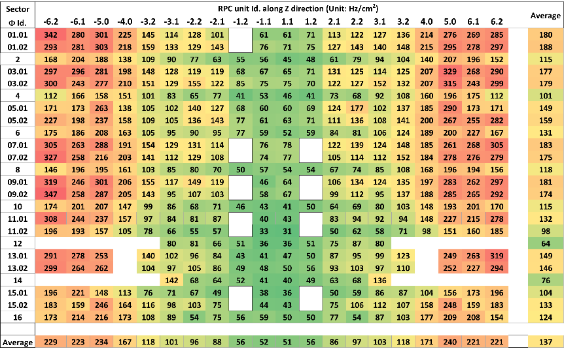
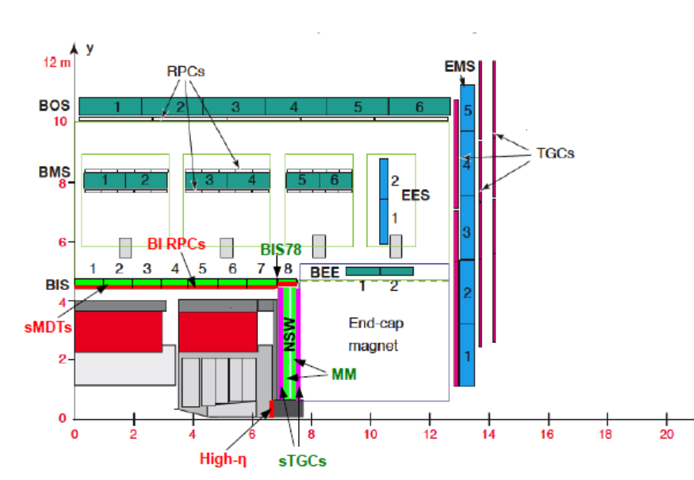
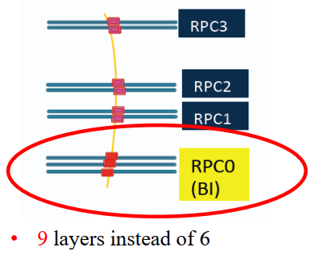
The Phase-II Upgrade of Muon RPC
L=7.5×10³⁴cm⁻²s⁻¹@13TeV
Current RPC system and its limitation
  The limited rate capability: ~ 100 Hz/cm² → 1 kHz/cm²
  Reaching the lifetime of 10 years @ LHC → lower efficiency
  The acceptance holes due to support structures
The desire for additional BI layers for HL-LHC
  Three layers of new RPC in the BI region
  Thin-gap design with higher rate capability and longevity
  Fix most of the acceptance holes

Slide 5
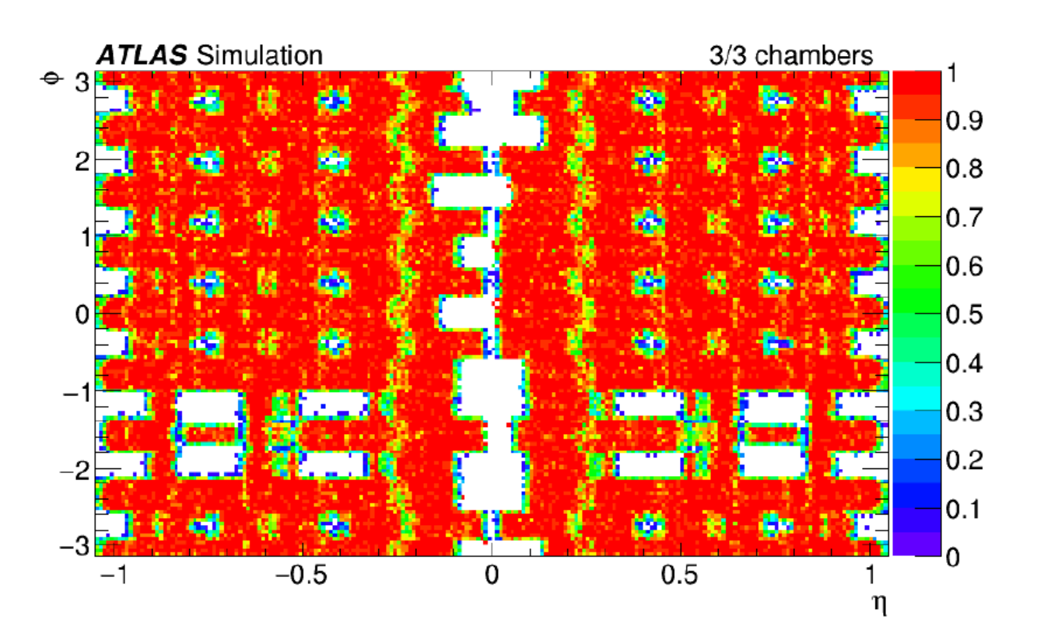
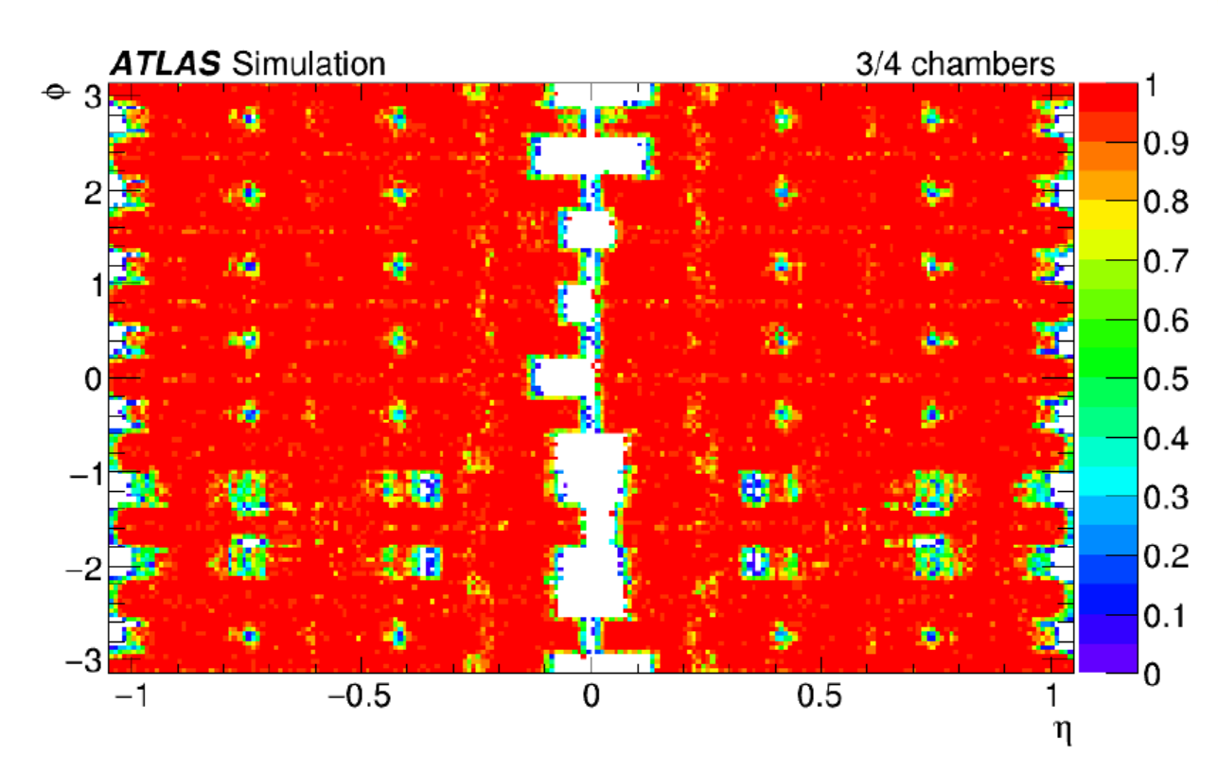
Advantages of the BI RPC Upgrade
Current trigger eff. ~ 70%
The new BI RPC fixed most of the acceptance holes.
Flexible trigger logic increases the trigger efficiency: 70% → 90%
Improved muon coverage important for offline analysis for physics with muon signature
High time resolution (order of 1 ns) with thin gas gap can be exploited for new physics searches
Expected trigger eff. with BI upgrade ~ 90%

Slide 6
Technical design: Thin-gap RPC
Thinner bakelite:
  Less voltage drop in bakelite → improve the rate capability, larger induced signals
Thinner gas gap:
  Less charge produced per event → improve rate capability and longevity
  Higher field → better time resolution
Improved readout panel
  Better mechanics flatness and hardness → better signal transmission and spatial resolution.
New generation FE electronic:
  Higher amplification factor and high S/N ratio to compensate the lost gas amplification.
Specifications:
High rate capability: → kHz/cm²
Longer longevity: >10 years@HL-LHC
Higher spatial resolution: <1 cm
Higher time resolution: ~ 0.5 ns
→ First application in large scale experiment
Low ε_{r} filler
Bakelite: 2 mm→1.5 mm
Gap size: 2 mm→1 mm
Readout panel
Copper strip/GND
Bakelite electrode
Gas gap

Slide 7
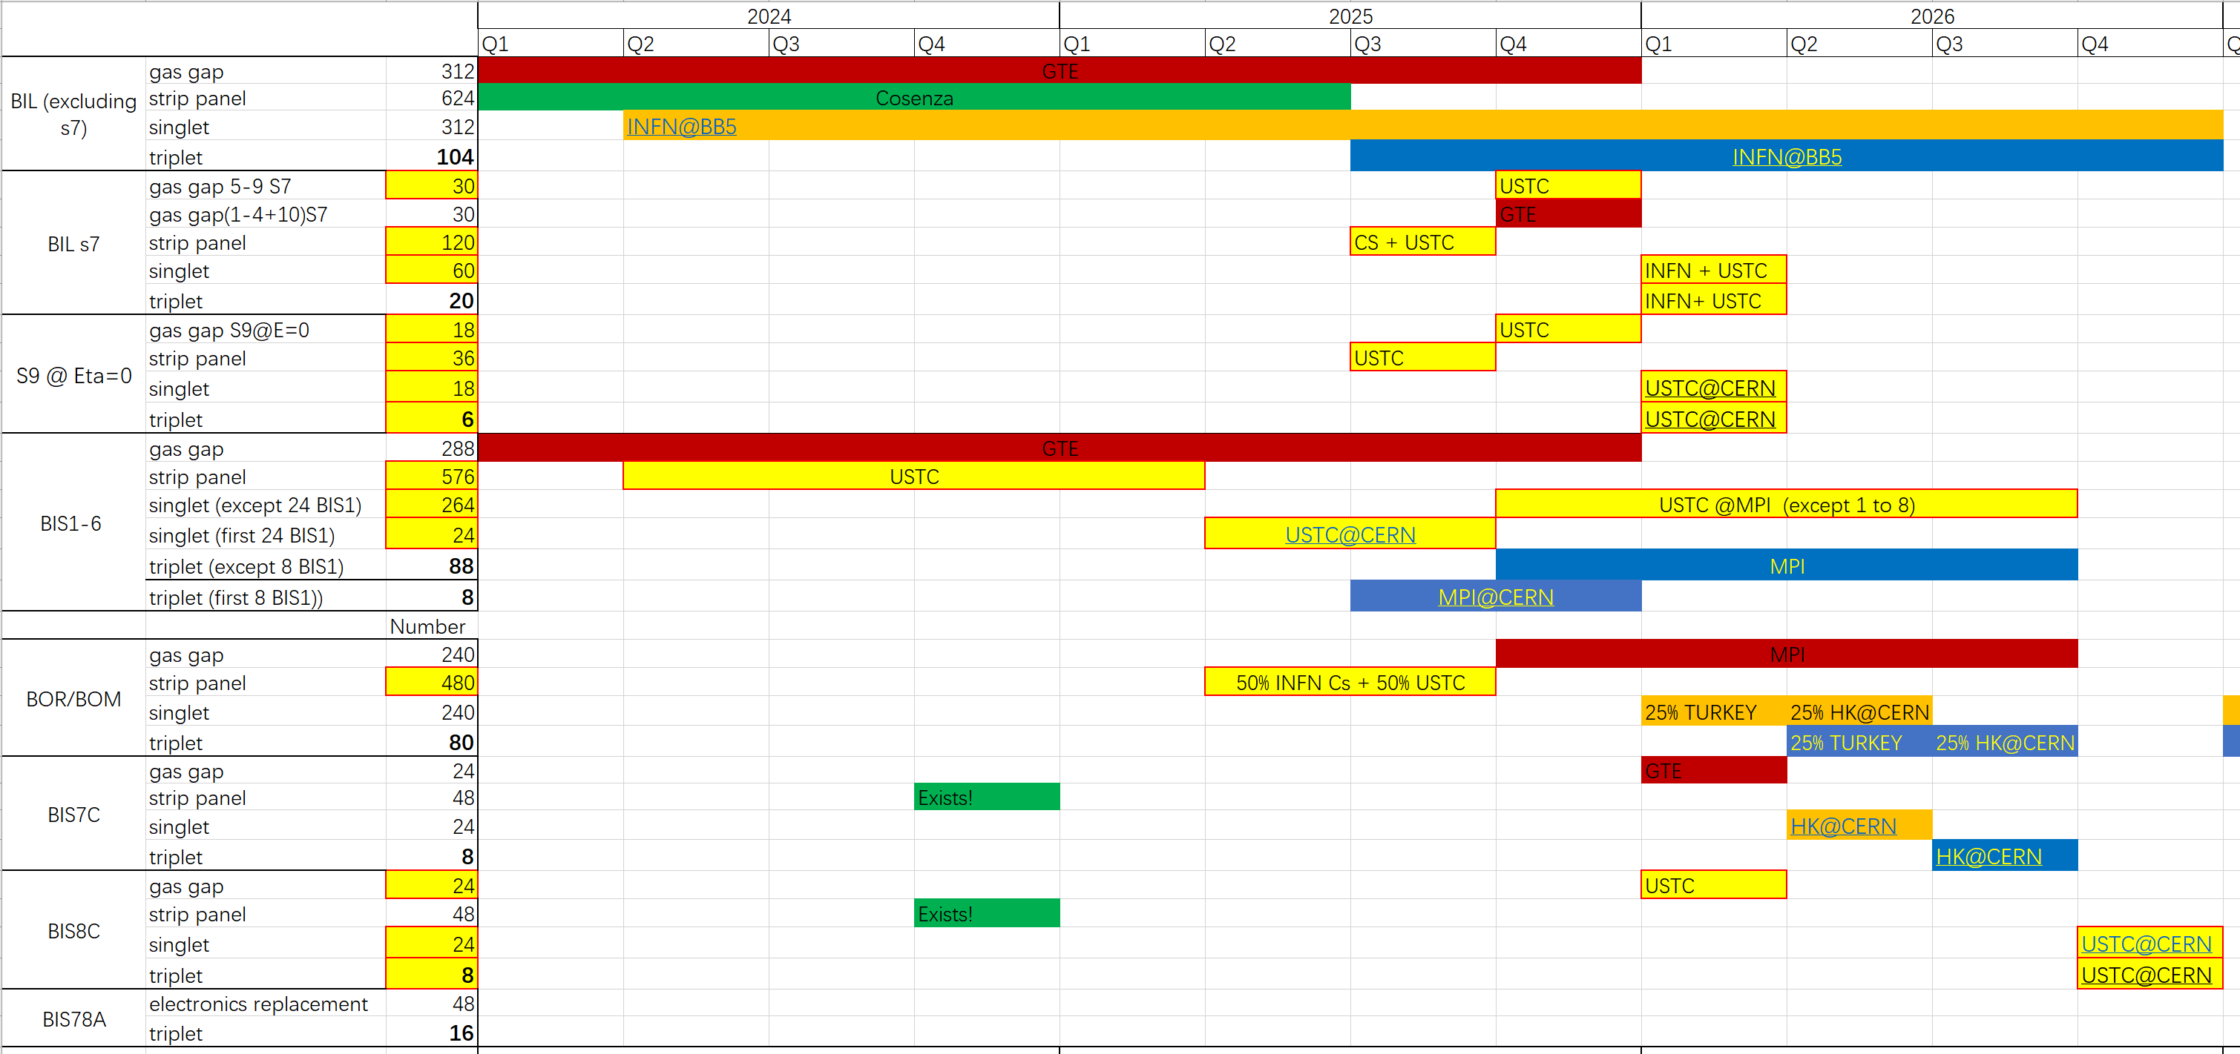
Tasks of the Chinese team
China contributions
We are here
Gas gap: 72 (~10%)
Readout panel: 912 (~50%)
FE board: 5000 (>50%)
Singlet: 360 (~50%)
Installation & commissioning

Slide 8
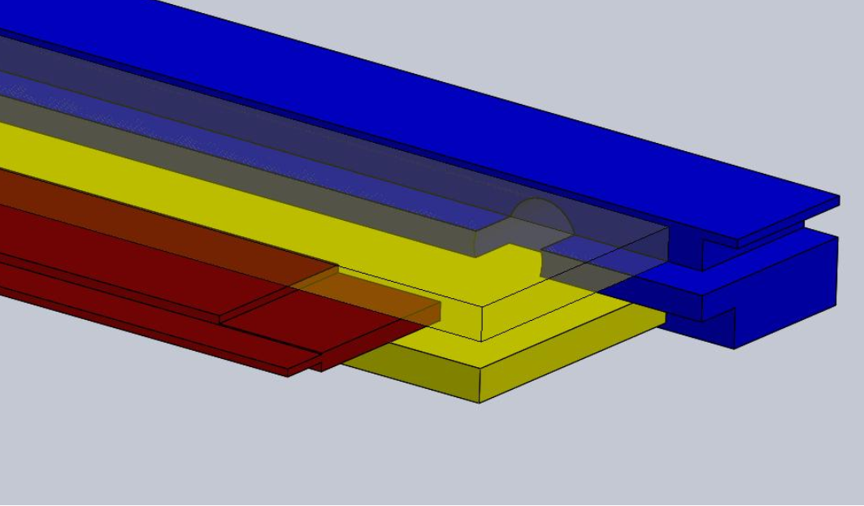
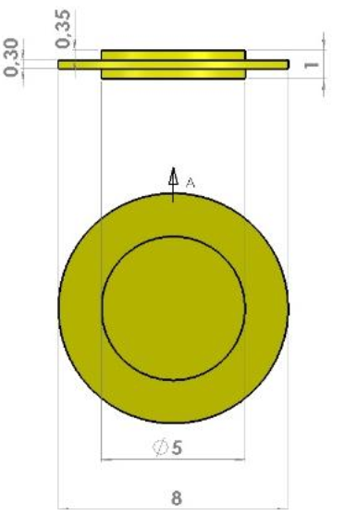
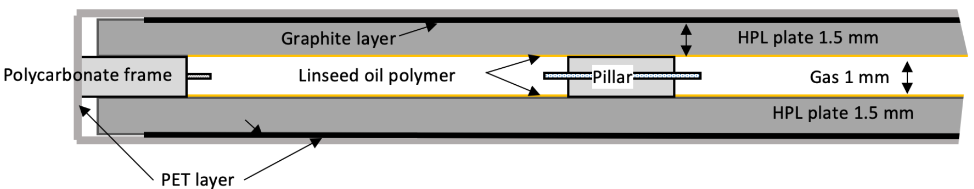
The thin gas gap production
Typical BIL: 2500 x 680 mm
Size: ~1.7m²
The largest gaseous detector with strict requirements on structure precision
  Length / thickness = 2500 / 1
  Spacer: 1 mm ± 10 μm
  Frames: 1 mm ± 30 μm
  Gap size: 1 mm ± 100 μm in 7×7 cm
Typical BIS: 1700 x 1100 mm
Size: ~1.9 m²

Slide 9
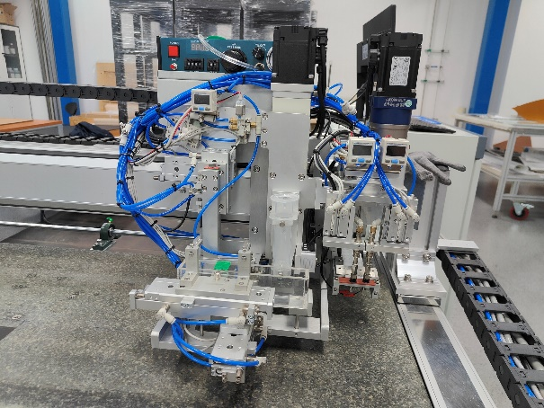
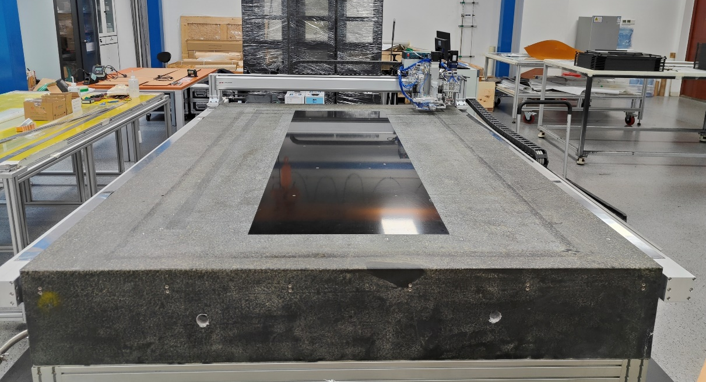
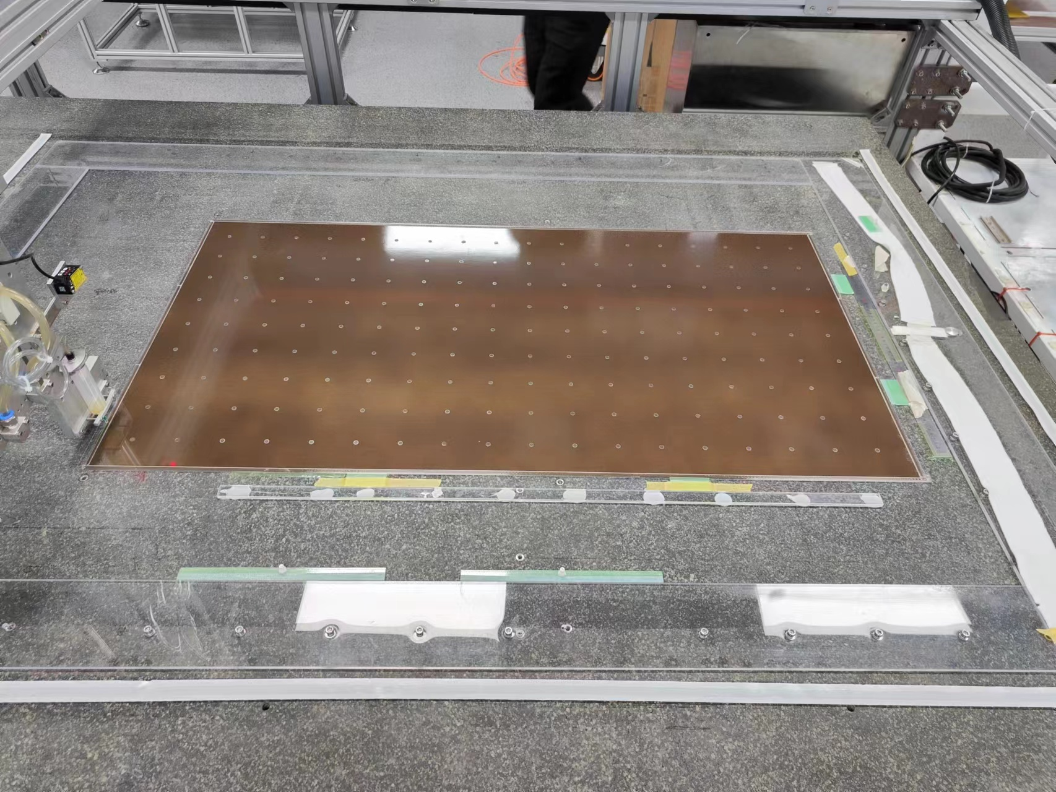
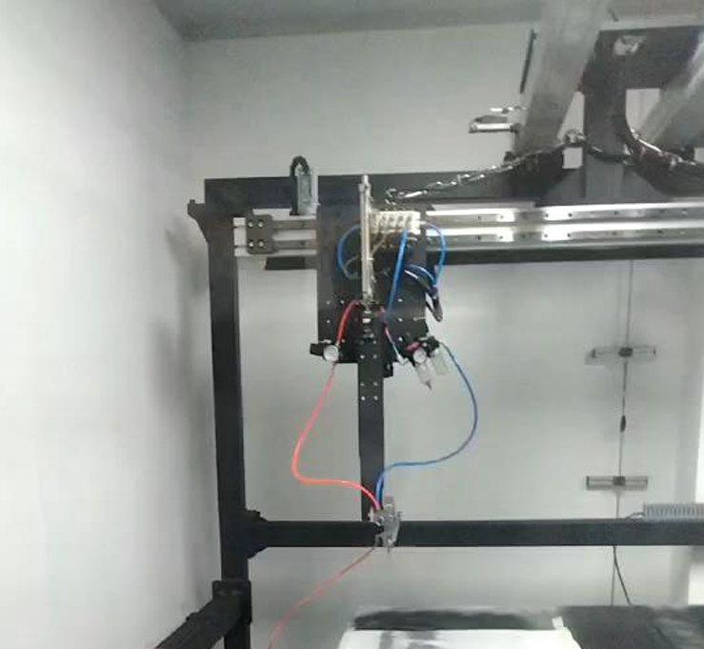
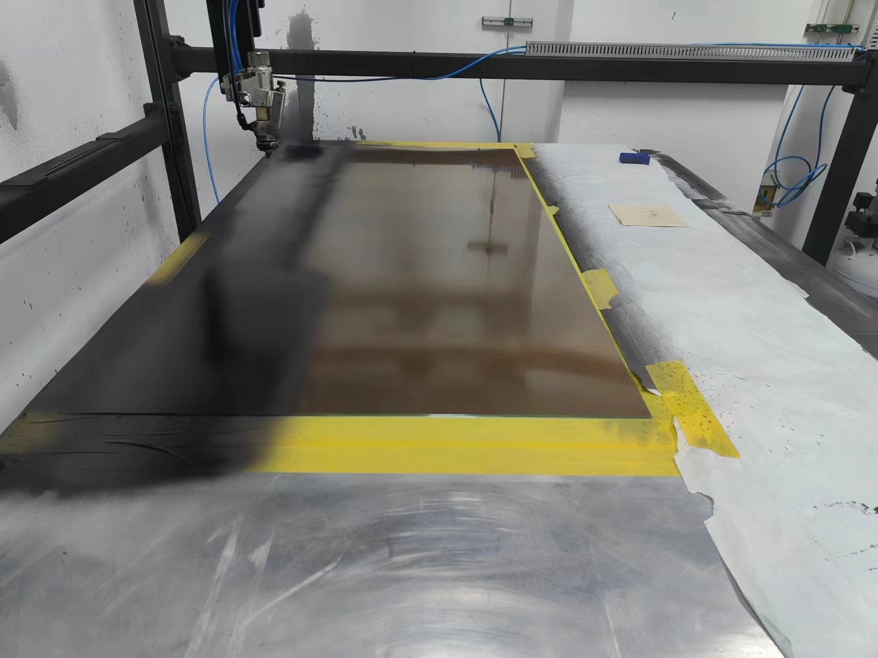
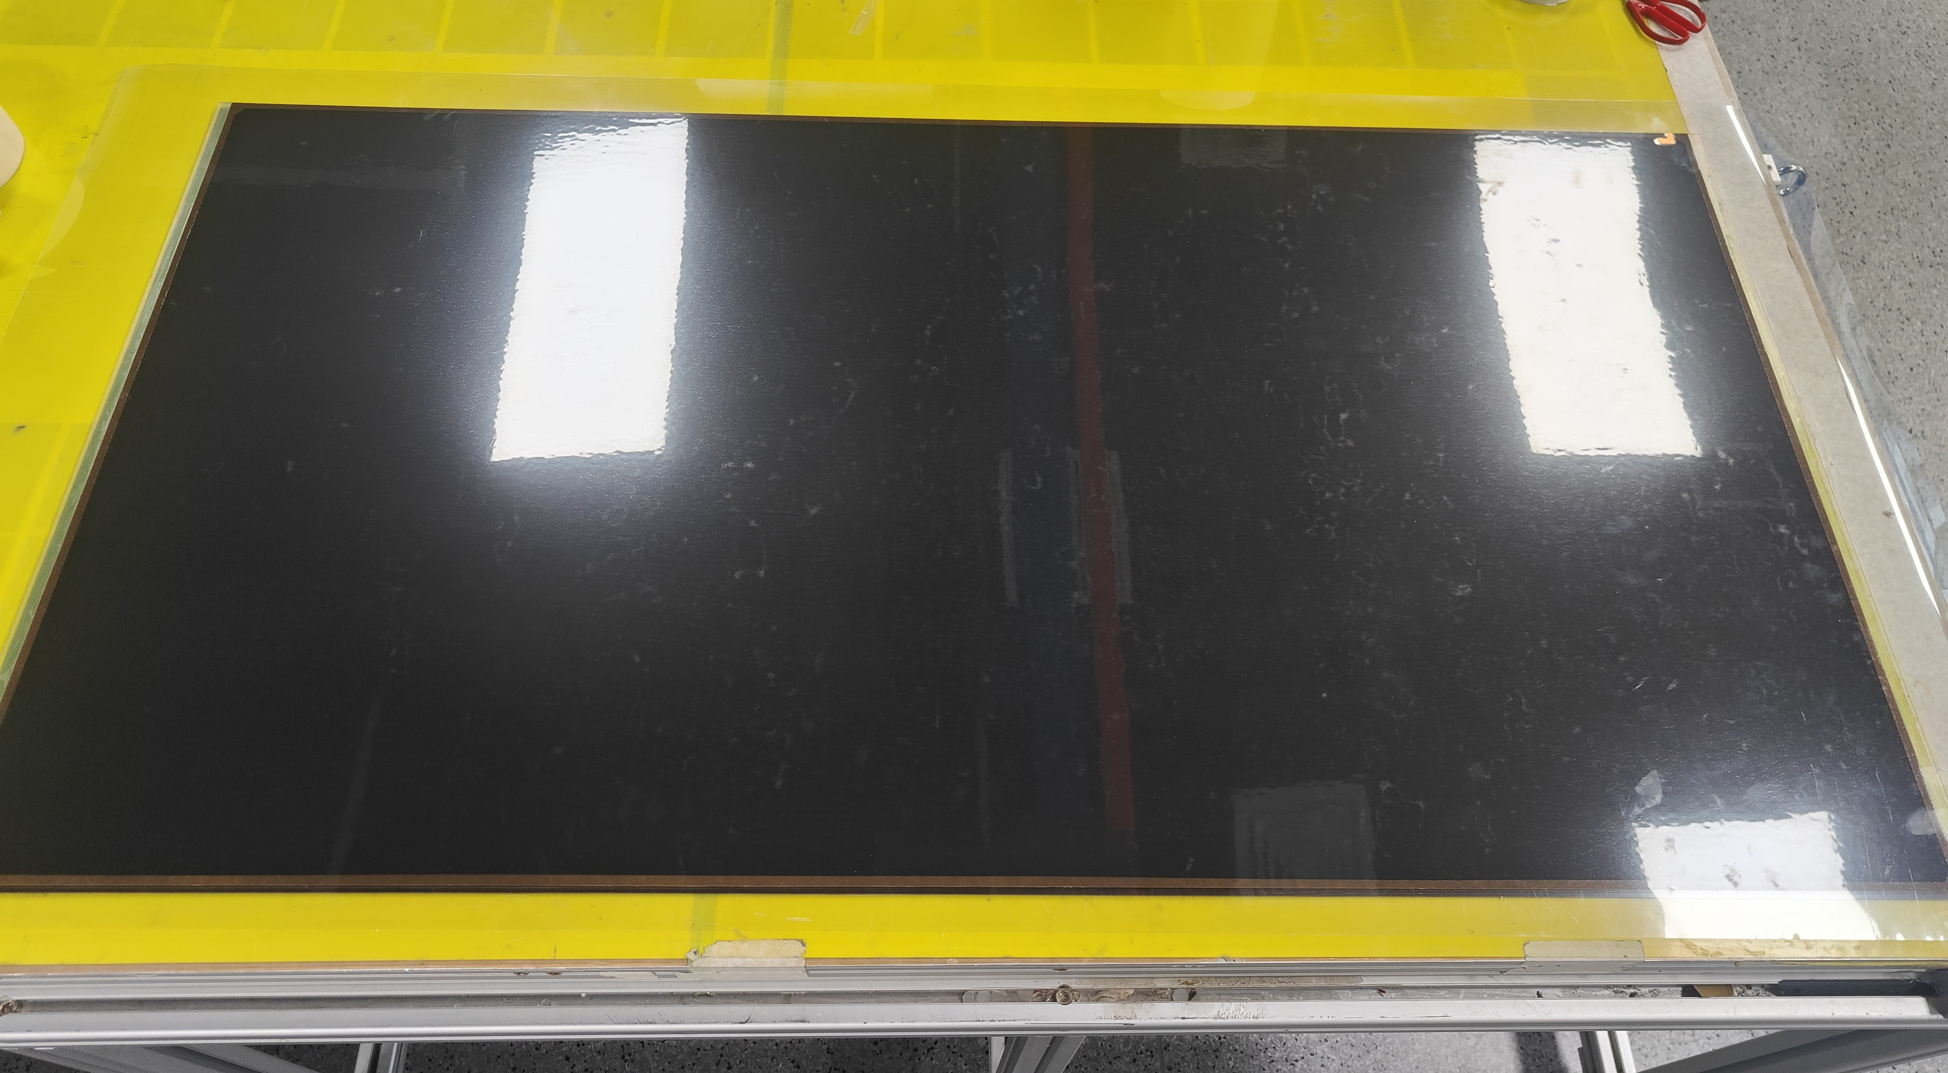
China gas gap production site
Full production line established
14 prototypes produced
  Size = 1300 x 680 mm²
Procedures are under optimization
Getting ready for mass production
Finished gas gap
Spacers placed
Graphite painting machine

Slide 10
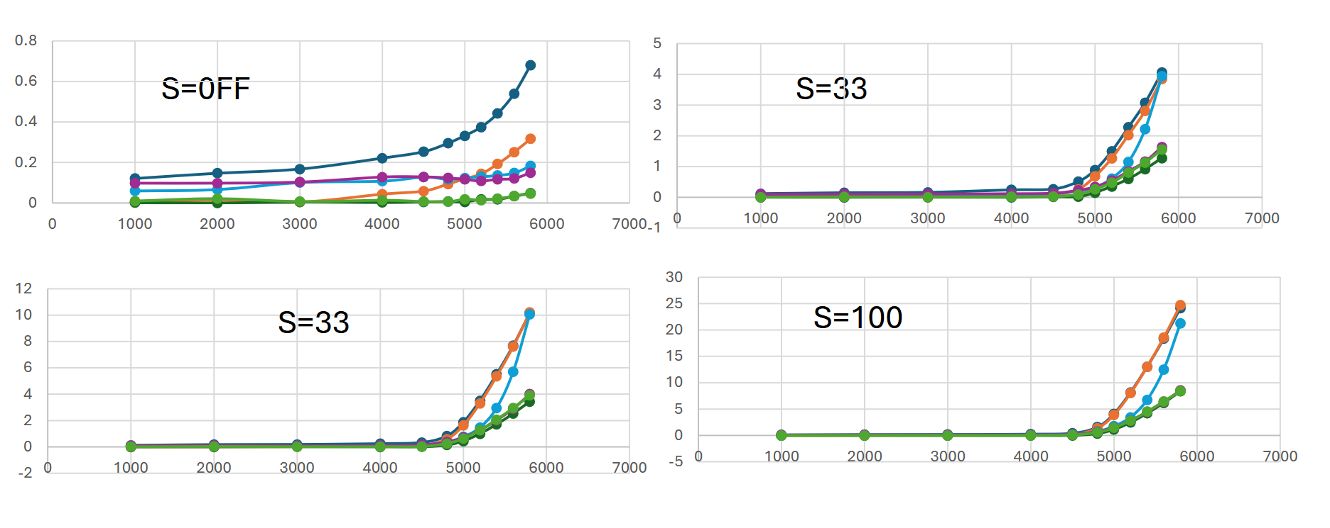
Aging test of gas gaps at GIF++
First scan at GIF++ with full source
First scan at CERN
Scan with different filters
Prototypes are under aging test at GIF++
Very low current observed
Qualified as a new gas gap production site.
Help solving the gas leak and drifting current problems in Italy production
72 gas gap to be finished in 2026.
S=OFF
S=10
S=33
S=100

Slide 11
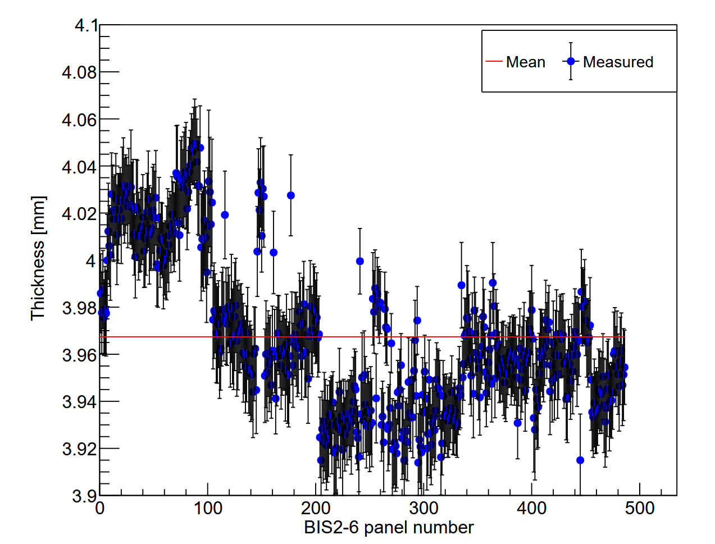
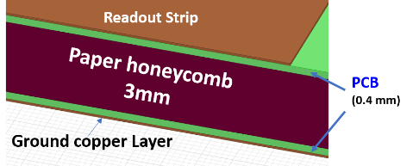
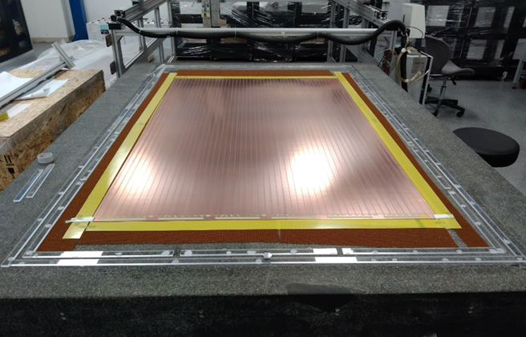
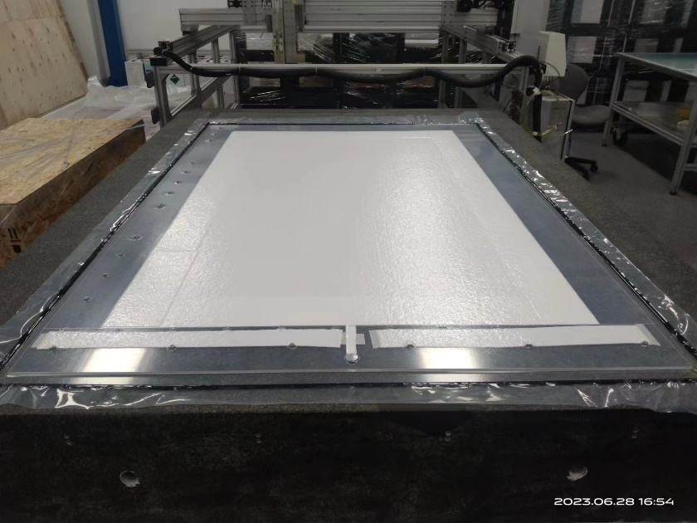
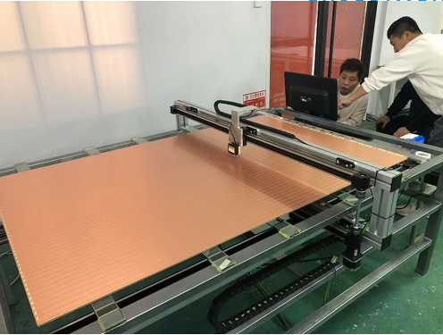
The readout panel production
Large size PCB → BIS = 1705 x 1072 mm
Flatness control → ± 100 μm in 7×7 cm
Developed vacuum bag production method
Qualification method → 400 measurement points/panel
All BIS panel production finished (~580 panels).
1.7m
1.1m
Large size PCB
Vacuum bag pressing
Automatic thickness scan

Slide 12
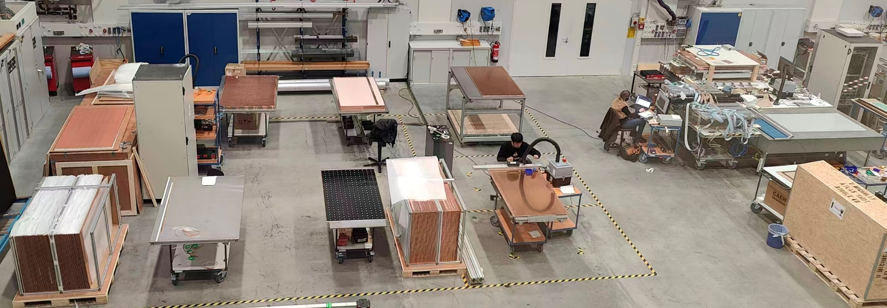
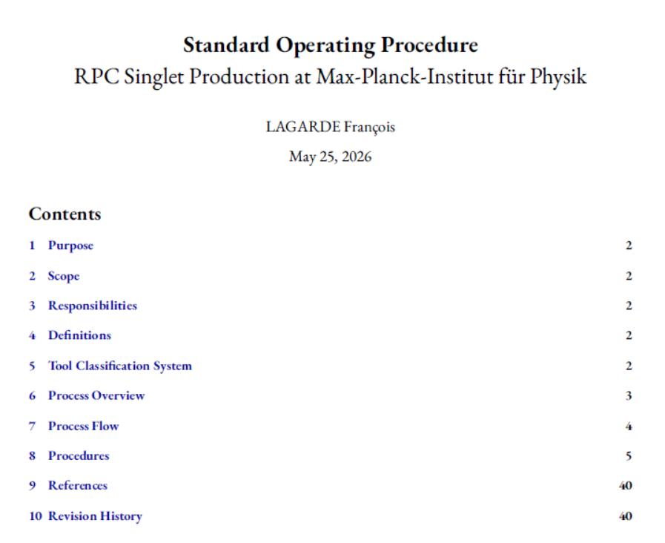
The singlet assembly and qualification
Technical challenge of building large & thin Barrel Inner RPC singlet
The basic functional unit of RPC, Quality Assurance needed
  gas tightness
  electrical connectivity
  leakage current
  efficiency
Large area, large quantity, systematic test
large-scale multi-layer test station and data acquisition system
A full production line established @ MPI
“Standard Operating Procedure” to guide the assembly and QA&QC
Production line at MPI
RPC singlet test station

Slide 13
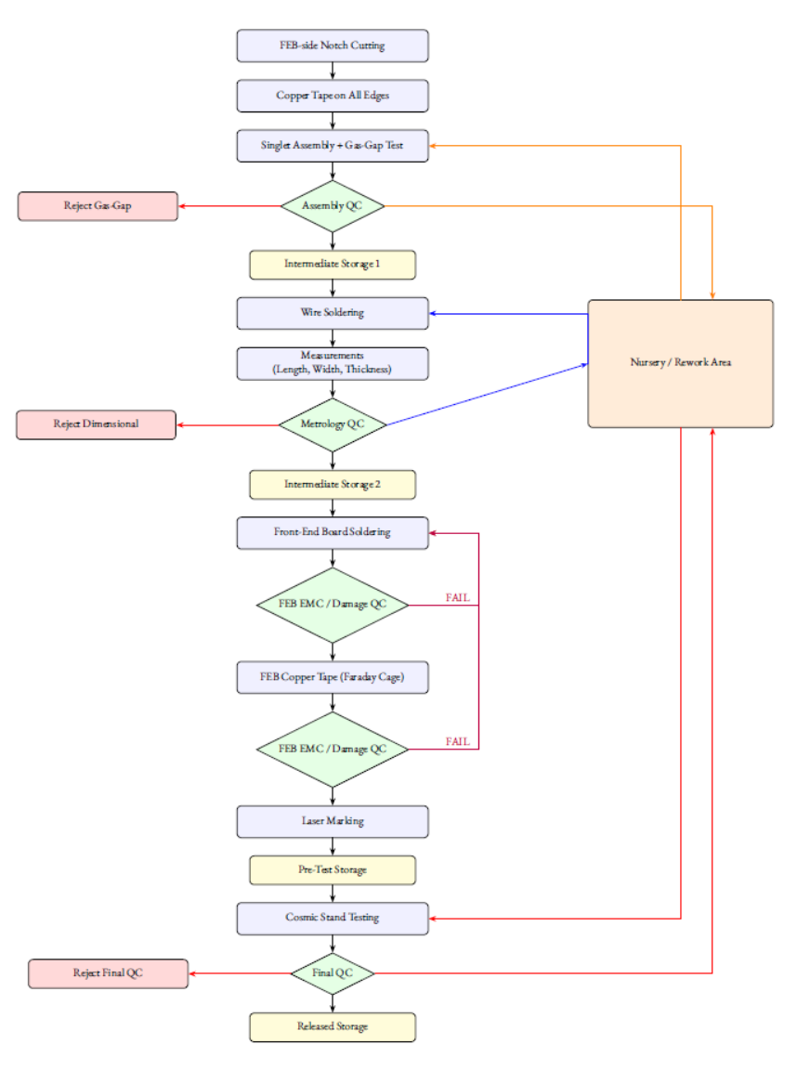
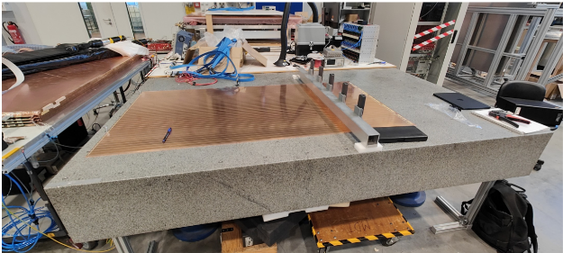
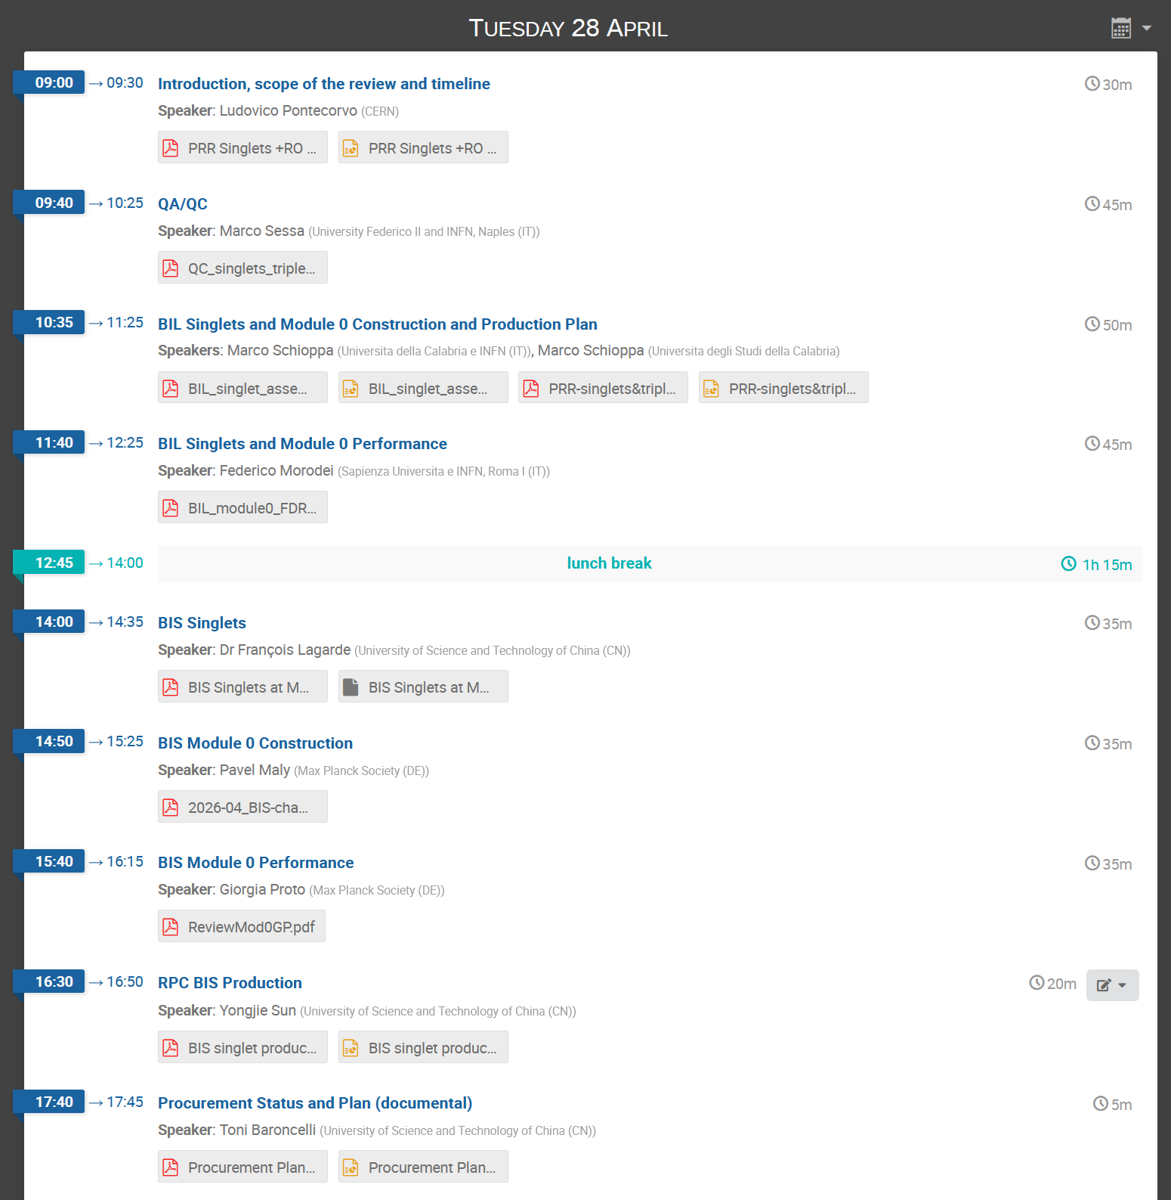

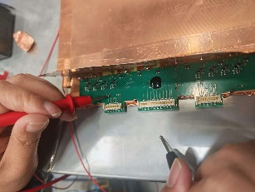
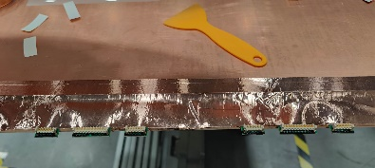
Singlet production status
Production Readiness Review held on 28 April 2026.
Feed back report with “passed with Recommendations”.
Mass production will start with all the answers to the report.
Assembly procedures:
1) Cutting of the 2 read-out panels
2) Taping of the 2 read-out panels
3) 2 read-out + gas-gap assembly
4) Soldering of the wires
5) Dimensions/thickness measurements
6) Front-end soldering
7) Faraday cage assembly
8) Cosmic-ray test

Slide 14
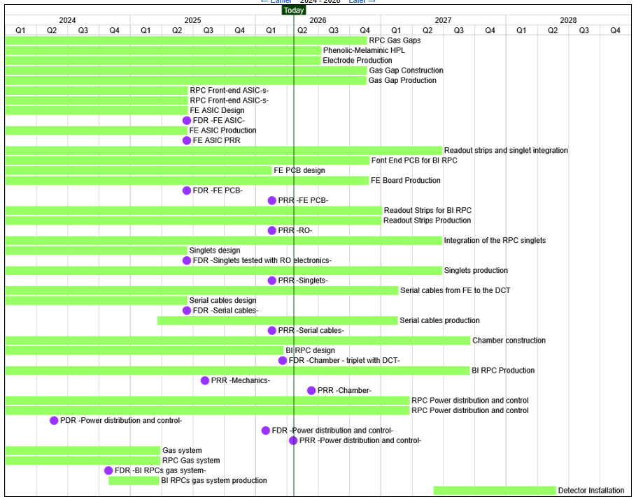
Adjusted timeline of the production
RPC gas gap prototype construction and test – Done
BIS readout panel production and qualification – Done
Qualification method of the FEE – Done
FEE production and qualification – 1000 pre-production
  Mass production will start after the Review in June.
  To be finished by the end of 2026
BIS singlet assembly – 21 pre-production
  Mass production planned from September
  To be finished by the middle of 2027
Cosmic ray test station – under construction
  Ready to be used from July 2026.
BOM/BOR panel production – in progress

Slide 15
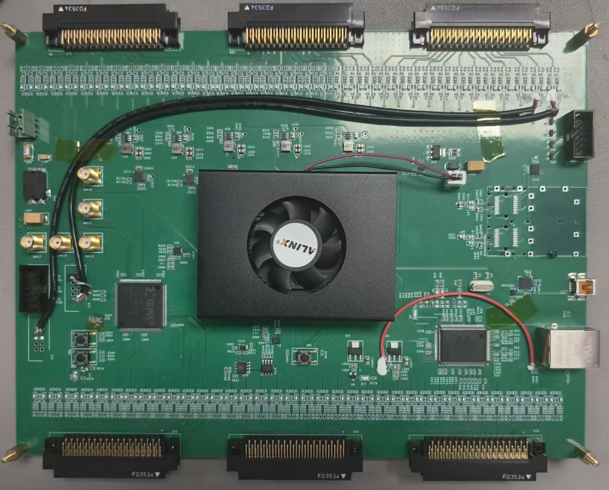
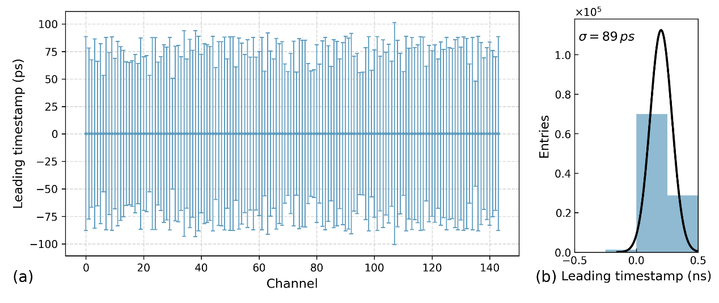
DAQ system for FEE test and for singlet qualification
Initially designed for the New front-end electronics (FEE) with a specialized Manchester encoding for data transmission (“the baseline solution”)
Quickly modified to the TDC mode for the test of “the backup solution”
DAQ functions：
  Provide 40MHz clock for FEE
  144 channels decode or TDC
  Trigger mode: External/self/master-slave
  Data package & upload
  Time resolution of 89 ps with 2 ns dead time
Made significant contribution to the test of the FEE boards.

Slide 16
Issues addressed
Quality of gas gaps produced in Italy company (GTE)
  Issue: gas leak → refurbishment produced gaps & modification of the gap design → solved.
  Issue: current drifting → pre-washing and re-oiling, Ar-treatment, monitoring in progress.
The FEB
  Delay of the board design and test → USTC offered an FPGA readout system for FEE test
  Fine-tune the working parameters and extra Faraday cage shielding for noise control.
  Restrictions of chips to USTC → FE board procured by USTC & chip bonding by HK
  Pre-production of 1000 FE boards.
The singlet
  Restrictions of FE boards with chips, singlets with electronics can not be assembled and tested in USTC
  Move the BIS singlet assembly line to MPI, ready for production.
These issues delays the important PRR for starting the production. With the pass of PRR, the mass production will start soon.

Slide 17
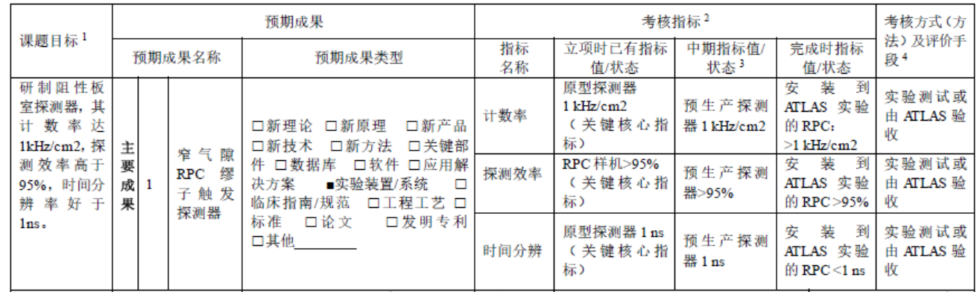
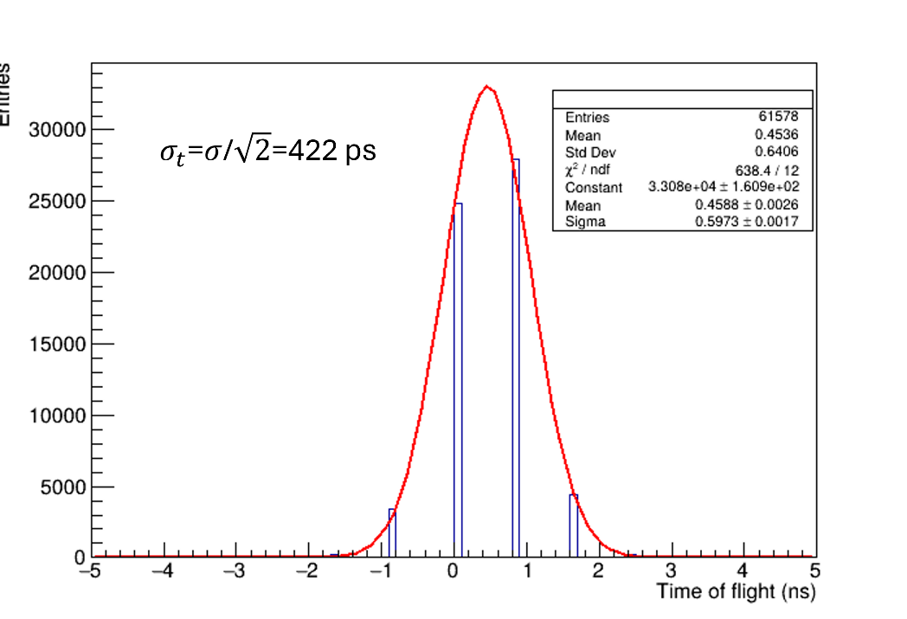
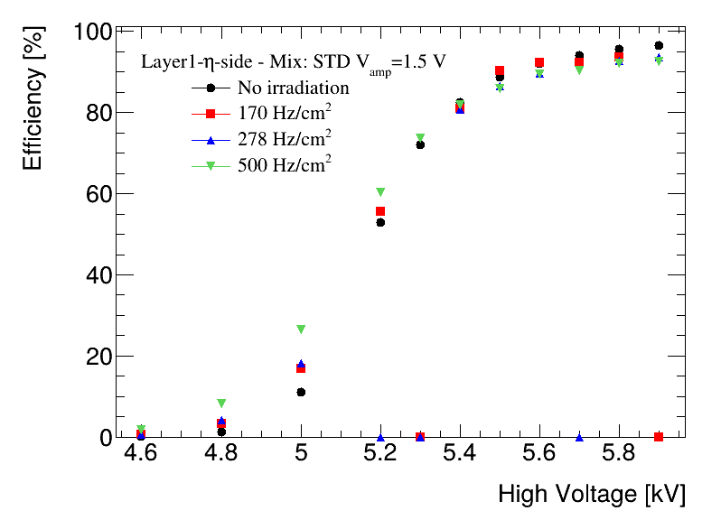
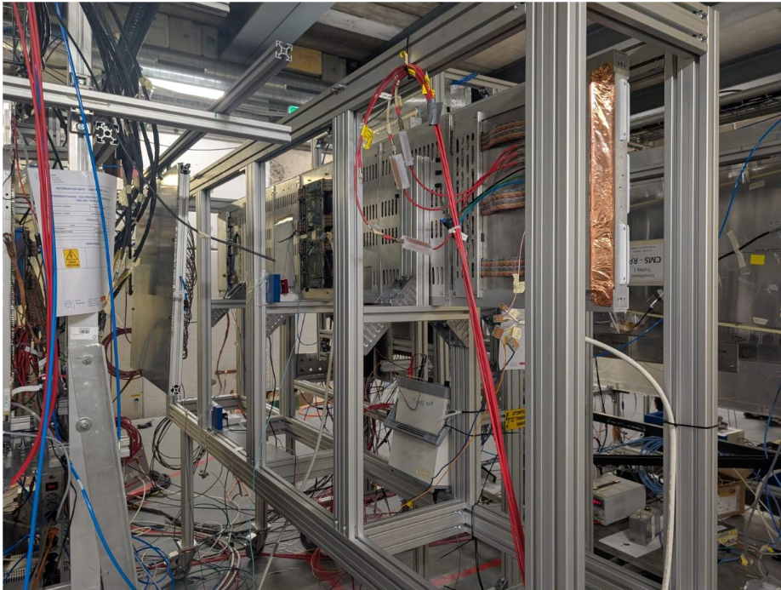
Indicators
Beam test arranged in May 2026 at CERN GIF++.
RPC singlets were tested with muon beam at gamma irradiation background.
Data analysis in progress.
Preliminary result indicates 95% efficiency and 422 ps time resolution achieved.
Under 500 Hz/cm² gamma irradiation and 3-5 kHz/cm² muon beam spot, no performance decreasing observed.

Slide 18
Final state indicators…
In the project application document, the final state indicators are expressed as “RPC detectors installed to ATLAS experiment…”
As we know, the HL-LHC will start to deliver beam after 2028.
The efficiency and time resolution can be tested with cosmic rays.
It’s difficult to achieve the rate capability without beam.
Proposal: modify the indicator as: “量产RPC模块达到1 kHz/cm²” by beam test method.

Slide 19
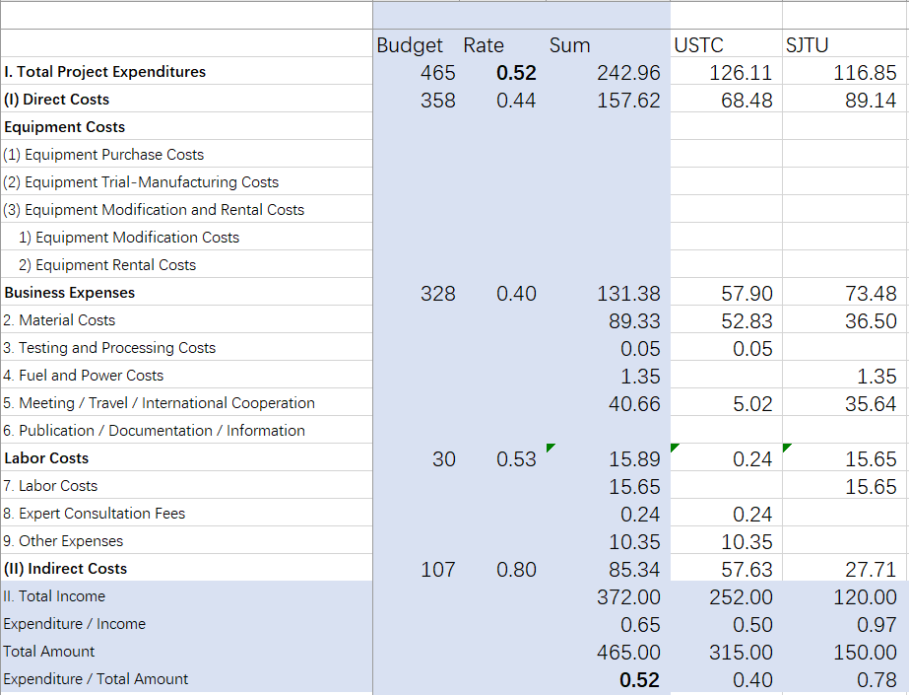
Budget
Implementation rate: 52%
Mainly on
  Bakelite procurement
  Gas gap prototyping
  FEB pre-production
  Readout panel production
  International shipment
Remained budget
  Gas gap production
  FEB production and qualification

Slide 20
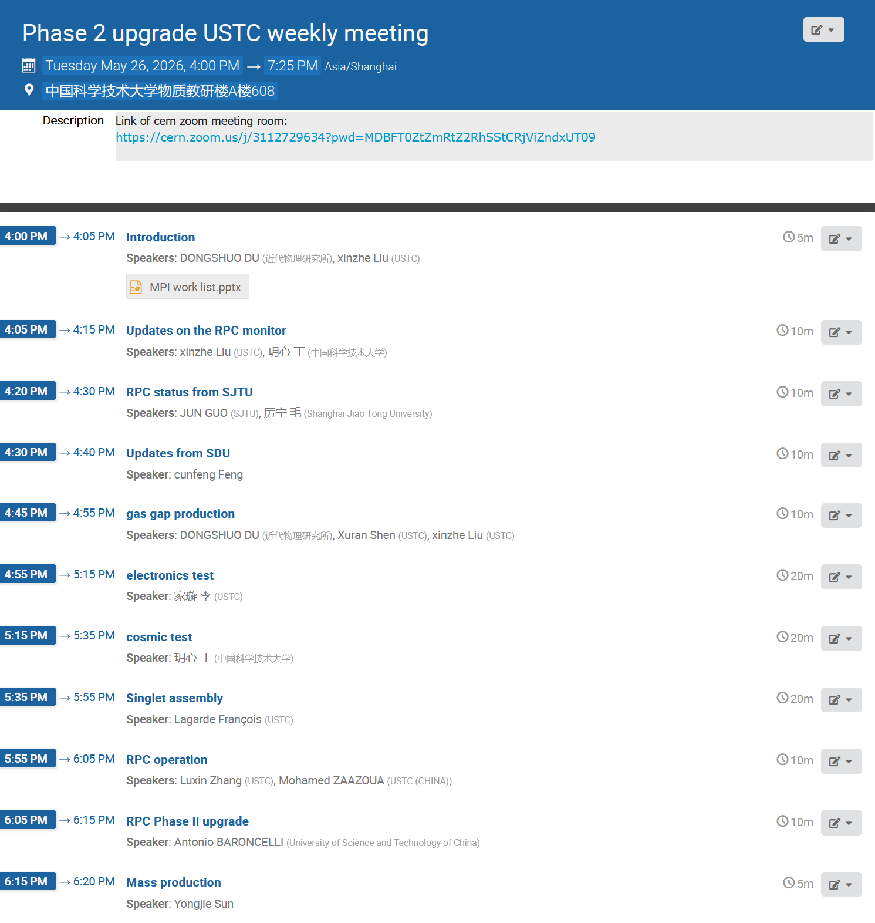
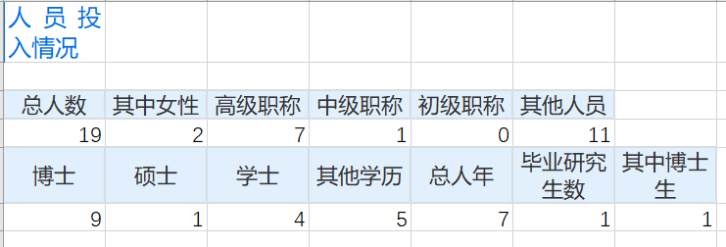
Organization and management
Weekly meeting for in-depth discussion about the progress and work arrangement.
Annual discussion during the CLHCP meeting.

Slide 21
Achievement
Publications
Jiaxuan Li, et al., A low-dead-time, sub-100 ps 144-channel TDC based on Kintex Ultrascale FPGA, JINST 20 (2025) P12027
Talks
杜东硕, The thin RPC gas gap development for the ATLAS Phase-II upgrade，第十届中国LHC物理会议，11月13-16日，青岛
Francois Lagarde, The RPC assembly for the ATLAS Phase-II upgrade，第十届中国LHC物理会议，11月13-17日，青岛
杜东硕, Mass production of RPC readout panels for ATLAS Phase-II upgrade and R&D on thin gas gap production at USTC，RPC2024，9月9-13日
杜东硕, Mass production of RPC readout panels for ATLAS Phase-II upgrade and R&D on thin gas gap production at USTC，第十四届全国粒子物理学术会议，8月12-18日，青岛
郭军, ATLAS Upgrade，CLHCP2025，10月29日-11月2日
孙勇杰, Status of RPC Muon trigger detector for ATLAS Phase-II upgrade，CLHCP2025，11月1日
李家璇, A FPGA-based DAQ system for RPC cosmic ray test，CLHCP2025，11月1日 , Status of RPC Muon trigger detector for ATLAS Phase-II upgrade，CLHCP2025，11月1日

Slide 22
Summary
RPC gas gap prototypes (130 x 68 cm²) built successfully and USTC has been qualified as a production site.
Mass production and qualification of BIS readout panels (580 pieces) finished.
Singlets pre-production at MPI and PRR passed with recommendations.
An FPGA-based readout system developed for FEE test and singlet qualification.
Getting ready for mass production and commissioning with controllable delays.
Chinese team covers most parts of the RPC production and makes significant contributions to ATLAS Muon upgrade.
Chinese team makes necessary adjustments to fulfill the project.

Slide 23
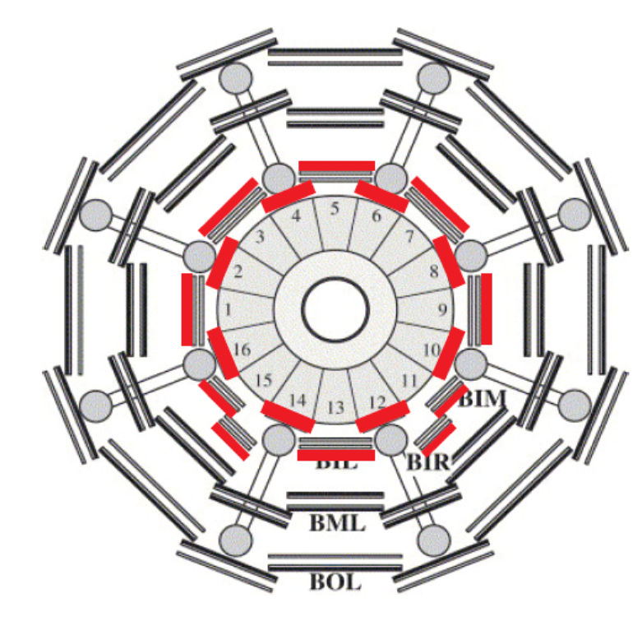
BIS
BIL
BOM/BOR

