Slide 1
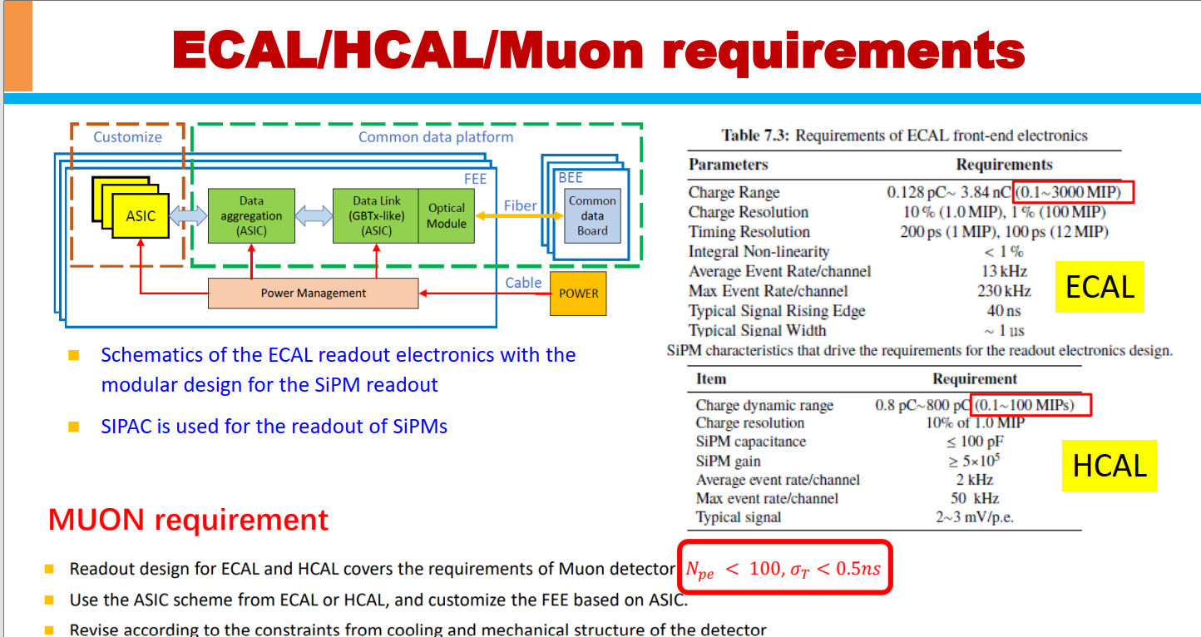
From Huaishen Li

Slide 2
Requirements of SiPM readout electronics for the Cherenkov detector
Parameters | Requirements | Remarks
SiPM size | 3mm x 3 mm PSS, or 1 mm x 1mm normal SiPM | Need further study
SiPM manufacturer | Capacitance, working voltage … | Under investigation (HPK, NDL, FBK …)
Sigal shape/amplitude | rise time: 3-5 ns width: 10-15ns amplitude: 2-3 mV/p.e | To be confirmed
Charge dynamic range | 1-10 p.e ? (e.g. 0.1-1.0 pC at gain=10⁶) | Need to measure charge for PSS
Charge resolution | 0.1 p.e at 1 p.e. | 10% at 1 p.e
Timing resolution | 30-50ps TDC? | Good enough， to reach the total resolution of 100-200 ps
SiPM numbers/Asic | 16-32 SiPMs ? | To reduce the electronics channels
Maximum event rate | 200-300 kHz | Mainly from dark noise rate
Others ? | Size, power consumption, integration related…

