Slide 1
第23周工作汇报
2026-06-01
何伟

Slide 2
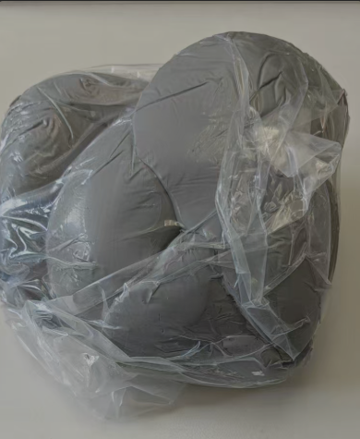
工作内容
调研深冷空分液氮制成的工业高纯氮和PSA变压吸附制成的高纯氮的氧含量
  GB/T 8979《纯氮、高纯氮和超纯氮》，高纯氮（≥99.999%，即 5N）的氧含量≤3ppm
  PSA现场制氮得到99.999%高纯氮，残氧可能在 1～5 ppm 范围浮动，需要实测验证
联系俞伯祥安排到现场测量氡含量，并联系了无锡的检测公司现场测量微量氧含量，准备PSA出气接口转接接头（DN25PN10 → 1/4不锈钢卡套接头）
由蔡啸协助测量了HX5837密封胶泥的本底，本底稍偏高，但用量不多的情况下，可以作为TAO输液管堵漏的加强措施使用
TAO复合源实验情况（夏商汇报）
对CERN的LHC中跨临界CO2制冷系统进一步调研
对国内在CO2制冷研究的单位和关键设备的供应商情况粗略调研

Slide 3


Slide 4
A Numerical Study of the R744 Primary Cooling
System for ATLAS and CMS LHC Detectors
International Journal of Refrigeration 165 (2024) 145–155
Stefanie Blust (NTNU) · Pierre A.C. Barroca (CERN) · Yosr Allouche (IIR) · Armin Hafner (NTNU)
Available online 26 May 2024 | Open Access (CC BY 4.0)

Slide 5
Presentation Outline
1
Background & Motivation
LHC detectors, thermal management history, F-gas regulations
2
R744 Primary Refrigeration System
Trans-critical cycle design, modular concept, key components
3
System A – Demonstration Plant
Prototype configuration, control logic, sequence of states
4
Numerical Modeling (Dymola/Modelica)
Model development, assumptions, control logic implementation
5
Results & Discussion
Simulation results, control logic optimization, experimental validation
6
Conclusions & Future Work
Key findings, next steps for final system deployment

Slide 6
1. Background & Motivation
Thermal Management History
Since 2000: CO₂ two-phase evaporative cooling for tracking detectors
AMS-02 Tracker & LHCb Velo: first R744-cooled silicon detectors
2PACL (2-Phase Accumulator Controlled Loop) design from Nikhef
ATLAS IBL (−35°C, 2×3.3 kW), CMS Pix-Ph1 (2×15 kW)
Only passive components inside detector volume (radiation-safe)
The LHC at CERN
World’s largest and most powerful particle accelerator
100 m underground, 27 km ring, superconducting electromagnets
Four detectors: ATLAS, CMS, ALICE, LHCb
ATLAS & CMS: general-purpose, search for Higgs boson, supersymmetry, extra dimensions
Silicon detectors subject to high radiation levels
Cooling essential to prevent thermal runaway
Why R744 (CO₂)?
Natural refrigerant – response to Montreal Protocol & F-gas phase-down
Non-flammable, non-toxic, zero ODP, GWP = 1
Excellent low-temperature thermodynamic & transport properties
High liquid density → compact components for confined underground spaces
Radiation-hard, non-conductive, non-corrosive → ideal for HEP detectors
Replaces C₃F₈/HFC-based systems in ATLAS & CMS upgrade

Slide 7
1. LHC Phase 2 Upgrade (2025)
2025 LHC Shutdown → Complete Replacement of ATLAS & CMS Tracking Detectors
New Requirements
Two-Loop R744-R744 Architecture
All-new silicon-based tracking detectors
10× higher irradiation than current detectors
Evaporation temperature: ≤ −40°C (primary target: −53°C)
Total heat dissipation: up to 550 kW
100% reliability (detectors worth several million euros)
ATLAS Final Configuration:
7 active + 2 backup compressor slices → 630 kW
CMS Final Configuration:
11 active + 2 backup compressor slices → 910 kW
n+1 redundancy for fail-safe operation & maintenance
Primary Loop (Surface):
Trans-critical CO₂ booster with piston compressors
2-stage inter-cooled compression
Secondary Loop – 2PACL (Underground):
Oil-free pumped liquid loop on evaporation side
Absorbs detector heat, keeps temperature < −40°C
Interface: Heat exchanger
2PACL side: condenser
Primary side: evaporator
Guarantees NO oil passes to detector pipelines
~86 m vertical pipelines (surface ↔ caverns)
Warm gas return → no insulation → cost & space savings

Slide 8
2. The Primary R744 Refrigeration Cycle
System Components
Key Design Parameters
Common Equipment (Surface):
• Water-cooled gas cooler: 35°C → 30°C
• HP valve (CV01): trans-critical pressure control
• Liquid receiver: supplies 2PACL & compressor inlets
Compressor Slices (parallel, surface):
• LP compressor: 6 bar suction
• HP compressor: 22.91 bar suction
• Pre-cooler HX: reduces compression losses
• Water-cooled interstage cooler
• Air-cooled gas cooler (bypass in winter)
• Oil separators (×2 in series) + accumulator
• HGBP valves (CV12/CV13): capacity control
Underground Plant Box:
• Evaporators in parallel (controlled by CV06)
• Post-heat exchangers: warm gas return
• Expansion valves (CV06): regulate superheat (5 K)
Evaporation temperature: −53°C (suction pressure: 6 bar)
Trans-critical operation (CO₂ critical point: 31.1°C, 73.8 bar)
HP setpoint: ~78.8 bar (function of gas cooler outlet temp.)
Liquid receiver pressure: 55 bar (liquid at 20°C to underground)
Pressure ratio: 10–15 (6 bar → 78.8 bar)
HP compressor suction: 22.91 bar, 5°C, 20 K superheat
Sub-cooling for 2PACL pumps: 10 K (liquid < −50°C)
Triple point margin: only 0.81 bar above CO₂ freezing (5.19 bar)

Slide 9
2. Modular Configuration & Redundancy
Modular Parallel Architecture
Trans-Critical Cycle Path
Each compressor slice = independent 50/70 kW unit
Identical slices in parallel → adjustable cooling capacity (0–100%)
Last activated slice fine-controls total capacity via CV12
n+1 Redundancy Scheme:
• Extra backup slice(s) always available
• Automatic fail-over on component failure
• Continuous operation during maintenance
• ATLAS: 7 active + 2 backup = 630 kW
• CMS: 11 active + 2 backup = 910 kW
Three Prototype Generations:
• System A → Control logic validation (this paper)
• System B → Oil management & pipeline behavior
• System C → Production-ready CMS commissioning unit
Final deployment: ~20 single units for ATLAS (9) & CMS (13)
CO₂ critical point: 31.1°C / 73.8 bar
Summer: raw water > 31.1°C → trans-critical mode
Winter (<−10°C): sub-critical possible but NOT used
(heat recovery planned; 20°C pipe dew-point limit)
Main Cycle States:
1→2: HP valve (78.8 → 55 bar, liquid receiver)
2→3: Liquid receiver supply
3→4: Warm liquid to underground
5→6: Expansion to 6 bar
6→7: Evaporation at −53°C (heat from 2PACL)
7→8: Post-heat to ambient temperature
8→11→12: LP compression (6 → 22.91 bar)
12→17→18: HP compression (22.91 → 78.8 bar)
18→19→1: Gas cooling (air + water)
Key Valves: CV01 (HP), CV04 (receiver P),
CV05 (MP liquid), CV06 (expansion), CV12/CV13 (HGBP)

Slide 10
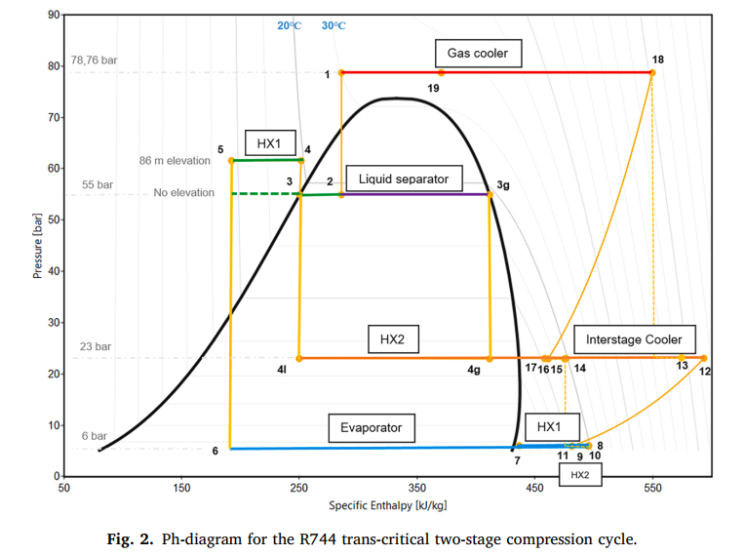
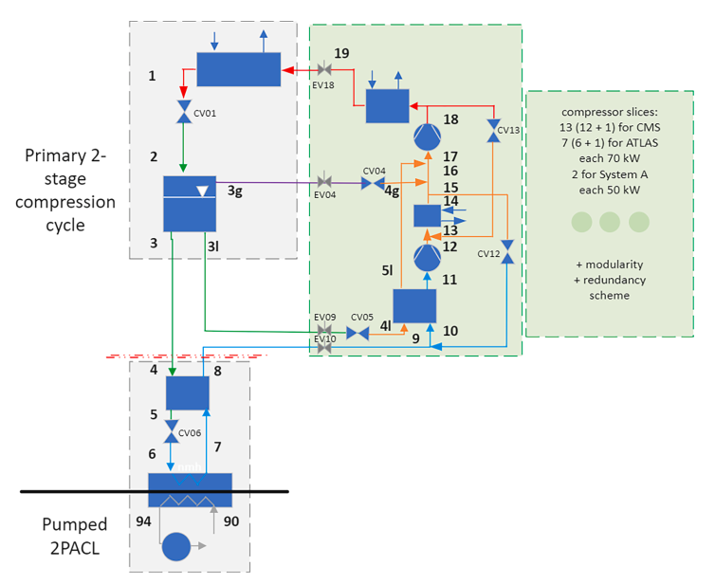
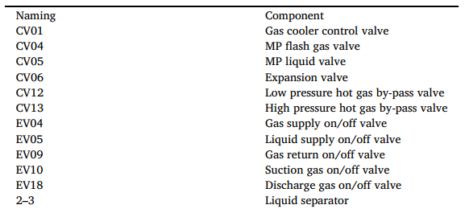
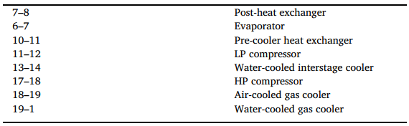

Slide 11
3. System A – First Demonstration Plant
System A Configuration
Control Logic – State Machine
Purpose: Validate control logic & system reliability
Max capacity: 100 kW (2 × 50 kW compressor slices)
Slice 1: DORIN LP + HP compressors
Slice 2: GEA Bock LP + HP compressors
LP max mass flow: 210 g/s | HP: 364 g/s
Connected to dummy load (no elevation difference)
Test Regime:
One cycle = 1-slice idle → load increase →
2-slice full capacity → load decrease → 1-slice
Load range: 0.6 kW (min) to 50 kW (max per slice)
Static tests at 0.6, 25, 50 kW
Dynamic tests with continuously varying load
Data extraction: 27 Oct 2021 from CERN demo plant
S0 – OFF: All actuators in safety position
S3 – STANDBY: Pressurized, components ready, CV12 inactive
S4 – ACTIVE: CV12 controls system suction pressure
S5 – PASSIVE: CV12 closed, max cooling, parallel with S4
Enabling Sequence (S0 → S3, ~261 s / 4.4 min):
1. 3-way valve opens air-cooled gas cooler
2. Flash gas supply (EV04) & discharge gas (EV18) open
3. HP compressor start (if suction pressure OK)
4. LP compressor start + liquid supply (EV05) open
Activation (S3 → S4): CV12 closes, suction P in range
Deactivation: Mass flow drops, LP suction < 5.98 bar,
standby timeout 500 s → disable
CV12 OD > 45% → enable CS2 | CV12 OD < 10% → disable

Slide 12
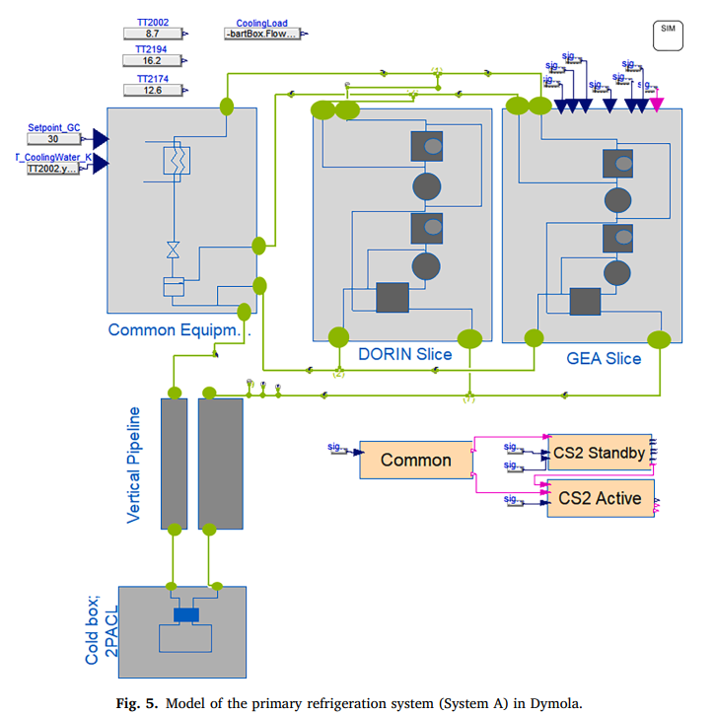
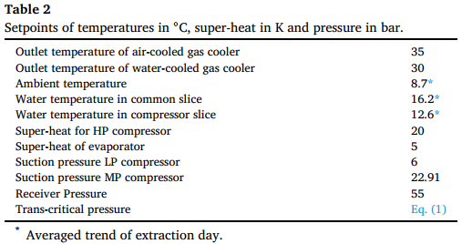
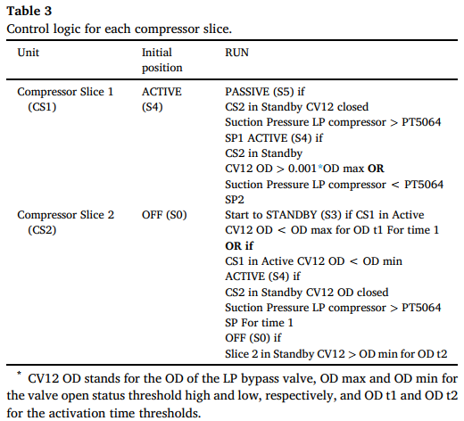

Slide 13
4. Numerical Modeling with Dymola/Modelica
Simulation Framework
Assumptions & 3-Phase Development
Software: Dymola (Dynamic Modeling Laboratory)
Language: Modelica (open-source, equation-based)
Library: TIL Suite 3.11.0 (TLK-Thermo GmbH)
• TILMedia: fluid properties (R744, air, water)
• TIL-FileReader: external data import
• DaVE: thermal system visualization
Model Structure (3 Units):
1. Common Equipment: gas coolers, HP valve, receiver
2. Compressor Slices (×2): compressors, HXs, valves
3. Cold Box / 2PACL: mass flow & superheat input
Component Models:
• Reciprocating compressors: polynomial-based
(DORIN & GEA Bock manufacturer data)
• Heat exchangers: plate counter-current flow
• Valves: orifice models with effective flow areas
• 3-way valve: linear directional control
Key Assumptions:
• Oil management: NEGLECTED
• 2PACL evaporator: NOT modeled (exp. data input)
• Zero pressure drop in components & pipelines
• Vertical pipe height = 1 m (System A is on-ground)
Phase 1: Simplified model
1 CS + common + dummy, Bitzer compressors, static 78 bar HP
Static (0.6/25/50 kW) & dynamic tests
Phase 2: Full 2-slice parallel model
Real geometry, DORIN + GEA Bock compressors
HP = f(gas cooler outlet T), control logic (NTNU+CERN)
Phase 3: Experimental validation
Real mass flow profiles from CERN test campaigns
Parameter tuning for suction pressure stability

Slide 14
5. Simulation Results – Control Logic Optimization
Optimized Control Logic (§4.2)
Averaged Mass Flow Input (§4.1)
Modification 1: Enabling canceled only if CV12 OD > 45% for >100 s
Modification 2: time1 reduced to 0.1 s (no standby wait)
Modification 3: OD_min = 5% (from 10%) → negligible effect
✓ Suction pressure: ±0.06 bar (25× improvement!)
✓ Overshoot during enabling reduced by 4%
Mass flow: 0.05 → 0.18 kg/s (14 min & 8 min ramps)
✓ Trans-critical P: 78.7 ± 1 bar
✓ Receiver P: 55 ± 0.2 bar
✓ Suction P: ~6 bar, fluctuation +0.3/−0.02 bar
Faster load ramp → greater suction pressure effect
Initial Control Logic – Issues
Key Findings
Mass flow: 0.05 → 0.178 kg/s (8 min) → 0.03 kg/s (200 s)
Trans-critical: 78.7 ± 2 bar | Receiver: 55 ± 1 bar
⚠ Suction pressure: +1.5 bar / −0.06 bar fluctuation
Large overshoot during enabling/disabling transitions
Control logic parameters CAN be fine-tuned via simulation
Longer zero-to-full-load transition → smoother suction P
Operational limits:
• Max: LP compressor (≤ 201 g/s)
• Min: evaporator/dummy load
• Long vertical pipelines naturally smooth transients

Slide 15
5. Experimental Validation – Simulation vs. Demo Plant
Simulation vs. Experiment (Data Set 2)
Sources of Experimental Fluctuation
Numerical pressure profiles: MORE stable than experimental
Trans-critical pressure:
• Simulation: stable at ~78.7 bar
• Experiment: ±10 bar (start/end), ±6 bar (mid-cycle)
Receiver pressure:
• ~0.7 bar constant offset (exp. vs. sim.)
Suction pressure (most critical):
• Experiment: total deviation of 2 bar
• Simulation: ±0.06 bar (after optimization)
Observation: 2-slice operation MORE stable than 1-slice
→ Less fluctuation during 2-slice mode
Overall: pressure averages correspond well
→ Model validated for design & optimization
1. Commissioning Phase:
Data taken during active commissioning → many
components simultaneously tested/adjusted
2. Oil Management:
Oil tanks emptied every 5–10 minutes
Cyclic return → periodic disturbances
Oil effects NOT captured in simulation
3. Cooling Water Instability:
±6 K water temperature fluctuation
Network issues → variable mass flow
Direct effect on receiver pressure stability
4. Simulation Advantages:
PID controllers precisely tunable
Actuators easily added/removed for testing
No physical disturbances (leaks, fouling, wear)

Slide 16
6. Conclusions & Future Work
Key Conclusions
Limitations
✓ R744 trans-critical system meets detector cooling needs:
stable −53°C under 0–100% load variation
✓ Modular parallel-slice concept validated:
flexible capacity, n+1 redundancy, maintainable
✓ Control logic proven through simulation & experiment:
slice enabling/disabling operates reliably
✓ Dymola/Modelica model successfully replicates System A:
good accuracy on pressure averages
✓ Control logic optimized via simulation:
suction pressure fluctuation reduced 25× (±0.06 bar)
✓ Experimental validation confirms model utility:
simulation is inherently more stable than real plant
(no oil, no water fluctuations, ideal components)
Oil management NOT modeled (key source of deviation)
2PACL evaporator not modeled in detail
Experimental data from commissioning (not steady-state)
Water temperature fluctuations (±6 K) not captured
Trans-critical pressure needs further model revision
Future Work
Fine-tune demo plant control logic based on simulation
Evaluate on-site year-round performance
System B: long pipeline behavior & oil management
System C: production-ready CMS Inner Detector unit
Final goal: 20 units (ATLAS 9 + CMS 13) with 100% reliability
Data: https://doi.org/10.18710/YVECMK

Slide 17
. System Specifications at a Glance
Refrigerant
R744 (CO₂) – Natural, GWP=1, ODP=0
ATLAS Final Config.
7 active + 2 backup slices → 630 kW
Cycle Type
Trans-critical 2-stage inter-cooled vapor compression
CMS Final Config.
11 active + 2 backup slices → 910 kW
Evaporation Temp.
−53°C (suction pressure 6 bar, triple point margin 0.81 bar)
2PACL Interface
Heat exchanger (condenser for 2PACL / evaporator for primary)
Trans-critical HP
~78.8 bar (f(gas cooler outlet temperature))
Vertical Pipeline
~86 m (surface ↔ underground caverns)
Receiver Pressure
55 bar (liquid at 20°C to underground)
Redundancy
n+1 scheme with automatic fail-over
HP Compressor Inlet
22.91 bar, 5°C, 20 K superheat
Simulation Tool
Dymola + Modelica + TIL Suite 3.11.0
System A Capacity
2 × 50 kW (DORIN + GEA Bock compressors)
Control Logic States
S0 (OFF), S3 (Standby), S4 (Active), S5 (Passive)
Final Slice Capacity
70 kW per compressor slice

Slide 18
Thank You
Blust, S., Barroca, P.A.C., Allouche, Y., Hafner, A. (2024)
A numerical study of the R744 primary cooling system for ATLAS and CMS LHC detectors
International Journal of Refrigeration, 165, 145–155
Open Access (CC BY 4.0) · doi:10.1016/j.ijrefrig.2024.05.026
Data: https://doi.org/10.18710/YVECMK

