Slide 1


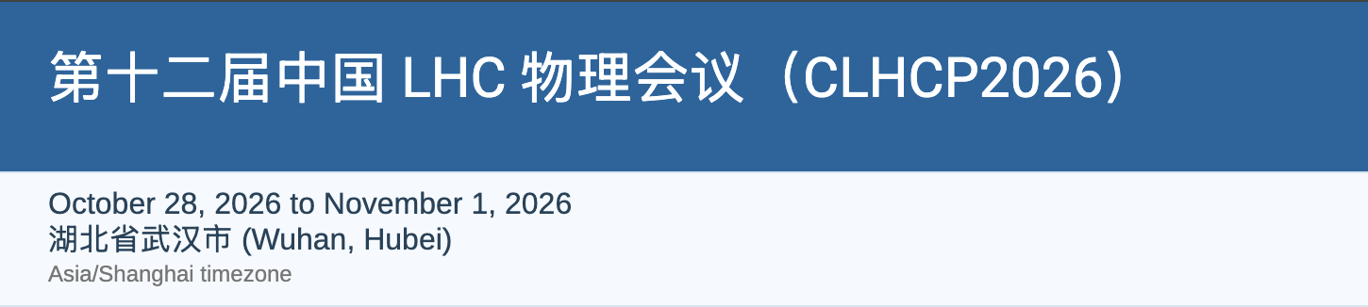
Search for Soft Unclustered Energy Patterns containing muons in the final state in pp collisions at 13TeV with the ATLAS detector
Ligang Xia (Nanjing University)
JHEP10(2026)206
SUEP search in ATLAS, CLHCP 2026, Wuhan
1

Slide 2


Motivation
A big barrier
Hidden valley models could explain the hierarchy problem and provide candidates for the dark matter.
They predict a dark sector in which the interaction is so strong that the dark particle could undergo a QCD-like parton showering.
The dark sector is weakly coupled to SM via a portal, e.g., a heavy Scalar mediator.
The main feature is that a dark showering appears as a group of large number of soft particles isotropically distributed, i.e. Soft Unclustered Energy Pattern (SUEP) instead of a jet.
This unconventional search complements those using jets:
  Di-jet resonance, semi-visible jets, emerging jets
The presence of muons also complements previous CMS searches using fully hadronic final state
We are here now.
Hidden Valleys
SM
Scalar
(Weak portal coupling)
QCD-like Dark Sector
(Strongly interacting)
QCD jet ($α_{S}≈0.11$)
SUEP($λ≫1$)
SUEP search in ATLAS, CLHCP 2026, Wuhan
2

Slide 3
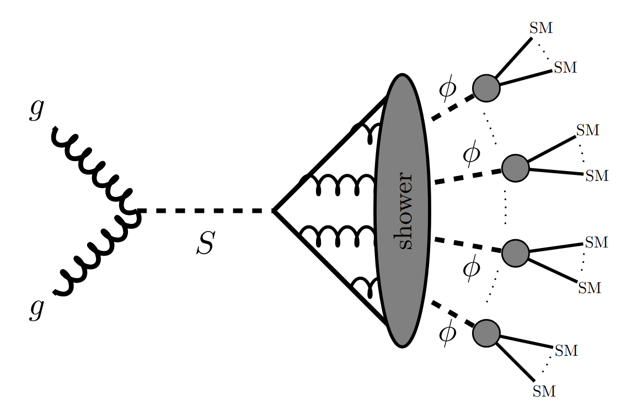
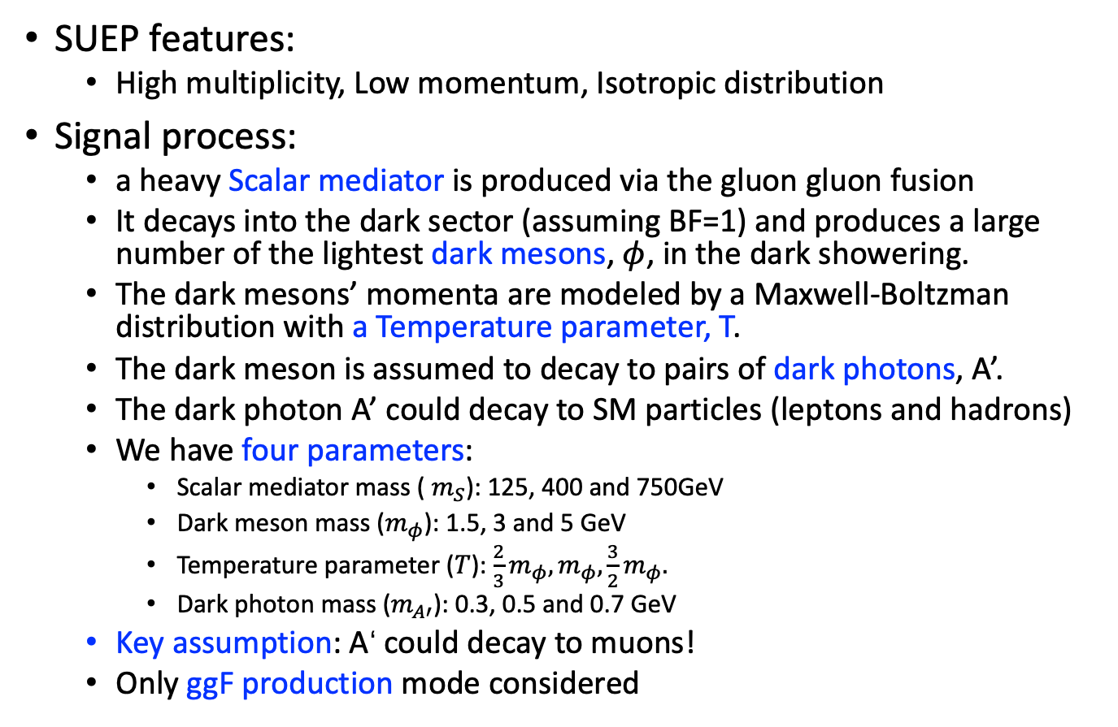
Signal Models
SUEP features:
  High multiplicity, Low momentum, Isotropic distribution
Signal process:
  a heavy Scalar mediator is produced via the gluon gluon fusion
  It decays into the dark sector (assuming BF=1) and produces a large number of the lightest dark mesons, $φ$, in the dark showering.
  The dark mesons’ momenta are modeled by a Maxwell-Boltzman distribution with a Temperature parameter, T.
  The dark meson is assumed to decay to pairs of dark photons, A’.
  The dark photon A’ could decay to SM particles (leptons and hadrons)
  We have four parameters:
    Scalar mediator mass ( $m_{S}$): 125, 400 and 750GeV
    Dark meson mass ($m_{φ}$): 1.5, 3 and 5 GeV
    Temperature parameter ($T$): $\frac{2}{3}m_{φ}, m_{φ},\frac{3}{2}m_{φ}.$
    Dark photon mass ($m_{A′}$): 0.3, 0.5 and 0.7 GeV
  Key assumption: A‘ could decay to muons!
  Only ggF production mode considered
QCD jet ($α_{S}≈0.11$)
SUEP($λ≫1$)
SUEP search in ATLAS, CLHCP 2026, Wuhan
3

Slide 4
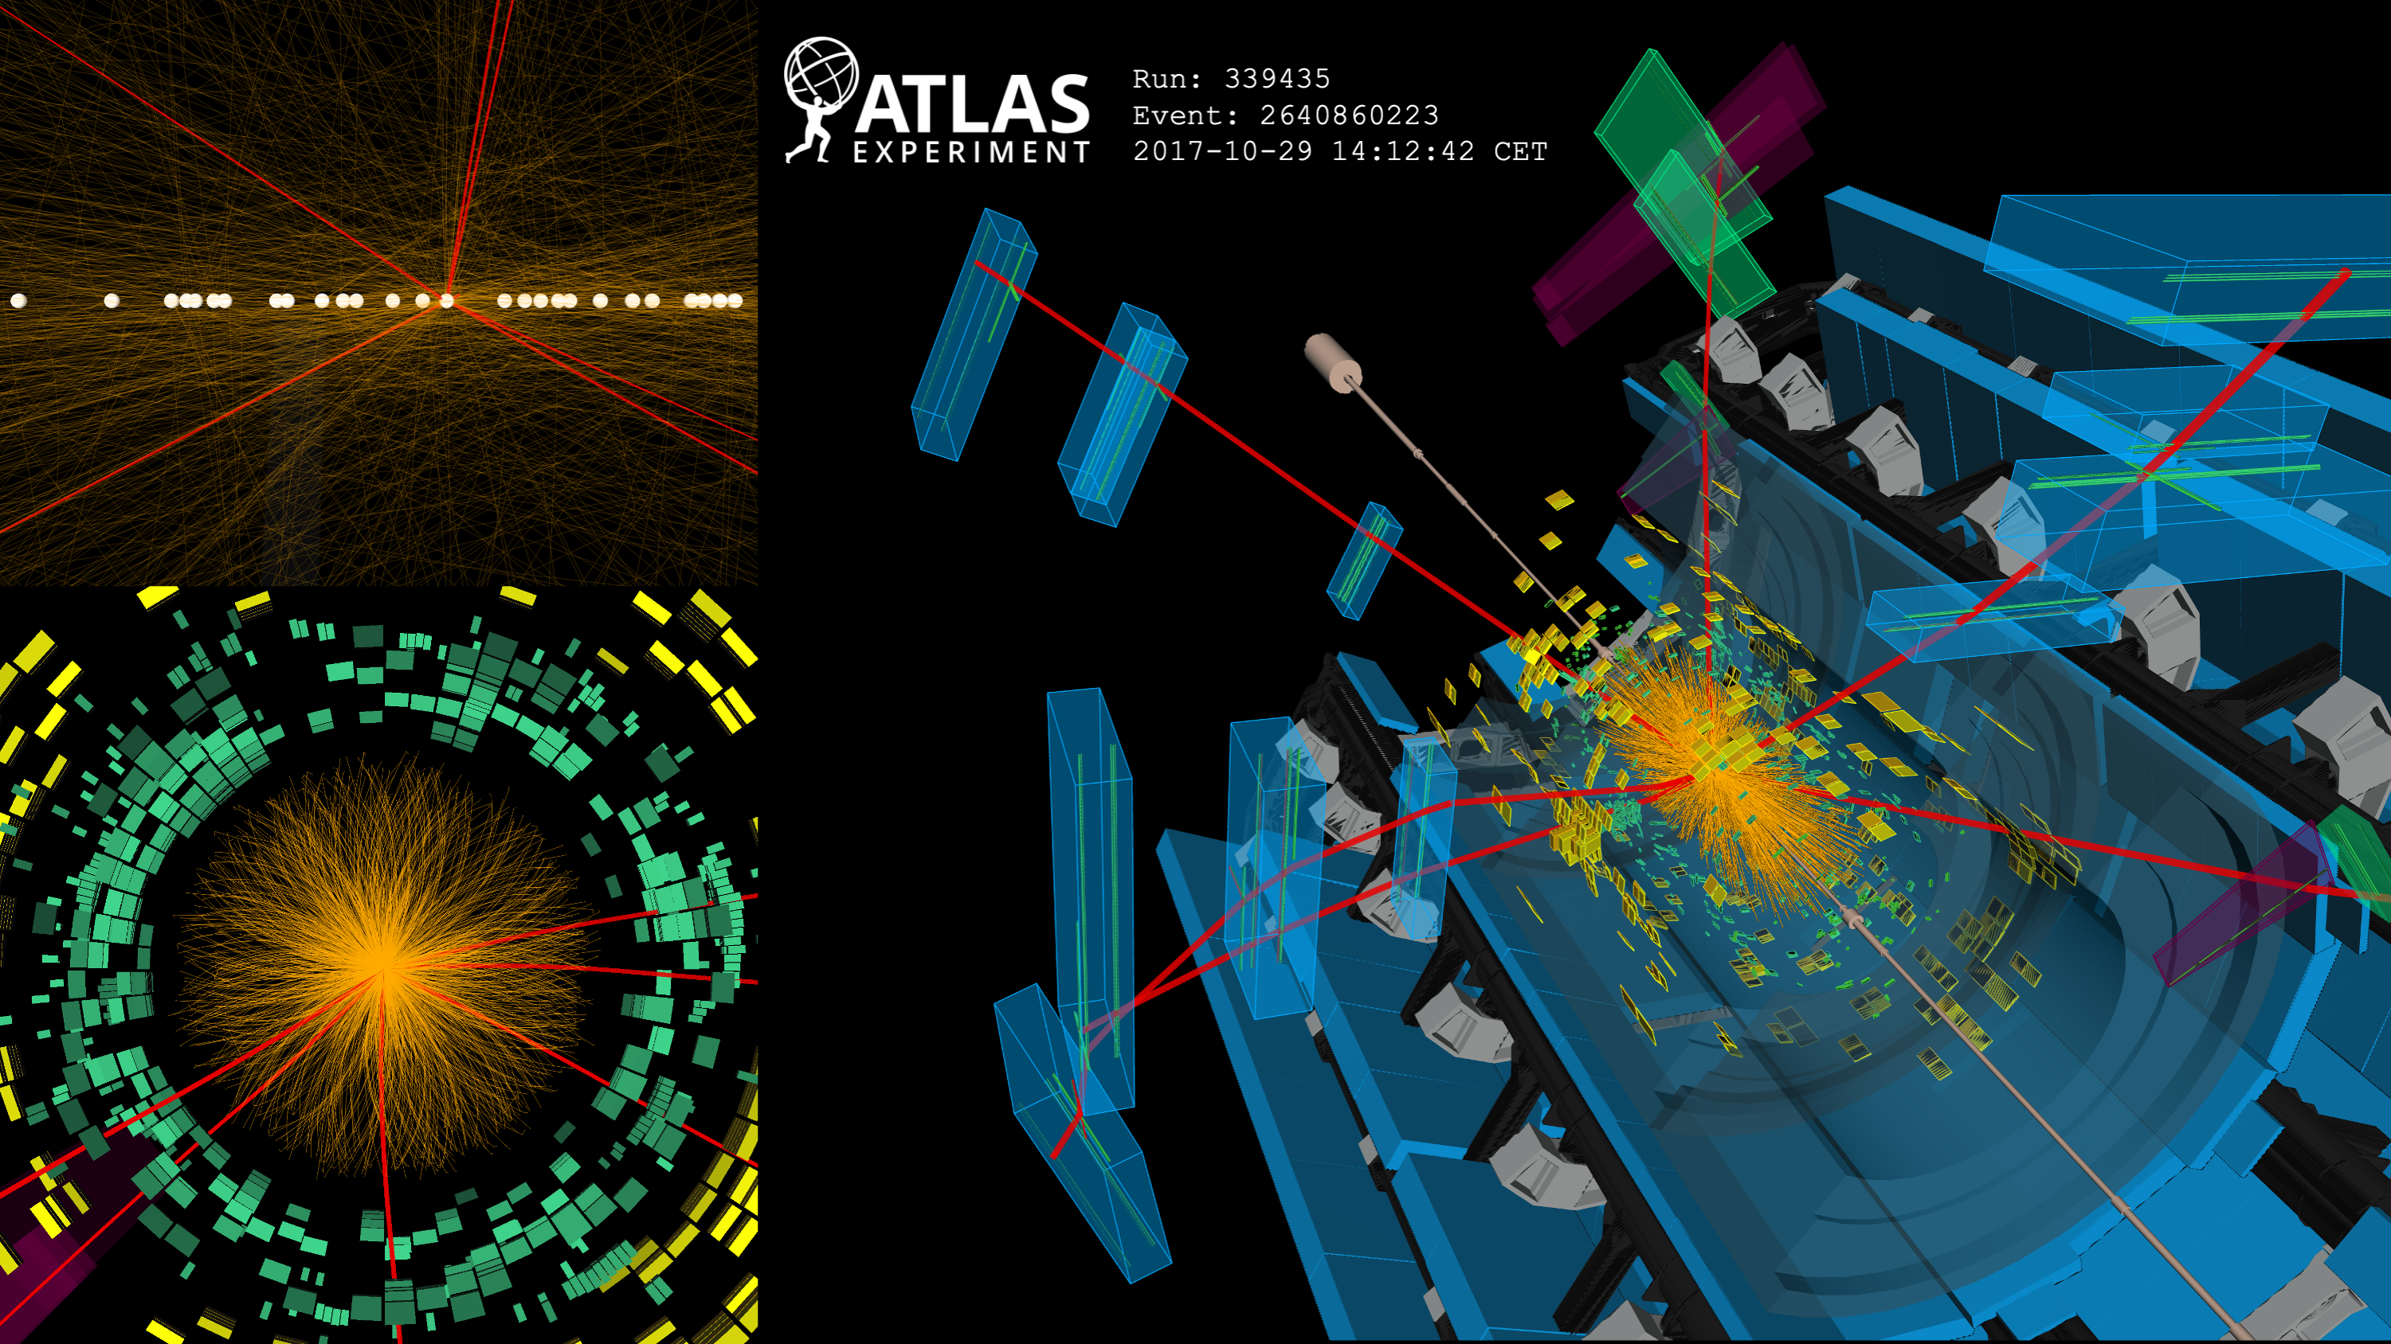
Signal topology
Large number of soft tracks from the same PV
Multiple prompt muons
The tracks and muons distributed isotropically
SUEP search in ATLAS, CLHCP 2026, Wuhan
4

Slide 5
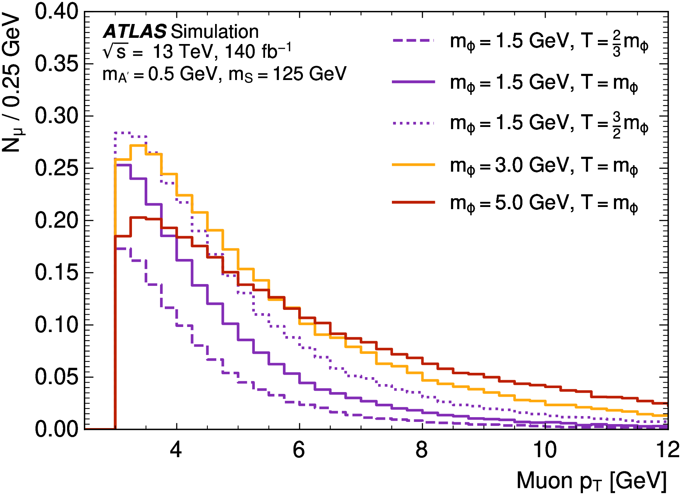
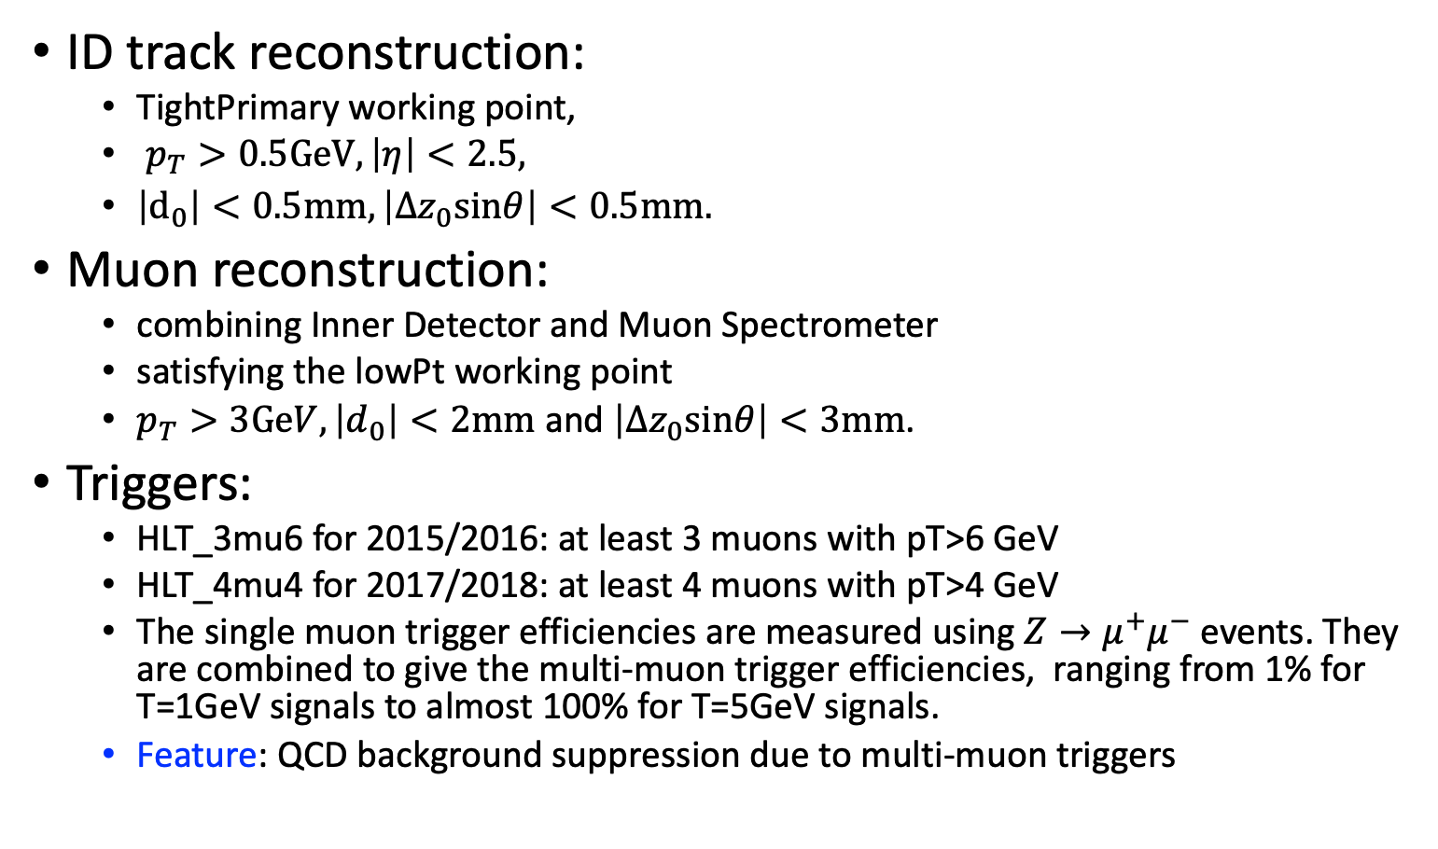
Event reconstruction
ID track reconstruction:
  TightPrimary working point,
  $p_{T}>0.5GeV, \left|η\right|<2.5,$
  $\left|d_{0}\right|<0.5mm, \left|Δz_{0}sinθ\right|<0.5mm.$
Muon reconstruction:
  combining Inner Detector and Muon Spectrometer
  satisfying the lowPt working point
  $p_{T}>3GeV,\left|d_{0}\right|<2mm$ and $\left|Δz_{0}sinθ\right|<3mm$.
Triggers:
  HLT_3mu6 for 2015/2016: at least 3 muons with pT>6 GeV
  HLT_4mu4 for 2017/2018: at least 4 muons with pT>4 GeV
  The single muon trigger efficiencies are measured using $Z→μ^{+}μ^{−}$events. They are combined to give the multi-muon trigger efficiencies, ranging from 1% for T=1GeV signals to almost 100% for T=5GeV signals.
  Feature: QCD background suppression due to multi-muon triggers
SUEP search in ATLAS, CLHCP 2026, Wuhan
5

Slide 6
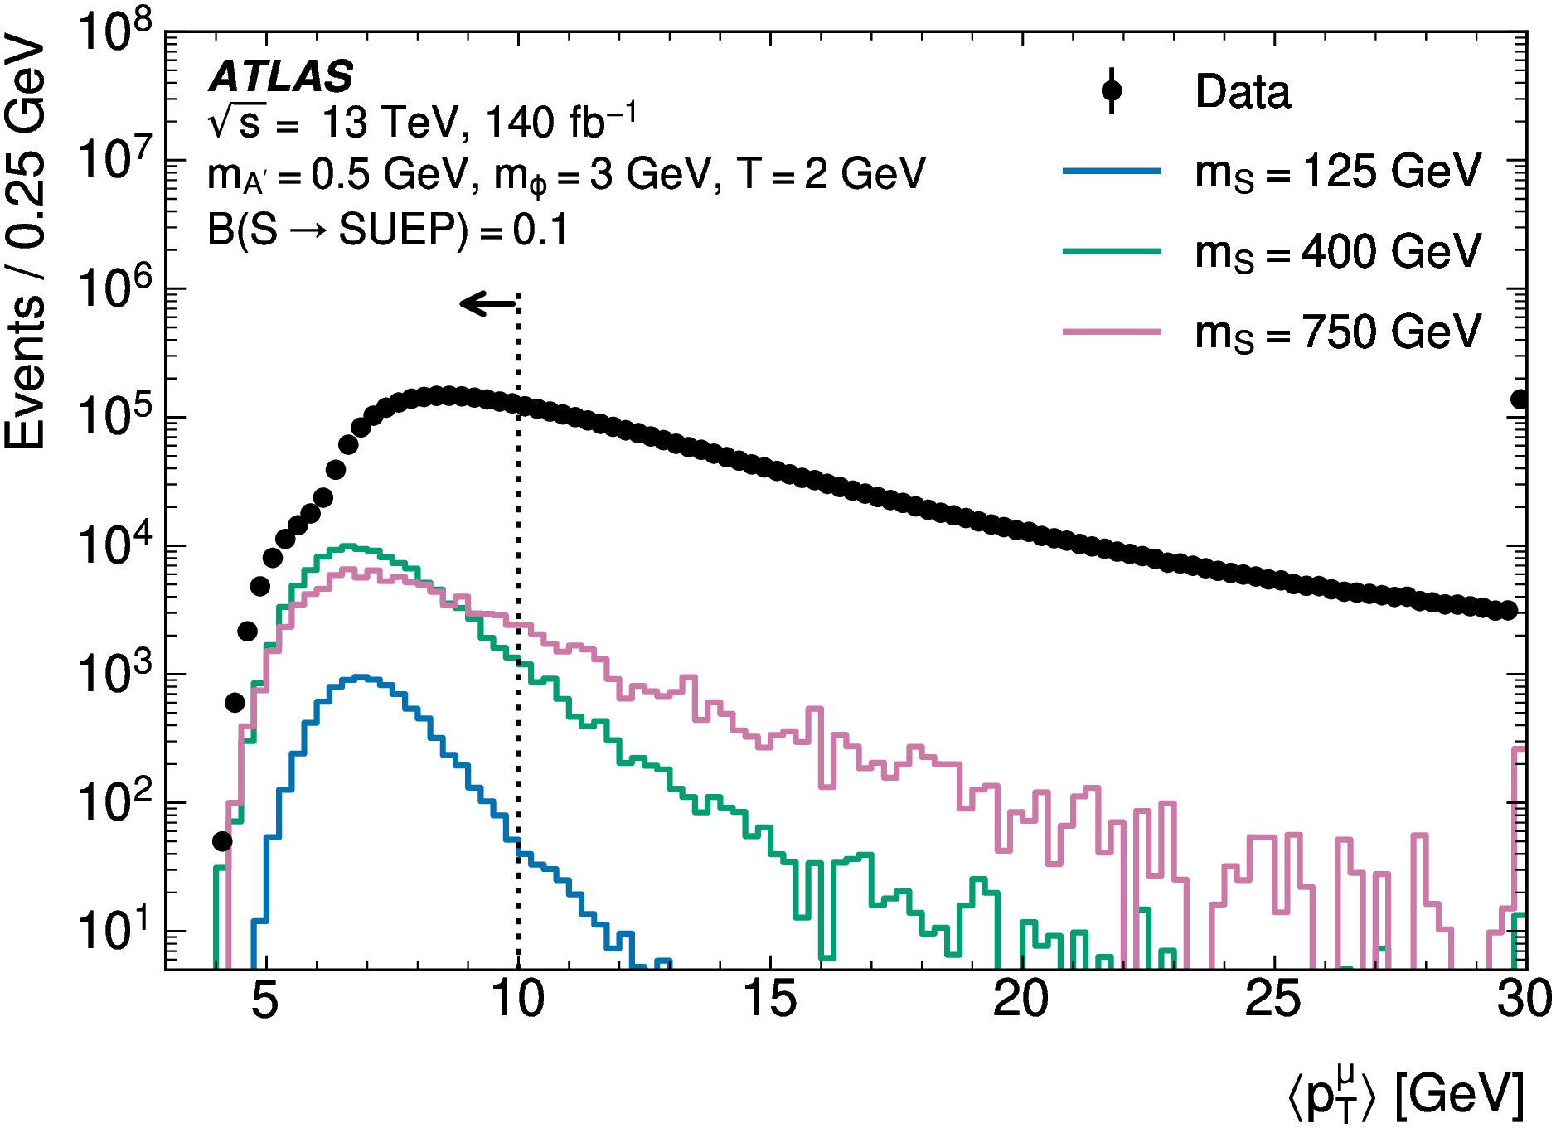
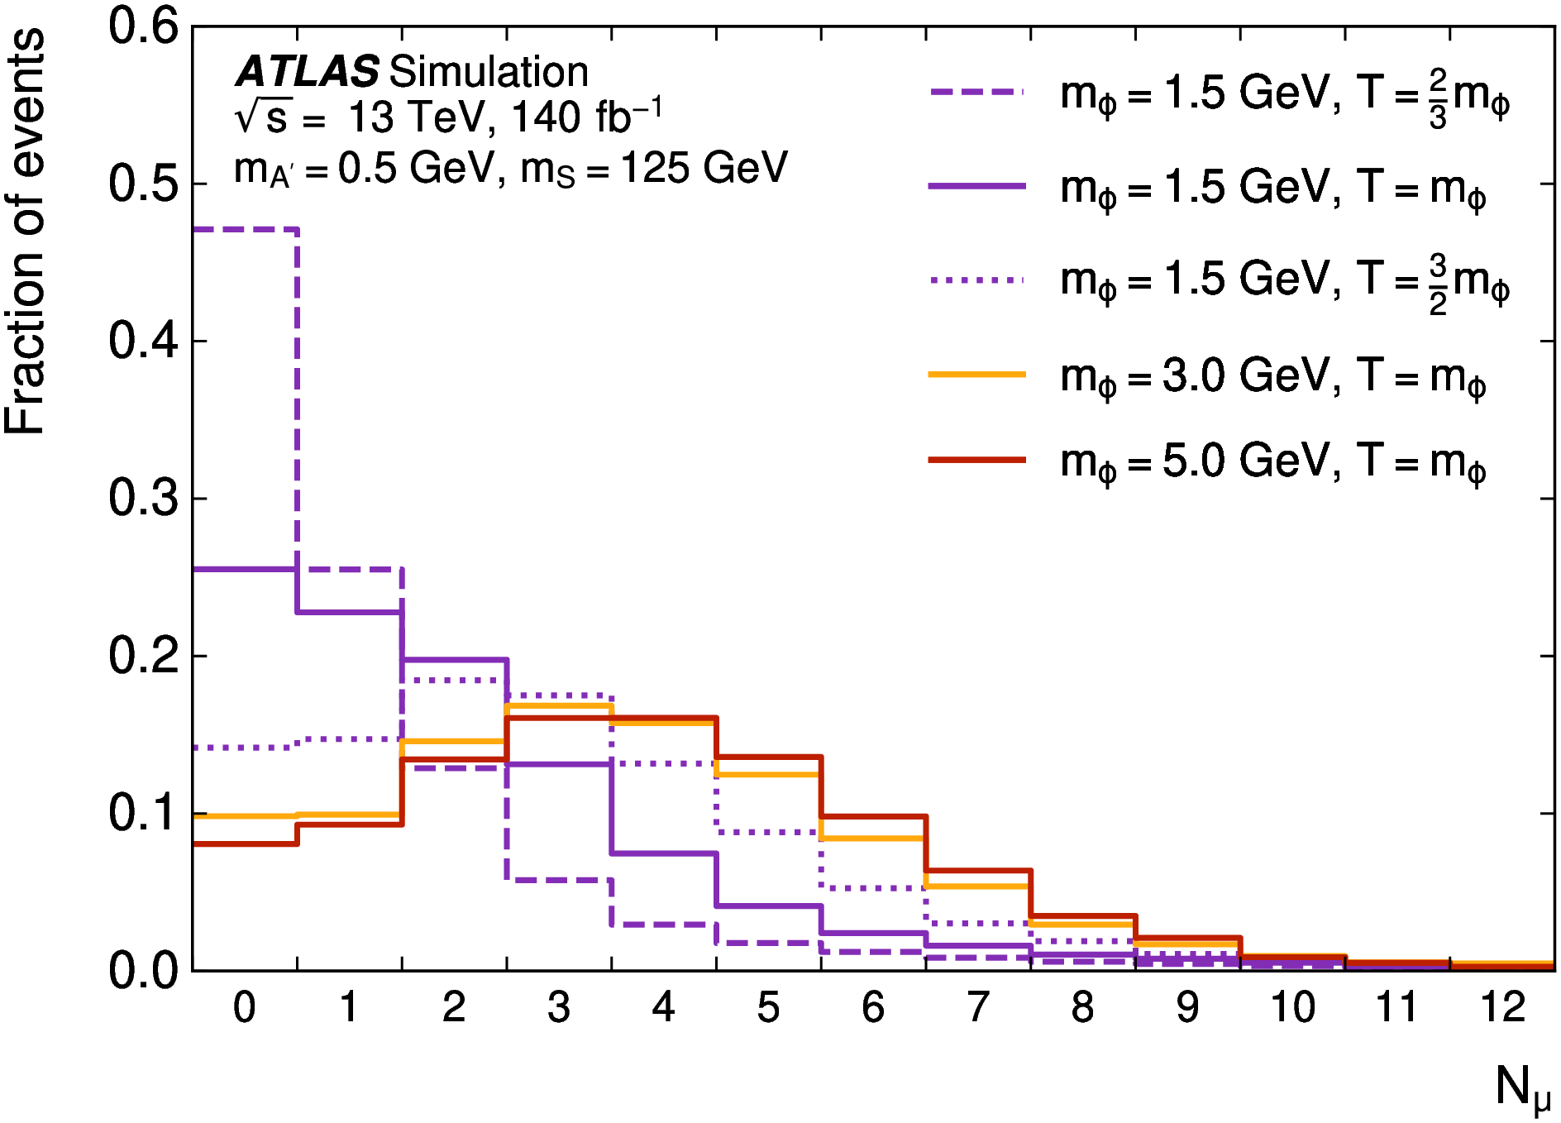
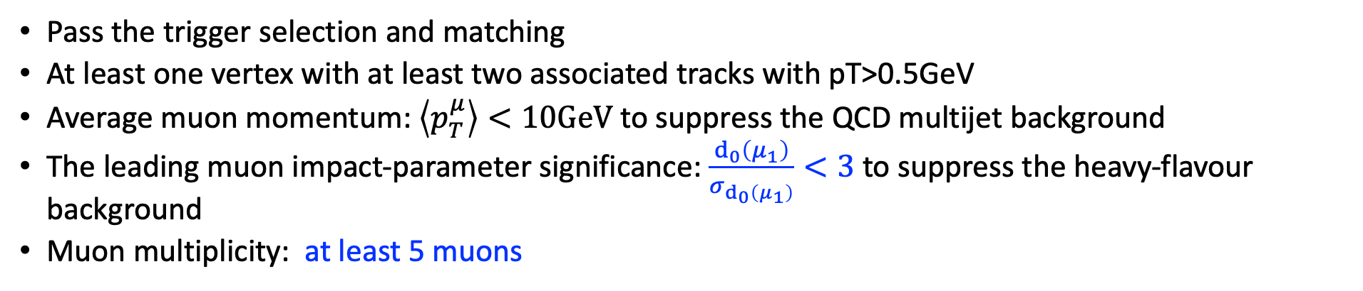
Event selection
Pass the trigger selection and matching
At least one vertex with at least two associated tracks with pT>0.5GeV
Average muon momentum: $\left\langle p_{T}^{μ}\right\rangle <10GeV$ to suppress the QCD multijet background
The leading muon impact-parameter significance: $\frac{d_{0}\left(μ_{1}\right)}{σ_{d_{0}\left(μ_{1}\right)}}<3$ to suppress the heavy-flavour background
Muon multiplicity: at least 5 muons
SUEP search in ATLAS, CLHCP 2026, Wuhan
6

Slide 7
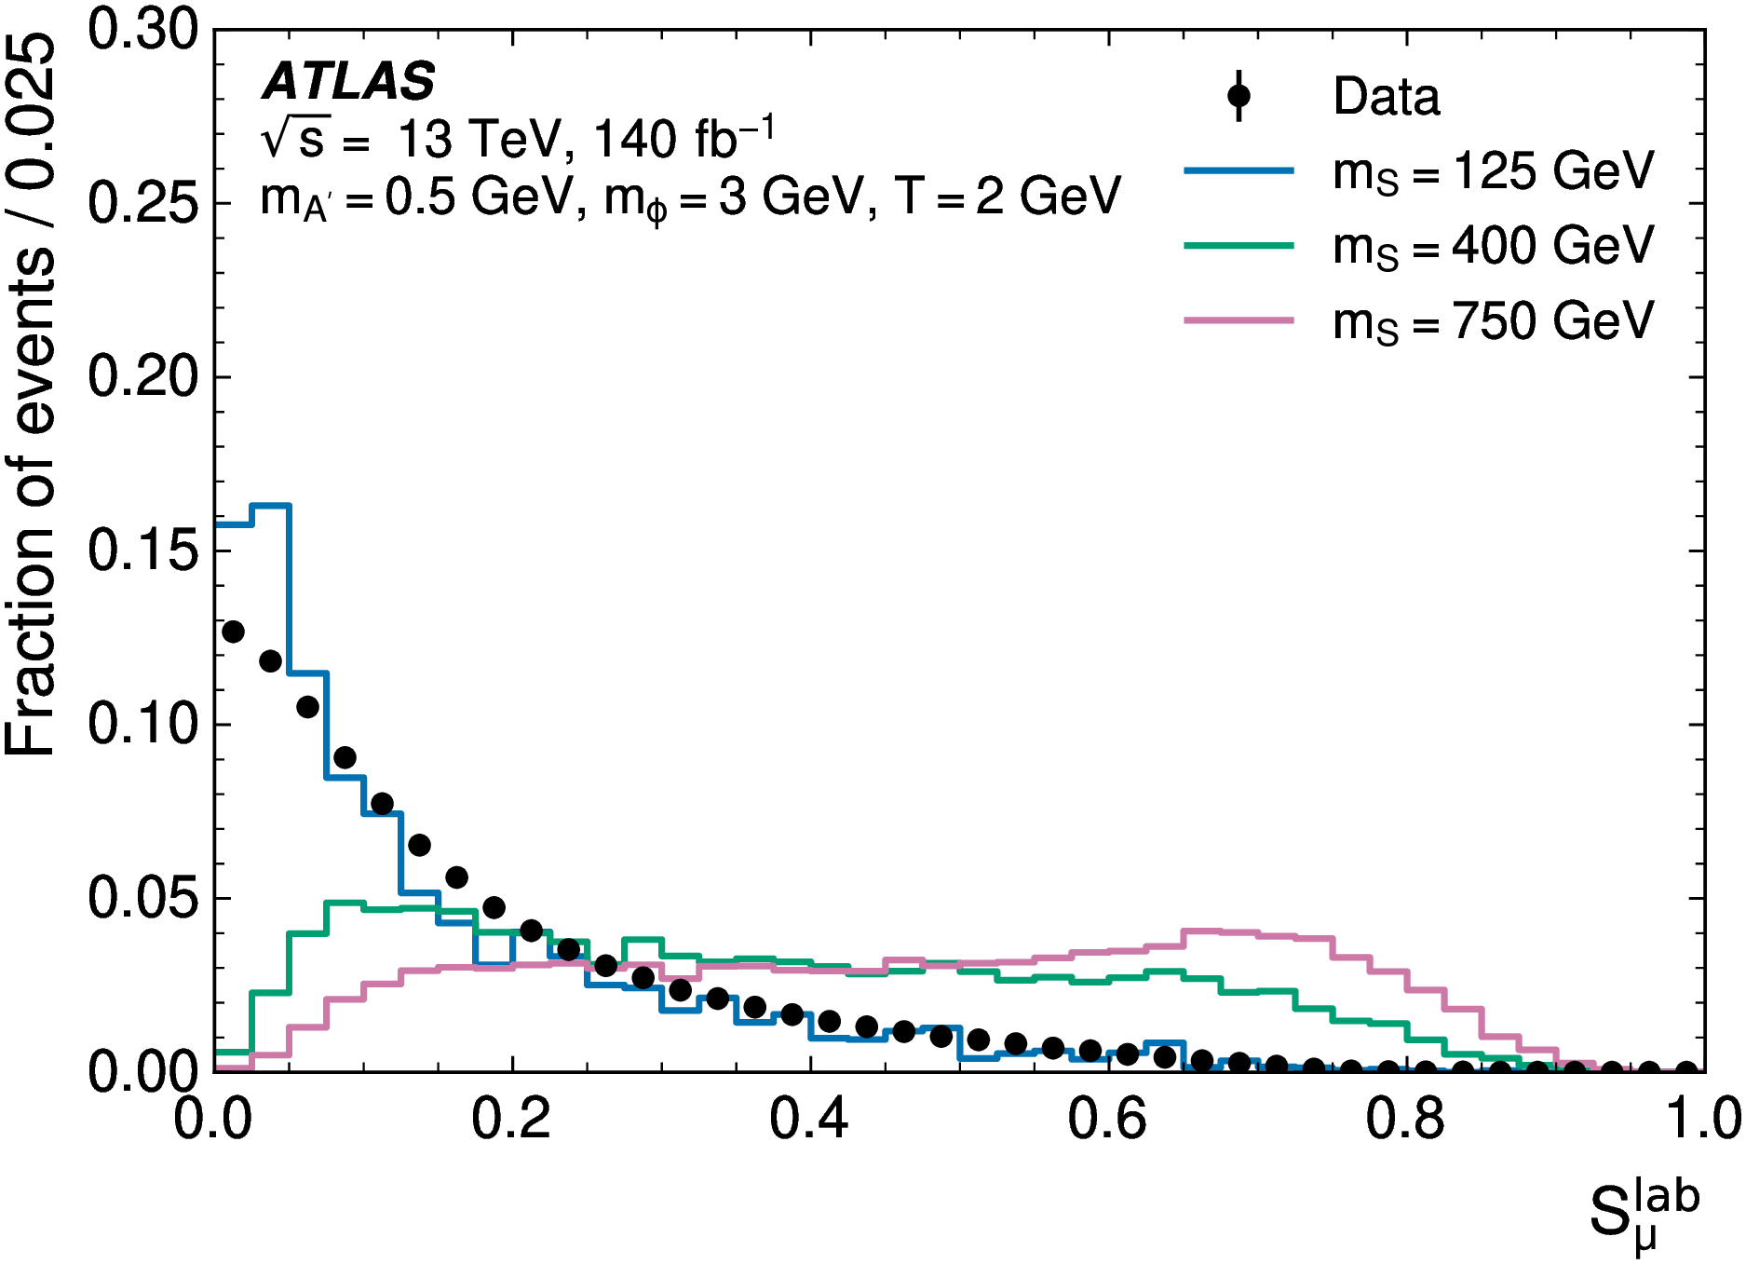
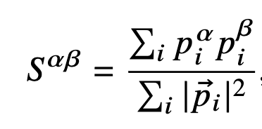
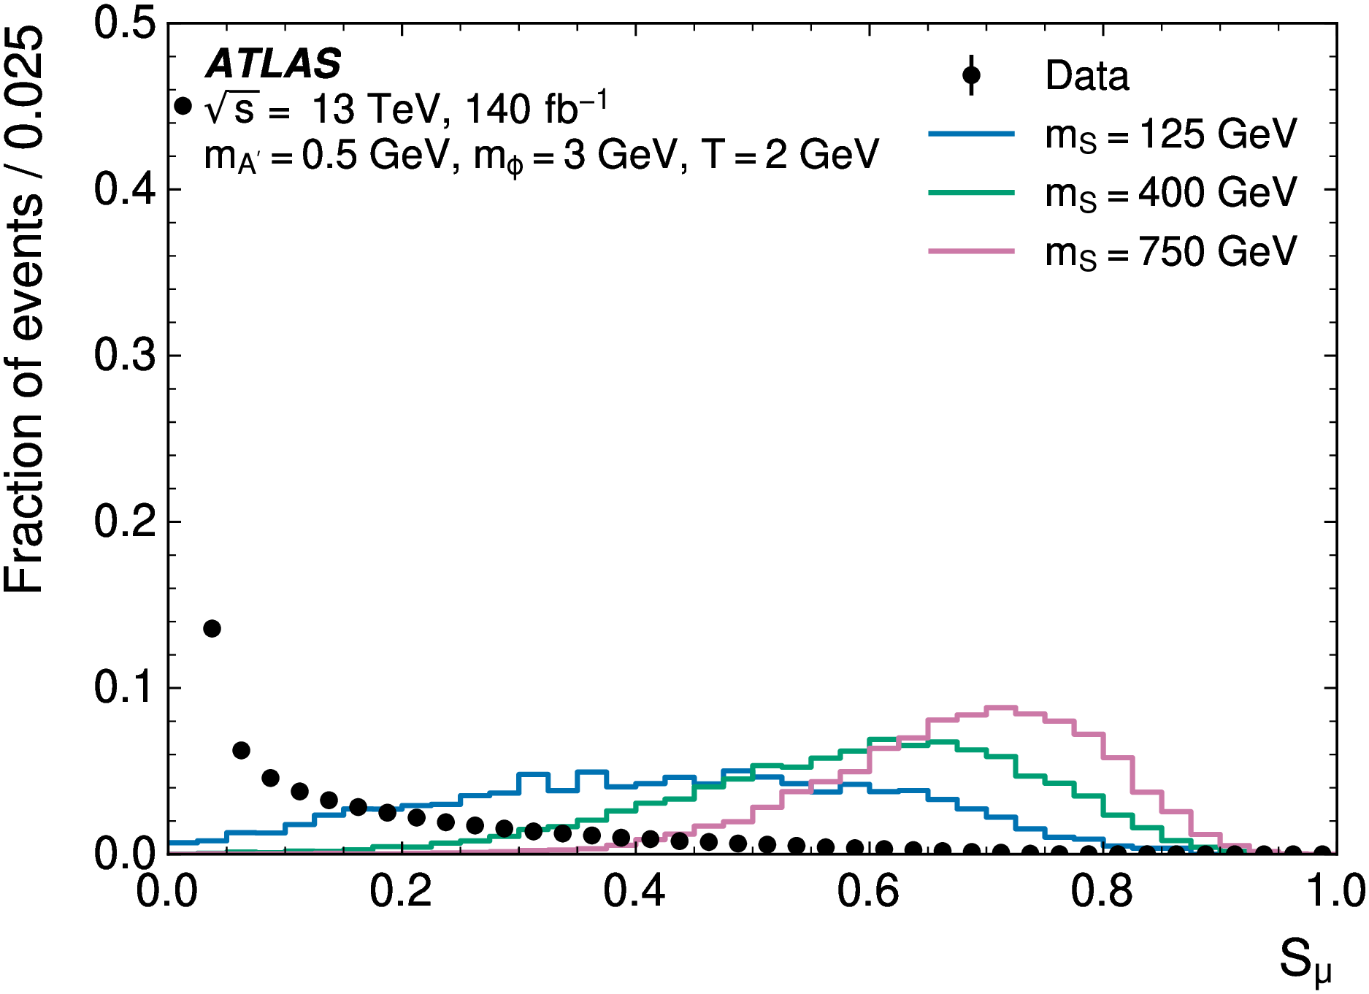
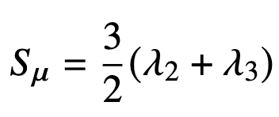
Two powerful observables (1)
Muon sphericity (SUEP features in isotropic distribution)
  calculated in the CoM system of the selected muons
  It is 0 for pencil-like configuration and 1 for isotropic configuration
  Its value is low for background while high for signal.
Lab frame
CoM frame
$α, β:$spatial indices
$$λ:eigenvalues$$
CR
SR
Background estimation:
$0.1<S_{μ}<0.2$: used for background estimation
$0.6<S_{μ}<1:$ used for signal searching (signal region)
SUEP search in ATLAS, CLHCP 2026, Wuhan
7

Slide 8
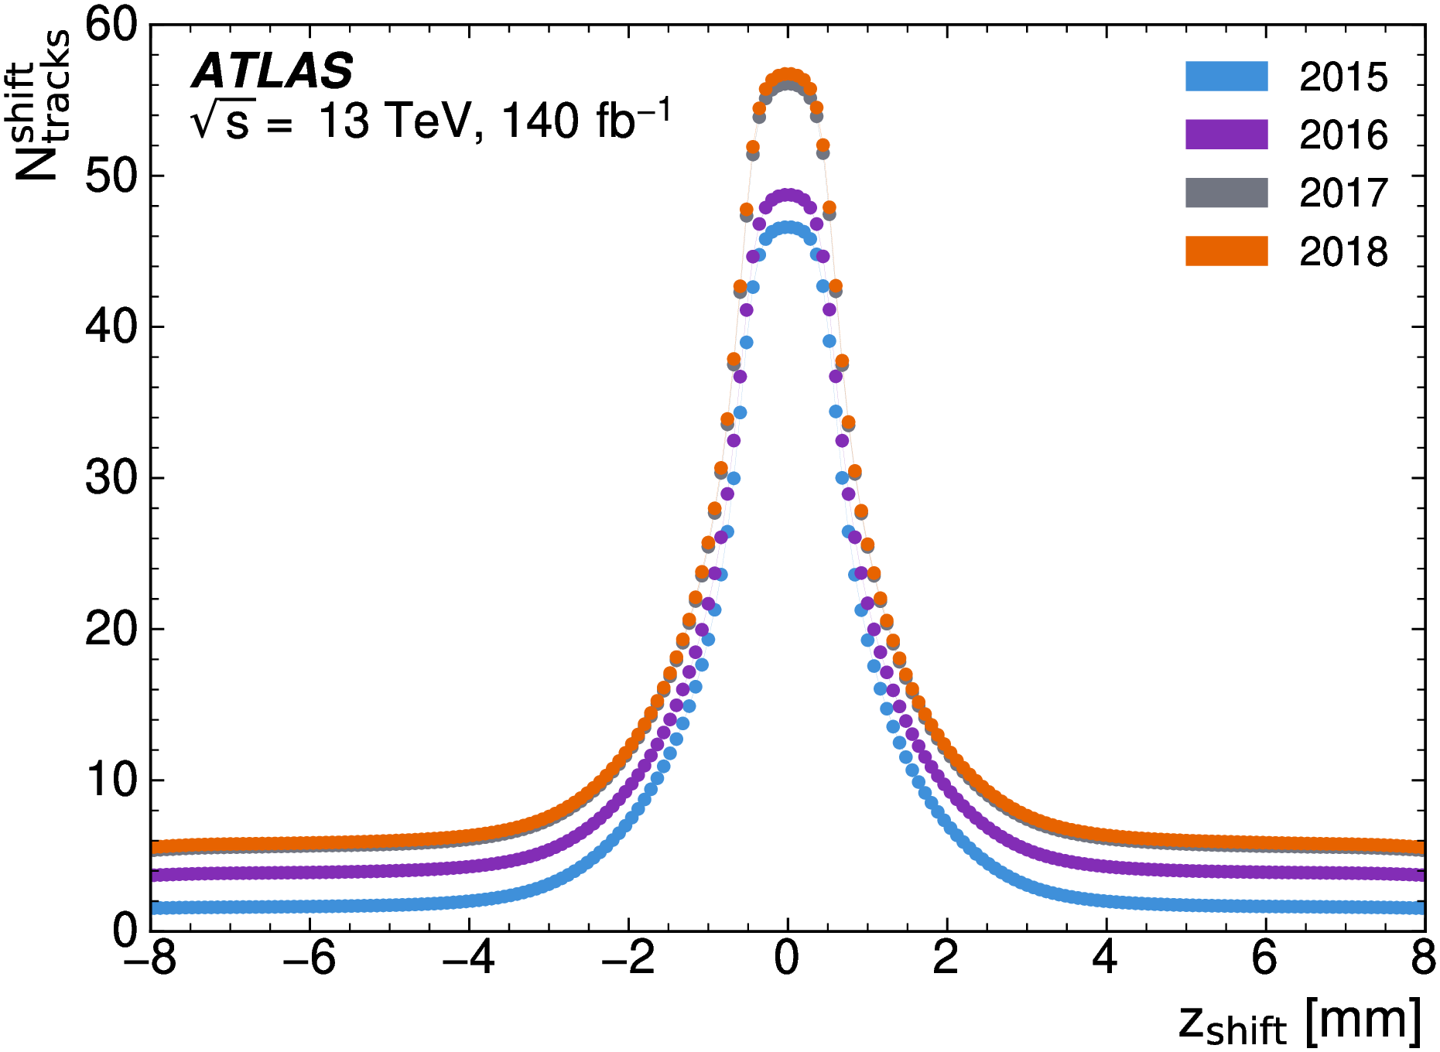
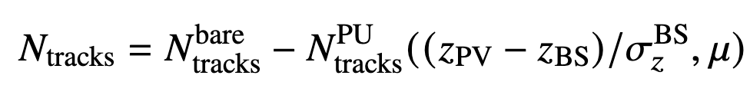
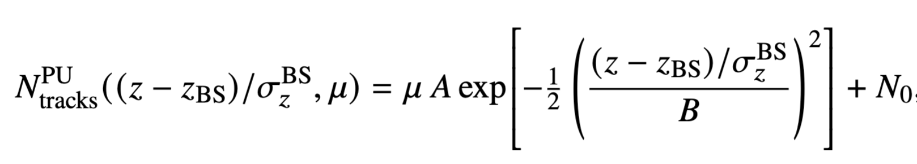
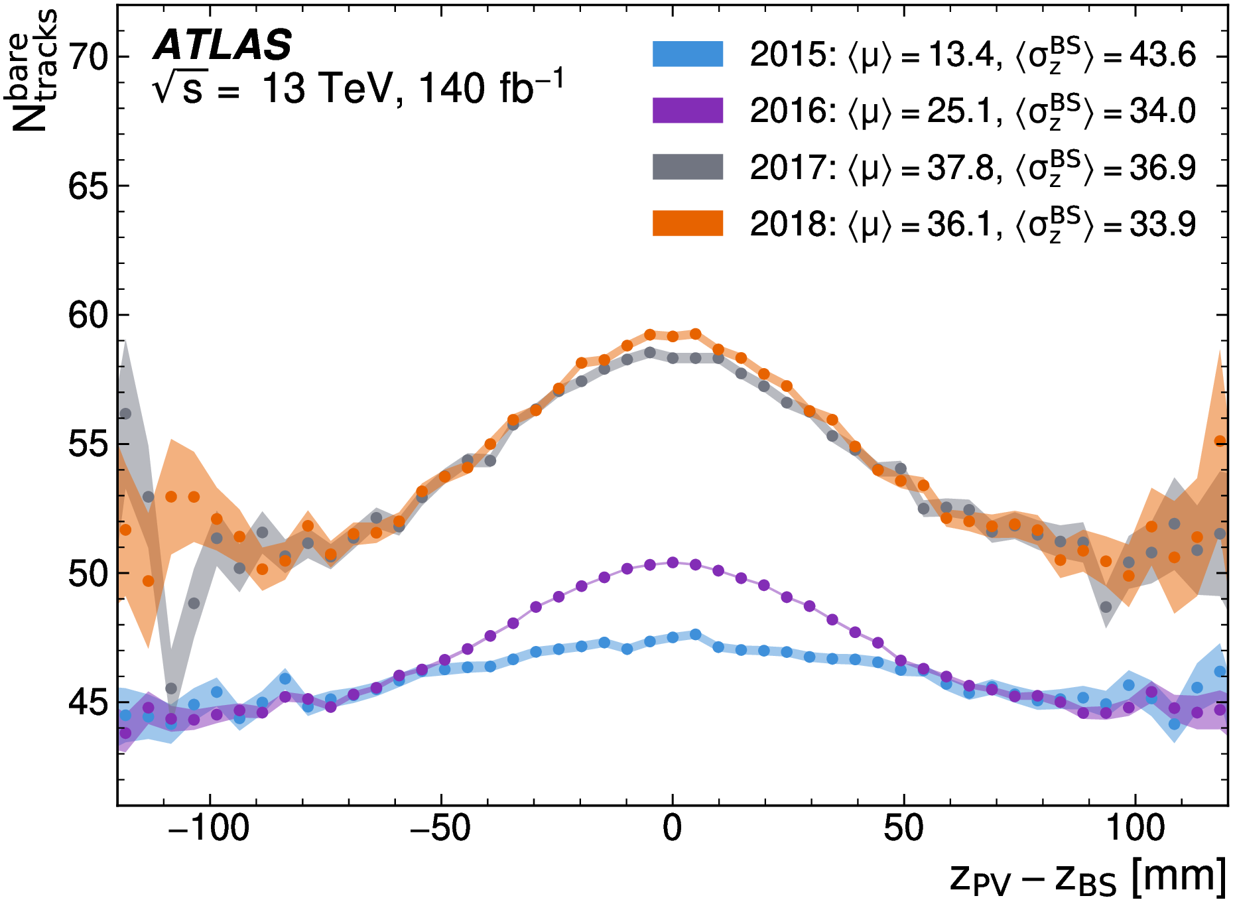
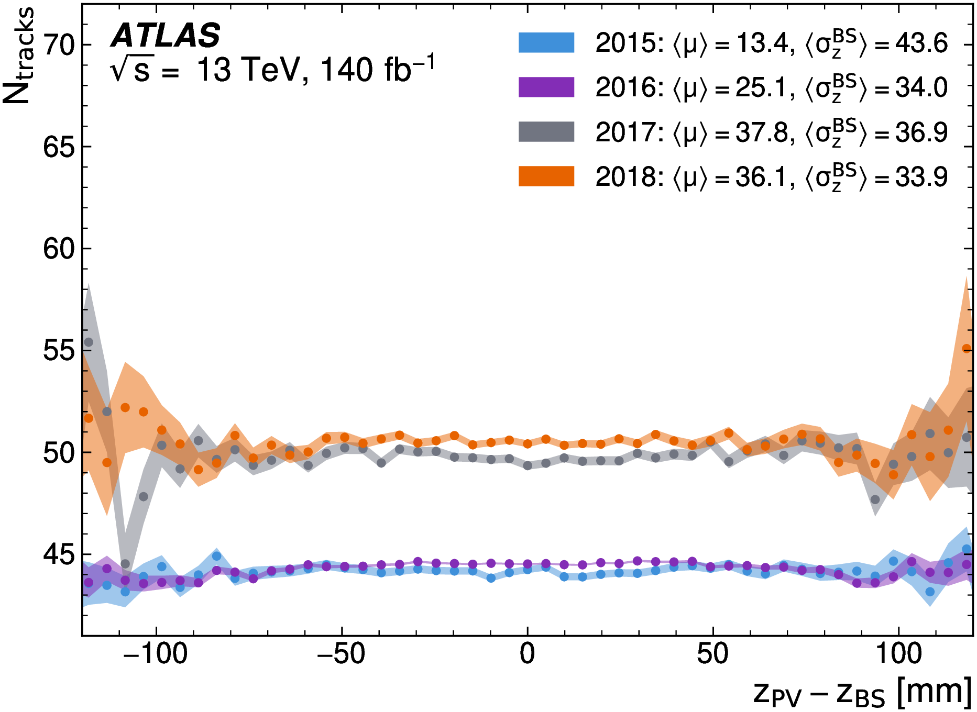
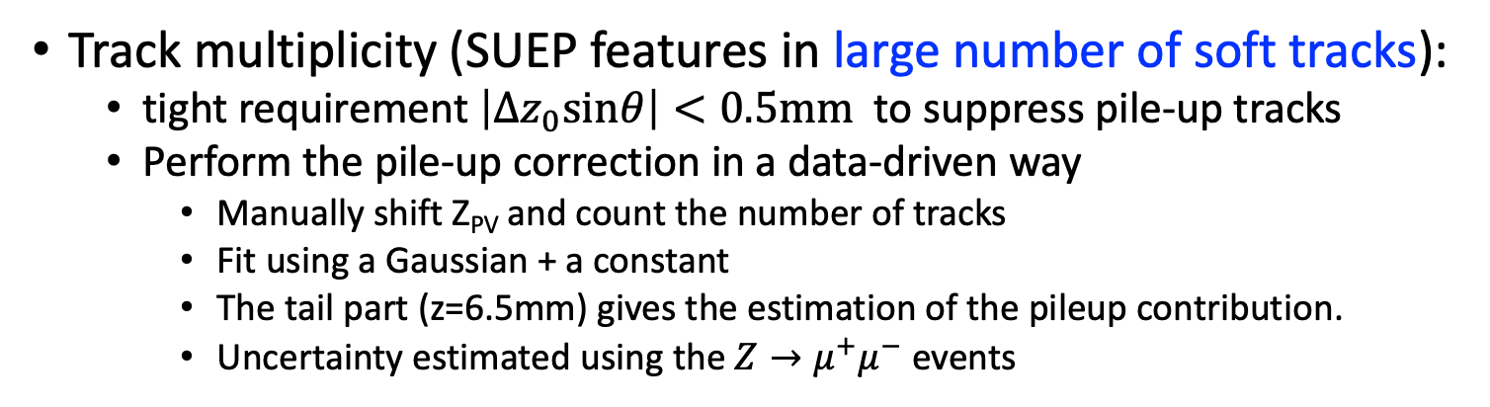
Two powerful observables (2)
Track multiplicity (SUEP features in large number of soft tracks):
  tight requirement $\left|Δz_{0}sinθ\right|<0.5mm$to suppress pile-up tracks
  Perform the pile-up correction in a data-driven way
    Manually shift Z_{PV} and count the number of tracks
    Fit using a Gaussian + a constant
    The tail part (z=6.5mm) gives the estimation of the pileup contribution.
    Uncertainty estimated using the $Z→μ^{+}μ^{−}$ events
Primary Vertex
Pile-up
Beamspot
SUEP search in ATLAS, CLHCP 2026, Wuhan
8

Slide 9
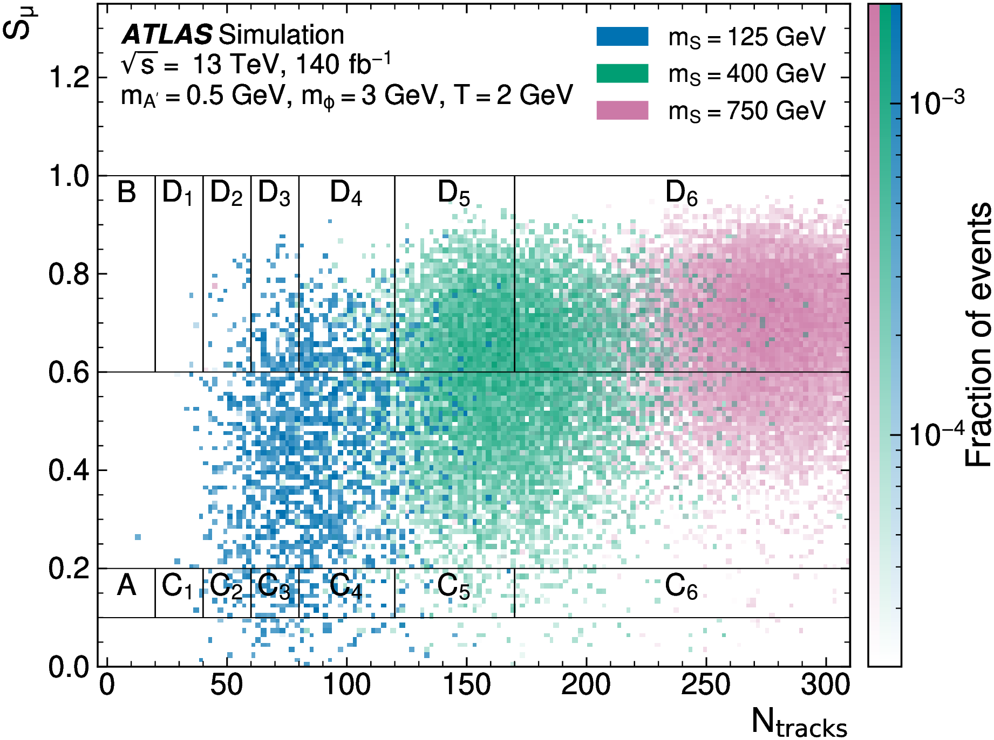
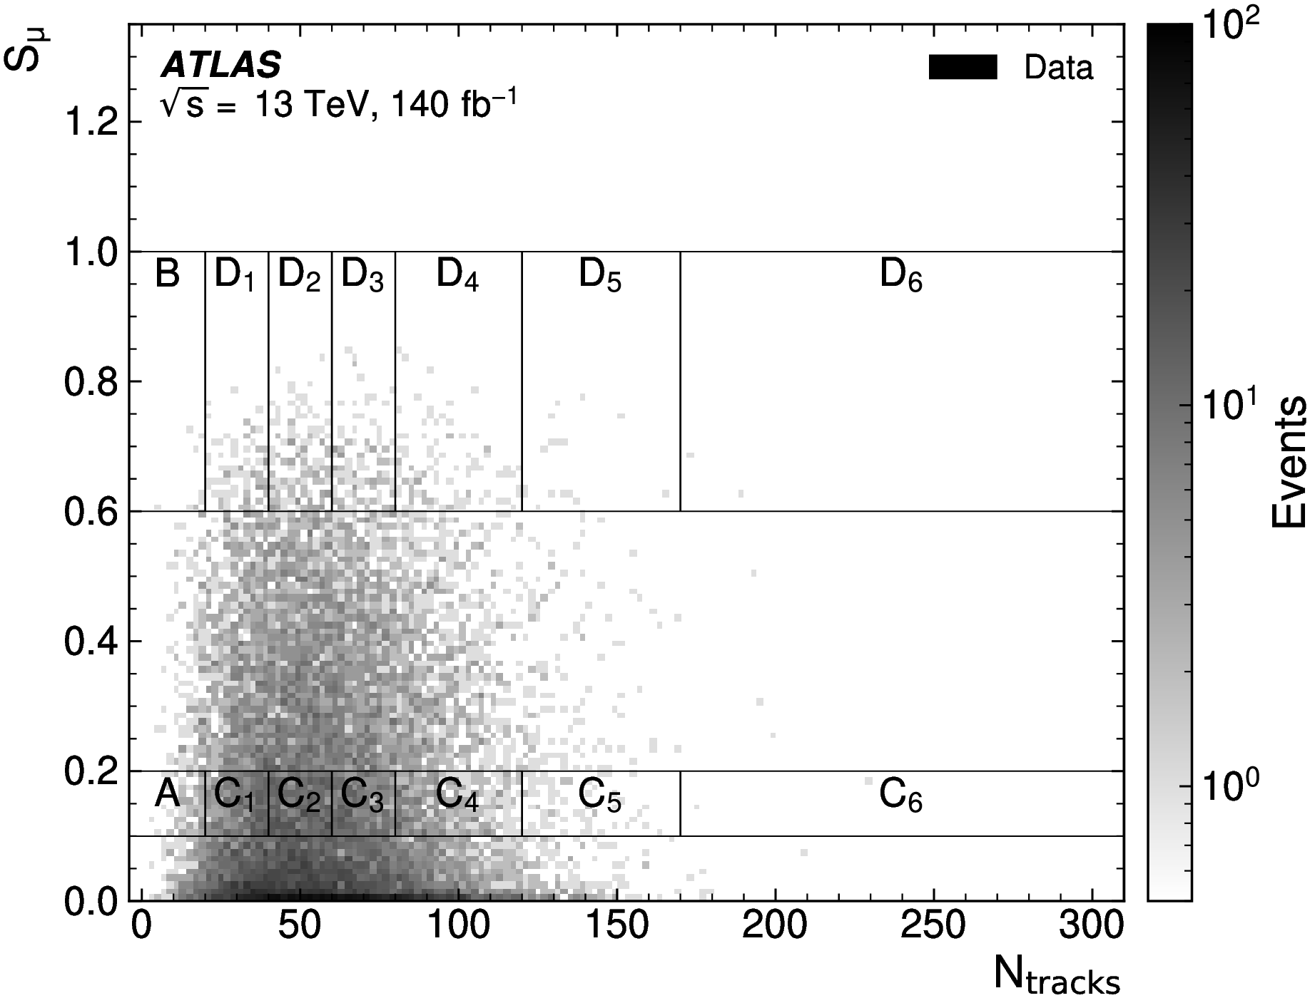
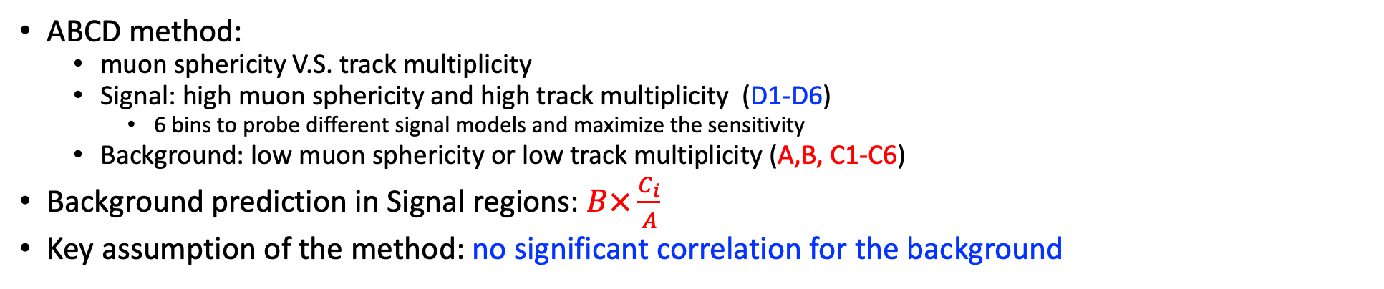
Background modeling strategy
ABCD method:
  muon sphericity V.S. track multiplicity
  Signal: high muon sphericity and high track multiplicity (D1-D6)
    6 bins to probe different signal models and maximize the sensitivity
  Background: low muon sphericity or low track multiplicity (A,B, C1-C6)
Background prediction in Signal regions: $B×\frac{C_{i}}{A}$
Key assumption of the method: no significant correlation for the background
Signal MC
Data
SUEP search in ATLAS, CLHCP 2026, Wuhan
9

Slide 10
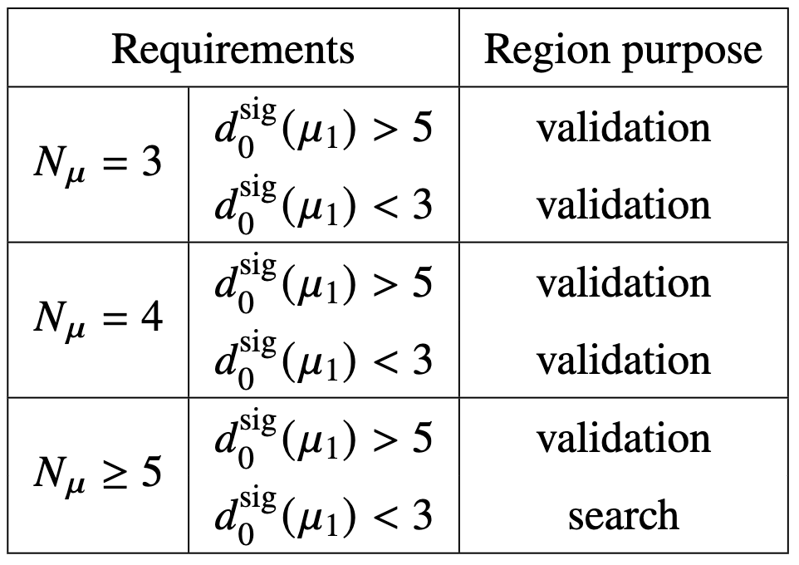
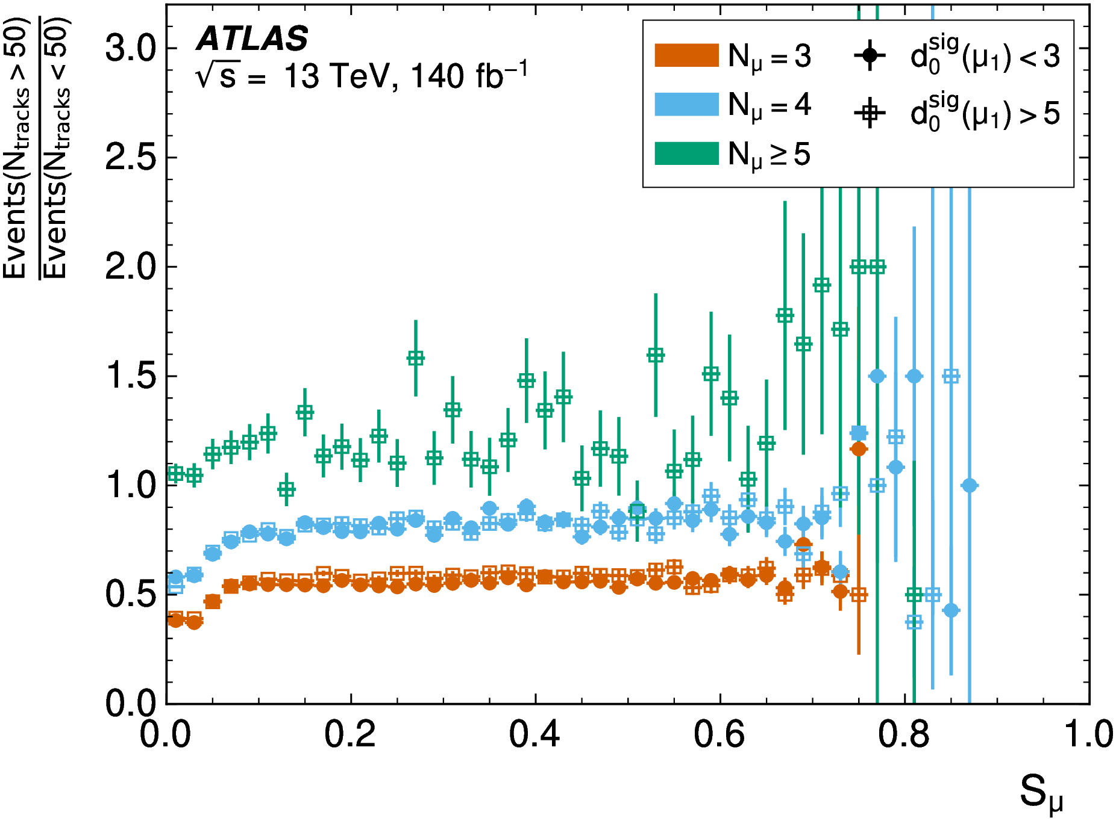
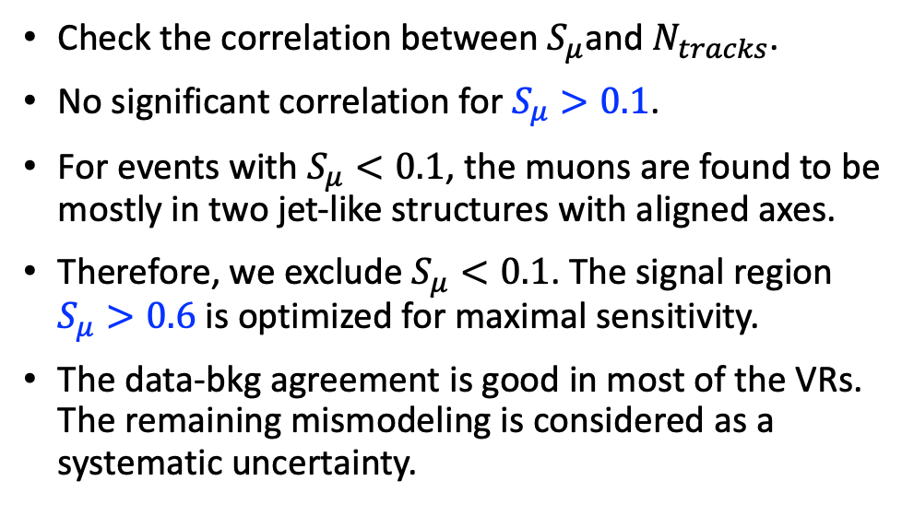
Background modeling in the validation regions
Check the correlation between $S_{μ}$and $N_{tracks}$.
No significant correlation for $S_{μ}>0.1$.
For events with $S_{μ}<0.1$, the muons are found to be mostly in two jet-like structures with aligned axes.
Therefore, we exclude $S_{μ}<0.1$. The signal region $S_{μ}>0.6$ is optimized for maximal sensitivity.
The data-bkg agreement is good in most of the VRs. The remaining mismodeling is considered as a systematic uncertainty.
SUEP search in ATLAS, CLHCP 2026, Wuhan
10

Slide 11
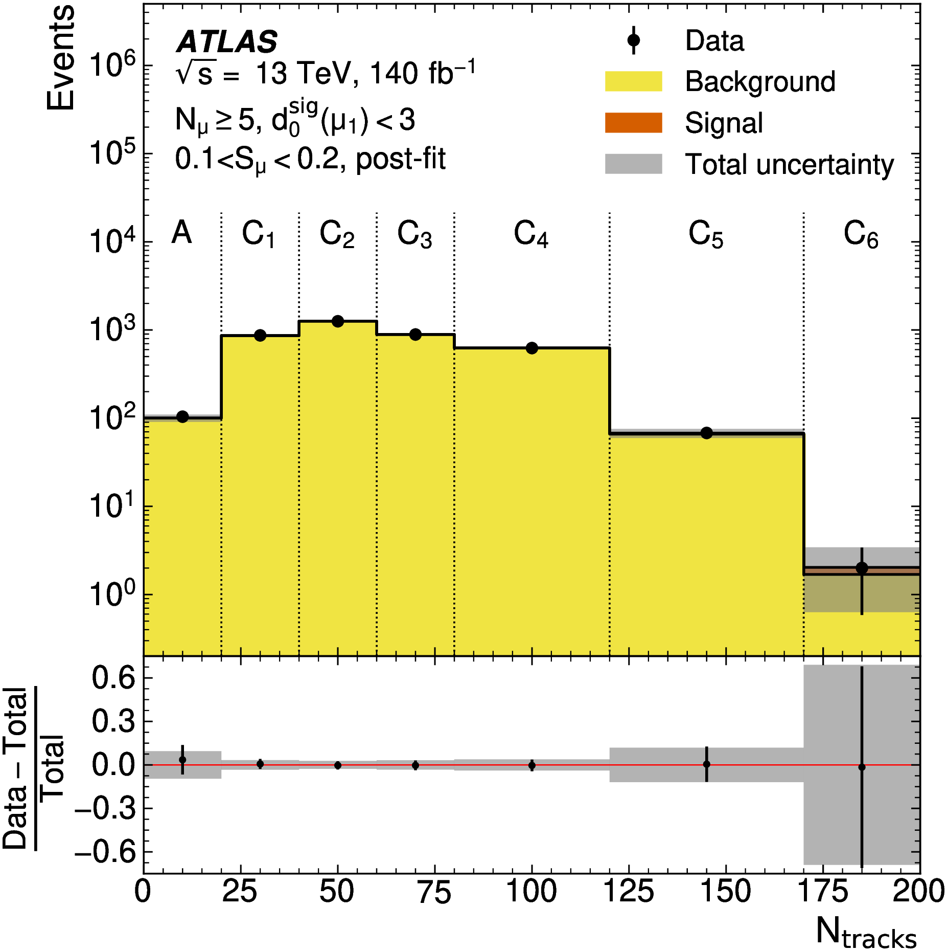
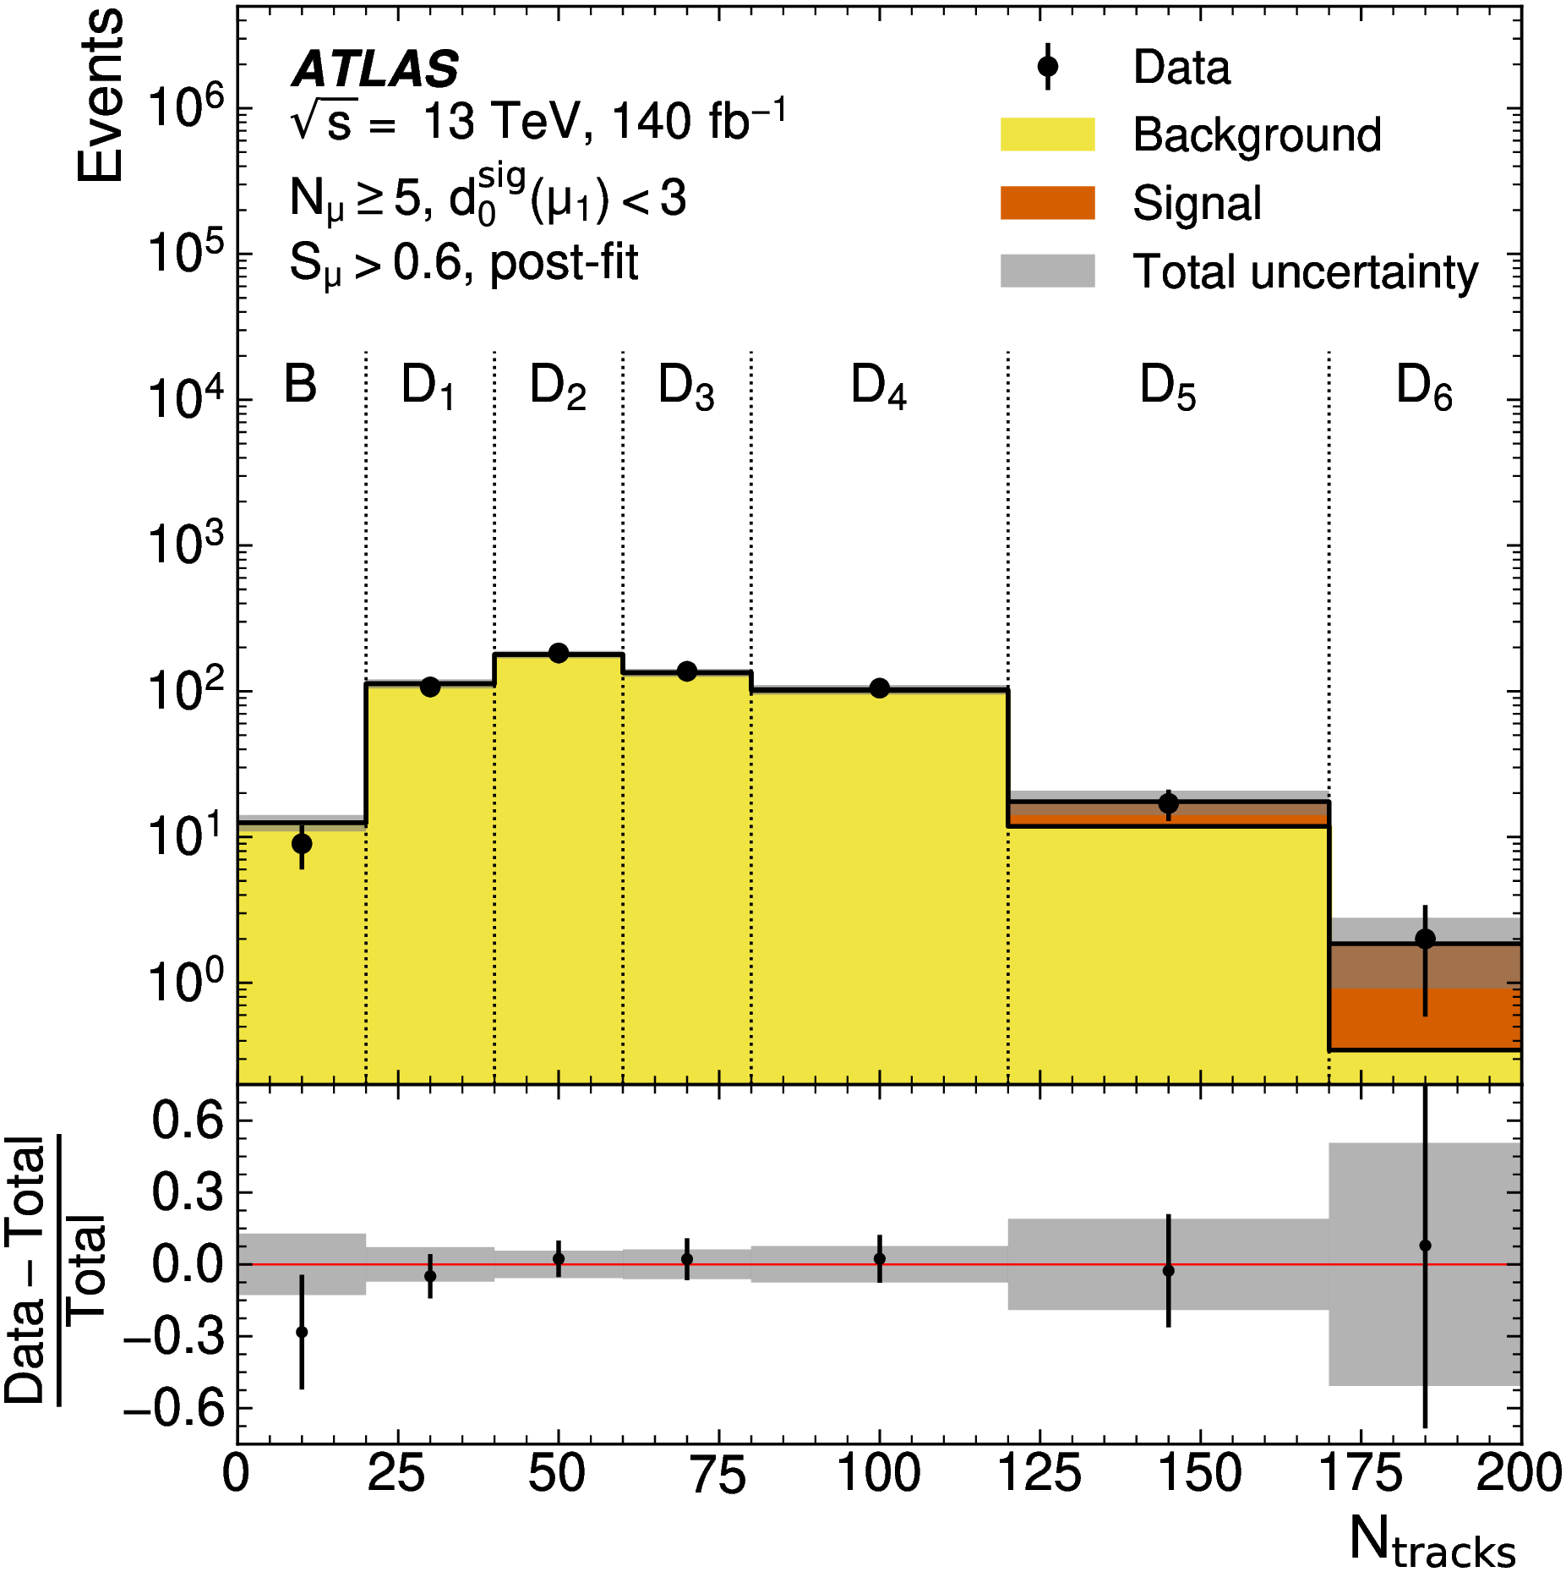
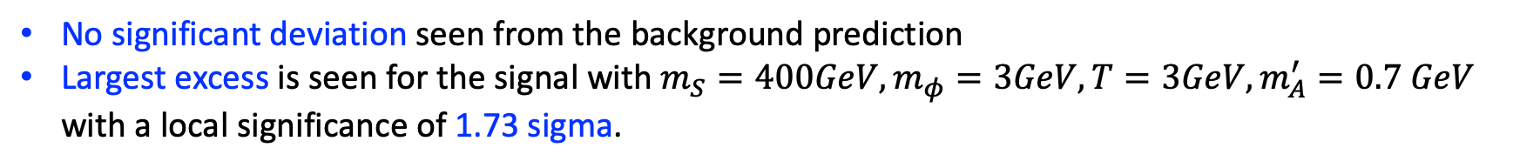
Statistical analysis in the signal regions
No significant deviation seen from the background prediction
Largest excess is seen for the signal with $m_{S}=400GeV, m_{φ}=3GeV, T=3GeV,m_{A}^{′}=0.7 GeV$ with a local significance of 1.73 sigma.
1.73 sigma
SUEP search in ATLAS, CLHCP 2026, Wuhan
11

Slide 12
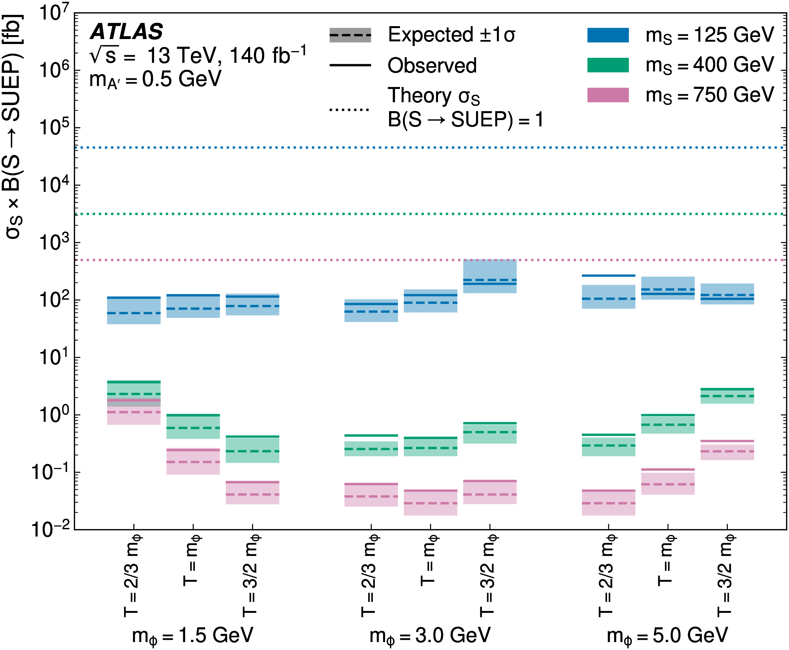
Upper limits
Lephad (mA’=0.5GeV)
Limits are provided on the production cross section at 95% Confidence Level (assuming 100% branching fraction of the mediator going to SUEP) .
  0.05 fb for 750 GeV
  0.4 fb for 400 GeV
  70 fb for 125 GeV (corresponding to B(H->SUEP)~0.2%)
SUEP search in ATLAS, CLHCP 2026, Wuhan
12

Slide 13
Summary
Based on the Run2 data (2015-2018), the SUEPs are searched with the multi-muon final state.
It is complementary to CMS searches with hadronic final state.
No significant excess over the background is observed. Stringent upper limits on the SUEP production cross section are provided.
Assuming the 125GeV mediator to be the Higgs, BR(H→SUEP) is ~0.2%.
Stay tuned for more wonderful results on dark QCD in the near future.
SUEP search in ATLAS, CLHCP 2026, Wuhan
13

Slide 14
BACK UP
SUEP search in ATLAS, LLP 2026, UK
14

Slide 15
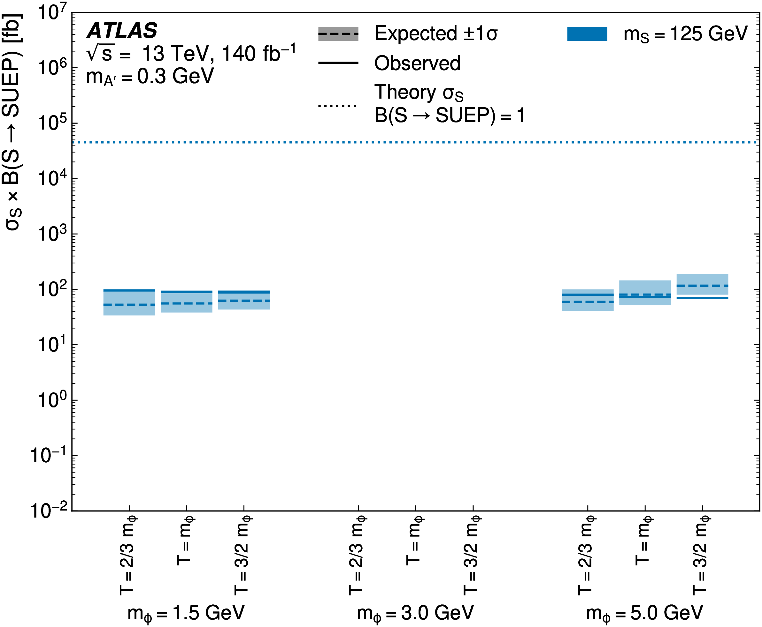
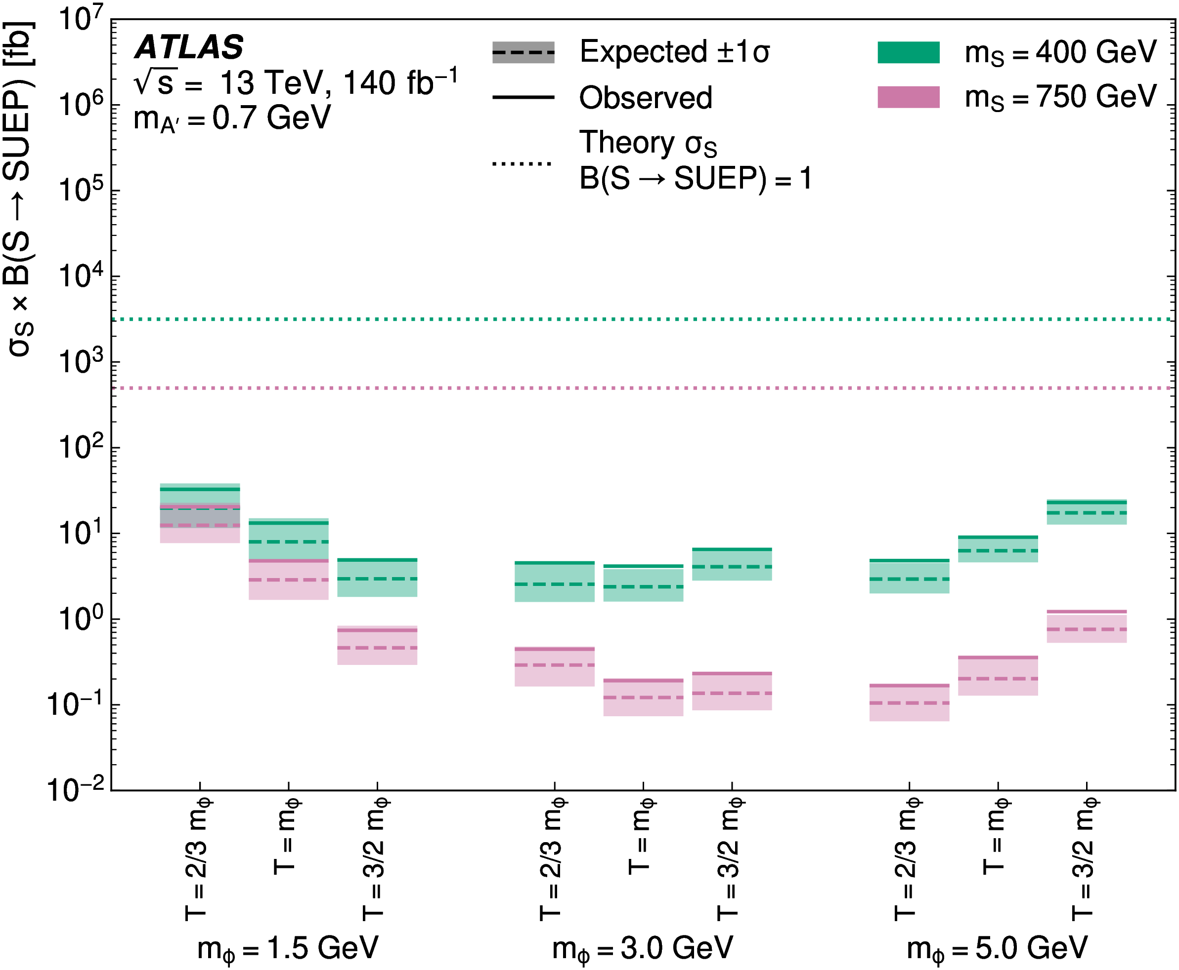
Limits for the leplep and hadhad mode
Leplep (mA’=0.3GeV)
Hadhad (mA’=0.7GeV)
SUEP search in ATLAS, LLP 2026, UK
15

Slide 16
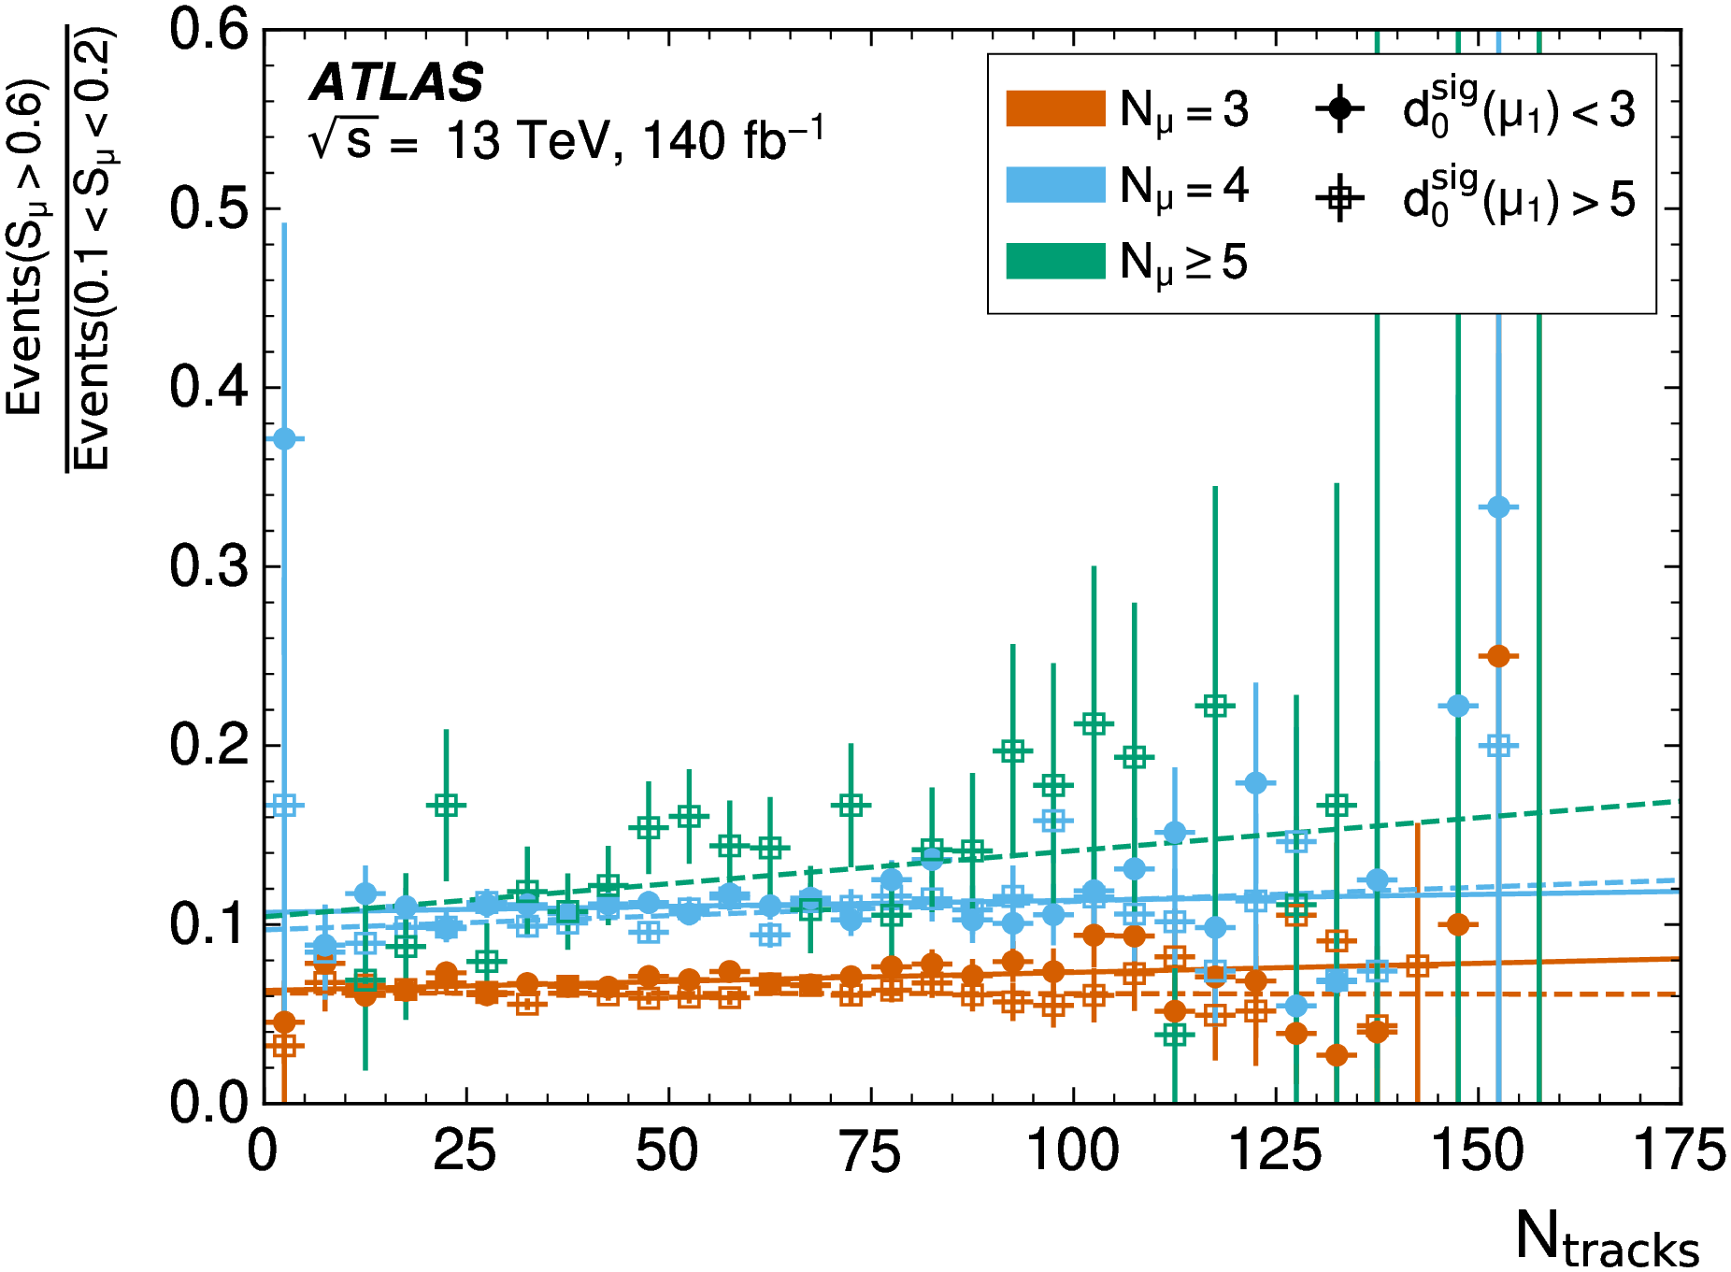
Background modeling in the validation regions
Check the correlation between $S_{μ}$and $N_{tracks}$.
Y axis: Ratio of Yield of $S_{μ}>0.6$to that of $S_{μ}<0.2$.
Small correlation is seen for $N_{μ}=3,4$ and seems bigger for $N_{μ}≥5.$
Based on the largest slope in the validation, a dedicated systematic uncertainty is included to account for the correlation (see next slide).
SUEP search in ATLAS, LLP 2026, UK
16

Slide 17
Systematic uncertainties
Luminosity uncertainty
ID Track reconstruction:
  CP recommendation
  1% -5% depending on the signal models mainly due to
Muon reconstruction:
  CP recommendation
  0.5% - 5% depending on the signal models mainly due to reconstruction efficiency
Trigger efficiency uncertainty:
  0.1% - 4% depending on the signal models
Pileup uncertainties:
  Pileup reweighting uncertainty: 1-3% on Ntracks
  Pileup track correction(comparing a shift at 6.5, -6.5 and 7 mm): 0.5% on Ntracks
SUEP search in ATLAS, LLP 2026, UK
17

Slide 18
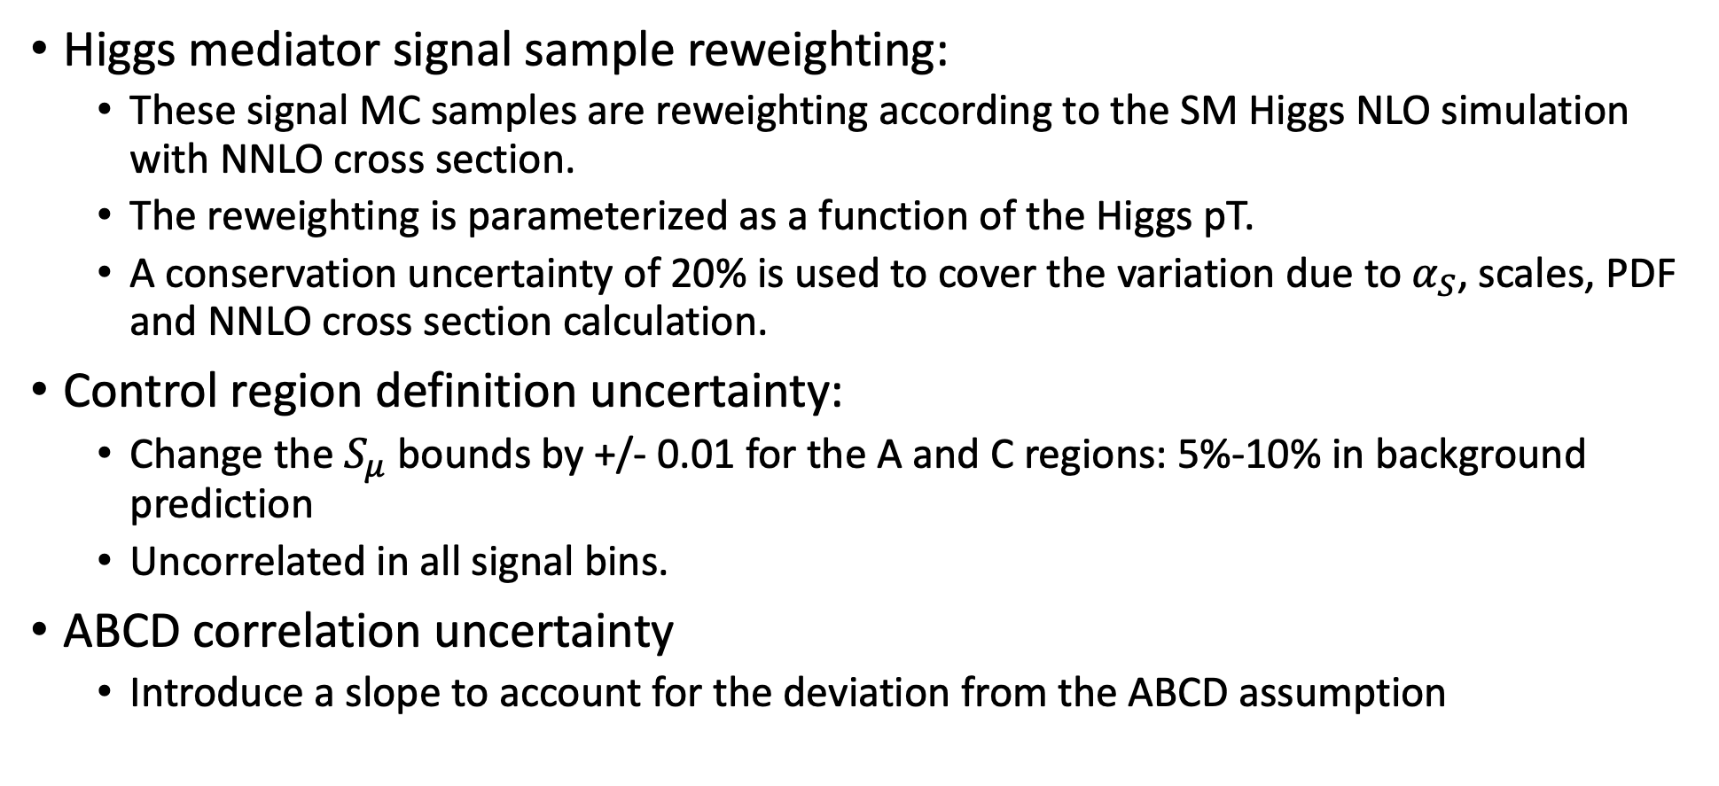
Systematic uncertainties
Higgs mediator signal sample reweighting:
  These signal MC samples are reweighting according to the SM Higgs NLO simulation with NNLO cross section.
  The reweighting is parameterized as a function of the Higgs pT.
  A conservation uncertainty of 20% is used to cover the variation due to $α_{S}$, scales, PDF and NNLO cross section calculation.
Control region definition uncertainty:
  Change the $S_{μ}$ bounds by +/- 0.01 for the A and C regions: 5%-10% in background prediction
  Uncorrelated in all signal bins.
ABCD correlation uncertainty
  Introduce a slope to account for the deviation from the ABCD assumption
SUEP search in ATLAS, LLP 2026, UK
18

