Slide 1
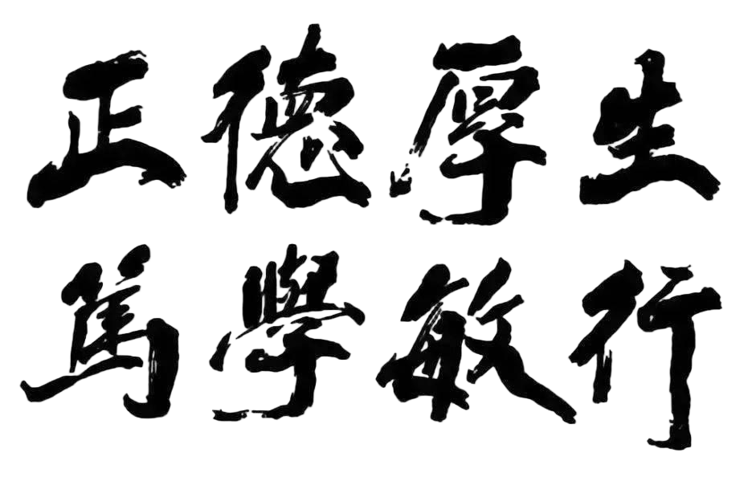
Predictions for CP violation in anti-triplet beauty baryon
to charmonium decays
Zhi-Peng Xing
worked with Jin Sun and Xiao-Gang He
2026-10-30
CLHCP2026

Slide 2
Introduction
SU(3) aymmetry analysis and its breaking
Numerical results and predictions
Conclusion

Slide 3
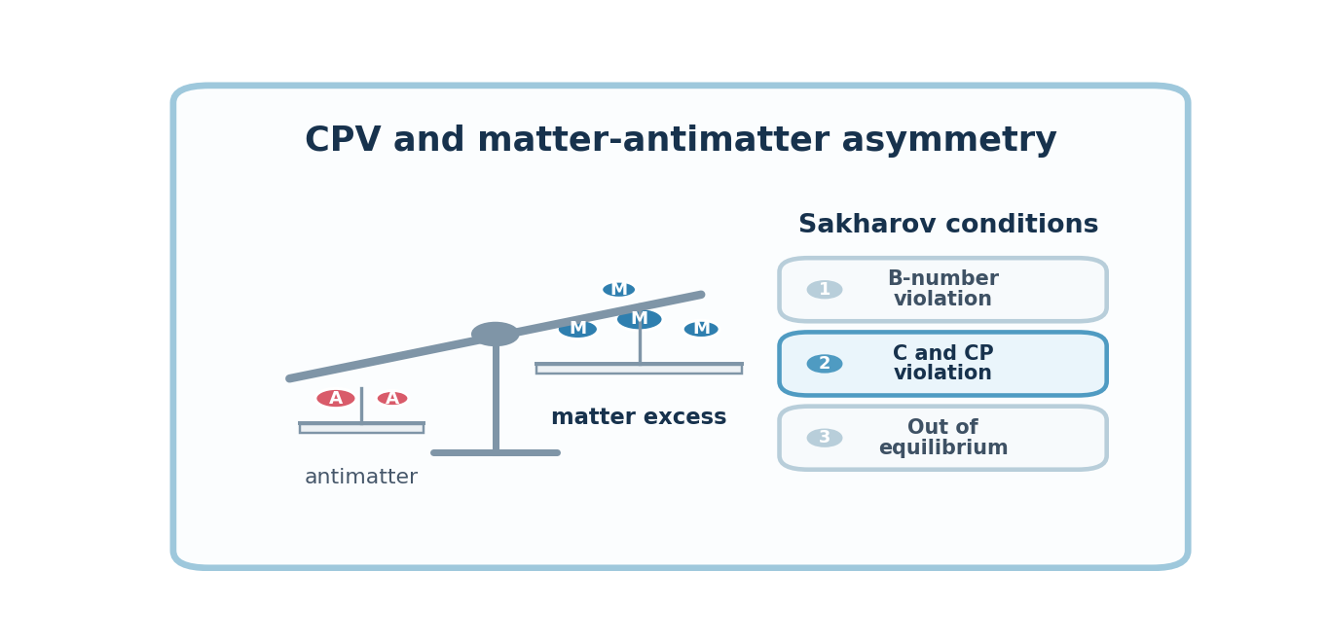
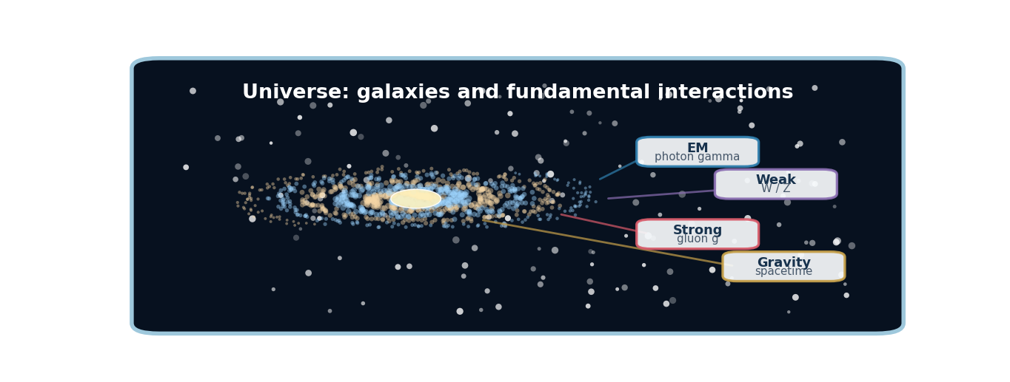
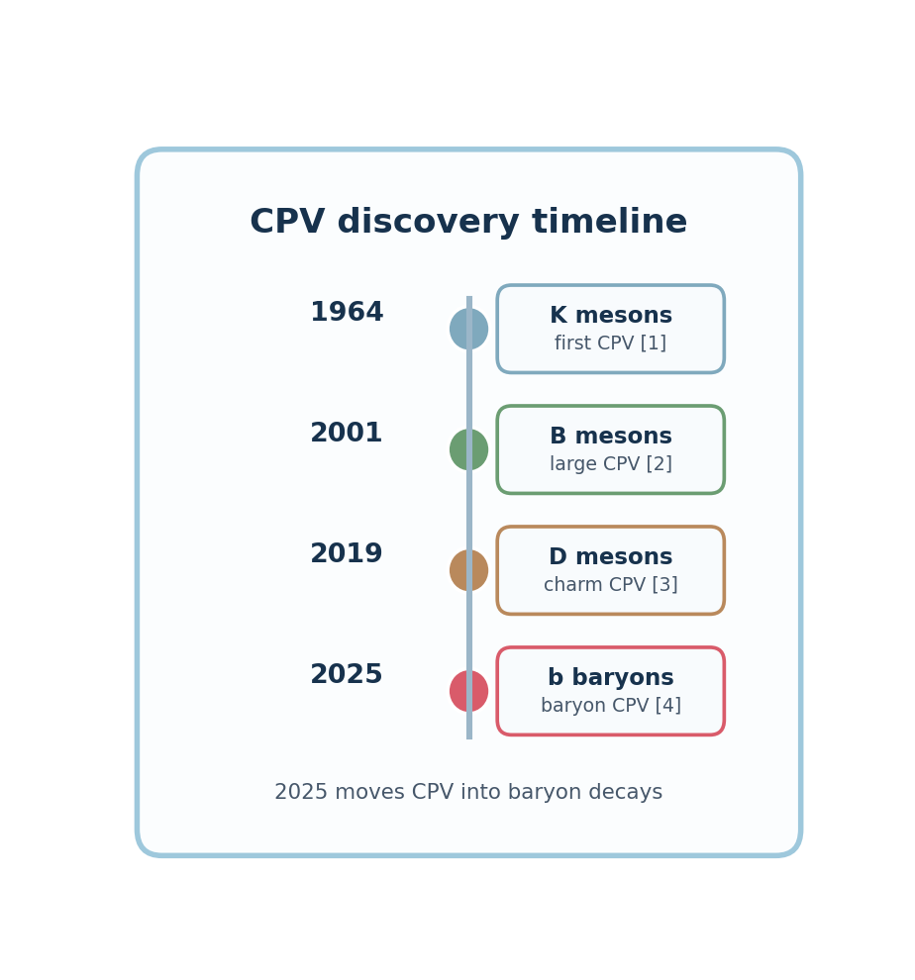
Introduction
CP violation is directly connected to the matter-antimatter asymmetry of the Universe.
The observed matter-rich Universe therefore motivates precision studies of CPV.
1.
LHCb: pp collisions; large B/D/b-baryon yields and excellent vertexing.
2.
Belle II: clean e+e- flavor factory; strong for neutrals and missing-energy modes.
3.
BESIII: threshold e+e- data; clean hyperon/charm-baryon spin analyses.
4.
New-physics CPV: EDM and long-baseline neutrino experiments probe sources beyond CKM.

Slide 4
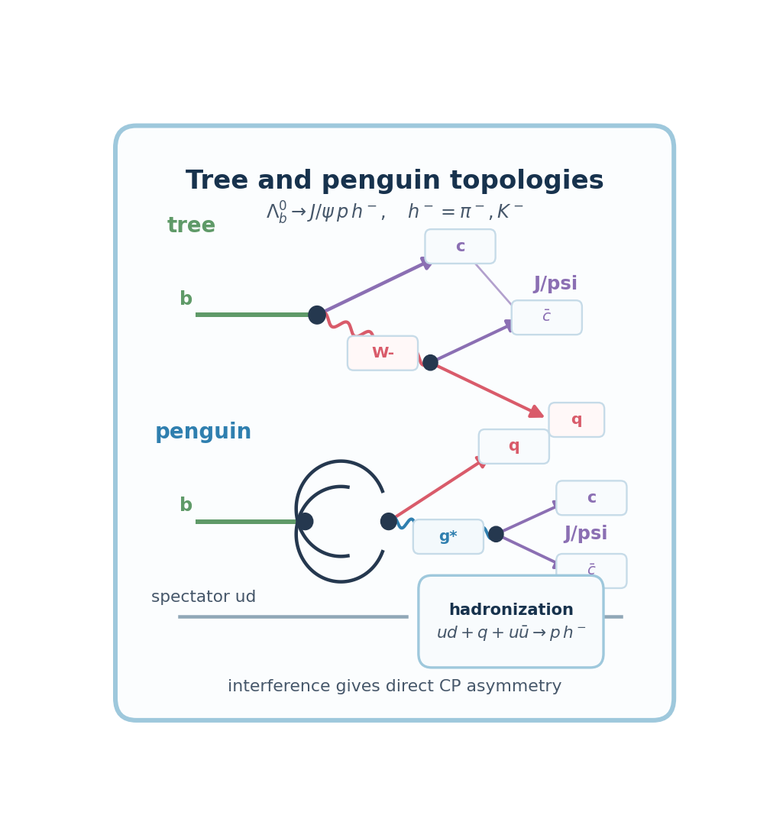
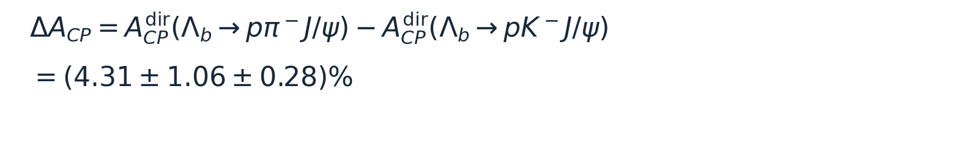
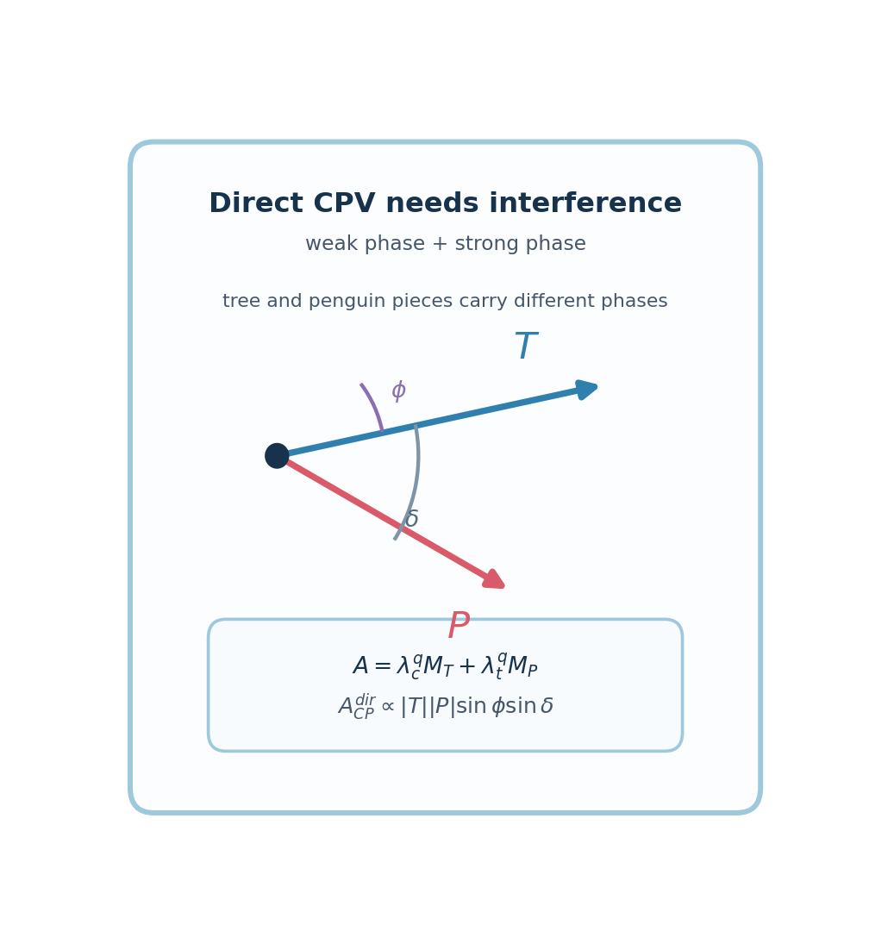
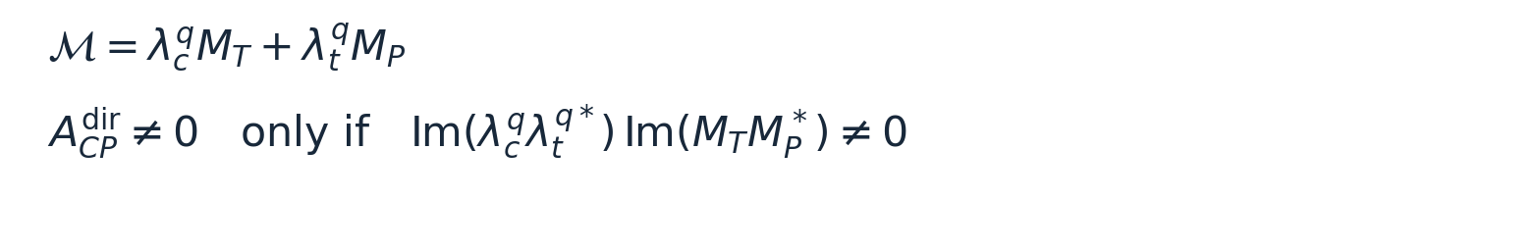
Introduction
1.
LHCb reports evidence for CP violation in beauty-baryon decays to charmonium final states.
2.
The theory question is how to explain the CPV observed in experiment and predict more CPV channels.
Direct CP violation requires interference between amplitudes with different weak and strong phases.
In these decays, tree and penguin contributions carry different weak phase and hadronic phases.
The strong phases are hard to calculate from first principles, so a symmetry strategy is useful.

Slide 5
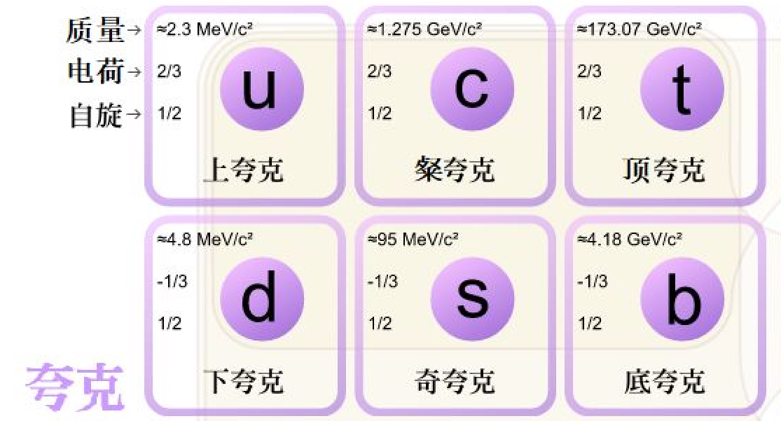
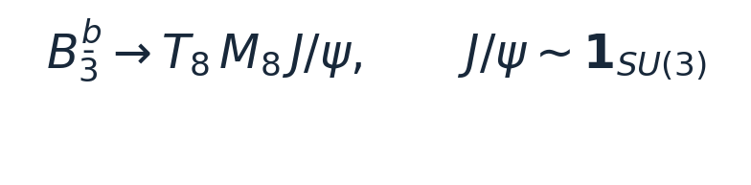
Introduction
1.
We uses flavor SU(3) to relate anti-triplet beauty baryons, light baryon octet states, and pseudoscalar mesons.
Weak interaction
2.
Because J/psi is an SU(3) singlet, the amplitude basis becomes compact enough to generate transparent relations.
3.
Under the symmetry of SU(3) flavor the iospin and uspin can be both considered.
The symmetry between u and (d,s) will change the structure of Hamiltonian
The symmetry transformation of U-spin will not affect the generation mechanism of CPV: the weak phase difference between tree level and penguin level.

Slide 6
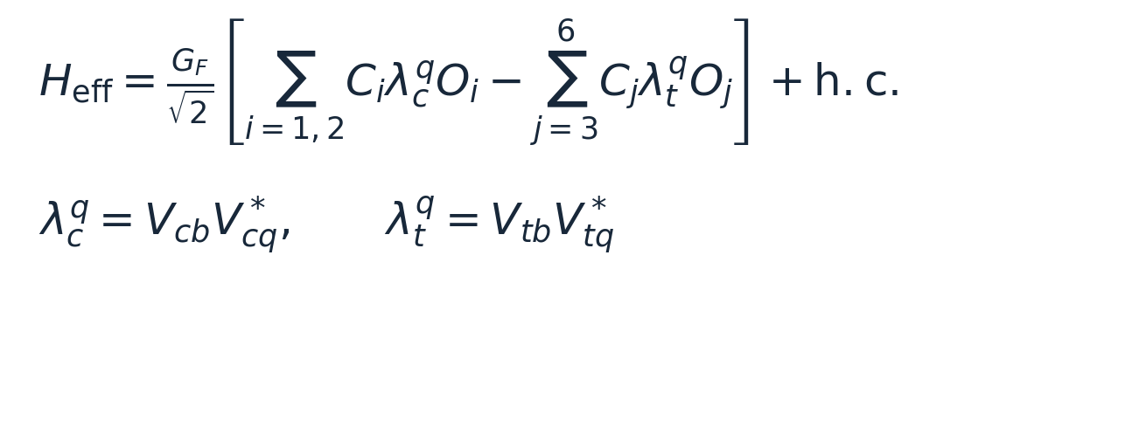
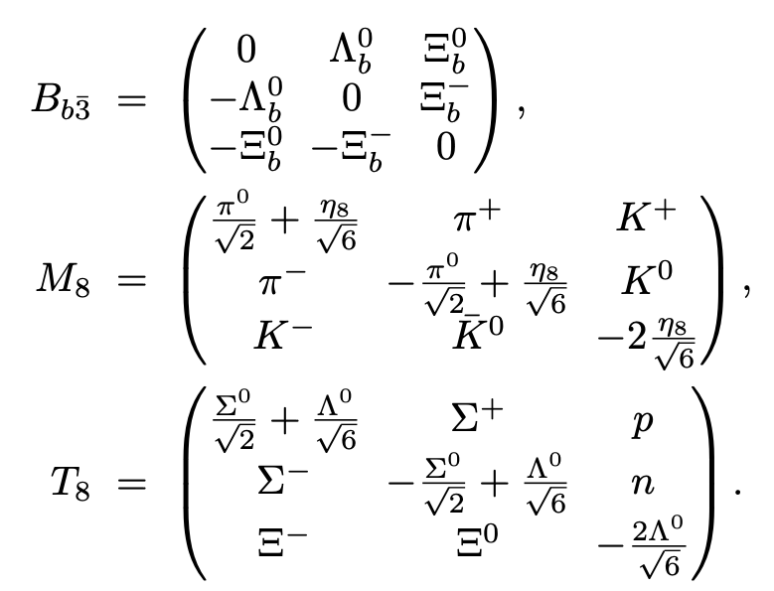
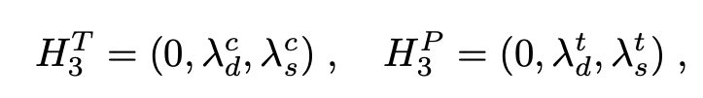
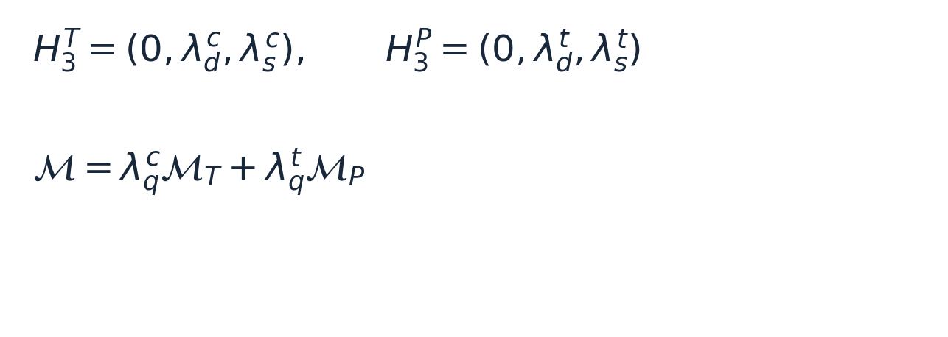
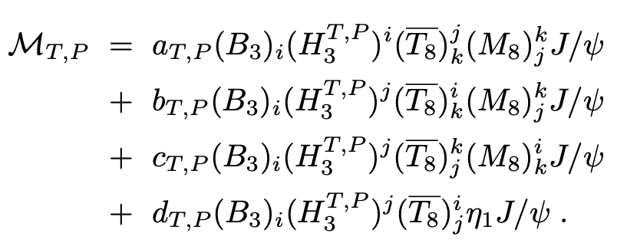
SU(3) aymmetry analysis and its breaking

Slide 7
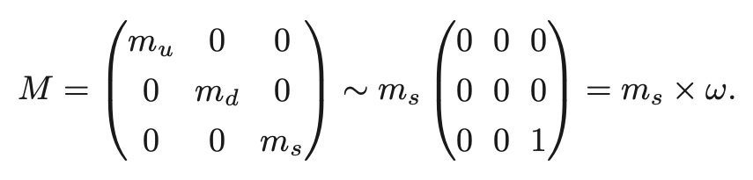


SU(3) aymmetry analysis and its breaking
The mass term of Hamiltonian can be divide into symmetry and breaking term.
We can seem that the symmetry term is mass term and breaking term in interaction term.
mass interaction
The M can be inserted into the quark lines connecting initial and final hadrons .
The M can be inserted into the quark lines connect the effective Hamiltonian directly to a hadron.
M in which a quark-antiquark pair must emerge from the vacuum, originating either from the quark condensate or from gluon emission.
1/2. This insertion corresponds to modifications of quark propagators, effects that have already been partly accounted in hadron masses and phase space factors.
3. quark condensate and quark-antiquark pair which emerge from the vacuum contain mainly contribution
~0.5

Slide 8
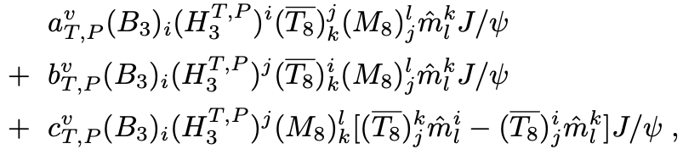
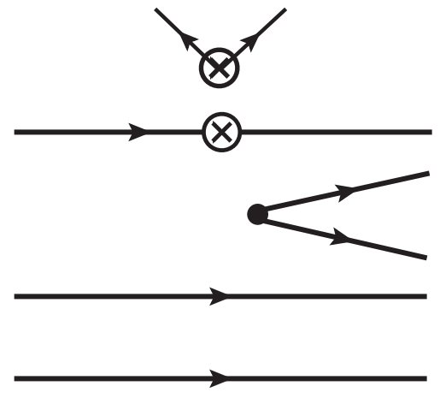
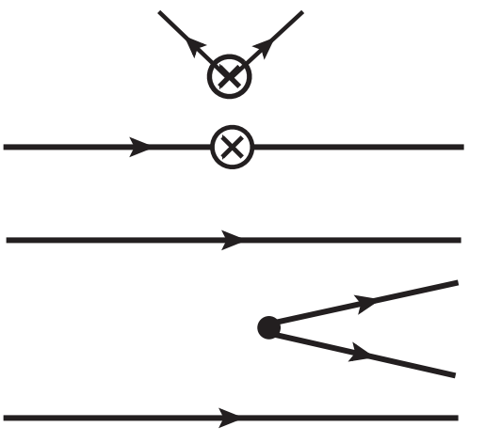
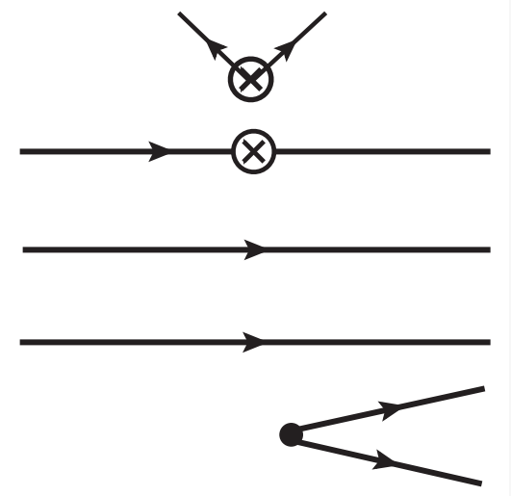
SU(3) aymmetry analysis and its breaking
OZI-suppressed

Slide 9
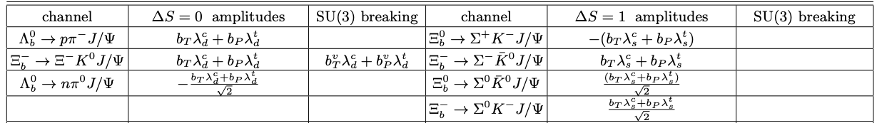
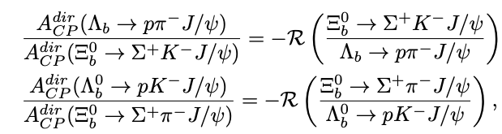
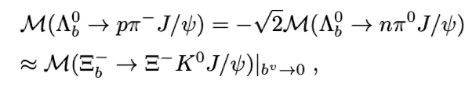

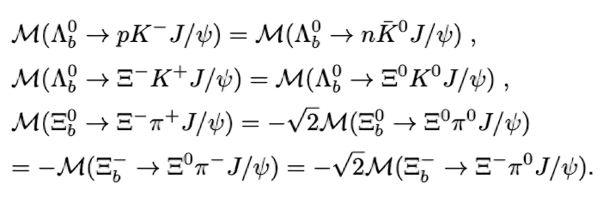

SU(3) aymmetry analysis and its breaking
iospin
U-spin
CP violation relation from u-spin
After expanding the amplitude，we can derive the SU(3) relations

Slide 10
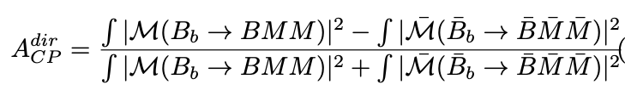

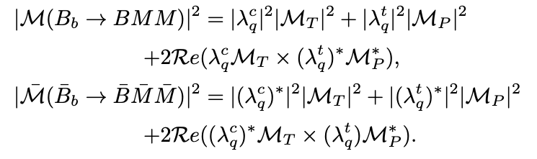
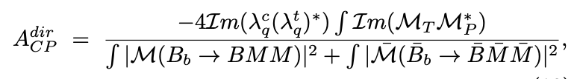

SU(3) symmetry analysis and its breaking
CPV in U-spin symmetry processes

Slide 11
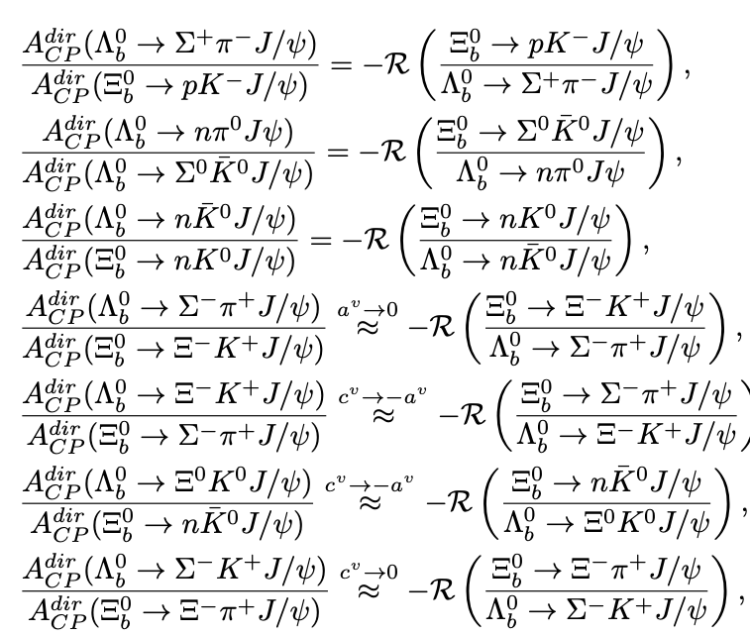
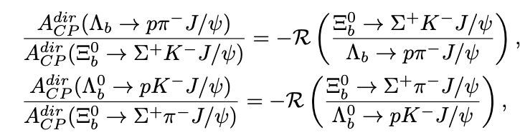

SU(3) aymmetry analysis and its breaking
For example
=
U-spin

Slide 12
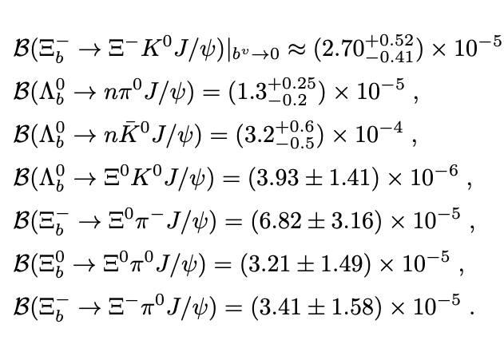
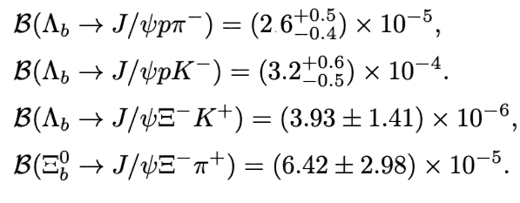


Numerical results and predictions
Several decay branching ratios have already been measured
Symmetry breaking
～

Slide 13
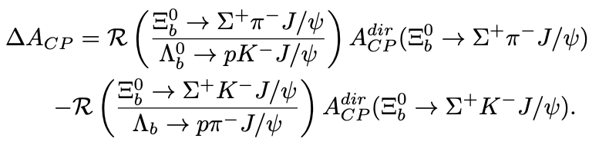
Numerical results and predictions
CPV

Slide 14
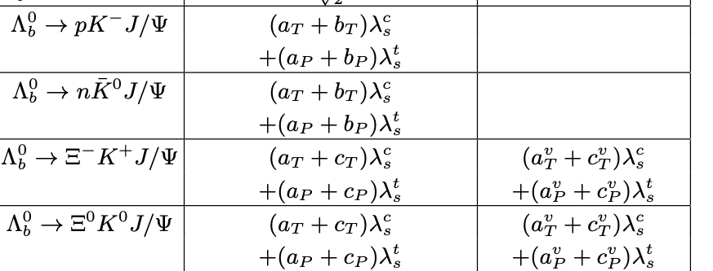
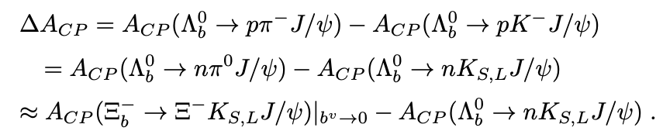
Numerical results and predictions
CPV
iospin

Slide 15
Conclusion
We gives a systematic flavor-SU(3) analysis of anti-triplet beauty-baryon decays to charmonium final states.
We construct the SU(3) symmetry breaking term from Hamiltonian
With the help of U-spin and Iospin relations we can predict the Br and CPV

