Slide 1


ATLAS ITk Strip Project Status Report
Xiyuan Zhang
Institute of High Energy Physics, CAS

Slide 2
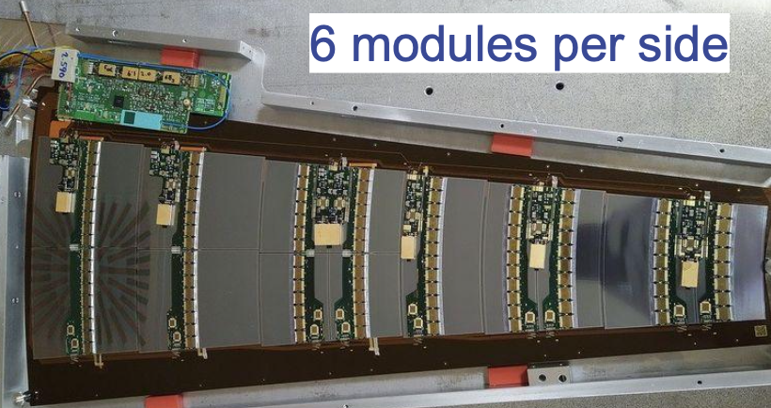
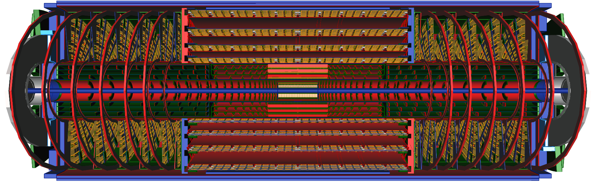
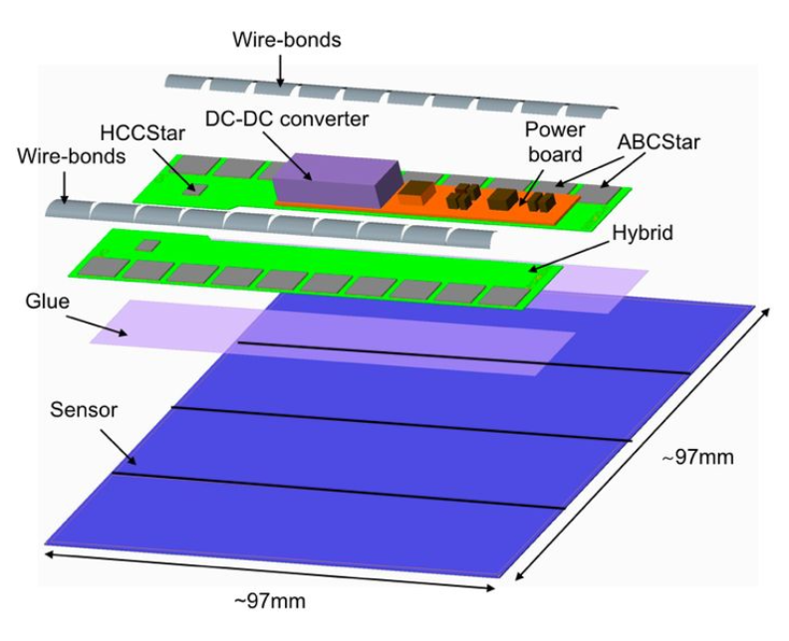
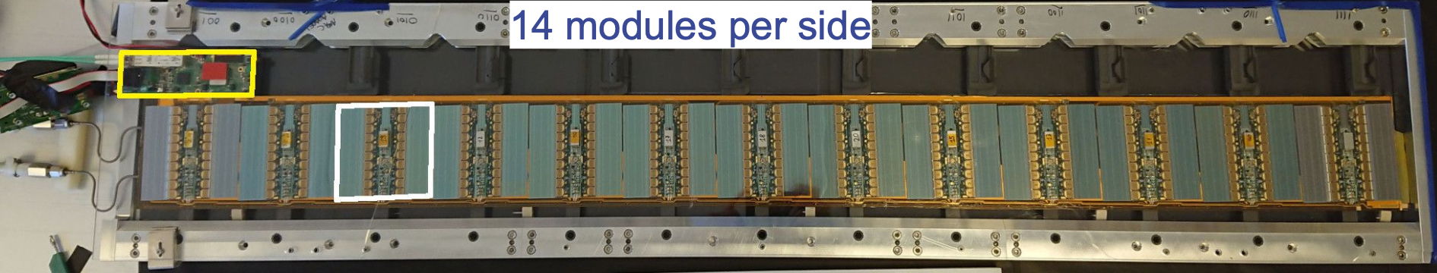
ITk strip detector
384 petals
in 2 endcaps
Barrel SS module
392 staves in barrel
8 different module geometries (2 for barrel, 6 for endcap)

Slide 3
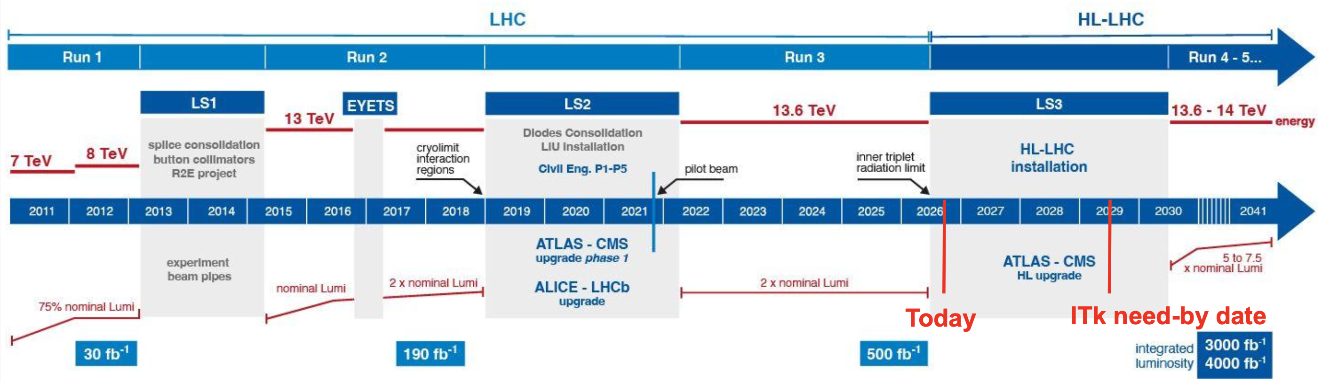
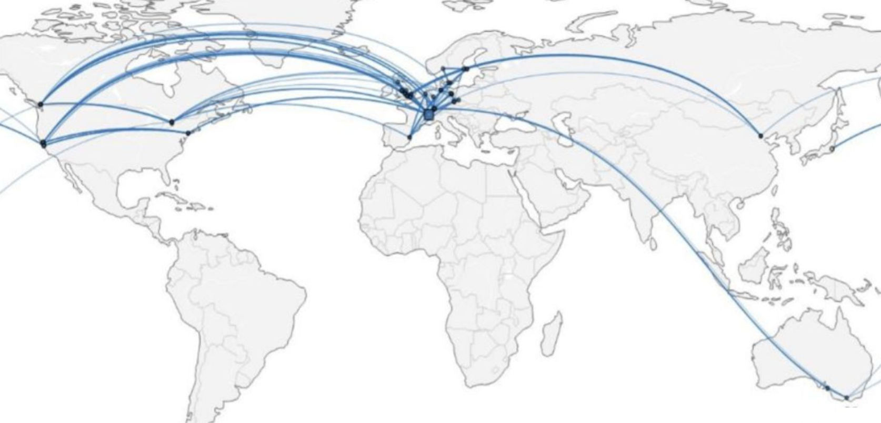
Production Timeline and Logistics
Energy and luminosity ramp up progressively
LS3 is the ITk installation window （2026～2030）
Production shared among ~60 institutes in 14 countries
Module production organised in 6 production clusters (2 Barrel, 4 Endcap)

Slide 4
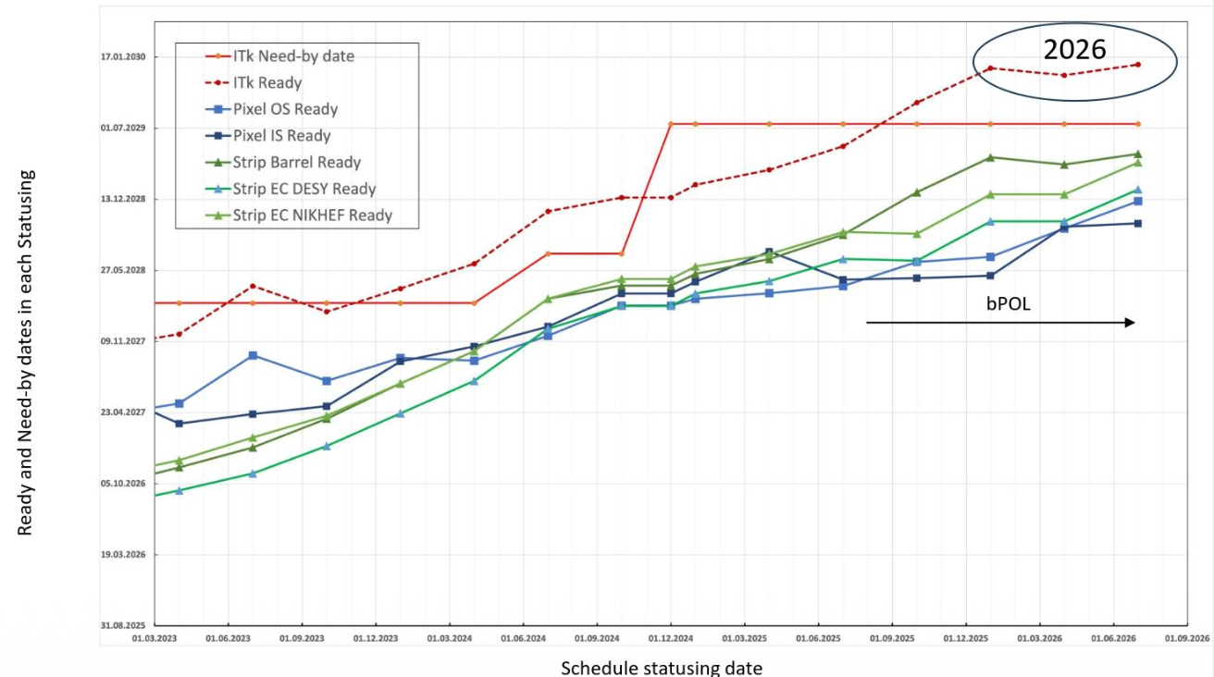
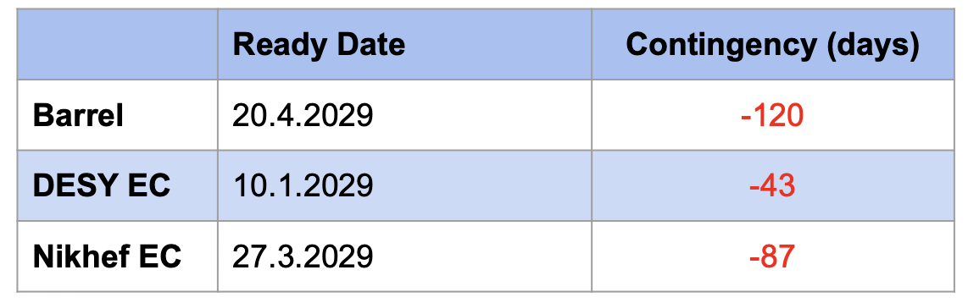
Production Overview
Productions ongoing and advancing steadily
Integration ongoing at different sites: CERN SR1 (barrel), DESY and Nikhef (endcap)
Installation phase has started: LS3 underground work: cables, crates, infrastructure
Addressing of technical issues
Last statusing (01.07.2026): increased negative float for ITk strips
Main drivers:
  bPOL
  endcap modules and barrel cores

Slide 5
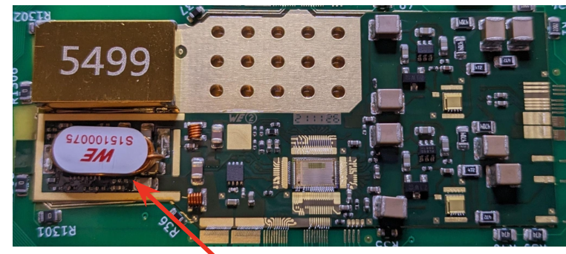
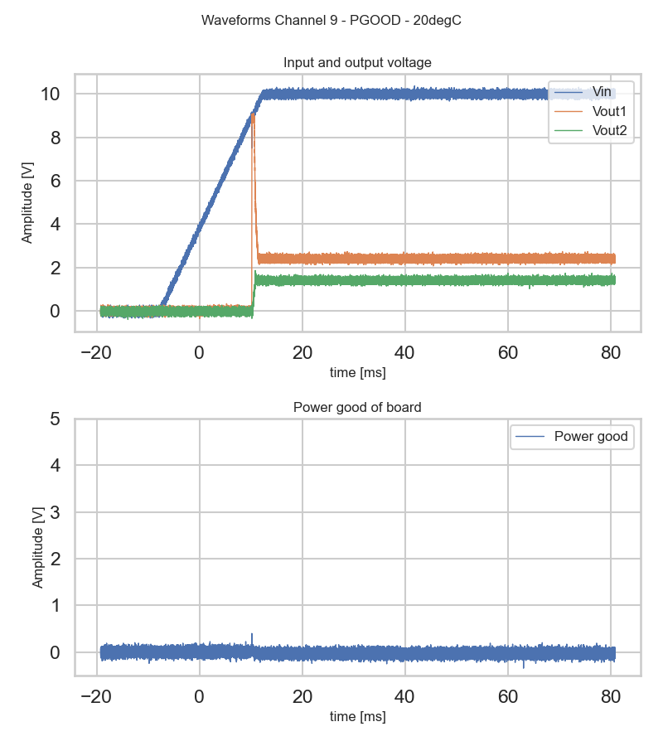
Technical Issues —— bPOL12V
bPOL12V: radiation hard DC-DC converter ASIC designed by CERN
  Used on every ITk module powerboard (17888) and EOS card (1656)
  Operated in cold volume @ -35°C, radiation doses between 7 Mrad – 70 Mrad
  Not accessible after installation
bPOL12V under the coil
Two issues found with bPOL v6:
  Wrong startup due to stress time
    After TID irradiation (> 1Mrad)+ stress ( bPOL powered but disabled )
    Mitigation: minimizes time in disabled state
Wrong startup
Normal operation

Slide 6
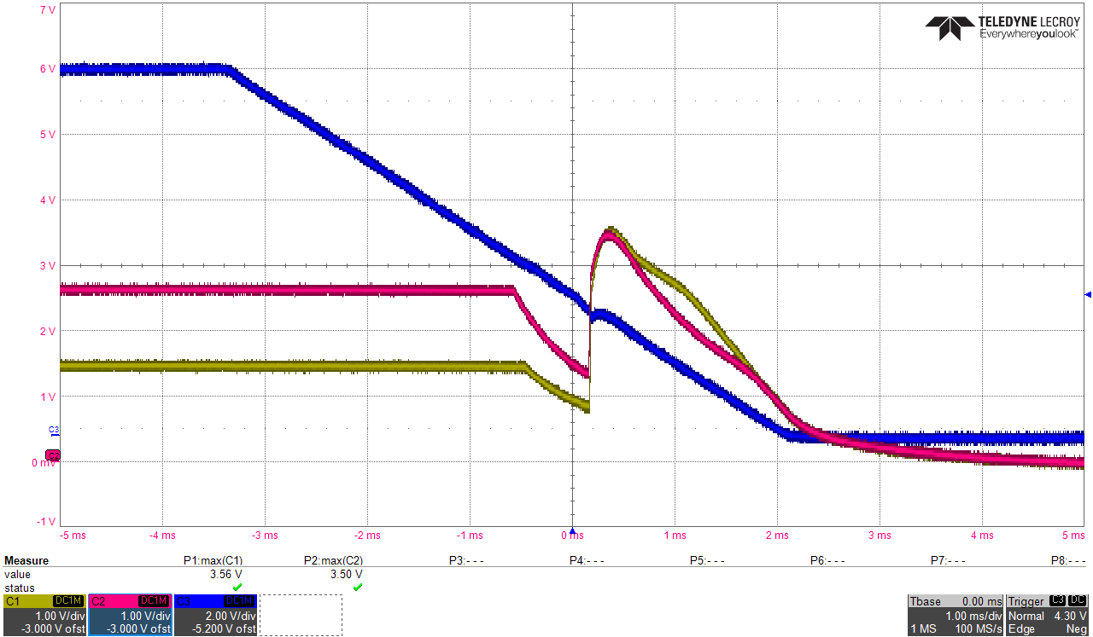
Technical Issues —— bPOL12V
Two issues found with bPOL v6:
  V_{out} rebound at power-off
    V_{Out} overshoots V_{In} at power-down when chip regulators turn off (V_{In} <~4.3V)
  Mitigations:
    Slowing down V_{In} ramp down + additional load
    ITk Strips applied mitigations to keep using bPOL v6 due to schedule constraints!
    Test and discussions about usage of new chip version (FX1) ongoing
    Reserved FX1 for last part of EOS card production

Slide 7
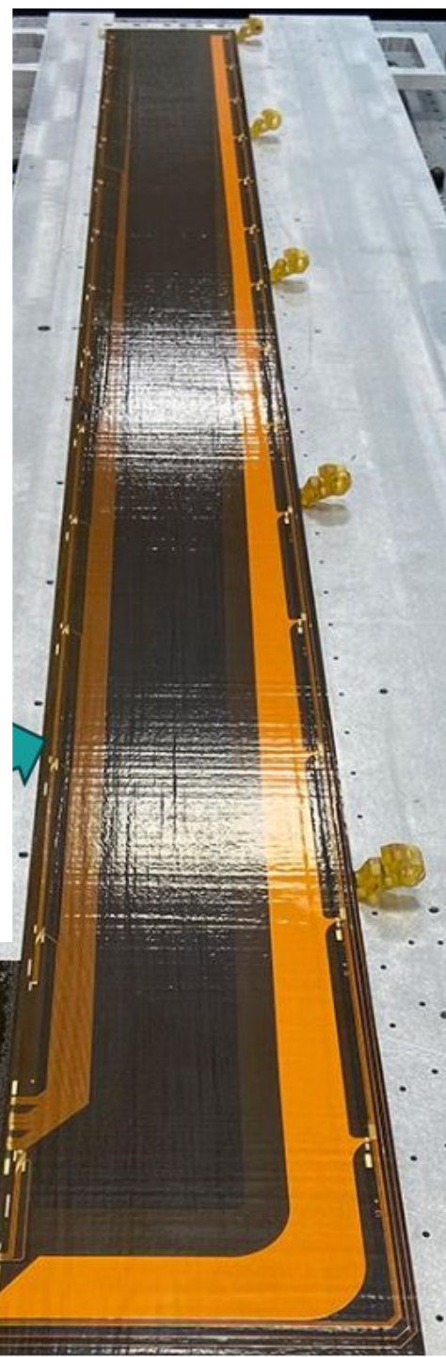
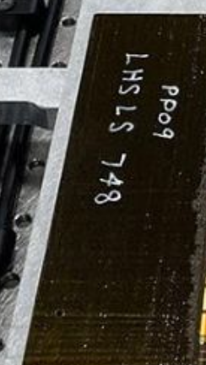
Barrel Cores
Many stave cores produced in UK being rejected due to high failure rates
  Failures arise mostly from track delamination from base polyimide
  Strong evidence for low peel strength of tracks to base polyimide
Mitigations:
  Changed to a material with ~2.5 times higher peel strength (similar to EC); no failures observed in 25 co-cures
  Significant work is undertaken to increase throughput
  Aim to starting recover float related to stave cores this year

Slide 8
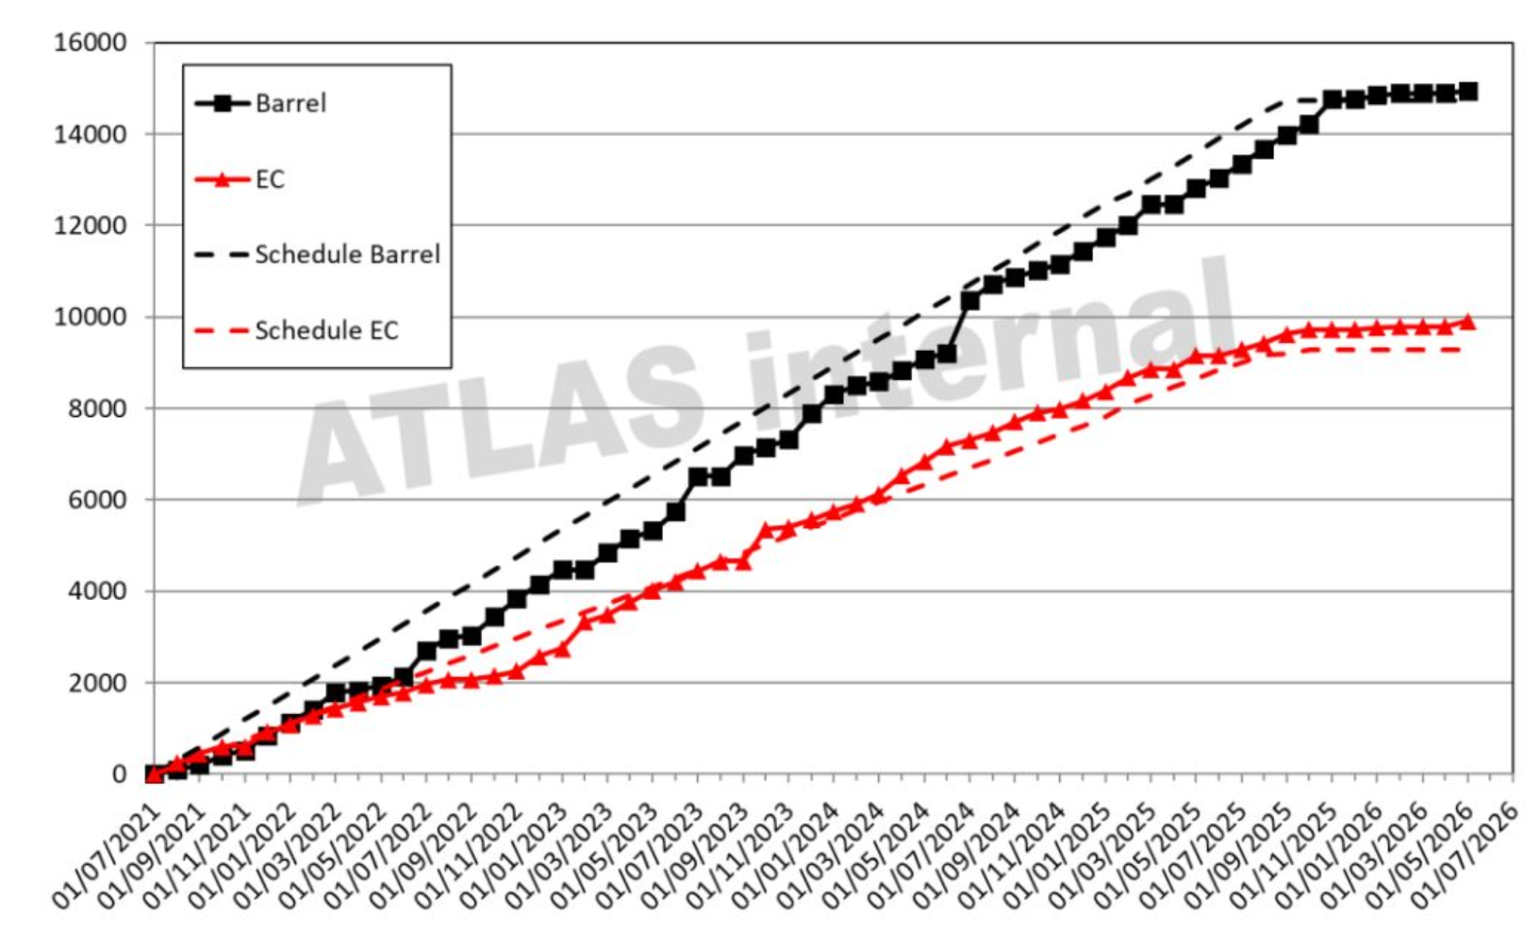
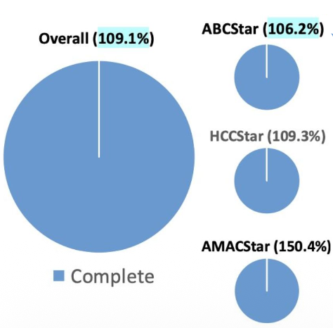
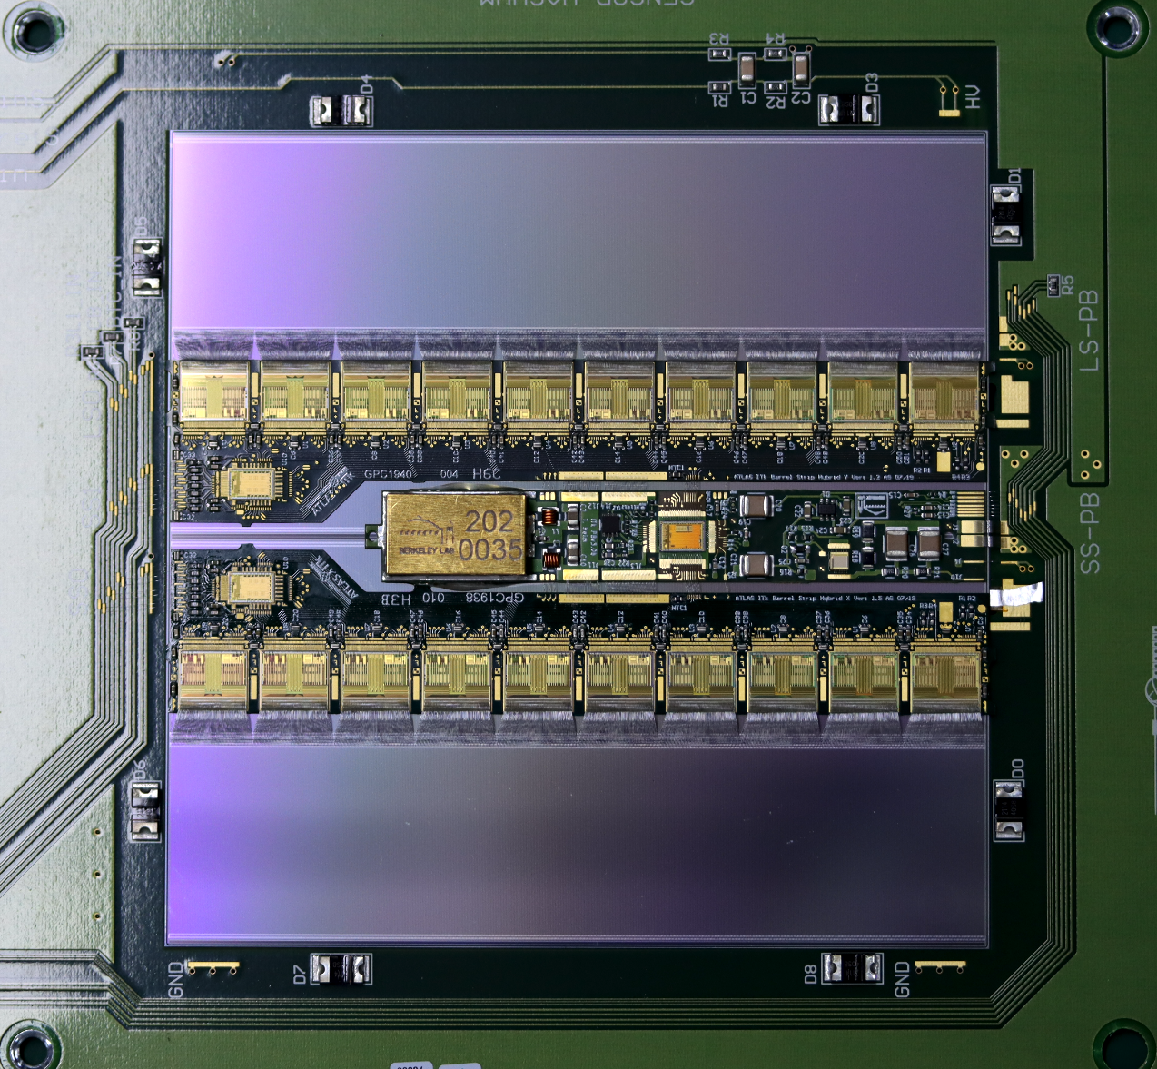
Sensor and ASIC Production Status
Sensor production is finished
  103.5% of production sensors delivered
  100% of production sensors accepted and ready for modules
ASIC production is finished
  Good stock of spare chips

Slide 9
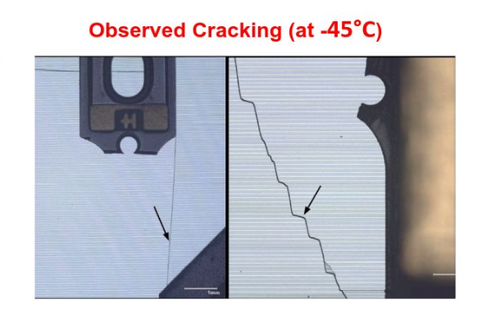
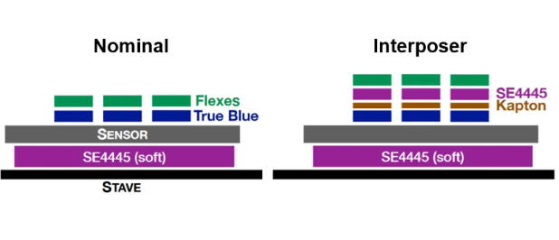
Flex Interposing and Assembly
Sensor cracking
  Early modules cracked when cooled to -45 °C
  Coefficient of Thermal Expansion (CTE) mismatch between copper and sensor: high stress in the gaps between flexes; the glue simply stretches and cannot prevent the abrupt change in bending direction.
Solution
  Introduce an Interposer: a soft SE-4445 adhesive layer + Kapton between flexes and sensor to decouple thermal stress and prevent cracking
Production status
  Majority of production sites online and running at high yield and throughput
  The endcap hybrid supply bottleneck has been solved by bringing a second production site online

Slide 10
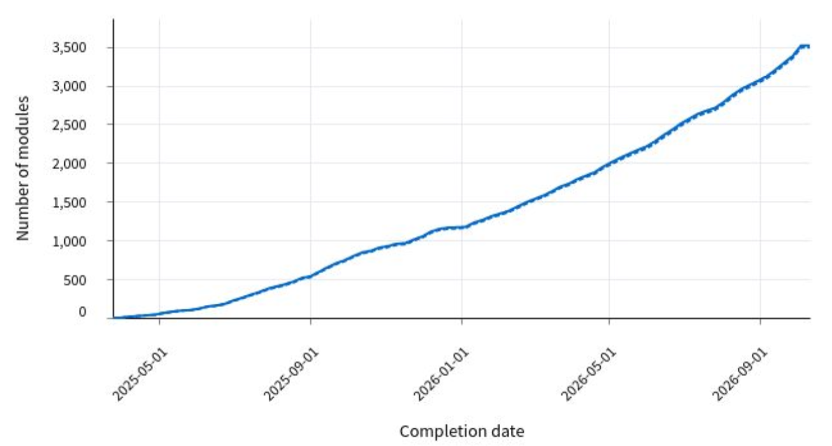
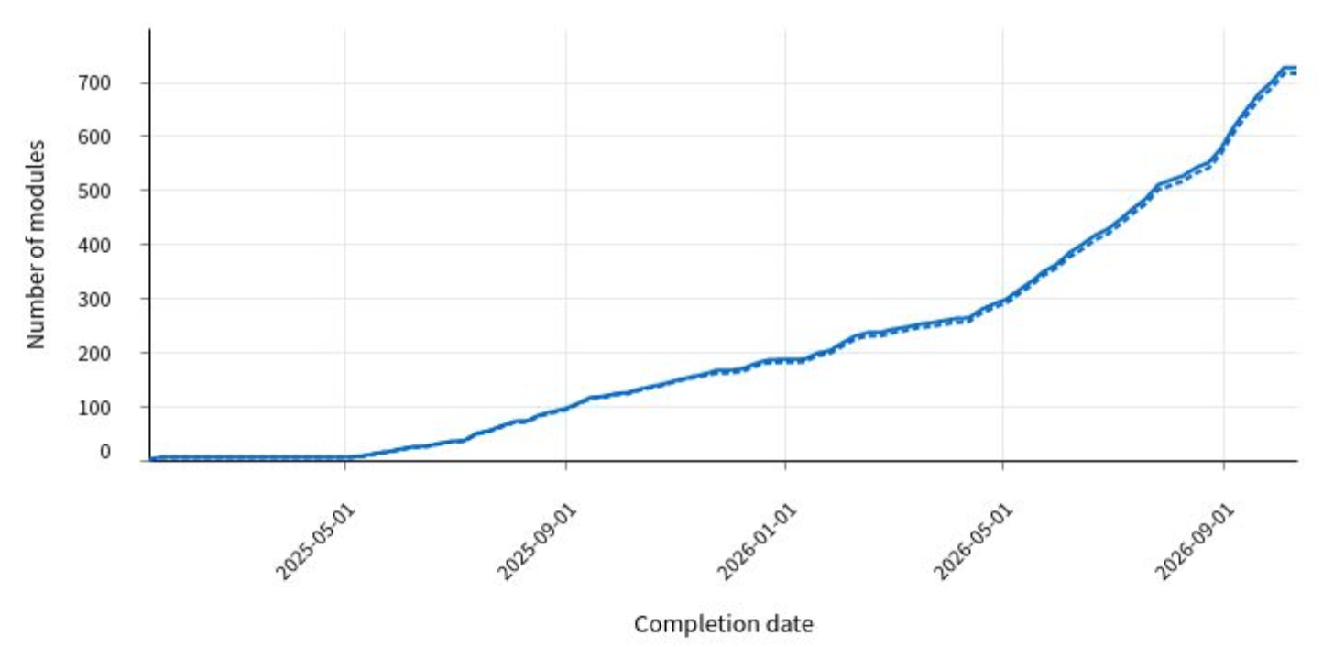
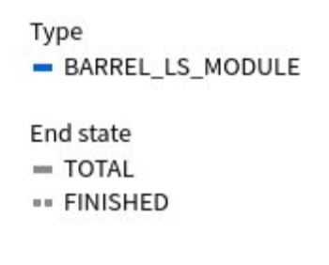
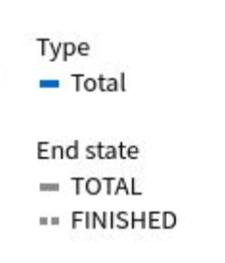
Modules
  Barrel and endcap module production have recovered after bPOL issue and continue to improve
    Barrel: over 3500 long strip (LS) modules built, yield: 90%
    Endcap: over 700 modules (all types) built, yield: 86.7% (R3M1) – 93.7% (R5M1)
    All yields above target, investigations to further improve ongoing
    ~25% of all strip modules have been built
    Barrel modules considered installable
    Endcap modules considered installable

Slide 11
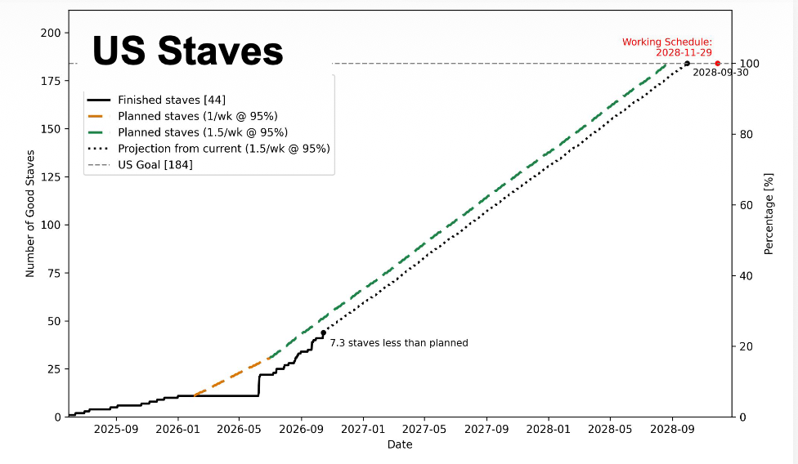
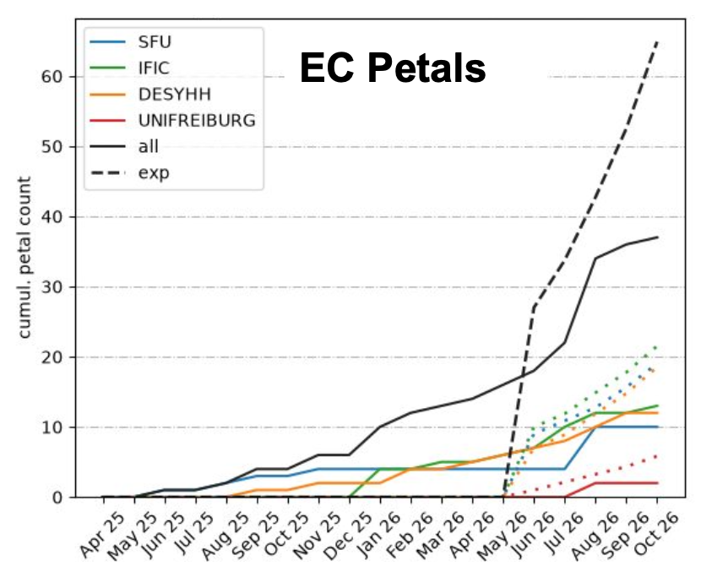
Local Support Loading
  Overall: Detector-grade staves and petals are in steady production
  Barrel:
    Achieved 1–1.5 staves/week/site; currently limited by assembly frame availability
    Producing more frames to parallelize loading & testing; short high-rate phases to recover float
    54 staves loaded and fully tested
Endcap:
  EC bus tape production finished, 228/400 petal cores produced
  All four loading sites up but currently behind schedule, expected to recover within next months
  37 petals loaded and 30 fully tested

Slide 12
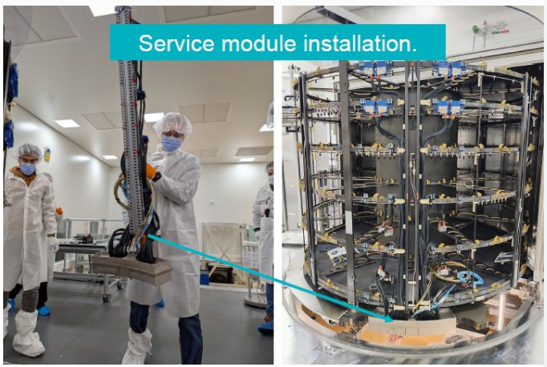
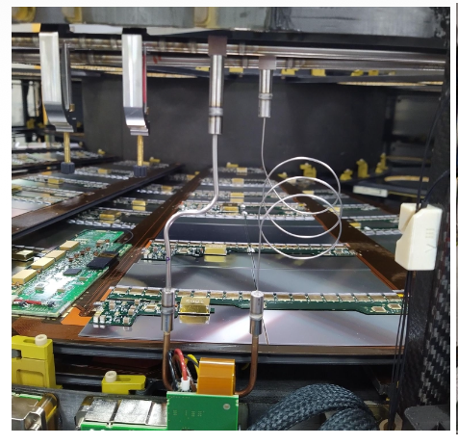
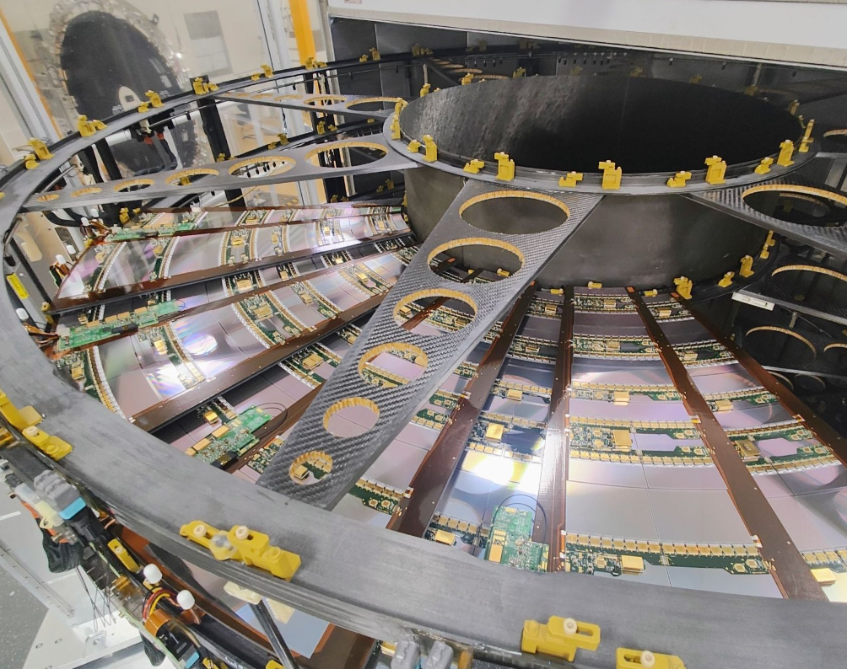
Integration
Integration is well advanced at CERN SR1 (Barrel), DESY, and Nikhef (Endcap)
Infrastructure & Tooling:
  Full powering and cooling services are available
  Insertion tooling is ready for both Barrel and Endcap; procedures are being deployed
Service Modules:
  In production (5 installed at DESY, 2 delivered to Nikhef, first expected at CERN this month)
Component Availability:
  20 petals and >35 staves are now available for integration
  Sufficient to start the first cold tests
Milestone Achieved:
  First 9 petals successfully installed at DESY (Sep 2026)
  Cooling line welding has started

Slide 13
Summary
Production Status:
  ITk strip production is in full swing
  Technical Challenges & Mitigations:
  bPOL v6: Mitigation strategies studied and validated to restart ramp-up production
  bPOL FX1: Extensive test program underway to assess its usability in later production
  Barrel cores & EC modules: Countermeasures taken to begin recovering schedule float
  Further schedule optimization is underway across the collaboration to recover delays where possible and ensure readiness for large-scale detector integration
  Thanks！

