Slide 1



The Muon Moonshot: Lunar Muonic Spectra and Tomography
Reporter: Zimo Hu
Peking University School of Physics, Class 8 of 2025
On behalf of the PKMu collaboration
https://arxiv.org/xxxx.xxxxx

Slide 2
Research Background
Muon tomography: widely used technology on earth
There readily exists research concerning secondary lunar photons
What if secondary lunar muons carry tomographic information?
Probable application on future lunar probing missions

Slide 3
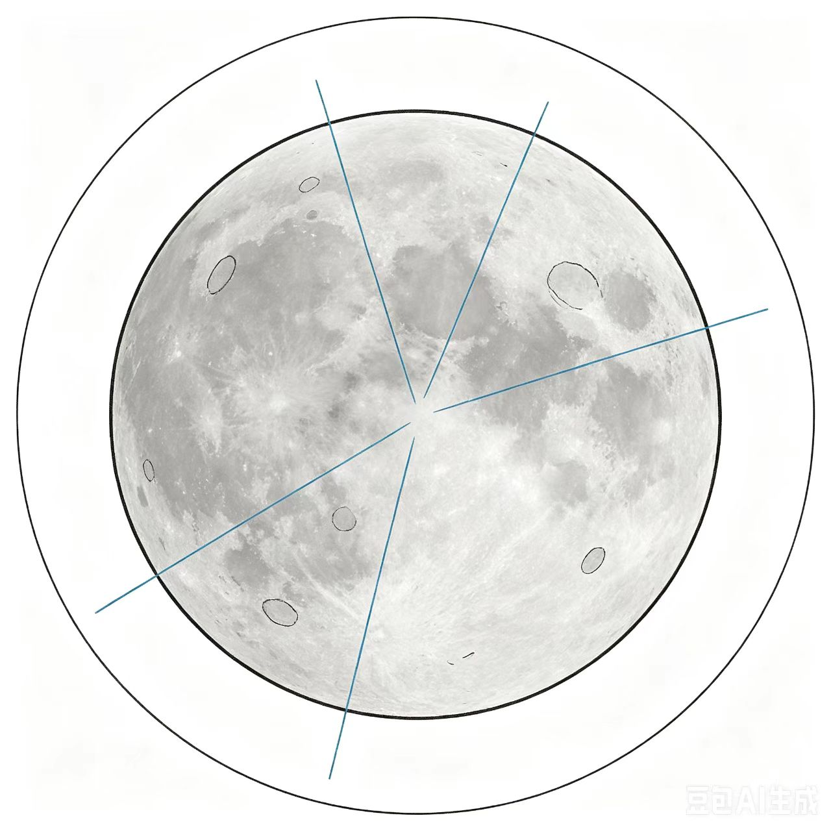
FLUKA Simulation Structure
A three-layer concentric sphere geometry (world, void, moon)
Used FLUKA’s internal GCR spectra
Measured the flux of muons, pions ,kaons and photons(benchmark) at multiple heights

Slide 4
Detailed Simulation Settings
FLUKA has its internal GCR spectra, one corresponding to solar minimum (465 MV), the other to solar maximum (1440 MV).
Selected moon radius to be 1737.1km
GCR was generated on a sphere slightly larger than the moon to avoid particle leakage. (To be exact, 5 cm larger than moon)
Most simulations are ran in patches of 4000*50*5=1 million primaries
this corresponds to 30s or 40s at solar minimum
Models DPMJET and RQMD used

Slide 5
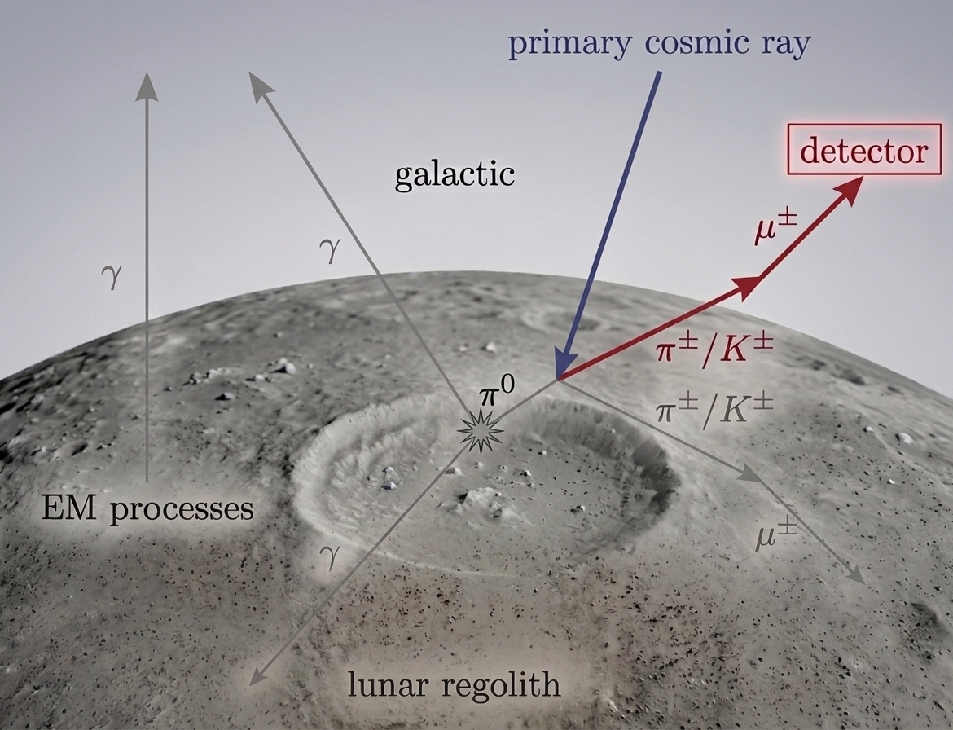
Physics Explanation
Primary galactic rays strike regolith and produce secondaries
secondary mesons: pions (charged or not)
kaons
Decay inside/outside regolith

Slide 6
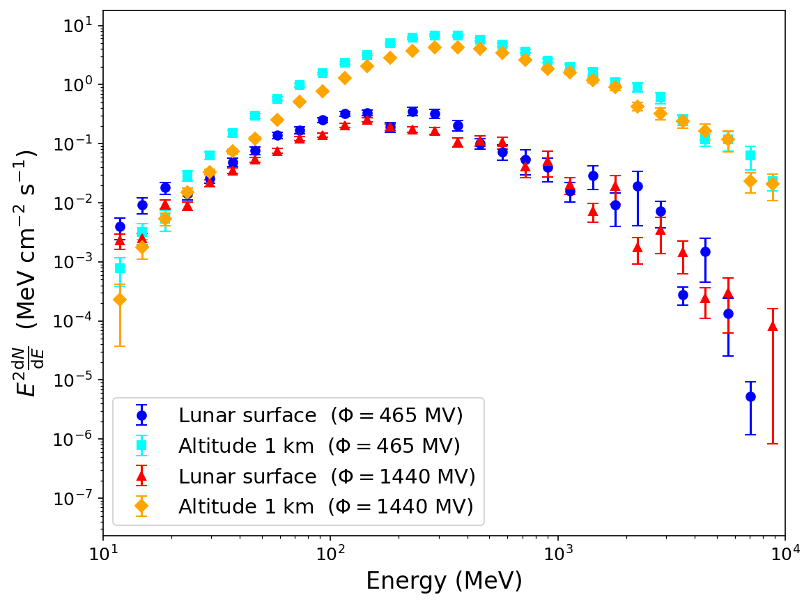
Height Sensitivity
Muon comes mostly from π±→μ±+ν_{μ} （channel near 100%）
π± has cτ=7.8 m
Primary CR penetration ~0.1 m to 1 m, which corresponds to pion generation depth
Therefore most charged pions come out of the surface undecayed
These pions subsequently decay into muons, vastly increasing muon flux at a height

Slide 7
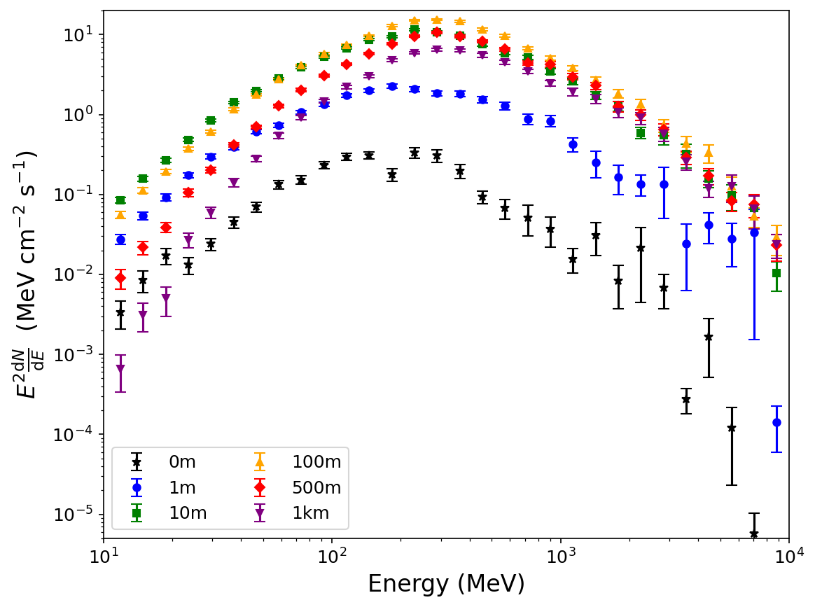
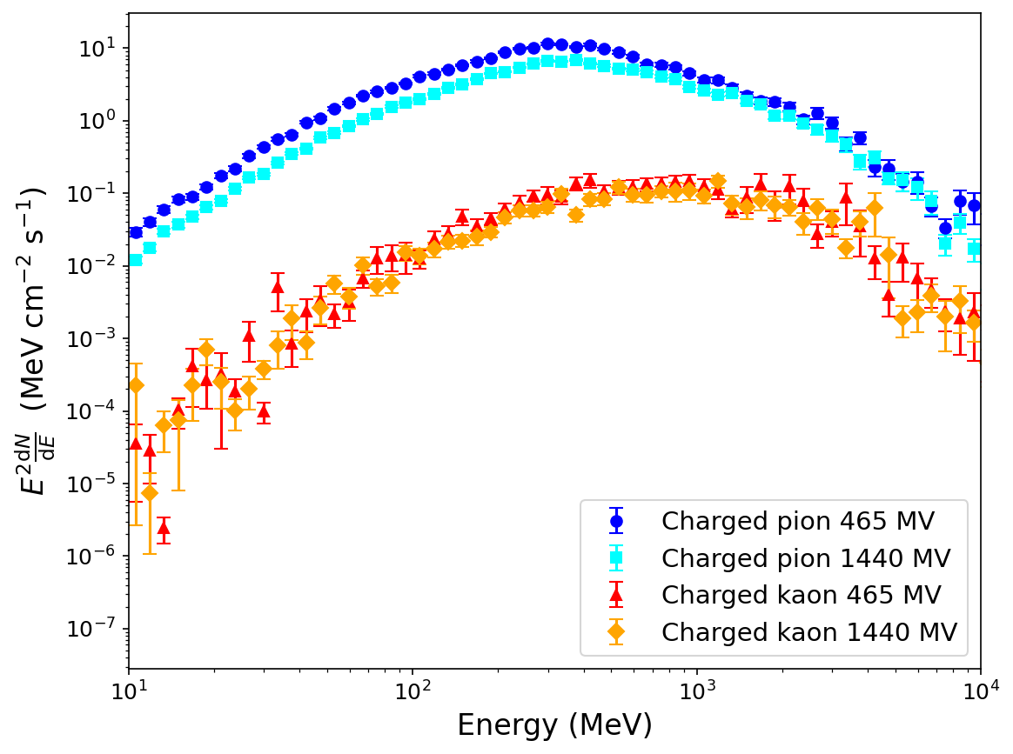
Simulation Results
Relevant meson flux at surface
Muon flux at different heights (465MV)

Slide 8
Tomographic Application
Idea:
Spectrum at a height vs Spectrum at surface where a hole exists
≈

Slide 9
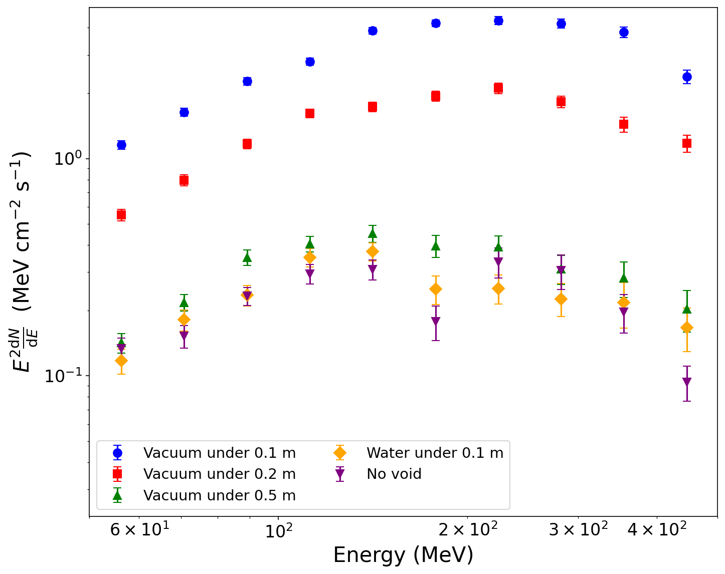
Simulation results
Investigated cases where a heterogeneous substance exists from (0.1/0.2/0.5 m) to 10m in order to show tomographic ability.
Differences of 1~2 orders of magnitude can be observed for cavities under shallow coverage in a few seconds.
Still could differentiate for thicker coverage or underground water by 5σ, given some minutes of data collection.

Slide 10
PID Requirements
Main background: charged pions
N(pi) + N(mu) nearly conserves, if PID fails, all sensitivity diminishes
TOF (Time-of-Flight) system requires ~100ps resolution for 1 m flight path to distinguish between E_{k}~100 MeV muons and pions
Corresponds to or is less difficult than existing probes like PAMELA and LIDAL
Should be an achievable method given an appropriate detector design

Slide 11
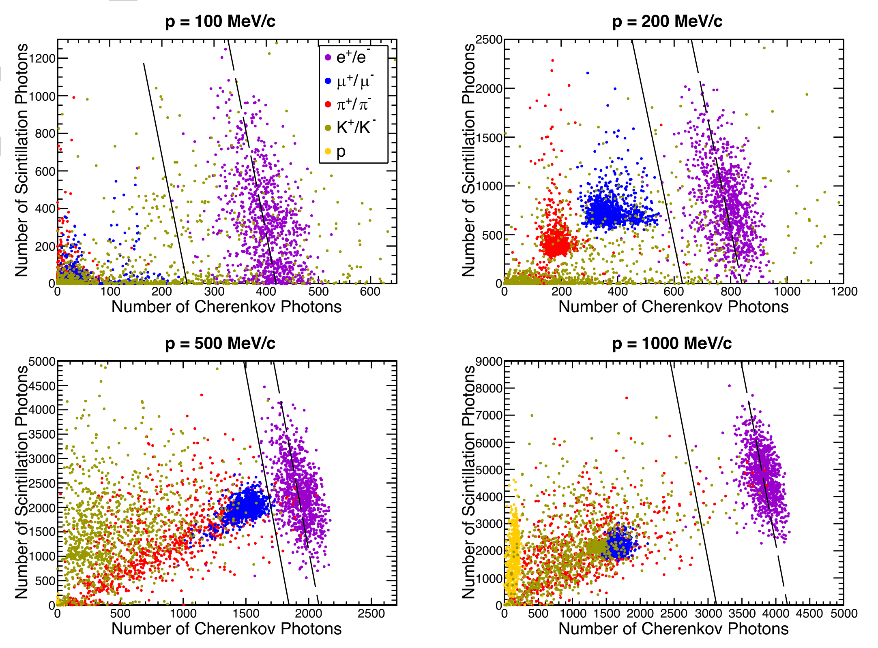
PID Requirements
Cerenkov methods sensitive to 200~500MeV kinetic energy.
Corresponds to the most sensitive spectral region (approximately 50~500MeV)
Pic from:https://arxiv.org/abs/2511.22864, acknowledgements to Dr. Yuhong Yu

Slide 12
Brief Summary
This research provided an analysis of the lunar muonic spectrum, using FLUKA simulated data. The spectrum is generated by the reactions between primal cosmic rays and the lunar regolith.
The obtained spectrum is proven to be sensitive to detector height variation in a range from the lunar surface to ~10m, or in other words, sensitive to underground cavities near the lunar surface.
The spectrum may be used as a method of lunar underground detection.

Slide 13
Prospect
Detailed designs of lunar detectors and probes used to seek underground structures
There exists the probability of probing ~100m structures using muon decay (rather than pion decay as used in shallow regolith detection). Angular distribution information may also be useful for macroscopic probing.
Further refined simulations that may give more details on the possibility and limitations of subsurface water (or other matter) detection.
Further investigation on sensitivity to cavity size (contrast to depth)

Slide 14
Thanks for listening

