Slide 1
Searching quantum entanglement at a Muon Collider
阿里木·肉孜
新疆大学
缪缪论坛——缪子物理与缪子技术创新学术论坛
PKU @ July 12-13, 2026
In collaboration with 李强，高乐耘，吾友鹏 et al.
JHEP 10 (2024) 211 & Phys.Rev.D 111 (2025) 3, 036008

Slide 2
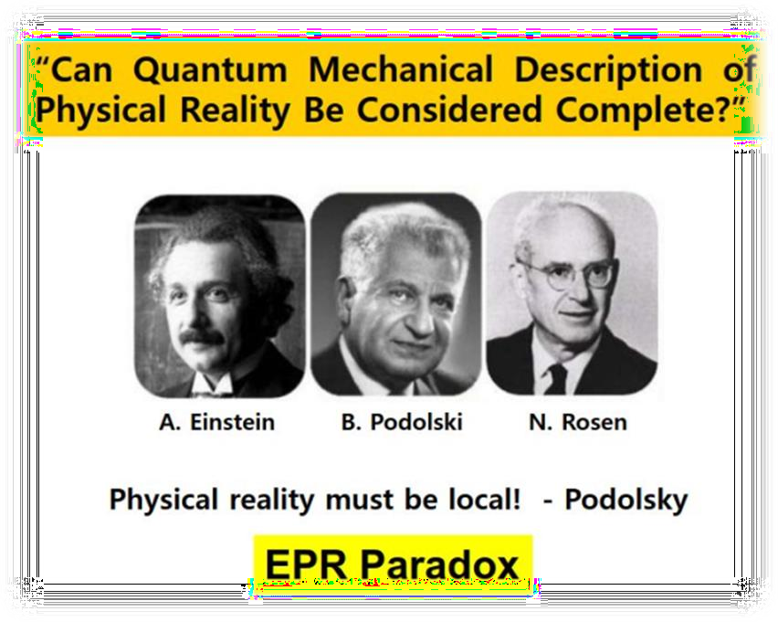
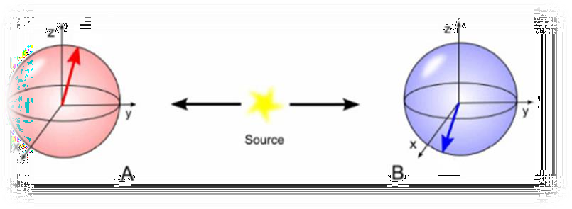








A short history of quantum Entanglement (1)
Einstein-Podolsky-Rosen——EPR文章 (1934），试图证明QM是不完整的。被关联的两个粒子的 物理观测量是以某种方式互相关联：测量一个粒子的物理量会影响另一个粒子的观测量，如动 量、位置。
Spooky action!
Quantum Mechanical Description of physics reality described by wave function is not complete without a “hidden-variable theory”

Slide 3
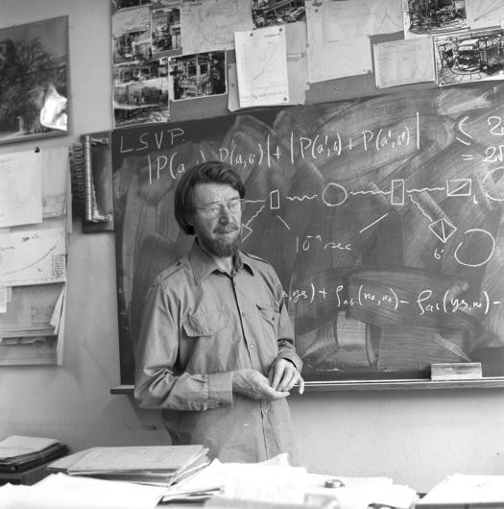
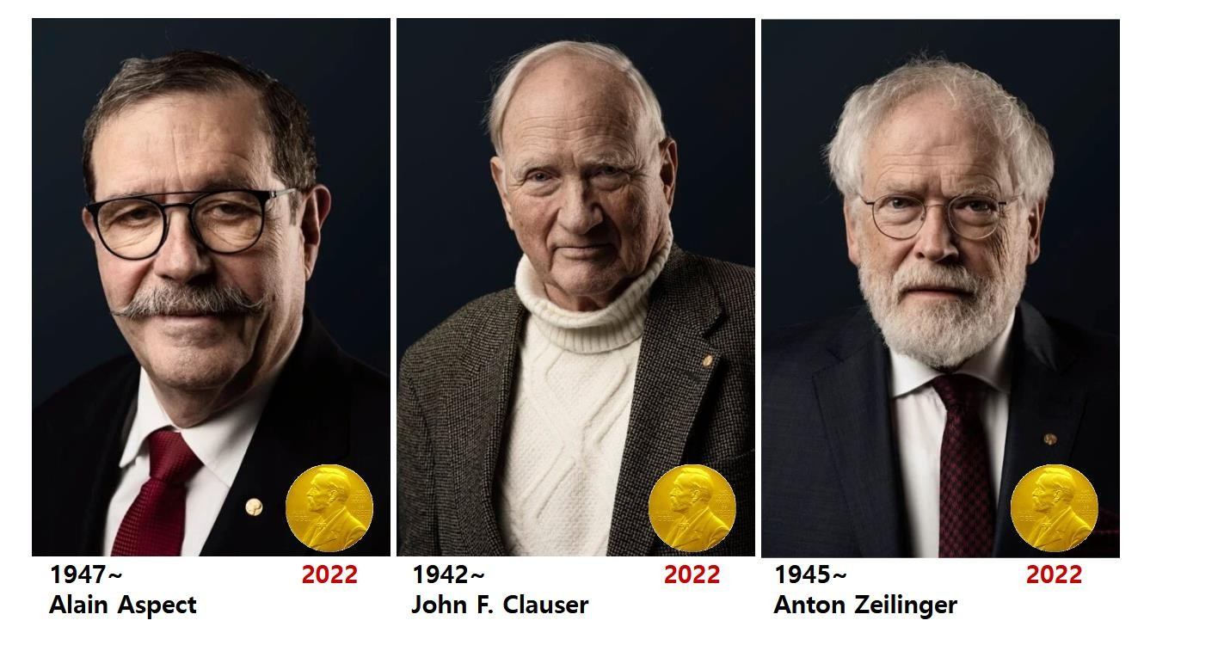
A short history of quantum Entanglement (2)
贝尔不等式的提🎧
1964年，物理学家约翰·贝尔提出了著名的“贝尔不等式”。贝尔不等式为局域性隐变量理论提供了可检验的预测：如果该理论正确，某些物理量的测量结果应该满足特定的数学关系。
量子力学是非局域性理论！

Slide 4


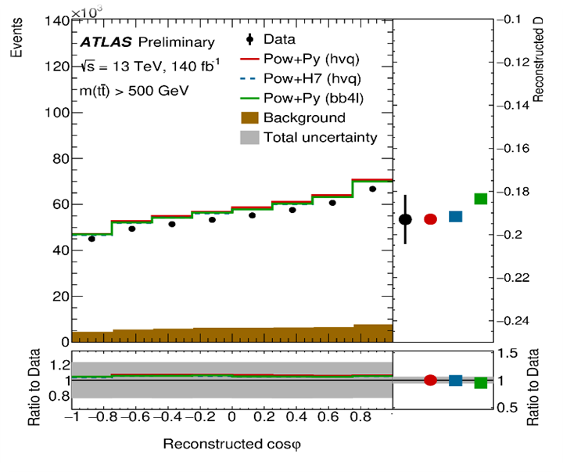
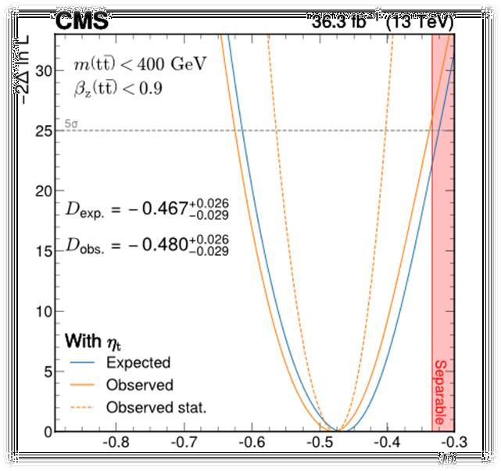
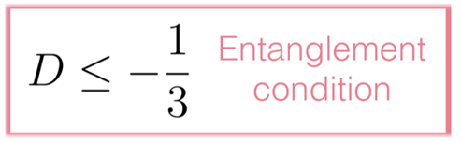
Observation by LHC experiments
ATLAS collaboration
CMS collaboration
Entanglement marker
𝒕𝒓 𝑪
𝑫 =
= −𝟑
𝒄𝒐𝒔𝝋
𝟑
Y. Afik
Eur. Phys. J. Plus 136, 907
(2021).
ATLAS Collaboration Nature 633, 542 (2024).
CMS collaboration.
Rep. Prog. Phys. 87, 117801 (2024).

Slide 5

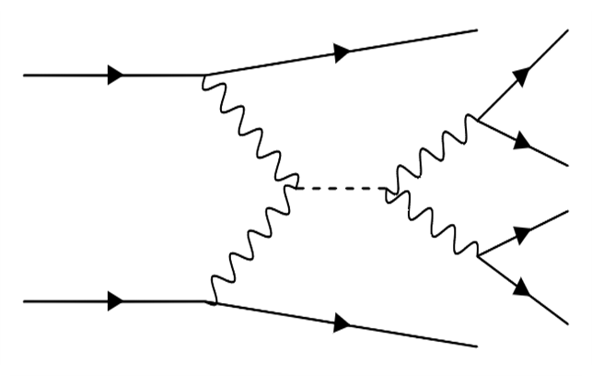
𝑯 → 𝒁𝒁 → 𝓁⁺𝓁⁻𝓁⁺𝓁⁻
𝟏 𝟏 𝟐 𝟐
Large number of Higgs events from Vector Boson Fusion (VBF)
𝝂_{𝝁}
_{𝓁}−
_{𝝁}+
𝟏
_{𝑾}+
𝒁_{𝟏}
_{𝓁}+
H
𝟏
_{𝓁}−
_{𝑾}−
𝟐
_{𝝁}−
𝒁
𝟐
_{𝓁}+
𝝂_{𝝁}
𝟐

Slide 6
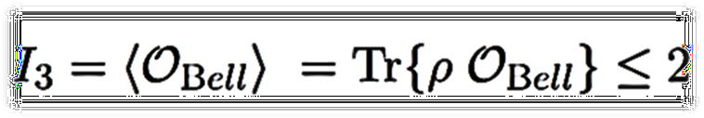
Two-qutrit : 𝑽𝑽(𝒁𝒁, 𝑾𝑾)
Bell-type inequality（CGLMP）
A.J. Barr et.al, Prog.Part.Nucl.Phys. 139 (2024) 104134
Spin density matrix (SDM)
  Gell-Mann Parameterization
Irreducible Tensor Parameterization
J.A Aguilar et.al
PhysRevD.107.016012

Slide 7
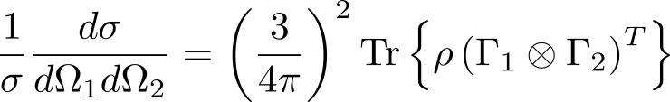

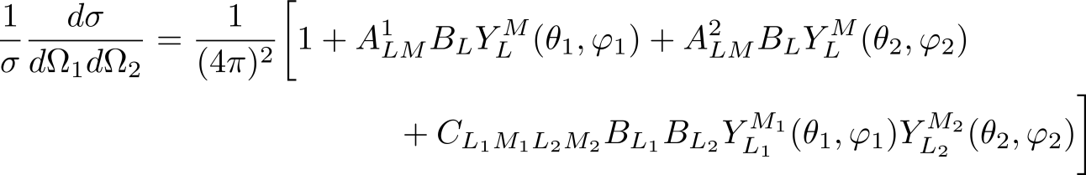
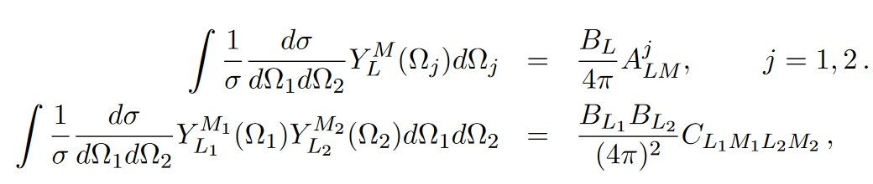
Quantum State Tomography（量子层析）
Differential Cross section: 𝑧𝑧 → 𝓁⁺𝓁⁻𝓁⁺𝓁⁻ (parent particle’s rest frame)
1 1 2 2
J.A Aguilar et.al PhysRevD.107.016012
Statistical average over events gives the polarization and correlation coefficients

Slide 8

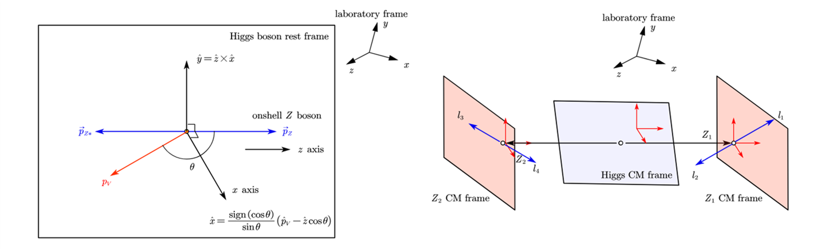
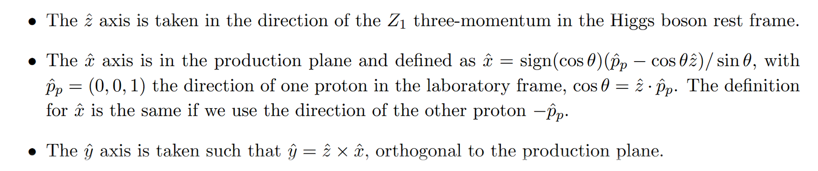
Reference frame: helicity basis

Slide 9

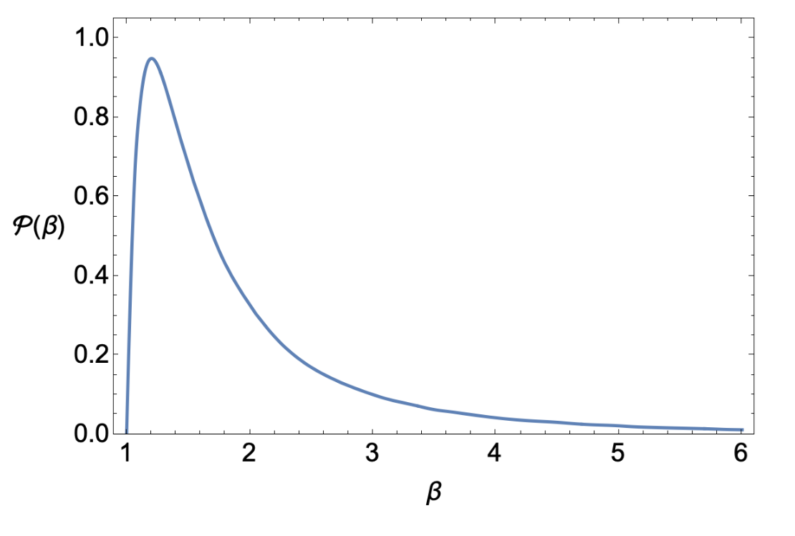










Quantum State of 𝑯 → 𝒁𝒁
Only 9 entries are non- zero!

Slide 10
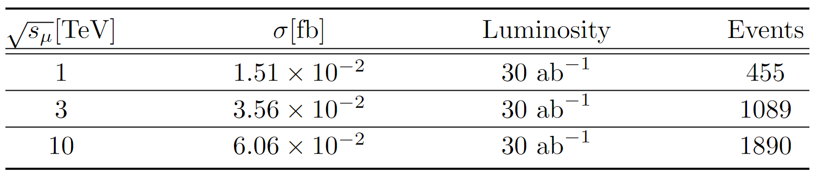
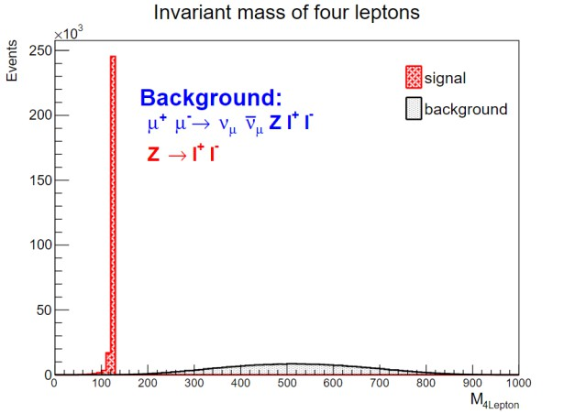
Numerical results
𝜇⁺𝜇⁻ → 𝐻 → 4𝓁 Events
Simulation Results from Madgraph
On-shell and off-shell bosons are identified based on the invariant mass of the lepton pairs.
Almost background free.

Slide 11
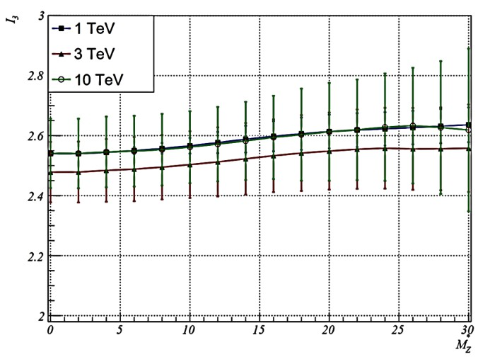
Numerical Results
𝜇⁺𝜇⁻ → 𝐻 → 4𝓁 Events
A good manifestation of statistical behavior, towards large 𝑀_{𝑍}, smaller events, thus large uncertainty.
The expectation value of 𝐼₃as function of the off-shell Z mass 𝑀∗ .
𝑍

Slide 12
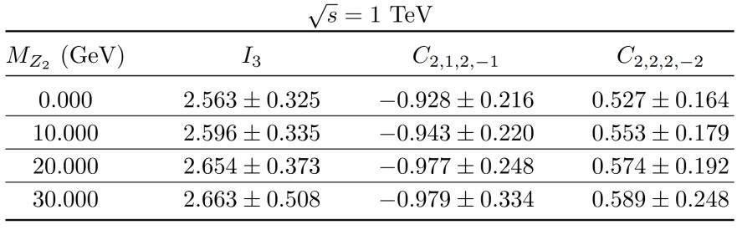
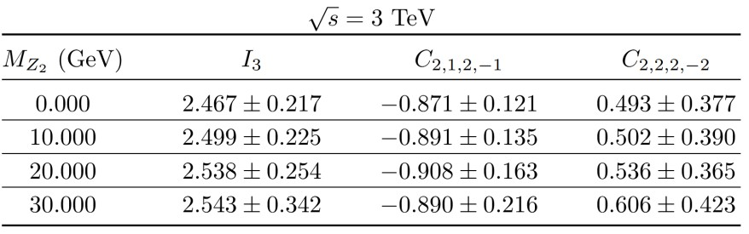
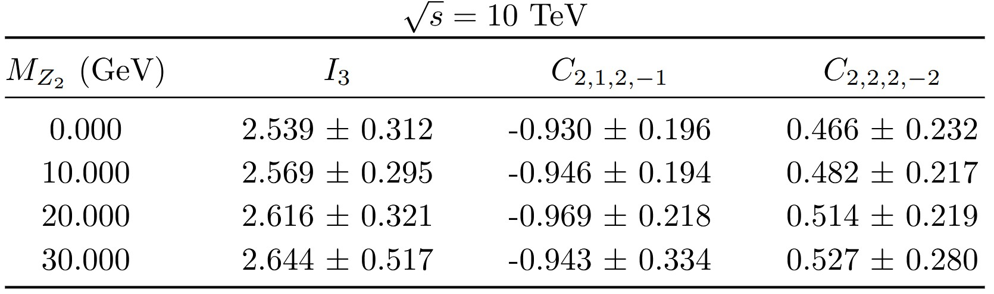
Numerical Results
Entanglement criteria:

Slide 13
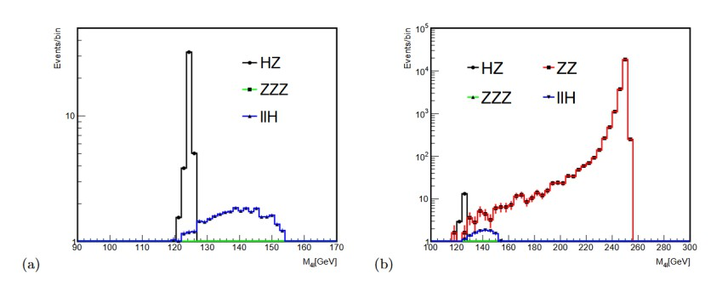

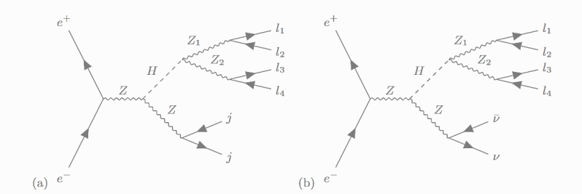

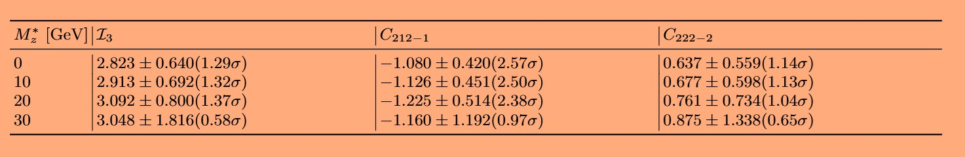
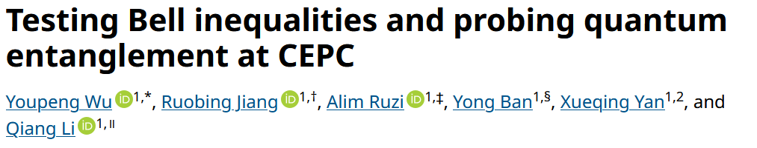
Application in CEPC

Slide 14
Summary
Quantum mechanics is non-local
No local hidden variable theory is compatible with quantum theory
Higgs decay can provide entangled qubit and qutrit system
Quantum entanglement is still present at extremely
relativistic environment.

