Slide 1
MuMu Forum -- Muon Physics and Muon Technologies Innovation Academic Forum
July 12-13, 2026, Beijing, China
Development Progress of CiADS Muon Source
Muon Science and Technology application platform at CiADS (MuST-CiADS)
Hanjie Cai, Jincheng Li
on behalf of MuST-CiADS team
Institute of Modern Physics, Chinese Academy of Sciences

Slide 2
Contents
Background
Development Progress of CiADS MuST
Summary

Slide 3
Background

Slide 4
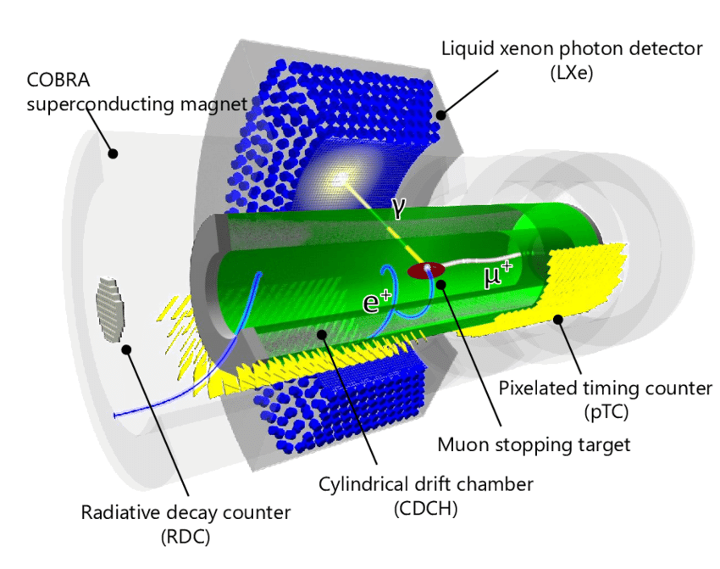
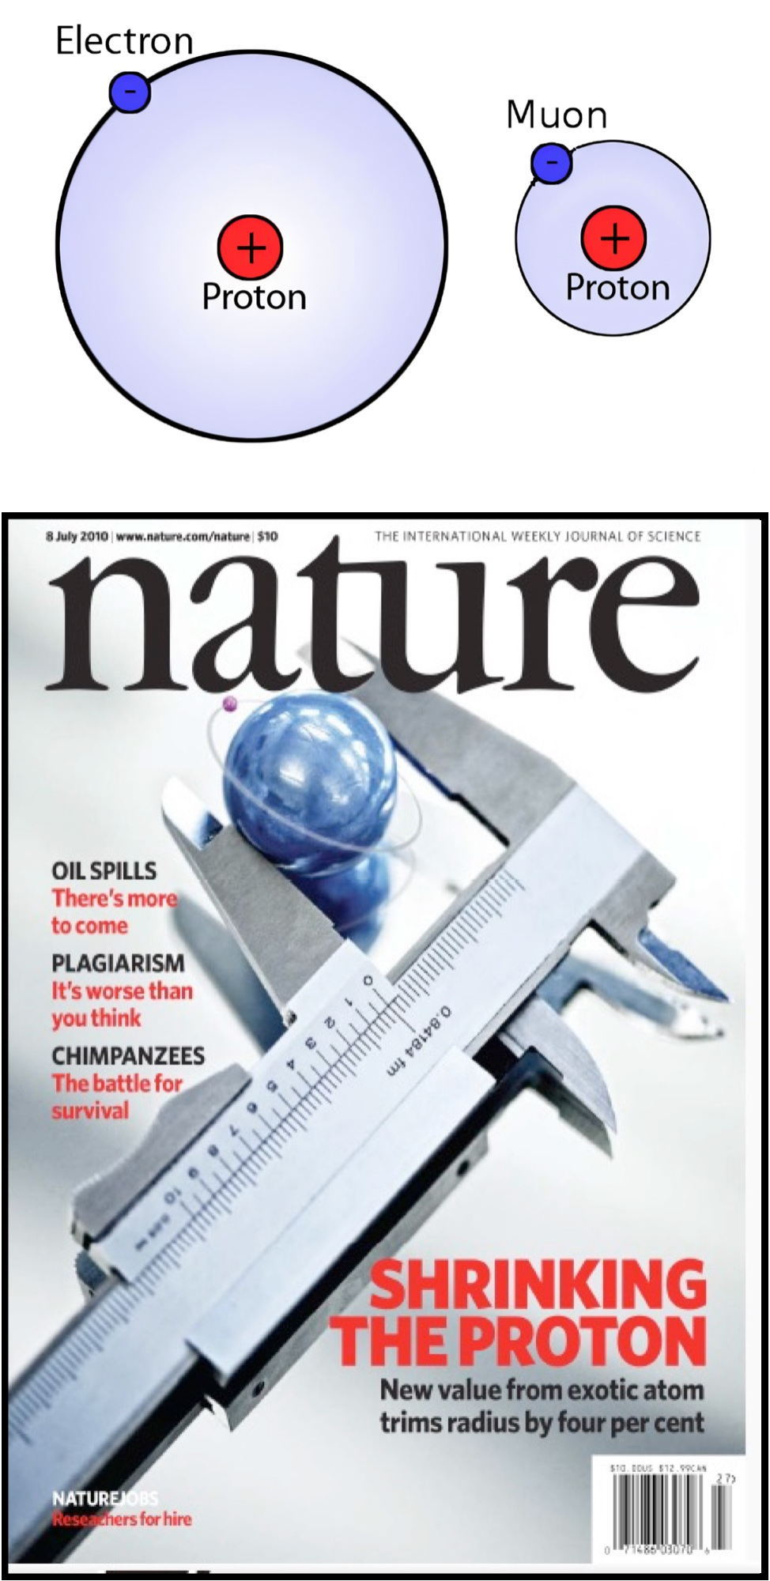
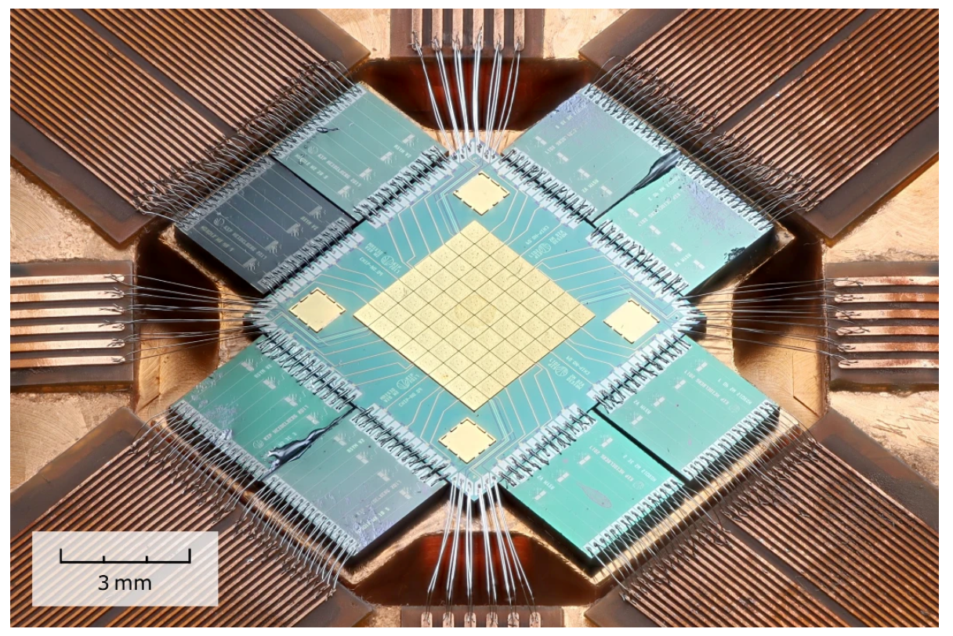
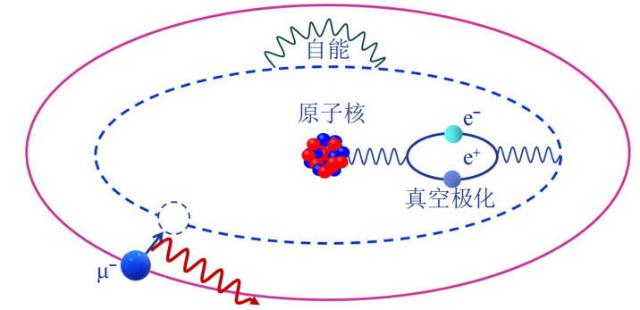

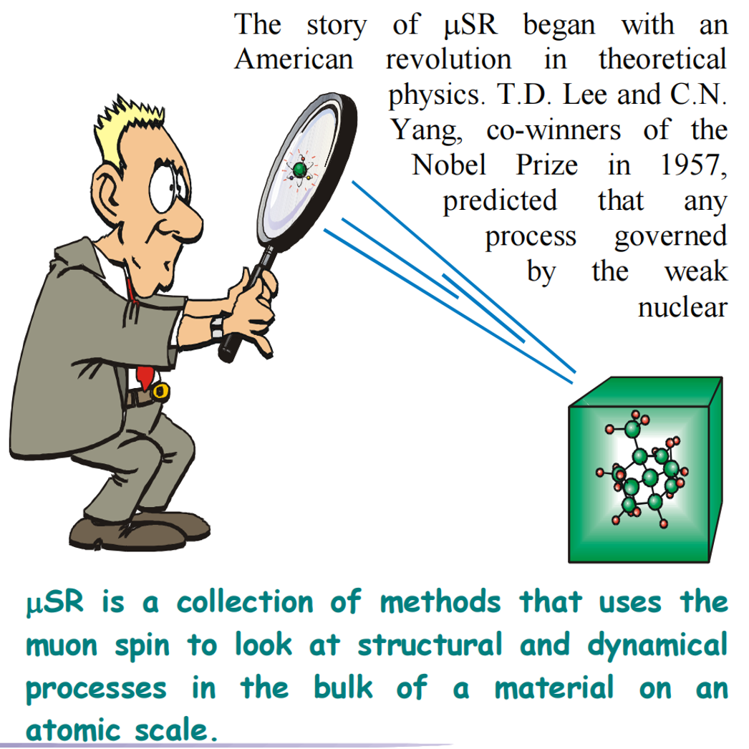
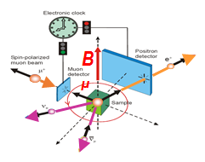
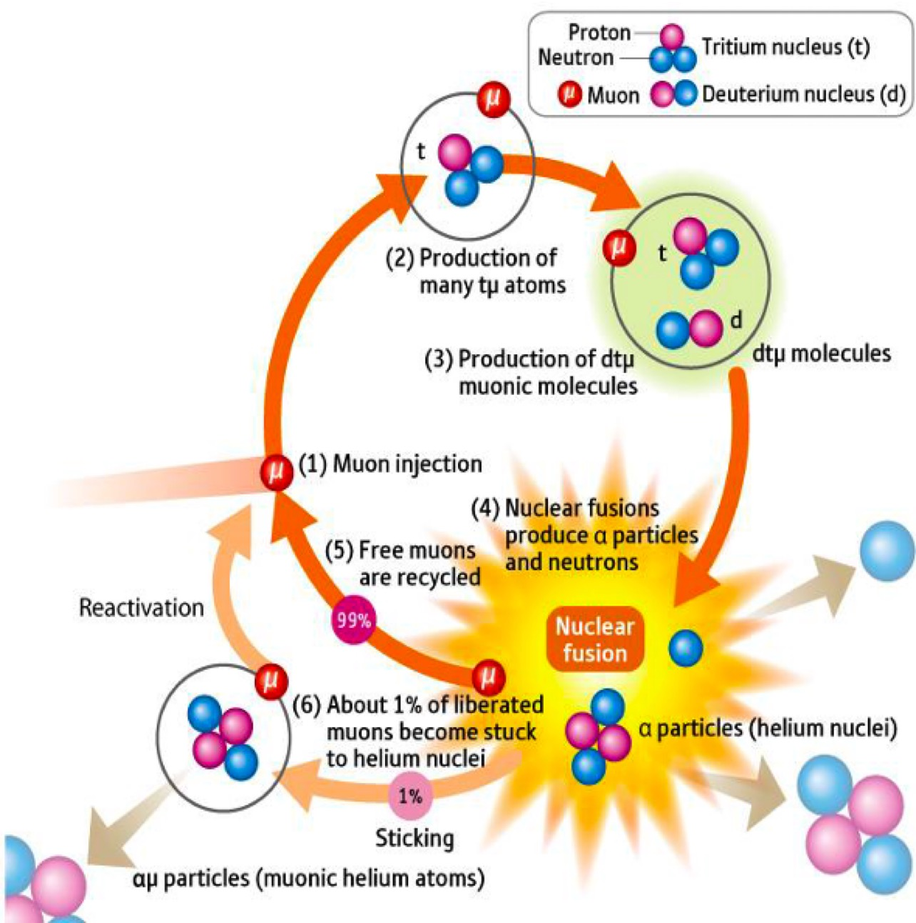
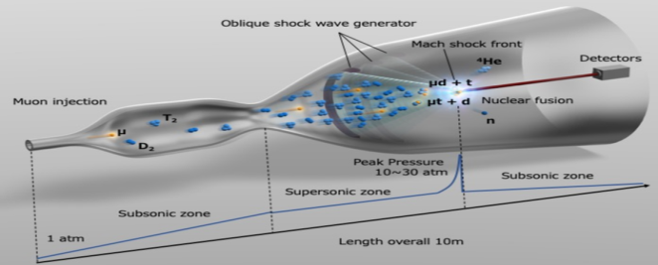
Muon source applications
Superconductor transition-edge calorimeter for X-ray measurement
Particle Physics
(g-2, Mu2e, COMET, MEG, Mu3e,, MACE, muEDM, etc.)
Nuclear/Atomic Physics
(strong-field QED test, nuclear fine structure, precision atomic spectroscopy)
Condensed Matter Physics (Magnetic materials, superconductors, semiconductors, quantum spin liquid)
Elemental Analysis; Muography; Biophysics; Chemistry; Muon-Catalyzed Cold Fusion

Slide 5
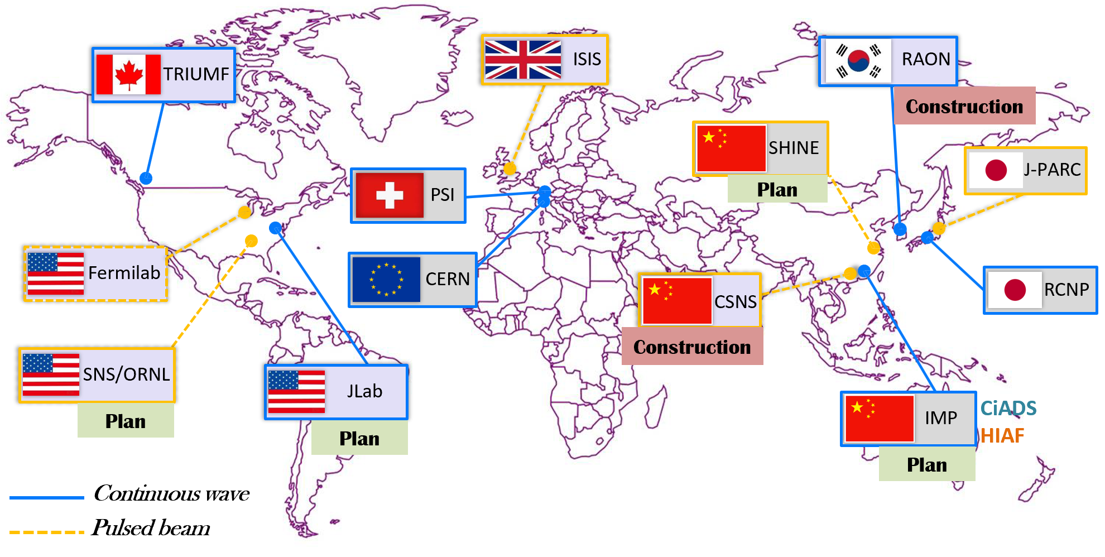
Muon sources
5 muon sources and several muon beamlines
Maximun surface muon rate ~1E8/s for both CW beam at PSI and pulsed beam at J-PARC

Slide 6
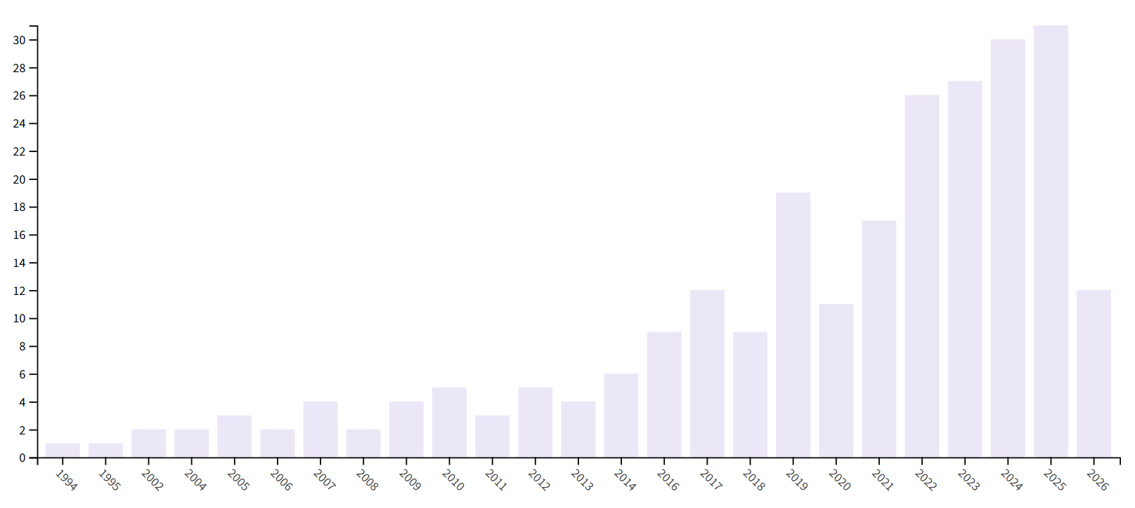
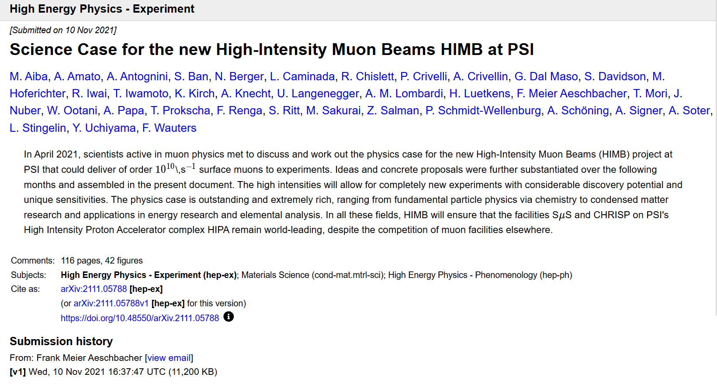
The trends
1. Higher intensity
2. New facility
Future high-precision experiments and applications call for an intensity of 10⁹~10¹¹μ/s
Several muon experiments and applications have been proposed in China
Efforts are underway to develop muon facilities at CSNS,HiAF,CiADS and SHINE
Soon, we will see first muon beam in China
Publications related to muon source:
increases rapidly in the last decade

Slide 7
Development Progress of CiADS MuST

Slide 8
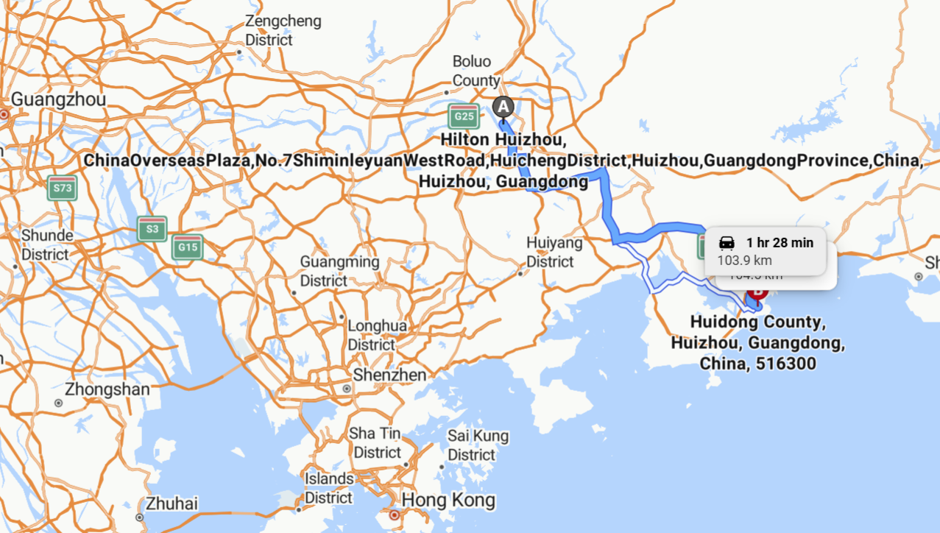
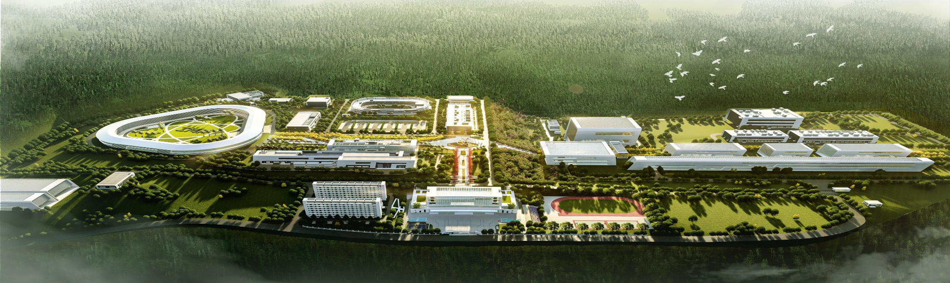
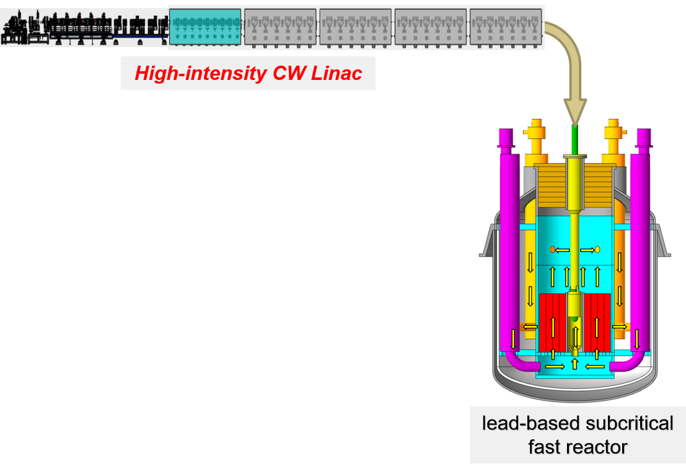
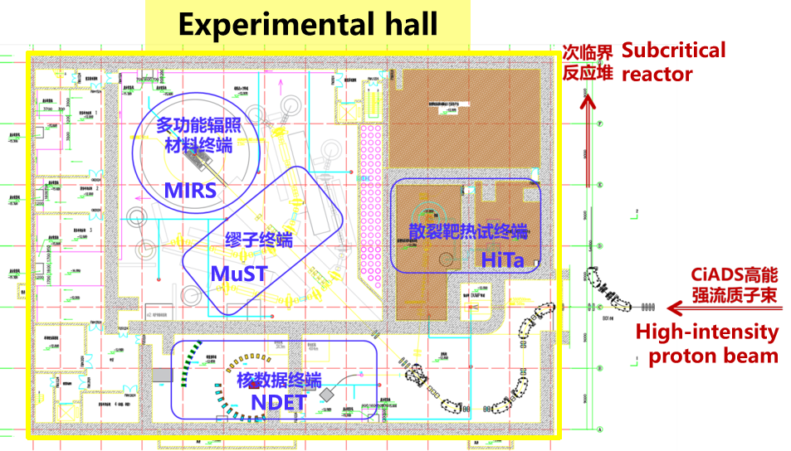
CiADS
100 kilometers
HIAF
CiADS
HIAF/CiADS
Location: Huizhou city
5-mA Proton Beam
Experimental hall for high-power beam applications
CiADS: China-initiative Accelerator-Driven Subcritical system, the world`s first megawatt-level ADS research facility
Construction Period: July 2021 – July 2027
The Superconducting Linear Accelerator
• Proton Beam Energy: 600 MeV
• Proton Beam Current: 5 mA
• Operation Mode: CW or Pulsed

Slide 9
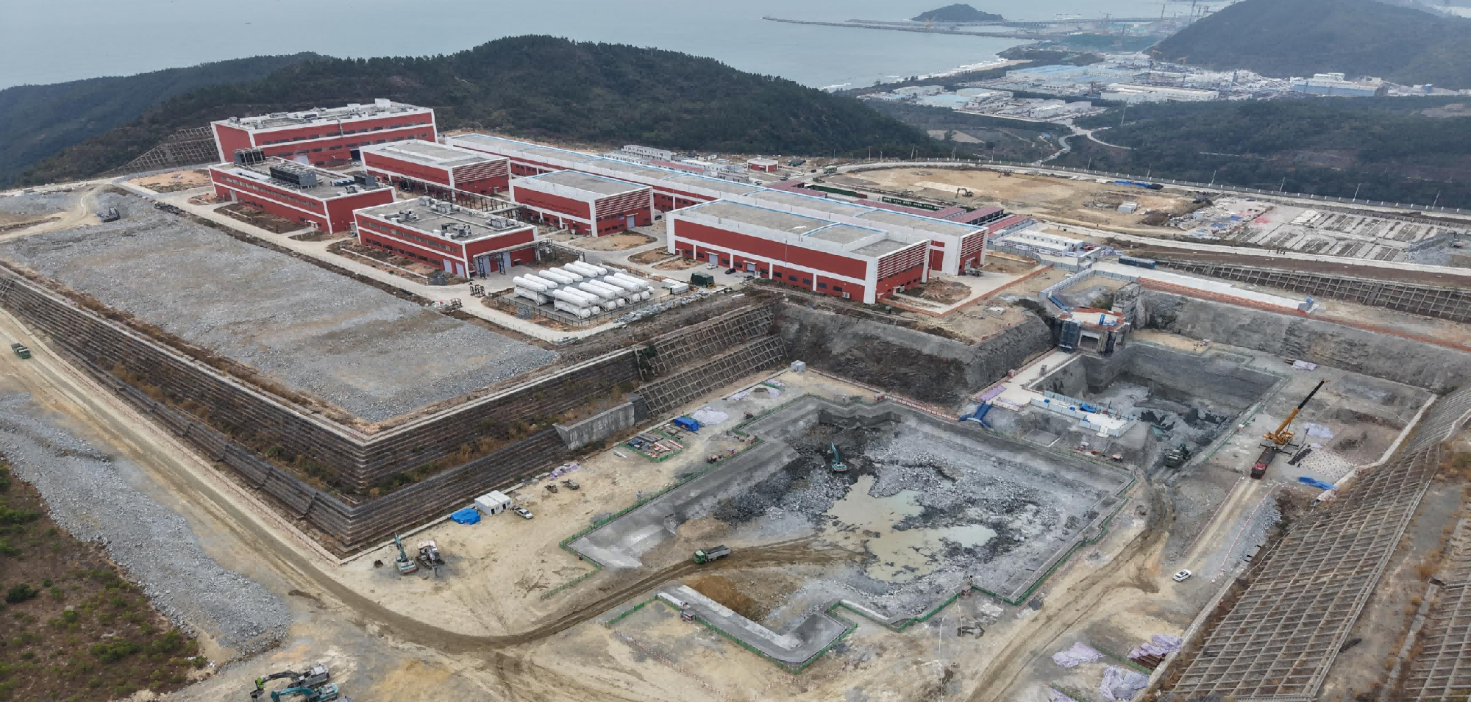
CiADS
2026.1
The Superconducting Linac
The Experiment Hall
The Reactor Hall

Slide 10
Timetable of CiADS Linac
2027~2030
3 MW:
600MeV & 5mA
2026～2027
250 kW:
500MeV & 500μA
2025～2026
  3 MW Commissioning
  Normal operation with MW-level proton beam
25 kW:
500MeV & 50μA
  Accelerator stability study
  Beam to the subcritical reactor and other terminals
  Assembly
  Commissioning
Beam time of the linac
3 months for the subcritical reactor
8–9 months for other terminals, including the muon source

Slide 11
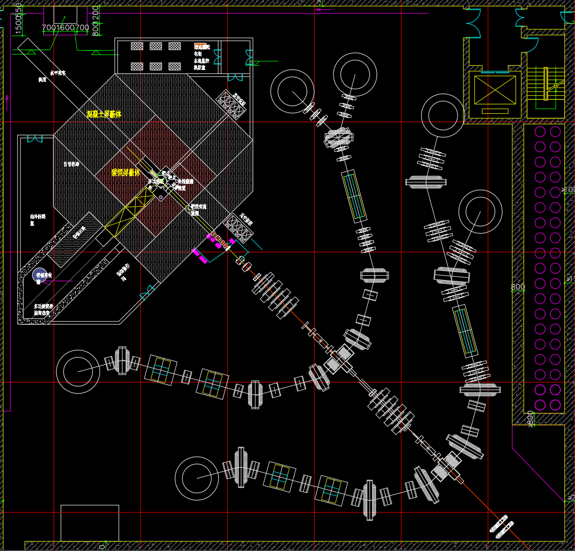
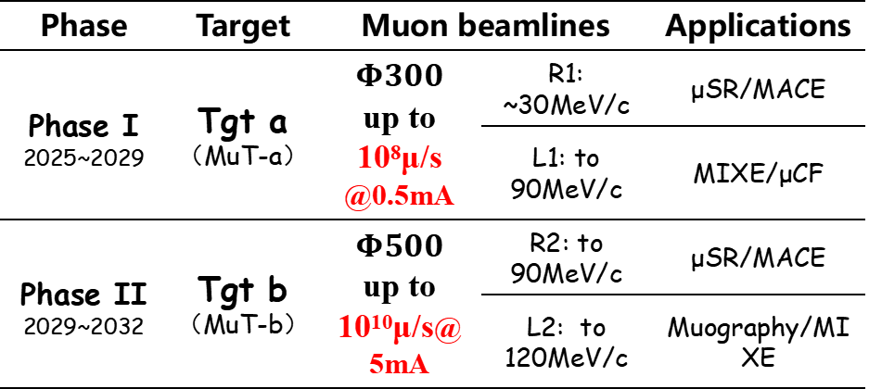
Layout and Plan of MuST
Conceptual Layout:
Each of the two tandem target feeds two muon beamlines, approximately mirror-symmetric to each other
To deliver muon beams to 6 terminals, with the intensity varies from 10⁷/s~10¹⁰/s
Plan with two phases：
MuB-R1
Muon beam lines
Phase | Target | Muon beamlines |  | Applications
Phase I 2025~2029 | Tgt a （MuT-a） | $$Φ300$$ up to 10⁸μ/s @0.5mA | R1: ~30MeV/c | μSR/MACE
 |  |  | L1: to 90MeV/c | MIXE/μCF
Phase II 2029~2032 | Tgt b（MuT-b） | $Φ500$ up to 10¹⁰μ/s@5mA | R2: to 90MeV/c | μSR/MACE
 |  |  | L2: to 120MeV/c | Muography/MIXE
Target station
MuT-a
MuB-R2
MuB-L1
Target stationMuT-b
Muon beam lines
Proton beam
MuB-L2

Slide 12
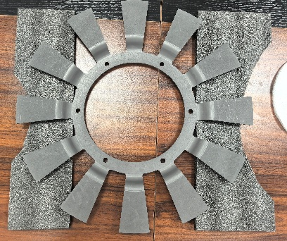
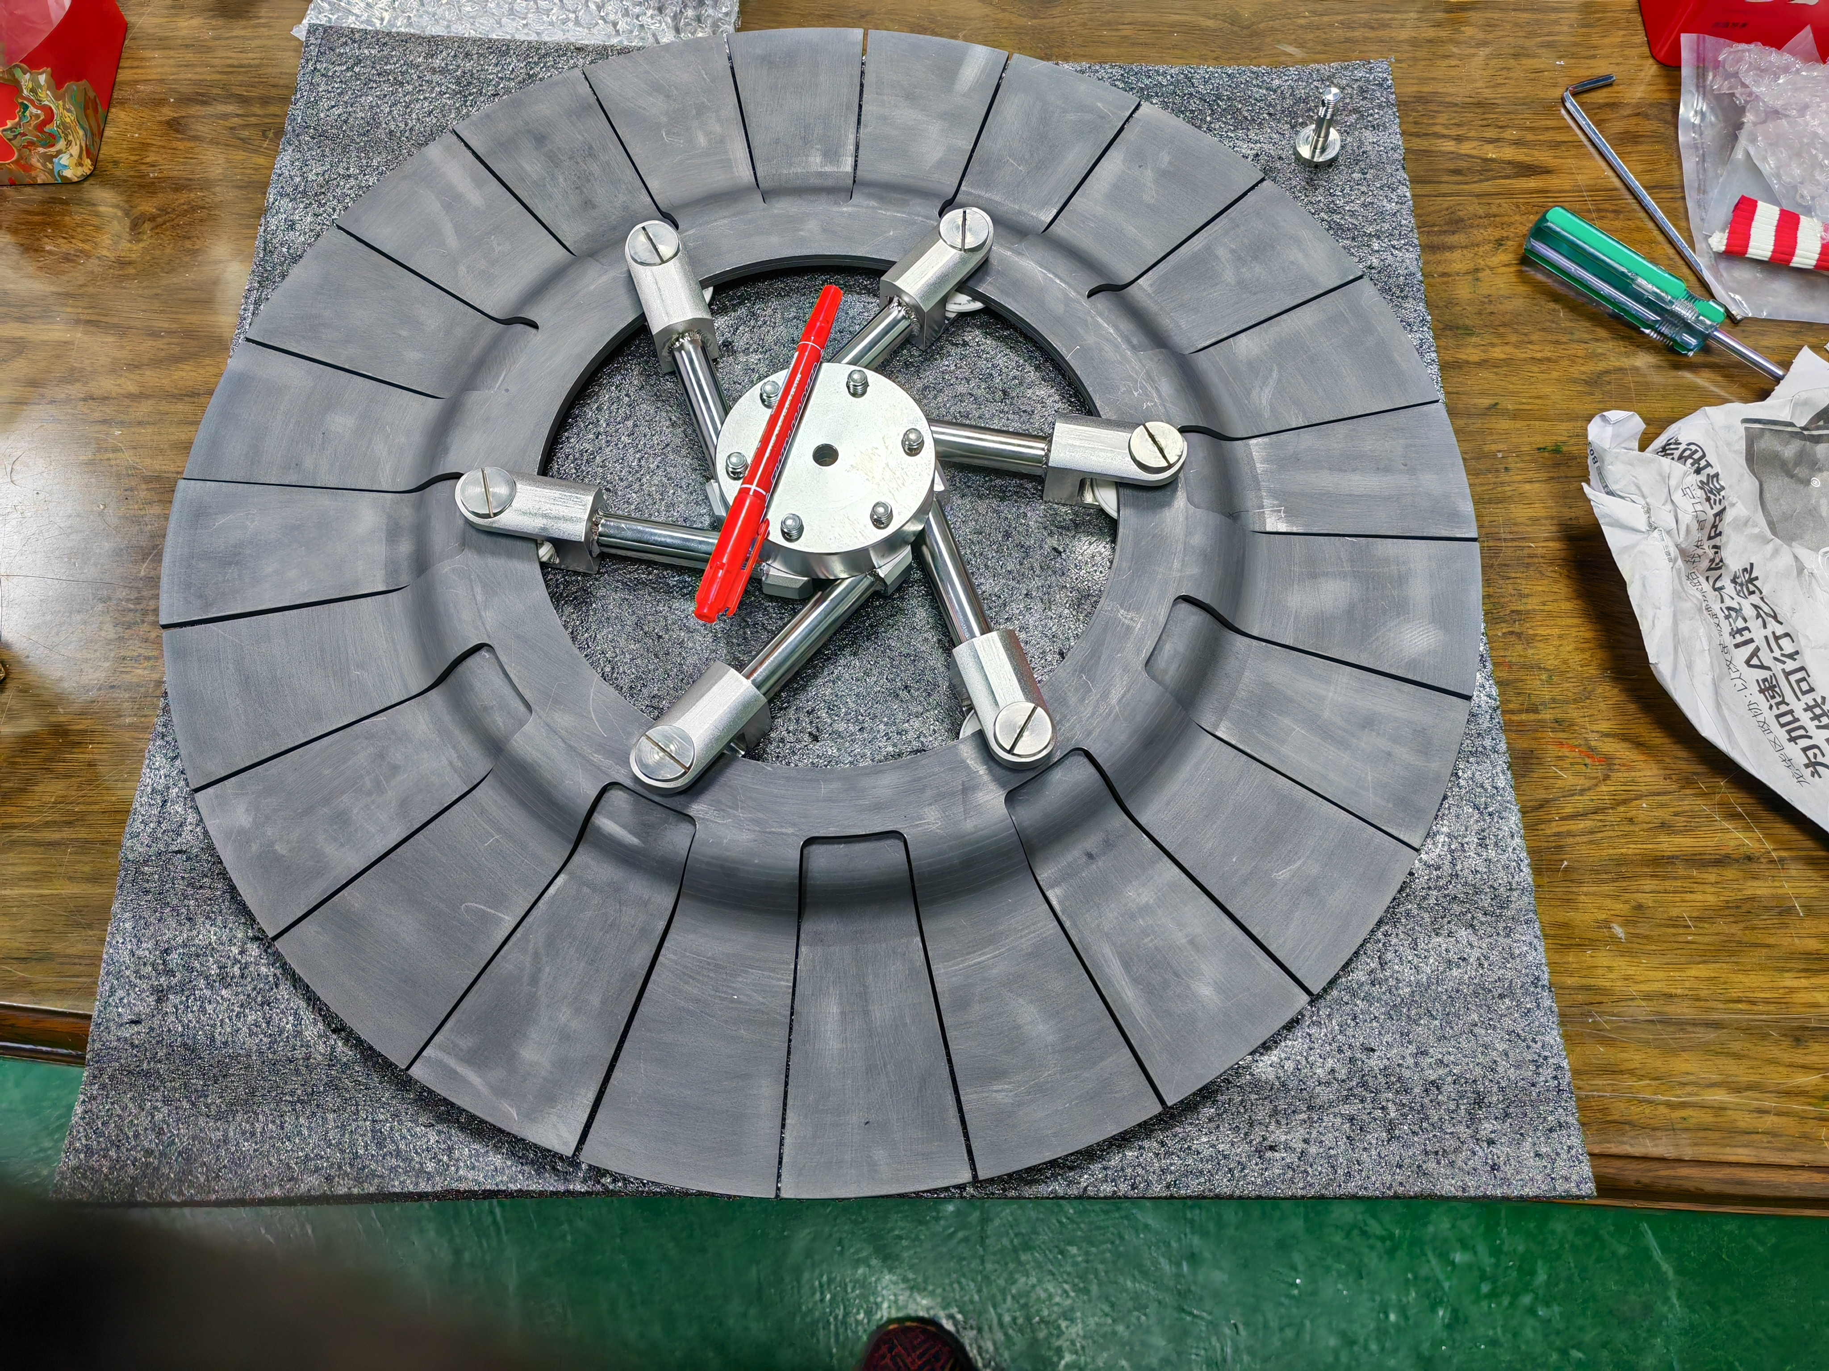
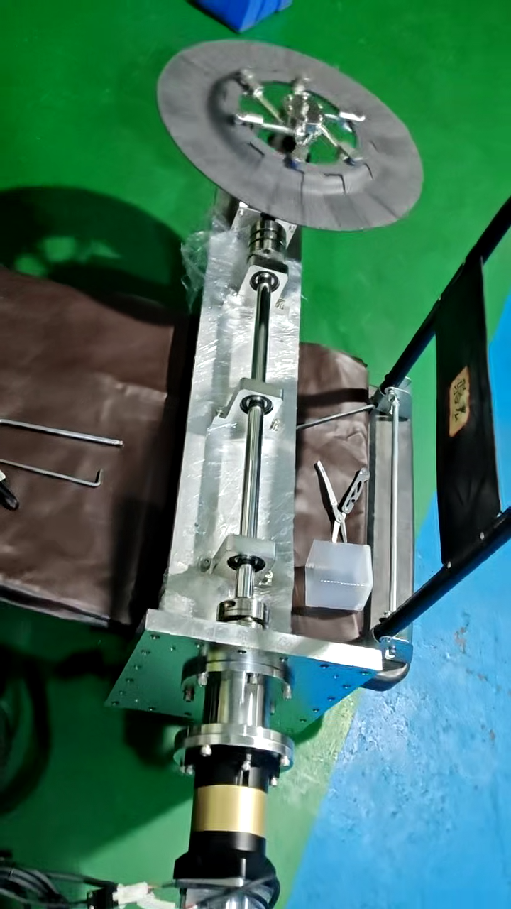
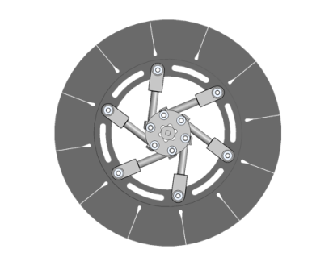
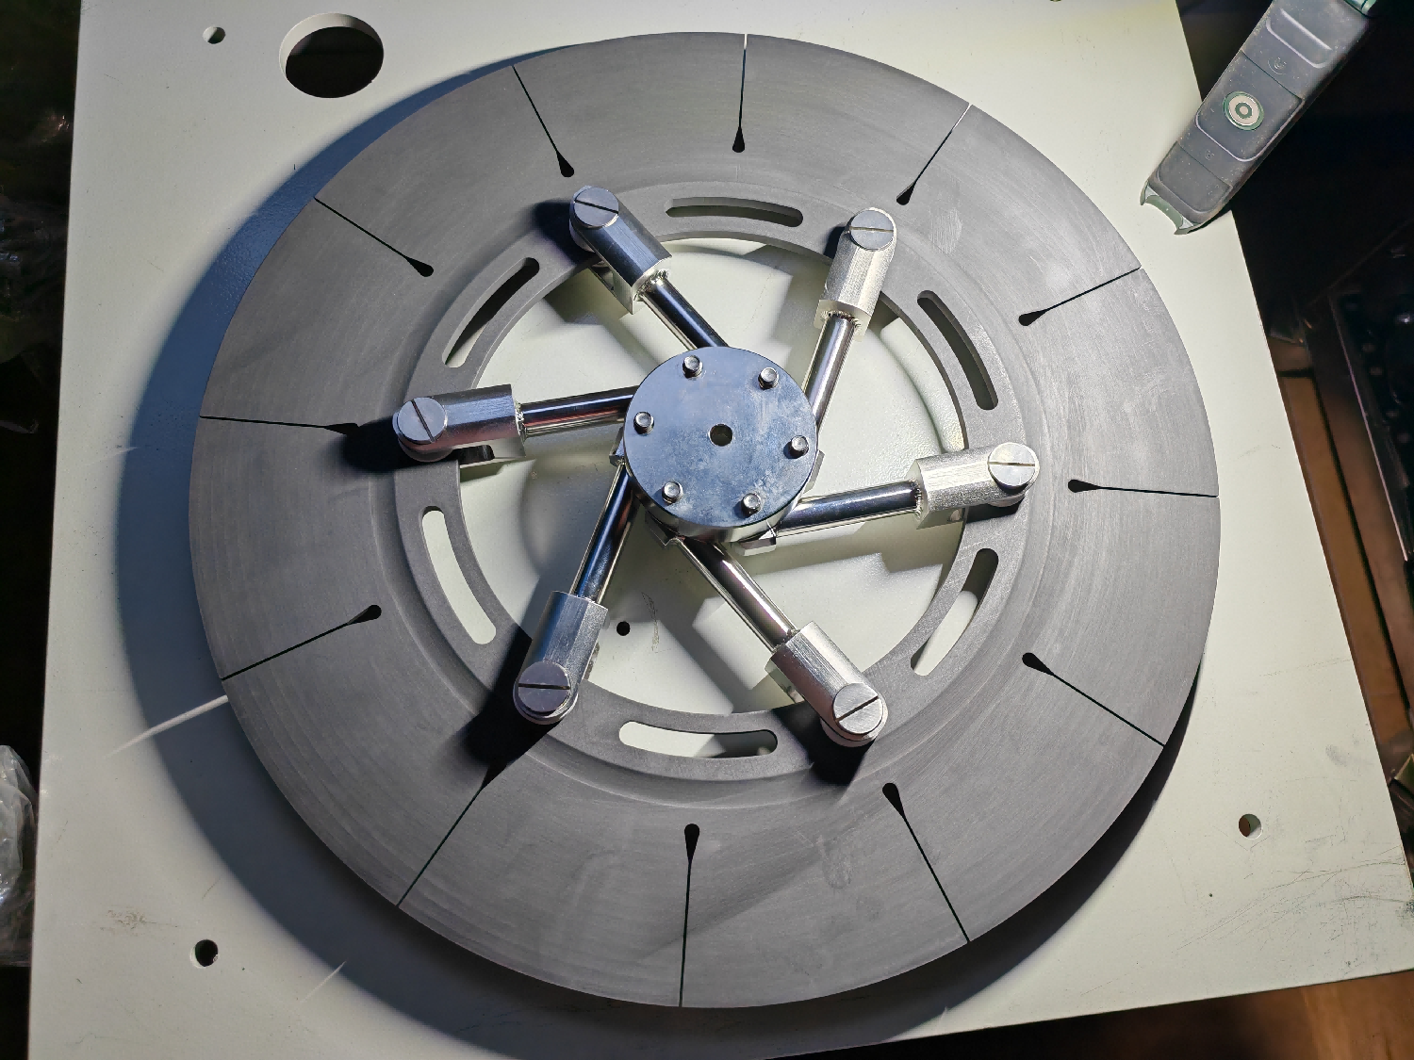
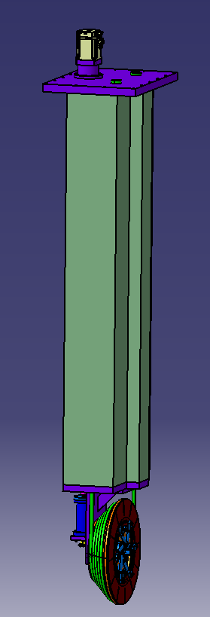
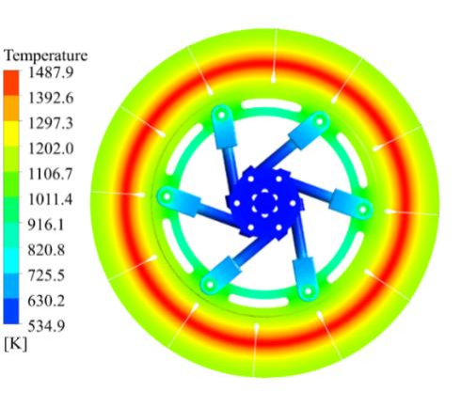
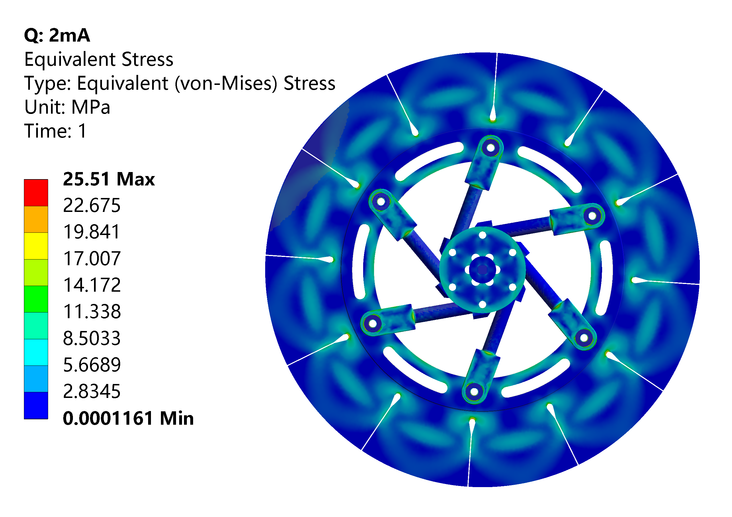
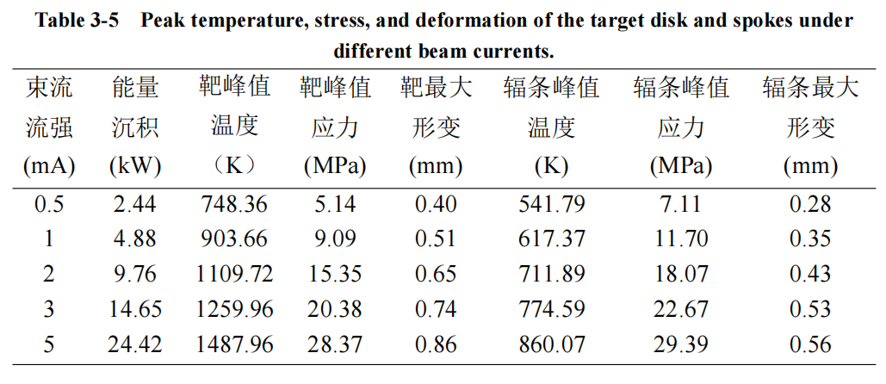
Development of the target
The first prototype
The second prototype
slant angle of 10°, effective thickness of 2 cm
Current(mA) | Temperature (℃) | Thermal stress (MPa) | Deformation (mm)
0.5 | 622 | ＜8.8 | 0.50
1.0 | 1096.4 | ＜14.9 | 0.64
2.0 | 1359.3 | ＜23.8 | 0.79
lant angle of 20°, effective thickness of 1 cm
Compact structure (Φ400mm) can operate well under a thermal power of ~25 kW.

Slide 13
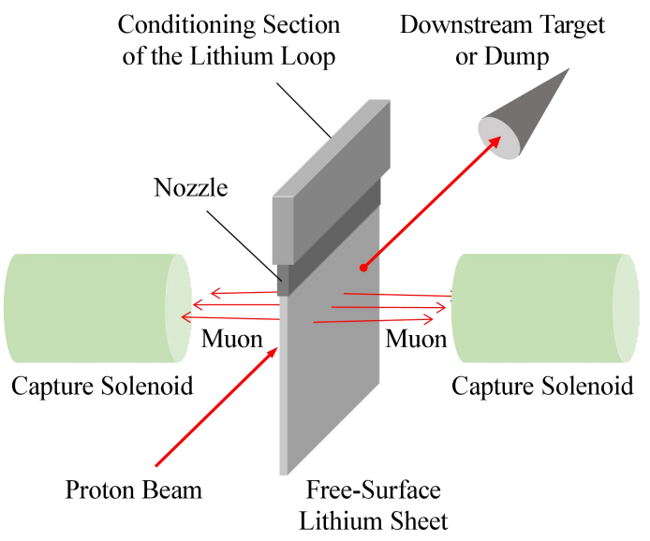
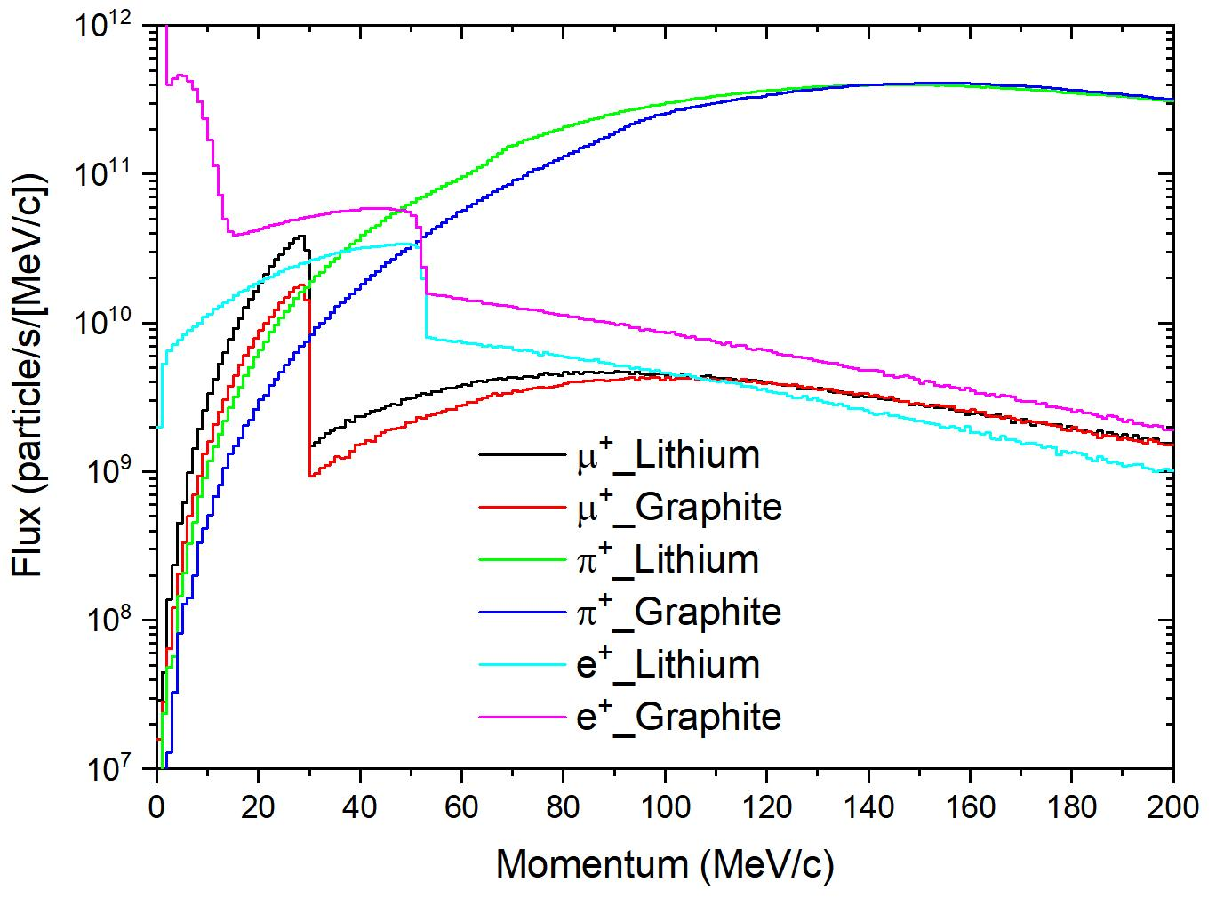
Development of the target
Concept of the liquid lithium jet target
Li target VS C target
  ×2 higher surface muon yield
  less radioactive nuclide and positrons background
  supporting higher beam power, free of irradiation damage
Li target VS C target
H.-J Cai et al, PRAB 27, 023703, 2024

Slide 14

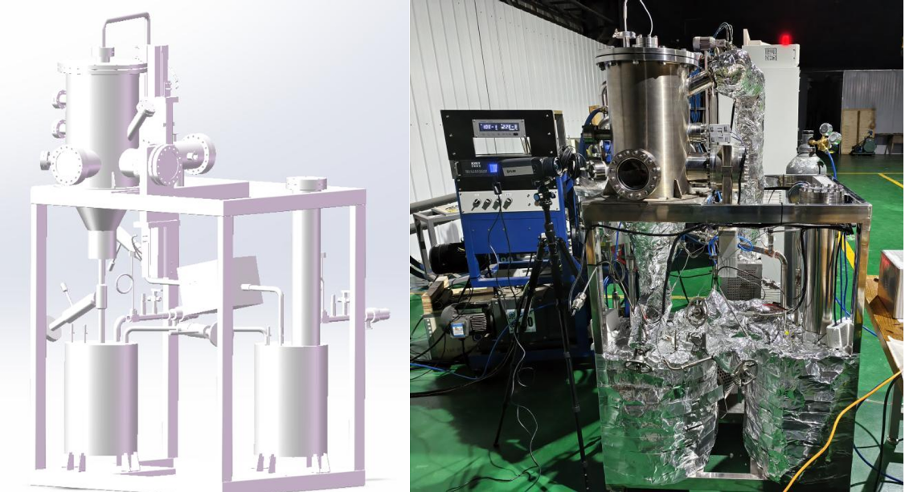
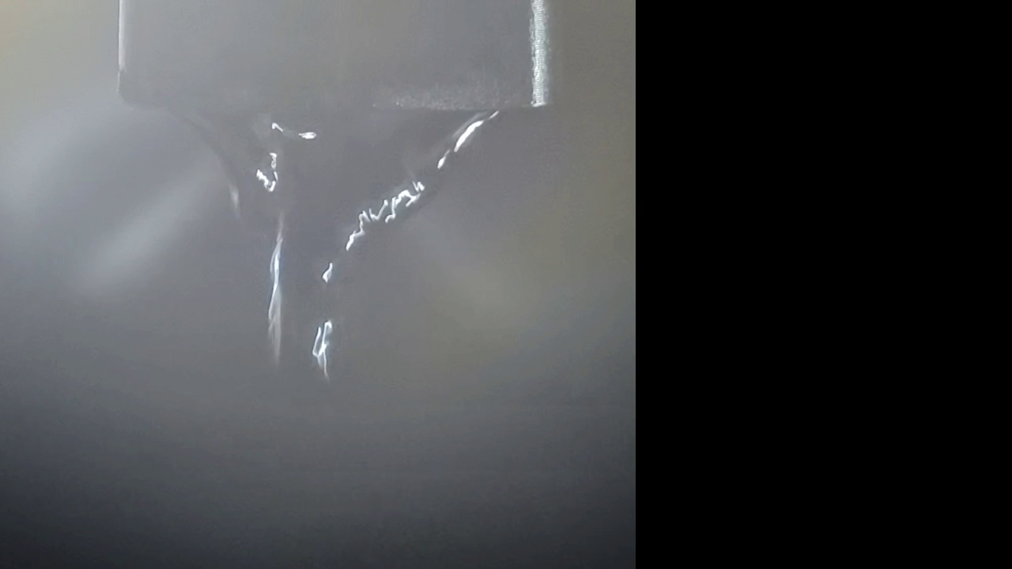
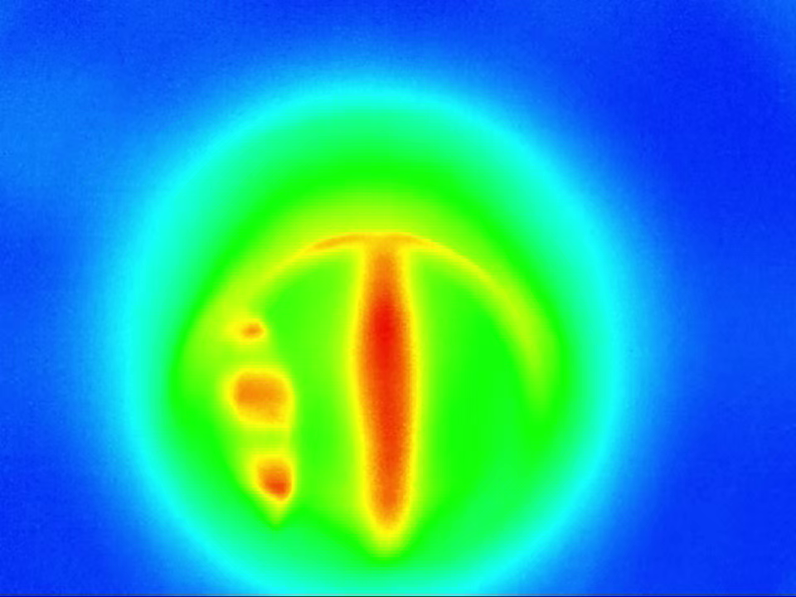
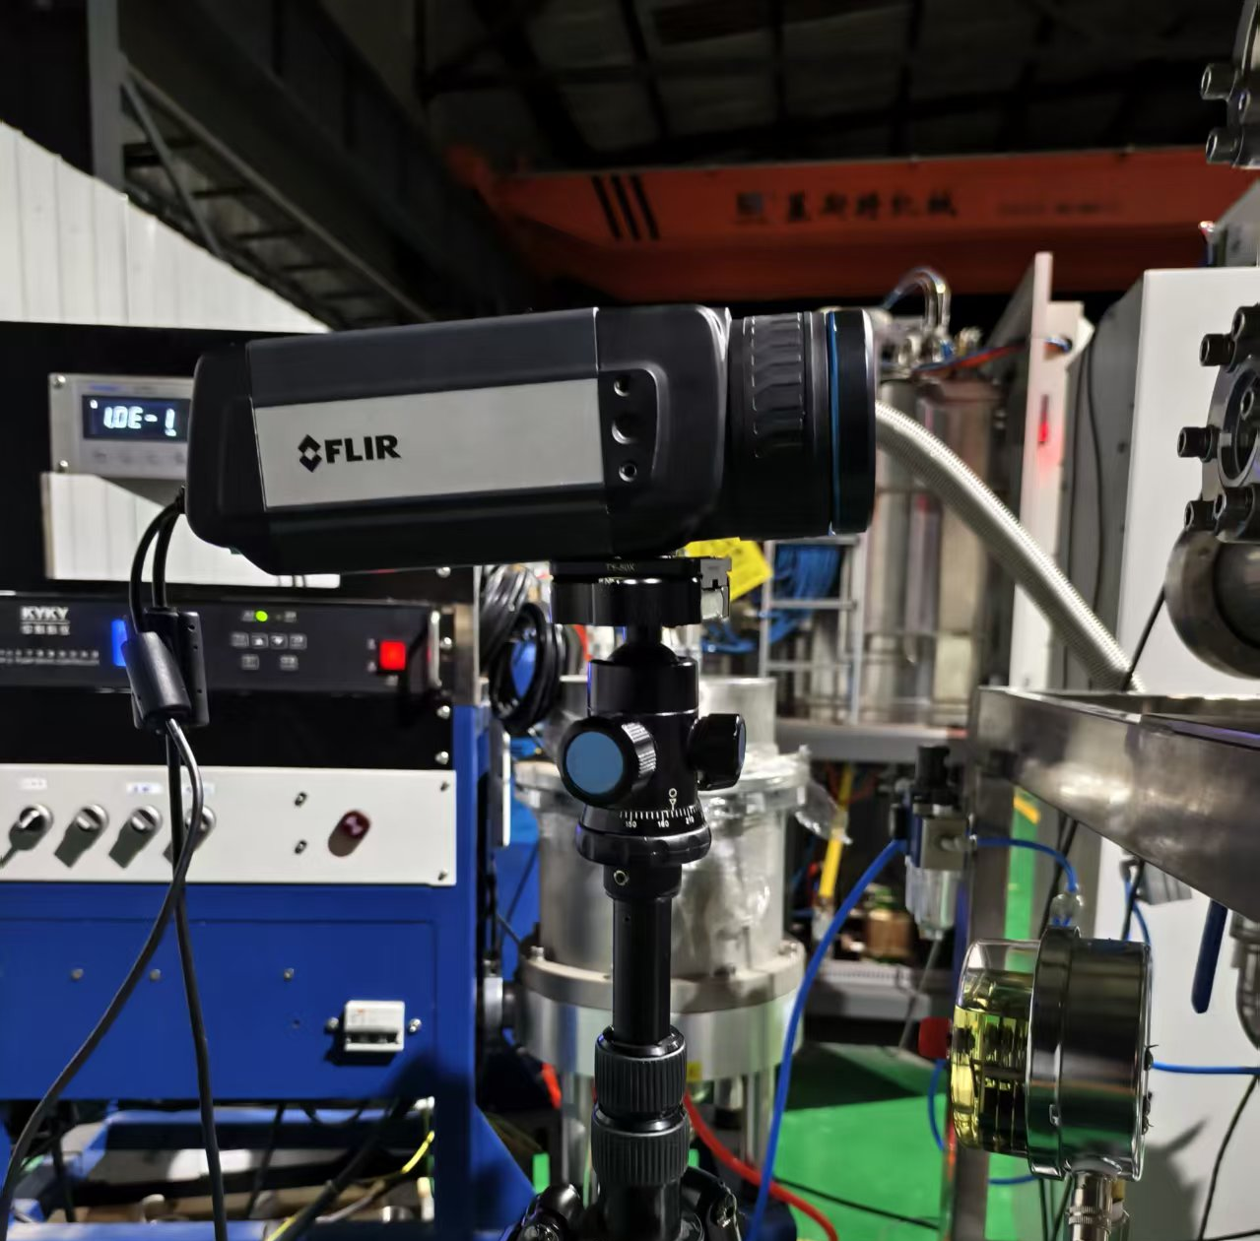
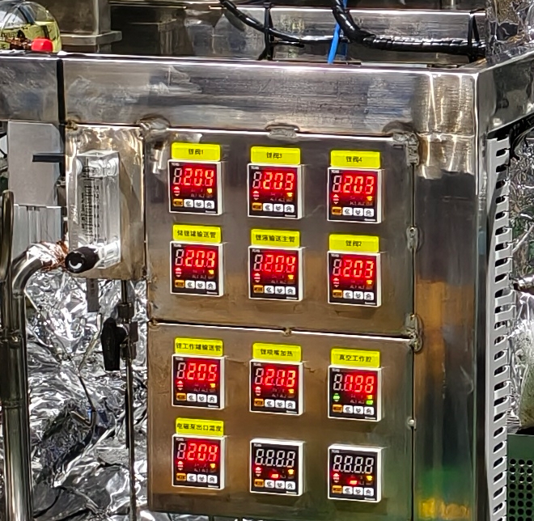
Development of the target
  The liquid lithium loop operated successfully;
  The First-stage experiments have been finished;
  The electromagnetic pump need to be exchanged for a higher mass flow.
Cooperated with Zongbiao Ye, Sichuan University

Slide 15
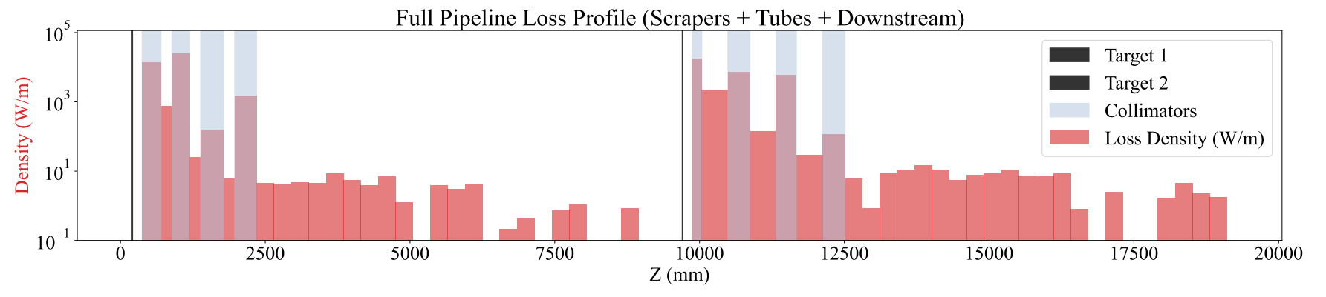
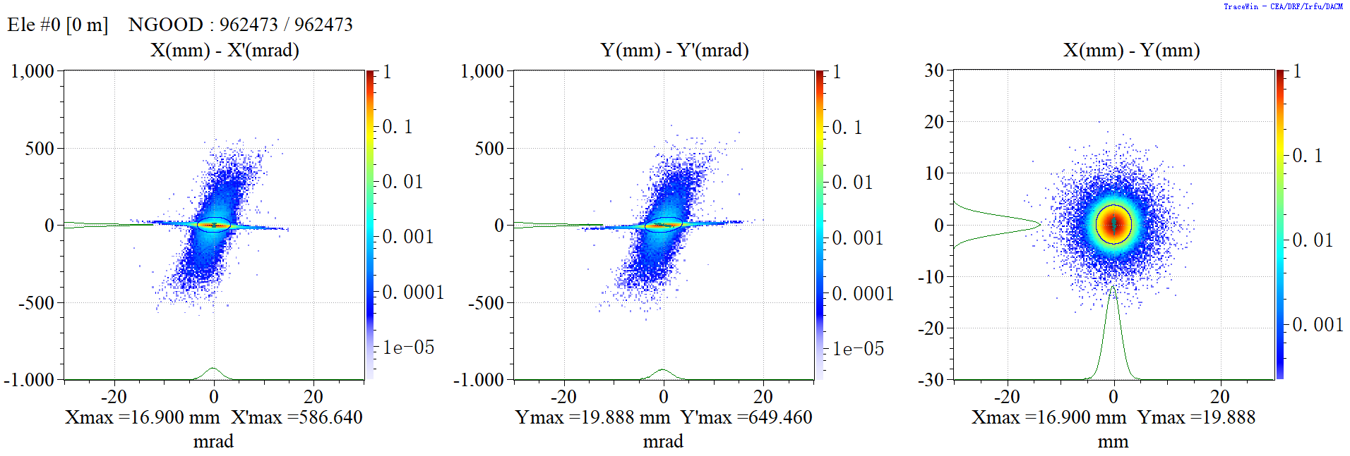
Development of the Collimators
The emittance will increase significantly after the beam penetrating the target: from ~1 mm·mrad to ~30 mm·mrad
A combination of collimators and quadrupole magnets is used to control the beam envelope and suppress beam loss
After optimization, the beam loss along the whole line is well below 10 W/m
Collimators
Collimators
Proton beam
Target station（MuT-b）
Target station（MuT-a）

Slide 16
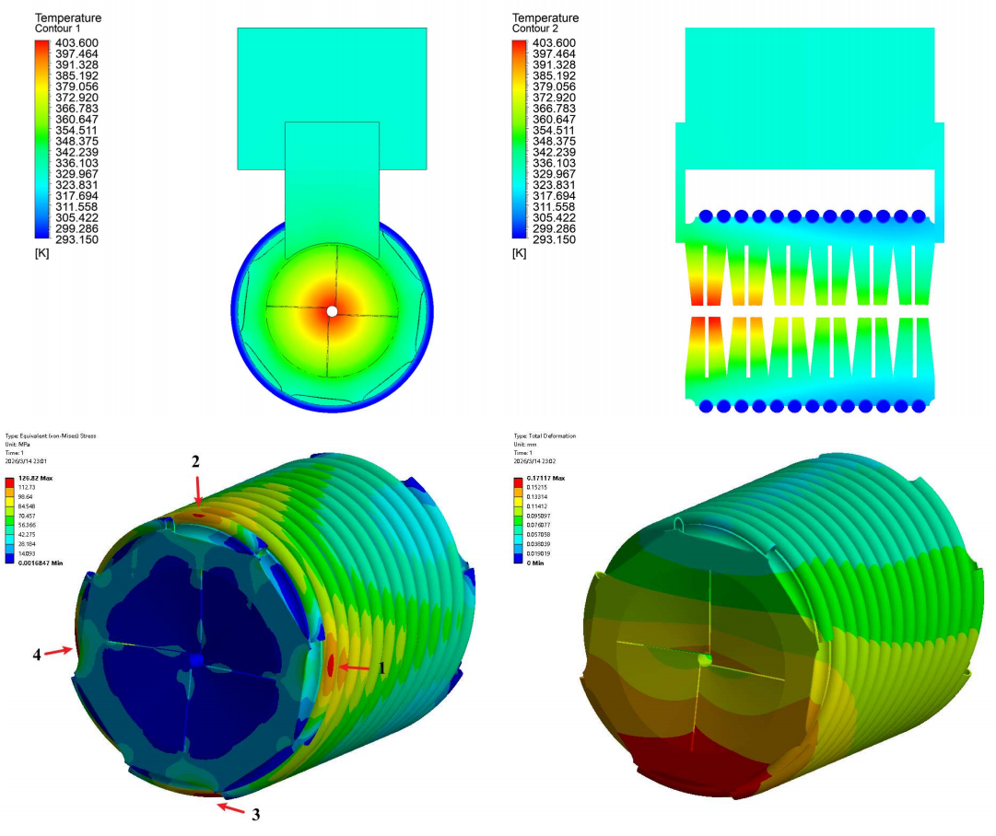
Development of the Collimators
The emittance will increase significantly after the beam penetrating the target: from ~1 mm·mrad to ~30 mm·mrad
A combination of collimators and quadrupole magnets is used to control the beam envelope and suppress beam loss
After optimization, the beam loss along the whole line is well below 10 W/m
Collimators
Collimators
Proton beam
Collimators were designed to work at 3-MW-proton beam
Thermal performance under a heat load of 32kW

Slide 17
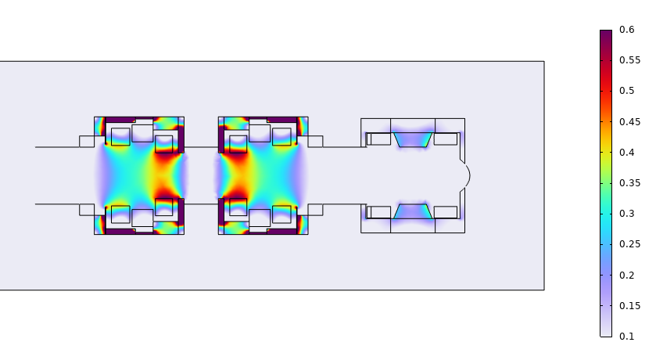
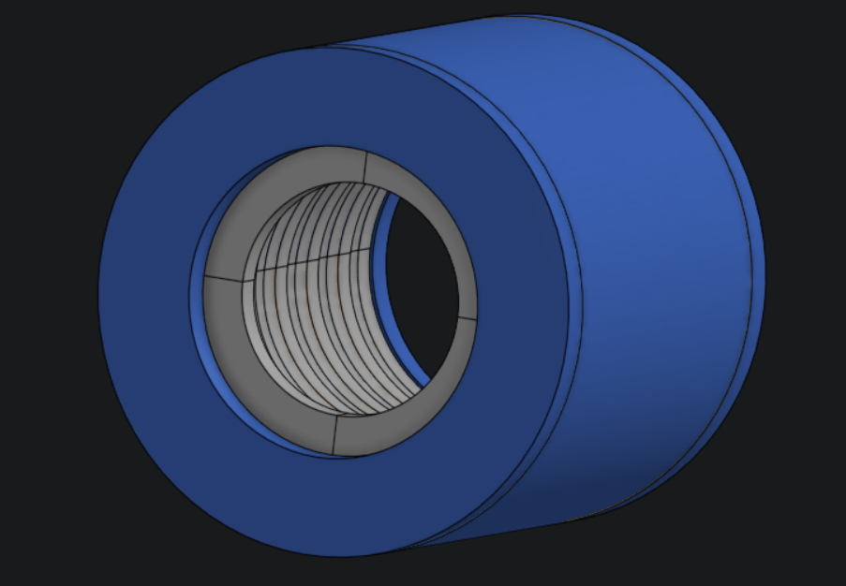
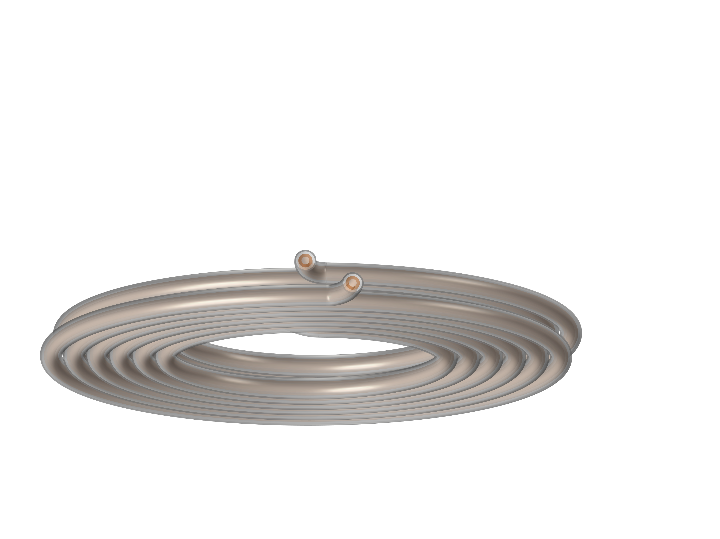
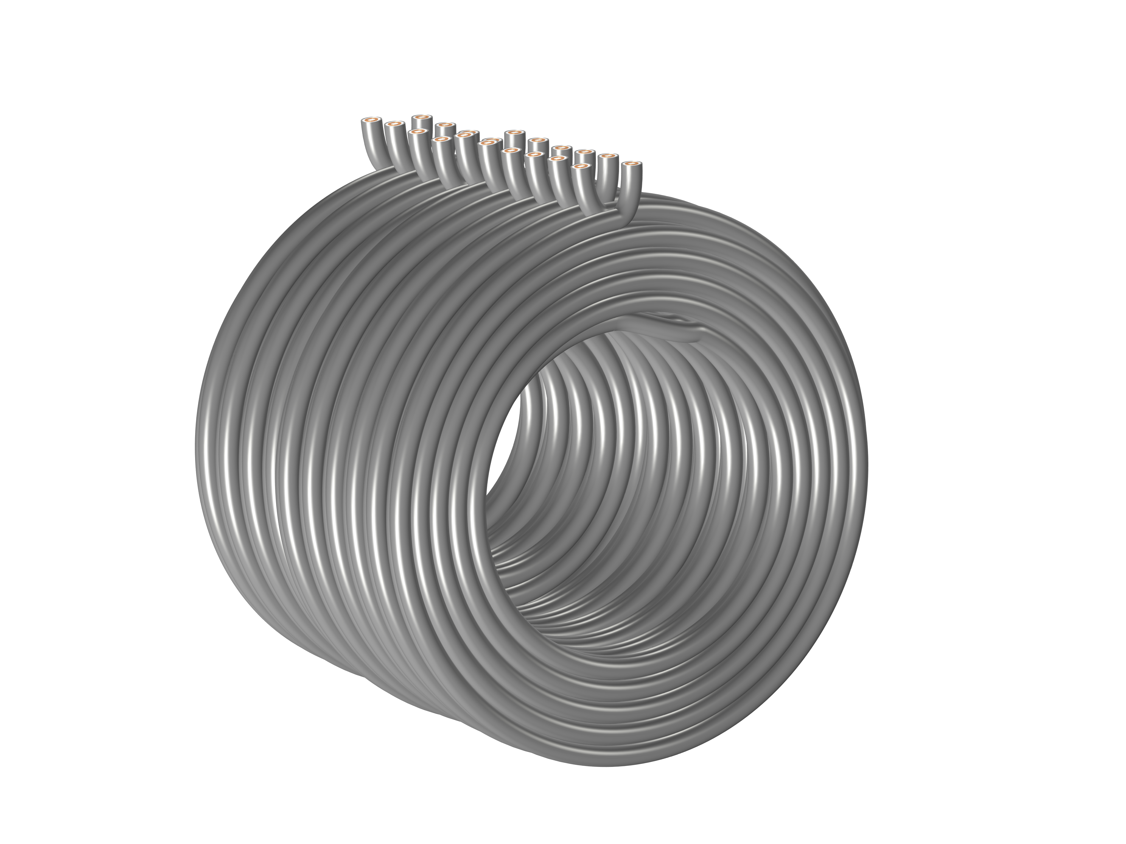
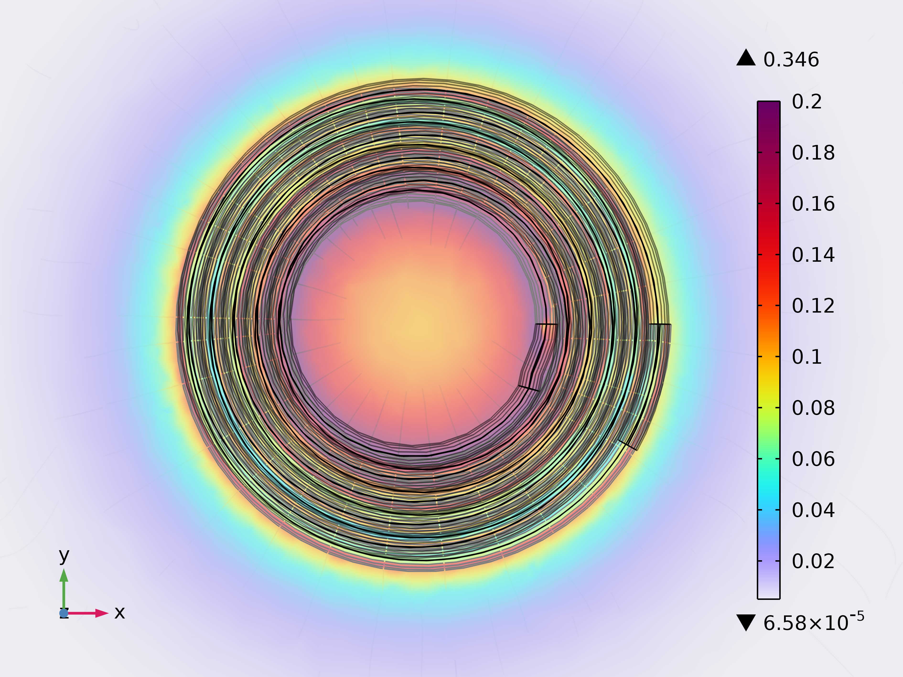
Development of the capture solenoid
Capture field design
To obtain a high capture efficiency
To reduce deflection effect of proton beam by fringe field
Field map of the front-end section
Configs | Inner radius (mm) | Layers | Quantity | I (A) | dT (℃) | P (bar)
1 | 300 | 5 | 1 | 2130 | 22 | 5
2 | 360 | 4 | 2
3 | 370 | 4 | 3
4 | 380 | 4 | 3
5 | 390 | 4 | 3
6 | 400 | 4 | 2
Armor
MgO
Copper
Water

Slide 18
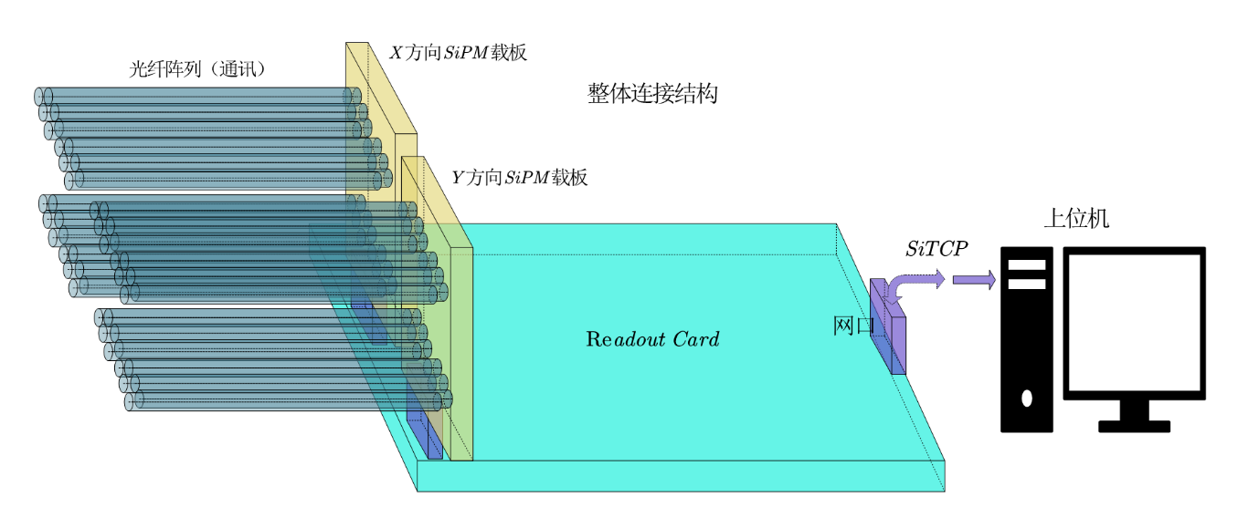
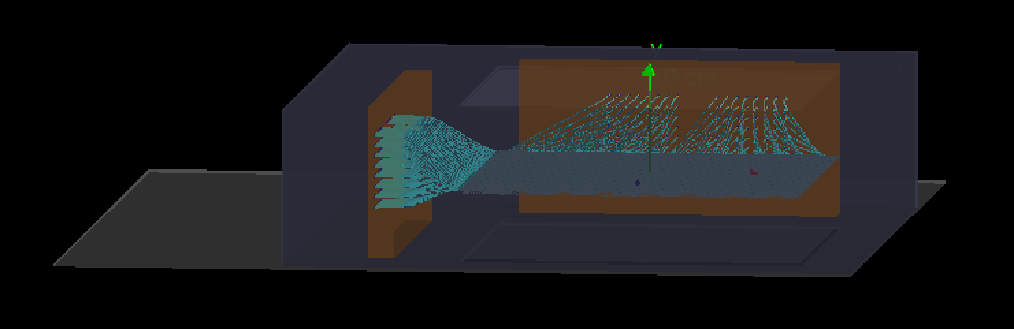
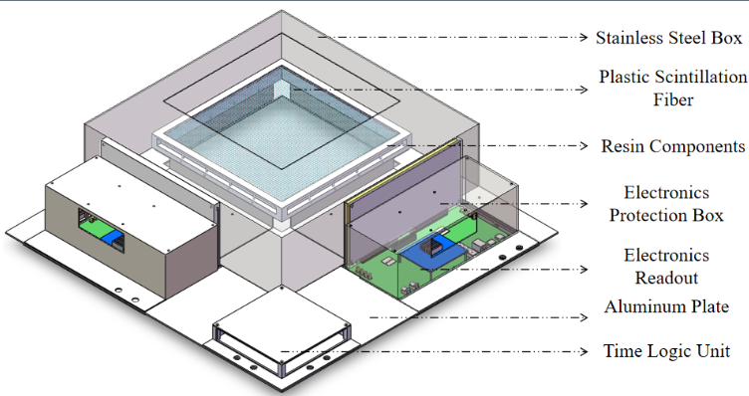
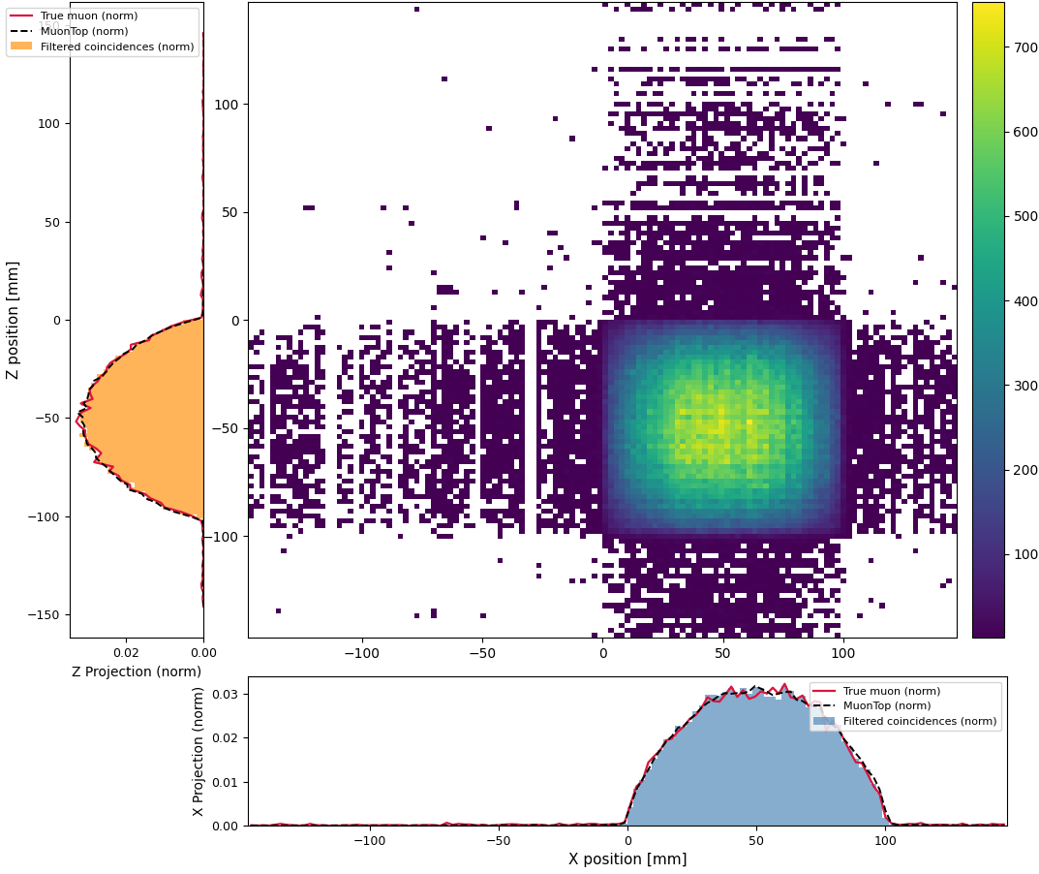
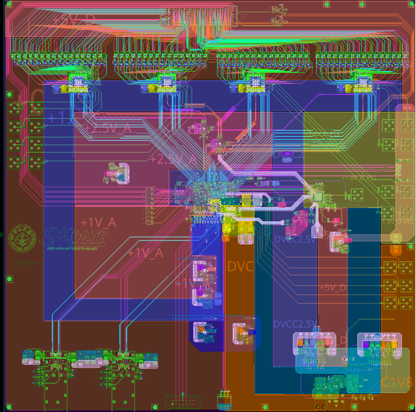
Development of muon beam monitor
Design specifications for the monitor
Position resolution: <5mm
Time resolution: 1ns
Trigger rate: 5MHz
Electronics dead time: 1%
Reconstruction of the muon beam
Electronics design
Design of the muon beam monitor Sci-Fi +SiPM
Cooperated with Jian Tang, Sun Yat-sen University

Slide 19
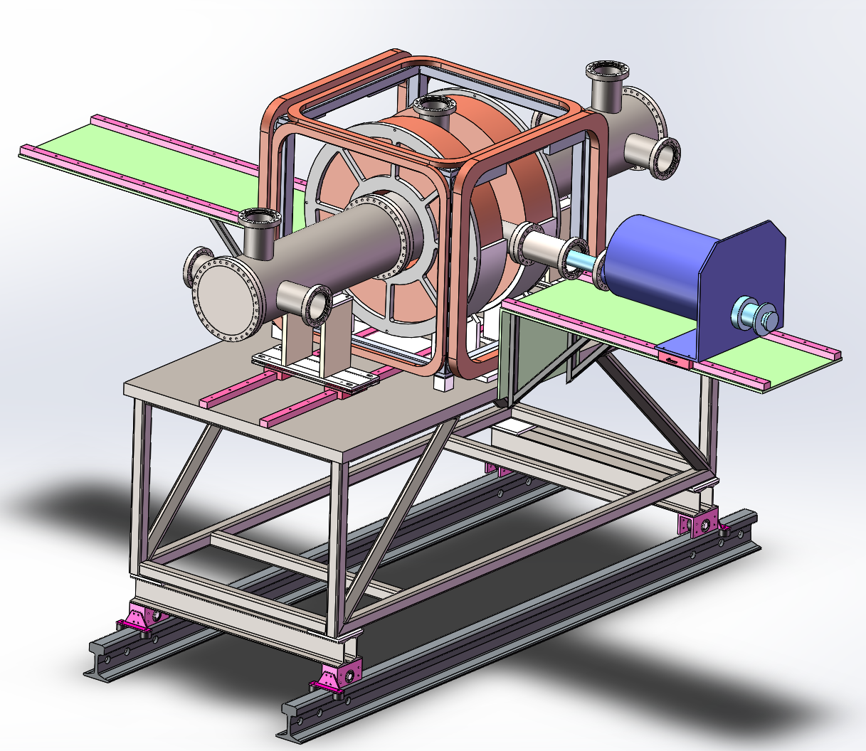
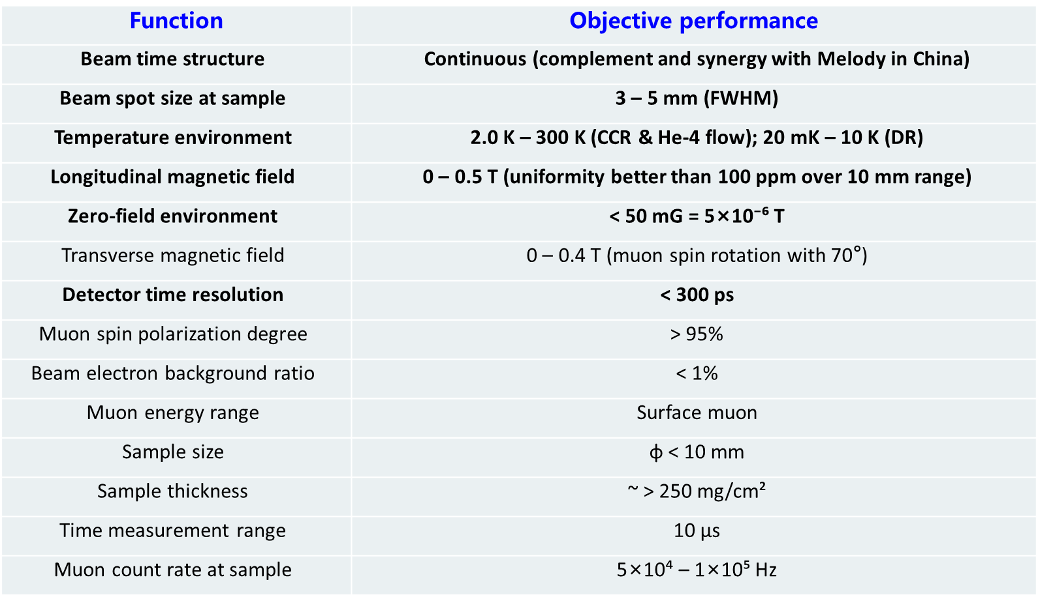
Development of MuSR Spectrometer
Conceptual design of a general-purpose μSR spectrometer
Objective performance
Cooperated with Ziwen Pan, USTC

Slide 20
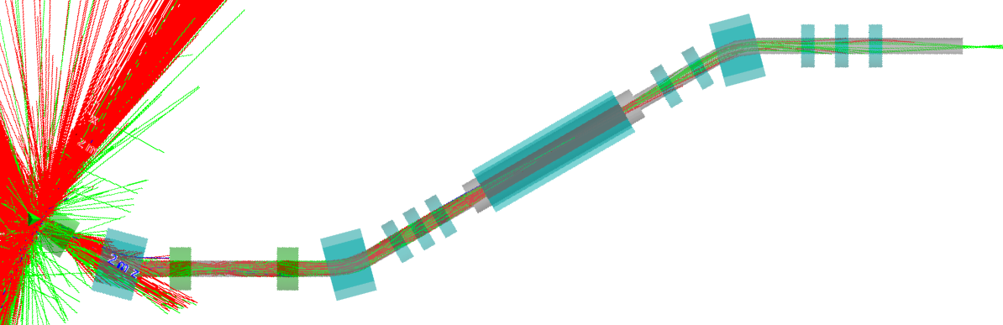




Progress of muon beamlines design
RMS envelope
Phase I, Line R1
Fucused into Φ30mm
Design of muon beamline
Three dipoles to avoid a direct line-of-sight to the target
Solenoid + QM focus surface muon beam into Φ30mm for μSR experiments
Intensity: ~5.6E6 μ⁺/s @ 0.5mA，Polarization~96.4%，Background_rate＜0.1%, Momentum~27.0±1.0MeV
Transmission
Within Φ300mm, overall efficiency of ~0.11% and intensity of ~2.1E7 μ⁺/s @ 0.5mA
Conceptual layout of 4 beamlines

Slide 21





Progress of muon beamlines design
RMS envelope
Phase I, Line L1
Fucused into Φ300mm
Transmission
Design of muon beamline
Full solenoid focusing for high-intensity surface/decay muons.
Aperture of Φ300mm to be cost-effective
An overall efficiency of ~1.2% and ~3E8 μ⁺/s surface muons @ 0.5mA
Within Φ300mm, overall efficiency of ~1.2% and intensity of ~3E8 μ⁺/s @ 0.5mA
Conceptual layout of 4 beamlines

Slide 22




Progress of muon beamlines design
RMS envelope
Phase II, Line L1
Fucused into Φ100mm
Design of muon beamline
Solenoid aperture of Φ500mm and double Wien-filters for a high efficiency
Towards 10 billion muon rate:
Surface muon: ~1E10 μ⁺/s @ 5mA
Decay muon (80 MeV/c): ~3E9 μ⁺/s and ~5E8 μ⁻/s @ 5mA
Transmission
Within Φ500mm, overall efficiency of ~3.9% and intensity of ~1E10 μ⁺/s @ 5mA
Conceptual layout of 4 beamlines

Slide 23


Summary
The conceptual design of the muon beamlines has been completed. The beam parameters are very competitive.
The development of the targets, the proton beam collimators, the muon beamline components and the MuSR spectrometer is ongoing, and good progress has been achieved.
The first muon beamline has entered the TDR phase. We warmly welcome collaborations and precious advice.

Slide 24

Thank you so much！

