Slide 1

CEPC vacuum chamber NEG coating automatic fabrication line development
Yongsheng Ma
Vacuum group, IHEP,CAS
CEPC Day 15-06-2026

Slide 2
Content
Production line development of NEG coating/ Spray for heating film
Radiation resistant heating-layer coating development
Workshop survey for production line
Next step work
Summary

Slide 3
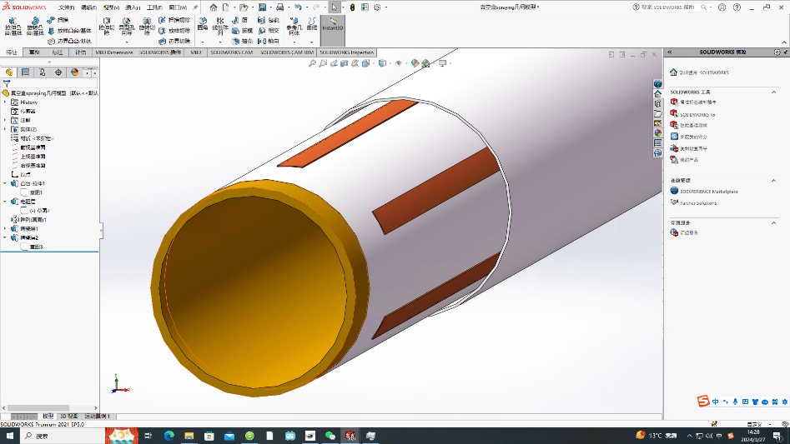
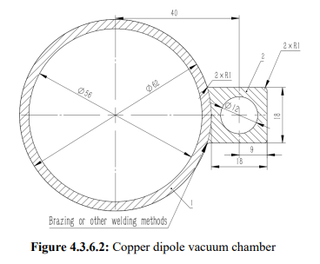
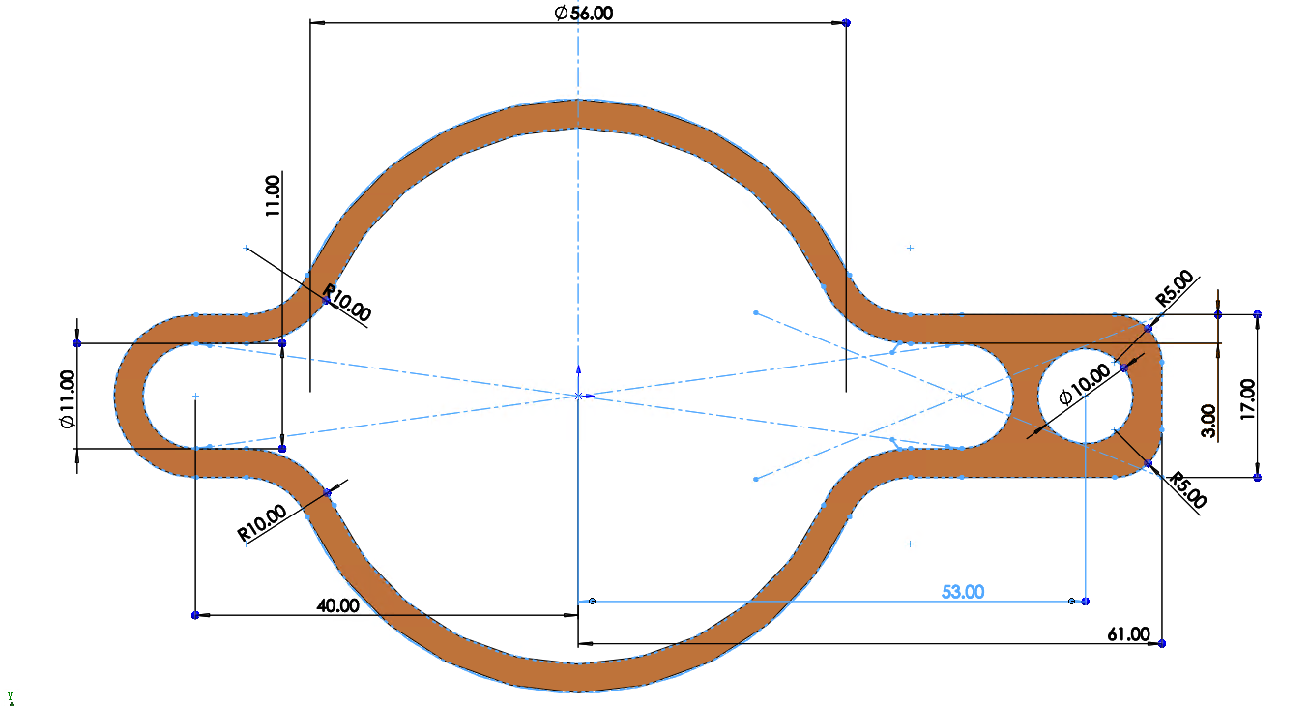
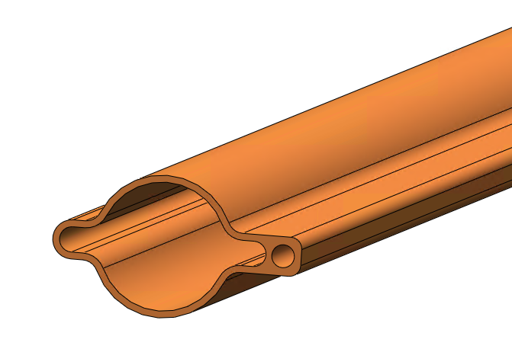
Structure of vacuum chamber for CEPC collider rings
Heating layer
Alloy copper
NEG coating
56
VC with photon absorber
Notes:
A thorough comparison of the advantages and disadvantages of the proposed distributed approach versus
the photon stopper approach is necessary for effective management of synchrotron radiation;

Slide 4
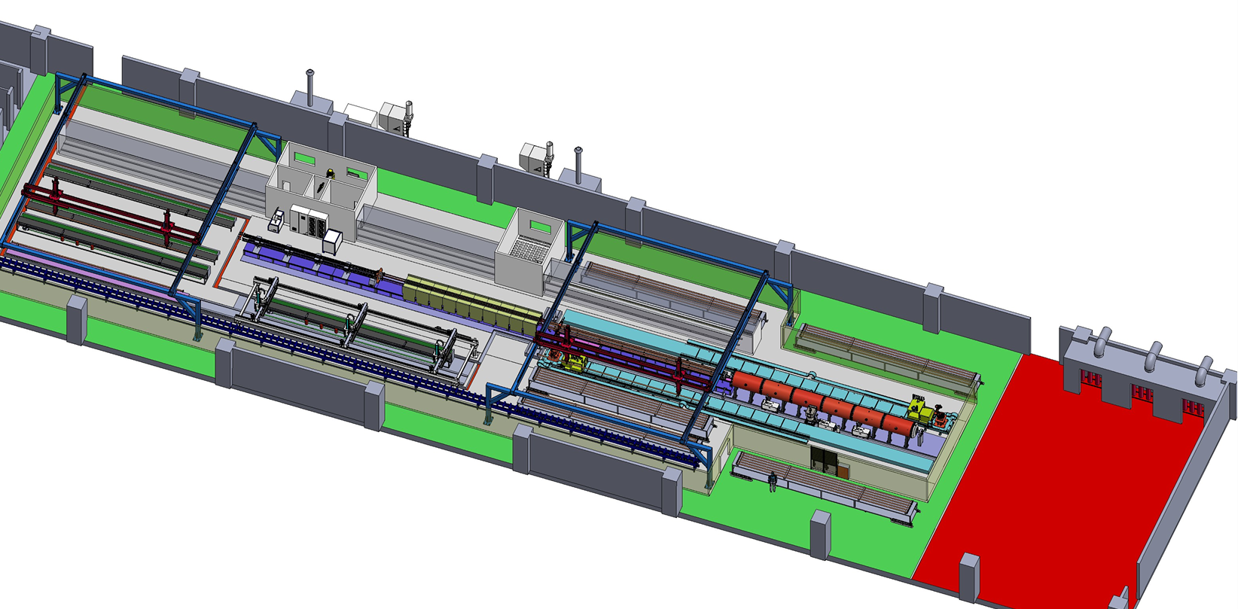
Preview of NEG coating/ Spray for heating film production line
Requirement
Due to the difference in length, two production lines will be used to complete the production of vacuum chambers for the CEPC collider. The quantity of NEG coating and spraying facilities for the two lines varies to match the production speed.
The full quantity of vacuum chambers for the collider will be manufactured within five years, utilizing two production lines operating at a combined capacity of 4,500 units per year.
Advantages
More stable process, less manpower, less NEG coating facility, more adaptive capacity in production, etc.
Heating layer spraying
Items | Specifications
Dimension | L 11400-d56-D62
Weight | 50~100kg
NEG coating | Thickness：200nm±30% SEY<1.1 S、Q、life-times
Spraying heating | Thickness<0.5mm Heating temperature <300℃
Cleaning (not include)
NEG coating

Slide 5
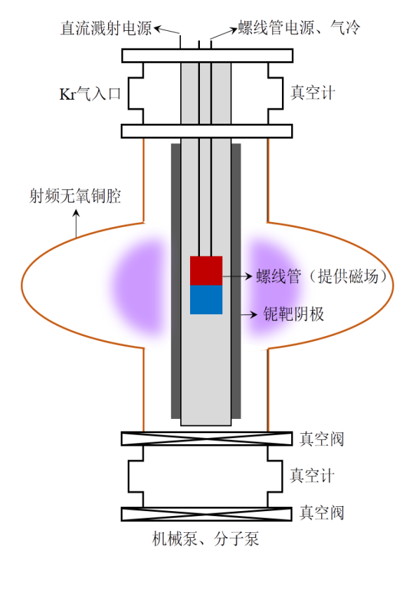
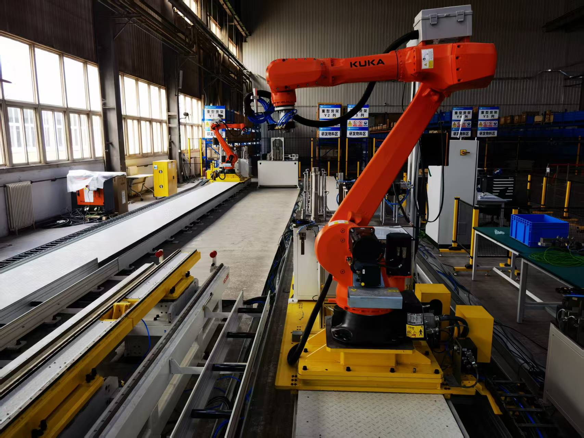
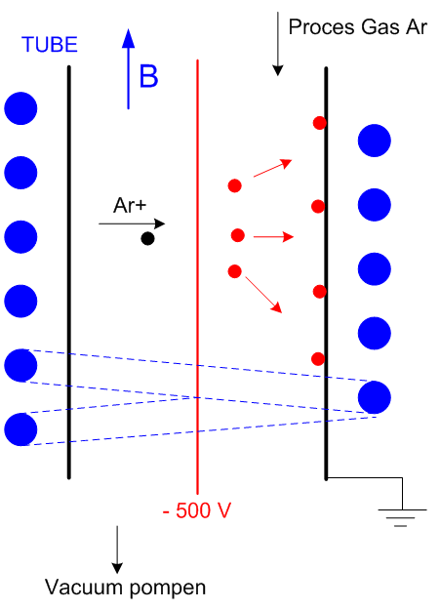
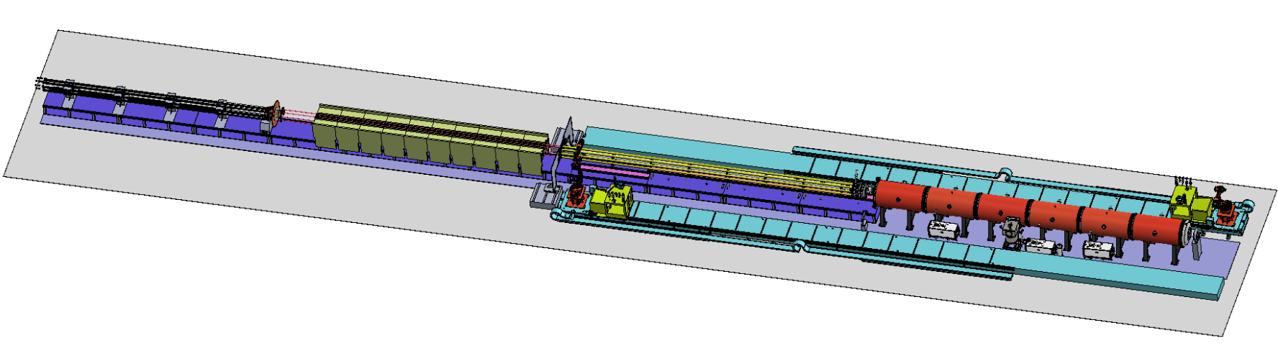
Layout & composition of NEG coating facility
NEG coating, VC assembly and disassembly with automatic robot arms.
DCMS for NEG coating
Kr+
磁环
Cathodes driven
Inside magnet
Cathodes
VC assembly
Vacuum oven

Slide 6
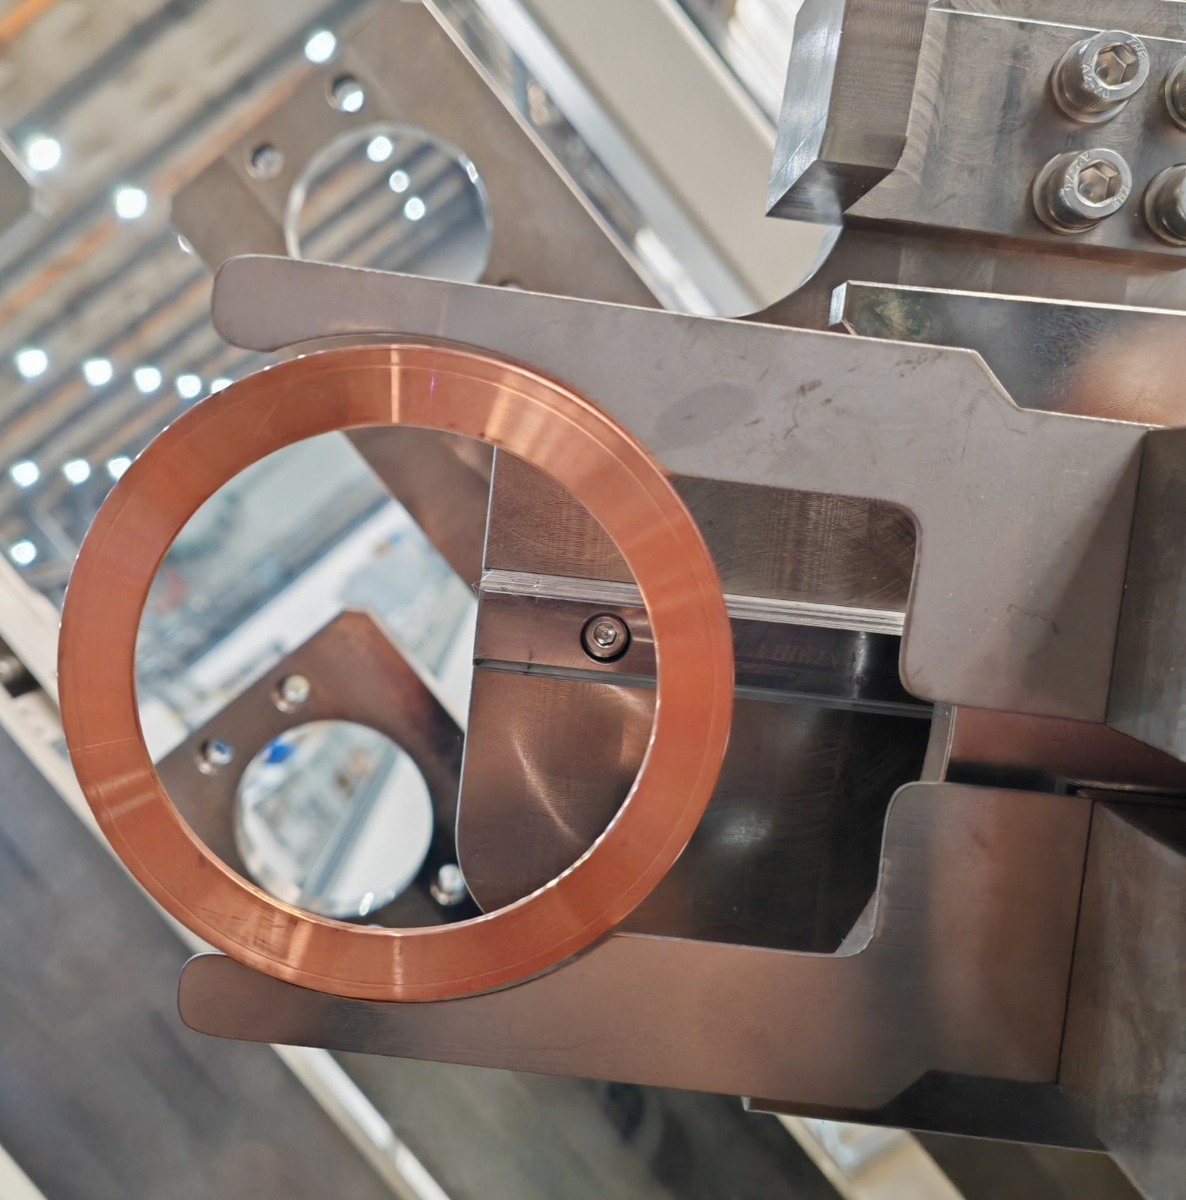
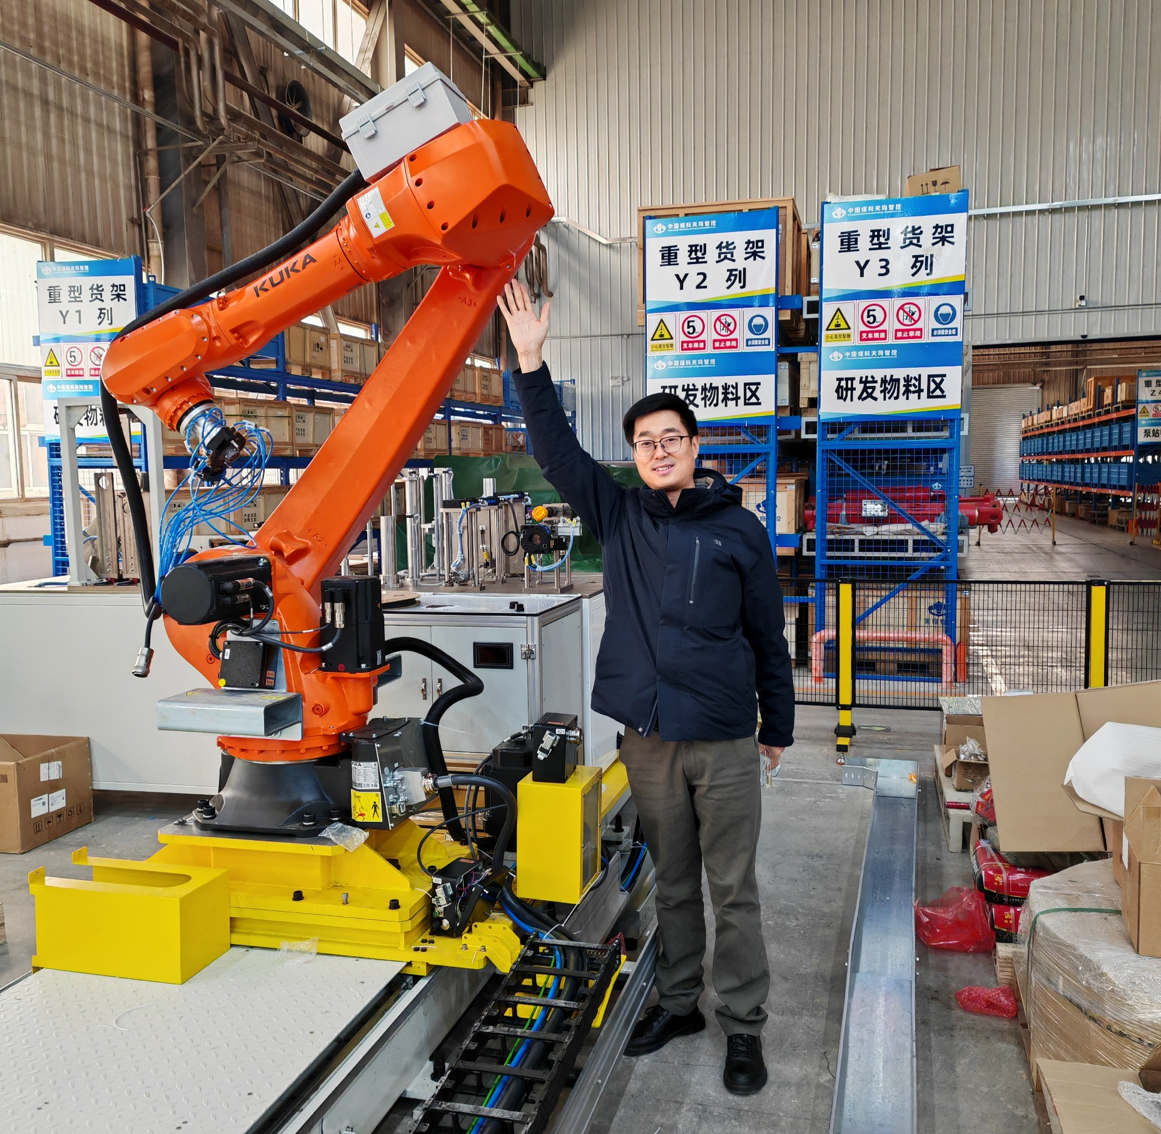
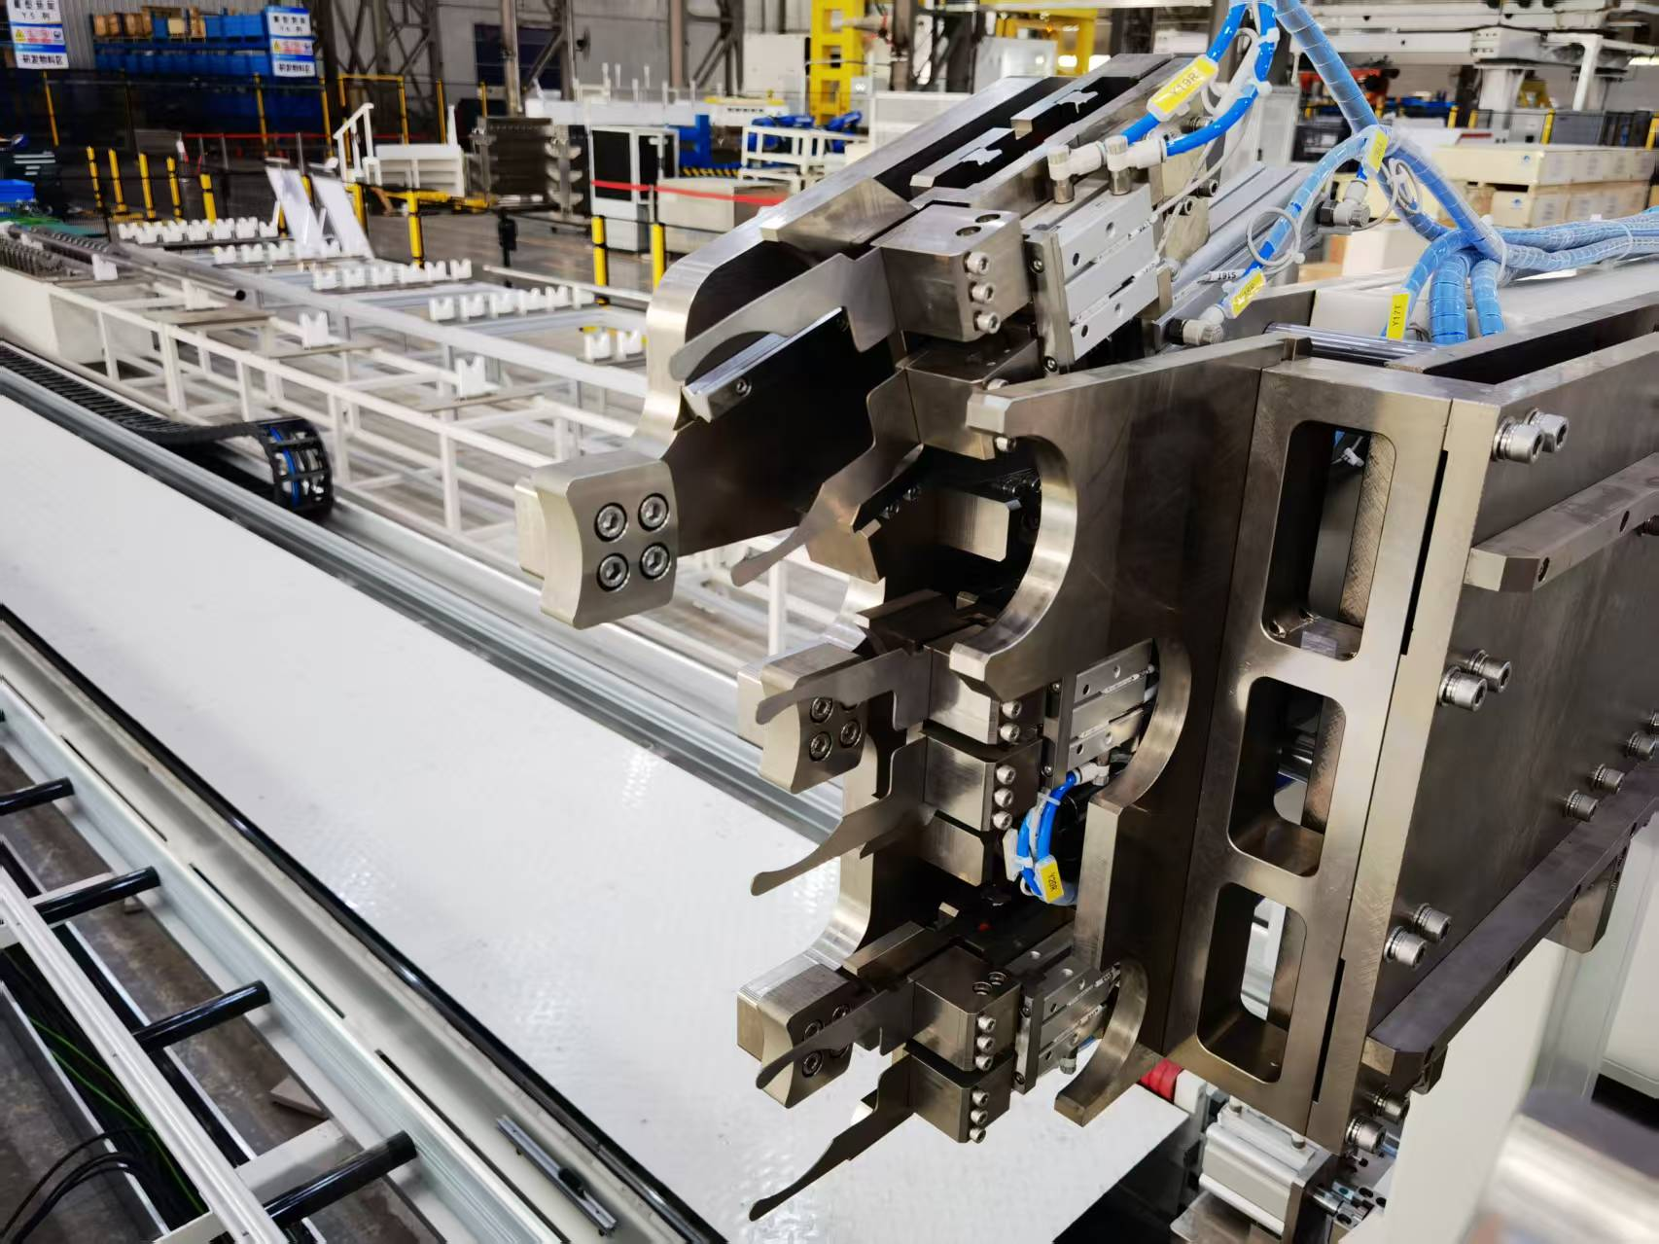
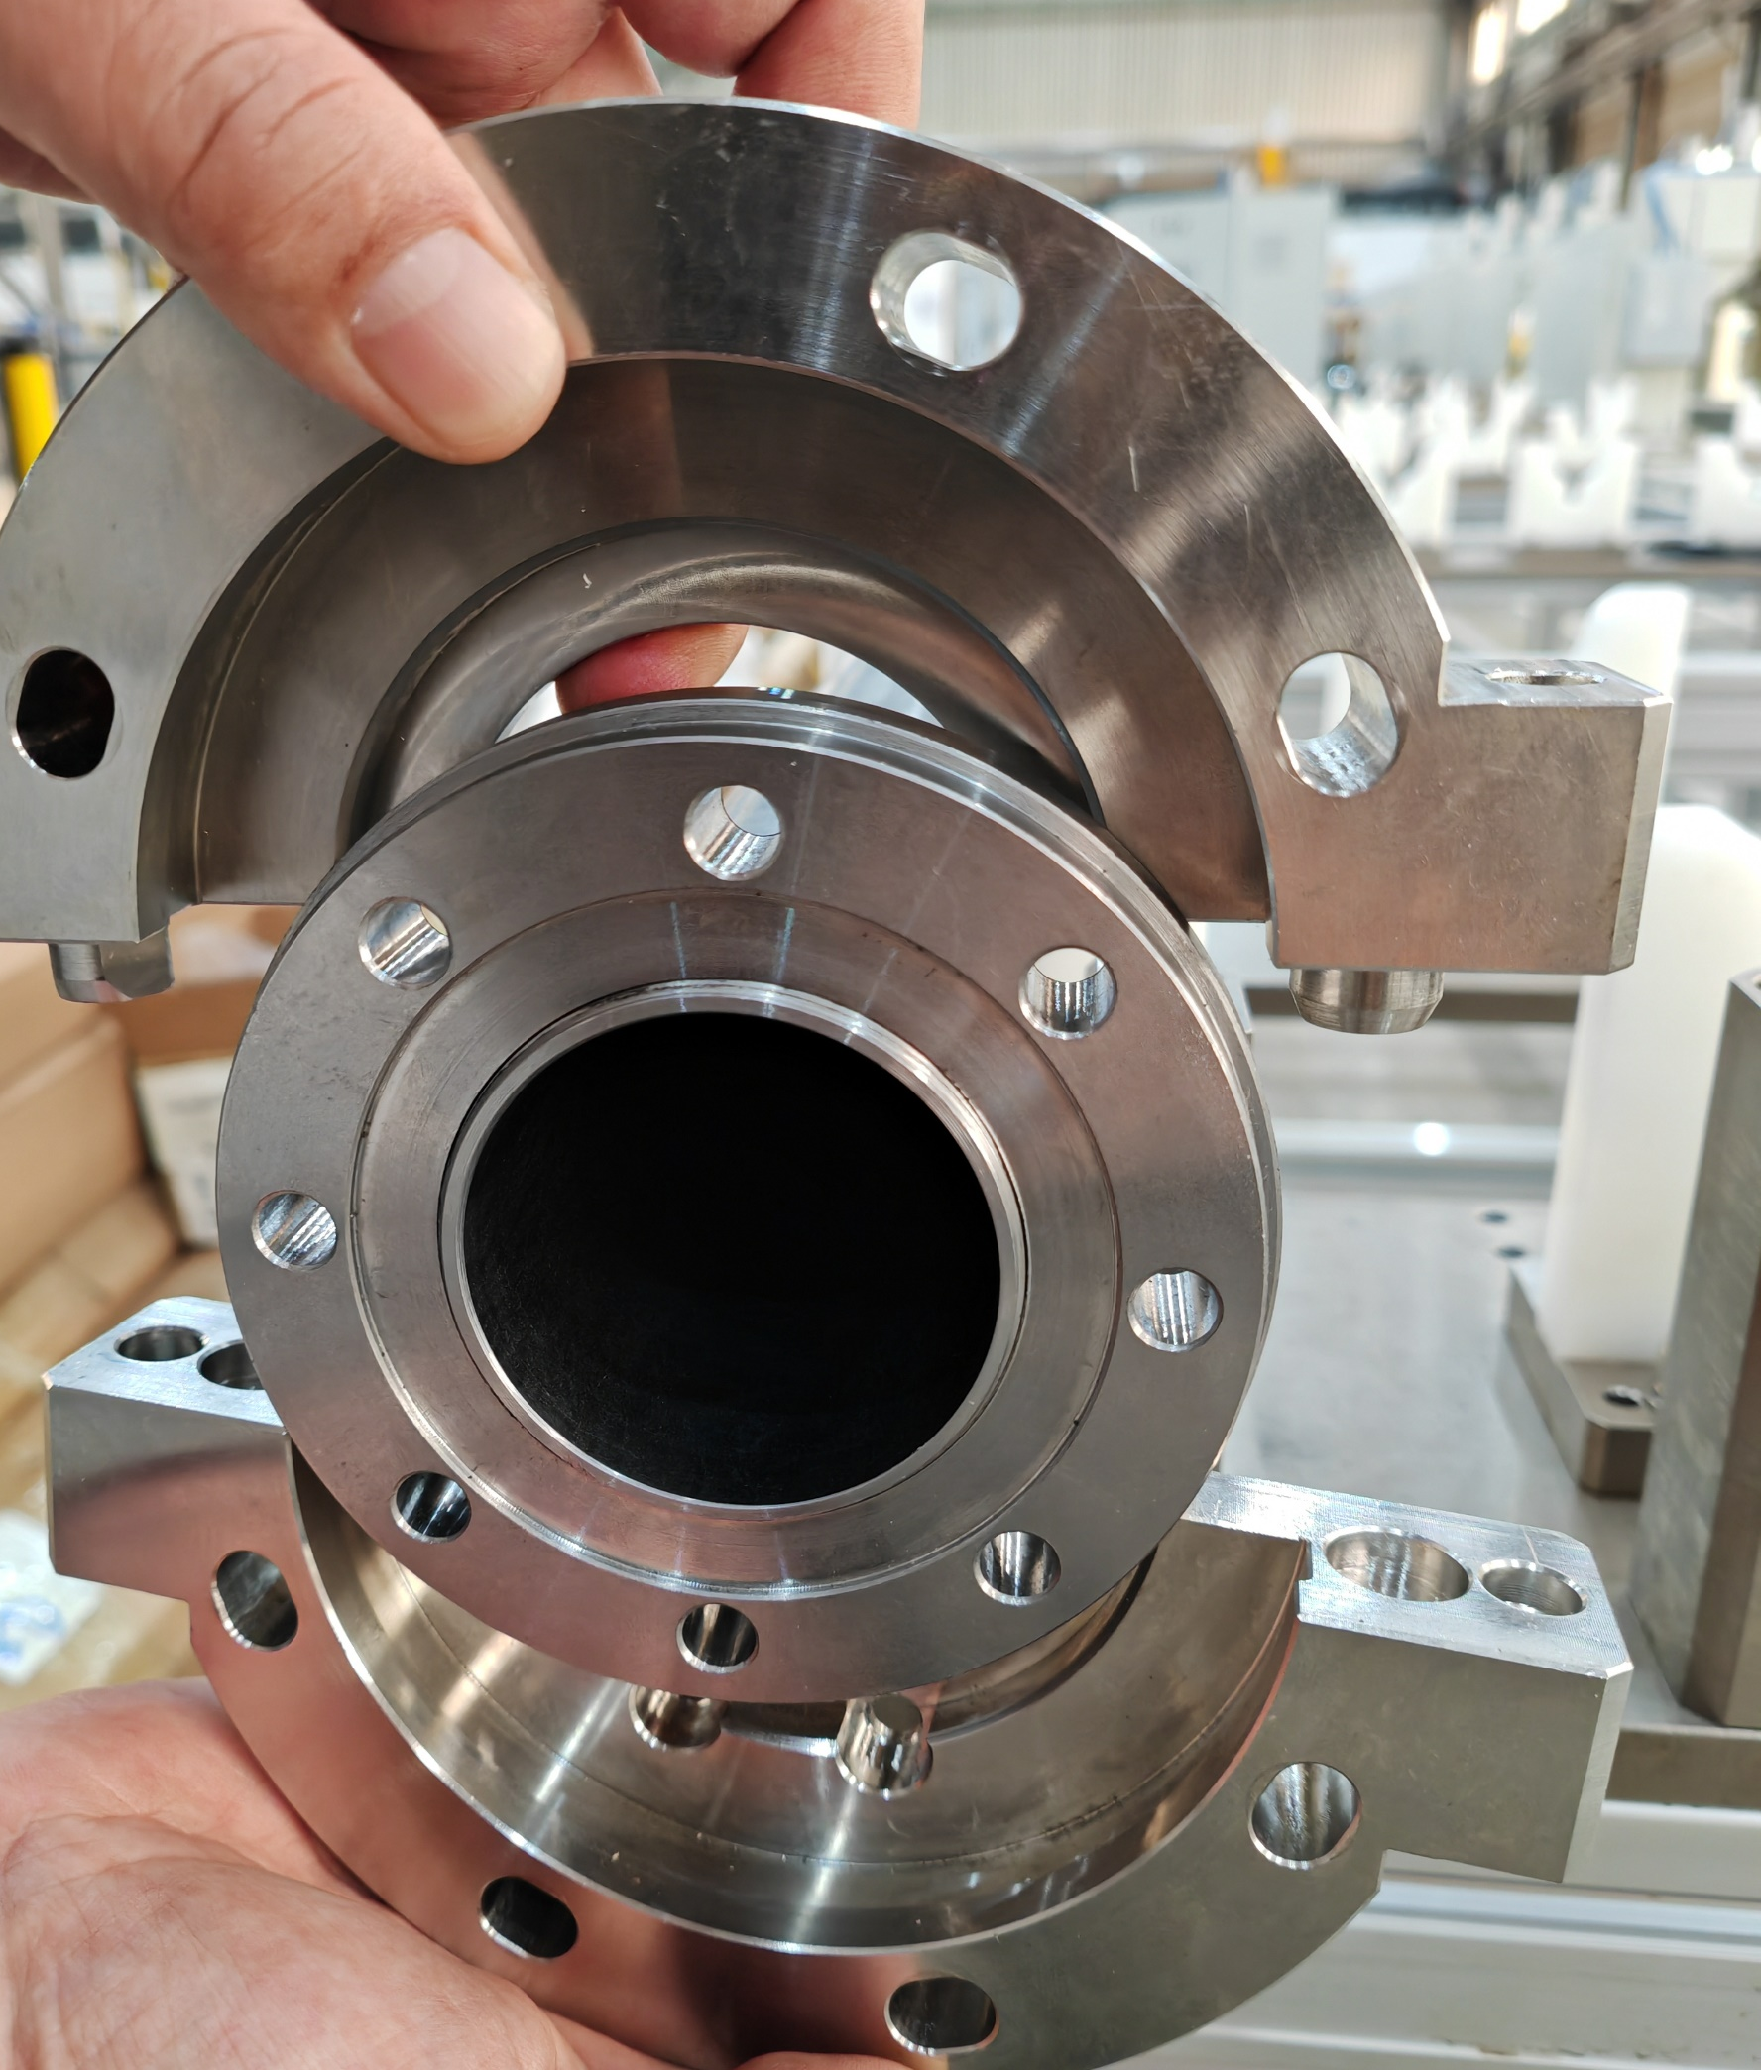
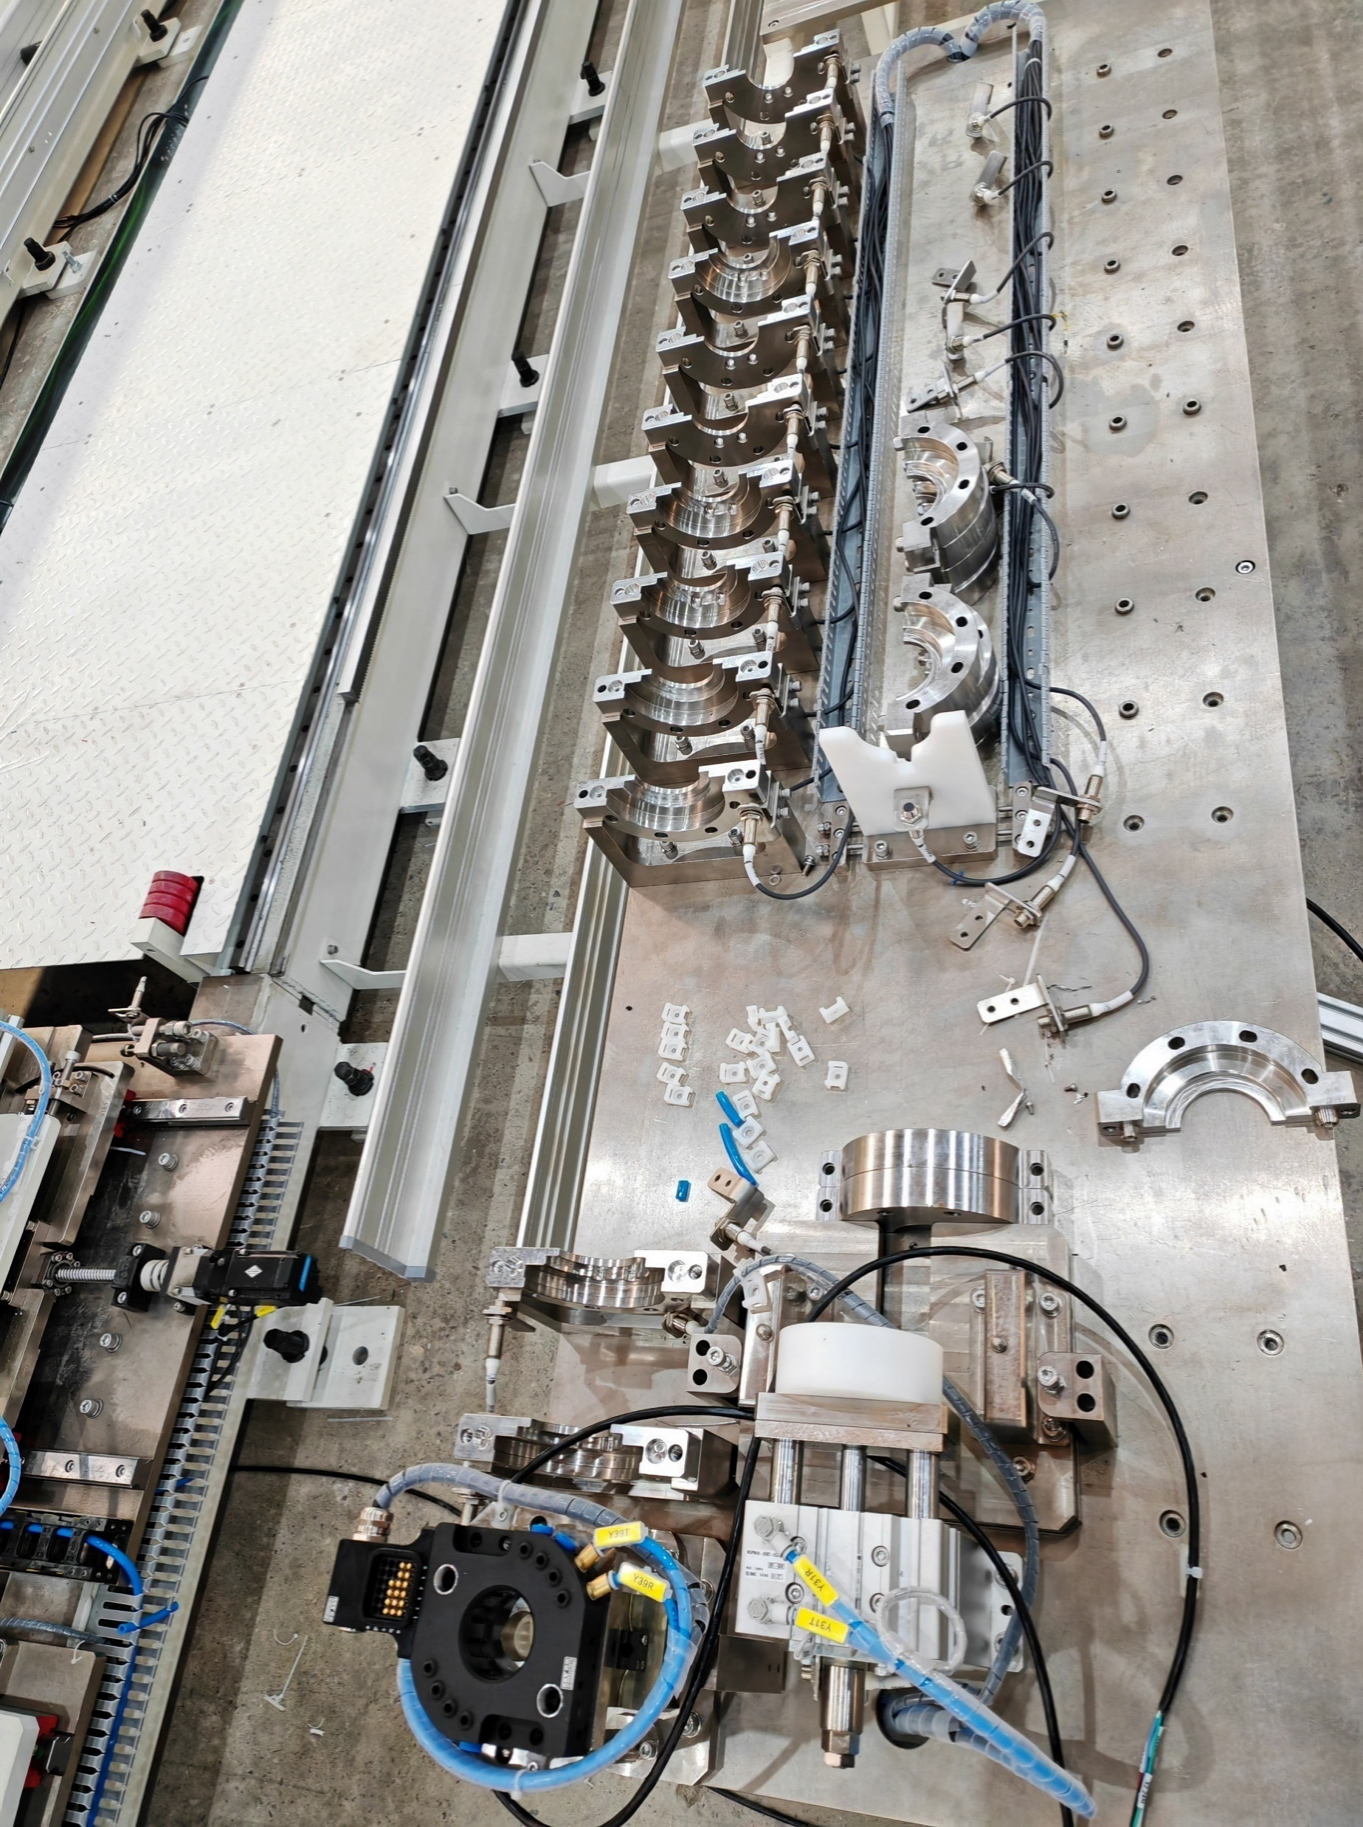
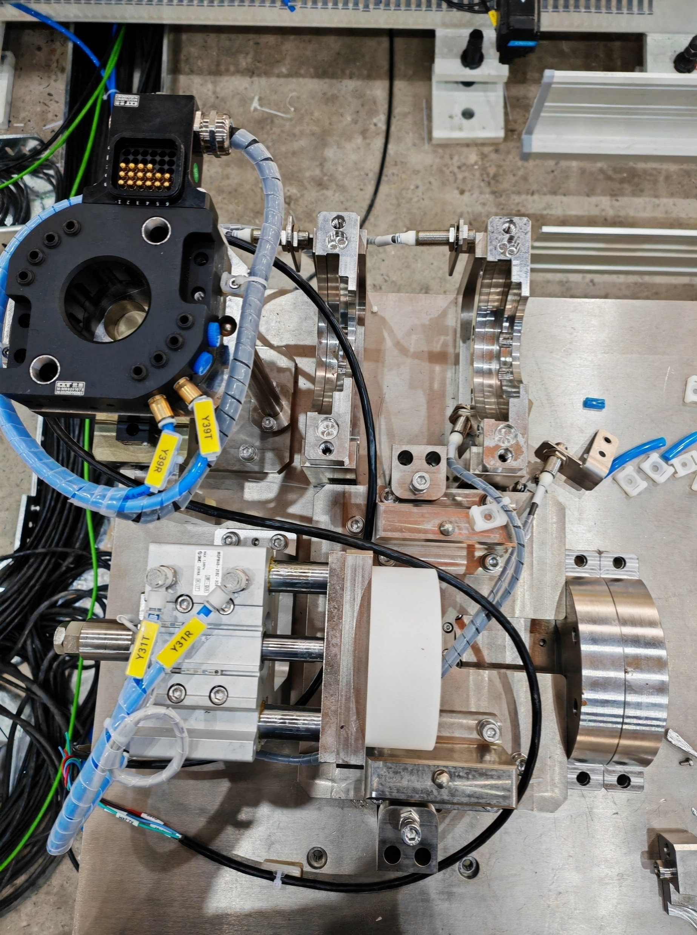
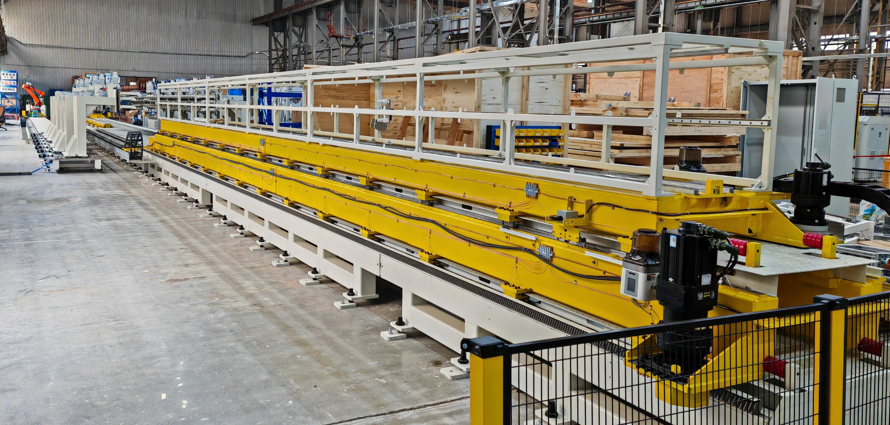
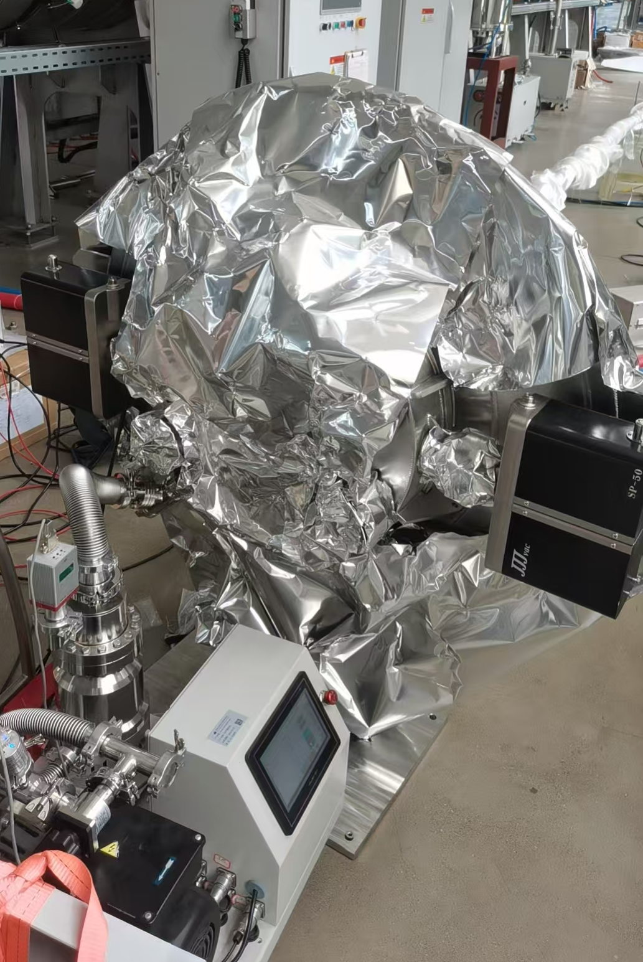
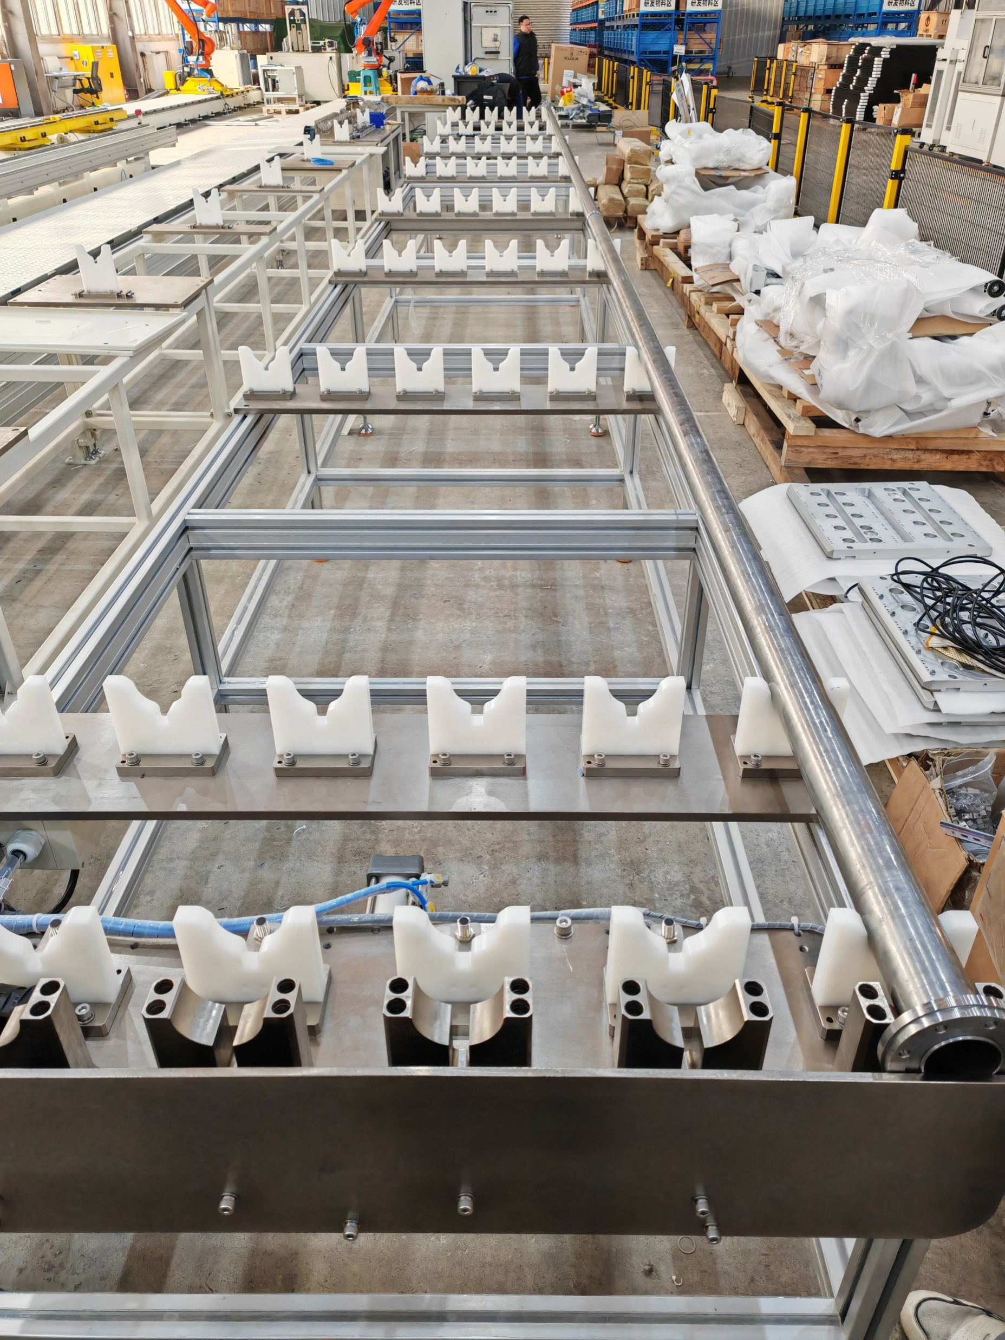
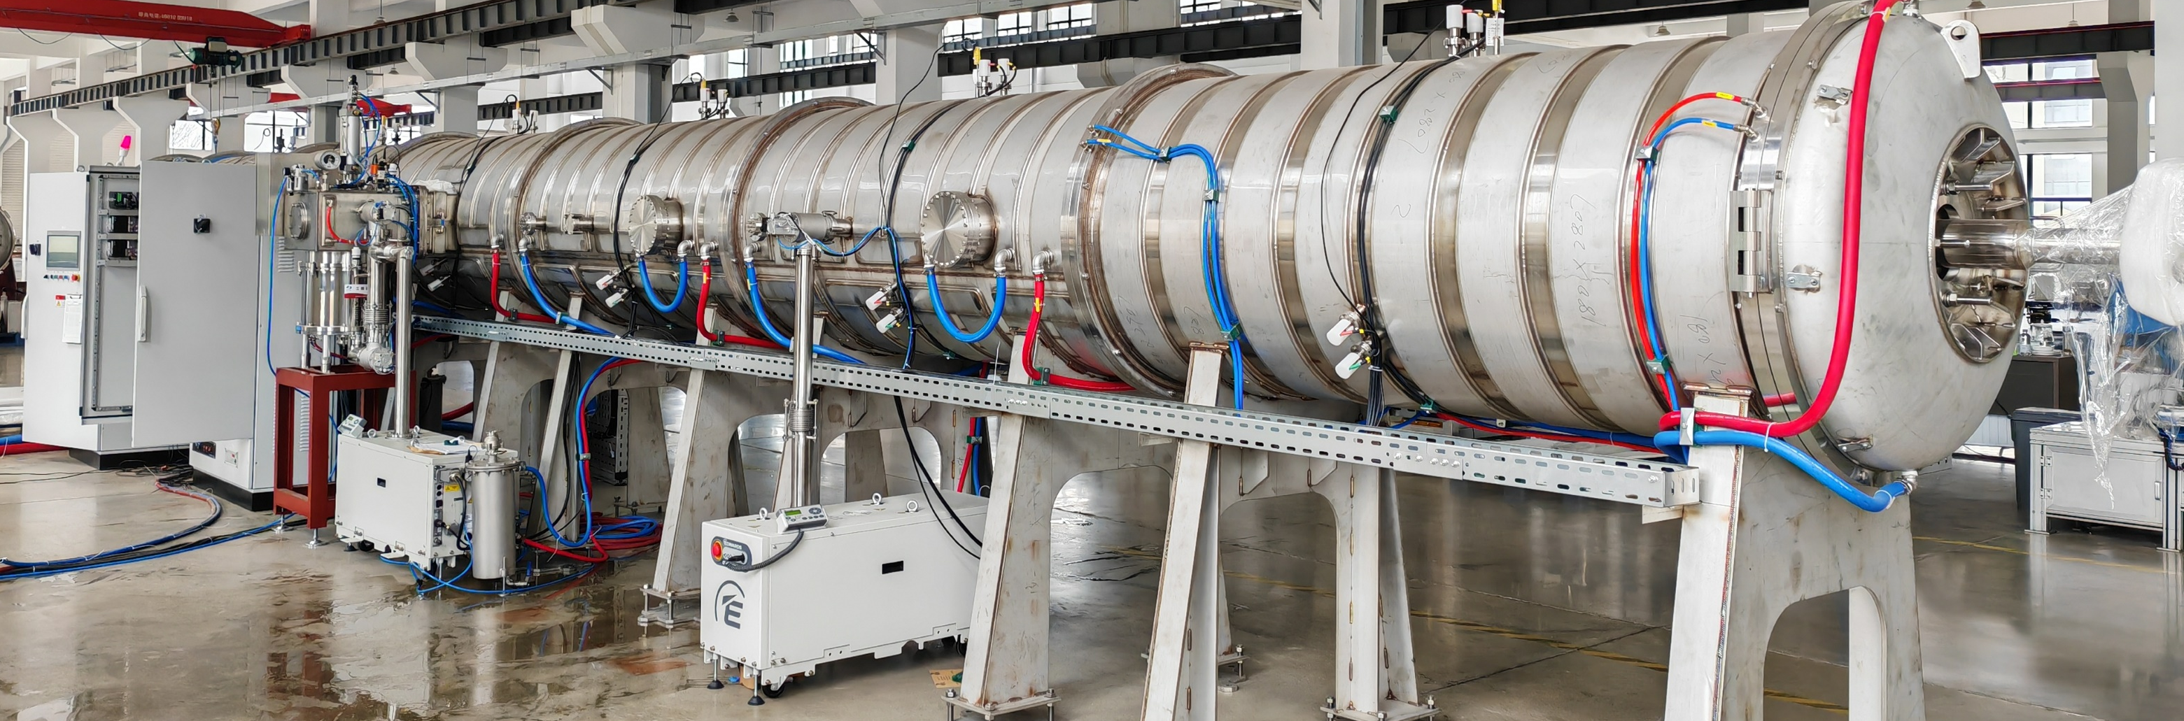
Layout & composition of NEG coating facility
自动化组装真空盒

Slide 7
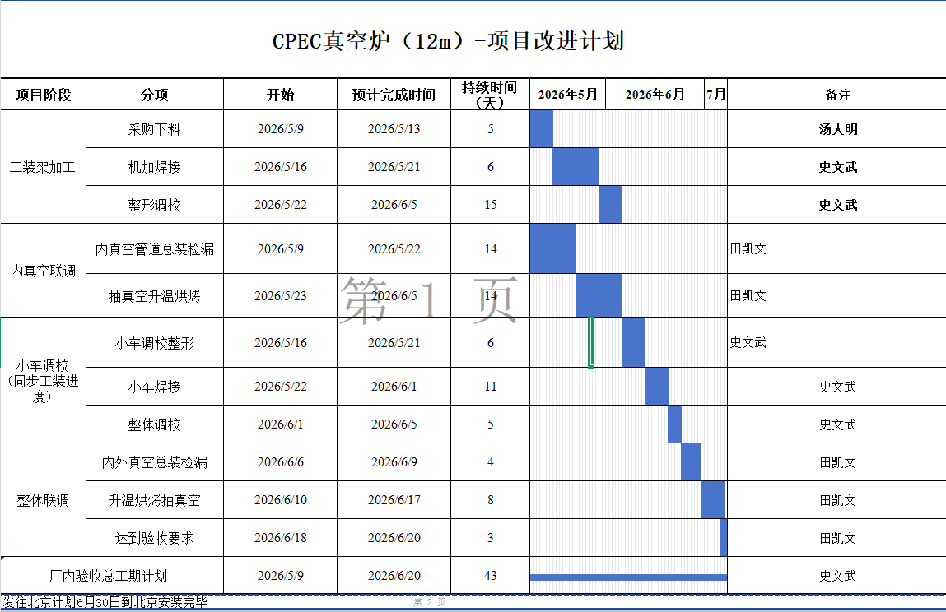
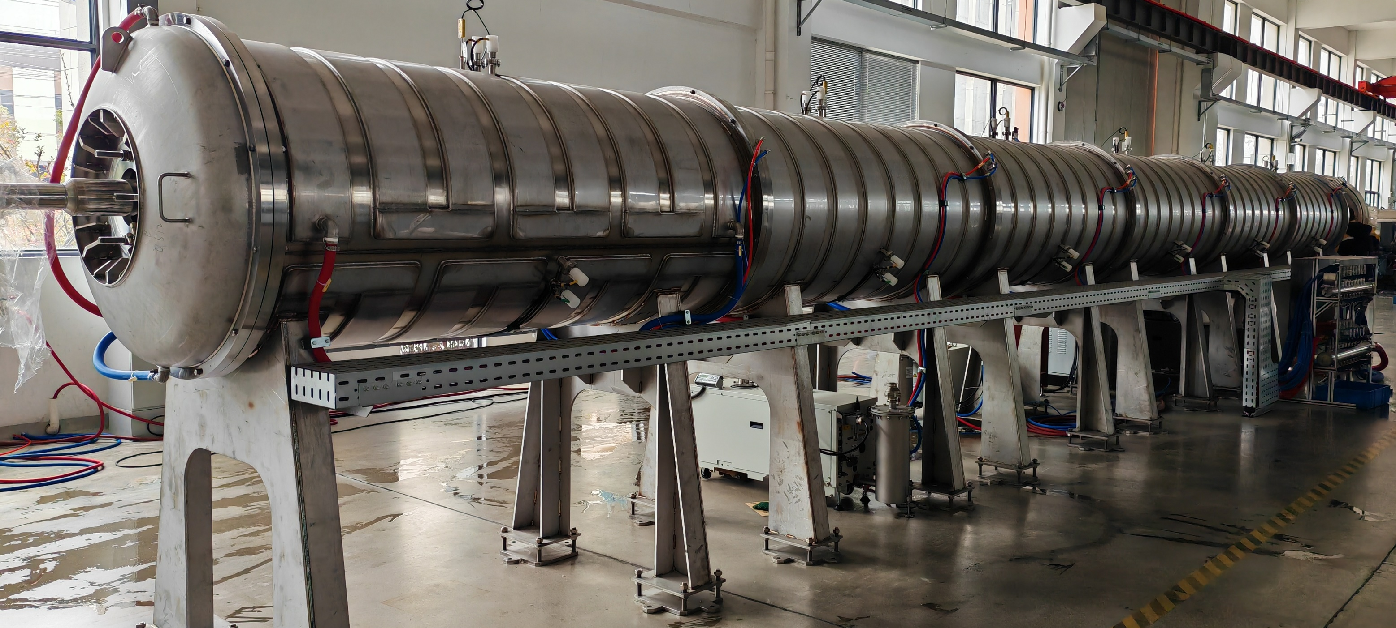

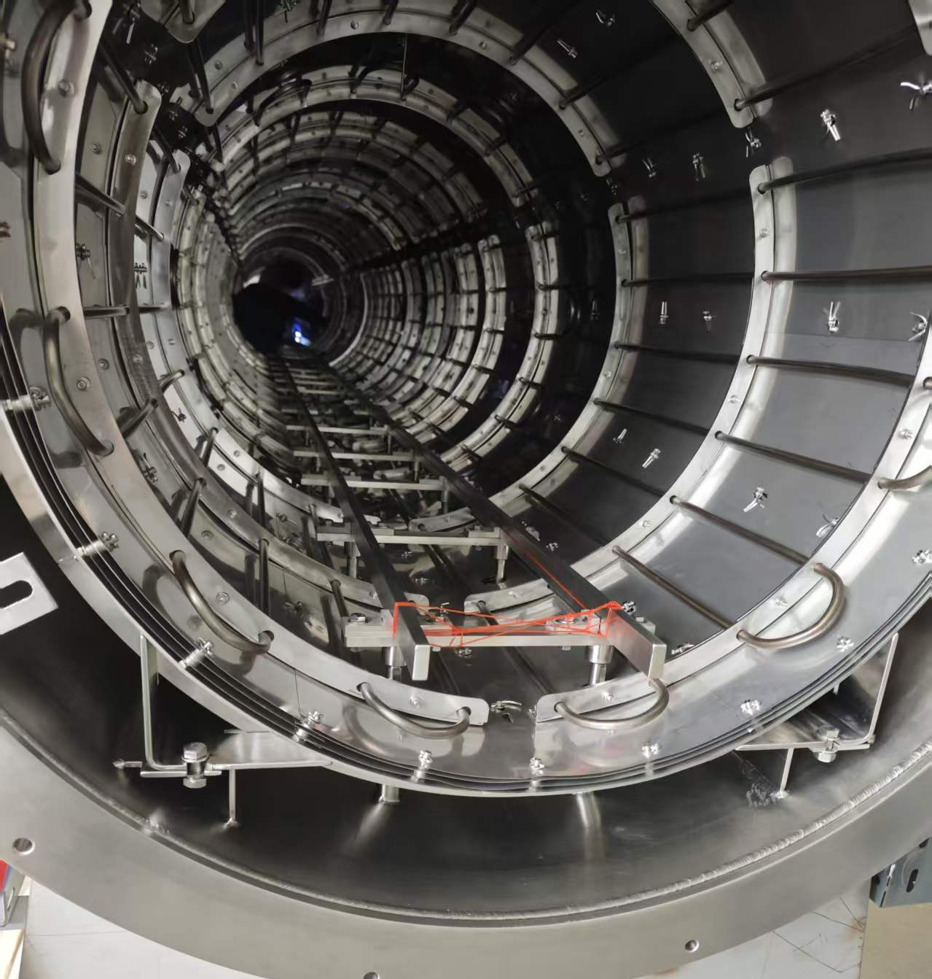
NEG镀膜真空炉进展
真空炉内支撑导轨存在卡顿现象，正在修改；

Slide 8
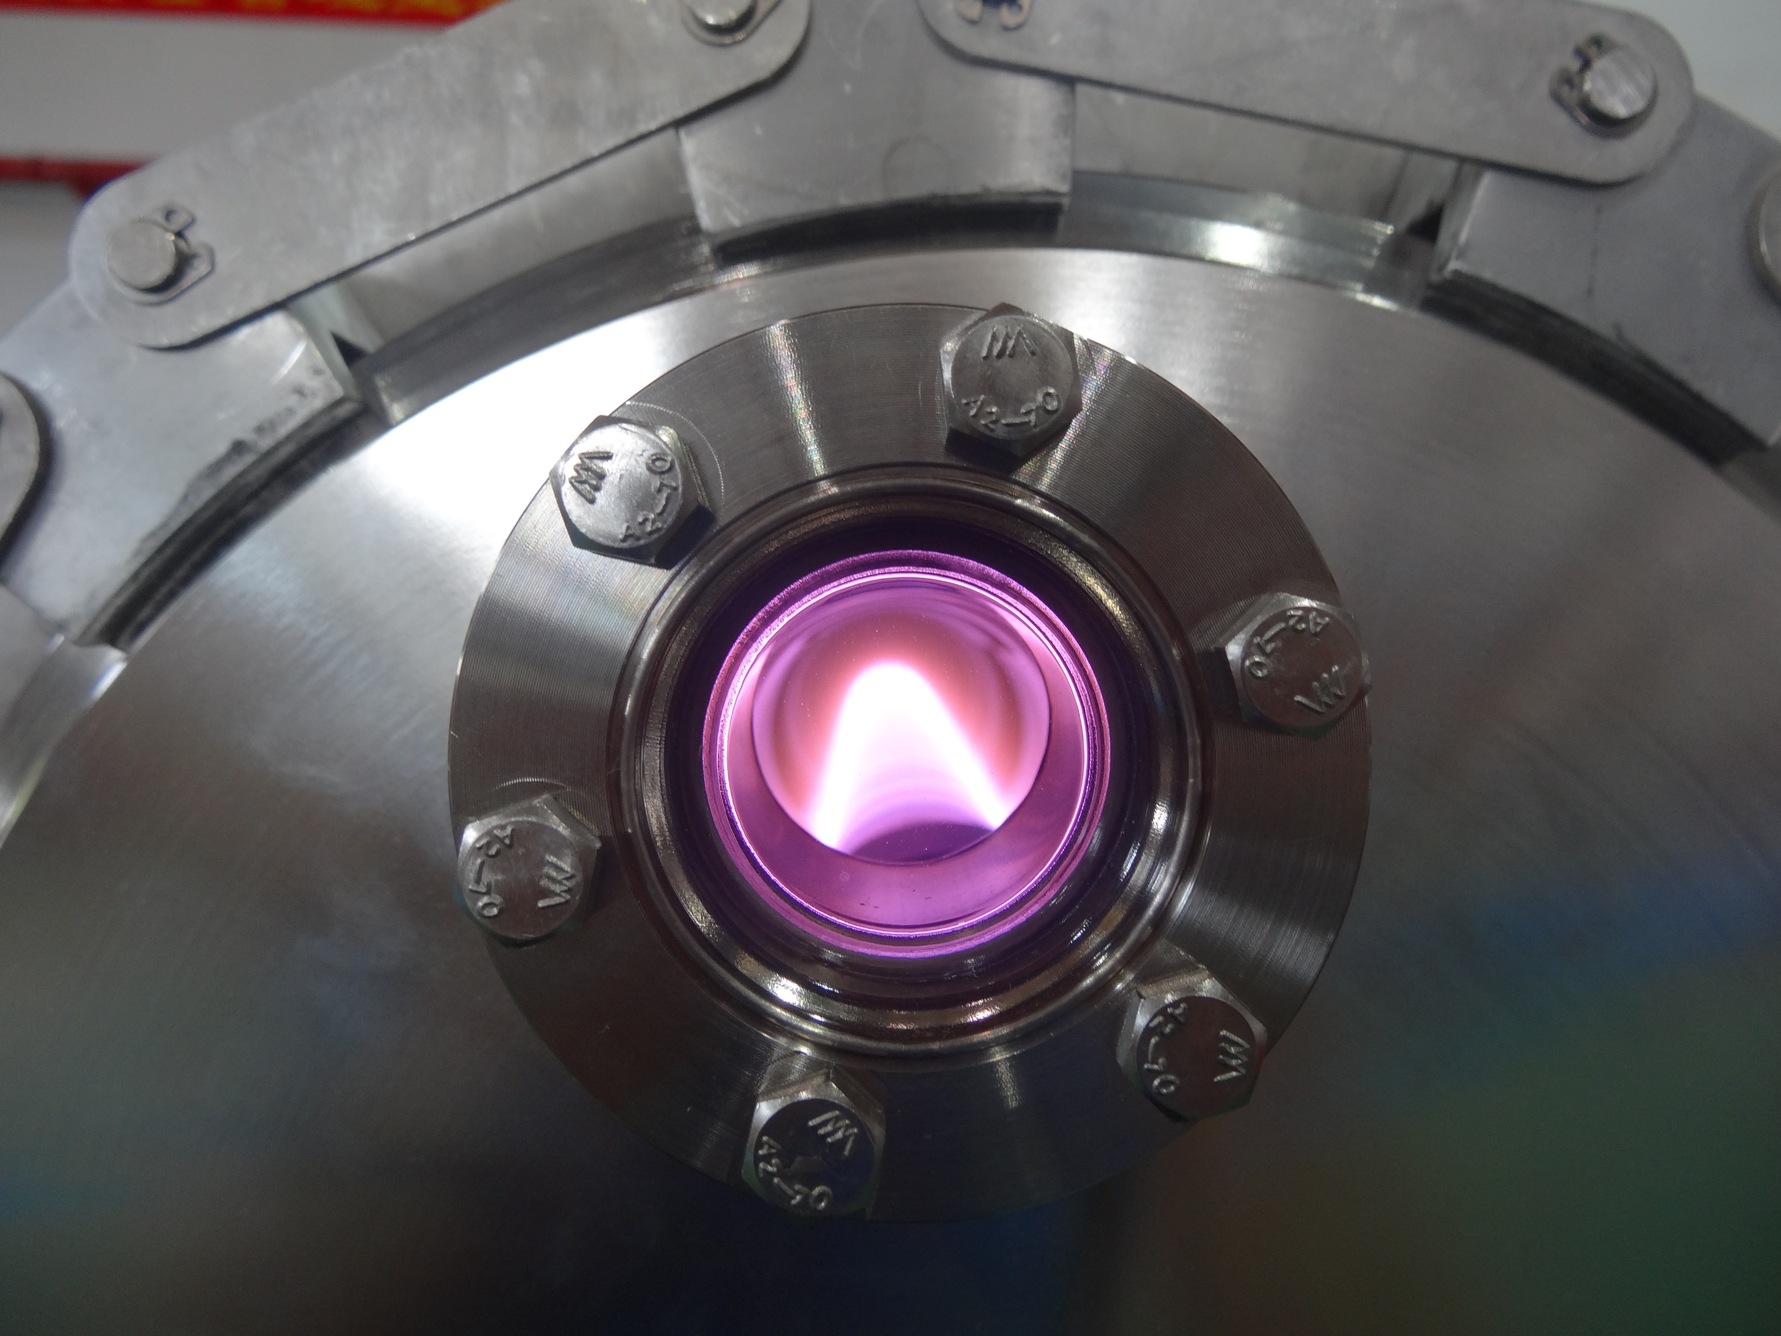
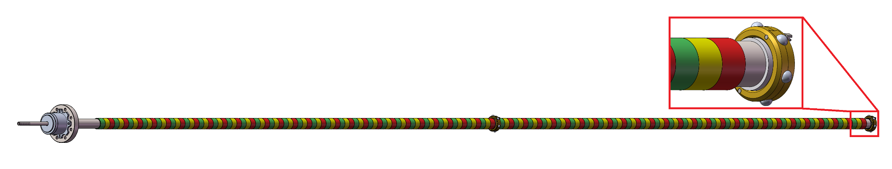
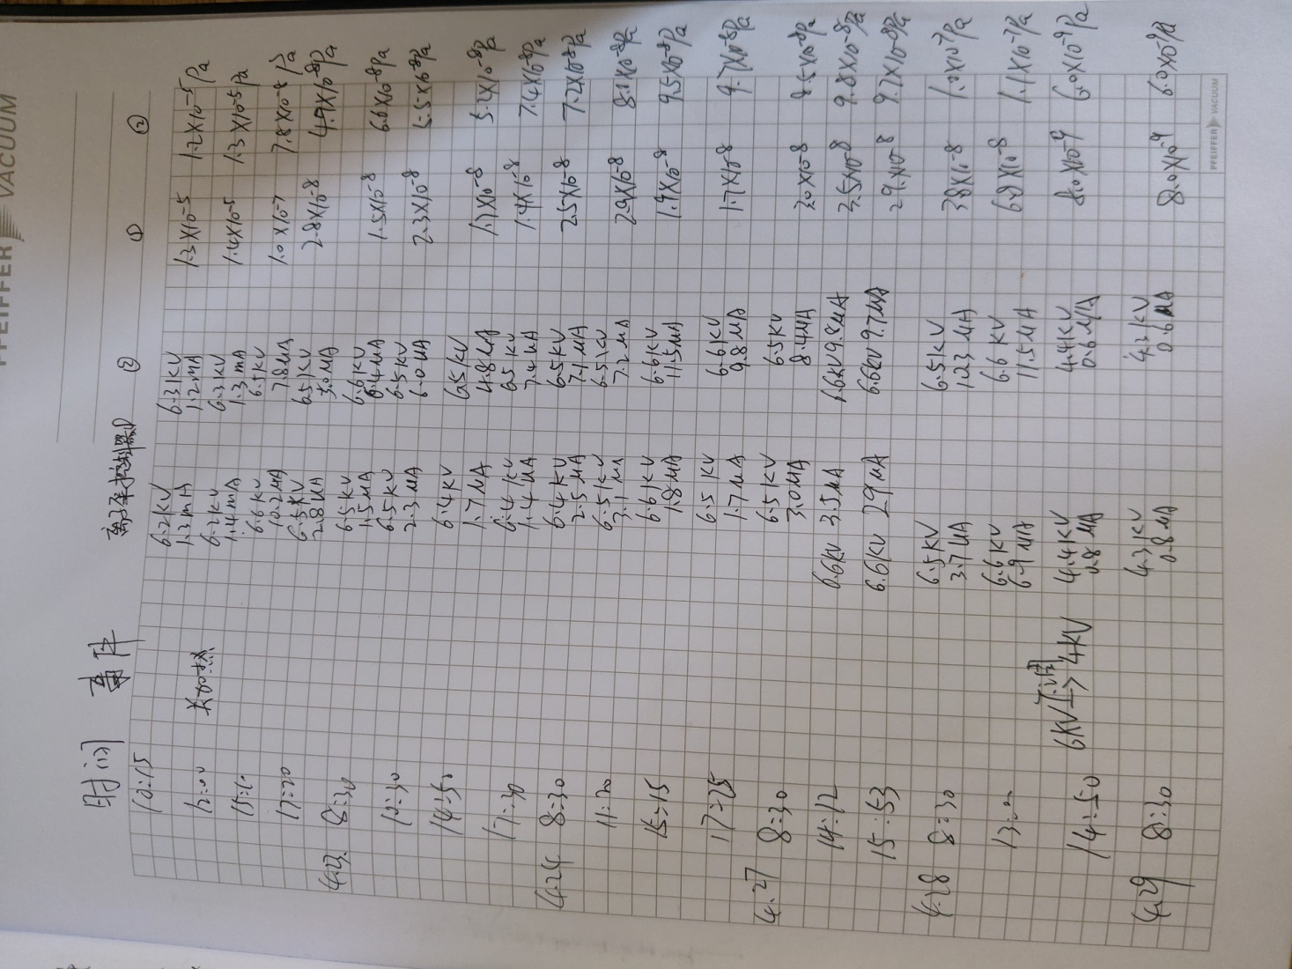
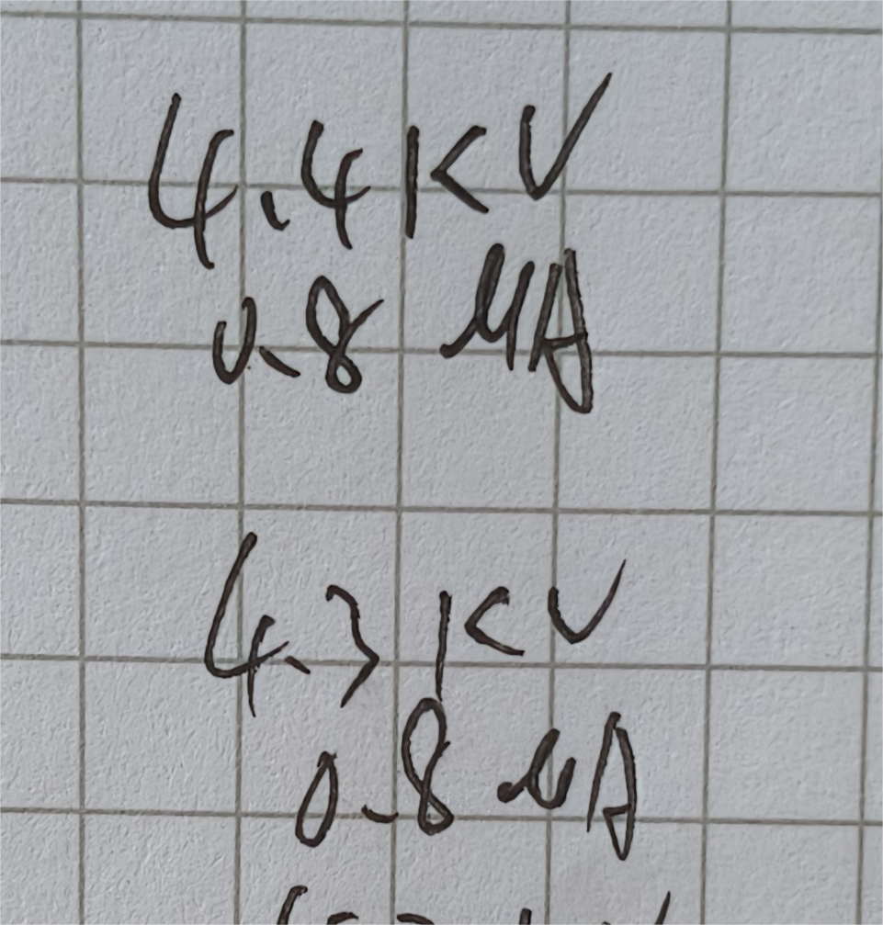
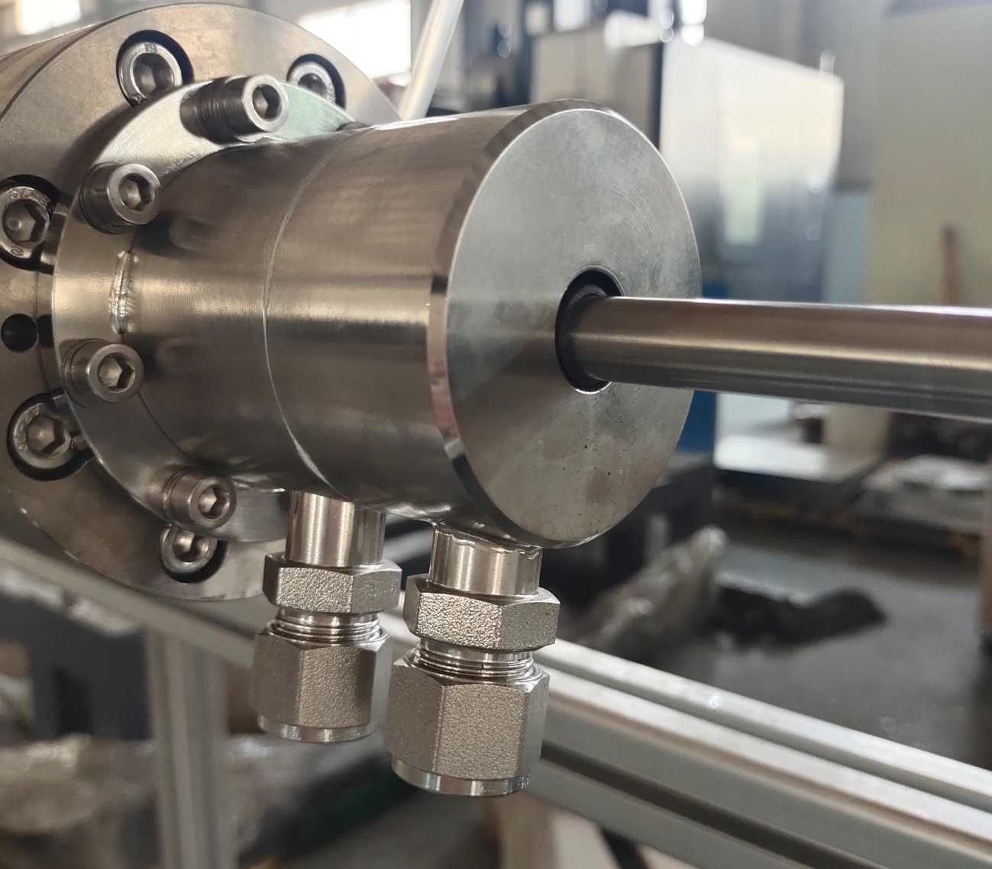
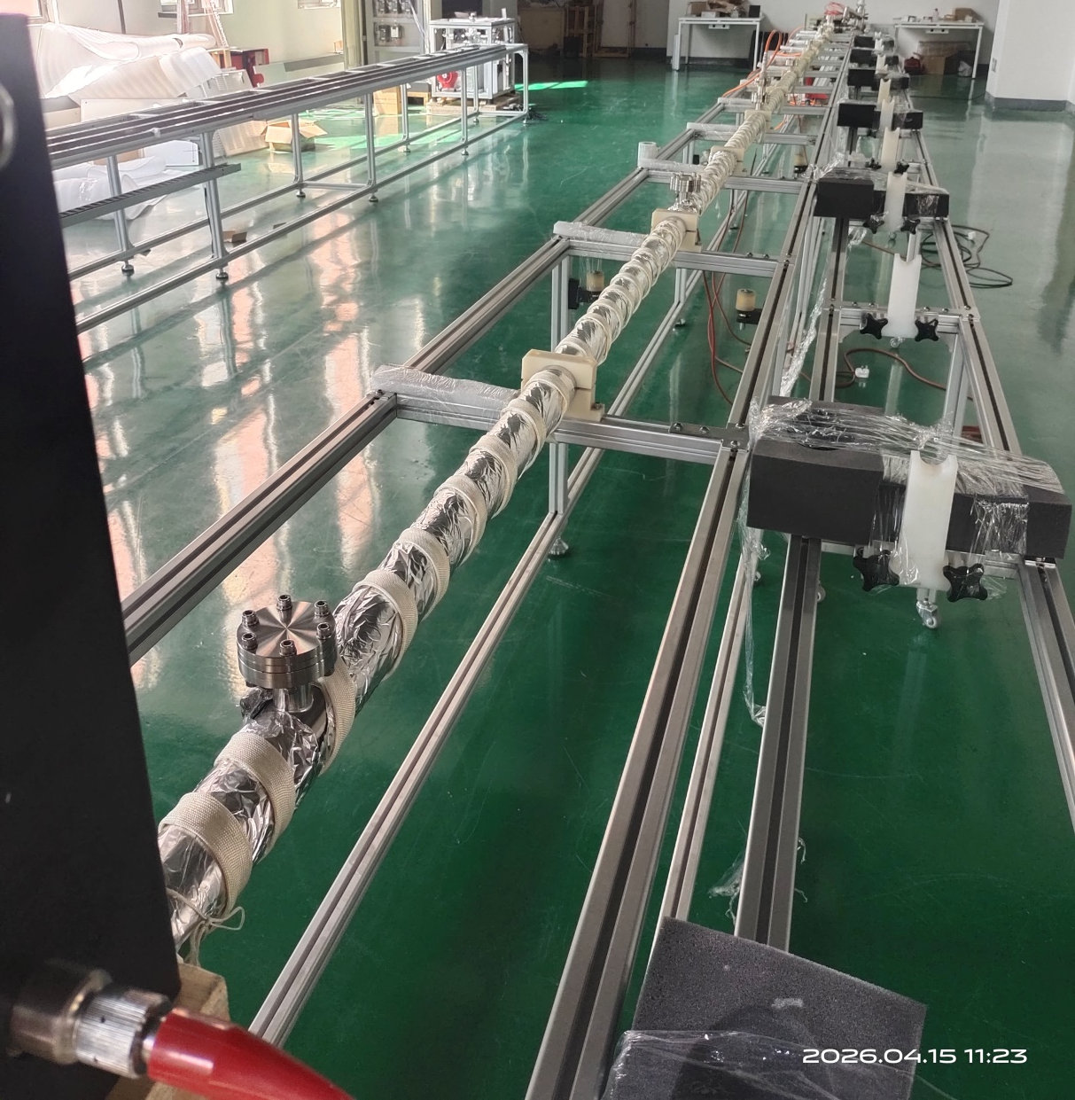
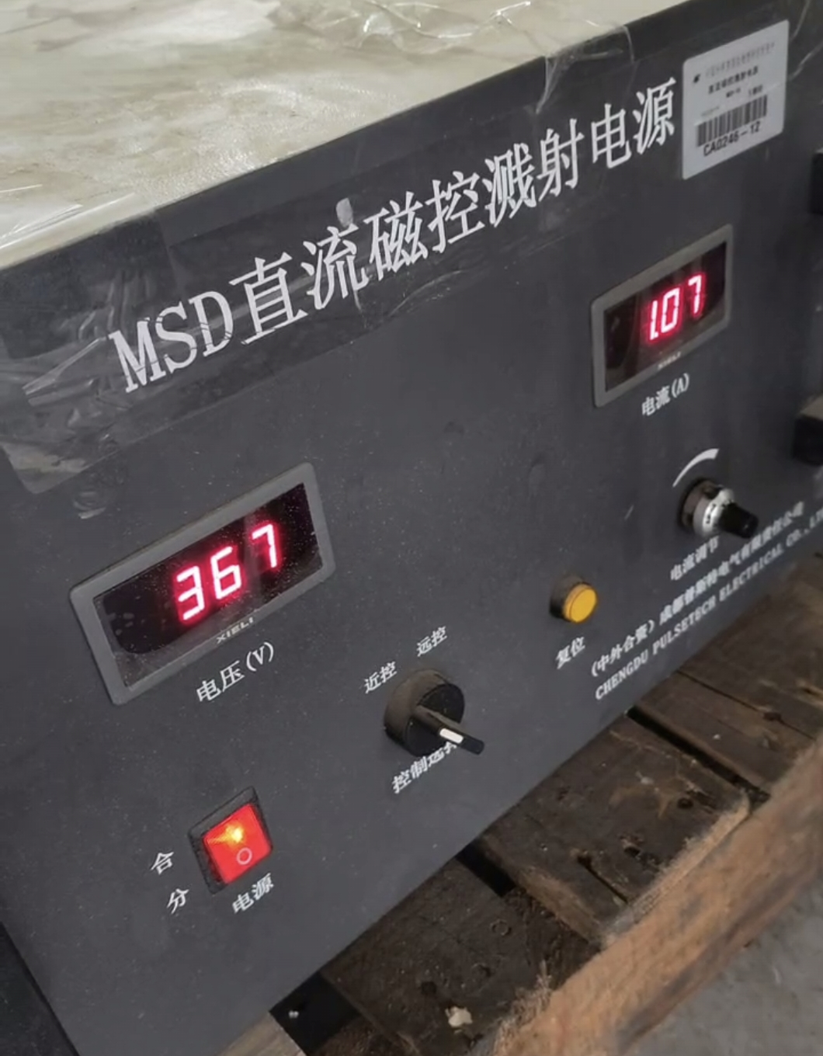
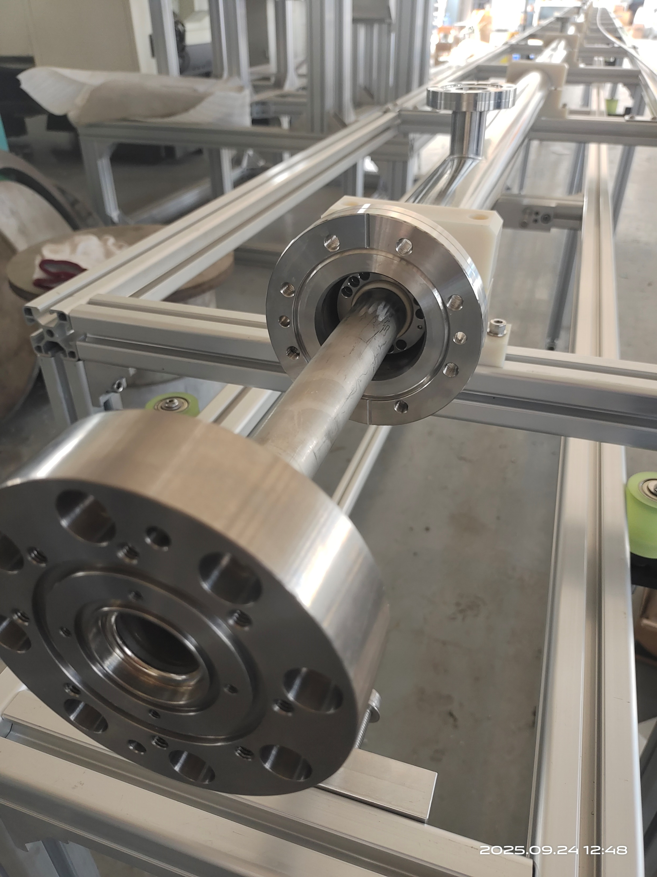
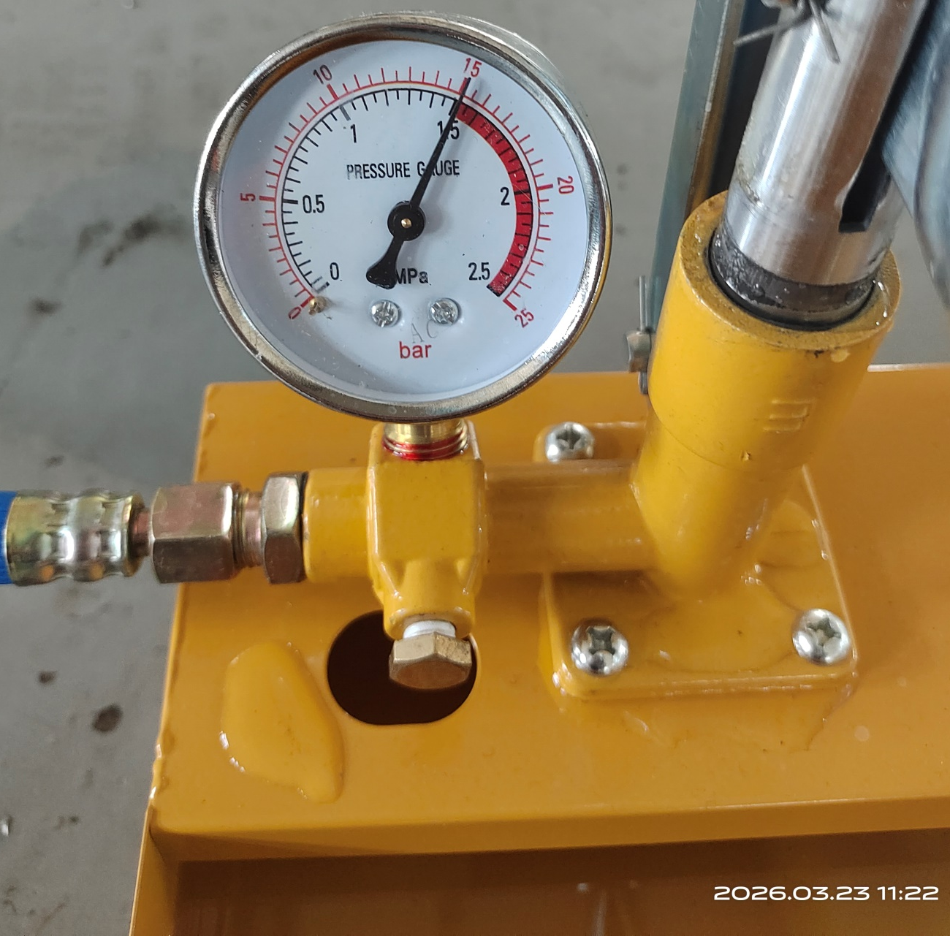
Prototype of cathode for massive NEG coating
~12000mm(12 meters)
Magnetron Cathode
Kr+
磁环
DCMS for NEG coating
Inside magnet
8

Slide 9
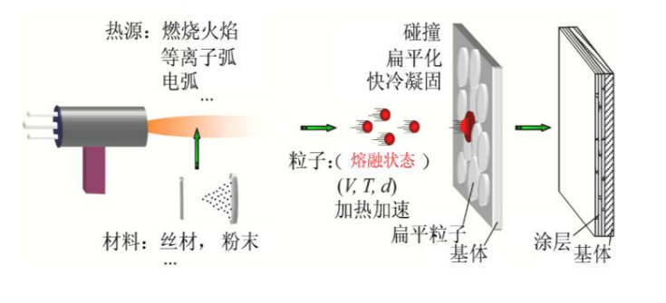
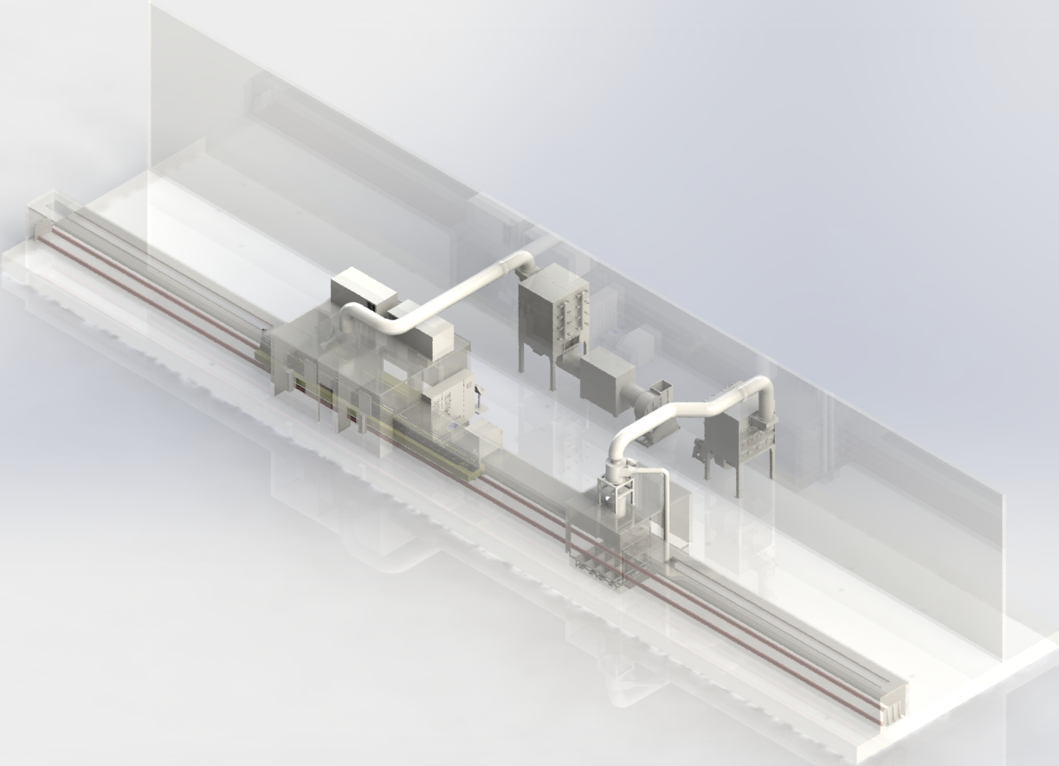
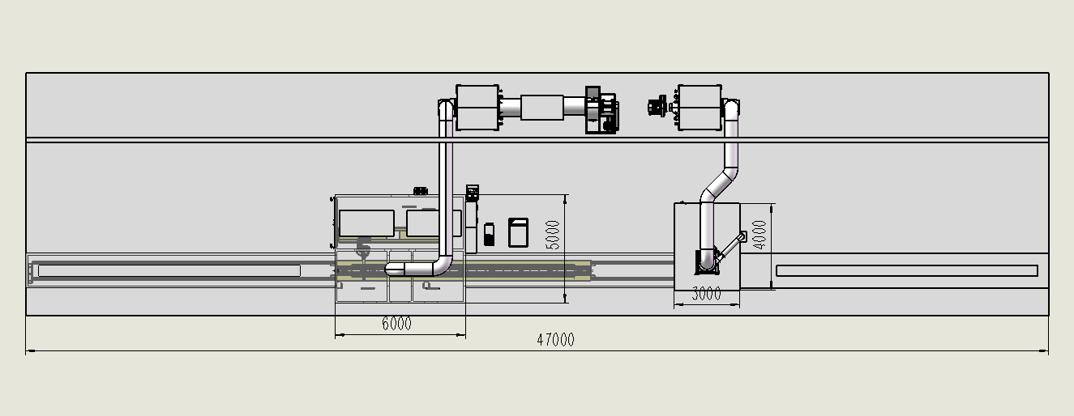
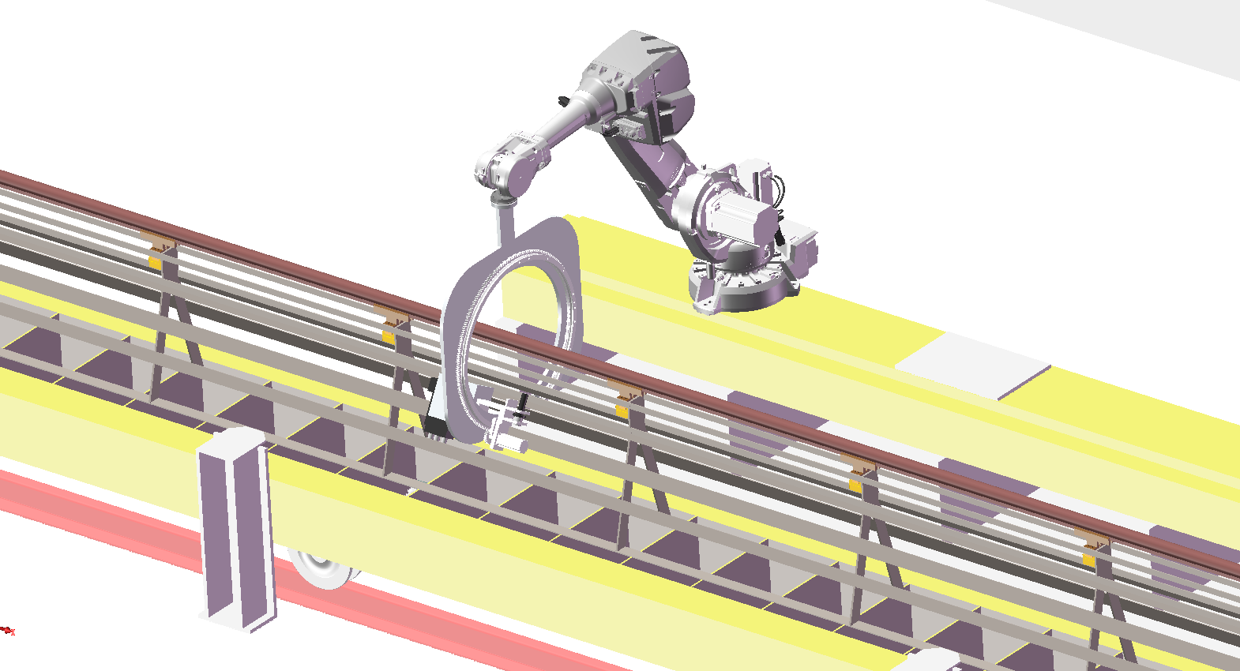
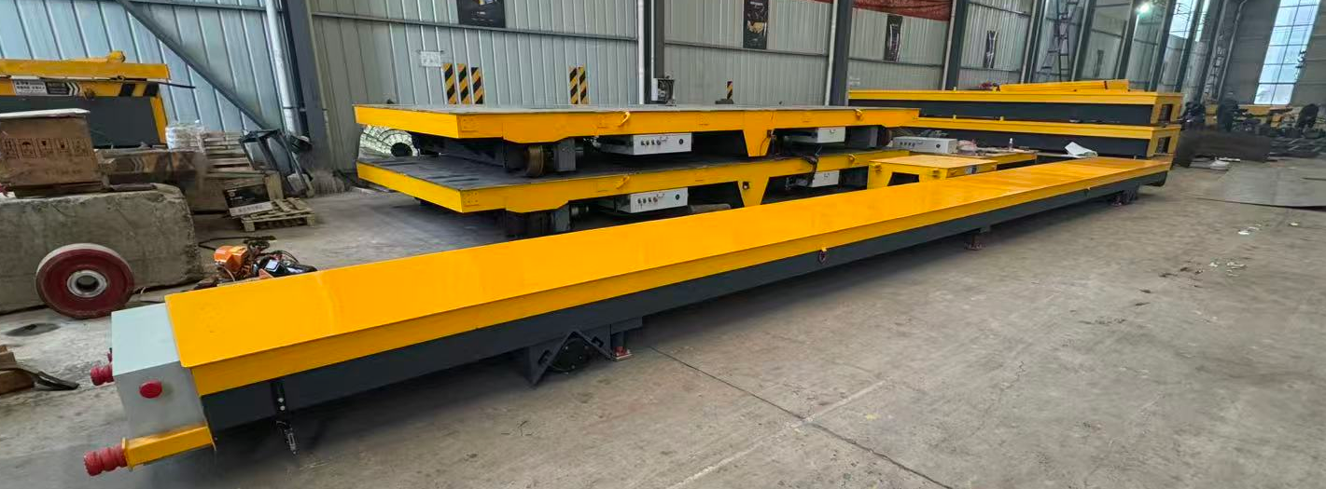
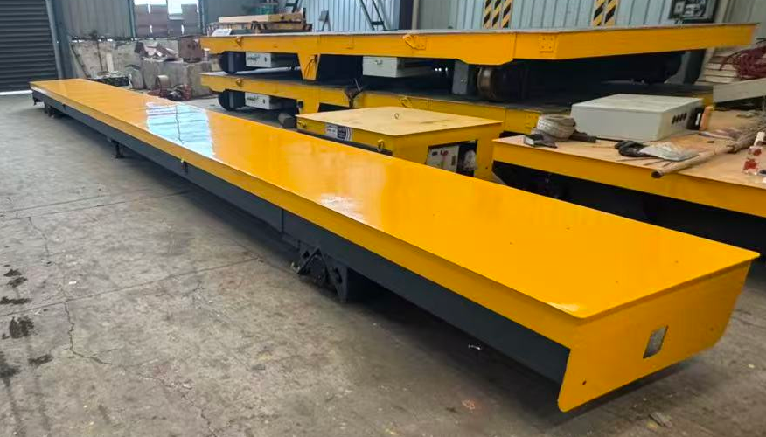
Plasma Spraying system
Plasma Spraying
& Laser etching room
Sandblasting room
The vacuum chamber will be transferred by motorized conveyance（length21.1m, width 1m ） to the coating station, where a robotic arm will execute multi-layer deposition using an automated spray un.
Notes:
Reciprocating motion

Slide 10
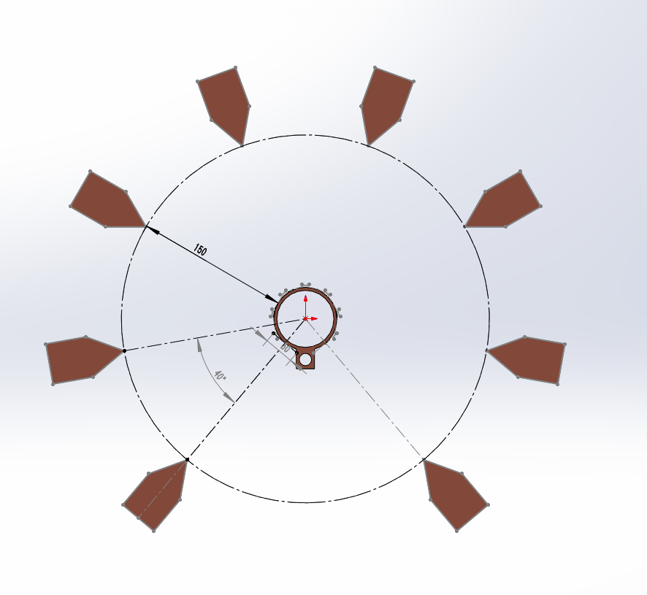
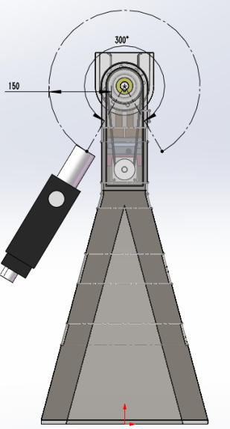
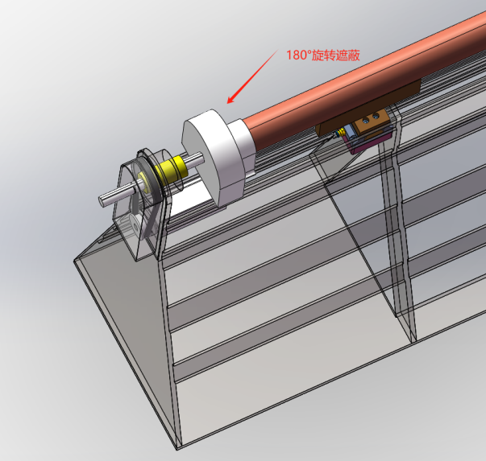
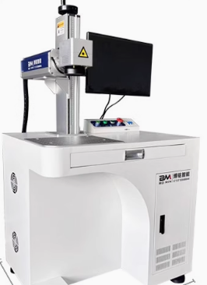
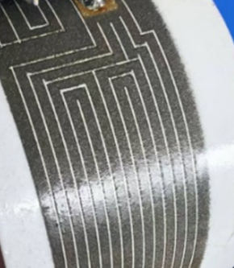
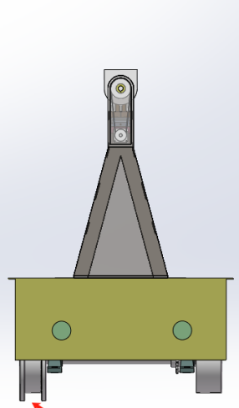
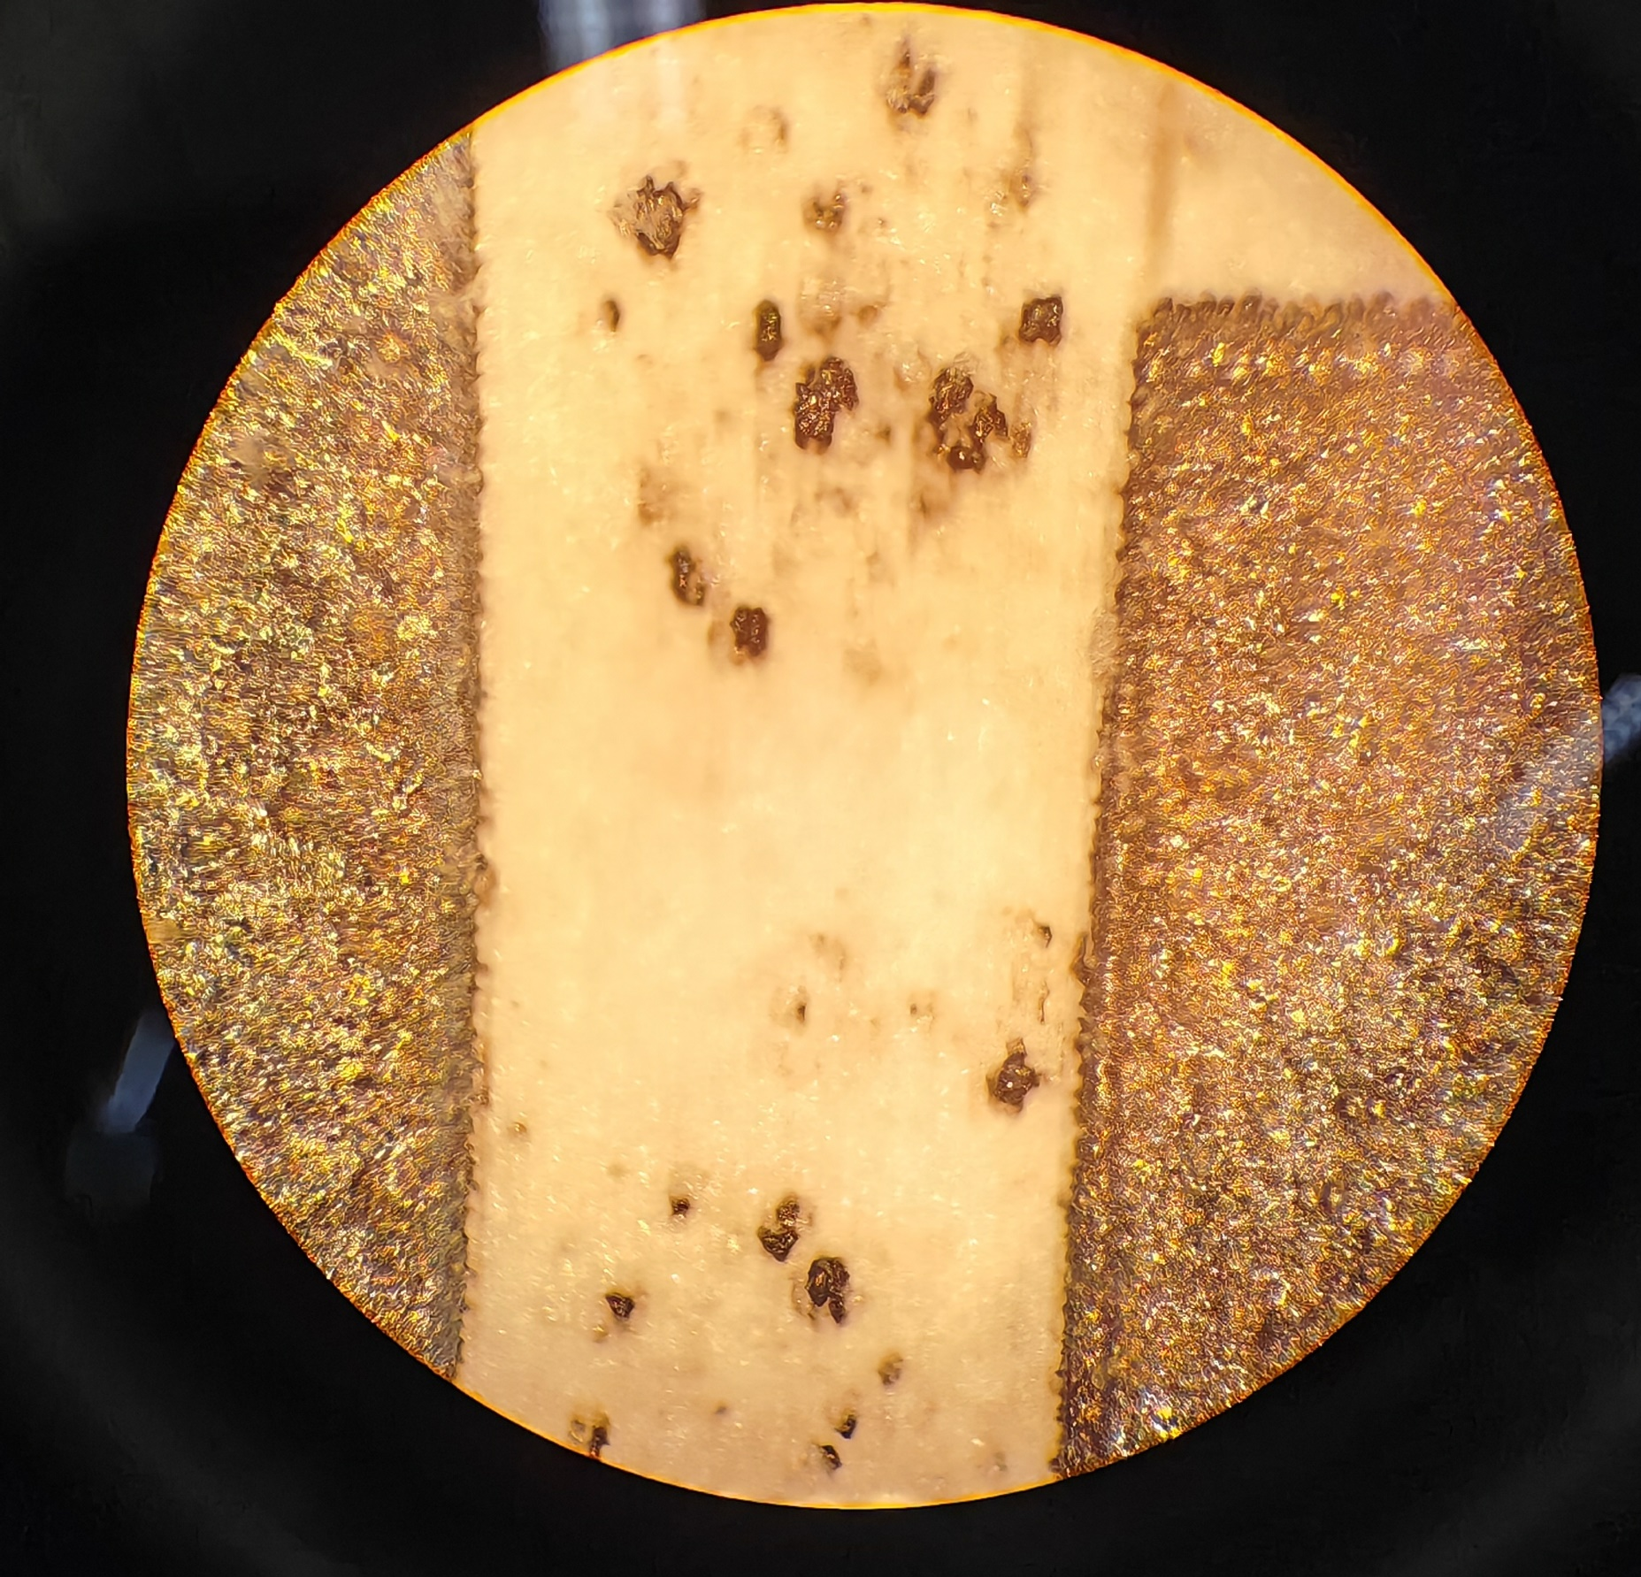
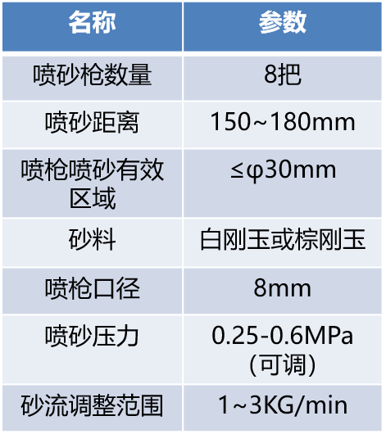
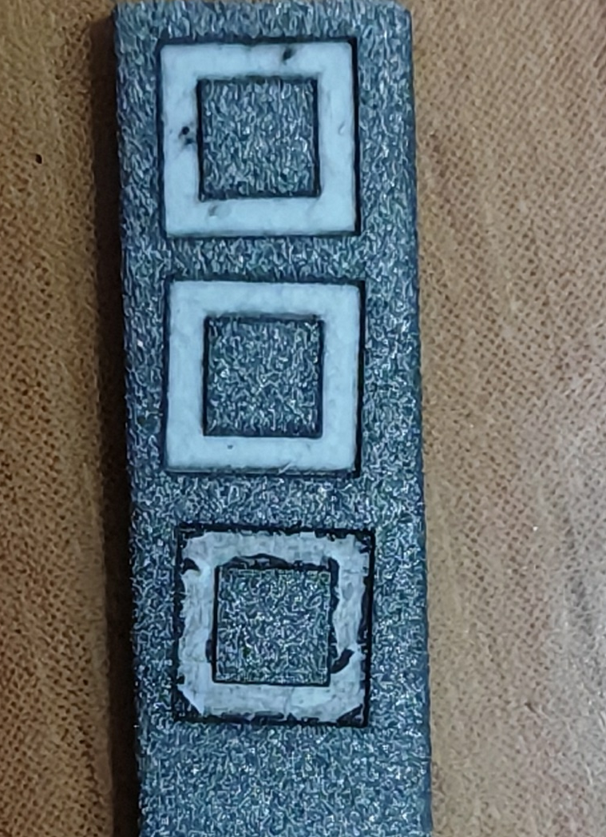
Heating coating spraying
The processing step for the heating coating spraying
Sandblasting
Plasma Spraying
Etching by laser
项目 | 参数
驱动方式 | 旋转气缸驱动
遮蔽材质 | 不锈钢
轴向可调节范围 | 100mm

Slide 11
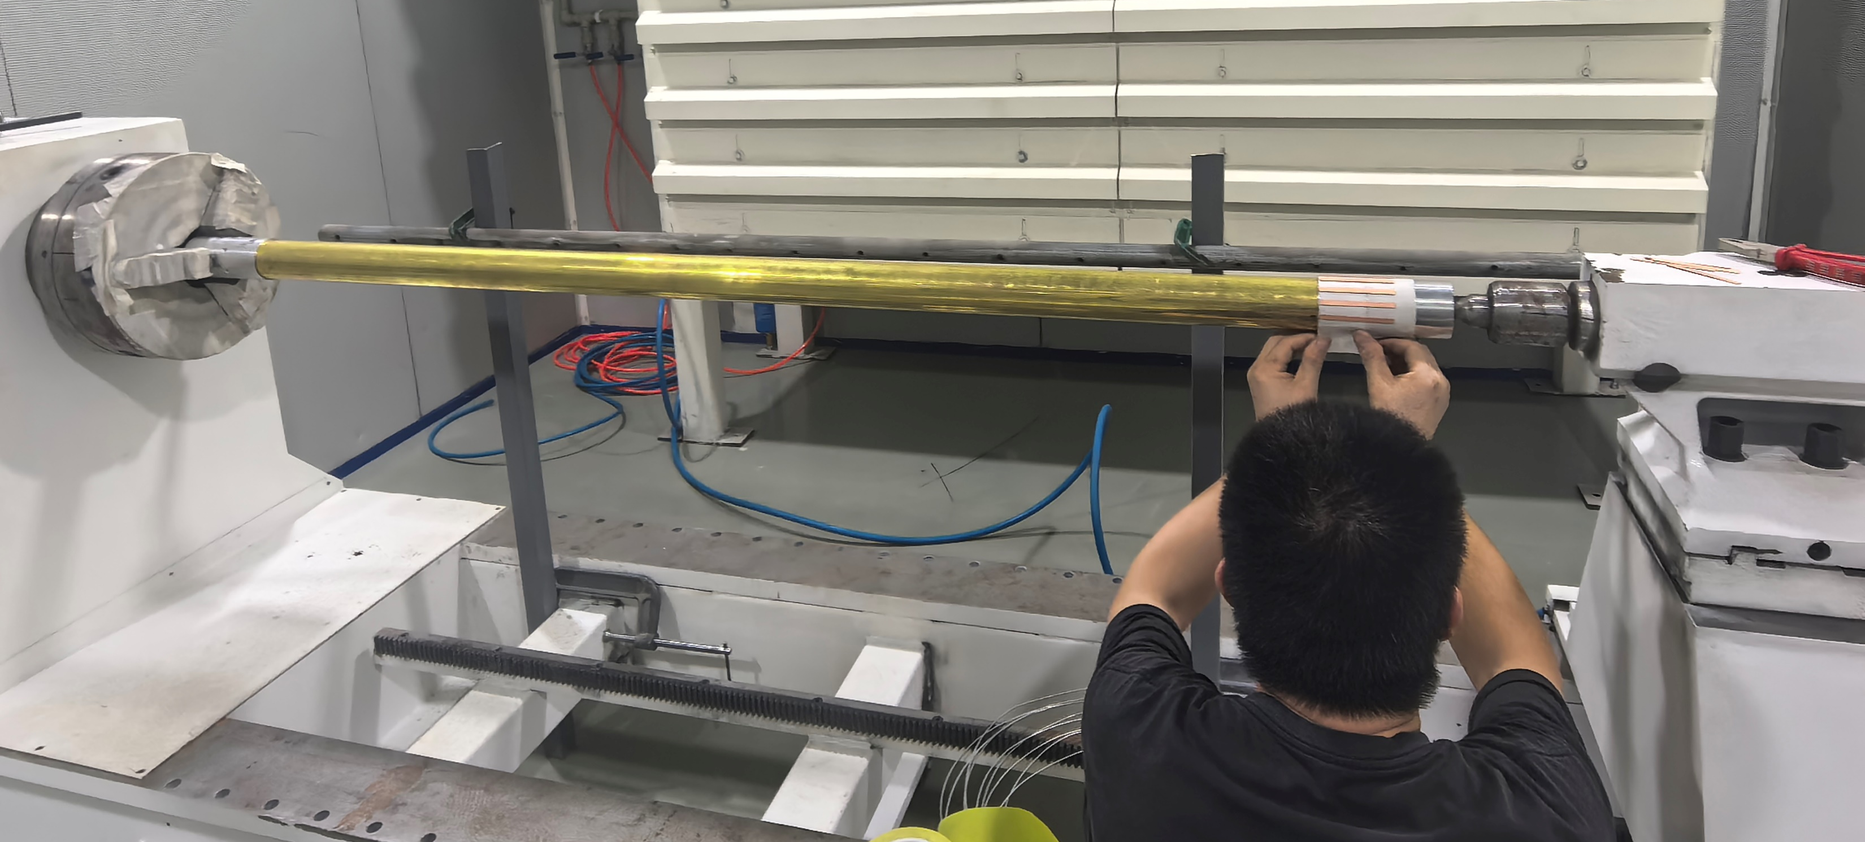
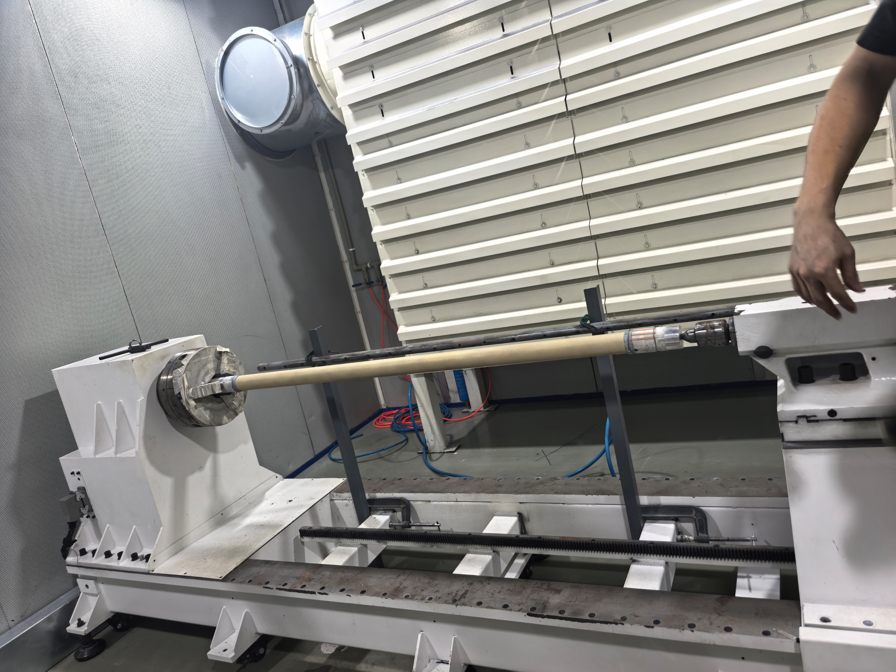
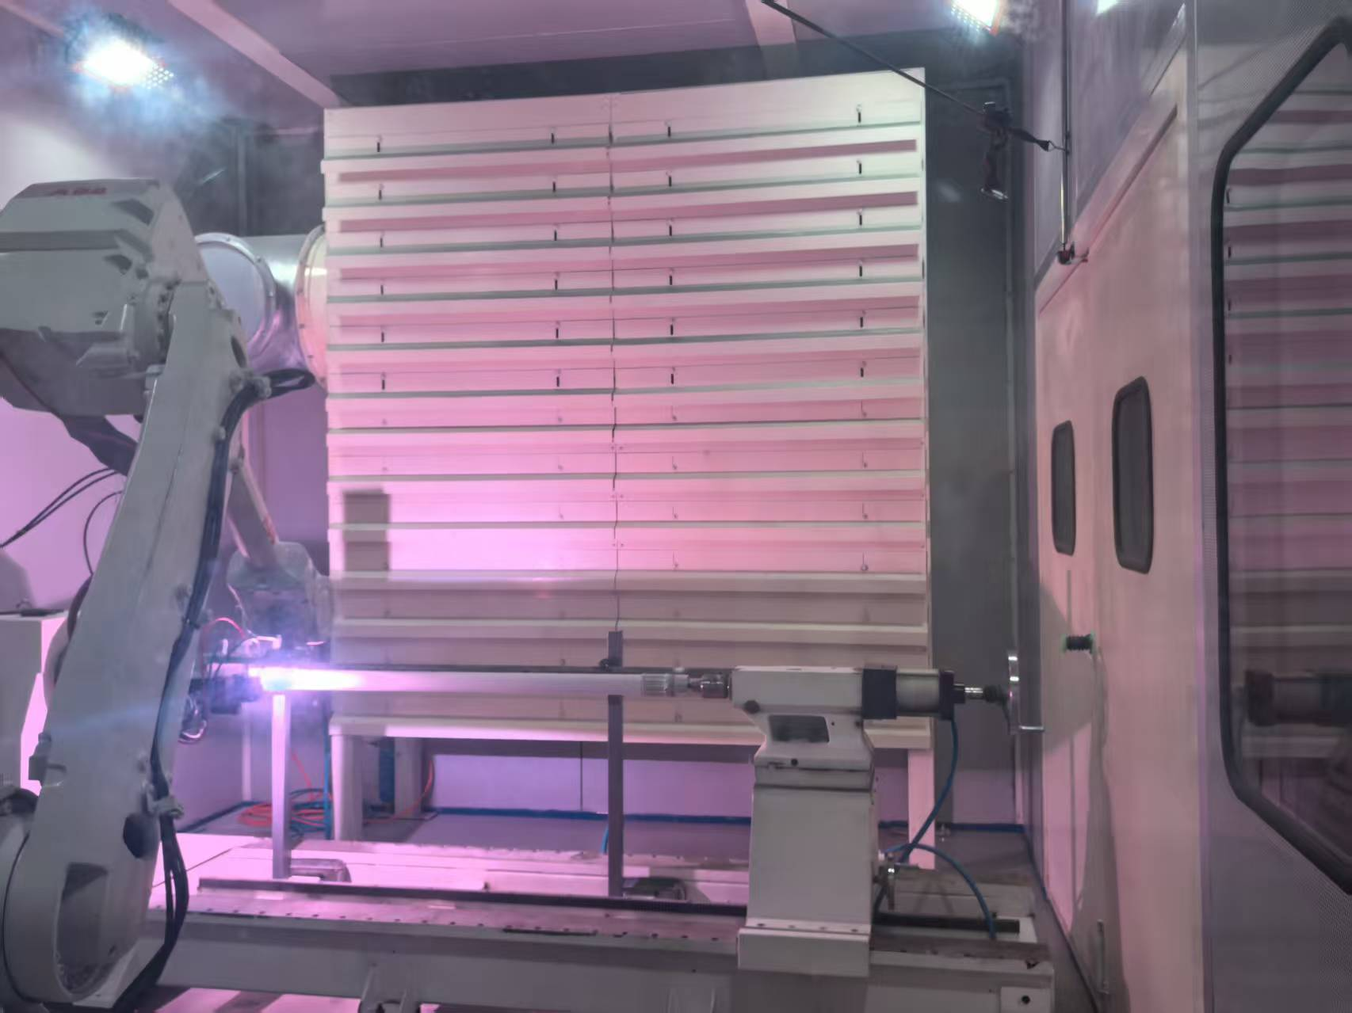
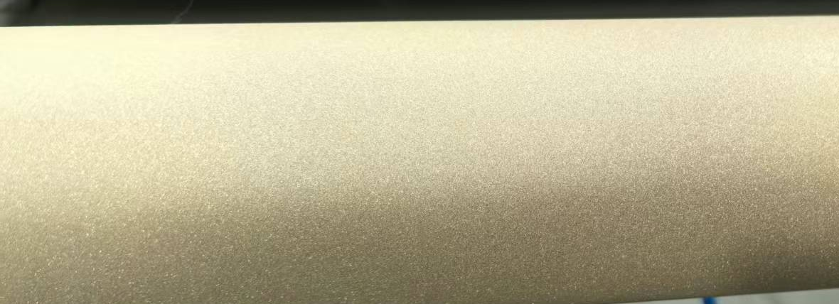



Length of 1.5m prototype of Spraying
A 1.5-meter prototype has been developed to validate key process steps that will be implemented in the production line.
Installation
Sandblasting
Spraying
Spraying_Isolation-layer
Spraying_Conductivity-layer
Spraying_Isolation_layer

Slide 12











Elements and thickness of thermal-spray heating layer
NiCr Conductivity-layer
Al₂O₃ isolation layer
NiCr Transition-layer
Al₂O₃ isolation layer
Thickness
Ni
Cr
Al₂O₃：174um
NiCr：64.5um
Al₂O₃：173um
=471um
Al
O
NiCr：59.5um
＜0.5mm
Cu

Slide 13






Prototype of thermal-spray heating layer and testing
Dimension: L1500*D60 Substrate: copper
Constant V=110V
Several ten times reheating tests which shows a good lifetimes and performance
D60-1500 mm

Slide 14





Prototype of thermal-spray heating layer for LS
Two antechamber prototypes are being developed for future light source applications（HEPS 二期、苏州光源） and deployment in FCC.

Slide 15





Bake-out system of FCC
BASELINE VS ALTERNATIVE SOLUTION
Bake-out temperature=230±30°C
Baseline: Heating Tracks (HT)
Alternative: Heating Cables (HC)
Thermal sprayed on the VC
TYPE | Ø_{COND} | Ø_{SHEATH} | t_{INSULATOR}
KN1600 | 0.57 mm | 3.2 mm | 0.95mm
KN400 | 1.14 mm | 4 mm | 1 mm
KN160 | 1.81 mm | 4.9 mm | 1.03 mm
Reference geometry for FE simulations
Ceramic insulator C2
Heating track T
Welded or groove-fitted on the VC
Ceramic insulator C1
Bond coat B
NEG
NEG
Metallic Sheath
COPPER-NICKEL
Insulation
MgO
Metallic conductor
KUMANAL
15

Slide 16
  租赁场地方案费用情况
北京市内：
北重园区：单价4.5元/平米/天；
首钢园区，巴威公司：单价3元/平米/天；
房山窦店：单价2元/平米/天；
北京周边：
高碑店、涿州、固安：单价0.5元/平米/天；其中固安距离较近有大量工业园区，为有限选择。
租金外的费用
地面处理费用，配电费用需要根据具体情况决定，大约20~30万。

Slide 17





  租赁场地方案（整条生产线）
河北高碑店
场地1：长宽高：60米×50米×8米（3000平米），年租金约44万/年，距离京港澳高速8km，距离高能所86km 。室外空间受限。
河北固安
场地2：长宽高：65米×24米×8米（1200平米），年租金约28.5万/年，距离大广高速约8km，距离高能所79km ，距离大兴机场27km。各项都满足。

Slide 18
未来工作主要内容
加热涂层：耐380V电压，封孔等技术开发， 测试通过电阻直接测温方案，长管道的均匀性，温度一致性等问题；
NEG镀膜：镀膜技术的不同将遇到的新问题，如长管道的厚度均匀性等，200nm薄膜寿命、PSD等；
后期工作不仅是自动化的调试更多是镀膜、喷涂技术、工艺问题；
建设PSD测试线站的必要性：加速器真空设计的重要依据，同行表达了在HEPS建测试线的必要性；
光子吸收器样机、MDI真空盒样机；
大尺寸RF屏蔽波纹管: 较高热负载（FCC的计算为150W）、高伸缩量等考验;
在长管道镀膜、喷涂国际无成熟方案，保持国际技术领先

Slide 19
Summary
PSD of 0.2um NEG coating should be pay more attention (most data bases on 1um NEG coating).
The production line for vacuum chamber NEG coating and thermally sprayed heating layers is currently under installation and conditioning.
It is capable of handling vacuum chambers with a minimum dimension of 56 mm and a maximum length of 11.5 meters for NEG coating applications. There are no dimensional restrictions for the thermal-sprayed heating layer process.
Additionally, a 1.5-meter prototype of the thermally sprayed heating layer has been fabricated, with relevant performance tests successfully completed.
Thermal-spray heating layer: compatible all size of vacuum chambers.
希望尽快确定场地以便设备进场安装调试，厂房以固安为首选地，兼具价格、交通优势。

Slide 20
Thanks for your attention!

Slide 21







Plasma spraying devices
The spraying system is similar to the system detailed in the following pictures.

Slide 22

Production line composition
Classification | Sub-devices | Parameters | Note
Electron-beam welder | Electron-beam gun Power supply Vacuum chamber | Meets the Length of 11.4m vacuum chamber 6 working position | Design and manufacturing
Brazing | Mechanical holder Power supply | 350℃ 11.4m long | Low temperature brazing in air by conductivity heating, expecting stead by double hole copper tube
Heating film spraying facility | Electron-beam gun Power supply Controller Mechanical Structure | Meets the Length of 11.4m vacuum chamber Multilayer Spray Ceramic and conductivity layer | R&D
NEG coating tower | Pumping system Vacuum measurement Power supply Vacuum chambers Discharge Gas Cathode、controller | Meets the Length of 11.4m vacuum chamber 6 working position Background vacuum <5e-7Pa Baking temperature 200℃ | Developing to be more fitted the production line
Measurement and testing | Dimension measurement Leakage testing | Dimension measurement 11.5m/0.1mm Leakage testing 1e-10 mbar·L/s | Design and manufacturing
Cleaning | rinsing | deionized water rinsing | Design and manufacturing
Production line auxiliary equipment | Moving band robot arm system controller | Meets the Length of 11.4m vacuum chamber | Design and manufacturing

Slide 23
真空喷涂场地Plan-A/B/C方案对比表
对比维度 | Plan-A：锅炉房西侧场地 | Plan-B：车队南侧临设位置 | Plan-C：租赁场地方案
方案类型 | 园区内建造临时建筑 | 园区内建造临时建筑 | 租赁现有场地/厂房
场地位置 | 锅炉房西侧场地 | 车队南侧，现施工临设位置 | 北京市内（北重/首钢园区）、北京周边（高碑店）
场地基础条件 | 1. 需占用消防通道，空间受限； 2. 有在用暖沟，15cm盖板不满足设备承重； 3. 需预留3米维修通道及设备进出空间 | 1. 长35m×宽10m×高5m以上，完全满足工艺需求； 2. 地面承重800kg/㎡，仅局部暖沟需处理； 3. 周边配套完善，无消防通道占用问题 | 1. 北重园区：最小可租700㎡，配套完善； 2. 首钢园区：最小可租400㎡，需排队租赁； 3. 高碑店厂房：长40-50m×宽30m×高7m，室外空间有限
总费用明细 | 暖沟改造：约48万元； 供电改造：方案一约35万元，总费用最低约58万元， 临建主体及配套：77.5万元； 水路改造：1万元； 总费用合计约161.5万元 | 1. 临建主体及配套：77.5万元； 2. 配电改造：25万元； 3. 水路改造：1万元； 总费用合计约103.5万元 | 1. 年租金：北重115万元/年、首钢76.5万元/年、高碑店15万元/年； 2. 一次性地面+配电改造：约20~30万元
优势 | 1. 场地在园区内，距离近，运输管理成本低； | 1. 场地尺寸完全适配工艺需求，空间更优； 2. 无大额承重改造成本，仅需局部暖沟处理； 3. 供电配套完善，改造成本低、可靠性高； 4. 不占用消防通道，合规风险更低 | 1. 无需临建主体建设，无大额一次性土建投入； 2. 园区厂房供电、消防等合规性有保障； 3. 可灵活选择场地，适配不同预算需求
劣势 | 1. 占用消防通道，存在合规风险； 2. 暖沟改造需额外48万固定成本； 3. 供电改造要么可靠性差，要么成本极高； 4. 场地空间严重受限，设备布局难度大 | 1. 需全额承担临建主体及配套建设成本，一次性投入103.5万； 2. 临建使用期限有限，期满需无条件拆除 | 1. 北京市内场地年租金成本高，长期使用成本远超临建； 2. 首钢园区场地需排队，租赁不确定性高； 3. 高碑店场地距离园区较远（80km），运输、管理成本增加
使用限制与风险 | 1. 临建使用期限最长2年，可延期1次，不得改变用途； 2. 占用消防通道，存在被要求整改/拆除的风险 | 1. 临建使用期限最长2年，可延期1次，不得改变用途； 2. 期满或城市建设需要时，必须无条件拆除 | 1. 受租赁协议约束，需按年支付租金，使用灵活性受限于租赁期限；

Slide 24


Plasma spraying devices
The spraying system is similar to the system detailed in the following pictures.

Slide 25

Normalized Average Pressure as a Function of Integrated Beam Current HEPS VS BEPCII
HEPS（6Gev） copper vacuum chamber with NEG coating
BEPC II（1.89Gev） AL vacuum chamber （no NEG coating）
HEPS (NEG coating /CuZrCr copper ) VS BEPCII (TiN coating for positron ring /AL )

