Slide 1

DA with errors of future BEPCII upgrade (BEPCII-UP) with crab waist scheme
Bin wang
15 June 2026

Slide 2
Outline
Introduction of the BEPCII-UP parameters and lattice
Error definition and corrector settings
Correction scheme
Correction performance
Summary and to do list

Slide 3
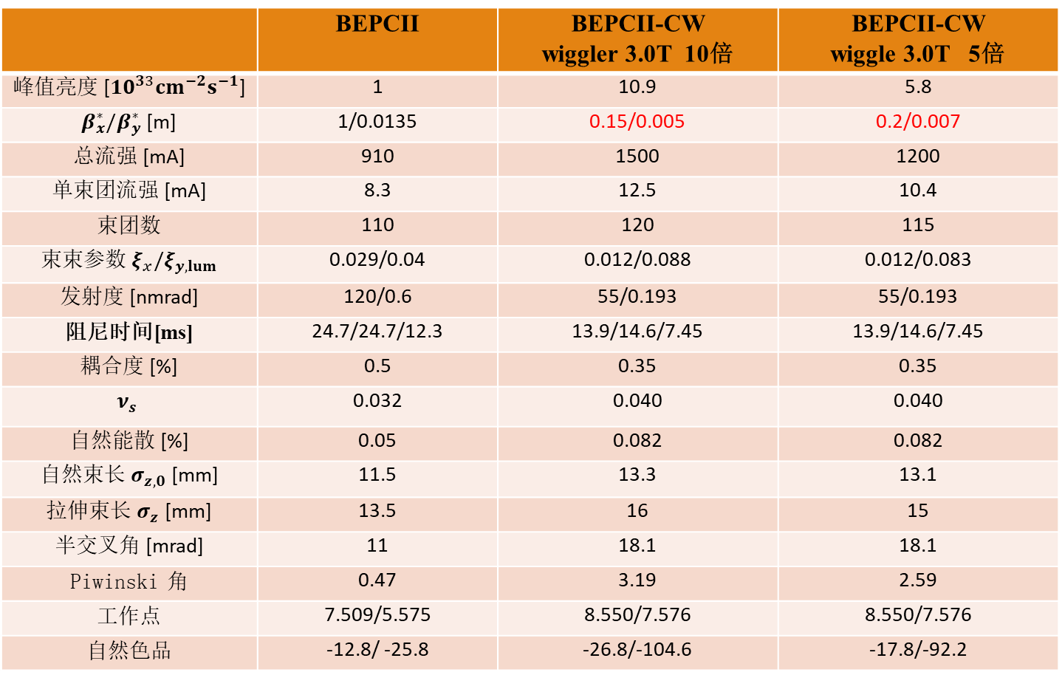
1.89GeV BEPCII crab waist 参数表（w. 3.0T wiggler）
 | BEPCII | BEPCII-CW wiggler 3.0T 10倍 | BEPCII-CW wiggle 3.0T 5倍
峰值亮度 [${10}^{33}cm^{−2}s^{−1}$] | 1 | 10.9 | 5.8
$β_{x}^{∗}/β_{y}^{∗}$ [m] | 1/0.0135 | 0.15/0.005 | 0.2/0.007
总流强 [mA] | 910 | 1500 | 1200
单束团流强 [mA] | 8.3 | 12.5 | 10.4
束团数 | 110 | 120 | 115
束束参数 ${ξ_{x}/ξ}_{y,lum}$ | 0.029/0.04 | 0.012/0.088 | 0.012/0.083
发射度 [nmrad] | 120/0.6 | 55/0.193 | 55/0.193
阻尼时间[ms] | 24.7/24.7/12.3 | 13.9/14.6/7.45 | 13.9/14.6/7.45
耦合度 [%] | 0.5 | 0.35 | 0.35
$$ν_{s}$$ | 0.032 | 0.040 | 0.040
自然能散 [%] | 0.05 | 0.082 | 0.082
自然束长 $σ_{z,0}$ [mm] | 11.5 | 13.3 | 13.1
拉伸束长 $σ_{z}$ [mm] | 13.5 | 16 | 15
半交叉角 [mrad] | 11 | 18.1 | 18.1
Piwinski 角 | 0.47 | 3.19 | 2.59
工作点 | 7.509/5.575 | 8.550/7.576 | 8.550/7.576
自然色品 | -12.8/ -25.8 | -26.8/-104.6 | -17.8/-92.2
于程辉、林椿涛、王逗、张源
王逗，BII crab waist 方案内部讨论会，2026.05.12
基于这个参数表对应的lattice进行误差校正。

Slide 4
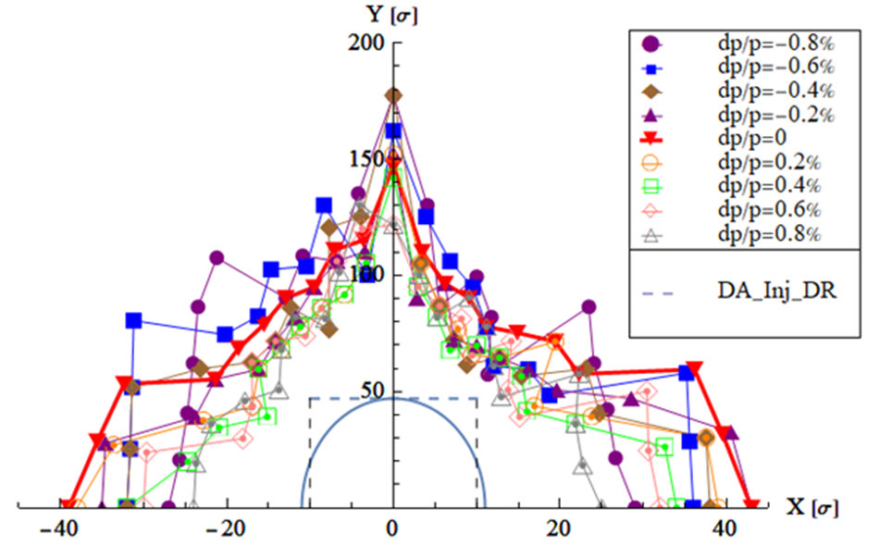
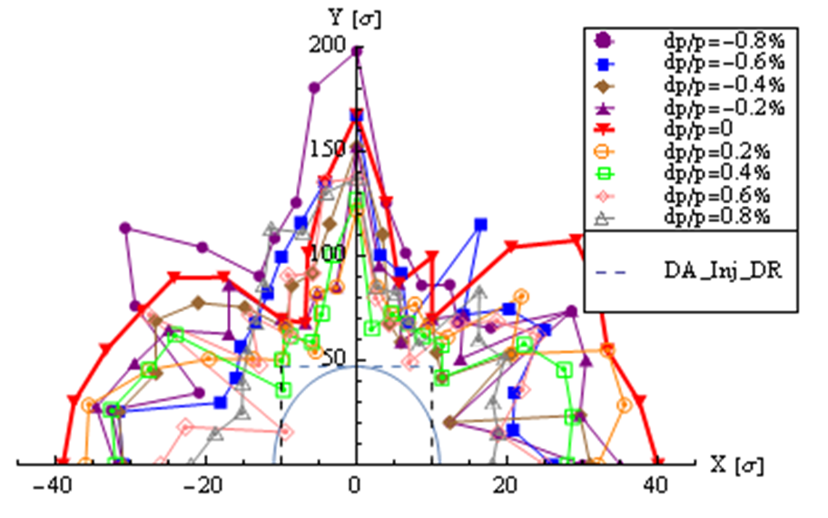
10倍亮度动力学孔径优化结果（β*=0.15m/5mm）
61% crab + 3T wiggler
bb off
bb on
原有36个六极铁全部自由（强度≤ 11）
加上所有B+S，总共86个变量
放开R3OS5强度限制（靠近3W1，有空间）
DA requirement by injection @1.89GeV
Without DR: 14σx, 136σy (εy= 0.0035εx)
With DR : 11.1σx, 47σy (εy= 0.0035εx)
（在10倍σx 处有47倍σy ）
Damping ring supports the achievement of the crab waist's high-luminosity goal.

Slide 5
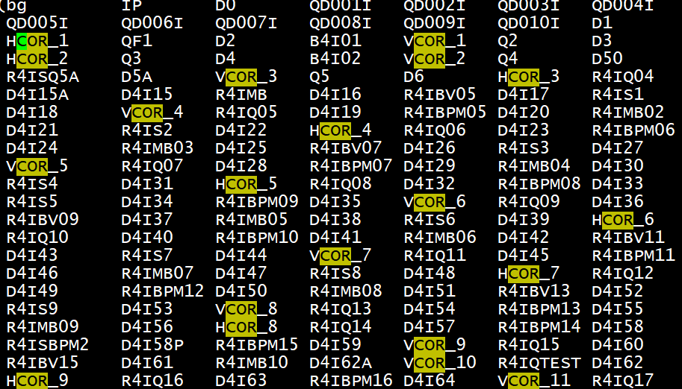
Error definition and corrector settings
Lattice 版本：lastext.x.txt.v1（04.18）
误差设置：
  对所有的B铁、Q铁和S铁加200微米的准直误差。
  没有考虑bpm的噪声和精度问题
校正：
  用上所有的水平校正子（35个）、垂直校正子（40个）和bpm（77个）。
  新增校正子主要分布在对撞区。

Slide 6
Correction scheme
Software: SAD and Matlab-based accelerator toolbox (AT)
Closed-orbit distortion (COD) correction was performed with sextupoles off, then the sextupoles were turned on and the COD correction repeated.
The dispersion correction and beta-beating correction are also used for optics correction.
The coupling and vertical dispersion correction are used to decrease the vertical emittance.
The above correction scheme is iterated until the emittance and tracking dynamic aperture satisfy the design requirements.

Slide 7
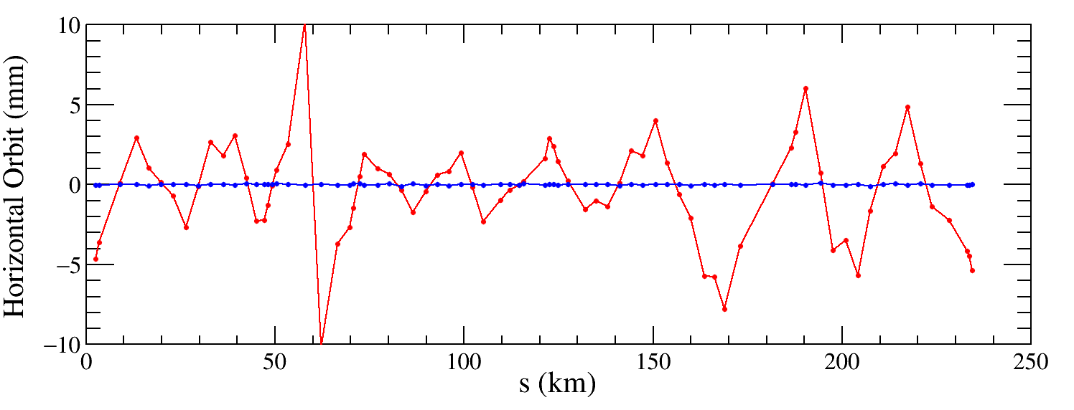
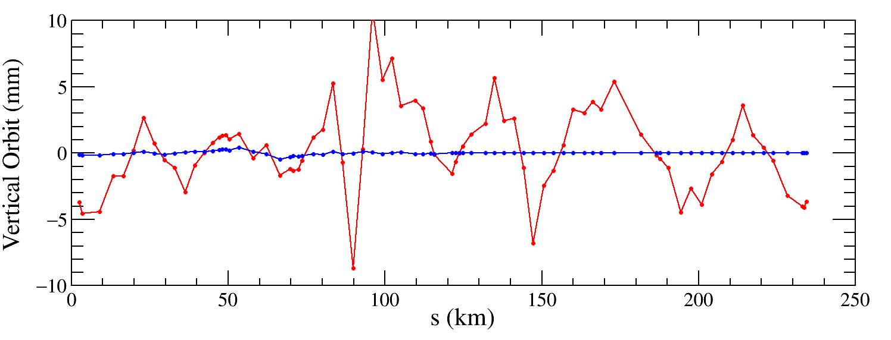

COD correction
The COD correction algorithm is based on the response matrix. By inverting the response matrix using singular value decomposition (SVD), the steering strengths can be derived to correct the distorted orbits.
The maximum and RMS closed orbit is about 200 μm for both horizontal and vertical closed orbit, respectively.

Slide 8
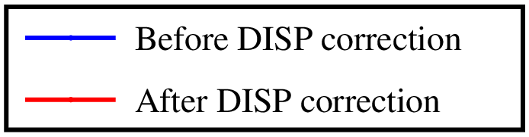
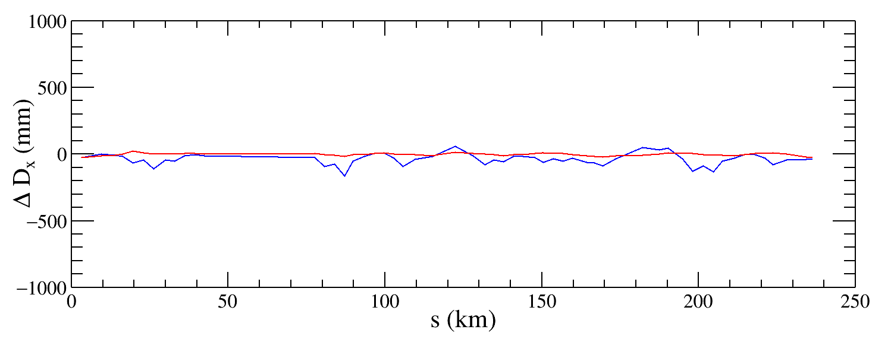
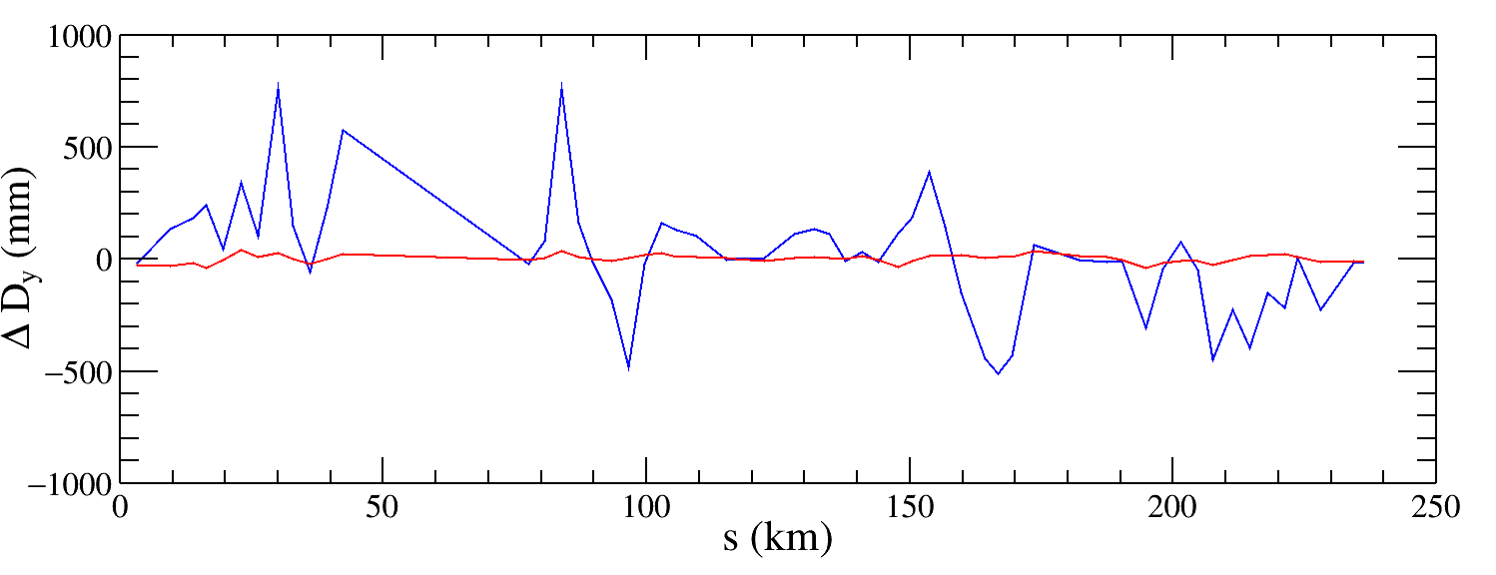
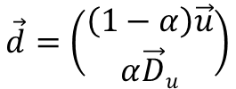

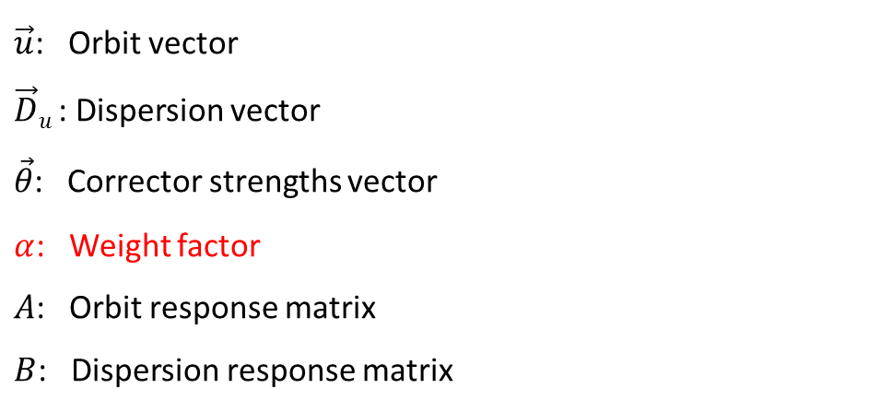


Dispersion correction
Dispersion free steering principle (DFS):$θ$_{c}
$$\vec{d}=\left(\begin{aligned}\left(1−α\right)\vec{u} \\ α\vec{D}u\end{aligned}\right)$$
M$=\left(\begin{aligned}\left(1−α\right)A \\ αB\end{aligned}\right)$
$$\vec{d}+M\vec{θ}=0$$
$\vec{u}$: Orbit vector
$\vec{D}u$: Dispersion vector
$\vec{θ}$: Corrector strengths vector
$α$: Weight factor
$A$: Orbit response matrix
$B$: Dispersion response matrix
The dispersion is corrected well, the RMS dispersion is about 5mm for horizontal dispersion and tens mm for vertical dispersion.

Slide 9
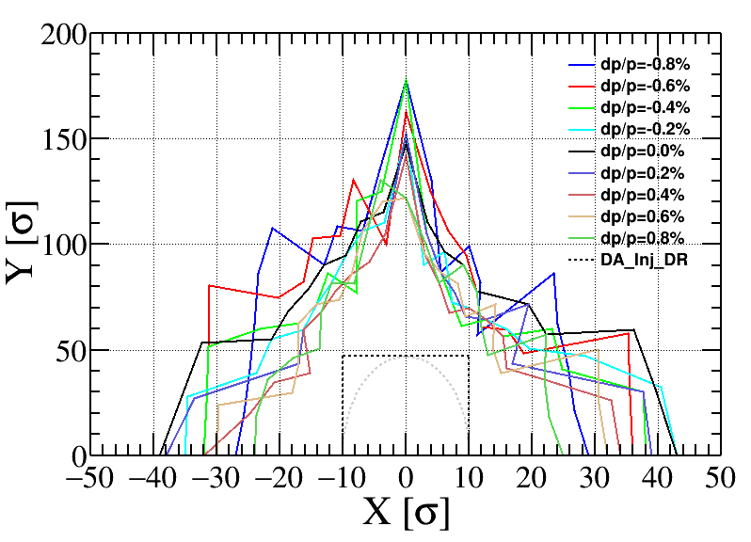
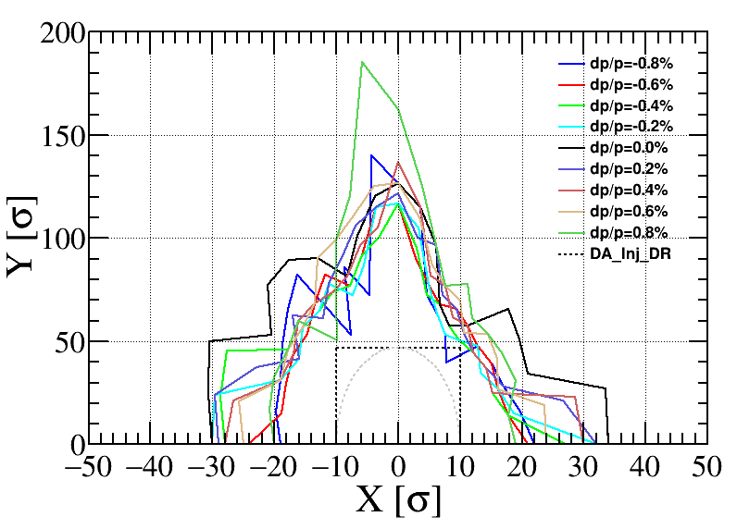
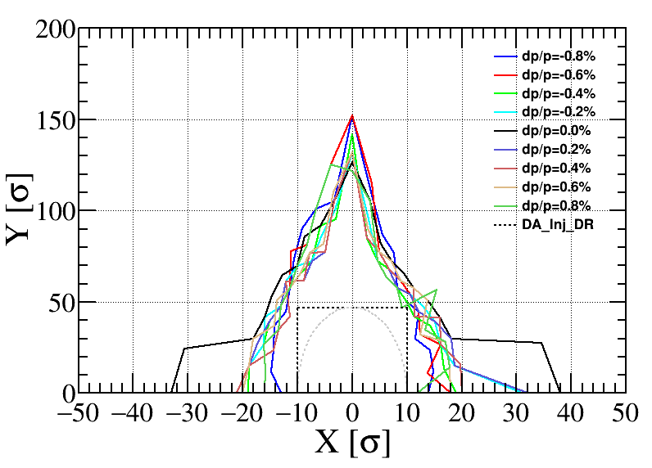
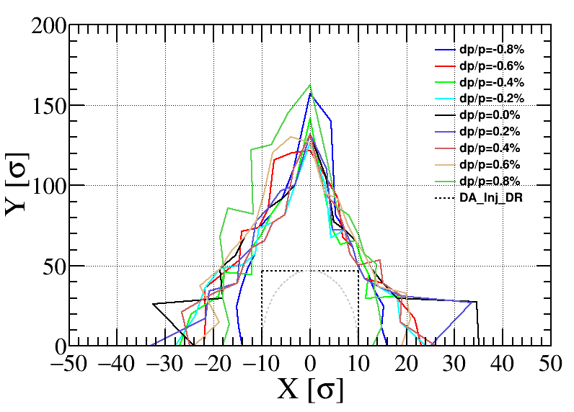
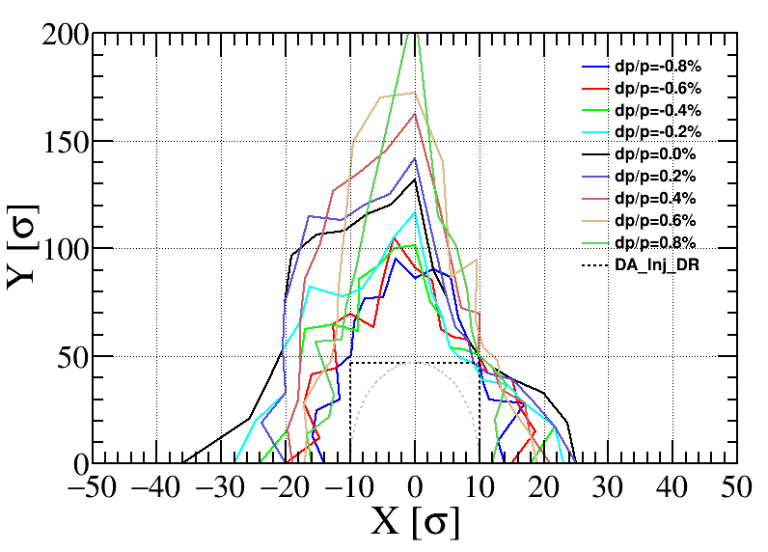
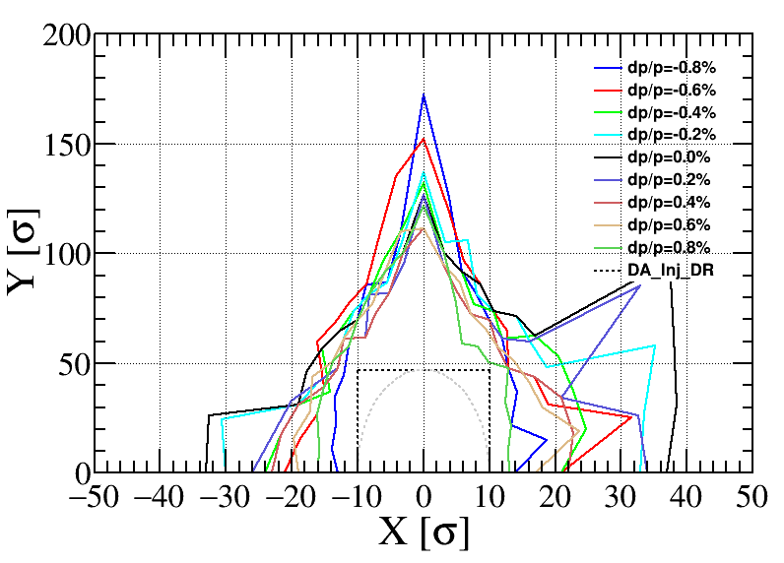
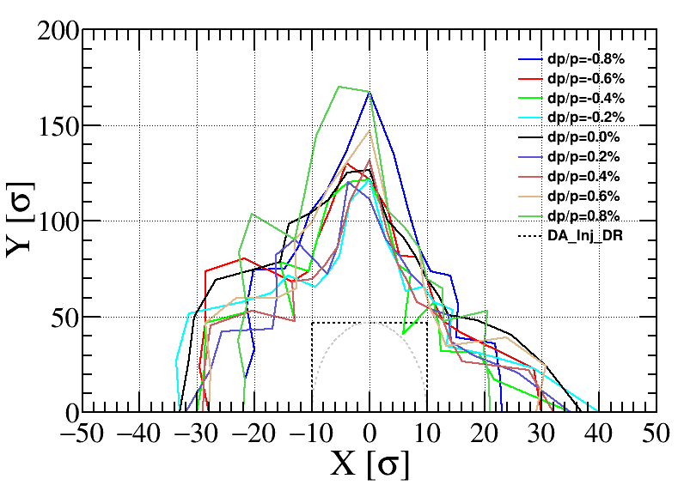
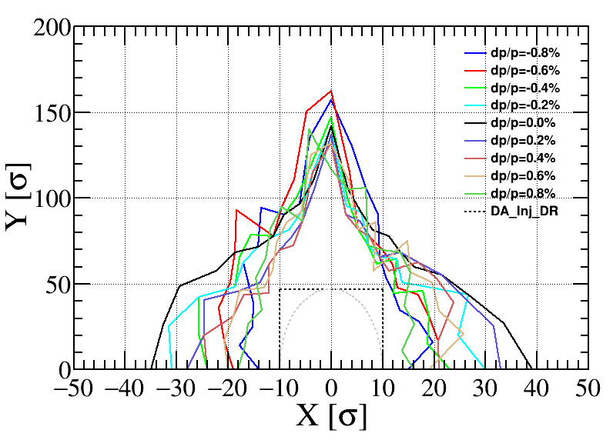
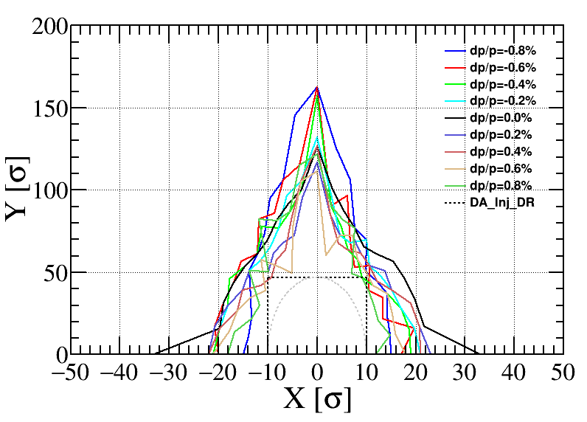
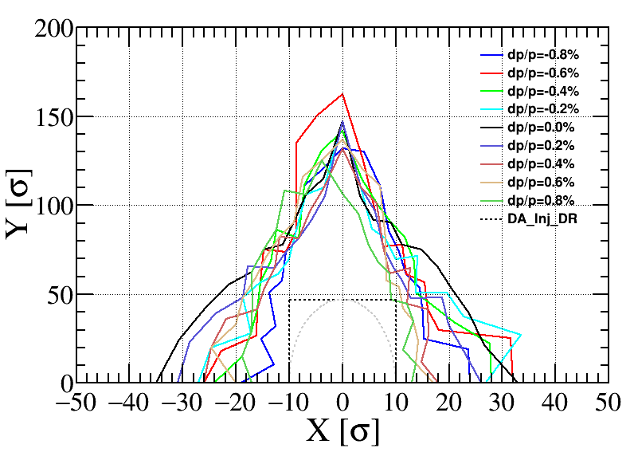
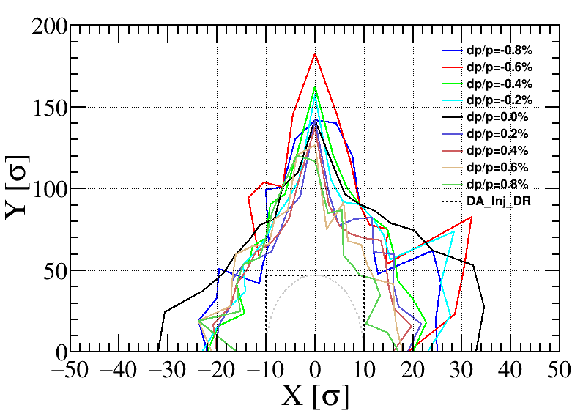
Bare lattice
孔径跟踪结果
200 um
完成10个seed的校正，没有考虑高阶场误差的情况下是满足注入需求（虚线方框）；

Slide 10

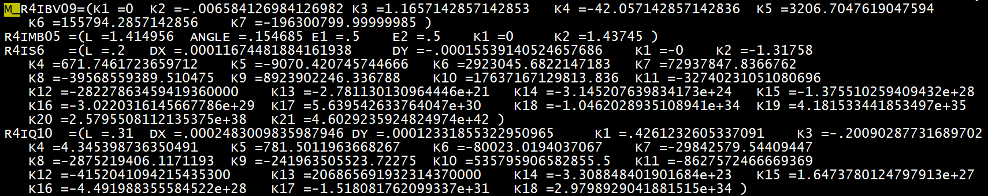
n | BEND | QUAD | SEXT
2 | -5.185E-05 | 0 | 0
3 | 1.530E-04 | 1.36E-04 | 0
4 | -6.900E-05 | 2.32E-05 | 3.82954E-4
5 | 5.261E-05 | 3.47E-05 | 1.06414E-4
6 | 2.130E-05 | 5.81E-05 | 4.91114E-4
7 | -1.917E-04 | 6.07E-05 | 9.69754E-5
8 | 0 | 3.14E-05 | 1.82908E-4
9 | 0 | 4.38E-05 | 6.93930E-4
10 | 0 | 3.44E-04 | 3.81692E-5
11 | 0 | 5.44E-05 | 3.08564E-5
12 | 0 | 4.80E-05 | 5.96229E-5
13 | 0 | 1.26E-05 | 3.48266E-5
14 | 0 | 7.76E-05 | 8.76750E-5
15 | 0 | 2.54E-04 | 4.39130E-3
16 | 0 | 5.58E-05 | 9.41162E-5
17 | 0 | 2.44E-05 | 4.31761E-6
18 | 0 | 4.75E-04 | 1.40759E-5
19 | 0 | 0 | 6.60110E-6
20 | 0 | 0 | 1.32953E-5
21 | 0 | 0 | 6.38161E-4
高阶场误差
二极铁：在旁边插入一块0长度的MULT，根据公式把高阶场误差分别置入；
四极铁和六极铁：直接把磁铁列别改成MULT，然后添加高阶场误差。

Slide 11
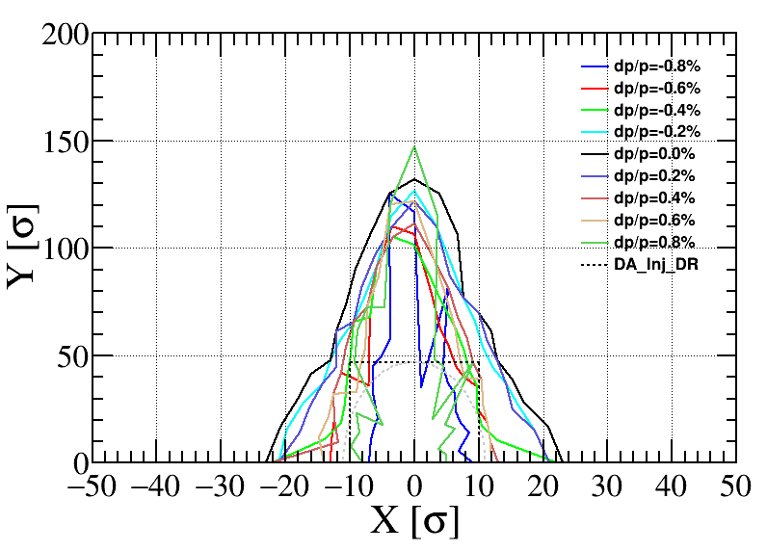

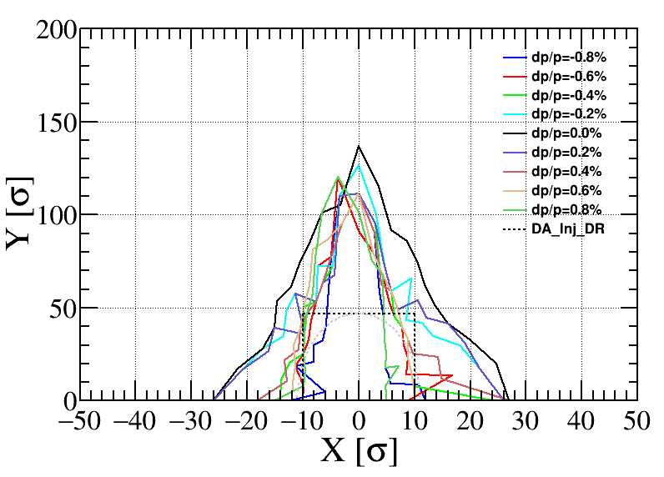
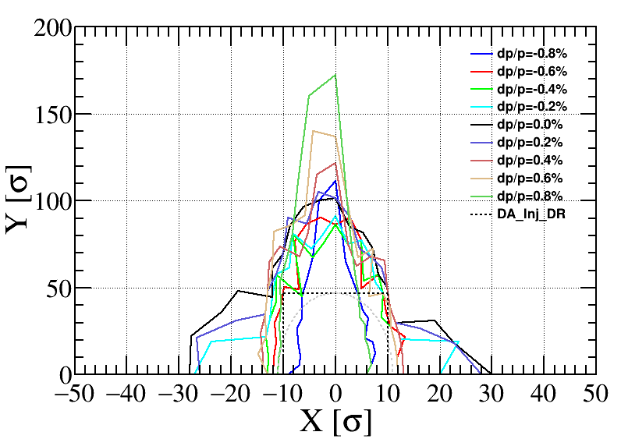
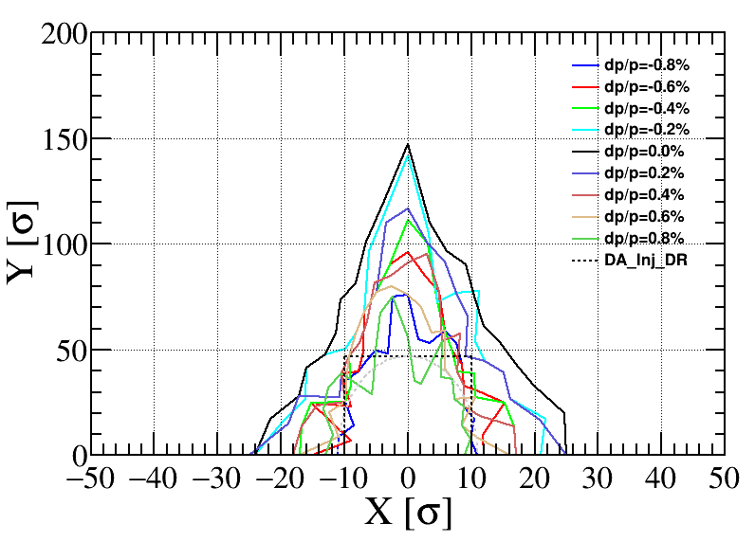
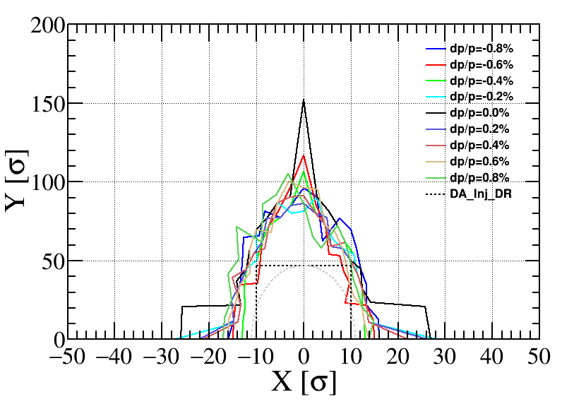
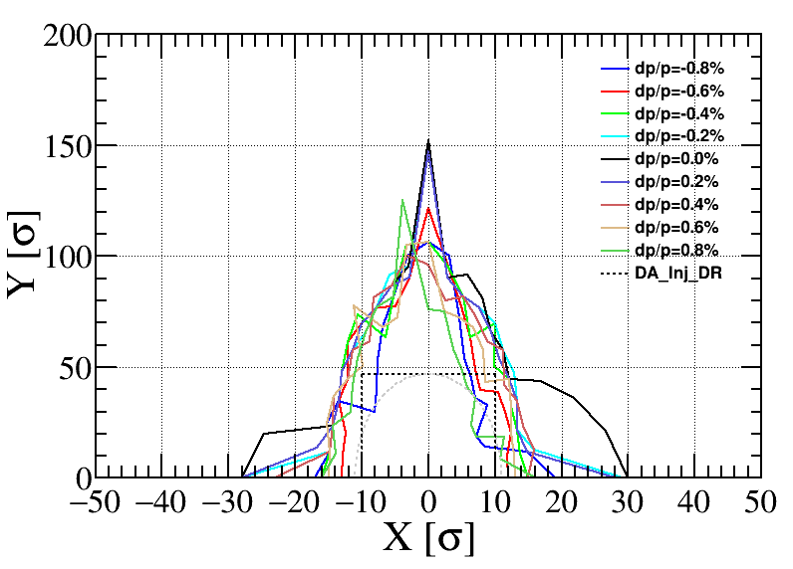
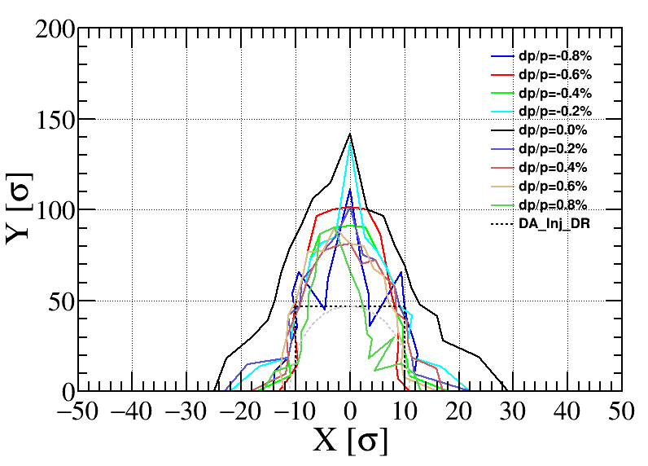
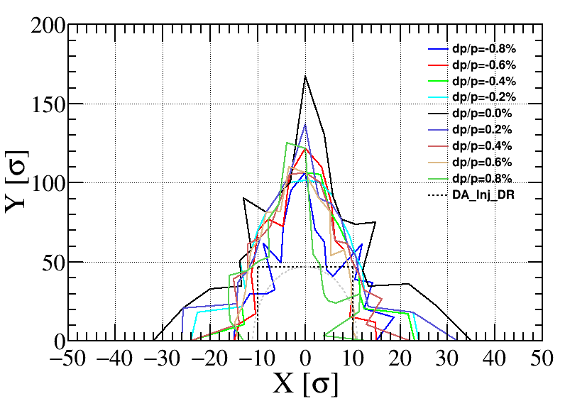
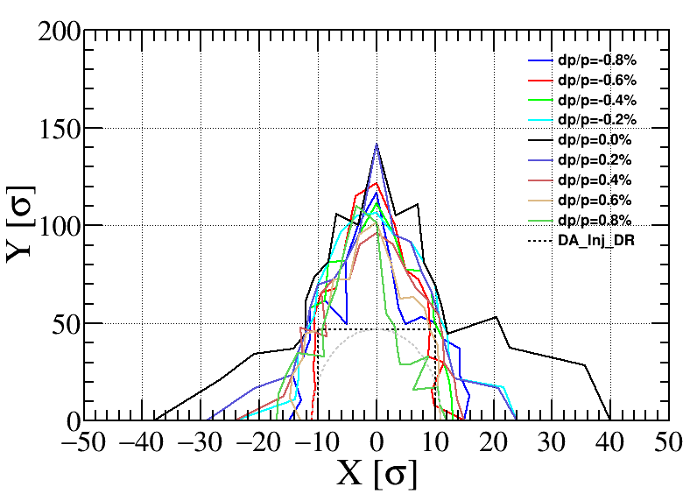
n | BEND | QUAD | SEXT
2 | -5.185E-05 | 0 | 0
3 | 1.530E-04 | 1.36E-04 | 0
4 | -6.900E-05 | 2.32E-05 | 3.82954E-4
5 | 5.261E-05 | 3.47E-05 | 1.06414E-4
6 | 2.130E-05 | 5.81E-05 | 4.91114E-4
7 | -1.917E-04 | 6.07E-05 | 9.69754E-5
8 | 0 | 3.14E-05 | 1.82908E-4
9 | 0 | 4.38E-05 | 6.93930E-4
10 | 0 | 3.44E-04 | 3.81692E-5
11 | 0 | 5.44E-05 | 3.08564E-5
12 | 0 | 4.80E-05 | 5.96229E-5
13 | 0 | 1.26E-05 | 3.48266E-5
14 | 0 | 7.76E-05 | 8.76750E-5
15 | 0 | 2.54E-04 | 4.39130E-3
16 | 0 | 5.58E-05 | 9.41162E-5
17 | 0 | 2.44E-05 | 4.31761E-6
18 | 0 | 4.75E-04 | 1.40759E-5
19 | 0 | 0 | 6.60110E-6
20 | 0 | 0 | 1.32953E-5
21 | 0 | 0 | 6.38161E-4
高阶场误差
二极铁的b2是主要影响孔径的因素。

Slide 12
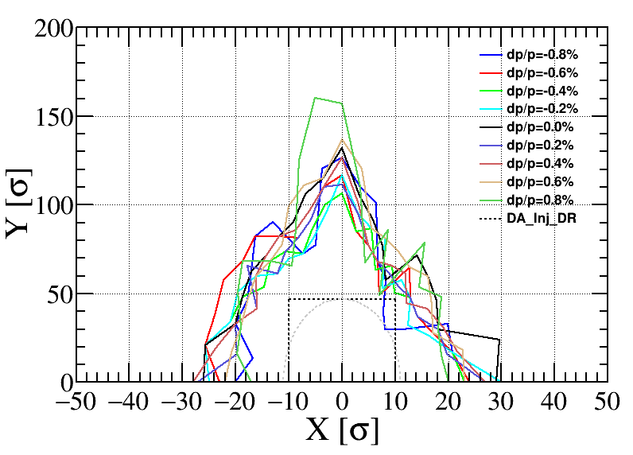
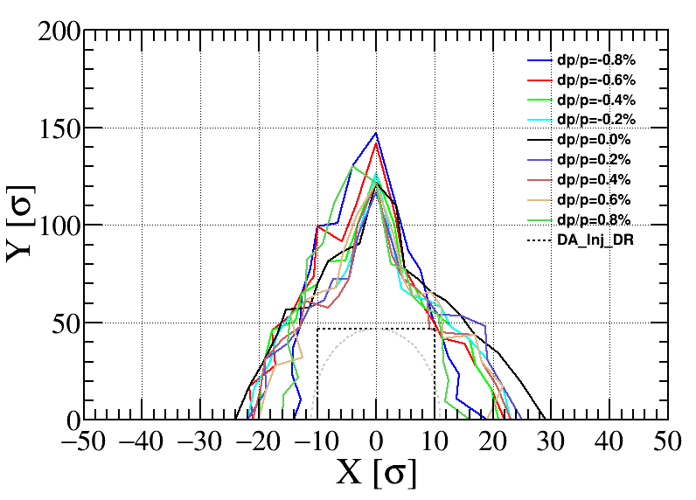
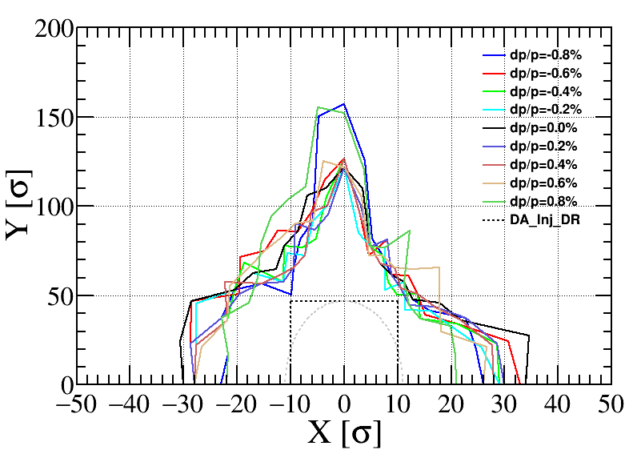
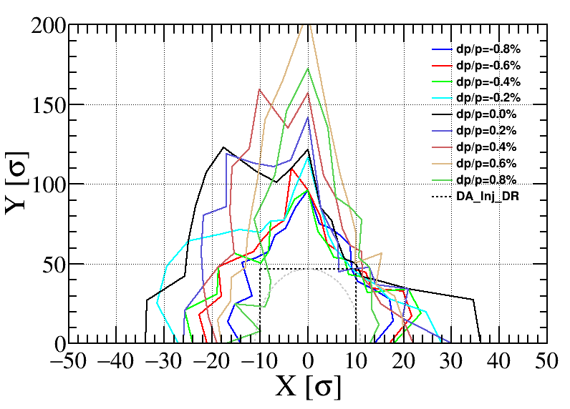
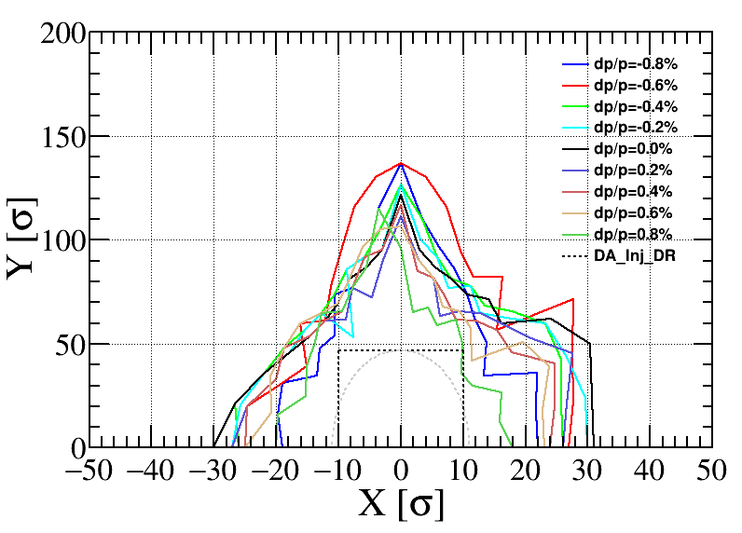
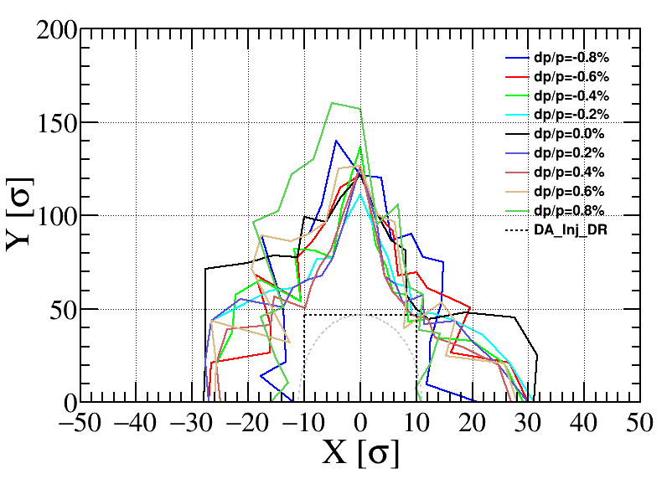
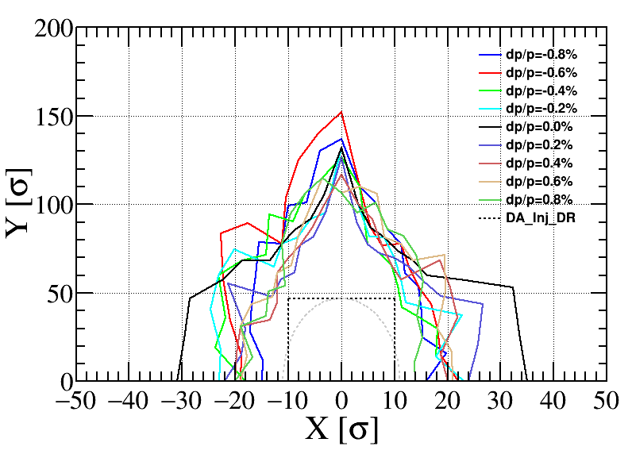
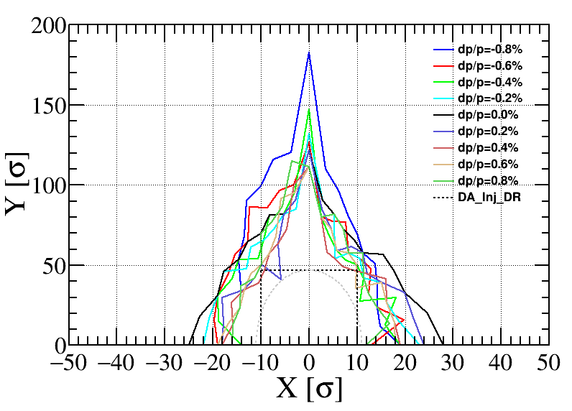
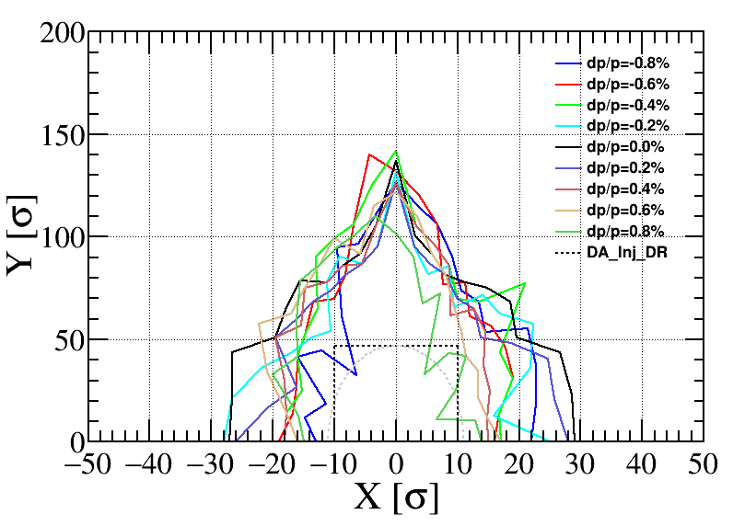
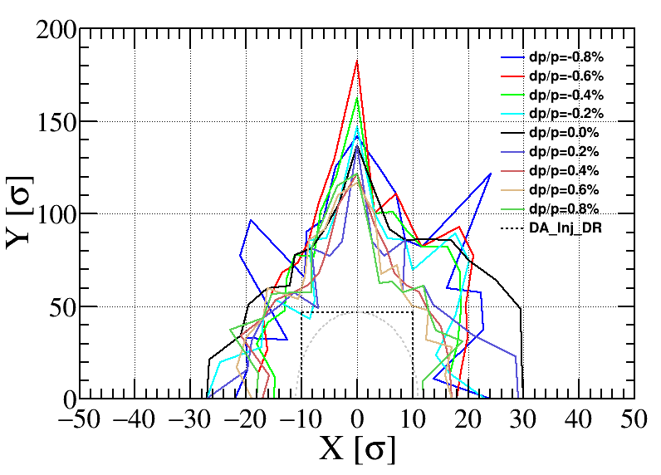
n | BEND | QUAD | SEXT
2 | 0 | 0 | 0
3 | 1.530E-04 | 1.36E-04 | 0
4 | -6.900E-05 | 2.32E-05 | 3.82954E-4
5 | 5.261E-05 | 3.47E-05 | 1.06414E-4
6 | 2.130E-05 | 5.81E-05 | 4.91114E-4
7 | -1.917E-04 | 6.07E-05 | 9.69754E-5
8 | 0 | 3.14E-05 | 1.82908E-4
9 | 0 | 4.38E-05 | 6.93930E-4
10 | 0 | 3.44E-04 | 3.81692E-5
11 | 0 | 5.44E-05 | 3.08564E-5
12 | 0 | 4.80E-05 | 5.96229E-5
13 | 0 | 1.26E-05 | 3.48266E-5
14 | 0 | 7.76E-05 | 8.76750E-5
15 | 0 | 2.54E-04 | 4.39130E-3
16 | 0 | 5.58E-05 | 9.41162E-5
17 | 0 | 2.44E-05 | 4.31761E-6
18 | 0 | 4.75E-04 | 1.40759E-5
19 | 0 | 0 | 6.60110E-6
20 | 0 | 0 | 1.32953E-5
21 | 0 | 0 | 6.38161E-4
高阶场误差
二极铁的b2是主要影响孔径的因素。去掉b2可以看到孔径没有明显的变化。B2对应的是K1四极场，我们把在误差校正过程中就考虑这一项误差。

Slide 13
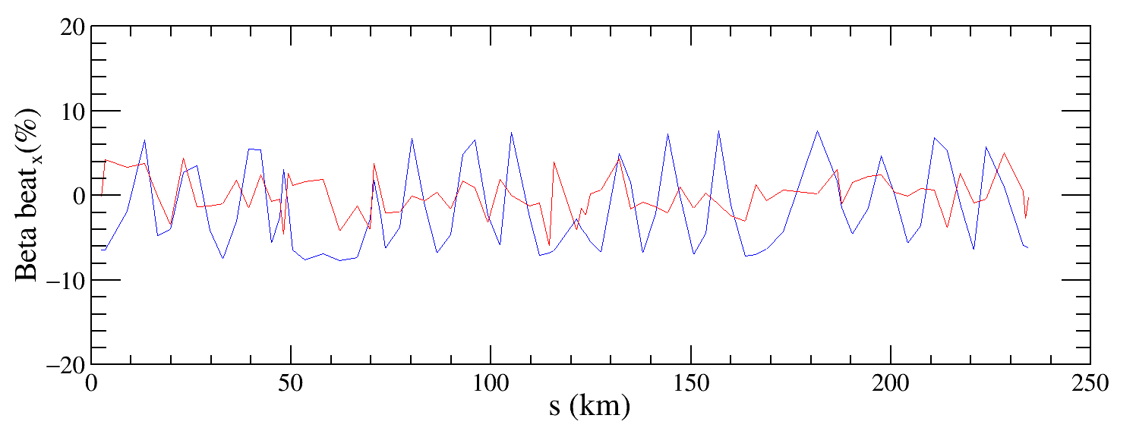
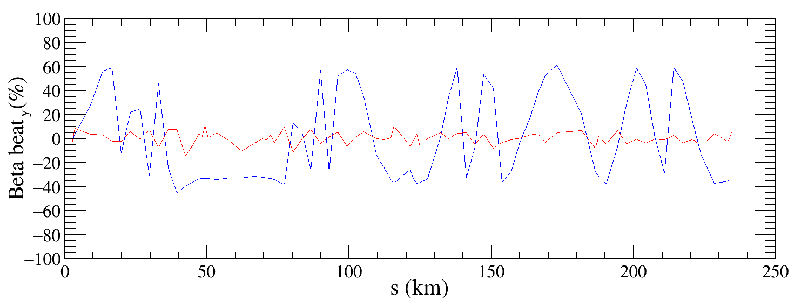
Beta-beating correction
Correct the beta functions with sextupoles on.
Based on AT LOCO: model based correction
  Establish lattice model M_{mod}, multi-parameter fit to the orbit response matrix M_{meas} to obtain calibrated model:
  Parameters fitted: K, KS …
  Use calibrated model to perform correction and apply to machine.
  Fit the dispersion at the same time.
  Application to correct beta-beating, dispersion and coupled response matrix.

Slide 14
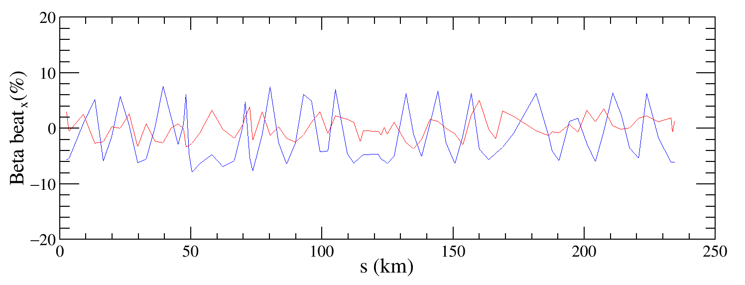
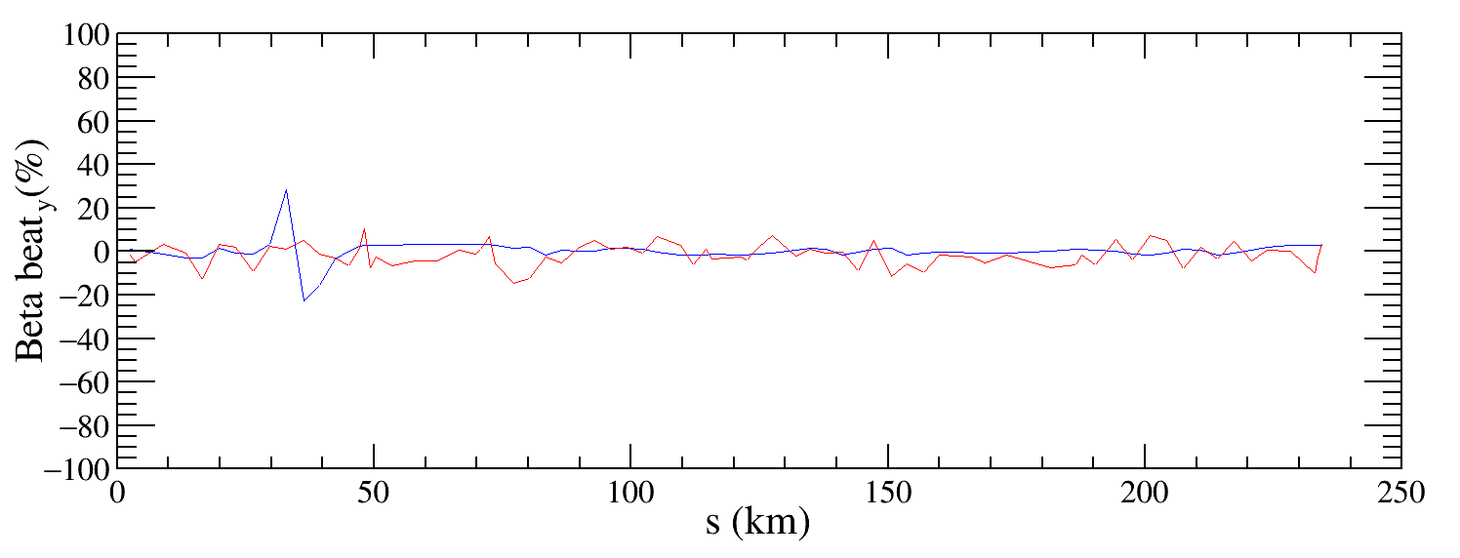
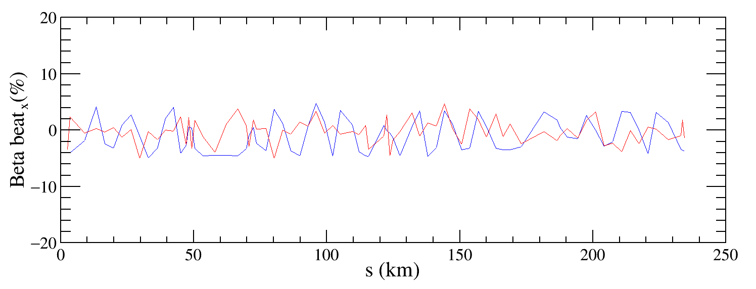
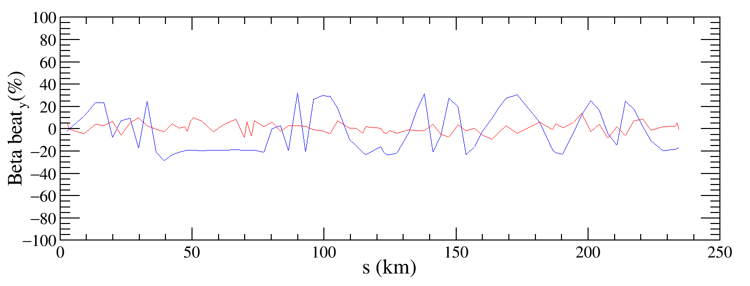
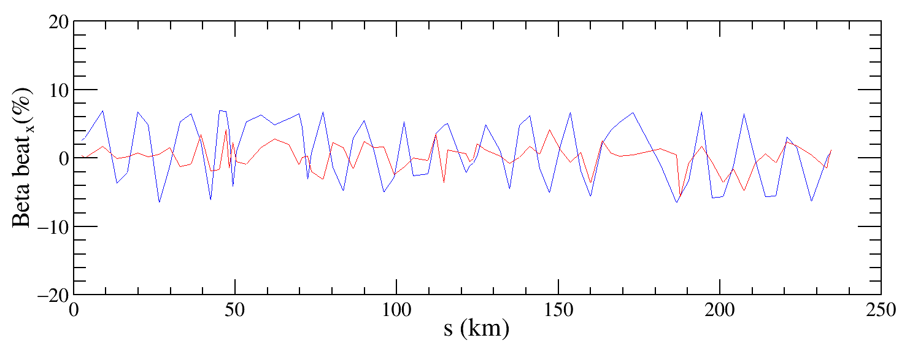
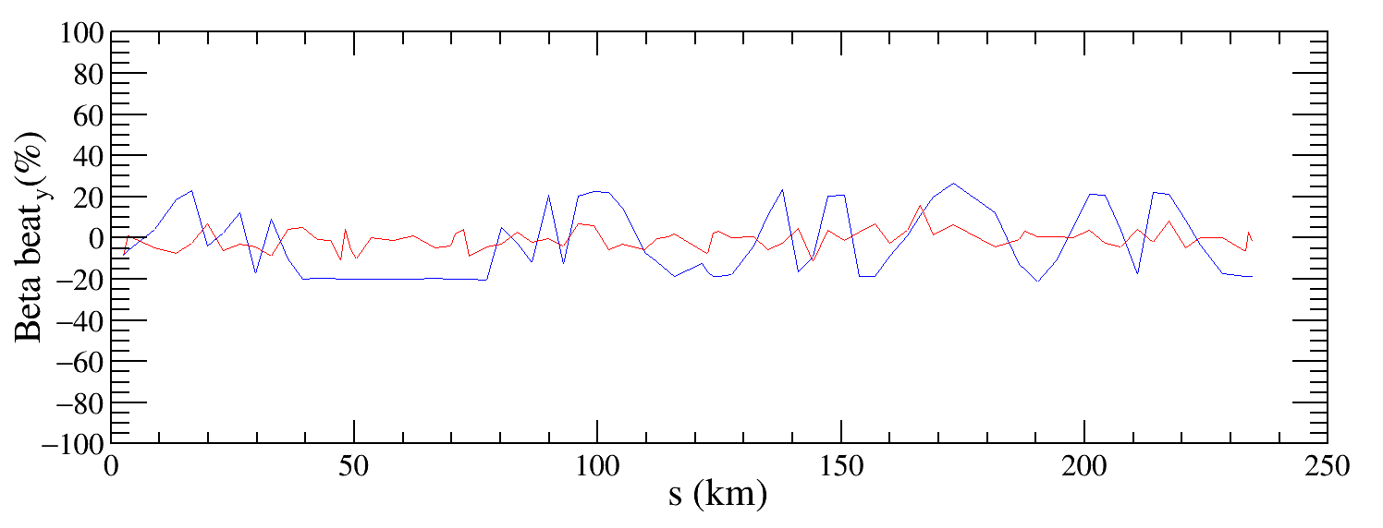












Beta-beating correction
beta beating有明显的降低，水平和垂直的beta beating分别降低至3%和8%，还在持续优化。

Slide 15
总结和下一步
完成了BEPCII-UP的lattice误差校正。对10个包含200微米准直误差的lattice进行误差校正，校正后的闭轨、色散和beta beating都有明显降低，孔径也明显恢复，基本上满足注入需求。
高阶场误差的研究表明，二极铁的b2是主要影响孔径的因素，把这一项作为误差源在校正过程中进行优化。
【正在进行】继续优化beta beating校正，期望可以校正到~3% 。

