Slide 1

FCC Week 2026 polarization summary
Zhe Duan
Accelerator Physics Group, Accelerator Division
Institute of High Energy Physics, CAS
Jun 15 2026, CEPC Day, email: duanz@ihep.ac.cn

Slide 2
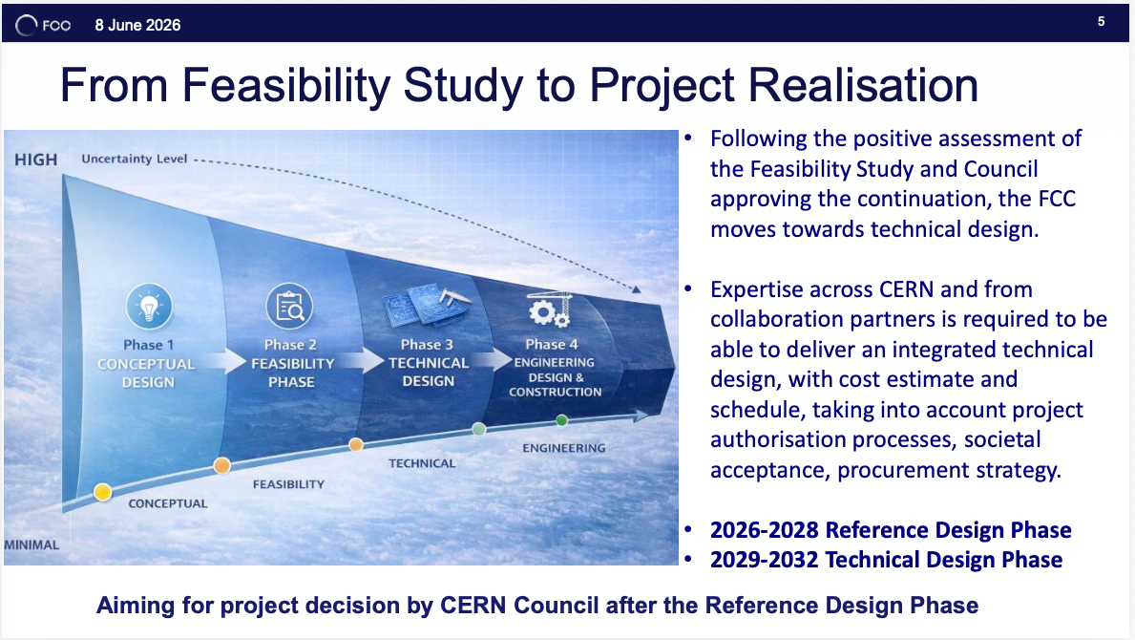
M. Benedikt, FCC Status and Plans for Reference Design Phase

Slide 3
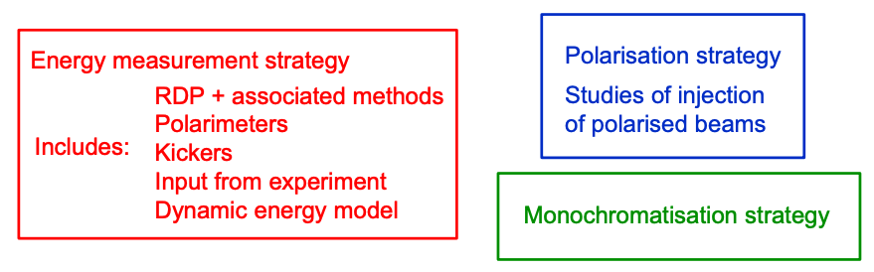
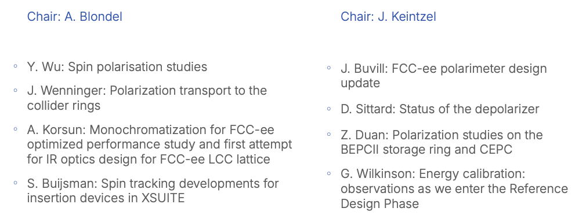
EPOL: Energy calibration, polarization and monochromatization
Key topics in EPOL
EPOL sessions at FCC Week 2026
Other talks related to EPOL
J. Bendavid, Beam energy calibration with di-muon
C. Carli, Polarization ring design
J. Heron, Buying Physics, performance-cost design trade-offs for availability and integrated luminosity

Slide 4
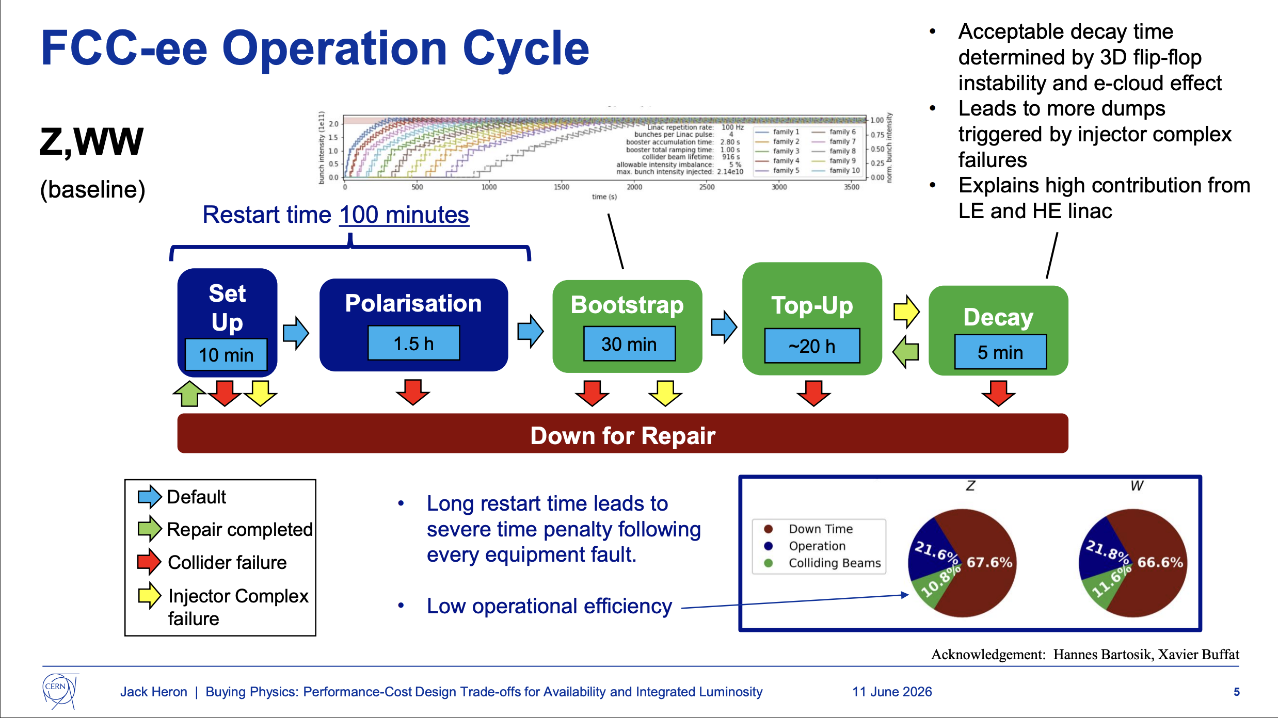
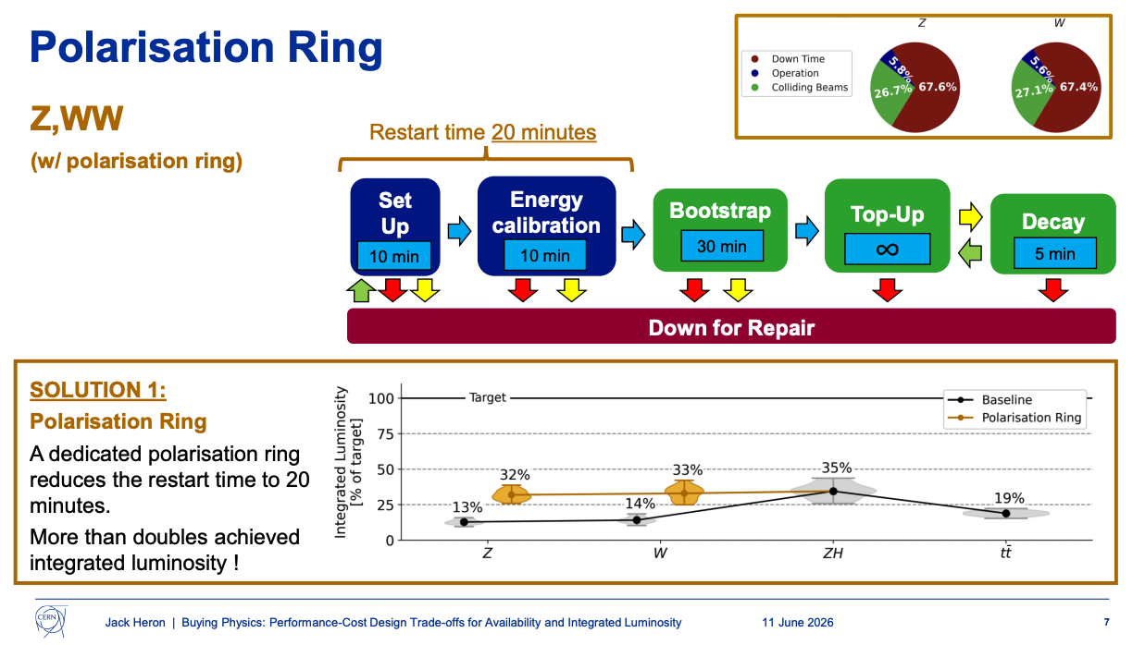
Buying Physics (J. Heron)
To polarize e+/e- beams in the collider rings, it takes ~100 minutes with strong asymmetric wigglers before injecting main colliding beam (wigglers off). Frequent beam aborts leads to very low operational efficiency.
Injecting polarized e+/e- beams from the source, improves availability and saves valuable physics time.

Slide 5
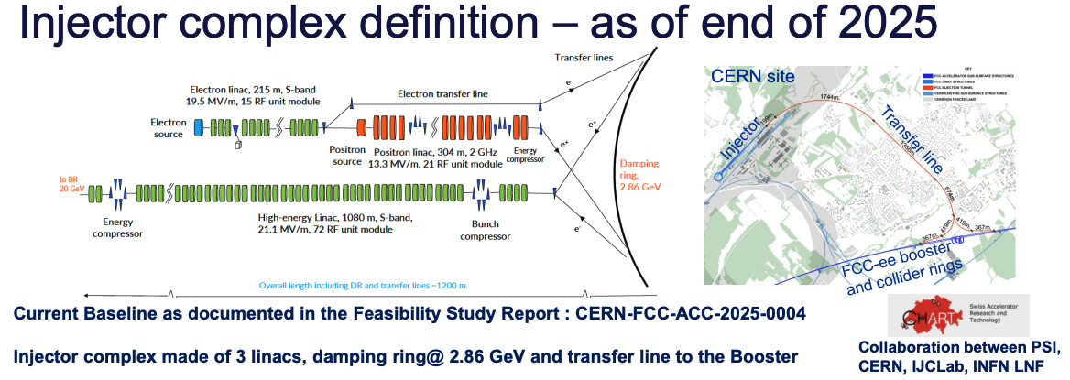
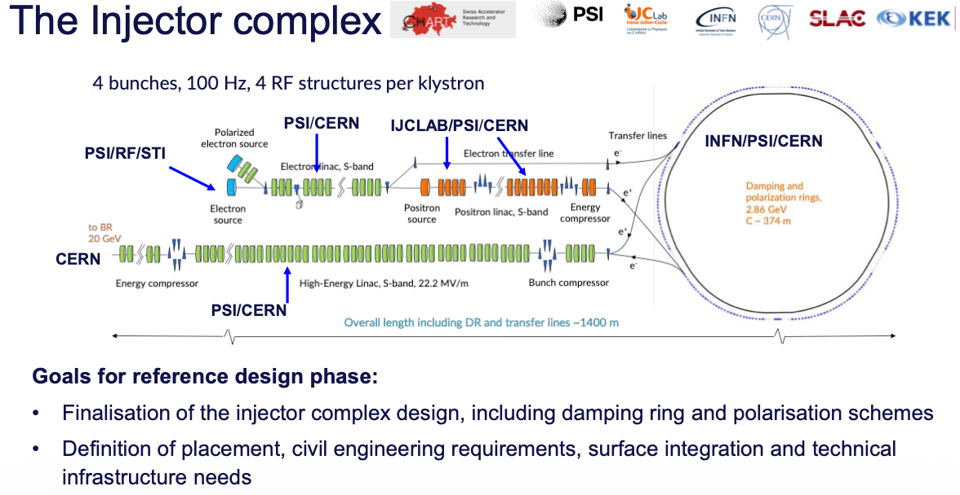
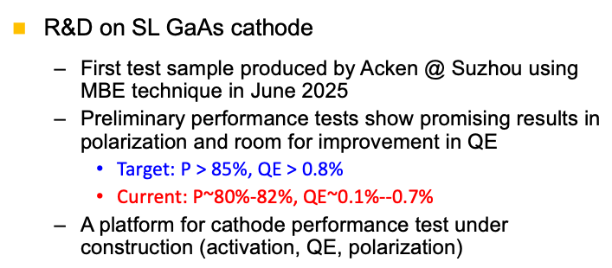
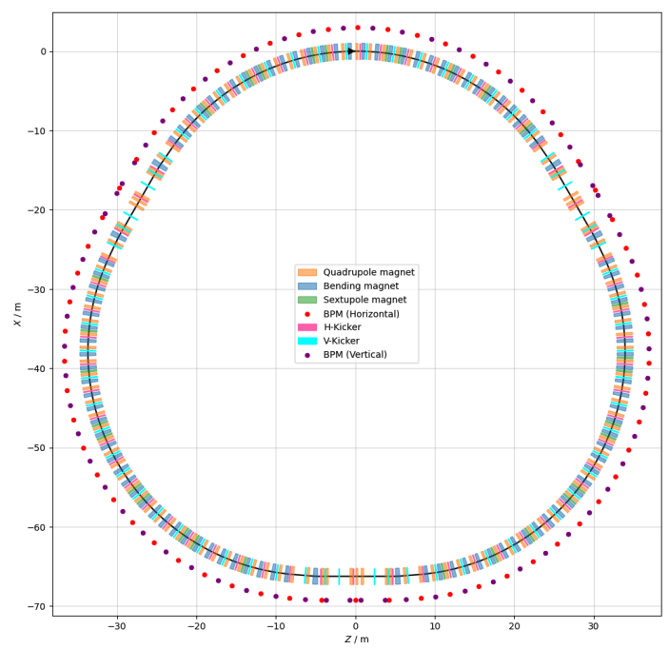
Injector new baseline
S. Gilardoi, FCC-ee Injector overview
M. Benedikt, FCC Status and Plans for Reference Design Phase
Polarized electron source not yet in the scope of CHART/FCC-ee injector Work Packages
One slide in “FCC-ee Injector overview” marked it as “with potential int. collab.” ( Potential synergy?? )
In my talk
C. Carli, Positron polarization ring
2.86 GeV, 211 m,
Polarization build-up time ~ 13 min,
Polarized beam have to pass through damping ring

Slide 6
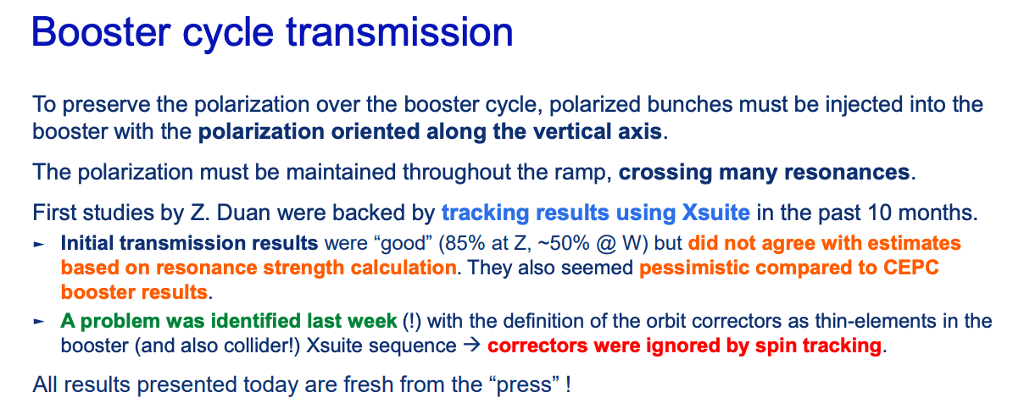
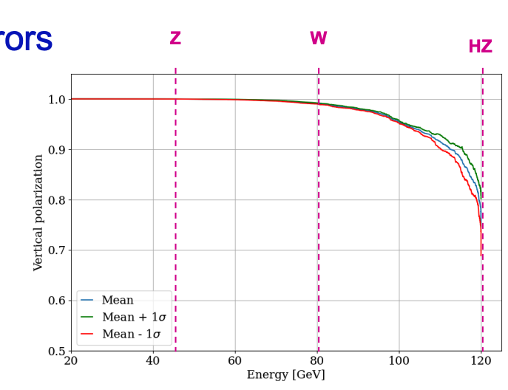
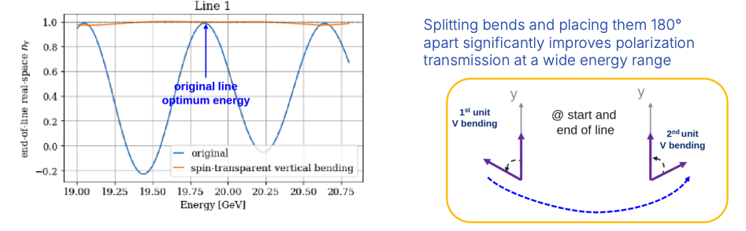
Polarization transport (J. Wenninger)
Very small polarization losses at Z & W in latest results
Improved spin transparency in the transport lines
Spin rotators at the start and at the end of the TL

Slide 7
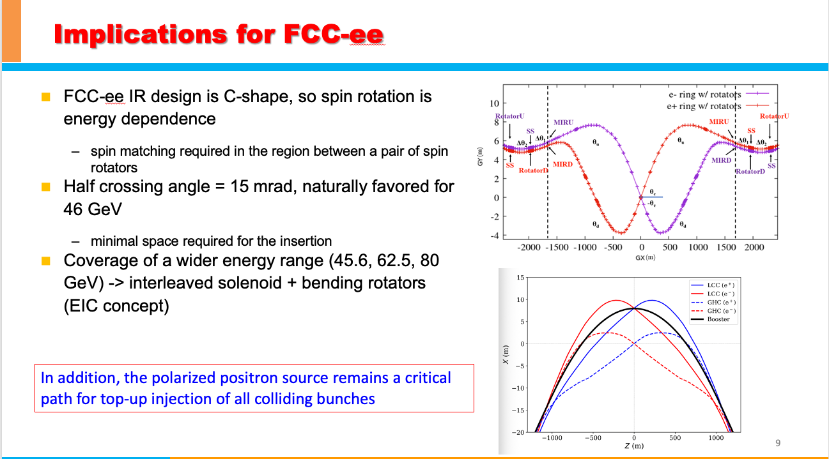
What about longitudinal polarization?
A natural extension from injecting polarized beams with potentially insignificance luminosity loss
I proposed this potential to A. Blondel, G. Wilkinson and F. Zimmermann, a revisit of the scenario of longitudinal polarization at FCC-ee is foreseen. Another possible synergy.
In my talk

Slide 8
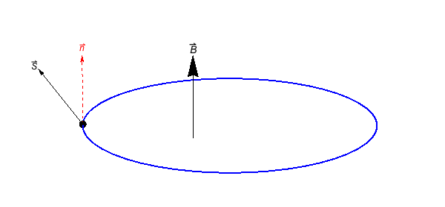

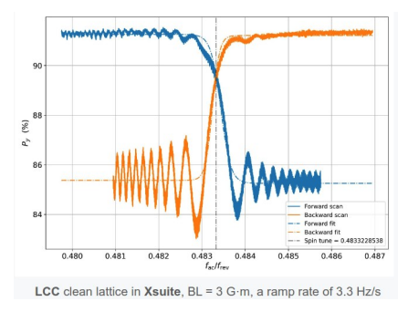
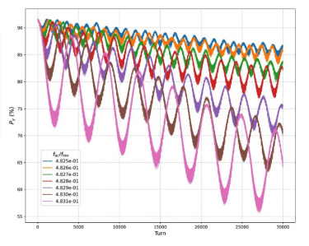
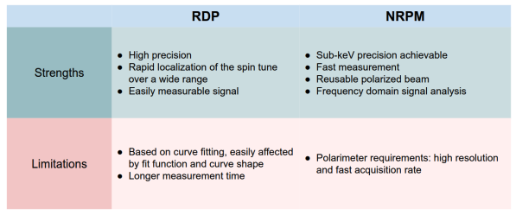
Energy measurement w/ polarized beams
Baseline technique: resonant depolarization scan (RDP) of polarized pilot bunches to locate the resonance
Novel approach: Near resonance polarization modulation (NRPM) by Yi Wu (EPFL), IPAC’26 best student award
IP/detector
IP/detector
polarimeter
Excite forced spin oscillation and the oscillation frequency indicates the distance to eigen frequency
Resonant depolarization scan
Near resonance polarization modulation

Slide 9
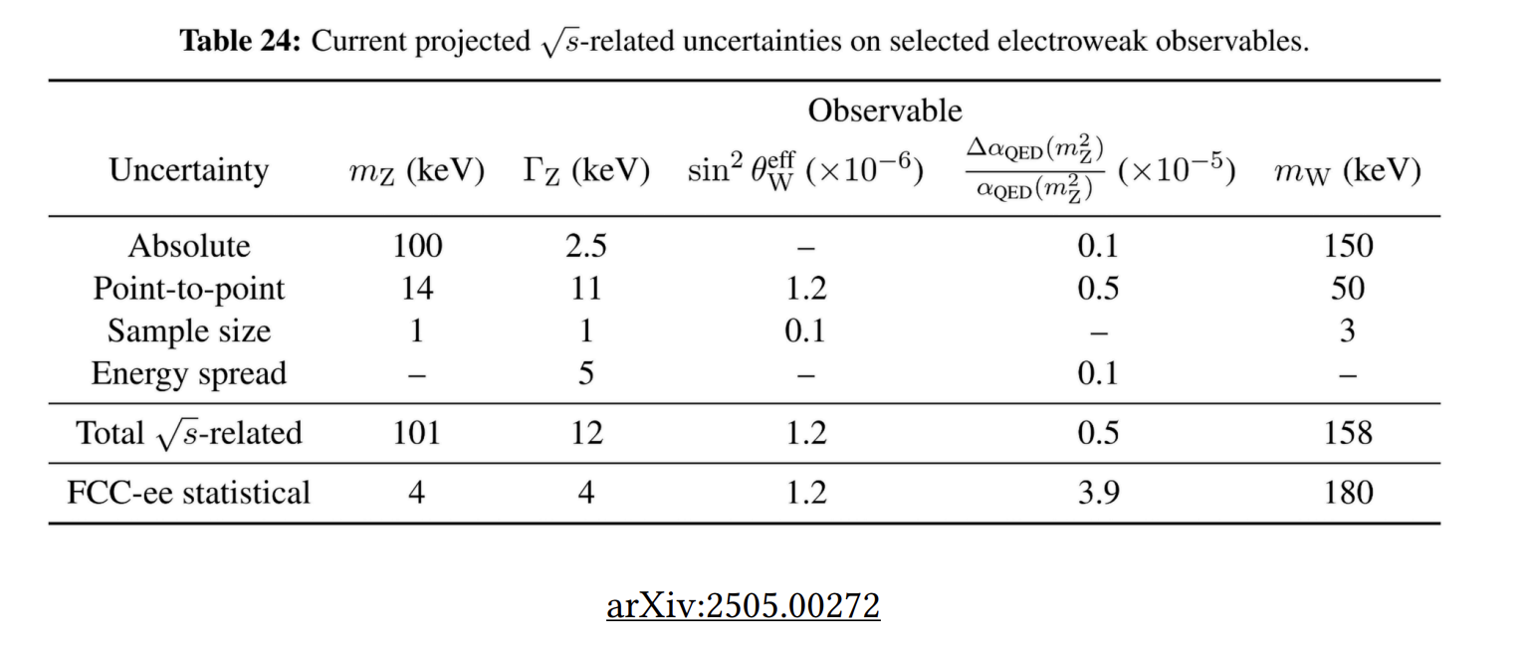
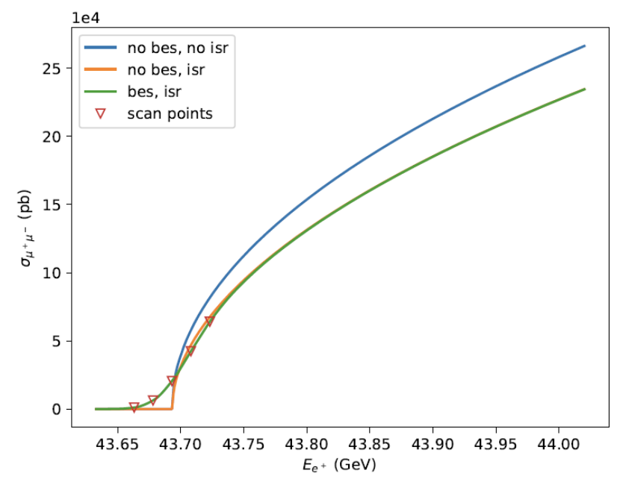
New method for cross-check absolute energy scale
Total uncertainty from E_{CM} on m_{Z} of ~ 100 keV, i.e., 1e-6, is assumed to come essentially from the RDP method
  G. Wilkinson: simulations suggest the biases from RDP corresponds to uncertainty of < 1e-7, however, we cannot assign our dominant uncertainty on m_{Z} through Xsuite simulation
Crosscheck the absolute energy scale: e+ on gas target di-muon production (J. Bendavid)
  Beam energy threshold for fixed target e+e- -> μ+μ- is 43.7 GeV
  Measure the energy of e+ beam (e- target), helps validate RDP results
  Offers possibility of achieving precision on beam energy of ~1e-7 or better
  Important questions:
    Tolerance on the nature/flux of the gas
    Machine implementation

Slide 10
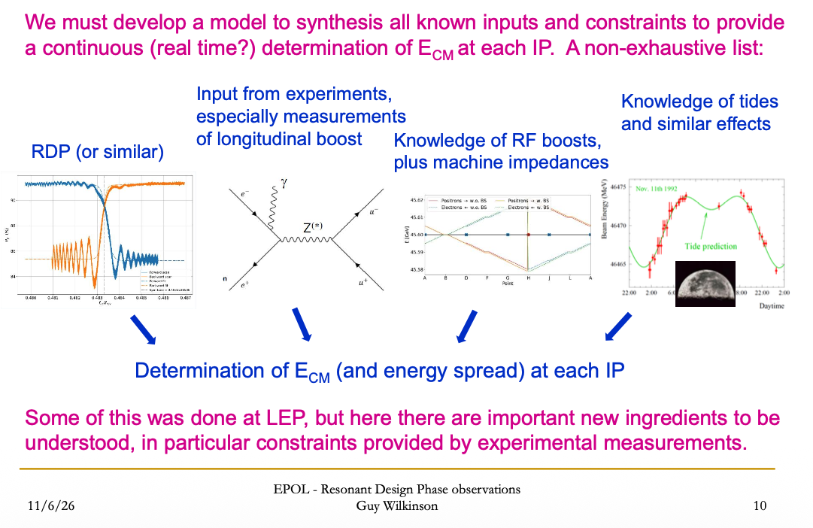
Towards a complete dynamic energy model

Slide 11
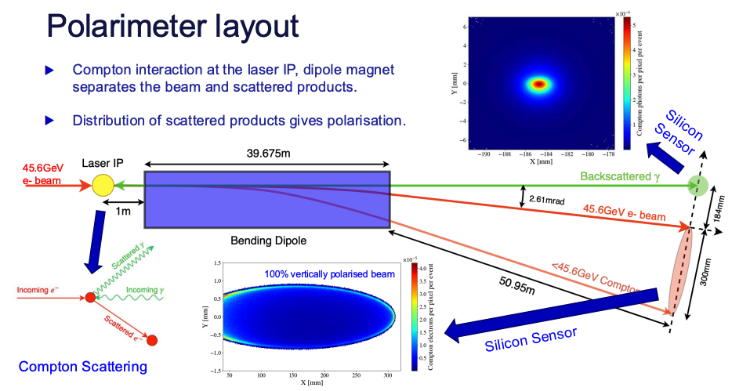
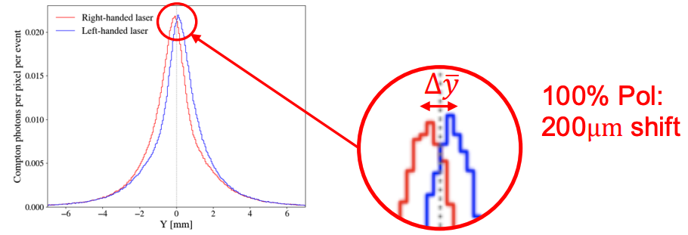
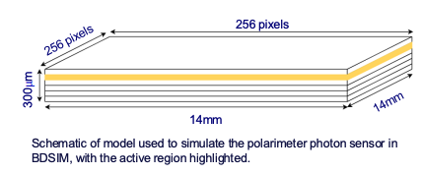
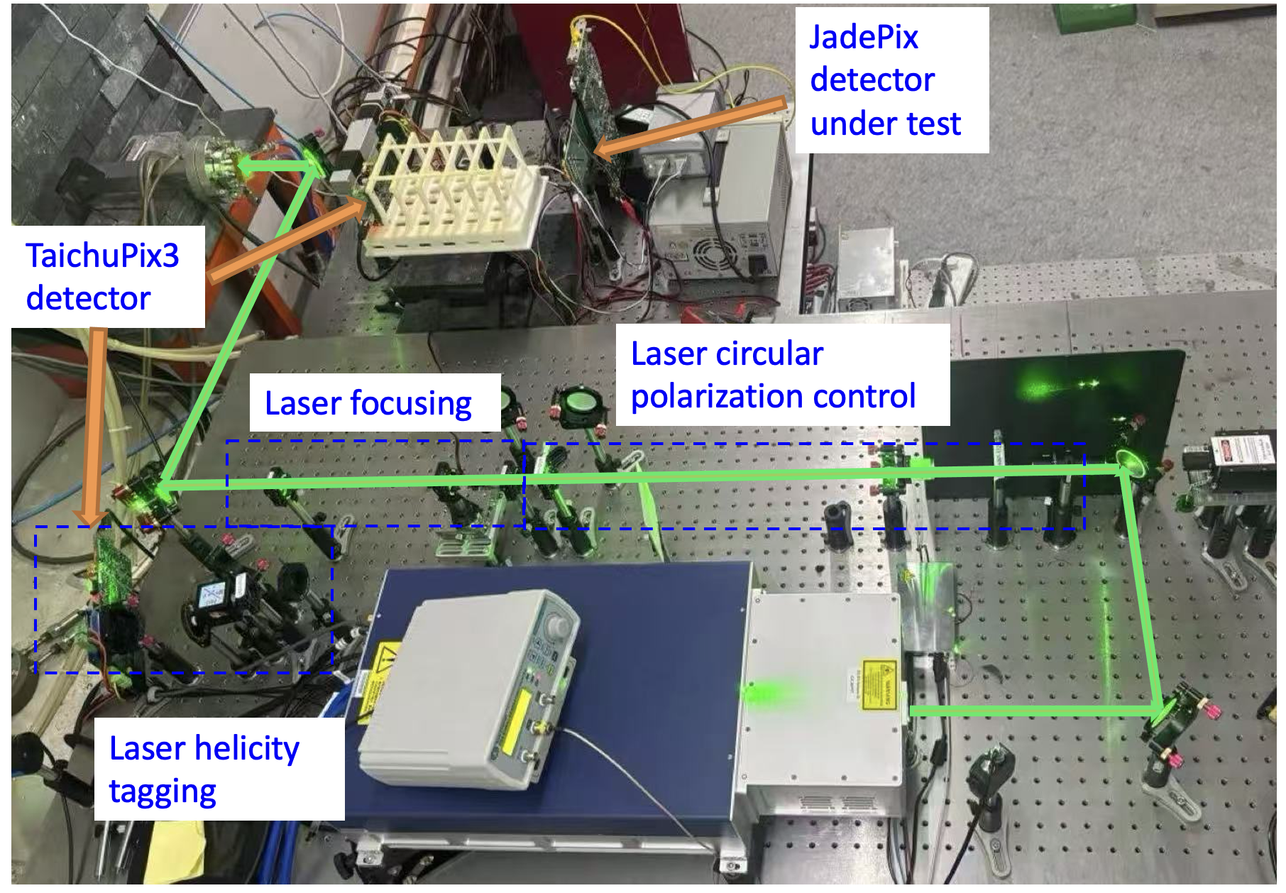
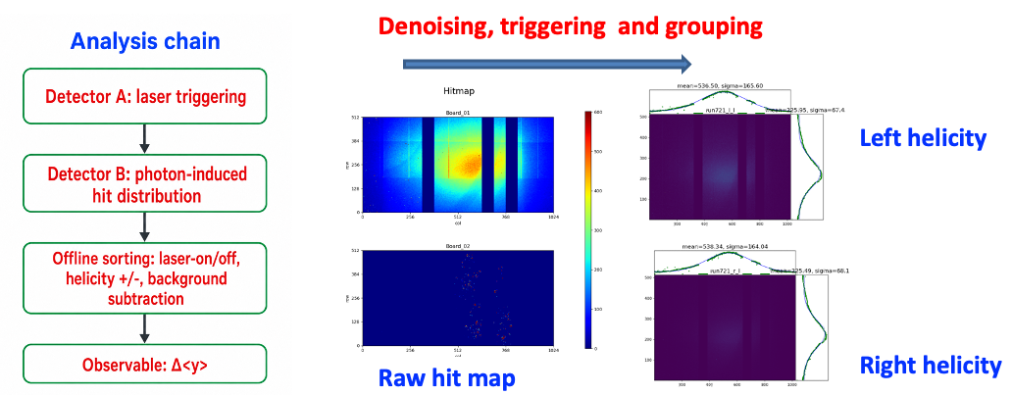
Compton polarimetry: J. Burvil
BDSIM simulation of the performance
  Timepix3 as a baseline for detector digitisation
  ~20s to achieve 1% error, if beam polarization is 10%
BEPCII Compton polarimeter
  Pixel detector for backscattered gamma detection
  Hands-on experiences in setting up and operating such a device
  Data analysis campaign under way

Slide 12
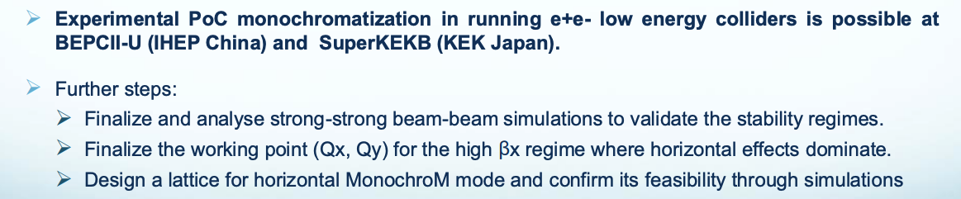
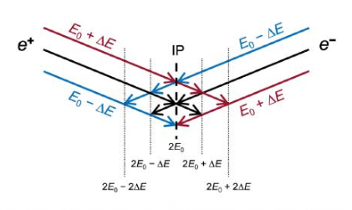
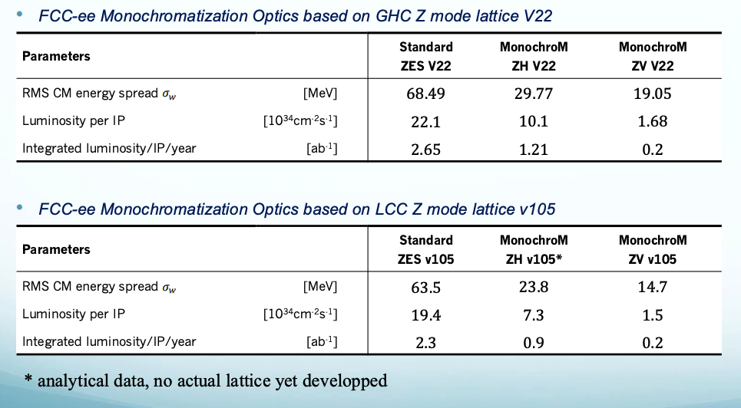
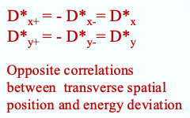
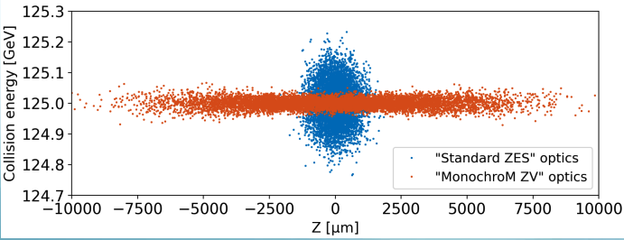
Electron Yukawa and monochromatization: A. Korsun
Run at center-of-mass energy of 125 GeV for Higgs pole, requiring the collision energy spread to be comparable to Higgs resonance width (4.2 MeV)

Slide 13
