Slide 1



Review of B and B_{s} decays
Concezio Bozzi
INFN Ferrara
XXXIII Physics in Collisions
Beijing, Sept. 6th 2013

Slide 2
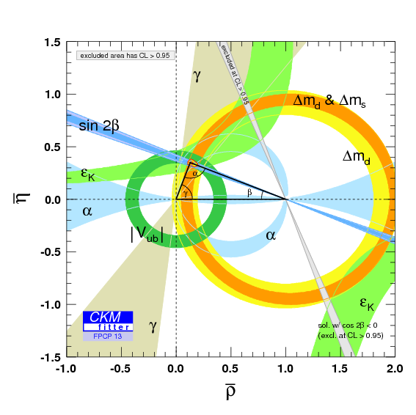
The relevance of B_{(s)} decays
Test the flavor sector of the SM
  Single source of CP violation in charged weak currents
  Suppressions due to hierarchy of CKM elements
  Suppression of flavor-changing neutral currents (FCNC, loop only)
  Suppression of chirality flips due to small quark masses
CKM unitarity triangle tested at the few percent level!
For a review of CP Violation, see talk by Stephane Monteil
Notes:
1) Update CKMfitter to the latest one

Slide 3
The relevance of B_{(s)} decays
New physics might not respect the many suppressions of the SM :
Search for physics beyond SM in the “quantum” way: increase luminosity and look for indirect effects due to virtual particles
complementary to the “relativistic” way: increase energy and look for direct production of new particles
Experimental reach (with significant simplifying assumptions)
Flavor (quarks)
Indirect searches probe higher mass scales!
(from Z. Ligeti)
LHC
Tevatron
Log(E) in GeV
Notes:
Increase figure at the bottom

Slide 4
Outline
The experimental facilities
Radiative, electroweak and “Higgs” penguins
Tree decays with τ leptons
Conclusion

Slide 5
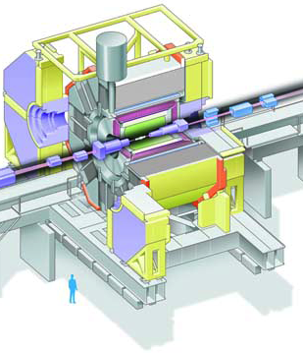


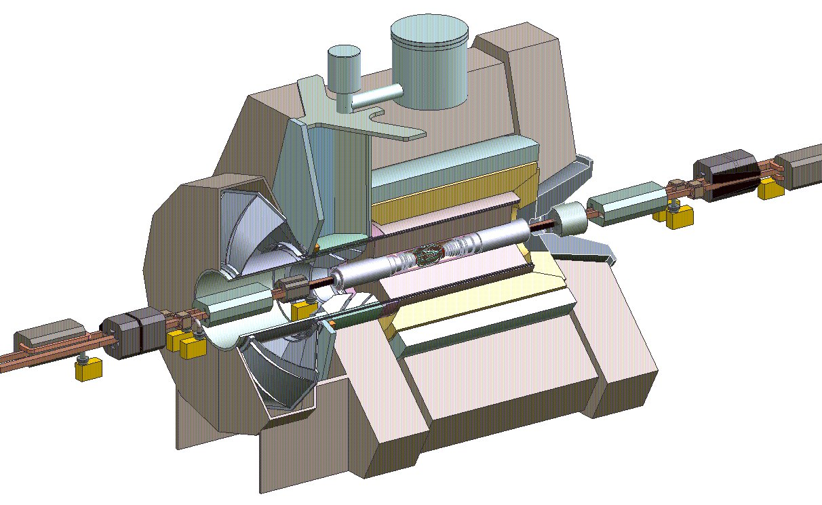
Experiments and data samples
Notes:
Vera’s slide

Slide 6
Very different energies and rates
Experiment | Beams | cm Energy | Int. Lum | # Events | # Events | S/B
 |  | [GeV] | [1/fb] | cc | bb
BABAR/Belle | e+e- | 10.58 | 424+711 | 1.2 10⁹ | ~10⁹ | 0.25
LHCb | pp | 7000 (8000) | 1.0 (2.0) | 2 10¹² | ~10¹¹ | ~0.005
e⁺e⁻: initial state with well defined energy-momentum and quantum numbers
simple events: exclusive 2-body or low multiplicity production
full event reconstruction: B_tag and B_signal: full PID, π⁰→ γγ detection
missing mass → neutrino reconstruction!
pp: very high rates, all flavor mesons and baryons produced,
high BG requires selective trigger, restricted acceptance
long decay paths, precision charged particle tracking, PID
complex events, normalization, relative rates! Many innovative techniques!

Slide 7
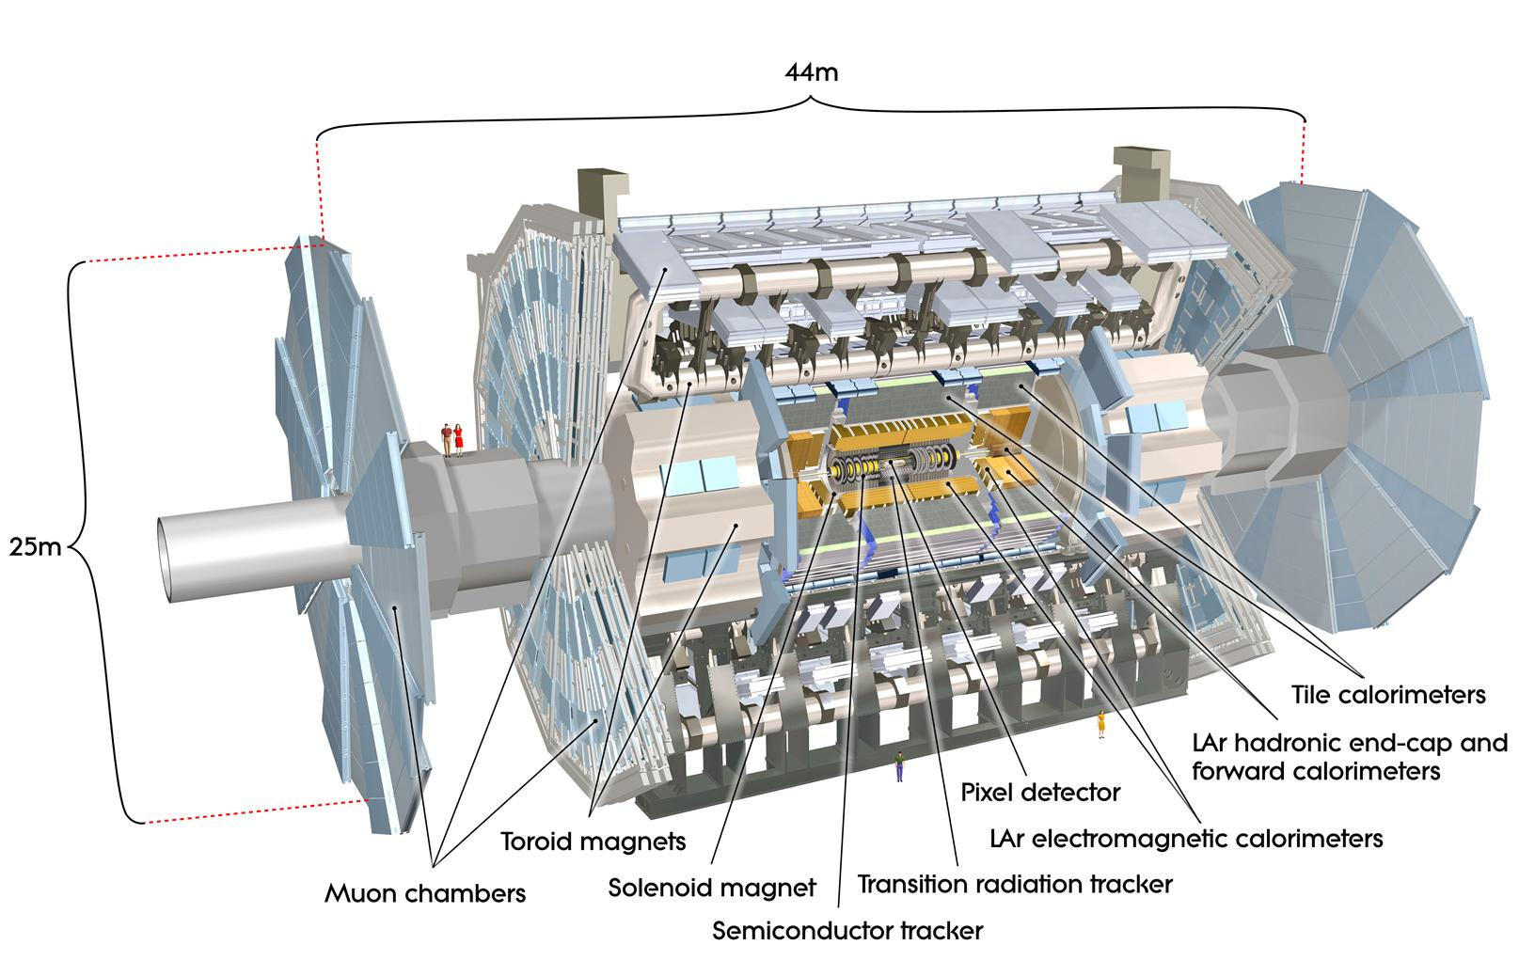
They play a role as well!
√s_{TeVatron} = 2 TeV
L_{TeVatron} ~ 10 /fb /exp
√s_{LHC} = 7-8 TeV
L_{LHC} ~ 25 /fb /exp

Slide 8
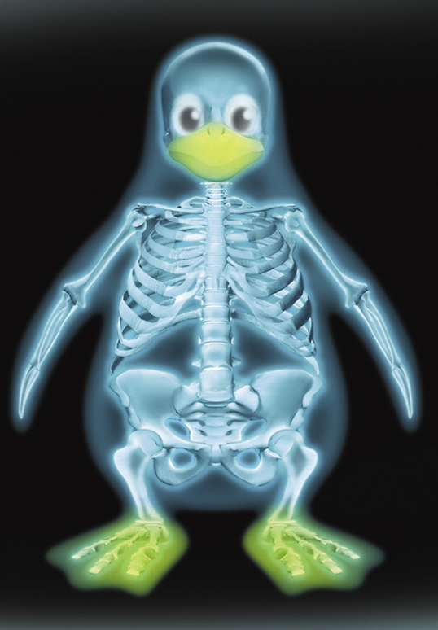
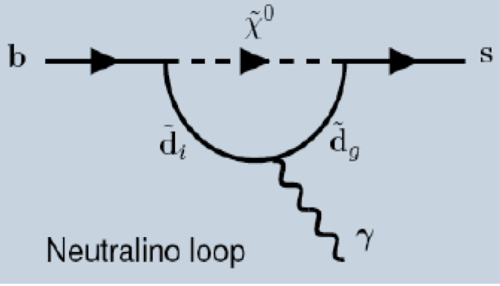
Penguin processes
Radiative
Electroweak
“Higgs”
SM
SUSY
Typical BR (SM)
10⁻⁵ – 10⁻⁴
10⁻⁶
10⁻⁹
Observables
Br, γ polarization
Angular distributions
Branching ratios
Lorentz
structure
i=1,2 Tree
i=3-6,8 Gluon penguin
i=7 Photon penguin
i=9,10 EW penguin
i=S (P) (Pseudo)scalar penguin
Left-handed part
Right-handed part
Suppressed in SM
Relevant
operators
Notes:
Improve Feynman diagrams and Hamiltonian

Slide 9
B→X_{s}γ
Nucl. Phys. B 867 (2013), 1
The inclusive decay has been precisely measured at B Factories
One of the strongest constraint in MSSM. Given the Higgs mass, only O(%) of the a-priory phase space left!
Many exclusive modes studied as well
At hadron colliders, measure exclusive decays to keep background at manageable level
LHCb performed first measurements in the B_{s} system
Br(b → sγ) = (3.43 ± 0.22) × 10⁻⁴
in agreement with the SM prediction
Br_{SM}(b → sγ) = (3.15 ± 0.23) × 10⁻⁴
691 ± 36
events
Br(B_{s}→ φγ) = (3.5 ± 0.4) × 10⁻⁵

Slide 10
Photon polarization in B⁺→K⁺π⁻π⁺γ
In SM, emitted photons are predominantly left-handed
Measure up-down asymmetry in K_{res}→Kππ decays
For a single intermediate resonance, A is proportional to the photon polarization
LHCB-CONF-2013-009
First measurement on a mixture of K resonances
Signal
Comb.
Missing π
Evidence for photon polarization in b→sγ decays at 4.6σ
Difficult interpretation due to multiple resonances. If theoretical prediction existed, first measurement of λ_{γ} would be possible
Partially
reco bkg
~8000 events
2fb⁻¹
Also, 1st measurement of CP asymmetry
Notes:
Put legend on plot, simplify equation

Slide 11
The B⁰→K*⁰μ⁺μ⁻ decay
B→K*μμ is described by 3 angles and di-muon invariant mass squared q²
Number of free parameters can be reduced by folding the  angle (if <0, =+π ):
Observables in blue are functions of Wilson coefficients and form factors. They depend on q²
A_{FB} zero crossing point precisely predicted in SM:
Notes:
Move theoretically cleaner observables to next slide

Slide 12
B⁰→K*⁰μ⁺μ⁻ is a hot topic!
Results from
A lot of other channels being studied as well, e.g.
B_{d}→K*⁰e⁺e⁻ , B⁺→K⁺⁺⁻ , B_{s}→φ⁺⁻ , Λ_{b} → Λ ⁺⁻, …
Notes:
Be quick on this

Slide 13
B⁰→K*⁰μ⁺μ⁻ : results
arXiv:1304.6325
1 fb-¹, ~900 events, 6 q² bins
Theoretically cleaner observables (reduced form factor uncertainties) can be calculated from the existing ones
Theory from Bobeth-Hiller-Van Dyk (2011), consistent with Matias et al (2013)
Good agreement with SM predictions
First measurement of A_{FB} zero crossing point :
Notes:
Enlarge labels, overwrite or

Slide 14
B⁰→K*⁰μ⁺μ⁻: new observables
arXiv:1308.1707
Observables with limited dependence on form-factors uncertainty at low q² have been proposed by several theorists
Different set of observables give different constraints  complementarity!
Good agreement for some observables
P₄’
Global analysis, Descotes-‐Genon et al. (arXiv:1307.5683): large New Physics contribution to the Wilson coefficient of the O₉ operator
some local discrepancies for others
o
SM
P₅’
3.7σ
SM predictions from J. Matias et al, arXiv:1303.5794.
Jaeger et al., JHEP 05 43 (2013), quote larger uncertainties
No definitive conclusion. More data and theoretical studies needed
Notes:
Reduce number of plots
Enlarge SM point
Separate LHCb and theory

Slide 15
B→h_{d}ll decays
Cabibbo-suppressed version of B→h_{s}ll, rate a factor ~25 lower
B⁺→π⁺μ⁺μ⁻ observed at 5.2σ in LHCb
Upper limits by Babar
events
JHEP 12 125 (2012)
arXiv:1303:6010, acc. by PRD
Notes:
Cabibbo-suppressed version of B→Xsll, rate x25 lower, move result outside plot

Slide 16
B⁰_{(s)}→μ⁺μ⁻
Rare in SM: FCNC process, helicity suppressed
Sensitive to scalar and pseudoscalar NP contributions
Precise SM prediction [Buras et al., 2012]
Time-integrated Br [Bruyn et al., 2012], with y_{s} and A_{ΔΓ} from HFAG:
Notes:
Remove superscript [1]

Slide 17
B⁰_{(s)}→μ⁺μ⁻: analysis strategy
Signal
Huge combinatorial background
Partially reconstructed decays and particle mis-ID
Background
Signal to background discrimination:
  Loose event selection
  classification in the plane m_{μμ} x BDT based on geometry and kinematics
Background PDFs obtained with data driven methods
BF measurement: simultaneous fit to m_{μμ} in BDT bins (LHCb) or categories (CMS)
Upper limits: CLs
B_{s} signal region
B_{d} signal region

Slide 18
B⁰_{(s)}→μ⁺μ⁻: results
arXiv:1307.5025, subm. to PRL
arXiv:1307.5024, acc. by PRL
BDT>0.7
Notes:
Put CMS label

Slide 19
B⁰_{(s)}→μ⁺μ⁻: implications
MFV: Minimal Flavour Violation models
SM4: SM with a fourth generation
RSc: Randall-Sundrum model with custodial protection
[Blanke et al., 2009]
MSSM: Minimal SUSY flavour models
AC: Agashe and Carone [Agashe and Carone, 2003]
RVV2: Ross, Velasco-Sevilla and Vives
[Ross et al., 2004]
AKM10: Antusch, King and Malinsky
[Antusch et al., 2008]
LL11: left-handed currents only [Hall & Murayama, 1995]
Notes:
No graph with the average, remind SM expectation

Slide 20


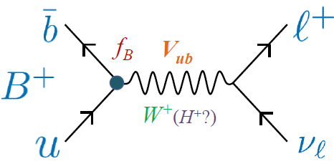
(semi) leptonic decays with τ leptons
B → τν and B → D(*)τν are tree level decays mediated by a W in SM
Lepton universality in SM, might be broken by mass-dependent couplings
→ Probe SM extensions to models with enlarged Higgs sector, e.g. 2-Higgs Doublet Model (2HDM) of MSSM
B → τν
B⁺
SM
Charged Higgs
W⁺ (H⁺)
SM expectation:
1.01 ± 0.29 ×
Based on average of incl. and excl V_{ub}, f_{B} from Na et al., 2012
B → D⁽*⁾ τν
Decays involving τ have additional helicity amplitude
Contribution from H± expected to enhance rates for B → D(*)τν
Test SM by measuring ratios (theoretically and experimentally cleaner)
ν
W- (H-)
τ
B
V_{cb}
R(D) = 0.297 ± 0.017 R(D*)=0.252 ± 0.003
SM:
D^{(*)}
Based on S. Fajfer, J. Kamenik, I. Nisandzic, PRD 85, 094025 (2012)

Slide 21
(semi) leptonic decays with taus
Due to the presence of at least two neutrinos in the final state, B Factories offer the most favorable experimental environment
BB events are fully reconstructed
  One B decay is fully reconstructed (hadronic or semileptonic tag)
  Look for signal decay of 2nd B meson
Discriminating variables
B → τν
B →D⁽*⁾ τν
Squared missing mass
E_{extra}: sum of calorimeter energy not associated with signal or tag
2
Notes:
Add decays next to relevant variables. Improvemen diagram of the decay.

Slide 22

B⁺→τ⁺ν: results
PRL 110, 131801 (2013)
PRD 88, 031102 (2013)
62.1 ± 17.3 events, 426 fb⁻¹
events, 711 fb⁻¹
Notes:
Add Babar and Belle next to the results

Slide 23
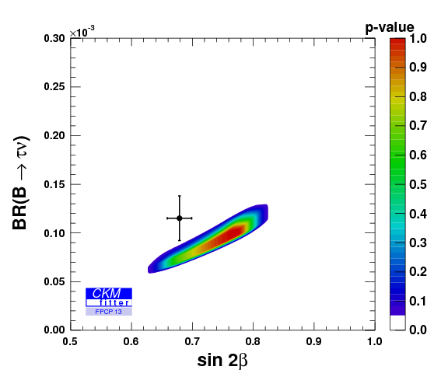
B⁺→τ⁺ν: interpretation
SM
Charged Higgs
Fit to CKM parameters without B(B→τν) and sin2β constraints
SM
Type-II 2HDM constraints
The Belle update of BR(B→τν) decreases the world average. Discrepancy in the CKM global fit between the world averages for B(B→τν) and sin2β has been eased significantly.

Slide 24
B→D⁽*⁾τν decays
ν
W- (H-)
τ
B
V_{cb}
D^{(*)}
A simple tree process, form factors measured for B → D^{(*)}l ν, decays involving τ have additional helicity amplitude
non-SM contribution from H± expected to enhance or suppress rates for B → D^{(*)}τν
Test SM prediction by measurement of ratios:
Several experimental and theoretical uncertainties cancel in the ratio!
BB events are fully reconstructed (3 ν in final state! )
  hadronic B tag
  D^{(*)} e± or μ± : No additional charged particles, E_{extra}<0.5GeV (no cut)
  Background suppression by BDT (combinatorial BG and D**lν)
Signal extraction by unbinned M.L. fit, fully 2-dimensional: M²_{miss} vs p*_{lepton} (e±,μ±)
  D⁰l, D^{*0}l, D⁺l, D^{*+}l, (e± or μ±)
  4 D^{(*)}π⁰lν control samples to assess D** lν backgrounds
Leptonic τ
decays only
Notes:
SM prediction (based on …)
SL B decay with (SM), NP contributions, why do we use the ratio.

Slide 25
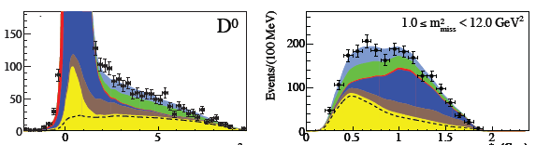
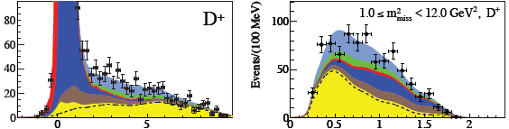
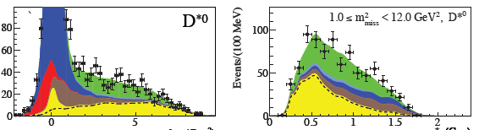
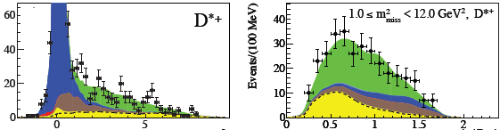

B→D⁽*⁾τν: fit results
PRL101802 (2012)
D⁰
D⁰
Fit results, combined using
Isospin relations:
B →D τ ν
D⁺
D⁺
N_{signal} 489 ± 63
R(D) 0.440 ± 0.058
syst. error ± 0.042
Events/25 MeV
Events/100 MeV
D^{*0}
B →D* τ ν
D^{*0}
N_{signal} 888 ± 63
R(D*) 0.332 ± 0.024
syst. error ± 0.018
Events/100 MeV
D^{*+}
D^{*+}
Fitted yields
Fixed yield
m²_{miss} (GeV²) p_{l}* (GeV)
Notes:
Keep slide, make it simpler. Show only less plots (combined charged and neutral)
Don’t show the results, put in backup. Take out event selection stuff.

Slide 26

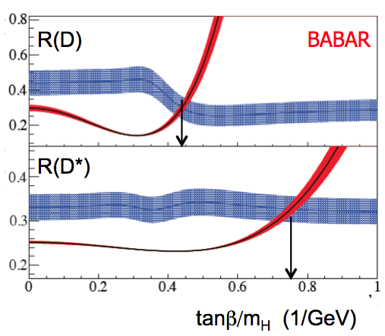
Results and implications on type-II 2HDM
PRL 101802 (2012)
Combination of R(D) and R(D*) excludes SM at 3.4σ
A charged Higgs (2HDM type II) of spin 0 coupling to the τ will only affect scalar helicity amplitude
- for Dτν + for D*τν
From the estimated effect of on the signal, the type II 2HDM can be excluded in the full tanβ - m_{H} parameter space at >99.8%, provided m_{H}>15 GeV.
Earlier Belle measurements confirm this trend.
Unpublished deviations from SM of Belle results presented at FPCP 2013 (A. Bozek)
R(D*) : 3.0σ ; R(D) : 1.4σ
Waiting for final results from Belle to confirm!

Slide 27
Limits on type-III 2HDM
arXiv:1303.0571 (2013)
Type-II 2HDM corresponds to a special case
More general models exist, for instance type-III HDM,
  e.g. Crivellin et al, arXiv:1206.2634(2012); Datta et al, PRD 86, 034027(2012)
  S_{L} (S_{R}) parameterize complex couplings of left- (right-) handed quarks
Impact on R(D⁽*⁾)
Type-II 2HDM is recovered if S_{R} = −m_{b}m_{τ} tan²β/m²_{H+}, S_{L} = 0.
Type-II has no solutions!
Notes:
Most of the efforts were done assuming specific type-II. More general model exist. For instance type-III. Take out H_eff

Slide 28
Adding info from q² distributions
Dilepton squared invariant mass q² is sensitive to Higgs couplings to quarks
SM
arXiv:1303.0571 (2013)
At S_{R} ± S_{L} ~ -1.5, p-value for R(D) is 0.4%
→ Exclusion with significance of at least 2.9σ

Slide 29
Conclusion
B and B_{s} decays are great probes to search for new physics effects induced by virtual particles in tree and loop diagrams
New physics has not been discovered, however there are intriguing “tensions”
  Angular analysis of K*μμ
  Isospin analysis of Kμμ (not discussed)
  B→D⁽*⁾τν
These should be followed up by collecting more data, analyzing other decay modes and performing more accurate theoretical studies
B Factories and hadron colliders nicely complement each other
  Experiments at the B Factories have nearly completed measurements on their final samples
  LHCb is now the major driver in many channels
  ATLAS and CMS can give substantial contributions in very rare decays with muons
  Belle-II will enter into the game on a longer time scale
Notes:
Quantitative summary

Slide 30
Backup

Slide 31
LHCb
Forward spectrometer optimised for heavy flavour physics at the LHC
Large acceptance 2<η<5
Low trigger thresholds
Precise vertexing
Efficient particle identification
Running at a constant luminosity of 4x10³² cm⁻²s⁻¹, <μ>~1.7, 4x design
Large boost (B mesons flight ~1cm)
Huge production cross section (~300μb)
Small S/B ratio

Slide 32
B→X_{s}γ
The inclusive decay has been precisely measured at B Factories
Known as one of the strongest constraint in MSSM. Together with the Higgs mass measurement, only O(%) of the a-priory phase space left!
Many exclusive modes studied as well
At hadron colliders, measure exclusive decays to keep background at manageable level
LHCb performed first measurements in the B_{s} system; now starting measuring photon polarization
BR(b→sγ) = (3.43±0.22) x 10⁻⁴
in agreement with the SM prediction
BR_{SM}(b→sγ) = (3.15±0.23) x 10⁻⁴
BR(B_{s}→Φγ)= (3.5 ± 0.4) x 10⁻⁵
Notes:
Check these values for the inclusive b→sgamma (experimental)

Slide 33
B→K*μμ: new observables
LHCb, arXiv:1308.1707
Observables with limited dependence on form-factors uncertainty have been proposed by several theorists
Different set of observables give different constraints  complementarity!
Good agreement for some observables
SM predictions from J. Matias et al, arXiv:1303.5794
some local discrepancies for others
2.5 σ
3.7σ
Descotes-‐Genon et al. (arXiv:1307.5683)
large New Physics contribution to the Wilson coefficient of the O₉ operator
Notes:
Reduce number of plots
Enlarge SM point
Separate LHCb and theory

Slide 34
B→hνν
PRD 87, 111103 (2013) 772 BB
B→K*νν limits within factor of ~5 of SM predictions (0.7-1.3x10⁻⁵)
Uniquely at B Factories!
Predict measurement with ~20% precision at Belle II with 50ab⁻¹
Notes:
Put in backup.

Slide 35
Type II 2HDM: compare with direct searches @ LHC
Notes:
backup

