Slide 1
Pulsed Muon Facilities
Adrian Hillier, ISIS Muon Group
MELODY26, CSNS, China
October 2026

Slide 2
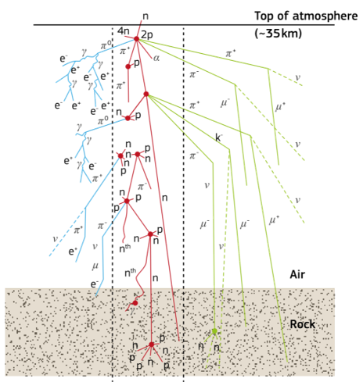
Muon Sources

Slide 3
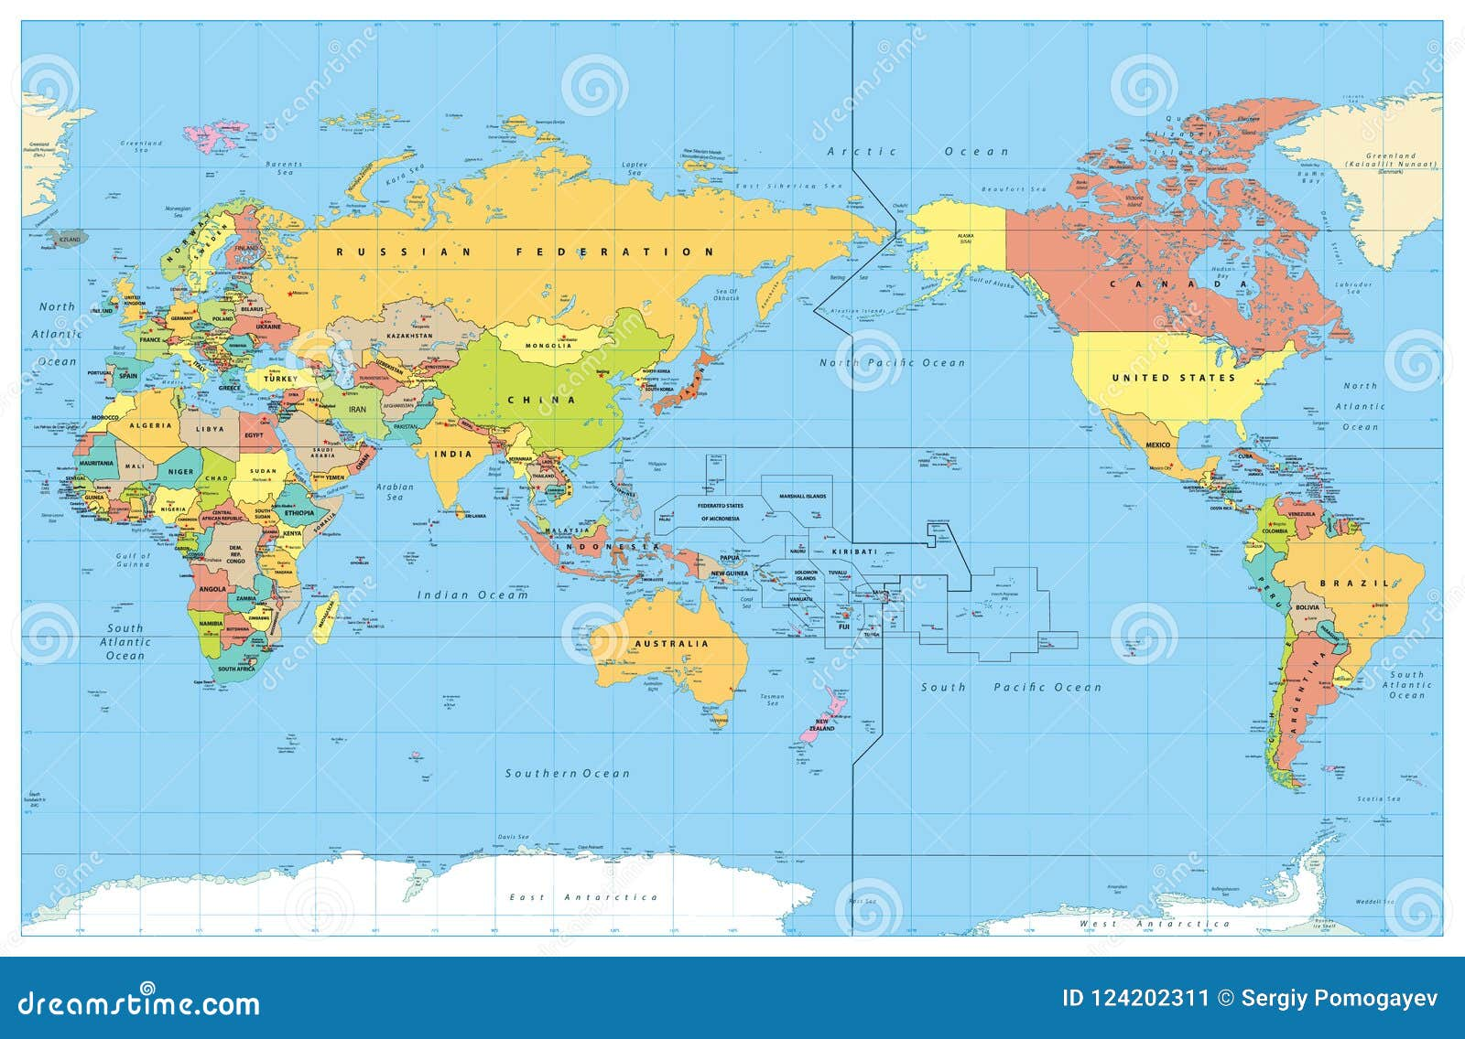
Muon Sources
PSI, Switzerland
TRIUMF, Canada
J-PARC
and MuSIC, Japan
ISIS, UK
MELODY, China

Slide 4
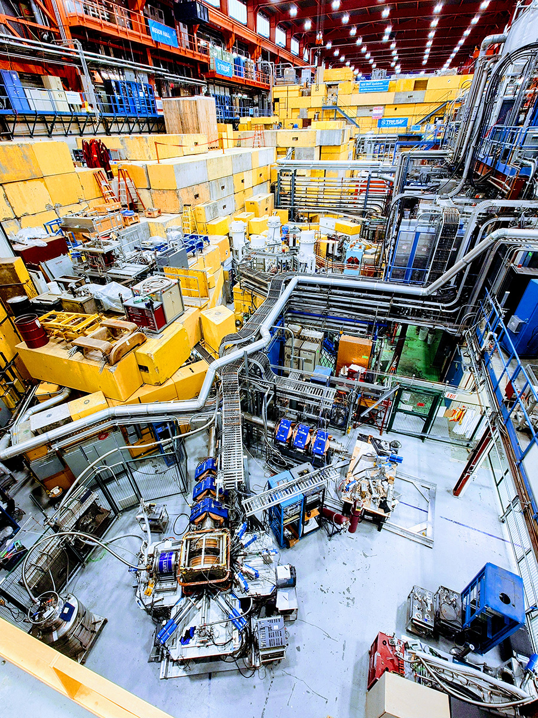
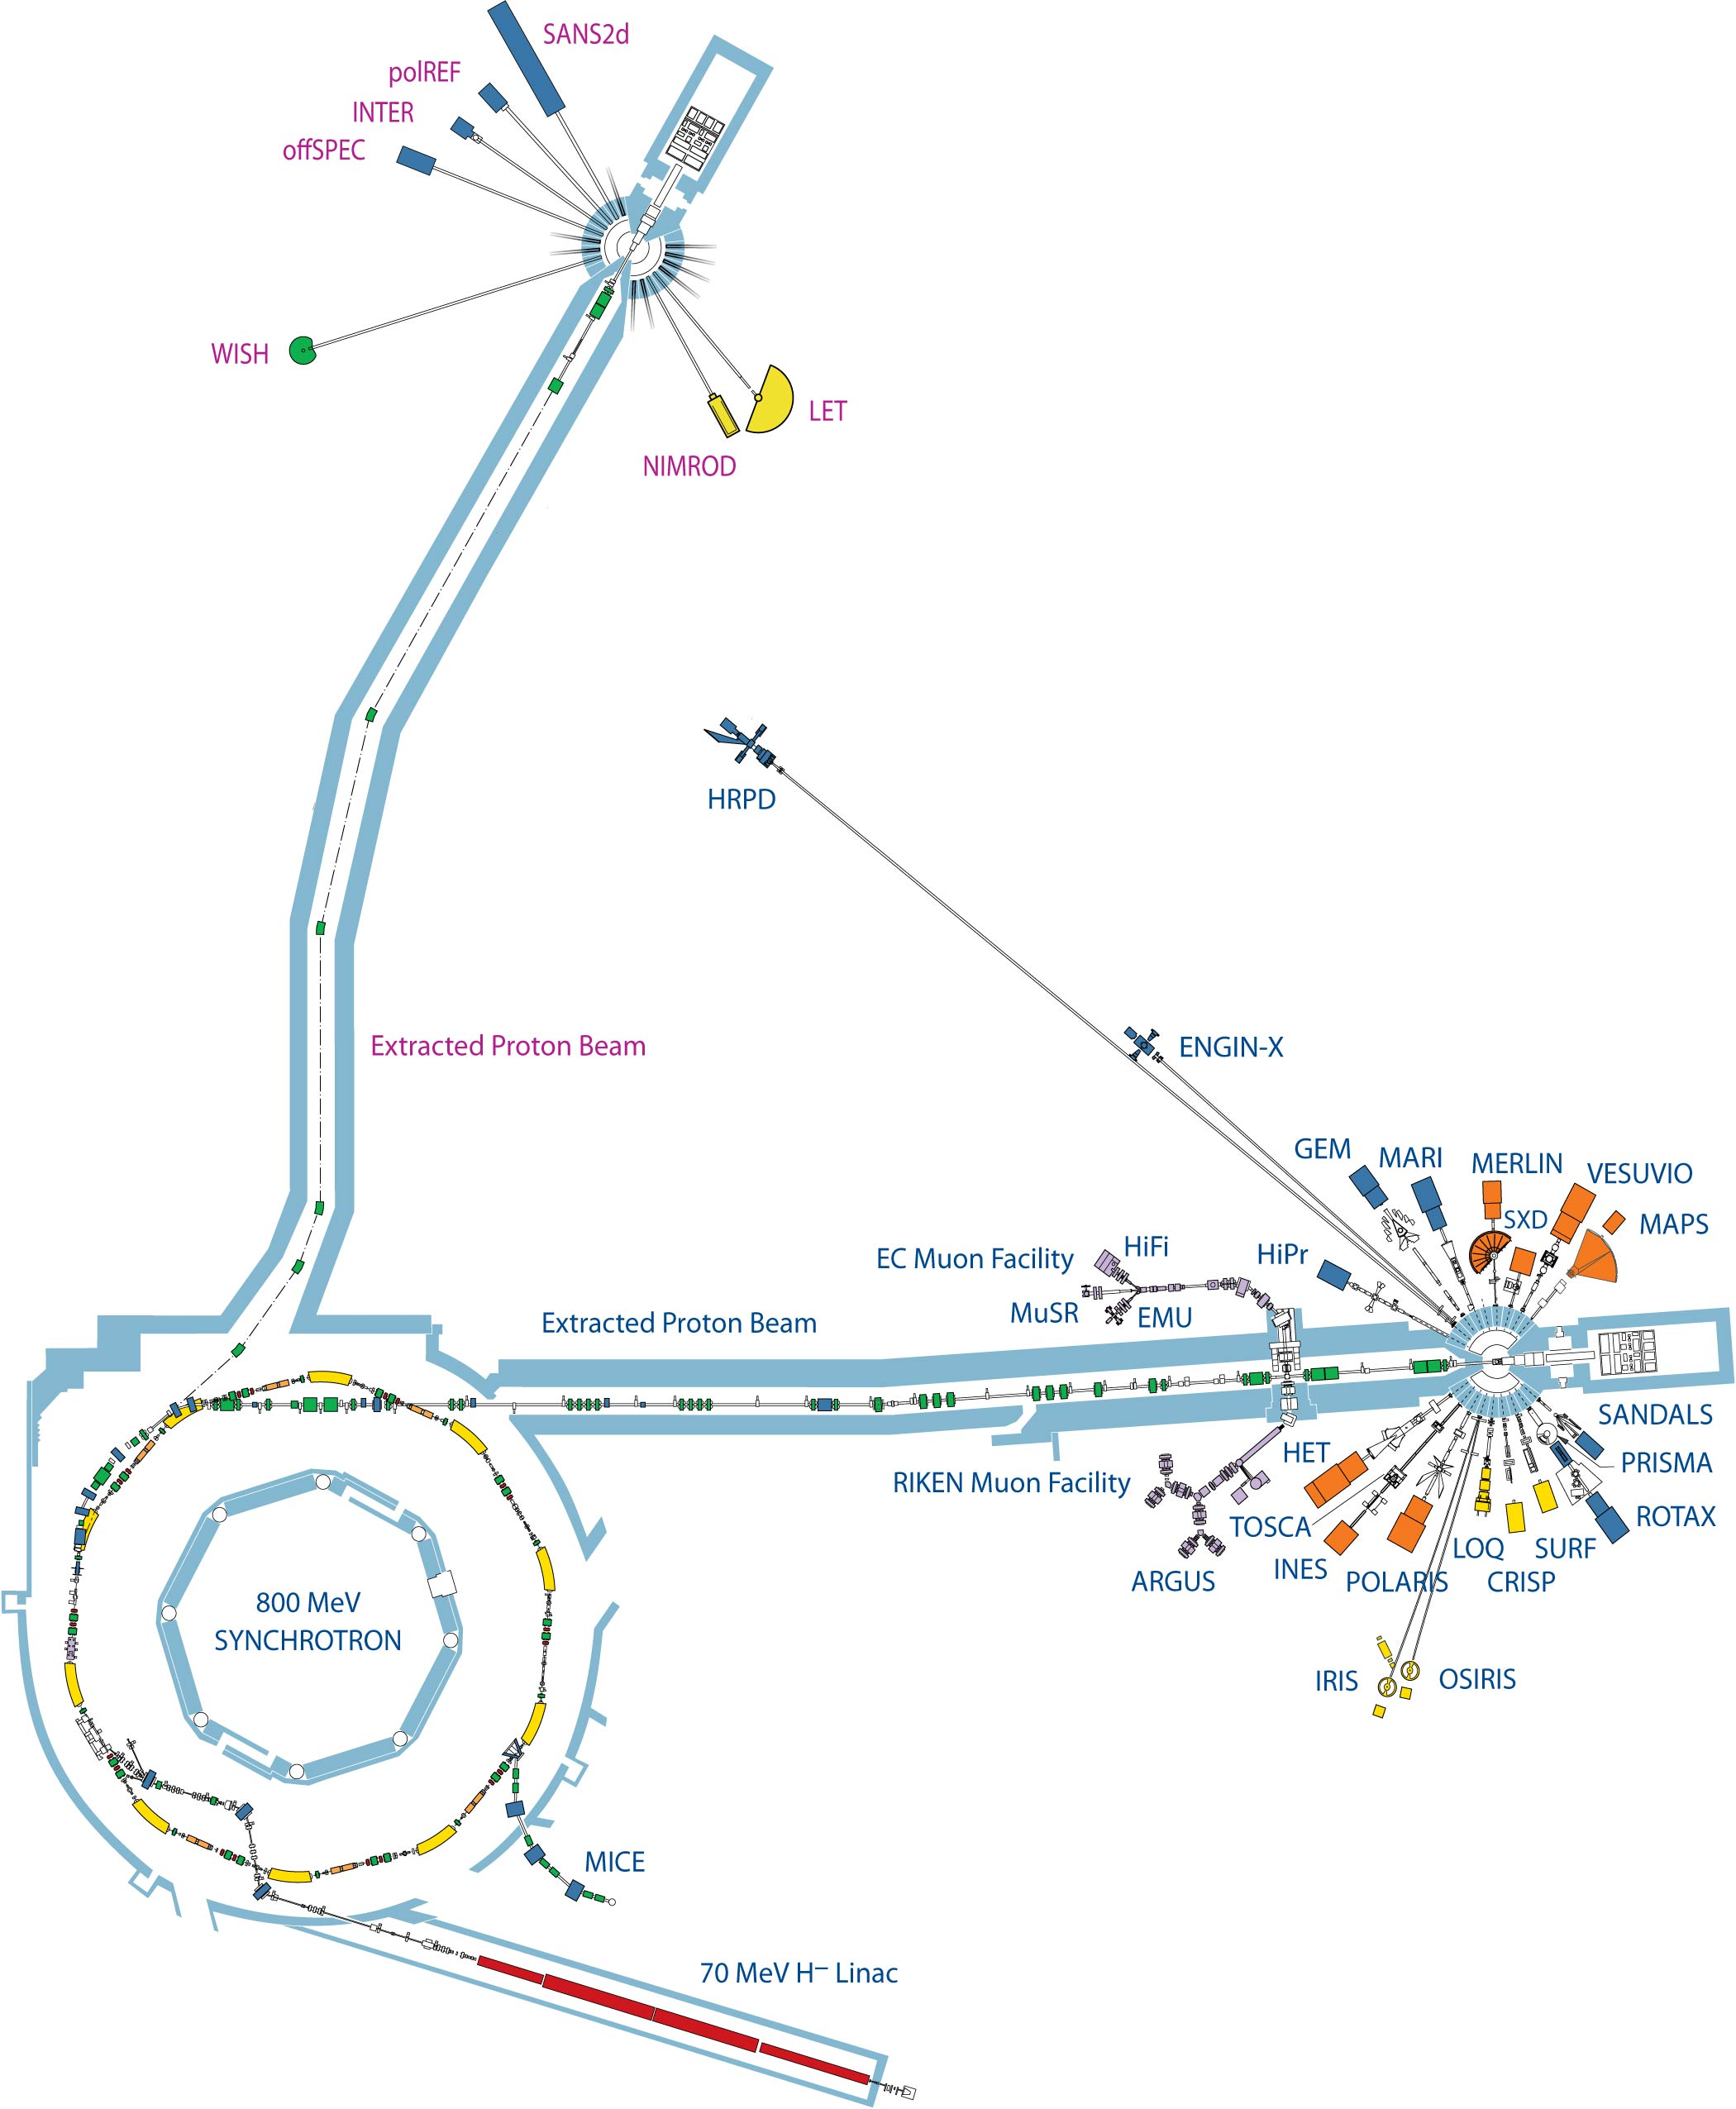
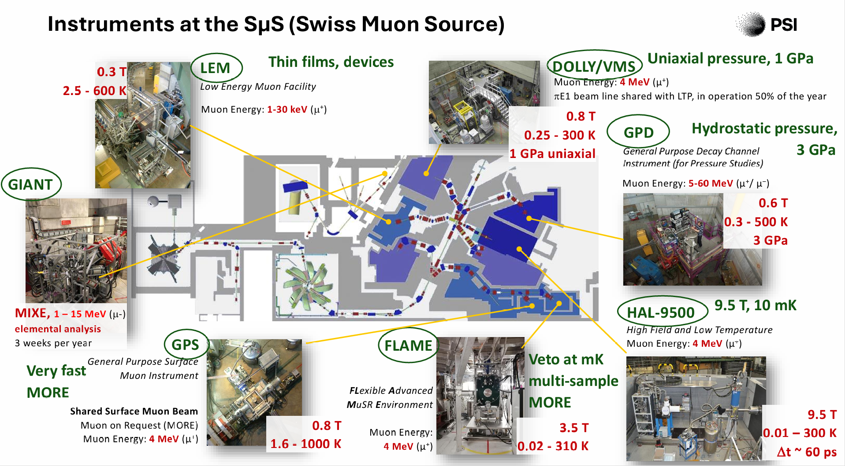
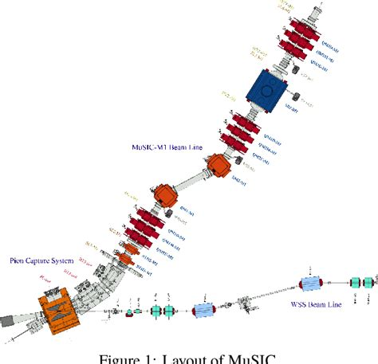
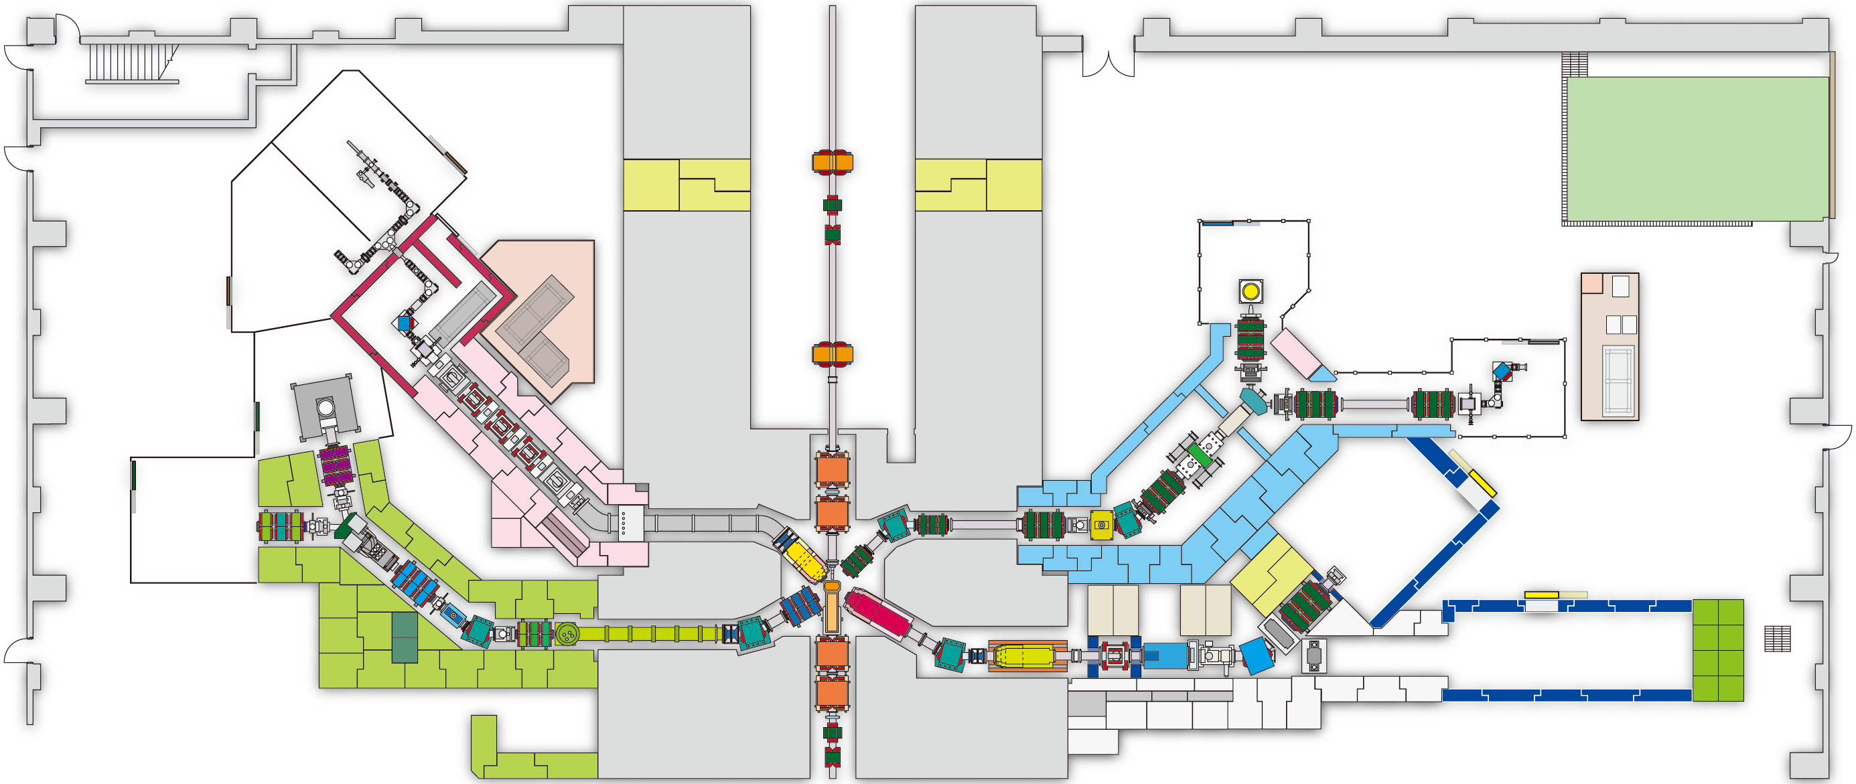
Muon Facilities
Continuous Muon Facilities
Pulsed Muon Facilities
MuX
S2
H2
H1
S1
S line
H line
U line
D line
U1A
D1
U1B
D2

Slide 5
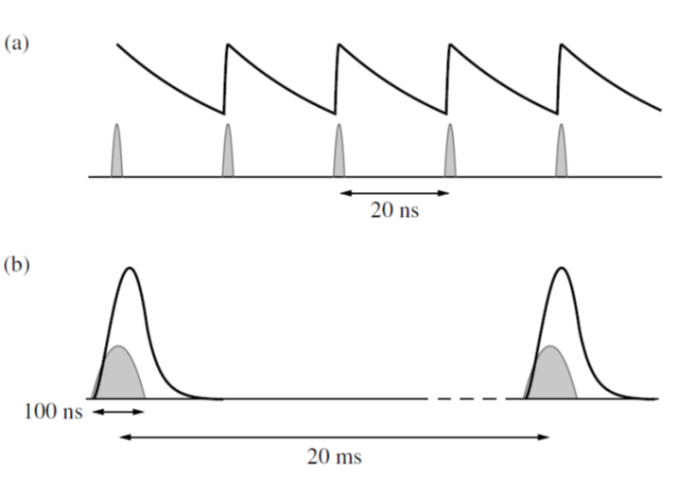
Pulsed and continuous sources of muons
Continuous source (e.g. PSI, TRIUMF)
Pulsed source (e.g. ISIS, J-PARC)
Single muons
Higher intrinsic background
Time resolution set by electronics (~10s ps)
-> fast relaxations, rapid precession
Rate limit set by single muon at a time constraint
More compact detector arrays
Bursts of many muons
Low intrinsic background
Time resolution set by muon pulse width (~50ns)
-> Weak relaxations, slow precession
Rate limit set by detector dead time
Big detector arrays to cope with high instantaneous rate

Slide 6

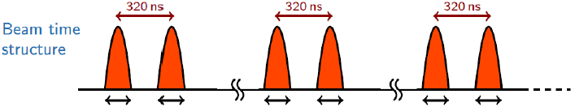
Muons at ISIS
50ns
50ns
50ns
50ns
50ns
50ns
20 ms

Slide 7
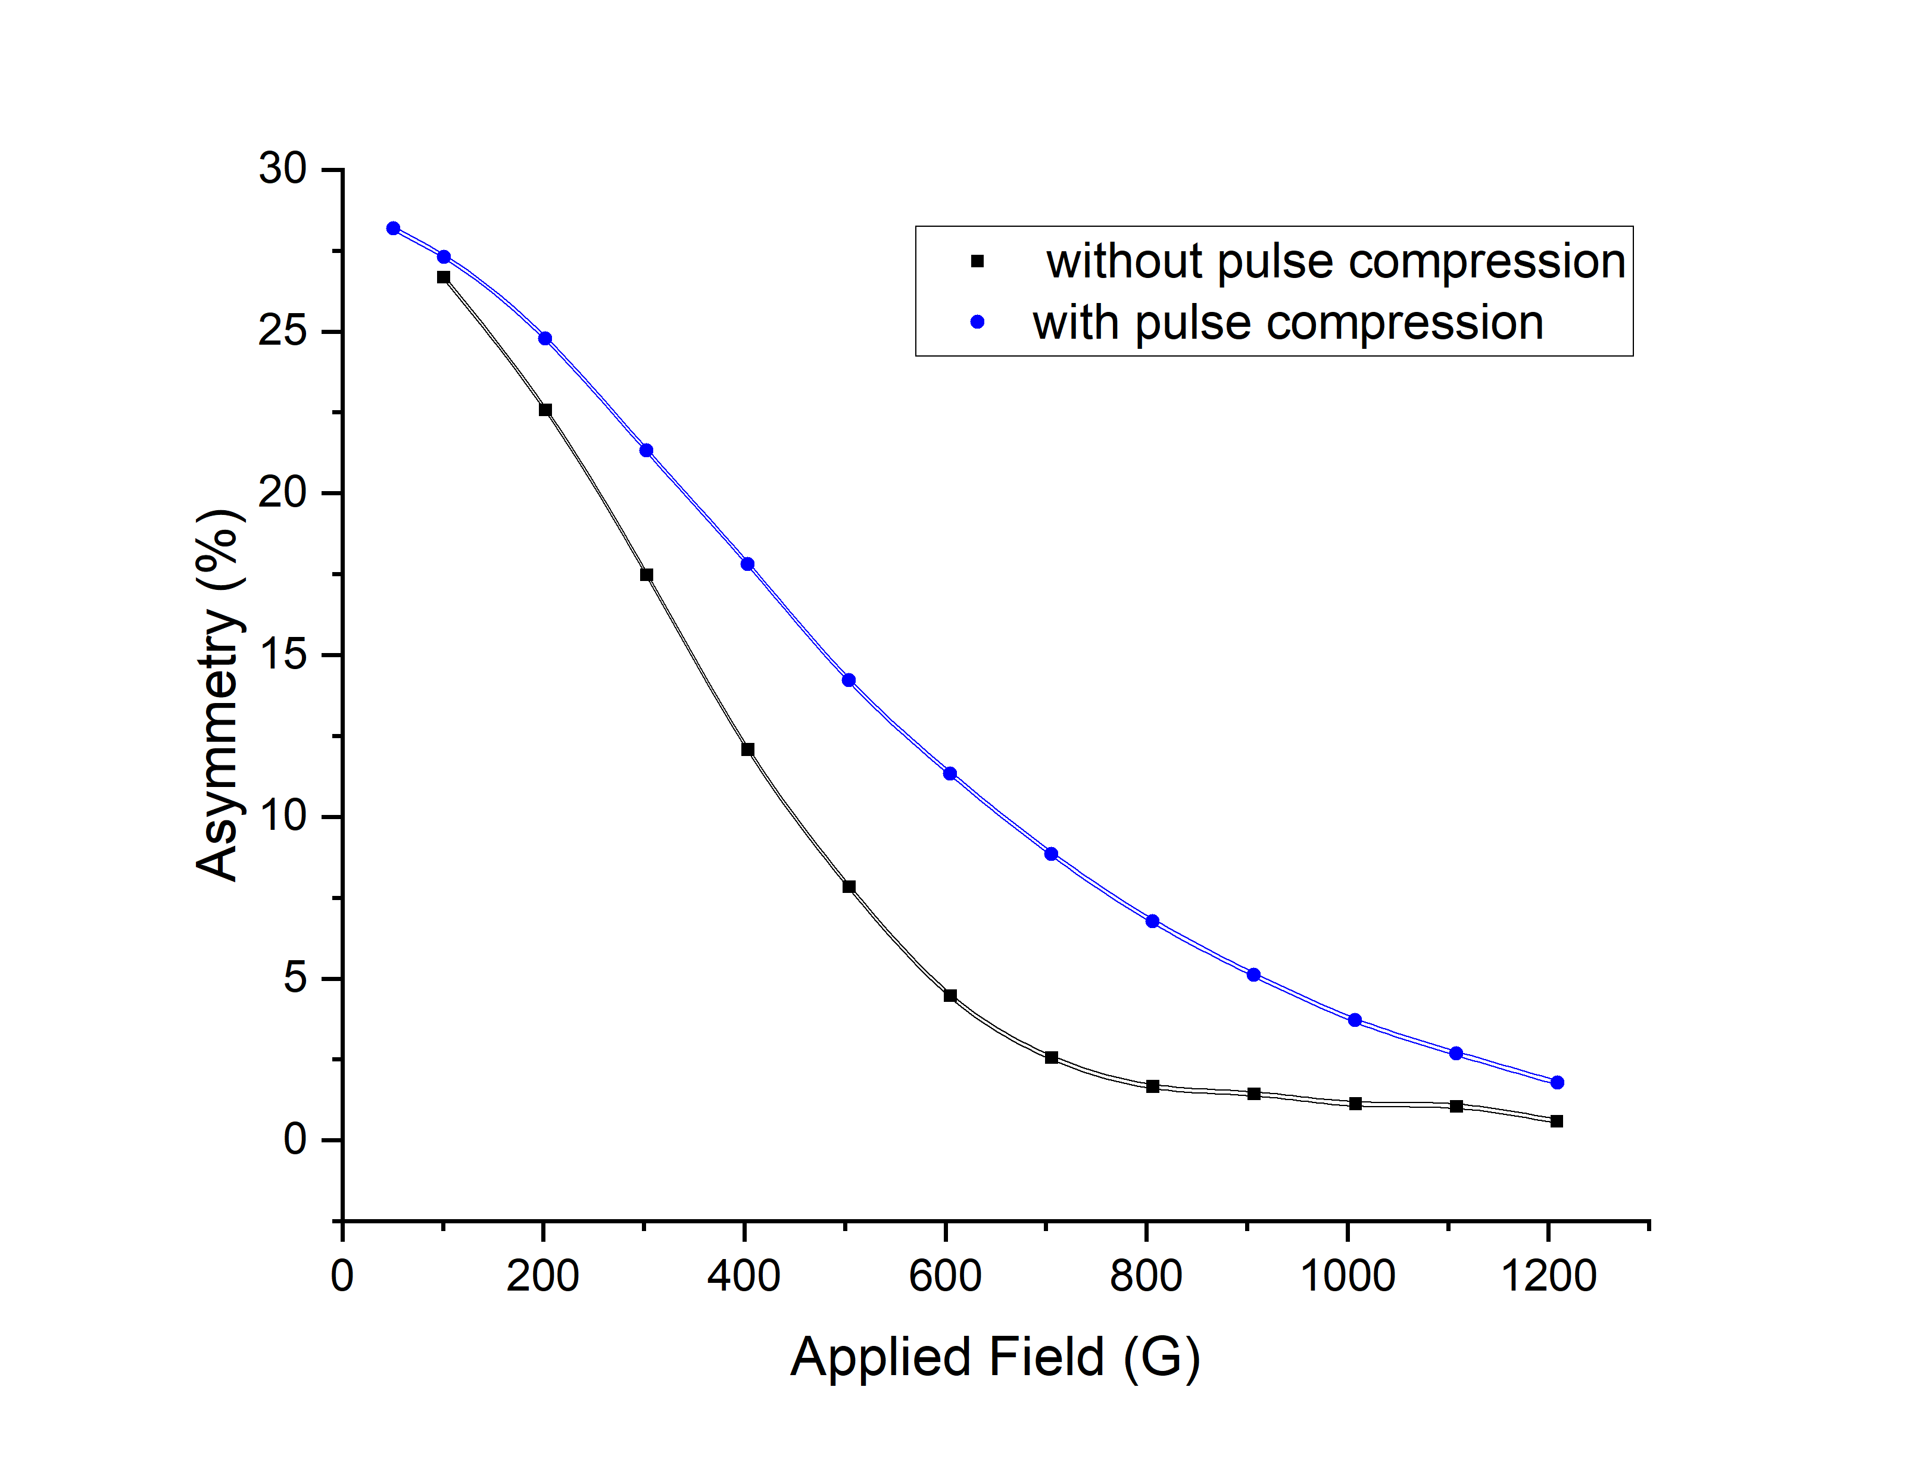
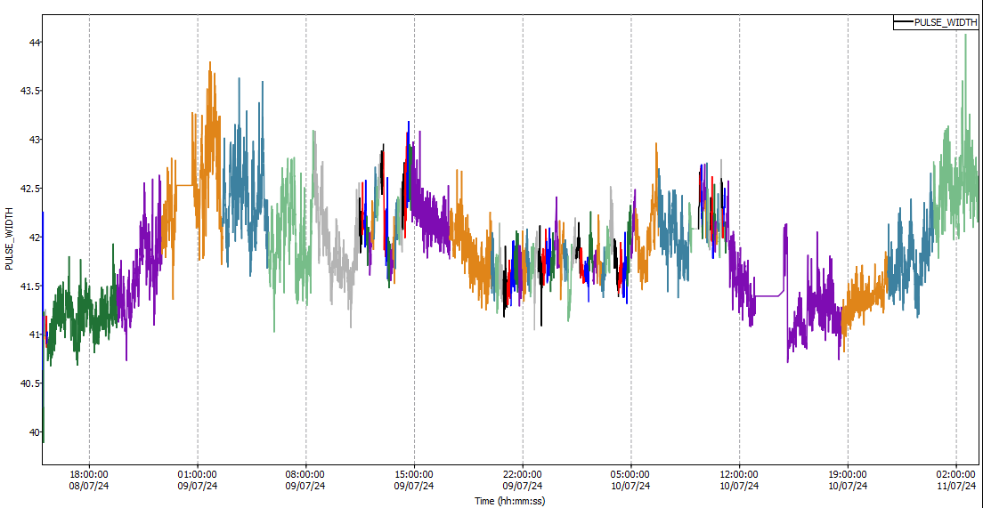
ISIS Proton Pulse Compression
Improving the performance of the muon spectrometers by optimising the proton beam
Shorter pulses give a better frequency response
Rotating phase space in the final stages of the proton acceleration reduces the pulse width (time)
Frequency response with and without pulse compression – MuSR Cycle 23_5

Slide 8
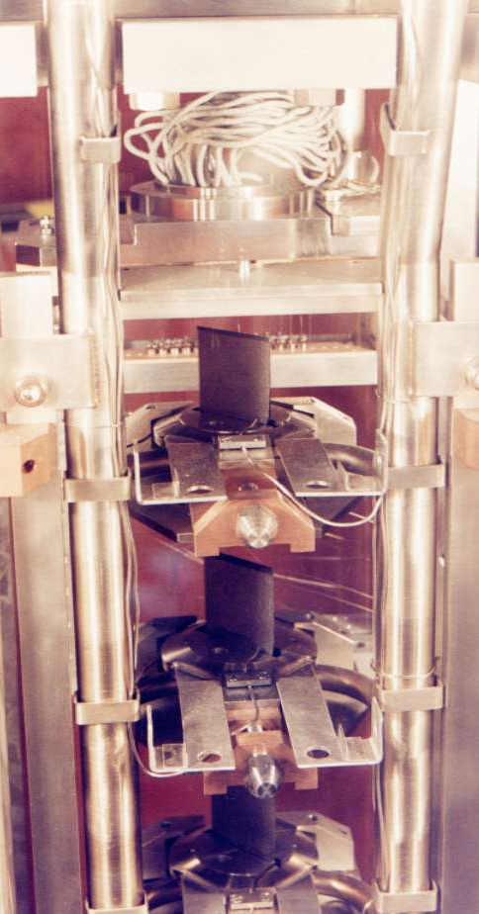
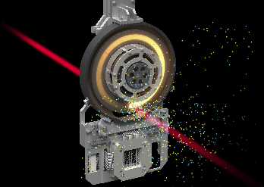
Muon Production Target
Made of graphite
The Muon Target
Muon Production Target
Beam focus
Protons
Target
Pions and muons

Slide 9
Muons at ISIS
MuX/MEIS

Slide 10
Muons at ISIS
Surface Muon beam
100% spin polarised
Fixed momentum ~27 MeV/c
Pulses split between beamlines
Decay Muon beam
Positive or negative muons
Spin polarised
Variable momentum ~15- 120 MeV/c
Pulses can be split between beamlines
CHRONUS
Hillier et al Philos Trans A (2019) 377 (2137)

Slide 11
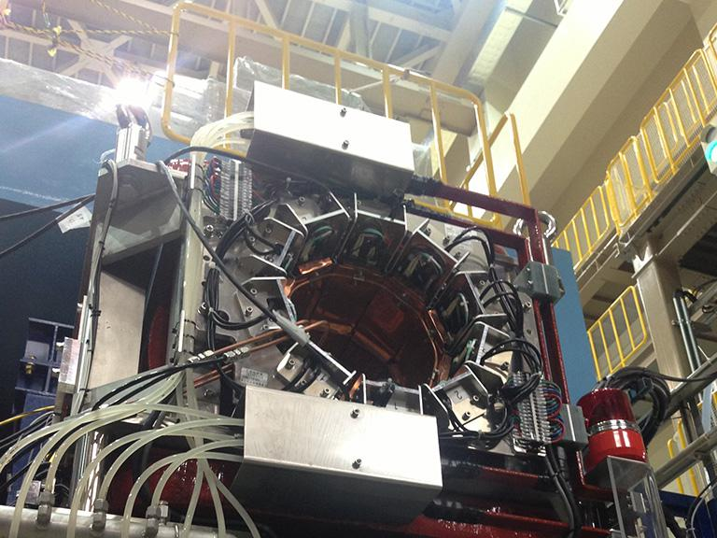
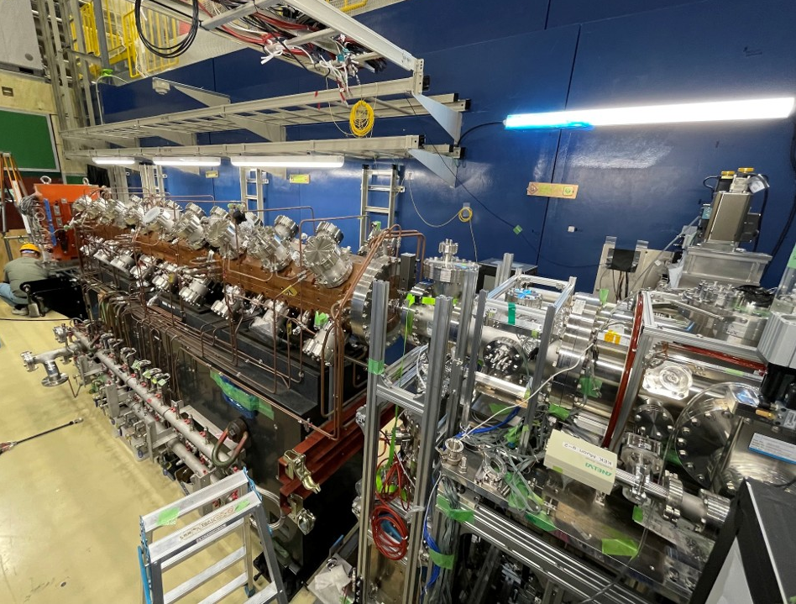
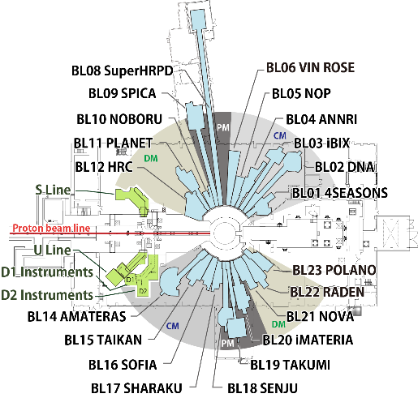

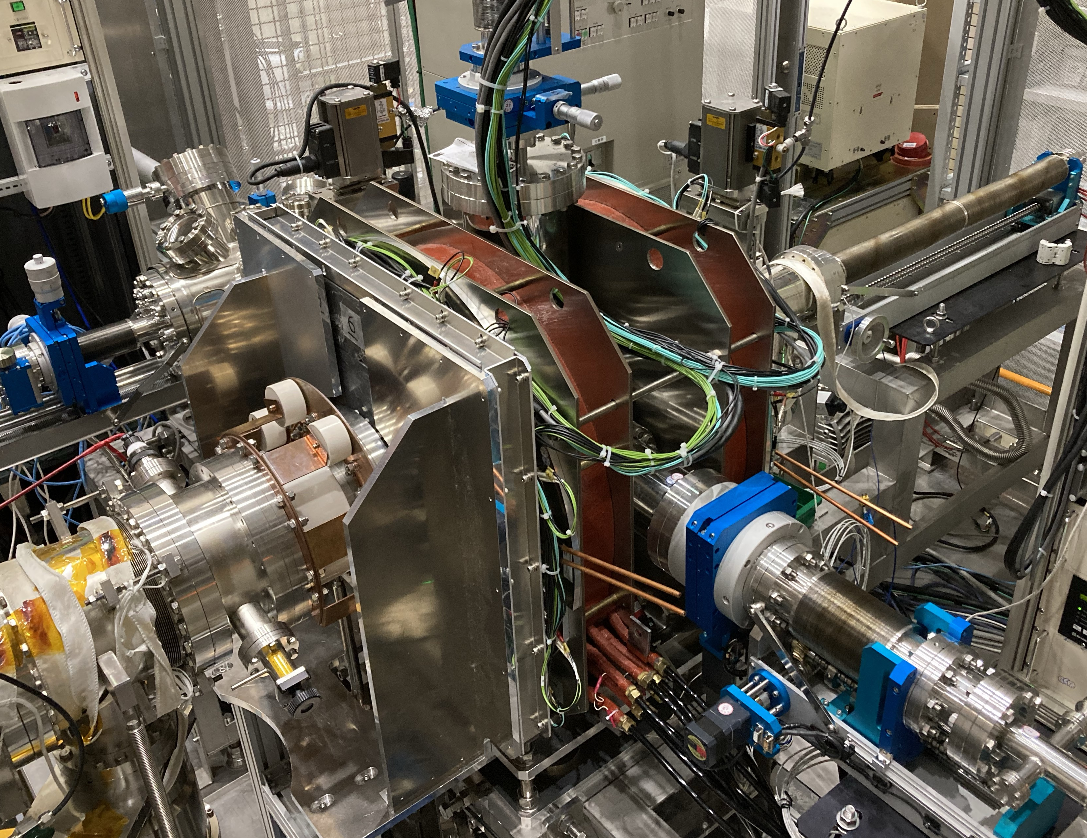
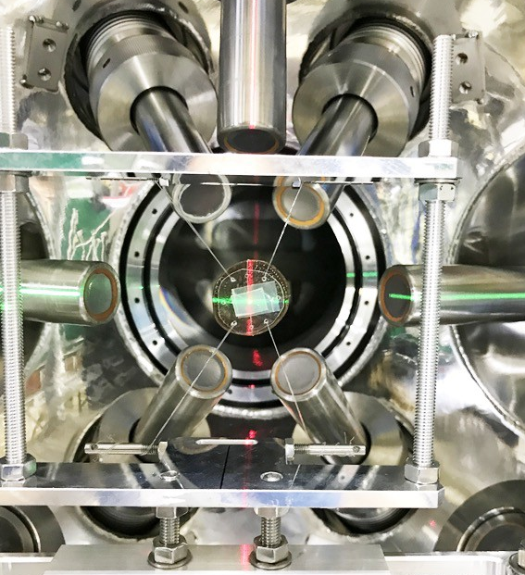
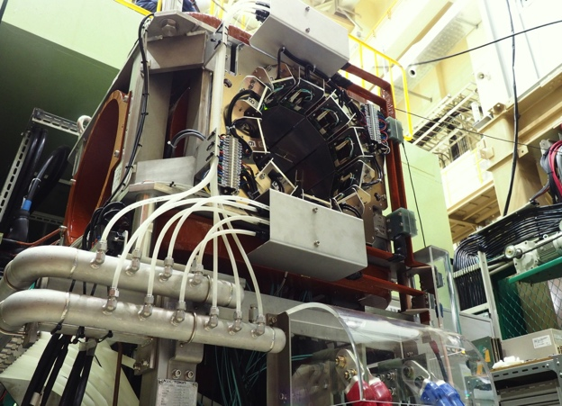
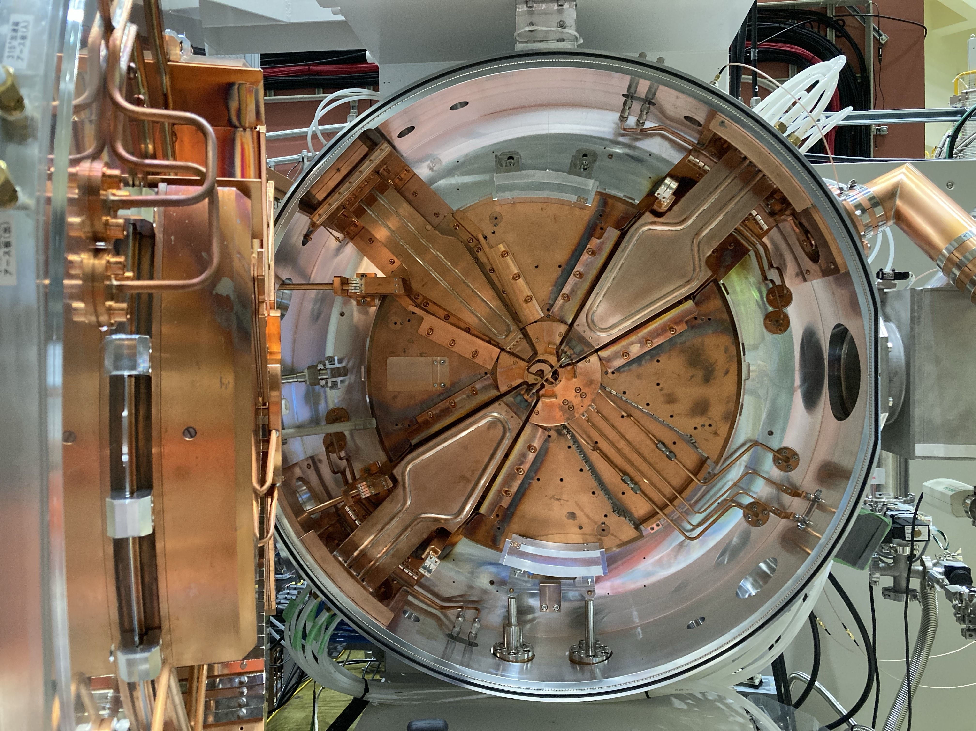
Muon beamlines
S line: Middle intensity 4MeV μ⁺
Simultaneous 4-area use (plan)
H line: High intensity 2-70 MeV μ⁺/μ⁻/π⁺/π⁻
Fundamental Physics, Muon Acceleration
S-Line
S1: μSR Spectrometer
H2
H1: SC Magnet for Mu HFS Spectroscopy
4 areas
Simultaneous use
S2
High Intensity
Muon Acc.
H2: Muon Accelerator
(under construction)
H1
S2: LASER Equipment for Mu 1s-2s Spectroscopy
S1
S line
H line
Muon Production Target
U line: Very-low energy (0.5-30 keV) μ⁺
Approach to Surface/Interface Sciences
D line: Middle intensity 0.1-70 MeV μ⁺/μ⁻
Versatile Use (material sci., heritage sci., etc.)
Ultra Slow Muon
Surface/Interface
U line
D line
U1A: μSR Spectrometer
Versatile Use
U1A
U1B
D1
U1B: Muon Transmission Microscope
(Prototype for Proof of Principle)
D2
D2: Elemental Analysis Chamber
D1: μSR Spectrometer
Images from Kawamura

Slide 12
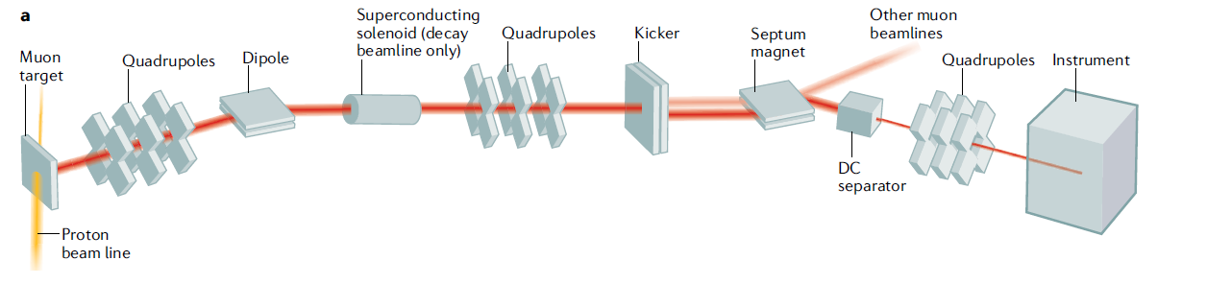
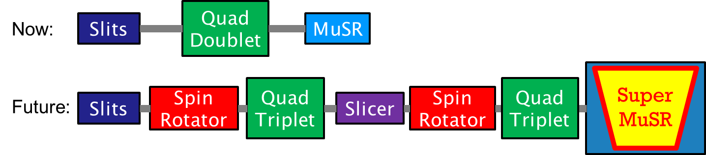
Pulsed Muon Instruments
Nat Rev Methods Primers 2, 4 (2022)

Slide 13
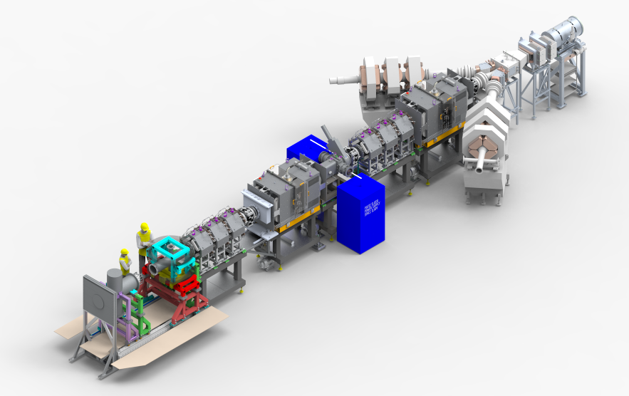
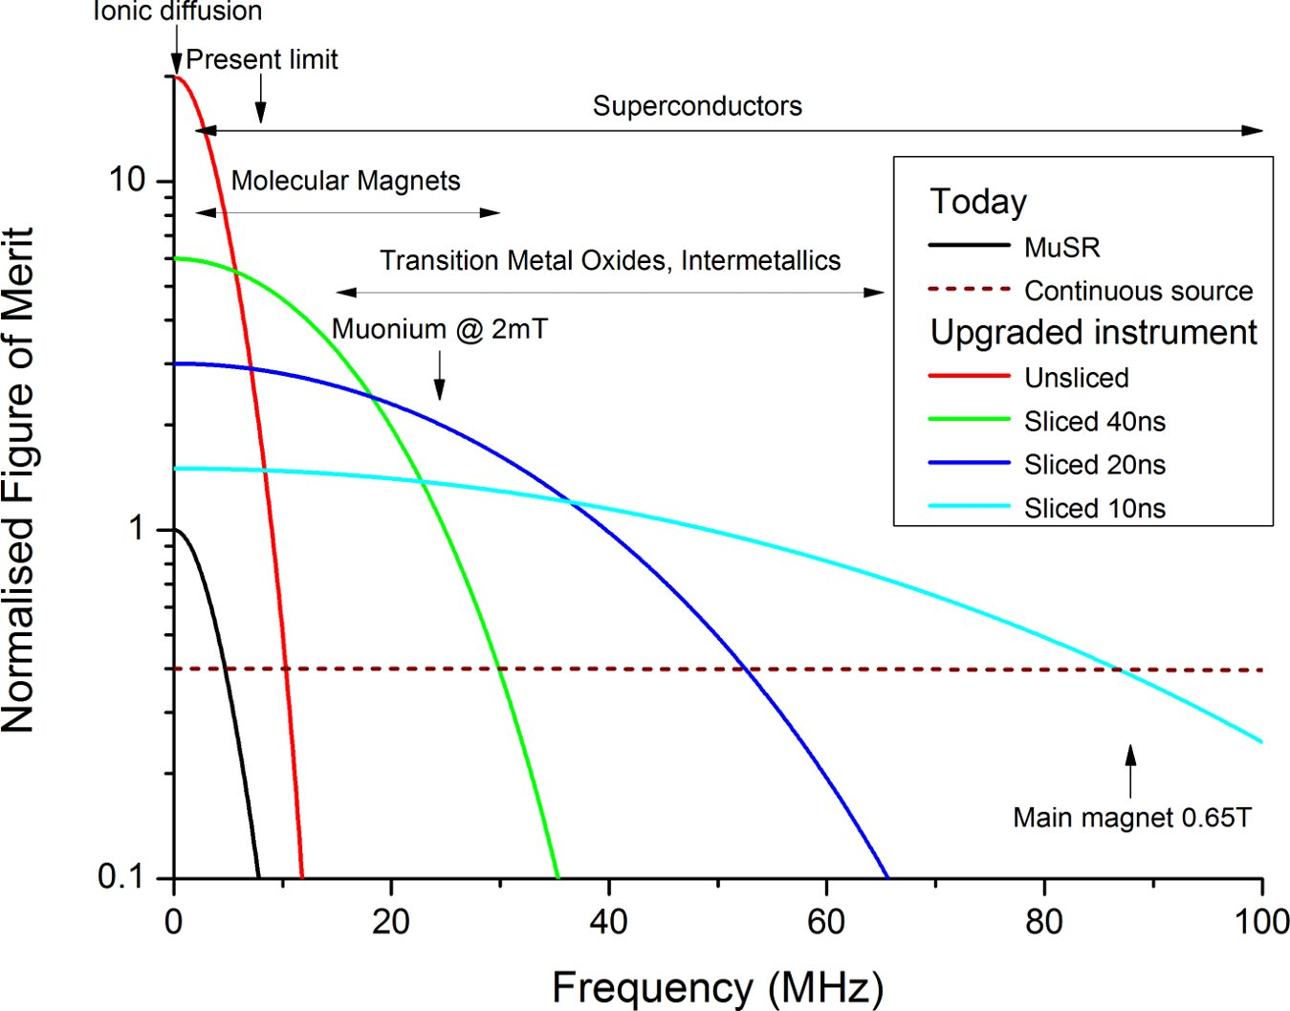
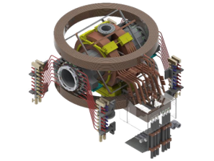
Super-MuSR
Detector and instrument improvements
Beamline improvements
  Use full muon flux and maximise information per muon
  New transverse magnet and cruciform with flypast tube
  Better zero-field (correcting quadrupolar terms)
  Pulse slicer reducing muon pulse length to ~10ns
  Spin rotators allowing higher transverse field experiments

Slide 14
Muon applications
Batteries operando
Biological materials
Muon lifetime measurements
Ionic motion
μ⁻
Muon
spectroscopy
μ⁺
magnetism
μ⁻SR
superconductivity
semiconductors
Elemental, isotope, oxidation state depth dependence analysis
Muon chemistry
Light illumination
Reaction kinetics

Slide 15
Science highlights I: chiral superconductivity in LaPt₃P –
ZF and TF MuSR

Slide 16
Science highlights II – KAgF₃: Using F--µ--F states to measure
magnetic materials
Discover an A-type AFM structure with $μ_{Ag}=0.47μ_{B}$
Use F--µ--F states above $T_{c}$ and DFT to find the muon site
Use magnetic oscillations to find the magnetic structure below $T_{c}$
J. M. Wilkinson et al., PRB 107 144422 (2023)

Slide 17
Scientific Highlight (Material Science)
Direct measurement of the evolution of magnetism and superconductivity toward the quantum critical point
We applied the µSR method in the superconducting dome of CeCo(In_{1-x}Zn_{x})₅. It was found that a magnetically ordered state develops at x∼ 0.03, coexisting with the superconductivity. The magnitude of the ordered magnetic moment is continuously reduced with decreasing x, and it disappears below x∼ 0.03, indicating a second-order phase transition and the presence of the quantum critical point (QCP). Furthermore, the superconducting penetration depth diverges toward the QCP. These facts provide evidence for the intimate coupling between quantum criticality and Cooper pairing.
presented to the press
W. Higemoto, M. Yokoyama et al., PNAS 2022 Vol. 119 No. 49 e2209549119

Slide 18
Scientific Highlights III – Battery materials
Dynamics from Ionic Motion
Spin-polarised muon stops in the sample​
Fields from nearby nuclei cause incoherent spin precession​​
Ion with nuclear moment moves near muon and flips the muon spin​ (or vice versa)
Muon decays and positron detected​
Signal depends on how often the muon spin was flipped
J. Sugiyama et al, Phys. Rev. Lett. 103, 147601 (2009)
Muons (both positive and negative) allow these effects to be probed over a range of length scales in, for example, battery materials
Figure from Innes McClelland

Slide 19
Scientific Highlights III – Battery materials (In Operando)
Li⁺ hopping rate
Changes in local structure
Li⁺ diffusion coefficient
I. McClelland et al., Chem. Mater. 35, 4149 (2023)​

Slide 20
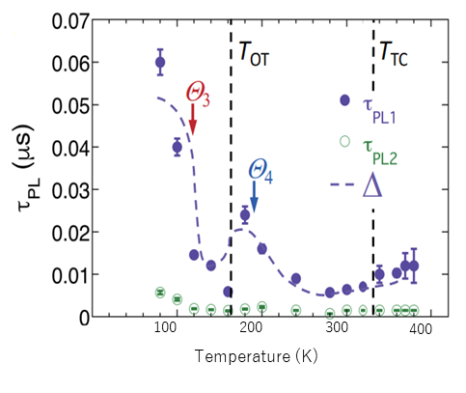
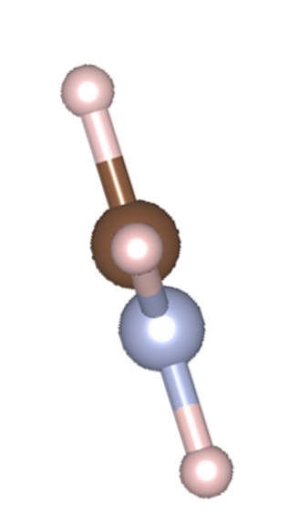
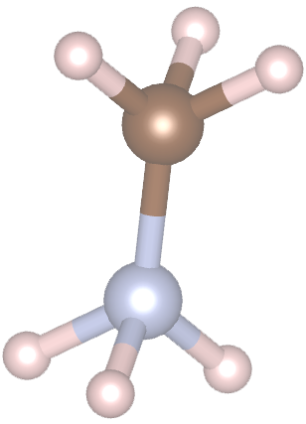
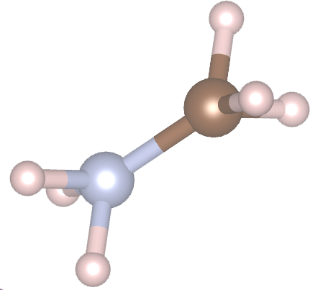
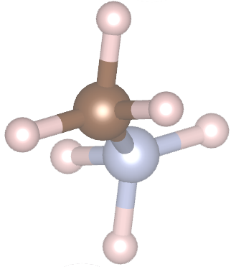
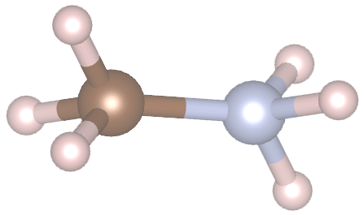
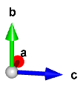
Scientific Highlight (Material Science)
μSR study on the hybrid perovskite solar cell
One promising next-generation solar cell material is a hybrid organic-inorganic perovskite (HOIP) compound. They are attracting attention because of their extremely high energy conversion efficiency of more than 25%.
A μSR study on archetypal HOIP, MAPbI₃, reveals that the charge carrier lifetime correlates with the rotation of organic molecules.
Local field caused by nuclear
magnetic moments
Slow-rotating
Fast-rotating
muon
Temperature dependence of charge carrier lifetime (circles) determined from photoluminescence measurements and muon spin relaxation rate (dashed curves). The vertical dashed lines indicate the structural transition temperatures.
The orientation of molecules seen from muon is almost constant.
The orientation of molecules seen from the muon is averaged out.
The muon spin exhibits relaxing behavior due to the local magnetic field from MA molecules.
Muon spin polarization is unchanged.
(Unable to follow changes in magnetic field)
I
Pb
The result indicates that the moderate suppression of the speed of free rotational motion of organic molecules is important for the long charge carrier lifetime.
We demonstrated the μSR study can contribute to the development of efficient and low-price next-gen. solar cell, optical device, etc.
muon
MA molecule
CH₃NH₃PbI₃
MA(Methyl Ammonium)PbI₃
A. Koda et al., PNAS 119, e2115812119 (DOI:10.1073/pnas.2115812119)

Slide 21
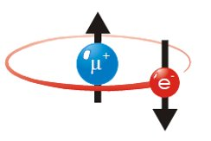
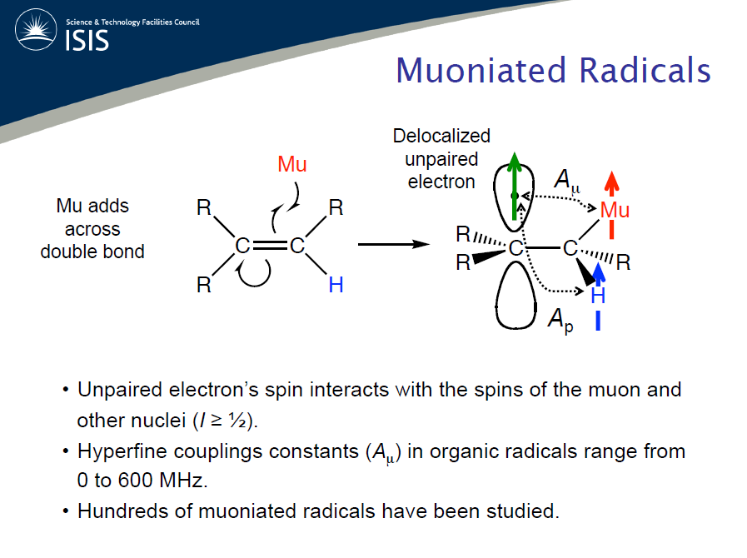
Scientific Highlights IV – Muonium Chemistry
Positive muons can capture electrons to form a light hydrogen isotope: Muonium (Mu)​
Mu acts as a radioactively labelled light isotope of hydrogen (similar Bohr radius, ionisation energy and reduced mass)
Mu can undergo the same reactions as a H-atom:
Addition: Mu + R₂C=CH₂ R₂ĊCH₂Mu
Abstraction: Mu + RX MuX + R·
Radical Combin.: Mu + ·OH MuOH
E- transfer: Mu + X^{n+} µ⁺ + X^{(n-1)+}

Slide 22
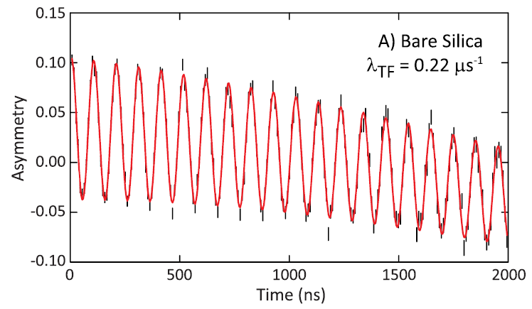
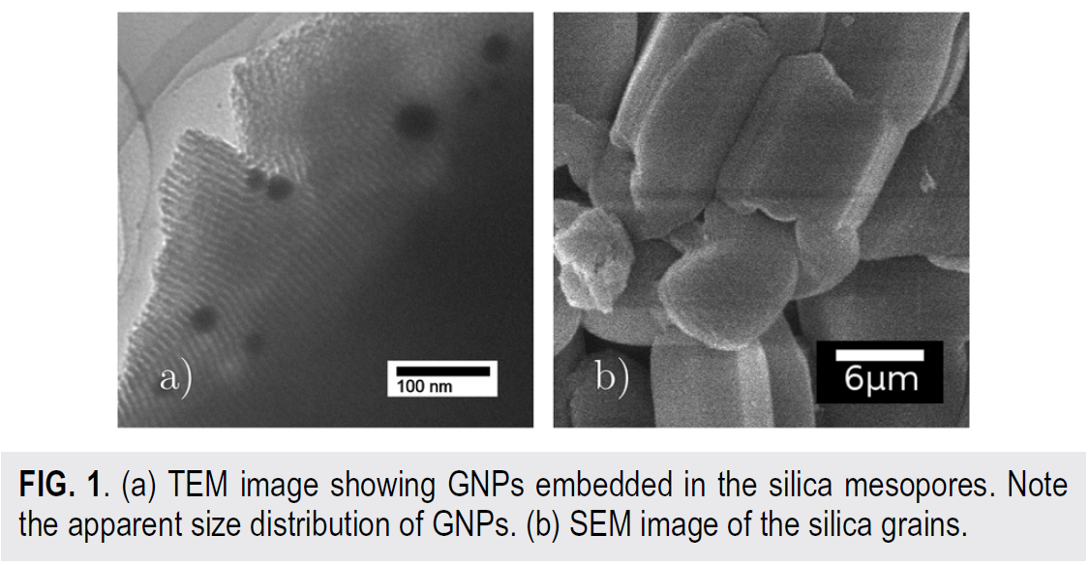
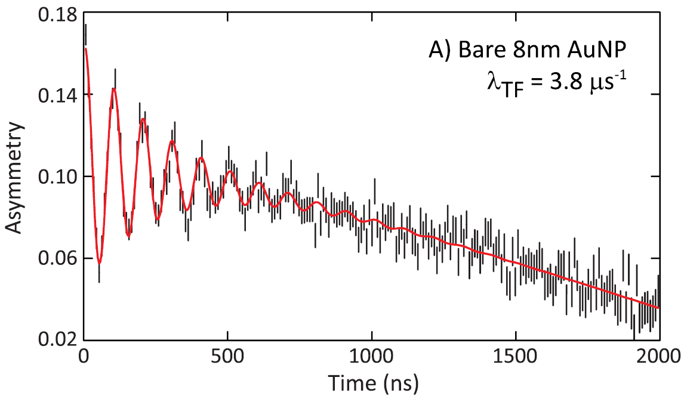
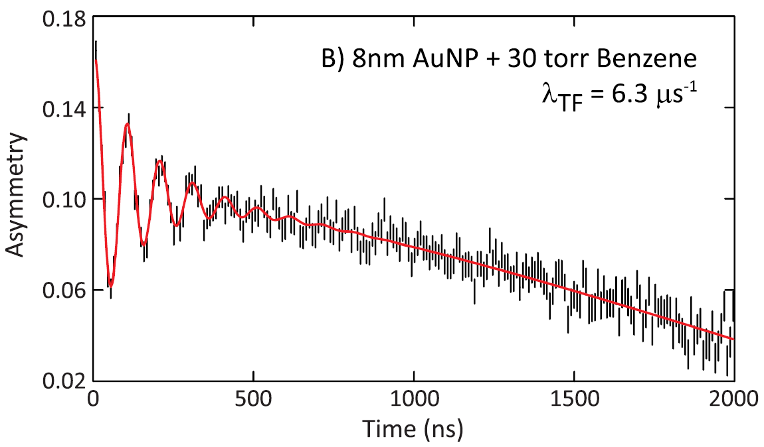
Scientific Highlights IV – Muonium Chemistry
Mu formed in bare silica
Mu reacts with gold nanoparticles
Mu reacting with 8 nm GNPs (6G TF)
Sequence of events:
Mu formed in silica escapes the mesopores,
Quickly diffuses to a GNP,
Loses e⁻ spin to metal, i.e. Mu -> µ⁺
(chemisorption reaction), hence Mu relaxation
Catalytic effect of
Benzene
2 - 3 fold catalytic effect from benzene on metal surface

Slide 23
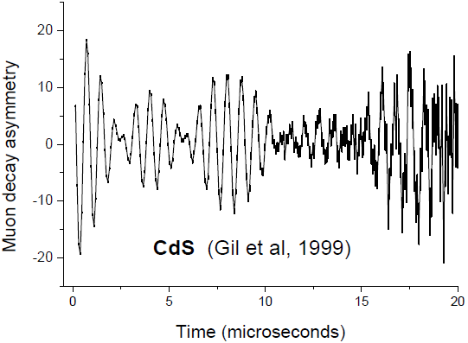
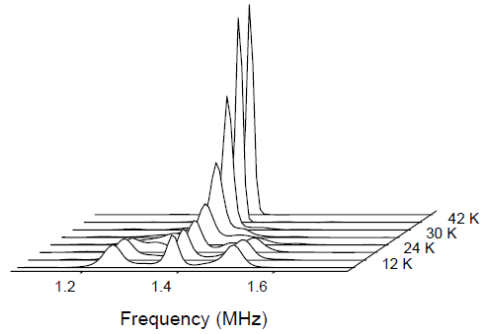
Scientific Highlights VI - Semiconductors
Generally studying muonium in the semiconductor
Hydrogen defect analogue
  Where it forms in the material
  What dynamics it experiences
Investigating paramagnetic centres
  e.g. NV centres in diamond
Charge carrier dynamics
  Thermal effects
  Light induced effects

Slide 24
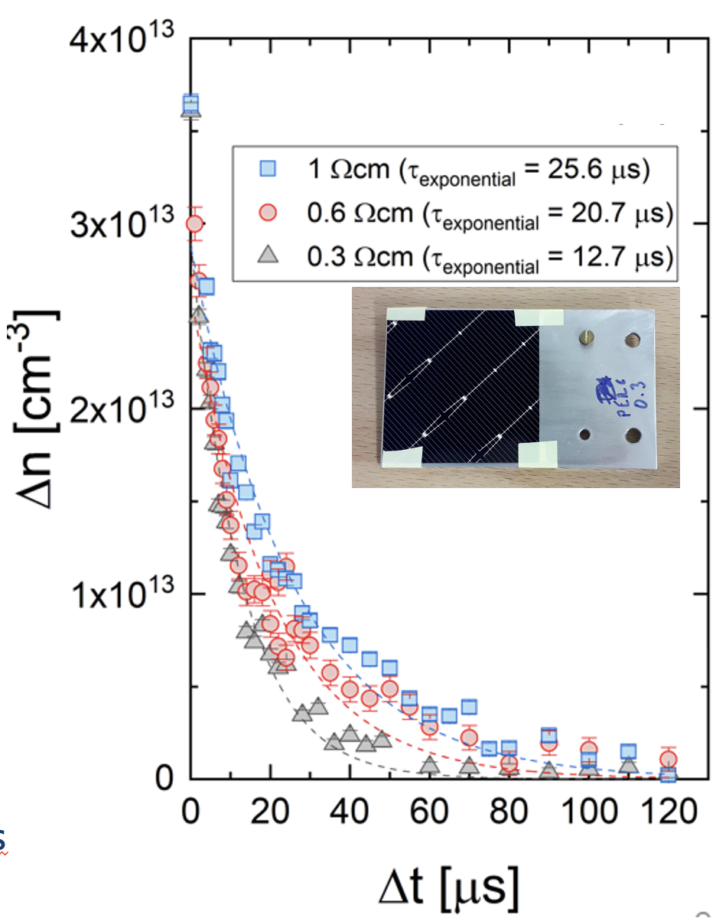
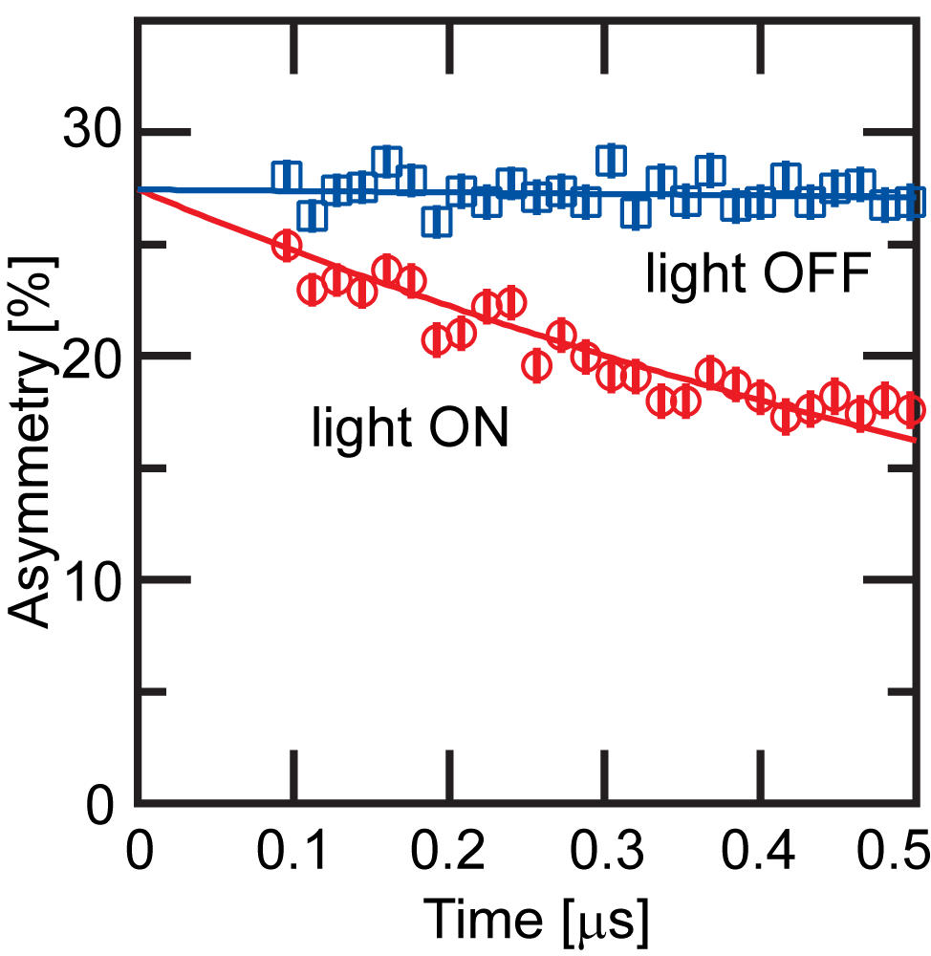
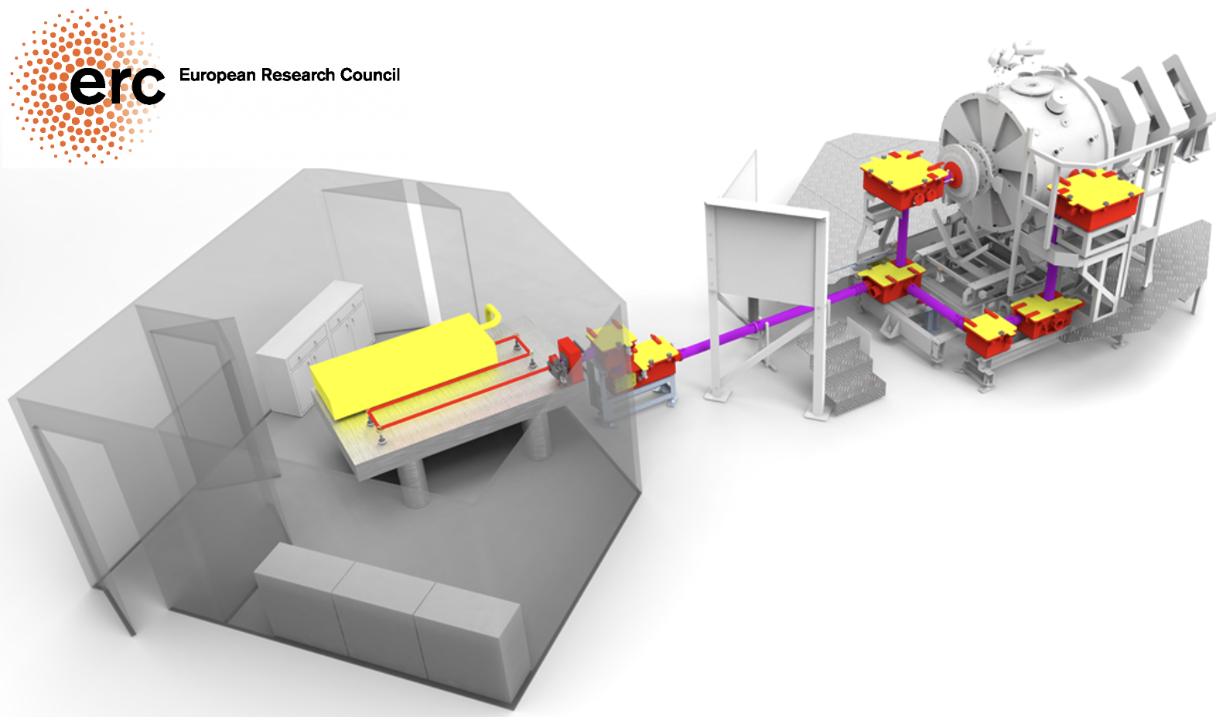
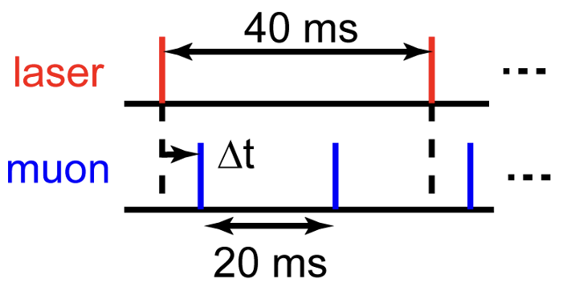
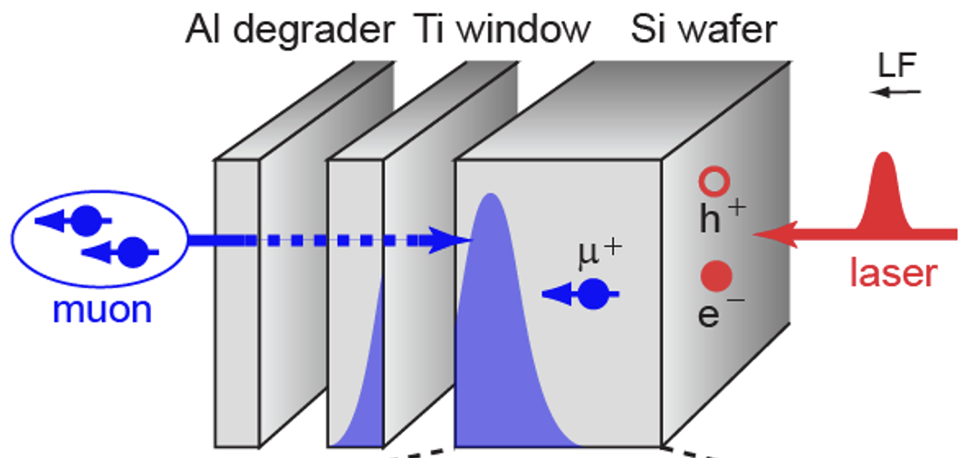
Scientific Highlights VI - Semiconductors
koji.yokoyama@stfc.ac.uk
Carrier-Mu interaction depolarises muon signal
  Relaxation rate tells
  carrier density
HIFI Laser for optically generating carriers in semiconductors
By changing the pulse delay, one can measure carrier lifetime spectrum
  Even in
  completed solar cells
Depth-dependent measurements enable carrier kinetics study
within a wafer
Applicable to many semiconductors. So far:
Si, Ge, SiC, GaAs
General-purpose setup for
light-pump muon-probe experiments
Review of Scientific Instruments 87, 125111 (2016).
Phys. Rev. Lett. 119, 226601 (2017).
Appl. Phys. Lett. 115, 112101 (2019).
Appl. Phys. Lett. 118, 252105 (2021).
Journal of Applied Physics 132, 065704 (2022).
Journal of Applied Physics 136, 055707 (2024).

Slide 25
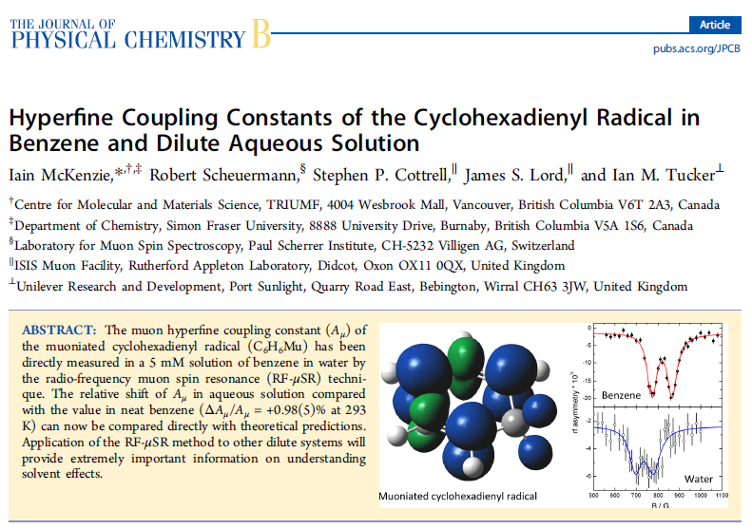
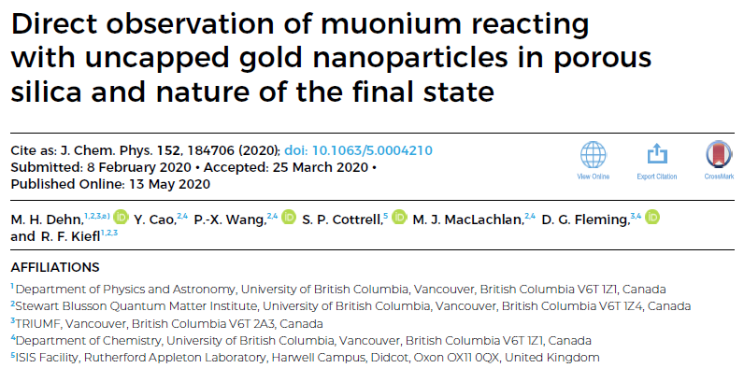
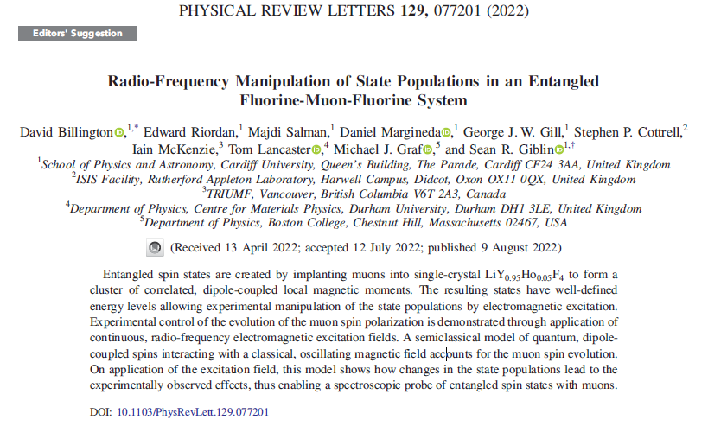
Swept field RF-µSR:
Slowly formed radicals
Final state determination
Manipulating state populations

Slide 26
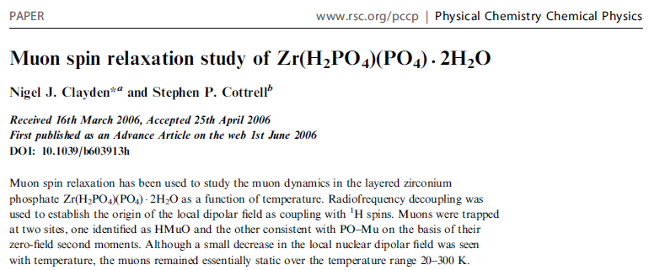
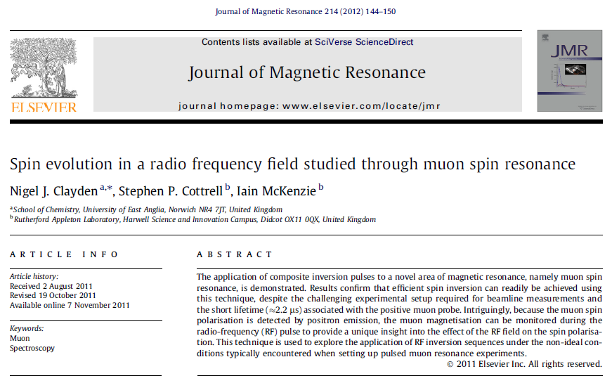

Pulsed RF-µSR:
RF Decoupling (‘NMR style’)
Spin evolution in RF field
Extend ISIS frequency response
Start to exploit pulse bandwidth to multiplex information
in a free precession signal – FT-NMR ⇒ FT-RFµSR

Slide 27

Pulsed Current
Pulsed and AC currents drive flux line lattice
Pulsed currents used to reduce ohmic heating
Clear change in lineshape as current is increased
Images from Muon spin spectroscopy OUP
Charalambous PRB 2002, 2006

Slide 28

Pulsed magnetic fields
Pulsed magnetic fields (sync to muon pulse) used to study delayed Mu formation
µSR can be carried out at higher frequencies
Large current applied (250A) without ohmic issues
Example shown on quartz
Images from Muon spin spectroscopy OUP
Shiroka PRL 1999

Slide 29
RF-uSR - Science
Semiconductors and Hydrogenic Impurity States
Charge state, site and electronic structure can be measured through hyperfine-selective RF methods. RF resonance can isolate paramagnetic centres and determine their symmetry, electronic structure and local dynamics
Chemistry, Soft Matter and Biology
Final-state identification: distinguishing prompt and delayed muon or muonium states, and measuring hyperfine parameters that are not always accessible from TF or ALC data alone.
Reaction kinetics and transient radicals: using muonium as a light-isotope analogue of H and D to test reaction theories, catalytic pathways and short-lived radical intermediates.
Gas-phase and porous-media chemistry: exploiting the unusual suitability of muon methods for low-density samples, where conventional NMR/EPR can be difficult and kinetic information can be obtained cleanly; Mu + propane H-abstraction is an important example.
Entry into biological and soft-matter problems: using familiar resonance concepts, calibrated resonators, simulated spectra and standard fitting workflows to make RF-μSR more approachable for non-μSR users.
Quantum Magnetism and Coupled Spin Systems
distinguish irreversible relaxation from coherent dephasing, spin exchange or polarisation transfer within a local spin cluster

Slide 30










Negative muons – usage at ISIS
Diverse science areas
  Cultural Heritage
      Bronze Age artefacts
      Mary Rose artefacts
      Baptismal Gates
      Swords
      Cannon Balls
      Sundials
      Coins
      Faience and glass
  Solar cells
  Piezoelectric devices
  Li batteries
  Advanced engineering
Hillier et al in Handbook of Cultural Heritage analysis
Cataldo et al, Appl. Sci 2022

Slide 31




Roman silver coins:
The fineness and quality of a coinage is often taken by historians to be a comment on the fiscal health of the issuing state
Yet very little is really known about its fineness and chemical composition
51(1)% Ag
49(1)% Cu
190 µm
B. V. Hampshire et al, Heritage 2, 400-407(2019)

Slide 32



Green fertiliser: Nitrogen fertilisers
typically, only 45-55% of the nitrogen applied is taken up by crops¹
¹Oluwadunsin et al (2022). J. Env Management 317 : 115395
 | Control Pellet |  | 1% BS Pellet |  | 5% BS Pellet
 | Mean | Std Dev | Mean | Std Dev | Mean | Std Dev
Total N, % w/w | 4.70 | 0.16 | 4.84 | 0.02 | 5.98 | 0.08
Total C, % w/w | 38.00 | 1.46 | 37.35 | 0.30 | 36.75 | 0.39
Total P, mg/kg | 13023.75 | 237.27 | 12929.75 | 202.86 | 12606.50 | 118.70
Total K, mg/kg | 31546.00 | 875.13 | 30863.50 | 217.77 | 29622.00 | 220.09
Notes:
This slide shows on the left where close to 50% of the population relies on mineral fertilisers for its food supply. On the right hand it shows a world map where N use in unbalanced with excess N applied as fertilisers causing diffuse pollution to water courses and also well as atmospheric pollution. Whilst we rely close to 50% of food supply on fertilisers, we also do not use it effectively at a global scale.

Slide 33






Scientific Highlight (Elementary Analysis)
Muonic X-ray non-destructive element analysis
The 1st-phase non-destructive element analysis of the Hayabusa-II returned samples was conducted successfully in July 2021 (S1-type project). The first result just came out.
1 mm
Oxygen in the Ryugu stones is less than the standard Carbonaceous Chondrite (Orgueil meteorite).
This implies that the standard meteorite had been oxidized by the atmosphere and that the Ryugu stone is more suitable to the standard specimen.
Hayabusa-II (CG image)

Slide 34



Elemental Mapping
µ⁻
Al
C
The spectrum from an area of 20x20 pixels next to the C, Al and Fe₂O
Image reconstruction of 5 mm aluminium rods in 20 mm carbon cylinder.
Radiating lines are artefacts from high-frequency components
Line between the Al rods is likely caused by rotation axis misalignment.
Fe₂O₃
C
Al

Slide 35

Muography
MeV/c Dependence – 10 min (decay µ⁺)
Muon Beam
27 MeV/c
Scintillator and Camera
32 MeV/c
Sample
37 Me27 MeV/c V/c
42 MeV/c
Images from Tom Ashton UCL

Slide 36


Muography
MeV/c Dependence – 10 min (decay µ⁺)
Muon Beam
27 MeV/c
Scintillator and Camera
32 MeV/c
Sample
37 Me27 MeV/c V/c
42 MeV/c
Images from Bjorklund UCL/ISIS

Slide 37

Protecting electronics from cosmic invaders
Single event upsets (SEUs) occur when high energy particles hit microelectronics, causing devices to malfunction. Solar flares and cosmic rays are the main sources of such particles and, with the ubiquitous nature and rapid advances in microelectronics; it’s an area of intense interest. The semiconductor industry is looking ahead by understanding how and why devices might become vulnerable.
“Our experiments are about understanding the probability of these events, which represents an important contribution to the semiconductor industry. This will inform future design decisions, enabling manufacturers to develop devices that are less susceptible to muon SEUs.”
Professor Bhuva, Vanderbilt University
doi: 10.1109/IRPS.2014.6860585

Slide 38


Slide 39

In Summary
Pulsed and Continuous Muon sources are complementary
The muon community needs both
Wide breadth of science
Industrial and societally relevant science
Pulsed environments are well suited to MELODY

Slide 41




Scientific Highlight (Atomic-Molecular Physics)
New Frontiers in Muon Atomic and Molecular Physics Pioneered by TES
The processes in muonic atom formation occur in rapid succession over just a few tens of femtoseconds; the full picture of how the muon moves and how the electron configuration and number change remains unclear.
The transition-edge sensor microcalorimeter (TES) has excellent energy resolution with high detection efficiency
The first precise measurement of the ‘electronic’ X-ray spectrum of muonic atoms
The full picture of muonic atom formation (femtosecond dynamics) has been revealed!
Phys. Rev. Lett. Editor’s suggestion
T. Okumura et al., PRL 127, 053001 (2021)

Slide 42



Scientific Highlight (Muon Acceleration)
First RF acceleration of cooled positive muons at J-PARC
Conventional muon beams have a large spread in position and momentum.
Cooling enables efficient acceleration within the short muon lifetime.
Thermal muonium from silica aerogel is laser-ionized to produce ultraslow μ⁺.
Electrostatic extraction to 5.7 keV is followed by RFQ acceleration to 100 keV.
Cooled positive muons
accelerated to 100 keV
Transverse phase-space reduction:
200× (horizontal), 410× (vertical)
A key step toward muon g−2/EDM
and transmission muon microscopy
Accelerated-muon peak at 2,280 ns
only with RF on and laser on resonance
S. Aritome et al., Phys. Rev. Lett. 134, 245001 (2025) DOI: 10.1103/PhysRevLett.134.245001
Notes:
Source: S. Aritome et al., “Acceleration of Positive Muons by a Radio-Frequency Cavity,” Physical Review Letters 134, 245001 (2025). https://doi.org/10.1103/PhysRevLett.134.245001. Figures 1 and 2 reproduced under CC BY 4.0 (cropped). Experiment conducted at J-PARC MLF MUSE S2 in March–April 2024. Thermal energy: 25 meV. Accelerated intensity: 2×10^-3 muons/pulse. Reduction factors refer to normalized transverse rms emittance relative to the incident surface-muon beam. The supplied KEK release https://www.kek.jp/en/press/202608311400 describes a subsequent June 2026 experiment in H2 (0.3 MeV, approximately 10 muons/s), distinct from this first demonstration. This slide summarizes the supplied PRL paper. PRL designation: Editors’ Suggestion, Featured in Physics.

Slide 43

Roman silver coins:
The fineness and quality of a coinage is often taken by historians to be a comment on the fiscal health of the issuing state
Yet very little is really known about its fineness and chemical composition
denarius of Julia Domna
3rd century (211-217 CE)
B. V. Hampshire et al, Heritage 2, 400-407(2019)

Slide 44
 | Control Pellet |  | 1% BS Pellet |  | 5% BS Pellet
 | Mean | Std Dev | Mean | Std Dev | Mean | Std Dev
Total N, % w/w | 4.70 | 0.16 | 4.84 | 0.02 | 5.98 | 0.08
Total C, % w/w | 38.00 | 1.46 | 37.35 | 0.30 | 36.75 | 0.39
Total P, mg/kg | 13023.75 | 237.27 | 12929.75 | 202.86 | 12606.50 | 118.70
Total K, mg/kg | 31546.00 | 875.13 | 30863.50 | 217.77 | 29622.00 | 220.09

Slide 45






Roman gold coins
During the AD 68/9 Civil Wars: Galba, Otho, Vitellius and then Vespasian fought for — and gained — control
A period of serious and sustained disruption.
Existing analyses shows a minor reduction in the purity of the gold coinage
Using X-ray fluorescence and u-XES, a number of heavily debased gold coins issued during the AD 68/9 and many slightly debased coins issued in their immediate aftermath.
aurei from the “year of four emperors”
AD 68/9
Coin 14
(Otho)
Coin 16
(Otho)
Cu
Ag
G. A. Green et al, Archaeological and Anthropological Sciences 14, 165 (2022)

Slide 46

Roman gold coins:
Using X-ray fluorescence and u-XES, a number of heavily debased gold coins issued during the AD 68/9 and many slightly debased coins issued in their immediate aftermath.
Debased Civil War gold coinages were indeed produced; that copper was used to debase Roman gold coins during this time, c. 185 years earlier than first shown
The metallurgical evidence from the gold coinage show the AD 68/9 Civil Wars caused significant and sustained disruption to the Roman economic system.
G. A. Green et al, Archaeological and Anthropological Sciences 14, 165 (2022)

Slide 47

Over Forty Years ago – Muons @ISIS

Slide 48


40 years since the inception of muons
14 November 1984 – first meeting to discuss the concept of muons at ISIS
2.5 years later first muons

Slide 49
Over Forty Years ago – Muons @ISIS

Slide 50
40 years since the inception of muons
14 November 1984 – first meeting to discuss the concept of muons at ISIS
2.5 years later first muons

Slide 51
Muons Instruments at ISIS
EC Muons
Fixed Momentum Muons ~27MeV/c
Positive muons
Longitudinal fields upto 5 T
Transverse fields upto 600+ G (pulse width limited)
Temperature range 30mK – 2000K
Laser excitation
Pulsed techniques e.g. RF, EF, Light, ac susceptibility
RIKEN
Variable Momentum Muons ~15 – 120 MeV/c
Positive or negative muons
Longitudinal fields up to 0.4 T
Transverse fields up to 600+ G (pulse width limited)
Temperature range 30mK – 500K
Pressure
Elemental Analysis
Ports for long term experiments
e.g. proton charge radius experiment
MuX/MEIS

Slide 52

ISIS Muon Instrument Suite
Instrument | Detectors | Rate (MEv/h) [Double pulse]
ARGUS | 192 | 50 [100]
EMU | 96 | 150
HiFi | 64 | 80
MuSR | 64 | 70
Surface muons
Also within the RIKEN-RAL Muon Facility:
Negative muon elemental analysis – MuX
Effects of Muons on electronics - MEIS
FAMU muonic hydrogen experiment – Port 1
Muon development beamline – Port 3
MuX/MEIS
Surface and decay muons

Slide 53

MuSR Today
64 detectors since 2004
0.65T main magnet
(down-rated to 0.32T because of PMTs)
Physically rotates between TF and ZF/LF experiment modes
Counts ~20% of positrons emitted from sample
Only ~10% of available incoming muons can be admitted, preventing detector saturation that cannot be corrected for

Slide 54


Comparison of MuSR to Super-MuSR
 | MuSR | Super-MuSR
Detectors | 64 | ~704
Solid angle coverage (of sphere) | 40% | 82%
Count rate (MEv/h) | 70 | ~1400
Maximum frequency/field | 8MHz (0.06T) | ~80MHz (0.6T)
Spin rotation | None (instrument rotation) | 0 to 75°
Smallest sample (mm) | ~10x10 on Ag | ~3x3 in flypast

Slide 55
Super-MuSR
Detector and instrument improvements
Beamline improvements
  Use full muon flux and maximise information per muon
  New transverse magnet and cruciform with flypast tube
  Better zero-field (correcting quadrupolar terms)
  Pulse slicer reducing muon pulse length to ~10ns
  Spin rotators allowing higher transverse field experiments

Slide 56




Super-MuSR Science Drivers
Weak relaxations and detailed material characterisation
Explicit calculation of
relaxation functions
Using both high rate and resolution
K. Tustain et al., npj Quantum Materials 5, 74 (2020)
J. M. Wilkinson and S. J. Blundell,
Physical Review Letters 125, 087201 (2020)
P.K. Biswas et al., Nature
Communications 12, 2504 (2021)

Slide 57
Muon Production Target
Made of graphite
Takes ~5% of the proton beam
The Muon Target
Beam focus
Protons
Target
Pions and muons

Slide 58
Muons Instruments at ISIS
EC Muons
Fixed Momentum Muons ~27MeV/c
Positive muons
Longitudinal fields upto 5 T
Transverse fields upto 600+ G (pulse width limited)
Temperature range 30mK – 2000K
Laser excitation
Pulsed techniques e.g. RF, EF, Light, ac susceptibility
RIKEN
Variable Momentum Muons ~15 – 120 MeV/c
Positive or negative muons
Longitudinal fields up to 0.4 T
Transverse fields up to 600+ G (pulse width limited)
Temperature range 30mK – 500K
Pressure
Elemental Analysis
Ports for long term experiments
e.g. proton charge radius experiment
MuX/MEIS

Slide 59
ISIS Muon Instrument Suite
Instrument | Detectors | Rate (MEv/h) [Double pulse]
ARGUS | 192 | 50 [100]
EMU | 96 | 150
HiFi | 64 | 80
MuSR | 64 | 70
Surface muons
Also within the RIKEN-RAL Muon Facility:
Negative muon elemental analysis – MuX
Effects of Muons on electronics - MEIS
FAMU muonic hydrogen experiment – Port 1
Muon development beamline – Port 3
MuX/MEIS
Surface and decay muons

Slide 60

The Rutherford Appleton Laboratory

Slide 61


The ISIS Pulsed Neutron and Muon Source
Instruments
Accelerators
Instruments
A World Centre for Condensed Matter Science with Neutrons and Muons
Typical year: 1200 experiments, 3000 visitors, 35 countries, 600 publications

