Slide 1
Super-MuSR – the next generation muon spectrometer at ISIS
Rhea Stewart (rhea.stewart@stfc.ac.uk)
Peter Baker, James Lord, Adrian Hillier & Alex Louat
MELODY 2026, Dongguan
24th October 2026

Slide 2
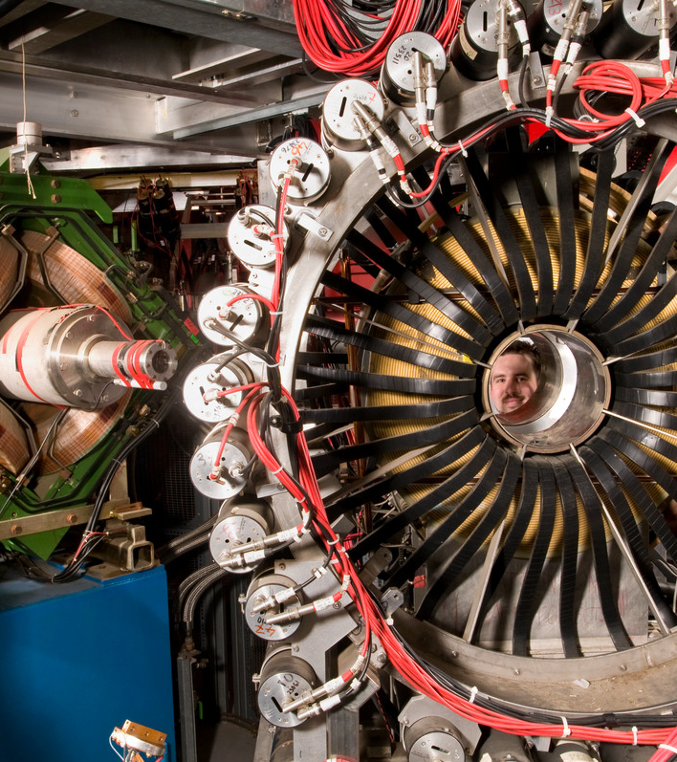
Talk Outline
A note about pulsed and continuous muon sources
The MuSR instrument today
The Super-MuSR upgrade
  Main components
  Expected performance
Scientific opportunities
Technical progress
Summary and timeline
Notes:
To replace photo with one of your own. 1) Send the geometric shape overlay to the back – Right-Click > Send to Back > Send to Back. 2) Replace image – use the guides provided to correctly position it. 3) Send your image to the back so that the geometric overlay re-appears over the image. Please remove or amend the image credit if you are using a different image to the one provided.

Slide 3
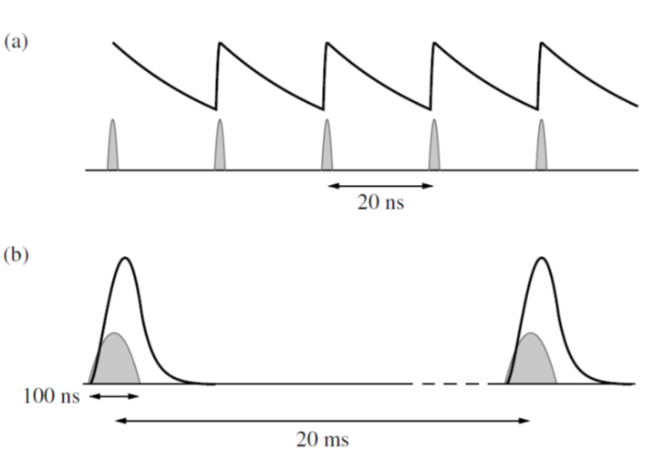
Types of muon source – pulsed and continuous
Pulsed
Continuous
Pulsed sources | Continuous sources
Bursts of many muons | Single muons
Frequency resolution set by pulse width (~ MHz) | Frequency resolution set by electronics (~ GHz)
Low intrinsic background | Higher intrinsic background
Flypast for small samples | Active collimation for small samples
Large detector arrays needed | Simple detector systems
Notes:
Showing that muon experiments are currently possible at two types of source and that each type of source has different strengths and challenges that dictate the most appropriate instrumentation. Highlight that may experiments currently need to use both types of source but that developments at many muon facilities are working towards blurring the distinction between the sources. Perhaps show an example data set (that could be done wholly on Super-MuSR) and explain why two experiments were needed.

Slide 4
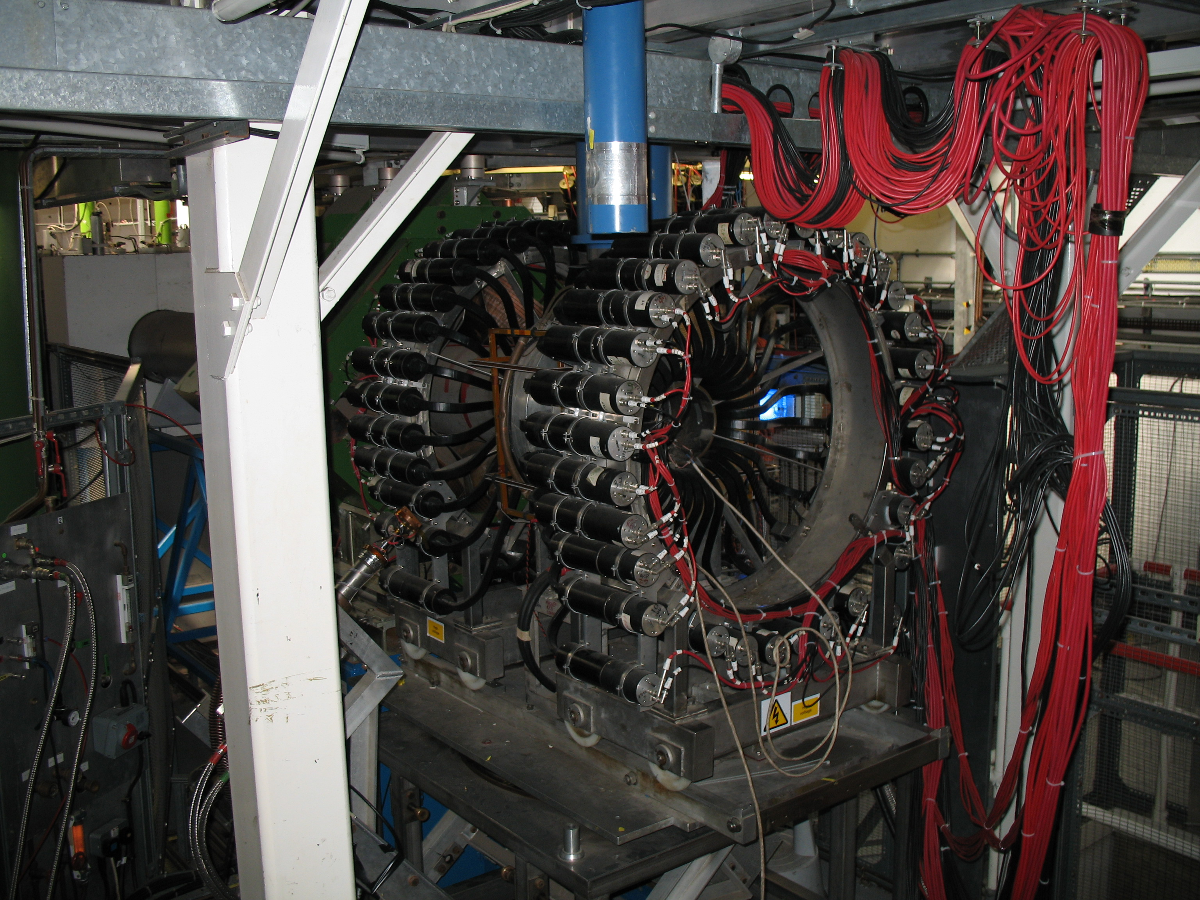
MuSR at ISIS Today
First MuSR instrument was built in 1987 with 32 detectors
Upgraded in 2004 with 64 detectors
Mostly studies quantum magnets and superconductors
Experiments are often at very low temperatures:
  70% dilution fridge (0.05-4K)
  20% ³He cryostat (0.25-10K)
  10% ⁴He cryostat (1.5-300K)
  CCR, flow cryostats, and furnace barely used

Slide 5
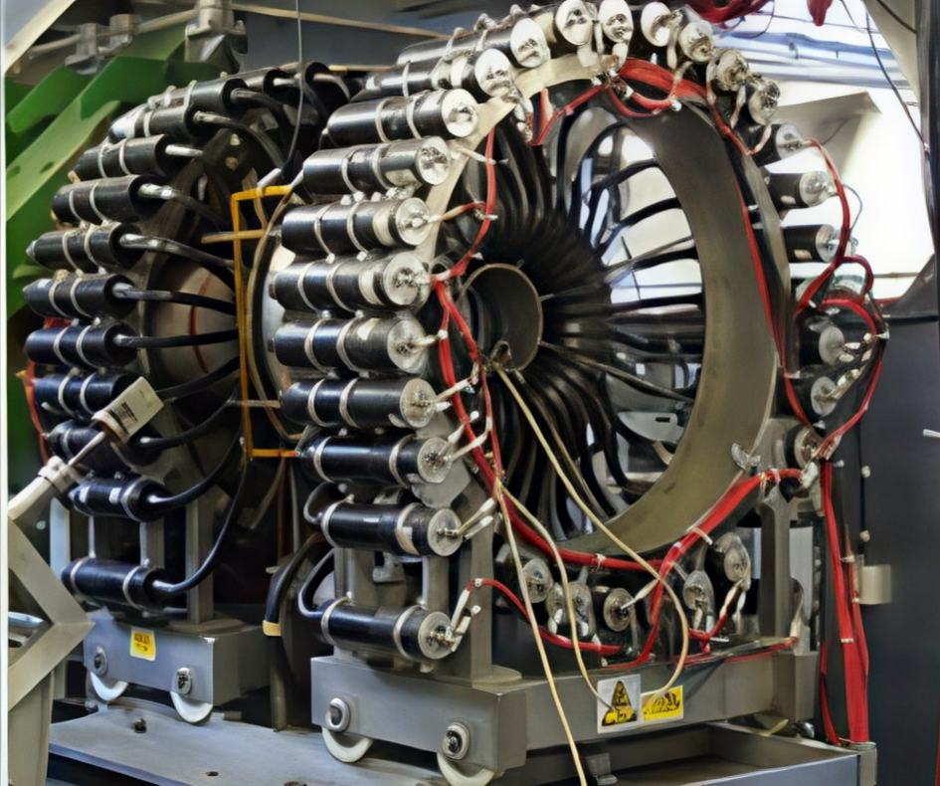
MuSR at ISIS Today
Detectors | 64
Solid angle coverage | 40%
Count rate (MEv/h) | 70
Maximum frequency (field) | 8MHz (0.06T)
Spin rotation | None
Smallest sample (mm) | ~10×10 on Ag
~ 50ns
µ⁺
Muon pulse width (ns) | ~ 50
Muon rate at sample point | ~ 10⁵ μ⁺s⁻¹
% beam used | ~ 10% (!)

Slide 6
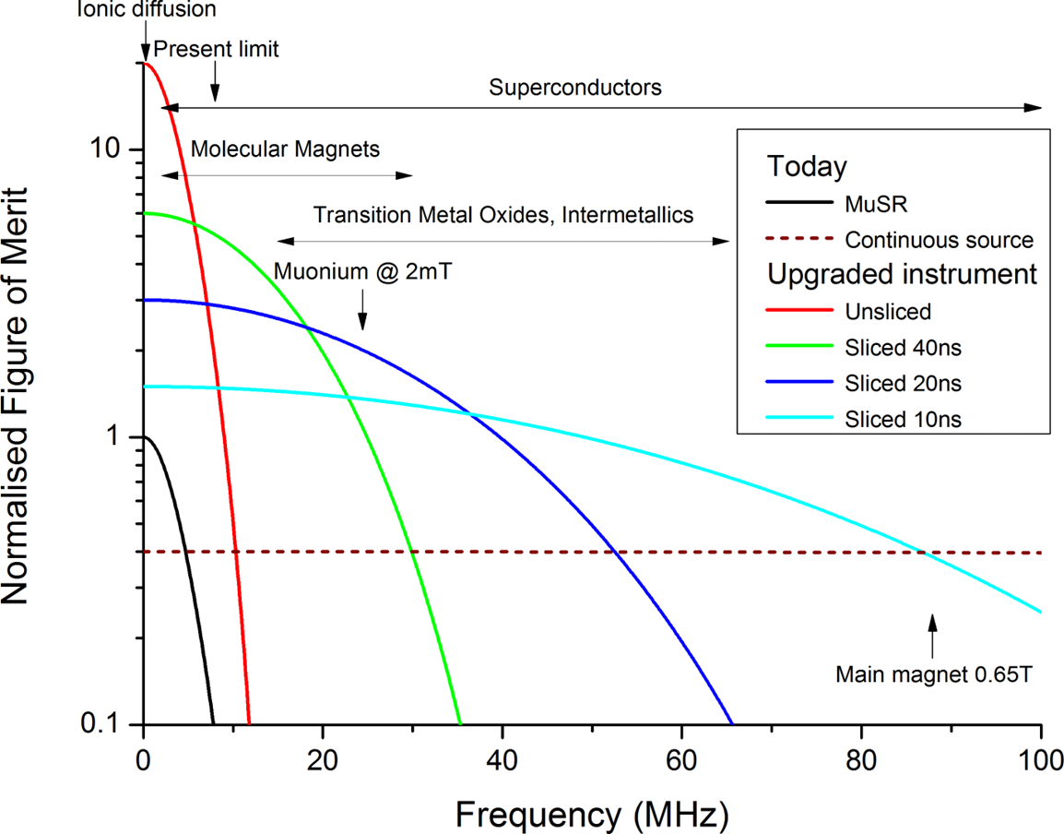
MuSR's current performance
Increase detector coverage and segmentation
Decrease muon pulse width

Slide 7
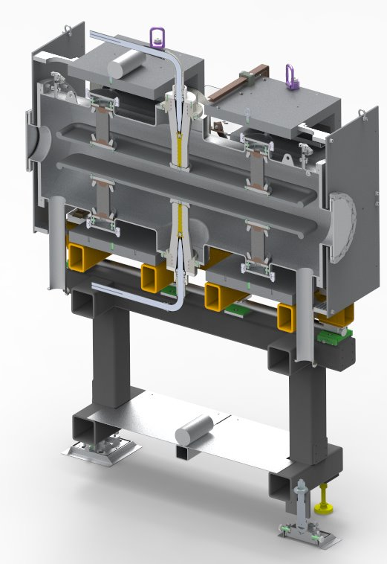
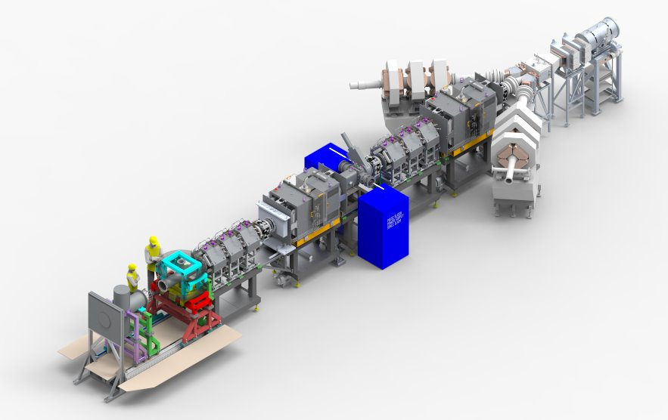
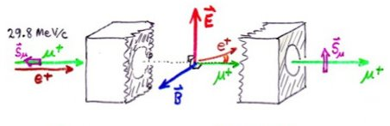
Super-MuSR upgrade
Two spin rotators with up to 75° spin rotation

Slide 8
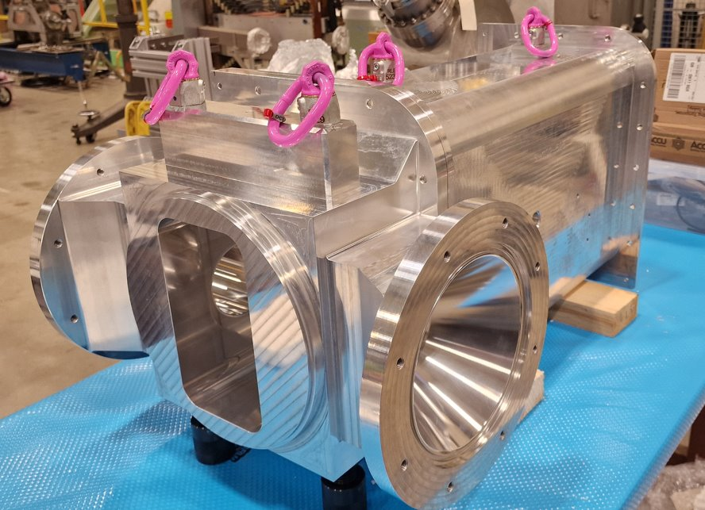
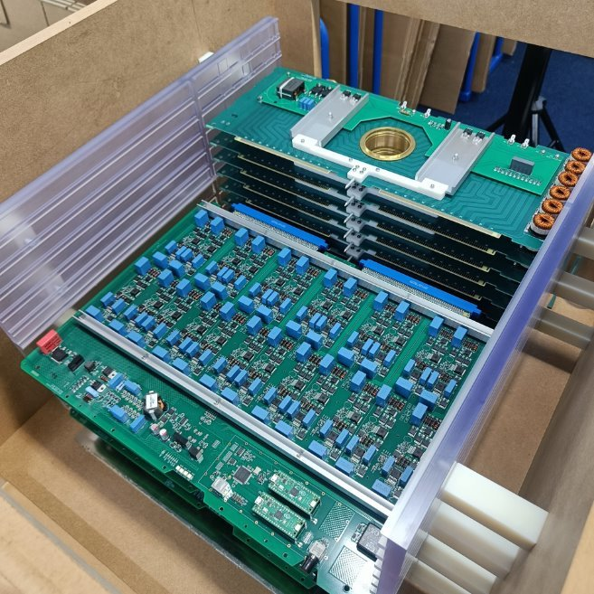
Super-MuSR upgrade
"Pulse slicer" to provide variable 10-50ns muon bunches

Slide 9
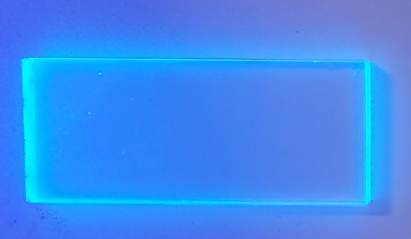
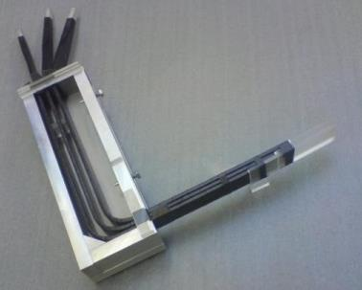
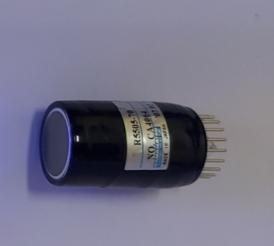
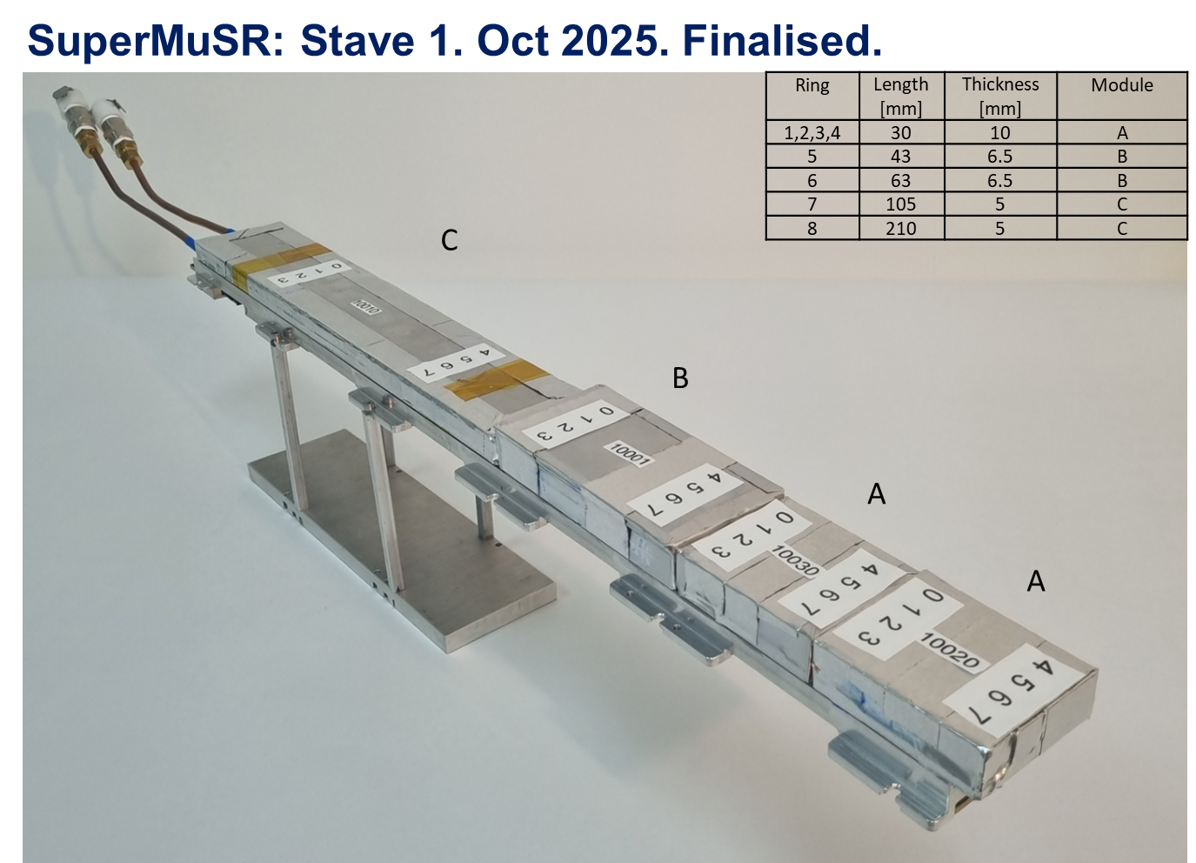
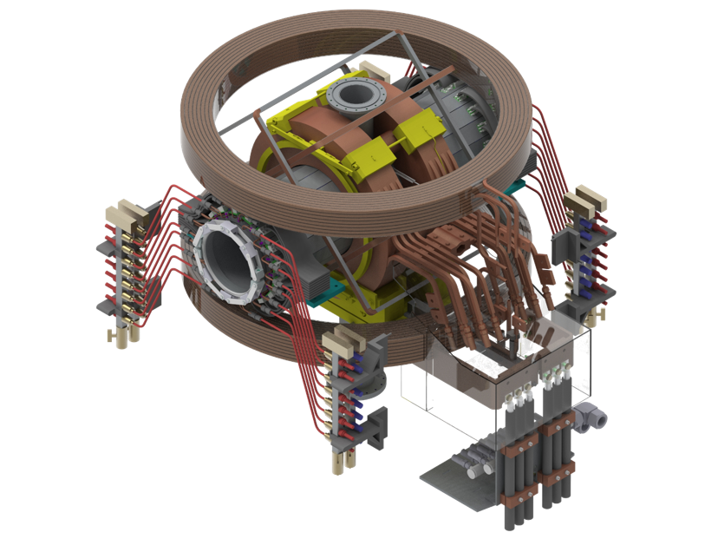
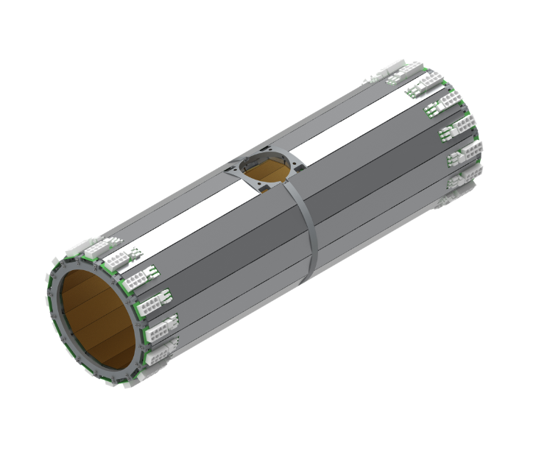
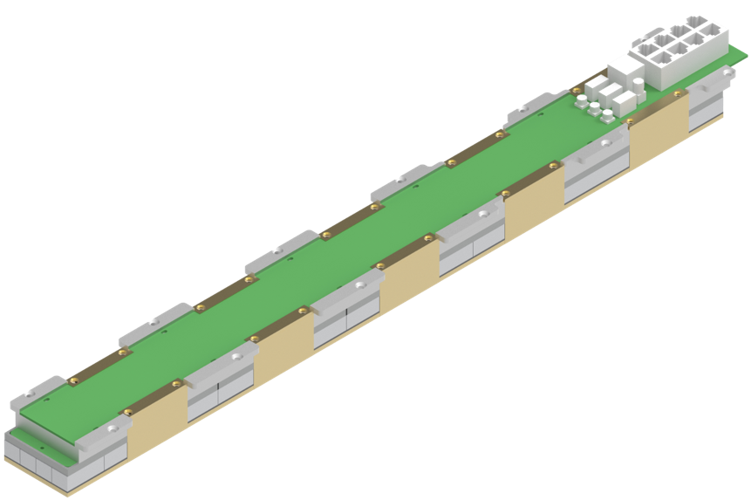
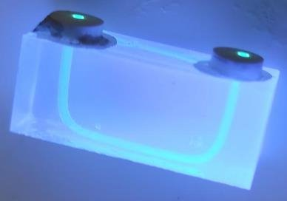
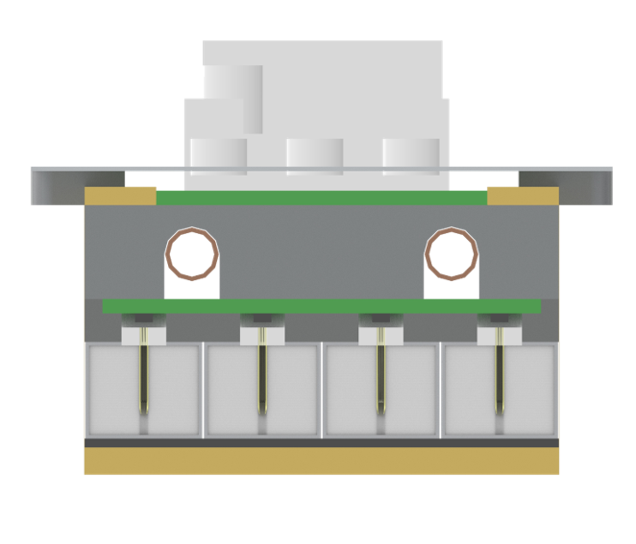
FROM:
plastic scintillator
+ clear long light-guide
+ PMT
Super-MuSR upgrade
TO:
New spectrometer and detector design
960 tiles
Barrel fits inside the magnet.
3. 1 barrel
2. 32 staves

Slide 10




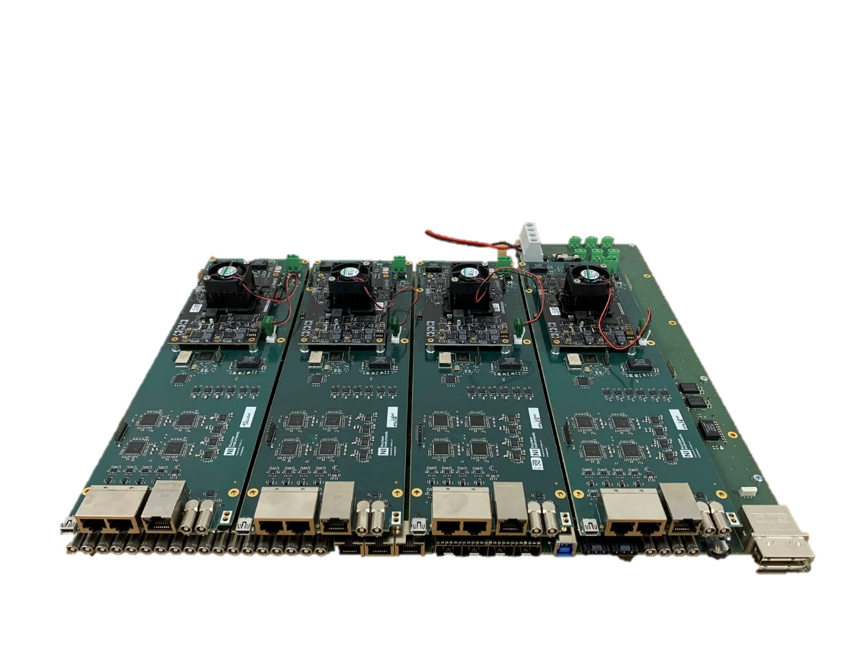
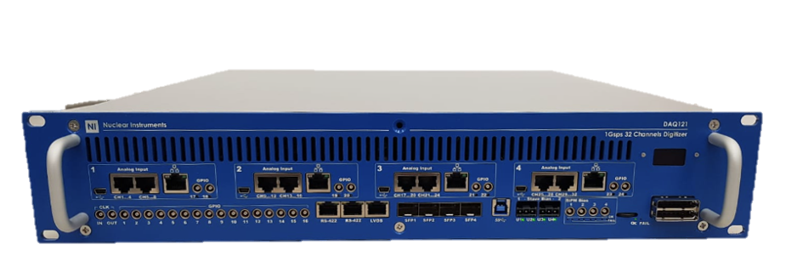
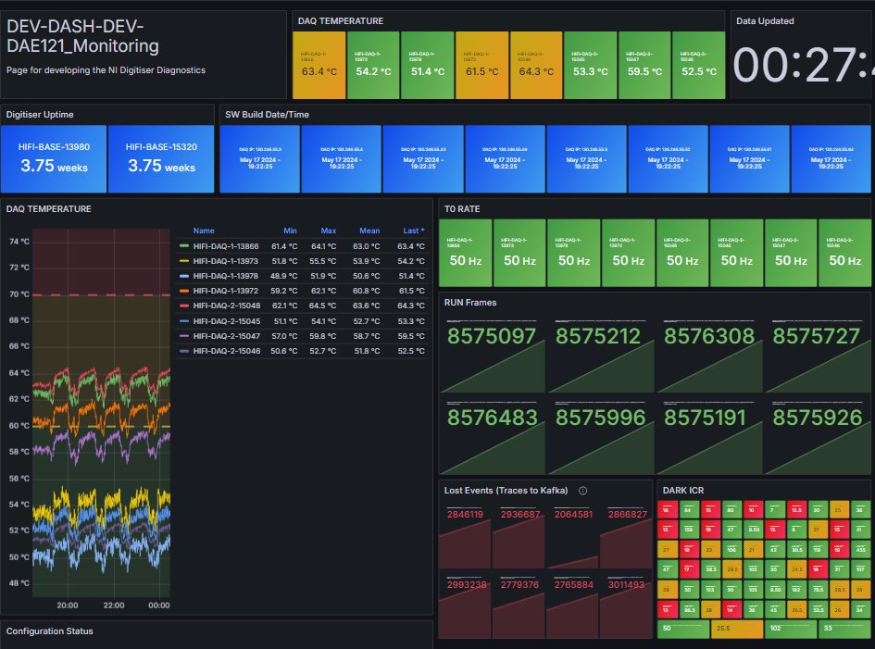
Super-MuSR upgrade
DAQ121 is a 1 G·S·s⁻¹ 12-bit Streaming Digitiser
A bespoke development for Muon Spectrometers at ISIS
Controlled from IBEX
ISIS Status
Packet (Date-Time)
Digitising DAE and event mode data collection
Live Grafana Monitoring

Slide 11
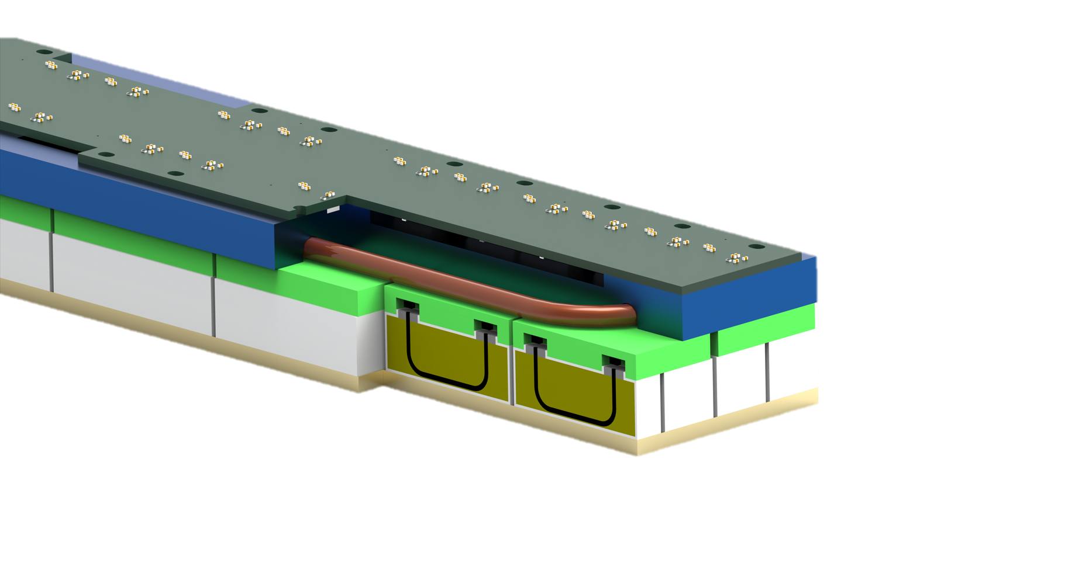

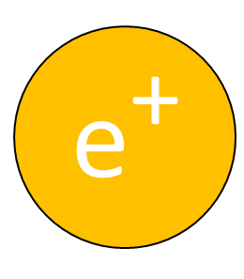
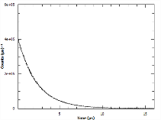

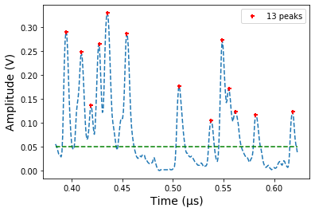


Digital muon data pipeline
From detector traces to analysable instrument data files.
Signals streamed to a broker
Positrons detected
NI DAQ 121
analyse as today!
Event filtering to histograms
Event formation
Event formation can be as simple as peak finding or implement more advanced digital signal processing. Event filtering allows selection of events that are important for analysis.

Slide 12
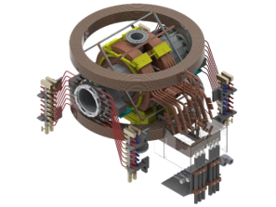
From MuSR to Super-MuSR
 | MuSR | Super-MuSR
Detectors | 64 | 960
Solid angle coverage (of sphere) | 40% | 80%
Count rate (MEv/h) | 70 | ~1400
Maximum frequency (field) | 8MHz (0.06T) | ~80MHz (0.6T)
Spin rotation | None | 0 to 75°
Smallest sample (mm) | ~10×10 on Ag | ~2×2 in flypast

Slide 13
Super-MUSR's expected performance
960 ch
~ 80% coverage
64 ch
~ 40% coverage
Pulse slicing

Slide 14
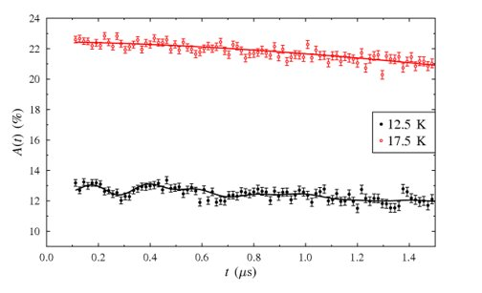
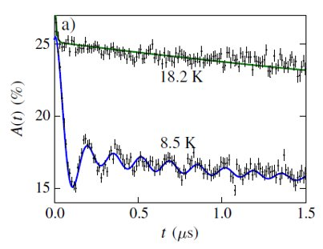
Science benefits – higher resolution
Ordered moments e.g. Na₂IrO₃
ISIS data
PSI data
e.g. S.K. Choi et. al. Phys. Rev. Lett. 108, 127204 (2012)

Slide 15
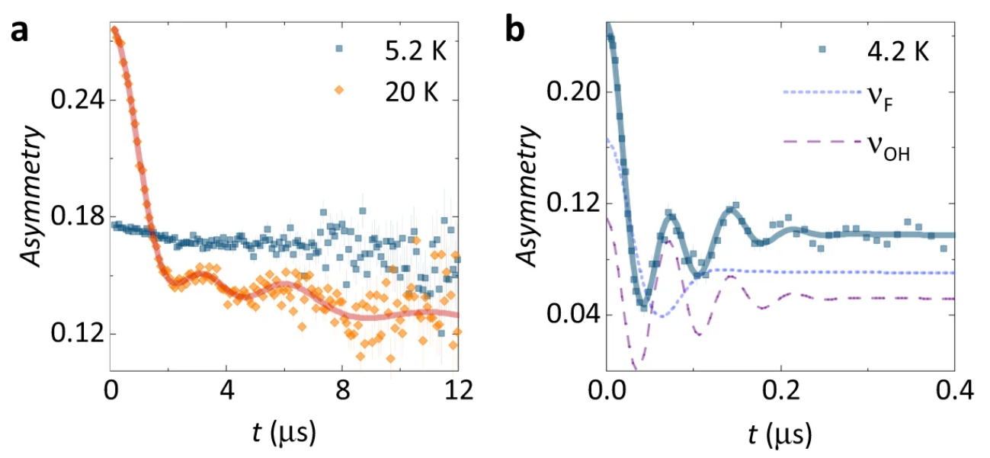
Science benefits – higher resolution
Materials with fast and slow relaxations e.g. Zn Barlowite
ISIS data
PSI data
e.g. K. Tustain et. al. npj Quantum Materials 5: 74 (2020)

Slide 16
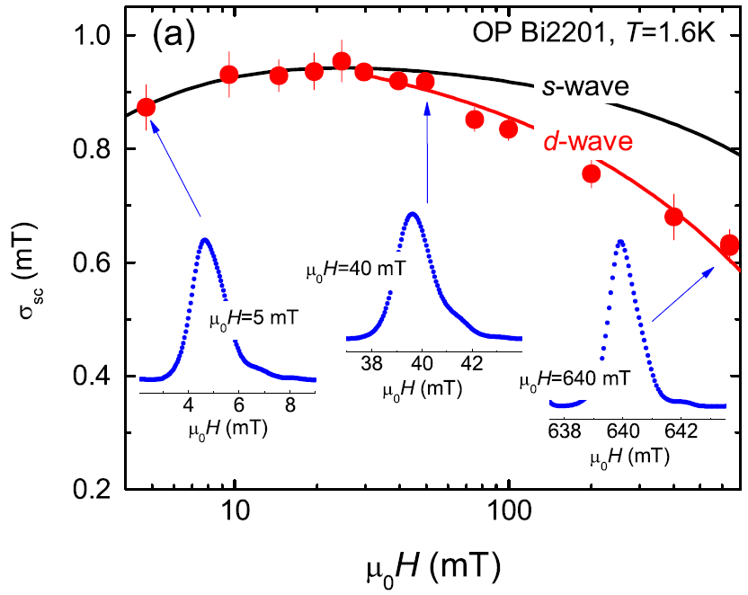
Which curve
fits best?
Science benefits – higher resolution
Transverse field measurements on superconductors
Sometimes clearer distinction between different gap models at higher fields
Spin rotators -> anisotropic effects can be probed
Better resolution to probe coexistence of magnetism and superconductivity.
...

Slide 17
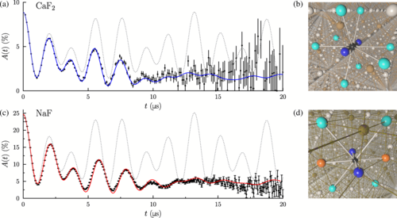
Science benefits – higher rates
Measurements on quantum decoherence e.g. F - μ - F states
J. M Wilkinson et. al., Phys. Rev. Lett. 125, 087201 (2020)

Slide 18
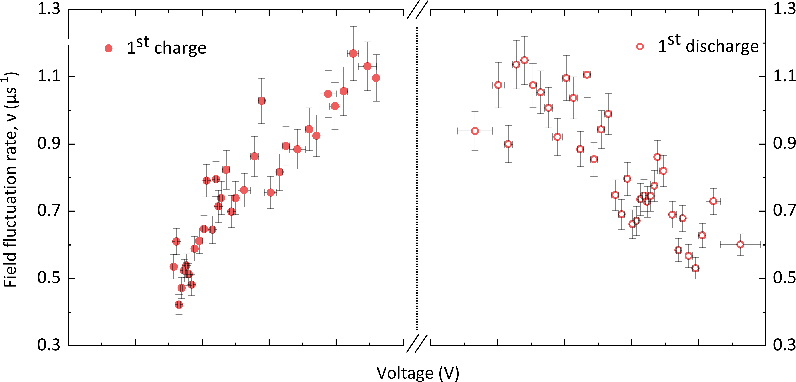
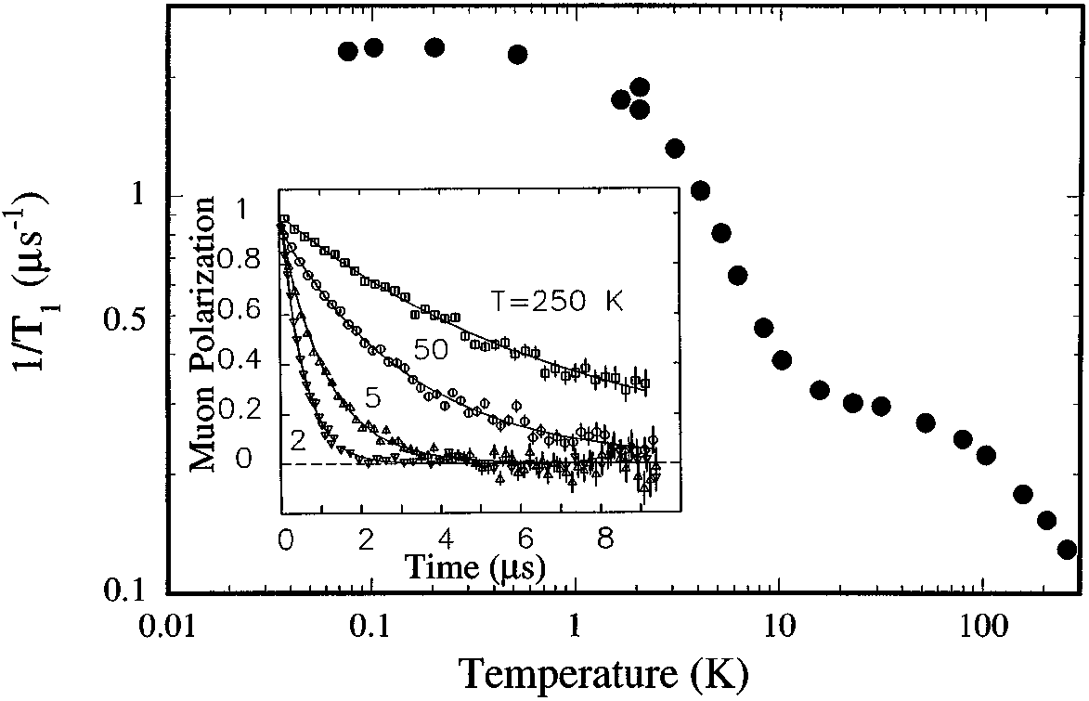
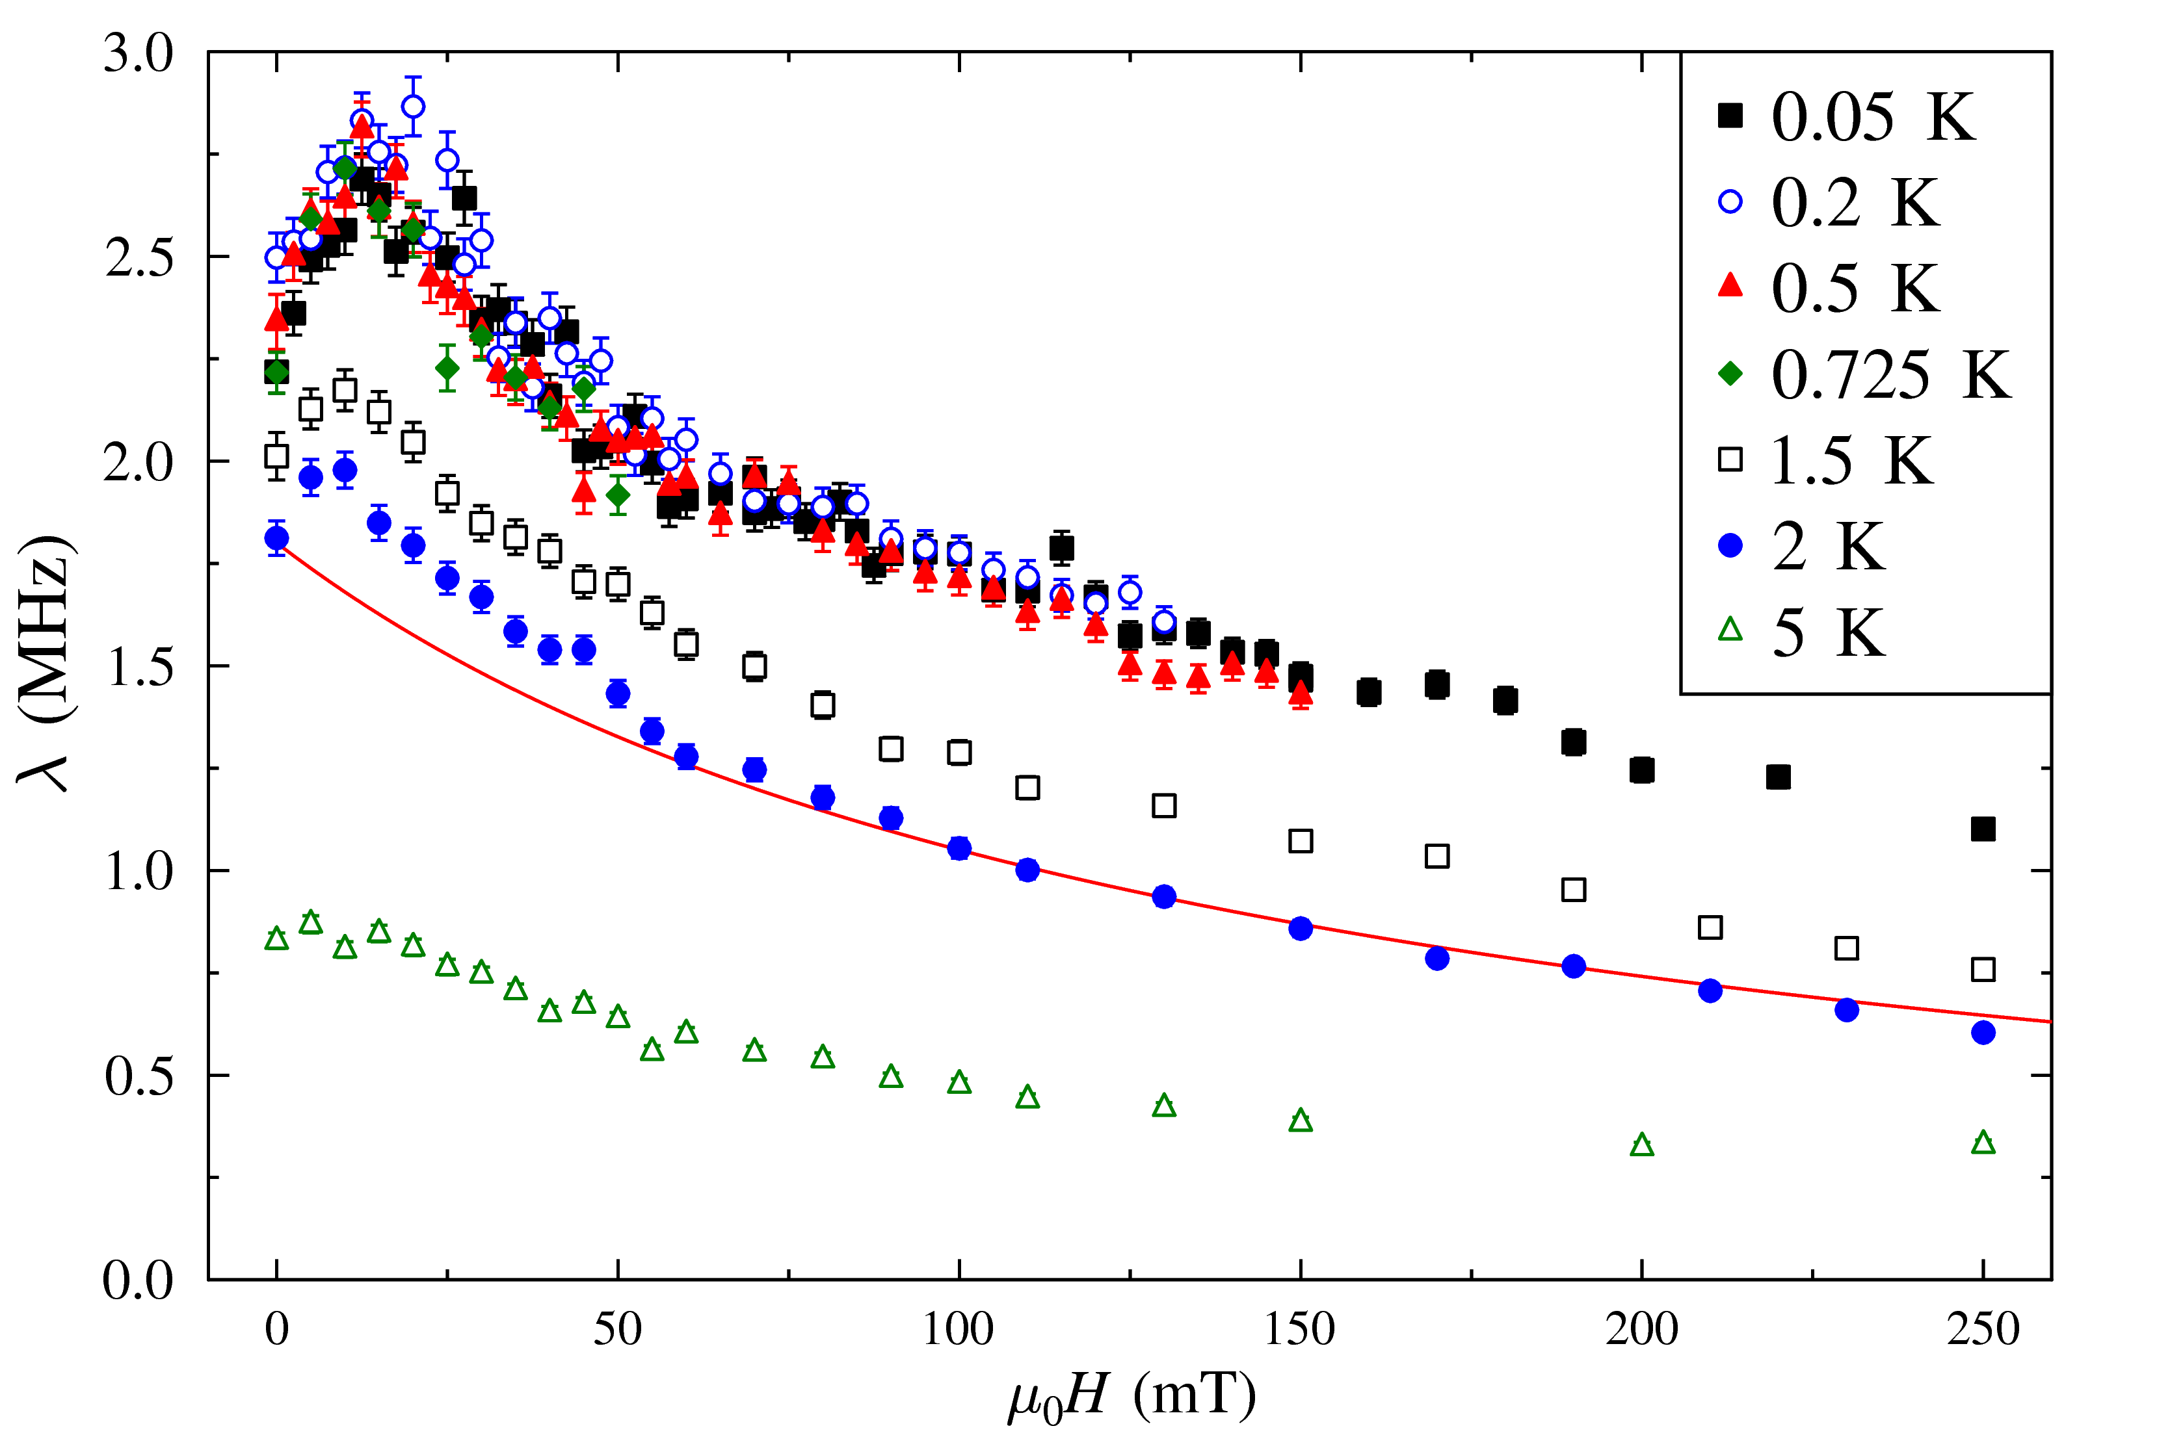
Science benefits – higher rates
Transient muon spectroscopy measurements
Battery cycling
Temperature scans
Field scans
2 days EMU - > 10h Super-MuSR
1 day MuSR -> 4h Super-MuSR
3 days MuSR - > 12h Super-MuSR

Slide 19
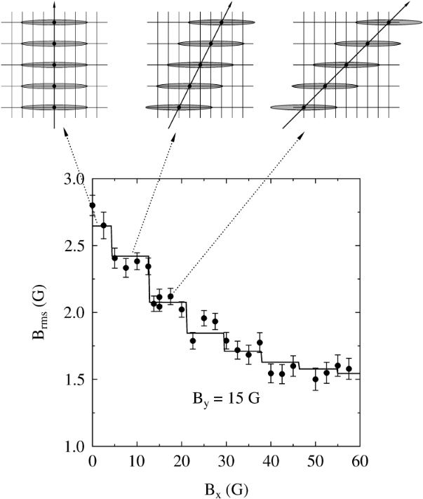
Science benefits –
Vector MuSR
Aligned crystalline samples
  Superconductors
  Ordered magnets
With or without spin rotator
  Apply B-fields on two axes
  Find direction of internal fields
Underexplored area to date

Slide 20
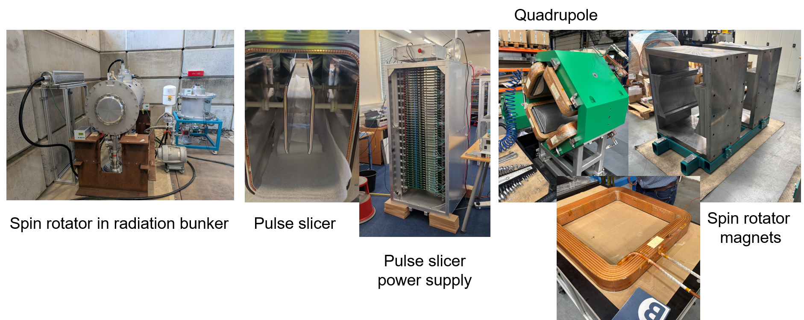
Technical progress – beamline components
First spin rotator demonstrated to reach 192kV operating voltage.
Pulse slicer power supply soon to be delivered. Expected to exceed desired performance.
Beamline magnets undergoing testing.

Slide 21
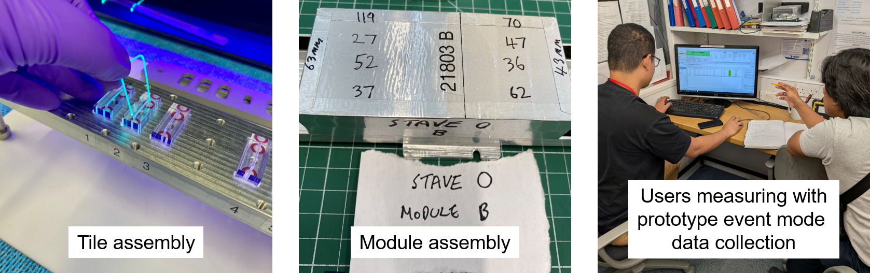
Technical progress – spectrometer
100% of detector tiles glued, with more than 50% fully wrapped and assembled.
Completed tiles being assembled into modules and staves.
Prototype event mode data pipeline running on HIFI and MuSR.

Slide 22
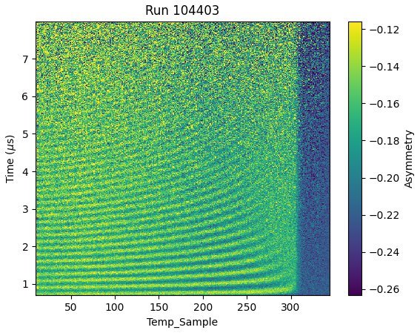
Technical progress - event mode data
transient muon spectroscopy measurements on LaCuO​
Analysis courtesy of James Lord, ISIS muon group

Slide 23
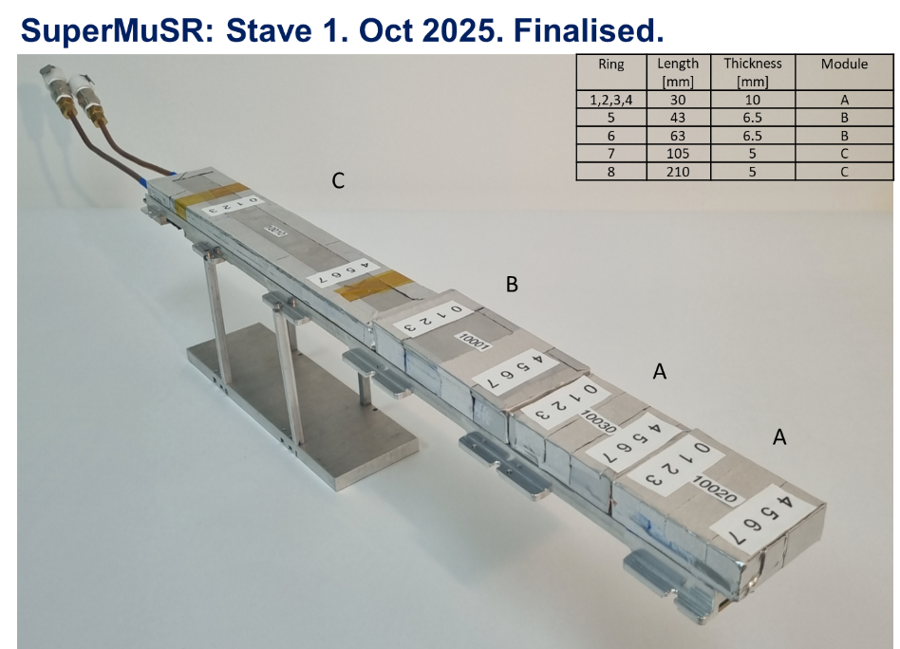

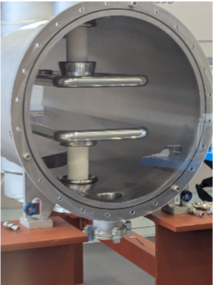
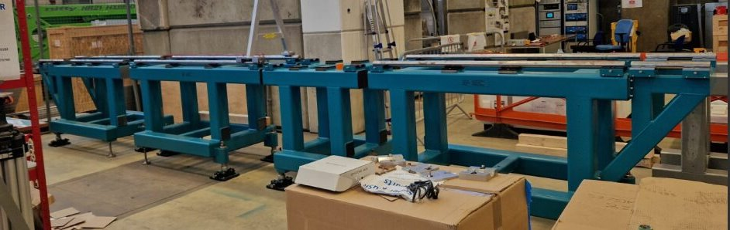
Summary & expected timeline
MuSR operation ends
and strip out
Commissioning and friendly users
User operation
Super-MuSR pre-build
Super-MuSR install
Dec 2026
… Now
Nov 2027
Mar 2028 ...
Super-MuSR will significantly extend the capabilities of pulsed muon sources:
  20 x counting rate of instruments today OR
  10 x frequency range with existing rate
higher data rates mean existing experiments will be better performed and new experiments will be feasible.

Slide 24
Additional slides

Slide 25
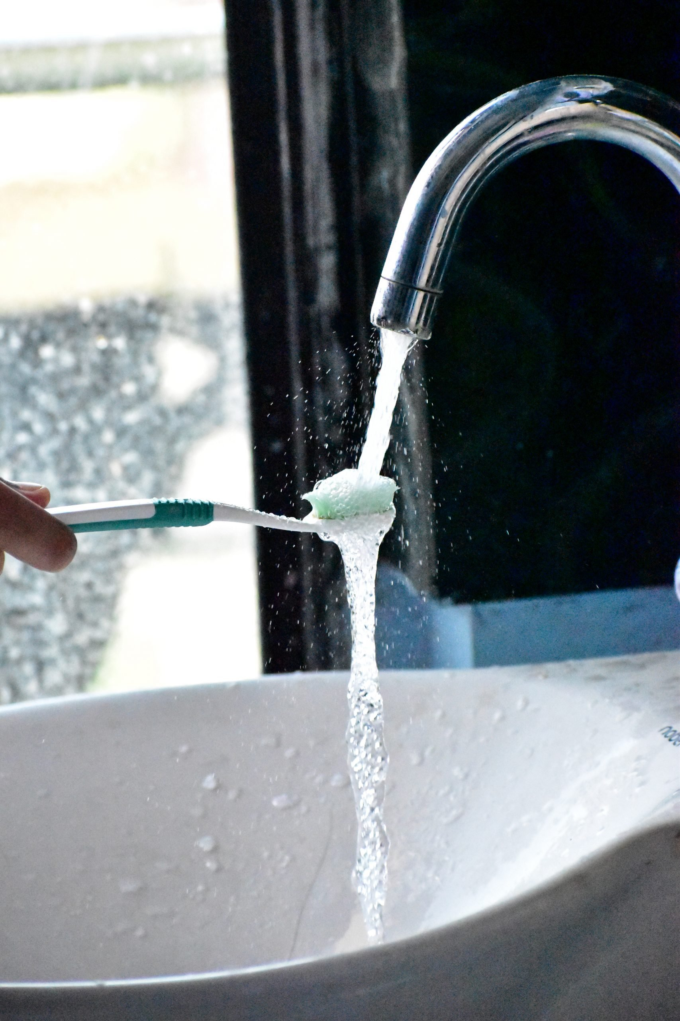
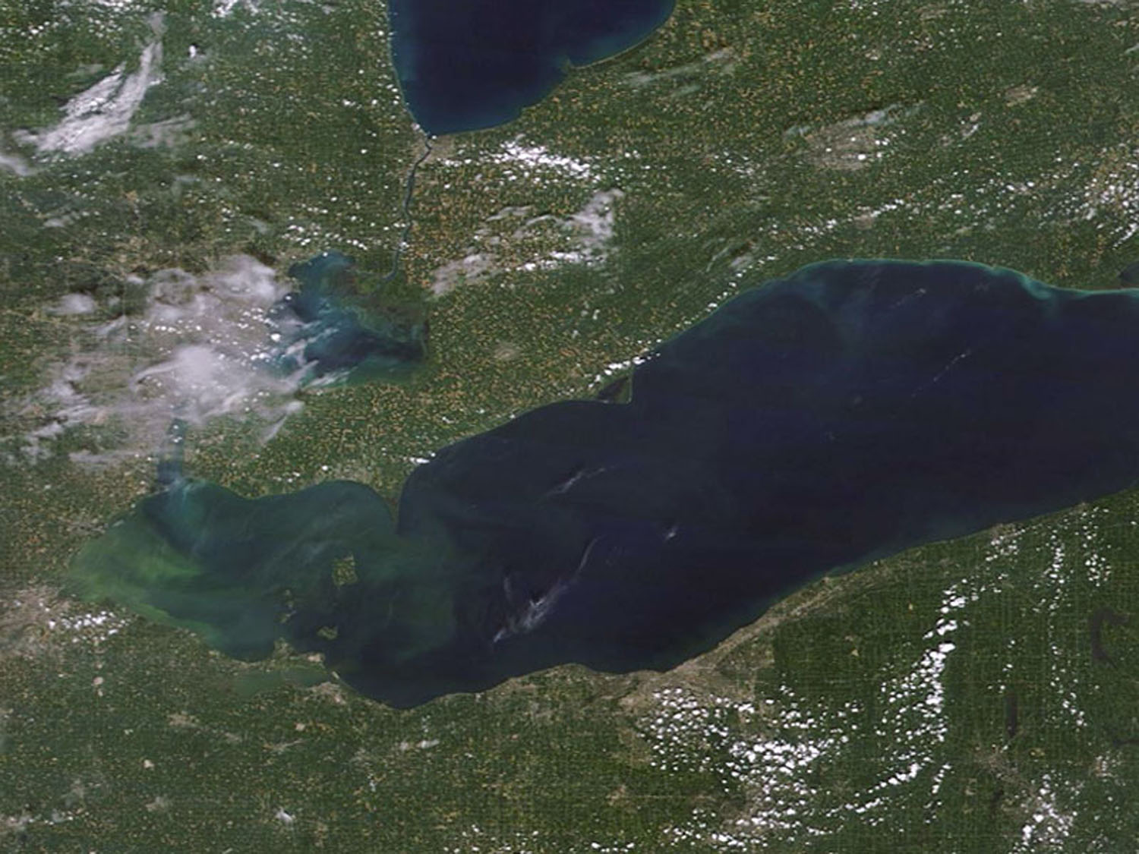

Data handling and reduction
Today’s data files: ~30MB per day
Temporary
Retained for analysis
Lake
Erie
Digitiser traces: ~100TB per day
Event mode data: ~100GB per day
Histograms: ~1GB per day
These data rates are upper bounds needed for planning –
the pulse slicer will reduce these when it is switched on

