Slide 1


Superconductivity with broken time-reversal symmetry in Sr₂RuO₄: pros and cons
Vadim Grinenko
Tsung-Dao Lee Institute, Shanghai Jiao Tong University, Shanghai
The 3rd Workshop on Muon Science Technology and Industry
MELODY2026
24 October 2026

Slide 2


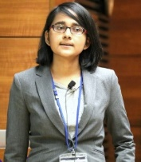
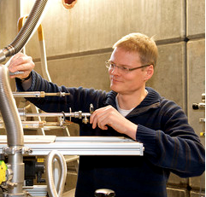


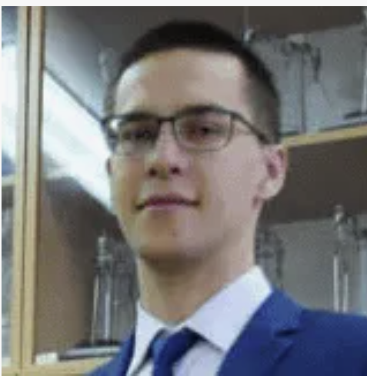


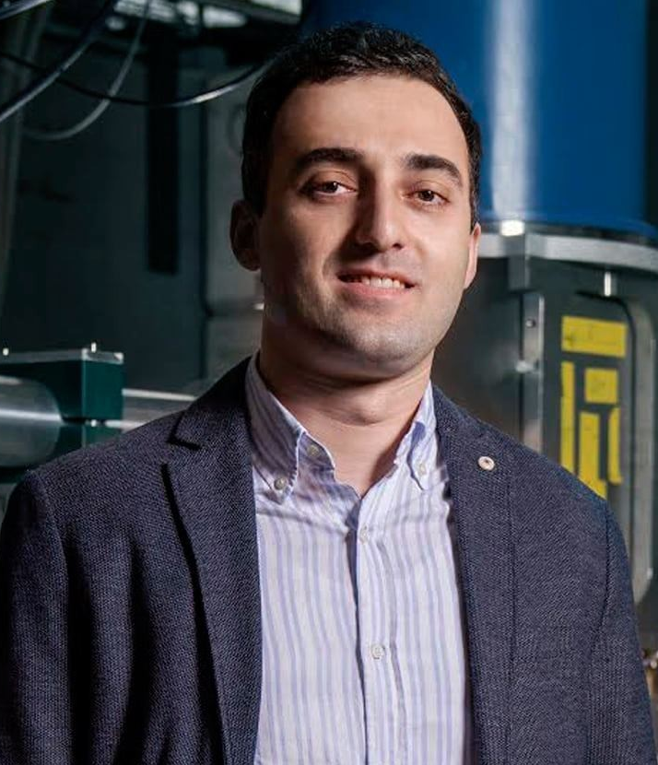



μSR investigations of Sr₂RuO₄ (main collaborators)
Experiment
Theory
Clifford
W. Hicks
University of
Birmingham
Shreenanda
Ghosh
The Johns Hopkins University
Hubertus Luetkens
PSI Villegen
Hans-Henning
Klauss
TU Dresden
Rajib Sarkar
TU Dresden
Manfred Sigrist
ETH Zurich
Anton Talkachov, KTH, Shtokholm
Julien Garaud
Institut Denis
Poisson CNRS-UMR
Rustem Khasanov
PSI Villegen
Zurab Guguchia
PSI Villegen
Yoshiteru Maeno
Kyoto University
Naoki Kikugawa
NIMS
Yongwei Li
TDLI, Shangahi

Slide 3
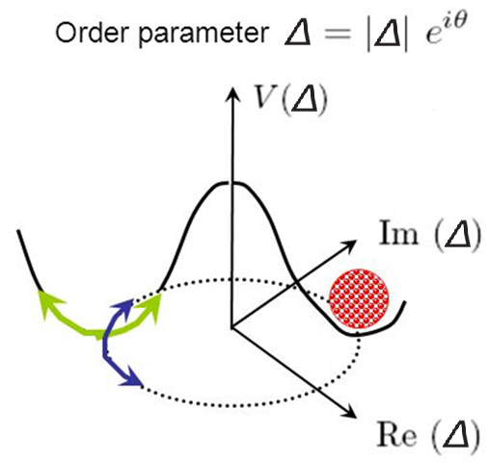
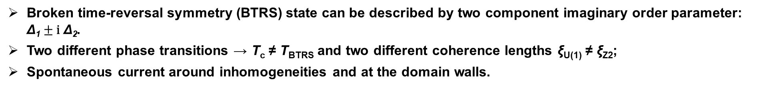
Superconductors with broken time-reversal symmetry
T
At T_{c} broken U(1)
T(Z₂) – time reversal symmetry: Δ Δ* ≠ | Δ_{α}|e^{iθ}
and
V (Δ)
?
?
https://slideplayer.com/slide/5363094/
The fundamental symmetry which spontaneously violates by any superconducting state.
Δ*
0
Δ
Two energetically equivalent states with Δ ≠ Δ*
meaning spontaneously broken Z₂ symmetry.
L.P. Gor’kov, Sov. Sci. Rev. A Phys. 9 (1987) 1;
M. Sigrist and K. Ueda, Rev. Mod. Phys. 63 (1991) 239.
Broken time-reversal symmetry (BTRS) state can be described by two component imaginary order parameter: $\text{Δ}\text{1}±\text{i} \text{Δ}\text{2}$.
Two different phase transitions → T_{c} ≠ T_{BTRS} and two different coherence lengths ξ_{U(1)} ≠ ξ_{Z2};
Spontaneous current around inhomogeneities and at the domain walls.
Notes:
According to modern theories, the possible ground states that are realized in nature are constrained by the symmetry of the physical system.
This, for example, explains appearance of charge-2e superconductivity: a condensate of electron pairs.
In this case, the number of components of the order parameter equals the number of broken symmetries.
We propose that, in some complex systems, the ground state is defined by the free-energy landscape but not by the symmetry of the system.
This, in particular, may result in new states of matter, including Chiral Quadrupling order with broken time-reversal symmetry and Charge-4e superconductivity.
In these states, the number of components of the order parameter can exceed the number of broken symmetries.

Slide 4
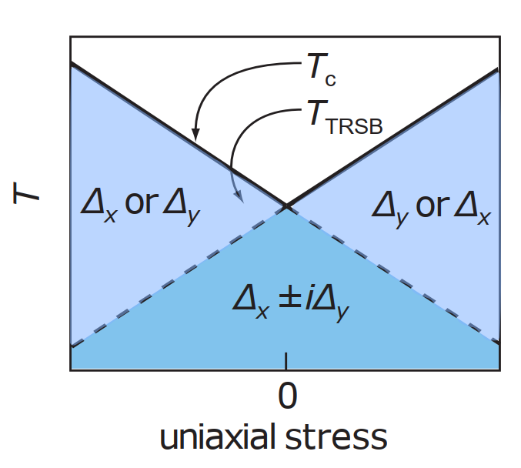
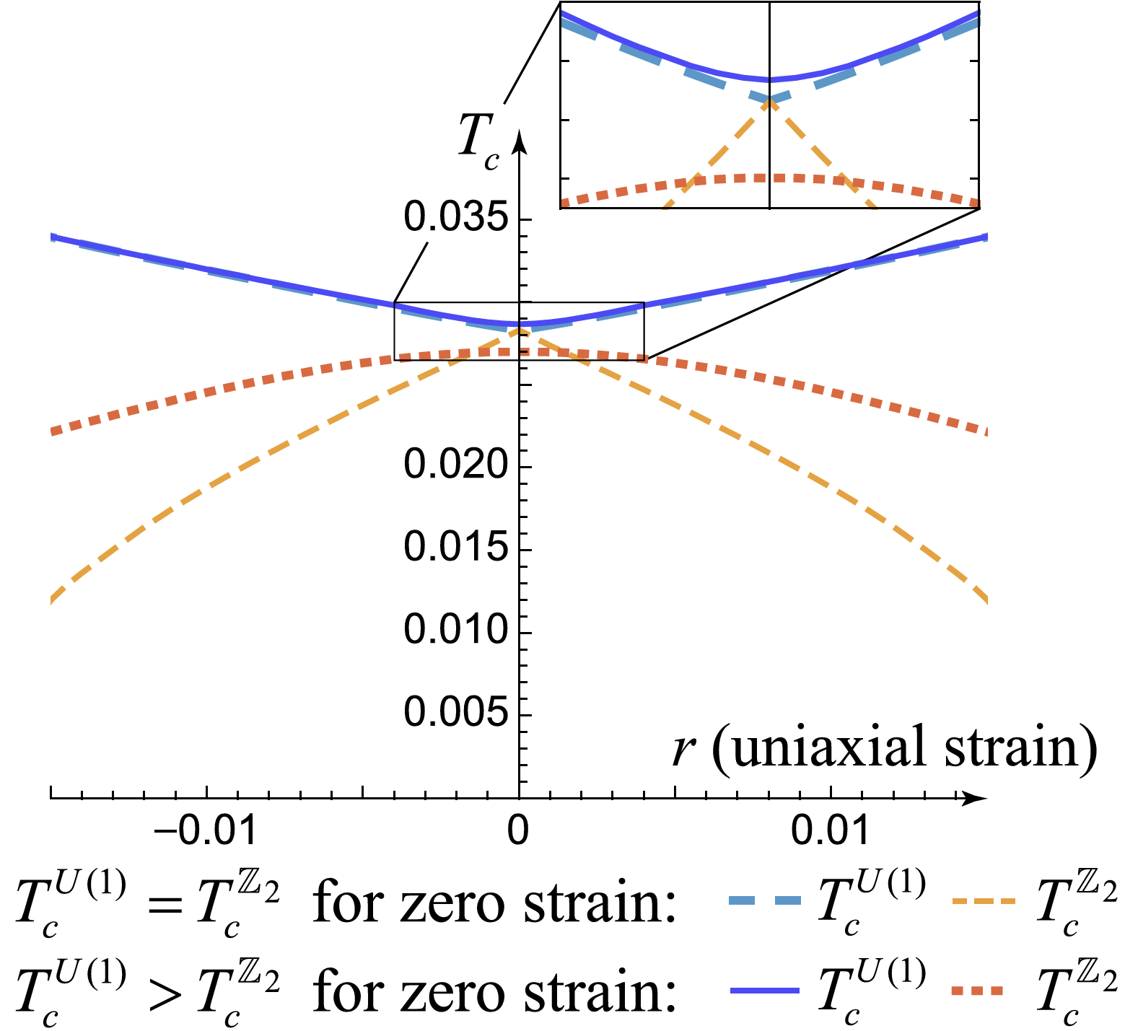
Superconductors that break time-reversal symmetry (BTRS)
Two-component order parameter |Δ₁₍₂₎|e^{iφ1(2)} with double degenerate states:
{|Δ₁|, |Δ₂|, φ₁ – φ₂ = θ₁₂} → {|Δ₁|, |Δ₂|, φ₁ – φ₂ = -θ₁₂}
Degenerate order parameter
Non-degenerate or accidentally degenerate order parameter
Intrinsically |Δ₁| = |Δ₂|, θ₁₂ = ±π/2 T_{c} = T_{BTRS}
Examples: p_{x} ± ip_{y}, d_{xz} ± id_{yz}, …
|Δ₁| ≠ |Δ₂|, θ₁₂ ≠ 0,π fine tuning for T_{c} = T_{BTRS}
Examples: s ± is’, s ± id, d ± ig, …
_{BTRS}
Δ₁ or Δ₂
Δ₁ or Δ₂
Δ₁ ± iΔ₂
Δ₁ ± iΔ₂
Symmetry-breaking perturbations of the crystal lattice lift the degeneracy.
The degeneracy is lifted by any perturbation.
V. Grinenko, S. Ghosh et al. Nat. Phys. 17, 748–754 (2021).
A. Talkachov and E. Babaev Phys. Rev. B 113, 144515 (2026).

Slide 5
What are experimental signatures of BTRS superconductivity?
Generation of spontaneous magnetic fields at domain walls, sample surfaces and around nonmagnetic inhomogeneities.
Experiments: µSR, Polar Kerr effect, non-reciprocal effects in transport.
Thermodynamic signature of two phase transitions.
Experiments: Specific heat, ultrasound and etc.
Multicomponent superconducting order parameter.
Experiments: several superconducting gaps in STM, ARPES, quantum vortex fractionalization, superconducting domain walls.
Are there examples of multicomponent superconductors?

Slide 6
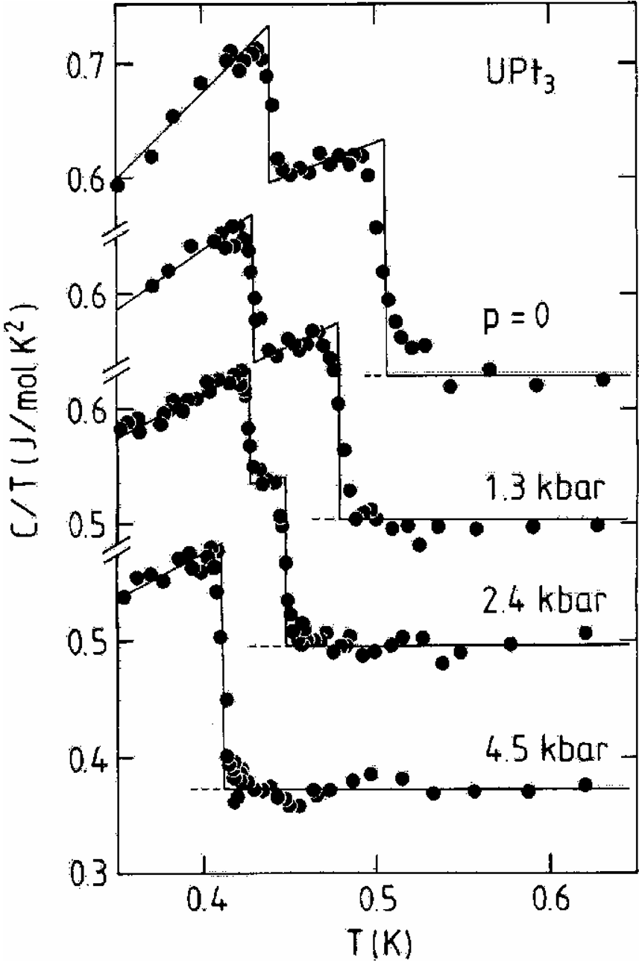
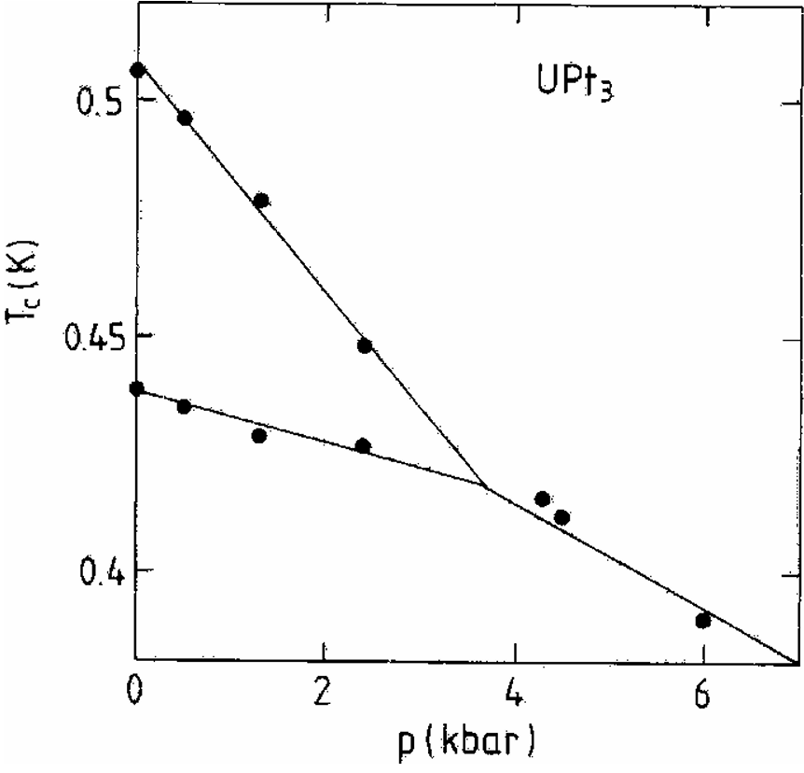
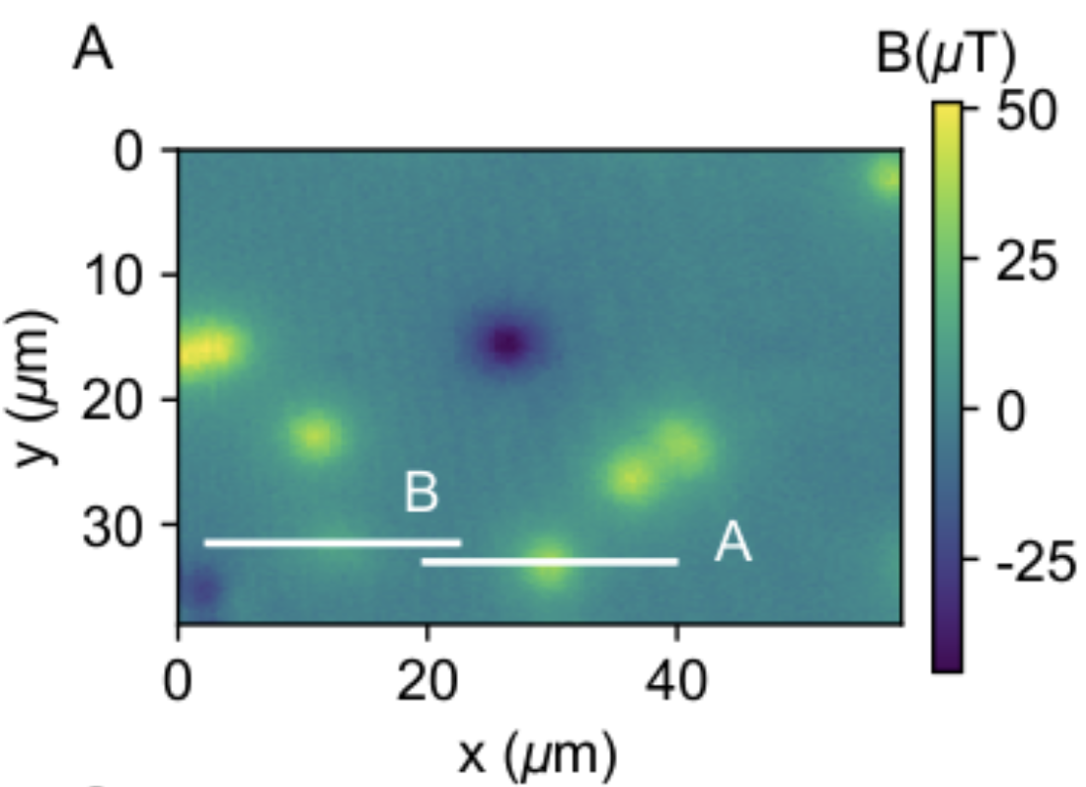
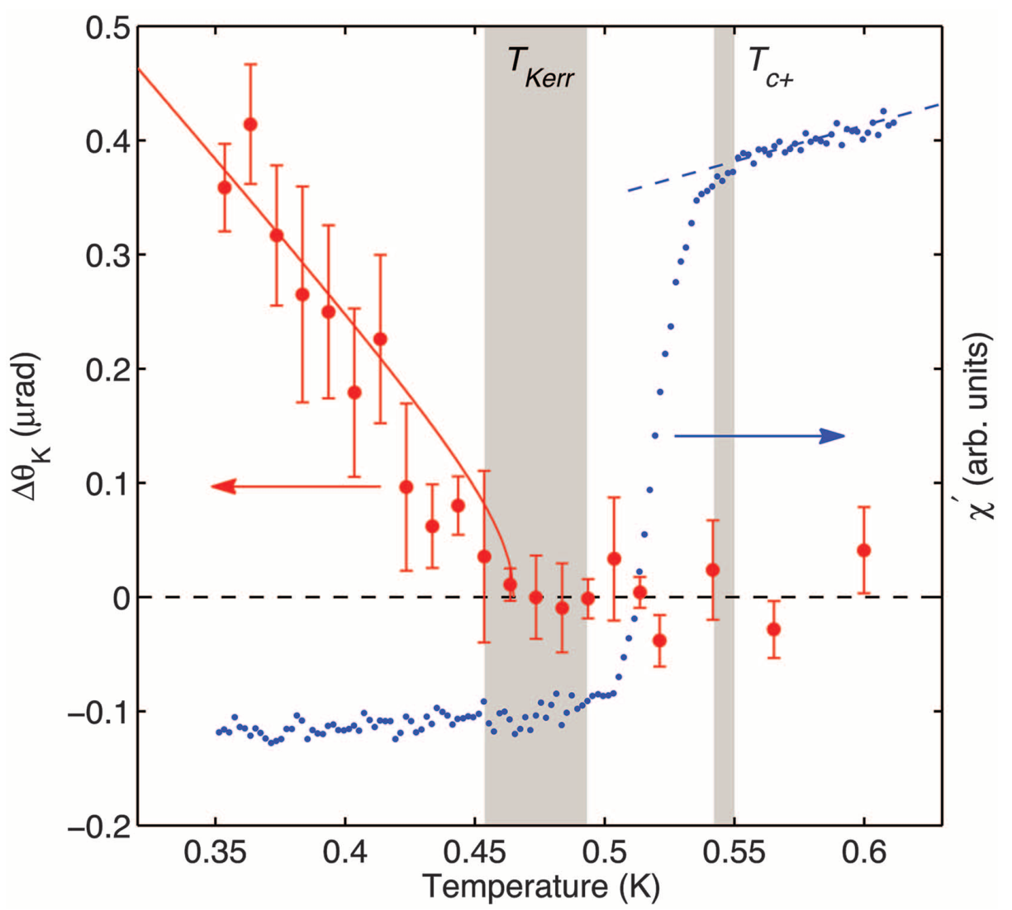
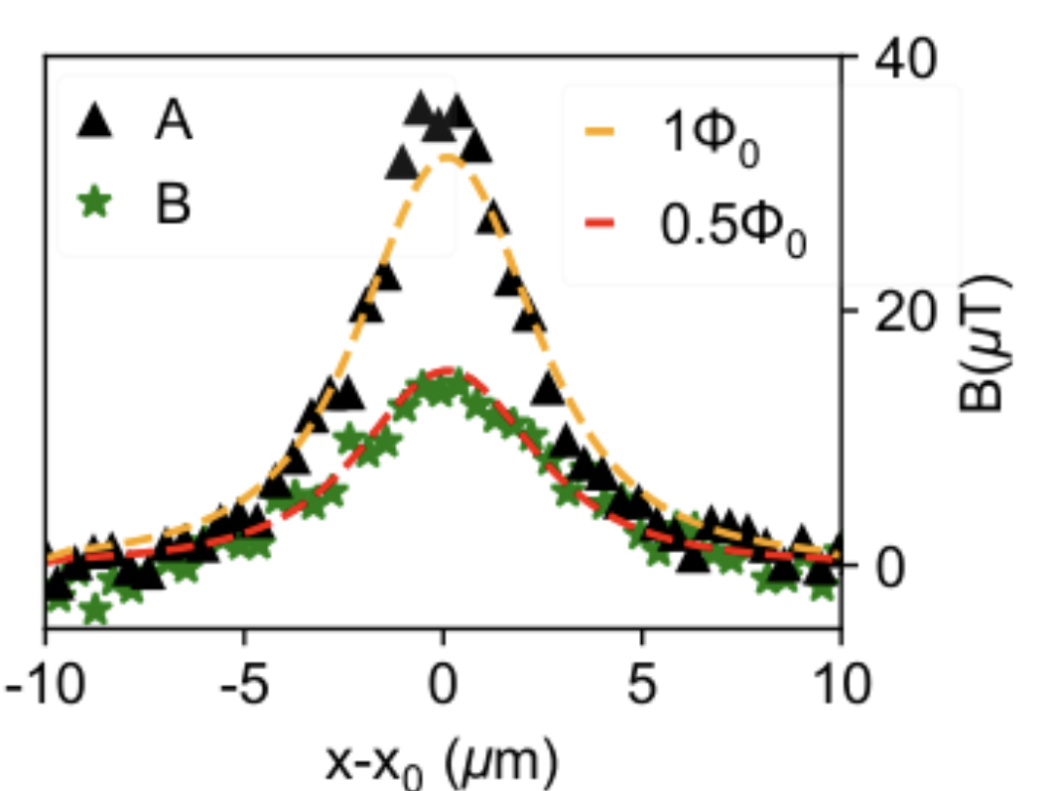
UPt₃ is a strong candidate for chiral superconductivity
Time-Reversal symmetry breaking
Two anomalies in the specific heat
Half-quantum vortices in the bulk
Kerr effect below T_{c}
E. R. Schemm et al. Science345,190-193(2014).
T. H. Trappmann et al, Phys. Rev. B 43, 13714 (1991).
P. García-Campos et al., arXiv:2512.03908

Slide 7
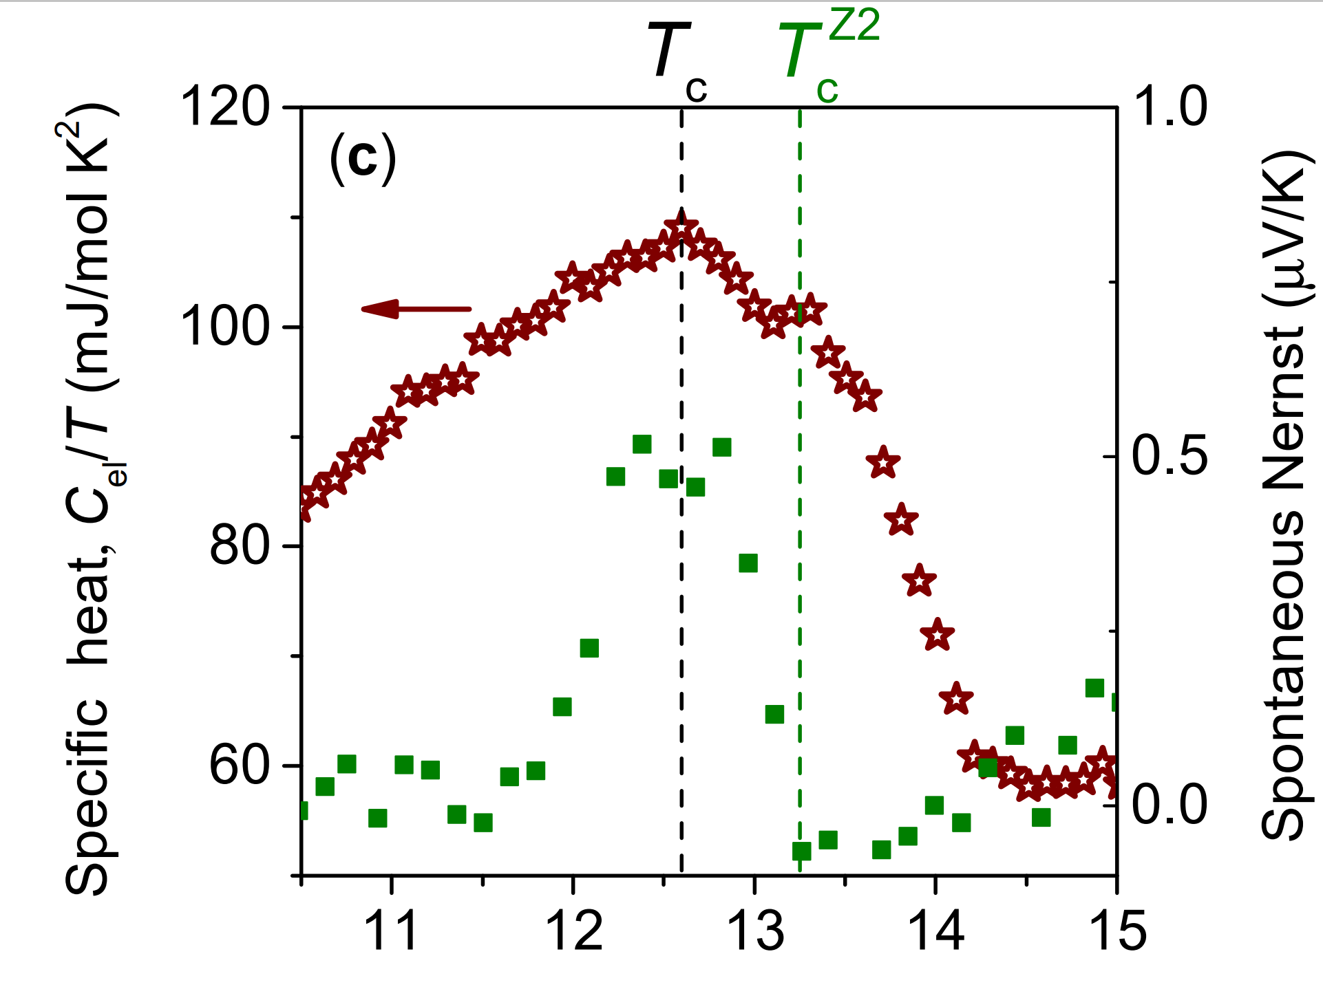
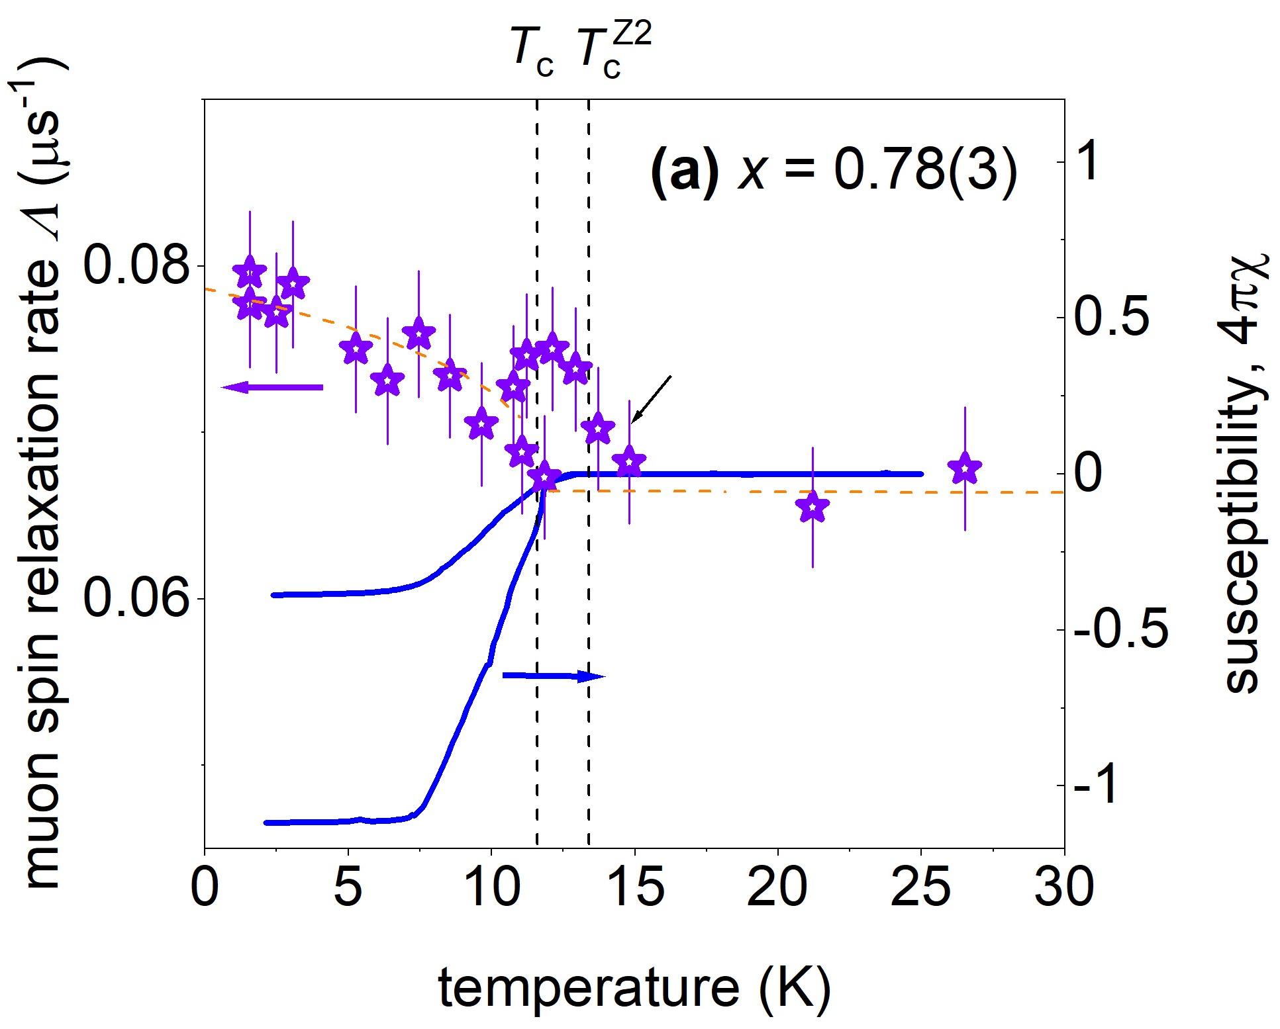
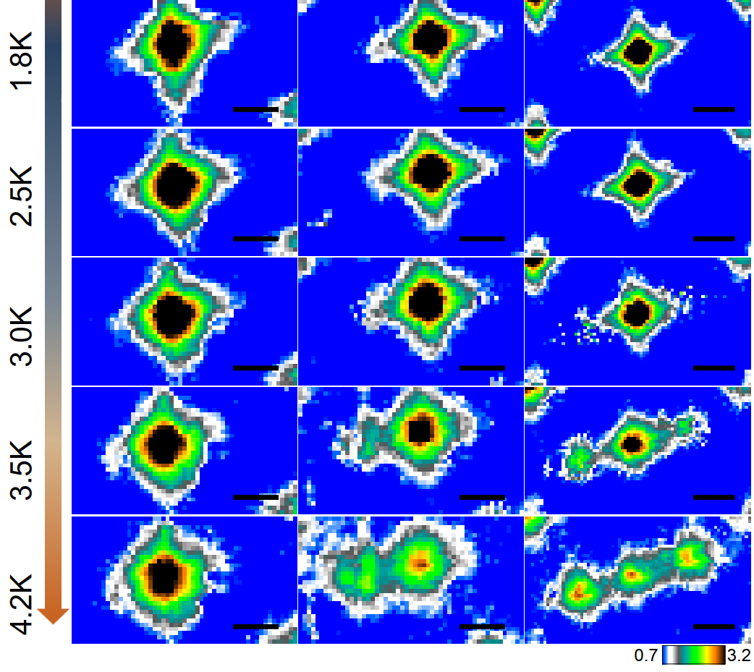
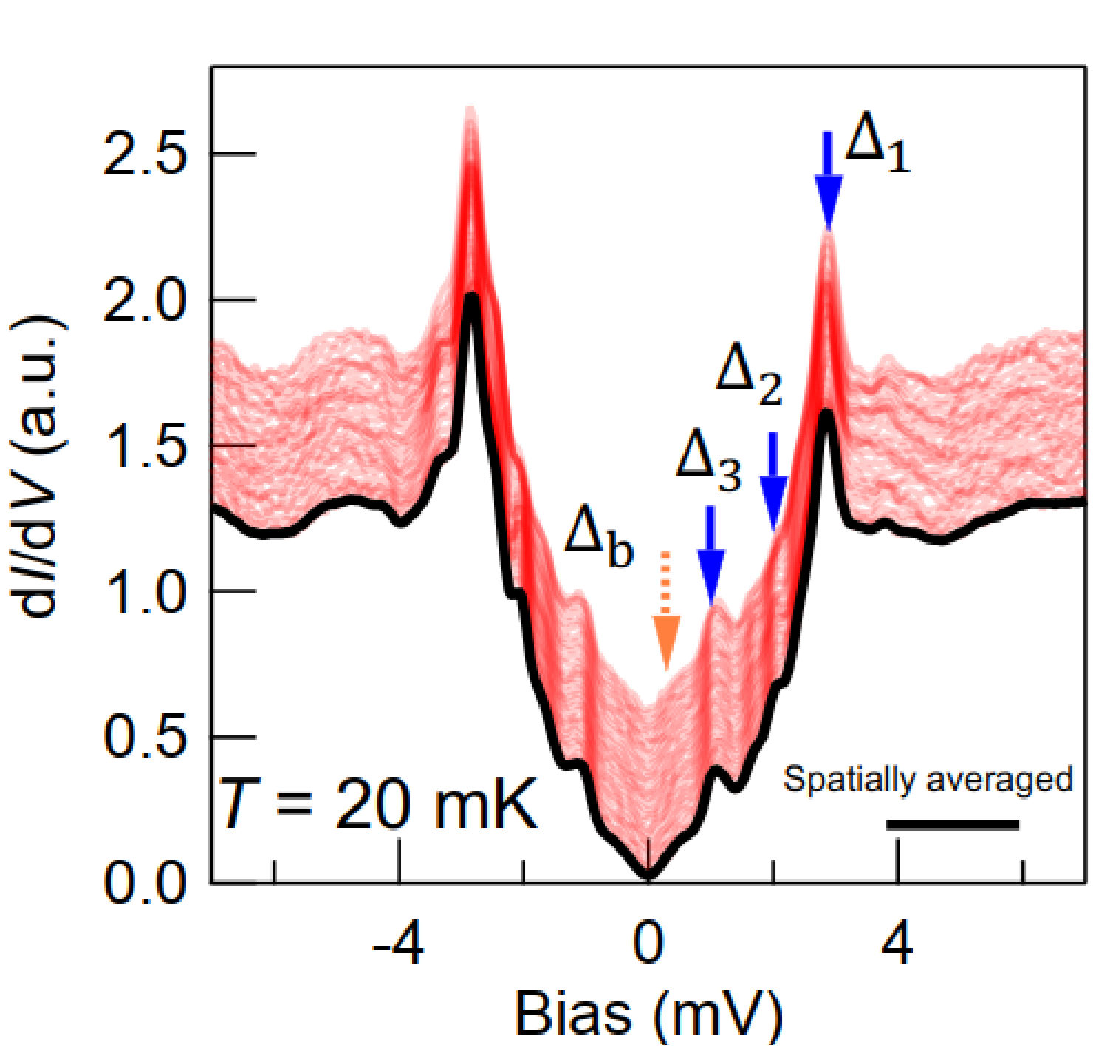
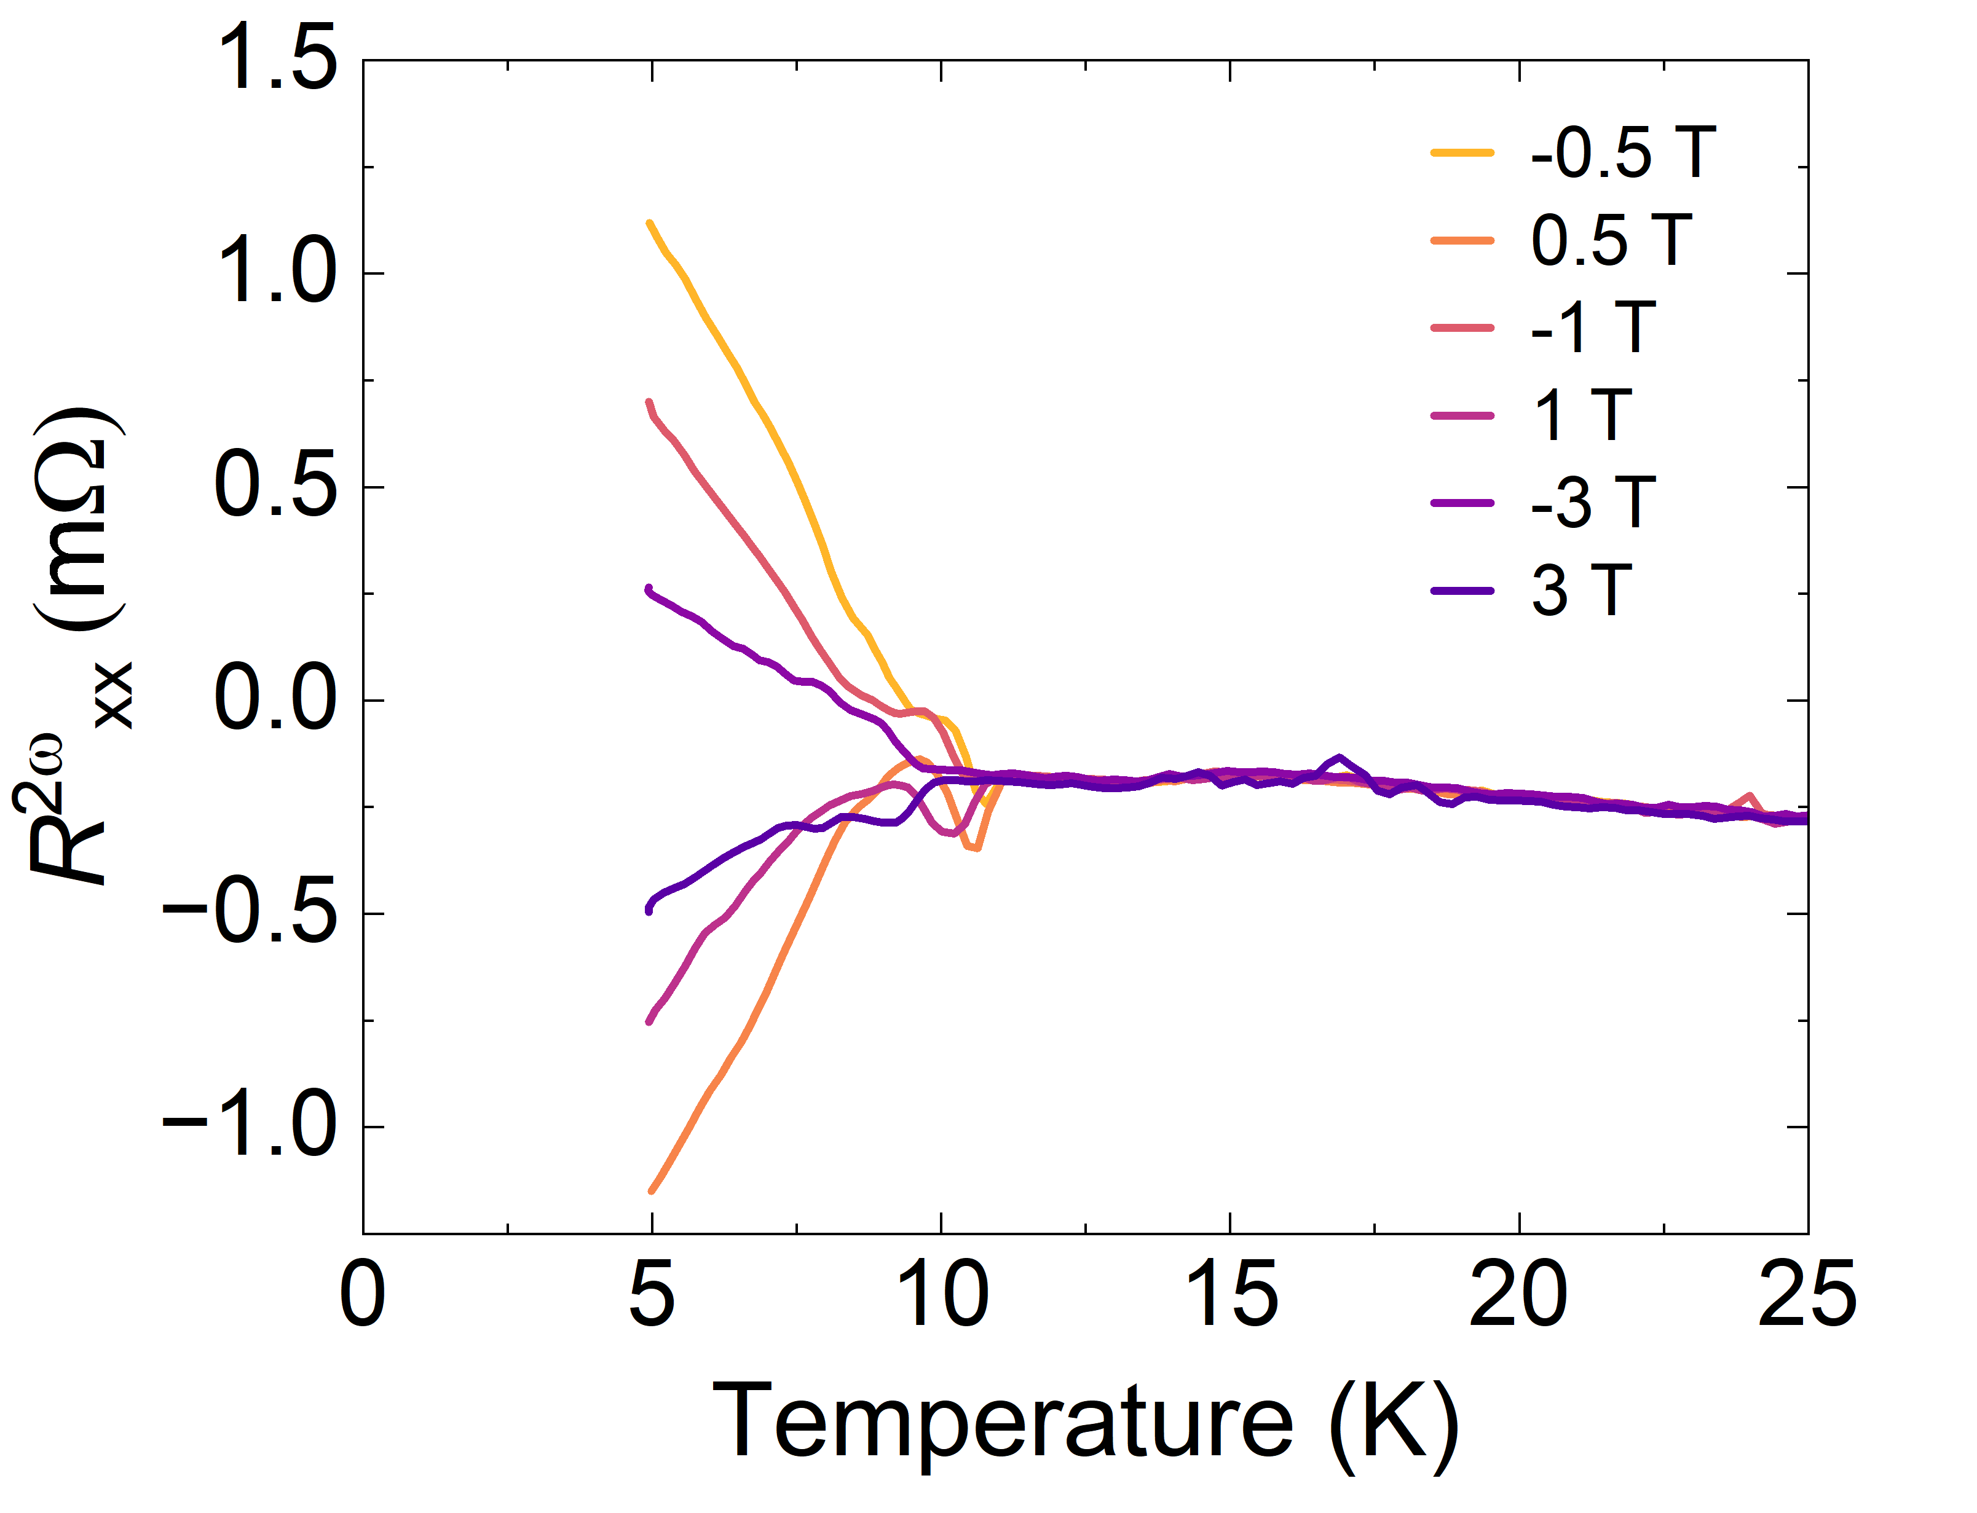
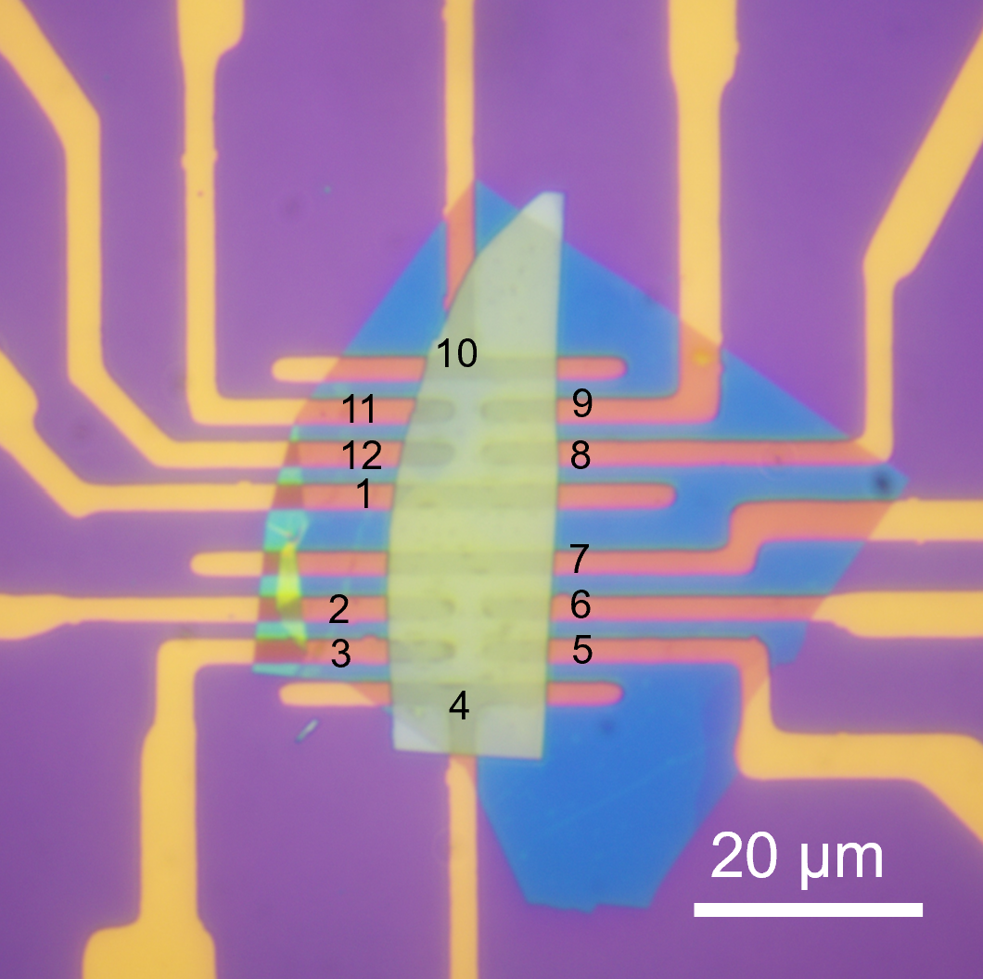
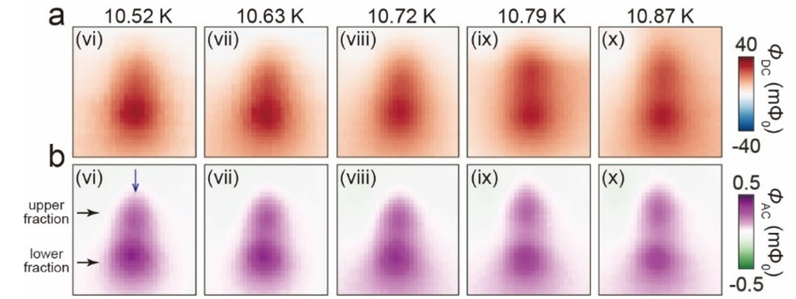
Strong evidence for multicomponent BTRS superconductivity in Ba_{1-x}K_{x}Fe₂As₂
Two anomalies in the specific heat
3-typs of unquantized vortices
Time-Reversal symmetry breaking
Muon-spin rotation (µSR)
STM
I. Shipulin et al., Nat Commun 14, 6734 (2023).
3-superconducting gaps
V. Grinenko et al., Nat. Phys. 17, 1254–1259 (2021)
Y. Zheng, Q. Hu et al., Science 393, 80-84 (2026)
V. Grinenko et al., Nat. Phys. 16, 789–794 (2020).
Second harmonic generation
Scanning SQUID
Q. Z. Zhou et al., arXiv:2408.05902
Y. Zheng, Q. Hu et al., Science 393, 80-84 (2026)
Y. Iguchi et al. Science 380,1244-1247(2023).

Slide 8
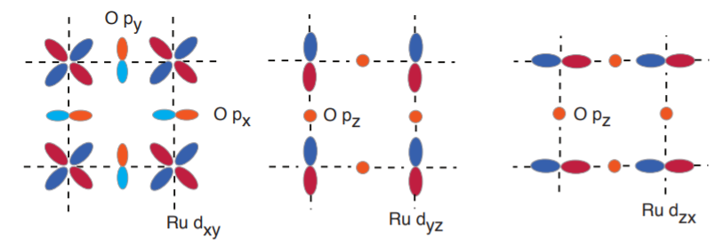
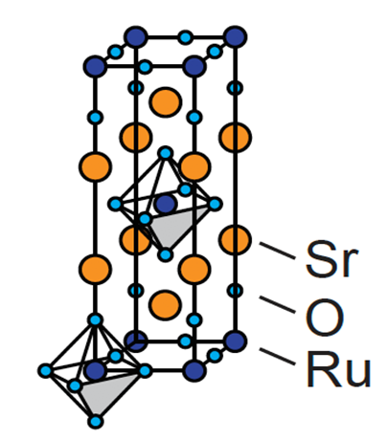
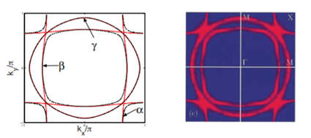
Sr₂RuO₄ is multiband superconductor
What do we know about Sr₂RuO₄?
Electronic orbitals relevant for conductivity
Crystal structure
Fermi surface
C. Hicks, MPI Dresden
S. Raghu et al., Journal of Physics: Conference Series 449, 012031 (2013).
Sr₂RuO₄ has a complex electronic structure, makes it similar to Fe-based superconductors.

Slide 9
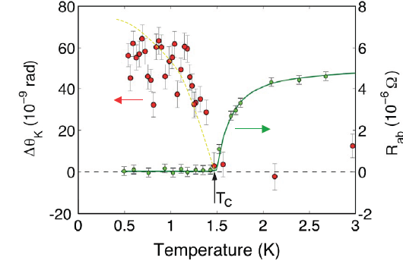
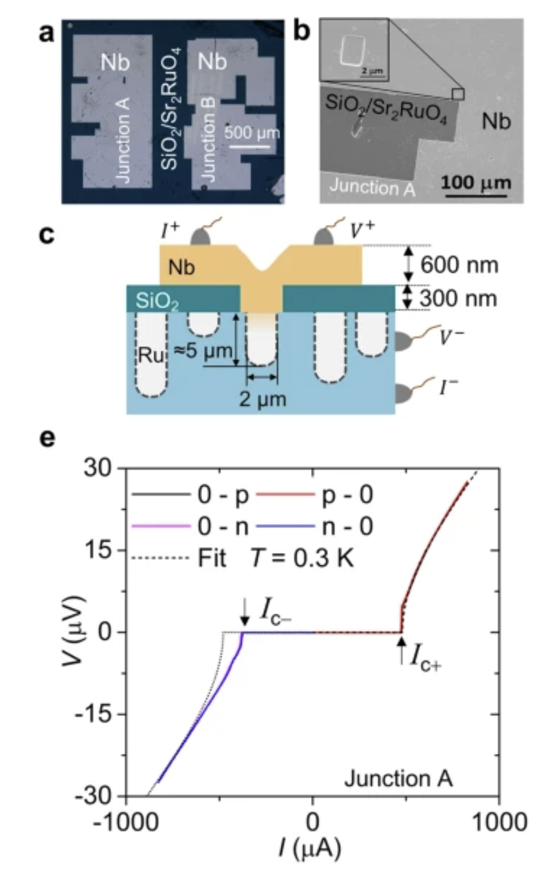
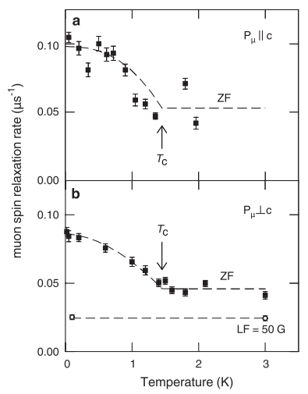
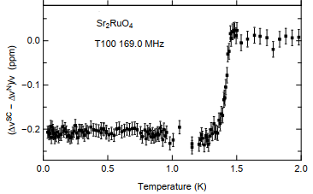
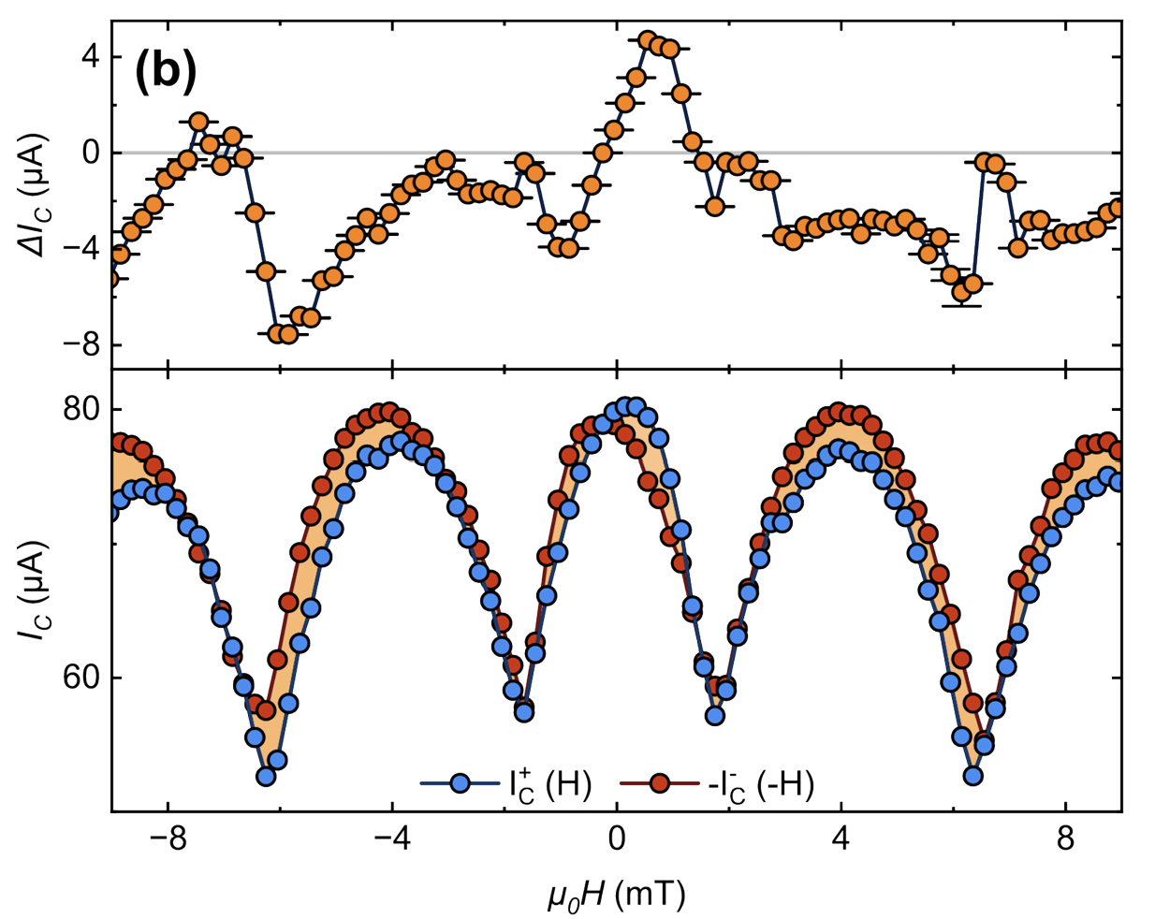
Some experimental evidences for multicomponent order parameter in Sr₂RuO₄
Superconducting diode effect
in ZF
Enhanced muon spin relaxation rate below T_{c} → spontaneous magnetic fields
Polar Kerr effect
J. Xia, A. Kapitulnik et al., PRL (2006)
Altogether these experiments are consistent
with chiral state.
Jump in transverse sound viscosity at T_{c}, -> indication for 2D order parameter.
M.S Anwar et al., Commun Phys 6, 290 (2023).
C. Lupien, PhD thesis (2002)
Luke, G. M. et al. Nature 394, 558–561 (1998)
S .Ghosh et al., Nat. Physics (2020) , S. Benhabib et al., Nat. Physics (2020)
R. Fermin et al., arXiv:2504.19361

Slide 10
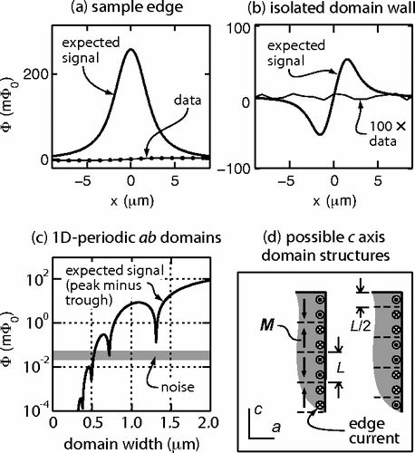
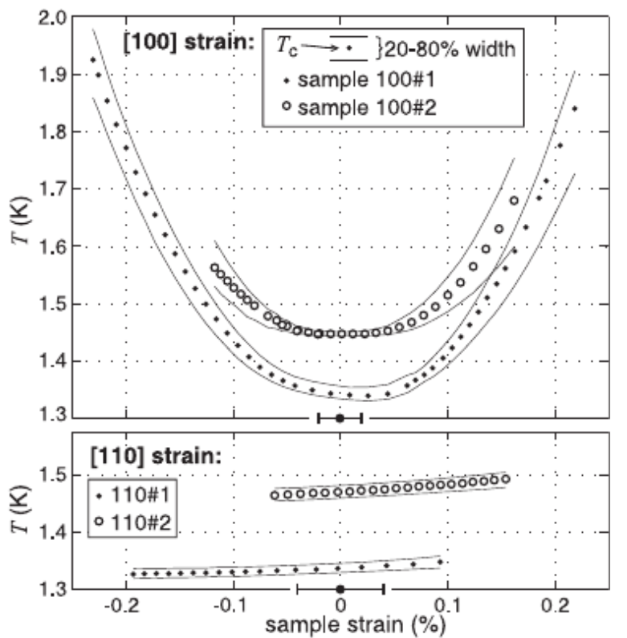
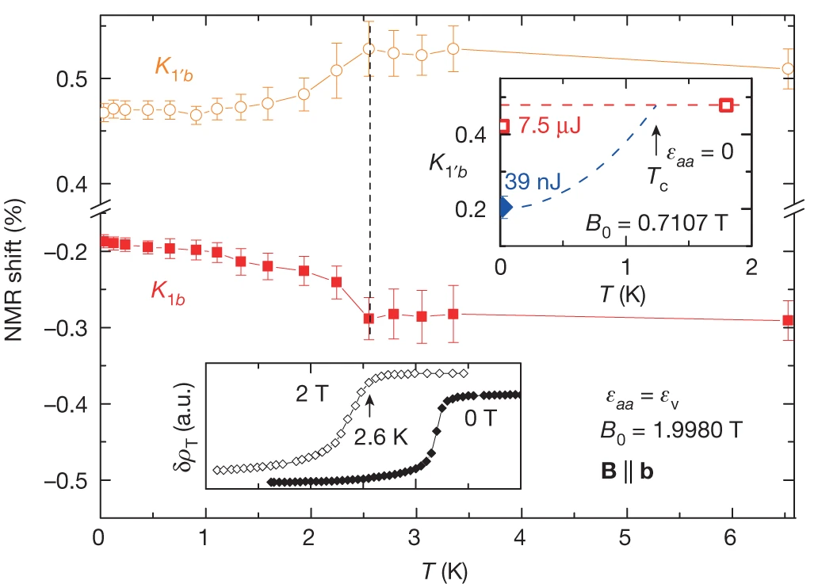
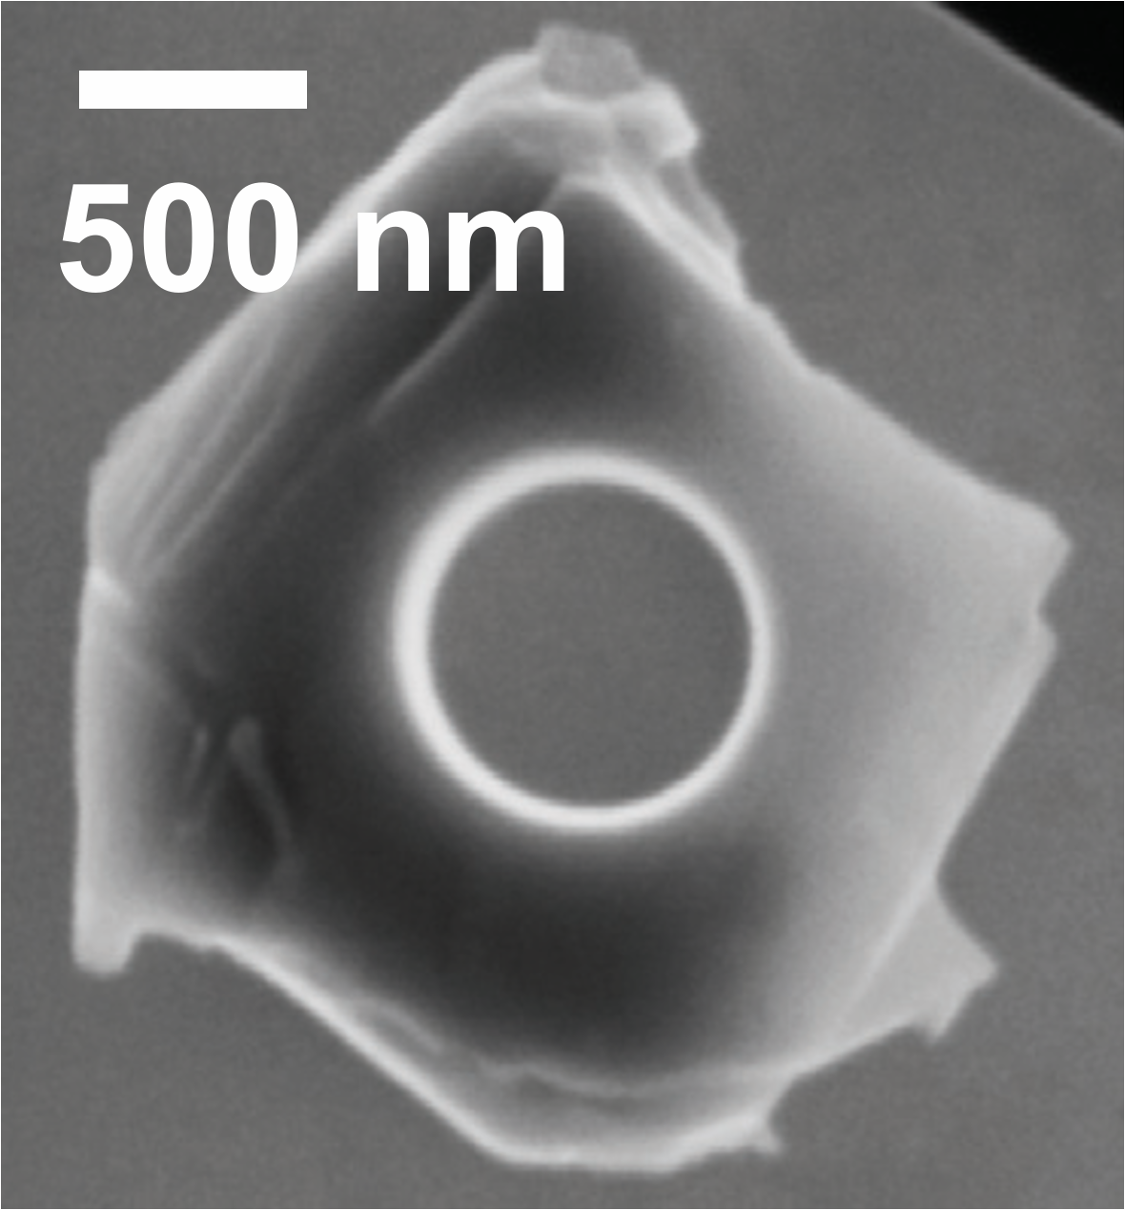
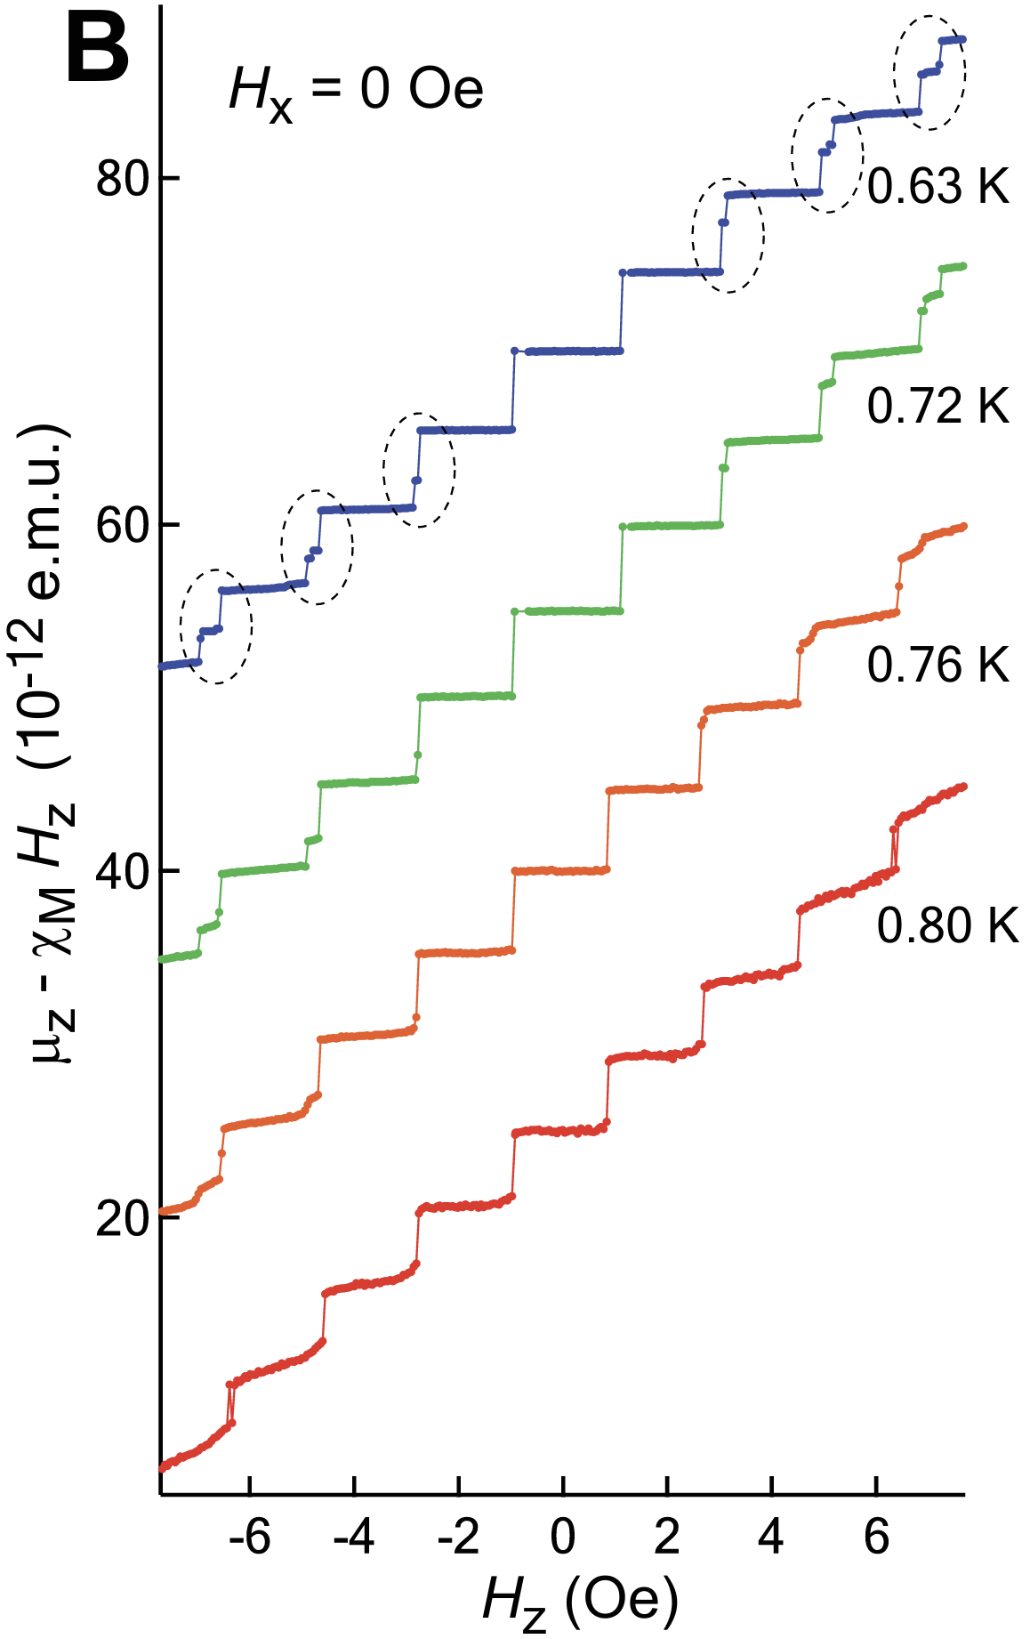
Evidences against chiral superconductivity in Sr₂RuO₄
Missing kink in T_{c} under strain
Scanning SQUID microscopy
Theory
Experiment
Absence of edge currents?
J. R. Kirtley, et al., Phys. Rev. B 76, 014526 (2007)
C. W. Hicks et al., Phys. Rev. B 81, 214501 (2010)
Half-quantum vortices are not observed
But Half-Height Magnetization Steps are observed
C. W. Hicks et al., Science 344, 283-285 (2014).
A. Steppke, et al., Science 355, eaaf9398 (2017).
J. Jang et al., Science331,186-188(2011).
A. Pustogow et al., Nature 574, 72 (2019).
The reduction of the NMR Knight shift below T_{c}
Non-chiral p-wave!?

Slide 11
The main motivation
Is Sr₂RuO₄ a chiral (Δ_{x} ± iΔ_{y}) superconductor?

Slide 12
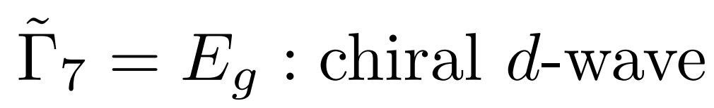
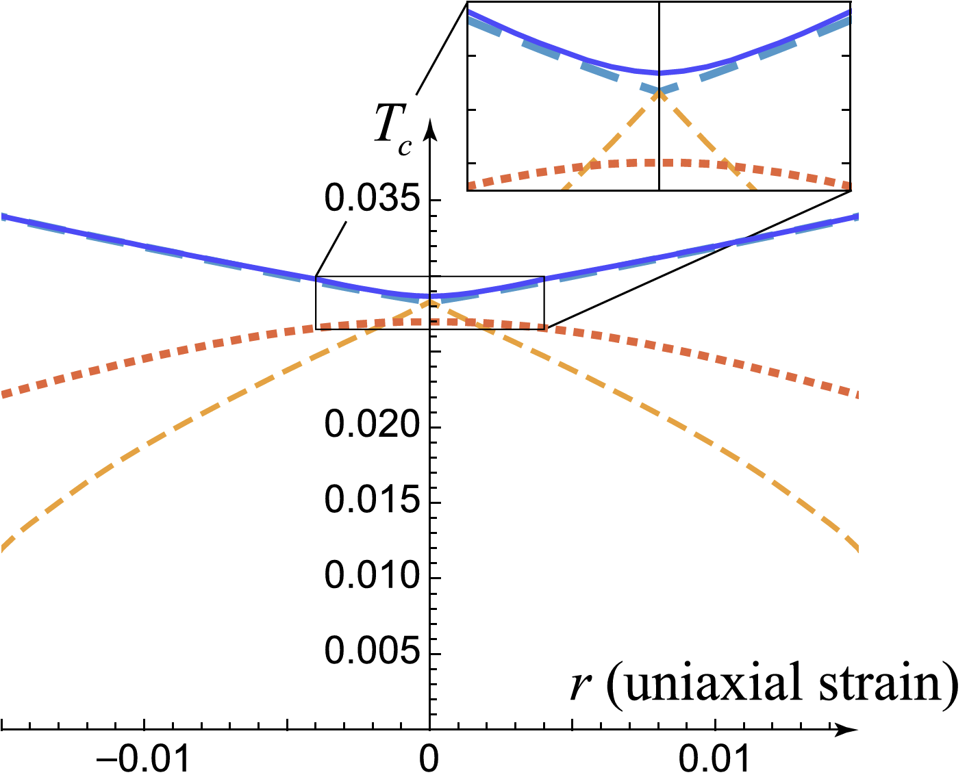
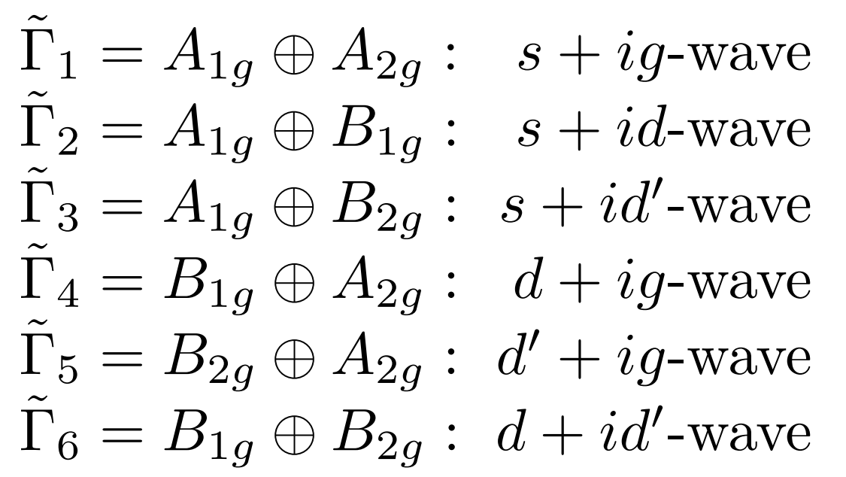
How can we distinguish between chiral and non-chiral superconductivity using µSR?
(d_{xz} ± id_{yz})
Accidentally degenerated sates:
T_{c} and T_{BTRS} transitions must split under symmetry breaking uniaxial strain.
Do not split with the hydrostatic pressure and isotropic disorder.
T_{c} and T_{BTRS} transitions must split under uniaxial strain.
Uniaxial pressure
Do split with the hydrostatic pressure and disorder.
(100) direction
(110) direction
V. Grinenko et al., Nat Commun 12, 3920 (2021).
Tetragonal
y
Splitting of T_{c} and T_{BTRS} is expected for both: chiral and accidentally degenerated orders.
Important demonstration that T_{c} and T_{BTRS} are related to a different phase transitions.
x
Orthorhombic

Slide 13
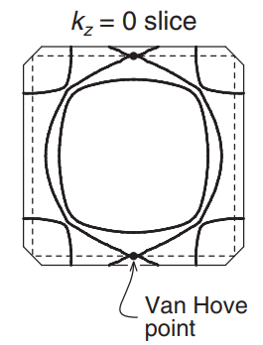
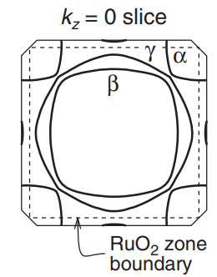
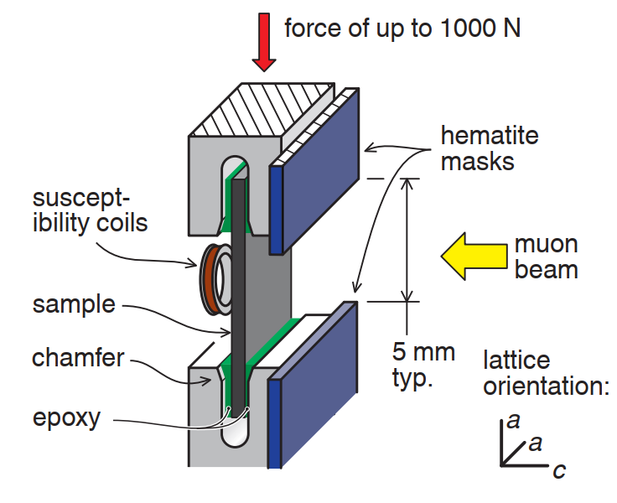
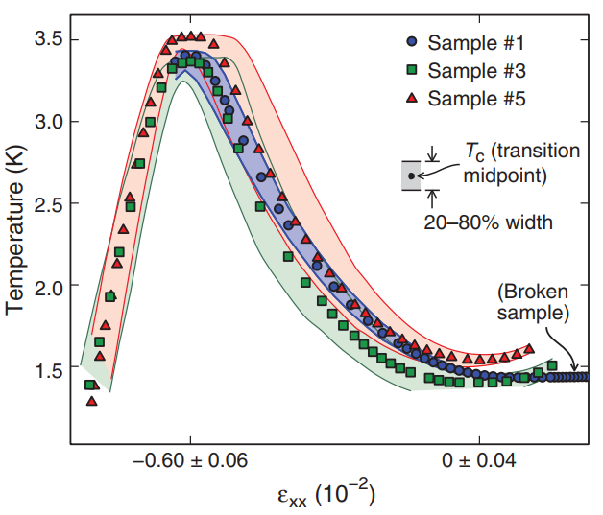
Sr₂RuO₄ under the (100) strain
Tetragonal
What is the effect of van Hove on BTRS state?
Can van Hove induce magnetism?
Orthorhombic
Experimental setup for the μSR:
along (100)
S. Ghosh et al., Review of Scientific Instruments 91, 103902 (2020).
V. Grinenko et al., Nat. Phys. 17, 748–754 (2021).
T_{c} is measured by AC susceptibility.
T_{BTRS} by zero-field µSR.
A. Steppke, et al., Science 355, eaaf9398 (2017).

Slide 14
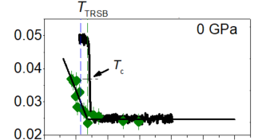
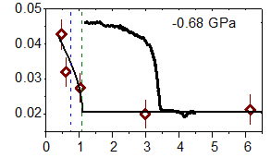
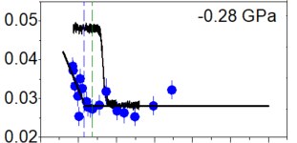
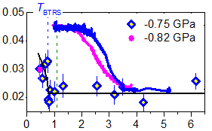
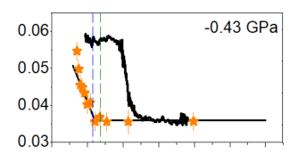
BTRS superconductivity of Sr₂RuO₄ under the (100) strain
Tetragonal
T_{BTRS}
T_{BTRS}
Orthorhombic
T_{c}
Relaxation rate, λ (µs⁻¹)
AC susceptibility
Relaxation rate, λ (µs⁻¹)
AC susceptibility
Temperature (K)
A. Steppke, et al., Science 355, eaaf9398 (2017).
Significant splitting of T_{BTRS} and T_{c}!
BTRS state exists above van Hove singularity!
Temperature (K)
V. Grinenko et al., Nat. Phys. 17, 748–754 (2021)

Slide 15
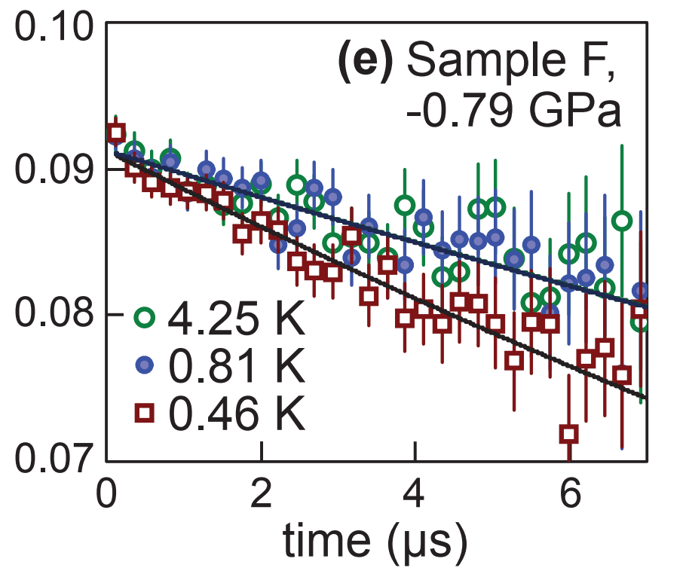
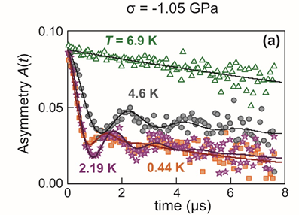
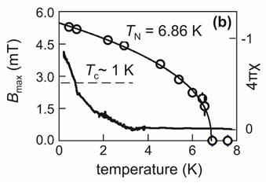
Strain induced SDW phase in Sr₂RuO₄
Tetragonal
Orthorhombic
van Hove
A. Steppke, et al., Science 355, eaaf9398 (2017).
An incommensurate SDW phase well above the van Hove singularity with T_{N} ~ 7 K;
V. Grinenko et al., Nat. Phys. 17, 748–754 (2021)
Small internal magnetic fields correspond roughly to 0.1 µ_{B} (similar to Sr₃Ru₂O₇);
The SDW internal field is 100 times stronger than spontaneous fields due to BTRS superconductivity.

Slide 16
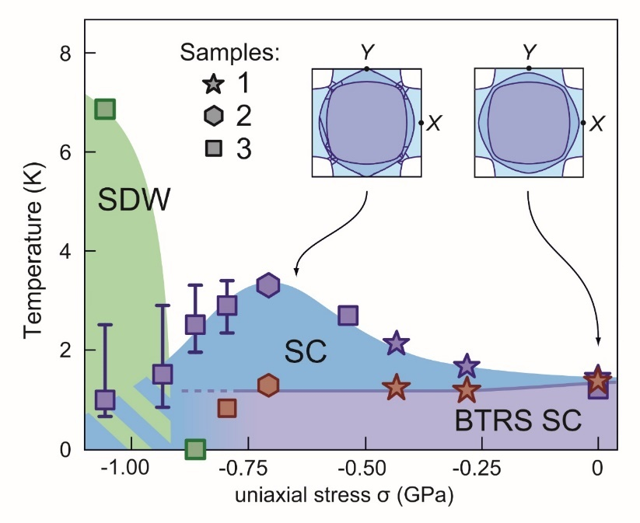
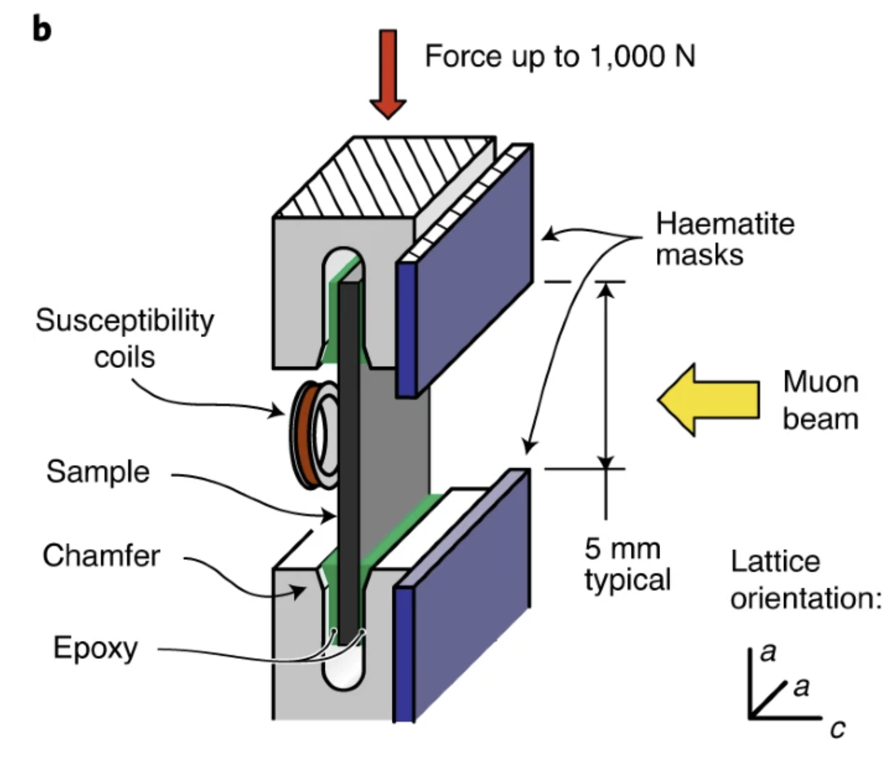


μSR measurements of Sr₂RuO₄ under uniaxial strain
Lifshitz transition
Spontaneous superconducting diode effect
Elastocaloric effect
SDW state
T_{BTRS}
T_{c}
V. Grinenko et al., Nat. Phys. 17, 748–754 (2021).
YS. Li et al., Nature 607, 276–280 (2022).
M. S. Anwar et al., arXiv:2211.14626v1
Superconducting T_{c} and T_{BTRS} split by uniaxial strain → two distinct phases!
SDW phase detected by μSR is confirmed by elastocaloric effect measurements.
Split T_{c} and T_{BTRS} is confirmed by spontaneous superconducting diode effect measurements.
Tetragonal
y
x
What is the evidence from other probes in favor of the μSR phase diagram?
Orthorhombic
Uniaxial strain induces spin density wave order (SDW) above the Lifshitz transition in odd with early theoretical predictions.

Slide 17

How can we distinguish between chiral and non-chiral superconductivity using µSR?
(d_{xz} ± id_{yz})
Accidentally degenerated sates:
T_{c} and T_{BTRS} transitions must split under symmetry breaking uniaxial strain.
Do not split with the hydrostatic pressure and isotropic disorder.
Disorder effect on T_{c}
T_{c} and T_{BTRS} transitions must split under uniaxial strain.
Do split with the hydrostatic pressure and disorder.
At small concentrations the dominant effect of La on T_{c} is related to a pair breaking effect.
V. Grinenko et al., Nat Commun 12, 3920 (2021).
La-doping results in isotropic in-plane disorder without anisotropic internal strain.
La-doping is an ideal tool to study the effect of disorder on T_{c} and T_{BTRS}
N. Kikugawa et al., Phys. Rev. B 70, 060508(R) (2004)

Slide 18

Time reversal symmetry breaking in Sr_{2-y}La_{y}RuO₄
1% of La doping suppresses T_{c} by 50% as compared with a impurity free T_{c0}
The normal state electronic specific heat is nearly the same for all samples, γ_{n} ≈ 40 mJ/mol-K² -> the DOS are unchanged.
Sharp superconducting transition -> homogeneous suppression of superconductivity by a pair braking effect.

Slide 19



Time reversal symmetry breaking in Sr_{2-y}La_{y}RuO₄
ISIS
PSI
ISIS
Sr_{1.98}La_{0.02}RuO₄
T_{BTRS} ≈ T_{c}
T_{BTRS} ≈ T_{c}
Y Li et al., arXiv preprint arXiv:2512.24585
V. Grinenko et al., Nat Commun 12, 3920 (2021).
Y Li et al., arXiv preprint arXiv:2512.24585
T_{BTRS} ≈ T_{c} in La-doped samples;
Together with the splitting between T_{BTRS} and T_{c} under uniaxial strain.
→ consistent with a chiral superconductivity in Sr₂RuO₄

Slide 20

Theory: Splitting of the T_{c} and T_{TRSB} under disorder for accidentally degenerated orders
Accidentally degenerated sates:
d+ig state
Manfred Sigrist
T_{c} and T_{BTRS} transitions must split under uniaxial strain.
Do split with the hydrostatic pressure and disorder.
V. Grinenko et al., Nat Commun 12, 3920 (2021).
B. Zinkl. & M. Sigrist, arXiv:2009.10089 (2020).
Fine-tuning is possible that transitions do not split with disorder.
Therefore, additional experiments are needed!

Slide 21

How can we distinguish between chiral and non-chiral superconductivity using µSR?
(d_{xz} ± id_{yz})
Accidentally degenerated sates:
T_{c} and T_{BTRS} transitions must split under symmetry breaking uniaxial strain.
Do not split with the hydrostatic pressure and isotropic disorder.
T_{c} and T_{BTRS} transitions must split under uniaxial strain.
Do split with the hydrostatic pressure and disorder.
Hydrostatic pressure preserves tetragonal symmetry a = b
V. Grinenko et al., Nat Commun 12, 3920 (2021).
Tetragonal
y
x
“Fine tuning” is impossible for both disorder and hydrostatic pressure!
D. Forsythe et al., Phys. Rev. Lett. 89, 166402 (2002)
N. Shirakawa et al., Phys. Rev. B 56, 7890 (1997)

Slide 22




The first μSR measurements of BTRS superconductivity under pressure
Rustem
Khasanov
Sample +cell
Sample
Tetragonal
x_{La}=0.01
BTRS transition temperature, T_{BTRS} (K)
T_{BTRS} = T_{c}
T_{c}
x_{La}=0.04
T_{BTRS}
Superconducting transition temperature, T_{c} (K)
T_{BTRS} ≈ T_{c} due disorder and under hydrostatic pressure
Temperature (K)
Evidence for two component chiral
superconductivity in Sr₂RuO₄.
Suppression of superconductivity and time-reversal symmetry breaking under pressure.
V. Grinenko et al., Nat Commun 12, 3920 (2021)

Slide 23

Sr₂RuO₄ under hydrostatic pressure
Rustem
Khasanov
New measurements under higher pressure
Tetragonal
T_{c}
T_{BTRS}
Temperature (K)
Y Li et al., arXiv preprint arXiv:2512.24585
V. Grinenko et al., Nat Commun 12, 3920 (2021)
T_{TRSB} follows T_{c} under the hydrostatic pressure.

Slide 24



The strength of spontaneous relaxation vs. T_{c} in Sr₂RuO₄ for samples with T_{c} ~ T_{BTRS}.
?
1. The relaxation rate has a minimum in the samples with T_{c} ≈ 1.45 K.
2. Relaxation is enhanced by superconductivity affecting disorder
n_{eff} ≈ n⁰_{eff}(1 - T_{c}/T_{c0}), where T_{c0} = 1.45 K.
3. Relaxation is suppressed by the hydrostatic pressure or with La-doping roughly following $Δλ∝J_{c}∝Δ_{SC}^{2}∝T_{c}^{2}$.
However, the relaxation should vanish for T_{c} ~ 1.4 K.
What is the mechanism for muon relaxation in exceptionally clean samples?
Y Li et al., arXiv preprint arXiv:2512.24585

Slide 25

Search for correlation with magnetic impurities
Magnetic susceptibility χ(T) for Sr2RuO4 samples
No correlation of the enhanced relaxation rate with typical magnetic impurities;
Scanning transmission electron microscopy (STEM) of clean and disordered samples revealed the dislocation density dislocation density of < 10¹¹ m⁻².

Slide 26



Possible new phase unrelated to superconductivity with a characteristic temperature of ~1 K
Two different contributions?
Transitions splits at zero strain
Relaxation persists in the normal state above H_{c2};
For 3 samples T* ~1 K -> new phase;
No T_{TRSB} for samples with T_{c} > 1.4 K -> too low density of superconductivity affecting impurities.
R. Khasanov et al., 2026
V. Grinenko et al., Nature Physics 17 (6), 748-754 (2021).

Slide 27


T_{c} studies under stress are inconsistent with chiral superconductivity
Inconsistency with ultrasound at least by a factor > 10 assuming T_{c} = T_{BTRS}!
Benhabib,
Nat. Phys. 17,
194 (2021)
Ghosh,
Nat. Phys. 17,
199 (2021)
G. Mattoni, et al., Nature Communications 17, 700 (2026).
[100] -direction
C. W. Hicks et al., Science 344, 283-285 (2014).
A. Steppke, et al., Science 355, eaaf9398 (2017).
A. Talkachov, E. Babaev et al., arXiv:2509.19137
The cusp is present only if T_{c} = T_{BTRS}; even a minor splitting will result in parabolic dependence of T_{c} on strain along [100] direction!
Can be explained by a non-chiral BTRS state with a d+is state.

Slide 28


Missing anomaly in the specific heat can be consistent with the 3-component GL model (d_{x2-y2} + is±)
Anton Talkachov, KTH, Shtokholm
Y Li et al., accepted npj Quantum Materials (2026)

Slide 29


Summary
Old picture:
ZF-µSR measurements of Sr₂RuO₄ under uniaxial strain, hydrostatic pressure and with different amounts of disorder previously suggested a chiral order parameter such as $d_{xz}+id_{yz}$.
New results:
The investigated disorder effect on the muon spin relaxation rate is consistent with BTRS superconductivity in Sr₂RuO₄, where the strength of the relaxation rate in the superconducting state $∝$ T_{c}².
However, in some cases the muon spin relaxation rate is affected by unknown magnetic contributions or a new mechanism for muon relaxation with a characteristic temperature T* ~1 K.
Given the missing kink in the strain dependence of T_{c} and the lack of a resolvable anomaly in the specific heat at T_{BTRS} under strain, the superconductivity of Sr₂RuO₄ is non-chiral but still may be consistent with a multicomponent mixed pairing state such as $d_{x^{2}{−y}^{2}}+is_{±}$.
Looking for postdocs and PhD students!
vadim.grinenko@sjtu.edu.cn

Slide 30


Spontaneous magnetic fields in chiral p_{x} ± ip_{y} superconductivity
Distribution of spontaneous fields and currents in one domain (p_{x} + ip_{y} )
Max B_{z} ~ 100 G for Sr₂RuO₄
Dimensionless
C. Kallin http://www.icmr.ucsb.edu/programs/documents/Kallin.pdf
J. R. Kirtley et al., Phys. Rev. B 76, 014526 (2007).
Furusaki, M. Matsumoto, and M. Sigrist: Phys. Rev. B 64 054514 (2001)
M. Matsumoto and M. Sigrist, J. Phys. Soc. Jpn. 68, 994 (1999)
Spontaneous currents flow along the surfaces, domain boundaries, and crystalline defects.
Chiral superconductivity has similarities with ferromagnetic state → spontaneous bulk magnetization.

Slide 31













Phase of the order parameter GL theory
It is useful to consider the Ginzburg-Landau (GL) theory to describe the Josephson effect.
If $L≪ξ$then
Since |ψ|~ 1 in the bulk, one get
With a possible solution:
where f(r) = 1 in 1 and f(r) = 0 in 2.
$$L≪ξ$$
$$−cocherence length$$
- expression for supercurrent
In zero field and for $θ_{1}$ and $θ_{2}$ are independent on r we can get
- the result depends on the phase difference between left and right and the gradient of the amplitude.
For $θ_{1}(r)$ and $θ_{2}\left(r\right).$
- this adds gradients of the phases
Currents in a superconductor appear spontaneously when there is a variation of phase and amplitude of the order parameter!

Slide 32


Spontaneous fields in non-chiral pairing states, domain walls
domain1
s + id
domain2
s - id
A domain wall stabilized by randomly located pinning centers.
the phase difference between s and d components
A. Benfenati et al., PRB 101, 054507 (2020).
Domain boundary pinned by defects produces dipolar spontaneous fields.
J. Garaud and E. Babaev, PRL 112, 017003 (2014)
Dipolar structure of the field → the net magnetic flux is zero

Slide 33



Spontaneous fields in non-chiral pairing states due to inhomogeneity
Spontaneous magnetic in a s+id superconductor
Spontaneous magnetic field due to spherical inhomogeneity
Order parameter’s modulus |ψ₁|,|ψ₂| (s+is state)
W.-C. Lee, S.-C. Zhang, and C. Wu PRL 102, 217002 (2009)
Non-chiral superconductivity has similarities with antiferromagnetic state -> the average field is zero.
V. L. Vadimov and M.A. Silaev, PRB 98, 104504 (2018)

Slide 34



Superconductors with broken time reversal symmetry – novel type of magnetism
Phenomenologically, broken time-reversal symmetry results in the appearance of a spontaneous magnetization (m) when a superconductor is cooled below T_{BTRS}.
m
C. Hicks, MPI Dresden
Theoretically, spontaneous fields appear around inhomogeneities and at the domain walls (no spontaneous fields in infinite homogeneous superconductor).
A direct observation of the field sources with such probes as scanning SQUID magnetometry is still missing!
The spontaneous fields regardless the structure can be observed in the muon spin rotation/relaxation (μSR) experiments!
V. Grinenko et al., Nat. Phys. 16, 789–794 (2020)
V. L. Vadimov and M.A. Silaev, PRB 98, 104504 (2018)

Slide 35




Spontaneous currents in a non-chiral s+is superconductor
Magnetic field
Phase
Defect pins
the domain wall
J. Garaud and E. Babaev, PRL 112, 017003 (2014); A. Benfenati et al., PRB 101, 054507 (2020)
, where
The spontaneous fields originate from a second term having the Skyrmionic form of CP² topological charge density. [E. Babaev, L. D. Faddeev, and A. J. Niemi, Phys. Rev. B65, 100512 (2002).]
In 2- band case:
$ψ =$ $(ψ_{1}{,ψ}_{2})$
B contains products of density gradients and gradients of the phases of the form

Slide 36
Spontaneous currents in s+is superconductor
Magnetic field
Phase
Defect pins
the domain wall
J. Garaud and E. Babaev, PRL 112, 017003 (2014); A. Benfenati et al., PRB 101, 054507 (2020)
The spontaneous fields originate from a second term having the Skyrmionic form of CP² topological charge density. [E. Babaev, L. D. Faddeev, and A. J. Niemi, Phys. Rev. B65, 100512 (2002).]
The fields associated with the magnetic field induced by internal Josephson currents between different bands (in momentum space), in the presence of relative density gradients caused by inhomogeneities.
Without inhomogeneities, spontaneous fields are perfectly compensated (counter-flow) since in momentum space all directions are equivalent, and there is no net current transfer.

Slide 37


Sr₂RuO₄ is multiband superconductor
Variety of possible superconducting order parameters in Sr₂RuO₄
Multi-band nature of the Fermi surface results in a possibility of mixed pairing states with the pairing mediated by spin fluctuations, candidates: s+id, d+ig, s+ip
Mixed pairing or chiral
?
d_{xz}+id_{yz}
A. T. Rømer, et al., PRL 123, 247001 (2019); PRB 102, 054506 (2020); PRB 104, 064507 (2021);
S. A. Kivelson, et al., npj Quantum Mat. 5, 43 (2020).
Alternatively, the orbital degree of freedom can encode chiral order parameters with a pairing originated from local interactions, candidates: d+id.
A. Ramires, and M. Sigrist, Physical Review B (2019).
H. G. Suh et al.,Phys. Rev. Research 2, 032023(R) 2020.
A. Ramires, arXiv:2110.10621.
A chiral p-wave is excluded according to the NMR Knight shift measurements:
A. Pustogow et al., Nature 574, 72 (2019).
K. Ishida, et al., J. Phys. Soc. Jpn. 89, 034712 (2020).
A. Chronister et al., PNAS 118 (25) e2025313118 (2021).
The reduction of the NMR Knight shift below T_{c}

