Slide 1

Unconventional superconductivity in topological chiral crystal
Tian Shang (商恬)
School of Physics, East China Normal University
2026.10.24 CSNS

Slide 2

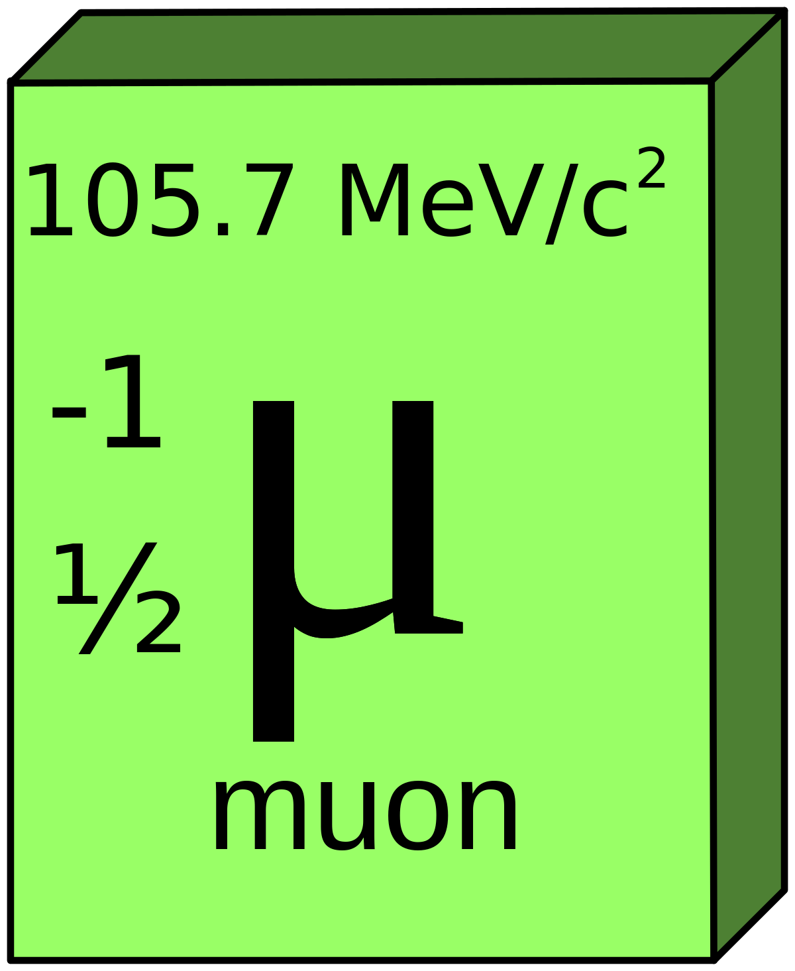

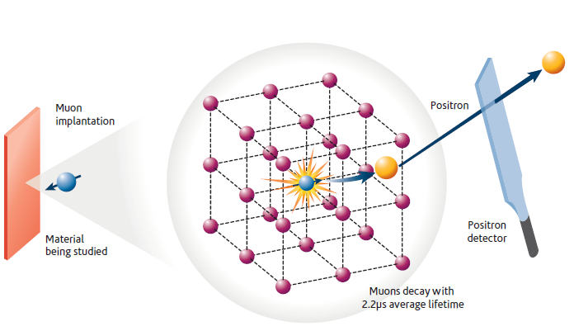
μSR
Outline
otation
elaxation
esonance
muon
spin
Topological chiral crystal
Basic principles of μSR
Unconventional SC in chiral crystal
Summary
Relaxation
S
R
Resonance
LaRhSi/LaIrSi Adv. Mater. 37, e11385 (2025)
ScIr_{2-x}Si_{x} Adv. Mater. 38, e74399 (2026)
Rotation
Notes:
Here, is the out line of my talk. First I will make a short introduction about the topological chiral crystal and the basic principles of muSR technique. Then I will talk about recent work of the muSR study on the two topological chiral crystals, which is LaRhSi/LaIrSi and ScIr2-xSix families. Finally, will be a short symmary.

Slide 3
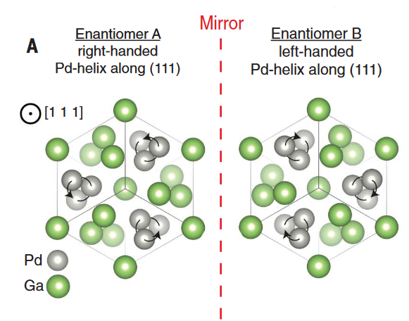
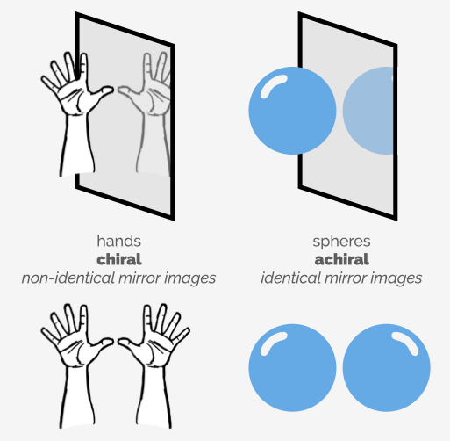
μSR
Topological chiral crystal
otation
elaxation
esonance
muon
spin
What is chirality?
What is a chiral crystal?
N. Schroter, et al., Science 369, 179 (2020)
An object is chiral if it is non-identical to its mirror image
An achiral object is identical to its mirror image
A chiral crystal is a crystalline solid whose internal atomic arrangement lacks any symmetry planes, inversion centers, or improper rotation axes
Out of the 230 space groups in crystallography, 65 space groups are chiral
Notes:
So, what is chirality? If the object is non-identical to its mirror image, then we can say this object is chiral, like our hands. If the object is identical to its mirror image, then it is achiral, like the balloon.
Then, what is a chiral crystal? It is defined as a crystalline solid whose atomic arrangement lacks any symmetry planes, inversion centers, or rotation axes. Out of the 230 space groups, there are 65 chiral space groups. Therefore, there should be many synthesized chiral crystals. Here is a typical example of the crystal structure of PdGa chiral crystal. Indeed, it is not identical to its mirror.

Slide 4
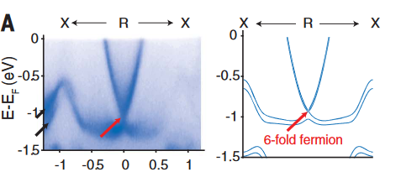
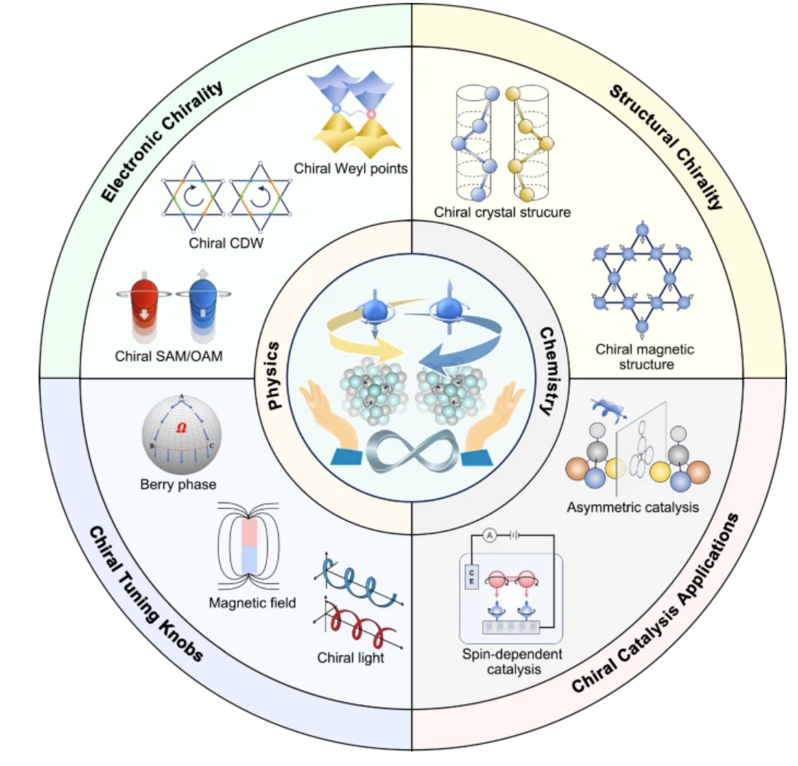
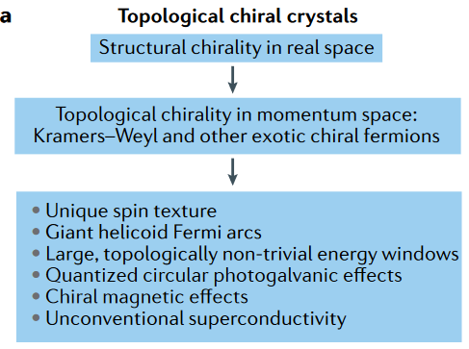
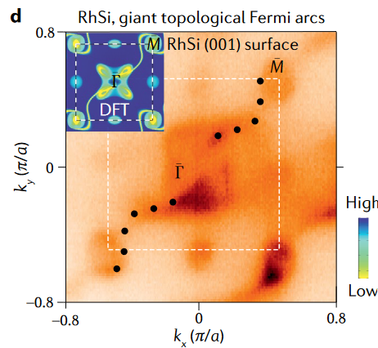
μSR
Topological chiral crystal
otation
elaxation
esonance
muon
spin
N. Schroter, et al., Science 369, 179 (2020)
M. Hasan, et al., Nat. Rev. Mater. 6, 784 (2021)
X. Wu, X. Wang, C. Felser, Riv. Nuovo Cim. 48, 241 (2025)
D. Sanchez, et al., Nature 567, 500 (2019)
Combination of structural and electronic chirality triggers the emergence of topological chiral crystals, which exhibit a plethora of exotic quantum phenomena
Band topology has been widely investigated in chiral crystals
Unconventional SC remains largely unexplored
Notes:
Due to the combination of structural and electronic chirality, topological chiral crystals exhibit may exotic quantum phenomena.
For example, Giant helicoid surface Fermi arcs have been experimentally verified in the CoSi family. They also host high-fold fermion excitations at high-symmetry points. They also show a much larger topologically nontrivial energy window than achiral topological materials.
3. Until now, band topology has been widely investigated in the chrial crystals, while the SC, especially the unconventional SC remains largely unexplored.

Slide 5
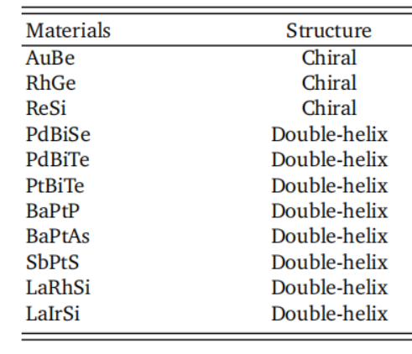
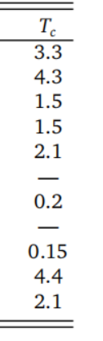
μSR
Topological chiral crystal
otation
elaxation
esonance
muon
spin
P2₁3 No.198
Y₃Rh₄Ge₁₃ I2₁3 No. 199 Tc = 1.45 K
(Ta,Nb)Rh₂B₂ P3₁ No. 144 Tc = 6-8 K
(Ta,Nb)Ge₂ P62₂2 No. 180 Tc = 2 K
Mo₃Al₂C P4₁32 No. 213 Tc = 9.2 K
Zr₅(Pt,Ir)₃ P6₁22 No. 178 Tc = 2.1 K
(Rh,Ir)Ge₄ I4₁22, No. 98 Tc = 1.2-2.5 K
Li₂(Pd,Pt)₃B P4₃32, No. 212 Tc = 3-7K
R. Nakajima, et al., J. Mater. Chem. 12, 12207 (2024)
Z. S. Gao, et al., Quant. Front. 1, 3 (2022)
Limited number of chiral crystals have been found to show SC
Either conventional or type-I superconductors, or not bulk
LaIrSi and LaRhSi belong to the same group as the well-studied CoSi family
Notes:
This is based on the fact that there are quite a limited number of superconducting chiral crystals. Here I list some reported superconducting chiral crystals.
Most of them either behave as a conventional SC or as a type I SC, some of them even lack bulk SC.
LiPdB and LiPtB represent an exception, where spin-triplet SC was realized by increasing the SOC. Recent theoretical work shows a nodal topological SC with dispersionless surface Majorana modes in LiPtB.
The well studied CoSi family belongs to the No.198 chiral space. For this space, some materials have been reported to show SC as well, including the LaRhSi and LaIrSi which we will discuss later.

Slide 6
μSR
Outline
otation
elaxation
esonance
muon
spin
Topological chiral crystal
Basic principles of μSR
Unconventional SC in chiral crystals
Summary
Relaxation
S
R
Resonance
LaRhSi/LaIrSi Adv. Mater. 37, e11385 (2025)
ScIr_{2-x}Si_{x} Adv. Mater. 38, e74399 (2026)
Rotation
Notes:
Before going to the results of our work, I would like to make a short introduction of muSR technique.

Slide 7
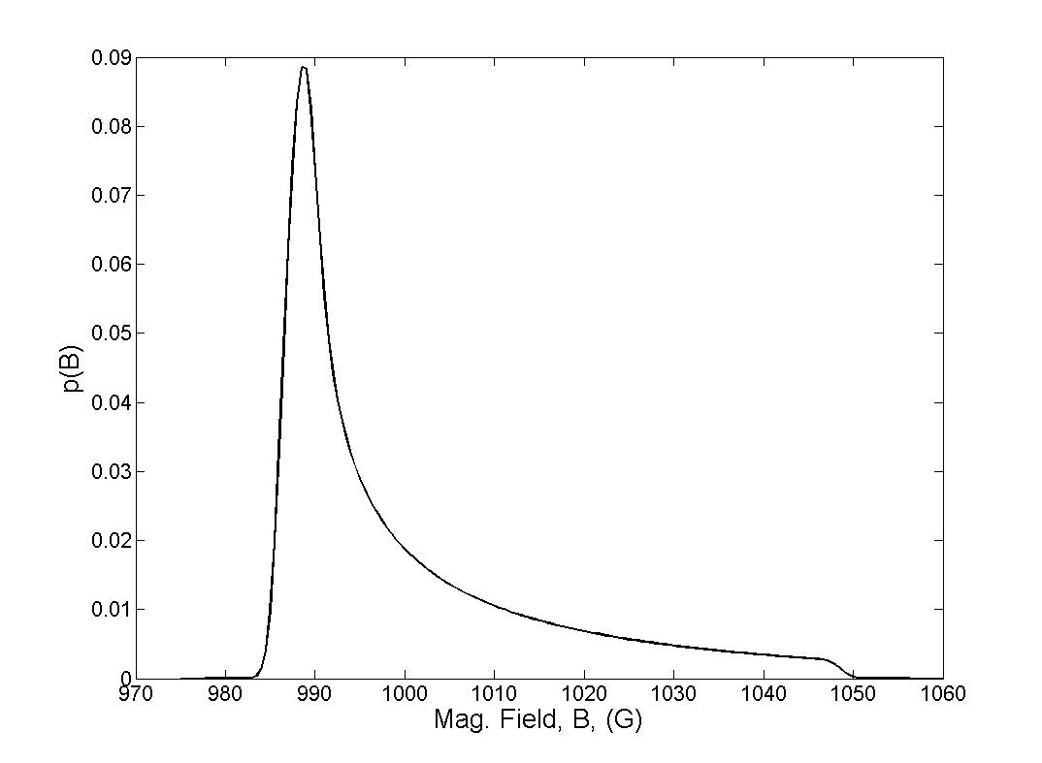
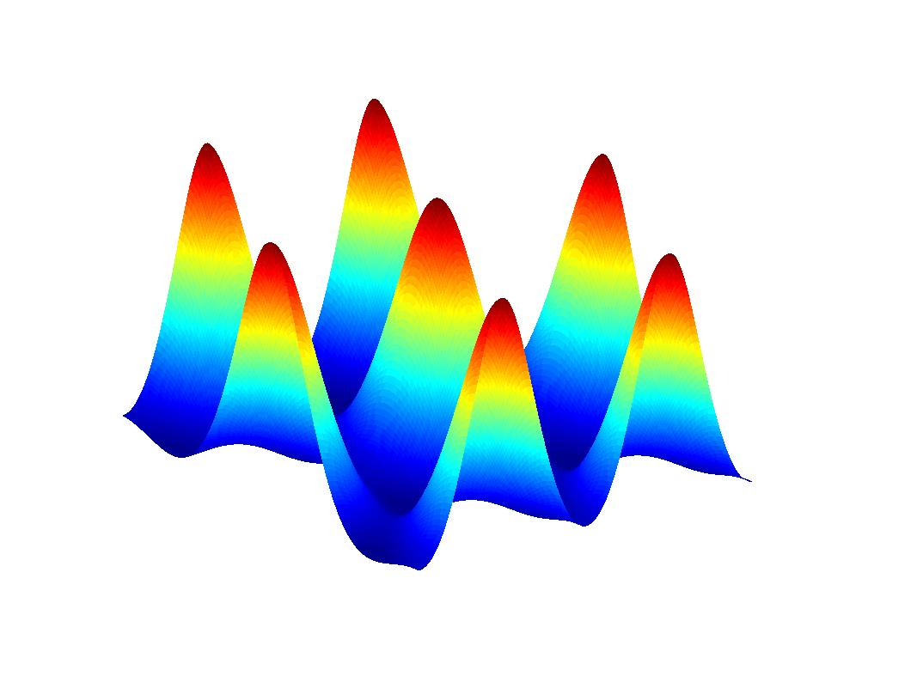
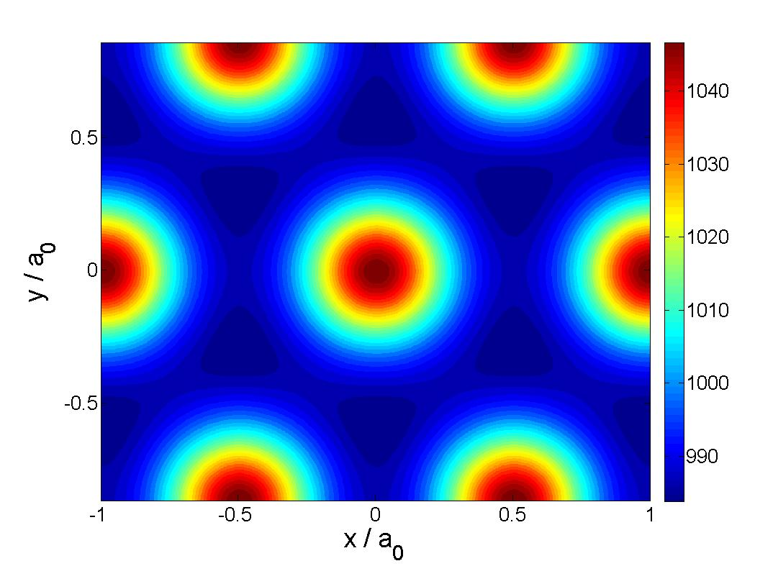
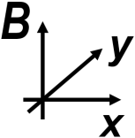
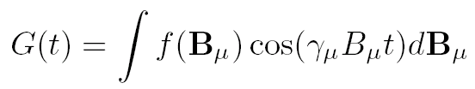
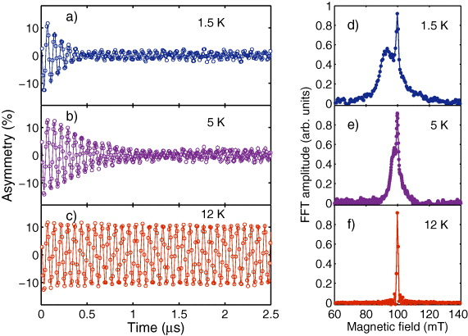
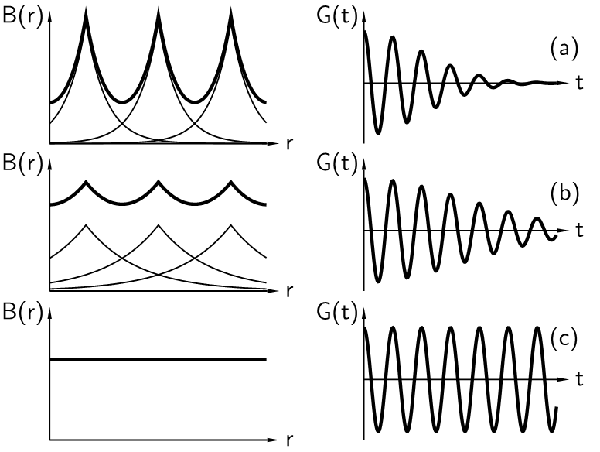
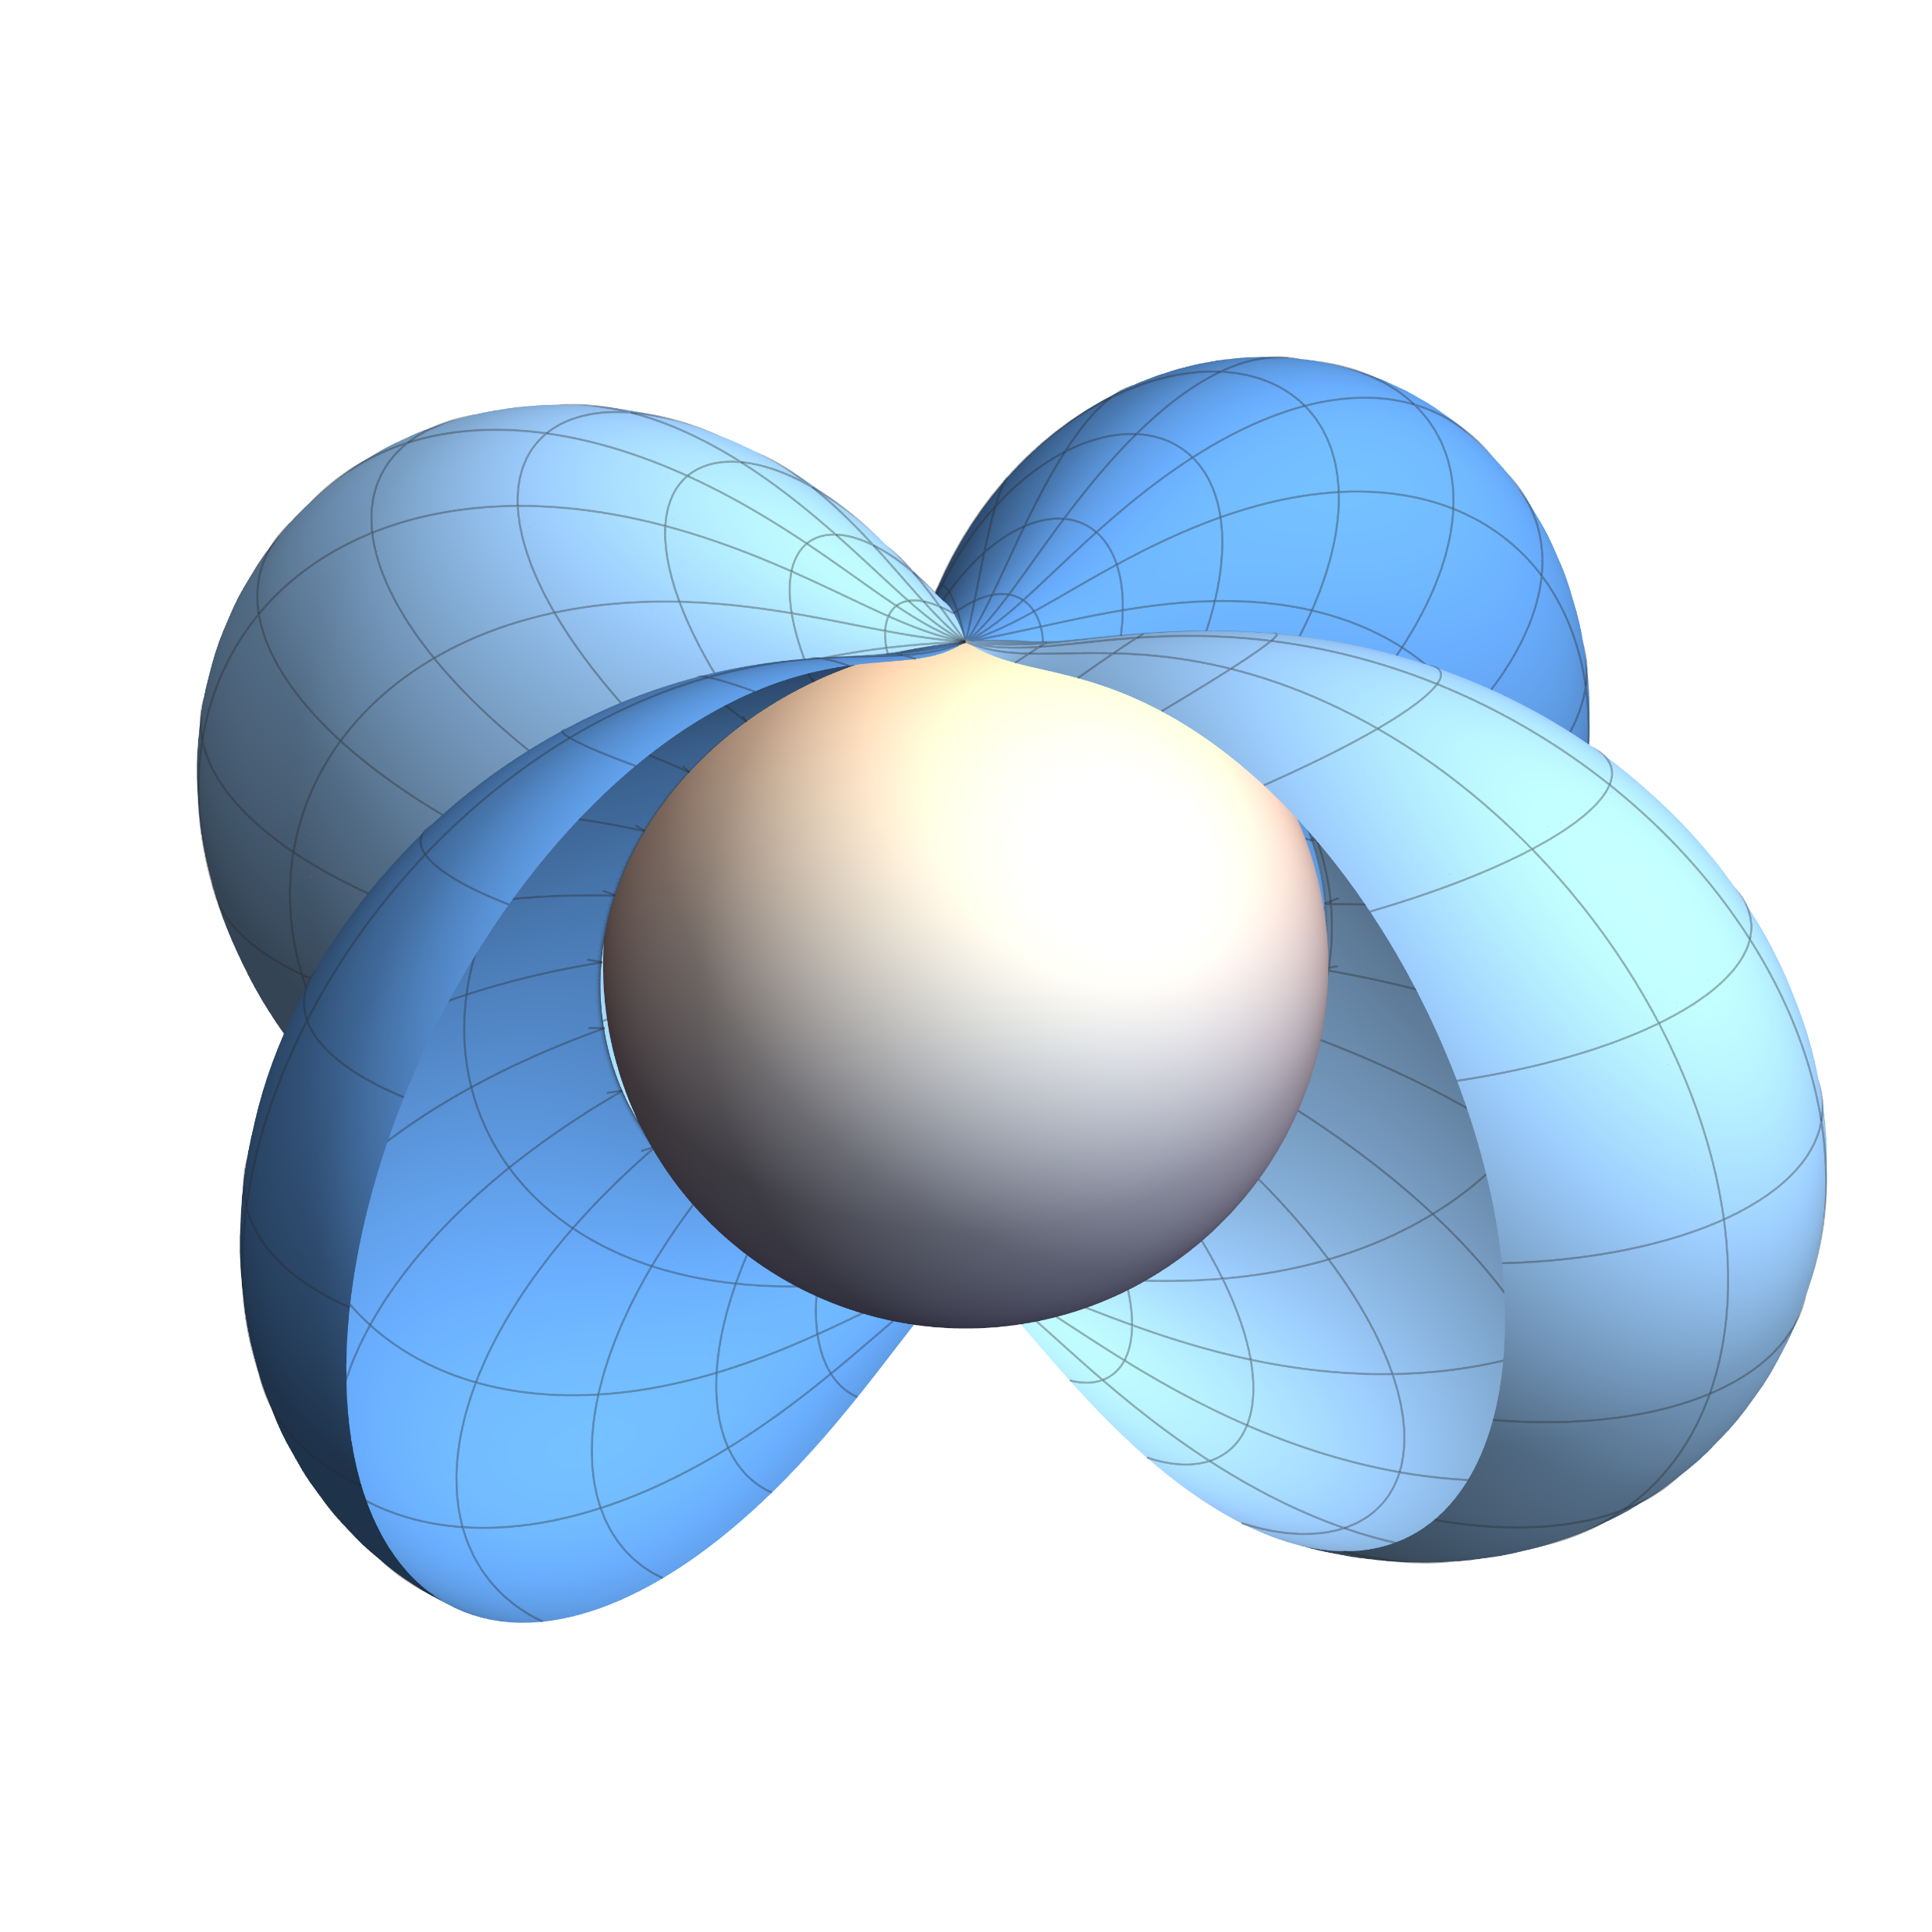
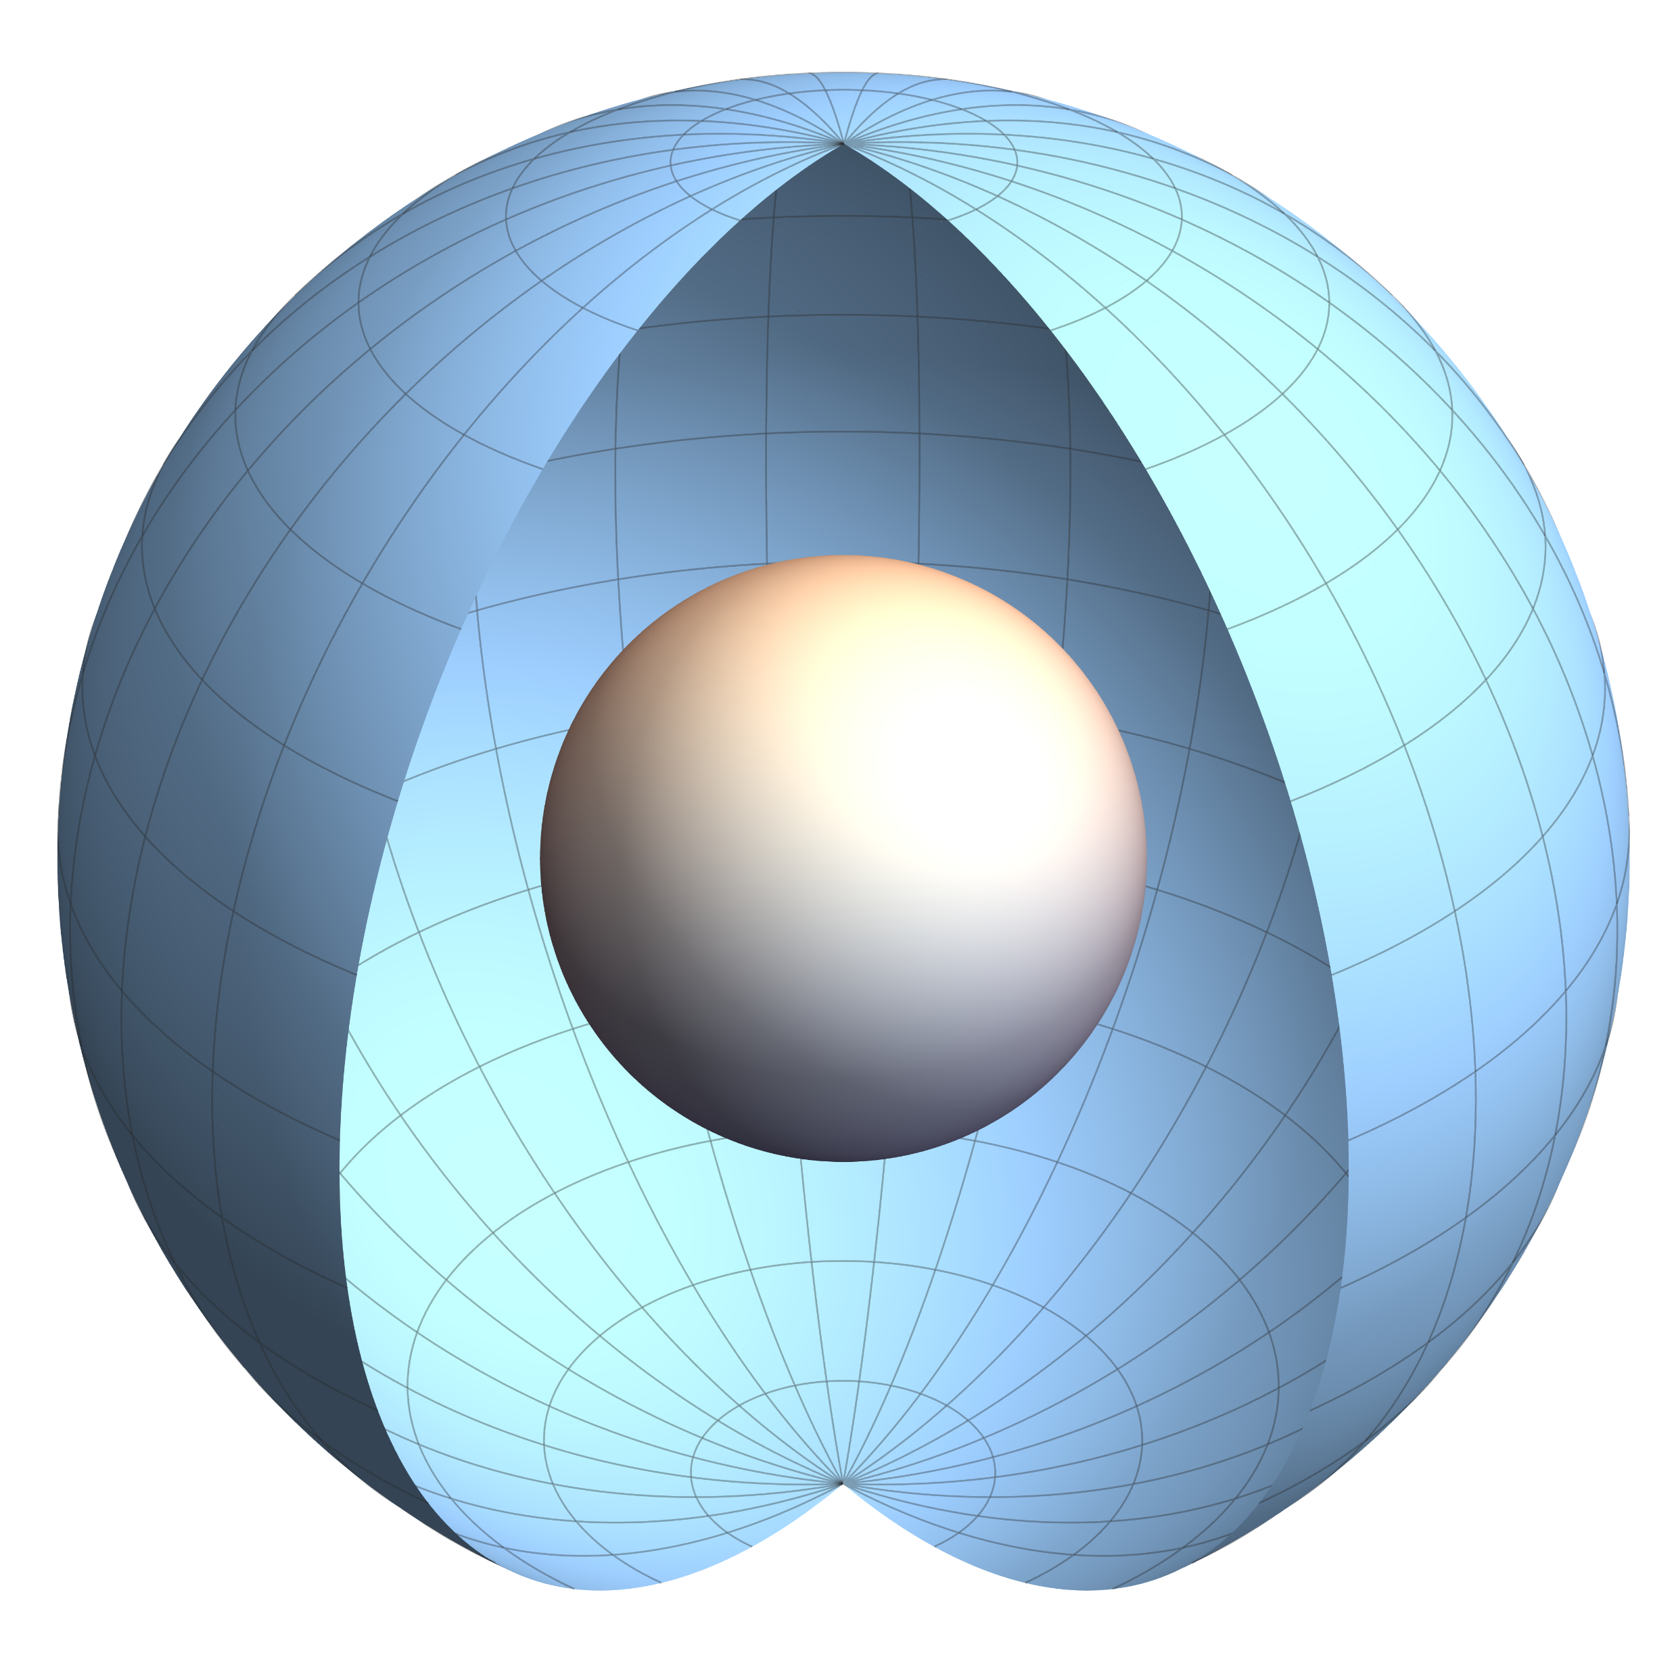
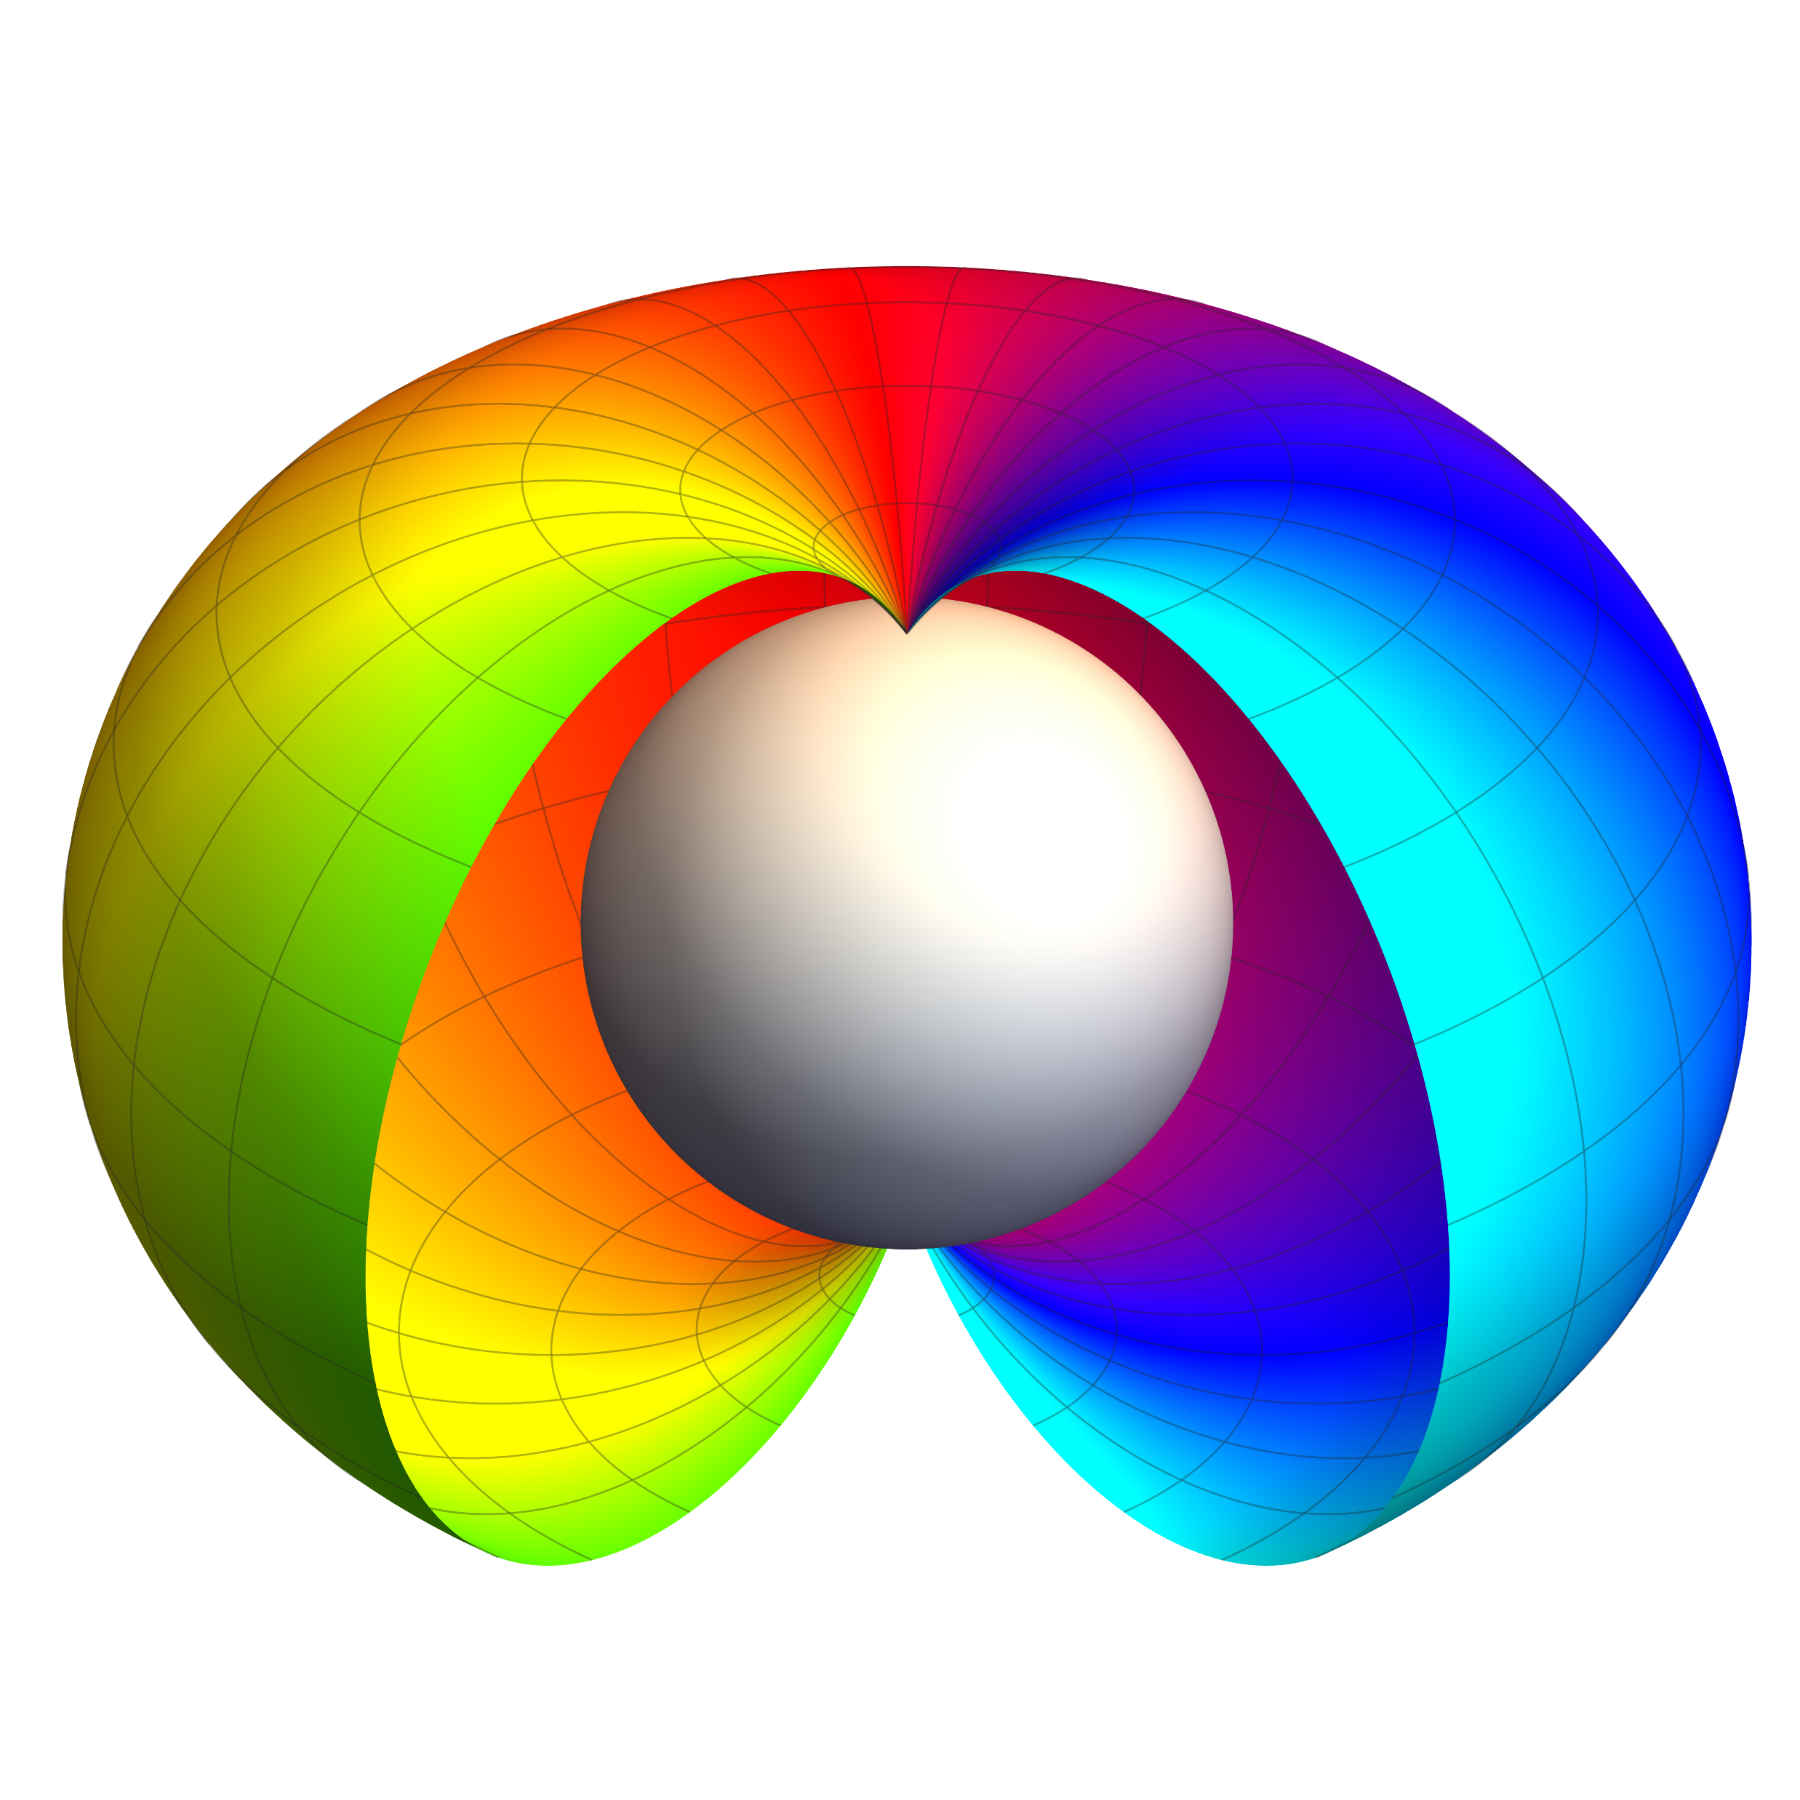
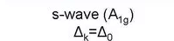
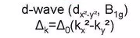



μSR
MuSR: basic principles for SC
otation
elaxation
esonance
muon
spin
Muons measure the local field distribution in the SC vortex phase
Second moment of p(B)
⟨ΔB²⟩ ∝ λ⁻⁴
magnetic
penetrate depth
B_{ext}
Gaussian distribution p(B)
B_{ext}
P(t)
σ ∝ ⟨ΔB²⟩^{1/2} ∝ λ⁻² ∝ ρ_{s}
superfluid
density
Brandt, PRB (2003)
T << T_{c}
λ⁻² versus T, H
gap value and pairing symmetry
T < T_{c}
T >T_{c}
Blundell, Contemp. Phys. (1999)
p-wave
Δ_{k} = Δ₀(k_{x} + ik_{y})
Shiroka et al.,NJP (2011)
Field distribution inside a SC (theory)
Muon-spin relaxation in a SC (exp.)
Notes:
7
In case of superconductor, once the sample is cooled with applied magentic field, the superconducting sampe will form the flux line lattice (FLL) in the superconducting state.
Depends on the positions, the amplitude of the magnetic fields is diffenent and therefore, the muSR frequency is different. By analyzing the field distrubtion, we can get the information of the superconducting properties.

Slide 8
μSR
Outline
otation
elaxation
esonance
muon
spin
Topological chiral crystal
Basic principles of μSR
Unconventional SC in chiral crystals
Summary
Relaxation
S
R
Resonance
LaRhSi/LaIrSi Adv. Mater. 37,e11385 (2025)
ScIr_{2-x}Si_{x} Adv. Mater. 38,e74399 (2026)
TaGe_{2-x}Al_{x}
Rotation
Notes:
Now, let’s move to the our first muSR study on the LaRhSi and LaIrSi.

Slide 9
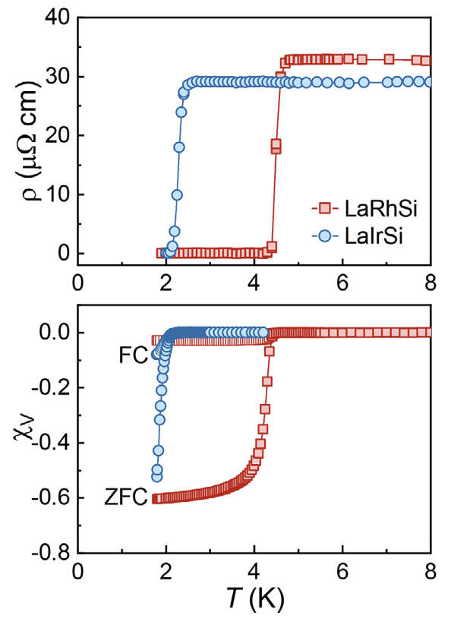
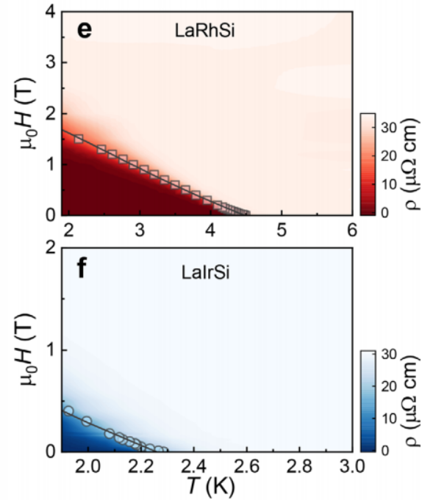
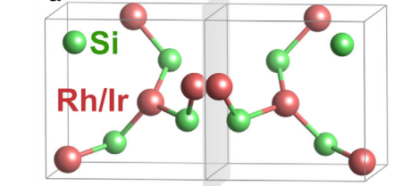
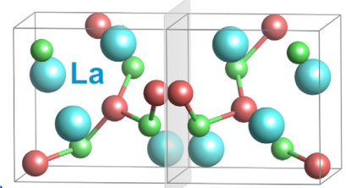

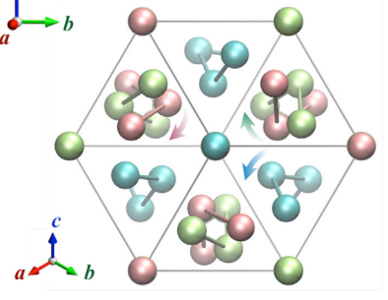

μSR
Unconventional SC in La(Ir,Rh)Si
otation
elaxation
esonance
muon
spin
LaRhSi/LaIrSi family hosts a double-helix chiral structure
RhSi/IrSi sublattice
La sublattice
Cubic B20 structure (P2₁3, no.198)
Both (Rh,Ir)Si and La sublattices are chiral
Only T_{c} was reported
LaRhSi (T_{c} = 4.4 K) and LaIrSi (T_{c} = 2.1 K)
Bulk SC was first confirmed
H_{c2}(T) shows multiband feature
H. F. Braun, J. Less-Common Met. 1984, 100, 105 (1984)
B. Chevalier, Solid State Commun. 41, 801 (1982)
T. Shang, et al., Adv. Mater. 37, e11385 (2025)
Notes:
Both LaRhSi and LaIrSi adopt the B20 crystal structure. Unlike the binary CoSi family, in LaRhSi/LaIrSi, both La and RhSi form chiral chains. Therefore, LaRhSi or LaIrSi host a double-helix chiral chain.
Up to now, only the Tc was reported in early 1980s.
We synthesized both LaRhSi and LaIrSi, and characterizes their SC by electrical resistivity and susceptibility. The susceptibility data confirm the bulk Tc at 4.4 and 2.1 K for LaRhSi and LaIrSi, respectively.
In addition, the Hc2(T) data also show multiband feature for both compounds.

Slide 10
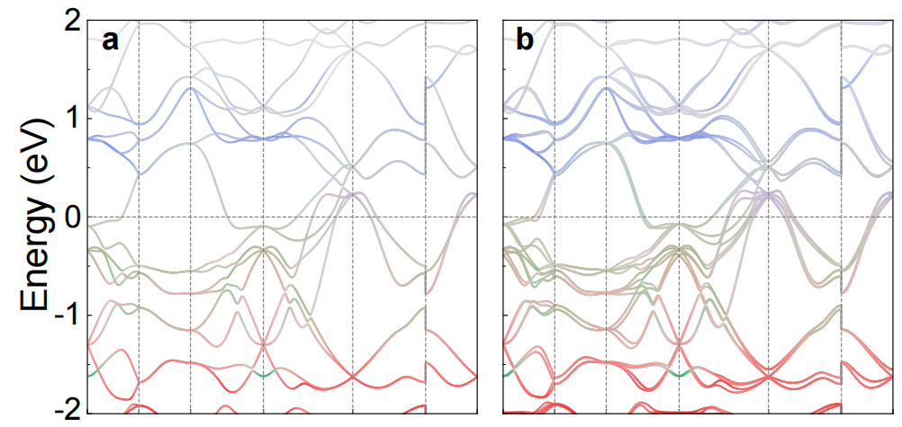
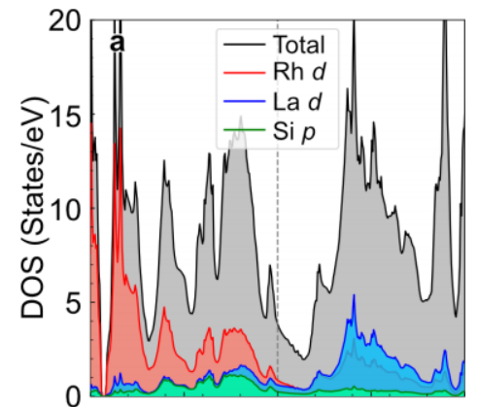
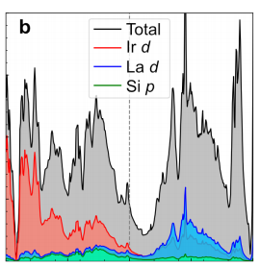
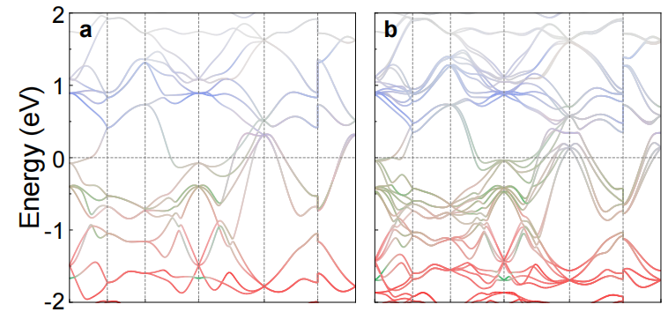

μSR
Unconventional SC in La(Ir,Rh)Si
otation
elaxation
esonance
muon
spin
Electronic band structure
LaRhSi
LaRhSi+SOC
LaRhSi
LaIrSi
LaIrSi
LaIrSi+SOC
T. Shang, et al., Adv. Mater. 37, e11385 (2025）
Rh/Ir and La atoms contribute most DOS
Comparable electronic bands near E_{F}
Band splitting is significant in LaIrSi
LaRhSi: E_{SOC} ≈ 37 meV
LaIrSi: E_{SOC} ≈ 207 meV
Notes:
To compare both compounds, we performed band-structure calculations based on the DFT method. For both compounds, the DOS near EF is dominated by the Rh/Ir(4d or 5d) and La 5d orbitals.
Both LaRhSi and LaIrSi show quite similar band structures near EF.
However, the SOC effect is more significant in LaIrSi than in LaRhSi. For example, the estimated band splitting due to SOC is about 37 meV in LaRhSi, while in LaIrSi, it is about 207 meV, almost 5 times larger in Ir case.
The SOC effect can be clearly seen around the high-symmetry gamma point.

Slide 11
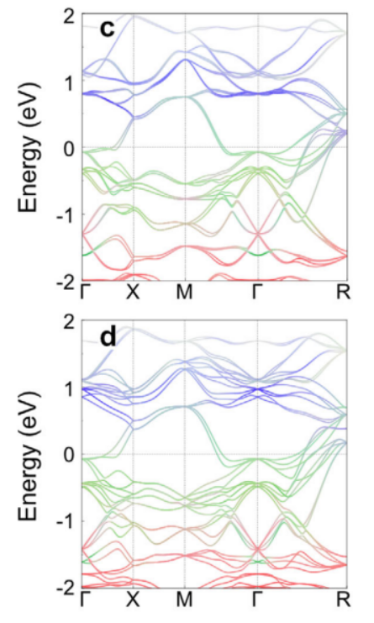
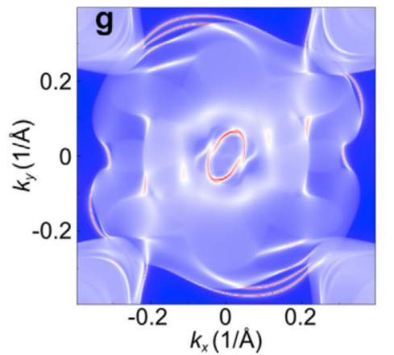
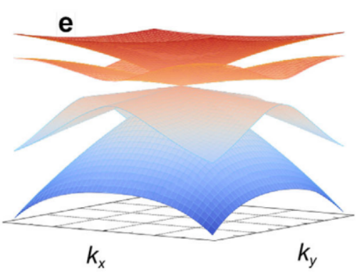
μSR
Unconventional SC in La(Ir,Rh)Si
otation
elaxation
esonance
muon
spin
Topological aspects
Unconventional fermions with Six-fold and four-fold degeneracy at the high-symmetric R and Γ point for both compounds
Giant helicoid surface Fermi arcs spanning the entire surface Brillouin zone
T. Shang, et al., Adv. Mater. 37, e11385 (2025）
Notes:
Both LaRhSi and LaIrSi are chiral crystal. Therefore, we expect that both compounds will show some novel topological features. For example, unconventional fermions with six-fold and four-fold degeneracy at high-symmetric R and gamma point.
Both compounds also show giant helicoid fermi arcs spanning the entire surface Brillouni zone, resembling the CoSi family of compounds.

Slide 12
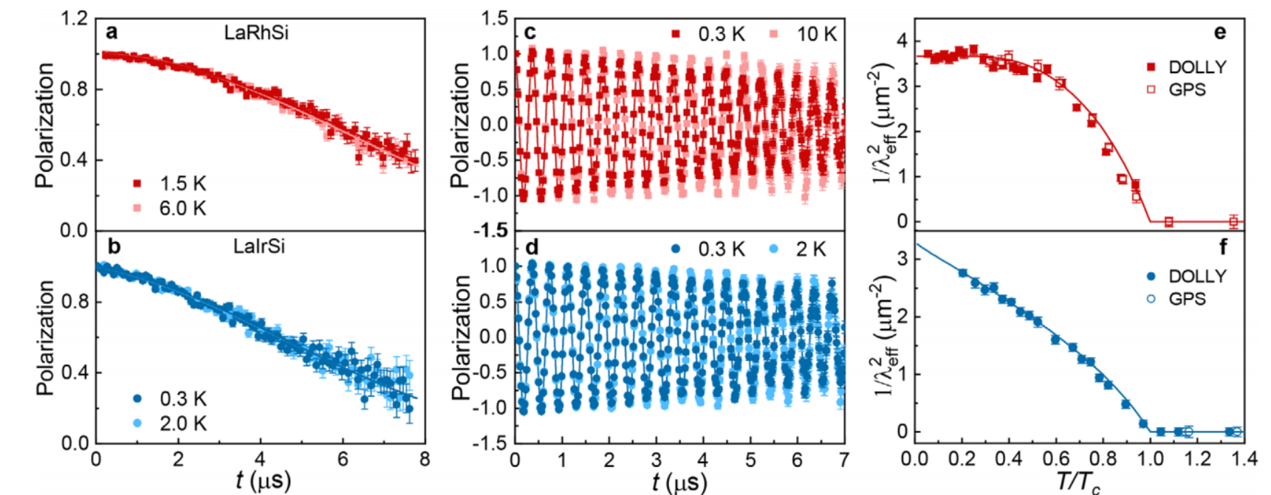
μSR
Unconventional SC in La(Ir,Rh)Si
otation
elaxation
esonance
muon
spin
μSR: nodeless to nodal SC
Relaxation is determined by nuclear moments
TRS is preserved in both compounds
LaRhSi: T-independent ρ_{sc} → fully gapped SC
LaIrSi: strong T dependent ρ_{sc} → nodal SC
T. Shang, et al., Adv. Mater. 37, e11385 (2025）
Notes:
Now we use muSR technique to investigate the SC properties of both compounds. First, we performed the ZF-muSR for both compounds in the superconducting and normal states. For both compounds, the ZF-muSR spectra are almost overlap for both temperatures. This confirm the absence of spontaneous fields in the SC state, and thus TRS is preserved in both compounds. Also both compounds show weak muon-spin relaxation, which is sole determined by nuclear moments.
The TF-muSR measures the magnetic penetrate depth and thus the superfluid density. LaRhSi shows almost temperature-independent superfluid density at low T. While superfluid density is almost linearly temperature dependent in LaIrSi. Therefore, LaRhSi shows fully gapped SC, while LaIrSi shows nodal SC, which confirms the presence of unconventional SC in this family.

Slide 13
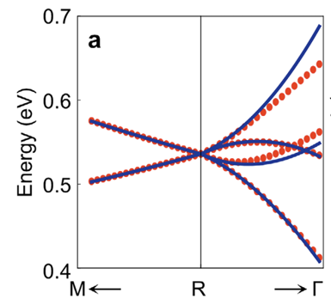
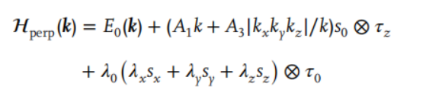
μSR
Unconventional SC in La(Ir,Rh)Si
otation
elaxation
esonance
muon
spin
Theory of nodal SC
Considering the isotropic spin-triplet pairing, an effective perturbation model around the R point was constructed:
E₀ = A₀ + A₂k²; λ₀ is the strength of SOC
A₃ represents the C₃-wrapping term, implying that the Fermi surfaces are not isotropic but only symmetric under C₃
Coexistence of SC with chirality-induced multifold fermions may stabilize unconventional pairing symmetry
A₀ = 0.536 eV, A₁ = 0.924 eV·Å, A₂ = -14.273 eV·Å²,
A₃ = 15 eV·Å²
T. Shang, et al., Adv. Mater. 37, e11385 (2025)
Notes:
In these chiral crystals, coexistence of SC with multifold fermions or unconventional fermions may stabilize unconventional paring symmetry.
Here for LaIrSi, as shown in the figure, we focus on the four Fermi surfaces, which are relatively large and contribute most to the density of states.
Considering the isotropic spin-triplet pairing, we construct an effective perturbation model around R point.
The mixing between spin-singlet (Δs) and spin-triplet (Δt ) components is a hallmark of noncentrosymmetric superconductors, where broken inversion symmetry permits such a mixing. It is important to note that previous approaches are based on a topologically trivial Hamiltonian with isotropic Fermi surfaces, while the spin triplet component exhibits significant anisotropy.

Slide 14

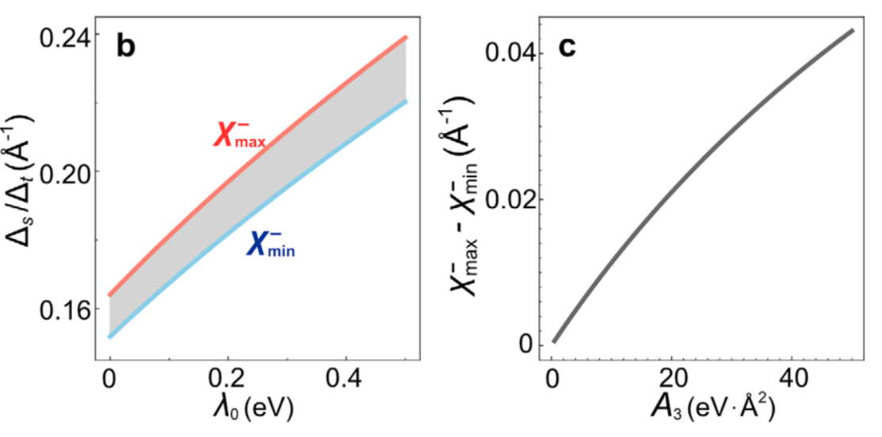
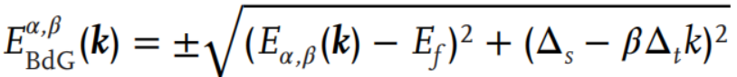
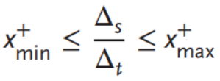
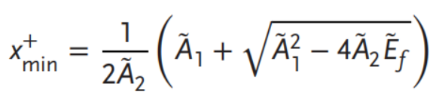
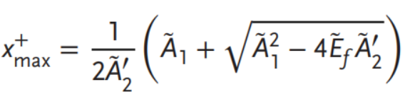
μSR
Unconventional SC in La(Ir,Rh)Si
otation
elaxation
esonance
muon
spin
Theory of nodal SC: effective Ginzburg-Landau model
For LaIrSi, considering the isotropic pairings (Δ_{s} and Δ_{t}), SOC (λ₀), the anisotropic wrapping term (A₃), and pairing potential
Superconducting quasiparticle spectrum reads:
For the E_{+,+} band (where α = +), the condition for nodal-line SC is given by:
The gap-nodes region(grey) is nearly invariant with respect to λ₀ (SOC)
It increases as the A₃ term
T. Shang, et al., Adv. Mater. 37, e11385 (2025）
Notes:
Further, following the Ginzburg-Landau model, we can get the superconducting quasiparticle spectrum.
With some calculations, we obtain the condition for the appearance of nodal-line SC. The Xmin and Xmax are functions of A parameters obtained from band structure fitting.
The gap-node region is nearly invariant with respect to SOC strength. But instead, it increases as the A3 term increases.

Slide 15
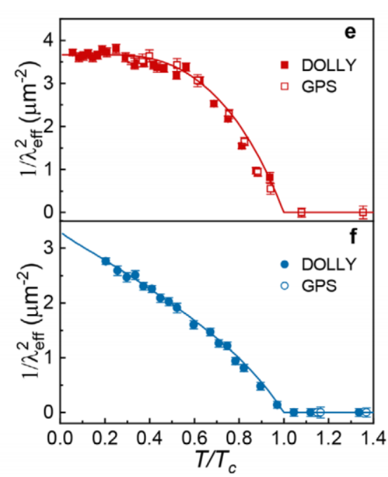
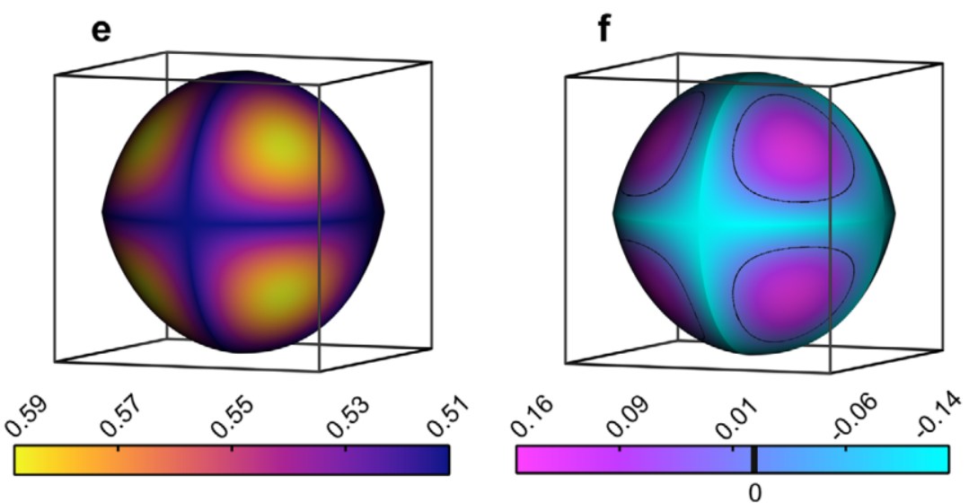
μSR
Unconventional SC in La(Ir,Rh)Si
otation
elaxation
esonance
muon
spin
Theory of nodal SC: effective Ginzburg-Landau model
Gap function of the anisotropic Fermi surface
Δ_{s}/Δ_{t} ~ 1.5
Δ_{s}/Δ_{t} ~ 0.9
Fully-gapped
Nodal
Gap on the E_{+,+} band is isotropic due to dominant spin-singlet pairing
Gap on the E_{-,+} band exhibits nodal lines due to dominant spin-triplet pairing
T. Shang, et al., Adv. Mater. 37, e11385 (2025)
Notes:
Based on the above theoretical work, we analyzed the temperature-dependent superfluid density.
For LaRhSi, the spin singlet is dominant, and it behaves as a fully gapped superconductor, while for LaIrSi, the spin triplet is dominant, and it shows a line-node SC. And the superfluid density is almost linearly temperature-dependent.

Slide 16
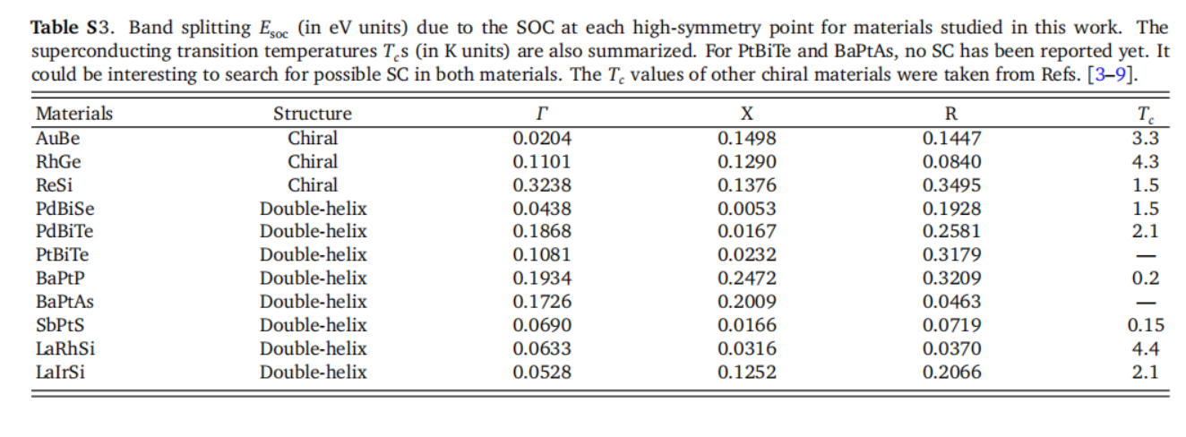
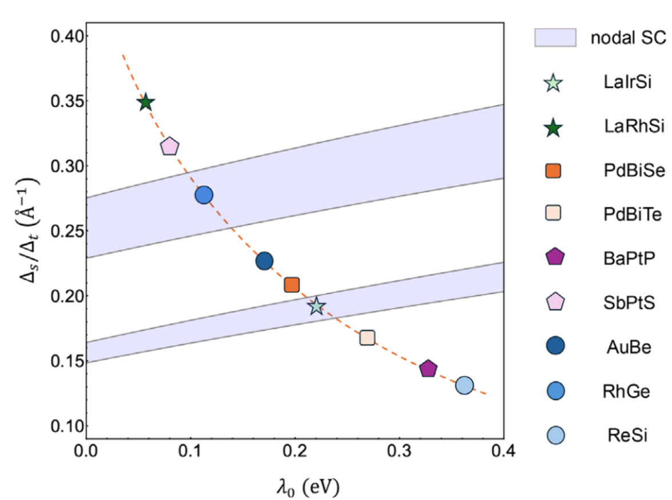
μSR
Unconventional SC in La(Ir,Rh)Si
otation
elaxation
esonance
muon
spin
Insights for other chiral crystals
nodal
nodal
λ₀ is important, but not as large as preferred
RhGe is a good candidate for unconventional and topological SC (not yet confirmed )
All these superconducting materials adopt a
chiral SP P2₁3 (No. 198)
T. Shang, et al., Adv. Mater. 37, e11385 (2025)
S. Mardanya, et al., Phys. Rev. Mater. 8, L091801 (2024)
Notes:
Based on our results from LaRhSi and LaIrSi, we extend the calculations to other superconducting chiral crystals with 198 SG. As shown in this phase diagram, there are two nodal regions. Following this phase diagram, to promote nodal SC or unconventional SC, the SOC strength is not as large as preferred.
For example, the SOC of ReSi is significant, but it is out of the nodal region. Therefore, it should be fully-gapped. By contrast, the RhGe shows moderate SOC, and it is located in the nodal region. Therefore, RhGe is a good candidate for searching for unconventional SC. Unfortunately, no bulk SC has been realized in this material.

Slide 17
μSR
Outline
otation
elaxation
esonance
muon
spin
Topological chiral crystal
Basic principles of μSR
Unconventional SC in chiral crystals
Summary
Relaxation
S
R
Resonance
LaRhSi/LaIrSi Adv. Mater. 37,e11385 (2025)
ScIr_{2-x}Si_{x} Adv. Mater. 38,e74399 (2026)
Rotation
Notes:
Now I will talk about our recent work on another chiral crystal, which is also belongs to the Kagome family. The ScIr2 doped with Si.

Slide 18
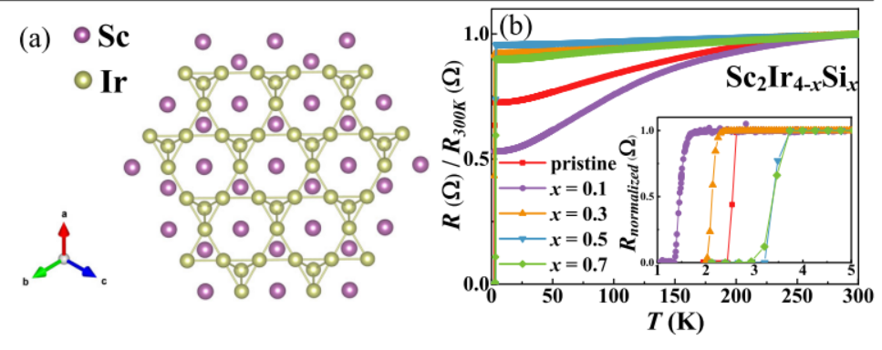
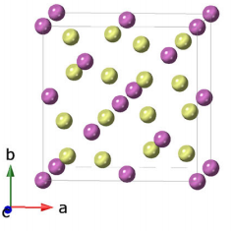
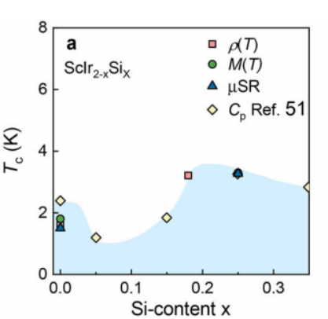
μSR
Unconventional SC in ScIr_{2-x}Si_{x}
otation
elaxation
esonance
muon
spin
SC in the newly discovered ScIr_{2-x}Si_{x}
SCI
SCII
K. Xia, et al., Adv. Mater. 38,e74399 (2026)
Z. Zhu, et al., Commun. Mater. 5, 85 (2024)
Ir atoms form a kagome lattice viewed along [111]
Tc is enhanced by Si doping.
Two-dome SC was observed in ScIr_{2-x}Si_{x} Unconventional?
Notes:
Recently, the ScIr2-xSix has been found to show very interesting SC properties. ScIr2 has a cubic crystal structure, and Ir atoms form a Kagome lattice viewed along the [111] direction.
The parent ScIr2 shows Tc at 2 K, which increases to close to 4 K by Si doping.
Interestingly, two-dome SC was observed in ScIr2-xSix. The underlying physics is unknow, and this two-dome SC may indicate unconventional SC.

Slide 19
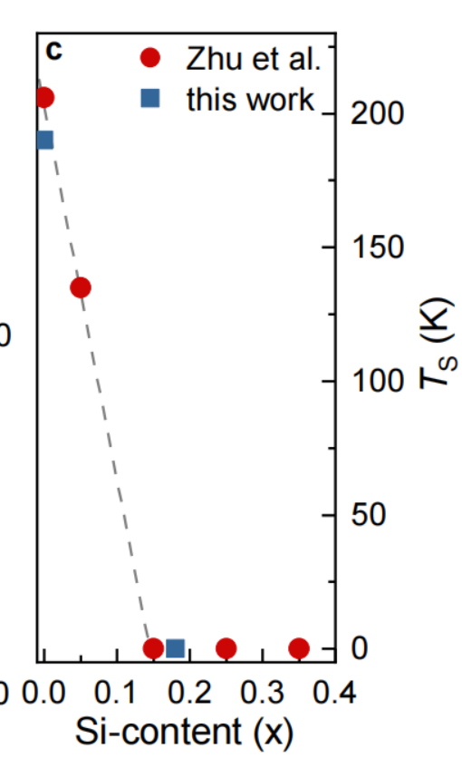


μSR
Unconventional SC in ScIr_{2-x}Si_{x}
otation
elaxation
esonance
muon
spin
Origin of two-dome SC
Fd-3m No. 227
R32 No. 155
Centrosymmetric
Noncentrosymmetric
K. Xia, et al., Adv. Mater. 38,e74399 (2026)
Structure phase transition at Ts = 190 K
Ts is quickly suppressed as Si is doped
Single-crystal XRD confirms the structure phase transition from high-T cubic to low-T rhombohedral phase (chiral crystal)
Notes:
To investigate this two-dome SC and to search for possible unconventional SC, we synthesized ScIr2-xSix samples
We first measure the resistivity data. Interestingly, the parent compound ScIr2 shows an anomaly around 190 K, which is quickly suppressed by Si doping.
For x > 0.1, no anomaly can be detected.
We performed single-crystal-x-ray diffraction measurements. We found that the anomaly at Ts is attributed to a structural phase transition. Below Ts, the cubic phase changes to the rhombohedral phase.
However, the Kagome lattice remains, which can be viewed along [001] direction. Interestingly, the low-T structure also belongs to the chiral space group. Therefore, ScIr2-xSix is also a chiral crystal.

Slide 20

μSR
Unconventional SC in ScIr_{2-x}Si_{x}
otation
elaxation
esonance
muon
spin
Characterization of bulk SC
rhomb.
cubic
K. Xia, et al., Adv. Mater. 38,e74399 (2026)
Cubic (x < 0.1) and rhomb. (x >1)
Two typical samples (x = 0 and 0.25) were chosen for μSR study
Bulk SC was confirmed for both compounds
ScIr₂: Tc = 1.8 K
ScIr_{1.82}Si_{0.18}: Tc = 3.3 K (nominal ScIr_{1.75}Si_{0.25})
Notes:
To investigate the superconducting pairing of ScIr2-xSix family. The x = 0 and 0.25 was chosen for the muSR studies. The normal Si content was determined as 0.18.
Bulk SC with Tc = 1.8 K and 3.3 K was confirmed by susceptibility measurements.

Slide 21



μSR
Unconventional SC in ScIr_{2-x}Si_{x}
otation
elaxation
esonance
muon
spin
μSR: nodal SC in ScIr_{2-x}Si_{x} family
K. Xia, et al., Adv. Mater. 38,e74399 (2026)
Both compounds can be best described by a two-band (s+d)-wave model:
ScIr₂: 0.8s (0.27meV) + 0.2d (0.32 meV)
ScIr_{1.82}Si_{0.18}: 0.8s (0.60meV) + 0.2d (0.73 meV)
Relaxation is determined by nuclear moments
TRS is preserved in both compounds
Notes:
First, resembling the LaRhSi and LaIrSi, the ZF-muSR confirms the preserved TRS in ScIr2-xSix family.
The TF-muSR measurements reveal that for both compounds, the temperature-dependent superfluid density is best described by an (s+d)-wave model. The weight of the d component is about 20%.
Therefore, ScIr2-xSix family is also a multigap superconductor. Since at least one band shows superconducting gap nodes, ScIr2-xSix can be classified as an unconventional superconductors.

Slide 22




μSR
Unconventional SC in ScIr_{2-x}Si_{x}
otation
elaxation
esonance
muon
spin
Electronic band structure high-T cubic phase
ScIr₂
ScIr₂
DOS is contributed by Ir-5d and Sc-4d orbitals
Two main bands cross the E_{F} for both compounds
Band splitting due to SOC is significant
E_{SOC} = 275 meV
ScIr₂+SOC
Flat band along Γ-L direction is pushed to E_{F} by SOC (10 meV below E_{F})
Flat bands are shifted upwards by 300 meV in ScIr_{1.82}Si_{0.18} (away from E_{F})
Flat bands and DOS peaks might be responsible for the structural instability in ScIr₂
Notes:
To further understand the unconventional SC in the ScIr2-xSix family, we also performed DFT calculations.
The DOS at the EF is contributed by Ir-5d and Sc-4d orbitals, which suggests possible strong SOC. There are mainly two bands that cross the EF, consistent with the multiband SC in ScIr2-xSix family.
For example, after considering the SOC, band splitting is estimated to be 275 meV along the Gamma-L direction. Also, the SOC further pushes the flat band close to EF, 10meV below EF.
Considering that the flat bands and DOS peaks are located at EF, they might be responsible for the structural instability in the ScIr2-xSix family.

Slide 23


μSR
Unconventional SC in ScIr_{2-x}Si_{x}
otation
elaxation
esonance
muon
spin
Electronic band structure low-T rhombohedral phase
ScIr₂+SOC
Electronic bands are quite similar
The rhombohedral phase lacks an inversion center, the SOC further lifts the degeneracy
Flat band splits into two bands along the Γ-L, resulting in a decrease in DOS
Lower Tc in the first SC dome
ScIr₂+SOC
Flat bands account for most of the DOS at E_{F}, which may explain the unconventional SC in ScIr_{2-x}Si_{x}
e.g., electronic correlations
Notes:
For the low-T rhombohedral phase, the main features of the band structure are quite similar. However, the low-T phase lacks an inversion center; the SOC further lifts the band degeneracy.
Flat band along the Gamma_L direction was split into two bands, resulting in a decrease of DOS. This may explain the reduced Tc in the first SC dome.
Considering that the flat bands account for most of the DOS at EF, this may explain the unconventional SC in ScIr2-xSix, e.g., the enhanced electronic correlations.

Slide 24




μSR
Unconventional SC in ScIr_{2-x}Si_{x}
otation
elaxation
esonance
muon
spin
Topological aspects
ScIr₂+SOC
T < T_{s}
ScIr₂+SOC
ScIr_{1.82}Si_{0.18}+SOC
Z.-M. Yu, et al., Sci. Bulltet. 67, 375 (2022)
DP splits into two Weyl points with topological charges C = ±1
Multifold fermions with topological charges of C = 3 at Γ point
Dirac point at X point shifts to E_{F} by Si doping
Ir atoms form a chiral chain
Giant helicoid Fermi arcs
Notes:
Now let’s look at the topological aspects of this family. In the high-T cubic phase, there is a Dirc point at X point. This Dirac point is shifted to EF by Si doping (almost located at EF).
The low-T rhombohedral phase belong to the chiral space group, therefore, ScIr2-xSix can be classified as topological chiral crystal. Du to the lack of an inversion center, the Dirac point splits into two Weyl points
Due to the chiral structure, resembling the other topological chiral crystal, mulifold fermion excitations exit at the high-symmetric gamma point.
In addition, a giant helicoid Fermi arcs were predicted on the surface states as well.

Slide 25
μSR
Conclusions and outlook
otation
elaxation
esonance
muon
spin
µSR is a powerful tool for studying unconventional superconductors, including the TRS breaking effect, superconducting pairings, and SC mechanism
A fully-gapped SC is tuned to a nodal-line SC by turning the ratio of spin-singlet to spin-triplet pairing via the strong SOC in the La(Rh,Ir)Si family.
For ScIr_{2-x}Si_{x}, two possible pairing mechanisms have been proposed: conventional electron–phonon coupling and one arising from spin- or charge fluctuations driven by electron correlation. The former results in an s-wave pairing, while the latter leads to various unconventional pairing symmetries (e.g., p-, d-,or f-wave)
The combination of chirality (structural and electronic) and unconventional SC makes superconducting chiral crystals good candidates for investigating topological SC
Our work calls for renewed investigations of unconventional SC in other studied superconductors with a chiral structure

Slide 26

μSR
Acknowledge
otation
elaxation
esonance
muon
spin
Paul Scherrer institut (PSI)
Ekaterina Pomjakushina
Dariusz Gawryluk
Hubertus Luetkens
Jonas Krieger
Toni Shiroka
ZJU (浙江大学)
陈晔 (Ye Chen)
胡伦辉 (Lunhui Hu)
袁辉球 (Huiqiu Yuan)
史明 （Ming Shi）
TJU (天津大学)
赵建洲（Jianzhou Zhao)
CityU (香港城市大学)
马均章 (JunZhang Ma)
MPI (马普所)
Mukkattu O. Ajeesh
Michael Nicklas
TUD (多特蒙德工业大学)
Igor Plokhikh
ECNU (华东师范大学)
徐杨 (Yang Xu)
詹清峰 (Qingfeng Zhan)
段纯刚 (Chungang Duan)
Thank you for your time!

Slide 27





μSR
Unconventional SC in ScIr_{2-x}Si_{x}
otation
elaxation
esonance
muon
spin
Materials with kagome lattice exhibit rich quantum phenomena
Y. Wang, et al., Nat. Rev. Phys. 5, 635 (2023)
Z. Guguchia, et al., npj quantum Mater. 8, 41 (2023)
Magnetic properties are widely studied
Unconventional SC kagome materials are extremely rare
Unconventional SC and CDW have been observed in the AV₃Sb₅ family
Notes:
The Kagome materials exhibit very rich quantum phenomena due to their specific band topologies, e.g., flat bands, VHs, topological band crossings, magnetic frustration, and so on. Since there are many studies on Kagome materials, I am not going to discuss all the details.
Among Kagome materials, their magnetic properties are widely studied, e.g., quantum spin liquid, skyrmion.
However, their SC remains largely unexplored, due to limit number of candidate materials. Recently, the unconventional SC and CDW have been well studied in VSb 135 family.

Slide 28




μSR
MuSR: basic principles
otation
elaxation
esonance
muon
spin
电子钟
正电子
数量
正电子探测器
正电子探测器
μSR
谱线
样品
B_{μ} = (2π/γ_{μ}) ν_{μ}
TRIUMF http://neutron.magnet.fsu.edu/muon_relax.html
缪子进动频率
Notes:
1. How we use the muons to measure the interesting materials?
2. Since muon has its own magnetic moment, we can treat muon as a very sensitive and local magnetic probe. Once the muons hit the samples, it will decay into postive electrons in 2.3 muS. The postive electrons will be counted by detectors.
3. Depends the interaction between muon spin and magnetic moment in the samples, the detected positron will show different asymmetry.
By analysizing the muSR asymmetry, we can get the informaiton of the muon depolarization and therefore the physical properties of the measured samples.

Slide 29





μSR
otation
elaxation
esonance
muon
spin

Slide 30
μSR
MuSR: applications
otation
elaxation
esonance
muon
spin
Magnetic materials
Mn, Co, Fe-based oxides
Heavy-fermion
Low-dimensional
Quantum Spin Ice/Liquid
Spin glass
Skyrmions
Topological
Superconductors
Cuprates
Iron-based
Unconventional SC
Magnetic SC
Topological SC
Relaxation
S
R
Resonance
Rotation
Semiconductors
organic, inorganic
Material Science
Multiferroic, battery
Magnetic thin films (spin valve)
Chemistry, Soft matter

Slide 31




μSR
Advantages of muons
otation
elaxation
esonance
muon
spin
μSR is a very sensitive magnetic probe
Mass: 105.65 Mev/c² ~ 207m_{e}
Charge: +e/-e
Spin: ½
Moment: 3.18 μ_{P} ~ 0.005μ_{B}
Gyromag. Ratio: 851.615 MHz/T
Decay period: 2.2 μs
Resolution: 10⁻³-10⁻⁴μ_{B}~0.01mT
590 MeV
The energy can be adjusted
keV MeV
surface bulk properties
Muons are almost ~100% spin polarized, enabling high resolution
Perfect compensated for NMR and neutron scattering techniques

Slide 32


μSR
Muon sources: MuSR
otation
elaxation
esonance
muon
spin
We are all here now!
We will be able to do muon experiments in China soon！

Slide 33




μSR
Unconventional/topological SC
otation
elaxation
esonance
muon
spin
Noncentrosymmetric SCs
p(c) ≠ p(-c)
Antisymmetric spin-orbit coupling (ASOC)
allows degeneracy of the Fermi surfaces.
Originates from atomic SOC and the hybridization between orbitals with different parity due to the spatial inversion symmetry breaking
CePt₃Si
E. Bauer et al. al., PRL (2004)
Rashba-type
lack of inversion symmetry
Saxena. Nature 427, 799 (2004)
Cooper-pair function allows mixture of single and triplet pairing
Centrosymmetric
Noncentrosymmetric
库伯对
Notes:
a, The inner and outer rings (separated for clarity) enclose occupied electron states in momentum space, typical of a normal superconductor. b, When space inversion symmetry is lacking, spins might rotate around the momentum-space surface, clockwise on one side and anticlockwise on the other.
Now I would like to introduce one type of the superconductor, which is non-centrosymmetric superconductor. The NCSC implies the superconductors with the crystal structure without inversion symmetry. For example, the Cet3Si, if we do the inversion operator along c-axis, the crystal structure is not overlap.
Due to the lack of inversion symmetry, the antisymmetric SOC will cause the band splitting. Compared to the normal superconductor, in the momentum space, when space inversion symmetry is lacking, spins might rotate around the momentum-space surface, clockwise on one side and anticlockwise on the other.
Due to the band splitting, the mixture of spin single and spin triplet is allowed in the NCSCs. While in case of centrosymmetric, only the singlet or the triplet is allowed.

Slide 34




μSR
Unconventional/topological SC
otation
elaxation
esonance
muon
spin
The mixed pairings yield novel/unconventional SC properties
CeIrSi₃
Li₂Pt₃B
CaPtAs
Y. Ōnuki, Physica C (2009)
H. Q. Yuan, PRL 97, 017006 (2006)
T. Shang, PRL 124, 207001 (2020)
Time-reversal symmetry
breaking
H_{c2} beyond Pauli limit
gap nodes
Notes:
Due to the mixed pairings, the NCSCs shows some unconventinal fearutes compared to the CSCs materials.
For example, the upper crystal field Hc2 is exceeding to the Palul limit.
The superconducting gap shows nodal structure
Also in some cases, the superconducting state breaks the time reversal symmetry below the Tc.

Slide 35






μSR
Unconventional/topological SC
otation
elaxation
esonance
muon
spin
How to realize topological SC?
Route 1: e.g., Cu_{x}Bi₂Se₃
Chemical doping in topological insulator
Route 2: e.g., NbSe₂/Bi₂Se₃
Bilayer of s-wave SC/topological insulator
Route 3: e.g., α-BiPd
Intrinsic SC + nontrivial band topology
Drawbacks: Doping-induced disorder and inhomogeneities
Drawbacks: Complex, difficult to fabricate,
relatively low T_{c}
Drawbacks: Few candidates, relatively low T_{c}
Advantages: One compound only, “clean” solution
Z. Sun, et al., Nat. Commun. (2015)
Jin-Peng Xu et al., PRL (2015)
S. Sasaki et al., PRL (2011)
K. Matano, et al., Nat. Phys. (2016)
S. Y. Xu, et al., Nat. Phys. (2014)
Y. Li, et al., Adv. Quantum Technol. (2019)
Notes:
NCSCs become the ideal platform to search for the possible topological SC in recent years.

Slide 36


μSR
Unconventional/topological SC
otation
elaxation
esonance
muon
spin
Topological Semimetal family
Nocentrosymmetric SCs
Inversion symmetry
Weyl semimetal with SC
Time reversal symmetry
Unconventional/topological SC
Majorana bound states
NCSCs become the ideal platform for searching the topological SC
Hongming Weng, et al., JPCM (2016)

Slide 37




μSR
MuSR: basic principles
otation
elaxation
esonance
muon
spin
Schematic TF µSR experiment
Schematic LF (ZF) µSR experiment
H
LF or ZF-µSR: very sensitive to weak internal fields and
useful for studying dynamics
ZF-µSR offers unique advantages (direct study of weak magnetism)
TF-µSR: excellent probe of magnetic fields: ω_{μ} = γ_{μ} ⋅ B

