Slide 1
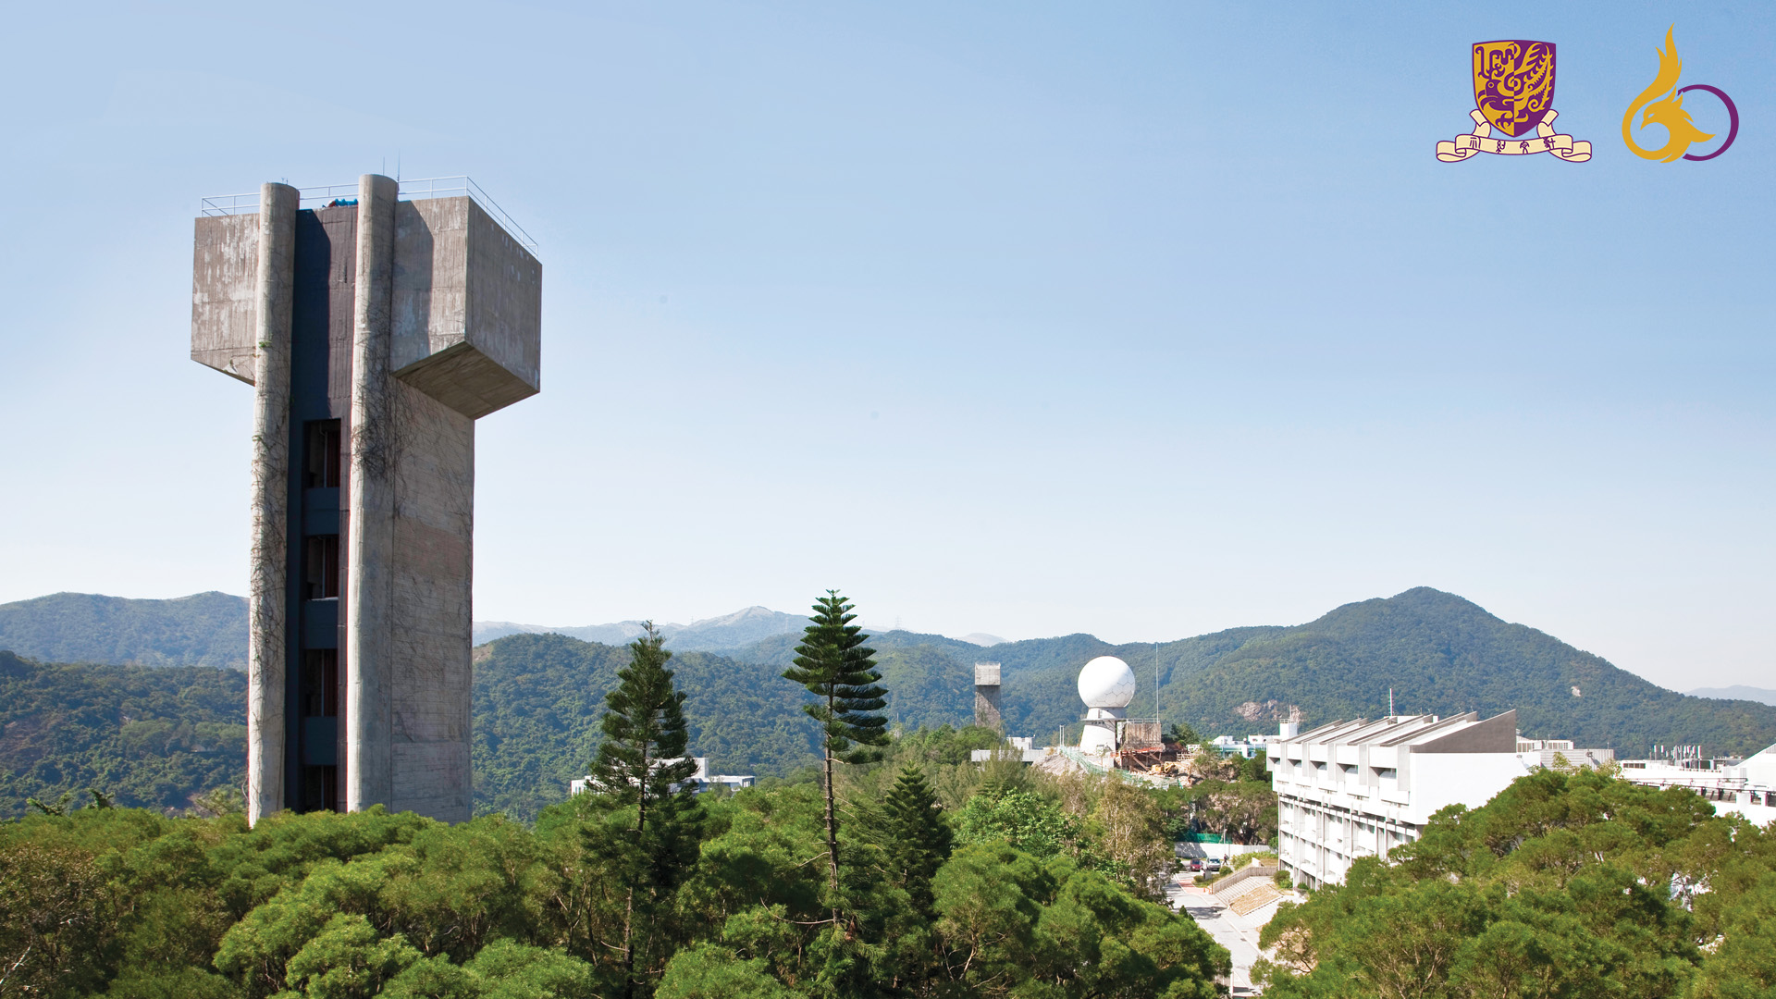
MELODY2026
Probing the symmetry of altermagnetic interactions
Qisi Wang 王奇思
Chinese University of Hong Kong 香港中文大学
24.11.2026 | Dongguan

Slide 2
Outline
Basics of altermagnetism & spectroscopy evidence
Inelastic neutron scattering study of g-wave magnon splitting in α-Fe₂O₃
Outlook on μSR study of unconventional magnets

Slide 3












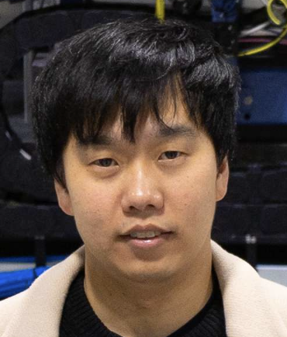








Collaborators
Tianren Wang
Yuehong Li
Yuetong Wu
Andong Liu
Yujie Yan
Yao Shen
Yu Feng
Xin Tong
Wei Luo
Seoul National University
Jaewon Choi
Stefano Agrestini
Mirian
Garcia-Fernandez
Ke-Jin Zhou
Yi Lu

Slide 4
Outline
Basics of altermagnetism & spectroscopy evidence
Inelastic neutron scattering study of g-wave magnon splitting in α-Fe₂O₃
Outlook on μSR study of unconventional magnets

Slide 5
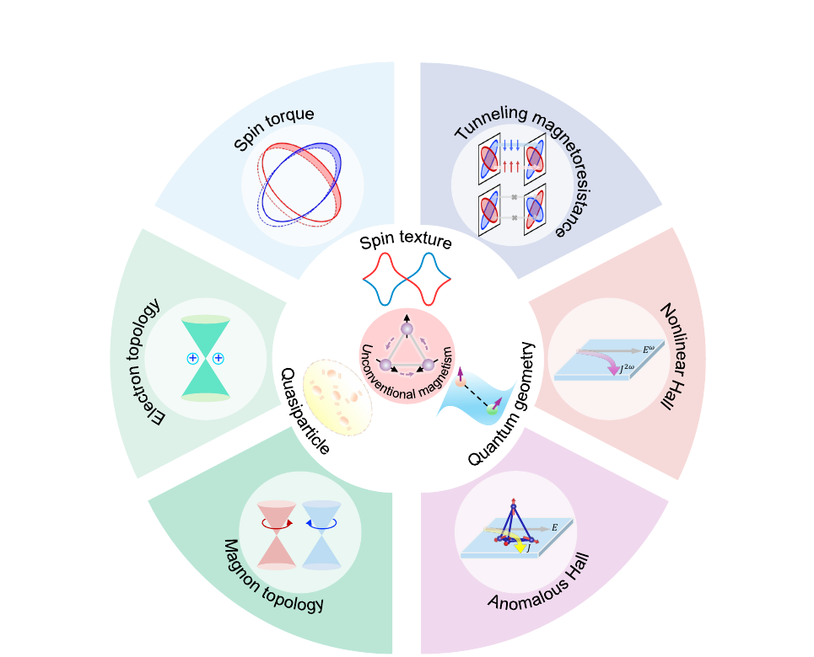
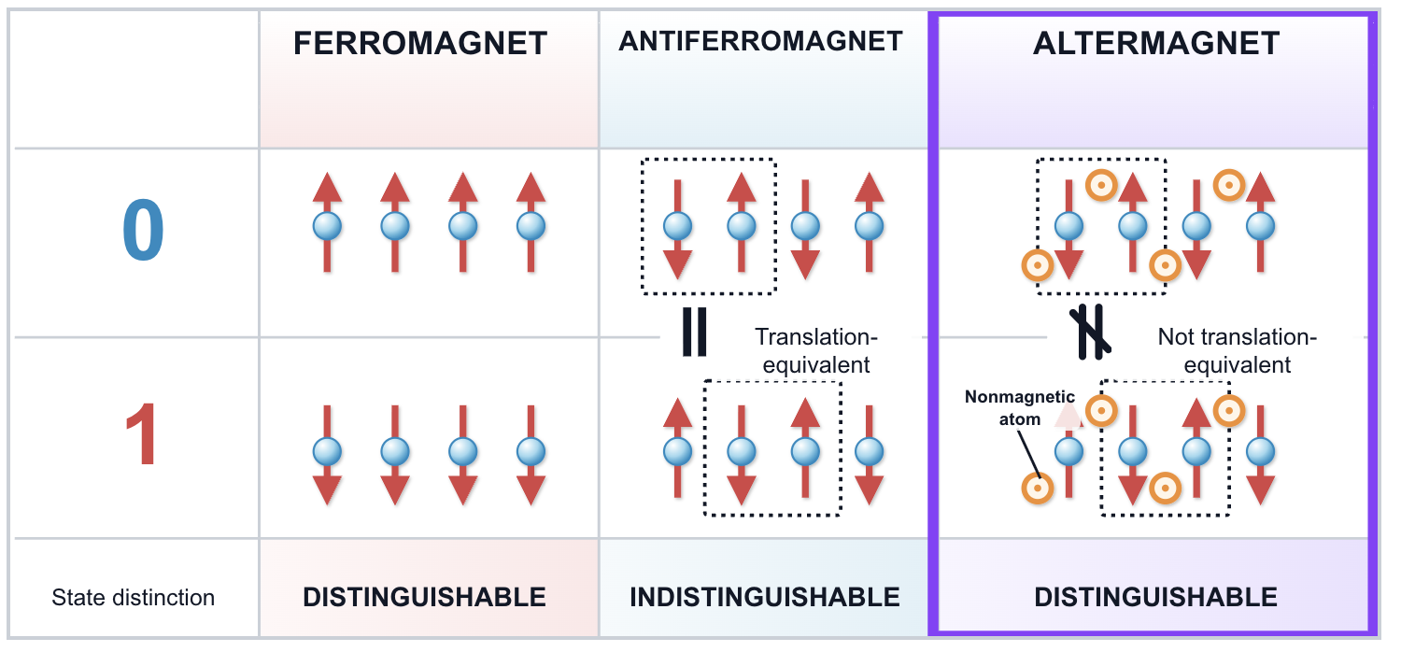
Unconventional magnetism: spintronics & magnonics
“Simplified” picture of altermagnetism
Altermagnets: zero net moment with broken PT & τT symmetry
Exchange spin-split electronic bands & lift the degeneracy of opposite-chirality magnon branches
X. Chen, W. Chen, Q. Liu, Q, The rise of unconventional magnetism
Notes:
A simplified picture to understand difference between AM and AFM: sublattice cannot be related by only translational operation, and certain rotation is needed, if we consider the atomic/ligand environment. This leads to a Q-dependent exchange field that split the spin-up and spin-down electronic bands

Slide 6
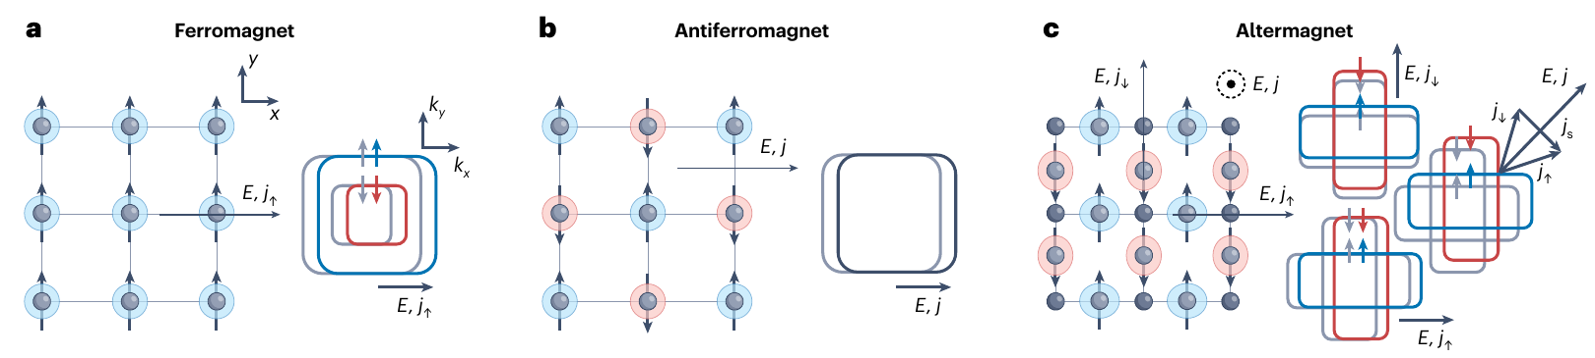
Altermagnets (AM): compensated yet spin-split
Edelstein effect
Zero net moment
Broken time reversal
Why it matters
Compensated sublattices suppress stray fields
Spin-polarized bands and T-odd responses survive
Exchange-scale splitting, THz dynamics, spin currents, no stray field
Altermagnet: Opposite-spin sublattices are related by crystal rotation — not by translation or inversion
AM retain AFM compensation while gaining FM-like spin-resolved functionality
Jungwirth et al., Altermagnetic spintronics, Nat. Phys. 22, 1012 (2026)
Notes:
Such spin-splitting yet zero net magnetization of AM lead to unique advantage in the spintronic or magnonic applications. Merit of both FM and AFM.

Slide 7
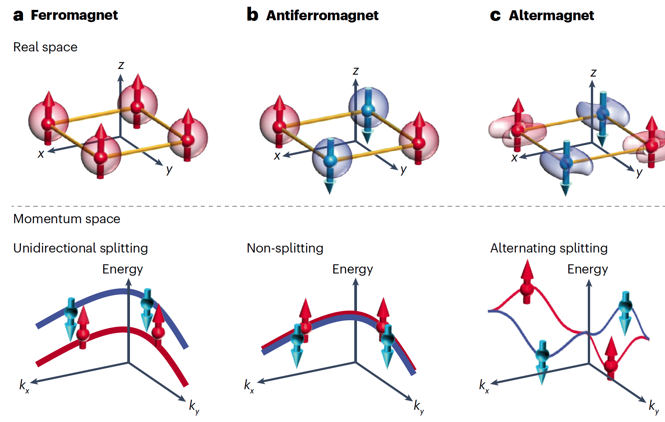
Electronic band splitting: crystal symmetry selects d-, g-, and i-wave
Why bands split
E↑(k) = E↓(Rk)
R connects opposite-spin sublattices
Generic k: Rk ≠ k → finite ΔE(k)
Invariant directions:
Rk = k → nodal degeneracy
d / g / i wave
2 / 4 / 6 nodal surfaces
Repeated crystal rotations force alternating spin sectors.
Symmetry-fixed zeros become nodal lines or planes;
Higher symmetry allowed harmonics generate more nodes.
The wave label is the lowest even-parity angular harmonic allowed by the altermagnetic spin group
The angular pattern (of spin-splitting) is a symmetry fingerprint
C. Song et al., Altermagnetic spintronics, Nat. Rev. Mater. 10, 473 (2025)
Notes:
Altermagnets are classified by the symmetry of the spln-splitting, which inherits from the crystal crystal.

Slide 8
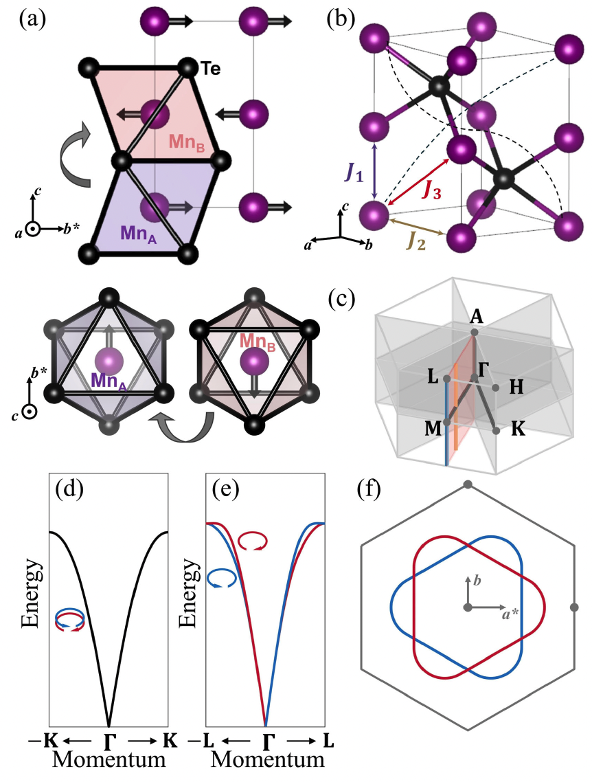
Magnon band splitting: the same symmetry logic
Why magnon split in AM
Two circular magnon modes are degenerate in a conventional AFM
Crystal rotation permits inequivalent long-range exchange paths: J₁₀ ≠ J₁₁
Nodal planes exchange the branches and protect degeneracy
Off nodal, energy and chirality split with the same g-wave sign pattern
Liu et al., Chiral Split Magnon in Altermagnetic MnTe, PRL 133, 156702 (2024)
Electronic and magnon splitting share a symmetry origin:
Unequal symmetry-related exchange paths (due to ligand environment) lift energy and chirality degeneracy away from nodal planes

Slide 9
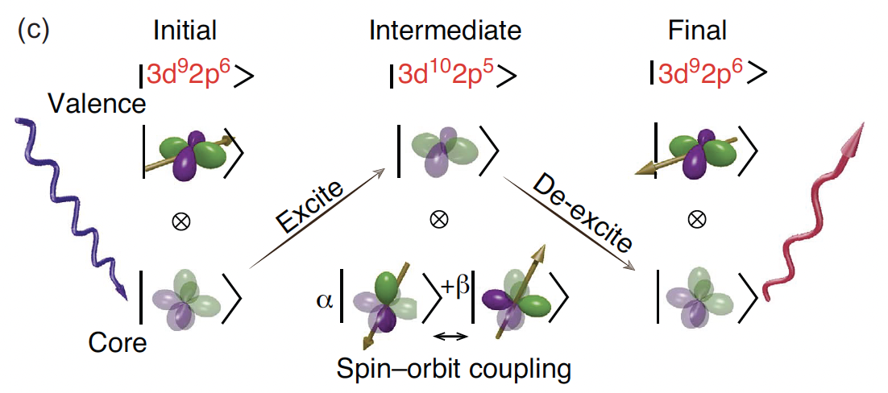
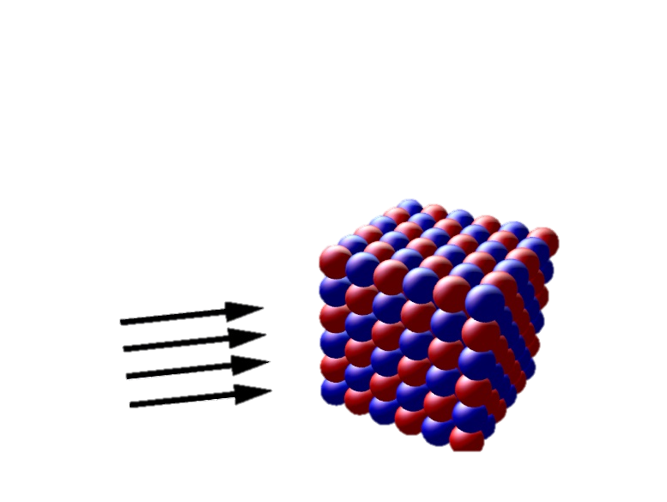
Resonant Inelastic X-ray Scattering (RIXS)
Spin-flip RIXS process
X-rays
Sensitivity to multiple correlations – charge, spin, orbital
Element specific
Enhanced cross-sections
Dipole / quadrupole spin interactions
Complementary to neutron: smaller crystal or thin films
C. J. Jia et al., Nat. Commun. 5, 3314 (2014)

Slide 10
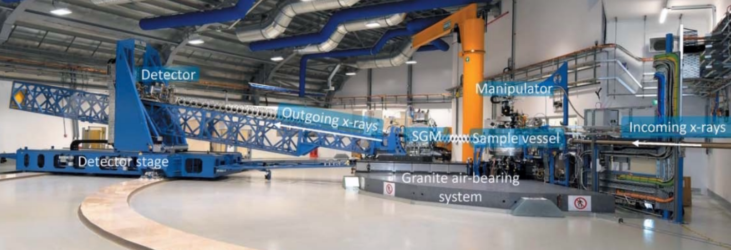
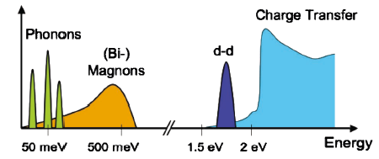
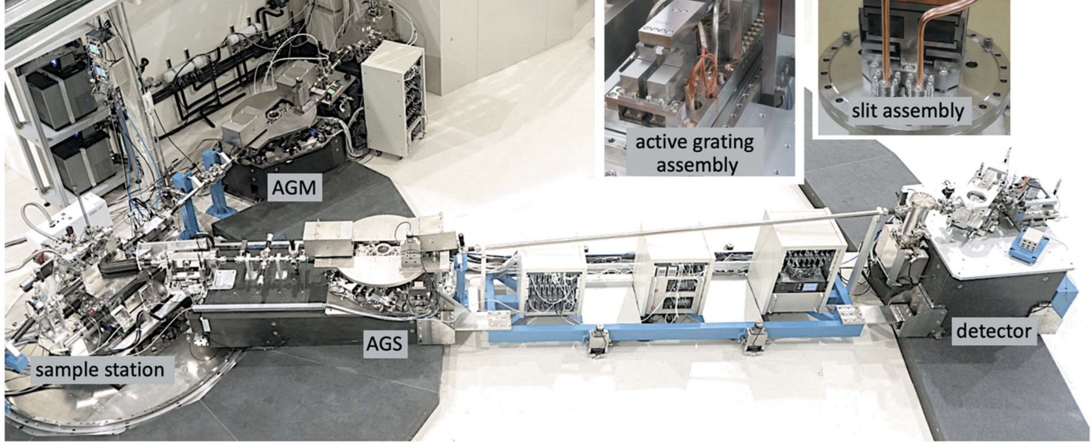
Resonant Inelastic X-ray Scattering (RIXS)
I21 beamline, DIAMND, UK
Evolution of RIXS resolution
J. Synchrotron Rad. 29, 563 (2022)
41A1 beamline, TPS, Taiwan, China
2009
2000
year
2025
38 meV @ Ni L-edge
12 m
L. J. P. Ament et al., Rev. Mod. Phys. 83, 705 (2011)
J. Synchrotron Rad. 28, 977 (2021)

Slide 11
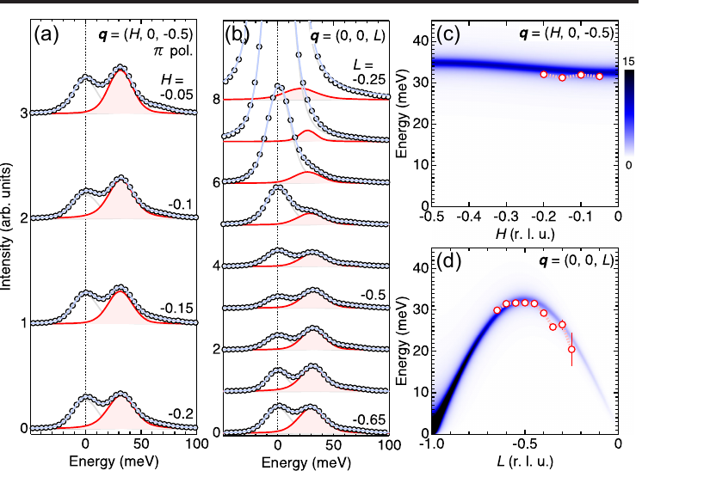
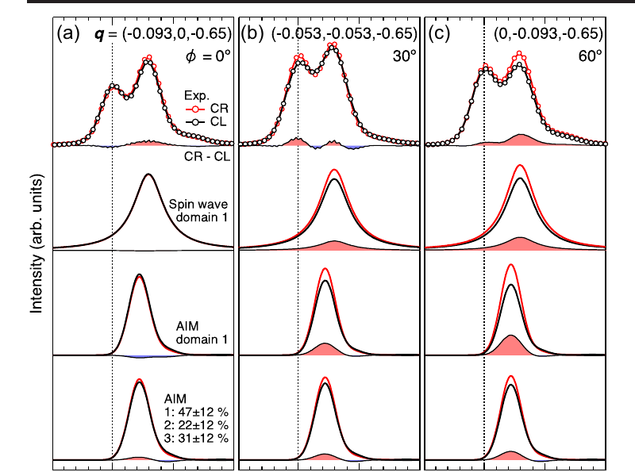
α-MnTe: RIXS-CD distinguishes C₃ magnetic domains
24 K; ΔE = 24 meV
~32 meV magnon; dispersion agrees with INS
φ-dependent CD fits three C₃ domain types
CD is controlled by symmetry and intermediate states
CD amplitude is not a direct measure of g-wave splitting
RIXS-CD provides a detailed magnetic-domain fingerprint, but not a direct ruler for magnon splitting.
Takegami et al., Circular Dichroism in RIXS: Probing Altermagnetic Domains in MnTe, PRL 135, 196502 (2025)

Slide 12
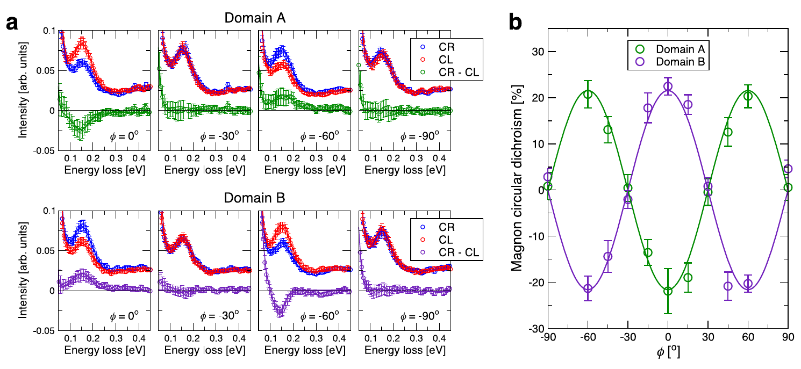
CrSb: RIXS-CD maps g-wave magnon symmetry
Cr L₃ edge; ΔE ≈ 32.5 meV; single-domain microregion
RCD(φ) = A cos(3φ)，|A| = 21.6 ± 1.7%
CD reverses sign between opposite AFM domains
CD → 0 along high-symmetry directions, matching g-wave nodes
Predicted splitting ~22 meV, below the experimental resolution
The evidence is threefold: cos(3φ) azimuthal symmetry, nodal zeros, and domain-sign reversal.
Biniskos et al., Systematic mapping of altermagnetic magnons by RIXS circular dichroism, Nat. Commun. 16, 9311 (2025)

Slide 13
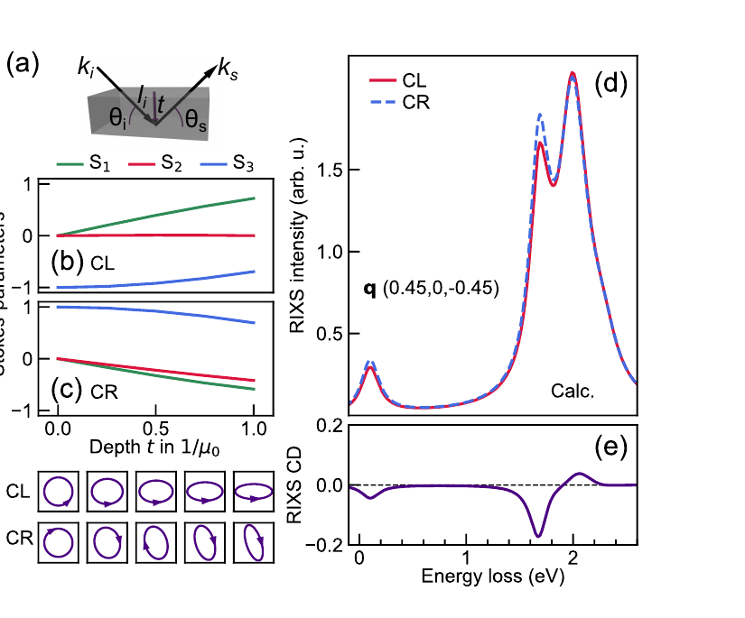
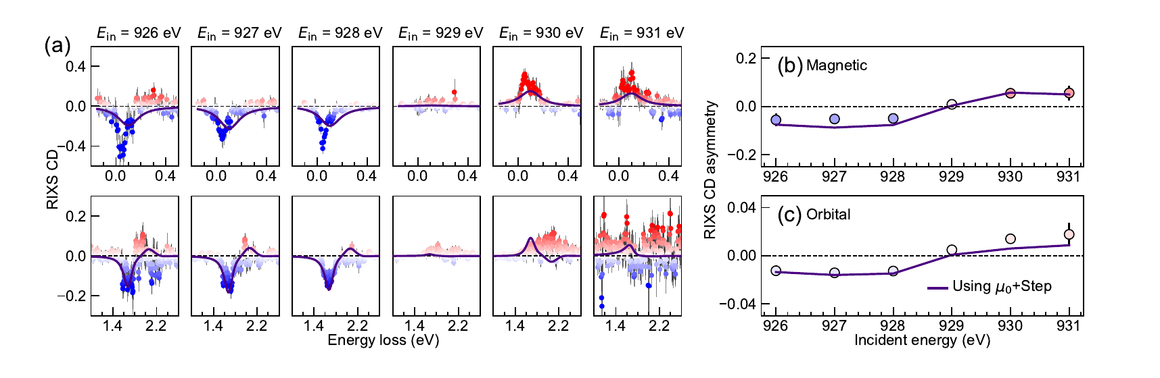
NOT always chiral: birefringence-induced RIXS-CD in CuO
Birefringence rotates CL/CR polarization with depth
Propagation-enabled model reproduces magnetic and orbital CD
CD reverses across Cu L₃ edge and survives at 240 K
RIXS-CD alone does NOT prove intrinsic chirality: model birefringence, propagation, and self-absorption.
Nag et al., Circular dichroism in resonant inelastic x-ray scattering from birefringence in CuO, PRR (2025)

Slide 14
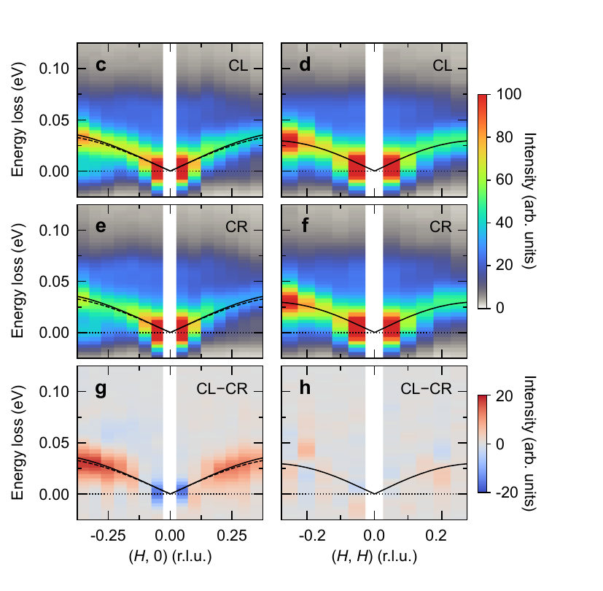
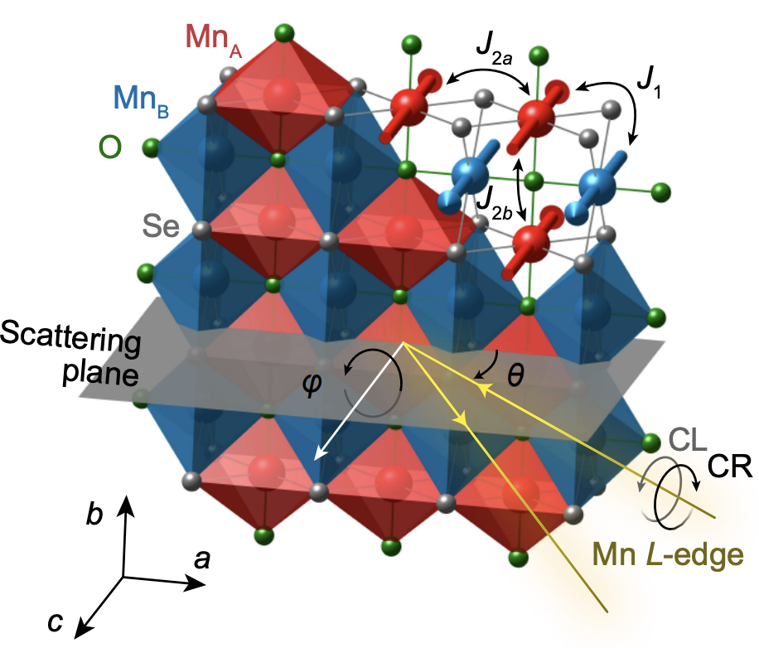
La₂O₃Mn₂Se₂: RIXS reveals d-wave altermagnetism
Yao Shen (IOP)
Lieb lattice
Semiconductor
~33 meV magnon; CD along (H,0), not along (H,H)
Predicted splitting ~2.4 meV ≪ Res. ≈ 27 meV;
Zhang, QW*, Yi Lu*, Yao Shen* et al., d-wave altermagnetism revealed by resonant inelastic X-ray scattering ,arXiv:2606.18731

Slide 15
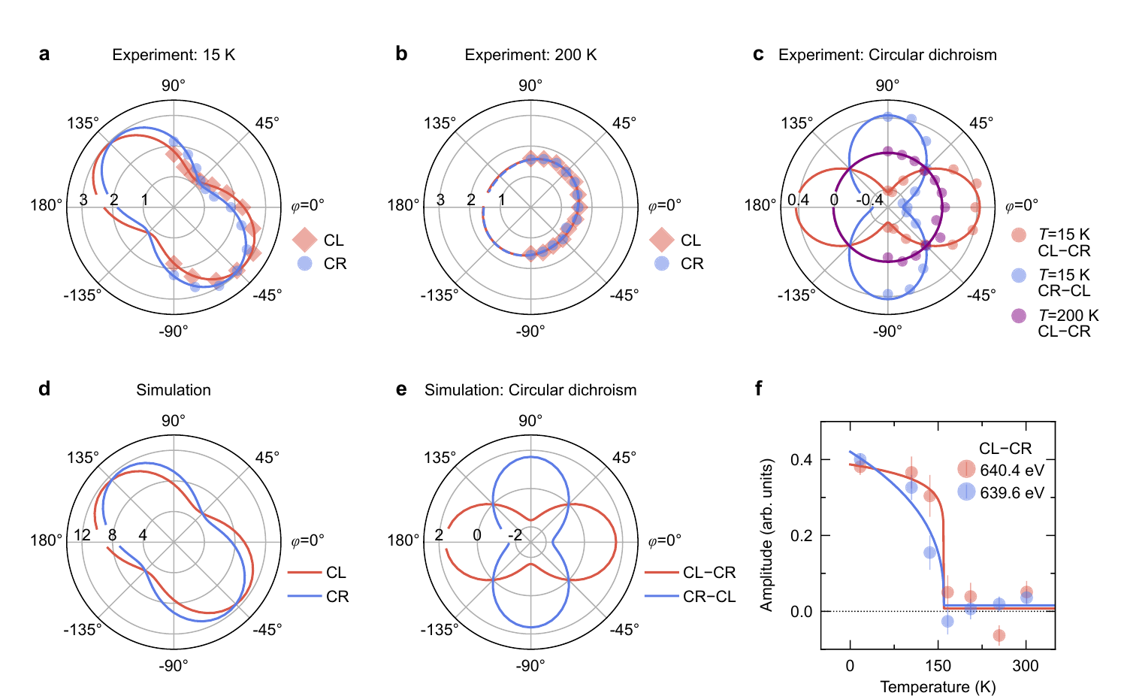
La₂O₃Mn₂Se₂: RIXS reveals d-wave altermagnetism
Yao Shen (IOP)
Lieb lattice
Semiconductor
~33 meV magnon; CD along (H,0), not along (H,H)
ED / RIXS-operator analysis supports [C2∥C4z] symmetry
Predicted splitting ~2.4 meV ≪ Res. ≈ 27 meV;
Polar scan: d-wave symmetry; CD vanishes > T_{N} ≈ 160 K
The d-wave pattern & disappearance of CD above T_{N} support altermagnetic symmetry.
Zhang, QW*, Yi Lu*, Yao Shen* et al., d-wave altermagnetism revealed by resonant inelastic X-ray scattering ,arXiv:2606.18731

Slide 16
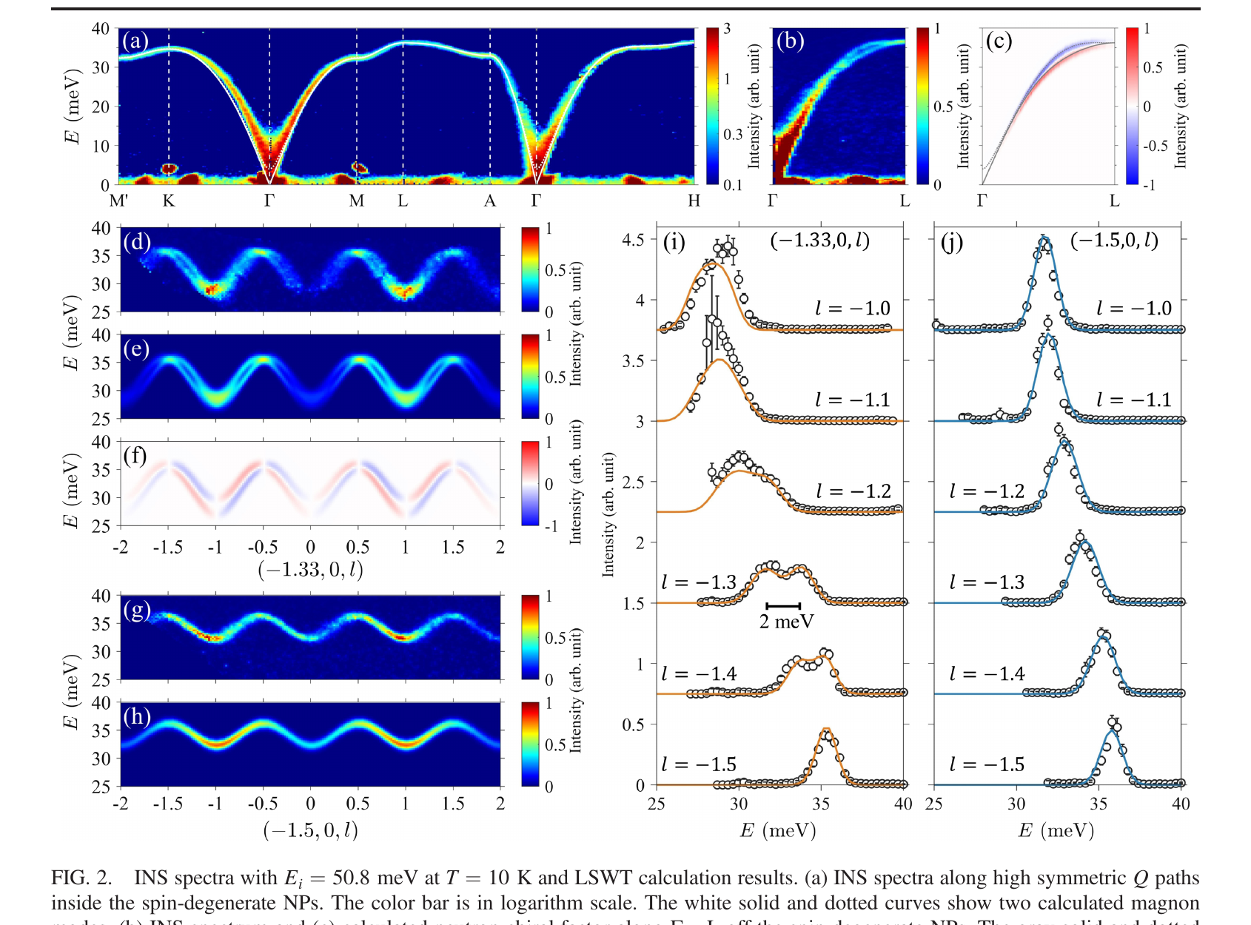
α-MnTe: first INS resolution of magnon splitting
Compare nodal- and off-nodal directions
Off-nodal doublet: ΔE ≈ 2 meV
Alternating J₁₀ / J₁₁ LSWT
Symmetric exchange lifts energy and chirality degeneracy in MnTe.
Liu et al., Chiral Split Magnon in Altermagnetic MnTe, PRL 133, 156702 (2024)

Slide 17
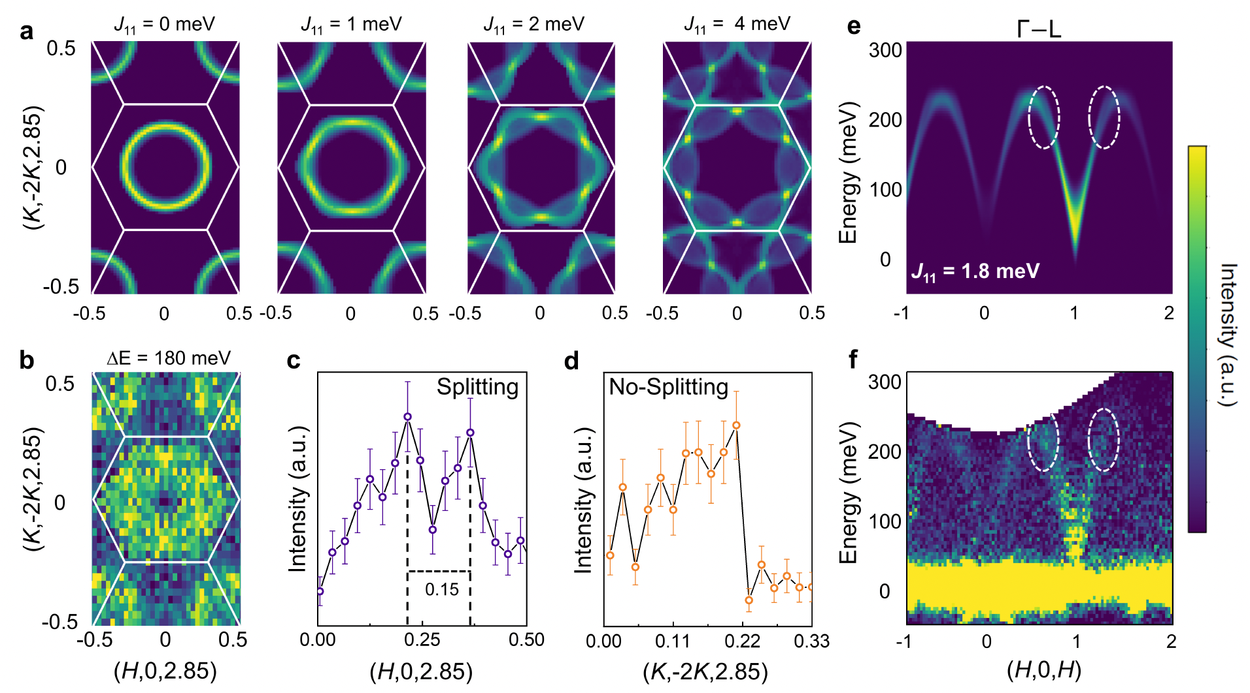
CrSb: spin-split magnons in a metallic altermagnet
Sixfold intensity pattern in the 180 meV constant-energy slice
Γ–L splitting: 0.15 r.l.u.
Symmetry-protected direction remains unsplit
J₁₁ ≈ 1.8 meV reproduces the pattern
Bandwidth 180–230 meV;
CrSb extends INS evidence from insulating to metallic altermagnets
Singh et al., Chiral Spin-Split Magnons in the Metallic Altermagnet CrSb arXiv:2511.16086 (2025)

Slide 18
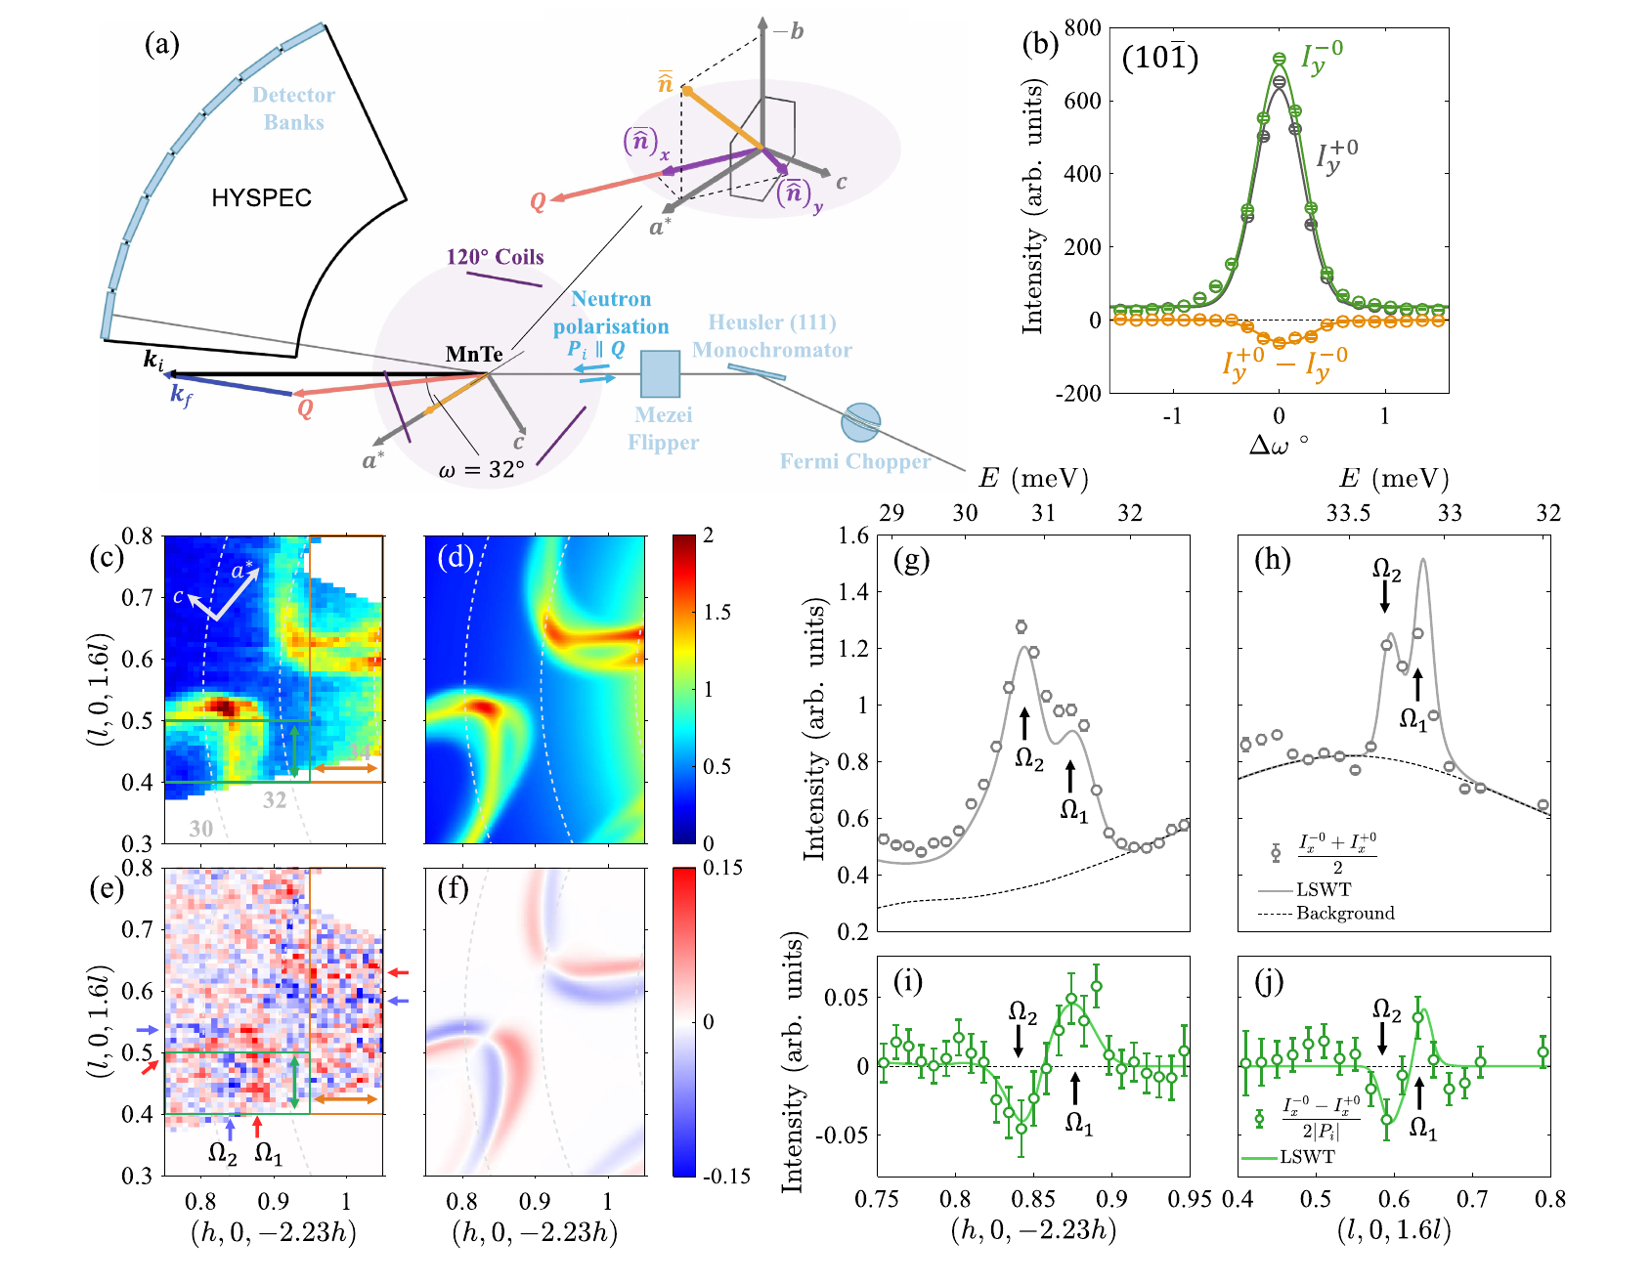
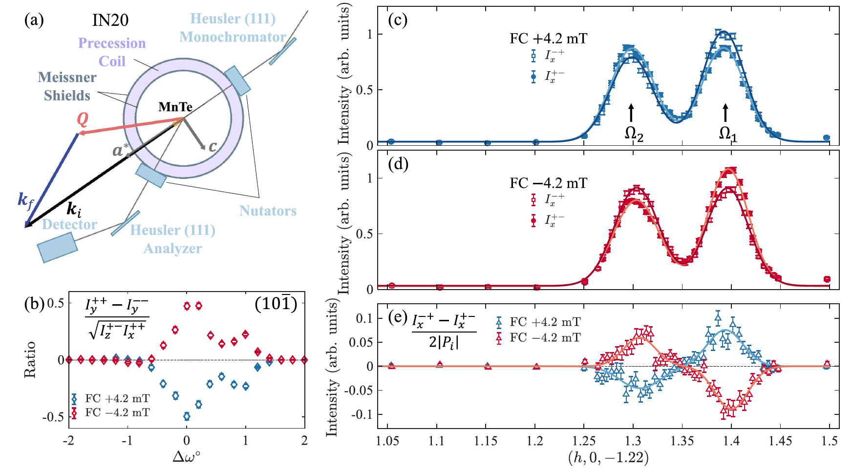
α-MnTe: Polarized INS reads and switches magnon chirality
M_{ch} ∝ difference between spin-flip channels
Ω₁ and Ω₂ have opposite signs: direct left / right-handedness
Sign reverses after ±4.2 mT field cooling: switchable chirality
Evidence advances to opposite handedness and reversible control.
Liu et al., Observation of Switchable Chiral Magnons in an Altermagnet, PRL 136, 236705 (2026)

Slide 19
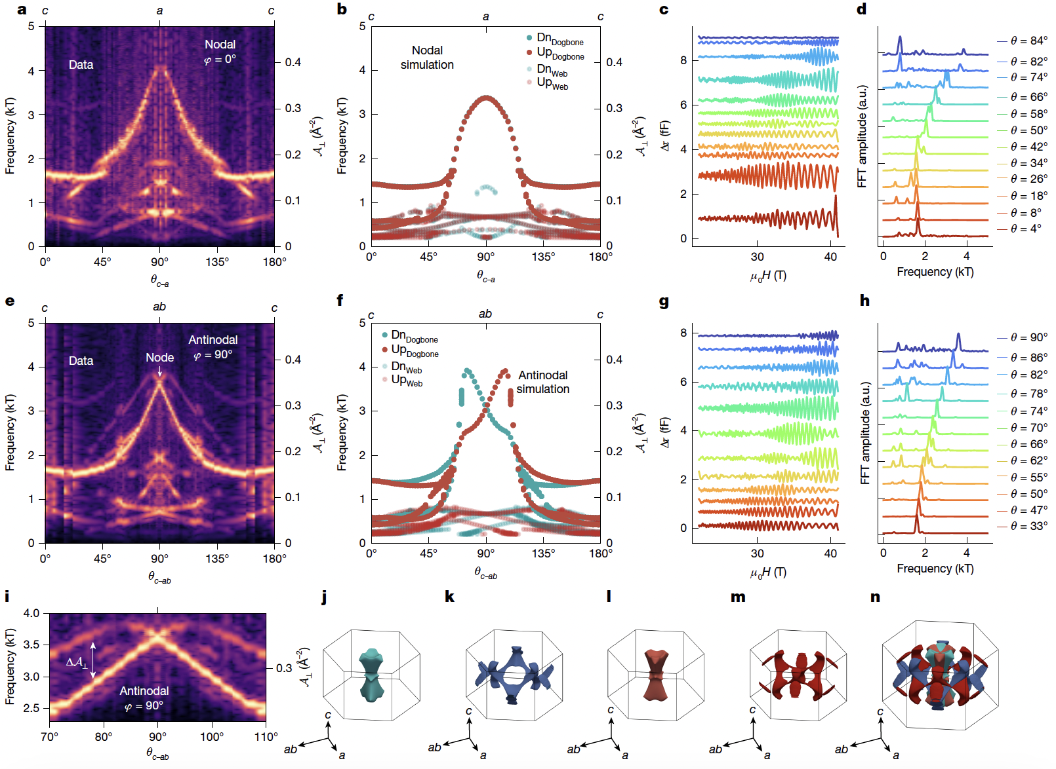
Key experimental challenges
Lack of characterization of altermagnetic order parameters from magnon spitting
Quantum oscillation in CrSb
M. Long et al., Nature 845, 656 (2026)

Slide 20
Outline
Basics of altermagnetism & spectroscopy evidence
Inelastic neutron scattering study of g-wave magnon splitting in α-Fe₂O₃
Outlook on μSR study of unconventional magnets

Slide 21
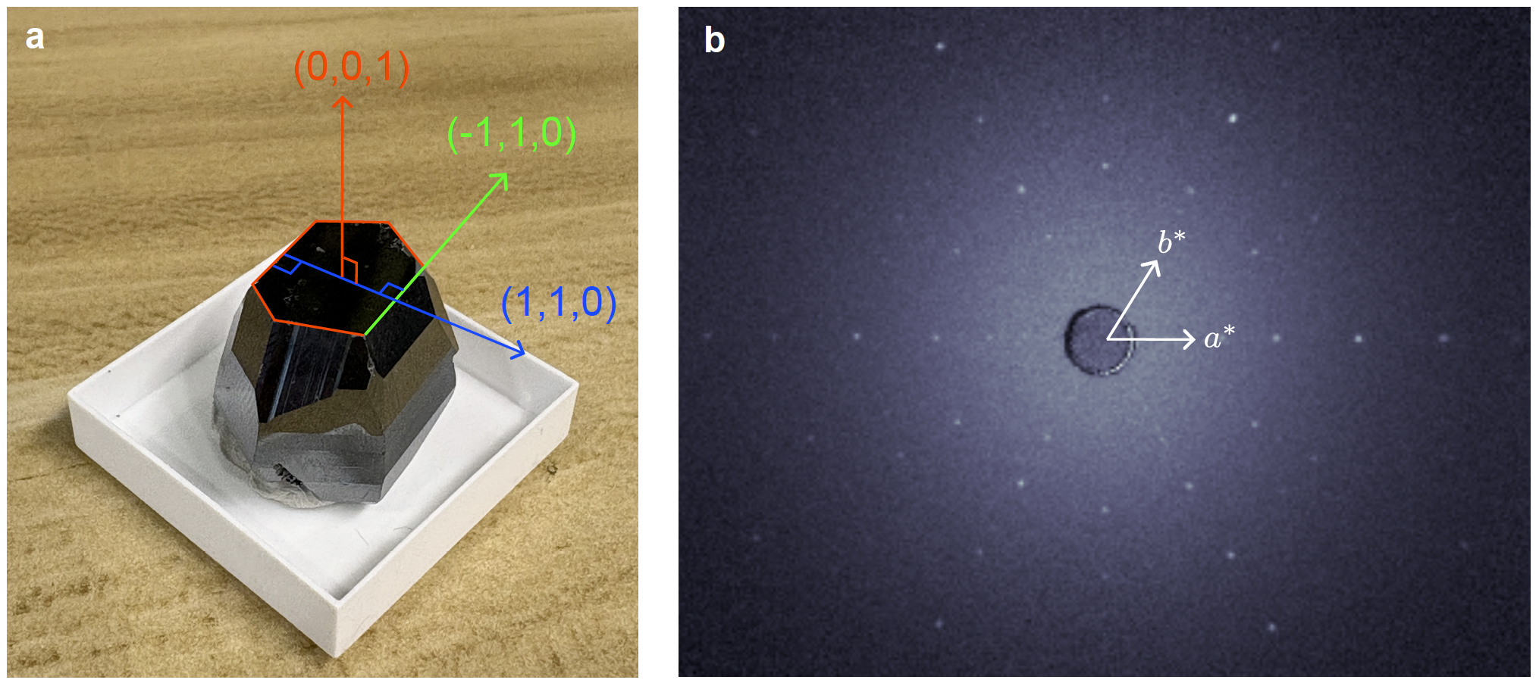

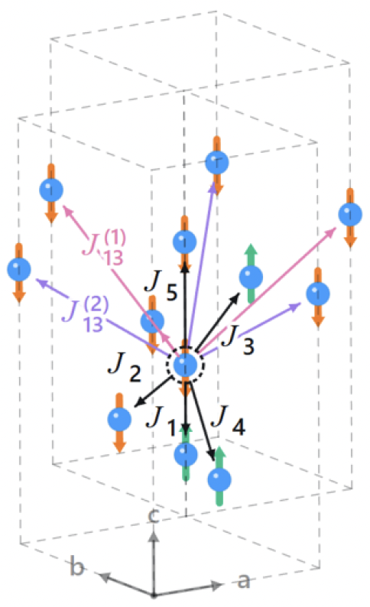
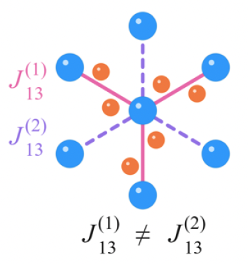
α-Fe₂O₃: correlated insulator, hexagonal, g-wave candidate
16 grams
Tianren Wang
T_{N} = 950 K >> RT
Low magnon damping
Chemical stability
Large crystal size
T. Wang, Y. Feng*, J. Choi*, Q.W.* et al., arXiv:2609.08693

Slide 22
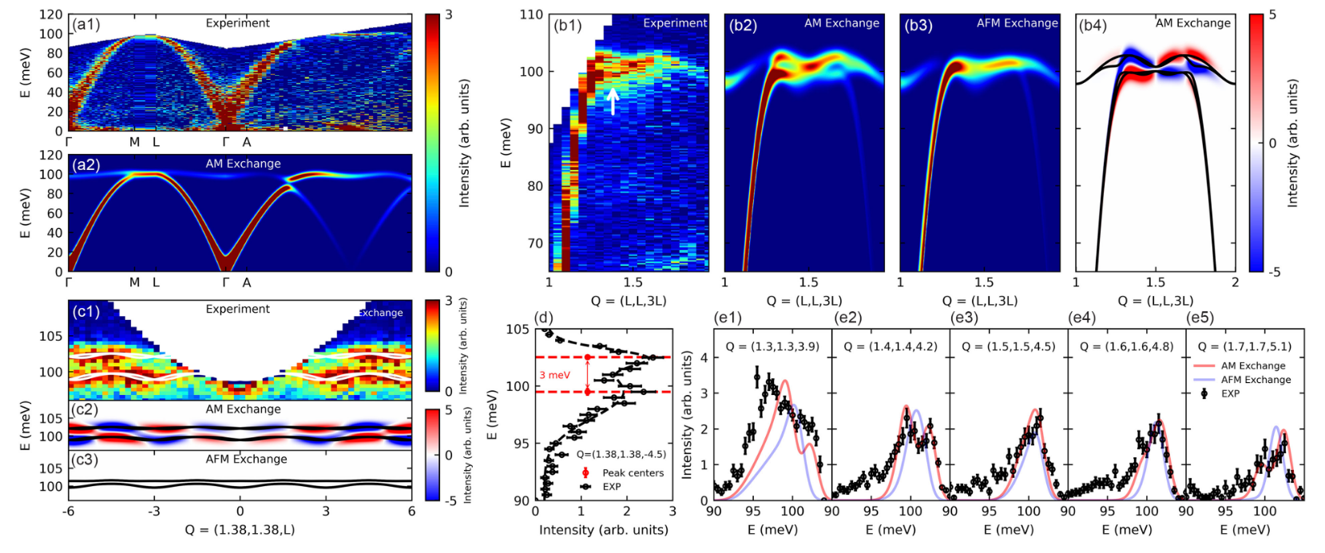
α-Fe₂O₃: previous INS resolving 3 meV magnon splitting
ARCS; T = 50 K; Eᵢ = 150 meV
Off-nodal: 3 meV splitting near 100 meV: J₁₃ / J₁₄
Still lack of angular information – order parameter?
Sun et al., Observation of Chiral Magnon Band Splitting in Altermagnetic Hematite, PRL 135, 186703 (2025)

Slide 23
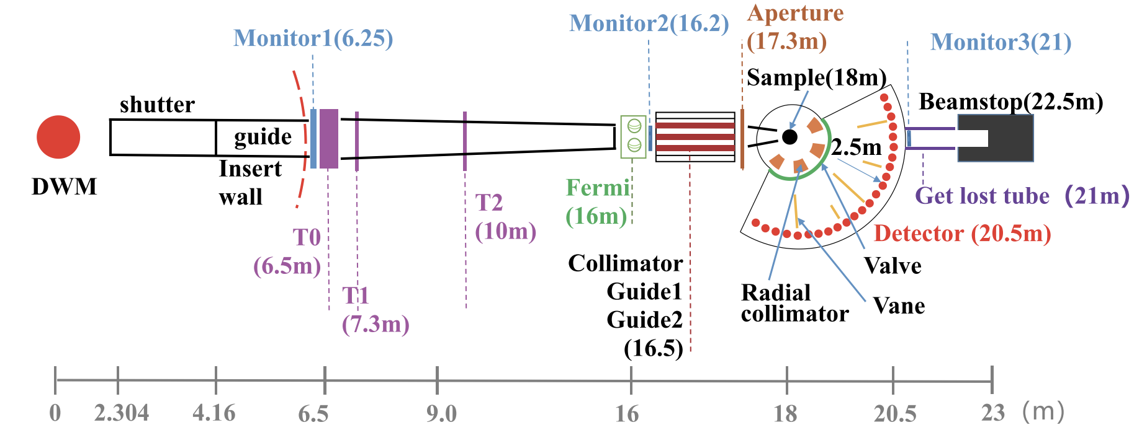
HD neutron spectrometer at CSNS
high energy direct geometry chopper spectrometer
Xin Tong
Wei Luo
Yu Feng
W. Luo et al., Nucl. Instrum. Methods Phys. Res. A 1046, 167676 (2023)

Slide 24
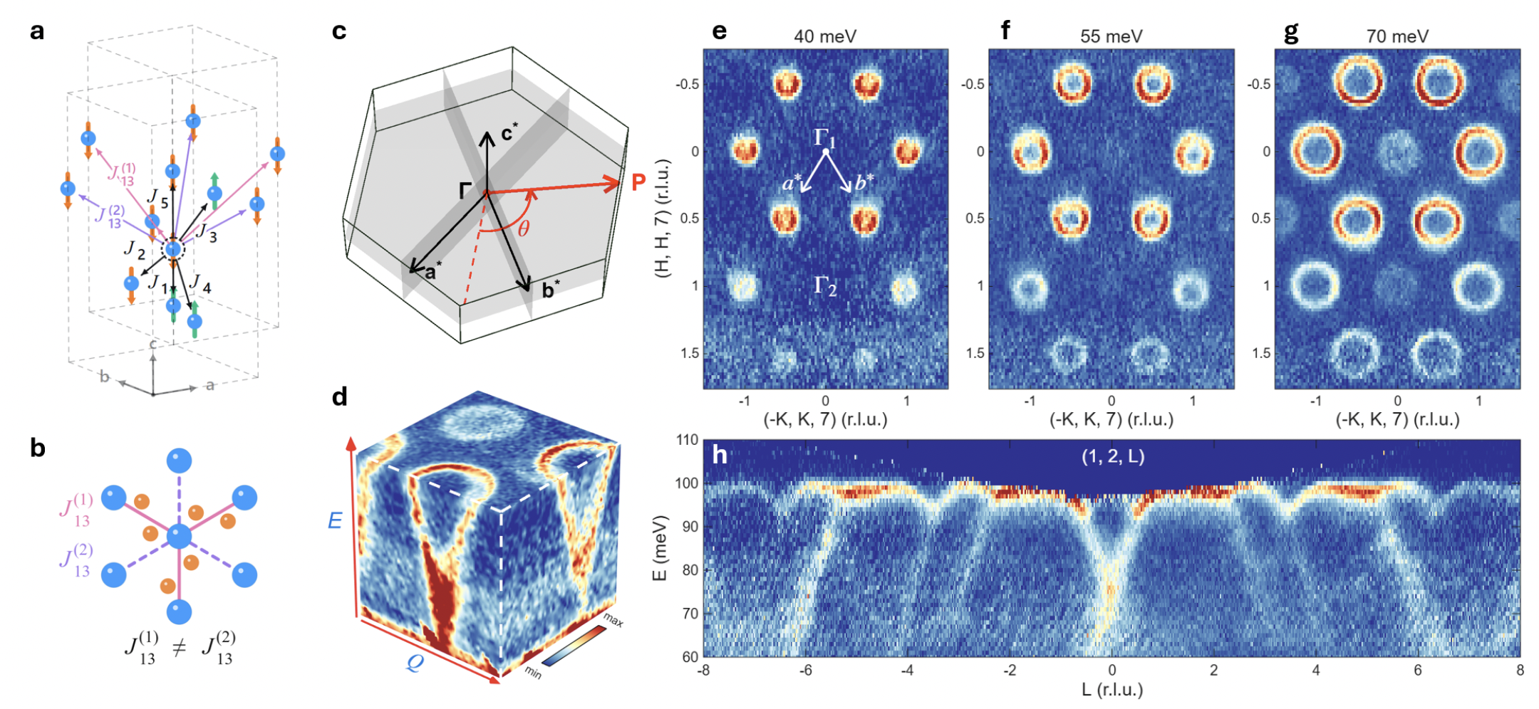
Spin-wave in the collinear magnetic state of α-Fe₂O₃
Tianren Wang
T. Wang, Y. Feng*, J. Choi*, Q.W.* et al., arXiv:2609.08693

Slide 25

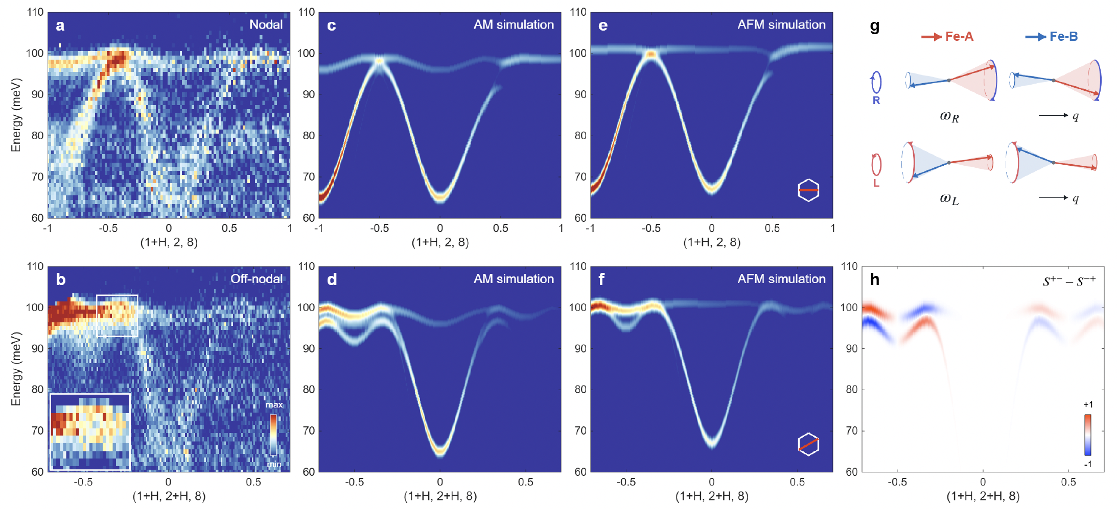

Magnon splitting in α-Fe₂O₃
T. Wang, Y. Feng*, J. Choi*, Q.W.* et al., arXiv:2609.08693

Slide 26
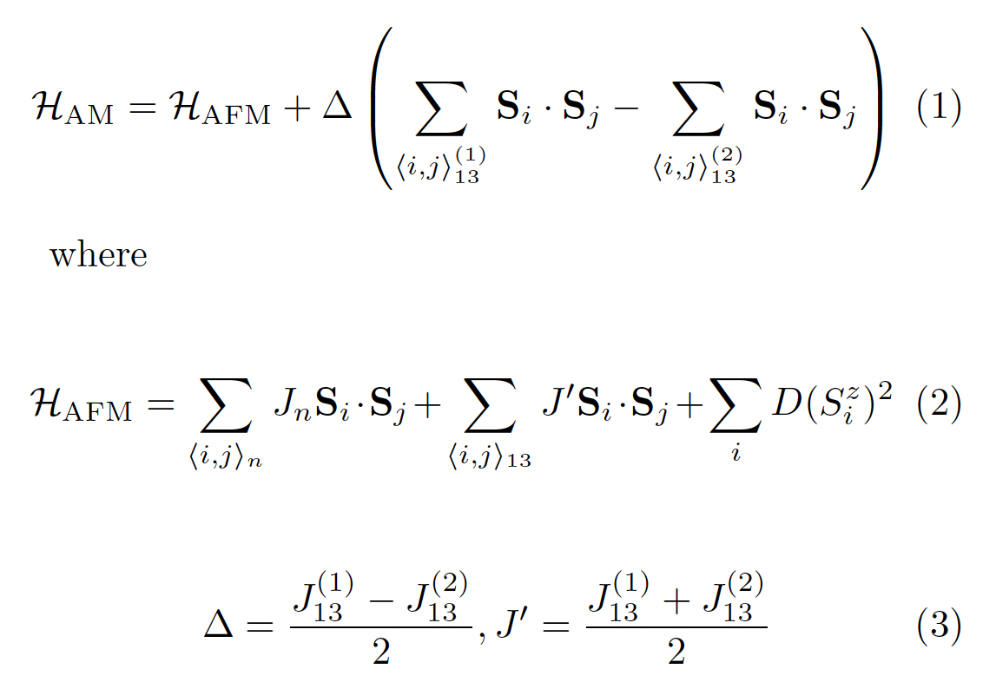
Magnon splitting in α-Fe₂O₃: AM with inequivalent J₁₃
T. Wang, Y. Feng*, J. Choi*, Q.W.* et al., arXiv:2609.08693

Slide 27
Magnon splitting in α-Fe₂O₃: AM with inequivalent J₁₃
T. Wang et al., arXiv:2609.08693

Slide 28
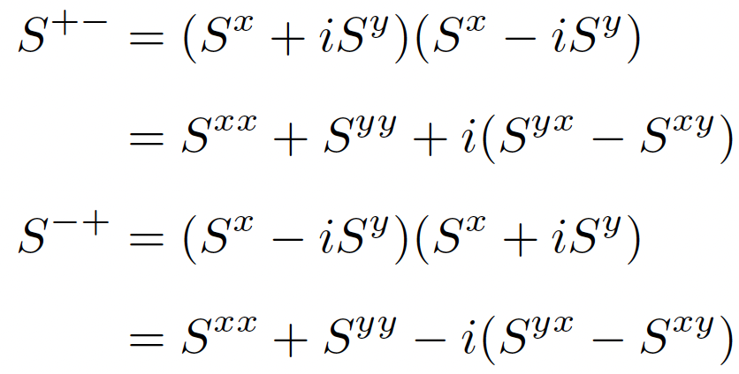

Magnon splitting in α-Fe₂O₃: opposite chirality
Circular transverse correlation
T. Wang et al., arXiv:2609.08693

Slide 29
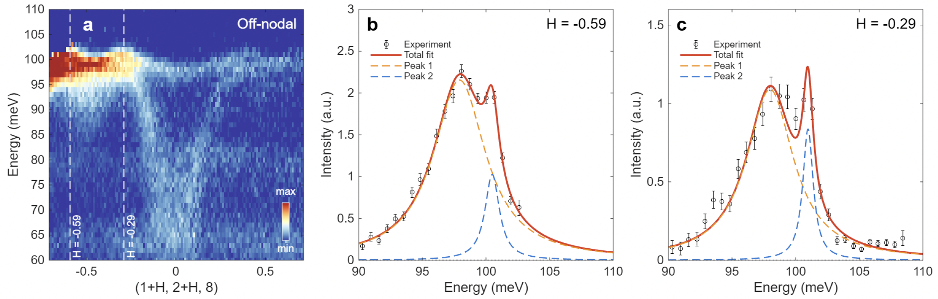
Magnon splitting in α-Fe₂O₃: off-nodal “line”
T. Wang, Y. Feng*, J. Choi*, Q.W.* et al., arXiv:2609.08693

Slide 30
Magnon splitting in α-Fe₂O₃: off-nodal “line”
T. Wang, Y. Feng*, J. Choi*, Q.W.* et al., arXiv:2609.08693

Slide 31
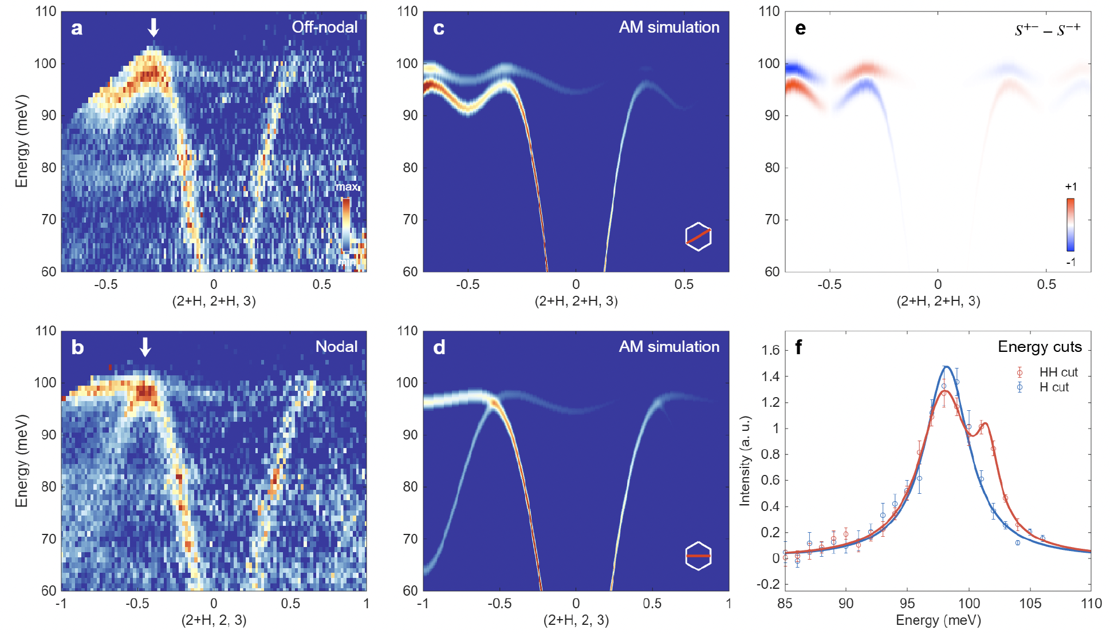
Magnon splitting in α-Fe₂O₃: observed in other BZ
T. Wang, Y. Feng*, J. Choi*, Q.W.* et al., arXiv:2609.08693

Slide 32
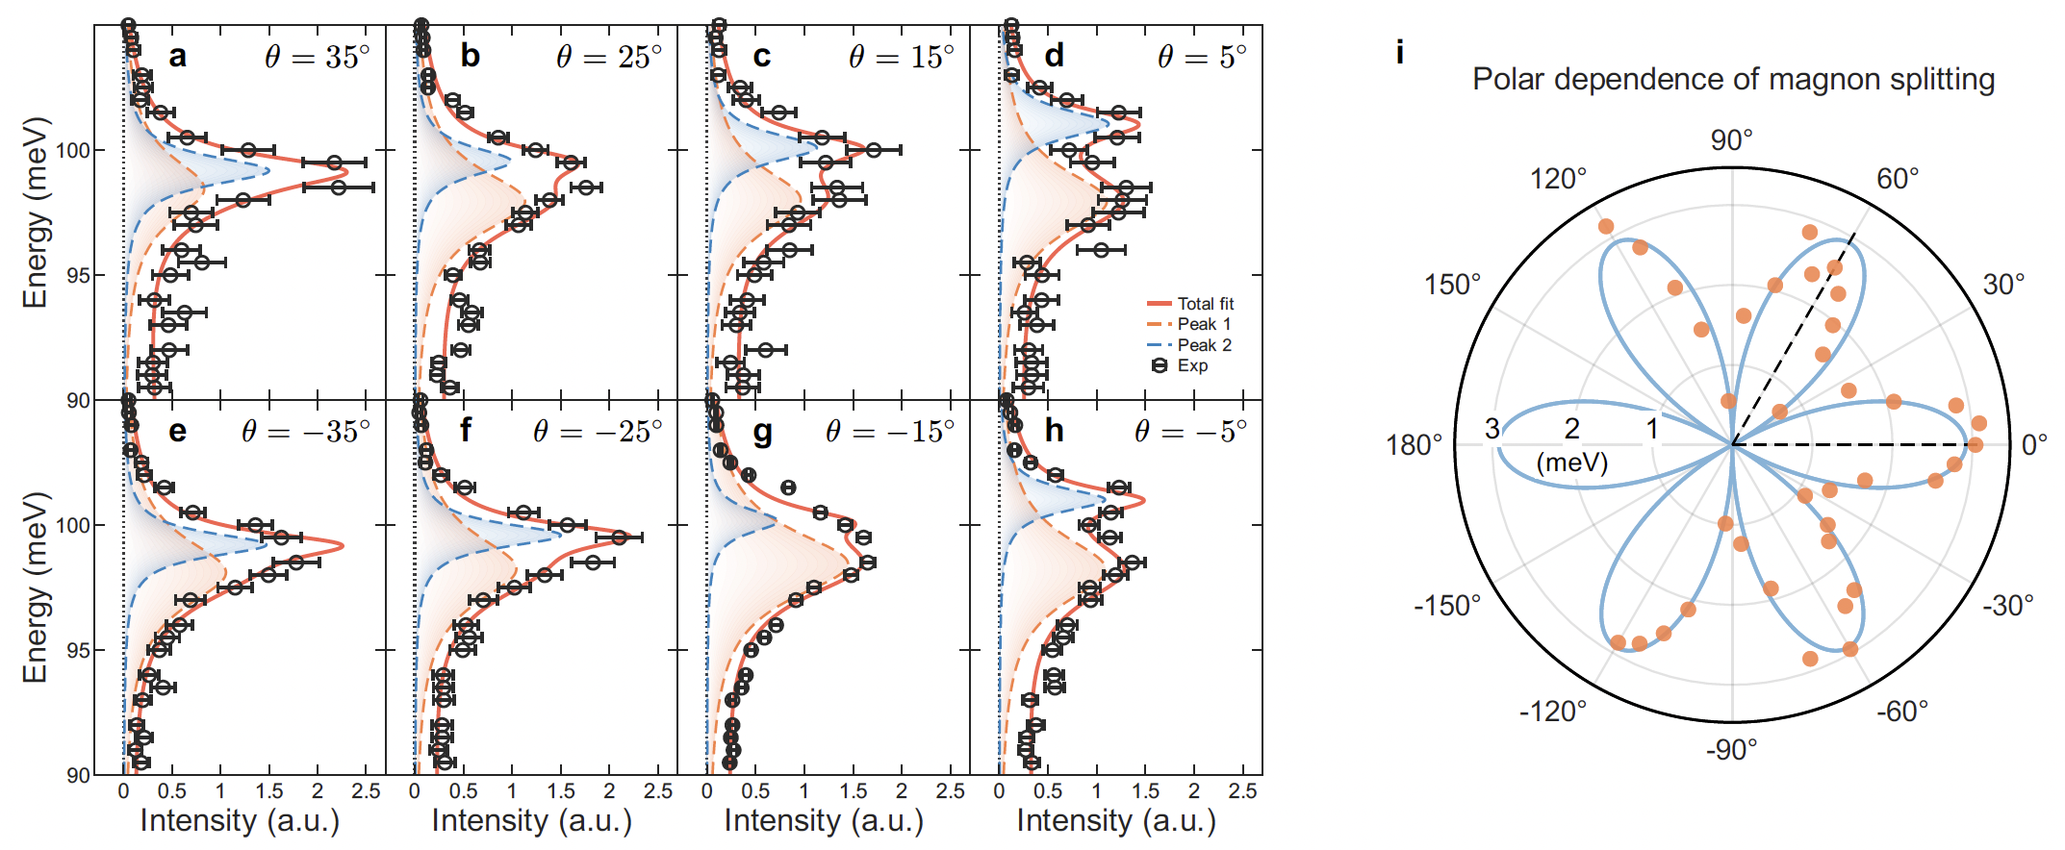
g-wave chiral altermagnetic magnon splitting in α-Fe₂O₃
T. Wang, Y. Feng*, J. Choi*, Q.W.* et al., arXiv:2609.08693

Slide 33
Outline
Basics of altermagnetism & spectroscopy evidence
Inelastic neutron scattering study of g-wave magnon splitting in α-Fe₂O₃
Outlook on μSR study of unconventional magnets

Slide 34
Outlook: μSR on altermagnets – high sensitivity to magnetism
Surface or bulk magnetism?
Systems challenging for neutrons

Slide 35
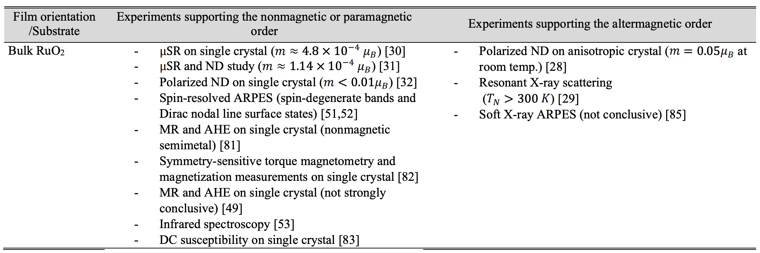
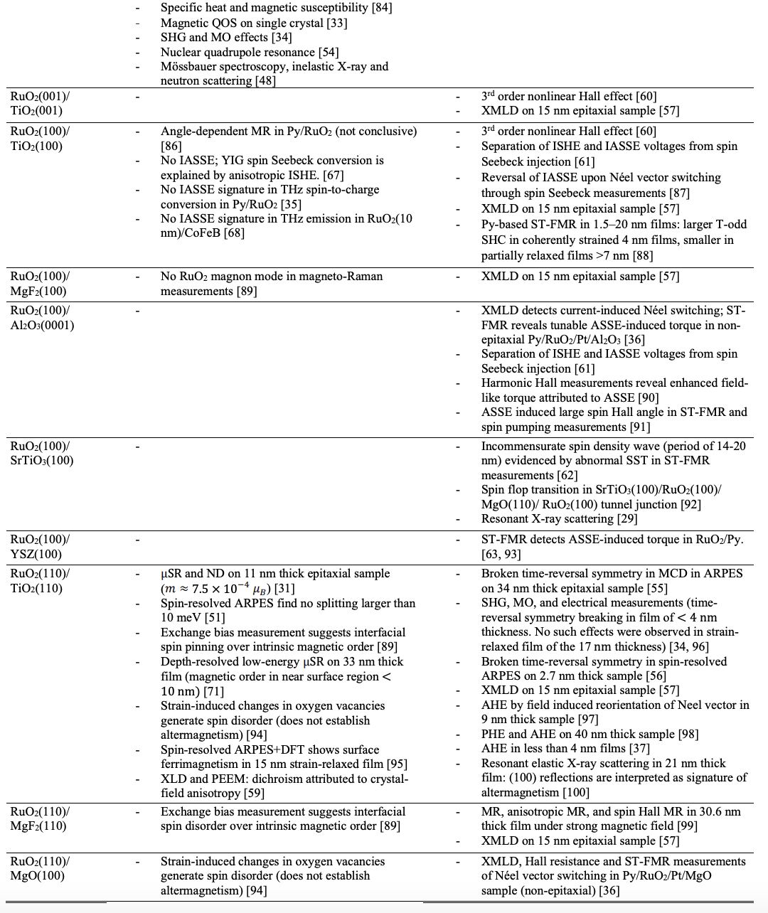
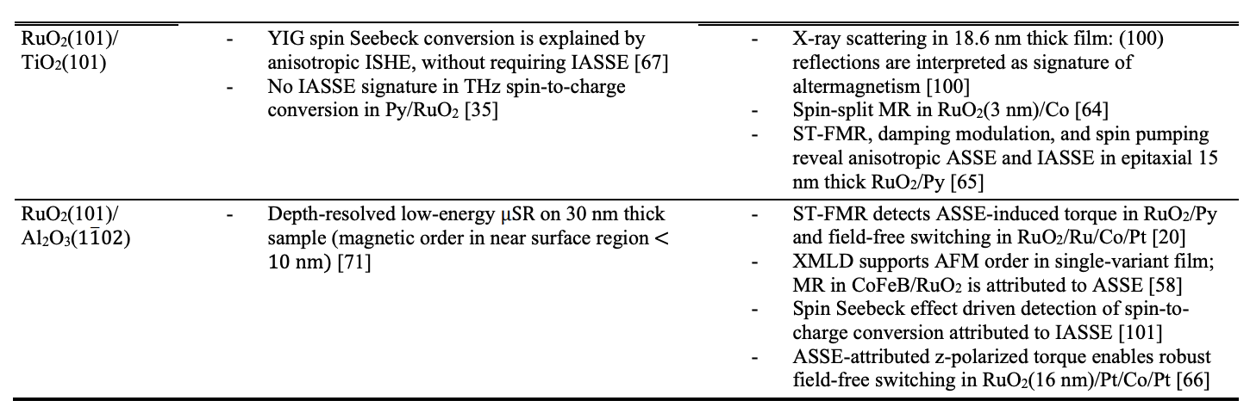
Outlook: μSR on altermagnets – high sensitivity to magnetism
(Alter)magnetism in RuO₂??
d-wave candidate: ARPES, AHE,…
H. Mavani et al., Conditions for Altermagnetism in RuO₂, arXiv:2610.07494

Slide 36
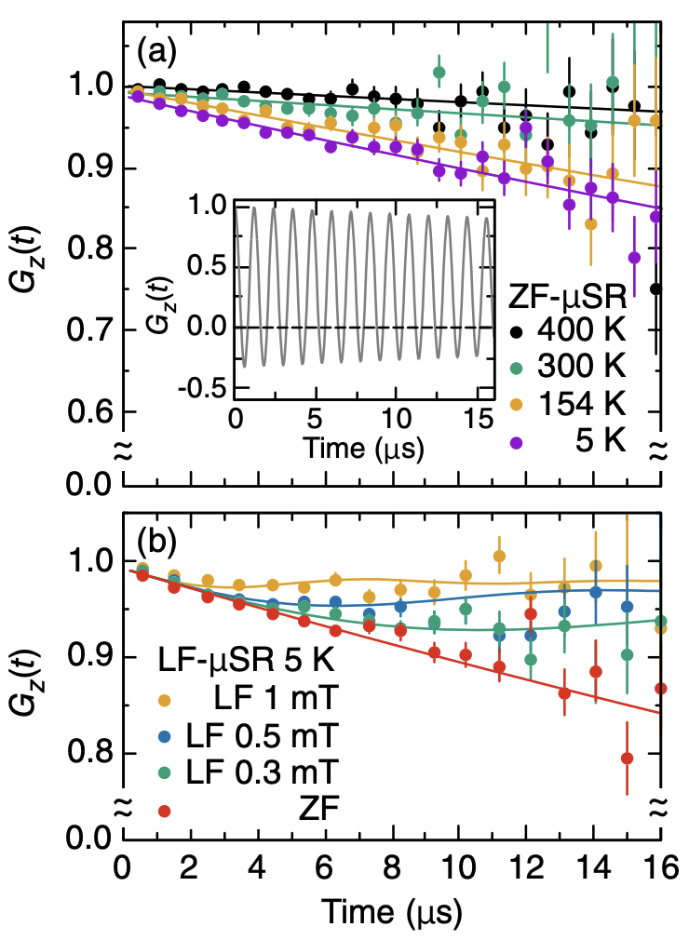
Outlook: μSR on altermagnets – high sensitivity to magnetism
RuO₂ single crystal
From ARTEMIS @ J-PARC
(Alter)magnetism in RuO₂??
d-wave candidate: ARPES, AHE…
DFT prediction |M_{Ru}| ~ 0.05 μB
RuO₂ single crystal
μSR estimation of upper limit:
|M_{Ru}| < 4.8(2) × 10⁻⁴ μB
M. Hiraishi et al., PRL 132, 166702 (2024)

Slide 37
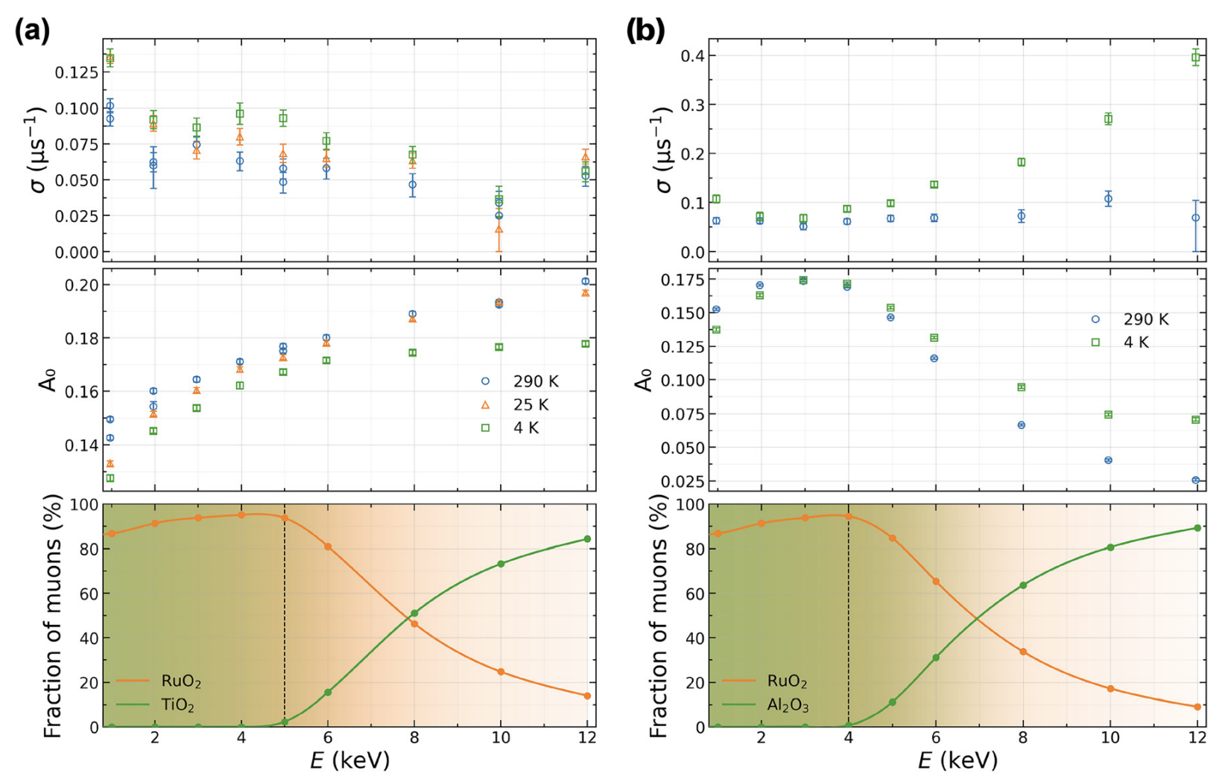
Outlook: μSR on altermagnets – high sensitivity to magnetism
RuO₂ film / TiO2
LE-μSR from μE4 @ PSI
(Alter)magnetism in RuO₂??
d-wave candidate: ARPES, AHE…
DFT prediction |M_{Ru}| ~ 0.05 μB
RuO₂ film / TiO₂
Magnetism from ~10 nm surface.
Volume fraction is < ~8.5%.
Inhomogeneous, static surface magnetism.
Surface defects, reduced dimensionality, local strain, or non-stoichiometry.
A. Akashdeep et al., APL 128, 022406 (2026)

Slide 38
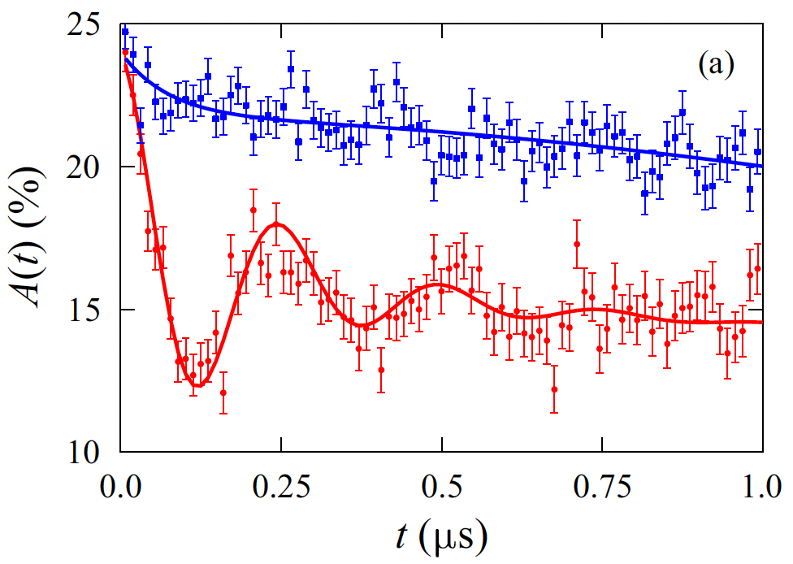
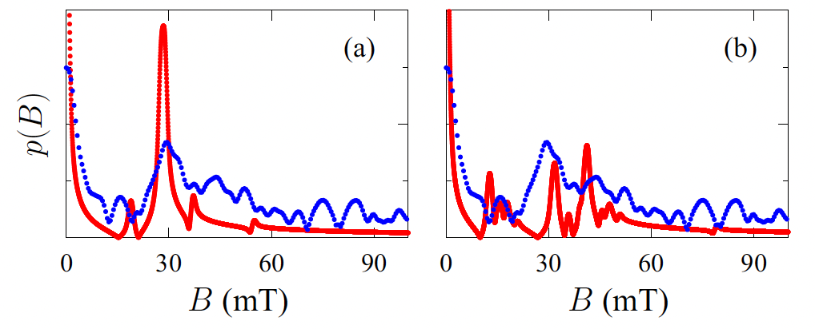
Outlook: μSR on altermagnets – high sensitivity to magnetism
V_{1/3}NbSe₂ single crystal
From GPS @ SIS
Magnetic structure in V_{1/3}NbSe₂?
(S = 1, V³⁺)
Simple AFM or double-Q?
Field spectra simulation: compatible with both
Simple AFM
Double-Q
N. P. Bentley et al., PRB 112, 134453 (2025)

Slide 39
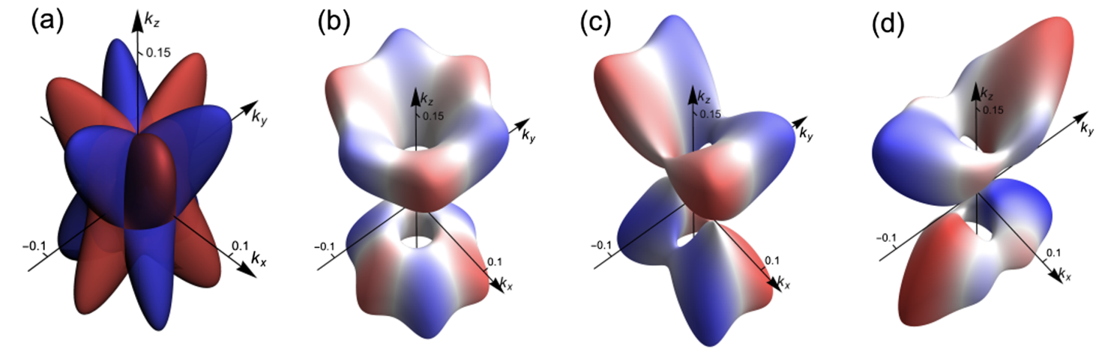
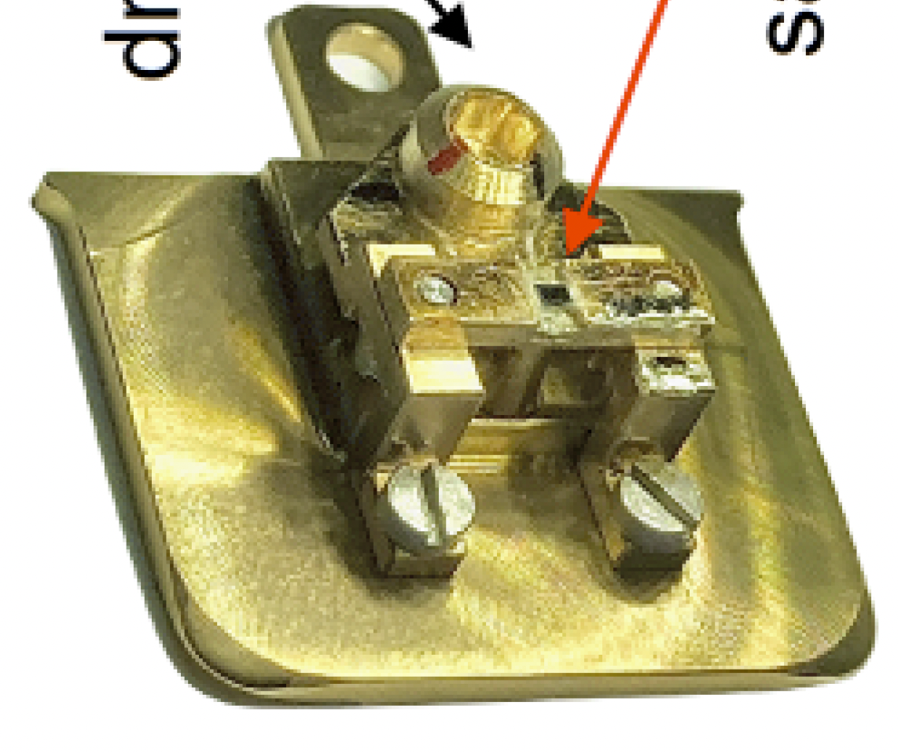
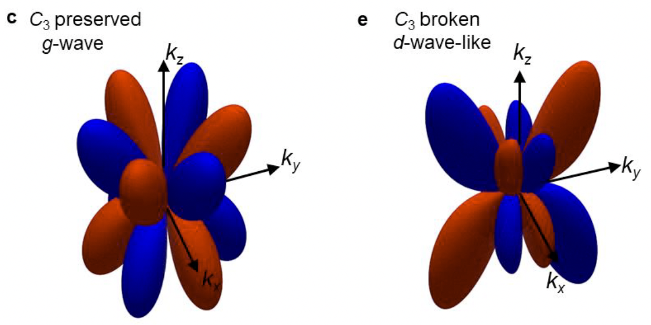
Outlook for α-Fe₂O₃ (and other candidates)
Symmetry tuning by strain
MnTe: g- to p-wave (share strain)
Driving screw
Sample
Belashchenko, PRL 134, 086701 (2025)
CrSb: g- to d-wave (epitaxial strain)
C. Song et al., Preprint doi.org/10.21203/rs.3.rs-8852675/v1

