Slide 1

A “deep” dive into materials with negative muons
“Bronze” Sea
Sn
μ⁻
Cu
Pb
Cu
Sn
Cu
Cu
Sayani Biswas (ISIS)
MELODY 2026, China
25th October 2026

Slide 2




Outline
ISIS Neutron and Muon Source
Elemental Analysis Techniques using μ⁻
Muonic X-ray Emission Spectroscopy (μ-XES)
μ⁻ lifetime
Applications of μ-XES
Liv Yarrow (09:00 tomorrow)
Juliet Spedding (10:00 tomorrow)
Upgrades @ ISIS

Slide 3
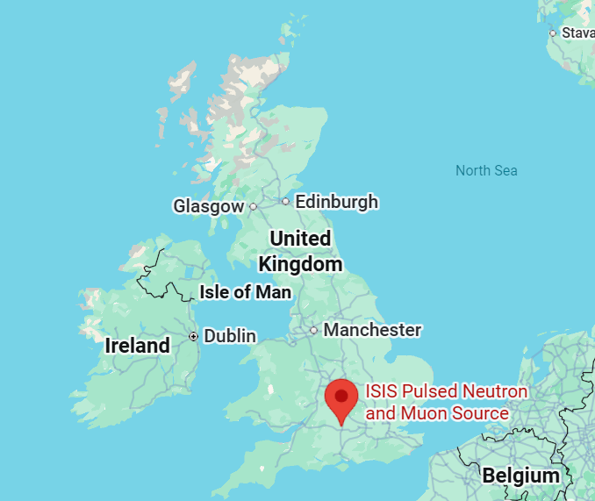
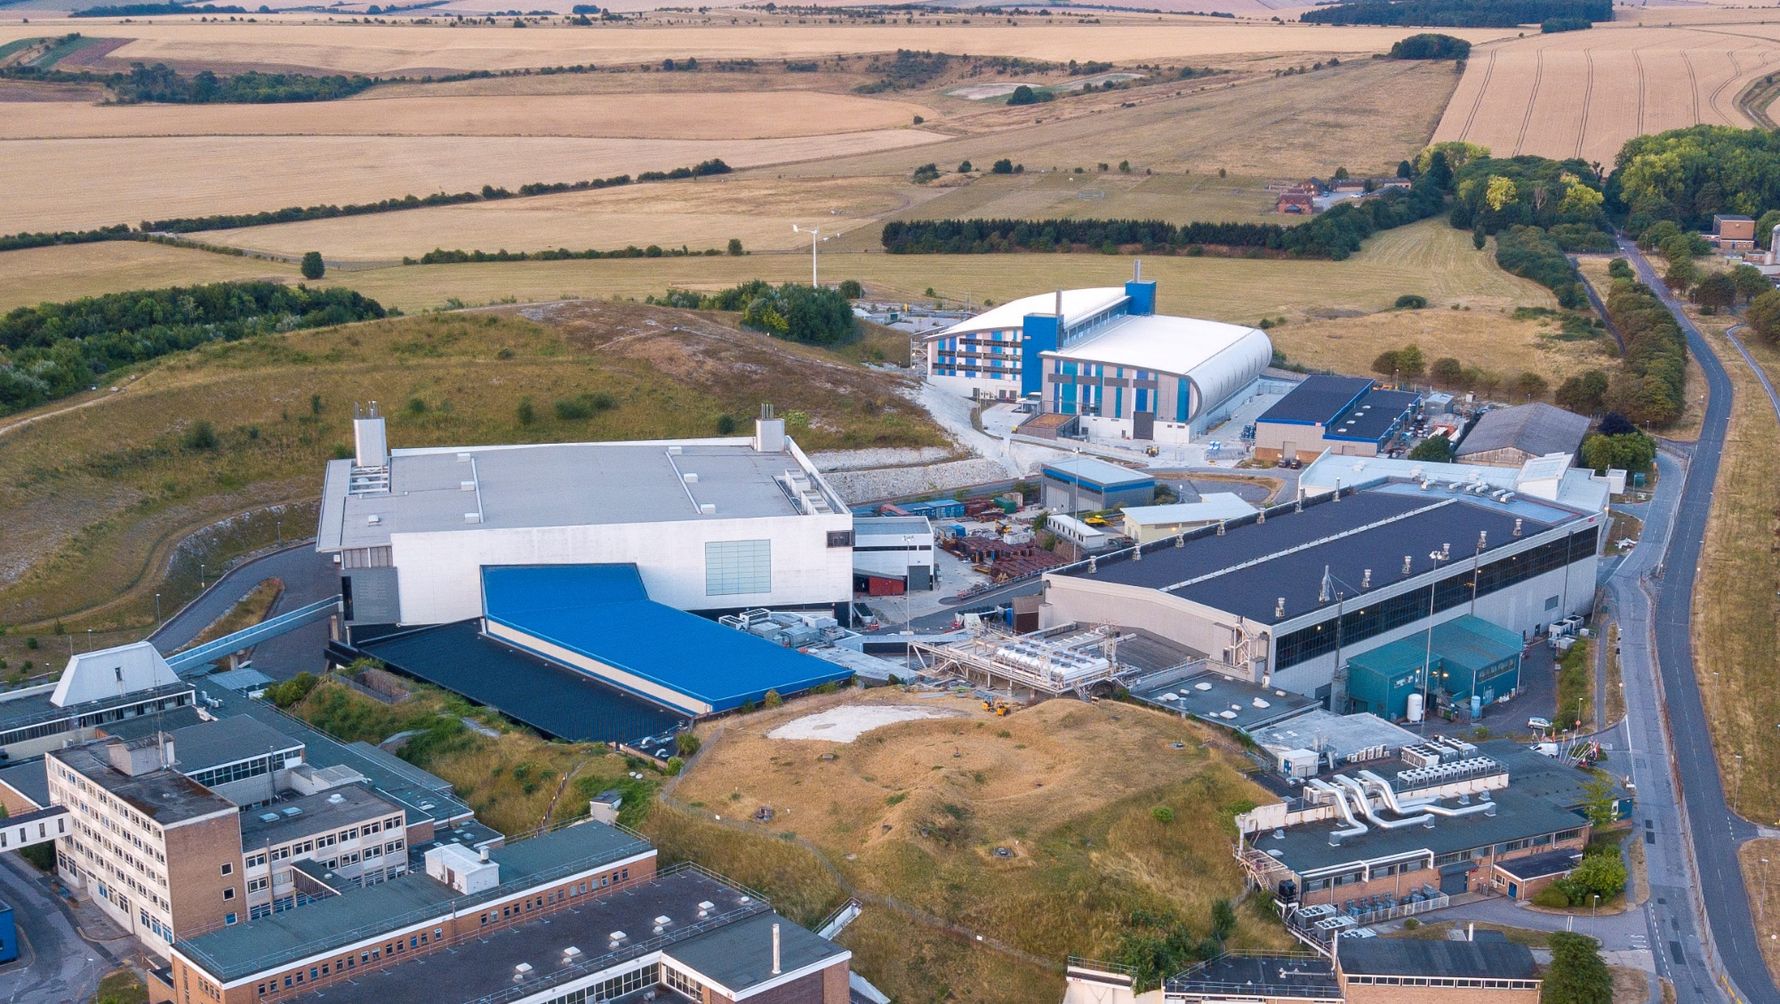

ISIS Neutron and Muon Source
Diamond Light Source
Target Station 2 (TS2)
Target Station 1 (TS1)
Muon Target
ISIS Neutron and Muon Source
High energy protons

Slide 4
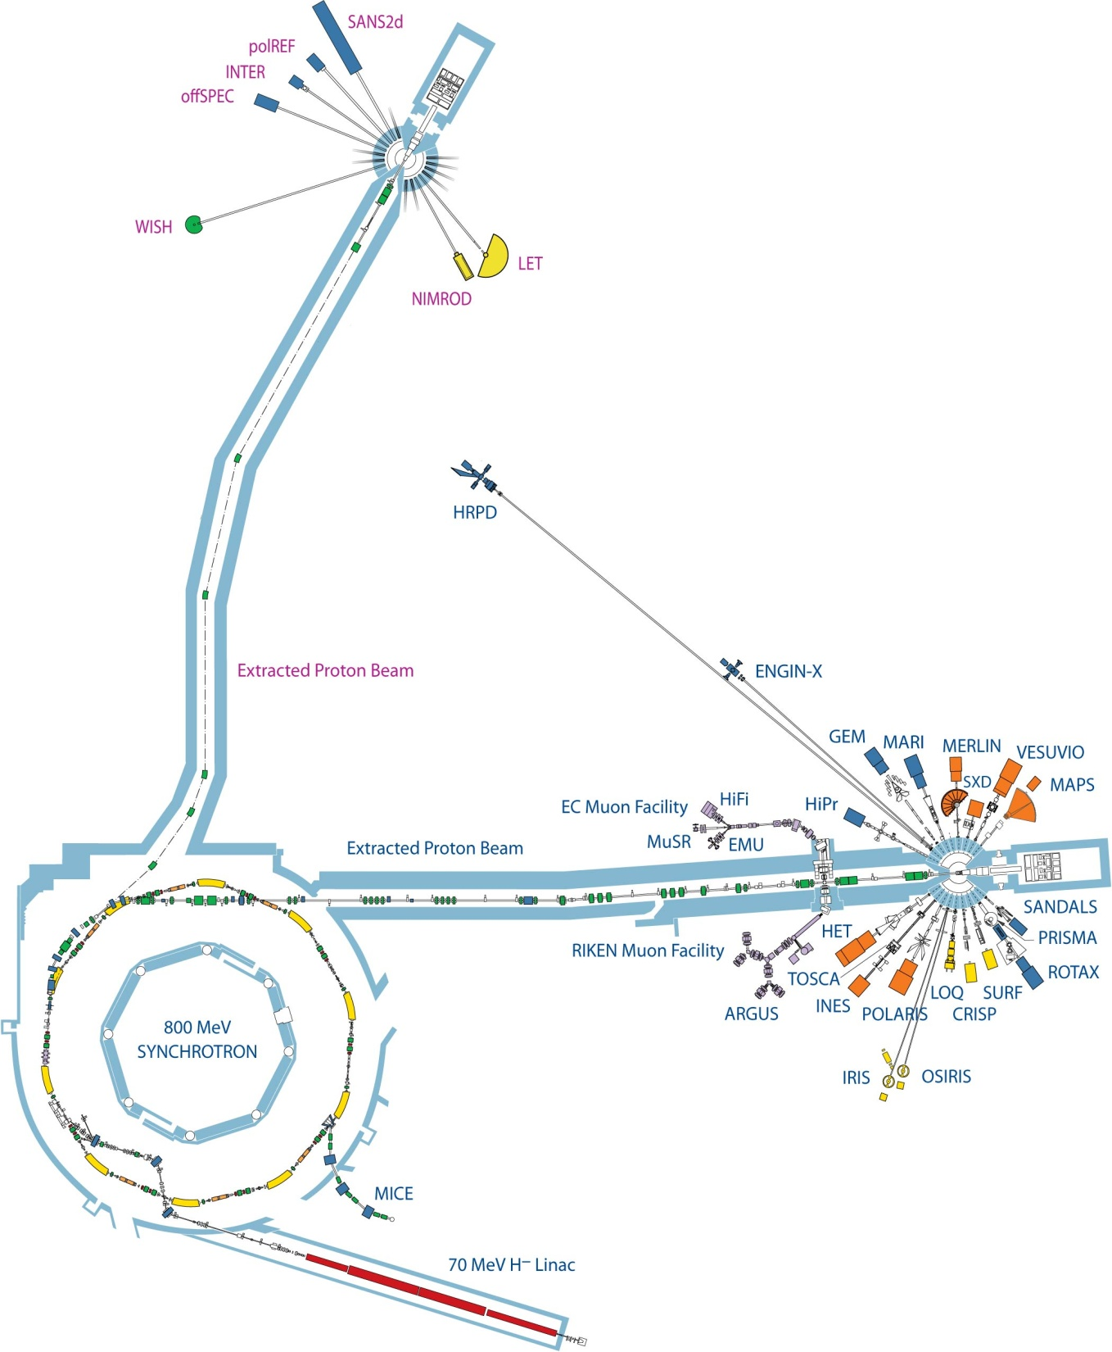
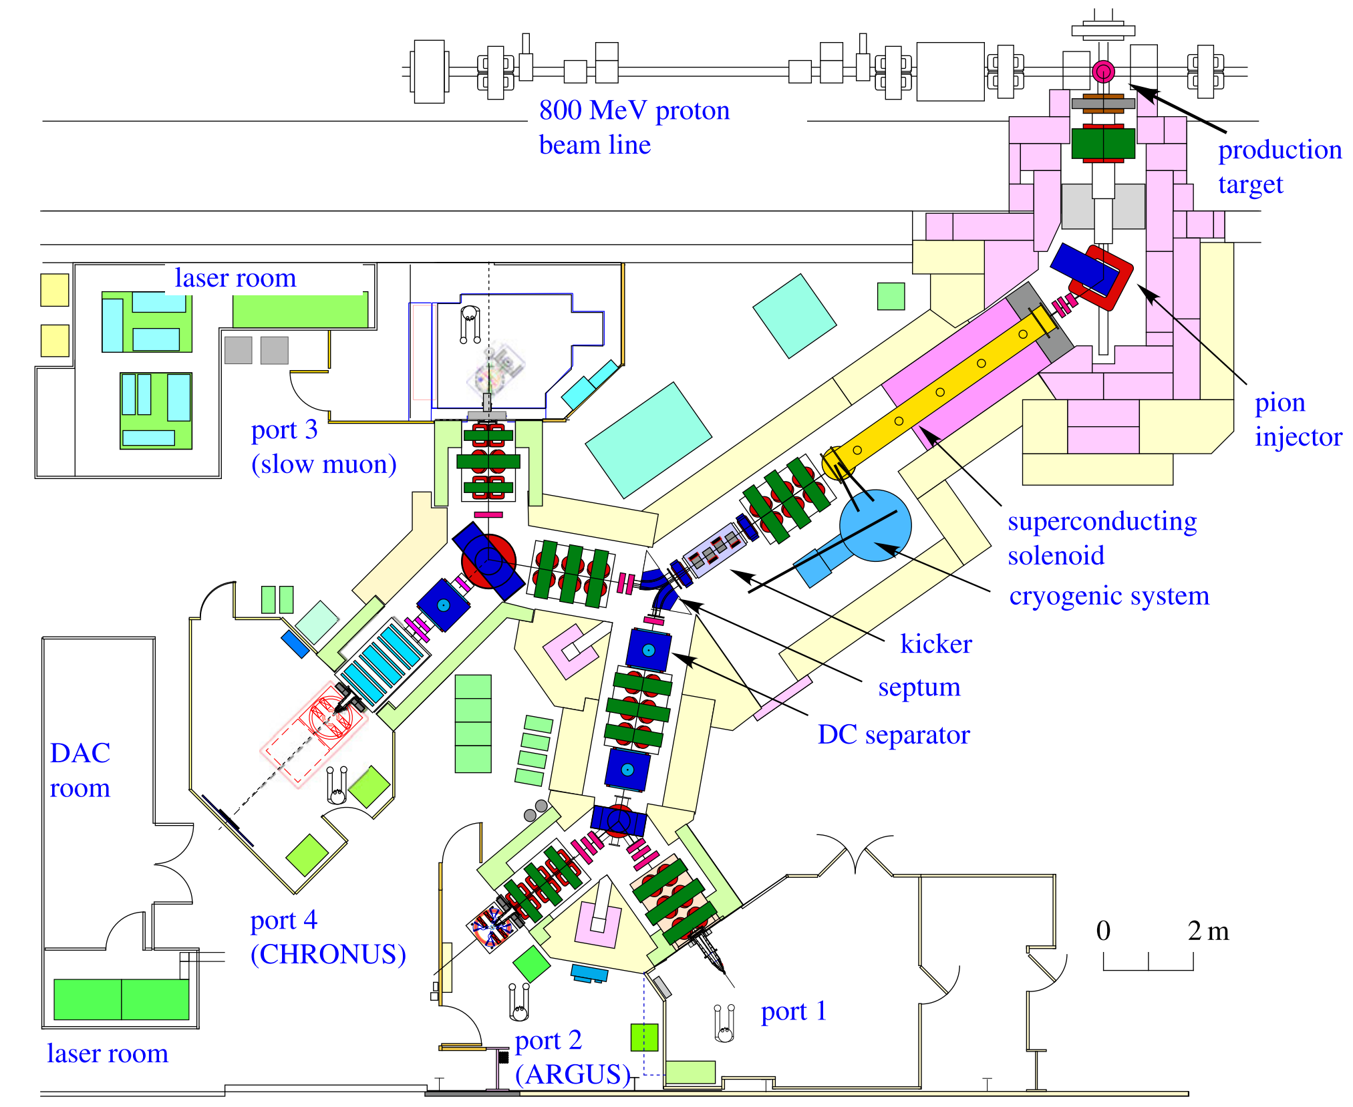
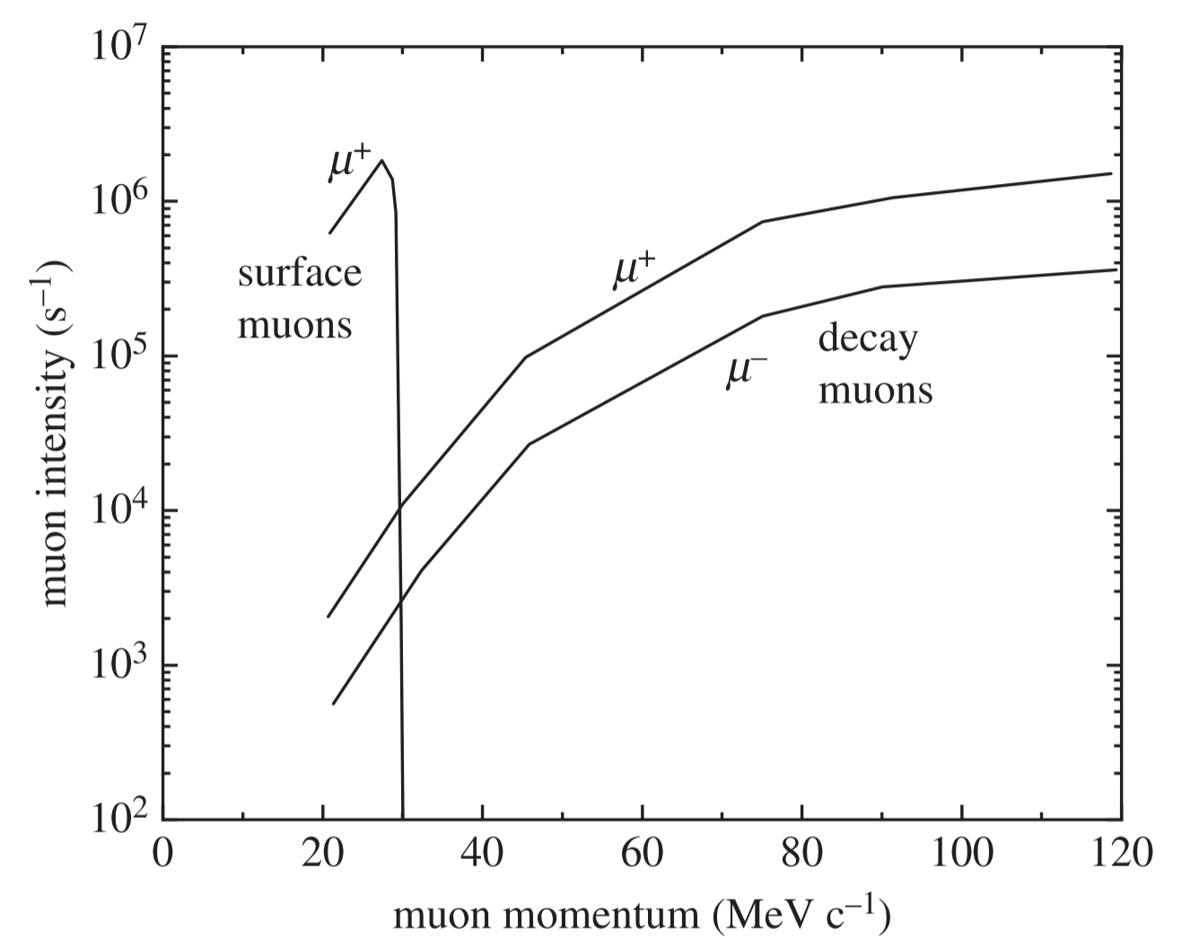
ISIS Neutron and Muon Source
Target
Station 2
(TS2)
Currently, we use the MuX
instrument in port 4, for elemental
analysis
C, 45°
10mm
Target
Station 1
(TS1)
Recently, we have also explored the ARGUS instrument in Port 2 for elemental analysis
RIKEN-RAL
Muon facility
A. Hillier et al, Phil. Trans. R. Soc. A, 377 (2019)

Slide 5
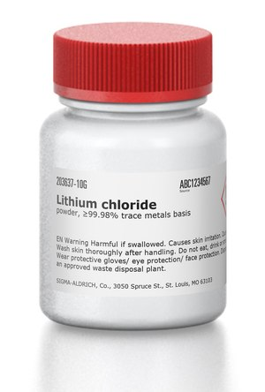
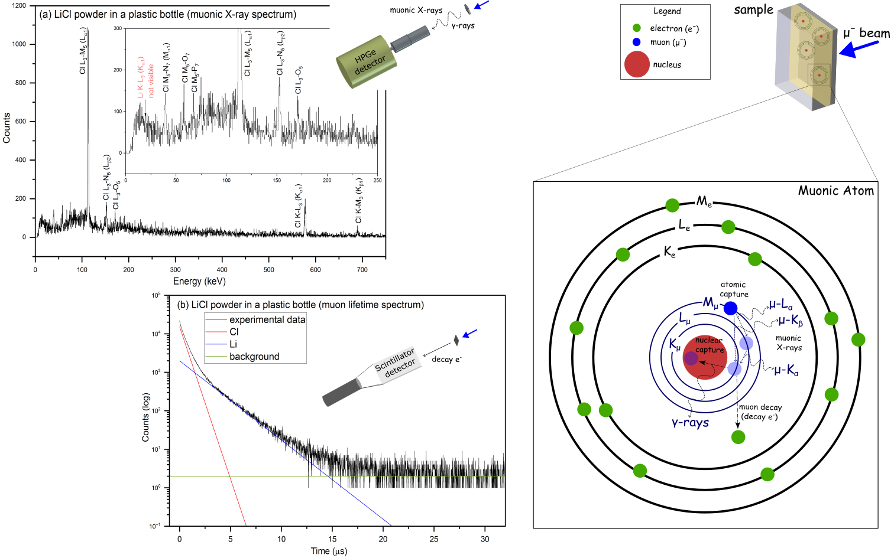
Elemental analysis techniques using μ⁻
µ⁻ @ 70 MeV/c
A. Berlie et al, ACS Omega, 11, 36 (2026)

Slide 6

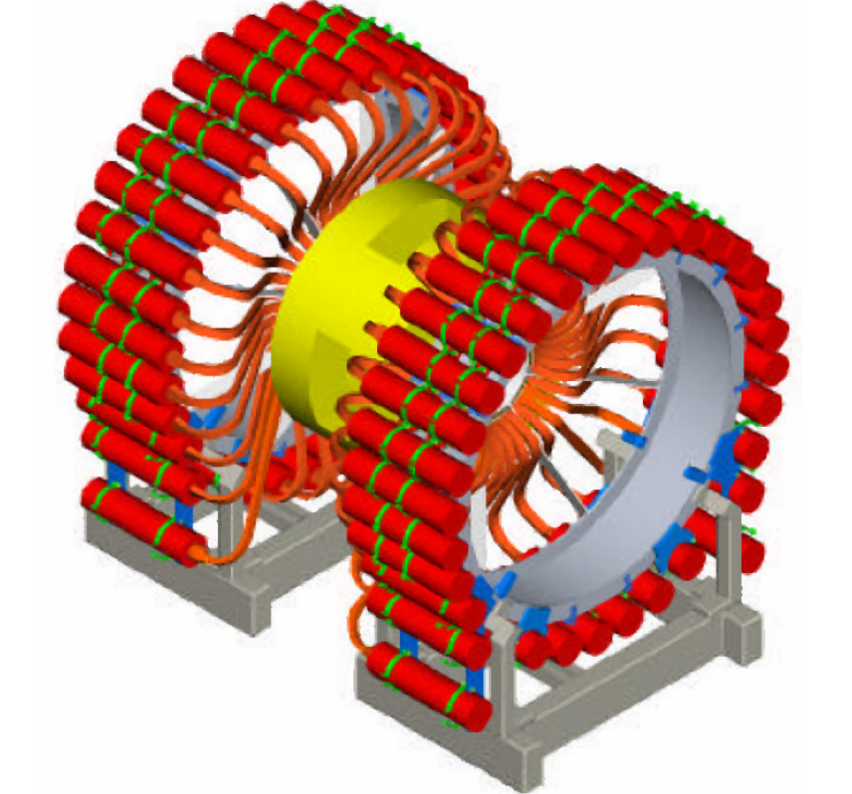
Elemental analysis techniques using μ⁻
MuX (4 HPGe detectors)
μ⁻ beam
Muonic X-ray Emission
Spectroscopy (µ-XES)
ARGUS (192 scintillator detectors)
µ⁻ @ 70 MeV/c
μ⁻ beam
µ⁻ lifetime
A. Berlie et al, ACS Omega, 11, 36 (2026)

Slide 7
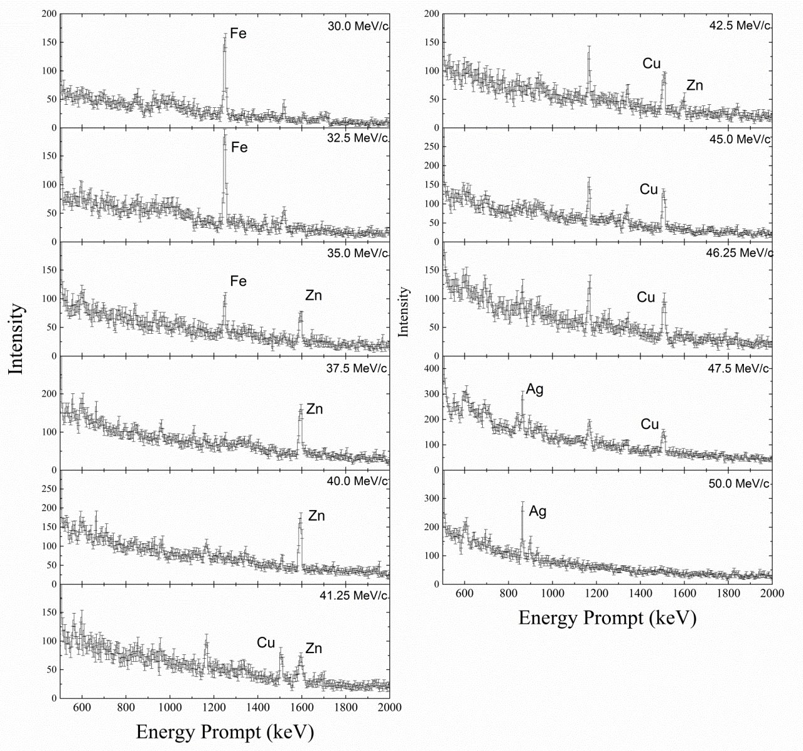
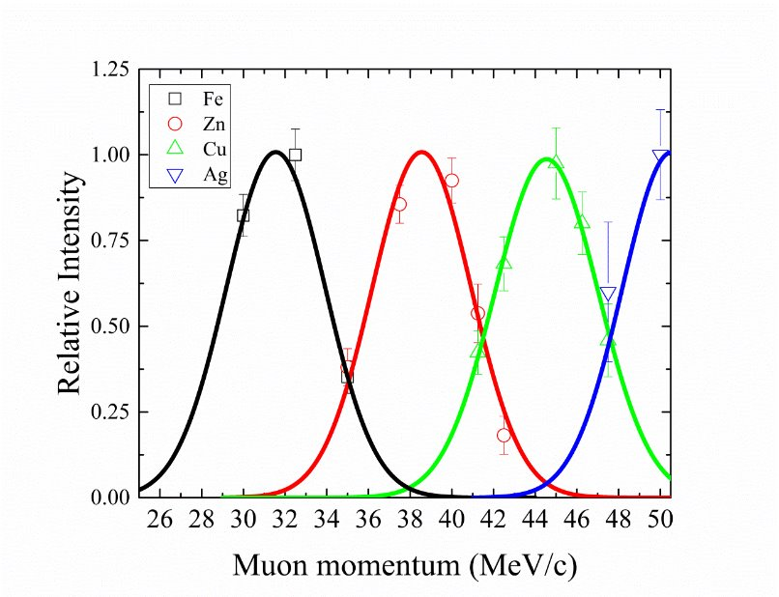
Depth sensitivity:
μ-XES Technique
Ag
1000μm
Fe
500μm
μ⁻ beam
Zn
500μm
Cu
500μm
A. D. Hillier et al, Microchemical Journal (2016)

Slide 8
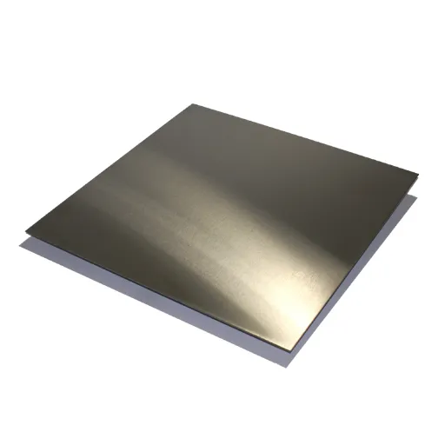
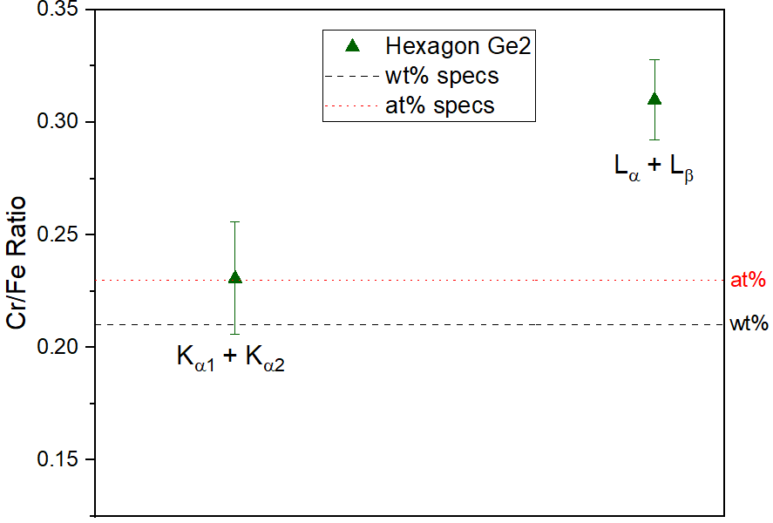
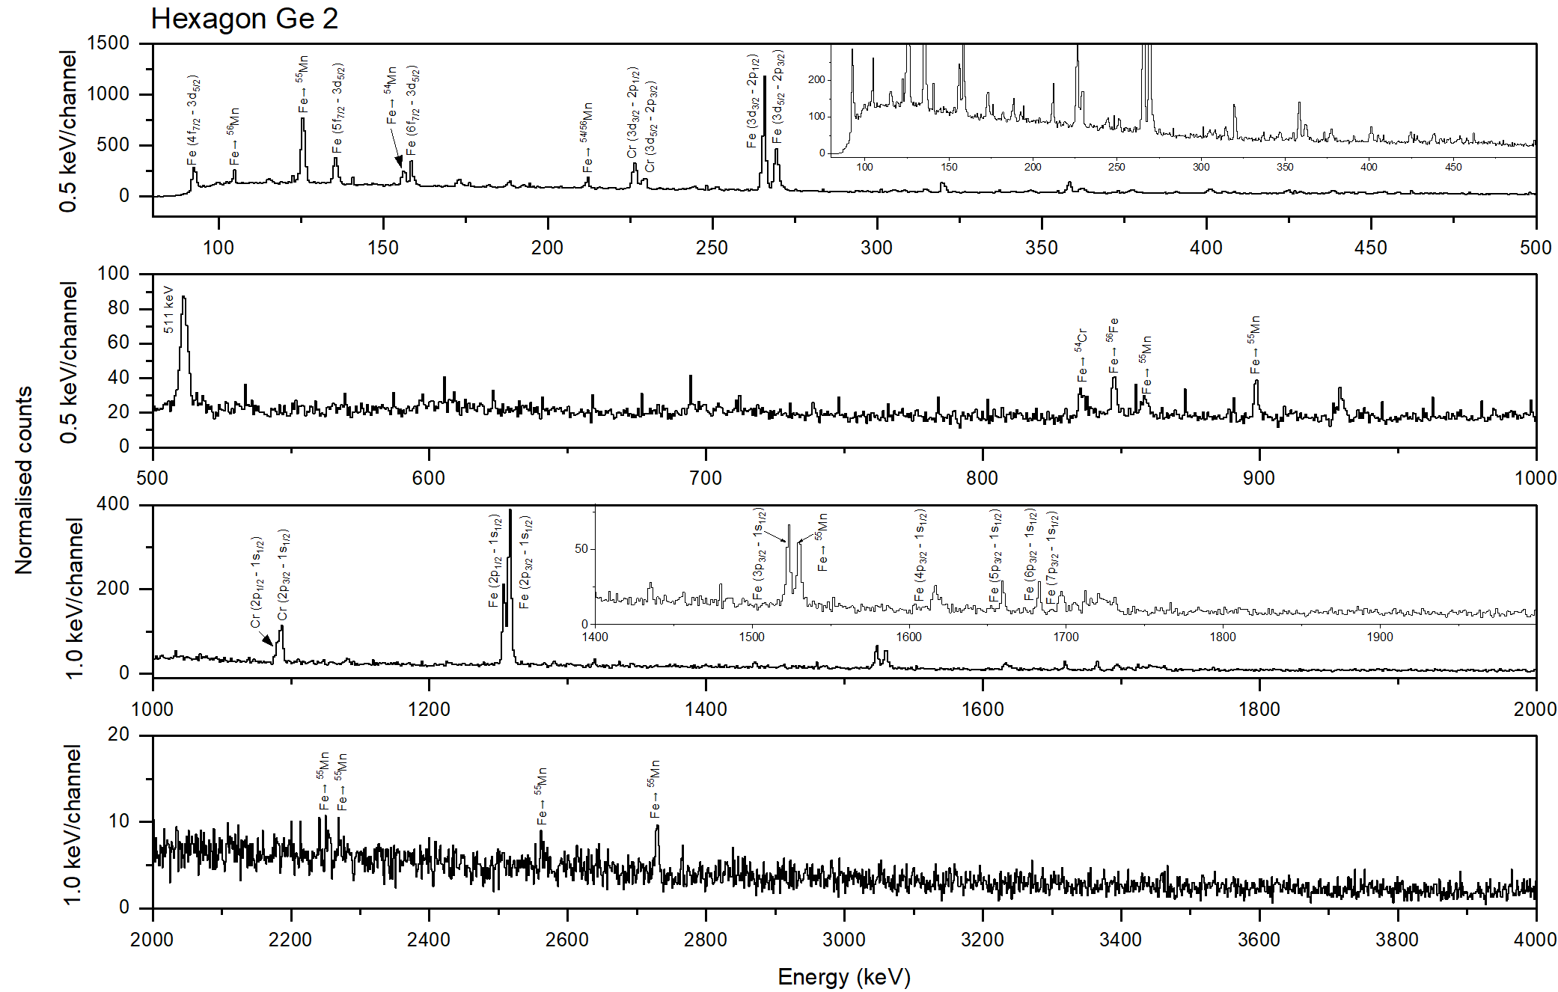
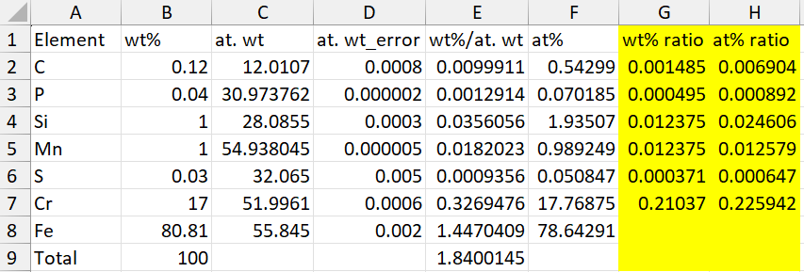
Elemental composition:
μ-XES Technique
Stainless steel (SS-AISI 430)
µ⁻ @ 30 MeV/c
Ratios wrt Fe
Ge6
μ⁻ beam
Ge7
Ge8
Ge2
S. Biswas et al, Heritage Science, 11 (2023) 43

Slide 9
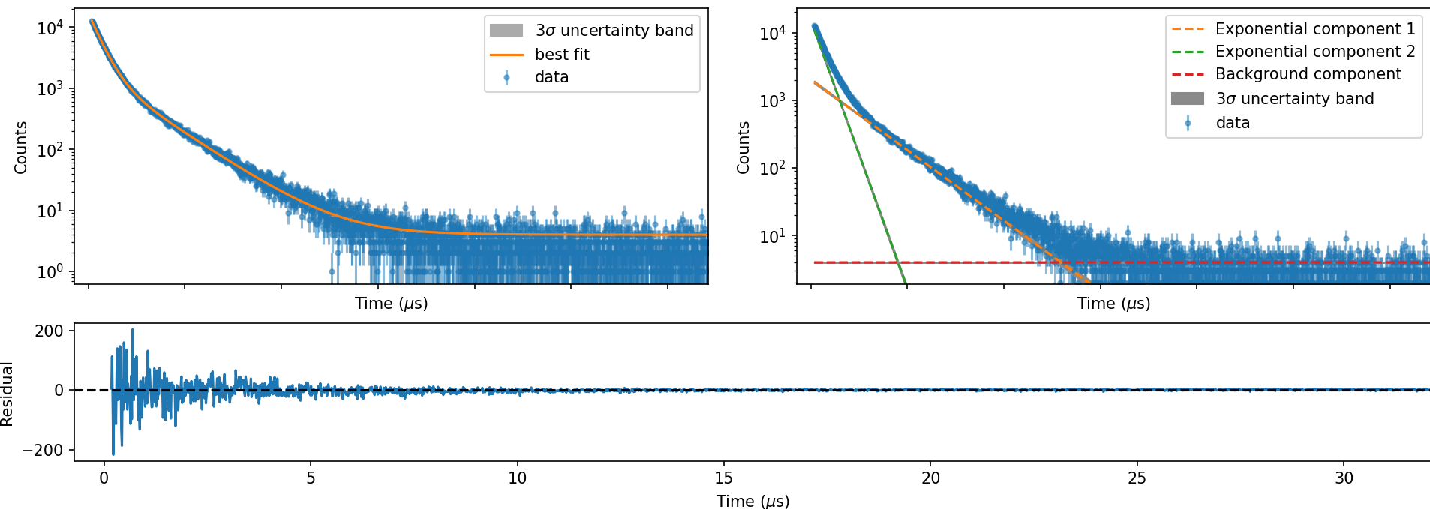
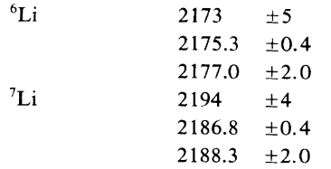
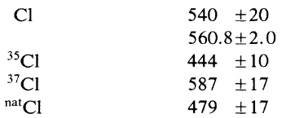

µ⁻ @ 70 MeV/c
μ-lifetime Technique
$$y=A_{1}e^{(−\frac{t}{τ_{1}})}+A_{2}e^{(−\frac{t}{τ_{2}})}+c$$
Preliminary Results
Li: 2.083(15) µs
Cl: 0.548(1) µs
Li/Cl ->
Exp: 1.0(2)
Theo: 1.0
T. Suzuki et al, Phys. Rev. C 35, 2212 (1987)

Slide 10
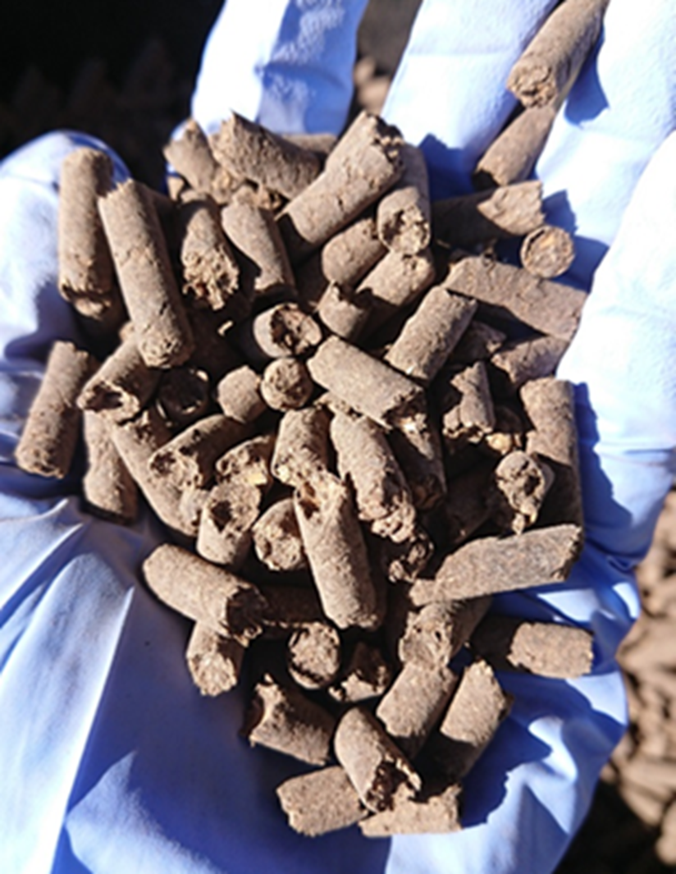

OMF : co-formulation of one or more inorganic fertiliser and one or more materials containing organic carbon (C_{org}); and nutrients of solely biological origin.
<16% N
Pb : 120 mg/kg dry matter;
Zn < 1200 mg/kg
biuret (C₂H₅N₃O₂) : 12 g/kg dry matter
Salmonella and E.coli
Etc.
Application of μ-XES
Organo-mineral fertiliser (OMF)
OMF challenges: Nutrients (N, P, K, Mg, S) are strongly bound to the organic component in OMF and this inhibits the easy release of nutrients into soil.
Solution: Addition of biostimulant to OMF.
Biostimulants are made from humic material, seaweed extracts, protein lysates, etc.
Inorganic component
Inorganic component
Biostimulants
Organic component
Organic component
OMF pellet
Prof. Ruben Sakrabani (PI),
Dr. Parveen Rupani, and Zoe Partington
Funders: Ofwat Innovation Fund, STFC Food Network

Slide 11
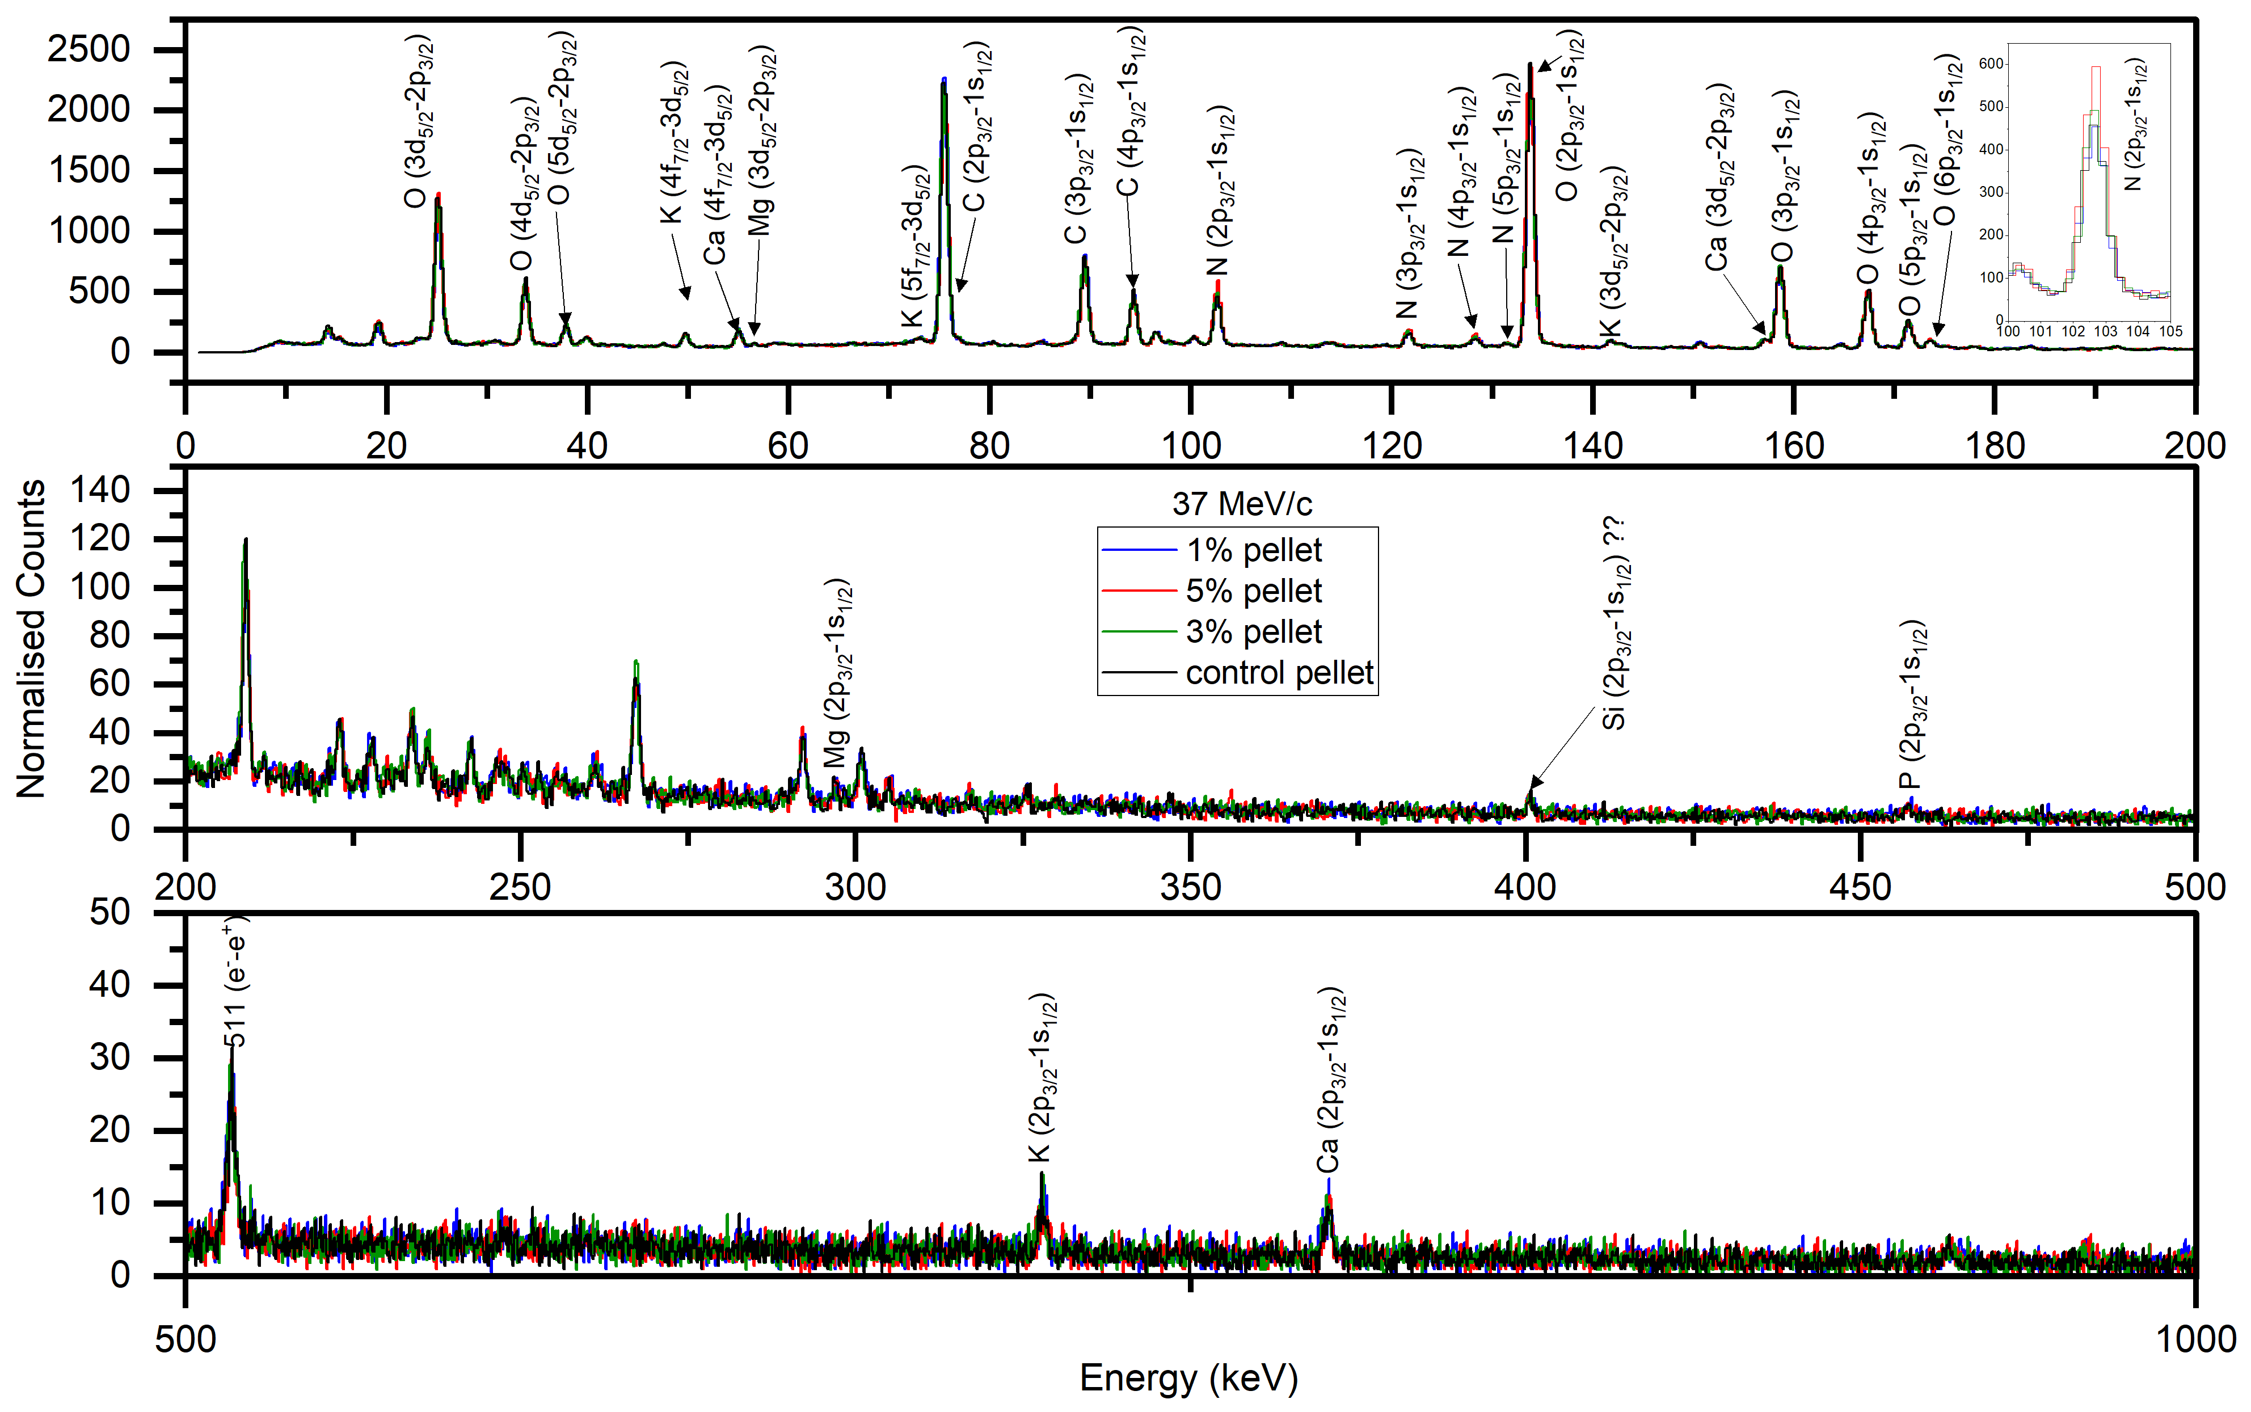
Aim: To assess the influence of biostimulants on nutrient (N, P, K, Mg, S) composition as a slow release fertiliser of OMF pellets using muonic X-ray experiments.
Application of μ-XES
Organo-mineral fertiliser (OMF)
Preliminary Results:
Control Pellet: 1% N, 8% C, 0.3% P and 0.7% K by mass
Momenta: 30 and 37 MeV/c
distribution of N, C, P, K was consistent at both depths within each pellet
Pellets having 5% biostimulant by mass showed 6% C -> a slight reduction compared to control whilst others did not show any effect.
Prof. Ruben Sakrabani (PI),
Dr. Parveen Rupani, and Zoe Partington
Funders: Ofwat Innovation Fund, STFC Food Network

Slide 12
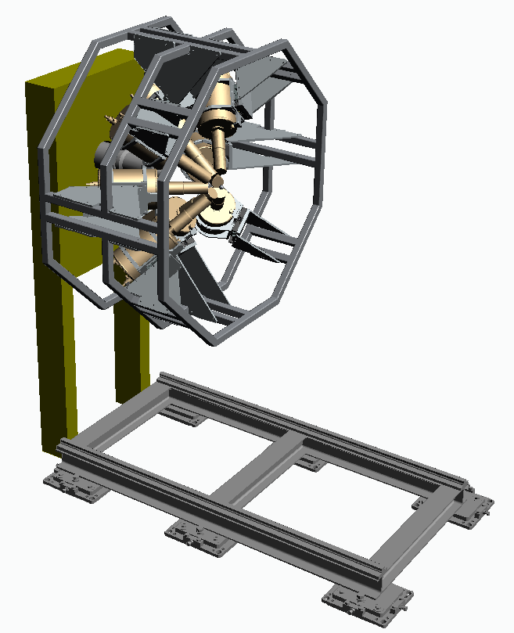
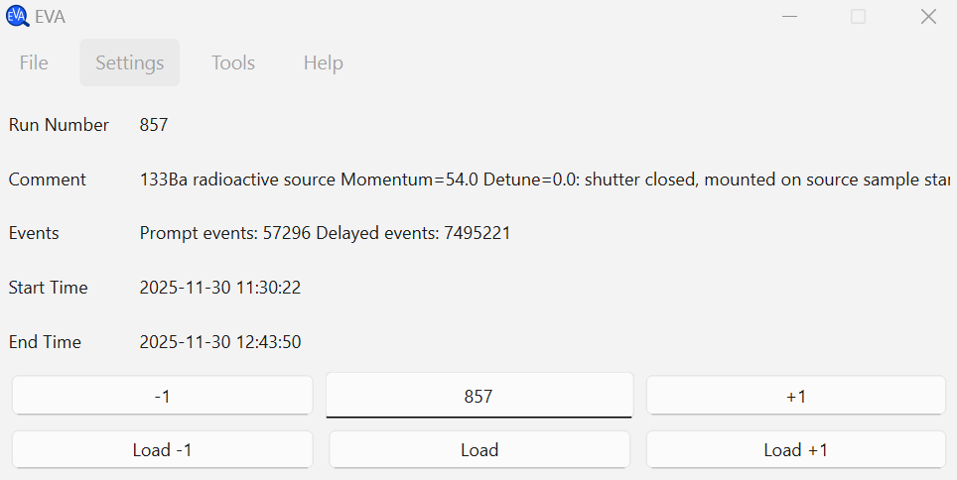
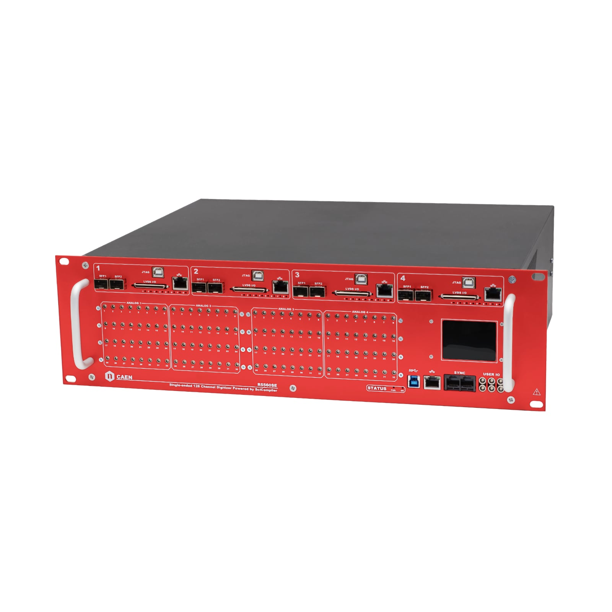
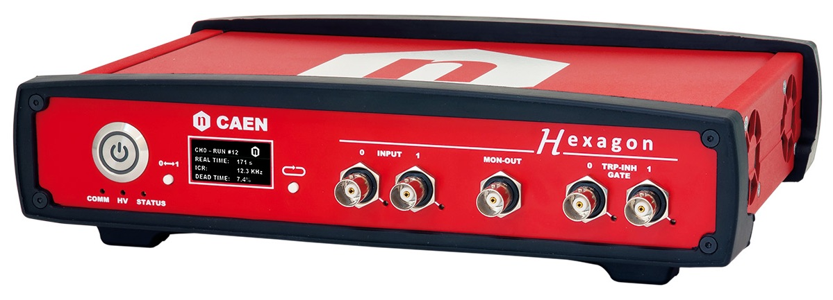
Upgrades @ ISIS
Data Analysis Software (EVA):
Setup:
8 HPGe
detectors
4 HPGe
detectors
Element/Isotope identification
DAQ:
Machine Learning
(element identification
& composition)
Periodic Table
(Mudirac)
Hexagons
(4 channels)
Peak fitting
R5560SE (128 channels)
https://github.com/ISISMuon/EVA
M. Bjørklund et al., J. Phys. conf. ser., 3222, 012020 (2026)
Simulations (SRIM/TRIM
& G4Beamline)

Slide 13
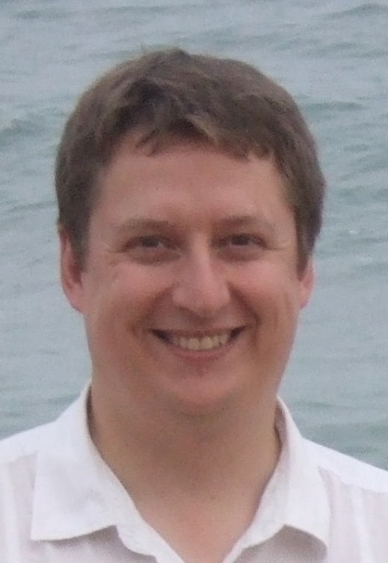


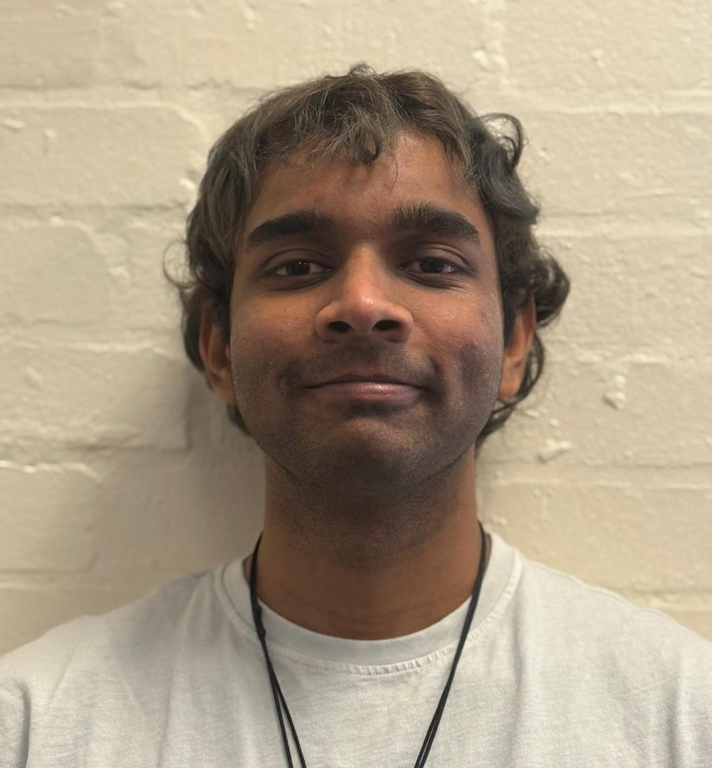
Acknowledgements
Me!
Muon Instrument Scientist
(Feb 2024- present)
ISIS Technicians
James R. Taylor
Jack Williams
Ashley Lester
Jeremy Moor
…
Adrian D. Hillier
Muon group Leader
Scientific Computing
Subindev Devadasan
Patrick Austin
Leandro Liborio
Philip Jones (Warwick U.)
Siddharth Dhanpal
Margaret Duff
Niall Bootland
Hussam Al Daas
Susmita Basak
…
Industrial Placement Students
Matea Bjørklund
(July 2024- July 2025)
PhD student (Oct 2026 - present)
Chendur Chandrasekaran
(July 2025- August 2026)
UK & international collaborators
ISIS Muon Group members

Slide 14


Slide 15
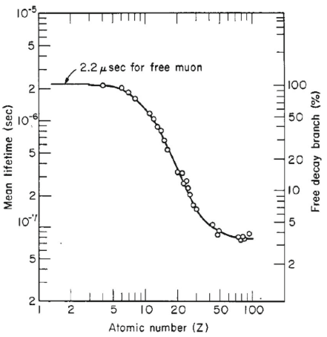
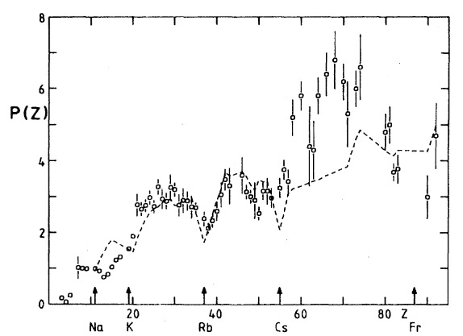
For Cu
(Z = 29)
8
T. Von Egidy et al, Phys. Rev. A 26, 2355 (1982)
T. Yamazaki et al, Phys. Scr. 11, 133 (1975)

