Slide 1
μSR in Nanocale Magnets and Superconductors
Dr. Suci Winarsih
Research Center for Quantum Physics
BRIN (National Research and Innovation Agency)
Indonesia
Presented at The 3rd Workshop on Muon Science Technology
and Industry (MELODY2026)
Sunday, 25th October 2026
Guangdong, China

Slide 2
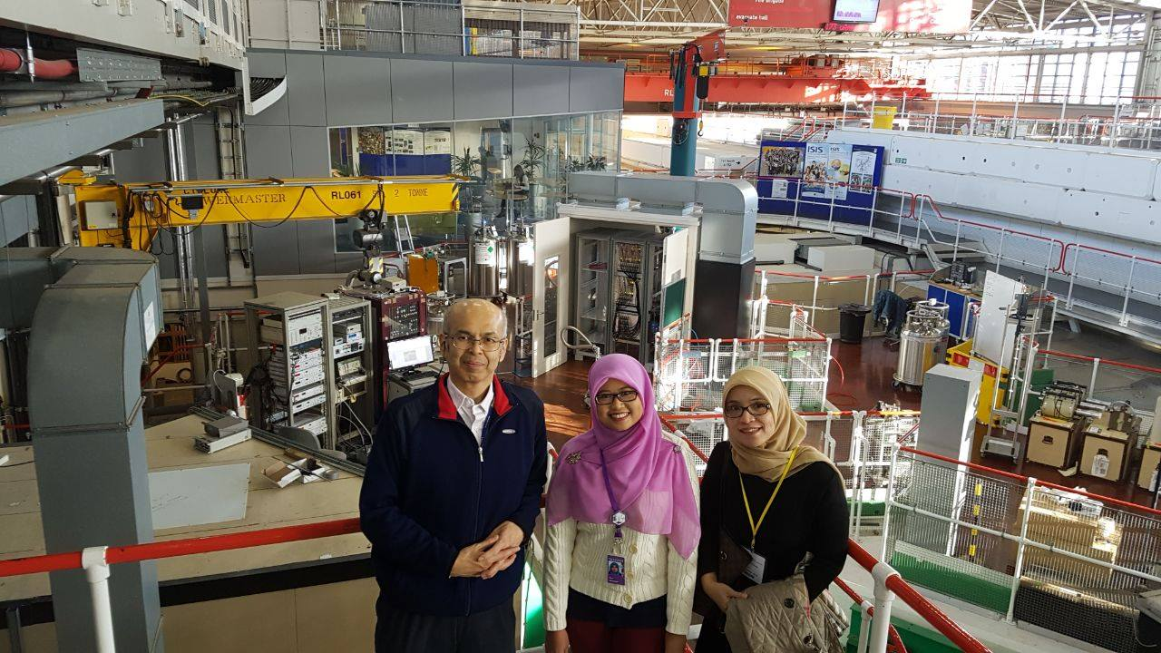




My Muon Journey
1st Visit @RIKEN-RAL Muon Facility
September 2017
Performed μSR experiments with
my PhD Students @ISIS Muon Facility-October 2025

Slide 3
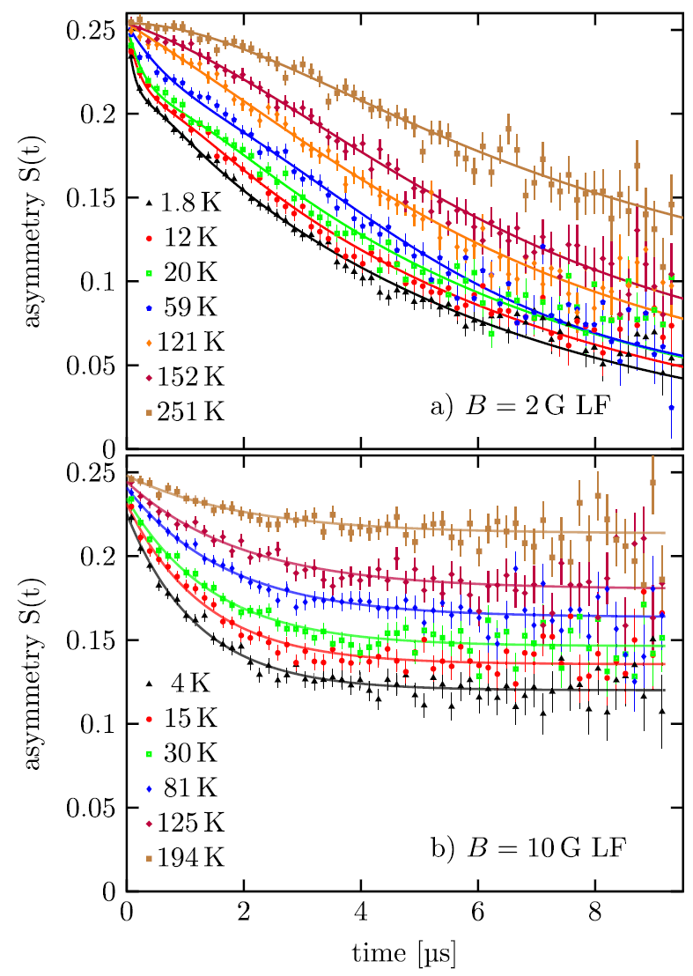
Nano-size Effect
Nano-size Effect Probed by μSR
The gold (Au) is diamagnetic in a bulk state, it becomes ferromagnetism when the particle size of Au 1.9 nm (capped by polyallyl amine hydrochloride, (PAAHC)
(Y. Yamamoto et al., PRL 93, 116801, 2004).
Evidence of magnetism: slowing down of fluctuating electronic moments in Au 2.2 nm capped with butanethiol.
A Mott insulator, CuO, the T_{N} is drastically decreased down to 30 K when the particle size was 2 − 3 nm. Bulk CuO has TN =229 K.
(X. G. Zheng et al., PRB 72, 014464, 2005).
(M. H. Dehn et al., Appl. Phys. Lett. 112, 053105, 2018)
Notes:
At high temperature: simple Gaussian behabiour.
Decreasing temperature: fast relaxing component develops, attributed to a slowing down of fluctuating electronic magnetic moments.

Slide 4
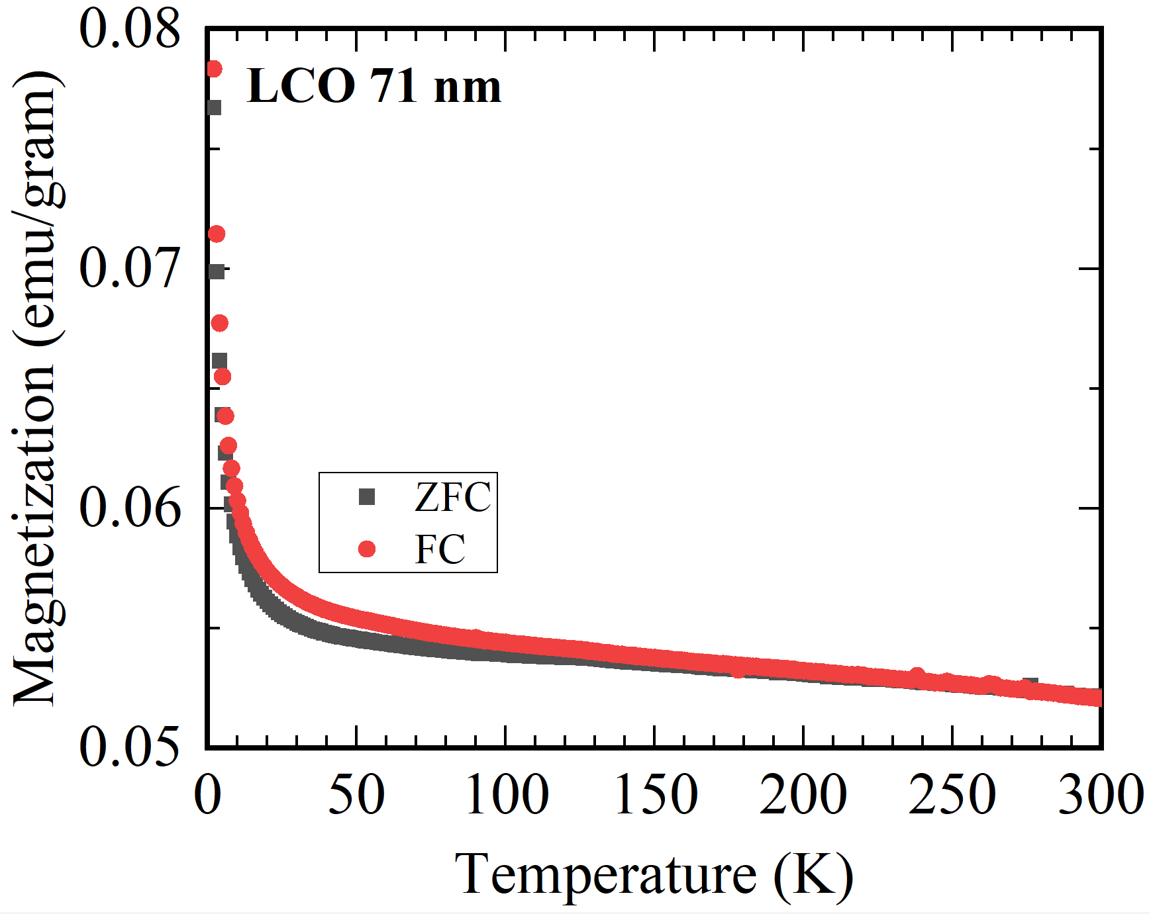
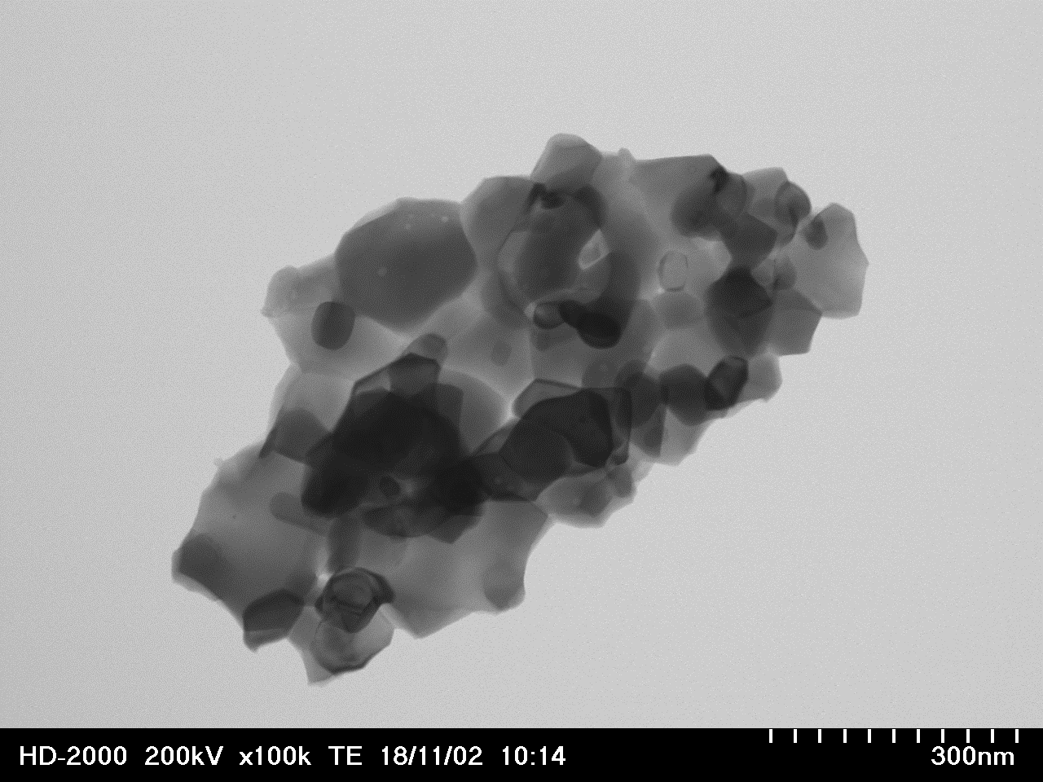
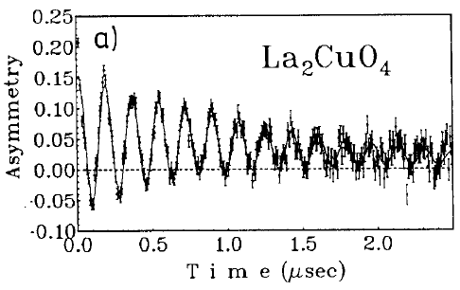
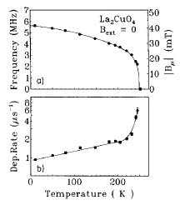
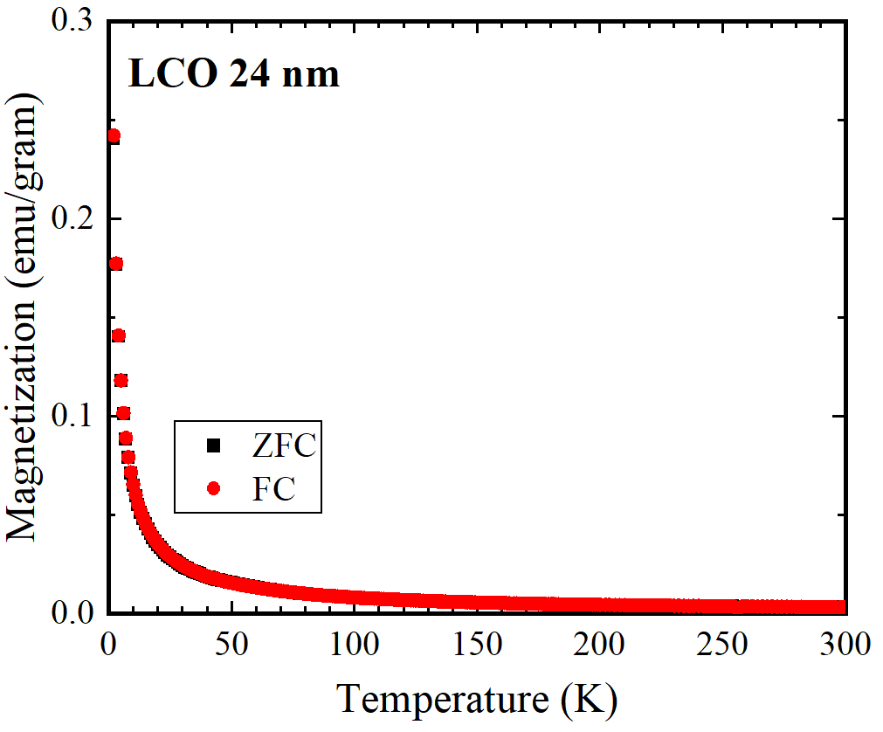
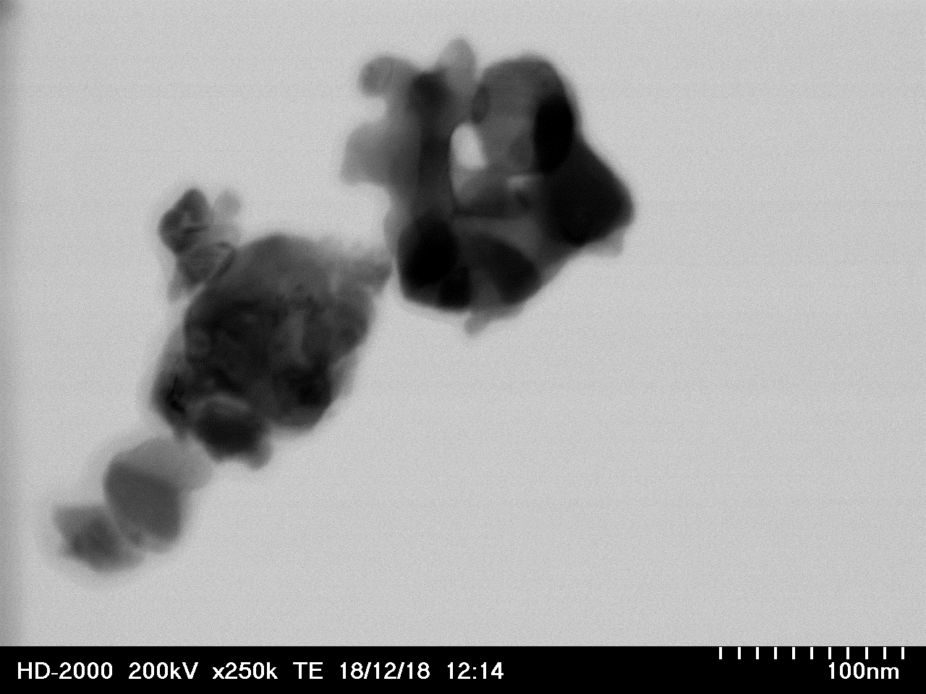
Bulk
La2CuO4
Long range magnetic ordering
Nanoparticles
Nanoparticles
J. I. Budnick et al., Phys. Lett. A 124, 103 (1987).
S. Winarsih, et al. (in preparation).

Slide 5
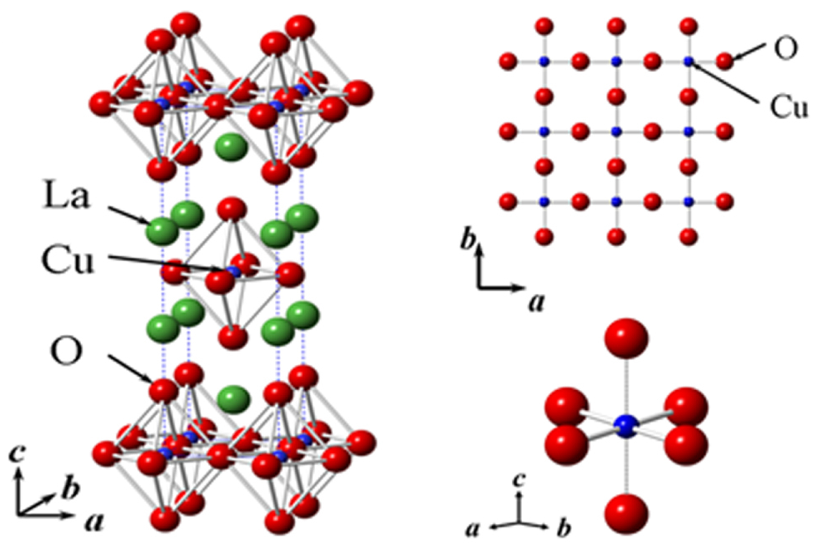

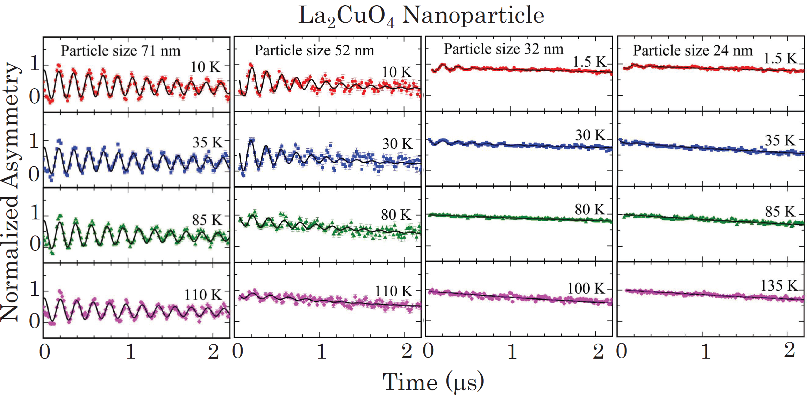
μSR Results-LCO NPs
Muon-spin precession component
Fast-depolarizing component
μSR experiments were performed at ISIS
$$A_{(t)}=A_{1}cos\left(γ_{μ}B_{int}t+φ\right)e^{−λ_{1}t}+A_{2}e^{−λ_{2}t}$$
S. Winarsih, et al. (in preparation).

Slide 6
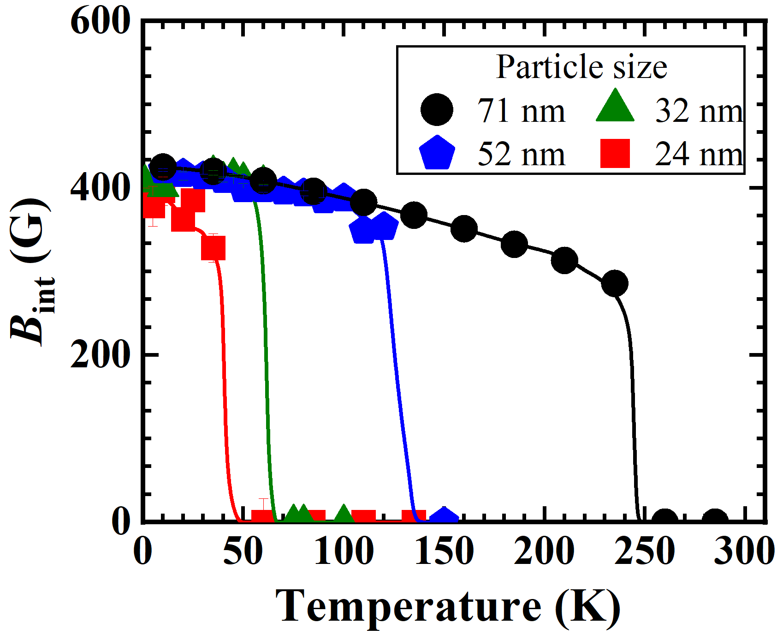
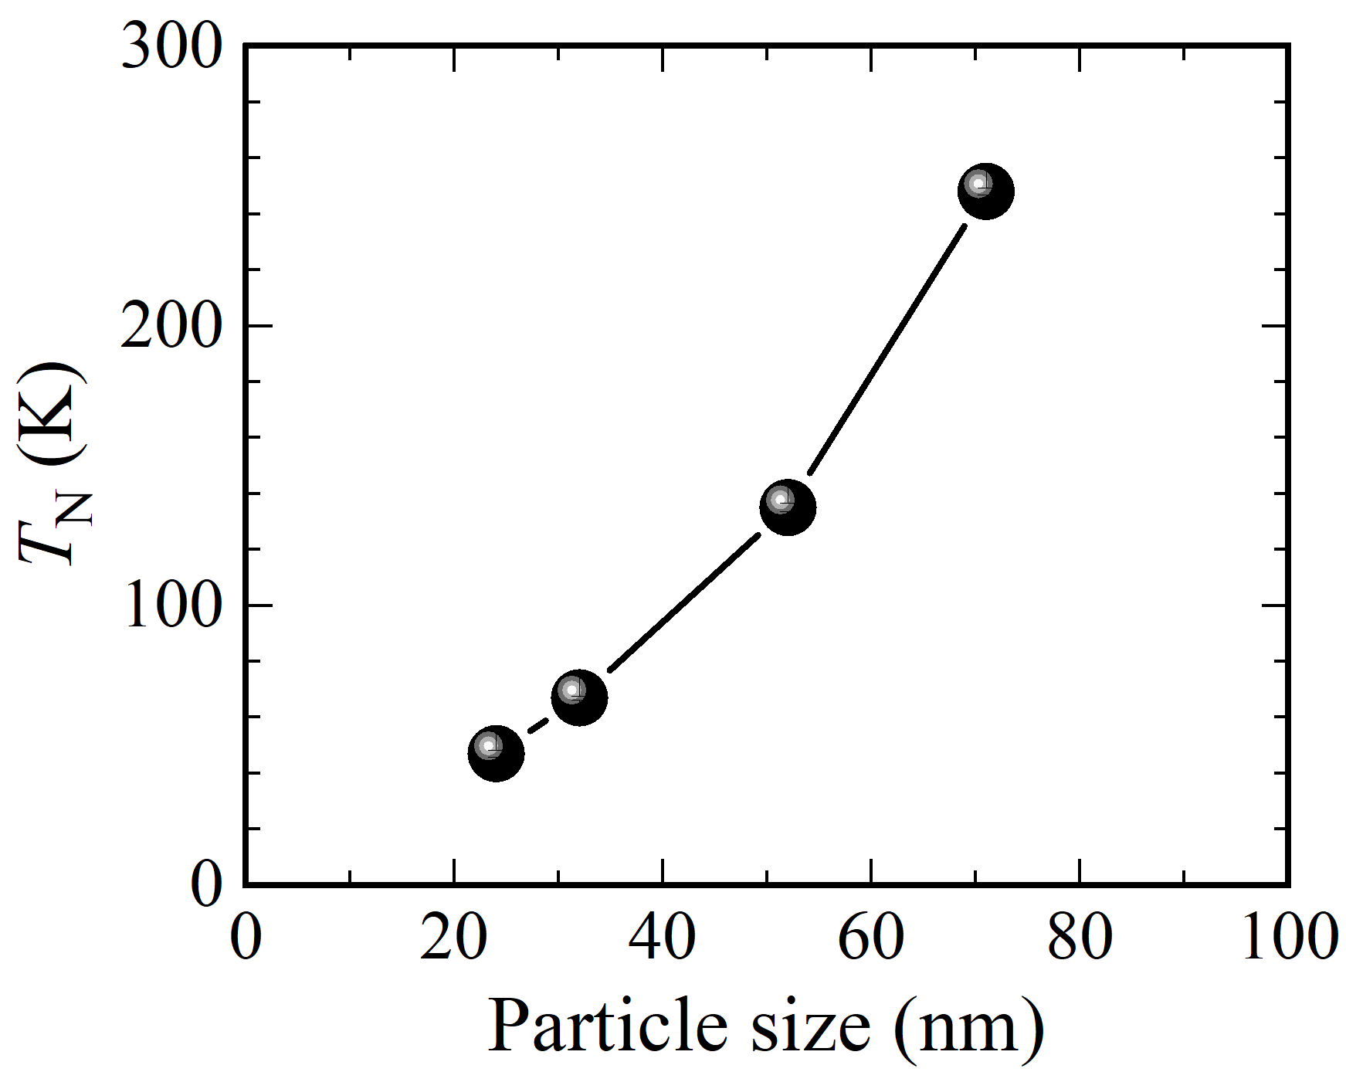
μSR Results-LCO NPs
TN strongly suppressed due to particle size effects.
TN of the bulk LCO = 325 K.
Hint did not significantly change among all LCO samples ≈ 420 G.
It is also as same as those observed in bulk LCO.
S. Winarsih, et al. (in preparation).

Slide 7
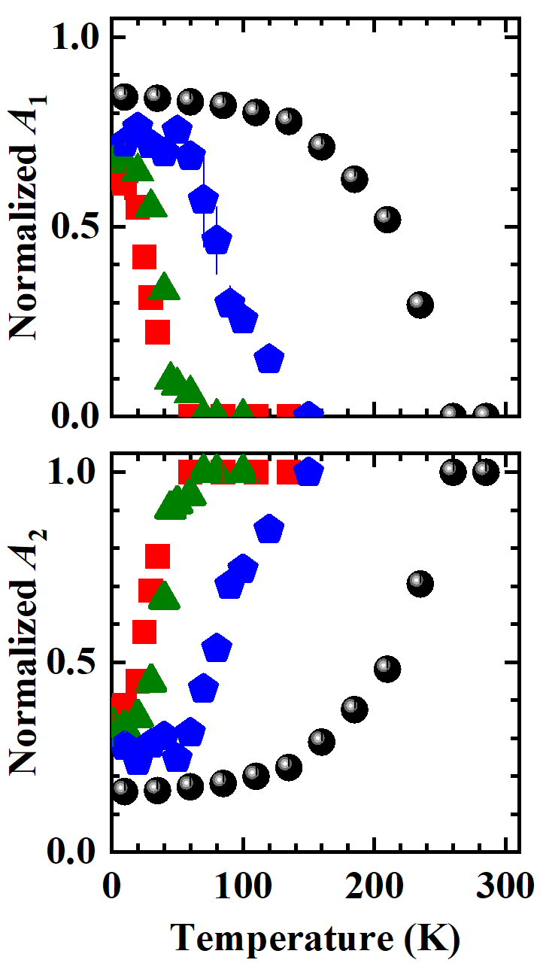
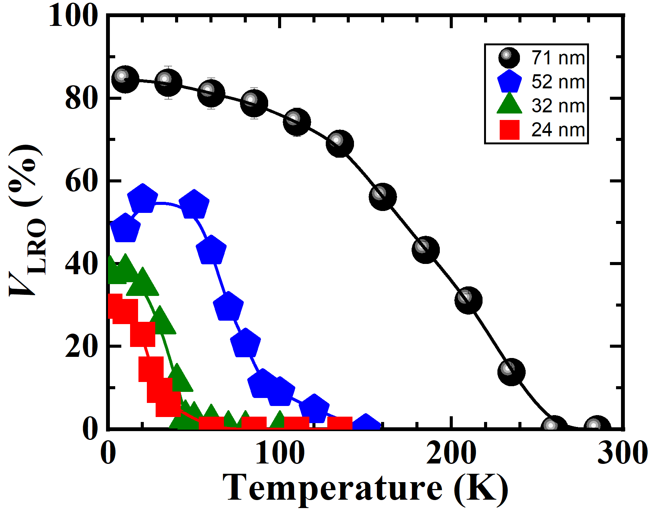
μSR Results-LCO NPs
Volume fraction VLRO decreases with reducing the particle size.
Long-range ordering decreased in a smaller particle size.
S. Winarsih, et al. (in preparation)
S. Winarsih, et al. (in preparation).

Slide 8
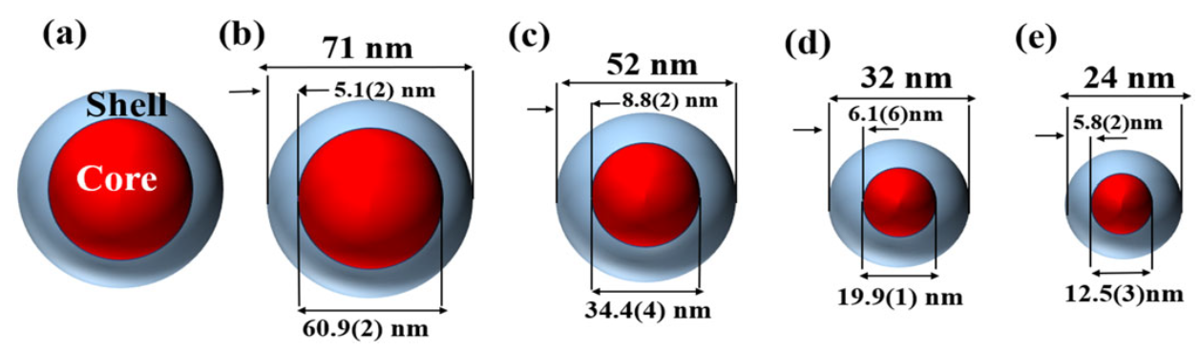
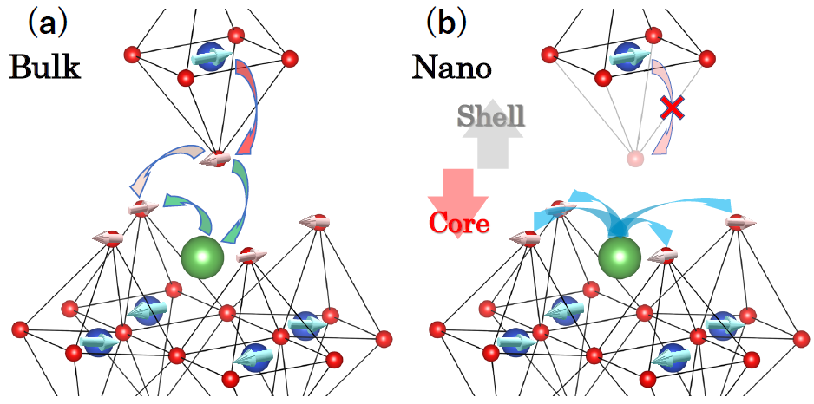
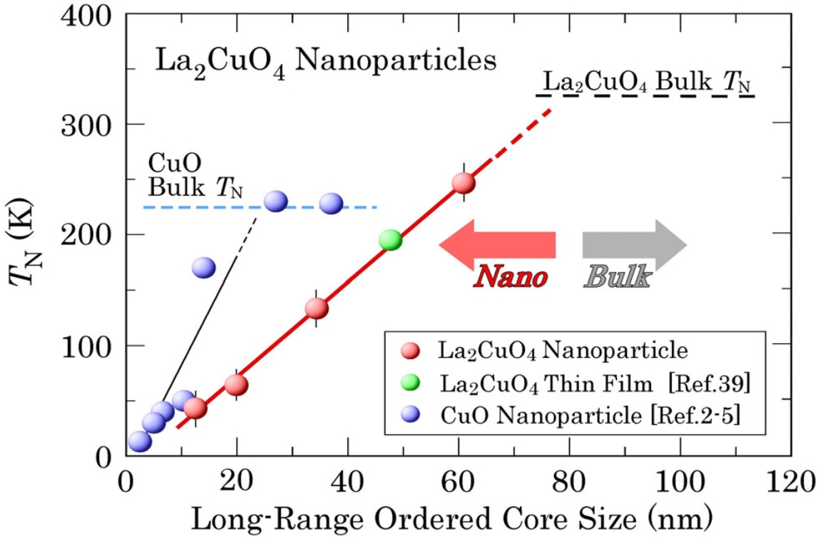
μSR Results-LCO NPs
Appearance of local magnetic frustrations near the surface of the nanoparticle.
S. Winarsih, et al. (in preparation).

Slide 9
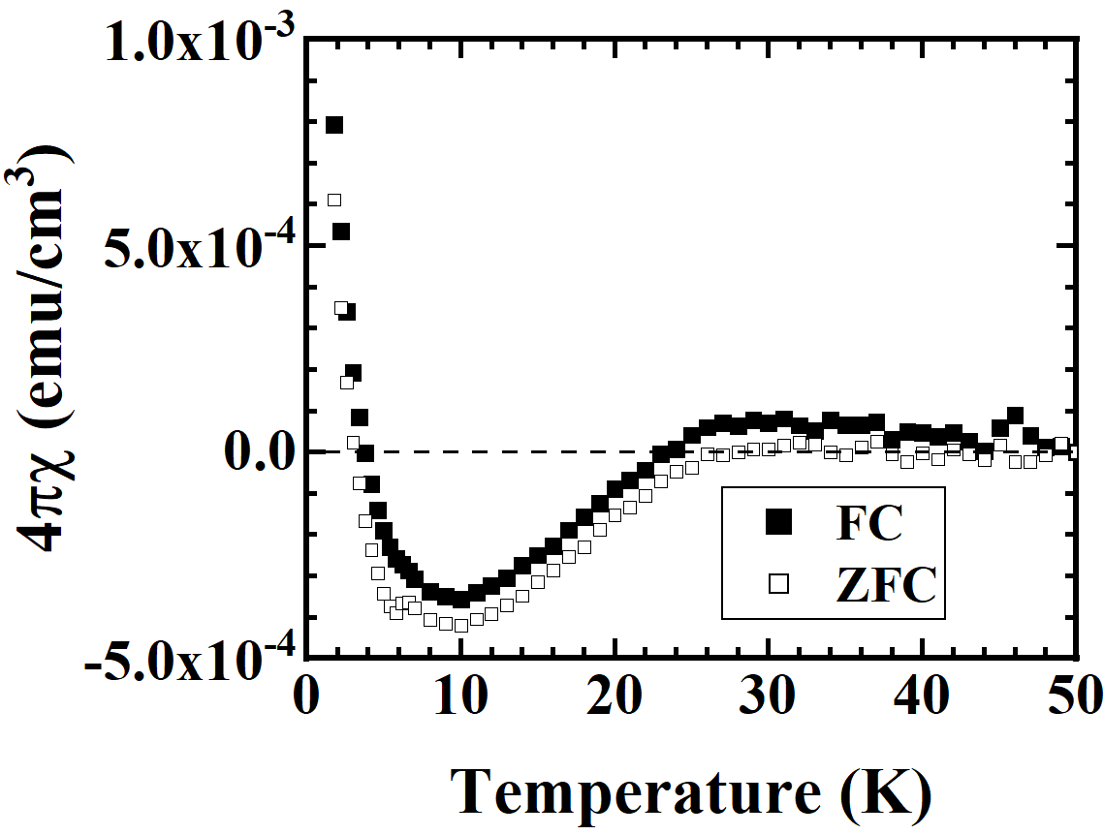
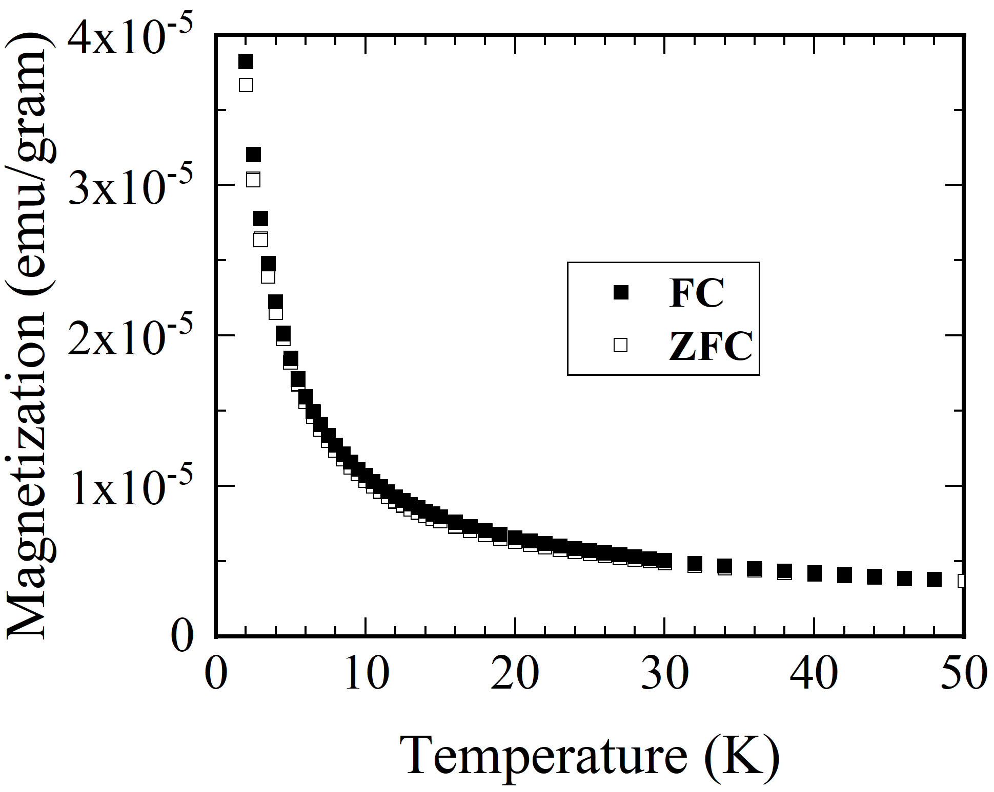
Superconductor La1.80Sr0.20CuO4 NPs
64 nm
39 nm
H = 10 Oe
H = 10 Oe
Tc ≈ 27 K
Superconducting (SC) state strongly suppressed.
Tc ≈ 27 K (similar as those observed in bulk LSCO)
SC state could not be detected.
S. Winarsih et al., J. Magn. Magn. Mater. 648, 174100 (2026) .

Slide 10
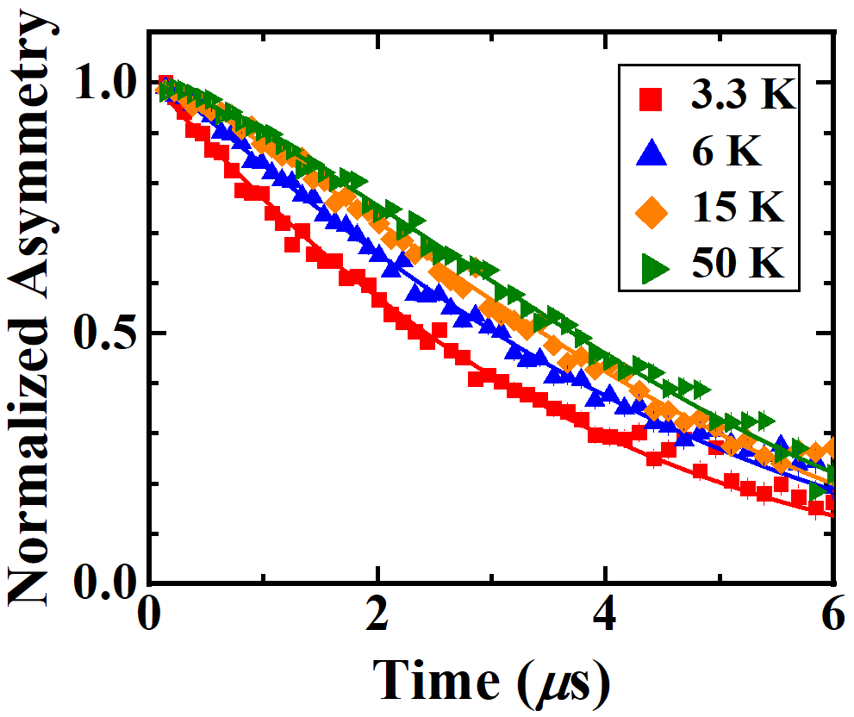


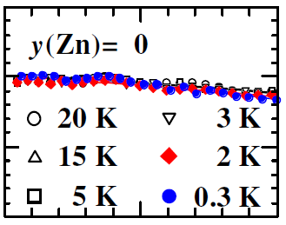
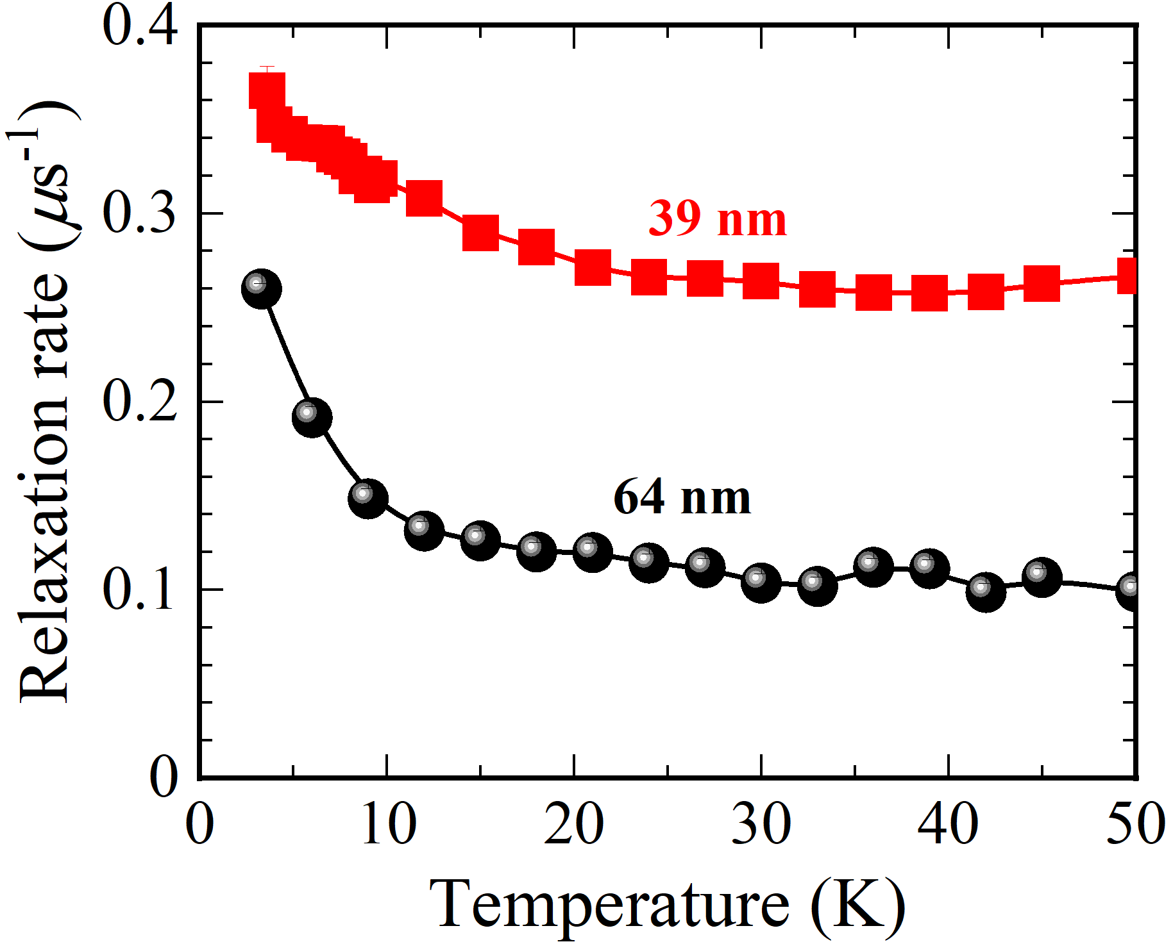
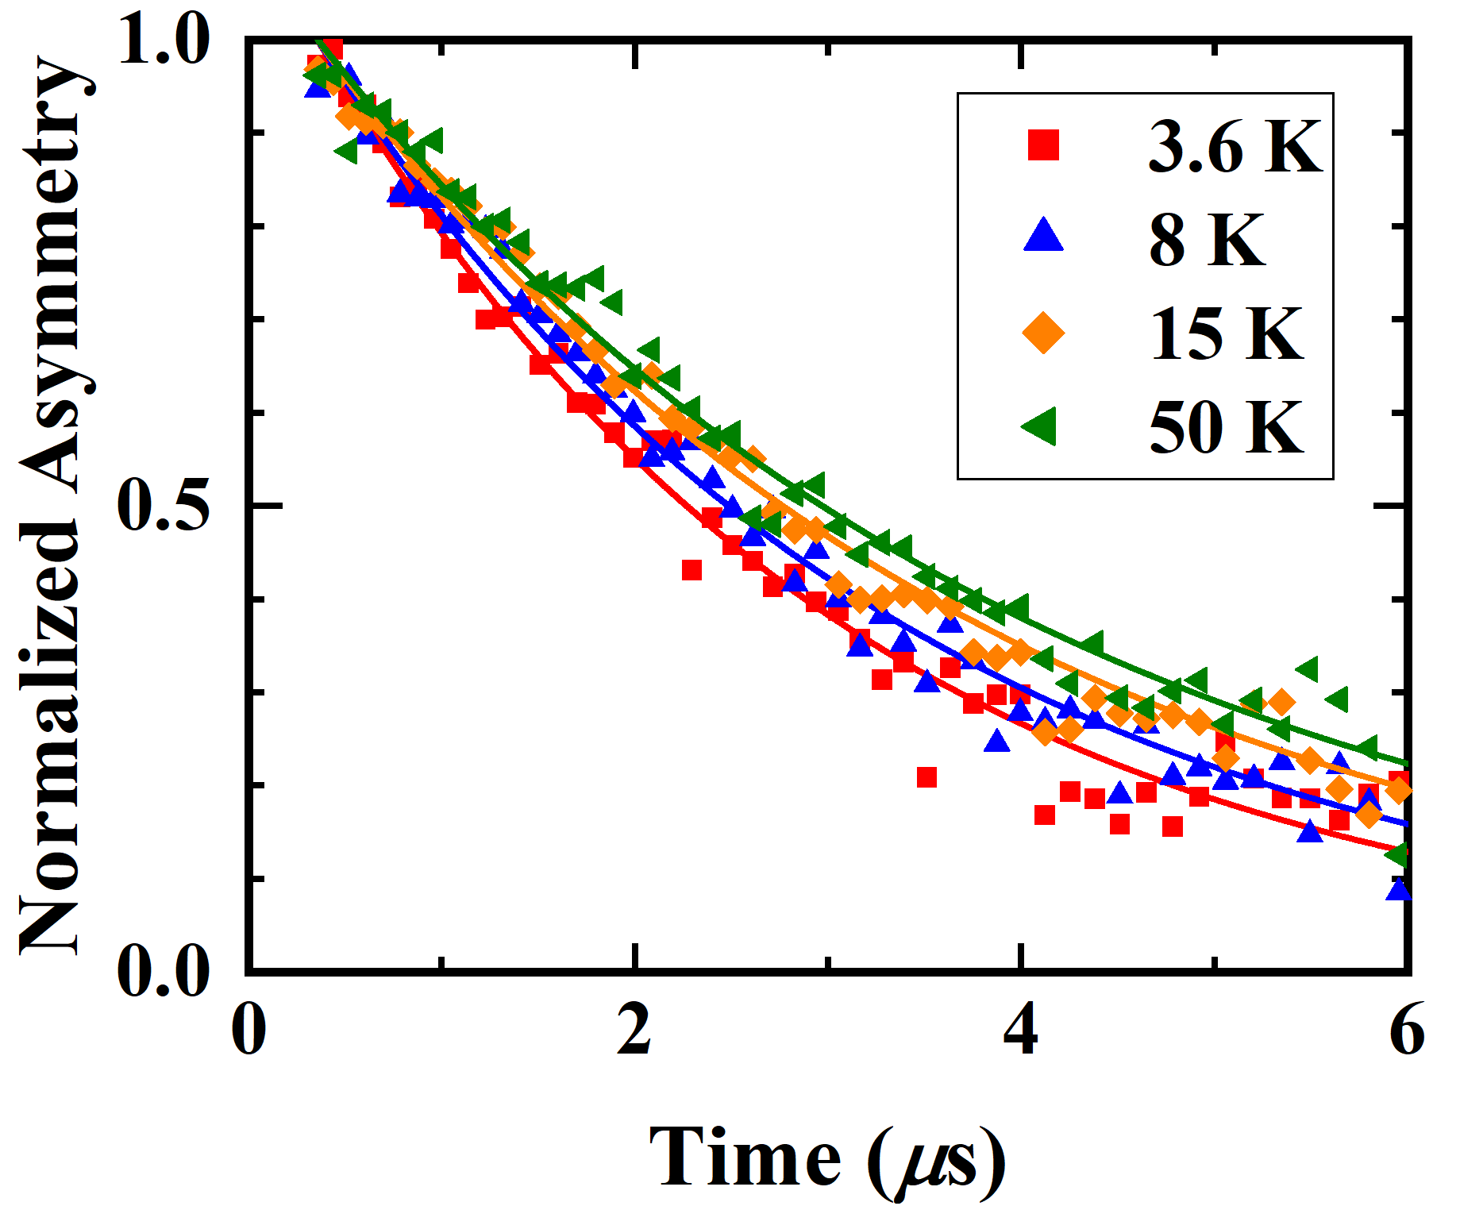


64 nm
μSR Results-LSCO NPs
Compare to the bulk case
Fitting function:
T. Adachi et al., Phys. Rev B 78, 134515 (2008).
$$A\left(t\right)= A_{0}e^{−λt}G_{z}(∆,t)$$
39 nm
Nano-sized effects caused strong suppression in the SC state.
Development of magnetic correlation starts at 30 K.
μSR experiments were performed at J-PARC
S. Winarsih et al., Nanomaterials 11, 3450 (2021).
Notes:
Relaxation rate starts to increase below 30 K then suddenly increase below 10 K.
Relaxation rate from ZF-muSR : T1 (spin-lattice relaxation).
Relaxation rate from TF-muSR : T1 (spin-spin relaxation).
Wide Gaussian is typical of nuclear dipole and static random field : KT function.
Exponential behaviour is electron-electron correlation. If this correlation become dominant, the time spectra can be analysed by using exponential function.

Slide 11
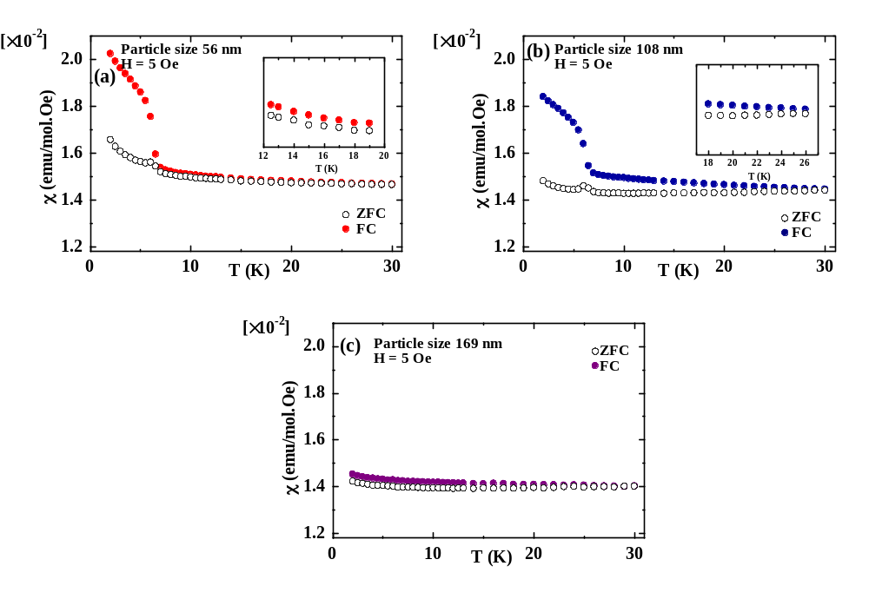
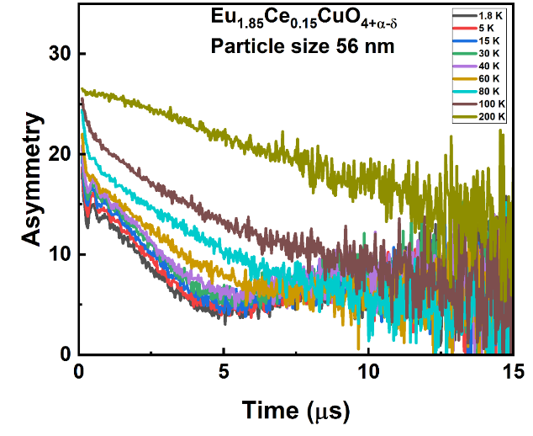

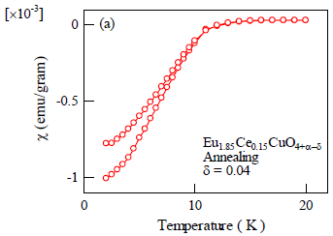
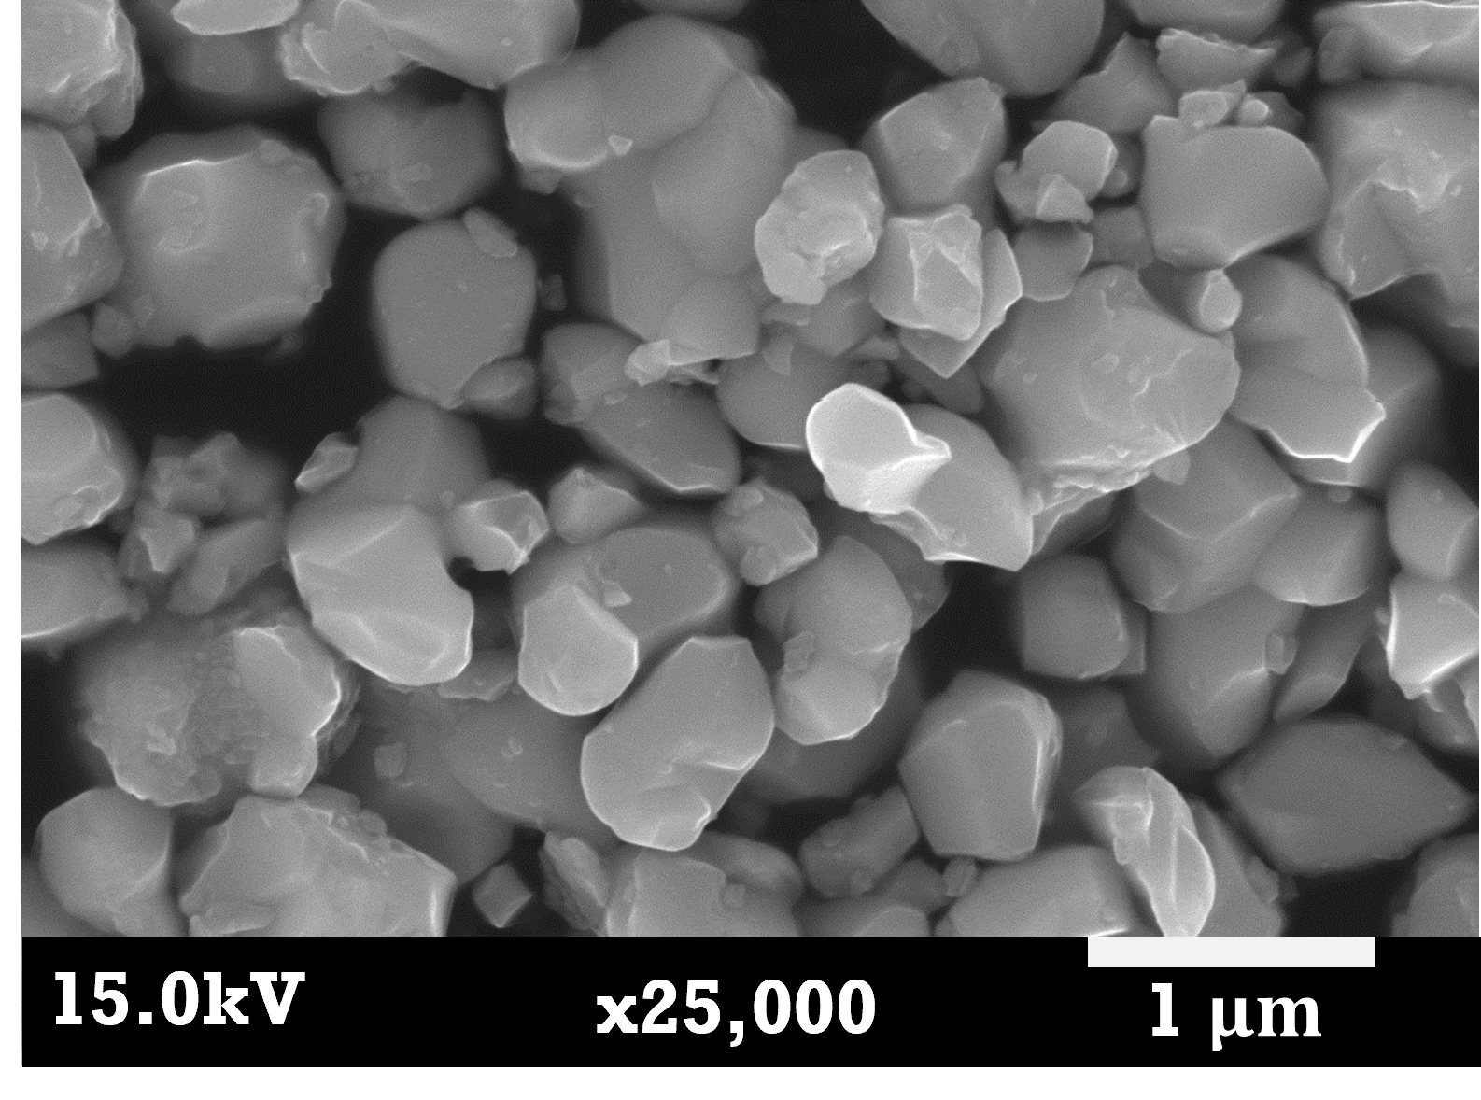
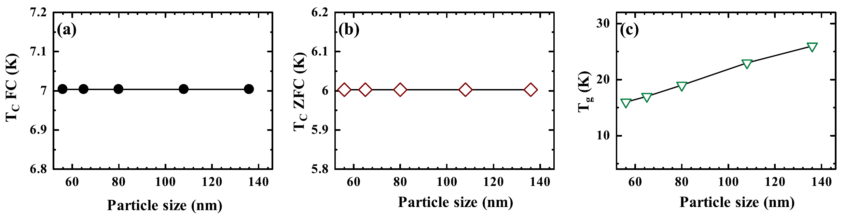
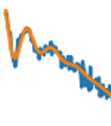
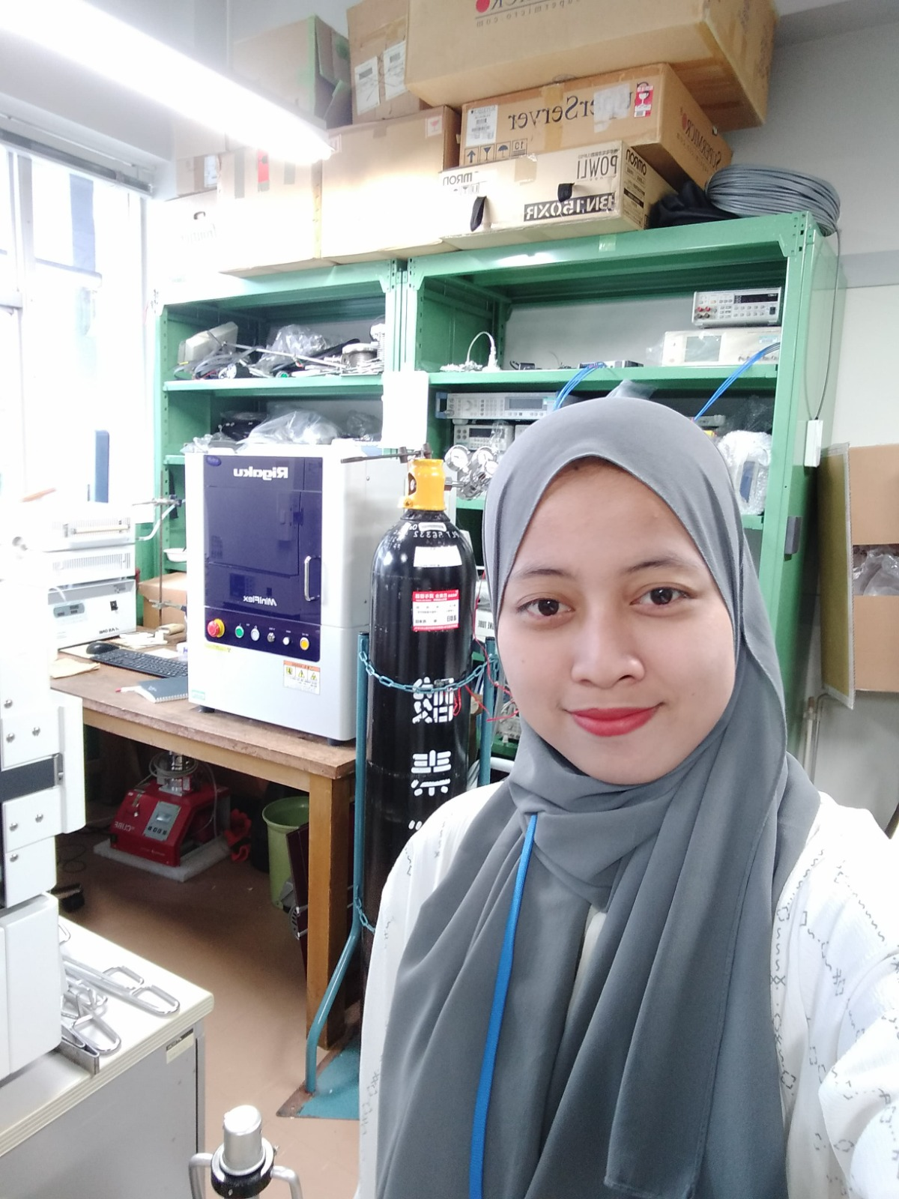

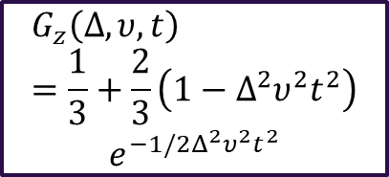


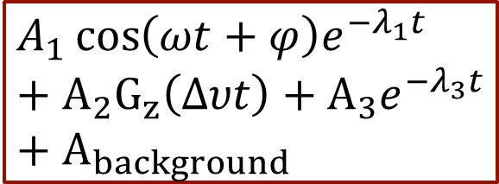

Electron-Doped Cuprate Superconductor Nanoparticles
NPs
Bulk
✅Kubo-Toyabe!
$$T_{g}$$
$$T_{c}$$
$$G_{z}\left(Δ, υ, t\right)=\frac{1}{3}+\frac{2}{3}\left(1−Δ^{2}υ^{2}t^{2}\right)$$
$$e^{−1/2Δ^{2}υ^{2}t^{2}}$$
$$T_{c}$$
nano
✅muon spin precession!
$$A_{1}\cos\left(ωt+φ\right)e^{−λt}$$
Superconductivity cannot be observed
Indication of spin glass state and ferromagnetic state
Different than those oberserved in bulk case
$$A_{1}\cos\left(ωt+φ\right)e^{−λ_{1}t}+A_{2}G_{z}\left(∆υt\right)+A_{3}e^{−λ_{3}t}+A_{background}$$
11
D. Nurmalasari, S. Winarsih, et al., Mater. Res. Express 12, 045001 (2025)
μSR experiments were performed at ISIS
Devi Nurmalasari
PhD Student

Slide 12
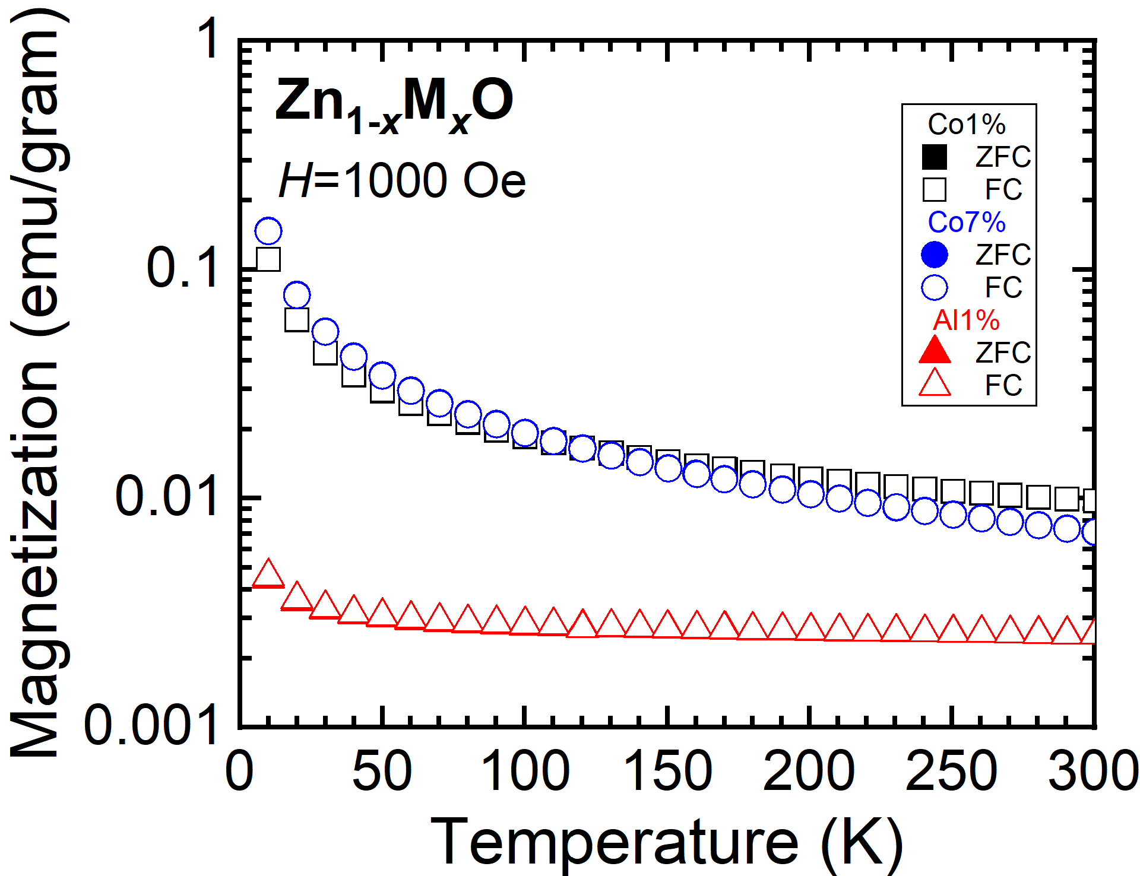
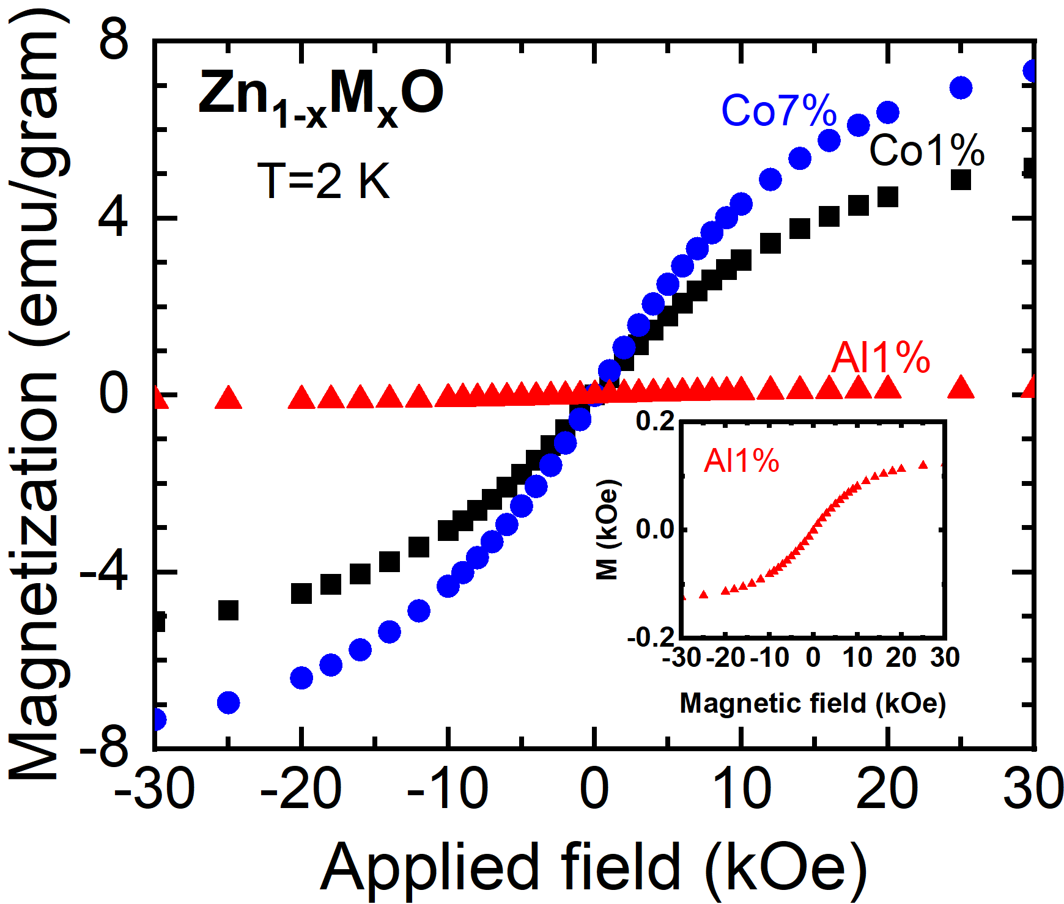
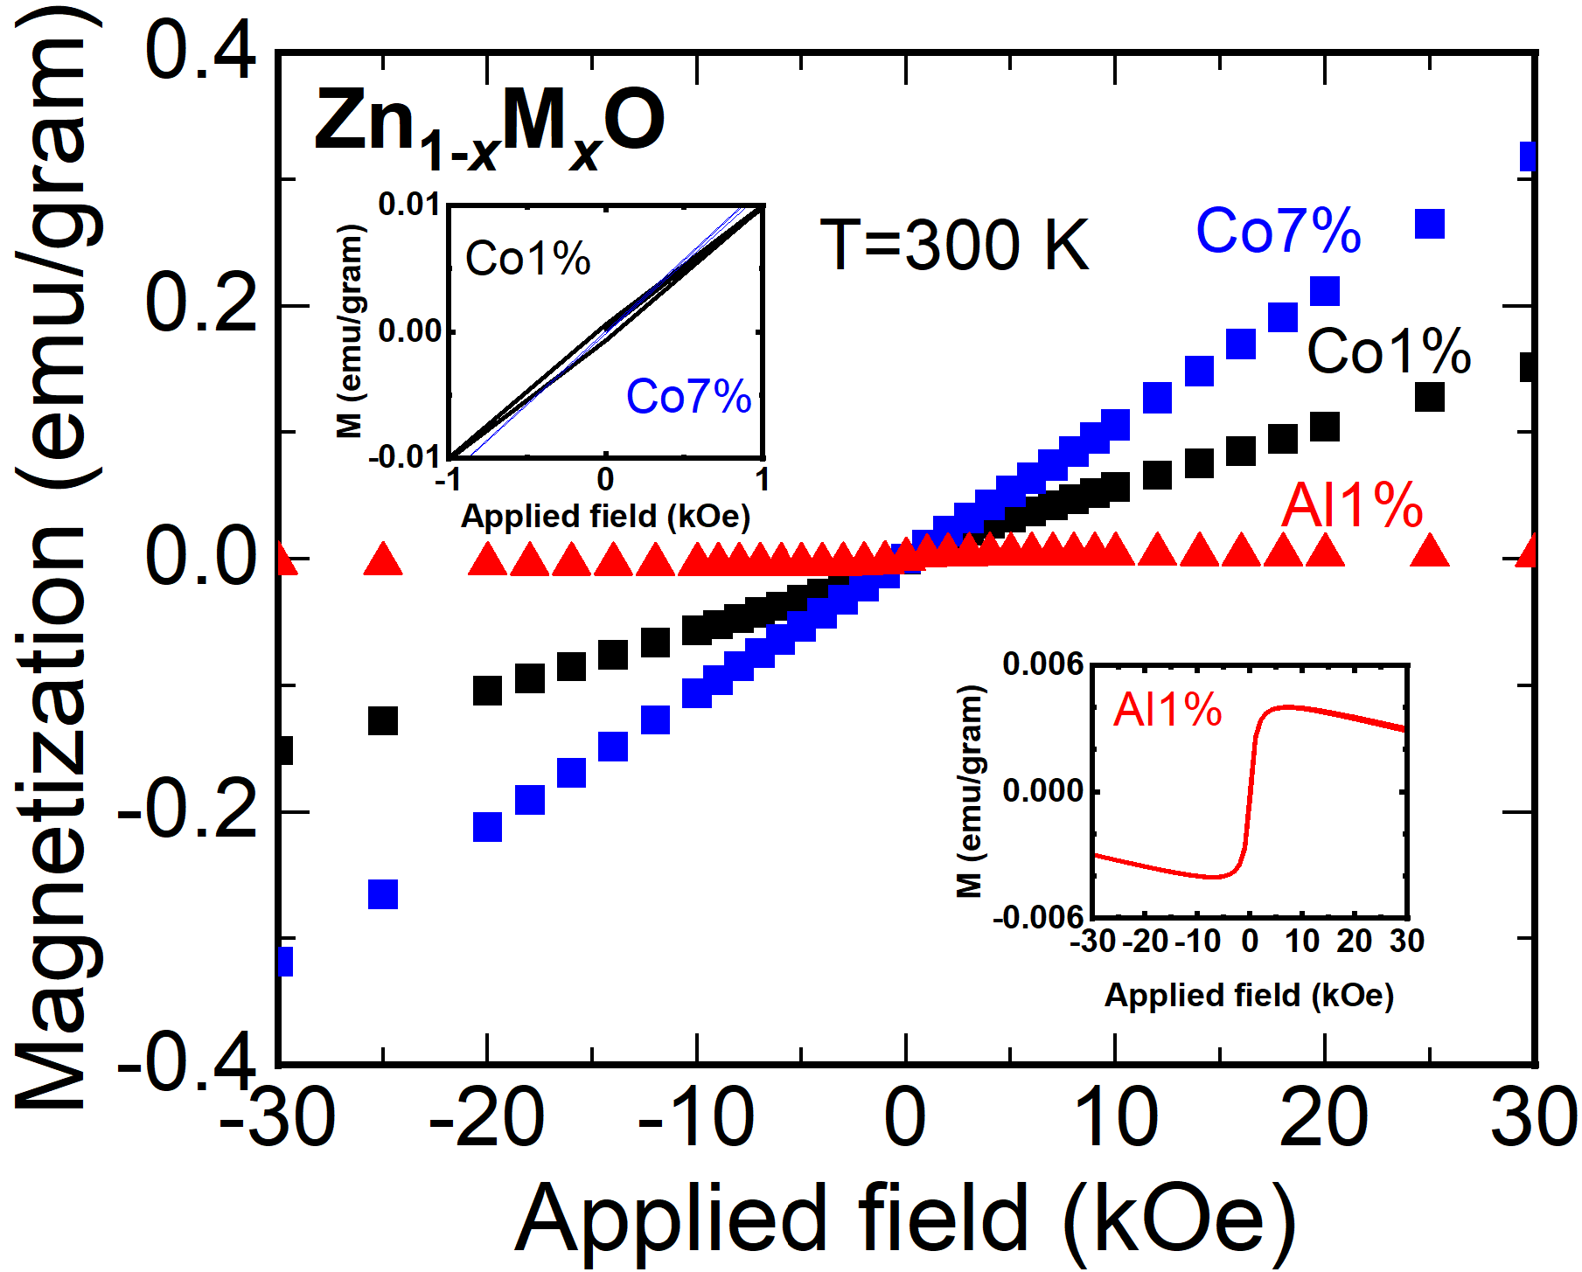
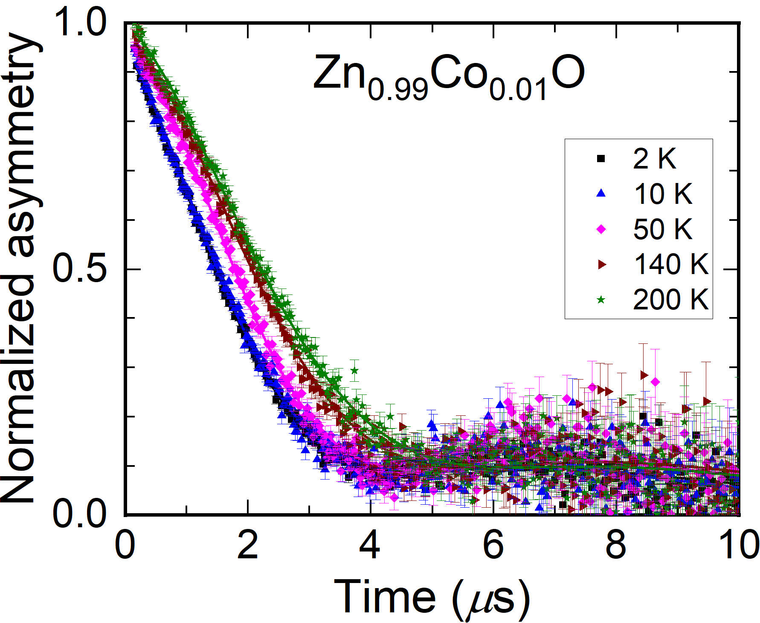
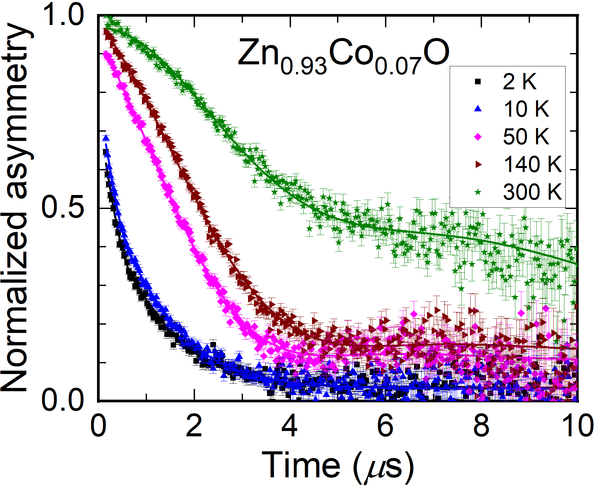
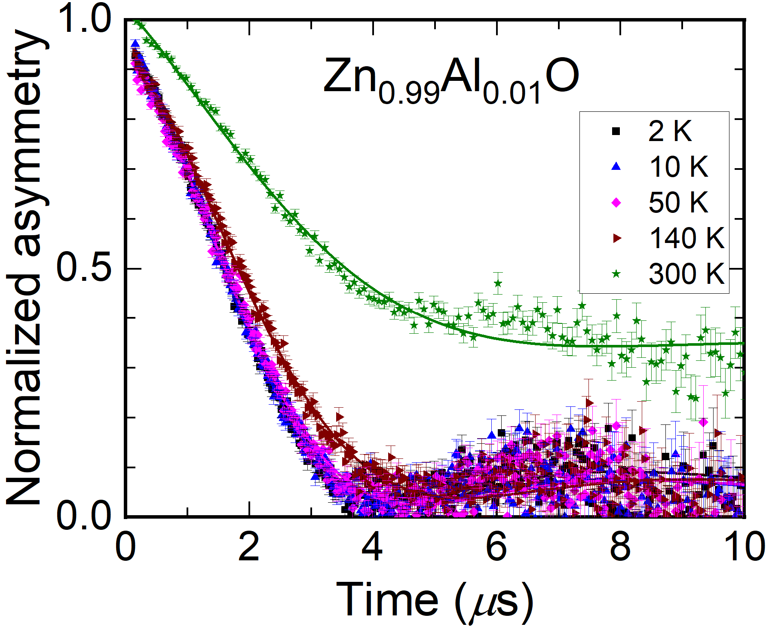


Zinc Oxide Nanoparticles (μSR, SANSPOL, & XMCD)
$$A\left(t\right)=A_{0}e^{−λt}G_{z}(Δ,t)$$
A₀ is initial asymmetry at t = 0
λ is muon-spin relaxation rate
G_{z}(Δ,t) is the static Kubo-Toyabe function
nano
Moh Milki-MSc Student
12
μSR and SANSPOL experiments were performed at ISIS; XMCD performed at Diamond.

Slide 13
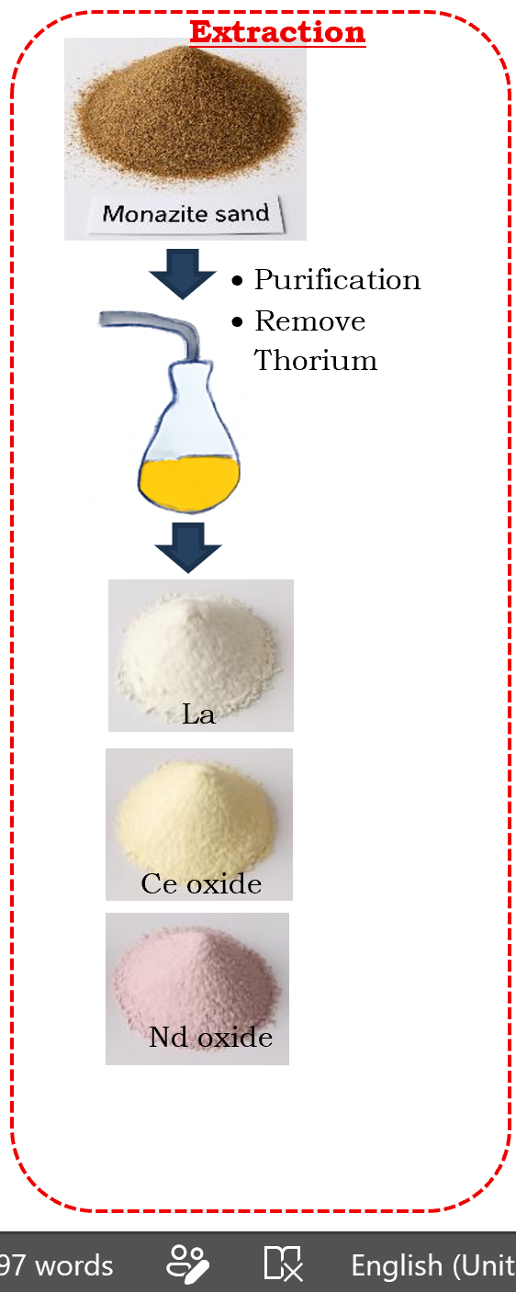
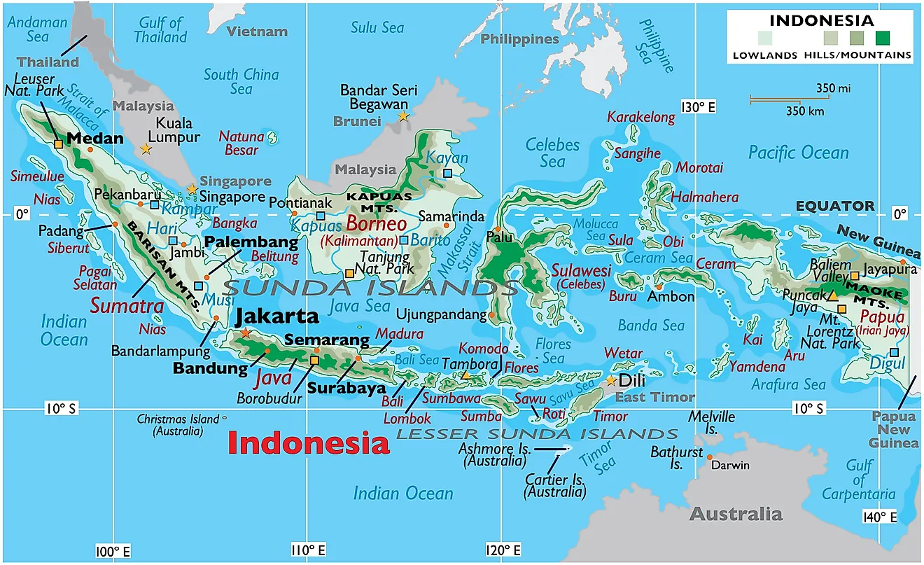
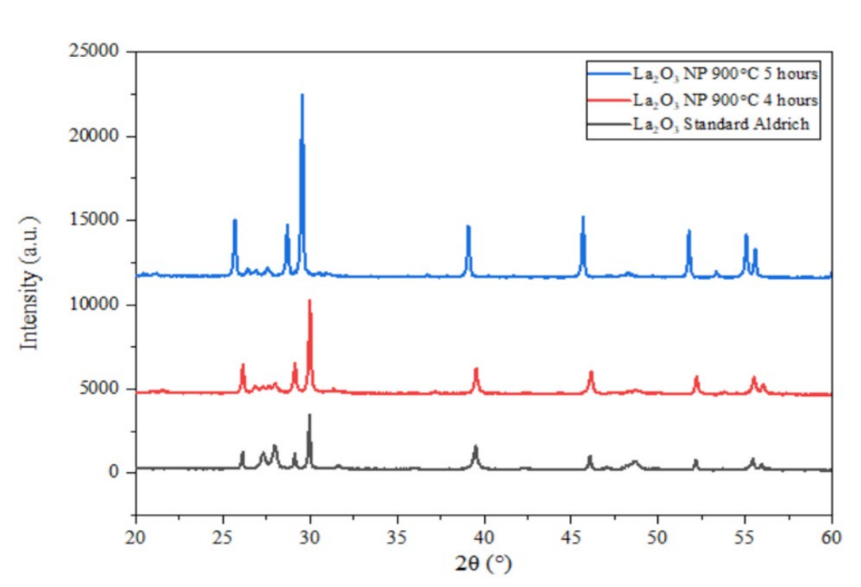
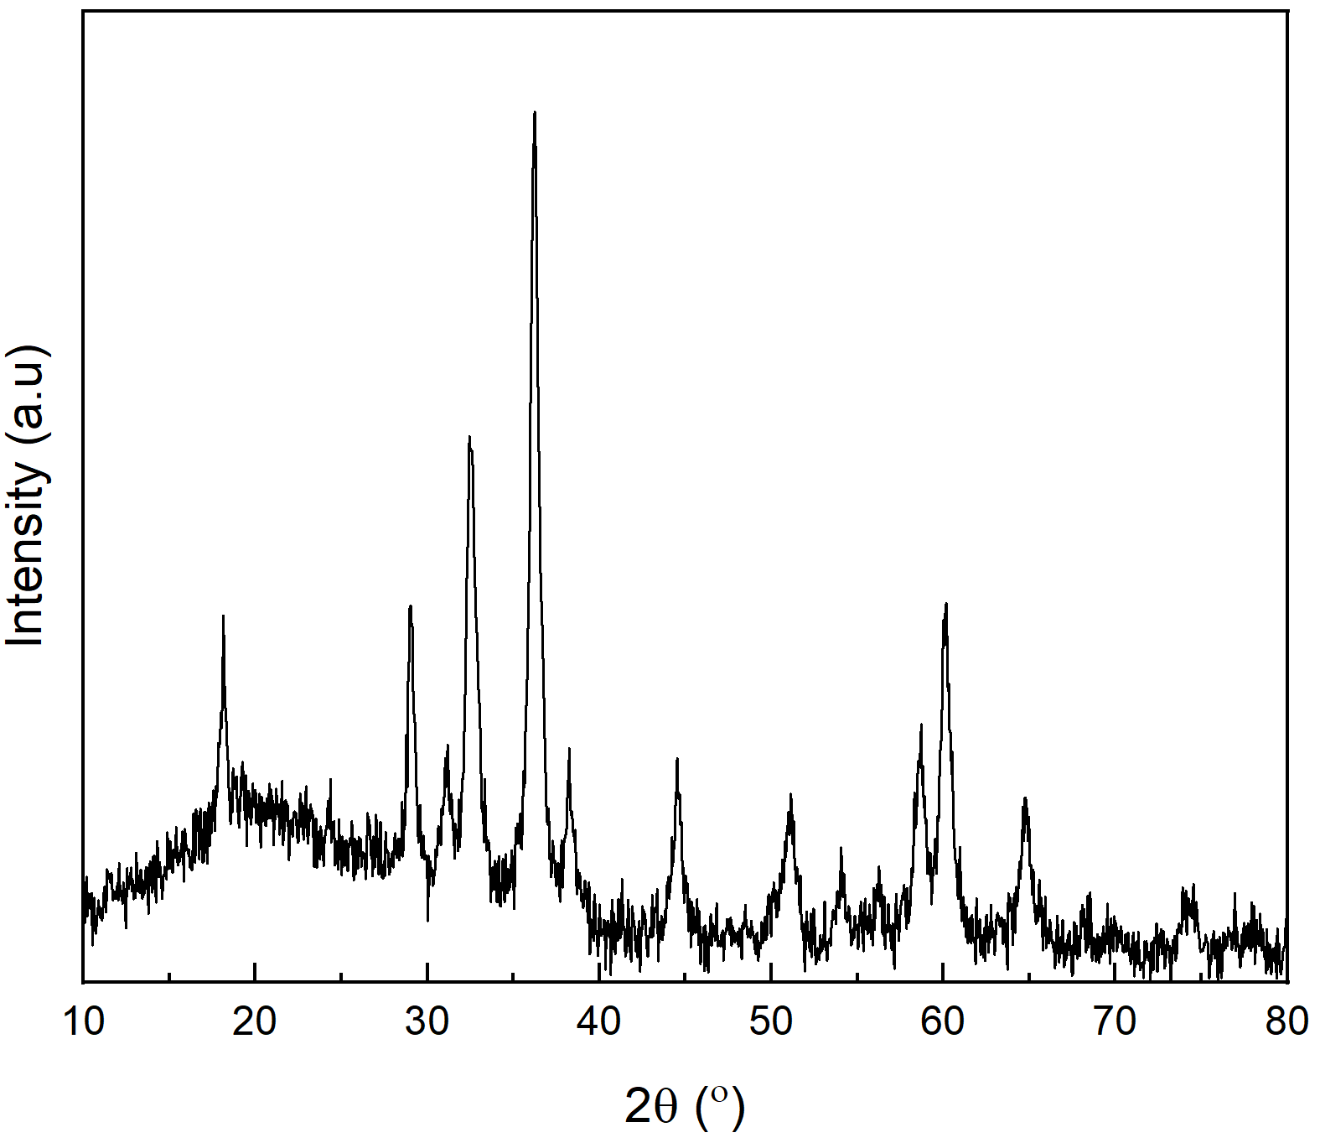
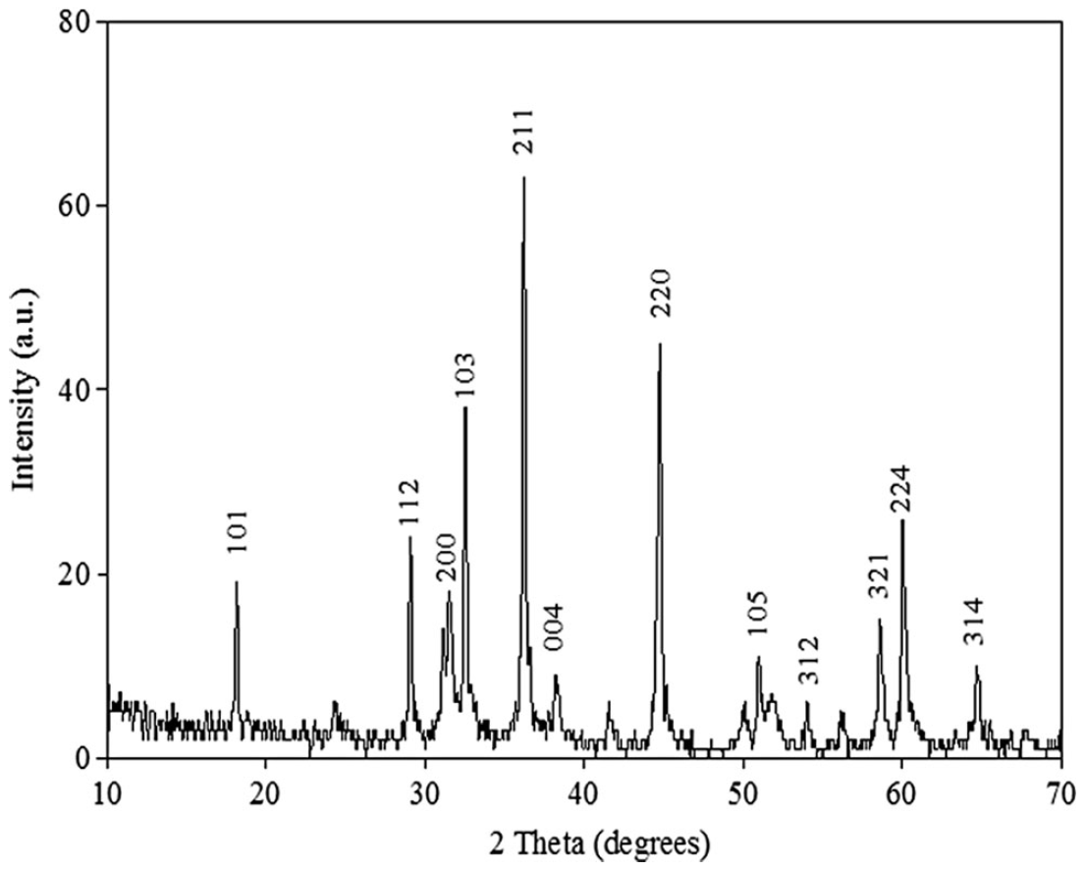
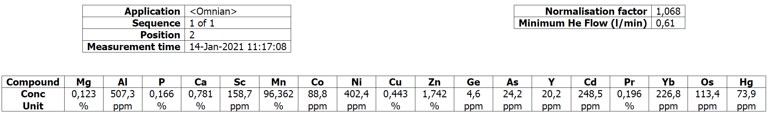
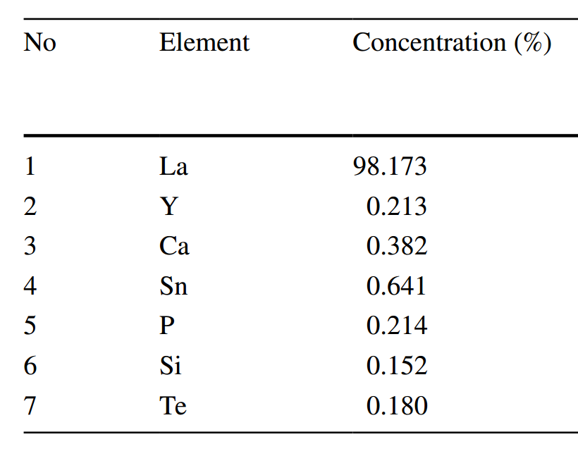
Mining by-products→REO→Functional materials
La2O3
Mn3O4
Extracted
Commercial
U: 2530 ppm→ 21.6 ppm
Th: 55,200 ppm→55 ppm
Samin et al., J. Sustain. Metall. 11:2965–2979 (2025).
Notes:
LaMnO3 crystal structure: orthorhombic Pnma; at 750 K the crystal structure change to be rhombohederal.
Orthorombic: a ≠ b ≠ c; rhombohedral: a = b = c.
Hasil akhir: Th 55 ppm dan U 21.6 ppm. Sudah jauh dibawah batas 500 ppm.
Yg di pasir monasit, semula U : 2530 ppm becomes 21.6 ppm, semula Th (55.200 ppm) menjadi 55 ppm.

Slide 14
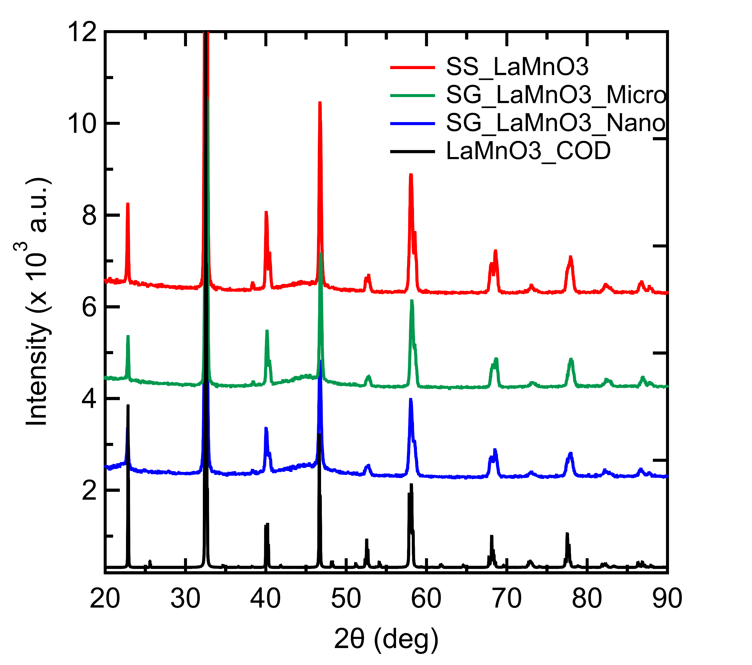
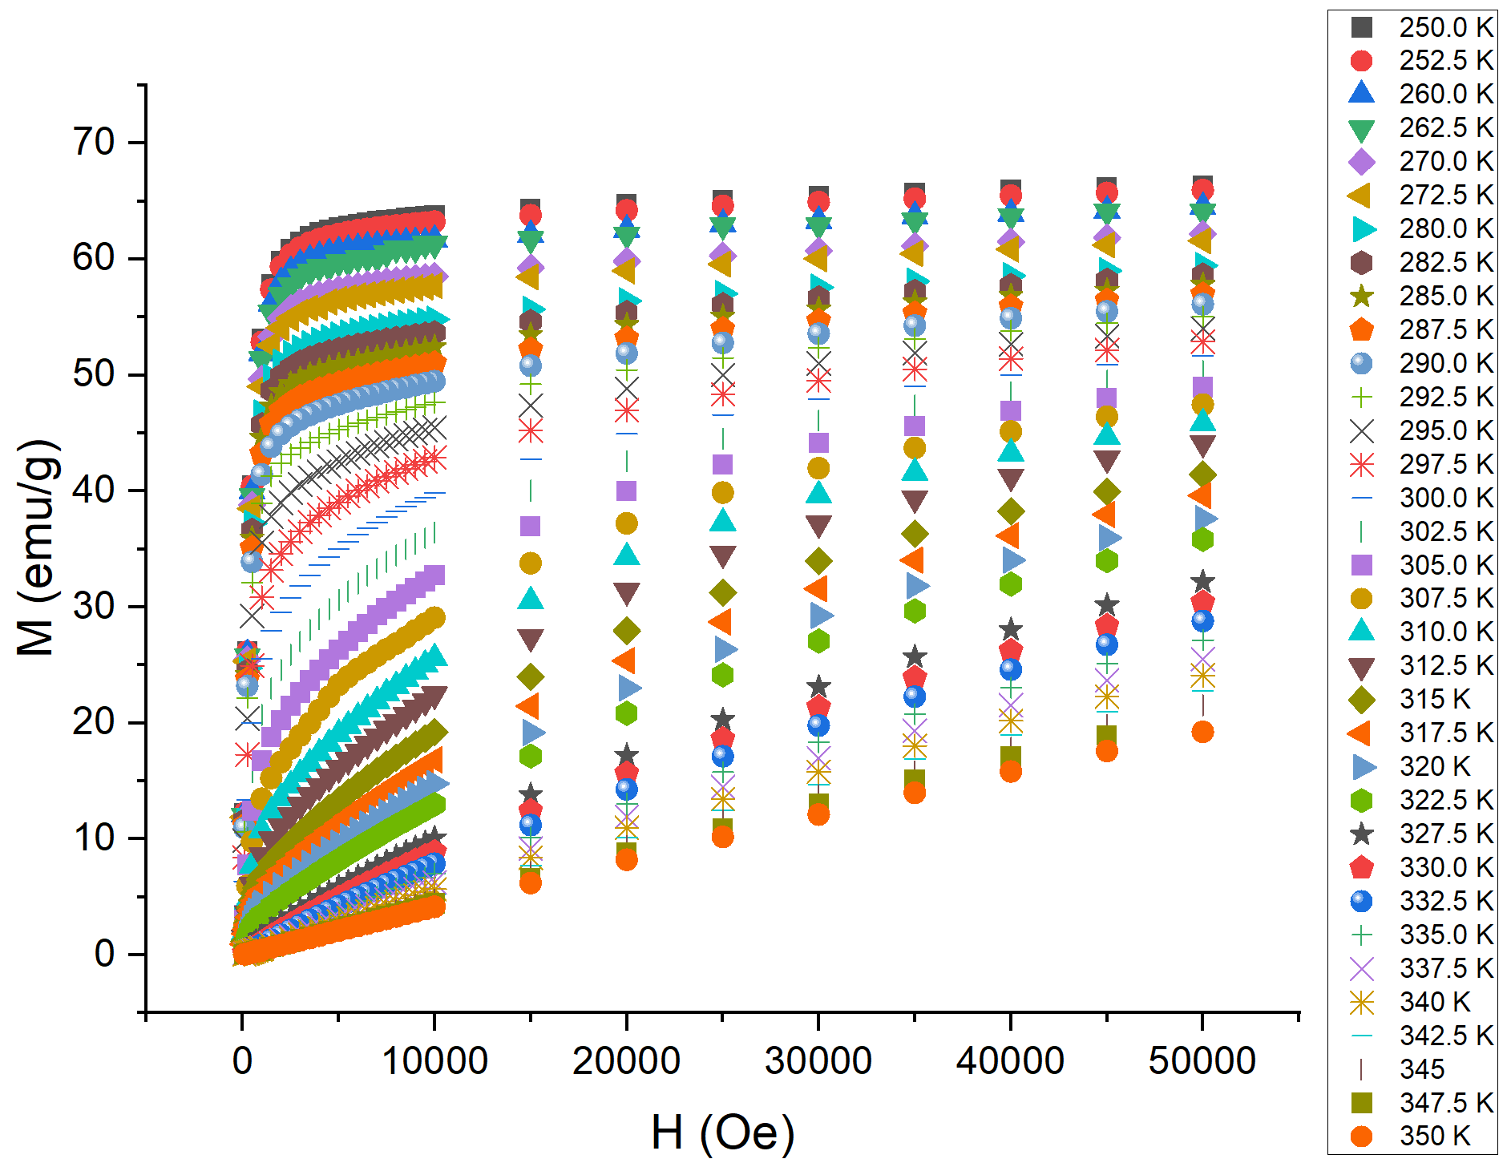
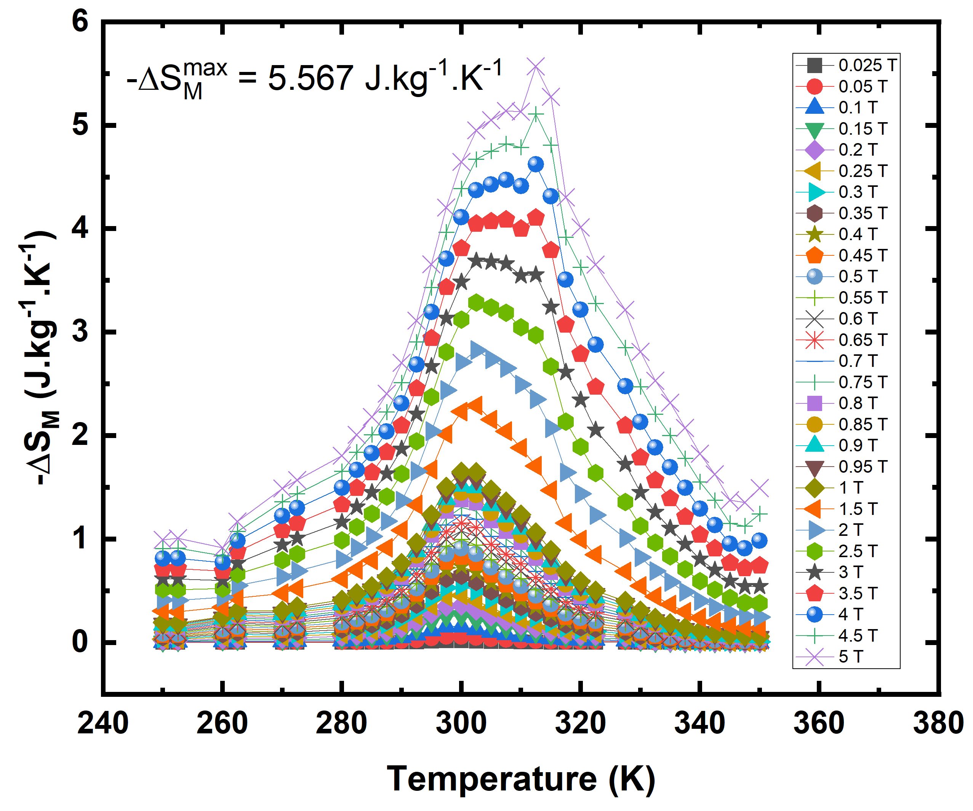
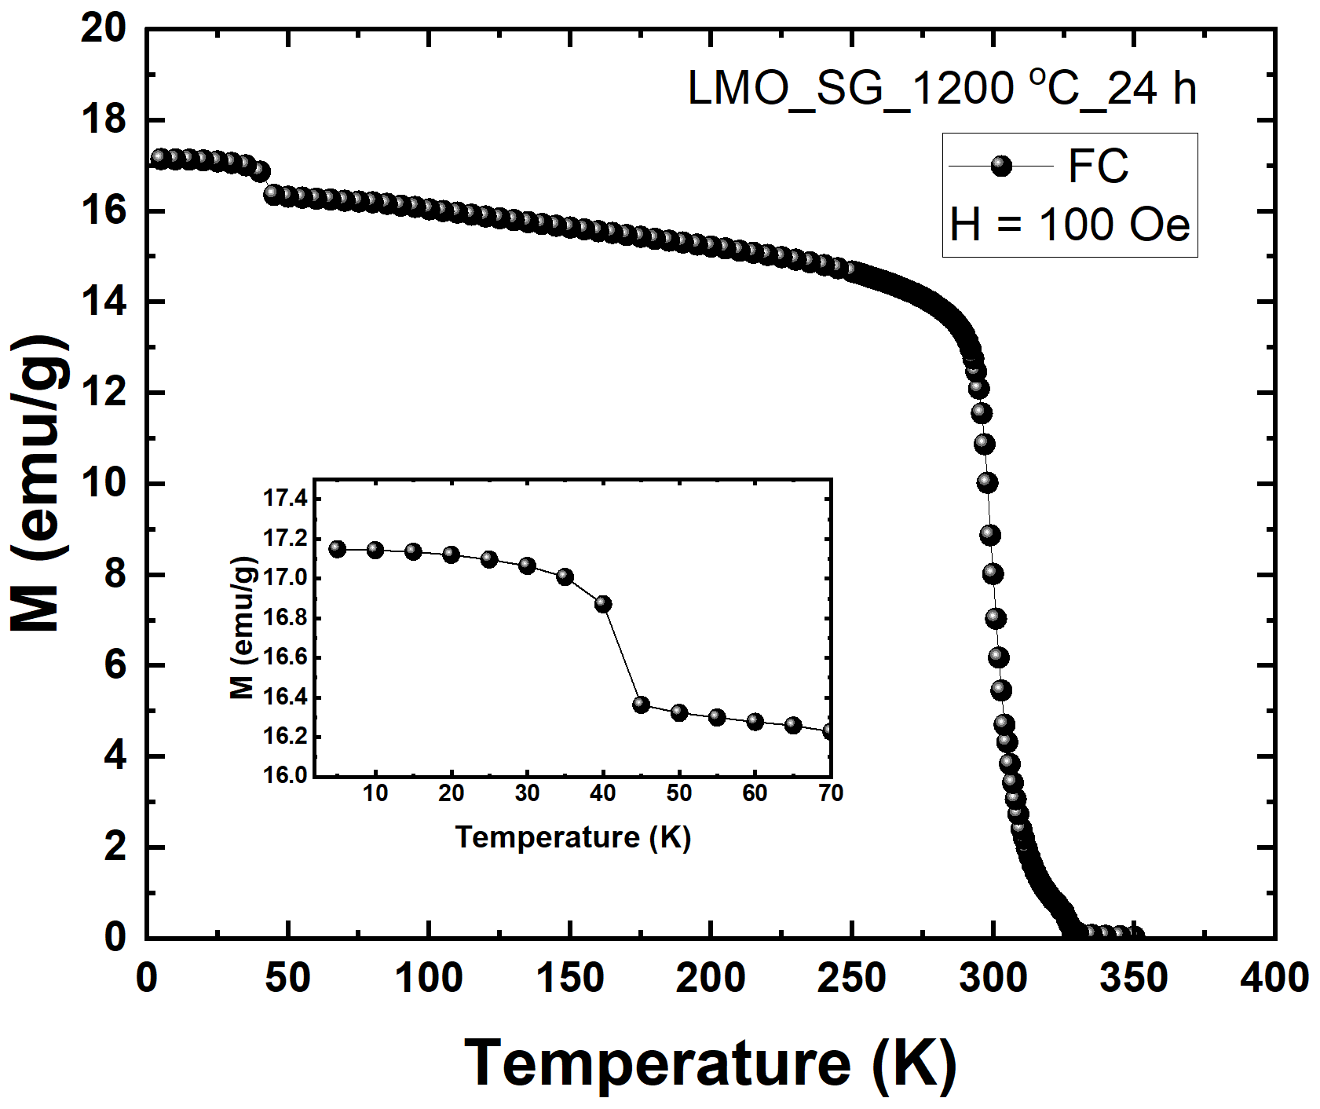
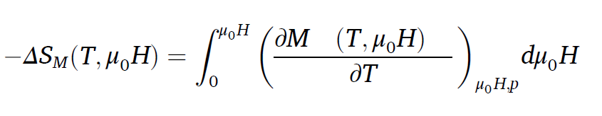

Mining by-products→REO→Functional materials
Solid oxygen?
Extracted
Commercial
ΔSM max LMO extracted = 5.57 J/kg⁻¹K⁻¹ at 300 K with field of 5 T; Working temperature 240-350 K.
J. Phys.: Condens. Matter 24 (2012) 366004
ΔSM max LMO commercial = 2.69 J.kg⁻¹K⁻¹ at 120 K with field of 5 T. Working temperature 50-180 K.

Slide 15

What we can do for this research in Indonesia?
Sample synthesis and basic characterization facilities are available in-house at BRIN, covering nanomaterials and quantum materials.
                Upstreaming REE from mining waste products to be functional energy materials.
                Biomass → catalysts.
                Green synthesis materials.
A rapidly growing number of users at large-scale facilities.
Notes:
Rapid growing number of users in the large-scale facilities.

Slide 16
Summary
Nanoscale effects alter magnetic behaviour: a transition from non-magnetic to magnetic, and a decrease in the transition temperature.
In superconductors, reducing particle size strongly suppresses superconductivity and induces magnetism.
μSR is a powerful probe of these phenomena in nanoparticles.
Future muon and neutron experiments will investigate the crystal and magnetic structure of LaMnO₃ derived from mining by-products, aiming to explain the enhancement of the Curie temperature and magnetocaloric (MCE) properties compared to the commercial one.

Slide 17


Open for Collaborations

Slide 18







Acknowledgements & Collaborators
FUNDINGS
COLLABORATORS
The UK International Science Partnerships Fund (ISPF).
LPDP Grant and BRIN, under grant numbers B-3842/II.7.5/FR.06.00/11/2023 and B-3855/III.10/FR.06.00/11/2023.
Bank Indonesia (grant number 28/17/BINS/P/B.
JSPS Core-to-Core Program (grant number JPJSCCB20240005).
JAPAN
Dr. Isao Watanabe (RIKEN)
Dr. Akihiro Koda (J-PARC)
Dr. Kazuki Ohishi (J-PARC)
Prof. Hirohuke Kuroe (Sophia Univ.)
Prof. Tadashi Adachi (Sophia Univ.)
INDONESIA
Prof. Widi Astuti (BRIN)
Dr. Dicky Rezky Munazat (BRIN)
Prof. Risdiana (UNPAD)
Dr. Budhy Kurniawan (UI)
Dr. Jumaeda Jatmika (BRIN)
Devi Nurmalasari (UNPAD)
Farah Nita Adila (UI)
Moh Milki I. M. (UI)
Muhammad Yudoyono Dwitanto (UNJ)
Anisa Hanum (UNJ)
UNITED KINGDOM
Dr. Alex Louat (ISIS)
Dr. Rhea Stewart (ISIS)
Dr. Koji Yokoyama (ISIS)
Dr. Stephen Cottrell (ISIS)
Dr. John Wilkinson (ISIS)

Slide 19

Suci Winarsih
National Research and Innovation Agency (BRIN)
Email: suci.winarsih@brin.go.id or suciwinarsih93@gmail.com

Slide 20
Staged pH Fractionation
Alkaline decomposition — Bangka monazite plus excess NaOH (water : NaOH : monazite = 1.7 : 1.5 : 1), 140 °C for 4 h. Every metal reports as a hydroxide: (U, Th, RE)(OH)₃.
Partial dissolution — the precipitate is dissolved in 14 N HCl down to pH 3.7, 80 °C for 2 h (dissolving more than 80% of the precipitate). At this point U, Th and the REs are all in solution together.
The pivotal step — precipitation of U and Th at pH 6.14–6.30 with 1 M NaOH. Th⁴⁺ and U precipitate as hydroxides well before the REE³⁺ do, so at this pH Th and U drop into the residue while the lanthanides stay in solution.
Precipitation of RE(OH)₃ at pH 9.8 from the filtrate — the step that leaves Th and U behind.
The remainder is cleared by the subsequent lanthanum purification stages, each of which dilutes the Th further:
Leaching RE(OH)₃ with 0.5 M HNO₃, 90 °C for 15 min → Ce stays behind as Ce(OH)₃ residue.
Ce separation at pH 4, then precipitation of Y, Nd, Pr, Sm, Gd at pH 8.25 with NH₄OH.
Lanthanum oxalate precipitation, La₂(C₂O₄)₃, with oxalic acid at pH 8.25 — oxalate is the classic Th scavenger, since Th-oxalate is far less soluble.
Calcination at 850 °C for 3 h → commercial La₂O₃.
Re-precipitation of La(OH)₃ at pH 8 with NaOH, calcination at 900 °C for 5 h → La₂O₃ nanoparticles.
Samin et al., J. Sustain. Metall. 11:2965–2979 (2025).

Slide 21
Summary
 | a | b | c | α | β | ϒ | V | Fraction (%) | Space group
SG LMO Nano | 5.46580 | 7.75417 | 5.52370 | 90 | 90 | 90 | 234.110 | 100 | P n m a
SG LCMO Nano | 5.43442 | 7.72246 | 5.49358 | 90 | 90 | 90 | 230.549 | 100 | P n m a
SG LCSMO Nano | 5.42538 | 7.73718 | 5.48667 | 90 | 90 | 90 | 230.315 | 100 | P n m a
SG LMO Micro | 5.47014 | 7.75857 | 5.51911 | 90 | 90 | 90 | 234.233 | 100 | P n m a
SG LCMO Micro | 5.46100 | 7.70645 | 5.48973 | 90 | 90 | 90 | 231.035 | 100 | P n m a
SG LCSMO Micro | 5.45019 | 7.70888 | 5.49433 | 90 | 90 | 90 | 230.844 | 100 | P n m a
SS LMO Micro | 5.46573 | 7.745595 | 5.52141 | 90 | 90 | 90 | 233.761 | 100 | P n m a

Slide 22

LaMnO3 Comparison with Literature
Tola et al.
Extracted LMO (present work):
TC = 299 K
ΔSM max = 8.52 or 5.56
J/kg⁻¹K⁻¹ with applied field
of 50 kOe at 300 K
Our extracted LMO has comparable properties with the benchmark of MCE (Gd)
P. S. Tola et al., Journal of Physics and Chemistry of Solids 111 (2017) 219–228.

Slide 23

La2CuO4 Nanoparticles
S. Winarsih, et al., Mater. Sci. Forum 966. 357 (2019).

Slide 24


What μSR Has Reported in Mott Insulator
Doping dependence
of TN La2CuO4+x
Estimation of the magnetic volume fraction
First report on long range magnetic ordering
Y. J. Uemura et al., PRL 59, 1045 (1987).
V. G. Storchack et al., PRB 94, 134407 (2016).
J. I. Budnick et al., Phys. Lett. A 124, 103 (1987).
T. Adachi et al., PRB 69, 184507 (2004).

