Slide 1






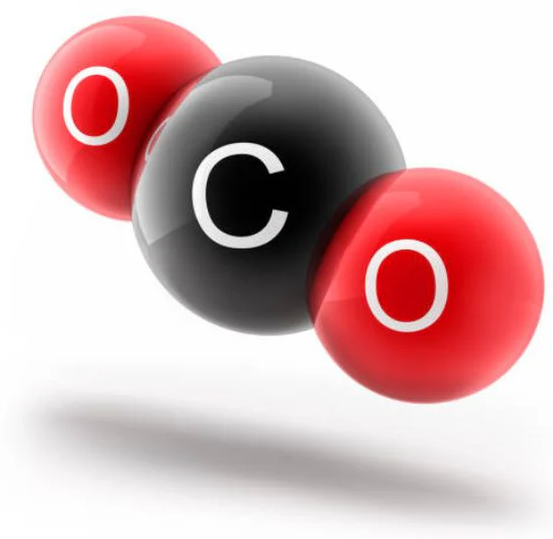

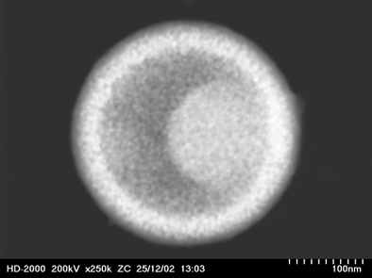
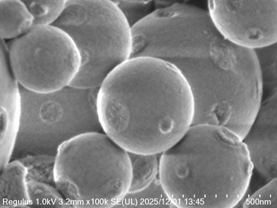
The Rational Synthesis of Next-Generation Core–Shell Adsorbents for Efficient CO₂ Capture
CO₂ Captured (Air)
N. Asikin Mijan
Senior Lecturer
Department of Chemical Sciences
Faculty of Science and Technology
Universiti Kebangsaan Malaysia
Yolk-shell catalyst

Slide 2





Detrimental Impact of CO₂ Emissions
Scientific sensus hold that greenhouse gas emission are the primary cause of global warming.
CO₂ is the major green house gaseous, worldwide 27 billions tonnes of CO₂ produced annually
Global warming cause increasing temperatures, increase the number of heatwaves occurring annually causing a lot of death.
Causes higher precipitation led to an increase the frequency of droughts and floods in various local areas.
Attempts to mitigate global warming are currently ongoing on a global political level backed by widespread scientific efforts.

Slide 3
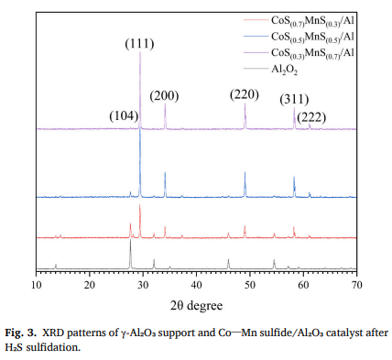
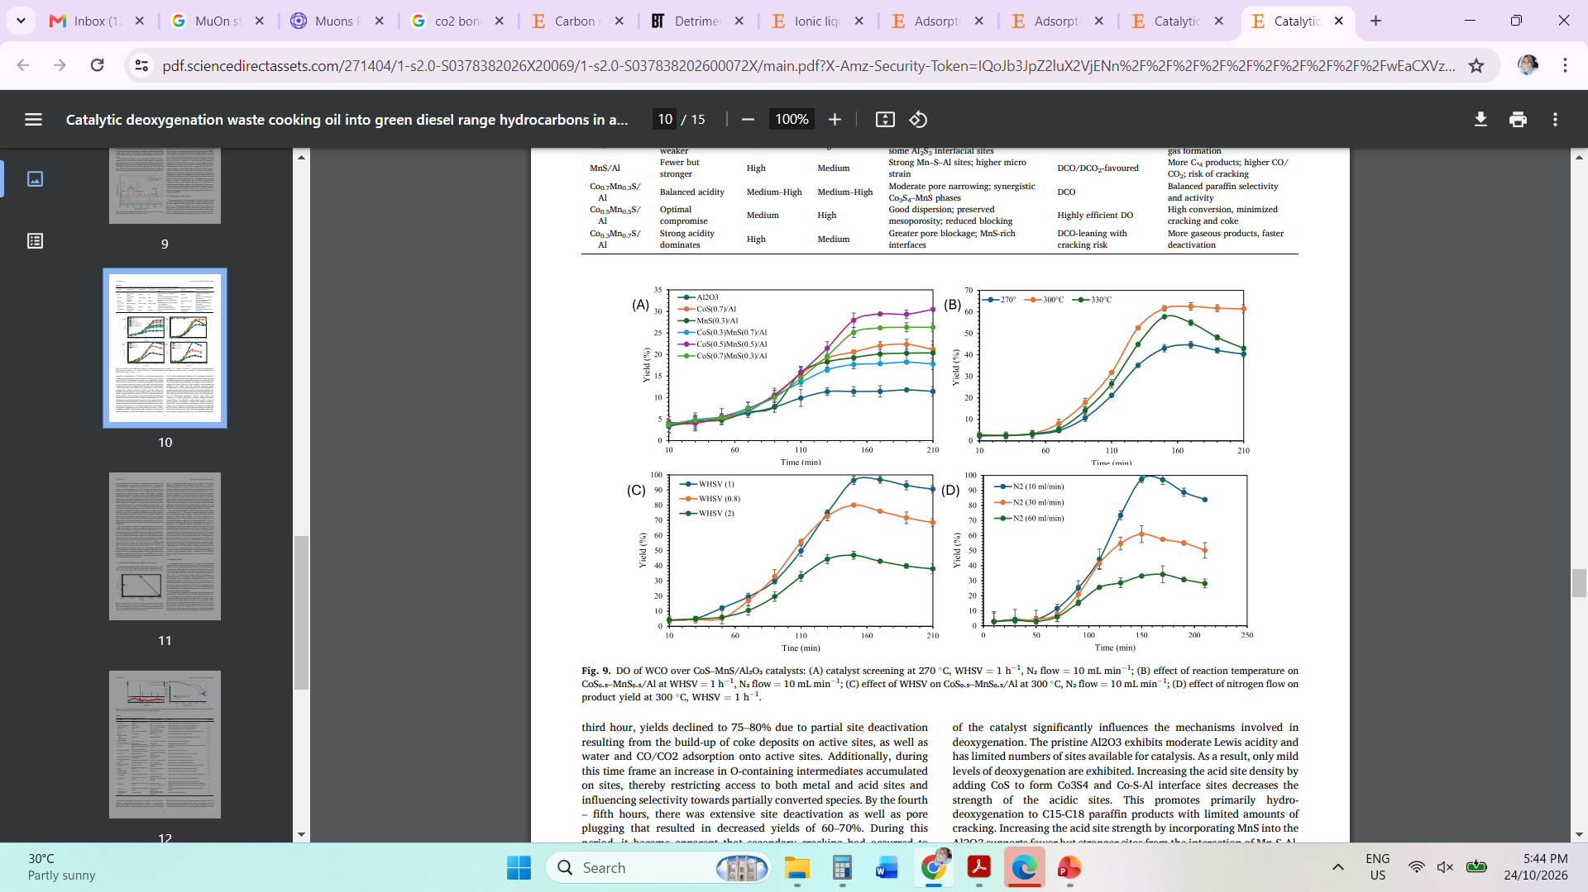
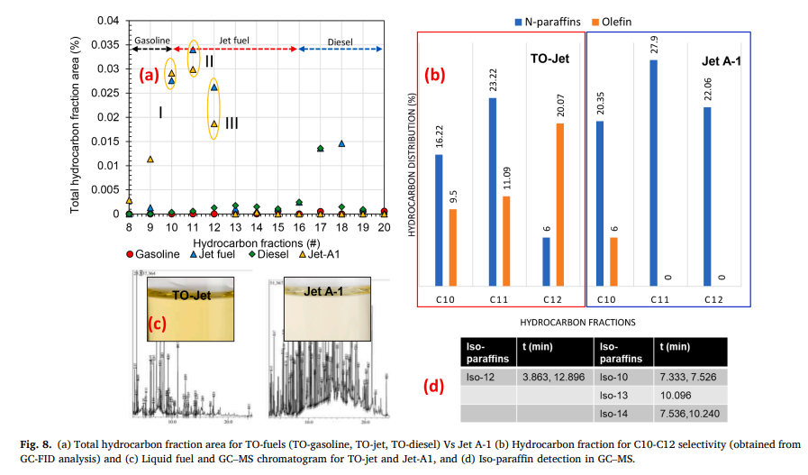
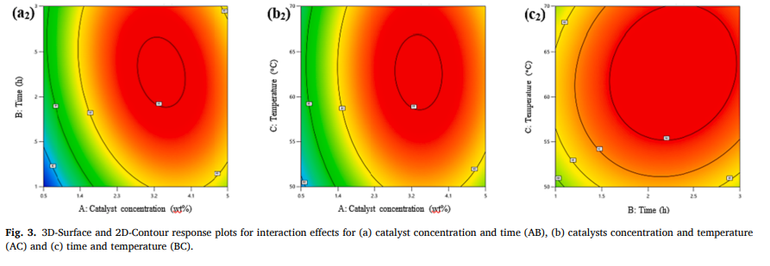
Overcoming The CO₂ Problem By Renewable Energy
Currently, a lot of research is being carried out to overcome the problem, such as by utilization of solar energy, biodiesel, green diesel, sustainable aviation fuel (SAF) and others
Laith K Obeas, G Abdulkareem Alsultan,.., Asikin-Mijan et al.(2025), Fuel Processing Technology, 288 (Green diesel)
N. Asikin-Mijan et al. (2022). Fuel, 325, 124917 (SAF)
Salima Kouider Elouahed, N Asikin-Mijan et al. (2024). Energ. Conv. Mana., 303, 118185 (Biodiesel)

Slide 4
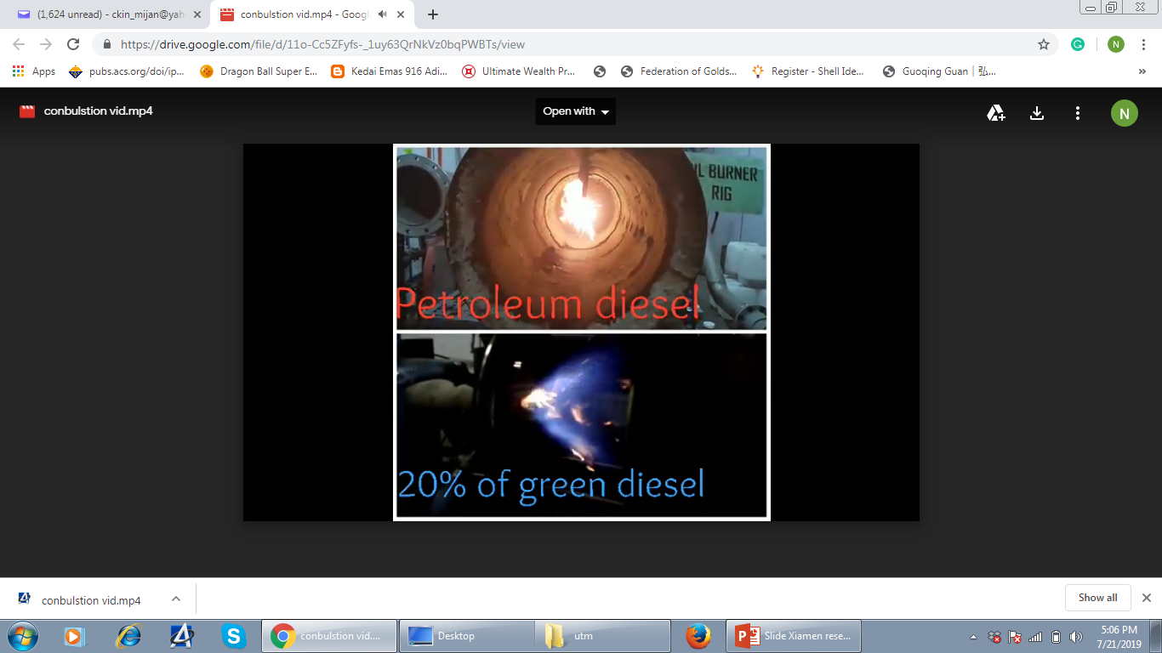
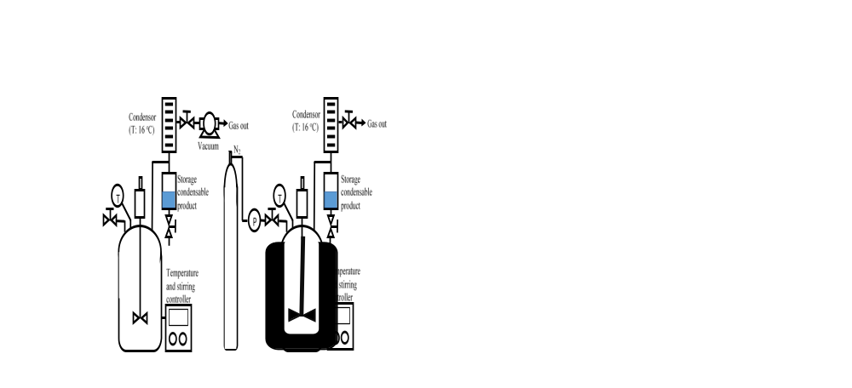
Renewable fuel – Reduced the CO₂ emission
[1]
[2]
Green diesel combustion properties
[3]
SO₂
CO₂
Emission test
Deoxygenation reaction set-up
GA Alsultan, Asikin Mijan et al. (2021). ACS Omega, 6: 408-415

Slide 5
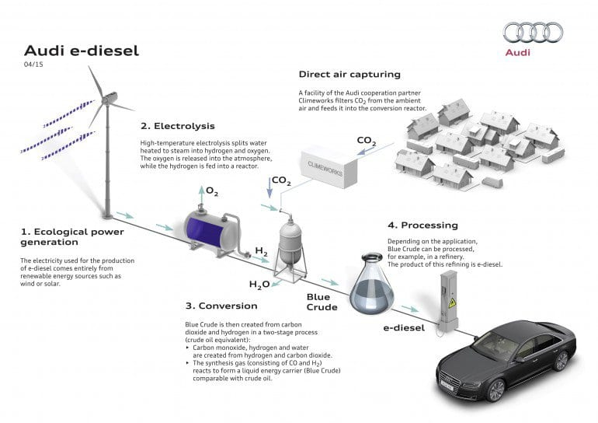
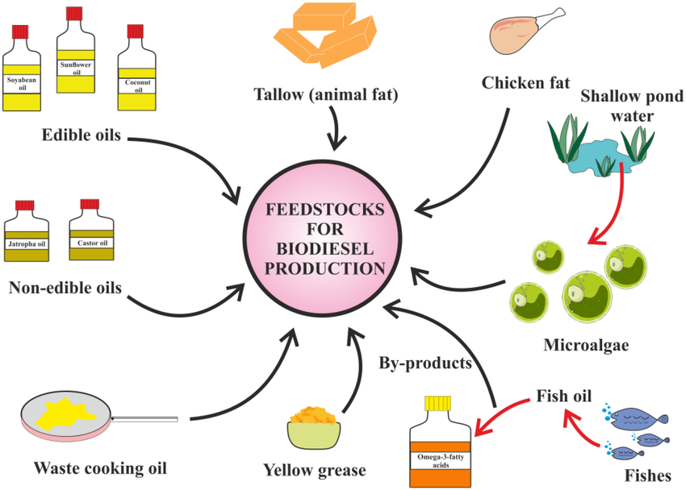
Feedstock become limitations for commercialization
CO₂-to-Fuel
Carbon capture, utilization, and storage (CCUS)
Multi-step climate mitigation process that intercepts CO₂ emissions directly from industrial
Audi companies- producing diesel fuel from CO₂ and H₂O and renewable energy sources (wind or solar or hydro power).
CO₂ obtained from biogas plant and CO₂ captured directly from air.

Slide 6
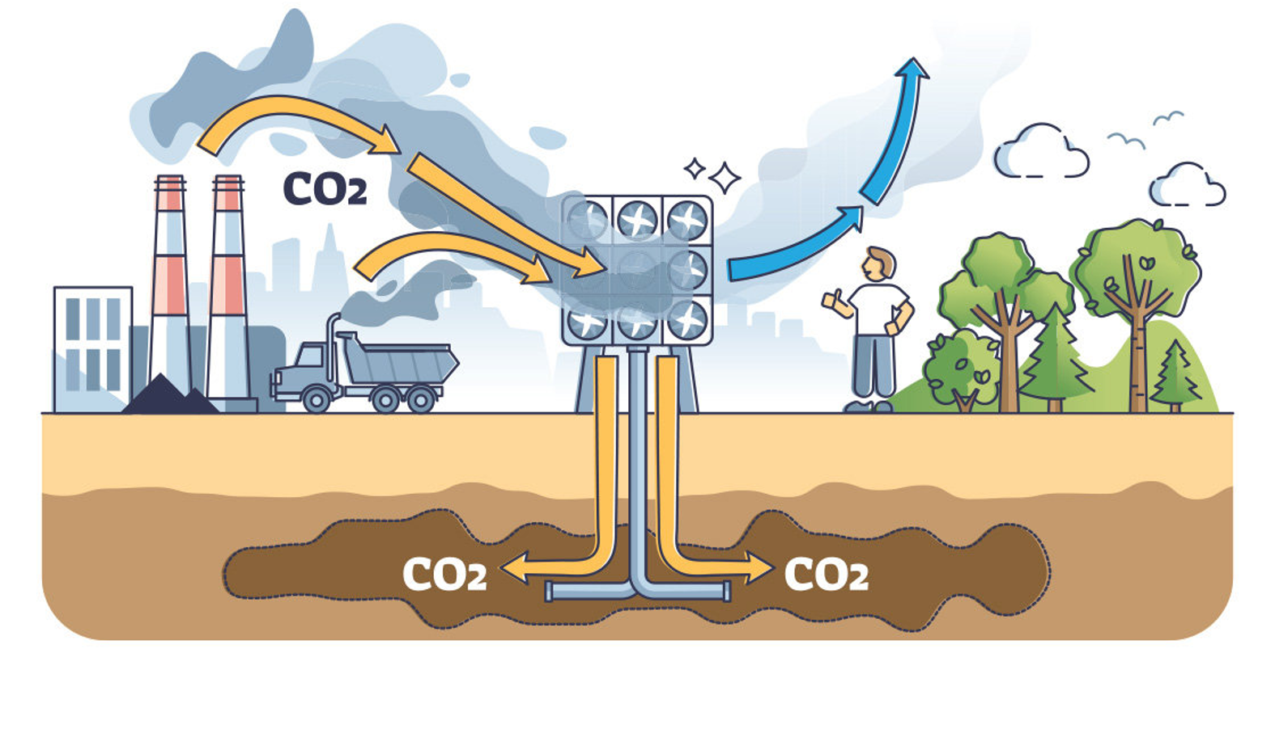

Carbon capture, utilization, and storage (CCUS)

Slide 7
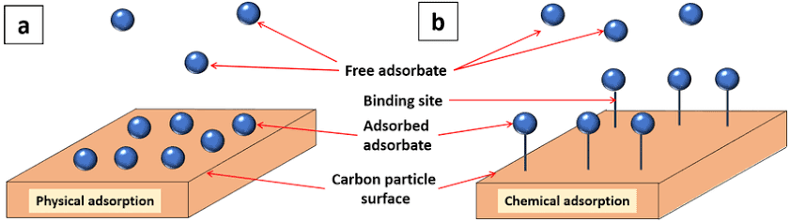
To Capture CO₂ , we need adsorbent
Adsorption is a reliable process technology since the 1960s for gas separation applications.
Adsorption based separations are achieved by passing the gas mixture (adsorbates) over a solid
(adsorbent)
The main opportunity for CO₂ capture lies in industrial processes that emit flue gases with low CO₂ concentrations

Slide 8
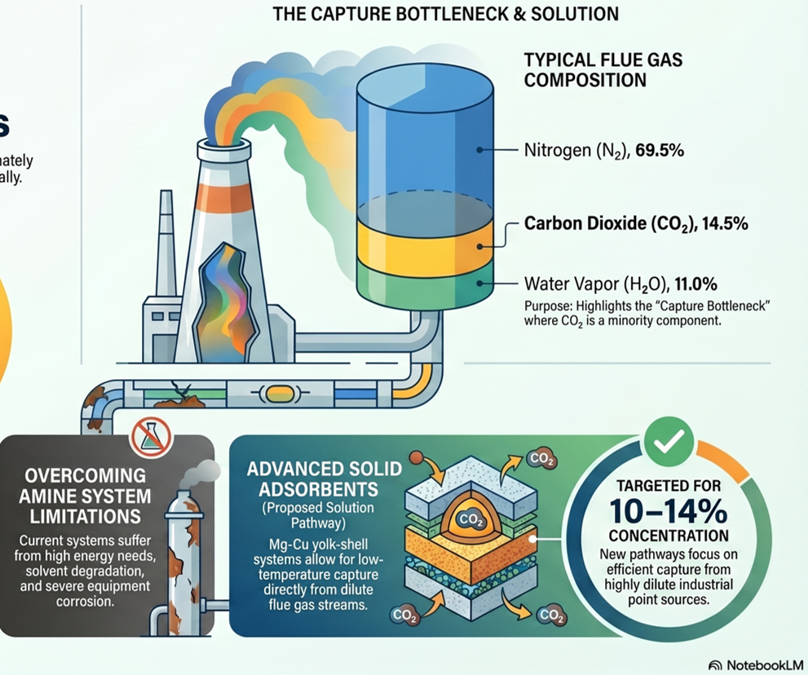
The Capture Bottleneck & Solution

Slide 9
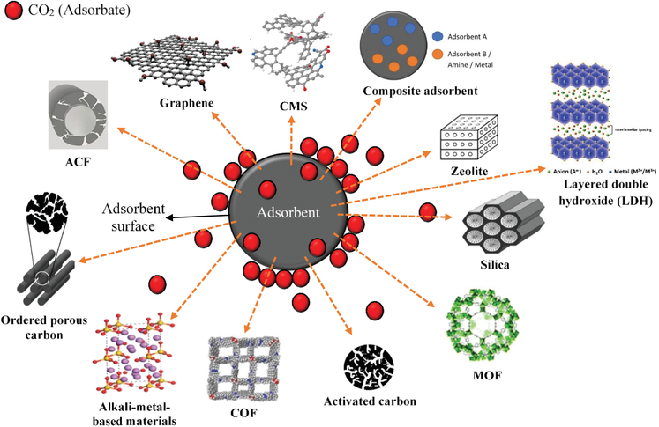
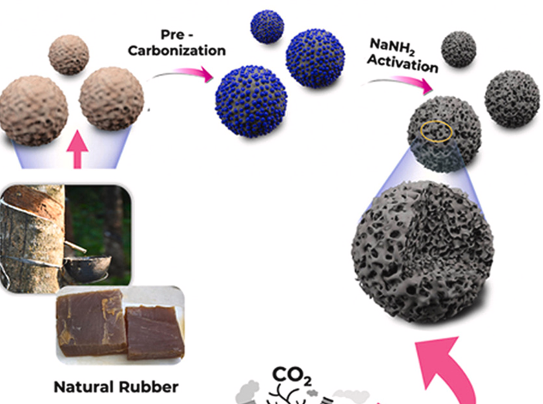
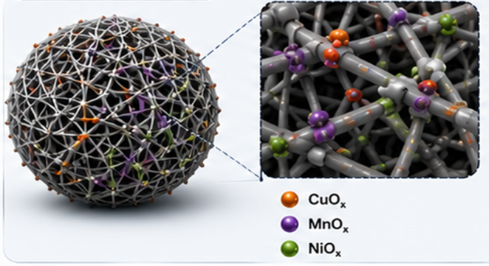
CO₂ capture adsorbent
M. Nurfarhana, N. Asikin-Mijan et al., 2023. Materials Chemistry and Physics
M. Nurfarhana, N. Asikin-Mijan et al., 2025. Materials Chemistry and Physics
Syawal Mohd Yusof, N. Asikin-Mijan et al. 2026. Industrial & Engineering Chemistry Research.

Slide 10
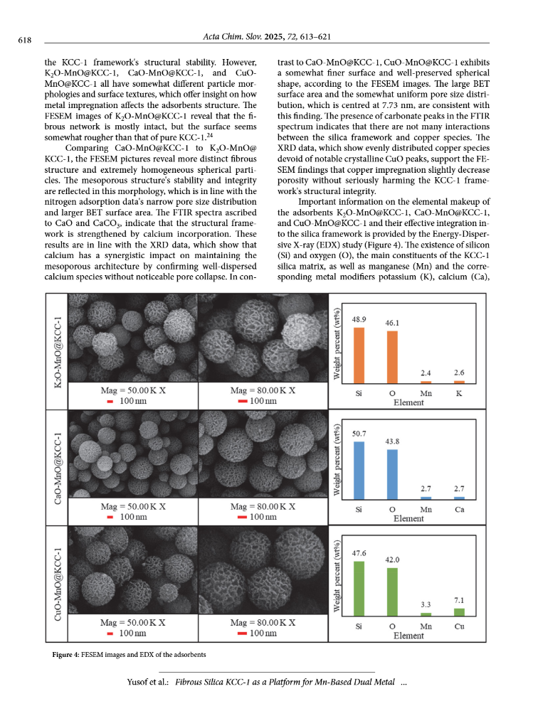
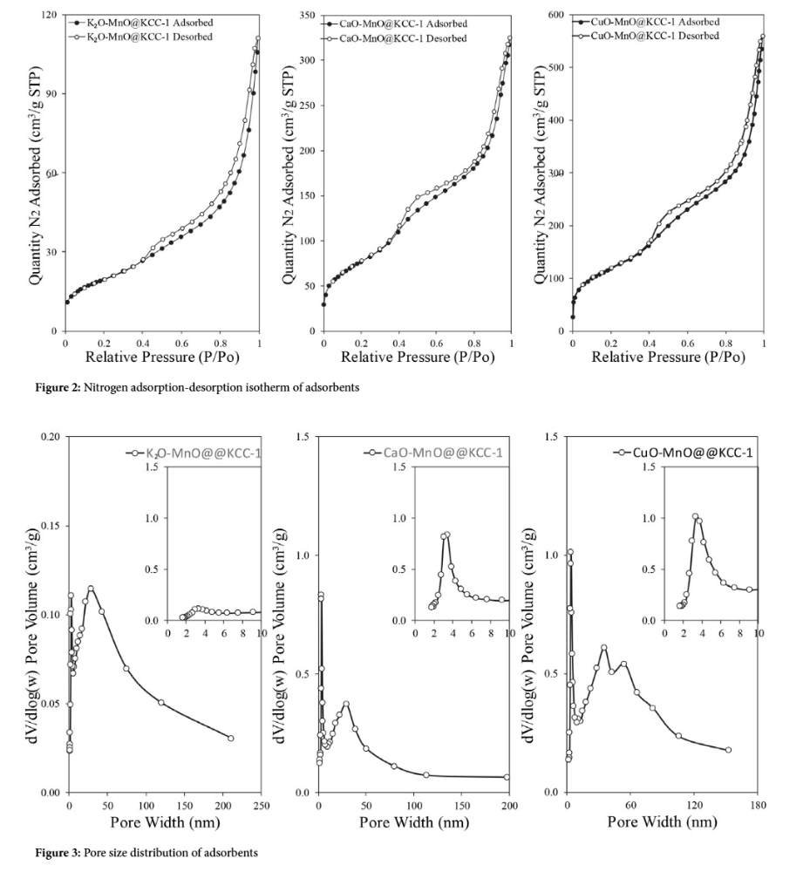
Key Criteria for Effective CO₂ Capture Catalysts
Abundance basic sites - Alkaline metal (Mg, Na)
(acidic CO₂ molecules bond directly with basic O²⁻ - Mg²⁺
^{MgO + CO}₂ ^{MgCO}₃
Optimized Pore Structure and Surface Area (Micropores 0.5-0.7 nm)
CO₂ molecules size approximately 0.23–0.51 nm (accommodate CO₂)
S. Yusof, N. Asikin-Mijan et al. 2026. Industrial & Engineering Chemistry Research.

Slide 11
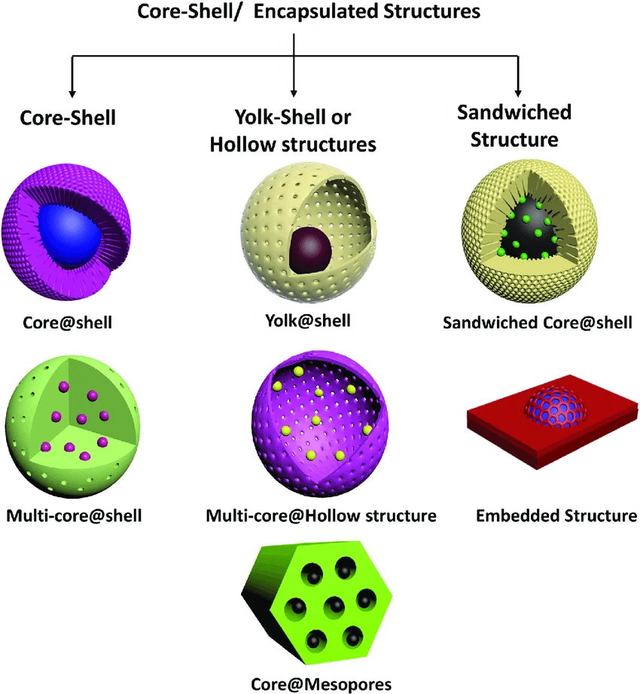
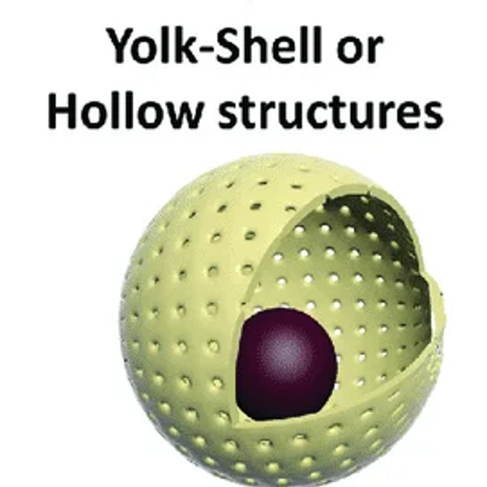
Solid adsorbent Yolk-shell structure: Type
The yolk–shell structure consist of a core, a void space, and an outer shell.
Higher specific surface area (porous shell)
The outer shell prevents core agglomeration and act as support (stability)
Movable core ensures full reactant contact hence maximizing mass transfer & active sites

Slide 12
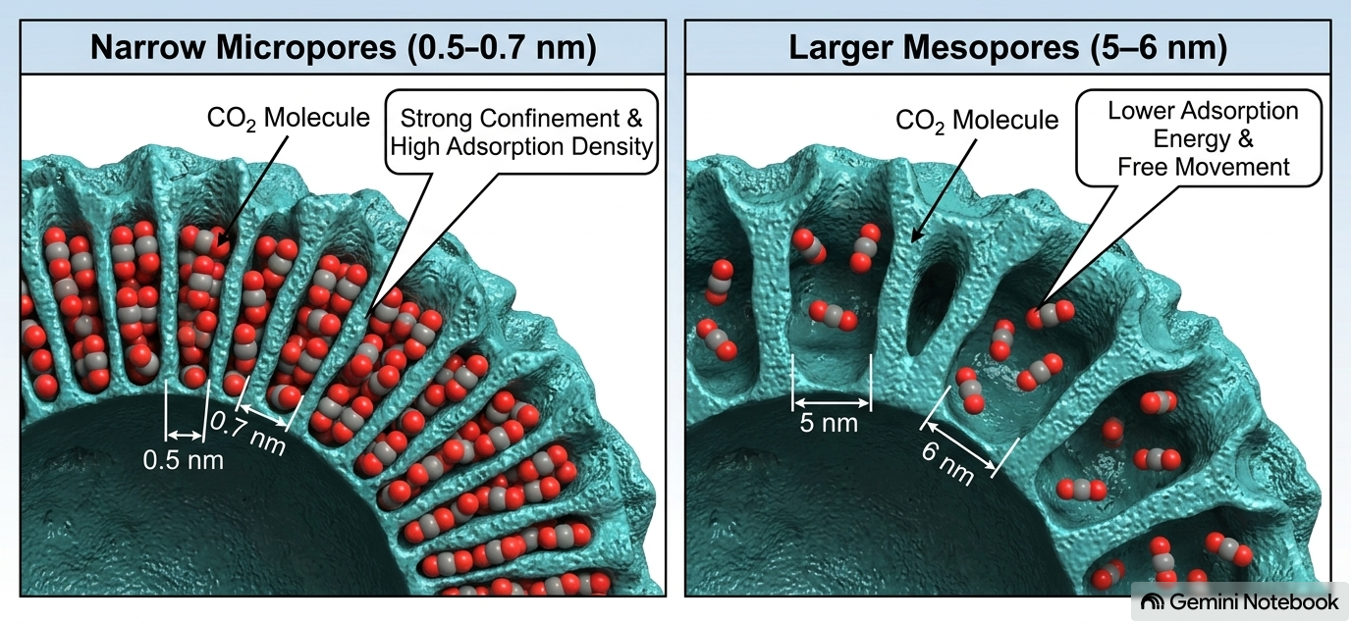
Aims: CO₂ Gas Adsorption Efficiency in yolk-shell adsorbent

Slide 13
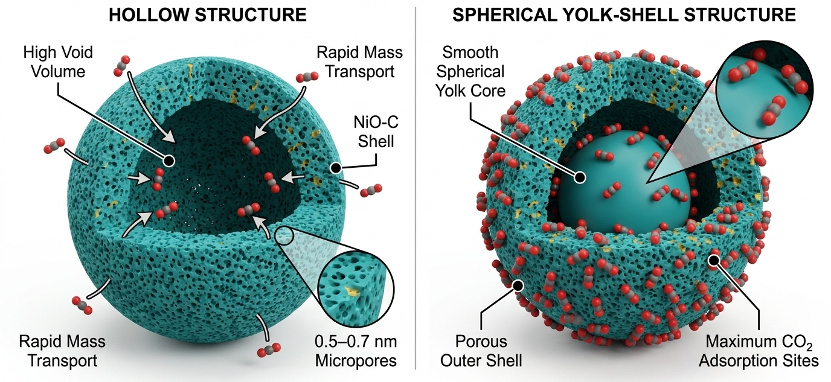
Targeted CO₂ Gas Capture efficiency

Slide 14
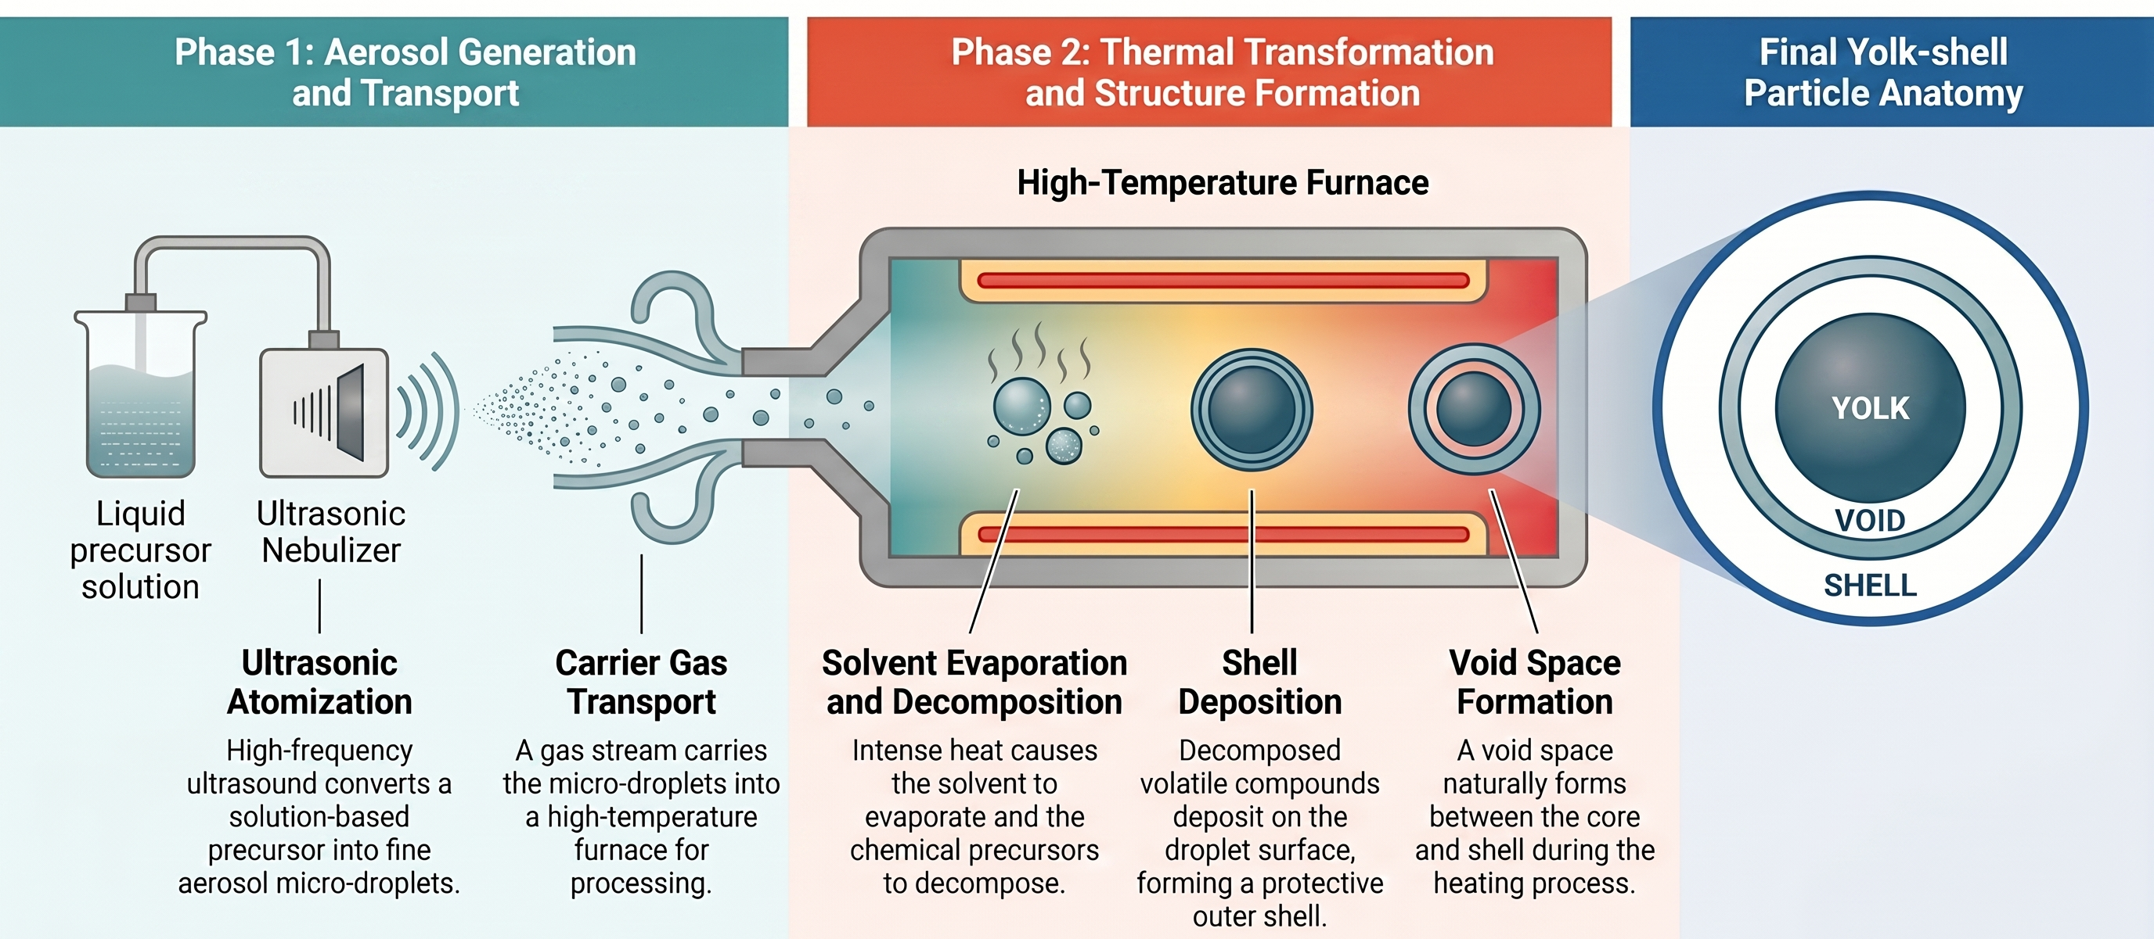
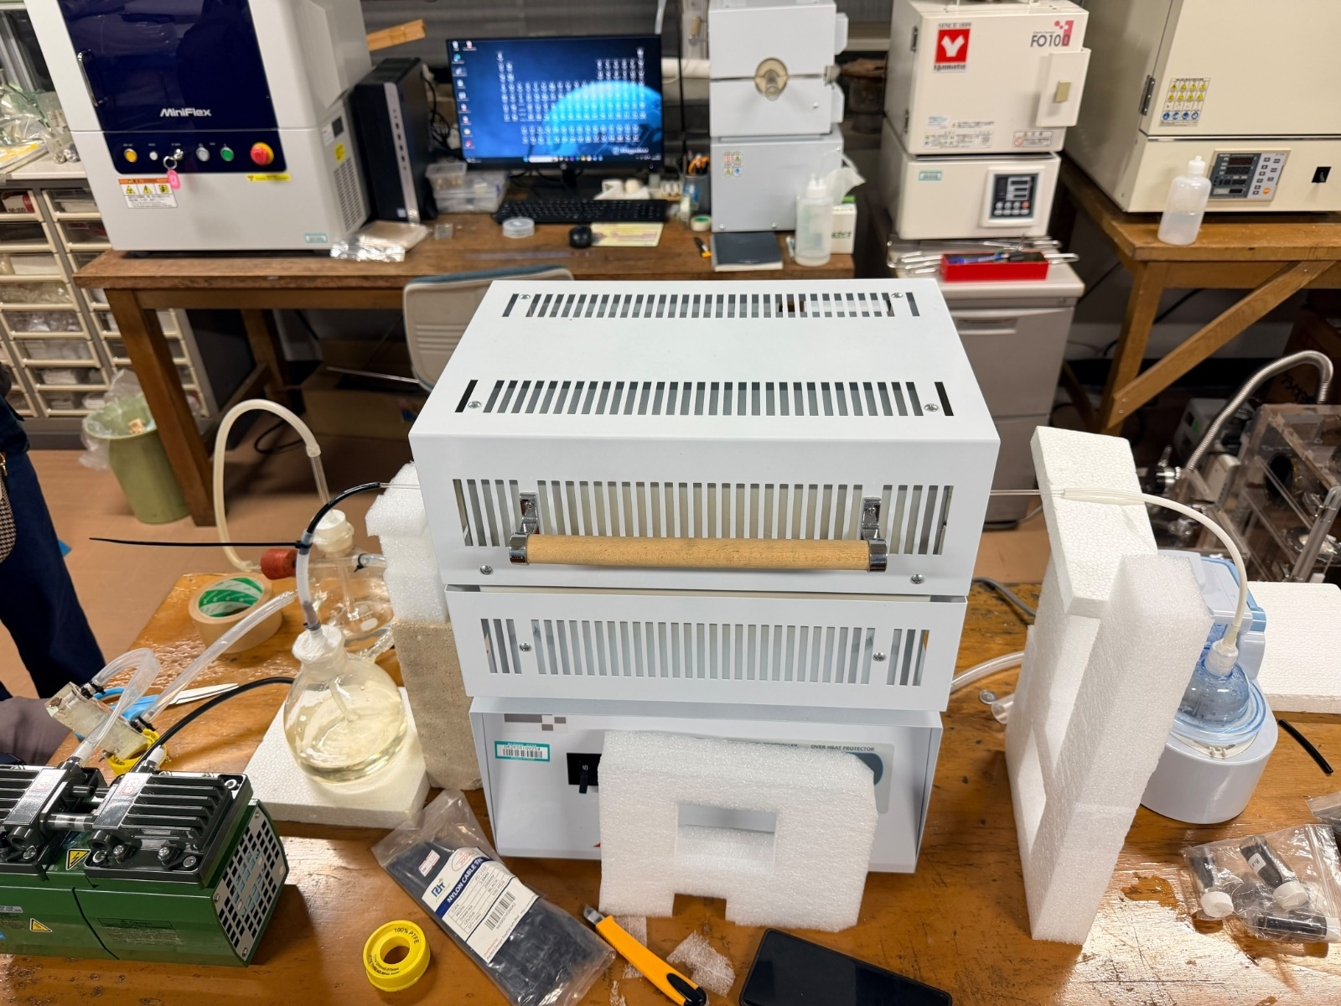
Yolk-shell Synthesis via Spray Pyrolysis
Spray pyrolysis is ideal synthesis process simplicity, cost-effectiveness, and scalability (Jeon et al., 2023)

Slide 15
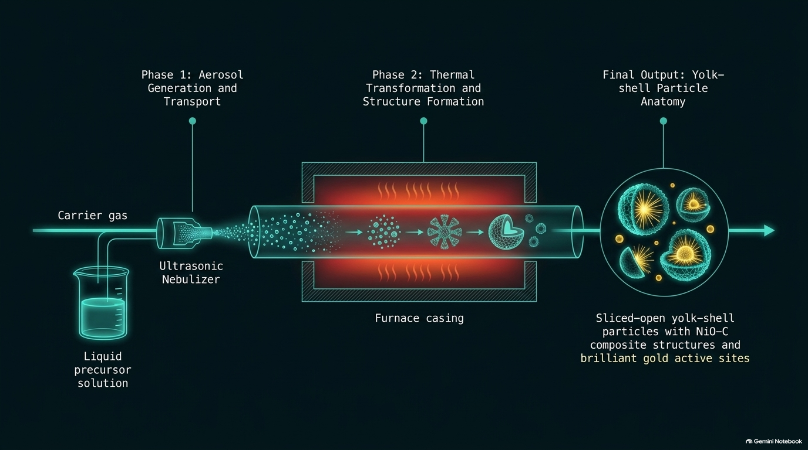
Sliced-open yolk-shell Al₂O₃ particles with NiO composite structures

Slide 16
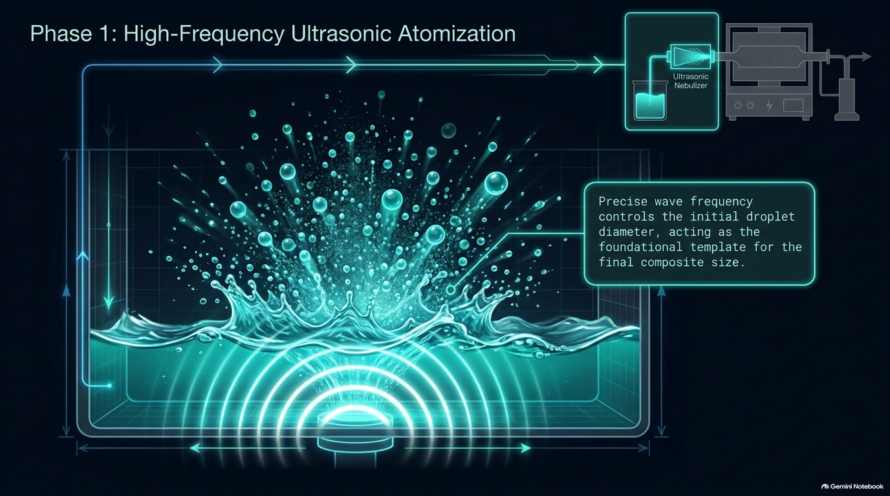

Slide 17
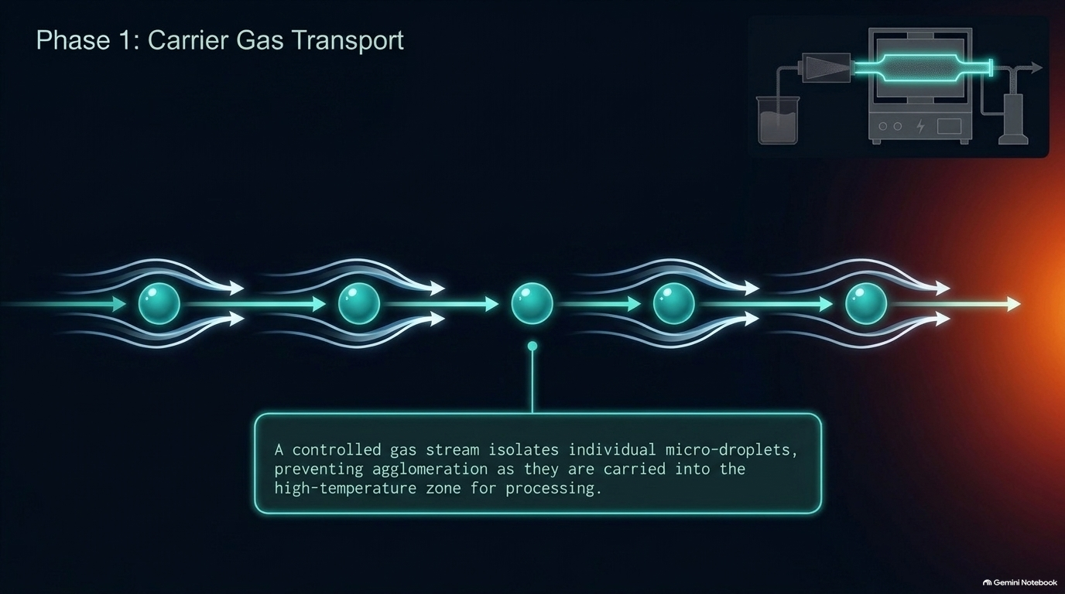

Slide 18
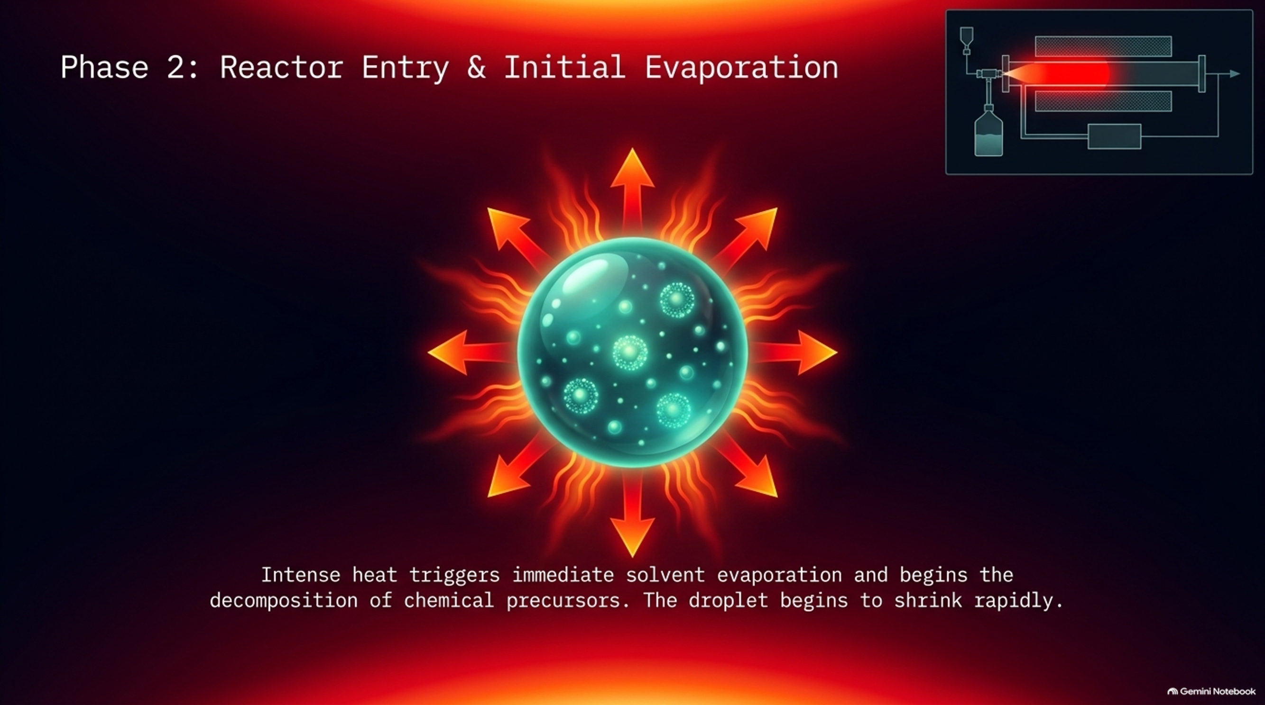

Slide 19
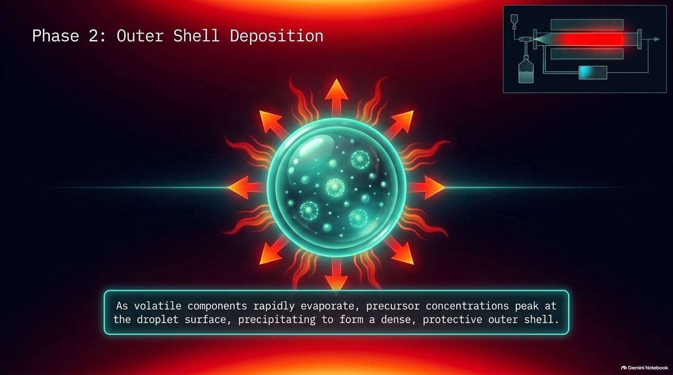

Slide 20
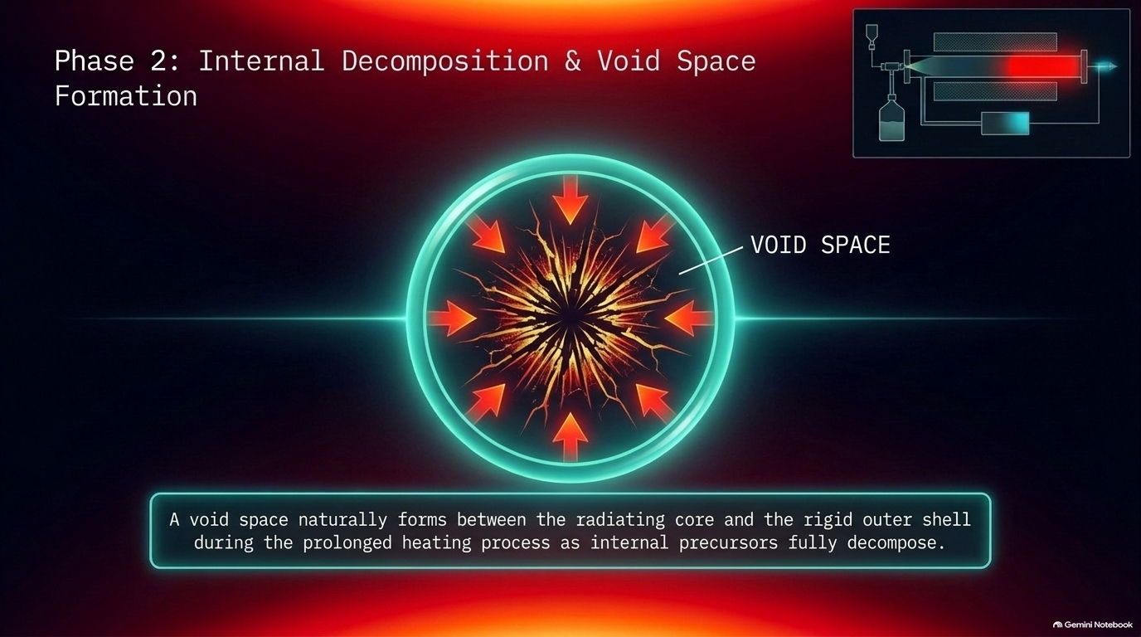

Slide 21
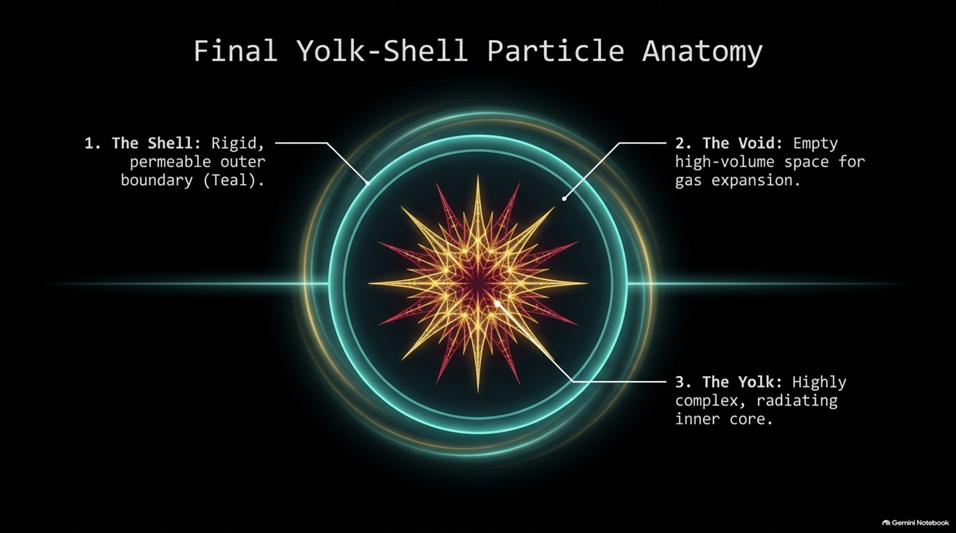

Slide 22


Slide 23
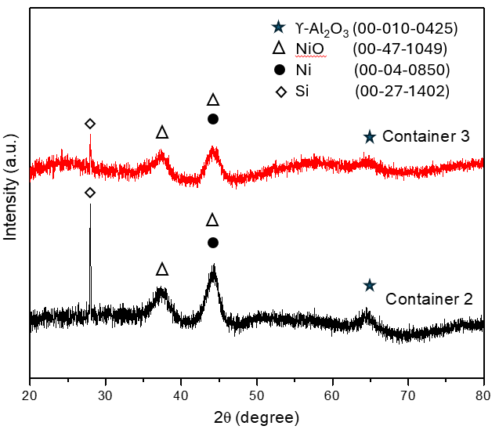
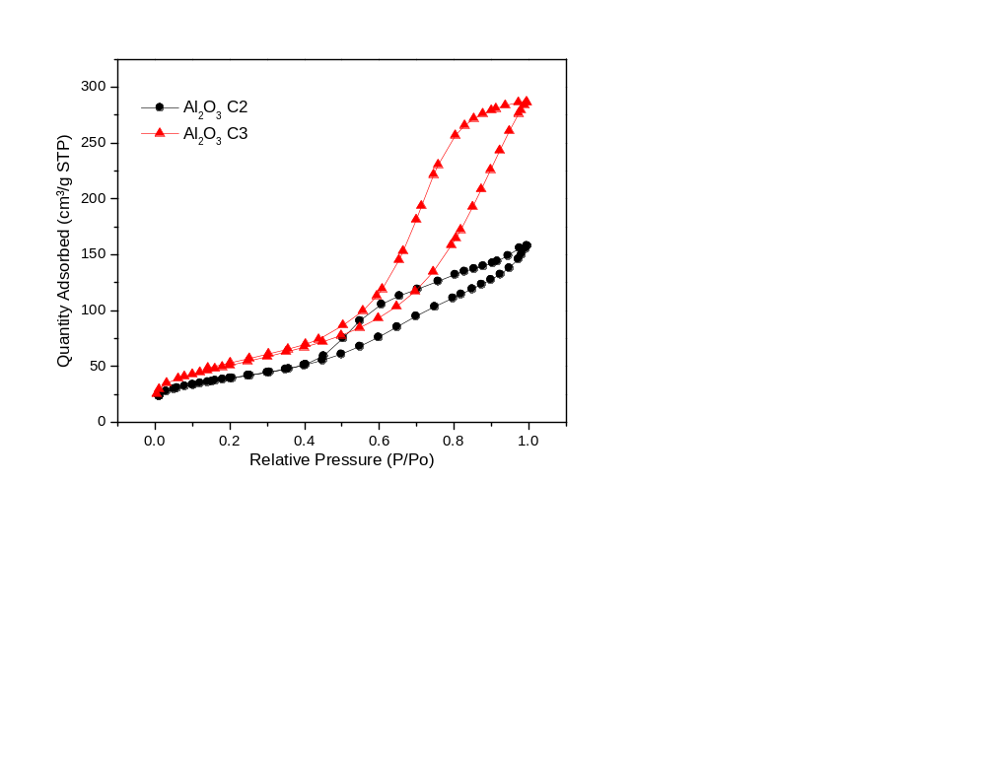
Validation of Ni, NiO, Al₂O₃ phase and porosity
NiO-Al₂O₃
Peaks at 2θ ≈ 37.4° and 44.5° are assigned to cubic NiO (JCPDS 00-47-1049)
Peak at 2θ ≈ 44.5° also indicates metallic Ni (PDF 00-04-0850), confirming partial NiO reduction
Adsorbent also existence of broad peak at 2θ ≈ 64.5° corresponds to γ-Al₂O₃ (JCPDS 00-010-0425), indicating low crystallinity/partial amorphous structure
Both catalyst exhibit Type IV isotherms, confirming mesoporosity, pore size (2-50 nm)
Limitation by BJH method
Pore size distribution within the microporous range (< 1 nm)(existed)
Spike at low relative pressures (P/P₀ < 0.01)
Sample | N₂ adsorption–desorption analysis
 | Surface area (m²/g) | Pore size diameter (nm)
NiO-Al₂O₃ | 142-184 | 5-6

Slide 24
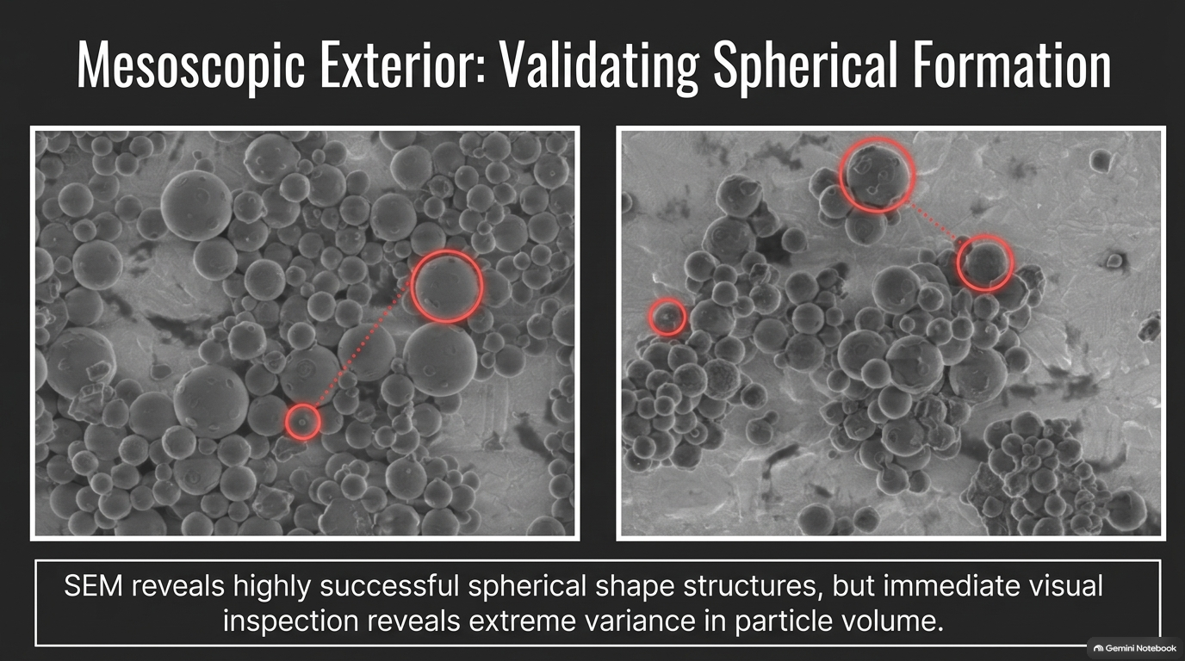

Slide 25
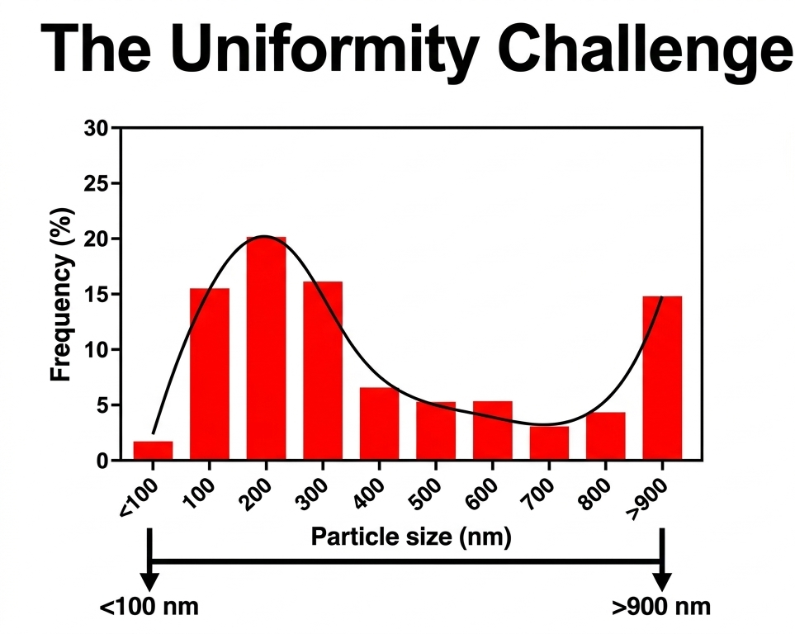
The overall particle-size range spans erratically from 100-900 nm indicating lack of controlled uniform growth during synthesis

Slide 26
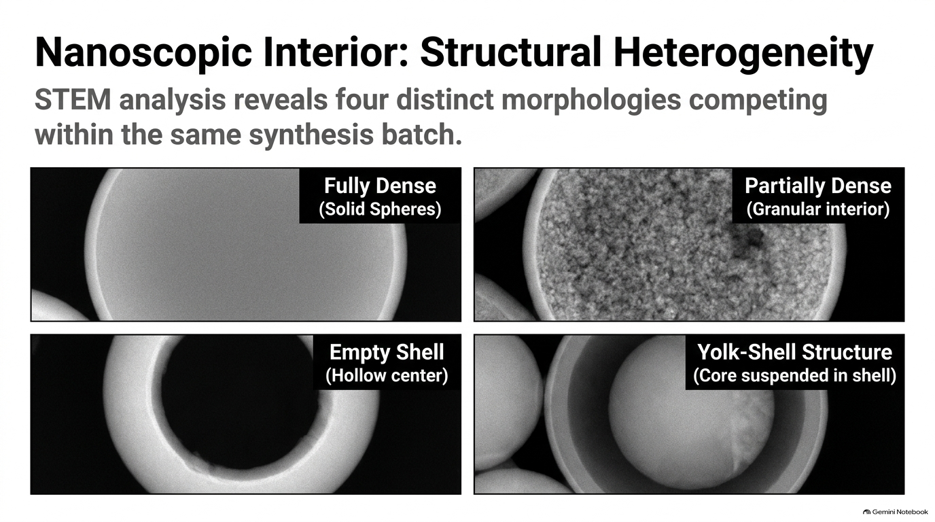
Solid spheres with fully dense
Partially dense spheres,
Empty shell
Yolk-shell structures.

Slide 28
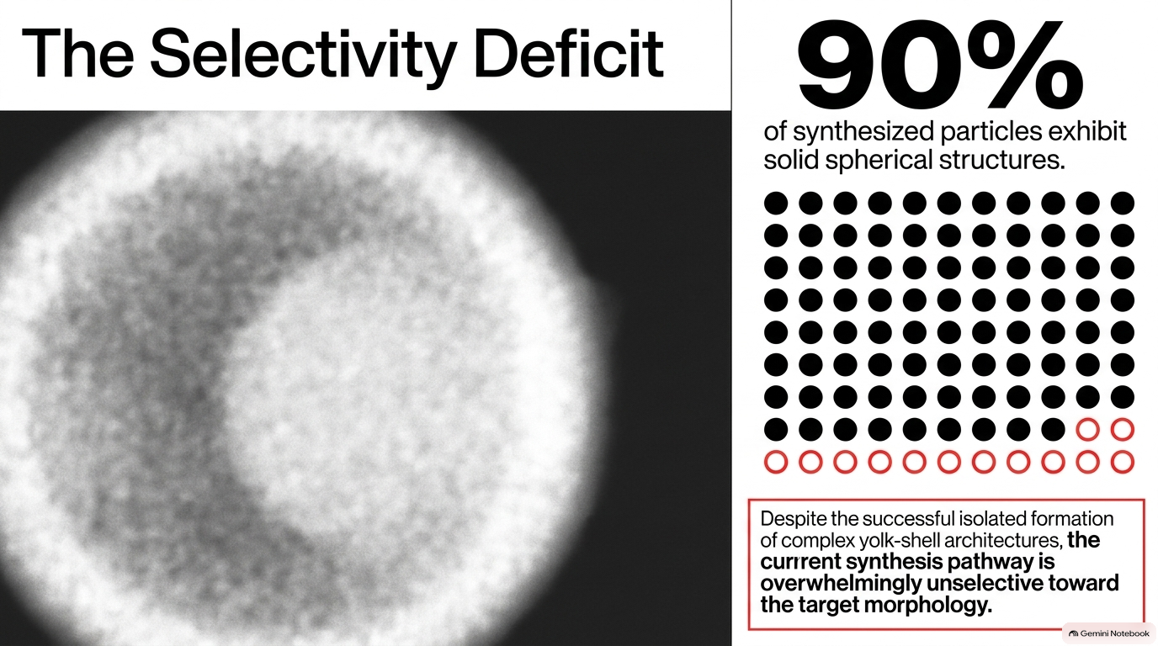

Slide 29
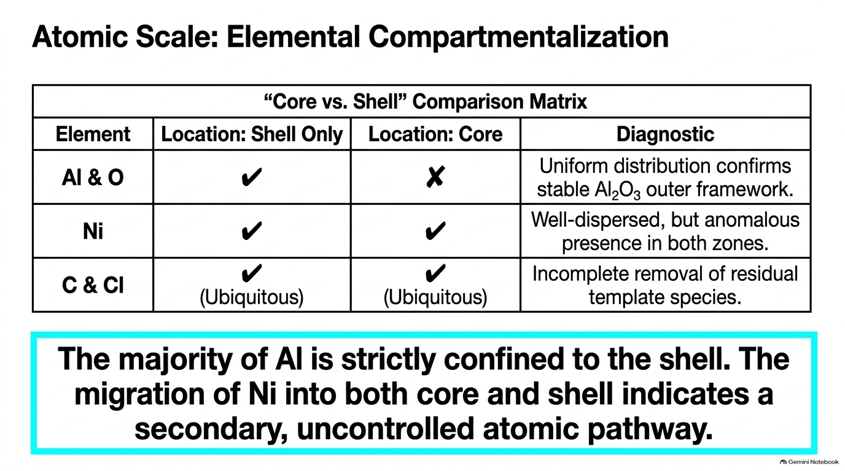
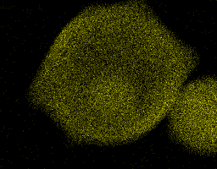



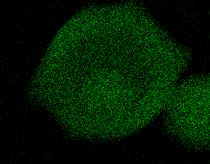
Al
Ni
C
Cl
O

Slide 30
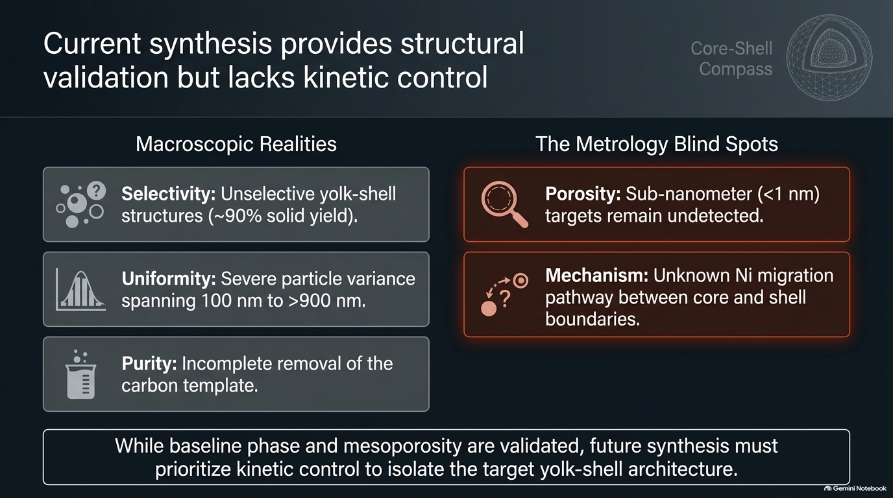

Slide 31
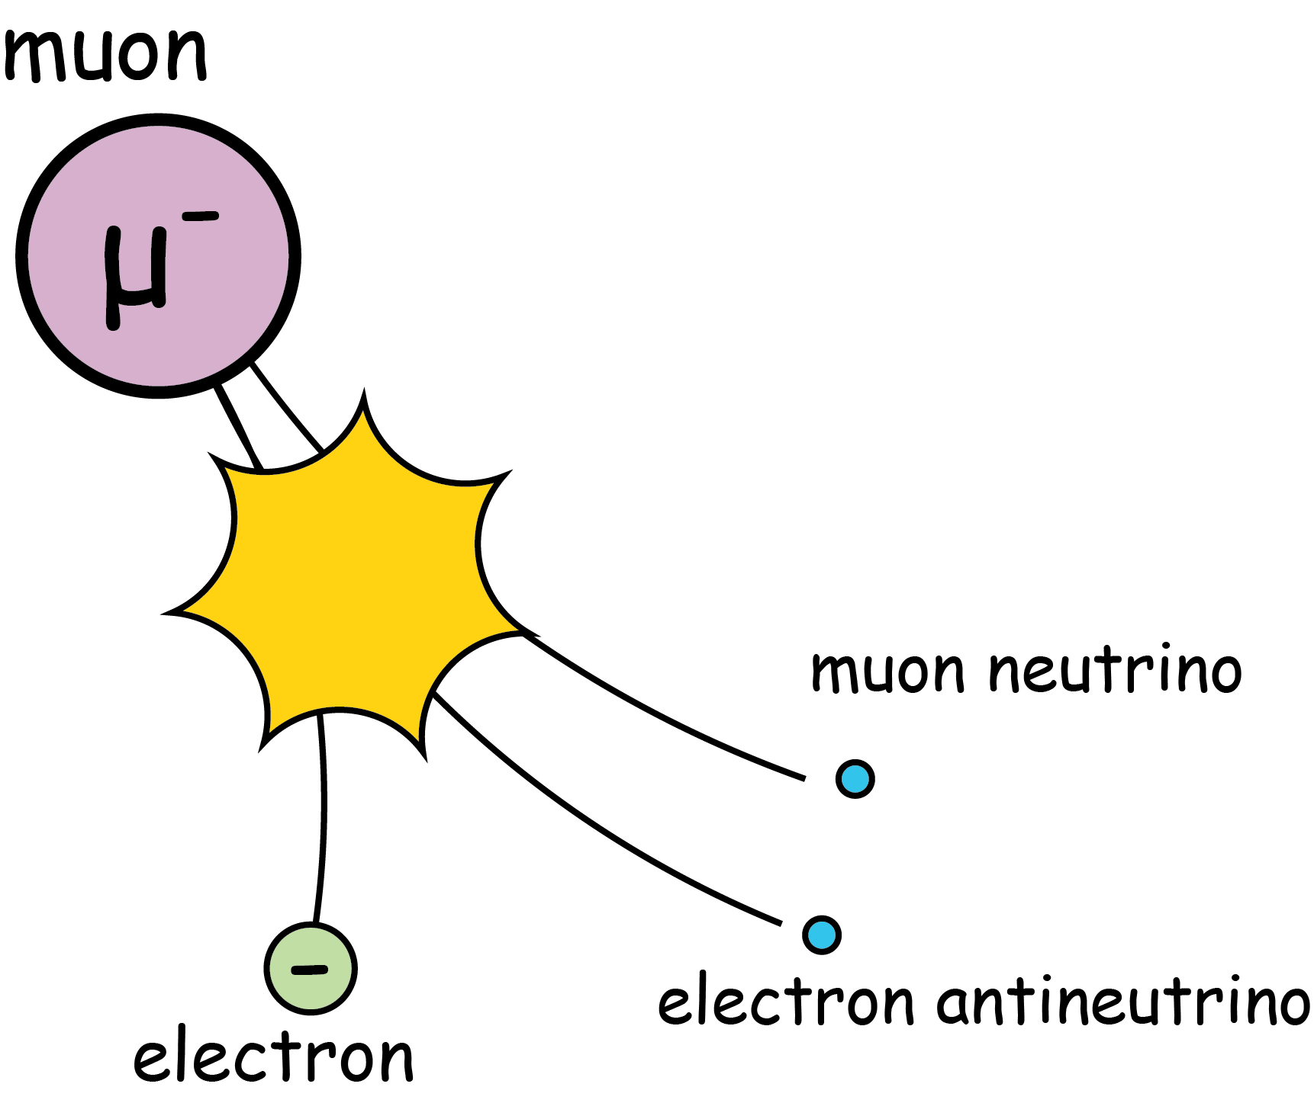
Will Muon Help me?

Slide 32

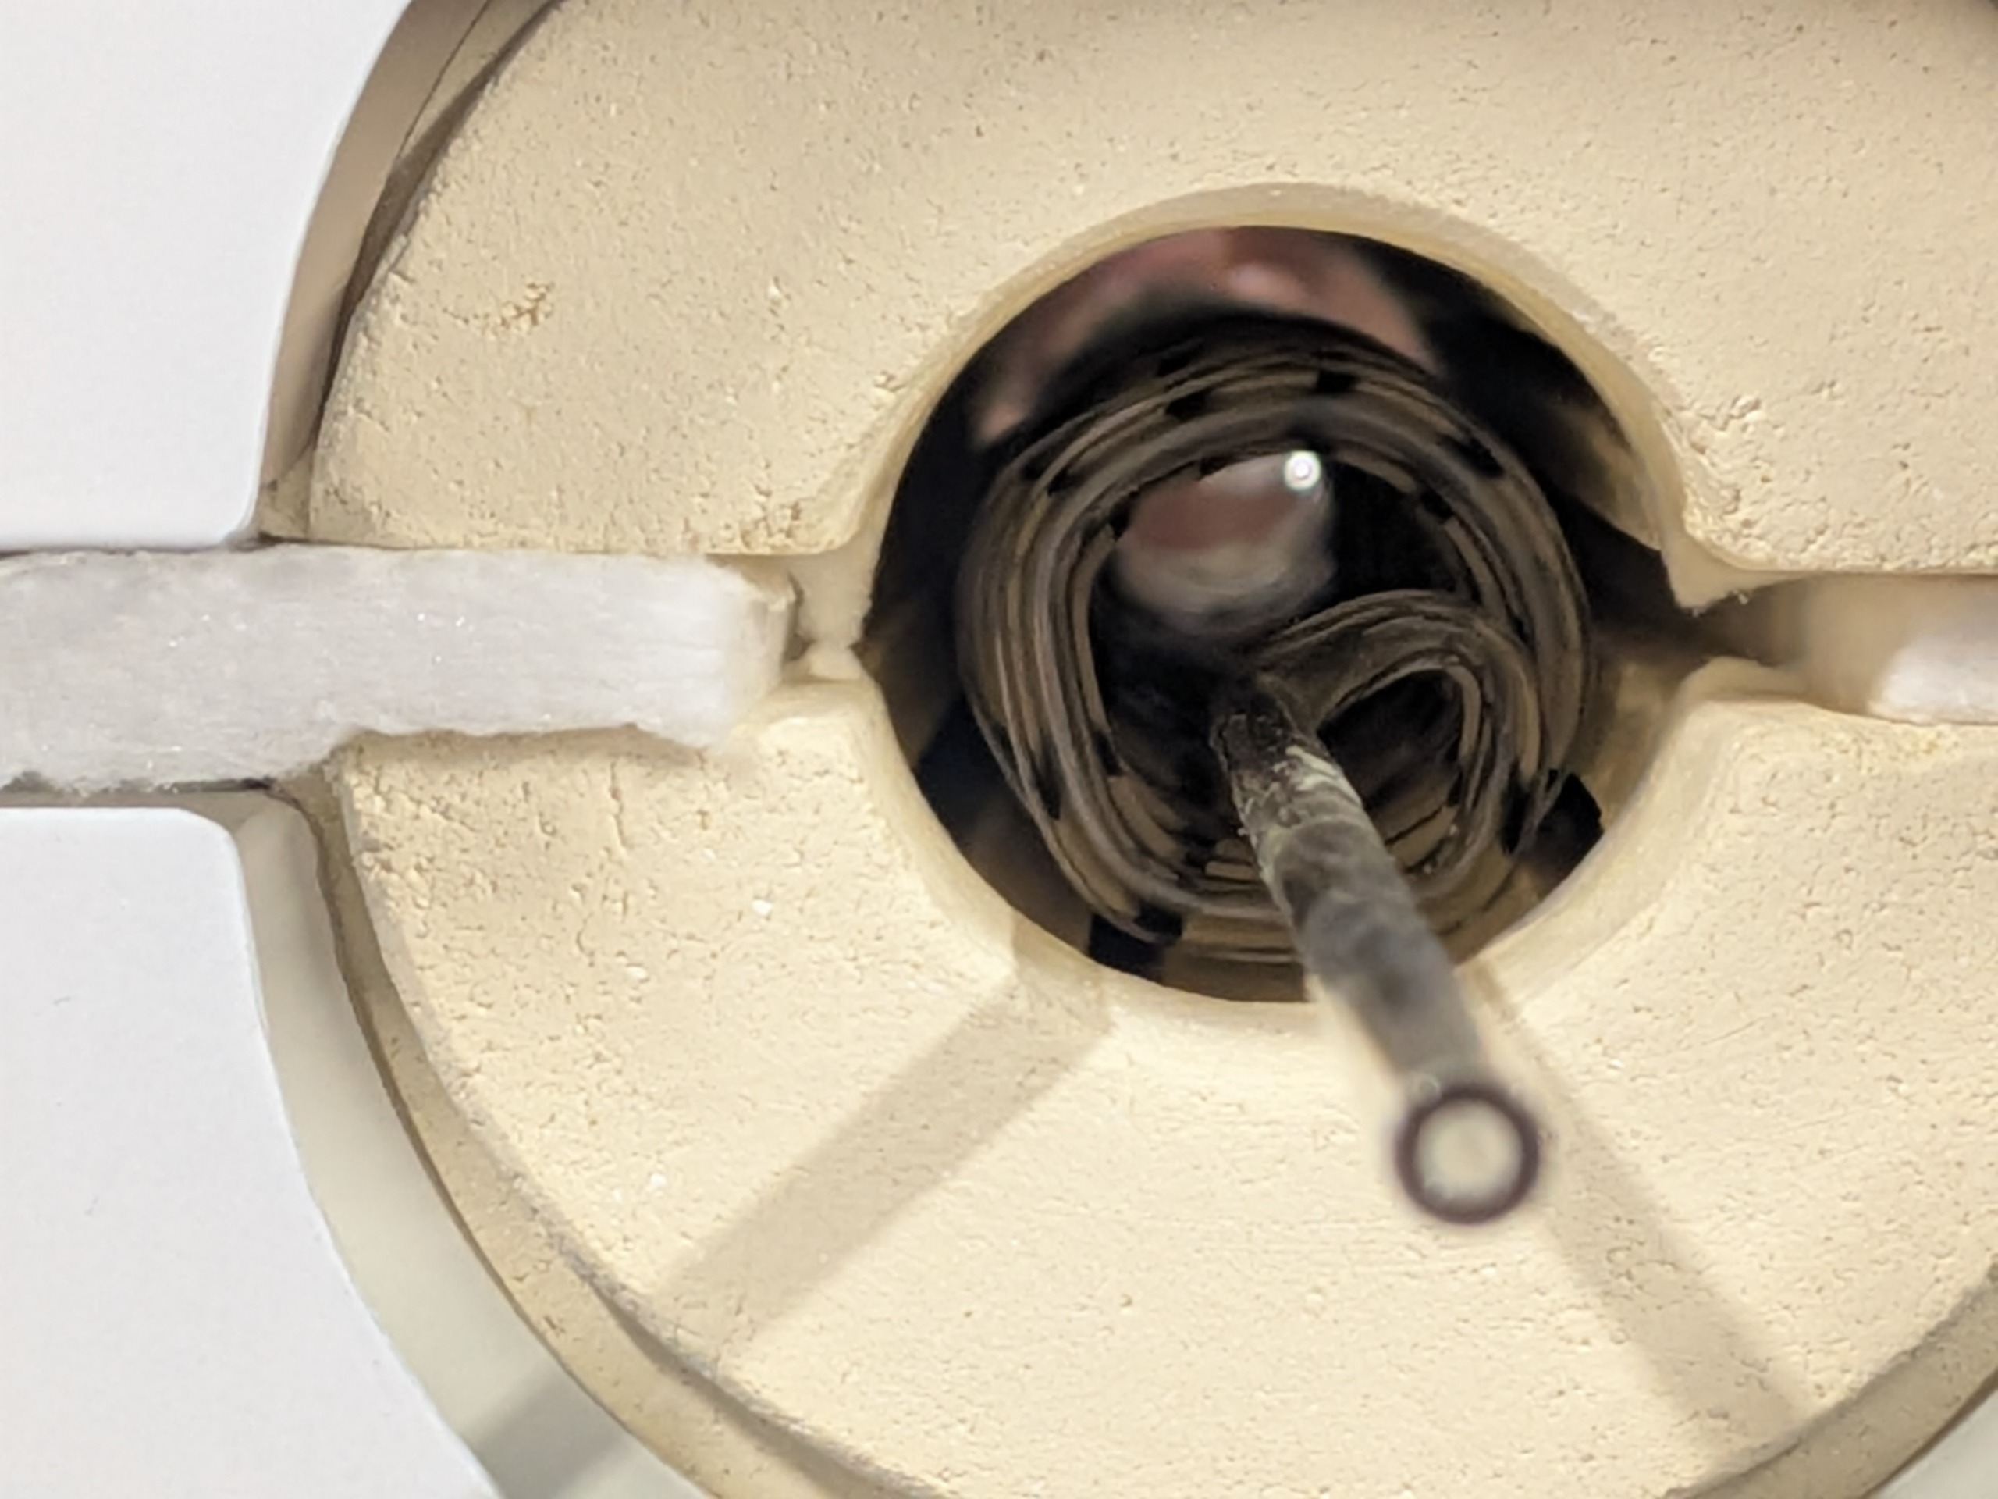

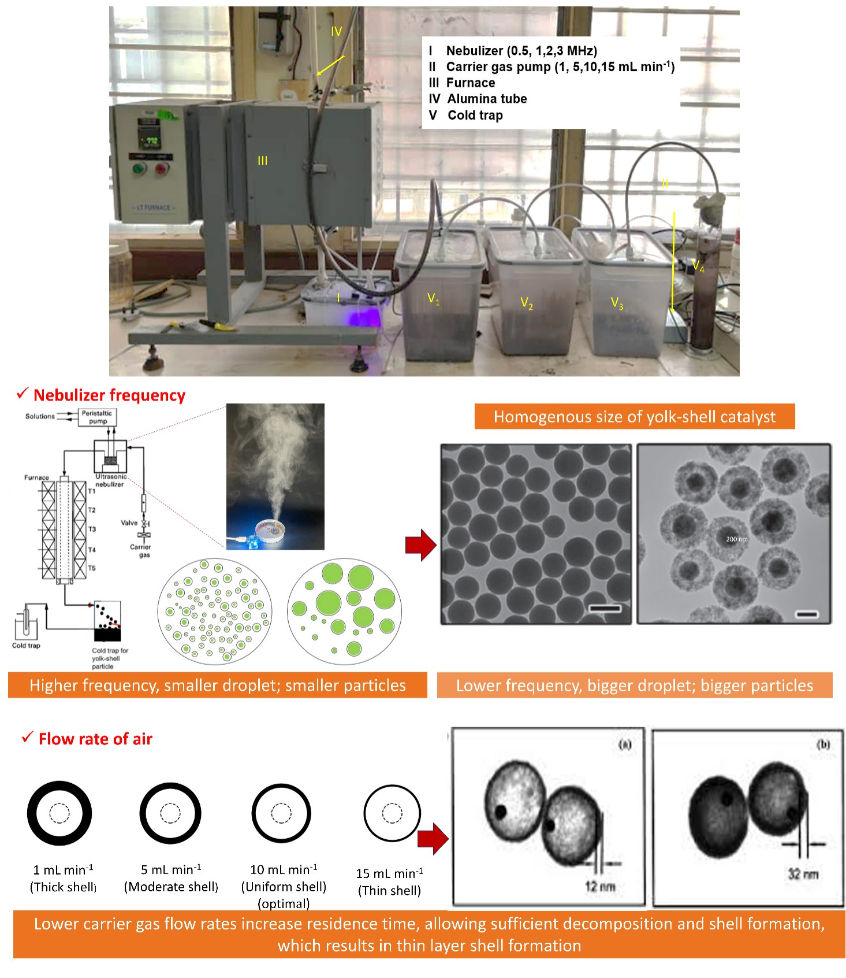
History and current acchievement
Start project 2025 (February) – Dr. Watanabe
Obtaining two Malaysian Grants
(1. Sakura Exchange program, 2. GUT grant, 3. GET grant (October 2026)
Optimizing the synthesis process

Slide 33
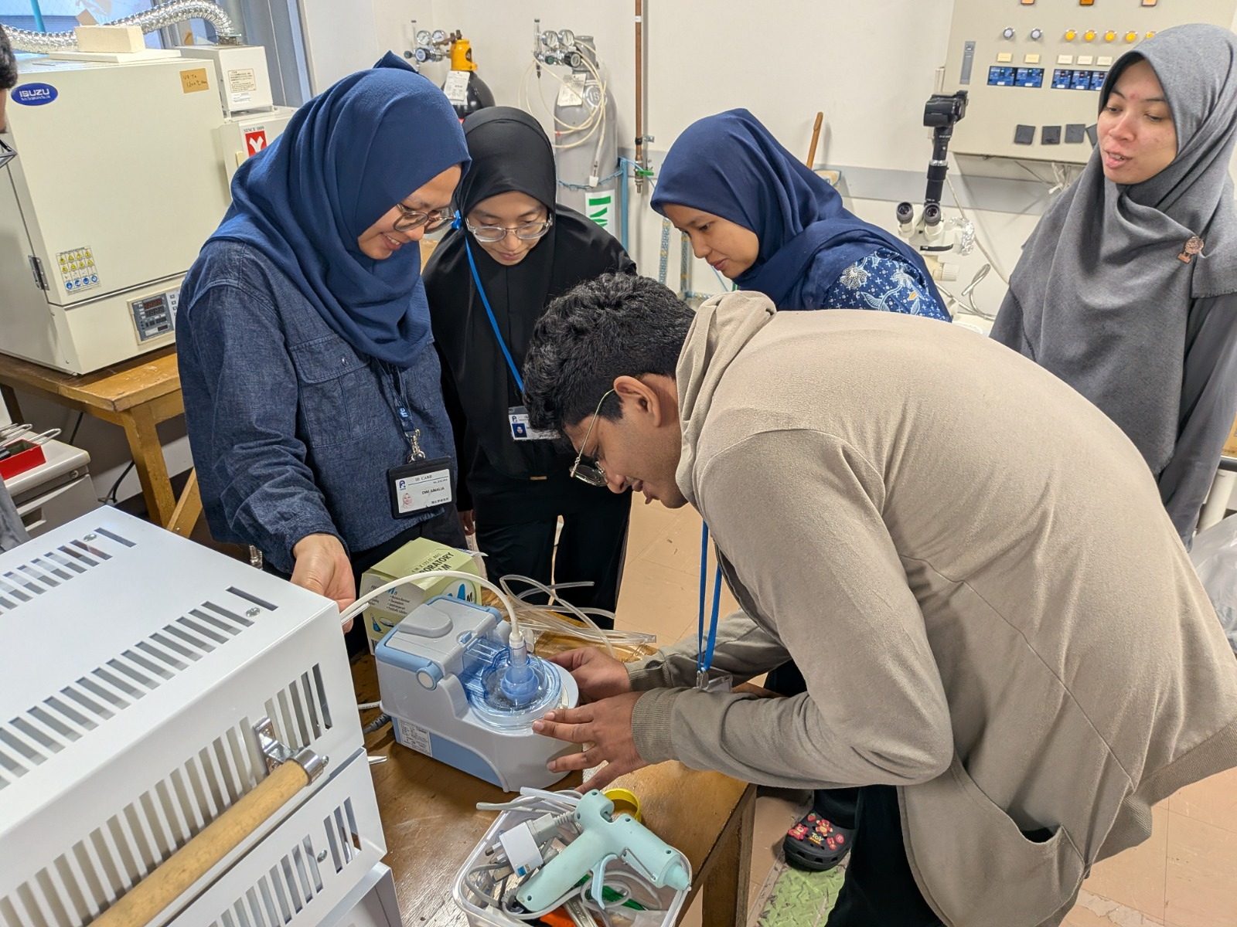
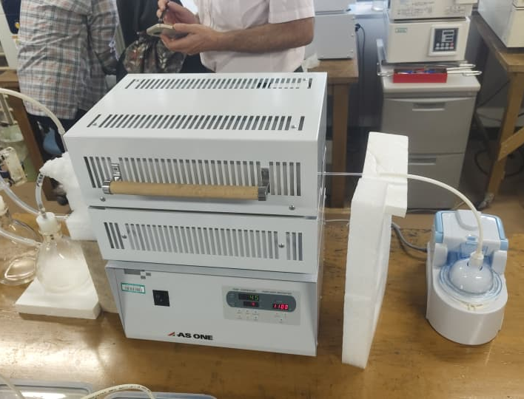
Oct-Nov 2026 collaboration – RIKEN JAPAN

Slide 34







Researchers
Yolk shell adsorbent
Yolk shell adsorbent
Dr. Nurul Asikin Mijan
(UKM)
Dr. Asma Samsuddin
(UKM)
Vassanthan
(UKM)
CO₂ Captured & Desorption,
Mr. Syawal Yusof
(UKM)
Assoc. Dr. Wan Roslan Wan Isahak
(UKM)

Slide 35




