Slide 1


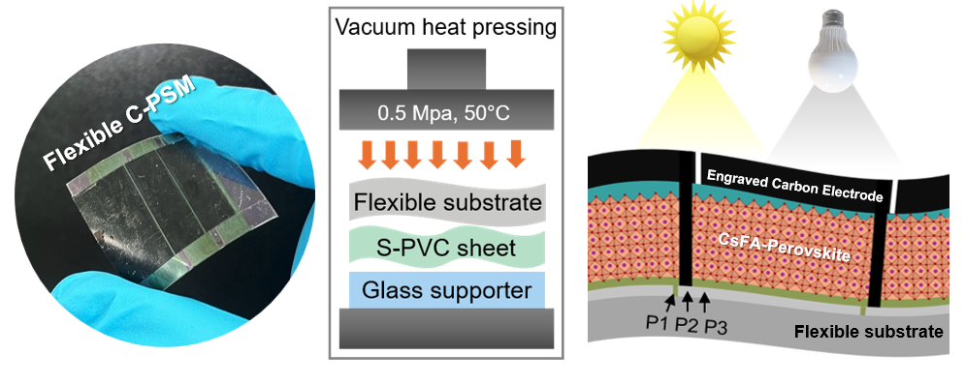





The 3rd Workshop on Muon Science Technology and Industry
23-26 October 2026, Dongguan, Guangdong, China
Reusable Dry-Laminated PVC Thermal Interface Engineering for Flexible Carbon Electrode-Based Perovskite Solar Cells and Modules
Woraprom Passatorntaschakorn, PhD.
Materials Science Research Center (MSRC),
Faculty of Science, Chiang Mai University, Chiang Mai, Thailand

Slide 2
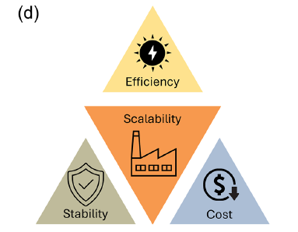
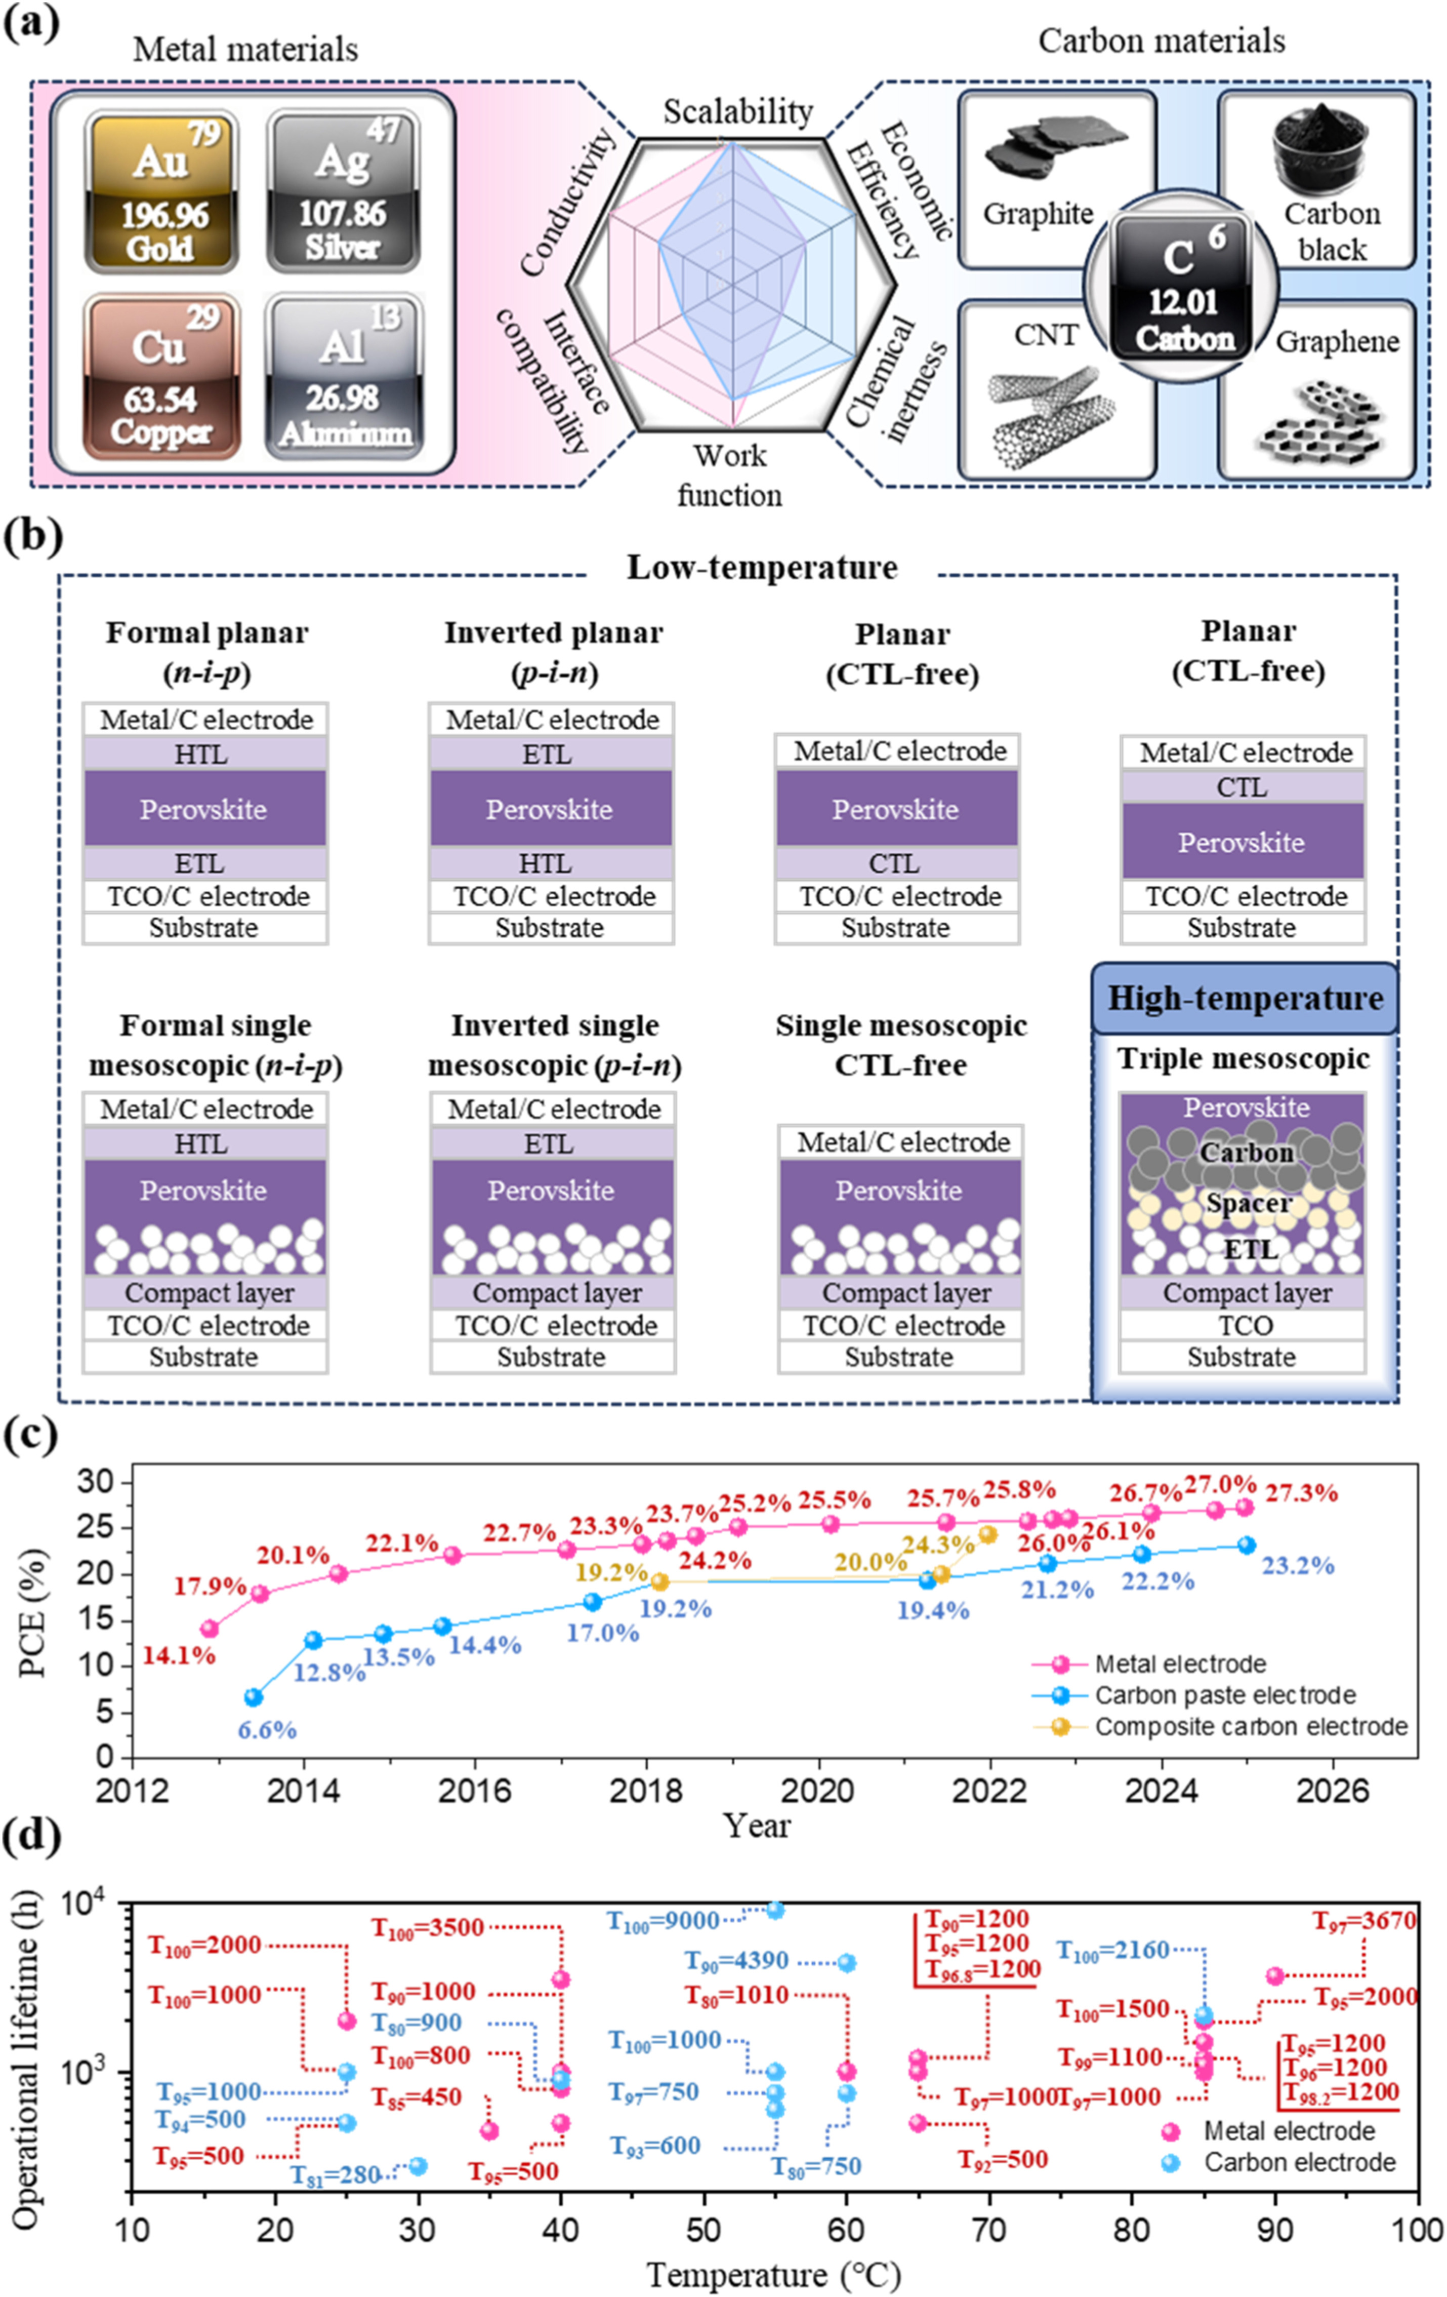
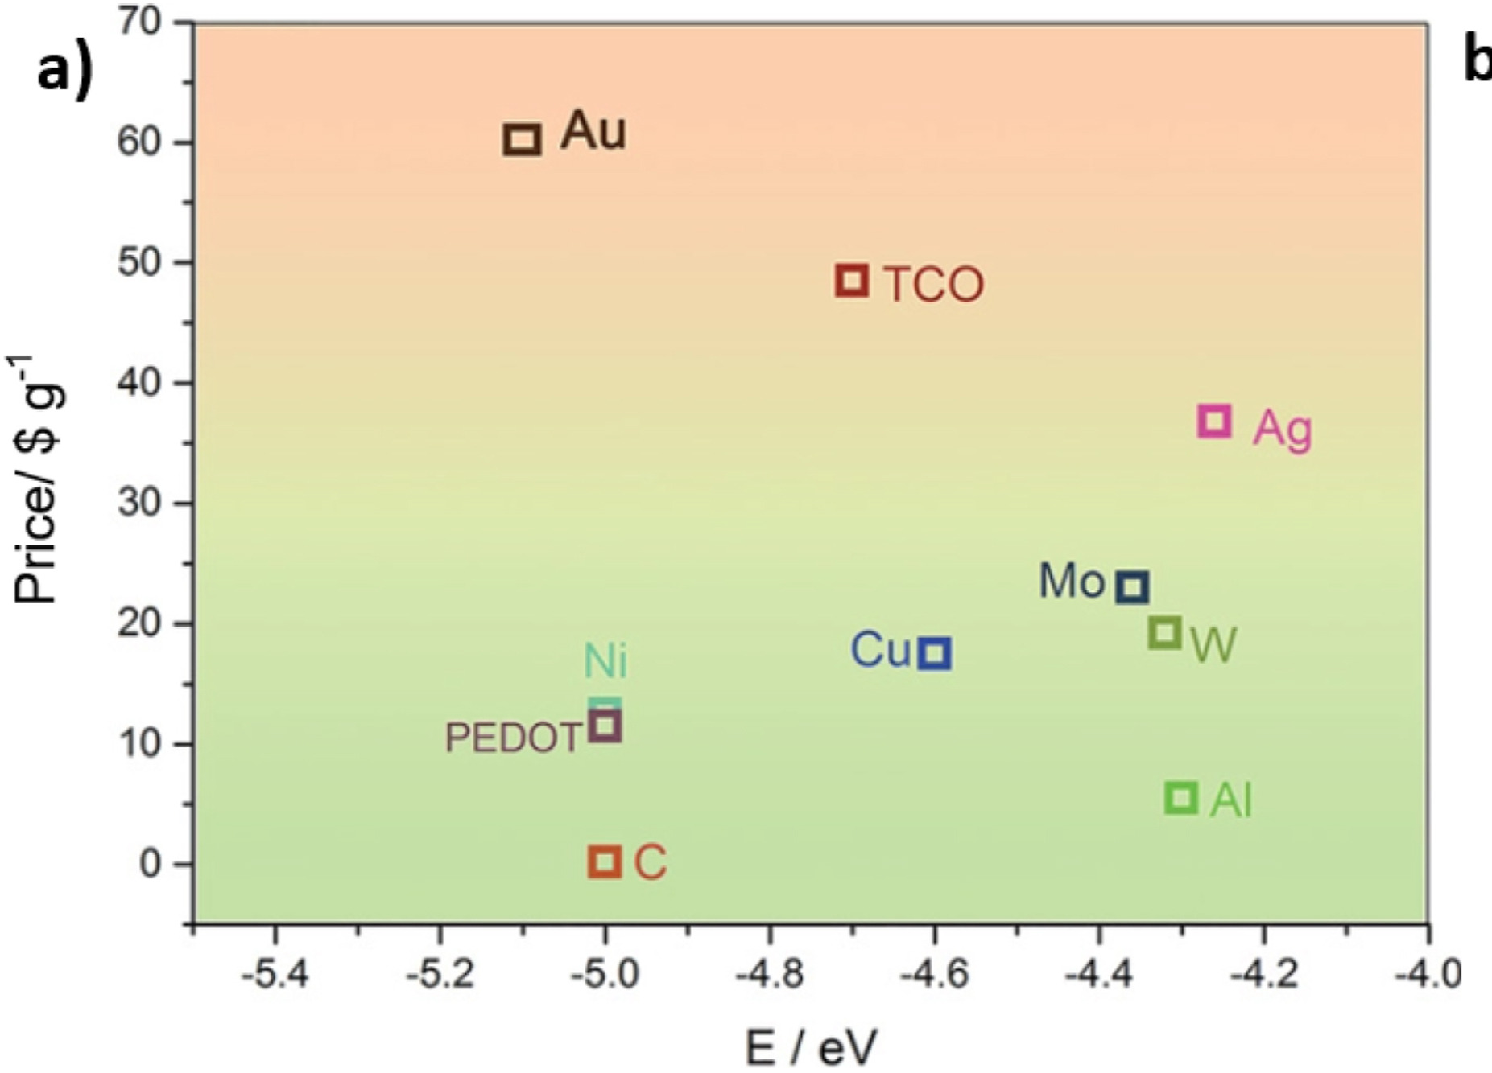
Why Carbon electrode-based PSMs?
Efficiency
Stability
Feng, Yan, et al. (2026). Photovoltaics: Research and Applications , 34(5), 503-522.
Cost
Yu, Y. et al. (2023). Carbon, 205, 270-293.
Luo, Long, et al. (2026). Renewable and Sustainable Energy Reviews, 226, 116474.
MELODY2026 - The 3rd Workshop on Muon Science Technology and Industry

Slide 3
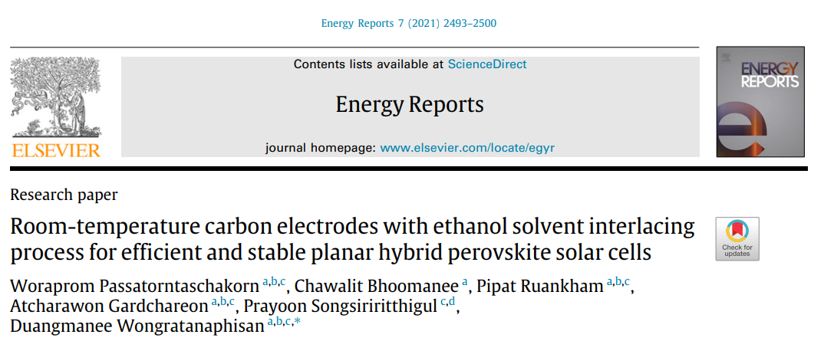
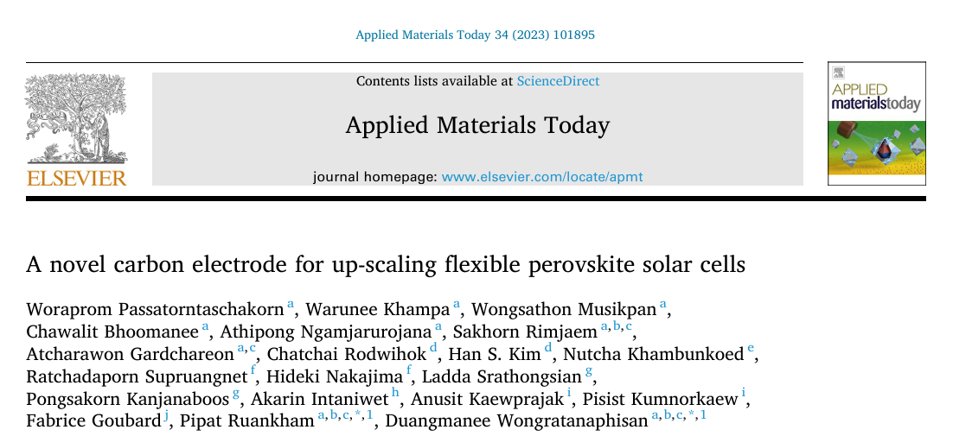
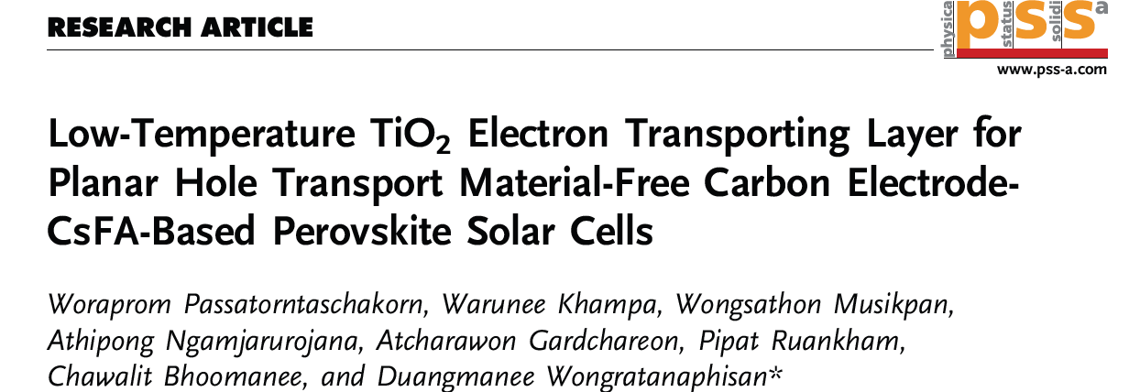
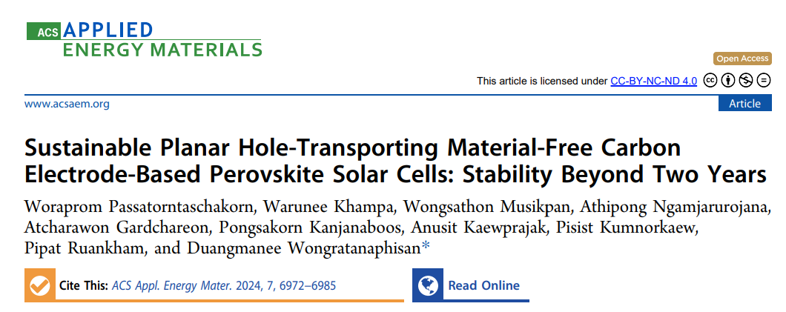
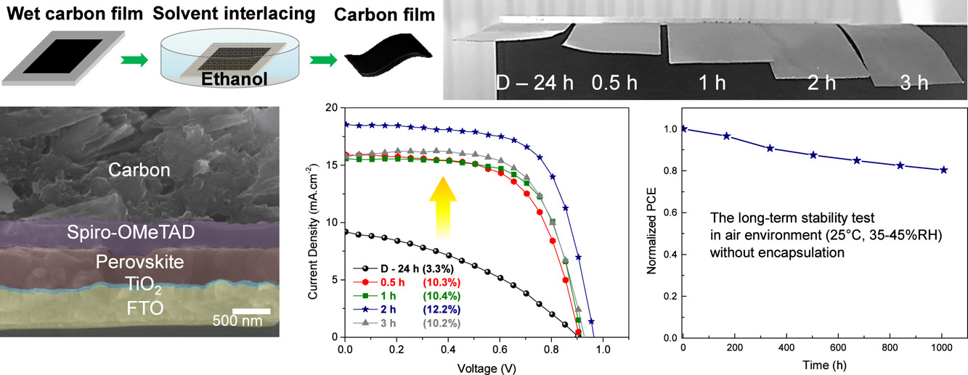
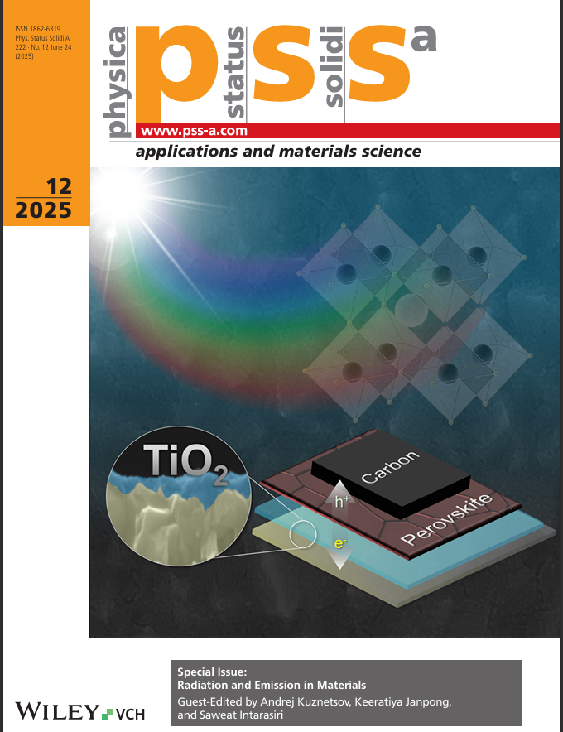
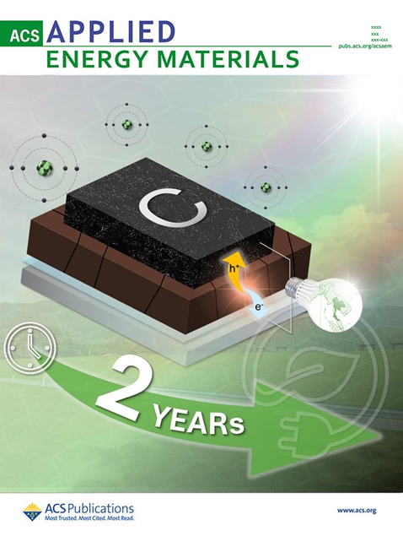
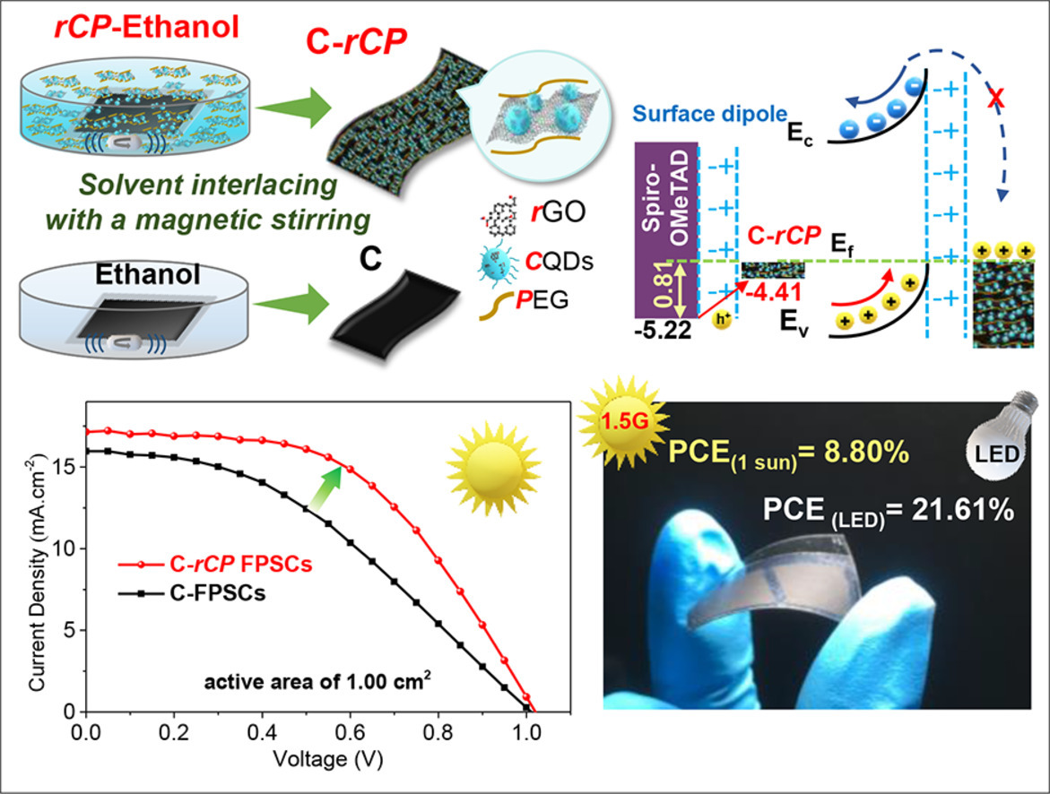
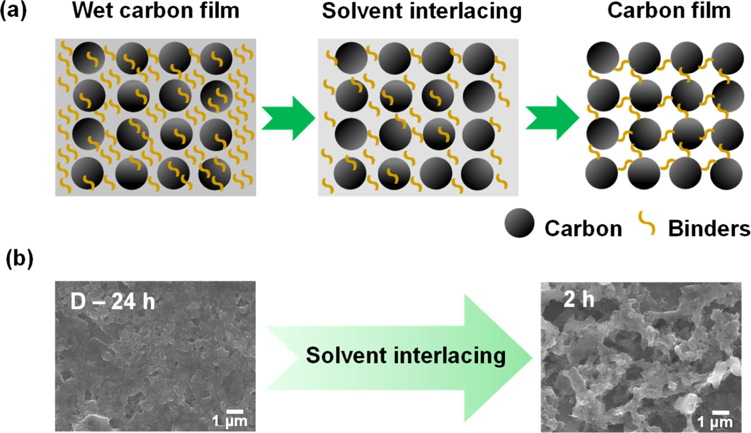
Background: Free-standing Carbon electrode-based PSCs
MELODY2026 - The 3rd Workshop on Muon Science Technology and Industry
3

Slide 4
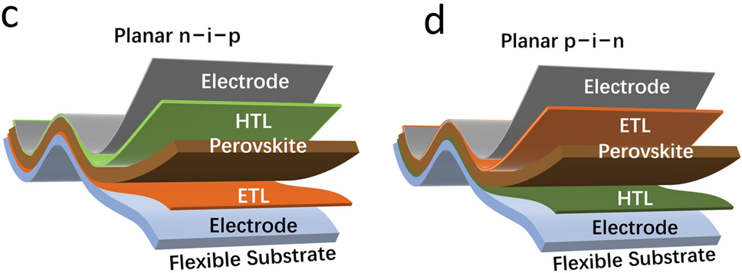
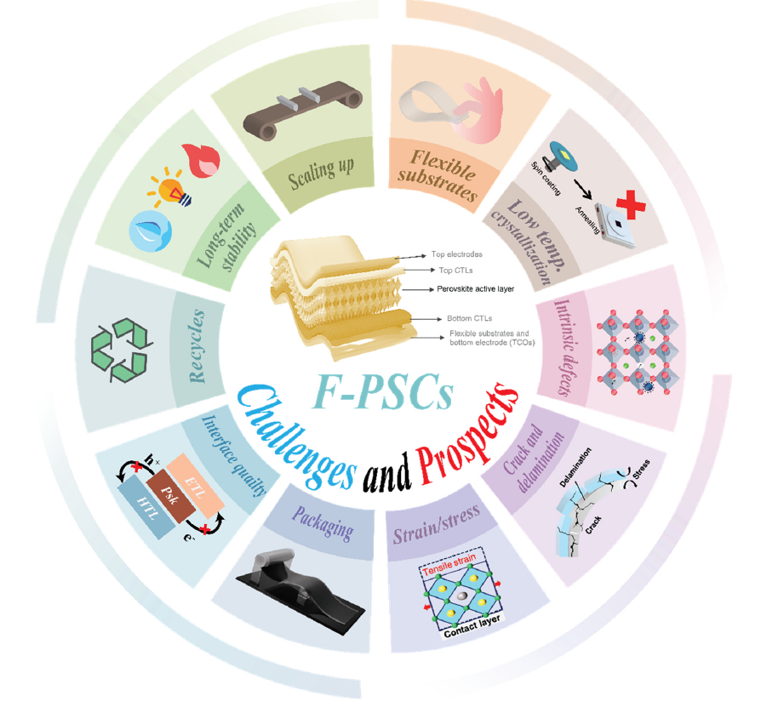
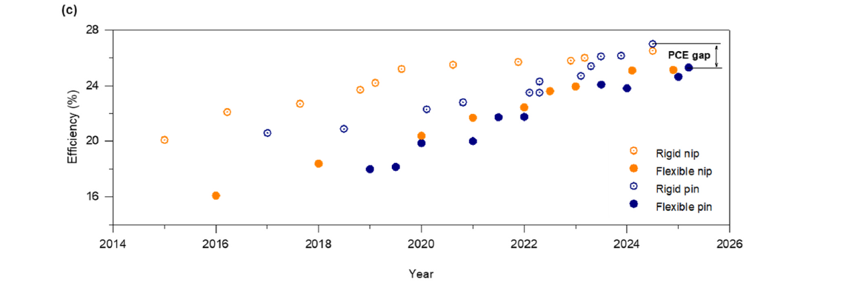
Challenges in Flexible PSCs
Regular architecture
Inverted architecture
Li, Xiongjie, et al. (2023). Nano-Micro Letters , 15(1), 206.
Hassan, Ali, et al. (2025). Materials Science and Engineering: R: Reports , 166, 101023..

Slide 5
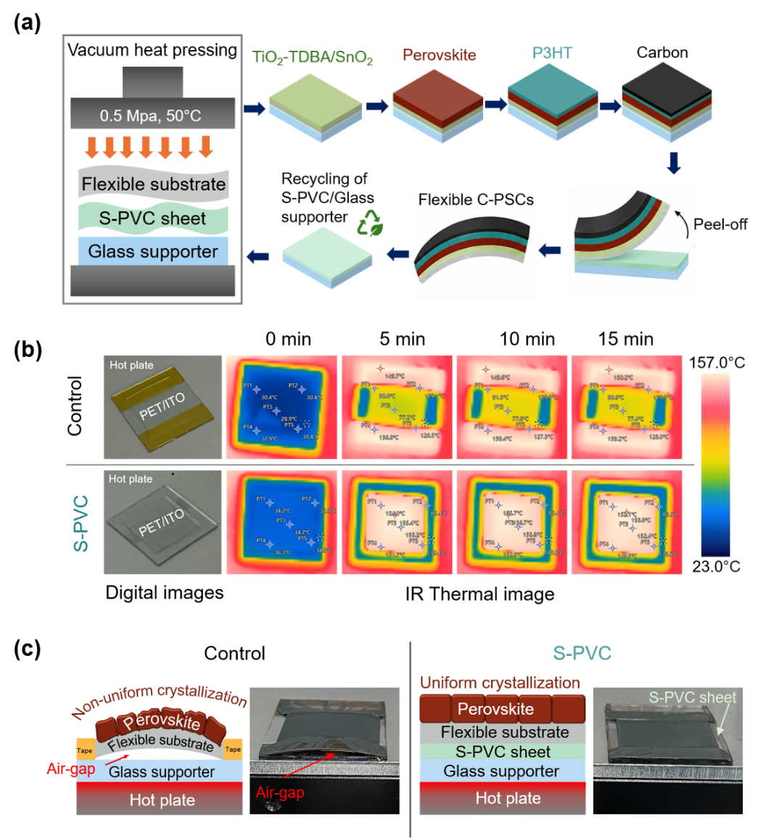
Low Cost & Simple Flexible C-PSCs Fabrication
Passatorntaschakorn et al. (2026), Materials Chemistry and Physics. (Under review)
MELODY2026 - The 3rd Workshop on Muon Science Technology and Industry

Slide 6
Interface Engineering for Flexible C-PSCs
Electrostatic PVC film enhances substrate contact, resulting in more uniform heat distribution during annealing.
Passatorntaschakorn et al. (2026), Materials Chemistry and Physics. (Under review)
MELODY2026 - The 3rd Workshop on Muon Science Technology and Industry

Slide 7
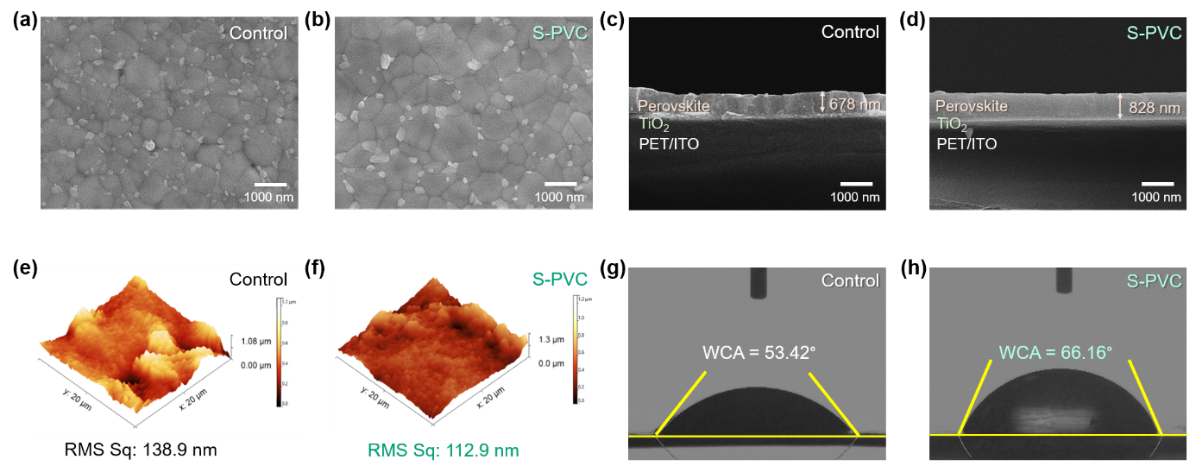
Morphology analysis
Electrostatic PVC-assisted processing promotes denser and more uniform perovskite grains by minimizing interfacial air gaps.
Passatorntaschakorn et al. (2026), Materials Chemistry and Physics. (Under review)
MELODY2026 - The 3rd Workshop on Muon Science Technology and Industry

Slide 8
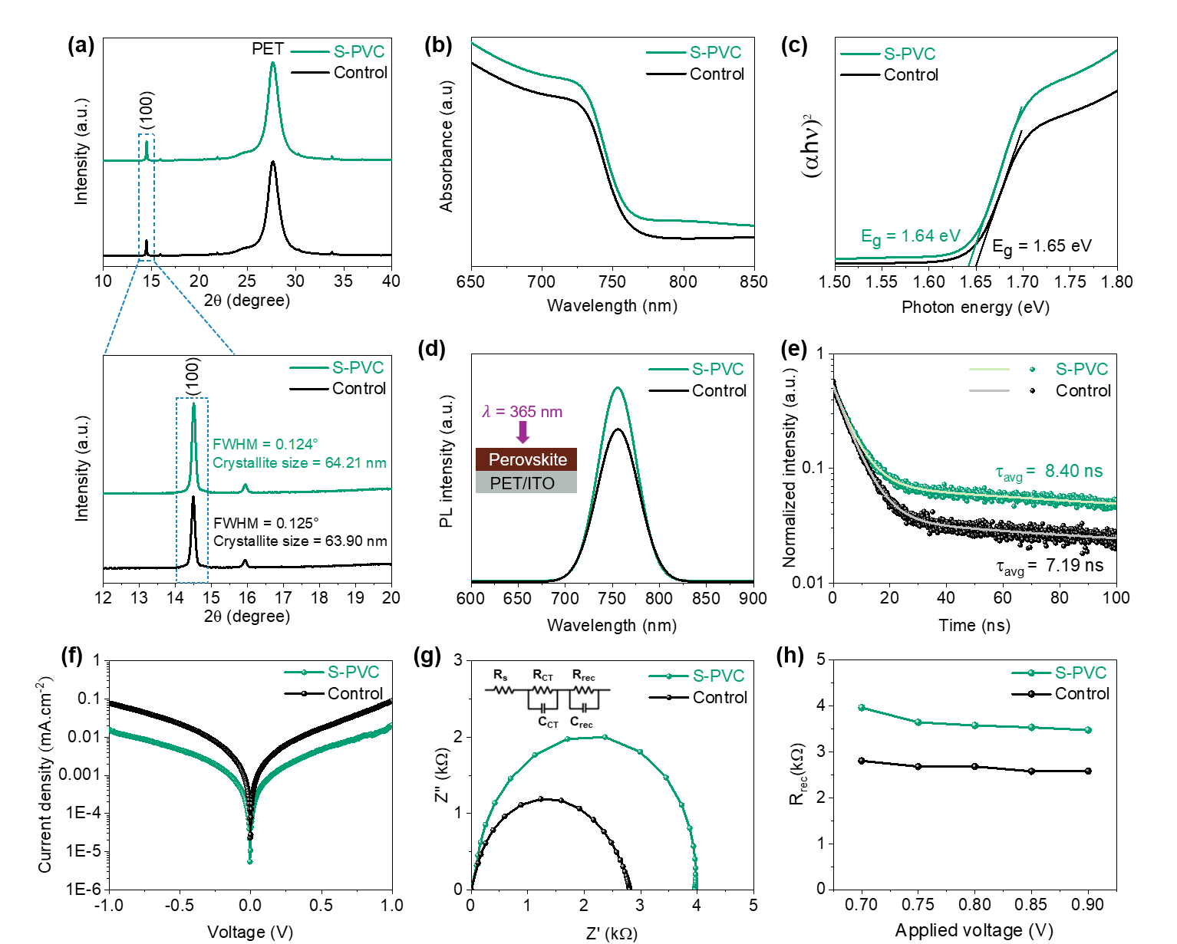
Crystallinity & Optical analysis
Electrostatic PVC-assisted processing enables homogeneous heat transfer, leading to improved perovskite
Higher PL intensity & Longer carrier lifetime indicate reduced trap-assisted non-radiative recombination due to improved perovskite crystallinity.
Passatorntaschakorn et al. (2026), Materials Chemistry and Physics. (Under review)
MELODY2026 - The 3rd Workshop on Muon Science Technology and Industry

Slide 9
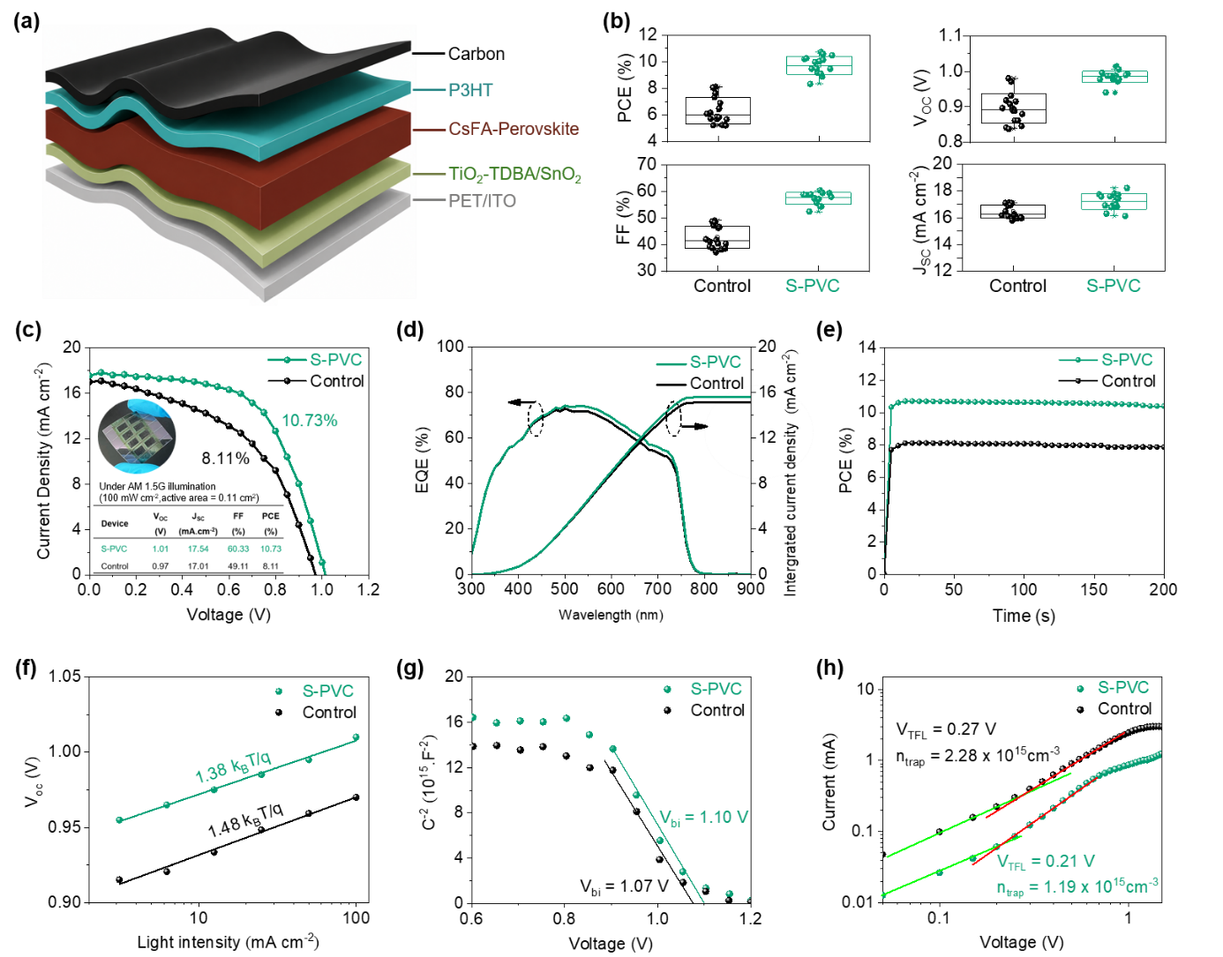
Photovoltaic Performance (Lab scale - 0.11 cm²)
Passatorntaschakorn et al. (2026), Materials Chemistry and Physics. (Under review)
MELODY2026 - The 3rd Workshop on Muon Science Technology and Industry

Slide 10
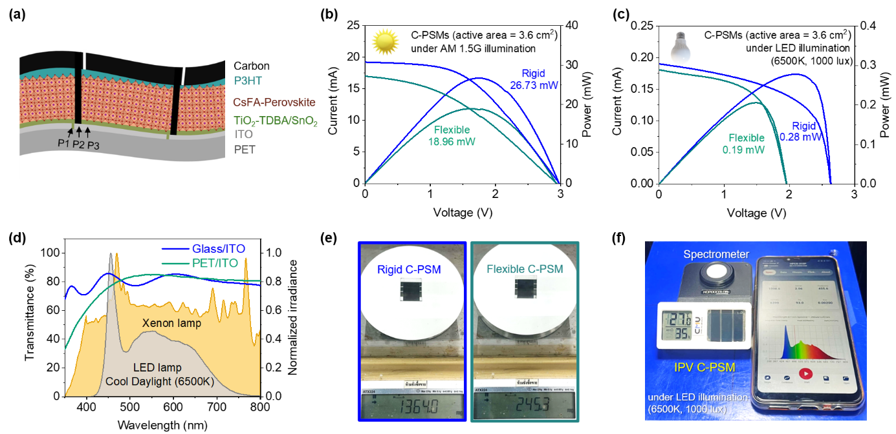
Photovoltaic Performance (Mini module- 3.60 cm²)
Passatorntaschakorn et al. (2026), Materials Chemistry and Physics. (Under review)
MELODY2026 - The 3rd Workshop on Muon Science Technology and Industry

Slide 11
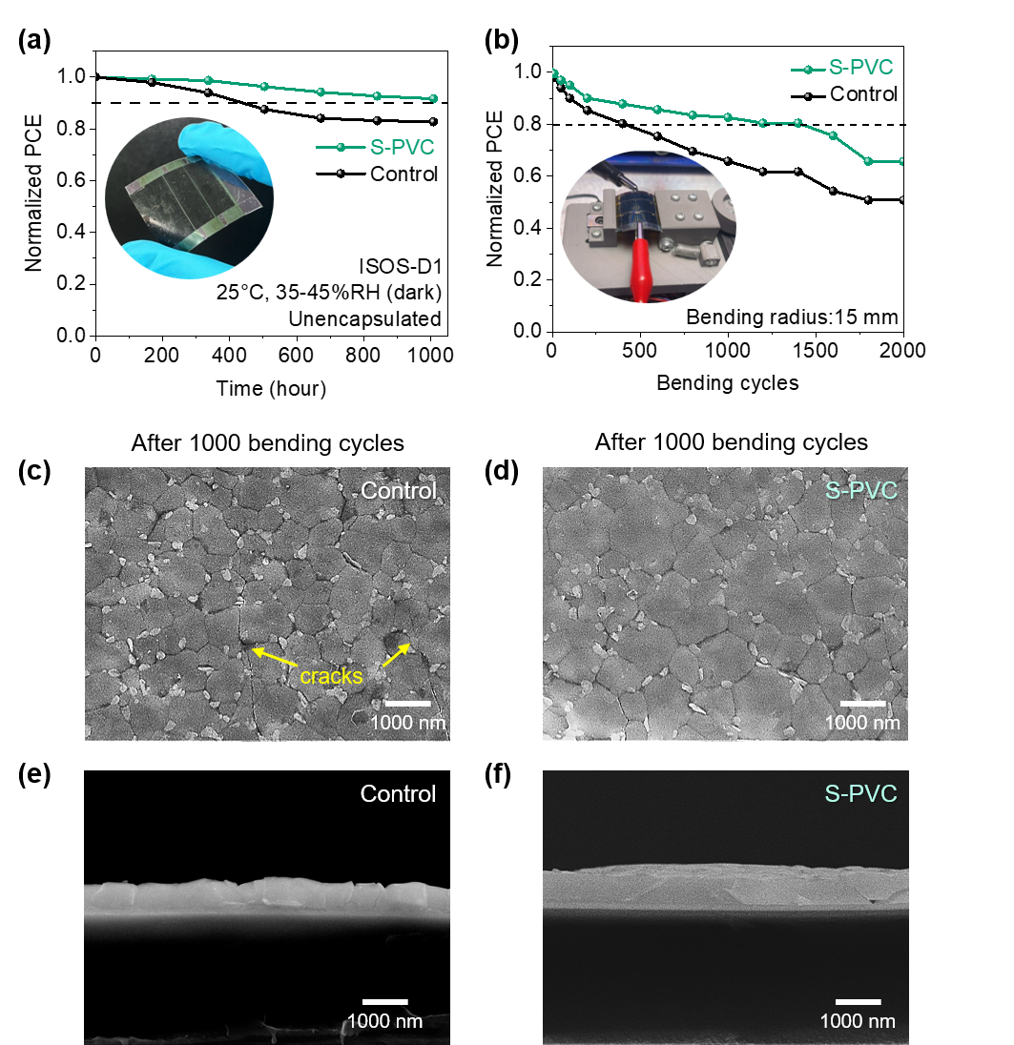
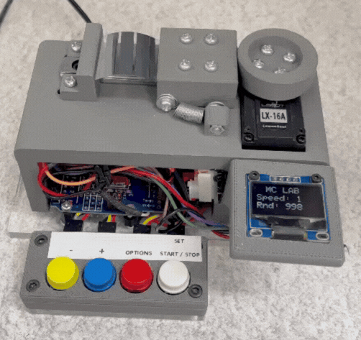

Stability Test
Bending radius: 15 mm, Speed: 0.14 m/s
The improved film quality enhances mechanical durability, maintaining stable performance after 1000 bending cycles.
Passatorntaschakorn et al. (2026), Materials Chemistry and Physics. (Under review)
MELODY2026 - The 3rd Workshop on Muon Science Technology and Industry

Slide 12
Conclusions:
Static cling PVC-assisted vacuum processing enables uniform heat transfer for the all low-temperature fabrication of flexible carbon-based perovskite modules.
Homogeneous annealing improves perovskite crystallinity, film quality, and suppresses defect-assisted recombination, resulting in enhanced device performance and mechanical durability after 1000 bending cycles.
This proposed strategy provides a low-cost and scalable approach for flexible perovskite photovoltaics with strong potential for both outdoor and indoor energy-harvesting applications.
Future:
Utilize muon spectroscopy to investigate thermal properties and charge-carrier dynamics in perovskite films and carbon electrodes.
MELODY2026 - The 3rd Workshop on Muon Science Technology and Industry

Slide 13

Thank you for your attention

