Slide 1
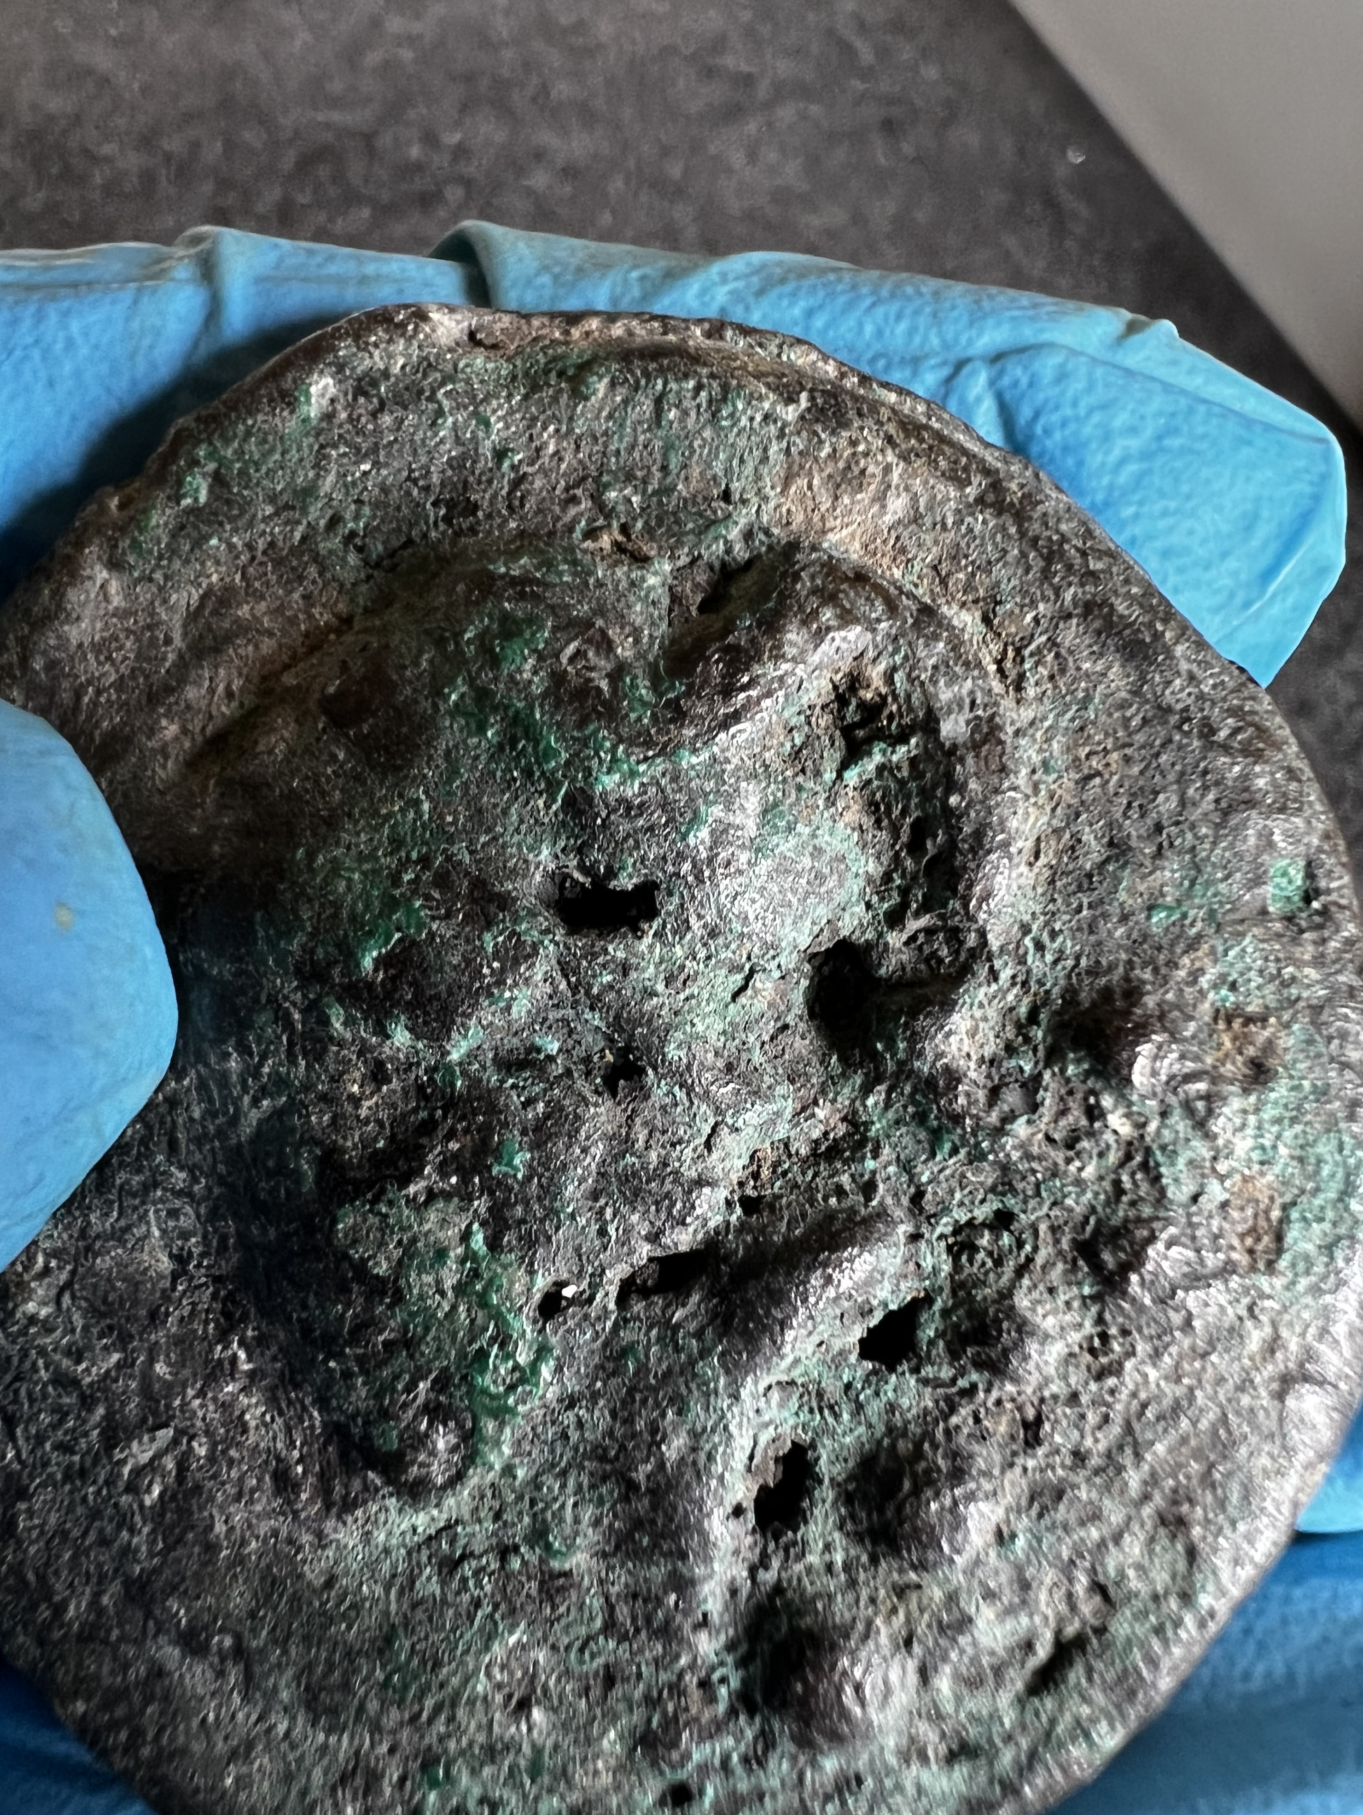
Expanding Monetary History with Muons
New Insights on Rome’s Cast Coinage
Liv Mariah Yarrow (CUNY)
A Cultural Heritage Application
Notes:
Agreed to give this talk to try to see the forest for the trees, to speak historically about my more technical numismatic work

Slide 2
Structure and Goals
Metallurgical Analyses Techniques and Problems
What Makes Coins Special
My Work on the Earliest Roman Coins and Why Muons Make Sense
What can a Physicist learn from a Historian about Cultural Heritage Issues?
Notes:
The definition of money is slippery and disputed . Hollander in 2007 wrote a wonderful book in the nature of money in the Later Roman Republic to try to bring something of modern scholarly perspectives to bear on the ancient economy. He uses a common definition of money and shows the diversity of money in use by Romans in the first century BCE.
Read slide, Discuss.

Slide 3
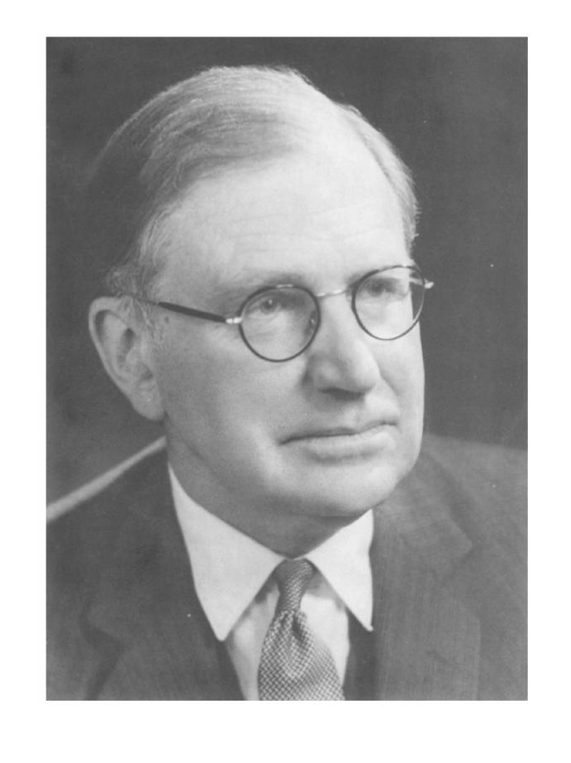
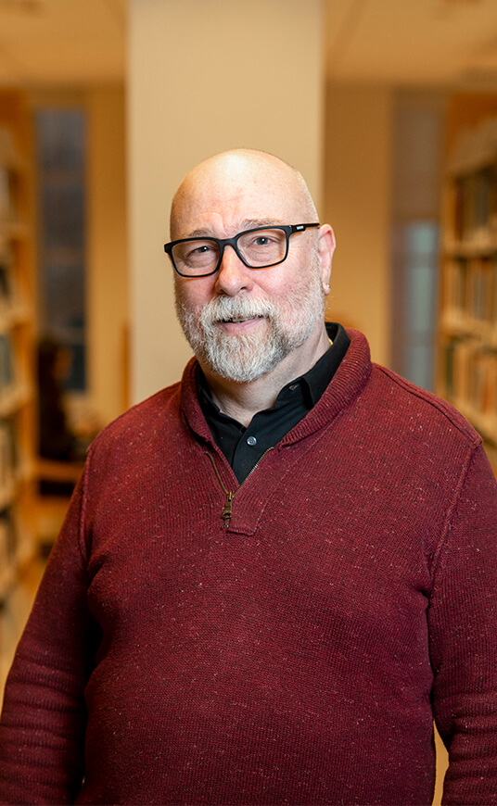
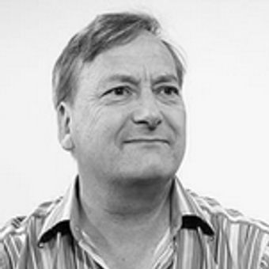
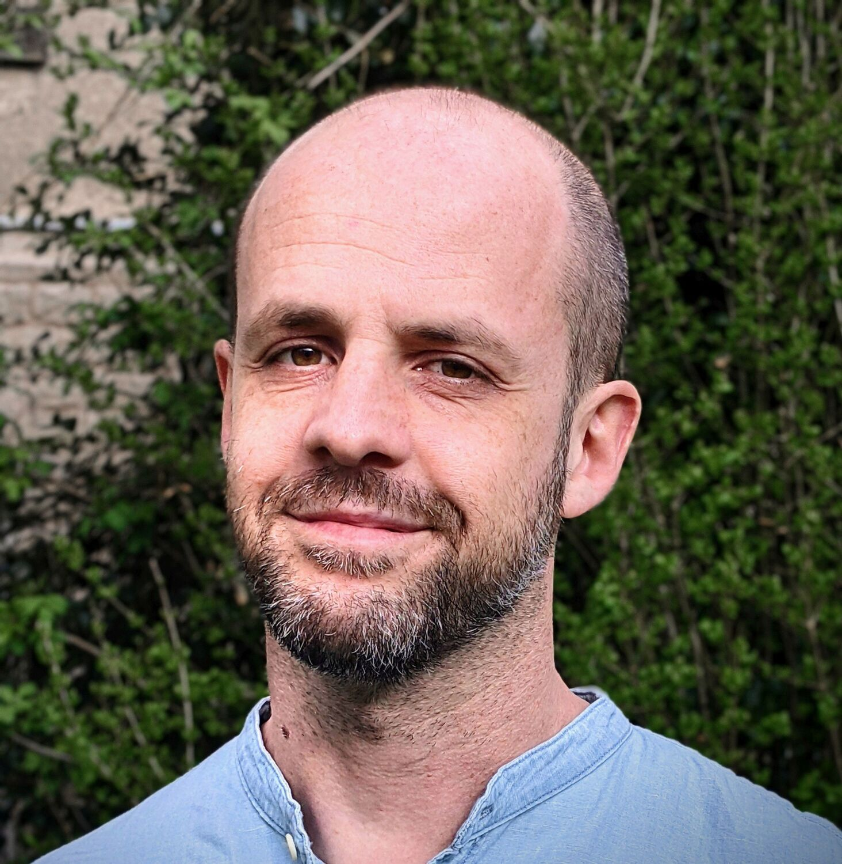
Humanists need Patient, Open-Minded Scientists!
(Gratitude and Inspiration)
Ron Daniel, Engineering Professor specializing in Robotics and Machine-Human Interaction
Nicola Ialongo, Archaeologist of Pre Historic Economies
The family of Sir Nevill Mott, Nobel Prize 1977 and his wife, Lady Ruth, the Classicist and Numismatist
Wayne Powell, Geologist and Archaeometallurgist
Why is a Roman Historian Here?!

Slide 4
Cultural Heritage Metallurgical Analyses
(Minimally) Invasive
Constraints
Selective Sacrifice of Whole Specimens
Dremel Sampling (Drilling)
Laser Ablation
(Inter)national Legislation
Institutional Policies
Scholarly Controversies
Selection of Appropriate Objects
Selection of Sampling Site
Heterogeneity of Artifact

Slide 5
Cultural Heritage Metallurgical Analyses
Nondestructive (?)
Constraints
pXRF
SEM
Neutron Activation
PIXE
Mu-XES = MIXE
Scholarly Skepticism and/or Lack of Understanding
Level and Scope of Analysis
Restrictions on transport of Objects
Costs

Slide 6
Cultural Heritage Metallurgical Analyses
(Coins and related objects)
Numismatic Specific
Diverse Manufacturing Techniques
Multiple Metals, Alloys and Admixtures used
Object Histories: Excavation, Historic Collections, Modern Market
Mass Produced Objects = one reading unlikely to be meaningful
Frequency of Fakes, Ancient and Modern
Divided Community
History of Bad Data

Slide 7
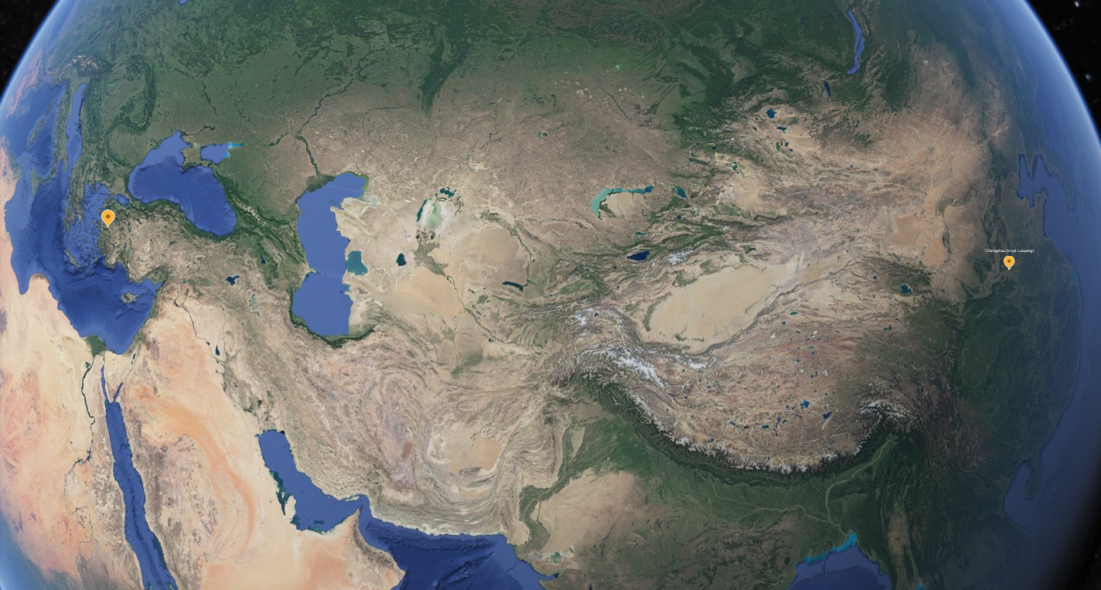
Parallel Evolutions
4,500+ miles apart!

Slide 8
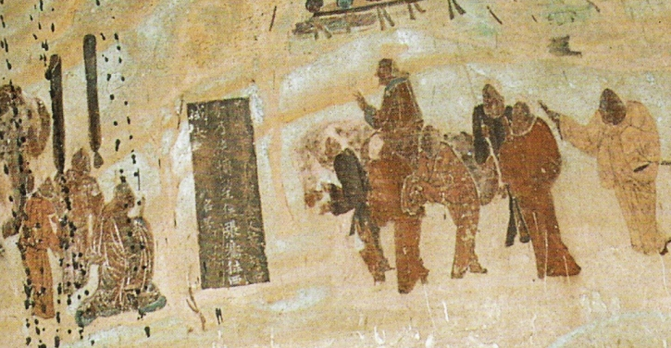
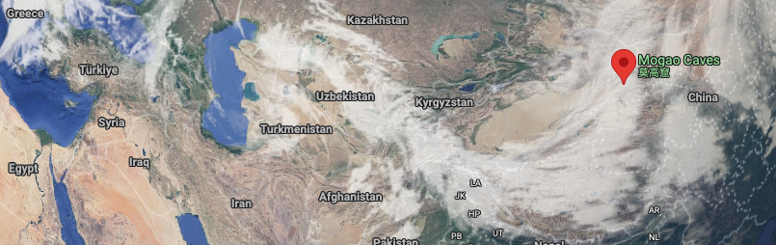
Recognized yet different
Sima Qian's Shiji, chapter 123:
“ The people (of Anxi, i.e. Parthia, mod. Iran) are settled on the land, cultivating the fields and growing rice and wheat. They also make wine out of grapes. They have walled cities … The coins of the country are made of silver and bear the face of the king. When the king dies, the currency is immediately changed and new coins issued with the face of his successor. The people keep records by writing horizontally on strips of leather. To the west lies …
Zhang Qian c. 130 BCE leaving emperor Han Wudi, for his expedition to Central Asia. Mural in Cave 323, Mogao Caves, high Tang Dynasty, c. 8th century CE.

Slide 9
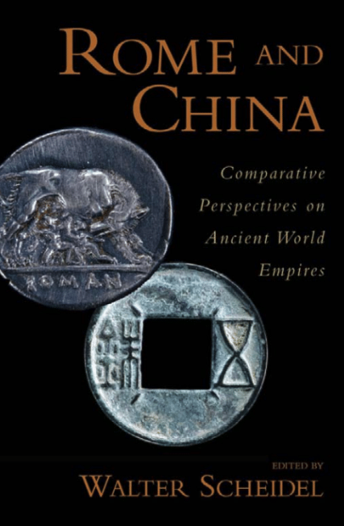
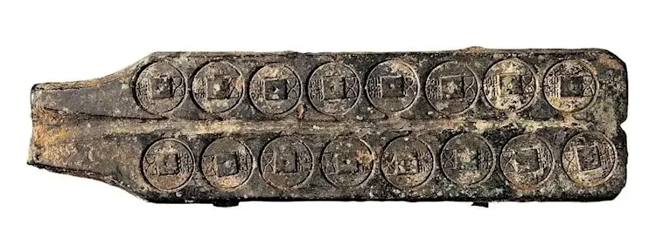
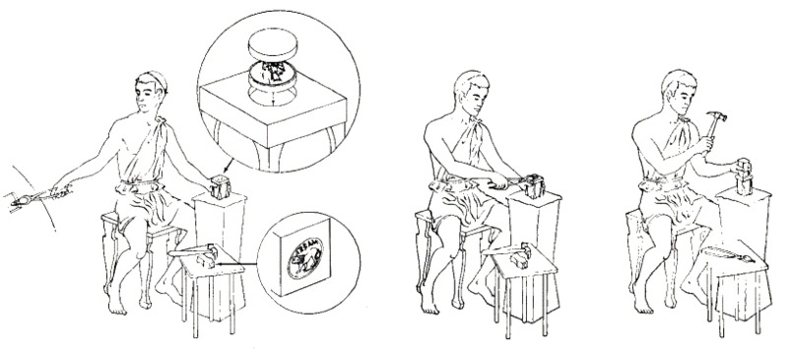
Key Differences
Base vs Primarily Precious Metals
Cast vs Primarily Struck

Slide 10
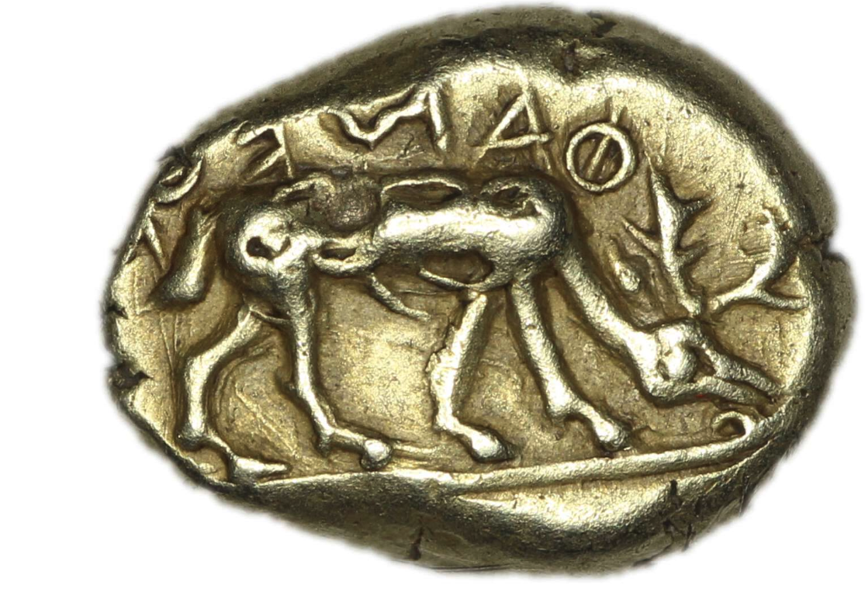
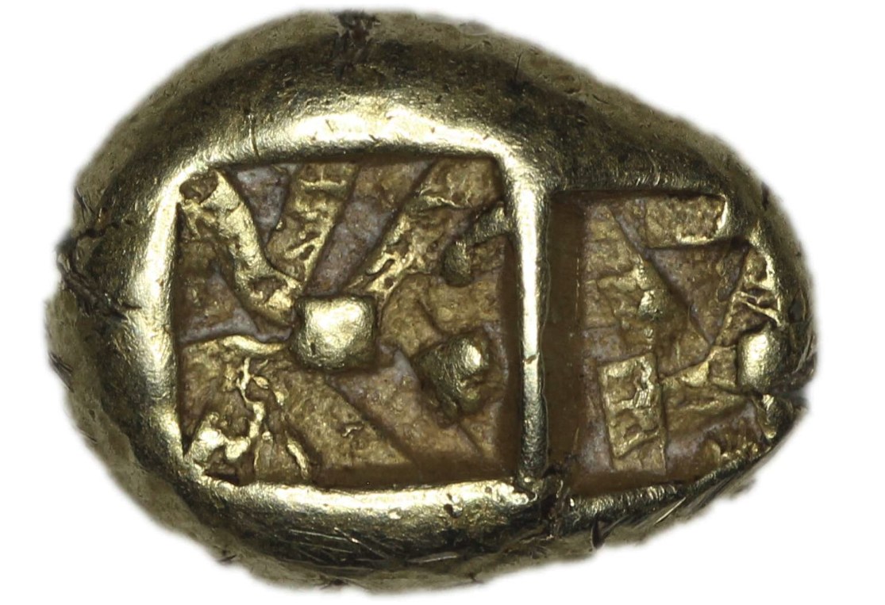
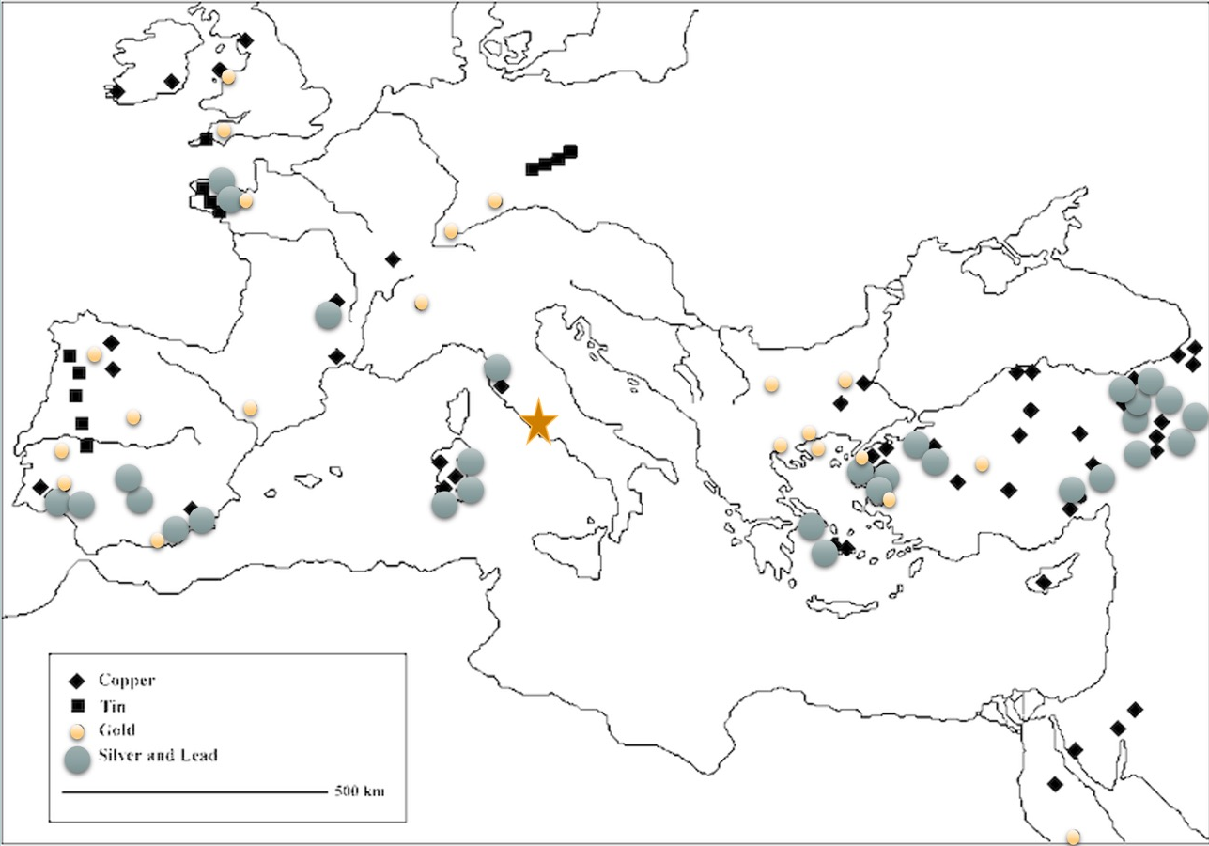
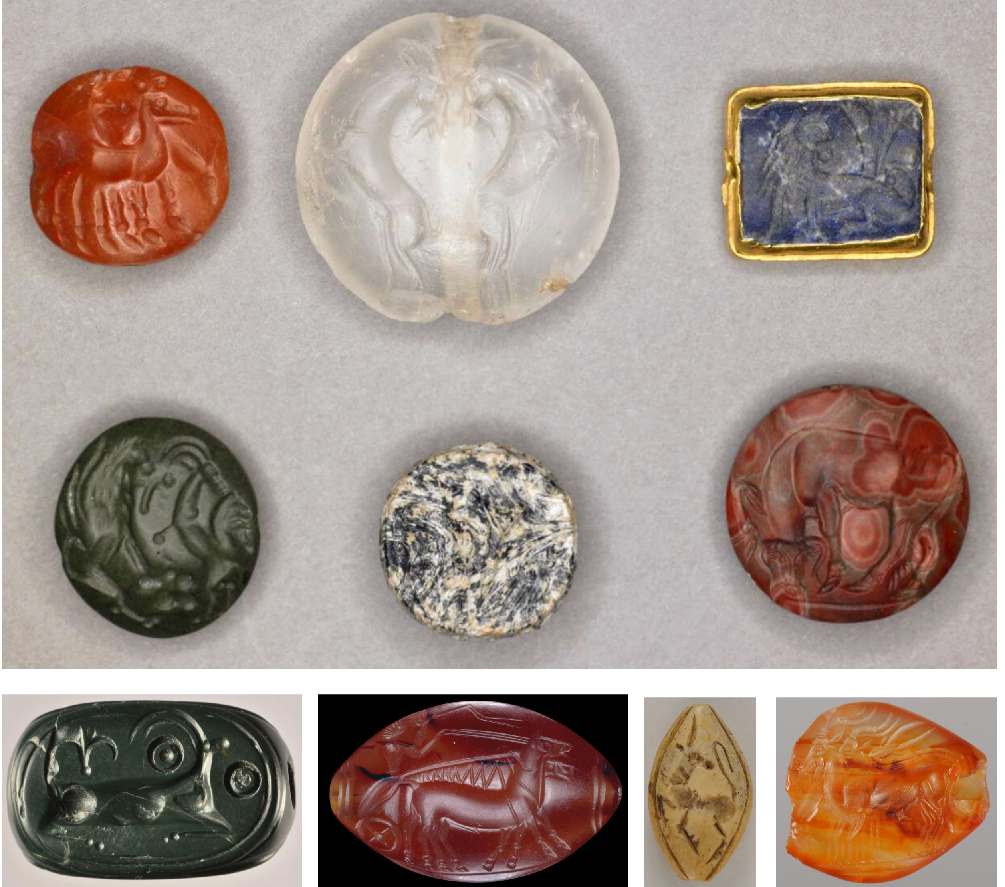
“I am the badge of Phanes”
ΦΑΝΟΣ ΕΜΙ ΣΕΜΑ
Electrum is a naturally occurring alloy of Gold and Silver

Slide 11
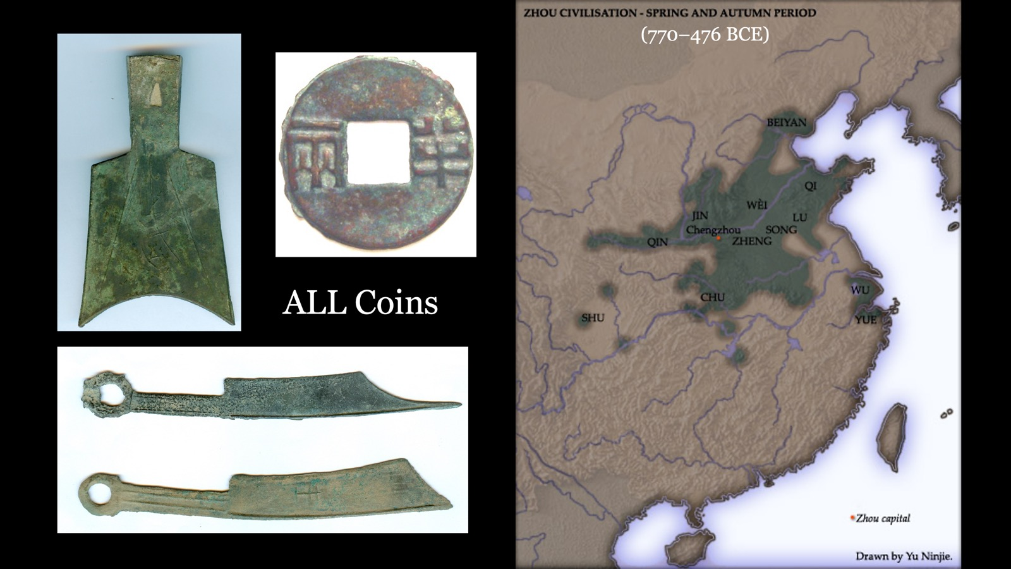
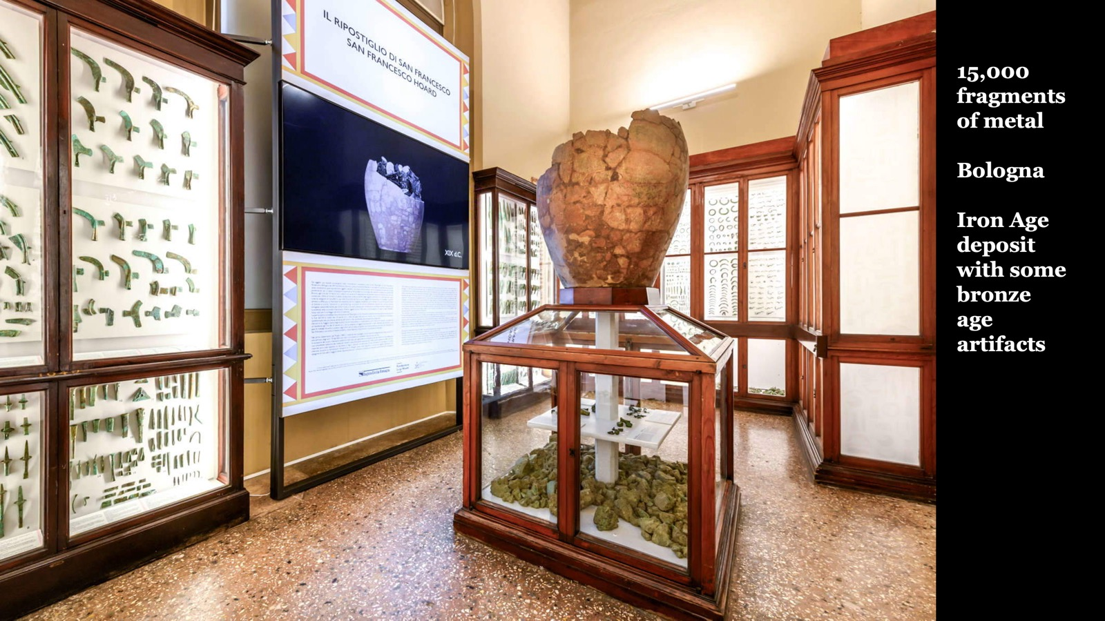
Early Rome is different than early Greece (more like China?!)

Slide 12
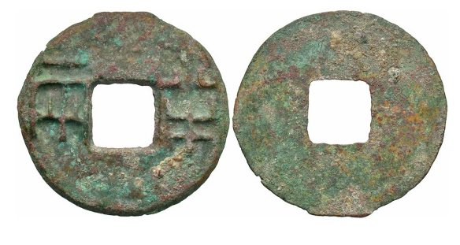
Big Historical and Economic Questions
What determines the form and use of money?
When and why do multiple forms of money co-exist in overlapping contexts?
Notes:
While I have lots of big questions some of my biggest around the emergence of Roman coinage center on two main themes
read slide

Slide 13
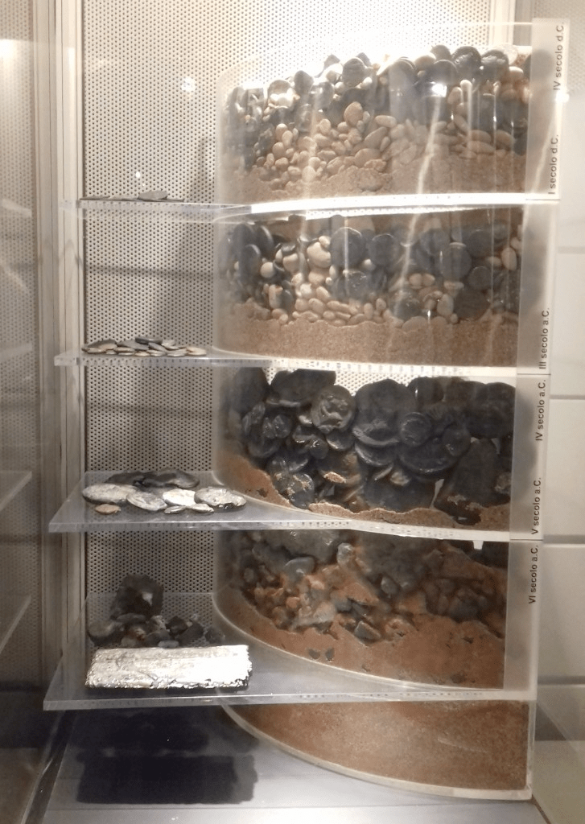
Past Logics
Societies develop from primitive to more complex
Societies without physical money are primitive
Intrinsic value is more primitive that symbolic money
Display in Palazzo Massimo, Rome
Notes:
Prior to Hollander and even today quite often scholars approach the study of ancient economies and specifically monetary objects like coins from a teleological perspective, one in which we presume progress from a state of primitivism to complex societies or “civiliations”. In essence, I’m asking you today to interrogate with great skepticism three underlying premises:
Read slide.
In essence, I’m suggesting that even if we do not understand the nature of an ancient economy or a scarcity of evidence for pervasive use of physical money, we should not assume that a society operated with ”only” barter. Barter itself is a romanticized concept associated with the primitive other as opposed to our own ‘sophisticated’ systems for measuring value, storing wealth, make payments and account for all these and more transactions.

Slide 14
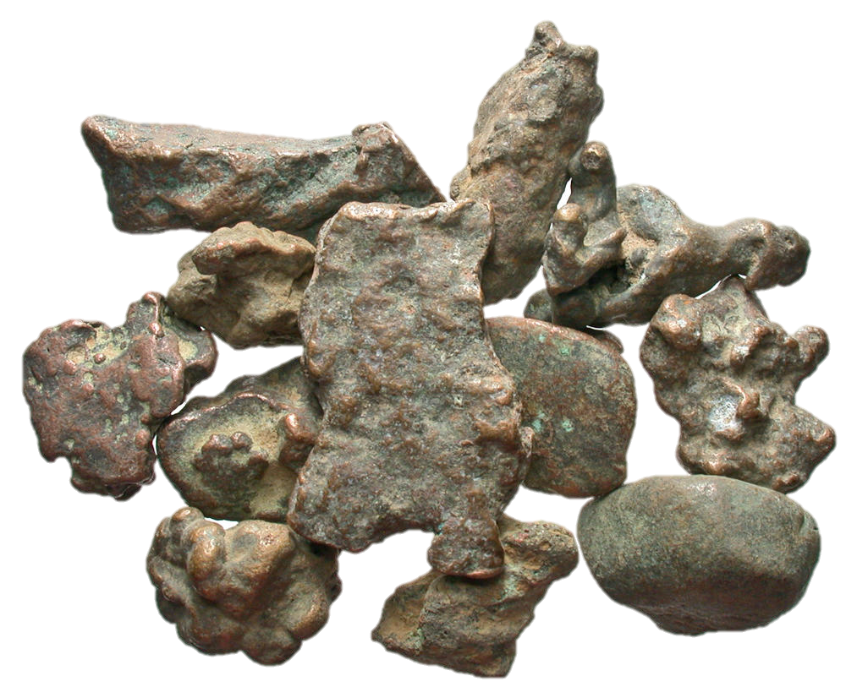
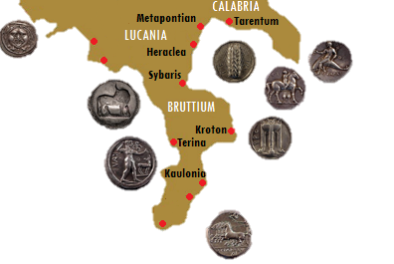
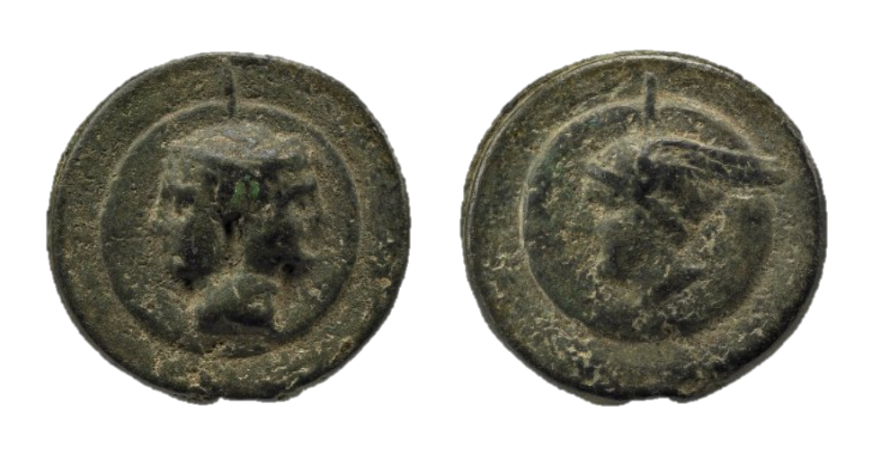
Aes Rude, Latin for rough bronze, no fixed recipe, used as money since Bronze Age, through Iron Age, down to at least 200 BCE
Struck Silver, introduced by Greek colonists in Southern Italy, c. 600 BCE
The Burnett Hypothesis
Intrinsic
Value?!
Bullion?!
Aes Grave, Latin for Heavy Bronze, invented at Rome c. 270-265 BCE, one coin = 324 grams!
Notes:
So Aes Rude are materials like those you see in the upper righthand corner of the slide. They are unshaped pieces of metal that are presumed to be bronze that do not seem to conform to any particular standard and usually without design. There are some examples that have rough designs or more intentional shapes like discs or rectilinear ingots, but these are the exception. They are found through out the Italic peninsula and are believed to have served as money from the 6th century maybe even the 7th century onwards. The Burnett Hypothesis explains the strangeness of Rome’s very first coins, called aes grave, or heavy bronze, as an attempt to integrate the logics of Greek coinages struck in S. Italy with the Indigenous monetary forms. I am largely a supporter of this hypothesis as long as we do not presume that the heaviness relates to intrinsic value.
That large coin at the bottom of the slide weighs a full Roman point about 324 grams. Or about the weight of a can of soda after you’ve had the first gulp, or a smallish cup of gas station coffee to go. You can hold it in one hand but it is going to more than cover your palm. The great confusion about this monetary innovation is that is seems so deeply impractical. Why make it this way?! The standard answer is because it must have a lot of bronze in it to be worth anything.

Slide 15
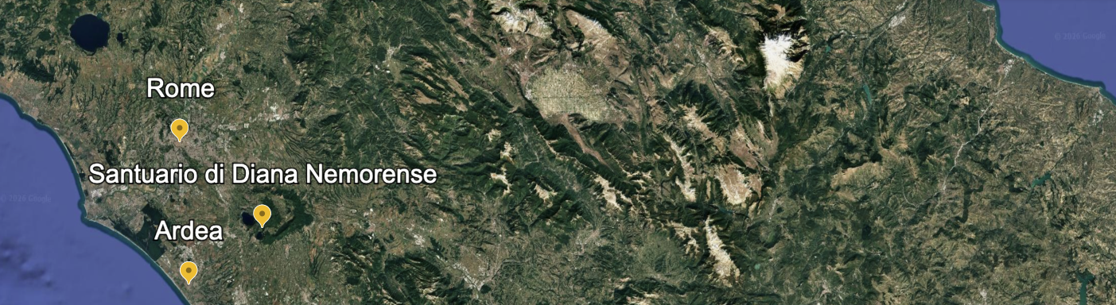
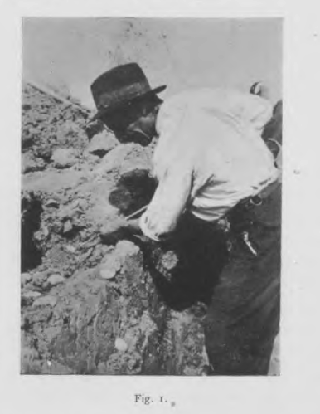
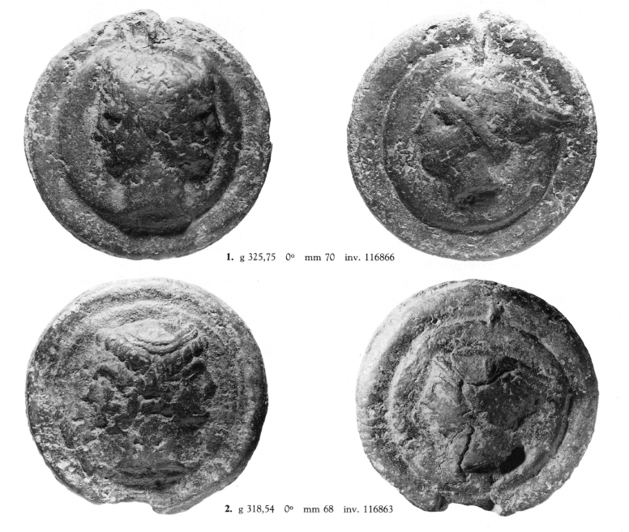
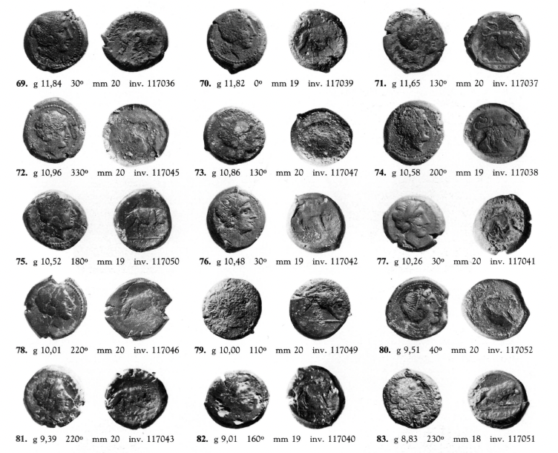
Very different monetary forms regularly found together
160 cast, 17 struck, all Roman
Eve of 1st Punic War
Ardea 1940 = CHRR 20 = Catalli 1989
Notes:
Our physical evidence says this is absolutely not true from how coins were used together. On the screen I show you parts of the Ardea hoard recovered in 1940. The coin is comprised of the earliest Roman bronze coins. On the left you see more of the aes grave. On the right we see small struck bronzes made at almost the same time also by Rome. We call this coin a litra but like aes rude and aes grave this is just a modern term we use for our own convenience and bears no relationship to what the Romans would have called them. The struck coins weight about as much as two nickels. Each. It would take 32 or more of these little struck coins to equal one of the largest of the cast coins. And, yet here they are together in the same context being saved or ritually deposited as similar objects of value. We cannot reconstruct an exchange rate but we can see that the two types of coin were made at about the same time and used in similar ways.

Slide 16
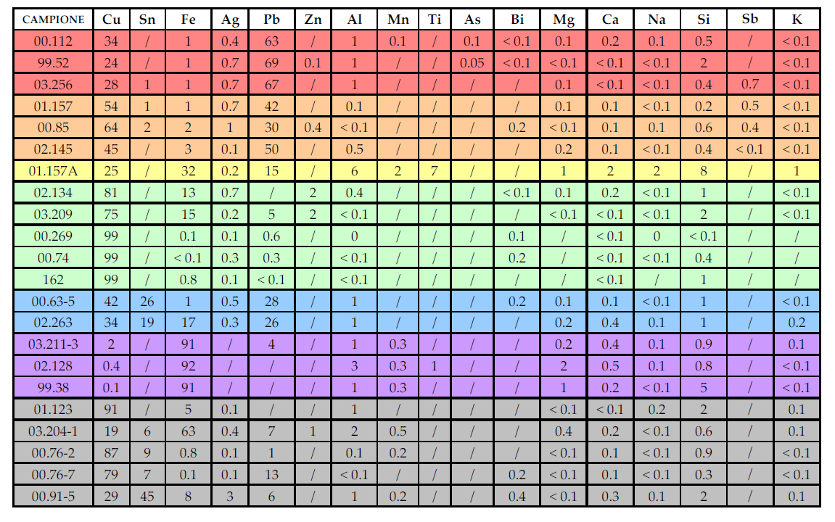
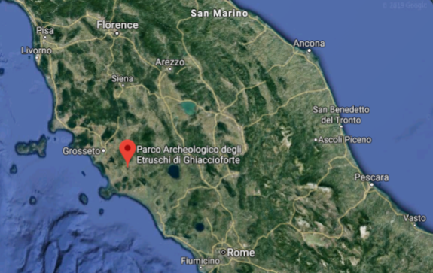
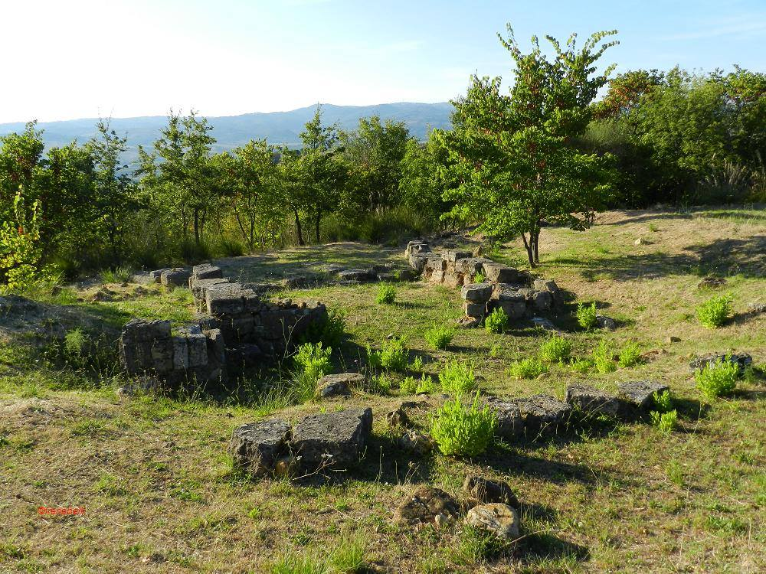
Ghiaccioforte Finds
Small Italic town
Destroyed c. 280 BCE by Romans
LOTS and
LOTS of aes rude
1:2, Cu:Pb
1:1, Cu:Pb
~100% Cu
1:4 Sn:Cu+Pb
9:1 Fe:var.
Many other
combinations
pXRF Surface Analyses
Baldassarri et al. 2007; cf. de Caro et al. 2005 on testing of Sardinian material
Notes:
However, My questioning of the idea that aes grave have intrinsic value based on their metal composition did not in fact grow out of their co existence alongside struck bronzes, but rather pXRF testing of aes rude published by a number of Italian scholars, perhaps most importantly the finds from Ghiaccioforte. This small oppidum North of Rome is believed to have been destroyed the Romans c. 280 BCE and never re inhabited. The site had a vast quantity of aes rude across the settlement in different contexts. The 2007 published results of surface analysis showed little to no homogeny in the elemental compostion of these pieces of italic money. If these objects traded based on weight how could everything of the same weight have the same intrinsic value if the individual objects are made up of radically different ‘recipes’. After handling a great deal of aes rude in museum collections and most especially the Nemi assemblage of such materials, I can say that I personally cannot guess the likely metal content of a piece of aes rude based on touch, feel, and looks, and I significantly doubt anyone using these pieces as money would have been able to do so. After looking at this data My only reasonable hypothesis seemed to be that the metal content didn’t matter only the weight of the object. That in fact aes rude was itself primarily a fiat currency, that is a symbolic form of money that derives value from its shared cultural significance not how the material can be re used. The question of what this means for aes grave and the burnett hypothesis has been exercising on my mind now for a number of years.

Slide 17
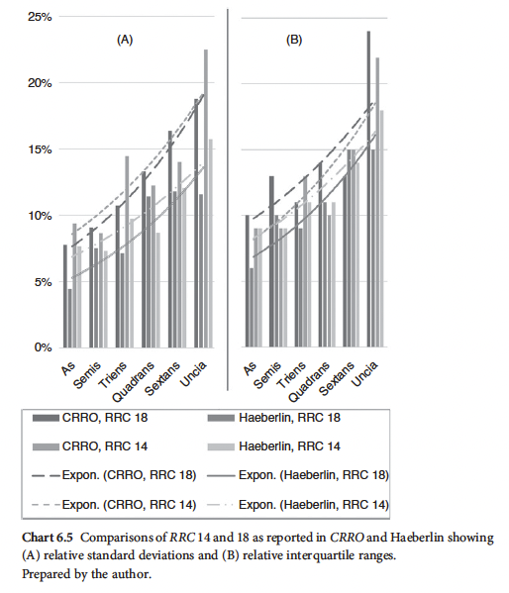
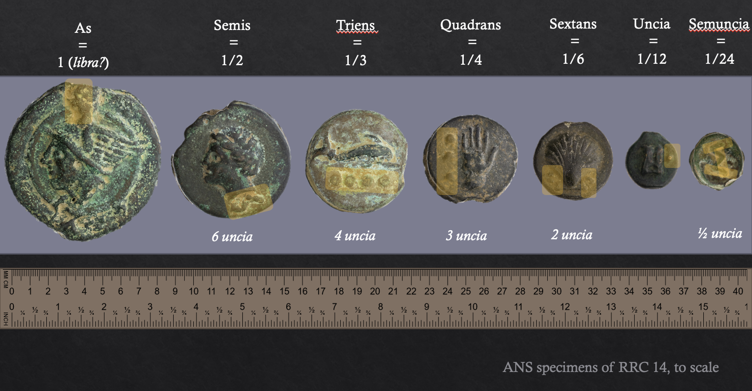
Metrology and that base-12 Denomination system
Hints against the worth by weight model
Yarrow 2023
Notes:
My first approach to this problem was to re analyze the metrological data for the earliest aes grave. Previous scholars from Haberlin to Thomsen to even Crawford relied on simple averages to determine weight standards with out statistically considering overall shape of the data and its variability. They also did not look at denominations in relationship one to another.
When Rome starts making cast coinage on the eve of the 1st Punic war a base-12 denomination system appears fully formed like Athena from the Head of Zeus, or Minerva from Jupiter if you prefer.
This denomination system is by far and away the most complex and nuanced known in the mediterranean at this time. NO other culture seems to have felt the need to make they’re money so granular in its available units and very few indeed used any sort of mark of denomination like this.
And, even more curious, the small denominations are vastly too heavy compared to the larger denominations. If these coins had intrinsic metallurgical value then the smallest coins should have been hoarded and prized for containing more of the desirable metal. There is also incredible variation in weights. That means little to no concern to regulate the weight of any individual specimen. And no expectation that users will care about such weight discrepencies and instead trade the objects on face value.
In fact fundamental to any coinage denomination system is the expectation that the coins will be accepted at face value. The Romans are communicating by the marks of value how those using their coinage should use them and that is not by putting them in a scale to weigh them.

Slide 18
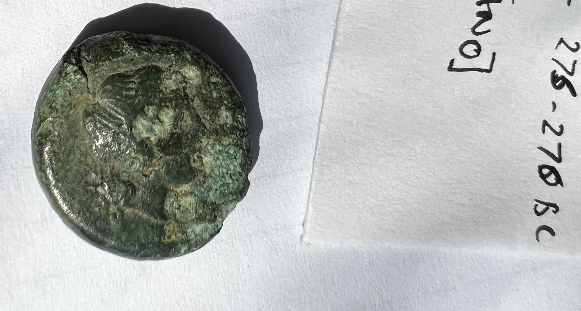
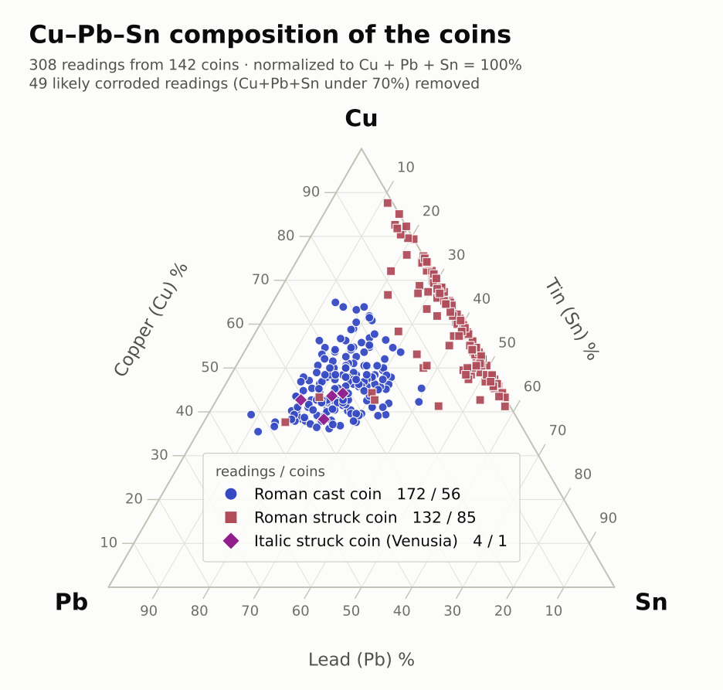
pXRF results of
Nemi excavation coins

Slide 19
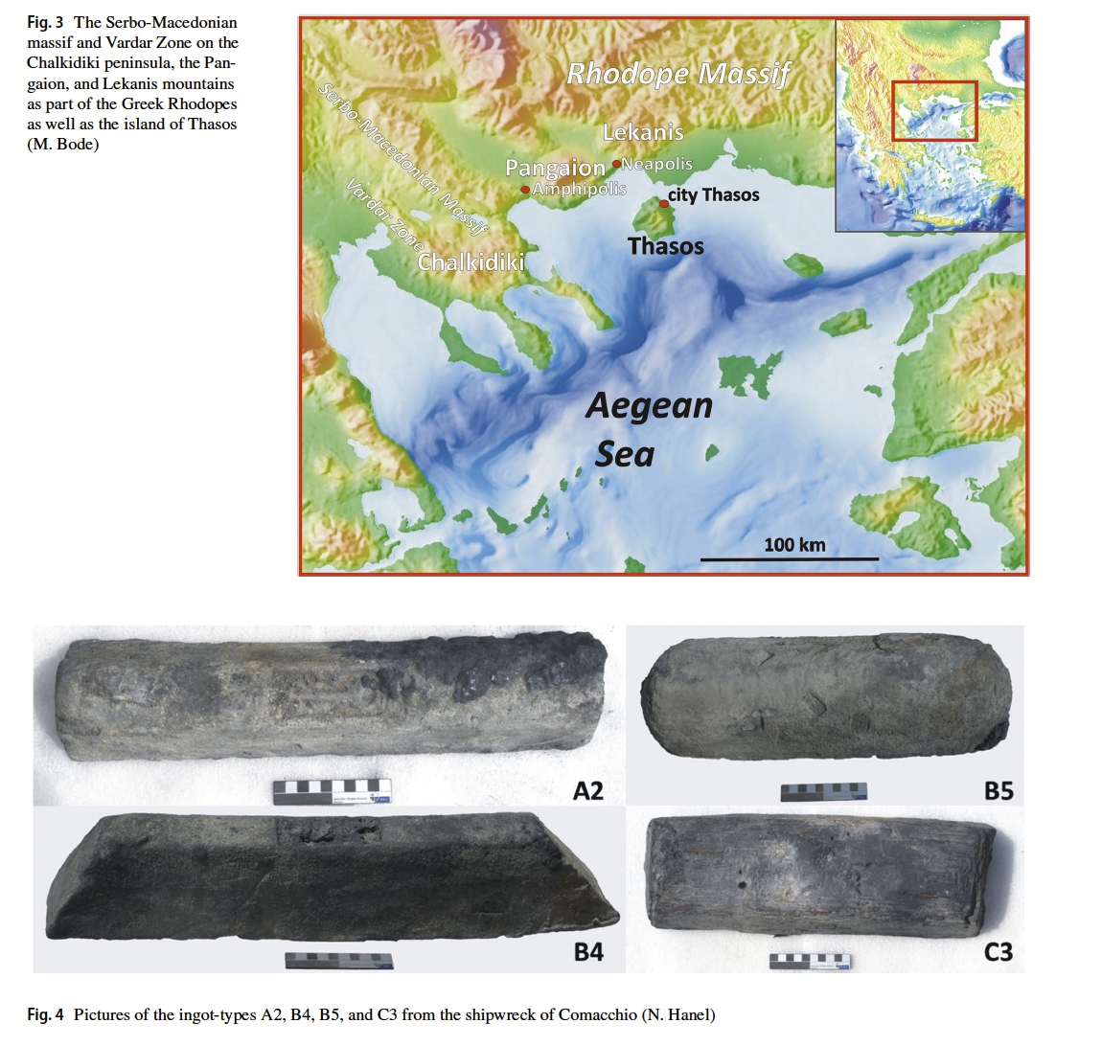
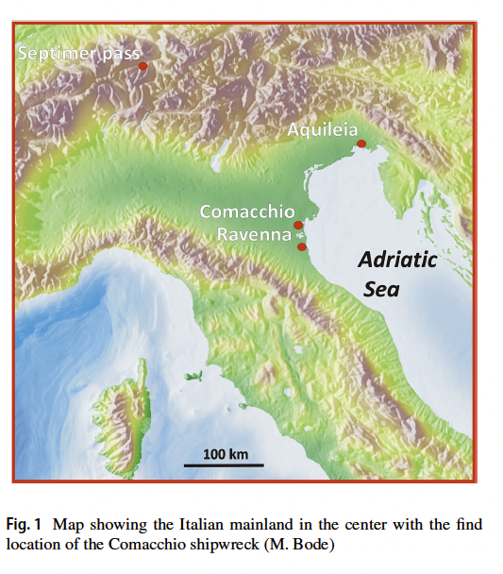
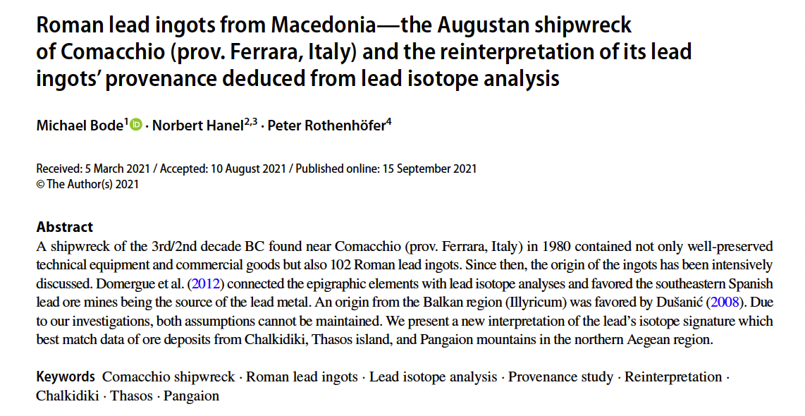
Why so much lead?
a cheap, versatile biproduct of silver mining
Notes:
Lead was cheap and versatile materials. Some have compared it to the plastic of the ancient world, seductive in its innumerable applications while silently harming the environment and causing unrealized health problems.
The ready availability of Lead in the ancient Mediterranean is directly tied to the silver production. The more silver that is extracted from the mines the more lead ingots can be exported for use in building and plumbing, cosmetics and the arts. Untold purposes. After the Hannibalic War Spanish lead becomes exceptionally common but it was already available from mines in Macedonia and Greece and widely traded. Rarely can we trace the exact origin of the lead because of extensive reuse and remelting of the materials.

Slide 20
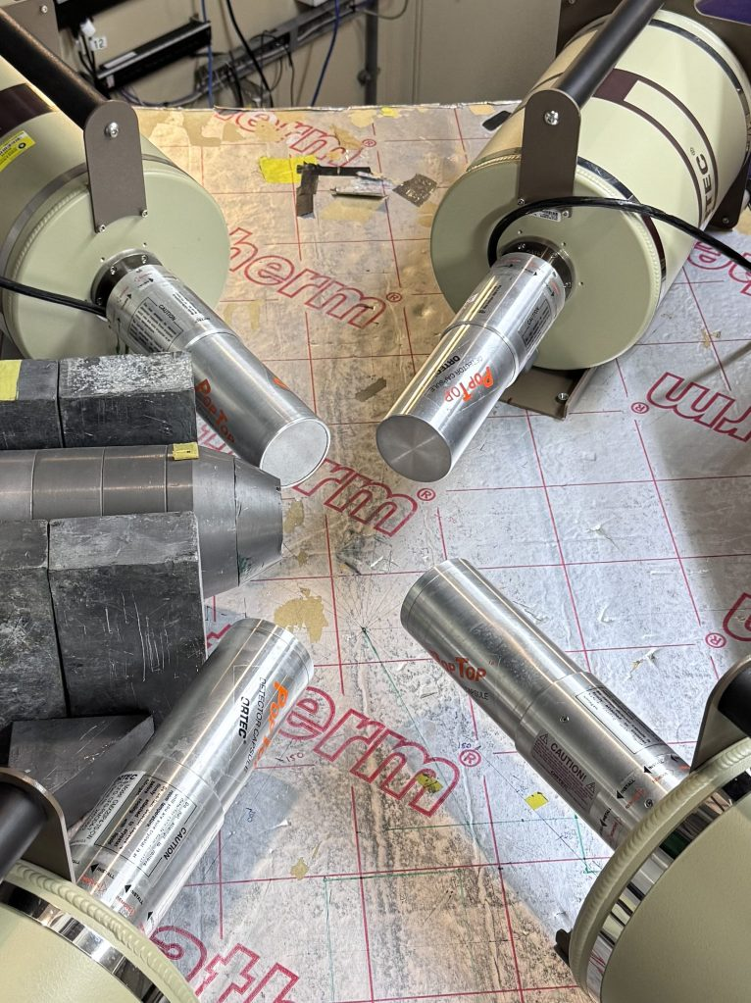
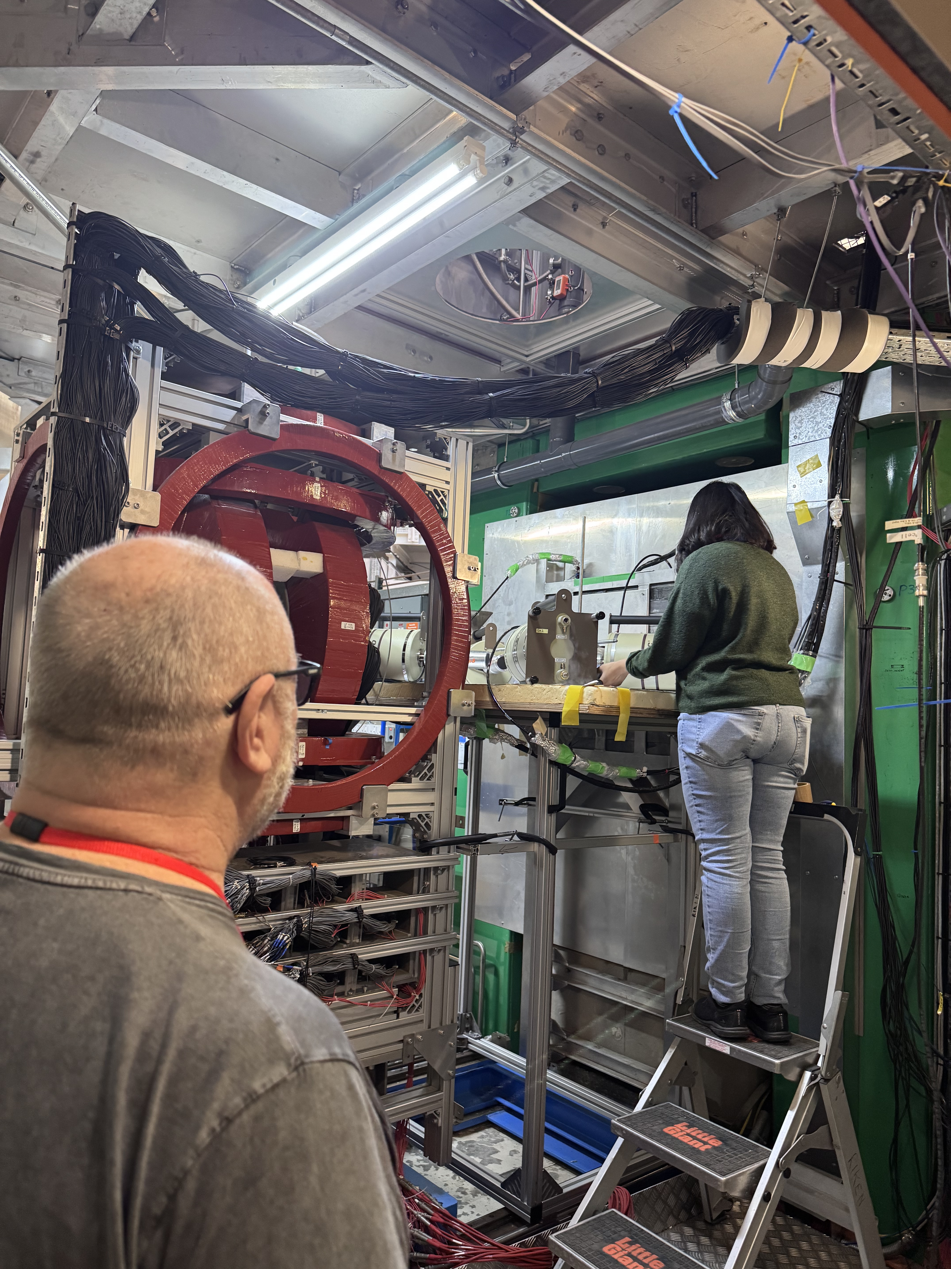
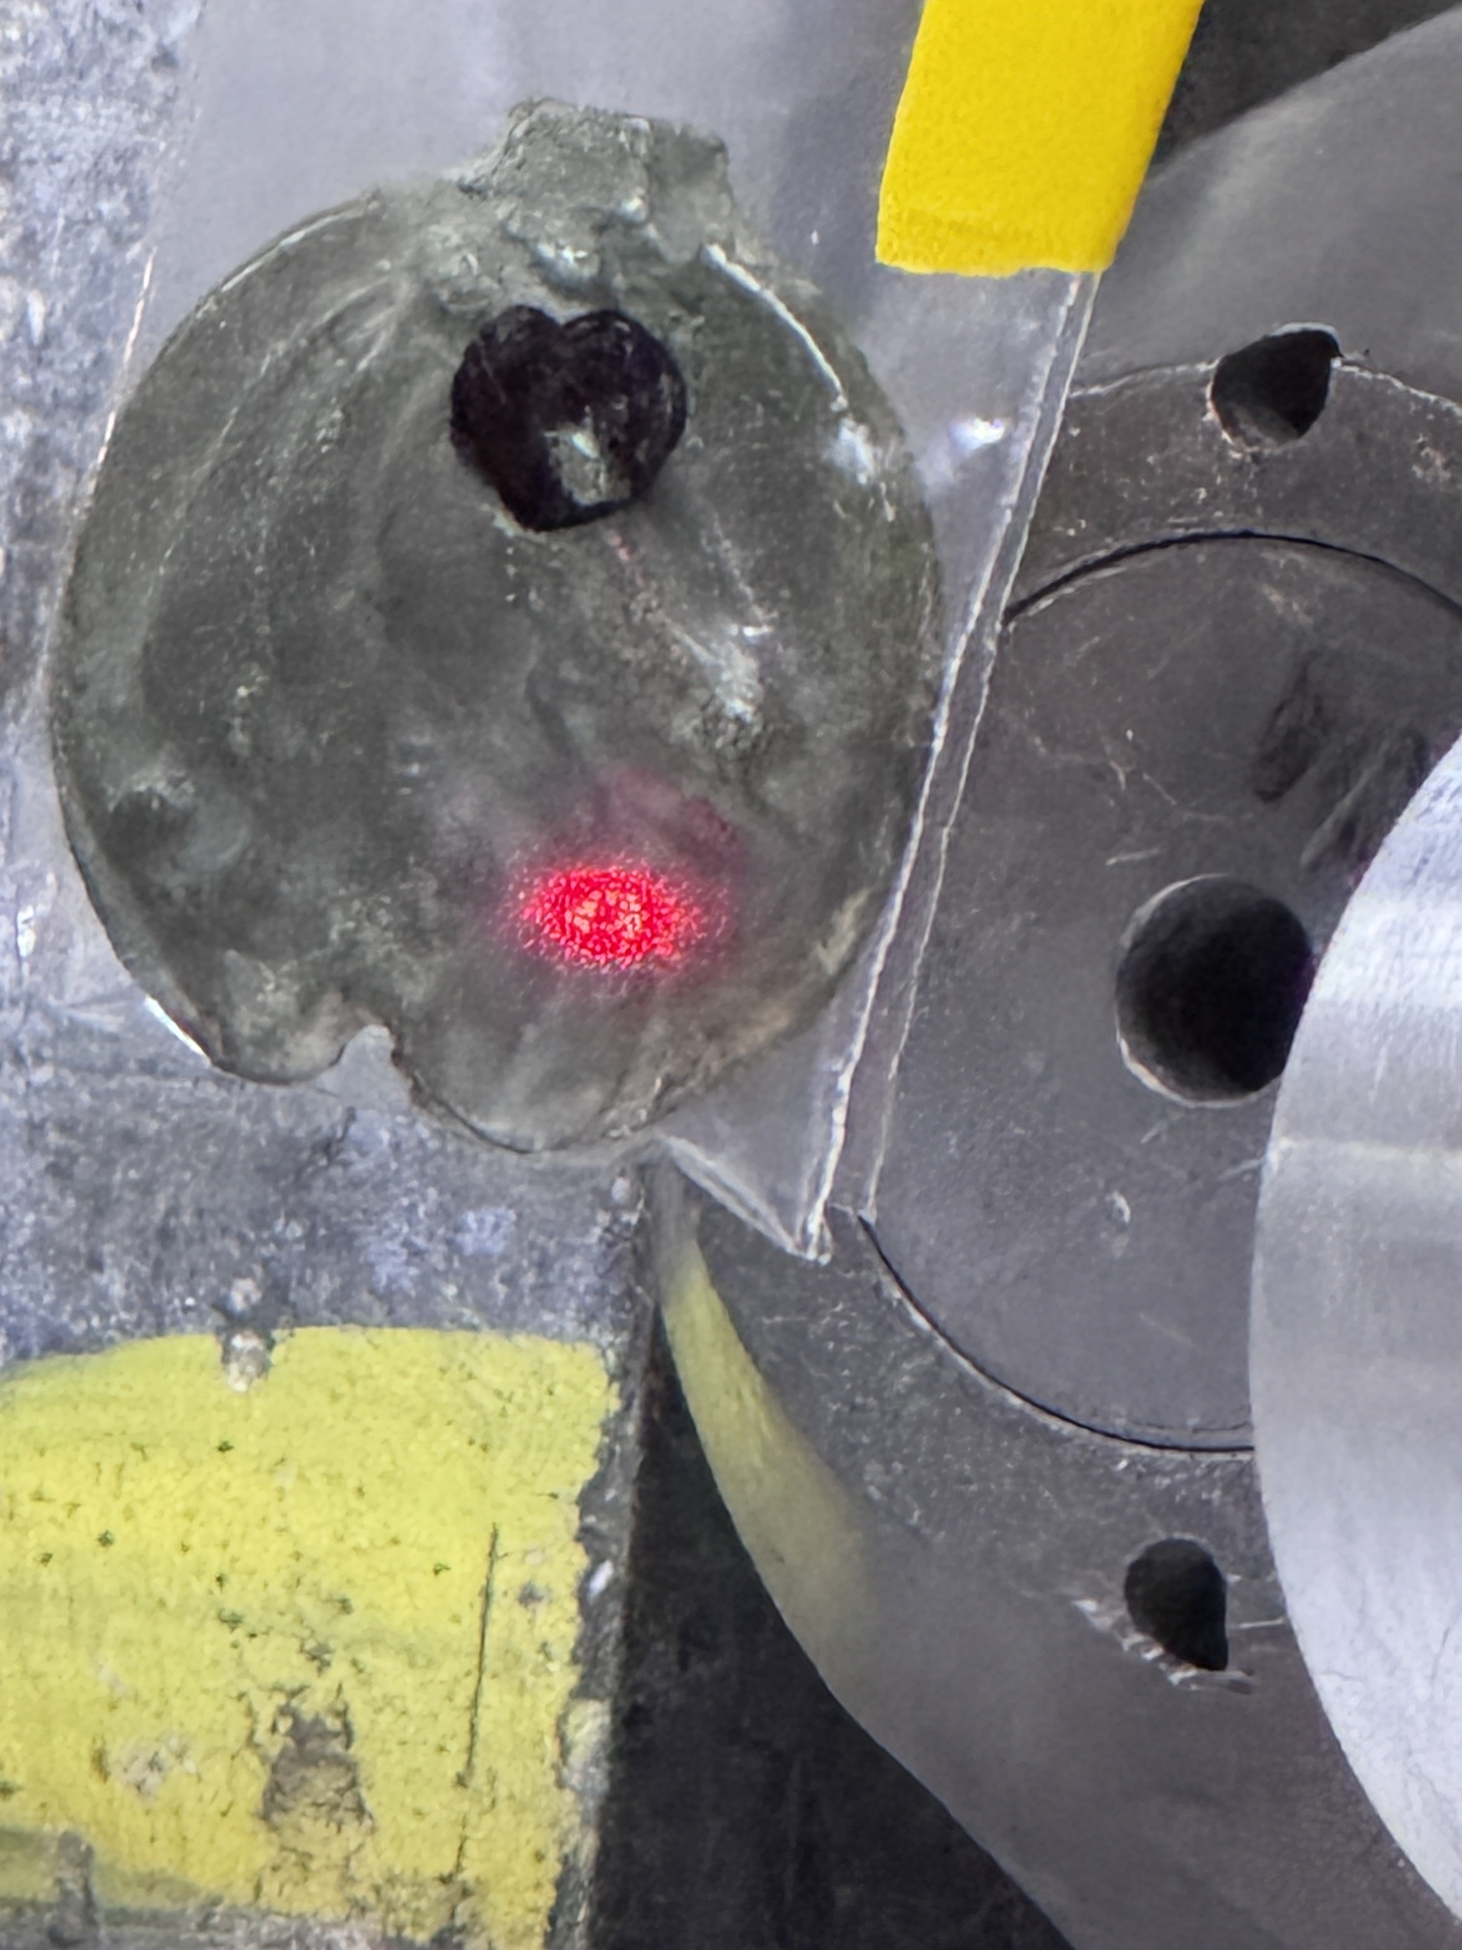
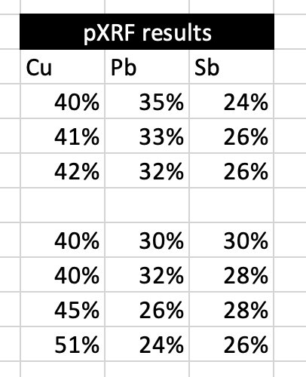
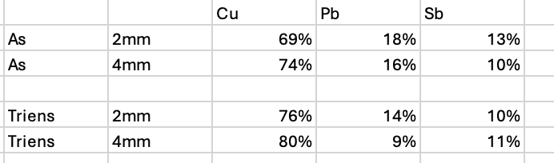
Initial Muonic Work
Challenges
How deep can we penetrate a leaded object?! How deep is useful?
What momentums to use and what length of the runs to use?
Can we use traditional collimators?
Preliminary experimental results for
Nemi RRC 18 samples
NCM 1890-1356/28 and 34
Notes:
This form of experimentation is time consuming and expensive, but I think it is worth it. On the screen you can see the results of multiple pXRF surface readings of the same nemi aes grave in orange and compare this to the subsurface MuX readings on the left. The objects still seem very heavily leaded and copper content increases as our modeling anticipated. After my six days at MuX this coming may on my second grant we should have a spread of data from at least three specimens of all Rome aes grave series.
This should let us confirm my hypothesis that there is a relatively stable recipe, but also see if this shifts over time or even perhaps between denominations in series. We do expect small objects to cool differently than larger ones effecting how we can model the interior structure and reconstruct an original recipe.
Our goal is to be able with an original recipe to being experimental archaeology wherein we reconstruct how exactly these objects were cast. We don’t even know what material was used for the molds! Once we can replicate casting we can cut a replica in half and better model the effects of various recipes on the cooling at different depth and determine what might have been the ancient manufacture process.
Additionally I hope to test the bronze votives in a similar manner to be able to make better direct comparisons. MuX is going offline for about 6 months or more in early 2027 for upgrades which should allow for faster readings with more sensors and this will empower isotopic analysis and comparison. This is theoretically feasible now but too time consuming with present equipment to be feasible. Isotopic analysis would be most useful for comparison of objects found at Nemi to determine if they may have had the same source metals even if those metals were heavily reused and re mixed.

Slide 21
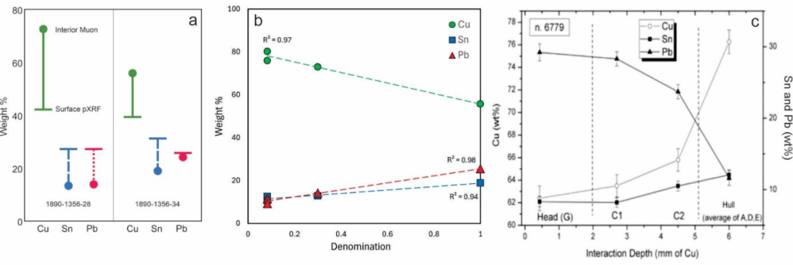
Prior results of muonic x-ray studies. A) Comparison of surface and 2mm interior analyses of aes grave; as expected; the Pb-bronze standard readings (not shown) had no meaningful difference at different depths; B) Compositional variation of aes grave relative to denomination; C) Compositional variation of leaded-bronze relative to depth (Cataldo et al., 2022).

Slide 22
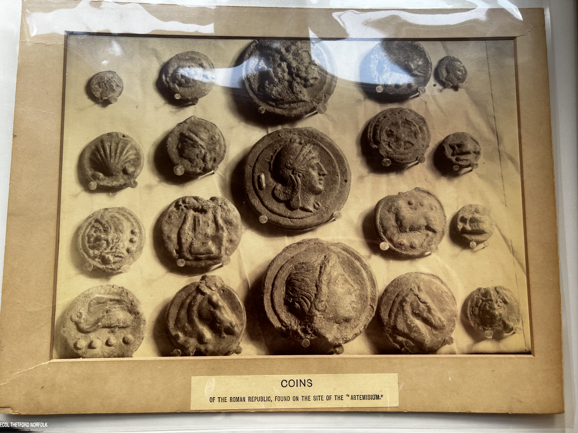
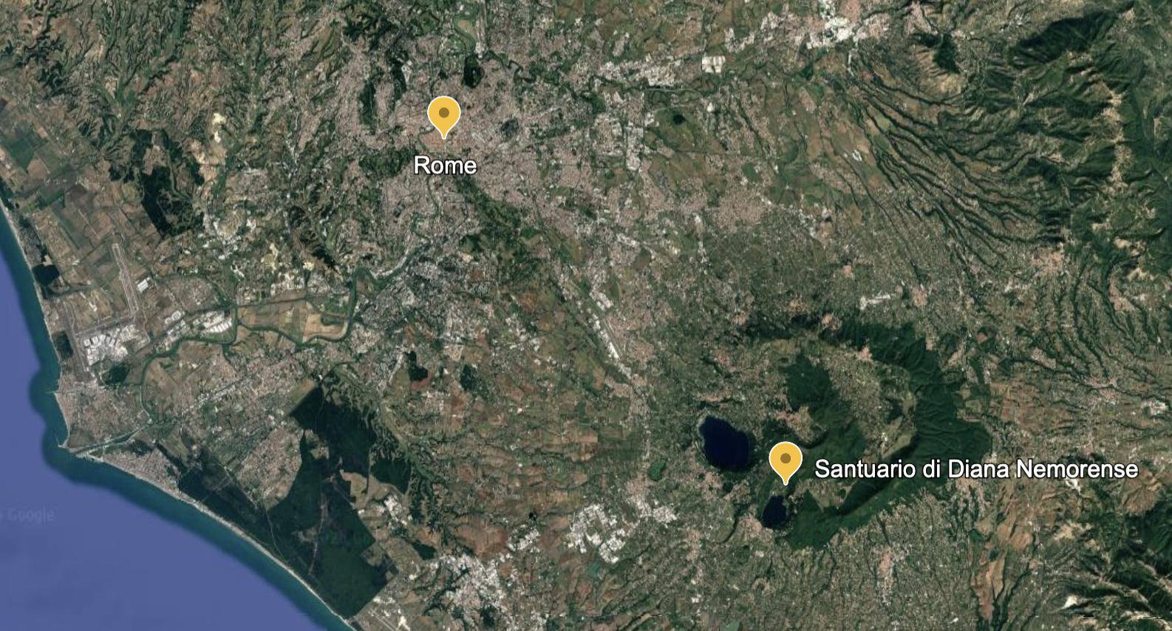
December 2026: Testing Multiple Samples from all Cast Coin Series from Nemi Votive Deposit
Is there a stable recipe?
Are series and denominations made from the same recipe? Is there change over time?
Can we model interior and surface readings such that we can predict the former from the latter?

Slide 23
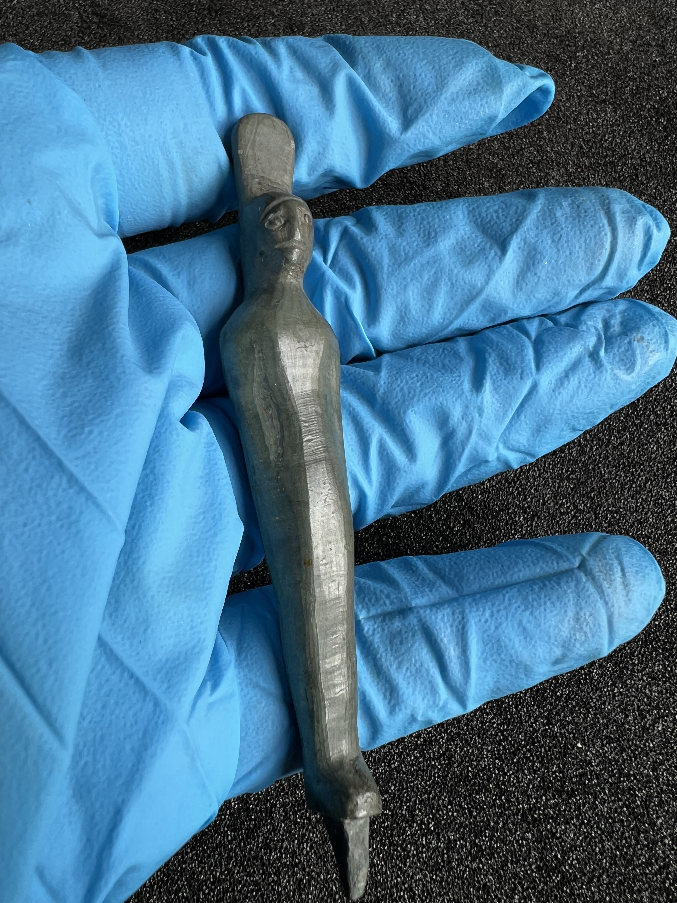
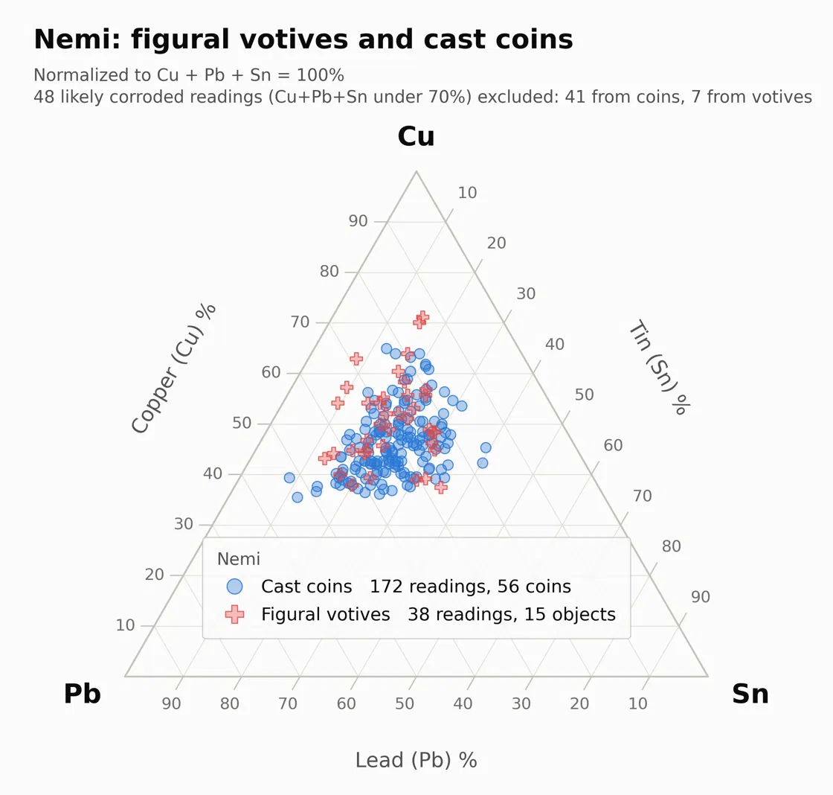
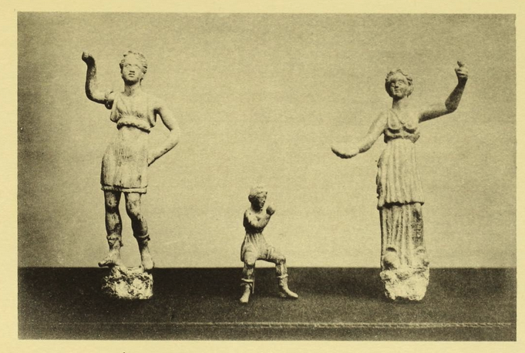
What Next!?
Notes:
In fact when we overlay the readings of nemi figural votives and the aes grave we see they look very much like they are made from the junky admixture of metal. This to me is hands down the most exciting part of this work and the backbone of my grant proposal due this coming Monday! I believe this connection and the overlap in find spots, namely in religious sanctuaries in the same deposition contexts, maybe the our most significant clue to why the Romans chose to create a cast coinage along side a struck coinage. It may even be that these objects were manufactured together. I’ll return to my speculations about why this might be the case, at the end of this talk, time allowing.

Slide 24

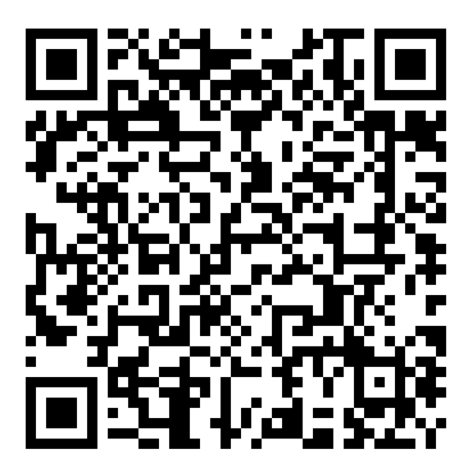
Successful Grant Narratives
For experimental time completed in 2025
For experimental time scheduled for December 2026

