Slide 1



Single-Q/Multiple-Q magnetic order and persistent spin dynamics in honeycomb cobalt oxides
Ping Miao
China Spallation Neutron Source (CSNS)
Institute of High Energy Physics
Chinese Academy of Sciences
P. Miao*, Y. Li* et al., Phys. Rev. B 109, 134431(2024)
Y. Gu, W. Xie, P. Miao*, Y. Li* et al., arXiv:2610.27663 (2026)
Notes:
各位老师好，接下来我汇报一下过去一年我的工作情况。

Slide 2
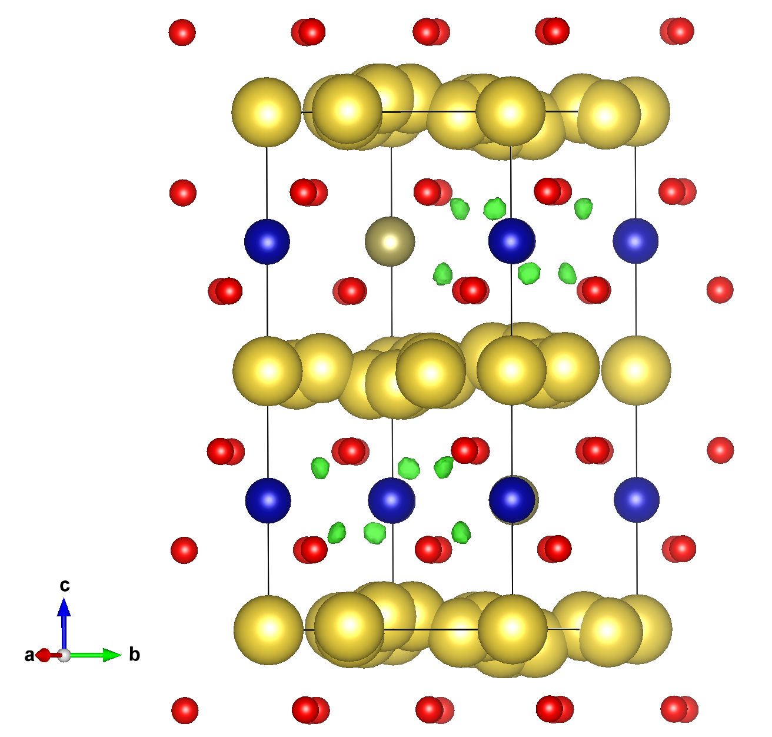
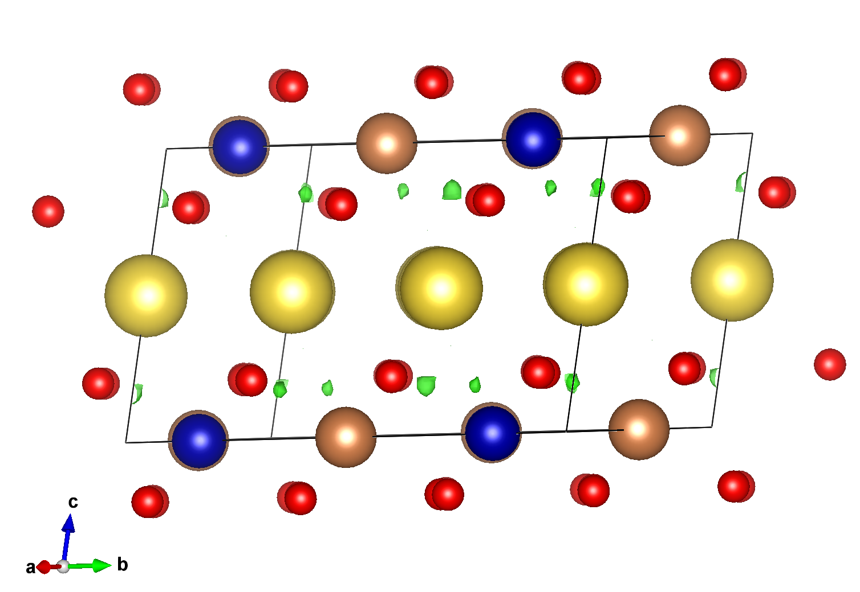
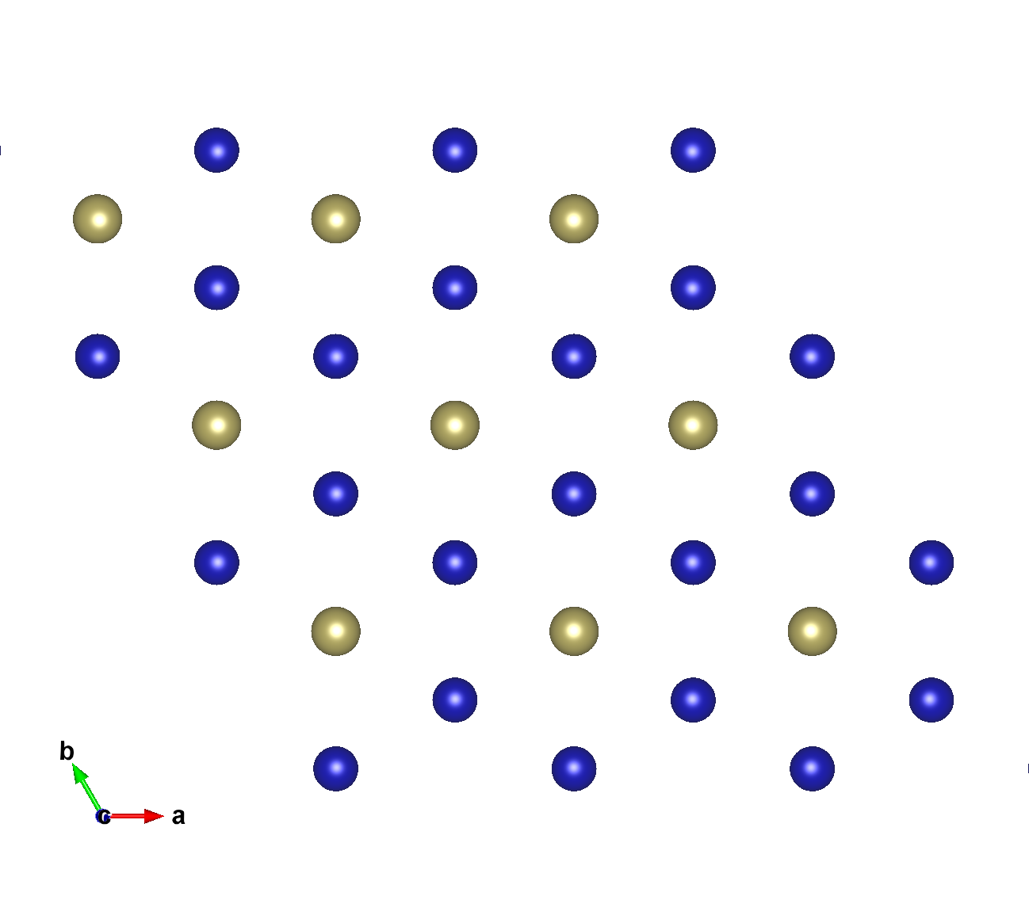
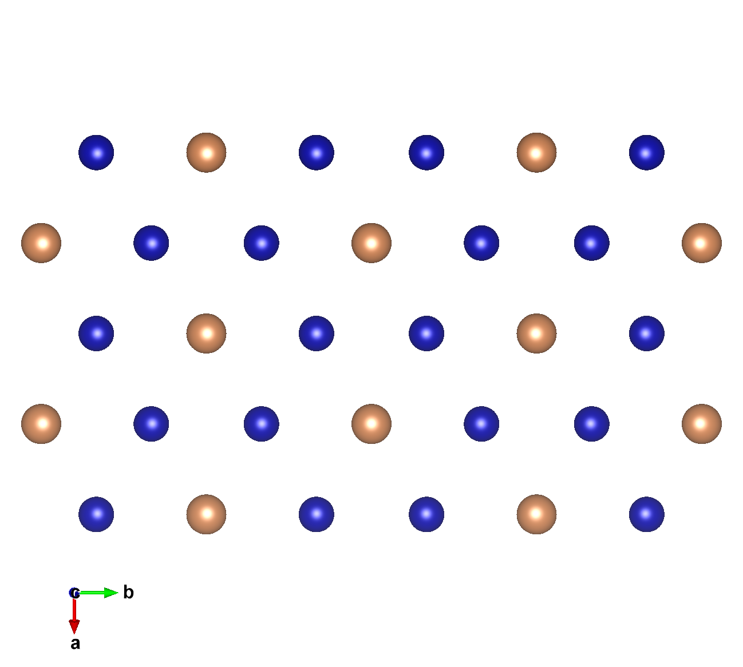
Honeycomb lattice of Na₂Co₂TeO₆ & Na₃Co₂SbO₆
Na₂Co₂TeO₆ (NCTO)
Na₂Co₂SbO₆ (NCSO)
O
O
Co
Sb
Te
Co
μ
Na
Na
μ
Co-Sb
Layer
Co-Te
Layer

Slide 3
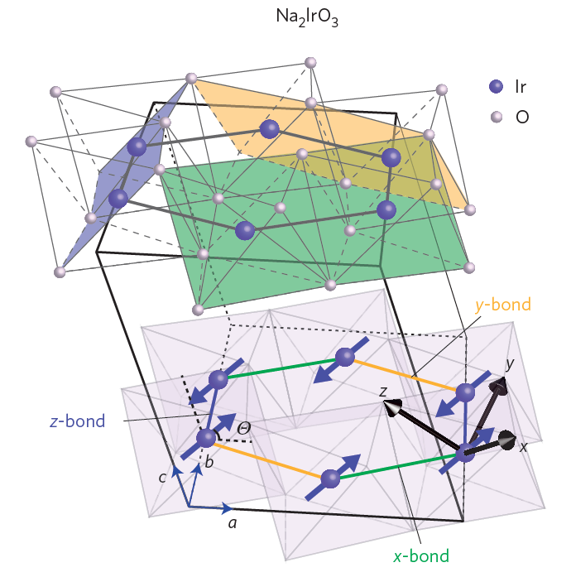
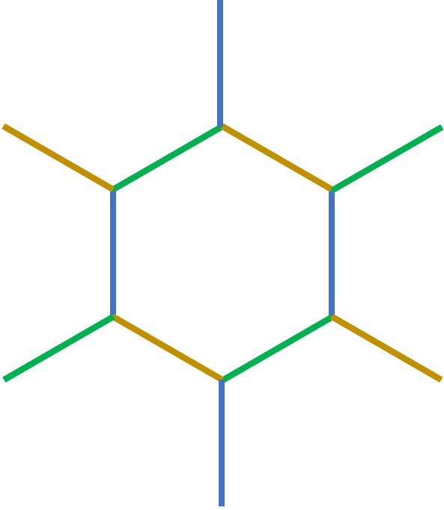
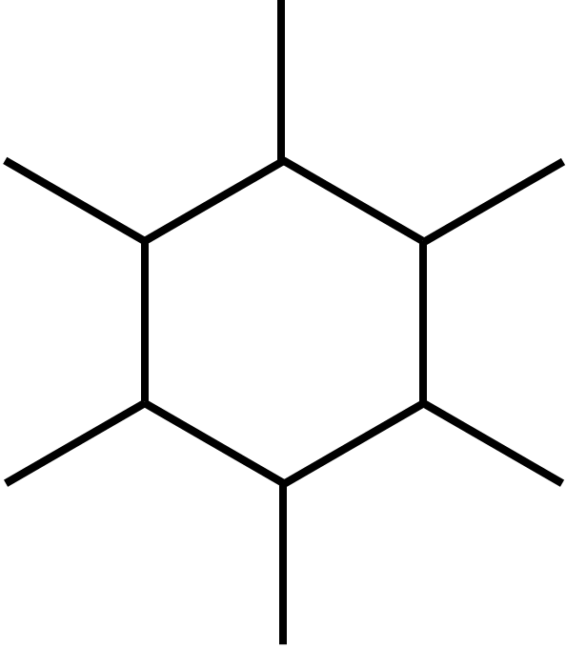
“Kitaev” or “XXZ” anisotropy?
“Kitaev” anisotropy:
the bond-dependent Ising
axes are mutually orthogonal.
highly frustrated*
“XXZ-Ising” anisotropy:
the bond-dependent Ising
axes are 120 degrees apart.
somewhat frustrated*
“XXZ-Heisenberg” anisotropy:
easy-plane
but still has U(1) symmetry.
not frustrated*
Chun et al., Nat. Phys. 11, 462 (2015)

Slide 4
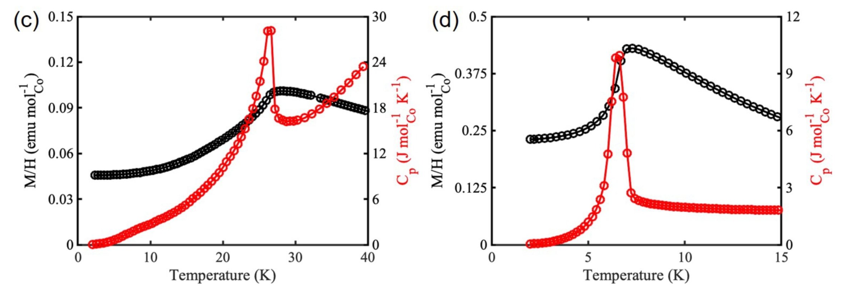
Long-range magnetic ordering in NCTO & NCSO
Na₂Co₂TeO₆ (NCTO)
Na₂Co₂SbO₆ (NCSO)
NCTO
NCSO
T_{N_T}
T_{N_S}
P. Miao*, Y. Li* et al., Phys. Rev. B 109, 134431(2024)

Slide 5
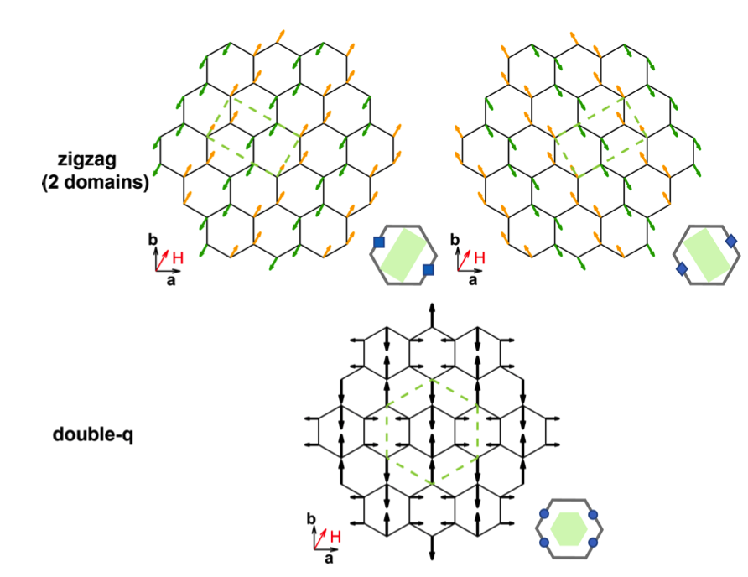
Single-Q or Double-Q magnetic order in NCSO?
q = (1/2, -1/2, 0)
q = (1/2, 1/2, 0)
Phys. Rev. Mater. 3, 074405 (2019)
Phys. Rev. B 109, L060410 (2024)
(1/2, 1/2, 0)
q =
+
(1/2, -1/2, 0)

Slide 6
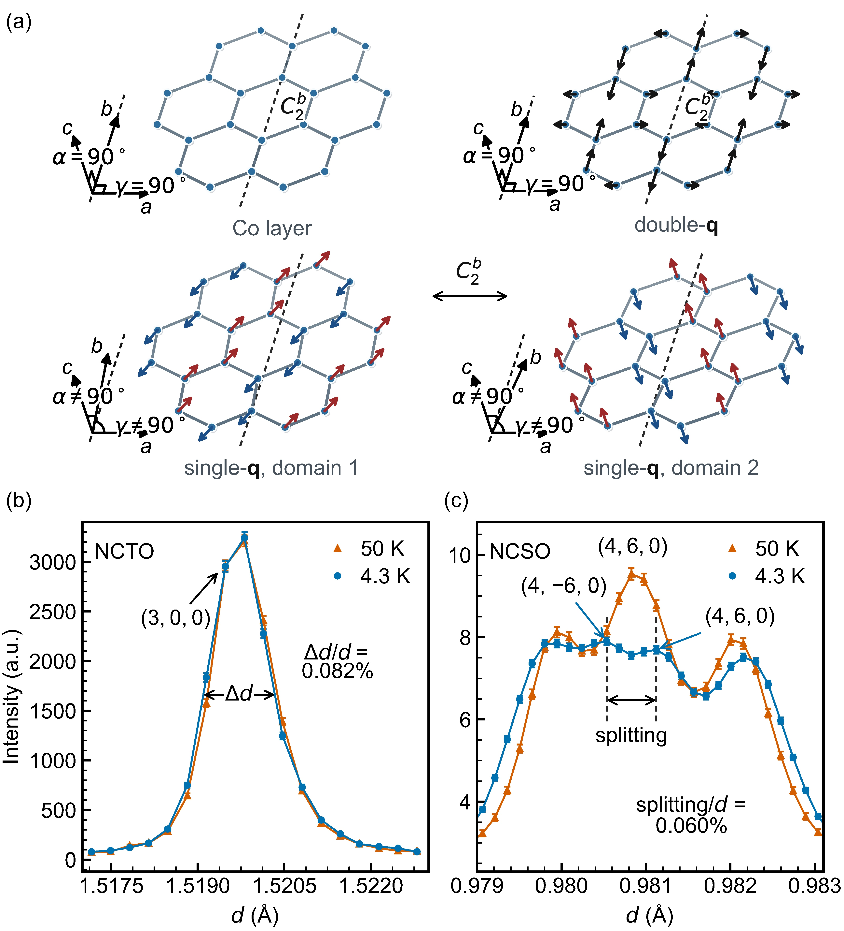
Single-Q or Double-Q magnetic order in NCSO?
(1/2, 1/2, 0)
q =
+
(1/2, -1/2, 0)
q = (1/2, -1/2, 0)
q = (1/2, 1/2, 0)
Y. Gu, W. Xie, P. Miao*, Y. Li* et al., arXiv:2610.27663 (2026)

Slide 7
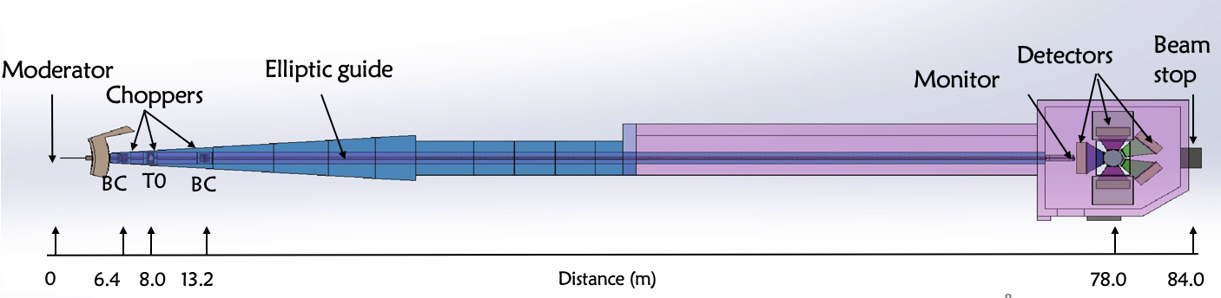
High-resolution Neutron Diffractometer (TREND)
First neutron on July 3, 2024
Specifications:
Applications
Bandwidth (Δλ) @ 5 Hz | 0.1–9.9 Å
Moderator | Decoupled poisoned hydrogen
Neutron beam size | 40(h)×10(w) mm²
Best resolution (Δd/d) | 0.027%
Neutron flux (n/scm²) | ≥5×10⁶
d-range @ 5 Hz | 0.4 – 4.7 Å (BS bank) 0.5 – 5.2 Å (HA bank) 0.6 – 7.1 Å (SEL bank) 1.1 – 11.9 Å (MAL bank) 2.3 – 31.0 Å (LAL bank)
Detecting tiny structural changes that significantly influence properties like superconductivity, colossal magnetoresistivity, multiferroicity, quantum magnetism etc.
Solving complex crystal or magnetic structures in advanced functional materials such as multiferroics, energy storage materials, catalysts, small-molecular medicine etc.
in-situ/operando measurements such as charge-discharge process in batteries, gas-adsorption process in porous materials etc.
Detecting defects in high-quality single crystals

Slide 8
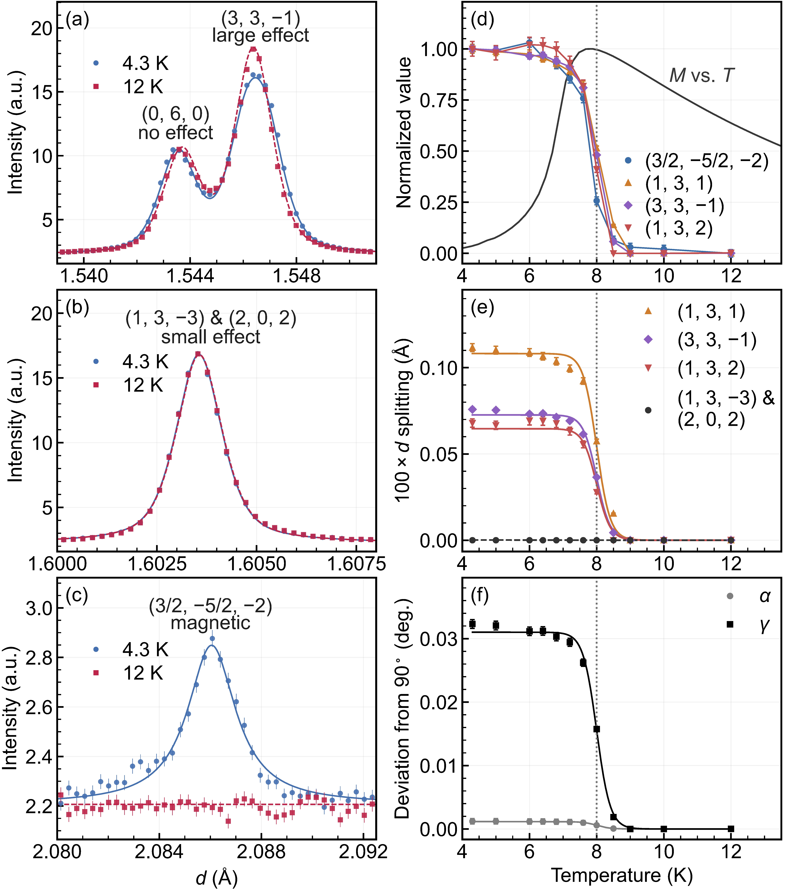
High-resolution neutron diffraction on NCSO
Single-Q magnetic order!
Y. Gu, W. Xie, P. Miao*, Y. Li* et al., arXiv:2610.27663 (2026)

Slide 9
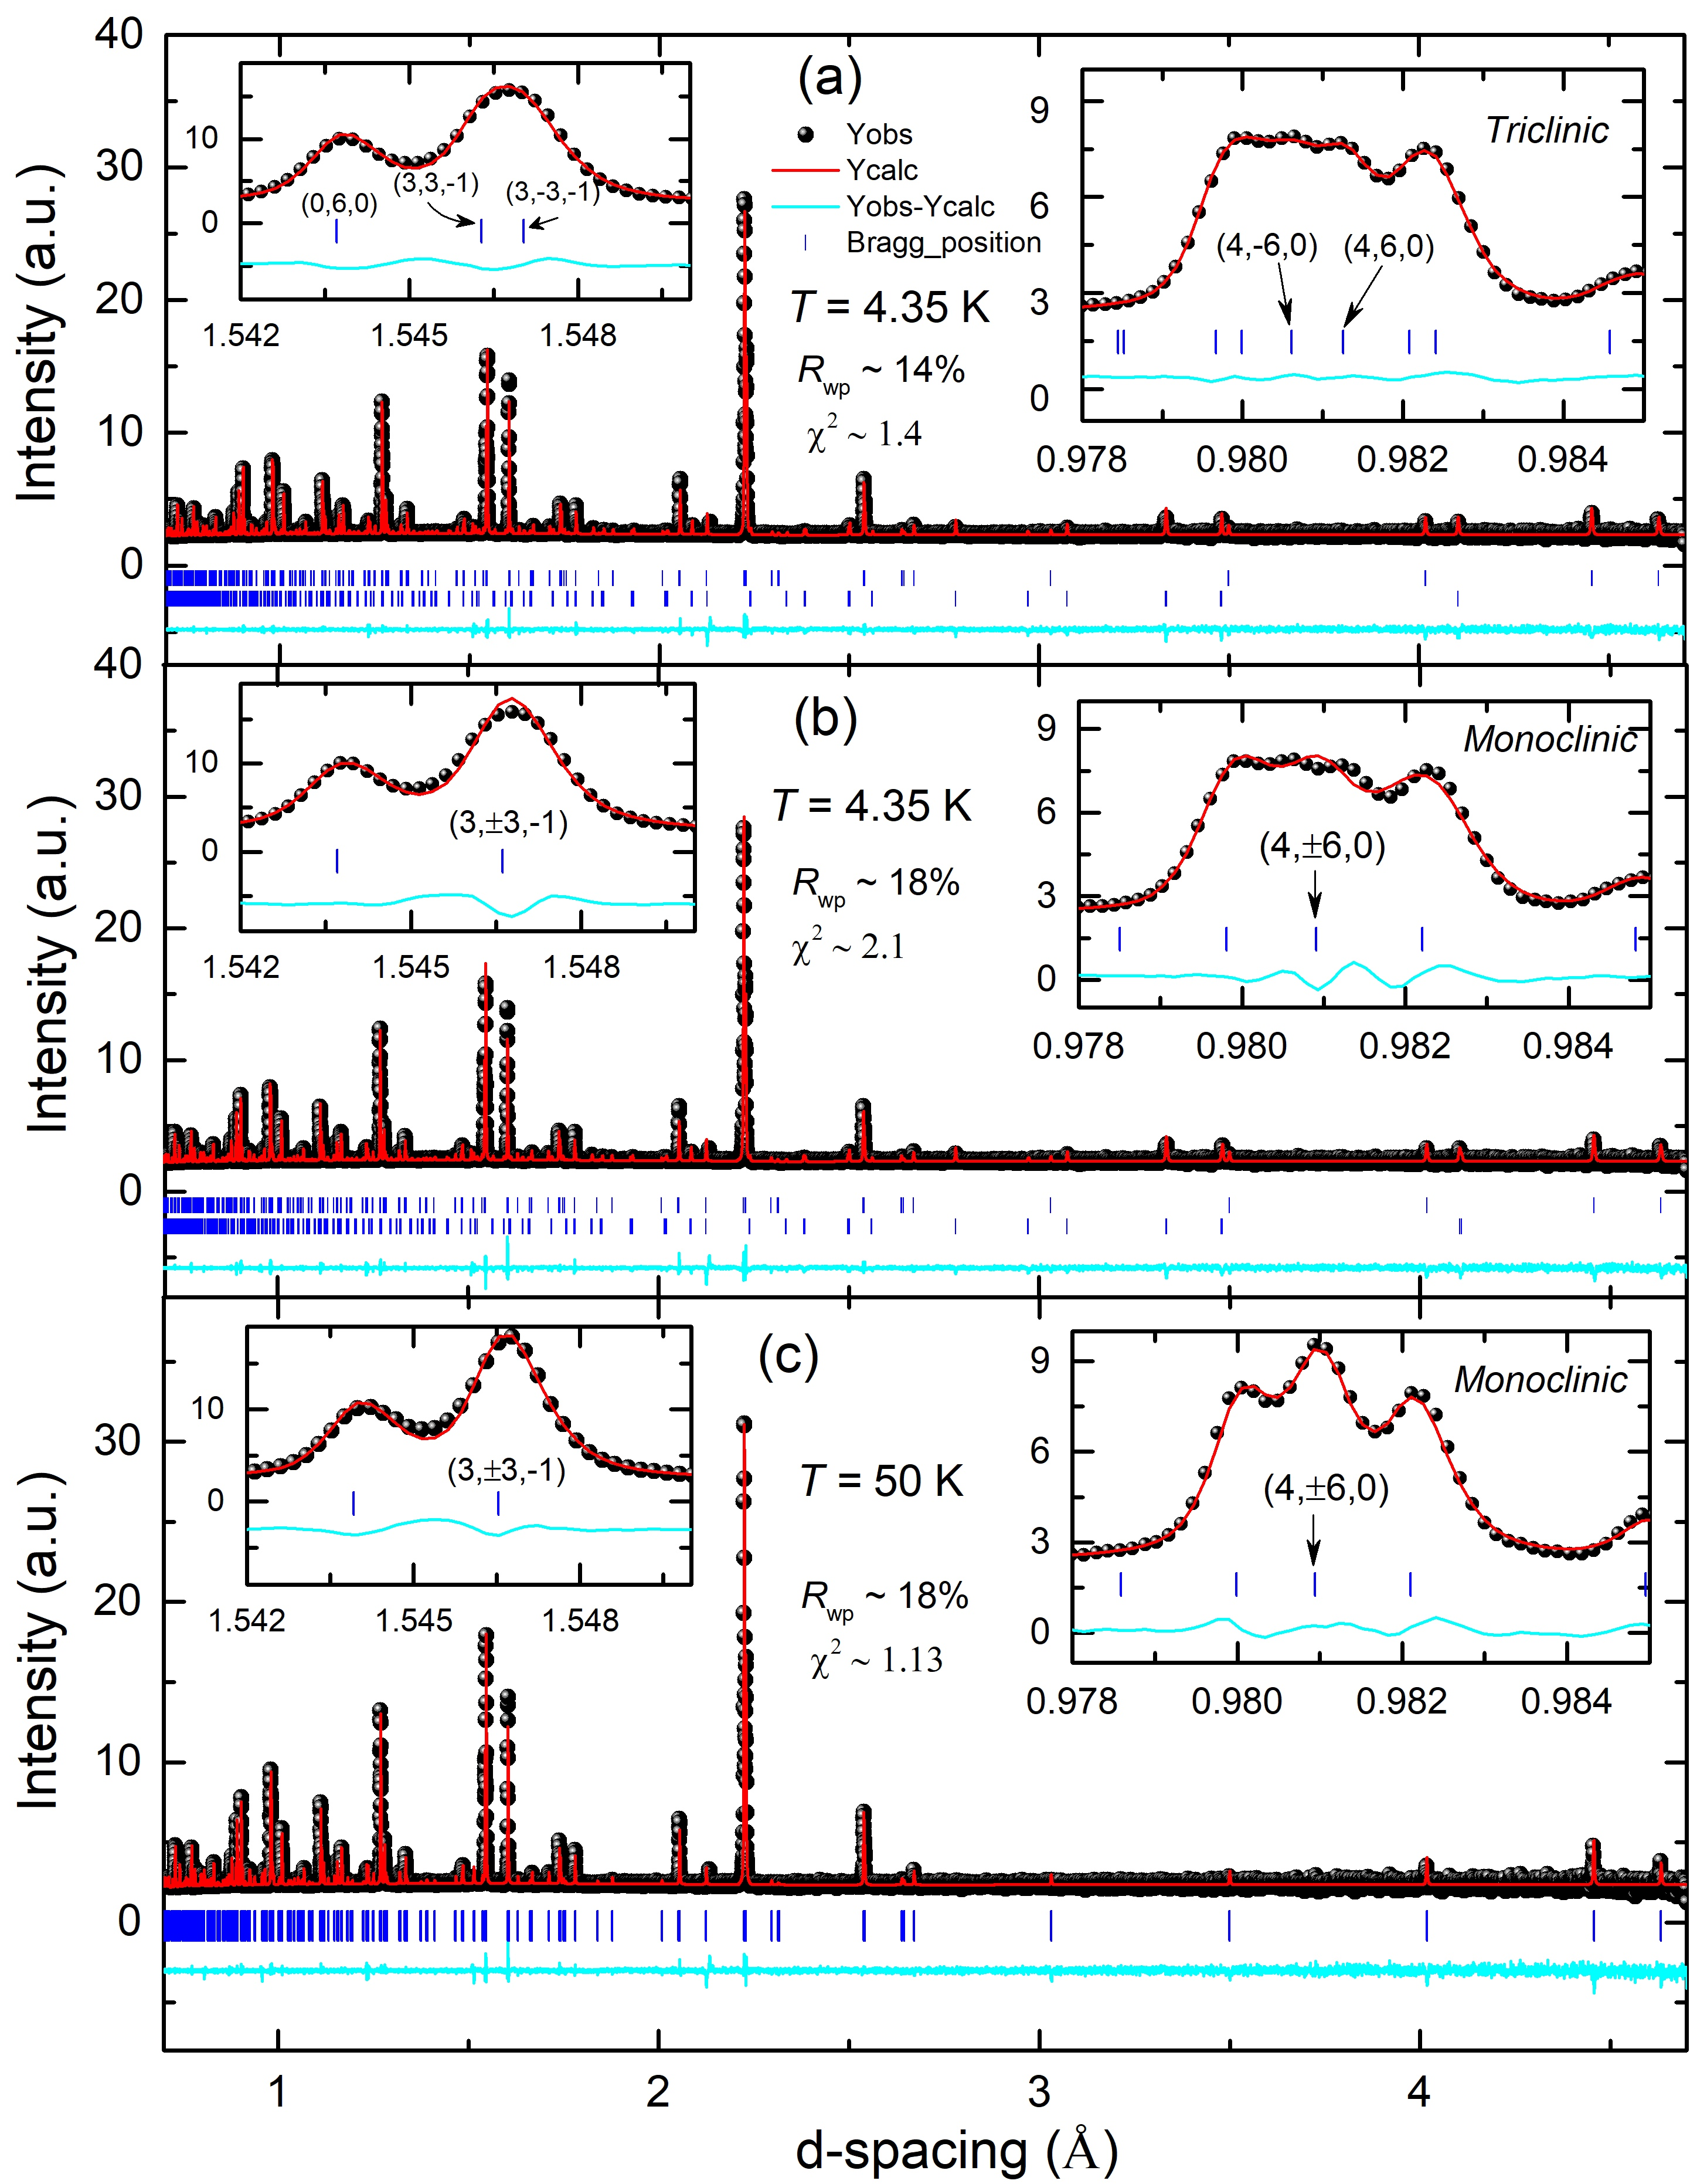
High-resolution neutron diffraction on NCSO
a = 5.36053(2) Å
b = 9.26106(3) Å
c = 5.63282(2) Å
α = 90.0008(4) °
β = 108.5736(2) °
γ = 90.0337(4) °
Y. Gu, W. Xie, P. Miao*, Y. Li* et al., arXiv:2610.27663 (2026)

Slide 10
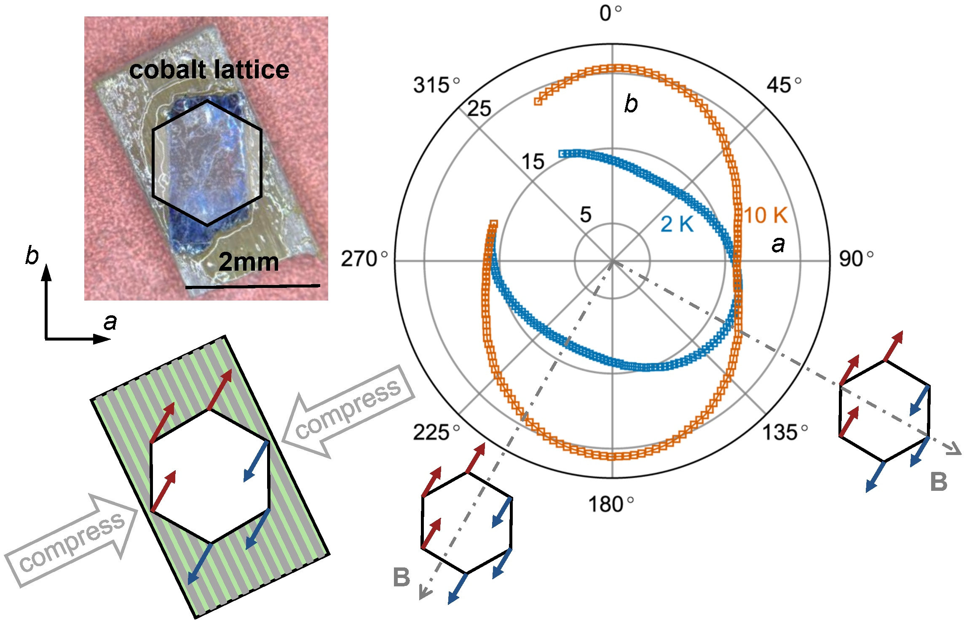
Magnetization with uniaxial compression in NCSO
Y. Gu, W. Xie, P. Miao*, Y. Li* et al., arXiv:2610.27663 (2026)

Slide 11
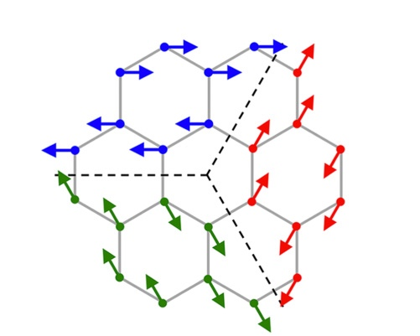
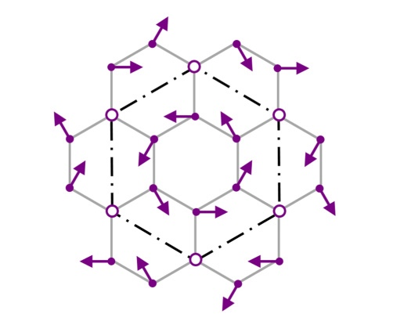
Single-Q or Triple-Q magnetic order in NCTO?
Single Q, Triple Domains
Triple-Q, Single Domain
q = (1/2, -1/2, 0)
q = (0,1/2, 0)
(1/2, 0, 0)
+
q = (0,1/2, 0)
+
(1/2, -1/2, 0)
q = (1/2, 0, 0)
Phys. Rev. B 94, 214416 (2016)
Phys. Rev. B 95, 094424 (2017)
Phys. Rev. B 103, L180404 (2021)
Phys. Rev. Res. 5, L022045 (2023)
Phys. Rev. Lett. 131, 146702 (2023)
Phys. Rev. Lett. 135, 136701 (2025)

Slide 12
High-resolution neutron diffraction on NCTO
Triple-Q magnetic order!
(1/2, 0, 0)
+
q = (0,1/2, 0)
+
(1/2, -1/2, 0)
Y. Gu, W. Xie, P. Miao*, Y. Li* et al., arXiv:2610.27663 (2026)

Slide 13
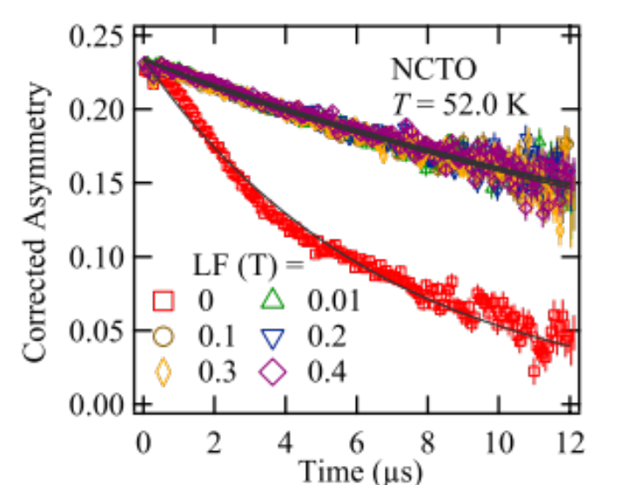
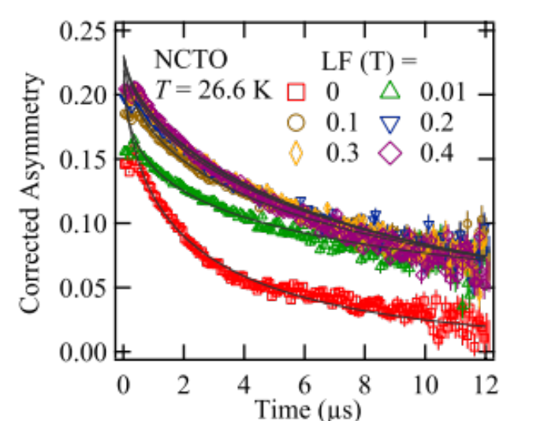
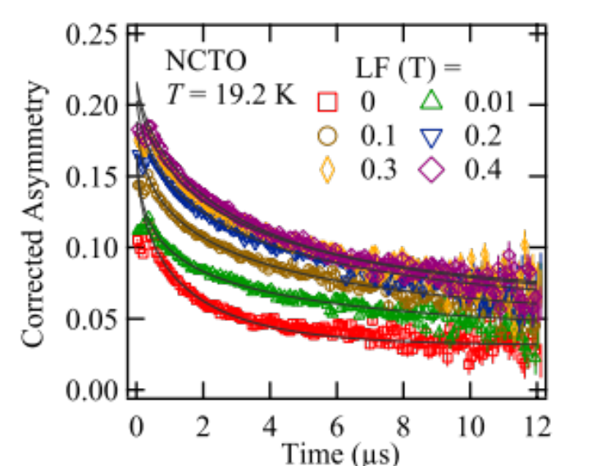
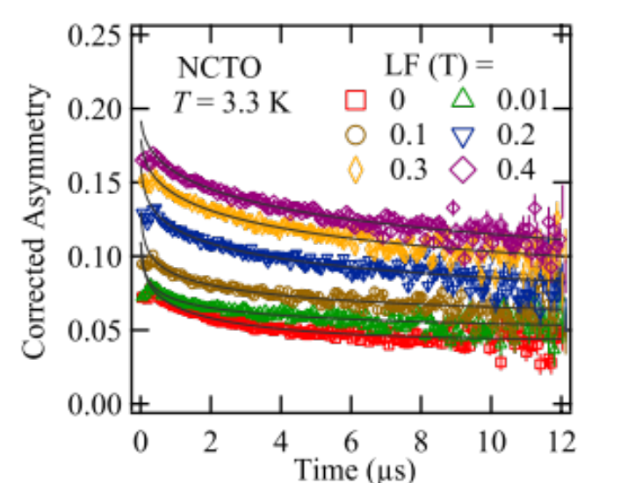
μSR on NCTO
P. Miao*, Y. Li* et al., Phys. Rev. B 109, 134431(2024)

Slide 14
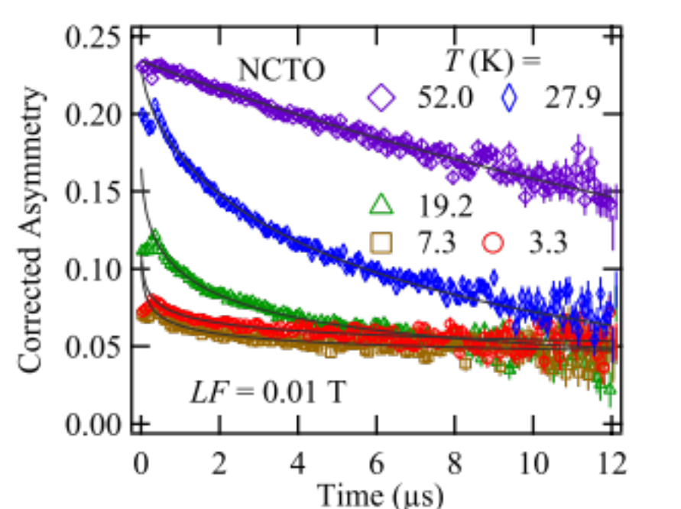
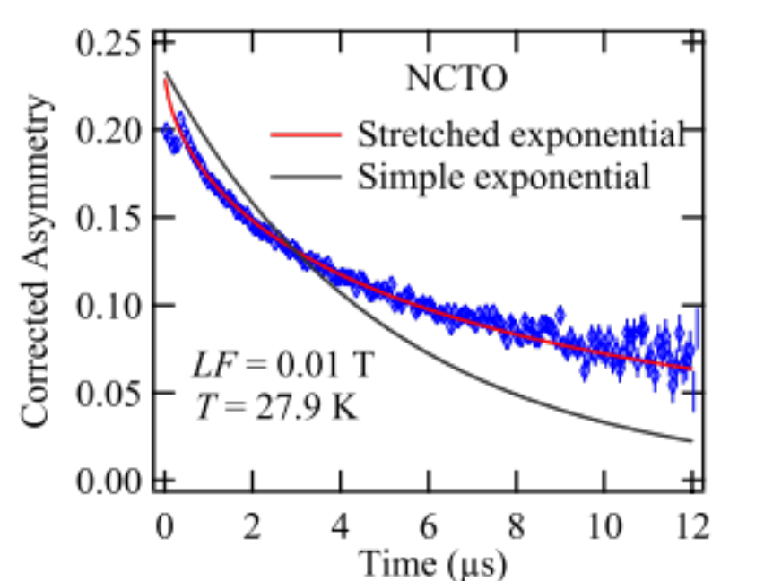
μSR on NCTO
α(H) = 1/3 @ LF = 0.01T
P. Miao*, Y. Li* et al., Phys. Rev. B 109, 134431(2024)

Slide 15
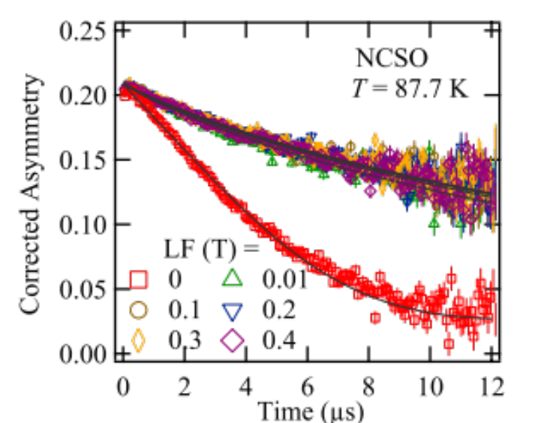
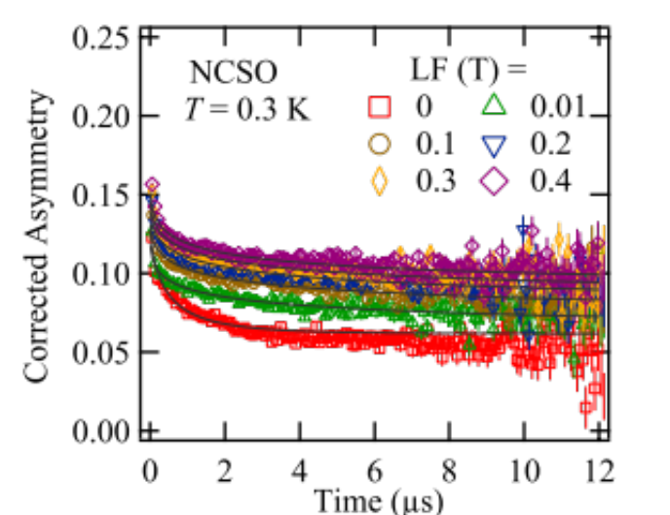
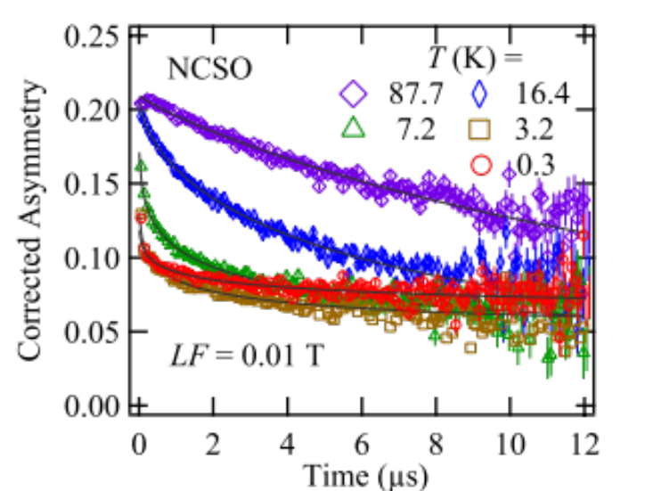
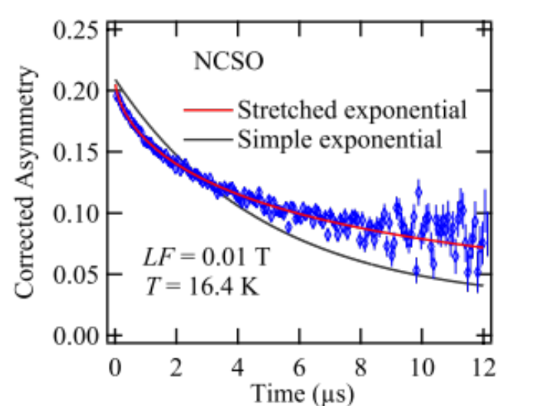
μSR on NCSO
P. Miao*, Y. Li* et al., Phys. Rev. B 109, 134431(2024)

Slide 16
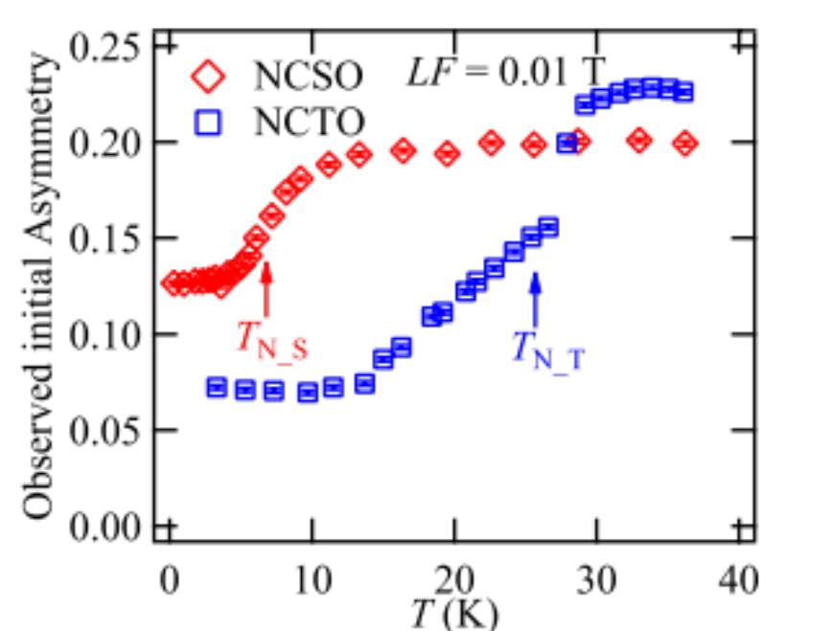
Initial asymmetries
NCTO
NCSO
T_{N_T}
T_{N_S}
P. Miao*, Y. Li* et al., Phys. Rev. B 109, 134431(2024)

Slide 17
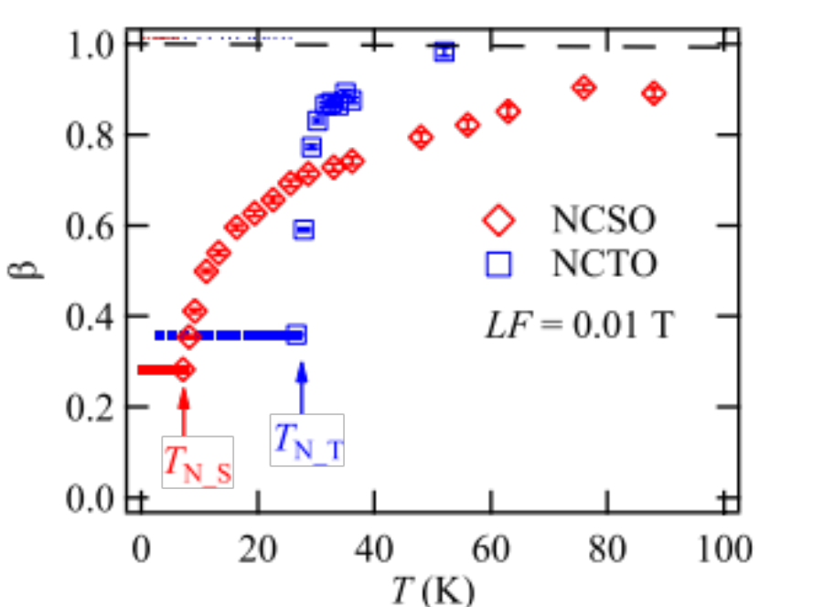
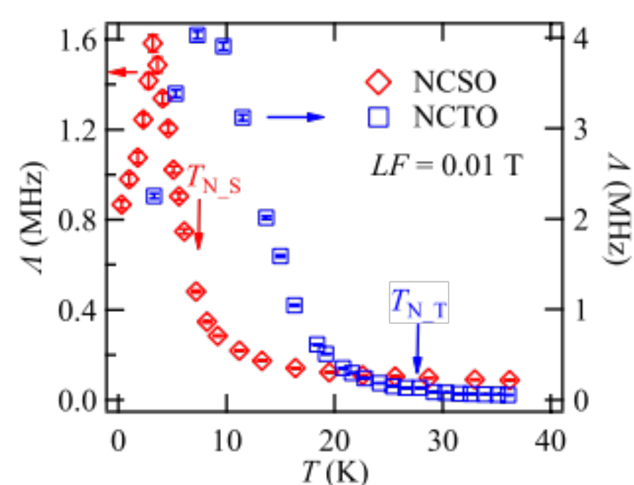
Stretched exponent & Relaxation rate
A broad distribution of correlation times
Spin fluctuations continue to exist much below T_{N_S}
P. Miao*, Y. Li* et al., Phys. Rev. B 109, 134431(2024)

Slide 18
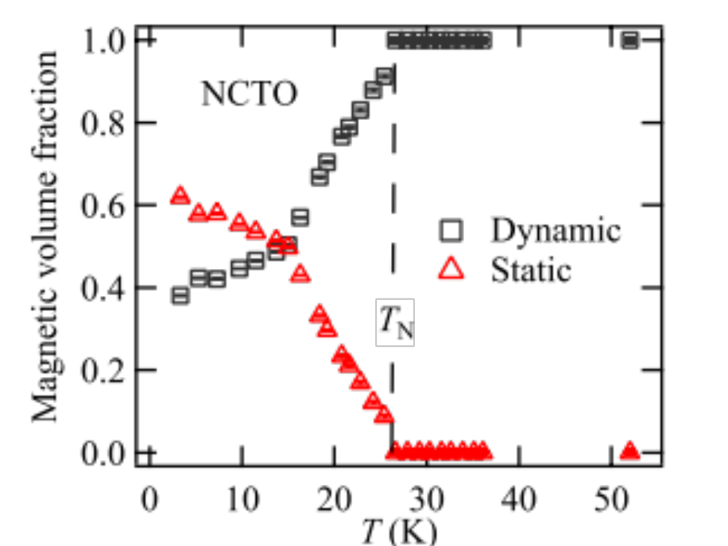
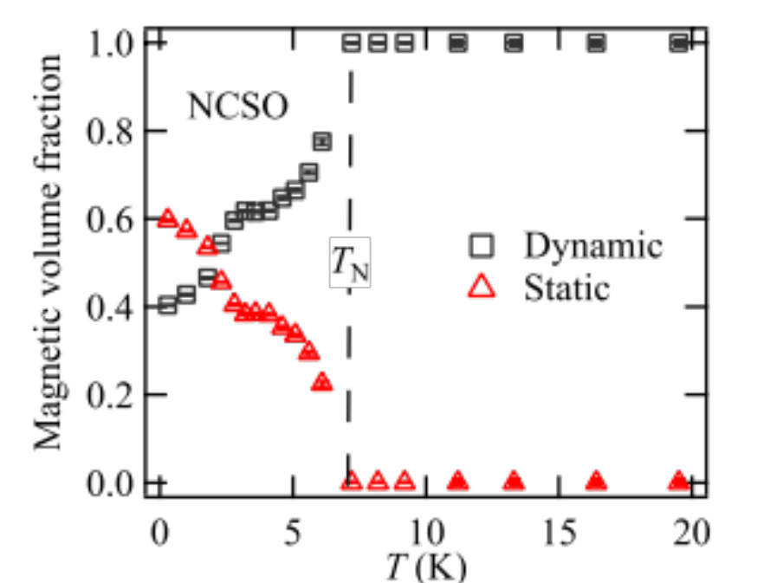
Magnetic volume fractions
P. Miao*, Y. Li* et al., Phys. Rev. B 109, 134431(2024)

Slide 19
Summary
High-resolution neutron diffraction provides unambiguous evidence for Single-Q magnetic order in NCSO and indicate Triple-Q magnetic order in NCTO.
μSR experiments shows that spin dynamics survives deeply into the magnetically ordered states in both NCTO and NCSO. Both systems show a broad distribution of correlation times, which is commonly observed in glassy magnets.

Slide 20




Thank you for your attention!
Ping MIAO
Institute of High Energy Physics Chinese Academy of Sciences
miaoping@ihep.ac.cn
+86-769-88931326
Notes:
我的报告就到这里，谢谢大家。

