Slide 1

The 3rd Workshop on Muon Science Technology and Industry
μSR studies of spin dynamics in frustrated rare-earth magnets
Hanjie Guo （郭汉杰）
Songshan Lake Materials Laboratory (SLAB)
2026-10-26
Dongguan

Slide 2
Outline
Quantum spin liquids and the role of muSR
QSL candidates hexaaluminates RE(Zn,Mg)Al₁₁O₁₉
Hidden-order-like state in the Shastry-Sutherland magnet Nd₂Be₂GeO₇

Slide 3

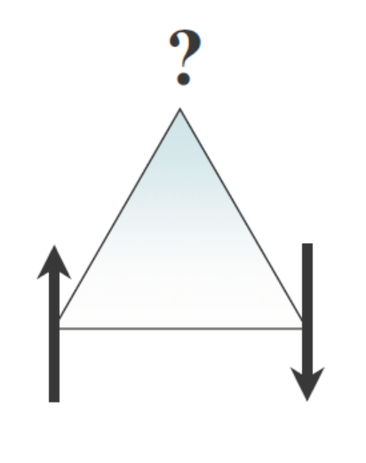
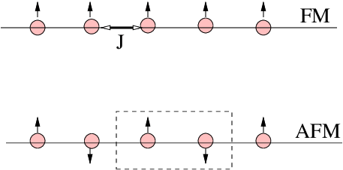
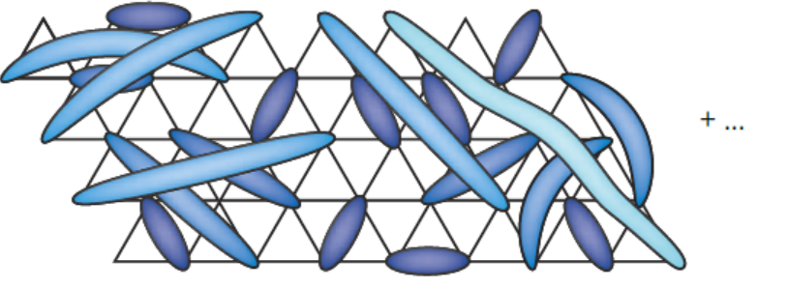
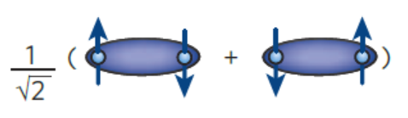
Quantum Spin Liquids
Introduction
conventional spin ordering
geometric frustration
P. W. Anderson
highly degenerate QSL
No long-range magnetic ordering
No spontaneous breaking of translation or rotation symmetry

Slide 4
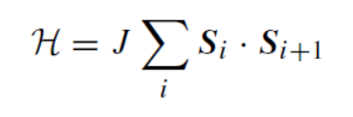
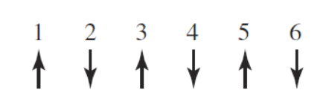
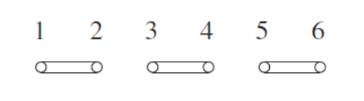
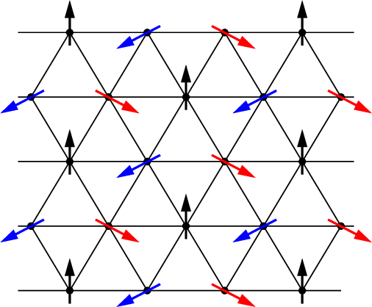
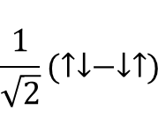




Quantum Spin Liquids
Introduction
$$\frac{1}{\sqrt{2}}(↑↓−↓↑)$$
$$E=−\frac{1}{4}JN$$
$$E=−\frac{3}{4}J∙\frac{N}{2}=−\frac{3}{8}JN$$
$$E=\frac{1}{4}Jcos\frac{2}{3}π∙\frac{1}{2}Nz=−\frac{3}{8}JN$$
$$E=−\frac{3}{4}J∙\frac{1}{2}N=−\frac{3}{8}JN$$

Slide 5
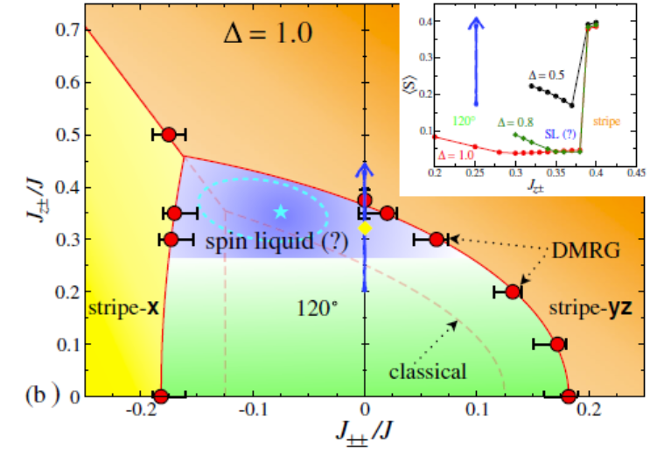
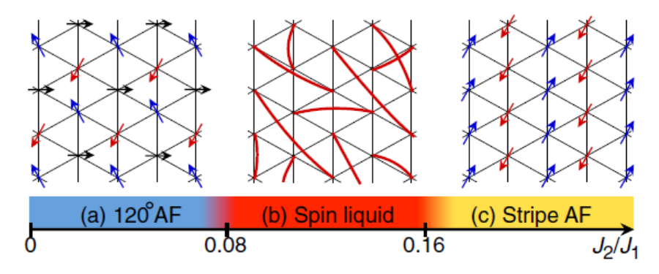
Quantum Spin Liquids
Introduction
anisotropy
next nearest neighbor
Y. Iqbal et al., PRB, 93, 144411 (2016)
Z. Zhu et al., PRL, 120, 207203 (2018)

Slide 6
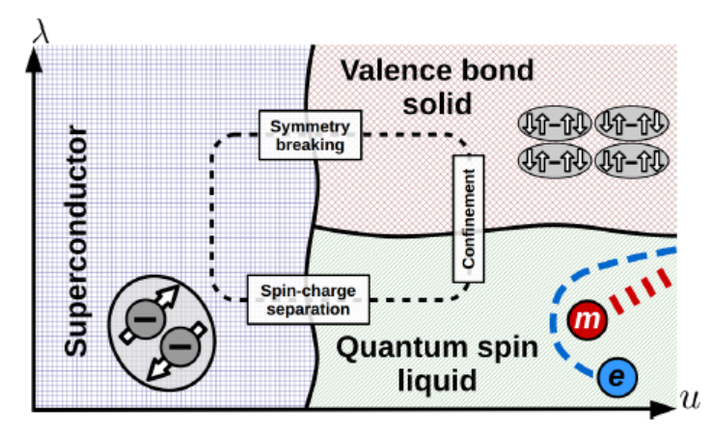
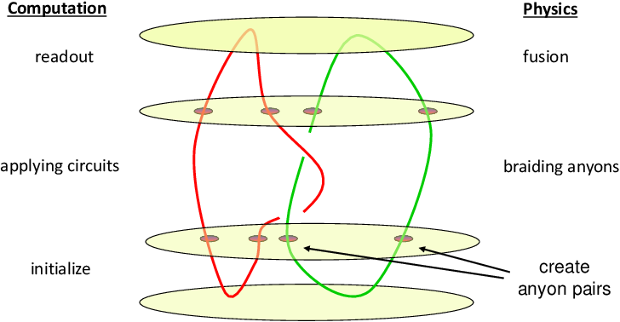
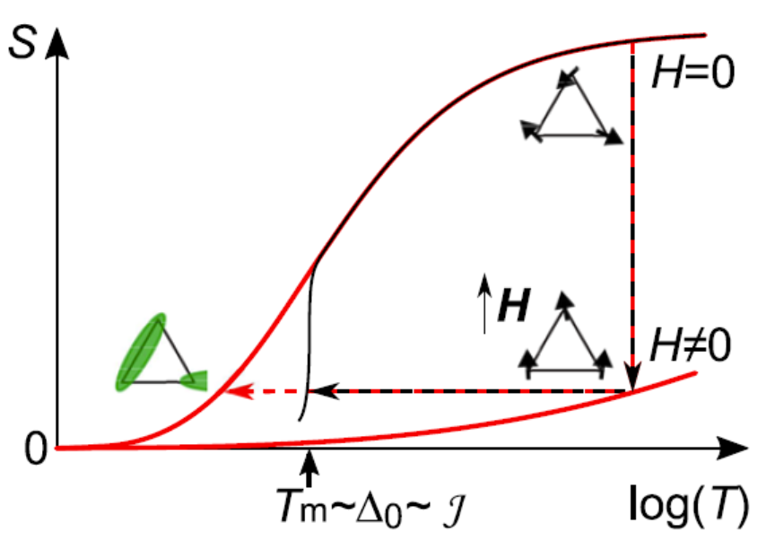
Quantum Spin Liquids
Introduction
closely related to SC
potential for quantum computation
adiabatic demagnetization refrigeration

Slide 7
Quantum Spin Liquids
Introduction
How to detect? Or what to exclude?
specific heat
susceptibility
neutron diffraction
……
no order parameters
exclude any long-range magnetic ordering, spin freezing, valence bond solid…
spinon fractional excitations
→ excitation continua
(ordered magnets may show similar behavior)
muon is very sensitive to magnetic fields!
distinguish between static and dynamic fields
polarized in ZF
inelastic neutron scattering
thermal transport

Slide 8
Hexaaluminates RE(Zn,Mg)Al₁₁O₁₉

Slide 9
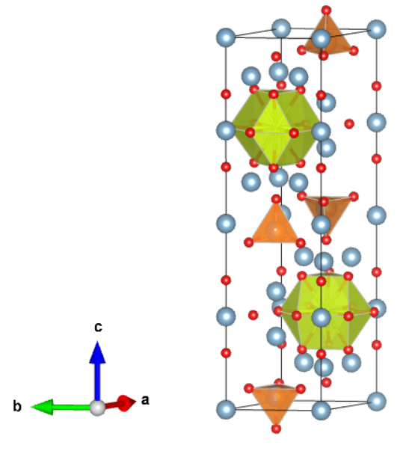
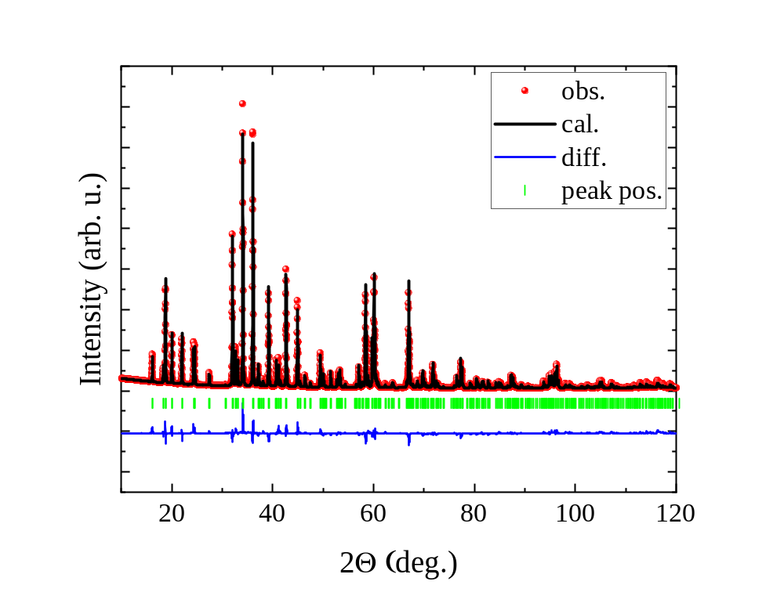
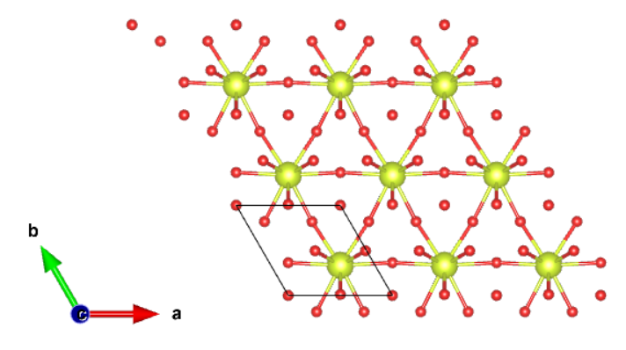
general structural features
Hexaaluminate
~11 Å
well separated→ quasi-2D; minimize influence from interlayer disorder
large differences in ionic radii→ no antisite disorder between magnetic and nonmagnetic ions
versatile rare earth ions (RE = La-Tb)
P6₃/mmc
a = b = 5.586026
c = 21.920176

Slide 10
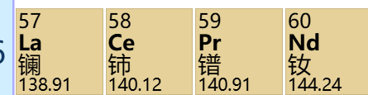
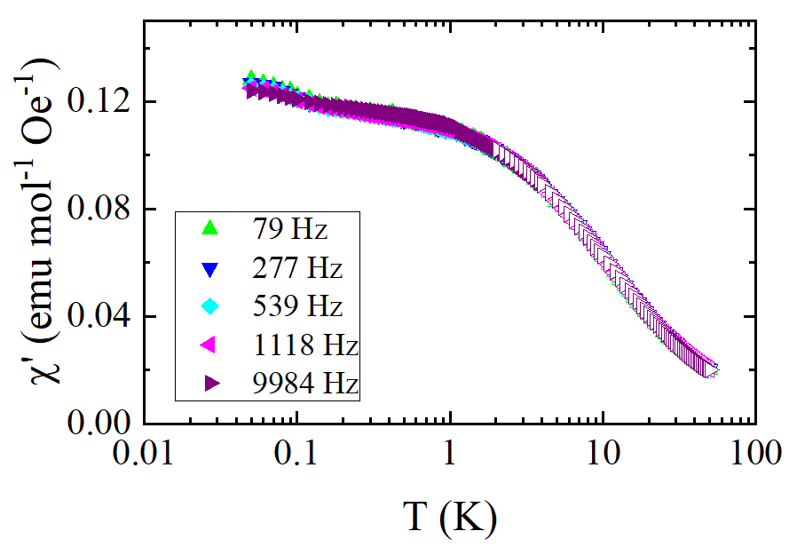
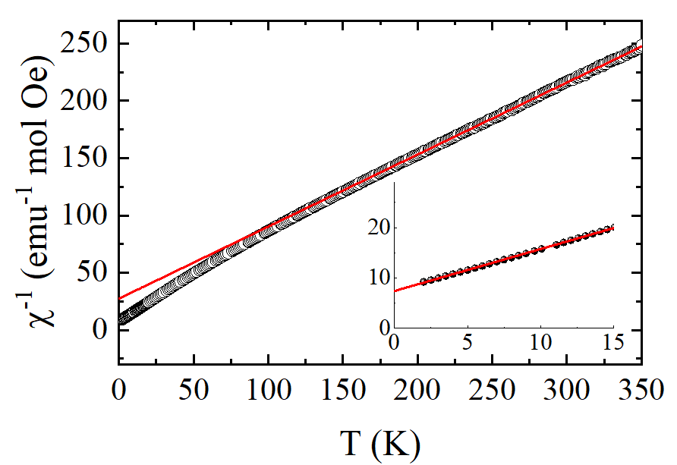
PrZnAl₁₁O₁₉ : susceptibility
Hexaaluminate
ac susceptibility：
no spin ordering down to 50 mK
no frequency dependence → no spin freezing
frustration index: f > 10/0.05 = 200
dc susceptibility:
Curie-Weiss fit (T < 15 K)
θ_{CW} ~ -10 K → strong AFM coupling
Bu, Guo et al., PRB 106, 134428 (2022)

Slide 11
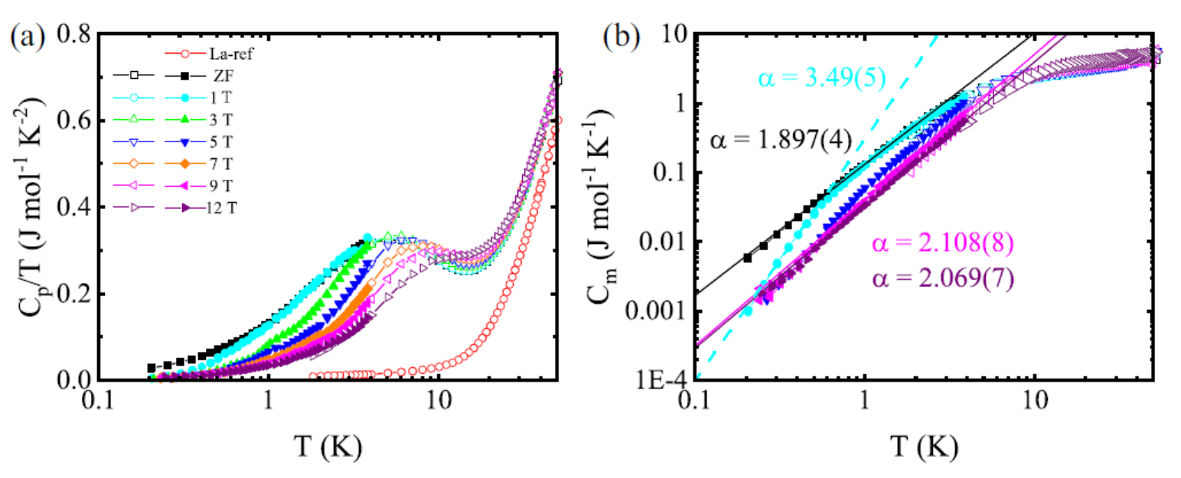
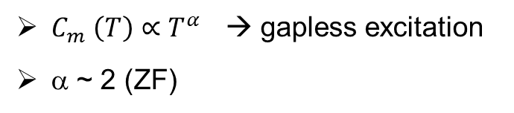
PrZnAl₁₁O₁₉ : gapless excitations
Hexaaluminate
gapless AFM: α = 3
gapless FM: α = 3/2
spinon Fermi surface: α = 2/3 or 1
Coulombic QSL: α = 3
Dirac QSL: α = 2 (ZF), α = 1 (fields）
$C_{m} \left(T\right)∝T^{α}$ → gapless excitation
α ~ 2 (ZF)

Slide 12
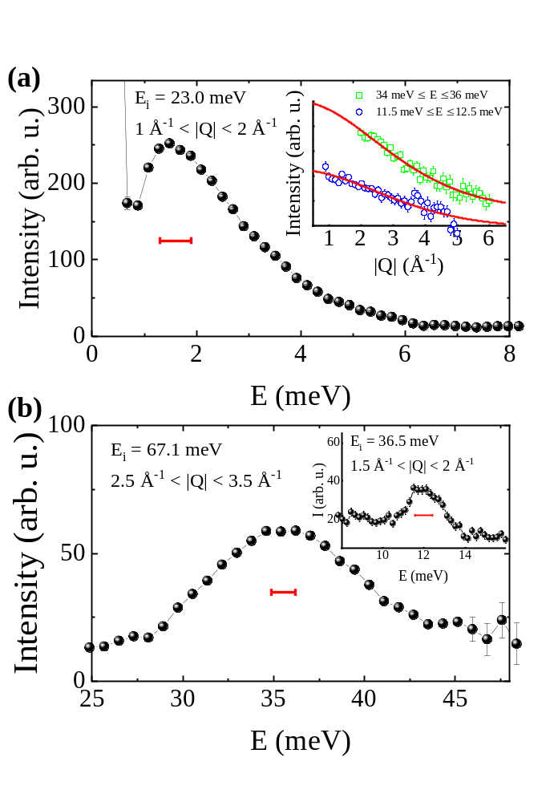
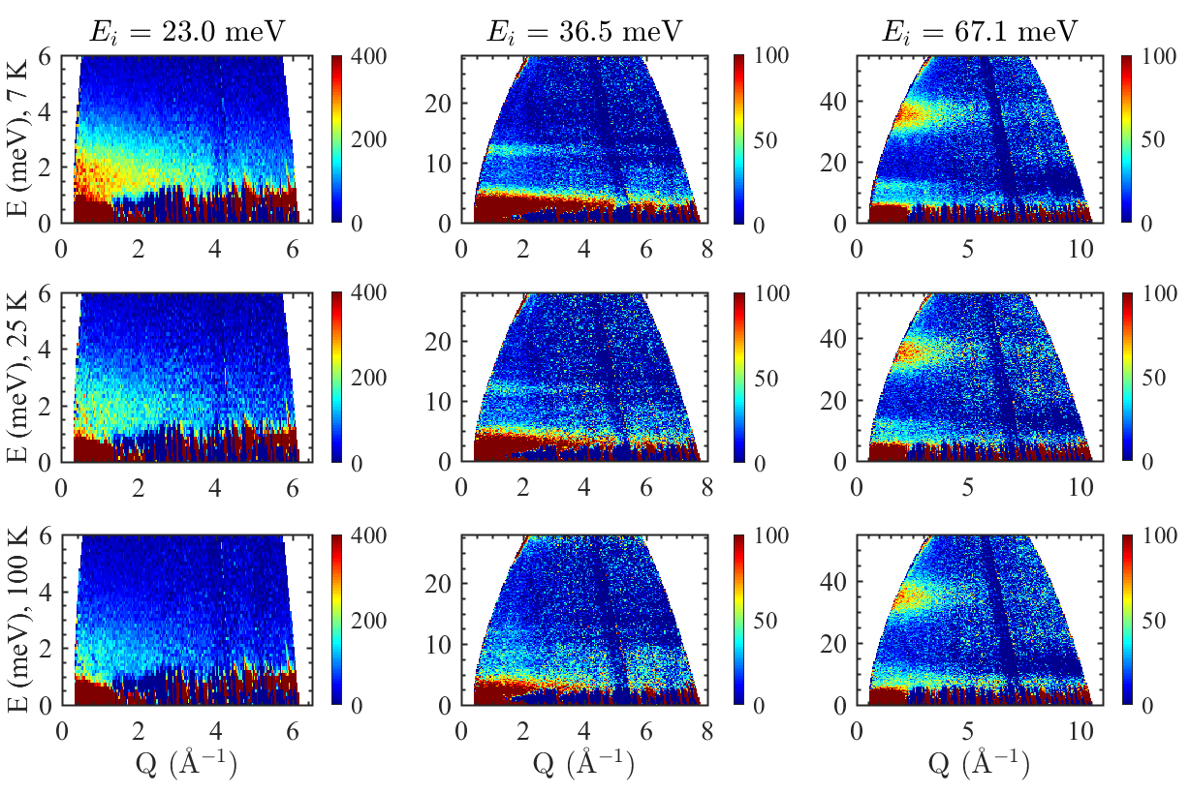
PrZnAl₁₁O₁₉ : low-E excitations
Hexaaluminate
Pr³⁺ (J = 4)：non-Kramers ion
D3h → 3 singlets, 3 doublets
peak overlaps at 12 meV and 36meV
E ~ 1.5 meV, diffuse, long tail on the high-E side
distinct from Schottky anomaly in HC → correlation effect

Slide 13
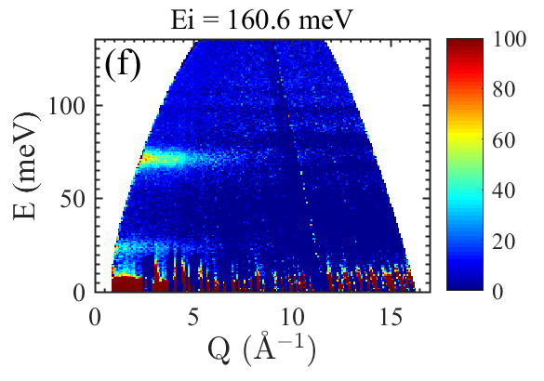
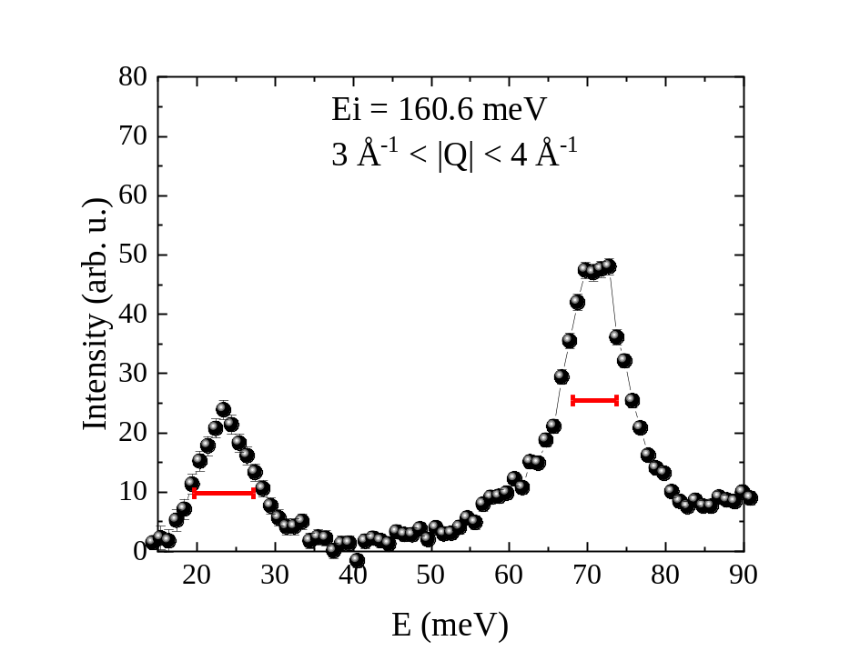
NdZnAl₁₁O₁₉: low-E excitations
Hexaaluminate
NdZnAl₁₁O₁₉: peak width comparable to instrument resolution
exclude disorder-induced peak broadening in PrZnAl₁₁O₁₉

Slide 14
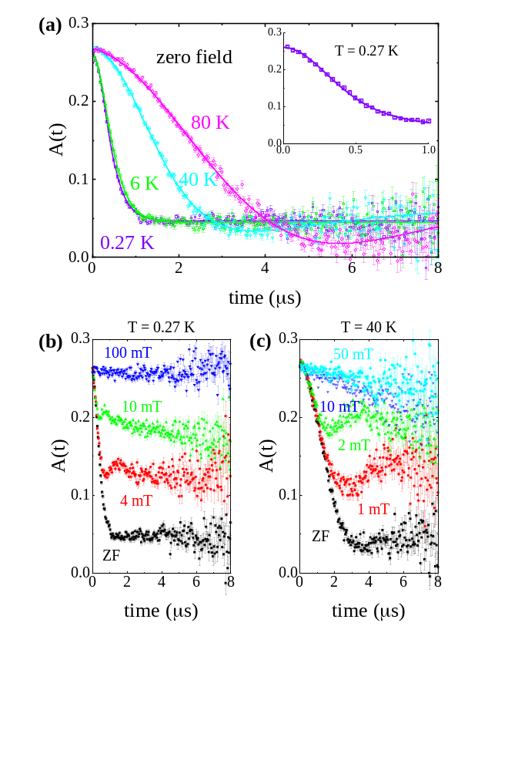
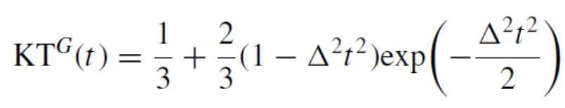
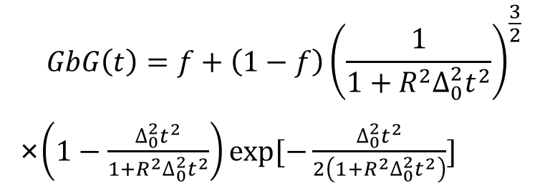
PrZnAl₁₁O₁₉：enhanced nuclear magnetism
Hexaaluminate
ZF-μSR spectra: Gaussian-broaden-Gaussian
$$GbG\left(t\right)=f+\left(1−f\right){\left(\frac{1}{1+R^{2}∆_{0}^{2}t^{2}}\right)}^{\frac{3}{2}}$$
×$\left(1−\frac{∆_{0}^{2}t^{2}}{1+R^{2}∆_{0}^{2}t^{2}}\right)exp⁡[−\frac{∆_{0}^{2}t^{2}}{2\left(1+R^{2}∆_{0}^{2}t^{2}\right)}]$
Δ has a Gaussian distribution width W
both ZF and LF data indicate a static ground state

Slide 15



PrZnAl₁₁O₁₉：enhanced nuclear magnetism
Hexaaluminate
Two ingredients:
non-Kramers ion, singlet ground state → van Vleck paramagnetism
large hyperfine interaction
nuclear spin
electronic angular momentum
$$ℋ_{HF}=A_{J}I∙J=g_{J}μ_{B}B_{z}J_{z}$$
$$B_{z}=A_{J}I_{z}/{g_{J}μ}_{B}$$
$$m_{z}=χ_{VV}B_{z}$$
Singlet ground state for the electronic system
intrinsic CEF ground state
local distortions induced by implanted muons

Slide 16
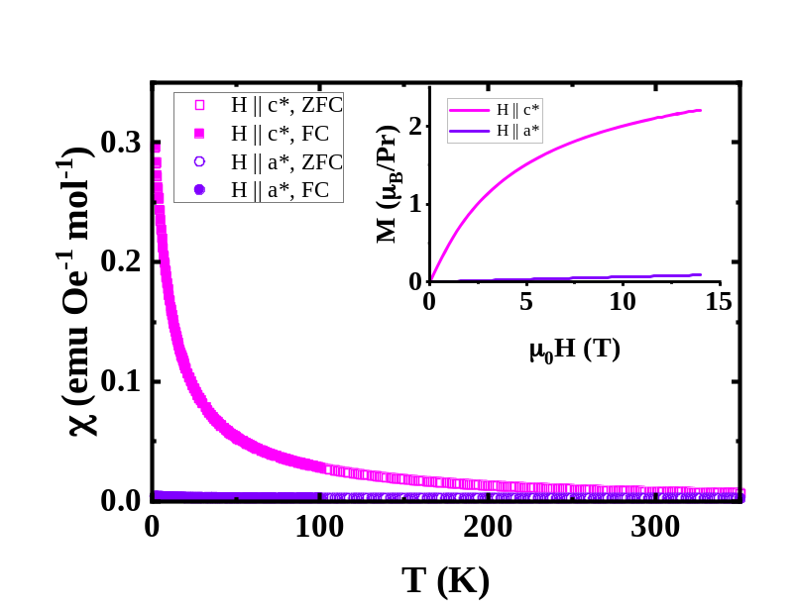
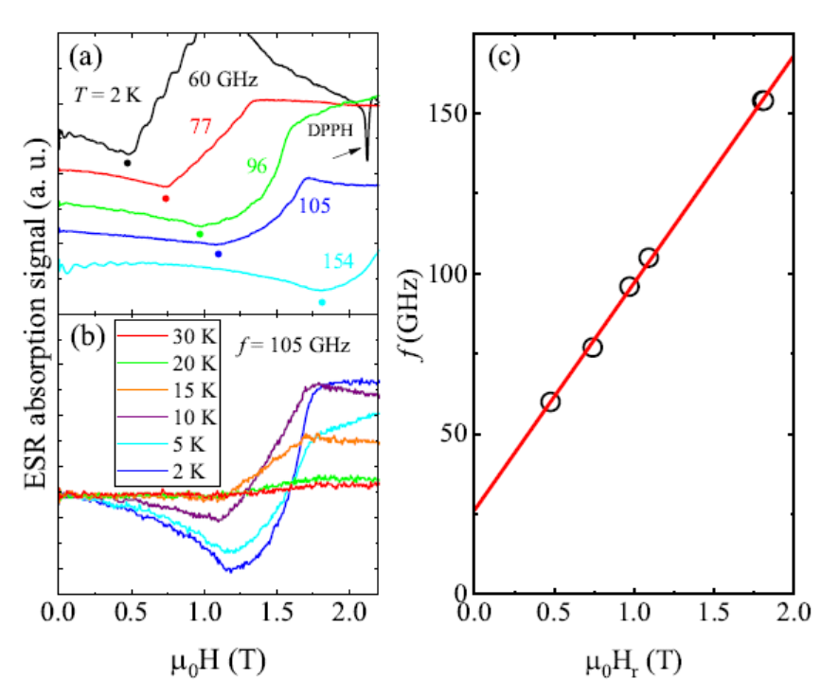
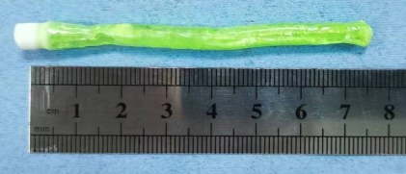
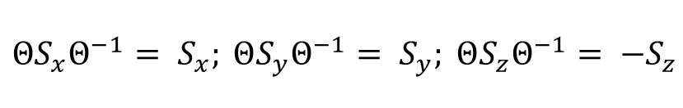
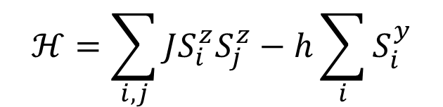
Intrinsic transverse field Ising model
Hexaaluminate
electron spin resonance (ESR)
PrMgAl₁₁O₁₉
H || c
In the frame work of intrinsic transverse-field Ising model
$$ℋ=\sum_{i,j}{JS_{i}^{z}S_{j}^{z}}−h\sum_{i}{S_{i}^{y}}$$
……
$${ΘS_{x}Θ}^{−1}= S_{x}; {ΘS_{y}Θ}^{−1}= S_{y}; {ΘS_{z}Θ}^{−1}= {−S}_{z}$$
Δ ~ 0.1 meV
S_{z}: dipole S_{x}, S_{y}: multipole
Cao, Guo et al., Mater. Futures 3, 035201 (2024)

Slide 17
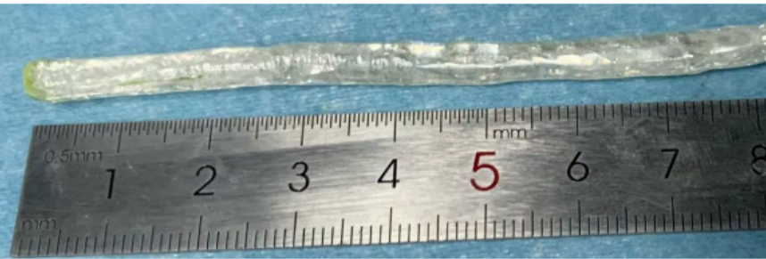
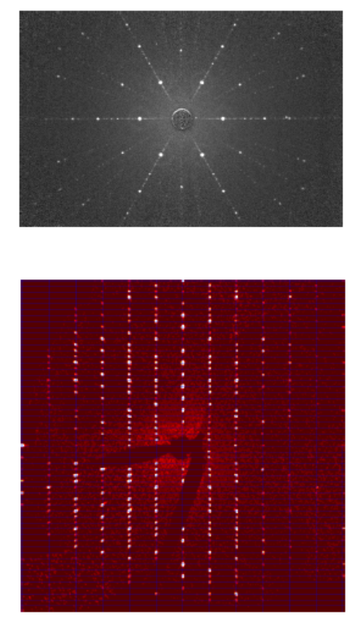
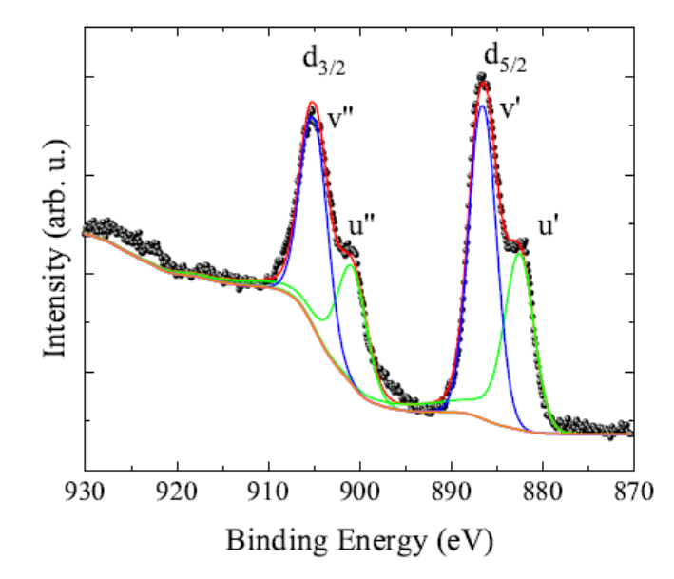
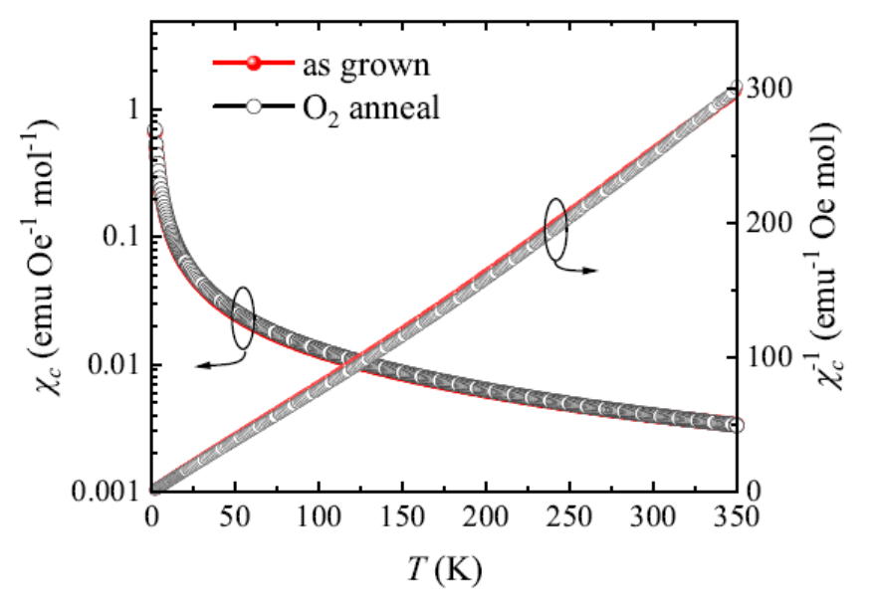
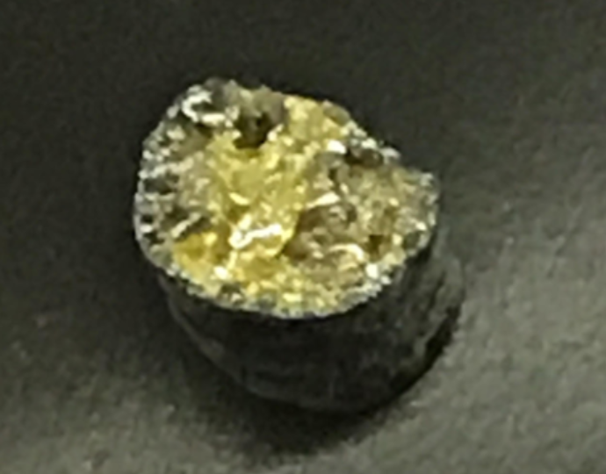
CeMgAl₁₁O₁₉: U(1) Dirac QSL candidate
Hexaaluminate
Very stable Ce³⁺ state
Ce2Zr2O7
oxidized Ce⁴⁺ on the surface
PRL 122, 187201 (2019)

Slide 18
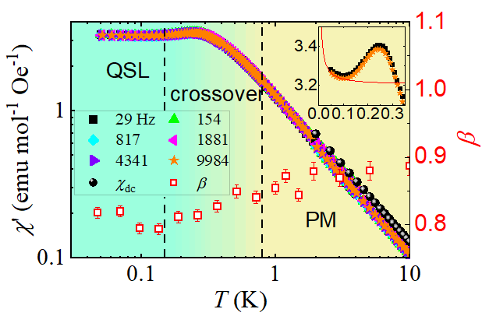
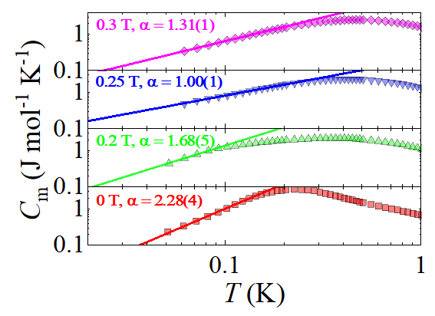
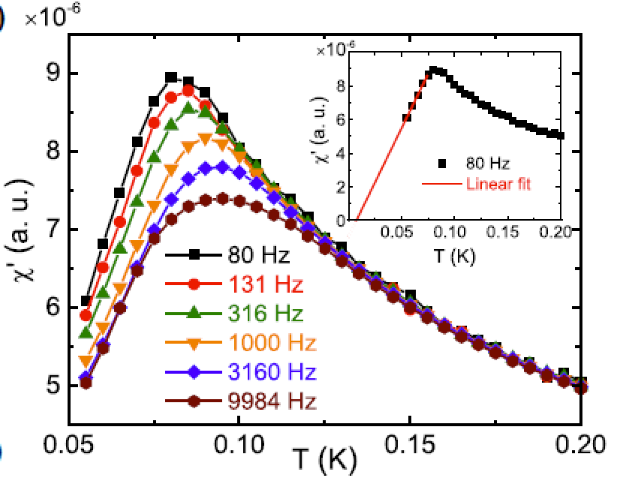
CeMgAl₁₁O₁₉: U(1) Dirac QSL candidate
Hexaaluminate
ac susceptibility:
magnetic correlations below ~0.2 K
no spin freezing
specific heat:
gapless excitations
α = 2, Dirac nodes
α = 1, Fermi pocket
C_{m} = AT^{α}
A(0.25 T)/A(0 T) =
0.041 (exp.) vs. 0.053 (theory)
YbZn2GaO5
PRL 133, 266703 (2024)
Cao, Guo et al., Sci. China: PMA 68, 267011 (2025)

Slide 19
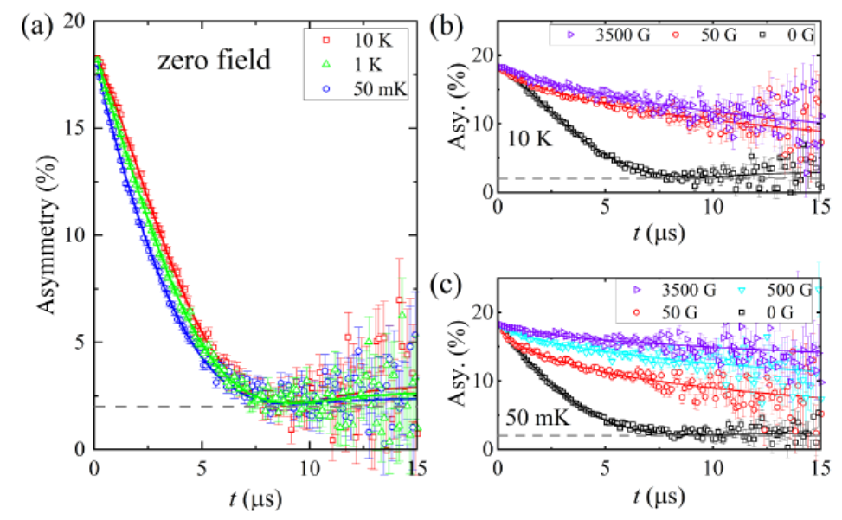
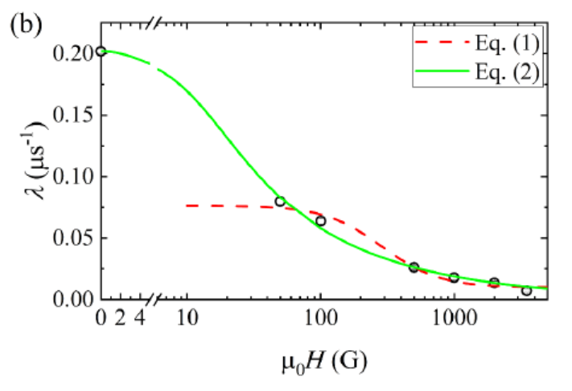
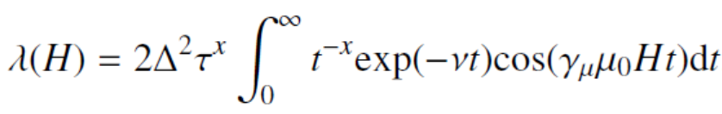
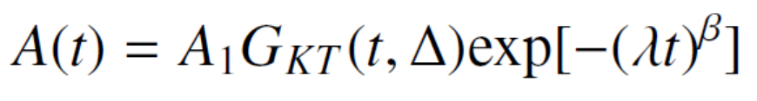
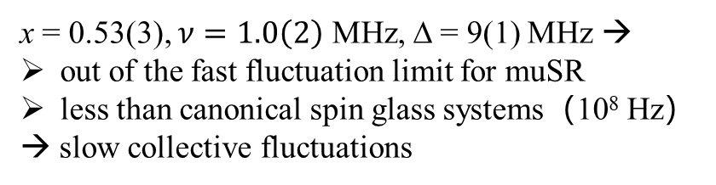
CeMgAl₁₁O₁₉: slow spin dynamics
Hexaaluminate
x = 0.53(3), $ν=1.0\left(2\right)$ MHz, Δ = 9(1) MHz →
out of the fast fluctuation limit for muSR
less than canonical spin glass systems（10⁸ Hz）
→ slow collective fluctuations

Slide 20
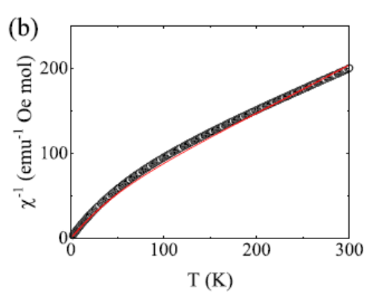
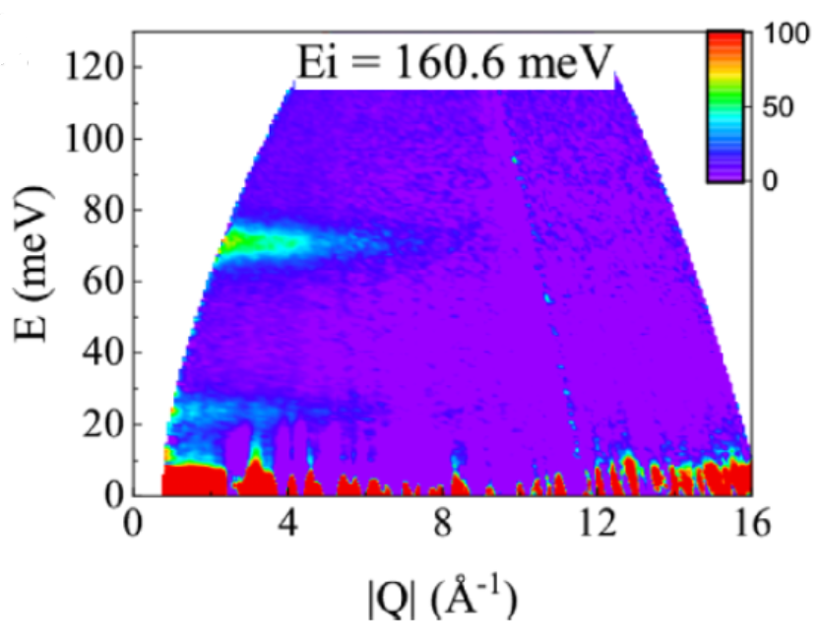
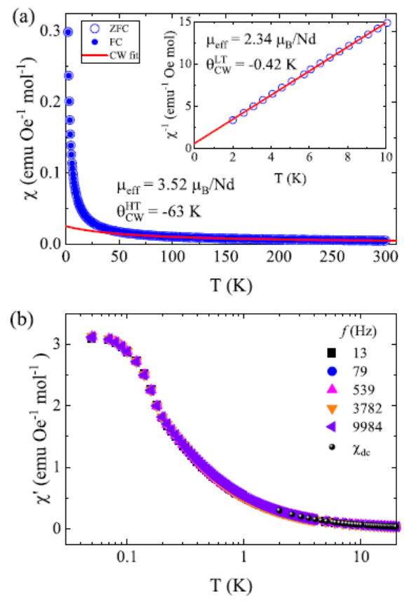


NdZnAl₁₁O₁₉: CEF ground state
Hexaaluminate
AFM dominant
no order down to 50 mK
Cao, Guo et al., PRB 112, 144409 (2025)
CEF fitting → Ising dominant anisotropy

Slide 21


NdZnAl₁₁O₁₉: CEF ground state
Hexaaluminate

Slide 22



persistent spin fluctuations
Hexaaluminate
ν = 85.3(8) MHz << 37 GHz（exchange fluctuation rate）

Slide 23







NdTa₇O₁₉ vs. NdZnAl₁₁O₁₉
$$\frac{g_{z}}{g_{xy}}=\frac{2.78}{1.22}=2.28$$
$$\frac{g_{z}}{g_{xy}}=\frac{4.54}{1.42}=3.2$$
$θ_{CW}=−0.46$ K
$θ_{CW}=−0.42$ K
Nat. Mater. 21, 416 (2022)
our work

Slide 24






ADR performance
Hexaaluminate
Superior ADR performance compared to some Gd-based compounds
NdMgAl₁₁O₁₉
0.75
0.5
JACS 147, 34862 (2025)

Slide 25
Summary for hexaaluminates
Using muSR, combined with other techniques (specific heat, susceptibility, neutron…), we identify several quantum spin liquid candidates
The versatility of rare earth ions provides a fertile ground for studying different models (intrinsic transverse field Ising model, Ising dominant XXZ model…)
QSLs retain a large amount of magnetic entropy at low temperatures;
small exchange energy scale means a small magnetic field can easily polarize the spin system – remove entropy at low T
→ excellent for magnetic cooling

Slide 26
Hidden-order-like state in the SSL Nd₂Be₂GeO₇

Slide 27


phase diagram
Nd₂Be₂GeO₇
Shastry-Sutherland lattice
phase diagram based on the Heisenberg model
= $J^{′}/J$
PRB 105, L060409 (2022)
SOC-induced anisotropy
QSL still exists?
Other exotic phases?

Slide 28





CEF ground state
Nd₂Be₂GeO₇
Ei = 53.1 meV
Ei = 25.1 meV
$$ℋ_{CEF}=\sum_{l,m}{B_{l}^{m}O_{l}^{m}}$$
Nd³⁺: J = 9/2
five Kramers doublets, four transitions at low T
C_{s} point symmetry: up to 15 nonzero $B_{l}^{m}$
Liu, Guo et al., under review

Slide 29





dimer model
Nd₂Be₂GeO₇
Electron spin resonance
y
x
$$g_{x}^{CEF}=2.02$$
$$g_{y}^{CEF}=0.14$$
$$g_{z}^{CEF}=3.18$$
J = 0.106(2) meV
 | CEF GS
m_{x} | 0.82
m_{y} | 0
m_{z} | 1.55
ESR transitions between the singlet and triplet are usually forbidden
Dzyaloshinskii-Moriya (DM) vector along z
$$\left|\left.s\right\rangle =α\right|\left.00\right\rangle + β|\left.10\right\rangle$$

Slide 30


magnetic ordering
Nd₂Be₂GeO₇
coexistence of long-range and short-range magnetic correlations
no spin-glass transition

Slide 31






hidden order?
Nd₂Be₂GeO₇
neutron diff.
ZF-μSR
 | CEF GS | neutron diff.
m_{x} | 0.82 | 0.60
m_{y} | 0 | 0
m_{z} | 1.55 | 0.66
thermodynamic phase transition
no order parameter（neutron, muon）
strong quantum fluctuations along c axis
magnetic order revealed after field-training
correlation length ξ ~ 90 Å > 10c
hidden order

Slide 32



spin dynamics
Nd₂Be₂GeO₇
In fast-fluctuating limit, Redfield formula:
$$λ\left(B_{l}\right)= \frac{2{(γ_{μ}Δ)}^{2}ν}{ν^{2}+{(γ_{μ}B_{l})}^{2} }$$
λ peaks when $ν= γ_{μ}B_{l}$

Slide 33




unusual field-enhanced spectral density
Nd₂Be₂GeO₇
nuclear spin
muon spin
Ba₆Nd₂Ti₄O₁₇
quadrupole splitting
Z. Naturforsch. 47a, 371-381 (1992)
Level crossing resonance:
flip-flop transition
PRB 111, 155148 (2025)

Slide 34


unusual field-enhanced spectral density
Nd₂Be₂GeO₇
ν = 2.6(1) GHz
spin-flop-like transition when H || c
H_{z}
Difference: not static!

Slide 35


Origin of field-induced order
Nd₂Be₂GeO₇
strong magnetoelastic effect
parameter a is not restored after the field-trained process
0.01% increase → negative pressure effect
$$I\left(Q\right)∝{\left|f\left(Q\right)\right|}^{2}\left\langle S_{0}S_{1}\right\rangle sin(Qr)/(Qr)$$
Speculation: positive pressure → disordered state
Nd₂Be₂SiO₇, external pressure…

Slide 36


Summary
Nd₂Be₂GeO₇
hidden-order-like transition
the order parameter after the field-trained process is a magnetic dipole; but the one after ZFC is unresolved
the stabilized AFM phase is dynamic in nature, but the moments fluctuate coherently in the 10⁻⁹ s time scale
the ground state is very sensitive to perturbations → resides at the boundary between the long-range ordered and dynamically disordered phases?

Slide 37









Acknowledgement
PhD Students
Collaborators
Yantao Cao
Andi Liu
Prof. Z.M. Tian
HUST
Dr. J. S. Gardner
ORNL
Prof. J.K. Zho
GBU
Prof. P.J. Sun
IOP
Beamtime
Dr. Koda Akihiro
Dr. Helen Walker
Dr. G. Wood
Dr. Toni Shiroka
Dr. Hubertus Luetkens
Dr. T. Hicken
Dr. J. Krieger

Slide 38

Thank you for your attention!

