Slide 1

UM · IAPME
The 3rd Workshop on Muon Science Technology and Industry (MELODY2026)
Neutrons Say ‘Disordered’, Muons Say ‘Ordered’:
Crystal Field Physics and Insights into Local Probes in SrTm₂O₄
Hai-Feng Li Associate Professor
University of Macau
Institute of Applied Physics and Materials Engineering
October 26, 2026
In collaboration with A. Bhat Kademane, D. L. Quintero-Castro, A. Wildes, et al.

Slide 2
Outline
01
Background & Motivation
Frustration vs. crystal field in SrRE₂O₄
02
Bulk Magnetism & Neutrons
θ_{CW}, M(H), D7 and SPODI: no order
03
Crystal Field
INS levels, DFT vs. EC model, anisotropy
04
μSR vs. Neutrons
Oscillation, dynamics, muon-induced distortion
05
Summary & Outlook
Reconciling local and bulk probes
MELODY2026 · The 3rd Workshop on Muon Science Technology and Industry · 26 Oct 2026
02/21
Notes:
[0:20] Five parts. First the compound and the question. Then bulk and neutron results, which find no order. Then the crystal-field model, which is the key to the system. The fourth part is where the muon comes in, and I will spend about half of the talk there. Then a short summary.

Slide 3
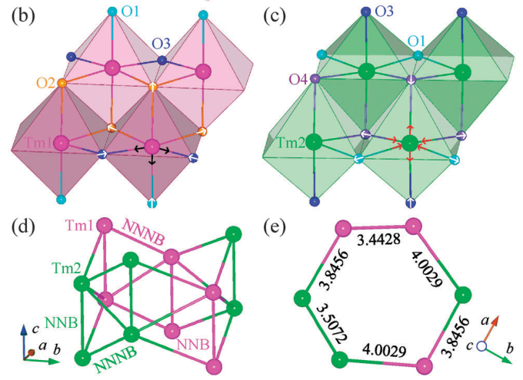
01 Background & Motivation
Zig-zag chains, frustration and a non-Kramers ion: is SrTm₂O₄ ordered?
Two inequivalent RE sites; zig-zag chains along c; NNB ≈ NNNB
Tm³⁺ (4f¹², ³H₆) is non-Kramers: CF singlet possible
Question: why do neutrons and μSR disagree?
Schematic: two zig-zag chains along c
Tm1 chain
Tm2 chain
c axis
NNB 3.38 Å ≈ NNNB 3.44–3.51 Å
MELODY2026 · The 3rd Workshop on Muon Science Technology and Industry · 26 Oct 2026
03/21
Notes:
[1:00] SrTm2O4 belongs to the SrRE2O4 family. The rare-earth ions sit on two inequivalent sites forming zig-zag chains along c. Nearest and next-nearest Tm-Tm distances are very similar, 3.38 versus 3.44 to 3.51 angstrom, which is the geometric frustration. Tm3+ is a non-Kramers ion, so a crystal-field singlet ground state is possible. Several family members order, or show short-range order, but Tm does not. The question for this talk: is the compound really disordered, and why does the muon see something different?

Slide 4
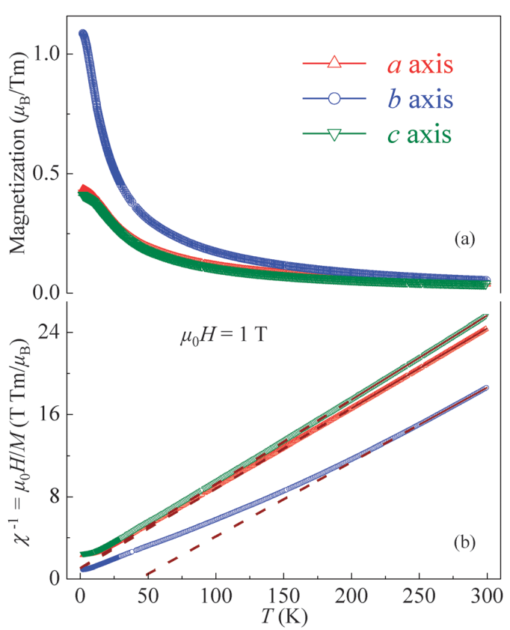
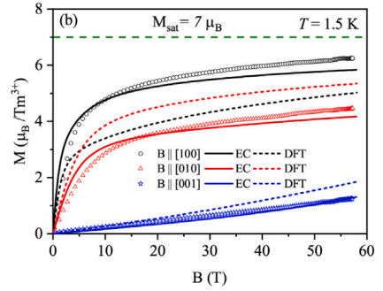
02 Bulk Magnetism & Neutrons
Bulk magnetism shows strong crystal-field anisotropy
θ_{CW} (K): AFM (−) vs FM (+)
+43
θ_{CW} changes sign: −12.7 K (a, c), +43.0 K (b)
High T: θ_{CW} = −41.6(2) K, μ_{eff} = 7.69(1) μ_{B} v.s. 7.56
2 K, 9 T: 37% of 7.0 μ_{B}; 58 T, a-axis: 6.24 μ_{B}
Not saturated
-12.7
-12.7
-41.6
a axis
b axis
c axis
580–880 K
MELODY2026 · The 3rd Workshop on Muon Science Technology and Industry · 26 Oct 2026
04/21
Notes:
[1:00] Along the three axes the Curie-Weiss temperature changes sign: minus 12.7 kelvin along a and c, plus 43 along b. In the high-temperature paramagnetic range we get minus 41.6 kelvin, a net antiferromagnetic coupling, and an effective moment of 7.69 Bohr magnetons, close to the free-ion value. At 2 kelvin and 9 tesla only 37 percent of the saturation moment is reached, and even at 58 tesla the a-axis moment is 6.24, not saturated. This points to strong crystal-field anisotropy. There is no hysteresis, so it is not a ferromagnet.

Slide 5
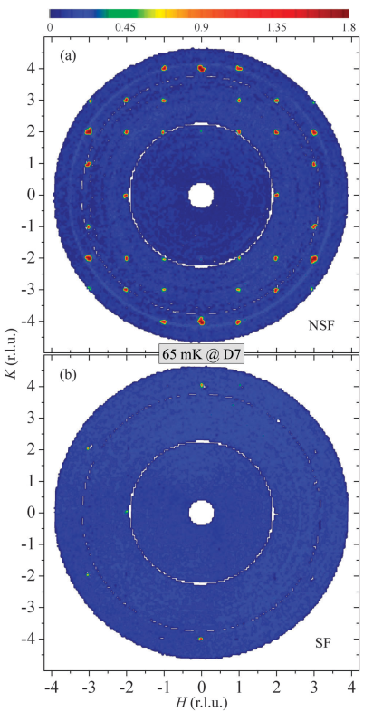
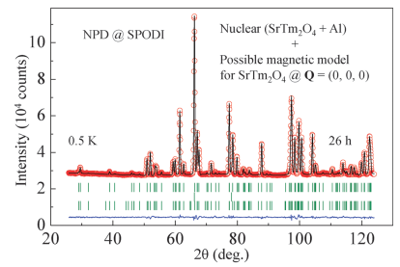
02 Bulk Magnetism & Neutrons
Neutrons find no magnetic order down to 65 mK
D7: no new peaks,
no diffuse
SPODI: no
magnetic peaks
Refined moment at 0.5 K (μ_{B})
D7 (polarized): no new Bragg peaks, no diffuse scattering
SPODI (0.5 K): moments +0.30(21), −0.20(21) μB, consistent with zero
Tm1
Tm2
−1
0
+1
+0.30(21), −0.20(21): consistent with 0
MELODY2026 · The 3rd Workshop on Muon Science Technology and Industry · 26 Oct 2026
05/21
Notes:
[0:50] Single-crystal polarized neutron scattering on D7, at about 65 millikelvin, shows no new Bragg peaks and no diffuse scattering. Powder diffraction on SPODI, about 26 hours at 0.5 kelvin, shows no magnetic peaks. The refined moments are plus 0.30 and minus 0.20 Bohr magnetons, each with an uncertainty of 0.21, so consistent with zero.

Slide 6
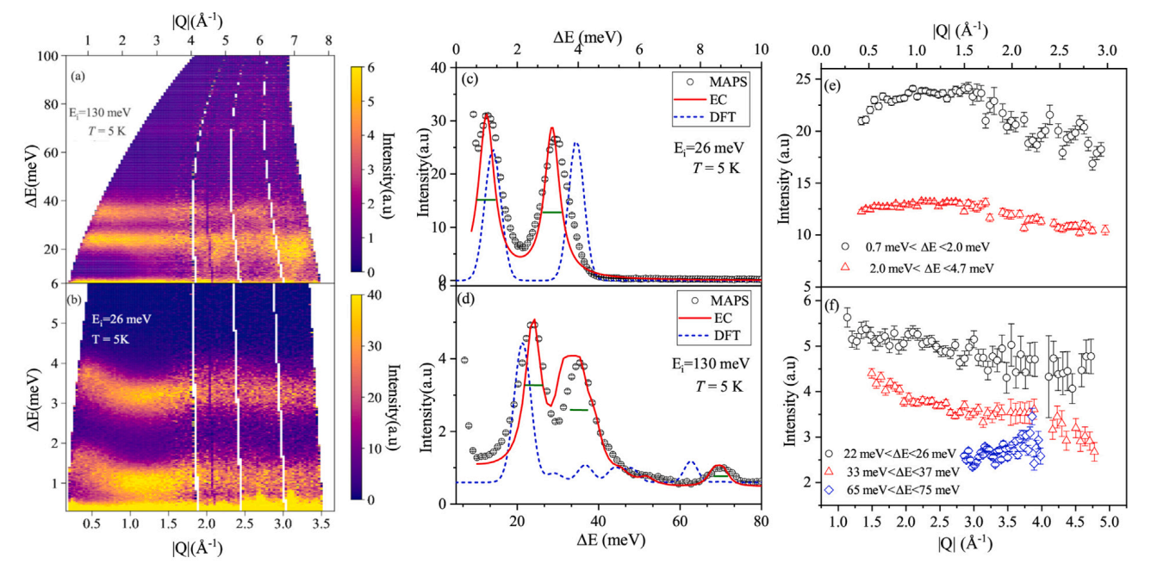
03 Crystal Field
INS reveals five crystal-field excitations
INS levels, meV (√E axis, not to scale)
E
71.00
35.82
23.72
3.412
1.230
0
blue: dispersive · orange: non-dispersive
MAPS, 5 K: 1.230(5), 3.412(3) meV (dispersive)
23.72(4), 35.82(6), 71.00(2) meV (non-dispersive)
Intensity falls with |Q|: Magnetic Origin
MELODY2026 · The 3rd Workshop on Muon Science Technology and Industry · 26 Oct 2026
06/21
Notes:
[0:45] Inelastic neutron scattering on MAPS at 5 kelvin sees five excitations. Two at low energy, 1.2 and 3.4 millielectronvolts, which are dispersive, so inter-ionic interactions are present. Three at higher energy, 24, 36 and 71, without dispersion. The intensity falls with Q, confirming the magnetic origin. These levels are the input to the crystal-field model.

Slide 7
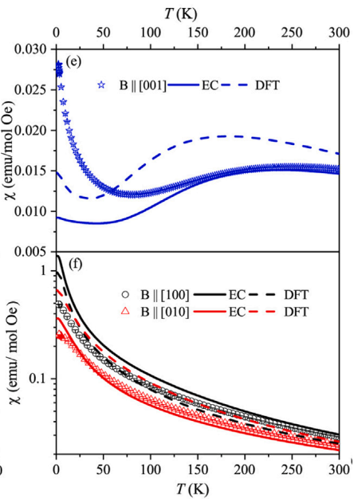
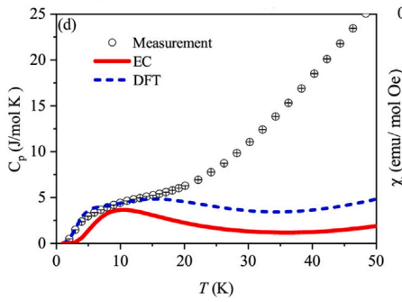
03 Crystal Field
An effective point-charge model describes the data; DFT does not
✘ DFT model (Wannier)
Low-energy levels only;
wrong M(H) trends
EC model fits INS, Schottky C(T) and high-T χ(T)
Effective charges −0.468e (Tm1), −0.725e (Tm2)
DFT (Wannier): low-energy levels only
✔ EC model (point charge)
Fits INS, C(T), high-T χ(T);
M(H): small deviation
MELODY2026 · The 3rd Workshop on Muon Science Technology and Industry · 26 Oct 2026
07/21
Notes:
[0:45] We used two models. A DFT model based on Wannier functions describes only the low-energy excitations and fails for the magnetization trends. An effective point-charge model, with oxygen charges fitted to the INS data, describes the INS spectrum, the Schottky anomaly and the high-temperature susceptibility. Small deviations at low temperature probably come from inter-ionic interactions, which are not included.

Slide 8
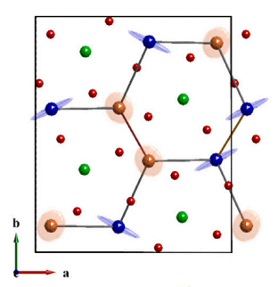
03 Crystal Field
Tm1 is easy-axis, Tm2 is easy-plane; the ground state is J = 0
g-tensor ellipsoids (schematic)
c (hard)
c (hard)
Tm1: easy-axis
Tm2: easy-plane (ab)
c is the hard axis for both sites
EC model: J = 0 dominates both ground states
CF singlet ground state; frustration is secondary
MELODY2026 · The 3rd Workshop on Muon Science Technology and Industry · 26 Oct 2026
08/21
Notes:
[0:45] The EC model predicts easy-axis anisotropy for Tm1 and easy-plane anisotropy for Tm2, and c is hard for both. For both sites the ground state is dominated by J equals zero. Together with weak dipolar interactions, this explains the absence of order. In this picture frustration is probably secondary to the crystal field.

Slide 9
04 μSR vs. Neutrons
μSR primer: an oscillation means the muon sees a static field
Zero field → Static local field → Spin precesses → oscillation
ZF-μSR: spin precesses in a static local field
Single frequency = single muon stopping site
Longitudinal Ffield-μSR separates static from dynamic
Fluctuating field → monotonic relaxation
ν = γμ·Bloc , γμ = 0.1355 MHz/mT
Bloc = 4.7 mT → ν ≈ 0.64 MHz
MELODY2026 · The 3rd Workshop on Muon Science Technology and Industry · 26 Oct 2026
09/21
Notes:
[1:00] A quick reminder, mostly for orientation. In zero field, if the muon sees a static local field, its spin precesses and we see oscillations in the asymmetry. That is why oscillations are usually taken as evidence of long-range order. A single frequency also tells us there is a single muon stopping site. The frequency gives the local field. If the field fluctuates, we only see a monotonic relaxation. A longitudinal field can then distinguish a static field distribution from dynamics.

Slide 10
04 μSR vs. Neutrons
The twist: ZF-μSR shows an oscillation
Single-frequency oscillation below 100 K
No clear critical temperature, expected for a second-order transition.
This contradicts bulk and neutrons. Is it intrinsic order, or an artifact of the probe?
Bulk + neutrons
No order
to 65 mK
ZF-μSR
Oscillation
Bloc = 4.7 mT
≠
Intrinsic order, or a probe artifact?
MELODY2026 · The 3rd Workshop on Muon Science Technology and Industry · 26 Oct 2026
10/21
Notes:
[0:40] Now the twist. Zero-field μSR on the same compound shows a clean single-frequency oscillation below 100 kelvin. But there is no critical temperature, as would be expected for a second-order transition. This contradicts bulk and neutrons. Is it intrinsic order, or an artifact of the probe? Let me show the data.

Slide 11
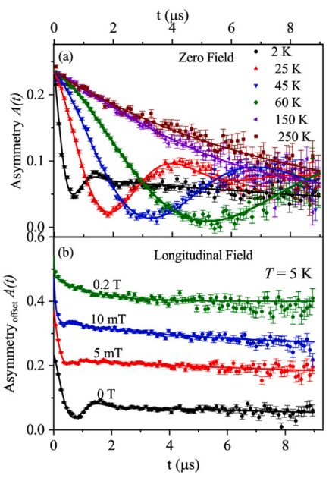
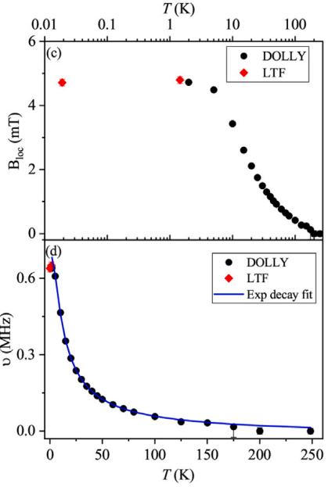
04 μSR vs. Neutrons
The local field grows smoothly and saturates at 4.7 mT
Bloc rises exponentially on cooling, no critical temperature
ZF spectra: a single oscillation that develops and damps as the temperature goes down.
Local field extracted from the fits. It increases exponentially on cooling and levels off below 2 kelvin at 4.7 millitesla.
In a compound with no spontaneous order the local field would be zero. But there is no clear critical temperature.
Either this is an unusual order, or the muon is doing something.
MELODY2026 · The 3rd Workshop on Muon Science Technology and Industry · 26 Oct 2026
11/21
Notes:
[1:00] On the left, the ZF spectra: a single oscillation that develops and damps as the temperature goes down. On the right, the local field extracted from the fits. It increases exponentially on cooling and levels off below 2 kelvin at 4.7 millitesla. In a compound with no spontaneous order the local field would be zero. But there is no clear critical temperature. So either this is an unusual order, or the muon is doing something.

Slide 12
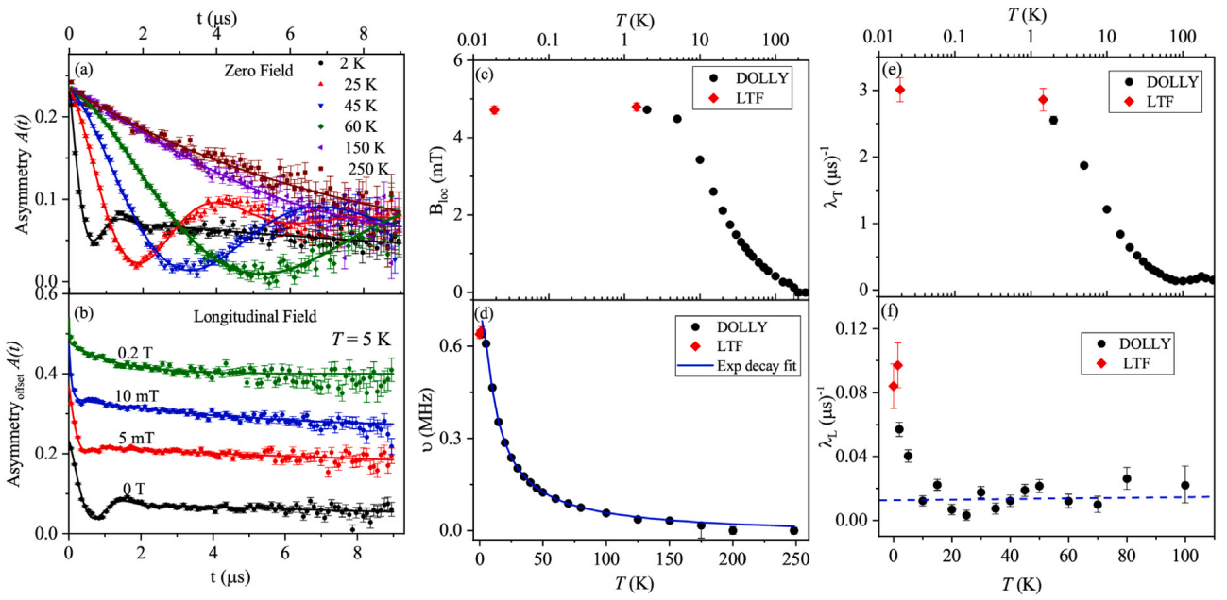
04 μSR vs. Neutrons
Four observations point to dynamic relaxation, not conventional static order
✔
δ = 11.3(3) K (activated law) = first CF gap
✔
λT (transverse relaxation) grows while Bloc (the local field) saturates (narrowing static distribution)
✔
λL (longitudinal rate) rises sharply below 10 K (origining from fluctuations)
✔
LF 0.2 T: relaxation persists; 0.5 T quenches
→ dynamic, quasi-static field
δ = 11.3(3) K = 0.97 meV, equal to the first CF gap
LF: oscillation quenched at 5 mT; relaxation persists at 0.2 T
MELODY2026 · The 3rd Workshop on Muon Science Technology and Industry · 26 Oct 2026
12/21
Notes:
[1:10] Four observations argue against conventional static order. First, the frequency follows an activated law with 11.3 kelvin, the same as the first crystal-field gap seen by INS. Second, the transverse relaxation keeps growing while the local field saturates; a static distribution would narrow. This resembles an extended critical regime, as reported for TmNi2B2C. Third, the longitudinal rate rises sharply below 10 kelvin, which can only come from fluctuations. Fourth, 5 millitesla quenches the oscillation but even 0.2 tesla does not quench the relaxation. The conclusion in the paper: the relaxation is dynamic and the muon feels a quasi-static field.

Slide 13
04 μSR vs. Neutrons
Muon-perturbed crystal fields have precedents
Pr-based pyrochlores
Pr pyrochlores: Foronda et al., PRL 114, 017602 (2015)
PrNi₅: Kayzel 1994; Feyerherm 1995
In those systems hyperfine interactions play an important role. Whether this matters for Tm is not discussed there, so I will not claim anything about it.
μ⁺ locally modifies CF levels (DFT-modelled)
PrNi₅
Quasi-static dynamics; μ⁺-perturbed CF
SrTm₂O₄
Non-Kramers Tm³⁺; hyperfine interactions：important role (not discussed)
MELODY2026 · The 3rd Workshop on Muon Science Technology and Industry · 26 Oct 2026
13/21
Notes:
[0:40] This idea has precedent. In Pr-based pyrochlores, a muon-induced local modification of the crystal-field levels was modeled with DFT. In PrNi5, quasi-static dynamics and a muon-perturbed crystal field were reported. The paper notes that in those systems hyperfine interactions play an important role. Whether this matters for Tm is not discussed there, so I will not claim anything about it.

Slide 14
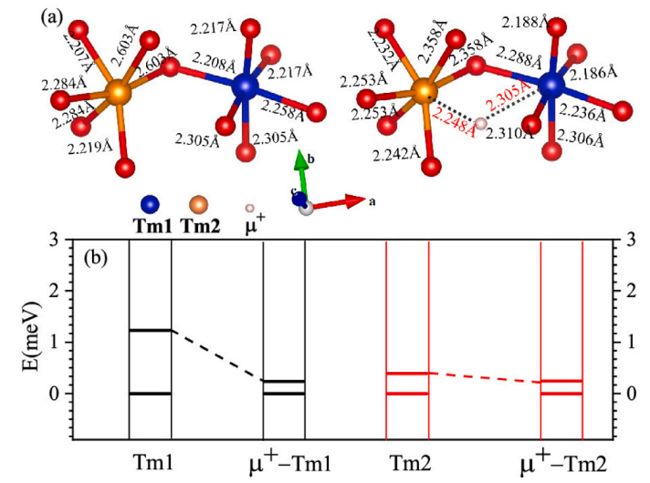
04 μSR vs. Neutrons
The muon shrinks the first CF gap by 38 (Tm2) – 80% (Tm1)
First gap, relative to unperturbed
Tm1
1.00
−80%
Tm2
1.00
−38%
Gaps → ≈ 0.6 meV (≈ 7 K): pseudo-doublet
DFT: one low-symmetry interstitial muon site
PC model (qualitative): gaps → ≈ 0.6 meV, a pseudo-doublet
Consistent with a muon-induced local moment
MELODY2026 · The 3rd Workshop on Muon Science Technology and Industry · 26 Oct 2026
14/21
Notes:
[1:00] To test this we located the muon stopping site with DFT: a single low-symmetry interstitial site, consistent with the single frequency. Then we recomputed the crystal field with the point-charge model before and after implantation. The first gap shrinks by about 80 percent for Tm1 and 38 percent for Tm2, to about 0.6 millielectronvolt, which gives an effective pseudo-doublet ground state. The point-charge model is only qualitative, so the statement is that the data are consistent with a muon-induced local moment.

Slide 15
05 Summary & Outlook
Only μSR perturbs the lattice, and only μSR sees order
Probe
Measures
Perturbs lattice?
Result
Bulk (M, C, χ)
Average over all Tm³⁺
No
No order; CF-dominated
Neutrons (D7, SPODI)
Ordered moment, Bragg peaks
No
None down to 65 mK
INS (MAPS)
Crystal-field levels
No
J = 0
dominated ground states
μSR
Local field at the muon site
Yes (muon distorts lattice)
Oscillation; dynamic, quasi-static
Lesson: pair local probes with DFT to quantify the perturbation they introduce
MELODY2026 · The 3rd Workshop on Muon Science Technology and Industry · 26 Oct 2026
15/21
Notes:
[0:45] Putting it together. Bulk and neutrons are non-perturbing and they agree: no order, crystal-field dominated. INS confirms J equals zero dominated ground states. Only μSR perturbs the lattice, and that is the probe where the oscillation appears. The lesson for this community: pair local probes with DFT to quantify the perturbation they introduce.

Slide 16
05 Summary & Outlook
Conclusions and outlook
No intrinsic order
Bulk + neutrons, down to 65 mK
Crystal-field dominated
No order to 65 mK; crystal-field dominated
μSR signal: muon-induced, dynamic
J = 0 ground states; Tm1 easy-axis, Tm2 easy-plane
μSR oscillation ≠ order
Muon-induced distortion; dynamic relaxation
Next steps
Fields, uniaxial pressure, XYZ polarization, low-T INS
MELODY2026 · The 3rd Workshop on Muon Science Technology and Industry · 26 Oct 2026
16/21
Notes:
[0:45] To conclude. SrTm2O4 shows no magnetic order down to 65 millikelvin. The physics is dominated by the crystal field, with J equals zero ground states, easy-axis Tm1 and easy-plane Tm2. The μSR oscillation is best understood as a muon-induced perturbation with dynamic relaxation. Next steps: higher fields, uniaxial pressure, XYZ polarization analysis and low-temperature INS. Thank you, I am happy to take questions.

Slide 17
Acknowledgements
Acknowledgements and references
Collaborators
References
A. Bhat Kademane, D. L. Quintero-Castro (Univ. Stavanger / HZB), K. Siemensmeyer, C. Salazar-Mejia, D. Gorbunov, J. R. Stewart, H. Luetkens, C. Baines
A. Senyshyn, O. Fabelo, A. Wildes, G. Roth, C. Zhang, J. G. Roca, K. Schmalzl, W. Schmidt, M. Boehm, B. Hou, and co-authors of Li et al. 2015
H.-F. Li et al., Absence of magnetic ordering in the ground state of a SrTm₂O₄ single crystal, J. Mater. Chem. C 3, 7658 (2015).
A. Bhat Kademane et al., Crystal field effects in the zig-zag chain compound SrTm₂O₄, J. Magn. Magn. Mater. 551, 169020 (2022).
F. R. Foronda et al., Phys. Rev. Lett. 114, 017602 (2015).
F. Kayzel et al., Hyperfine Interact. 85, 275 (1994); R. Feyerherm et al., Z. Phys. B 99, 3 (1995).
Facilities
ILL · MLZ (FRM-II) · ISIS · PSI SμS · HLD-EMFL · HZB
MELODY2026 · The 3rd Workshop on Muon Science Technology and Industry · 26 Oct 2026
17/21
Notes:
Thank you to my collaborators, especially A. Bhat Kademane and D. L. Quintero-Castro, and to the facilities: ILL, MLZ/FRM-II, ISIS, PSI and HLD-EMFL. [Add funding information here.] Please keep this slide up during the questions.

Slide 18





The 3rd Workshop on Muon Science Technology and Industry (MELODY2026) · Oct. 26, 2026
Thank you for your attention & welcome all possible collaborations!
haifengli@um.edu.mo

Slide 20
Backup
Backup 1: Activation energy vs. perturbed gap
δ = 11.3(3) K equals the unperturbed first gap; perturbed PC gap ≈ 7 K
The paper does not resolve this
Our reading (interpretation, not in the paper): PC model is qualitative; the activation may reflect thermal population of levels on other ions
Activation energy of ν(T)
δ = 11.3(3) K = 0.97 meV
(= unperturbed first gap, 'coincidentally')
PC model, muon-perturbed gap
≈ 0.6 meV (≈ 7 K)
(qualitative)
Not resolved in the paper
MELODY2026 · The 3rd Workshop on Muon Science Technology and Industry · 26 Oct 2026
18/21
Notes:
If asked: the activation energy of the precession frequency is 11.3 kelvin, equal to the unperturbed first gap from INS, while the point-charge calculation gives a perturbed gap of about 7 kelvin. The paper does not resolve this. Possible readings: the point-charge model is explicitly qualitative, and the activation may reflect thermal population of levels on ions beyond the nearest neighbours of the muon. That is our interpretation, not a result from the paper. A quantitative calculation is needed.

Slide 21
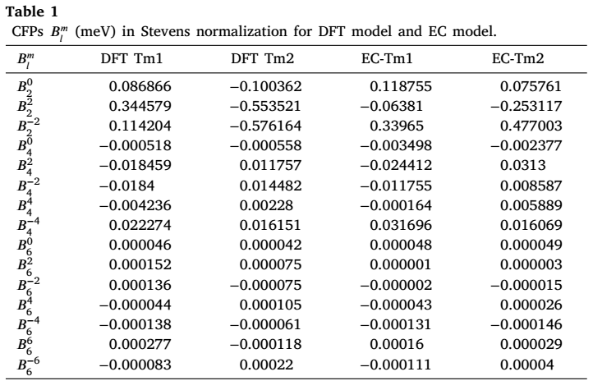
Backup
Backup 2: Crystal-field parameters and eigenstates
EC: J = 0 ground state; J = ±1 first excited
DFT: Tm1 ground state J = 0; Tm2 dominated by J = ±1
First excited state from Tm2; second from Tm1
MELODY2026 · The 3rd Workshop on Muon Science Technology and Industry · 26 Oct 2026
19/21
Notes:
Backup. Crystal-field parameters and eigenvectors of both models. In the EC model both sites have predominantly J equals zero ground states, with J equal plus or minus one dominating the first excited state. In the DFT model the Tm2 ground state is dominated by J equal plus or minus one. Among the low-energy excitations, the first originates from Tm2 and the second from Tm1.

Slide 22
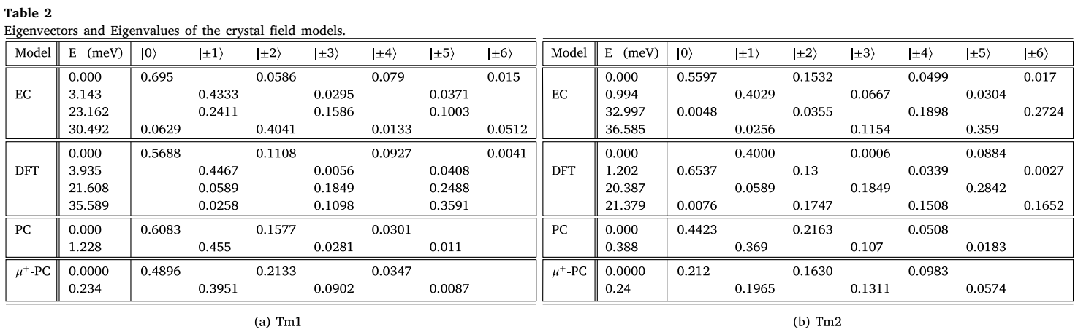
Backup
Backup 2: Crystal-field parameters and eigenstates
EC: J = 0 ground state; J = ±1 first excited
DFT: Tm1 ground state J = 0; Tm2 dominated by J = ±1
First excited state from Tm2; second from Tm1
MELODY2026 · The 3rd Workshop on Muon Science Technology and Industry · 26 Oct 2026
19/21
Notes:
Backup. Crystal-field parameters and eigenvectors of both models. In the EC model both sites have predominantly J equals zero ground states, with J equal plus or minus one dominating the first excited state. In the DFT model the Tm2 ground state is dominated by J equal plus or minus one. Among the low-energy excitations, the first originates from Tm2 and the second from Tm1.

Slide 23
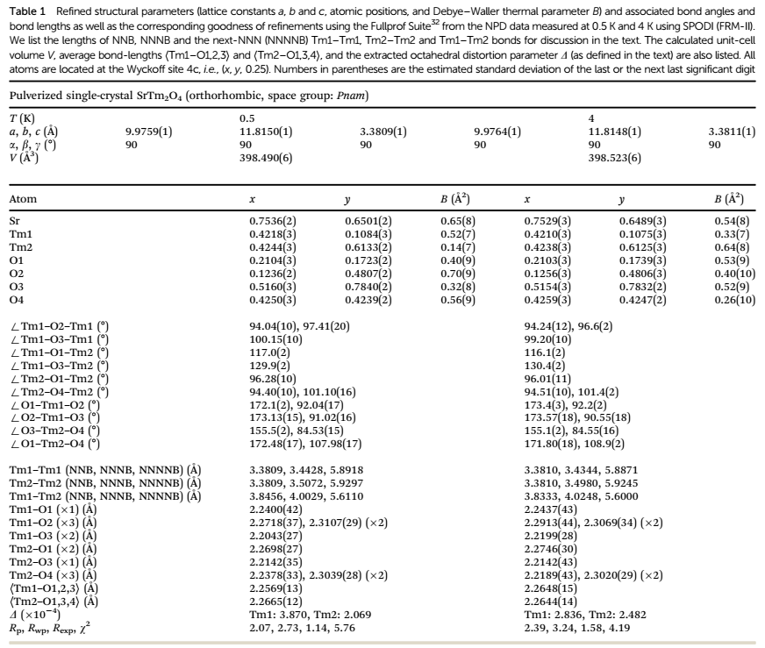
Backup
Backup 3: TmO₆ distortion and bond lengths
D (×10⁻⁴) at 0.5 K: Tm1 3.870, Tm2 2.069
4 K → 0.5 K: Tm1 D grows, Tm2 D falls
Same distortion modes as SrTb₂O₄
MELODY2026 · The 3rd Workshop on Muon Science Technology and Industry · 26 Oct 2026
20/21
Notes:
Backup. The octahedral distortion parameter D at 0.5 kelvin is 3.87 times ten to the minus four for Tm1 and 2.07 for Tm2. On cooling from 4 to 0.5 kelvin, D of Tm1 increases and D of Tm2 decreases. The distortion modes are the same as in SrTb2O4.

Slide 24
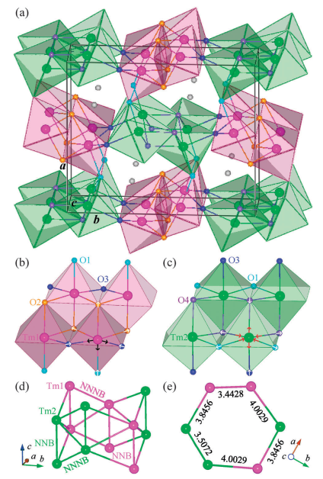
Backup
Backup 3: TmO₆ distortion and bond lengths
D (×10⁻⁴) at 0.5 K: Tm1 3.870, Tm2 2.069
4 K → 0.5 K: Tm1 D grows, Tm2 D falls
Same distortion modes as SrTb₂O₄
MELODY2026 · The 3rd Workshop on Muon Science Technology and Industry · 26 Oct 2026
20/21
Notes:
Backup. The octahedral distortion parameter D at 0.5 kelvin is 3.87 times ten to the minus four for Tm1 and 2.07 for Tm2. On cooling from 4 to 0.5 kelvin, D of Tm1 increases and D of Tm2 decreases. The distortion modes are the same as in SrTb2O4.

Slide 25
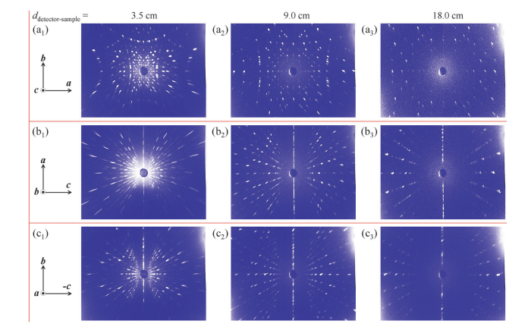
Backup
Backup 4: Sample quality
ICP-OES: Sr₁.₀₇(₃)Tm₂.₀₇(₆)O₄.₀₀(₂)
Neutron Laue (OrientExpress) fixes a, b, c
IN3: mosaic FWHM ≈ 0.6° for (6,0,0), (0,4,0), (0,0,2)
MELODY2026 · The 3rd Workshop on Muon Science Technology and Industry · 26 Oct 2026
21/21
Notes:
Backup. The crystal is nearly stoichiometric by ICP-OES. Orientation was fixed by neutron Laue diffraction, and the mosaic spread measured on IN3 is about 0.6 degrees on all three axes.

Slide 26
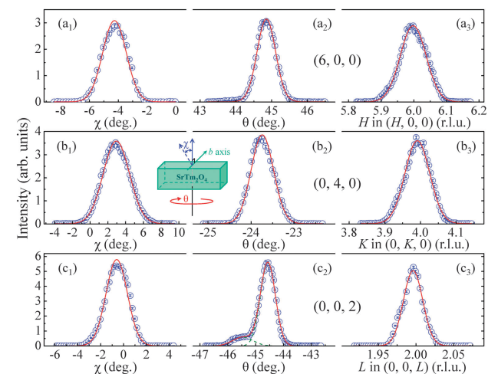
Backup
Backup 4: Sample quality
ICP-OES: Sr₁.₀₇(₃)Tm₂.₀₇(₆)O₄.₀₀(₂)
Neutron Laue (OrientExpress) fixes a, b, c
IN3: mosaic FWHM ≈ 0.6° for (6,0,0), (0,4,0), (0,0,2)
MELODY2026 · The 3rd Workshop on Muon Science Technology and Industry · 26 Oct 2026
21/21
Notes:
Backup. The crystal is nearly stoichiometric by ICP-OES. Orientation was fixed by neutron Laue diffraction, and the mosaic spread measured on IN3 is about 0.6 degrees on all three axes.

