Slide 1


μSR in water: new insights into muon-biology
The 3rd Workshop on Muon Science Technology and Industry，MELODY2026
Amba Datt Pant^{1,2}
          ¹ Institute of Materials Structure Science, KEK, Japan
          ² J-PARC center, Japan
pant@post.kek.jp
Oct. 24-26, 2026

Slide 2
Contents
Muon-biology: Fundamentals → applications
(results using positive muon)
New insights into μSR in water
  Formation of MuOH in ice; proposed new model
  [A. D. Pant, e al., Phys. Rev. B 110 (2024) 104104]
  Validity of proposed model for D₂O
  [A. D. Pant, et al., J. Phys. Soc. Jpn. 95(1) (2026) 014603]
  Quantum coherence of muon in ice
  [A. D. Pant, et al., Phys. Rev. B 114 (3) (2026) 034106; + Press release]
  Muonium relaxation in liquid water (before and after freeze-thaw)
  [A.D. Pant, et al., JPS Conf. Proc. 45 (2026) 011037 ]

Slide 3
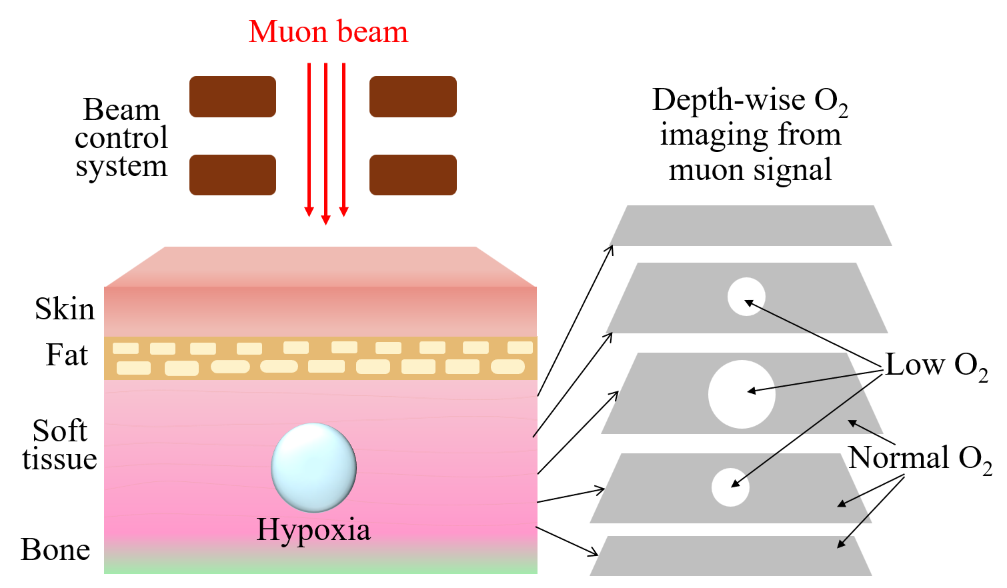
Introduction/Motivation
Fundamentals of muon-biology
Systematic study plan starting from water
Applications in medical/clinical fields
Hypoxia (low O₂) in tumor for cancer research
Muon in Bio-samples
Cells, Tissues
Protein, DNA
R•
Peptides
μ⁺
Amino acids
Buffer
Mu
Salt solution
Water + O₂
μ⁺
Dia.
water
A. D. Pant, et. al., JPS Conf Proc. 45 (2026) 011037
Muon and its species interact differently with environments
KAKENHI Grants: 21K15583 and 26H01510

Slide 4
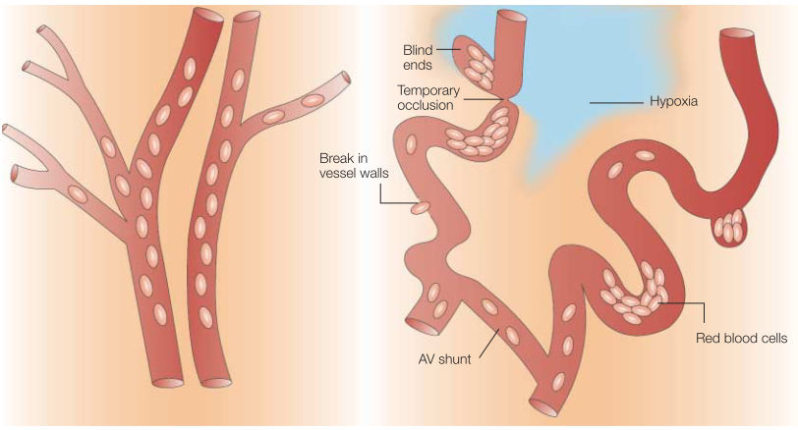
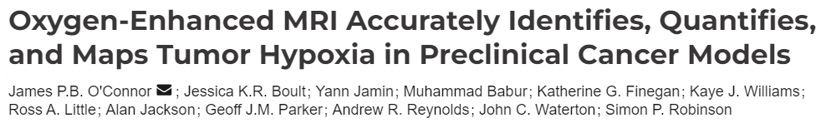
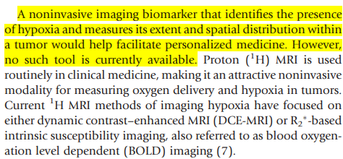

Muon for cancer research: motivation
Vascular network of normal tissue versus tumour tissue
Need of noninvasive techniques for hypoxia detection
Nature Reviews Cancer, 4 (2004) 437-447
Cancer Res., 76 (4) (2016) 787–795
Low oxygen region
O₂ heterogeneous
O₂ < 0.26 g/L, < 7 mmHg
Normal tissue
Tumour tissue
Low oxygen concentration or hypoxia plays a crucial role in the diagnosis and treatment of tumours and cancer

Slide 5
Advantages of muon method over existing methods for detection of hypoxia
Methods | Working principles | O₂ in blood | Limitations and advantages
Positron Emission Tomography (PET) [1] | Interaction of positrons and gamma rays | - | Does not directly measure O₂ but indirectly assess oxygen metabolism after radiation therapy, offline
Blood Oxygen Level Dependent (BOLD) MRI [2] | Interaction of protons with magnetic field and it detects change in the blood oxygenation level based on magnetic property of Hb | - | It measures deoxyHb not concentration of O₂
Pulse oximetry [3-4] | Light absorption from Hb | arterial blood | Not accurate to measure spatial distribution of O₂ in deeper level from skin surface, same data for COHb and HbO₂, not accurate for dark skin color
Blood gas analysis [5] | Chemical sensor reaction with gas in blood, taking a blood sample and measure O₂ and CO₂ levels | arterial blood | Not noninvasive, need to extract blood, complexity to deal extracted blood, offline
Proposed muon method [6,7] | Direct interaction of O₂ with muonium | O₂ in both arterial and venous blood | Noninvasive, no need of any perturbations, measurement at any temperature and even without external field, online
[1] T. Grönroos and H. Minn, Eur J Nucl Med Mol Imaging, 34 (2007) 1563; [2] J. L. Tatum, et al, Int J Radiat Biol, 82 (2006) 699,
[3] A. Jubran, Critical Care, 3 (1999) 2, R11, [4] G. Mardirossian, et al, Anesth Prog. 39 (1992) 194; [5] J. W. Severinghaus, et al., J. Clin. Monitor., 2 (1986) 125–139; [6] A. D. Pant, et al., J. Phys.: Conf. Ser., 551 (2014) 012043; / Nucl. Inst. Methods in Phys. Res., A, 1011 (2021) 165561; [7] A. D. Pant, et. al., JPS Conf Proc. 45 (2026) 011037

Slide 6
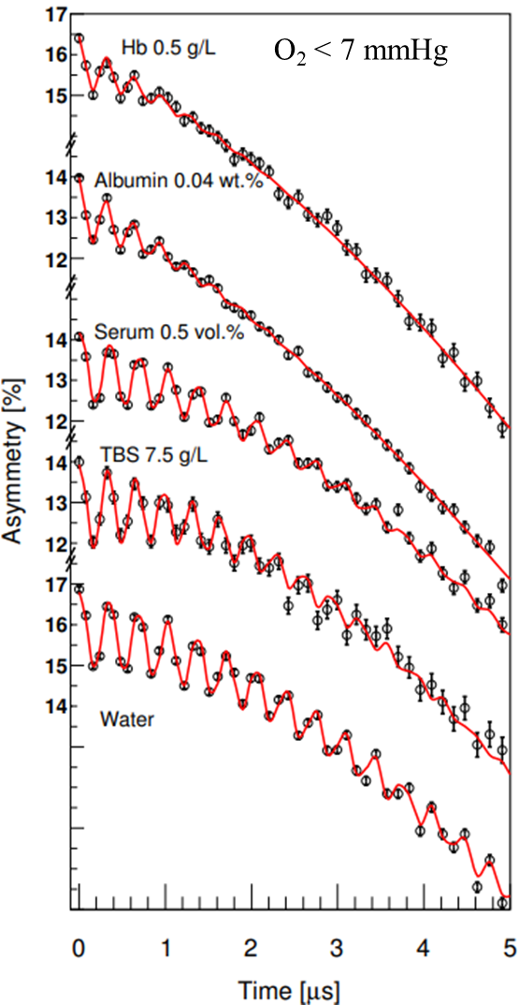
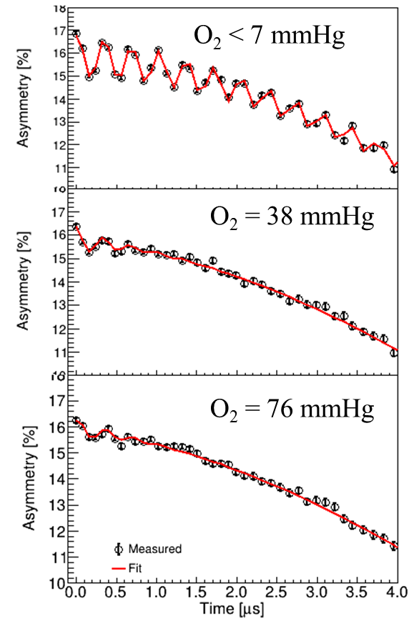
Sensitivity of muon method for hypoxia detection
O₂ detection in buffer solutions of proteins using muon
Relaxation of muonium in water in the presence of O₂
Spin-exchange interaction
Mu(↑↑) + O₂ → Mu(↑↓) + O₂
Chemical reactions
Mu + O₂ → MuO₂
Both cause relaxation of Mu
pO₂ in tumors in human body is heterogeneous, less than 5 mmHg
Measurable partial pressure by μSR = 0.3 to 300 (mmHg)
Sensitivity of MuSR matches perfectly
Muon interactions with water and proteins ?
A.D. Pant, et al., J. Phys.: Conf. Ser., 551 (2014) 012043
A.D. Pant et al., Nuclear Inst. and Methods in Physics Research, A 1011 (2021) 165561
Validity of hypoxia (low O₂) detection by muon
Motivation: μSR in water

Slide 7

Muon in biology related studies: updates (~60 years)
1981: Percival
Missing fraction in water
1995: Roduner
Mu interaction with O₂ in aq. soln
2014: Pant
O₂ detection in Hb soln
2017: Bossoni
human brain ferritin
1976: Percival
Mu in water
1968: Myasishcheva
Mu in ice
1988: Leung
MuOH and MuH in aq. soln
1992: Risch-Kehr
RK theory for polyacetylene
2004: Hubbard
ALCR in DNA
2015: Kobayashi
e/p transfer due to enzymatic rxn
1970
2024: Pant
MuOH in ice
1979: Bucci
DNA and water solutions
1982: Nagamine
Long lived Mu in water
2000: Nagamine
Electron transfer in cyt c protein
2014: Sugawara
Hydration dependent et in cyt c
2021: Pant
O₂ detection in biological aq. solns
1991: Cox
LCR study, HMuO in ice
2001: Torikai
Electron transfer in DNA
2006: Nagamine
Magnetism in human blood, oxyHb, deoxyHb
This talk: μSR in water

Slide 8
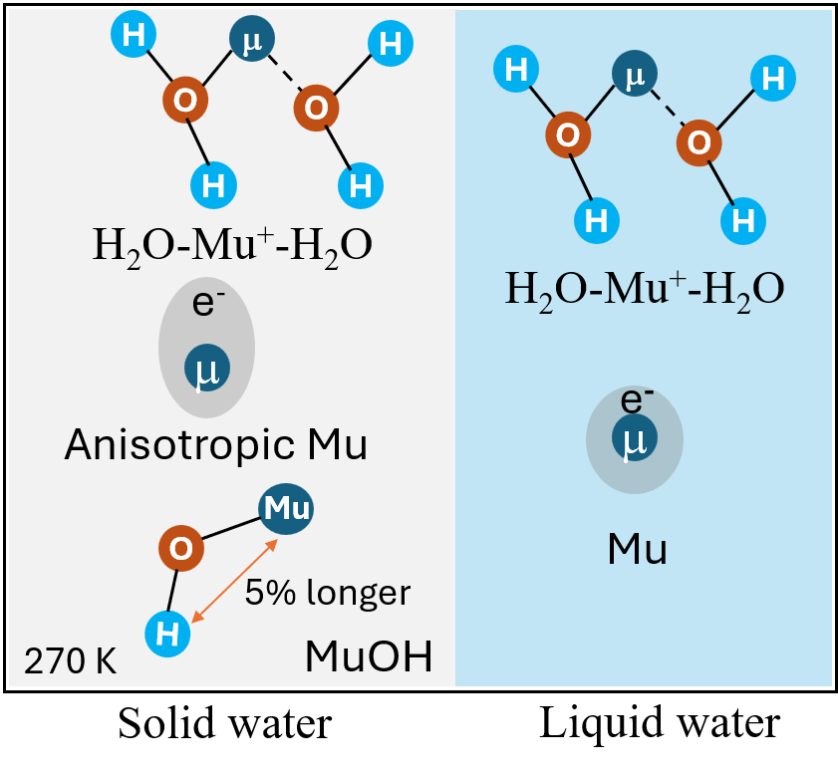
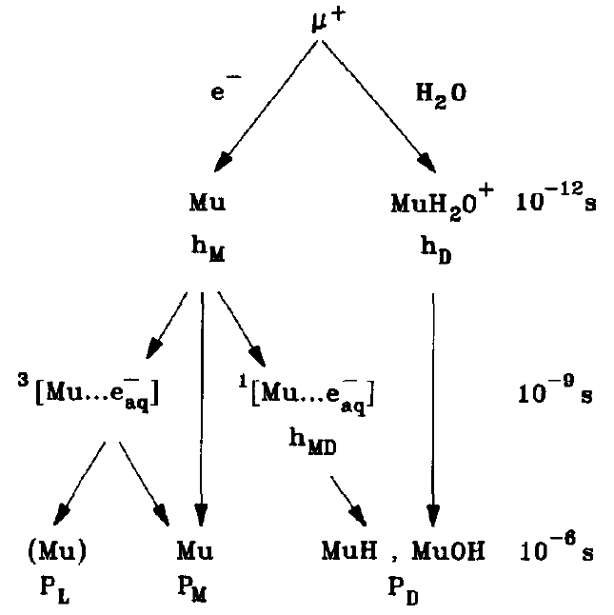
Liquid
μSR in H₂O (~60 yrs)
A(t) = f_{Mu} + f_{MuOH} + f_{dia.μ}
A(t) = f_{Mu} + f_{dia.μ}
1988: Leung
Mu rxn with hydrated e⁻
1982: Nagamine
Long lived Mu in water
1995: Roduner
Mu interaction with O₂ in aq. soln
ZF and weak TF
1976: Percival
Mu in water
1991: Cox
LCR study, HMuO in ice
Pant: proposed new model
New insights: μSR in water
2024: MuOH in ice
2026: Mu in H₂O & D₂O
2026: Quantum coherence
1968: Myasishcheva
Mu in ice
1981: Percival
Missing fraction in water
2004: Wang
ZF μSR in ice phases
1970
1980
1990
2000
2010
2020

Slide 9
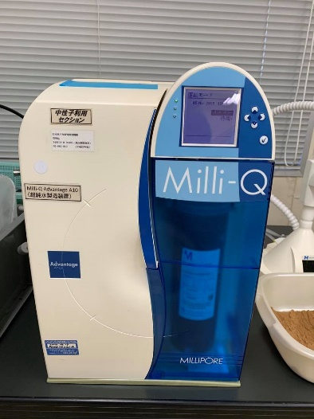
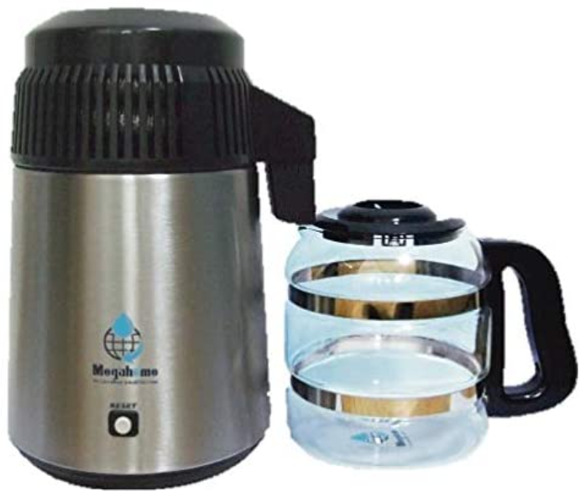
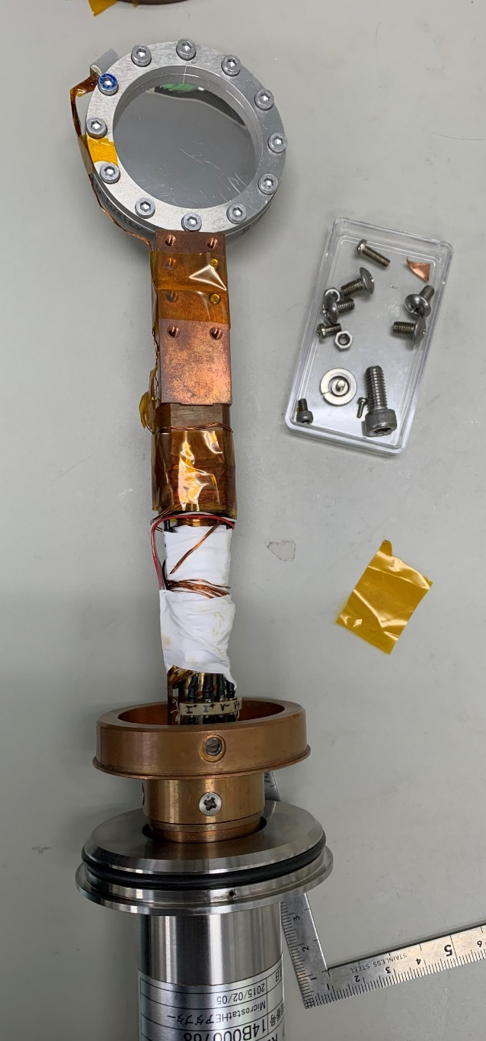
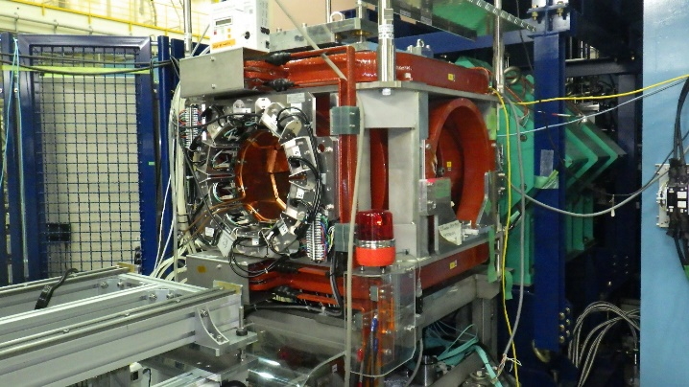
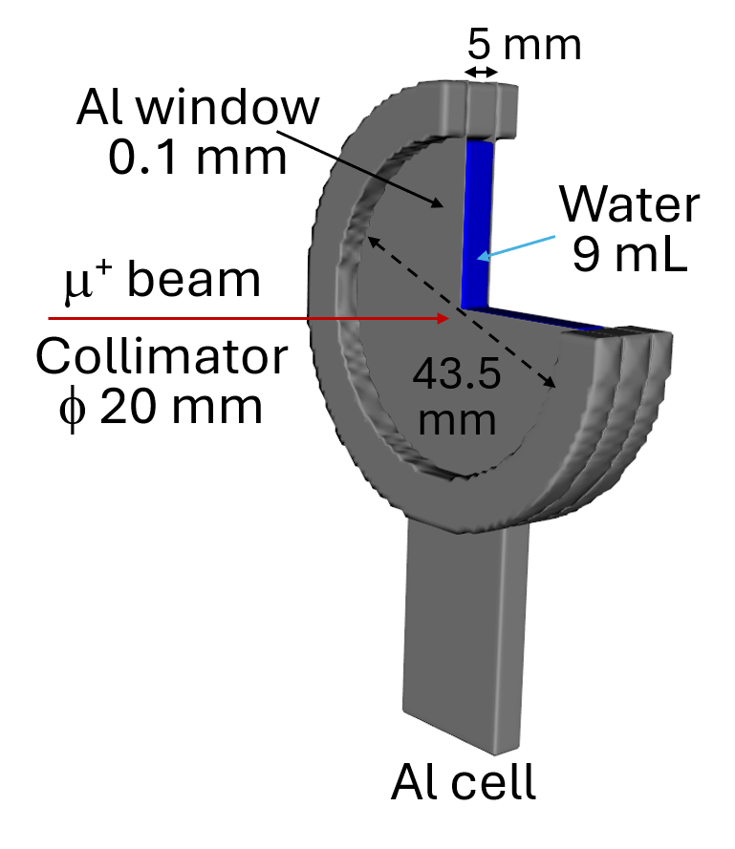
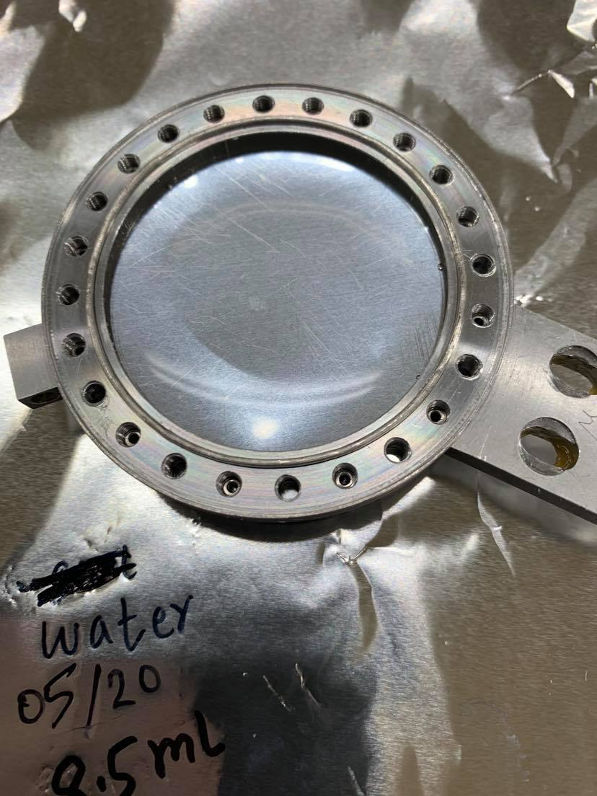
μSR in water
Experiment Set-up
overview
Distill twice
Field: Zero field,
TF < 20 G
T: 100 K – 300 K
Water from Milli-Q
N₂ bubbled
Spectrometer at S1, MLF, J-PARC
ZF, TF < 20 G
300 K – 220 K
H₂O, D₂O
O₂ control (bubble by N₂ or O₂) and seal in Al cell
Connect to micro-cryostat head and use thermal shield

Slide 10
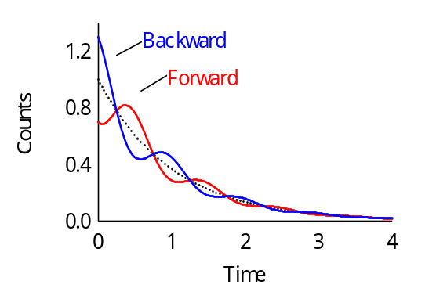
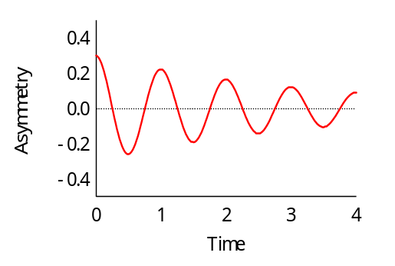
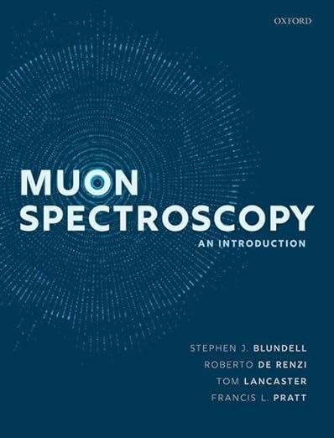
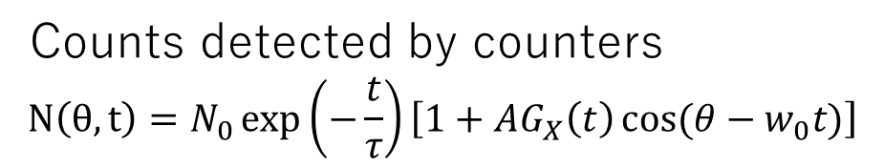

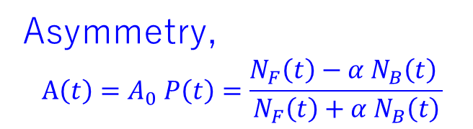
Muon technique
Muon spin rotation, relaxation and resonance (μSR) method
Local field
e⁺
B ⊥ Sμ
TF
μ⁺
μ⁺
S_{μ}
μ⁺
v
Sample
Forward counter
Backward counter
m_{μ} ~ 1/9 m_{p}, 207m_{e}
Spin polarized (100%)
μ_{μ} ~ 3.2 μ_{p}
Asymmetric decay to e⁺
Muonium, Mu = μ⁺e⁻
Mu, 100 times more sensitive than μ
Mu, light isotope of H
Counts detected by counters
$$N\left(θ,t\right)=N_{0}\exp\left(−\frac{t}{τ}\right)\left[1+AG_{X}\left(t\right)\cos{(θ−w_{0}t)}\right]$$
Asymmetry,
$$A\left(t\right)=A_{0} P\left(t\right)=\frac{N_{F}\left(t\right)−α{ N}_{B}\left(t\right) }{N_{F}\left(t\right)+α N_{B}\left(t\right)}$$
where, P(t) is polarization function,
is balance parameter between the two detectors,
A₀ is initial asymmetry at t=0,
N_{B} and N_{F} are backward and forward counts, respectively.
$$μ^{+}→ e^{+} + ν_{e} + \overline{ν_{μ}}$$
Ref. book

Slide 11
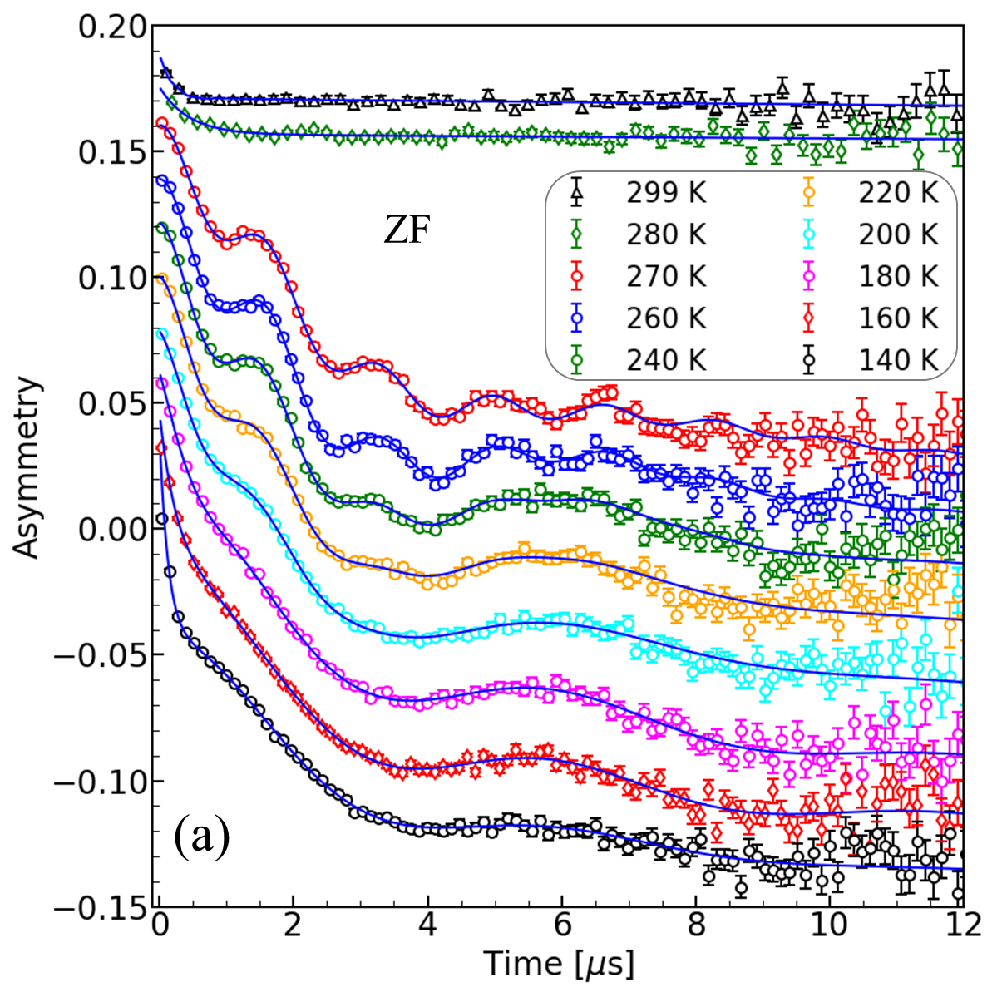
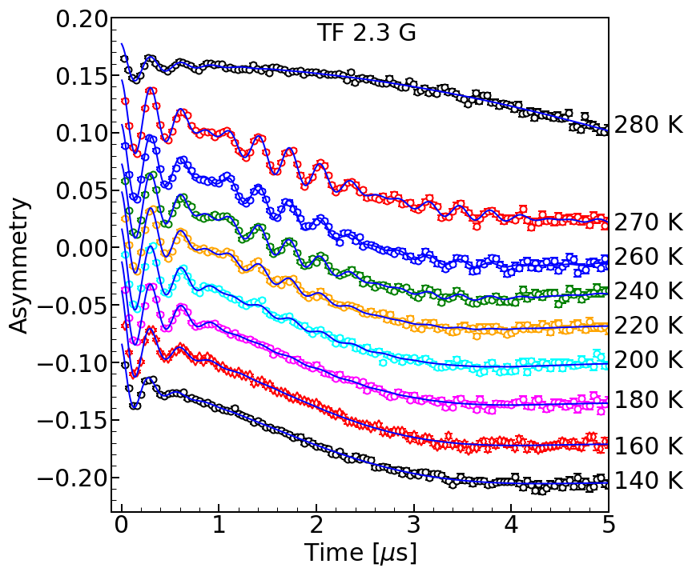
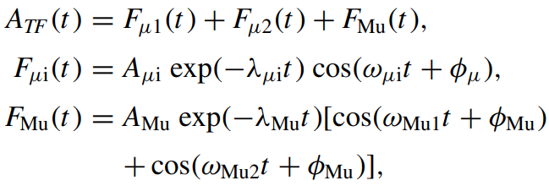
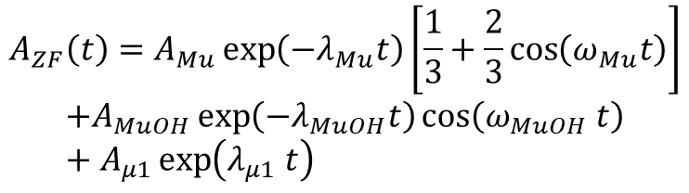
Temperature-dependent ZF and TF 2.3 G spectra
A.D. Pant et al., Phys.Rev. B 110, 104104 (2024)
Mu
Shifted for display
O
$$A_{ZF}\left(t\right)=A_{Mu}\exp\left(−λ_{Mu}t\right)\left[\frac{1}{3}+\frac{2}{3}\cos\left(ω_{Mu}t\right)\right]$$
$$+A_{MuOH}\exp\left(−λ_{MuOH}t\right)\cos\left(ω_{MuOH} t\right)+A_{μ1}\exp\left(λ_{μ1} t\right)$$
H
Proposed a model (frozen):
A(t) = f_{Mu}(t) + f_{MuOH}(t) + f_{dia.μ}(t)

Slide 12
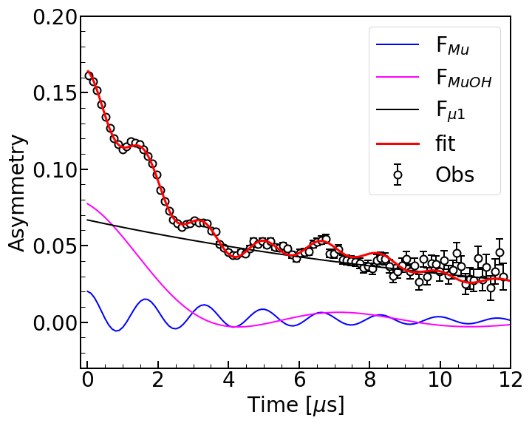
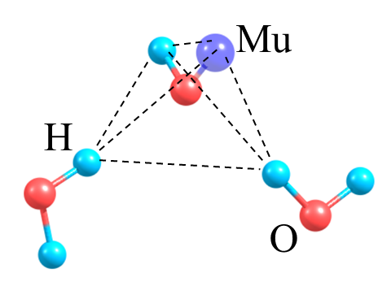
Formation and structure of MuOH in frozen ice
A(t) = f_{Mu}(t) + f_{MuOH}(t) + f_{dia.μ}(t)
A.D. Pant et al., Phys.Rev. B 110, 104104 (2024)
ZF 270 K
H
μ
H
H
H
μ
O
H
H
O
O
H
O
H₂O-Mu⁺-H₂O
H
e⁻
H₂O-Mu⁺-H₂O
μ
e⁻
Anisotropic Mu
μ
Mu
MuOH ~ 0.2 MHz
Mu
O
5% longer
Mu ~ 0.6 MHz
4S system
H
MuOH
270 K
Solid water
Liquid water
PIMD and quantum simulation also support the result of longer Mu-H in MuOH than H-H in H₂O by 5%
Muon provides info about nearby H so it can be used for DNA study because DNA damage and mutations arise from improper hydrogen bond networking
Notes:
H-H distance in H₂O is 1.57 Å, Mu-H distance in MuOH is 1.65 Å

Slide 13
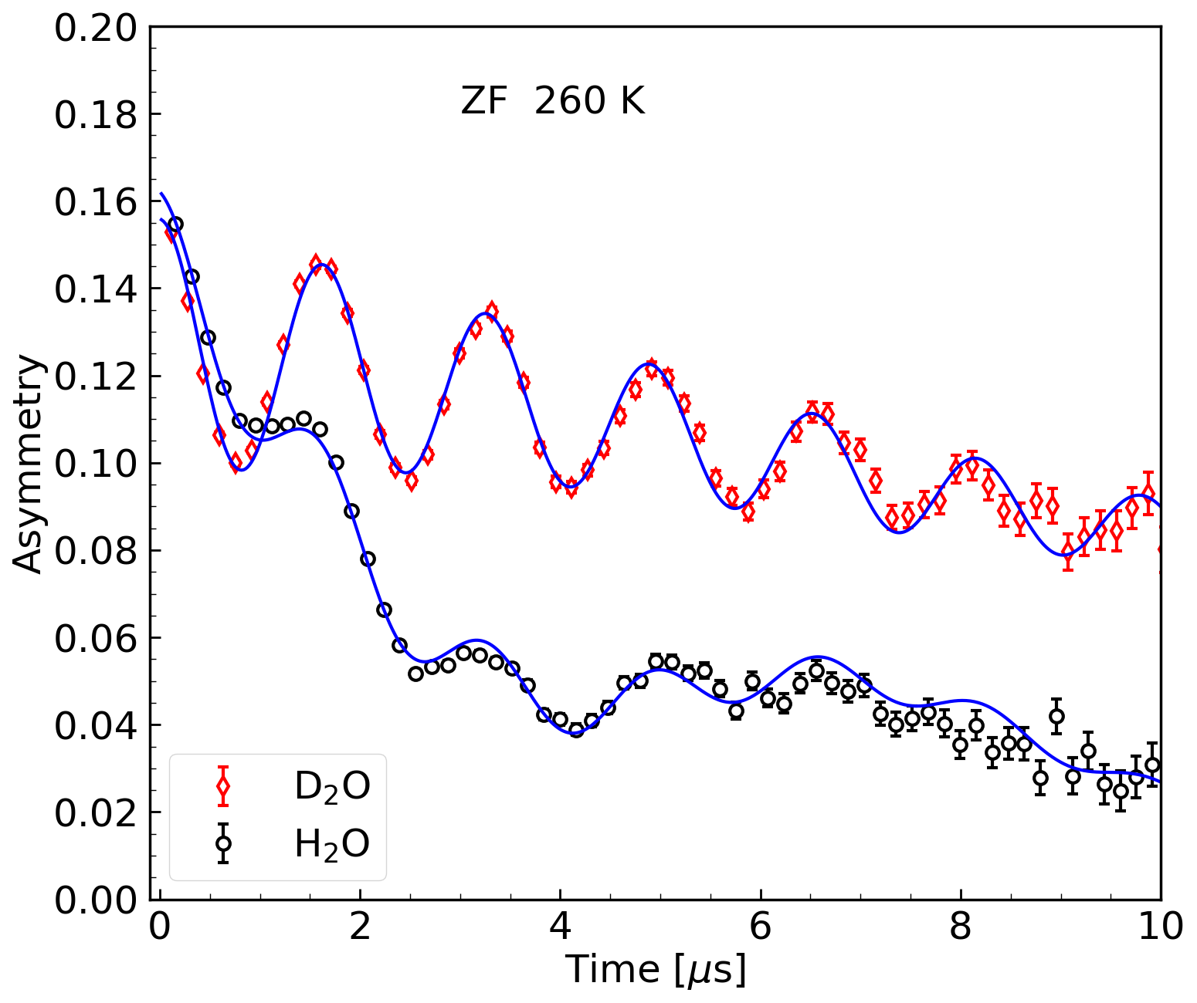
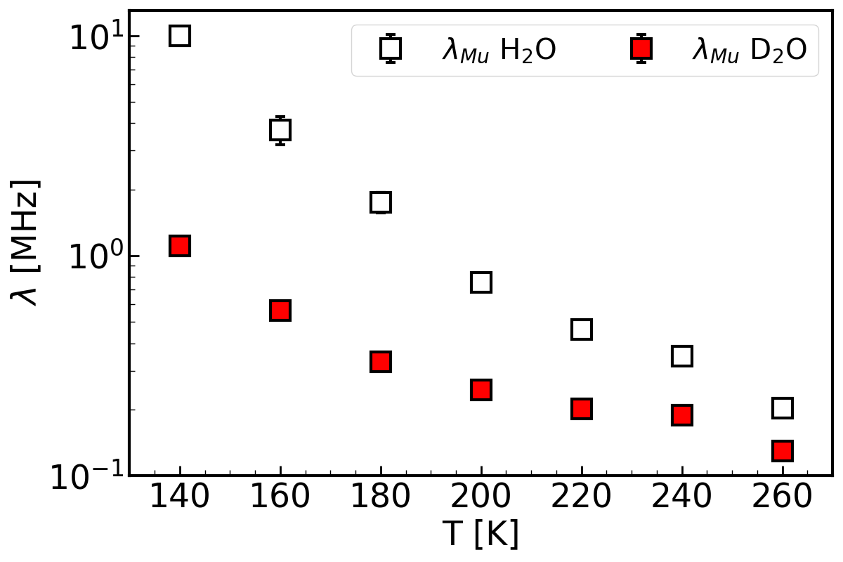
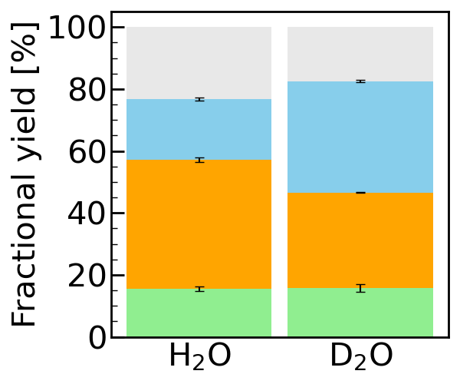
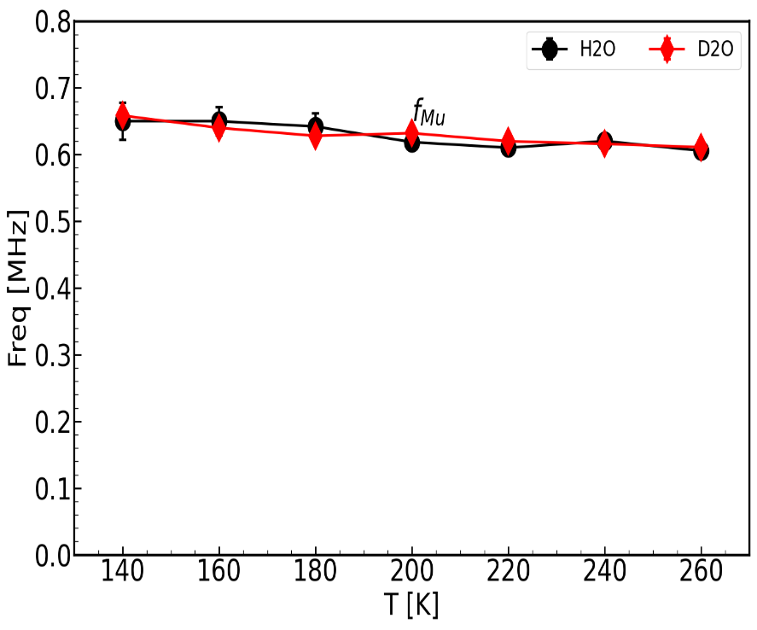
Validity of proposed model confirmed by measuring D₂O
Missing
Missing
Mu in S=1/2 (H₂O)
S=1 (D₂O)
A(t) = f_{Mu}(t) + f_{MuOH}(t) + f_{dia.μ}(t)
Mu
Mu
μ₁
μ₁
MuOH
MuOD
Nuclear magnetic field of p and D
f_{Mu} H₂O
f_{Mu} D₂O
Mu frequency and relaxation in different spin-environment
A.D. Pant, et al., J. Phys. Soc. Jpn. 95 (1) (2026) 014603

Slide 14
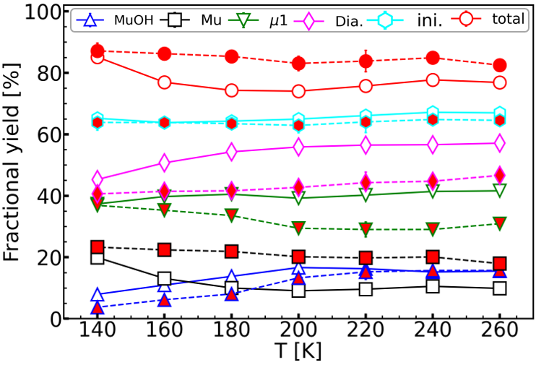
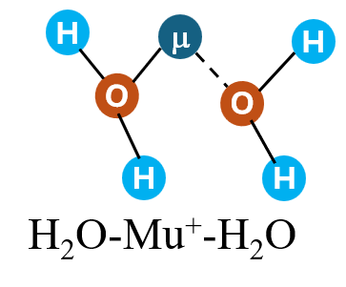
Fractional information (tentative) of muon species in H₂O and D₂O
Missing
(~20%)
μ₁=
MuOH /
MuOD
Muonium
(Mu = μ⁺e⁻)
A.D. Pant, et al., J. Phys. Soc. Jpn. 95 (1) (2026) 014603

Slide 15
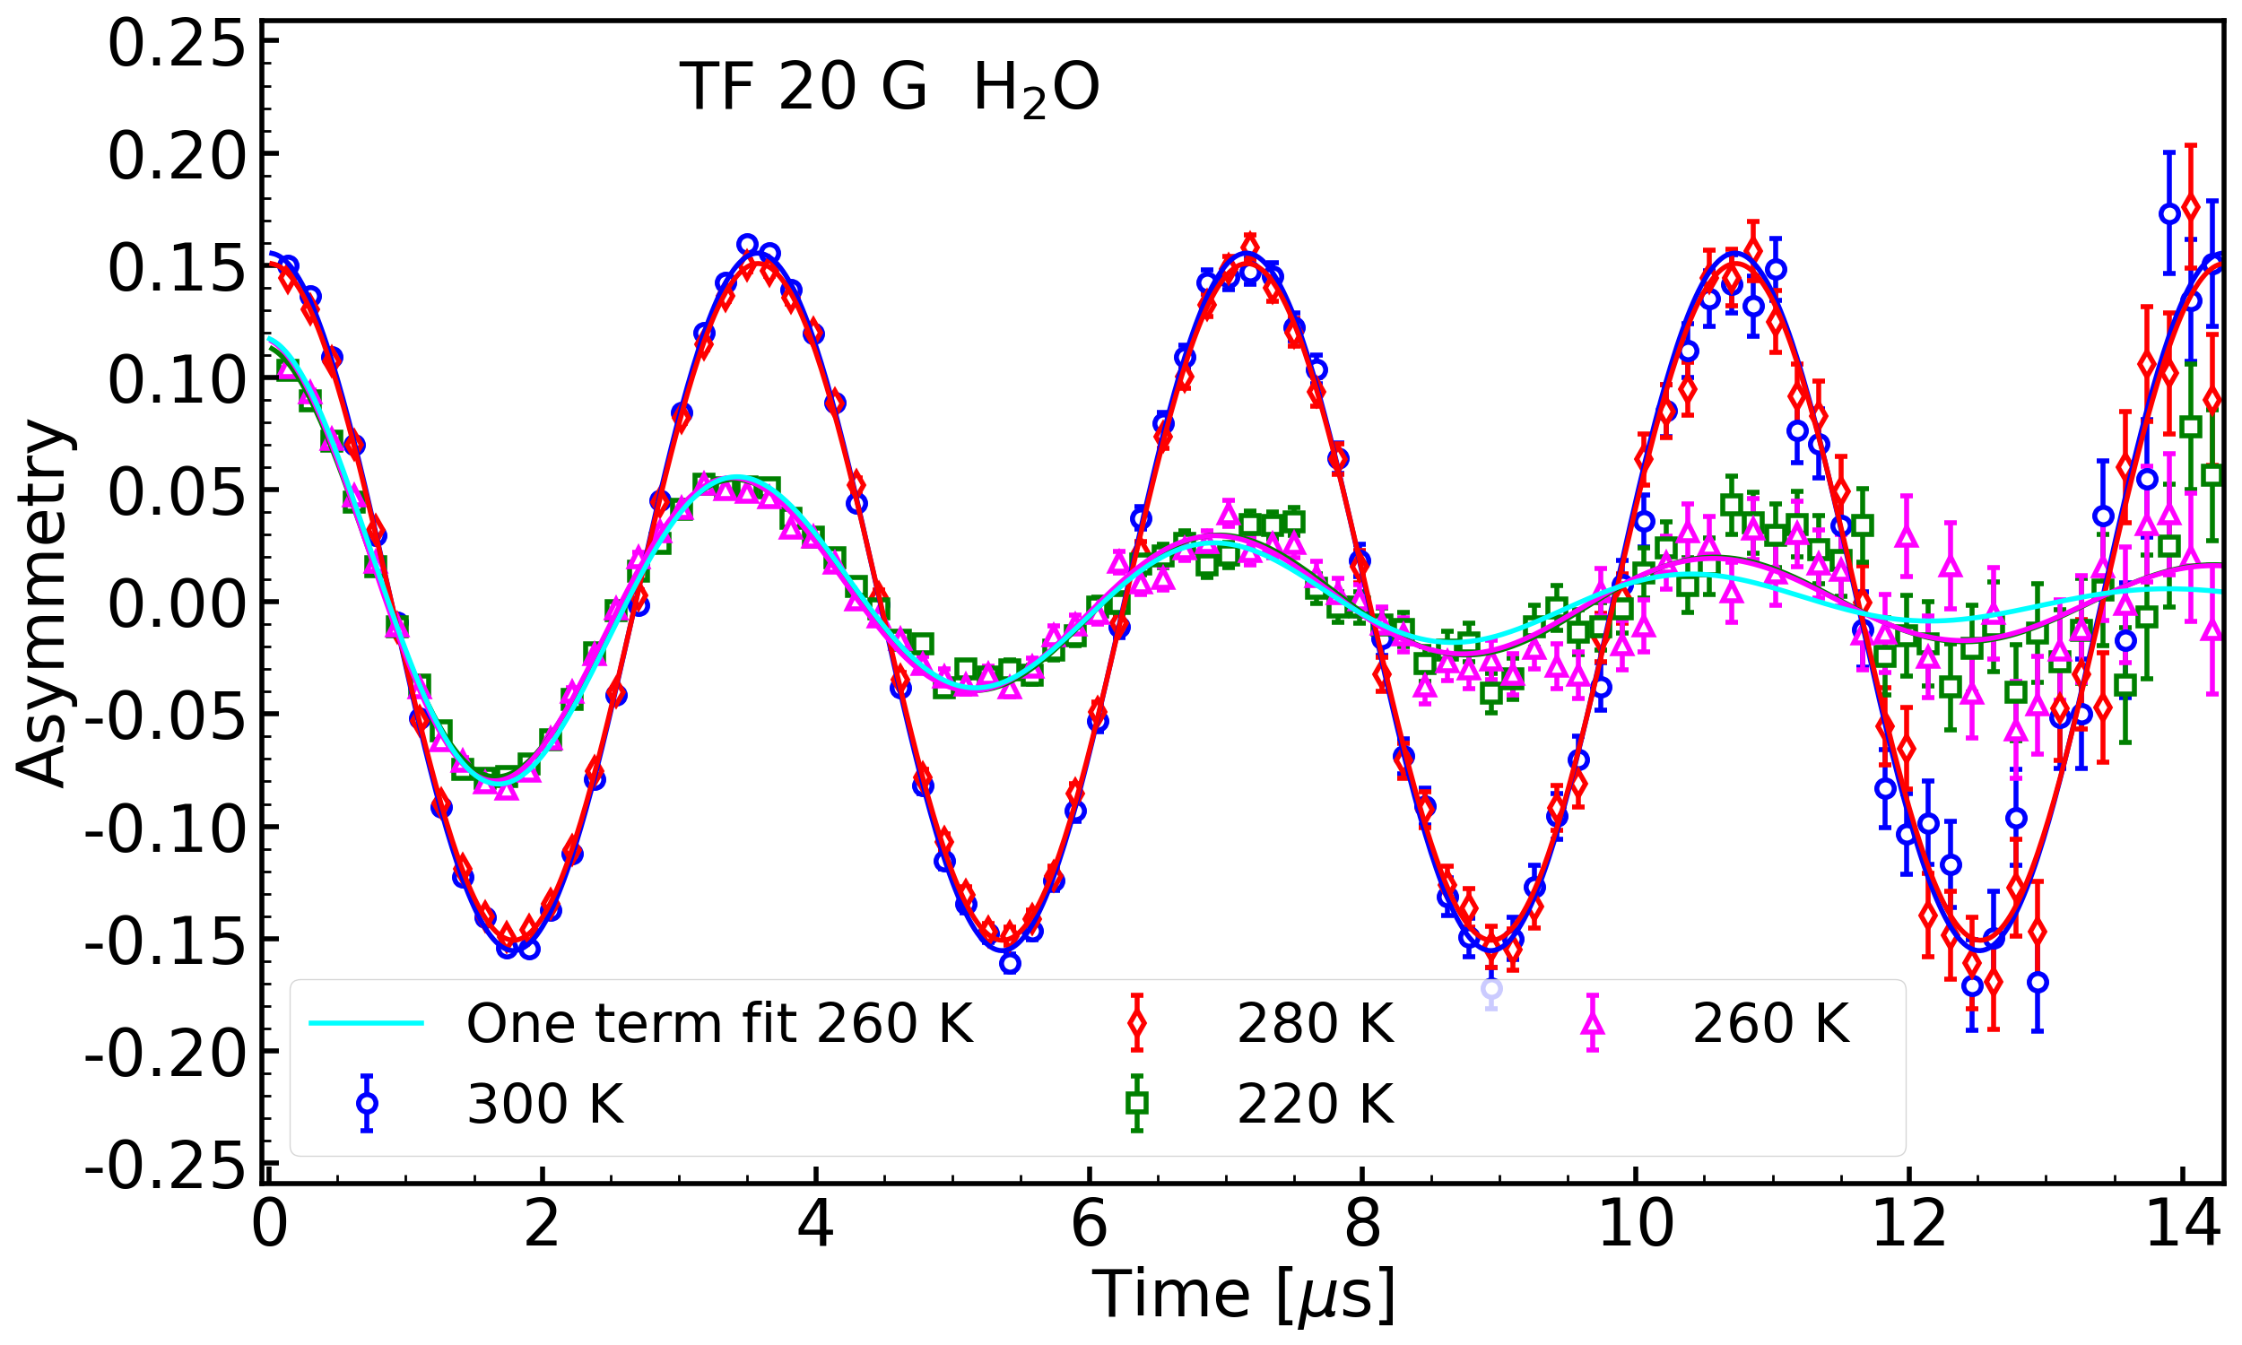
Muon spin relaxation and frequency change in water and ice
A. D. Pant et al., Phys. Rev. B 114 (3)(2026) 034106
300 K
280 K
260 K
220 K

Slide 16
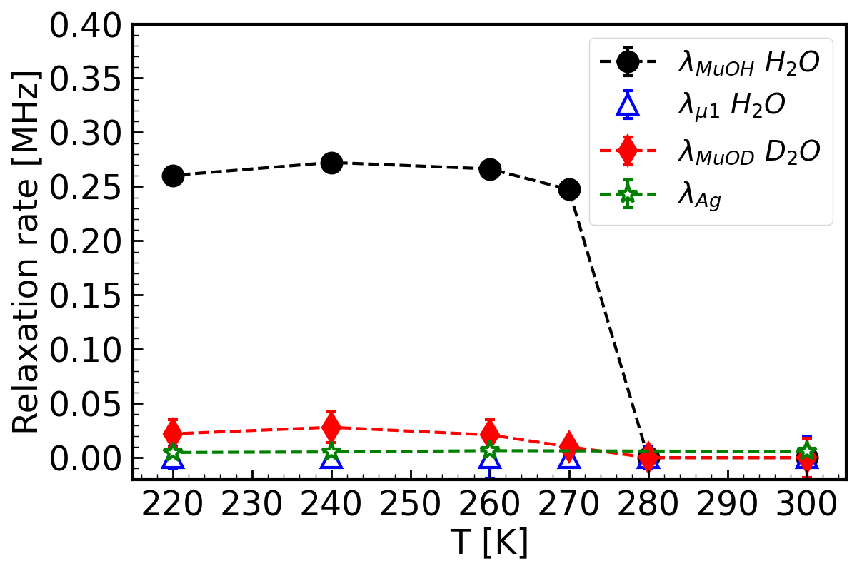
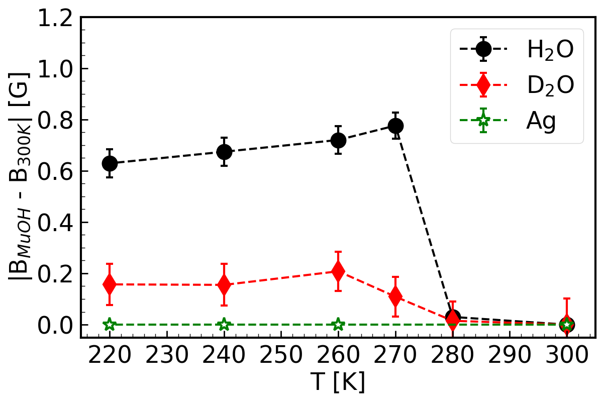
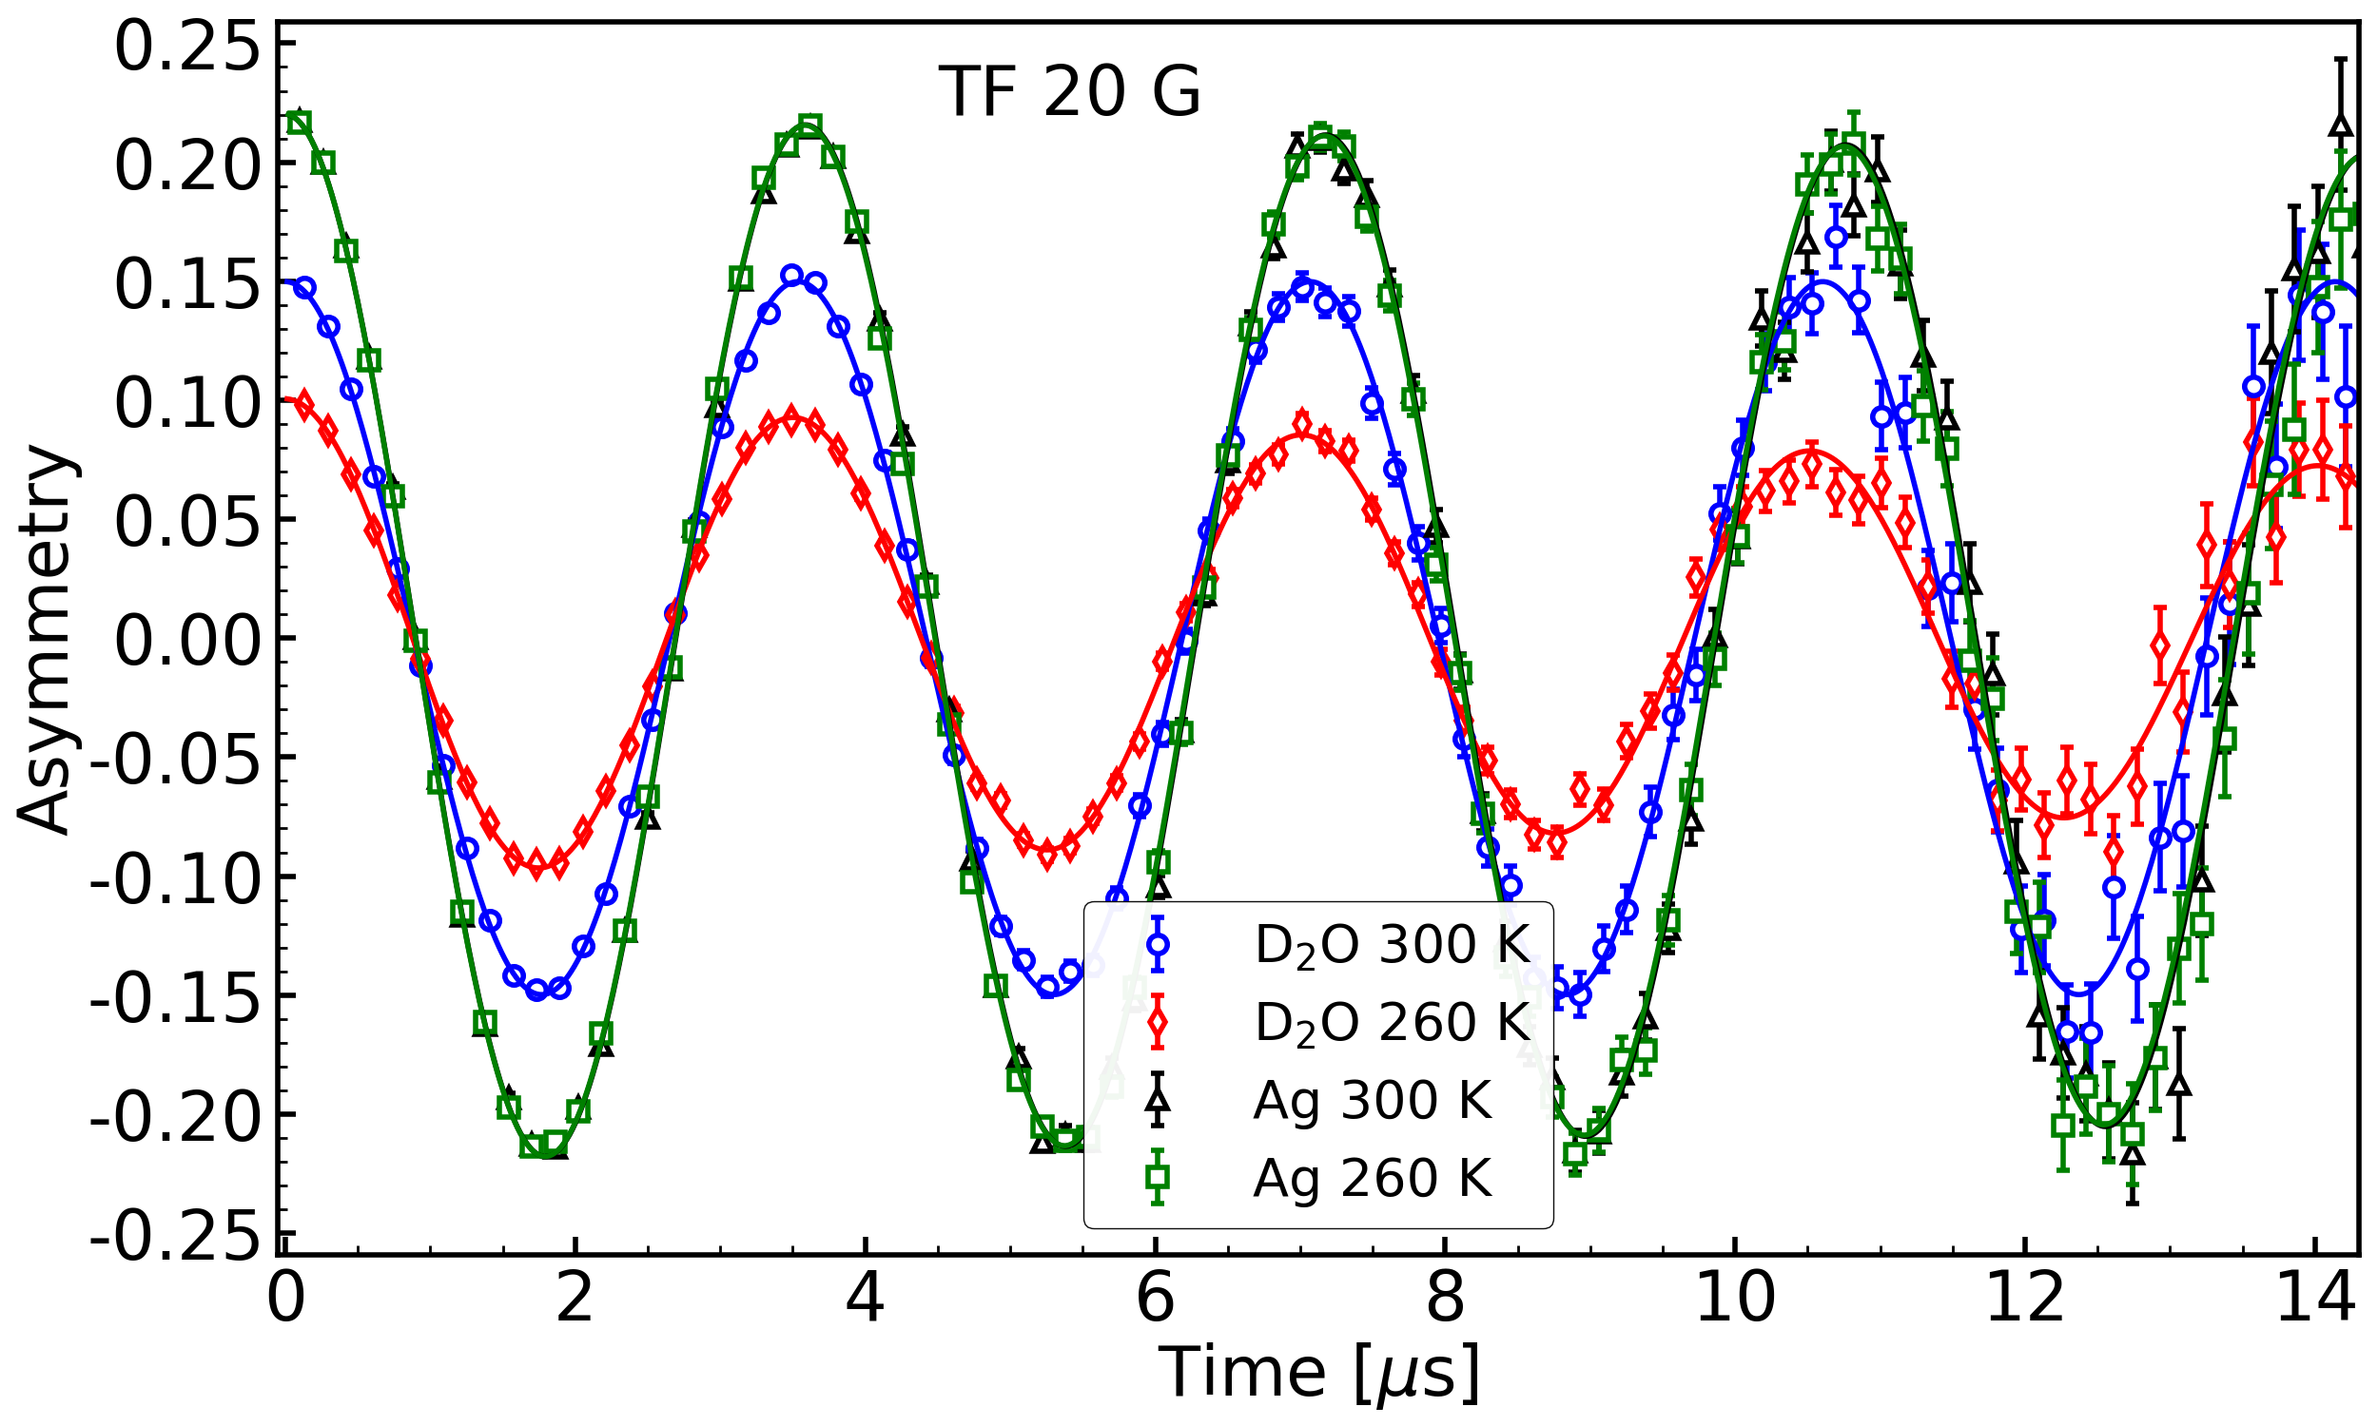
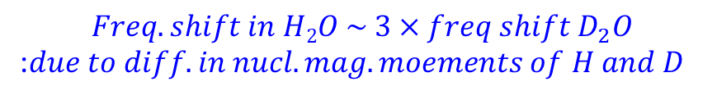
Conventional model:
$$A \left(t\right)=A_{μ2}\exp\left(−λ_{μ2} t\right)\cos\left(ω_{μ2} t\right)+A_{μ1 }\exp\left(−λ_{μ1} t\right)\cos\left(ω_{μ1} t\right)$$
$$Freq. shift in H2O \sim 3×freq shift D_{2}O$$
:$due to diff. in nucl. mag. moements of H and D$

Slide 17
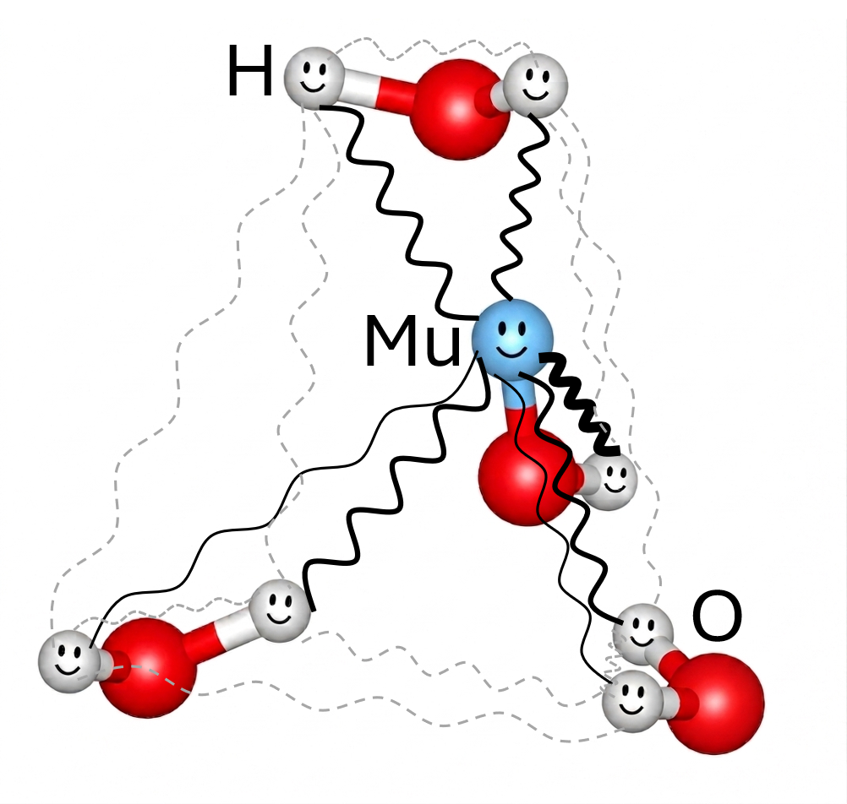
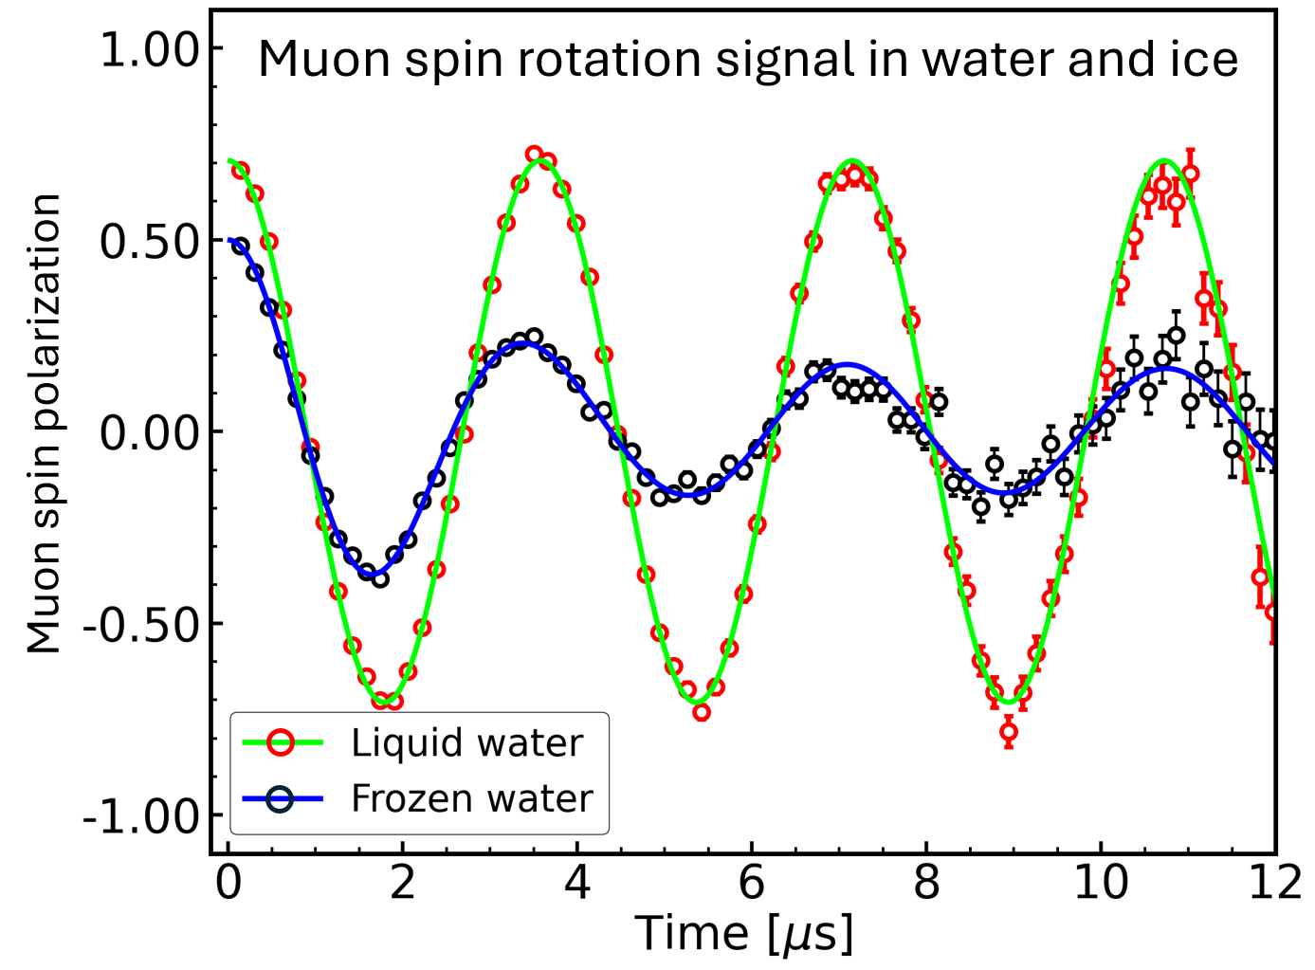
Quantum Coherence of Muon in Ice
At TF 20 G, A(t) = f_{Mu}(t) + f_{MuOH}(t) + f_{dia.μ}(t)
A(t) = A_{MuOH}G_{6S}(x_{i},y_{i},z_{i},t) + A_{μ1}cos(wt)
A. D. Pant et al., Phys. Rev. B 114 (3)(2026) 034106
Press Release KEK+J-PARC:
https://www.kek.jp/ja/press/202607101400
Origin of muon spin relaxation and frequency shift in frozen water explained by spin-dipole quantum coherences

Slide 18
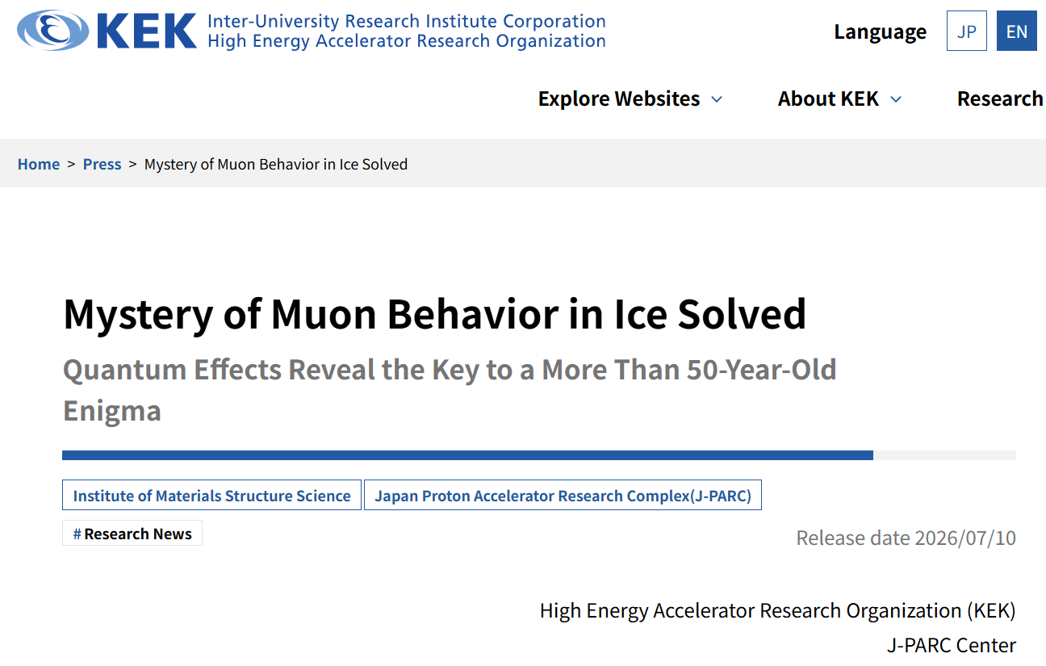
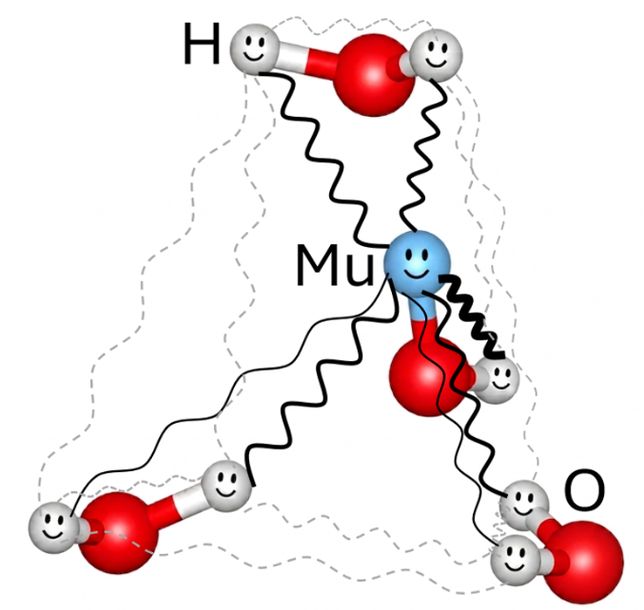
Press Release: KEK and J-PARC
A. D. Pant et al., Phys. Rev. B 114 (3)(2026) 034106
A.D. Pant, et al., J. Phys. Soc. Jpn. 95 (1) (2026) 014603
A.D. Pant, et al., JPS Conf. Proc. 45 (2026) 011037
A.D. Pant, et al., Phys. Rev. B 110 (10) (2024) 104104
Press Release KEK+J-PARC: https://www.kek.jp/ja/press/202607101400
A major breakthrough in establishing the fundamentals of muon biology for future applications

Slide 19
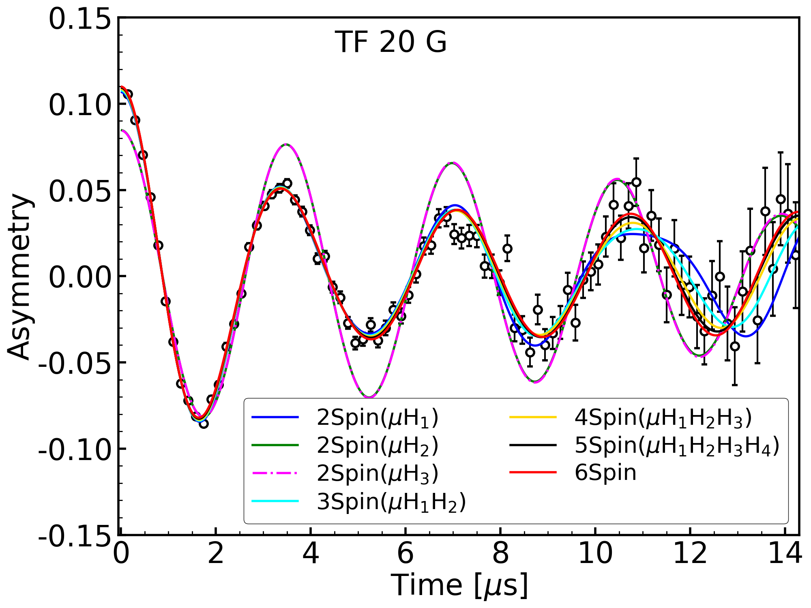
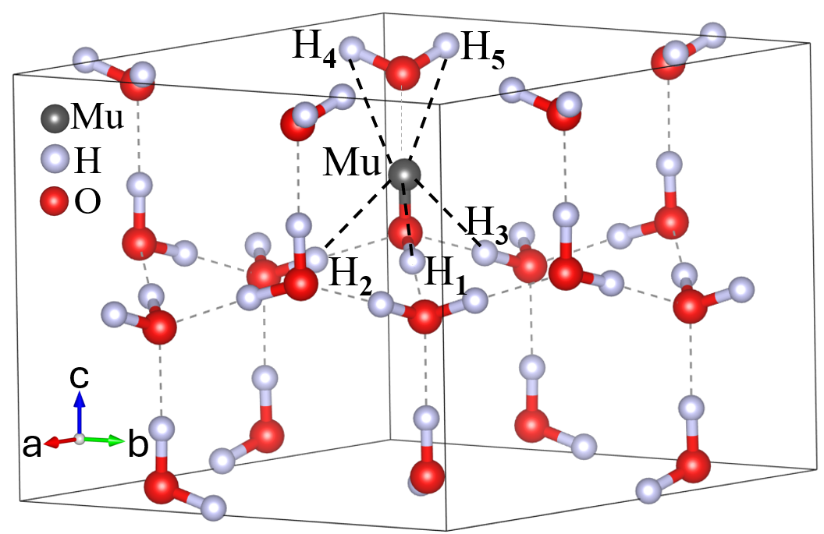
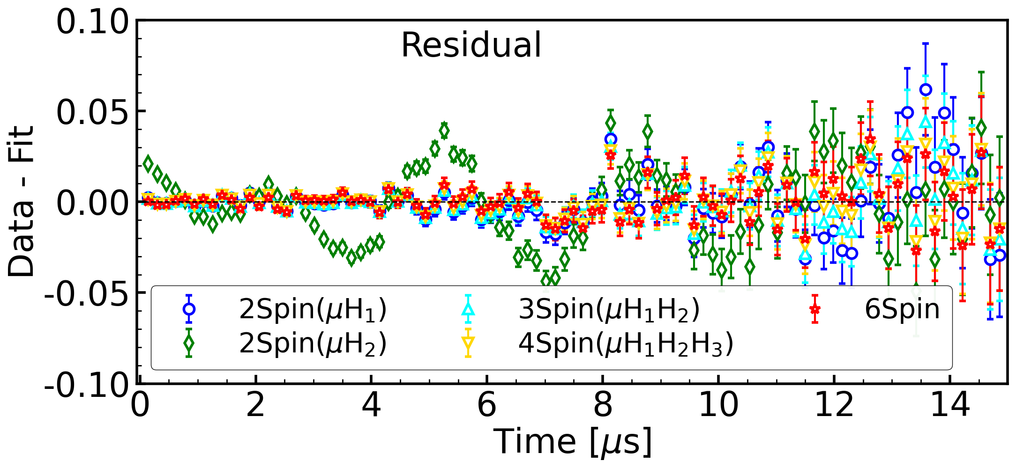
Spin-dependent behavior
A(t) = A_{MuOH}G(x_{i},y_{i},z_{i},t) + A_{μ1}exp(-λ_{μ1}t)Cos(wt)
@ least 2S (μH₁) should be included
Including more interactions improve the fitting

Slide 20
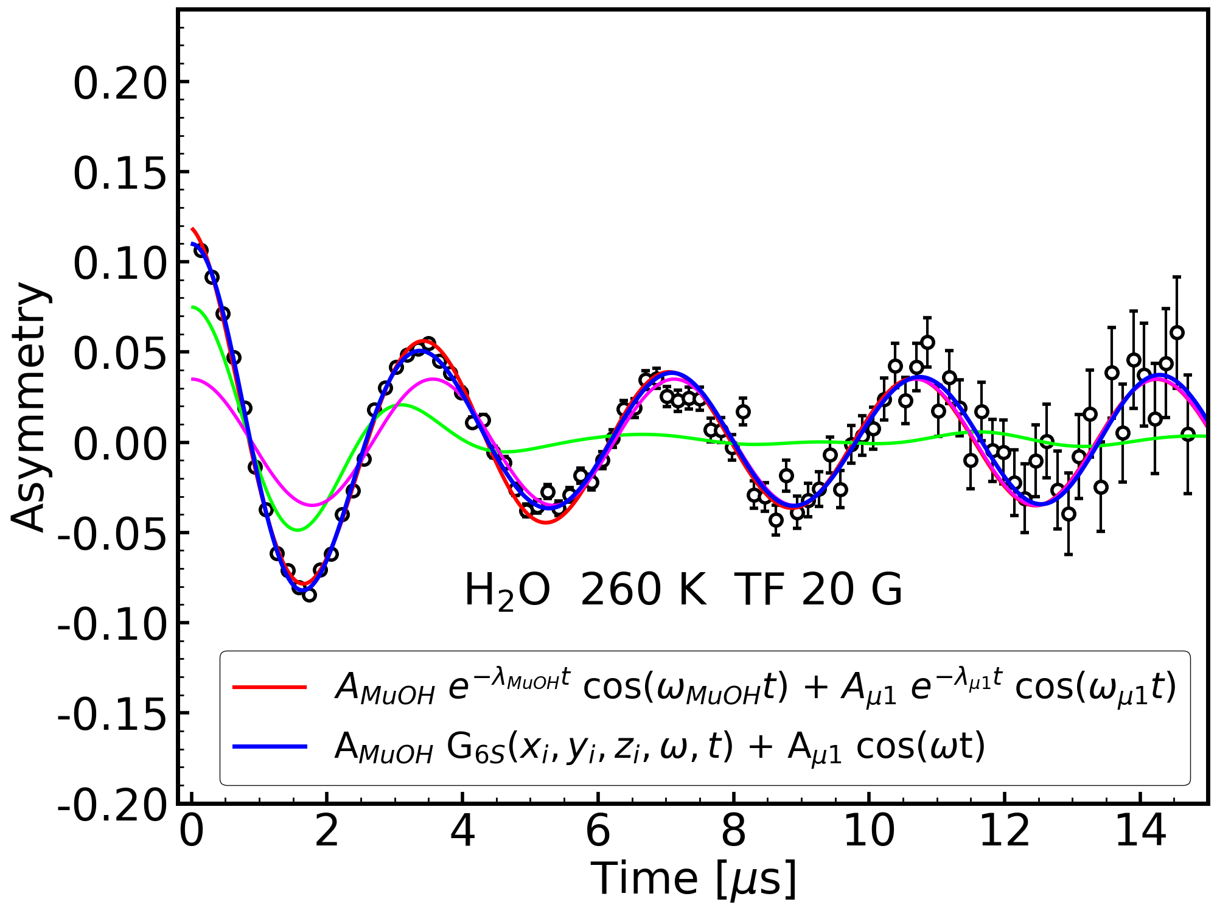
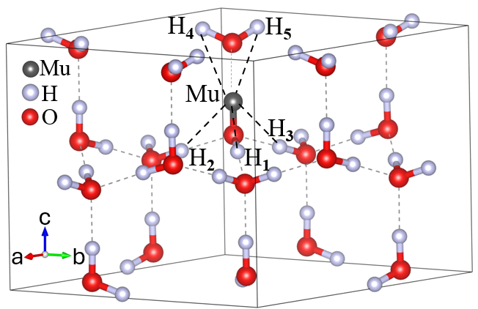
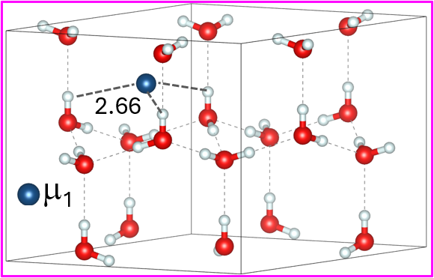
Two diamagnetic muon species distinguished in ice at TF 20 G
No need of phenomenological relaxing terms if we include μ-H interactions
Only MuOH contribution can not reproduce the signal indicates need to two terms (two dia. muons, MuOH & μ₁)
μ₁ may be stopping near the hexagonal cage of ice

Slide 21
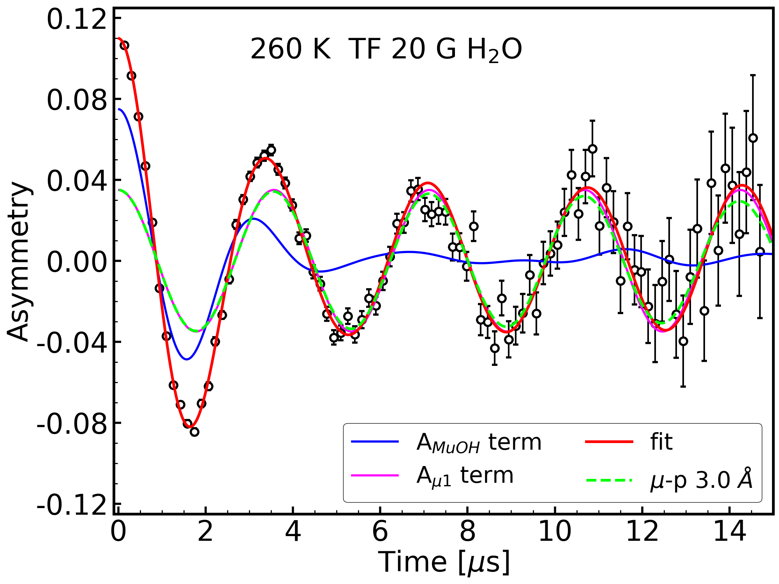
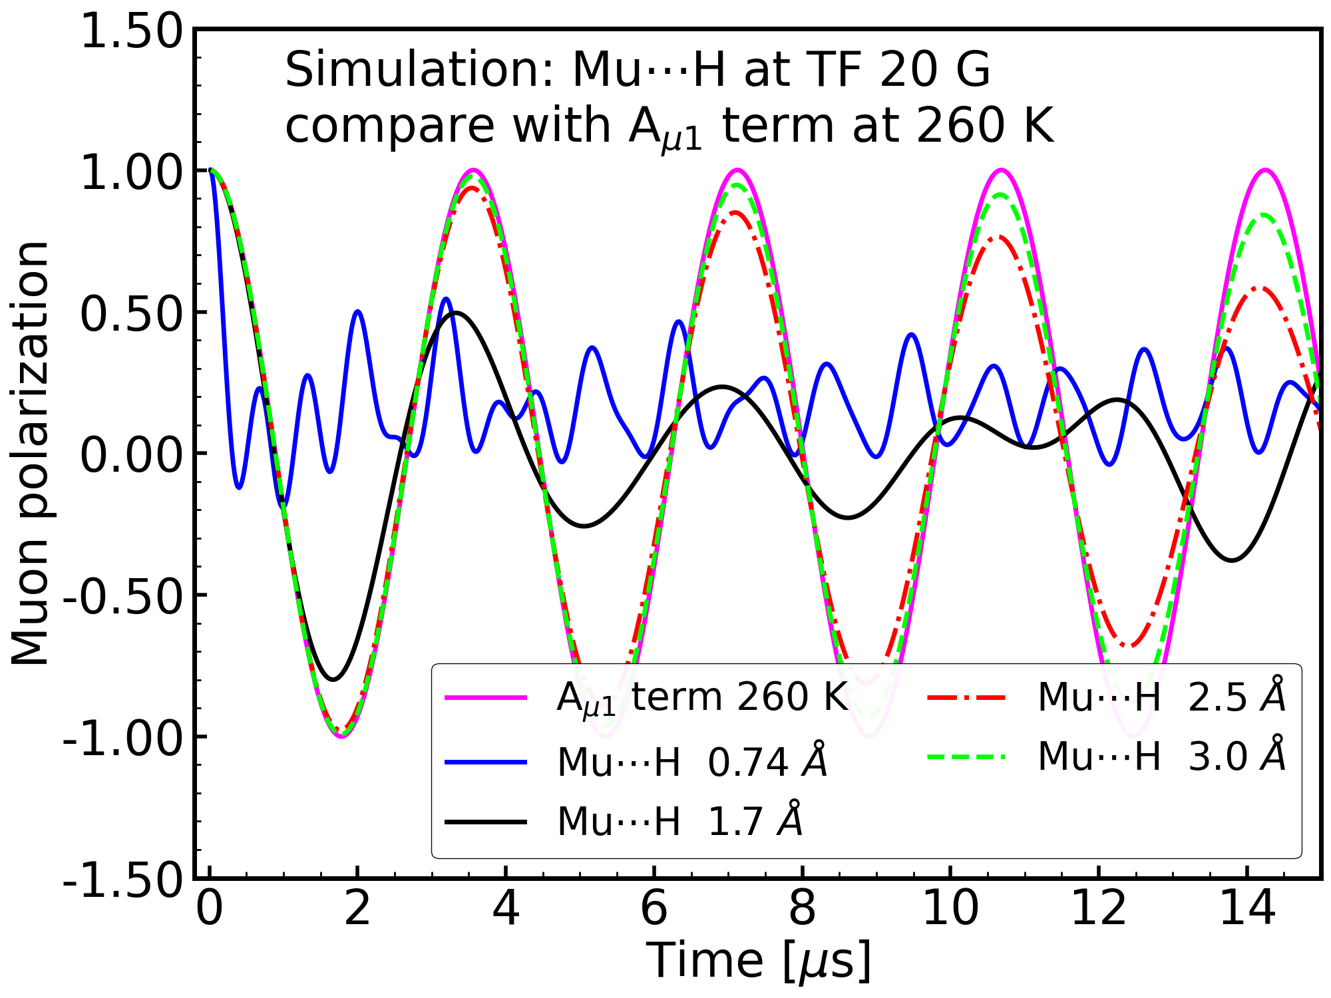
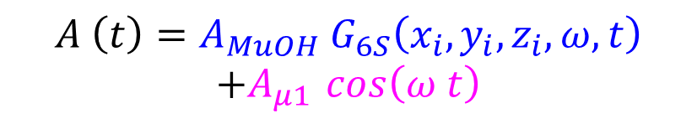
Where is μ₁ ?
Quantum simulation: Mu---H distance
(spin-dipole + Zeeman term)
TF20G: simulation
$$A \left(t\right)=A_{MuOH} G_{6S}\left(x_{i}, y_{i}, z_{i}, ω, t\right)$$
$$+A_{μ1 }\cos\left(ω t\right)$$
μ₁ should be at least > 2.5 Å from H of H₂O
Phys. Rev. B 114 (3)(2026) 034106

Slide 22
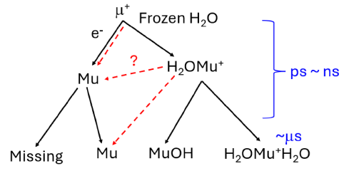

Muon species in water/ice
Pant et al (new insights)
Percival et al (old model)
Liquid water
No MuH signal observed
Leung et al, Chemical Physics 121 (1988) 393-403
Percival et al, Chemical Physics 32 (1978) 353-367
Missing + Mu + dia.μ in liquid water
A.D. Pant et al., J. Phys. Soc. Jpn. 95, 014603 (2026)

Slide 23


μ₁ is not MuH
Quantum simulation: Mu---H distance
(spin-dipole interactions)
ZF: simulation
ZF H₂O 260 K
Phys. Rev. B 110 (10) (2024) 104104

Slide 24



Muonium relaxation in liquid water:
Before and after frozen-thaw
(O₂ detection by μSR)
A.D. Pant, et al., JPS Conf. Proc. 45 (2026) 011037
Spin-exchange interaction
Mu(↑↑) + O₂ → Mu(↑↓) + O₂
Chemical reactions
Mu + O₂ → MuO₂
Both cause relaxation of Mu
Ref. a: J. Chem. Soc., Faraday Trans. 91, 1935 (1995)
Ref. b. NIM A 1011, 165561 (2021)

Slide 25
Summary
μSR in water and ice: new insights
  Formation of MuOH molecule from μSR spectra
  A new model: A(t) = f_{Mu} + f_{MuOH} + f_{dia.μ1}
  Quantum coherence of muon in water
  Applicable to Physics, Chemistry and Biology
Deeper insights into μSR in condensed matter, including water, hydrated samples, and aqueous solutions
Technical requirements / recommendations
  Zero-field condition: (0 ± 1 μT) & stray field from nearby BLs
  Background correction from water,O₂, buffer,.. for μSR in biology

Slide 26
















Acknowledgement/collaborators
Amba D. Pant
Akihiro Koda
Katsuhiko Ishida
Hiromi Sakai
Nara Med. Univ.
Anup Shrestha
Anjan Dahal
Kazuaki Kuwahata
CDP, TU, Nepal
Jumpei Nakamura*
MasatoshiHiraishi
Shoichiro Nishimura
Koichiro Shimomura
Masanori Tachikawa
Burkhard Geil
Univ. Göttingen, Germany
Yokohama City Univ.
Puspa Malla
Hari S. Mallik
KEK/J-PARC, Japan
Thank you for your attention !
JSPS, MEXT, KAKENHI
21K15583 & 26H01510

Slide 28
Ref. slides

Slide 29


Precise structure of H₂O using muons
DFT and PIMD support the result
Muon provides info/site about nearby H
DNA damage/structure: improper H bond-networking
Mu-H in MuOH found longer than H-H in H₂O by 5%

Slide 30

Path integral molecular dynamics (PIMD) supports the Expt. Results
PIMD
Mu
O
PIMD: Elongation of Mu-O bond
μSR expt: muon-proton distance (Mu-H in MuOH)
μSR
H

Slide 31


PIMD details
A.D. Pant, et al., J. Phys. Soc. Jpn. 95 (1) (2026) 014603

Slide 32



Muon technique
O₂ controlled circulating experimental set-up
(in vivo like set-up)
Membrane module (for gas-liquid mixing)
Oxygen sensor
(Vernier)
Magnetic
stirrer
Air pump
Hb (bovine origin) sol^{n}
Experimental set-up
Oxygen sensor
(NeoFox commercially available)
accuracy 0.01%
Muon target chamber

Slide 33



ZF spectra in water/ice
Wang et al., Physica B 350 (2004) e451–e454
T dependent ZF in ice phases
Brewer, J. H., et al, PRB 33 (1986) 7813-7816
Kadono, R., et al. PRL 100(2008) 026401.
Sugiyama, J., et al. PRB 82 (2010) 214505.
A(t) = F_{Mu}(t) + F_{2S}(t)
Where,
F_{Mu}(t) = A_{Mu} exp(-λ_{Mu} t)
F_{iS}(t) = A_{iS} exp(-λ_{iS} t) G_{iS}(t)
A(t) = F_{Mu}(t) + F_{3Scol}(t)
A(t) = F_{Mu}(t) + F_{3Stri}(t)
Need of new model !

Slide 34



T dependent muon fractions in water and ice
Cox et al., Hyperfine Interactions 65 (1990) 993-1004
T dependent fraction of muon
(thermal conversion of muon)
Our measurement
Percival et al., Chemical Physics 32 (1978) 353-367
Qualitative agreement
Diamagnetic and muonium fractions in H₂O [• P_{D}, o(1-P_{Mu})].
Notes:
Between 160 K and the melting point, PM and PD are essentially constant; below 160 K PM increases at the expense of PD (Percival et al)

Slide 35



Muonium relaxation in water/ice
T dependent relaxation rate of Mu, TF 2.3 G
P. W. Percival et al., Hyperfine Interactions 17-19 (1984) 543-550
Our measurement
Mu signal
muon signal
Muonium spin relaxation rates (λ_{M}) in a single crystal of H₂0 as measured from the precession signal in a 10 G transverse field.
f(t) = a₀ + a_{μ} exp (-λ_{μ} t) cos(γ_{μ} field_{μ} t + φ_{μ}) + a_{Mu} exp (-λ_{Mu} t) cos(γ_{Mu} field_{Mu} t + φ_{Mu})
Qualitative agreement
Notes:
Relaxation is attributed to electron-nuclear dipolar coupling of muonium to lattice protons, modulated by translational diffusion of muonium along c-axis channels of the ice lattice. (Percival et al)

Slide 36





About system/model/mechanism in literature
Cox et al
Percival group
Liq. water
Defect, proton transfer
40%
60%
14%
18%
8%
Reaction rate, diffusion
Leung et al, Chemical Physics 121 (1988) 393-403
Percival et al, Chemical Physics 32 (1978) 353-367
Existence of both H₂O-Mu⁺-H₂O and HMuO
S. Cox, et al., Hyperfine Interact. 65 (1991) 993
Physica Scripta 1992 (1992) 292; Hyperfine Interact. 86 (1994) 747

Slide 37

Conventional model (for all T)
$$A \left(t\right)=A_{μ }\exp\left(−λ_{μ} t\right)\cos\left(ω_{μ} t\right)$$
Liquid phase
$$A \left(t\right)=A_{μ1 }\exp\left(−λ_{μ1} t\right)\cos\left(ω_{μ1} t\right)$$
Below freezing point
$$A \left(t\right)=A_{μ2}\exp\left(−λ_{μ2} t\right)\cos\left(ω_{μ2} t\right)$$
$$+A_{μ1 }\exp\left(−λ_{μ1} t\right)\cos\left(ω_{μ1} t\right)$$
What are μ₁ and μ₂ ?

Slide 38
At ZF
A(t) = f_{Mu}(t) + f_{MuOH}(t) + f_{dia.μ}(t)
At TF 20 G
due to time resolution (8ns), we do not expect Mu contribution
A(t) = f_{Mu}(t) + f_{MuOH}(t) + f_{dia.μ}(t)

Slide 39


$$A \left(t\right)=A_{μ2}\exp\left(−λ_{μ2} t\right)\cos\left(ω_{μ2} t\right)+A_{μ1 }\exp\left(−λ_{μ1} t\right)\cos\left(ω_{μ1} t\right)$$
$μ2$ → MuOH $μ1$ → ${(H}_{2}O−{Mu}^{+}−H_{2}O)$
Model including muon-proton interactions:
$$A \left(t\right)=A_{MuOH} G_{6S}\left(x_{i}, y_{i}, z_{i}, ω, t\right)$$
$$+A_{μ1 }\cos\left(ω t\right)$$
μ-H₁ = 1.694 Å, μ-H₂₋₅ = 2.3 Å

Slide 40




$$A \left(t\right)=A_{MuOH} G_{6S}\left(x_{i}, y_{i}, z_{i}, ω, t\right)$$
$$+A_{μ1 }\cos\left(ω t\right)$$
Including 6S, there is remaining field
Shift is 1% of set value
Within field distribution of spectrometer
Even though, possibility of consistence diff.
Origin ?
Include more interactions !!

Slide 41


Mu fraction in D2O is higher than that in H2O → consistence ZF results
$$A \left(t\right)=A_{MuOH} G_{6S}\left(x_{i}, y_{i}, z_{i}, ω, t\right)+A_{μ1 }\cos\left(ω t\right)$$

Slide 42


Site and charge of μ₁ ?
Tentative μ1 site in Ih ice
μ1 is at least > 2.5 Å far from protons of H2O
→Center of hexagonal cage
$$A \left(t\right)=A_{MuOH} G_{6S}\left(x_{i}, y_{i}, z_{i}, ω, t\right)$$
$$+A_{μ1 }\exp\left(−λ_{μ1} t\right)\cos\left(ω t\right)$$
Charge state of dia. μ₁ → study in progress

Slide 43



Weak TF scan, 270K, ice
Two diamagnetic muon species (μ₁, μ₂) in ice
Axially symmetric anisotropic Mu
A(t) = f_{AnisotropicMu} + f_{MuOH} + f_{dia.μ1}

Slide 44

Breit-Rabi diagram for anisotropic Mu in ice
M = +1
M = 0
ν₁₂
Mu, triplet state
At low TF
f_{Mu1} = v₁₂
f_{Mu2} = v₂₃
Mu beating pattern
At Zero-field,
v₁₂ = v₂₃
v₂₃ = 0.60(0) MHz
Single freq Mu
ν₂₃
M = -1
Mu, singlet state
ZF 270 K ice
ν₂₃ = 0.60(0) MHz
M = 0
[T/10⁴]

Slide 45

Muon (μ⁺) and muonium (Mu = μ⁺e⁻)
e⁻
 | H | Mu
Mass (m_{e}) | 1837.15 | 207.769
Reduced electron mass (m_{e}) | 0.999456 | 0.995187
Ground state radius (Å) | 0.529465 | 0.531736
Ground state energy (eV) | -13.5984 | -13.5403
Nuclear Gyromagnetic ratio (s⁻¹ T⁻¹) | 2.67520× 10⁸ | 8.51607 × 10⁸
Hyperfine frequency (GHz) | 1.42041 | 4.46330
μ⁺
μ⁺
Muon (μ⁺)
Mass 1/9 m_{p}, 207m_{e}
Light proton
Spin polarized (100%)
Muonium (Mu): ($μ^{+}$ + e⁻ )
103 times more sensitive than $μ^{+}$
Applications of muon:
It probes the local electronic and spin states of surrounding atoms and molecules around stopping sites in the materials with a high sensitivity.
 | Charge (e) | Spin | m/m_{e} | μ / μ_{p} | / 2π (MHz / T ) | τ (μ s)
e electron | ± 1 | 1/2 | 1 | 657 | 28025 | ∞
μ muon | ± 1 | 1/2 | 207 | 3.1833 More sensitive | 135.5 | 2.1971
p proton | ± 1 | 1/2 | 1836 | 1 | 42.58 | ∞
μ⁺ like a light proton
Mu like a light isotope of H atom
μ⁻ behaves like a heavy electron

