Slide 1
NMR Probe for Spinon Excitations in Quantum Magnets
Weiqiang Yu/于伟强
Renmin University of China/中国人民大学
Melody-2026
Dongguan，October 26, 2026
Notes:
Good afternoon everyone. I am Weiqiang Yu from Renmin university of china. First I would like to thank Prof. Rui Zhou and coorganizers for for inviting me to this nice conference. Today, I will present our recent appoarch to spinon excitation by NMR in quantum magnets.

Slide 2
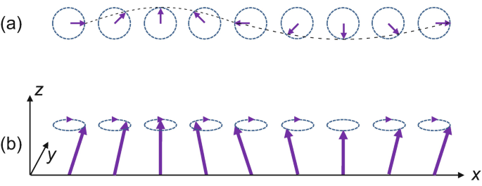
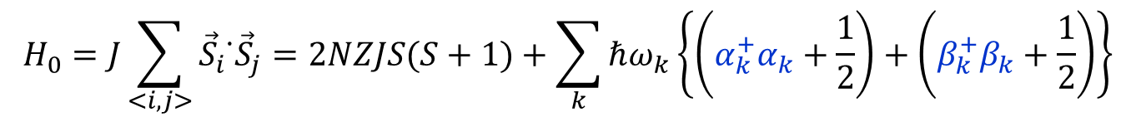
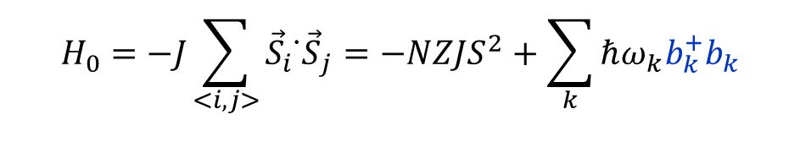
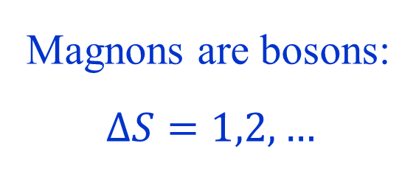
Introduction: Spin-wave theory in ordered magnets
Magnons are bosons:
$$ΔS=1,2,…$$
Ferromagnet
$$H_{0}=−J\sum_{<i,j>}{{\vec{S}}_{i}{ ̇\vec{S}}_{j}}=−NZJS^{2}+\sum_{k}{ℏω_{k}b_{k}^{+}b_{k}}$$
$$H_{0}=J\sum_{<i,j>}{{\vec{S}}_{i}{ ̇\vec{S}}_{j}}=2NZJS(S+1)+\sum_{k}{ℏω_{k}\left\{\left(α_{k}^{+}α_{k}+\frac{1}{2}\right)+\left(β_{k}^{+}β_{k}+\frac{1}{2}\right)\right\}}$$
Antiferromagnet
Notes:
We known that for the ordered magnets, the elementary excitations are described by spin-wave theories, where Magnon excitations carries integer spins so that they are bosonic excitations.

Slide 3

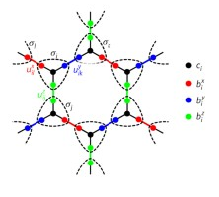
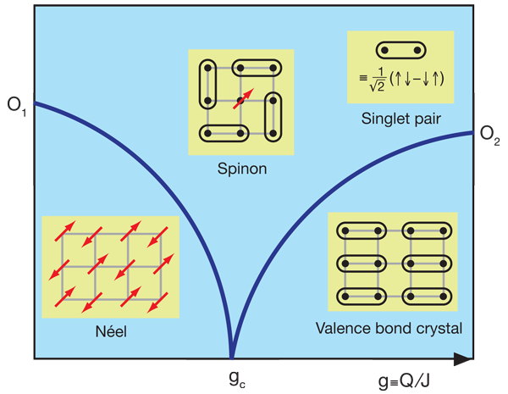
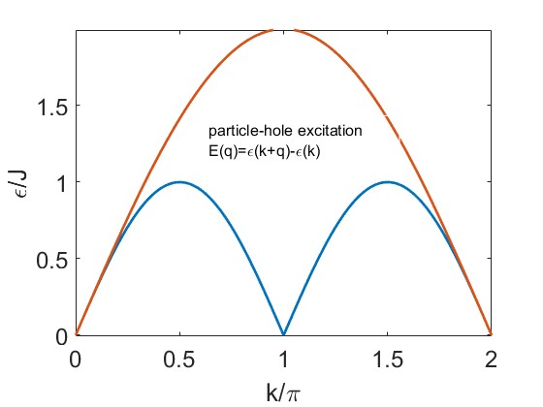
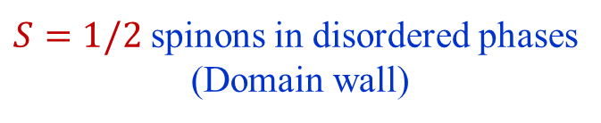

Spinon in Intrinsic Quantum Disordered States
2D and 3D systems with
frustrated magnetic interactions
$S=1/2$ spinons in disordered phases
(Domain wall)
Singh et al., Science (2004)
$$W_{p}=±1$$
Kitaev Quantum Spin liquids
(QSLs)
Deconfined QCP (DQCP)
S=1/2 spin chain
May host high-T superconductivity or quantum computation
Challenge to realize spinons in 2D and 3D materials
Notes:
However, if the magnetic systems are low dimensional or consisting strong magnetic frustration, the magnetic ordering may be suppressed and giving rise to intrinsic quantum disordered state. In this case, Spinon excitations emerges in in quantum magnets, carrying only one-half spin quantum numbers. Theoretically, this is exemplified in three cases, in the 1D spin chain, the frustration induced quantum spin liquids and a novel quantum phase transition called deconfined quantum critical point in 2D and 3D . Spinon in 2D may host application potential for high-temperature SC or quantum computations, however, it is a tremendous experimental change to construct spinons in 2D and 3D materails.

Slide 4
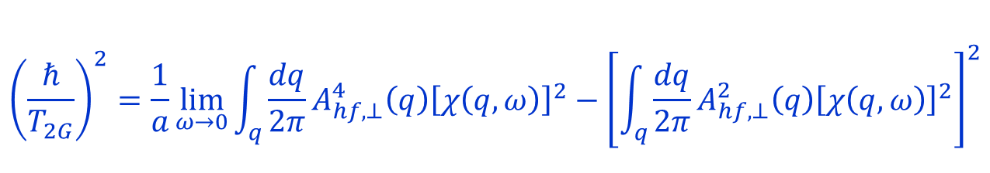
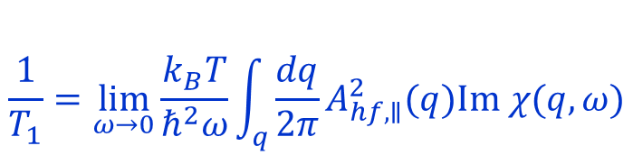

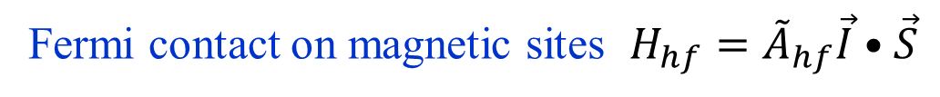
NMR as a local, low-energy probe of spin dynamics
Fermi contact on magnetic sites $H_{hf}={\tilde{A}}_{hf}\vec{I}•\vec{S}$
Dipolar coupling on ligand sites $Hhf=\vec{I}{ \tilde{A}}_{hf} \vec{S}$
Hyperfine coupling
Absence of NMR line split in quantum disordered magnets
Knight shift (singlet)
$$K_{s}\left(T\right)=A_{hf}χ_{0}/N_{A}μ_{B}$$
$$\frac{1}{T_{1}}=\lim_{ω→0}{\frac{k_{B}T}{ℏ^{2}ω}}\int_{q}{\frac{dq}{2π}A_{hf, ∥}^{2}(q)\text{Im} χ(q,ω)}$$
Spin-lattice relaxation rate
$${\left(\frac{ℏ}{T_{2G}}\right)}^{2}=\frac{1}{a}\lim_{ω→0}\int_{q}{\frac{dq}{2π}A_{hf,⊥}^{4}\left(q\right){\left[χ\left(q,ω\right)\right]}^{2}}−{\left[\int_{q}{\frac{dq}{2π}A_{hf,⊥}^{2}\left(q\right){\left[χ\left(q,ω\right)\right]}^{2}}\right]}^{2}$$
Spin-spin relaxation rate
Notes:
One of the superior tool to search for spinon excitations is by NMR, which is a low, low-energy probe. Taking advantaging of the hyperfine coupling among the nuclear spins and elctron spins, we can look for characteristic of spinons in multiple approaches, such the absence of NMR line split in quantum disordering, the change of the Knight shift present a singlet, and the low-energy electronic spin dynamics probed by both the spin-lattice relaxation rates by 1/T1 and the by spin-spin relaxation rate by the 1/T_2G.

Slide 5
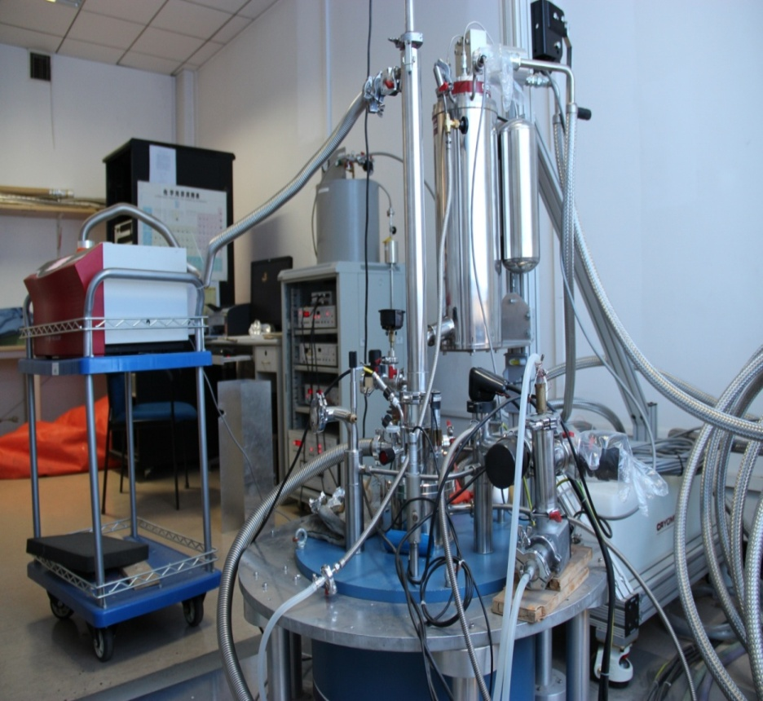
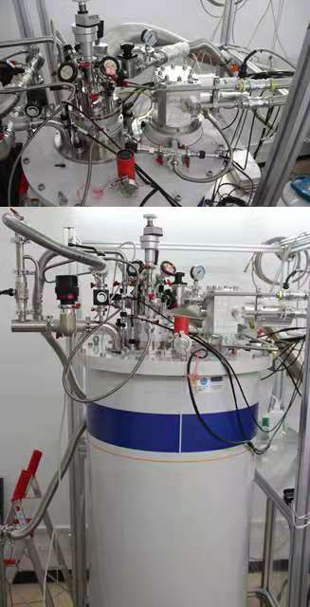
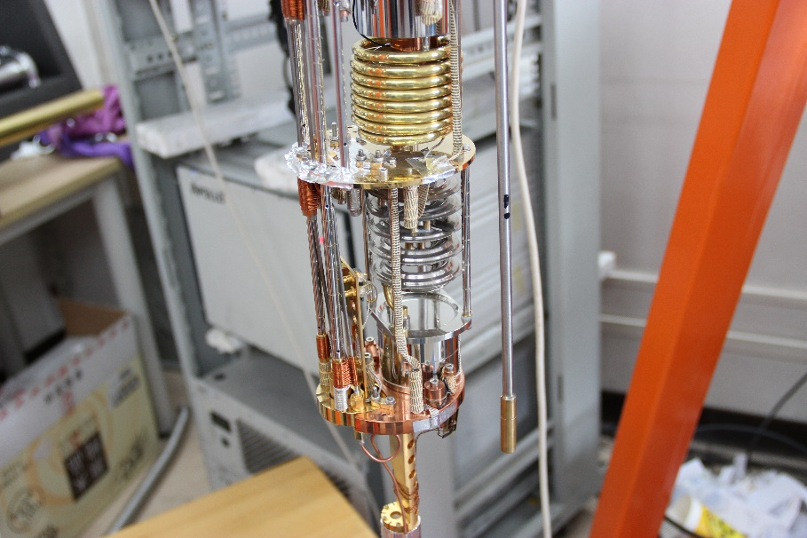
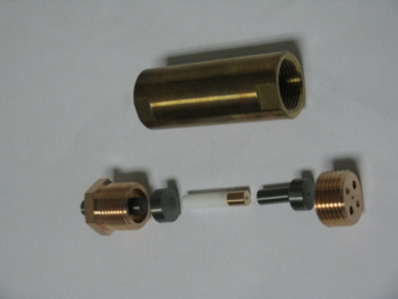
NMR + Extreme Conditions @RUC
16 T
+ 2.4 GPa
+ 25 mK
(bottom loading DR)
26 T/ 14 GPa NMR:
in collaboration with SECUF
Phys. Rev. B 114, L231101 (2026)
12 T + 1.5 K + 2.4 GPa
Notes:
Note that spinon excitation usually exits in narrow parameters spaces, where tuning and low-energy probe is important. In our lab, we can carry a combination of 16 T, 2.4 Gpa and 25 mK NMR measurement. We also succeeded 26 T and 14 Gpa measurements by the collaboration with secuf, such as in a lab led by professor ssRui Zhou.

Slide 6
NMR search for disordered states and spinon excitations
NMR evidence of Spinons in a S=1/2 spin chain compound copper benzoate Cu(C₆H₅COO)₂·3H₂O.
NMR evidence of Deconfined quantum criticality in a quasi-2D Shastry-Sutherland compound SrCu₂(BO₃)₂.
Notes:
In this work I will present our two recent work on the approach for spinon exictations. One is in a 1D spin chain compound copper benzoate, and the other one is one a 2D shastry-sutherland compound. Let’s move on the first one.

Slide 7
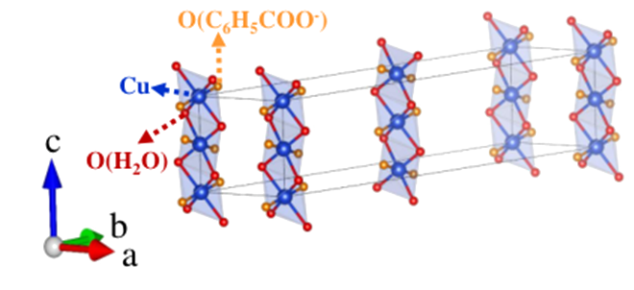
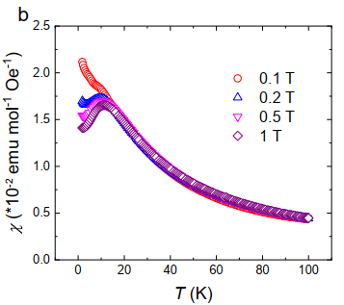


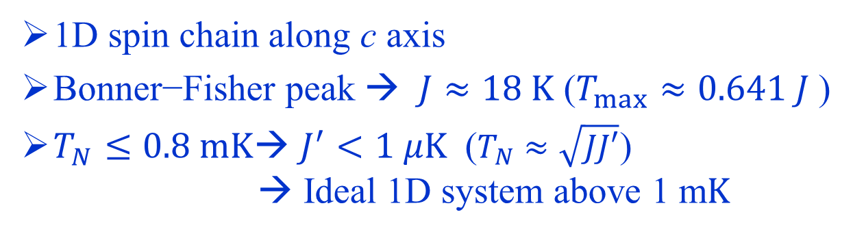

Copper Benzoate: Structure and effective interactions
$$J$$
$$J′$$
$$T_{max}=12 K$$
Cu(C₆H₅COO)₂·3H₂O
1D spin chain along c axis
Bonner−Fisher peak → $J≈18 K$ ($T_{max}≈0.641 J$)
$T_{N}≤0.8 mK$→ $J^{′}<1 μK$ ($T_{N}≈\sqrt{JJ′}$)
→ Ideal 1D system above 1 m$K$
H. Koizumi et al., JPSJ 18, 117(1963)
M. Date et al., Prog. Theor., Phys. Suppl. 46, 194 (1970)
D. C. Dender et al., Phys. Rev. Lett. 79, 1750 (1997)
Y. Karaki et al. Physica B 329-333, 1002 (2003)
Y. Chen et al., arXiv 2510.11551 (NC, in press)
Notes:
Copper Benzoate is a material discovered over sixty year ago. It consists of spin chains running along the c axia. The magnetic exchange coupling is a Heisenberg type with a amplitude about 18K, as deduced from a Bonner fisher peak at about 12 K. The interchain coupling is estimated to be less than 1 microk therefore, the system can be well treated as a 1D system with temperature above 1mK.

Slide 8
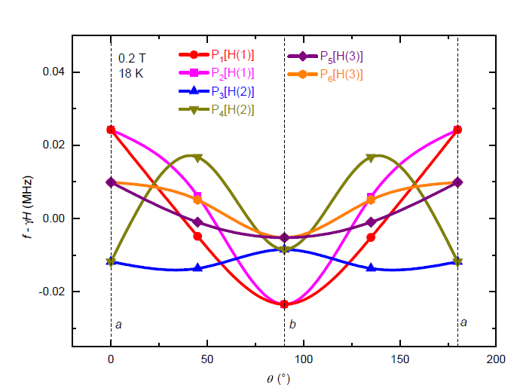
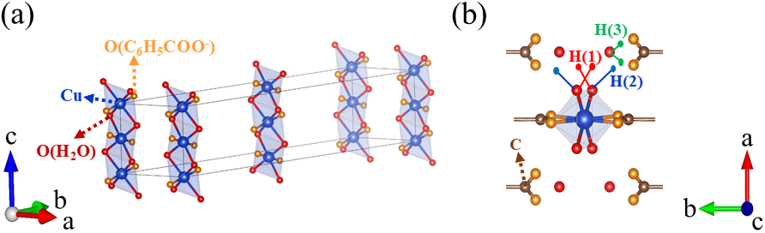
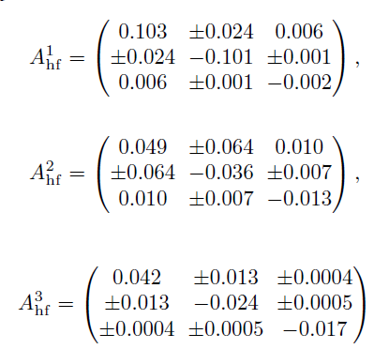

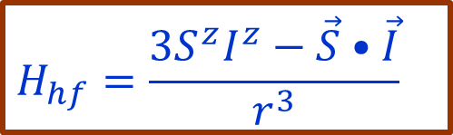

¹H NMR spectra simulation: dipolar $A_{hf}$from lattice parameters
$$H_{hf}=\frac{3S^{z}I^{z}−\vec{S}•\vec{I}}{r^{3}}$$
$$1/T_{1}$$
$$K_{s}$$
Cu(C₆H₅COO)₂·3H₂O
H//b: Agrees with data within 10-20% error!
M. Date et al., Prog. Theor., Phys. Suppl. 46, 194 (1970)
Y. Chen et al., arXiv 2510.11551 (NC, in press)
Notes:
We can look into excitation by NMR. In fact, we looked at proton NMR on three proton sites. By using the lattice parameters and the exchange coupling, and assuming the simple hyperfine coupling among the nuclear spin and electron spins, the NMR resonance frequency can be directly calculated at specific field, temperature and field orientations. With this, the hyperfine coupling constant is deduced as a tensor; in particular, with field along the b direction, the calculated hyperfine coupling constant is only about 10 to 20% off the measured data, whose accuracy is quite surprising.

Slide 9
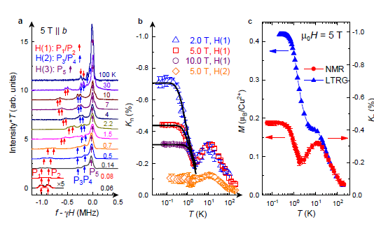
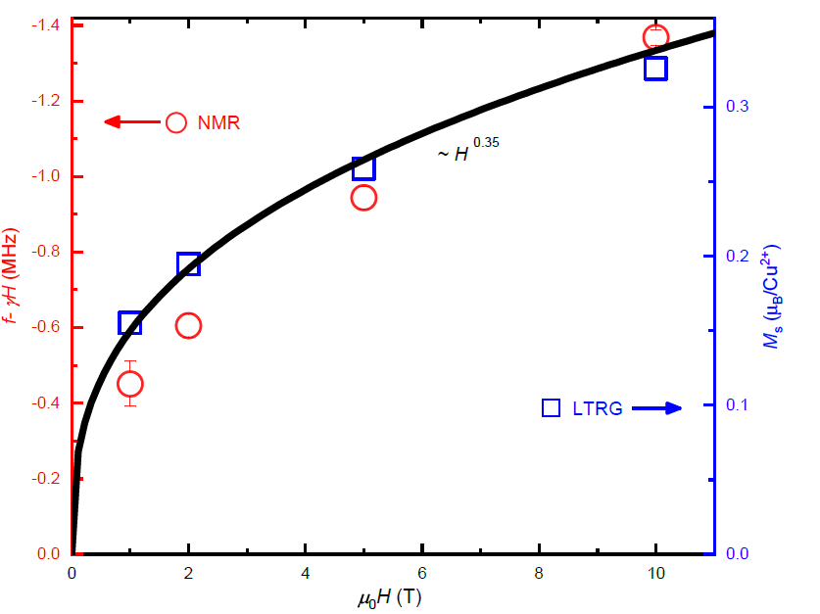
Field-induced staggered field and spin canting
DM interactions:
Field-induce staggered moments
Staggered moments induced spin canting
Y. Chen et al., arXiv 2510.11551 (NC, in press)
Notes:
Here I show the measured spectra. There are multiple peaks from different proton sites, The NMR knight site is then calculated as functions of temperature, by the change of the resonace frequency. As show here, the 1D feature is shown by a peak located at abut 12K. On the other hand, there is a large upturn at temperature below 1K. Note that NMR Knight shift is usually not sensitive to shottky anomaly, In particular, the field depencedc of the upturn does not follow the Shottkey behaviors. We then simulated the Kngiht shift with the sine-Gordon form, which is quite good agreement with the experiment data as shown here. The red one is the measurement Knight shift, and the blue one is the calculated Knight shift, which show very similar behaviors. In the zero temperature limit, both the experimental one and the measured one can be converted to the local moment of elctron, which folloiw a power-law scaling with field. From this, we realized such upturn is caused by field-inded staggered moment first by the by the DM interactions; In feedback, this DM interaction induced staggered magnetic moments through a spin canting effect.

Slide 10
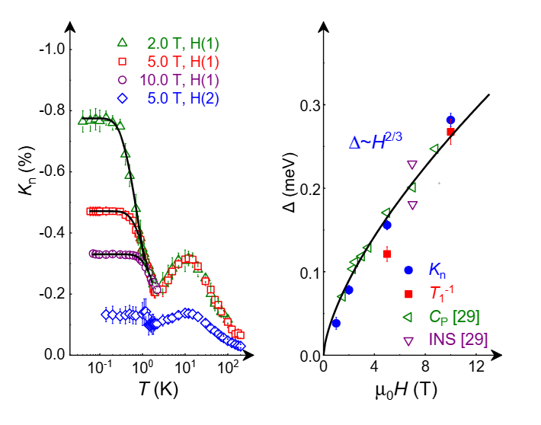
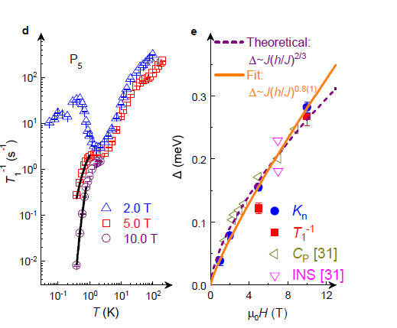

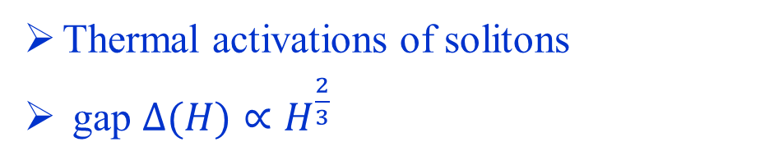
Field-induced thermal solitons
$$K_{n}=a+be^{−Δ/K_{B}T}$$
Thermal activations of solitons
gap $Δ(H)∝H^{\frac{2}{3}}$
Y. Chen et al., arXiv 2510.11551 (NC, in press)
Notes:
This reduction of the downturn with increasing temperature can be understood the thermal creation of solition. We can fit the data with a thermal
Similar, the NMR 1/T1 can also be fit to a thermal activation function. We then plot all the gap values as a function of fields, which agress with the soliton gap by a power-law scaling with field H^2/3 as expected by the sine-Gordon form.

Slide 11



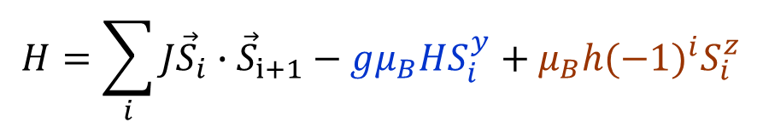

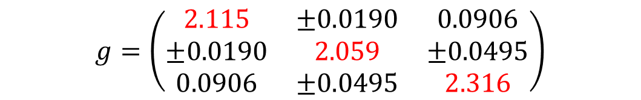
Crystal symmetry and effective staggered field
苯甲酸铜研究背景
Cu-Cu-Cu line is buckled
$$H_{DM}=\sum_{j}{{(−1)}^{j}\vec{D}∙({\vec{S}}_{i}}×{\vec{S}}_{i+1})$$
Non-linear term
sine-Gordon function
$$H=\sum_{i}{J{\vec{S}}_{i}}∙{\vec{S}}_{i+1}−gμ_{B}HS_{i}^{y}+μ_{B}h{(−1)}^{i}S_{i}^{z}$$
$$g=\left(\begin{matrix}2.115 & ±0.0190 & 0.0906 \\ ±0.0190 & 2.059 & ±0.0495 \\ 0.0906 & ±0.0495 & 2.316\end{matrix}\right)$$
DM interactions
→Field-induced staggered field (also see in BaCo₂V₂O₈, E8 state)
Sine-Gordon model (non-linear terms)
Gapped soliton excitations
D. C. Dender et al., Phys. Rev. Lett.79.1750 (1997)
J. Z. Zhao, et al., Phys. Rev. Lett. 90, 207204 (2003)
Notes:
Indeed, in the crystal structure, the Cu-Cu bond is bucked along the c axis, so that one unit cell contains two copper atoms. This leads to a DM interactions. With the application of external field, a staggered field is induced, which can be described by a sine-Gordon function, and the g factor also turns into a tensor. Consequentaly Gapped soliton excitations arise.

Slide 12
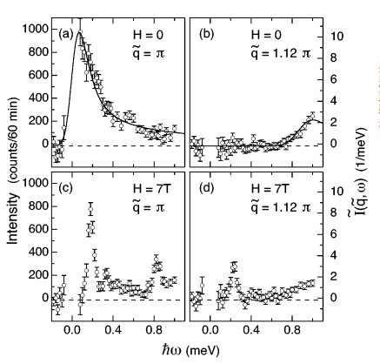
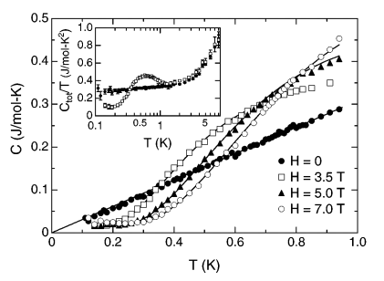
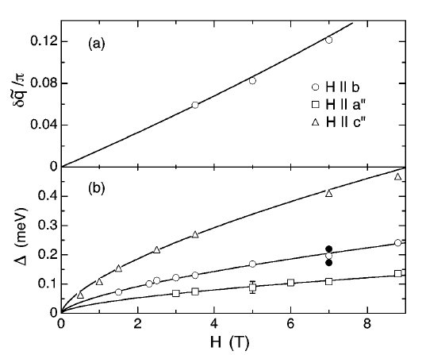
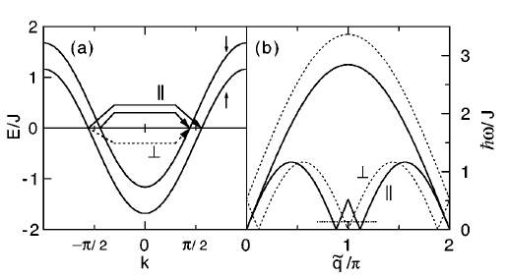
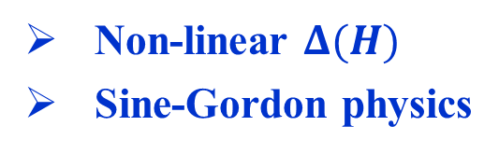
Under field: from gapless to gapped excitations
H=0,spinons excitation
H≠0，energy gap
Non-linear $Δ(H)$
Sine-Gordon physics
D. C. Dender et al., Phys. Rev. Lett.79.1750 (1997)
Notes:
This material has already be studied by INS. At zero field, spinon excitations are demonstrated by gapless excitations at both q=pi/a. However, with application of field, although gapless excitations is expected in some in wave vectors, gapped excitations are resolved instead. This is also seen by the specifie heat with gapless excitation at zero field and gapped excitations at finite field. To be more interesting, the gap value scales with field with a non-linera form, that is , delta is proportional to H to the power of two thirds. This is proposed as a sine Gordon functions as explained by the following PPT.

Slide 13
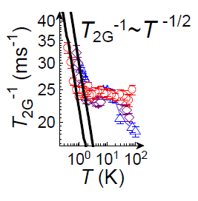
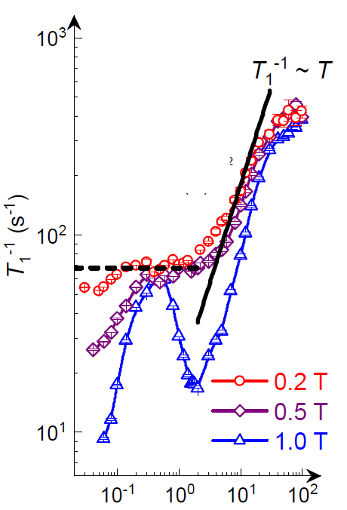
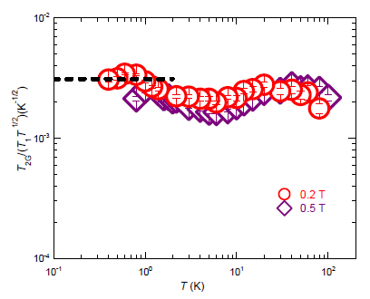
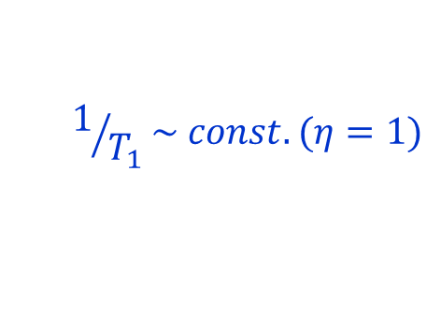
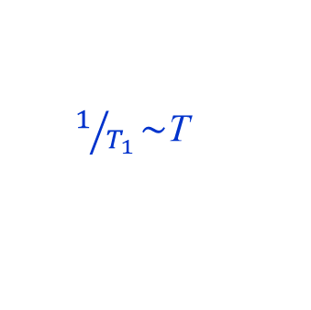

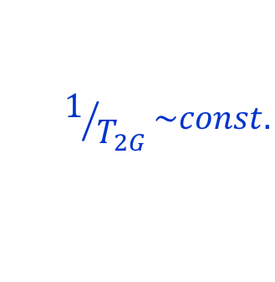
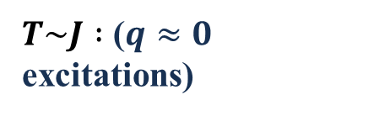
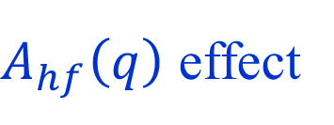

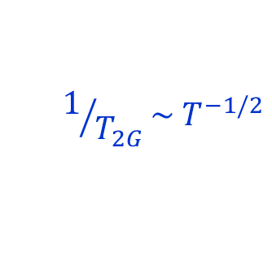
Low-field spinon excitations seen by $1/T_{1}$ and $1/T_{2}$
$A_{hf}\left(q\right)$ effect
$T\sim J :$ ($q≈0$ excitations)
$1/{T_{1}}\sim$T
$$1/{T_{2G}}\sim const.$$
$T≪J :$ ($q≈π/a$spinon)
$$1/{T_{1}}\sim const. (η=1)$$
$$1/{T_{2G}}\sim T^{−1/2}$$
Y. Chen et al., arXiv 2510.11551 (NC, in press)
$$T_{2G}/{(T}_{1}T^{1/2})\sim const.$$
Notes:
In order to achieve spinon excitions, we have to reduce the NMR field as low as possible, For example, we used a low field of 0.2~T. From here, the spin-lattice relations show different temperature dependence. Blow 20~K, a linear temperature dependence is found, which can be understood by uniform spin fluctuation at q=0; upon further cooling below 1K , 1/T1 exhibits a constant; which can be underestood by the spinon fluctuations at pi/a. Most importantly, the 1/T2G show a constant a high temperature and a 1 over squreroot of T below 1K, in excellent agreement such a spinon picture. Furthermore, we make a caling of T2G/T1times square of T, which exhibits a constant as espected for a spinon.

Slide 14
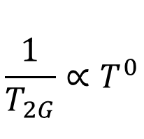
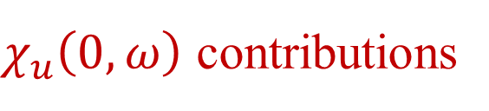
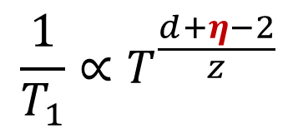
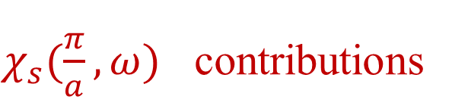
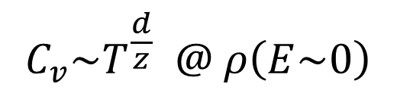
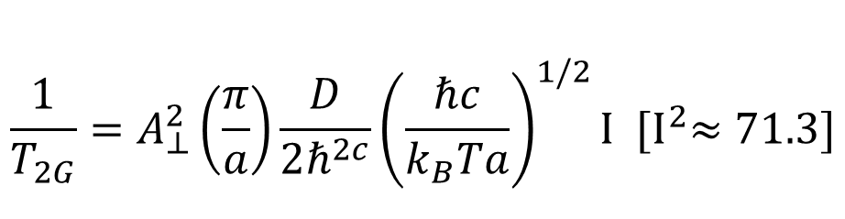
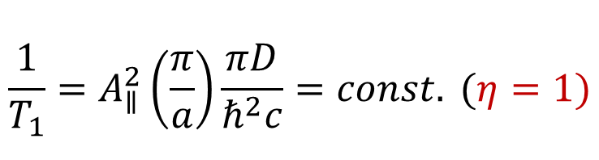

Scaling behaviors in critical regimes: “Difference is important”
For 1D Heisenberg antiferromagnetic chain w/o ordering
$χ_{s}(\frac{π}{a},ω)$ contributions
$χ_{u}\left(0, ω\right)$ contributions
$$\frac{1}{T_{1}}=A_{∥}^{2}\left(\frac{π}{a}\right)\frac{πD}{ℏ^{2}c}=const. (η=1)$$
$$\frac{1}{T_{1}}∝T$$
$$\frac{1}{T_{2G}}=A_{⊥}^{2}\left(\frac{π}{a}\right)\frac{D}{2ℏ^{2c}}{\left(\frac{ℏc}{k_{B}Ta}\right)}^{1/2}I {[I}^{2}≈71.3]$$
$$\frac{1}{T_{2G}}∝T^{0}$$
$$C_{v}\sim T^{\frac{d}{z}} @ ρ\left(E\sim 0\right)$$
QCR:
$$\frac{1}{T_{1}}∝T^{\frac{d+η−2}{z}}$$
Lattice dimension d; anomalous dimension 𝜂 (spin correlations); $ω\sim k^{z}$
S. Sachdev, PRB 50, 13006 (1994); A. W. Sandvik et al., PRB 97, 104424 (1998);
M. Takigawa et al., Phys. Rev. Lett. 4612 (1996); K. Ishida PRB 53, 2827 (1996)
Notes:
Note these spinon dynamics in 1D has already been framed theoretically, and shown in some 1D material. The constatnt 1/T1 gives a anomalous dimension eta=1 which is typical for 1D spinon.

Slide 15



Double ${1/T}_{1}$ relaxation and inverse Laplace transformation analysis
Y. Chen et al., arXiv 2510.11551 (NC, in press)
Notes:
However, I should note that the raw data in spin recovery at low temperature exhibit two component relaxation, as shown below 0.4~K, which indicates the system has an inhomogeneity. In fact, we adopted a inverse Laplace transformation analysis on the spin recovery, a distribution of 1/T1 can de deduced with a slow component and a fast component.

Slide 16





Quenched disorder effect analyzed by ILTA
Slow component
$1/{T_{1}}\sim T$ @ T < 0.4 K
Volume fraction of the slow component：
$\text{w}\text{₂}\sim ln$(T/T₀)
QMC with domained disorder
$ξ \sim ln$(T/T₀)
Y. Chen et al., arXiv 2510.11551 (NC, in press)
Notes:
By this ILTA analysis, we can map the distribution of 1/T1 as a 2D color map as a function of temperature. Upon cooling, the fast component is the spinon that we describe that persists in nearly two decades of temperature range below 2K. The slow component, emerges below 0.2 K and decreases with temperature; Indeed, it follows a linear temperature dependence, which indicates a gapless behavior. In fact, we can estimate the volume fraction of the slow component by the spectral weight , which follows an excellent logarithmic temperature increase. With this, we conclude that the slow component will prevail in the zero temperature limit where the spinon excitations will be depleted. This is in fact support by our QMC calculations, that a random singlet phase emerges with a diverging correlation length in 1D due to weak random bond disorder of 3%.

Slide 17






Gapless random singlet (at H=0, T=0 only)
$$H=\sum_{i}{\text{​}J_{i}S_{i}\text{​⋅}S_{i+1} , }\text{​}\text{​}J_{i}=J+∆J_{i}$$
Singular form at E~0:
existence of long-distance singlets
$$N(E)∼\frac{1}{\left|E\right|ln3\left(1/\left|E\right|\right)}​$$
$${χ\sim T}^{−1}ln ^{−2}(1/T)$$
Strong disorder
Daniel Fisher, Phys. Rev. B 50, 3799 (1994)
T. Shiroka et al., Phys. Rev. B 99, 035116 (2019)
Notes:
The random singlet phase is propoised by Daniel fisher et al about 30years ago. The bond or site disorder, which is inevitable in real 1D materials, which lead to singly formed with different distance. Because of the existance of long-distance singlet, a singular behavior emerges at zero energy and leads to divergence of the uniform susceptibility as verified by 1D cuprate by strong doping.

Slide 18





Random singlet crossover with weak disorder: $H>0, T>0$
Different crossover temperatures in different quantities
→∆J/J ≈ 0.02-0.05
→ ${T=0: w}_{2}→100\%$ : RS is inevitable in real 1D materials
$$K_{n}\sim T^{−1}ln ^{−2}(Ω/T)$$
$$Ω≈10 \text{K}$$
Notes:
In our case, we are in a weak disorder regime. From the specgtral analysis, we also observe the divergence of the NMR knight shift and the FWHM when approaching zero temperature limit, which indicates that the system will follow to a RS fixed point in the zero field and zero temperature limit.

Slide 19




Specific heat and thermal conductivity
$$\frac{C}{T}=γ[1+b/{\left(ln\frac{T}{T_{0}}\right)}^{2}]$$
No dramatic changes on total DOS at low energies
1D percolation threshold $P_{c}=1$ against $κ=1/3C_{v}l$
B. Y. Pan, S. Y. Li et al., Phys. Rev. Lett. 129, 167201 (2022)
Y. Chen et al., arXiv 2510.11551 (NC, in press)
Notes:
Note our data also explains the dicrepency of the specific data and the thermal conductivity. The specific heat shows a linear T plus a logarithmic correlation at low T; where the thermal conduction shows a largely reduced value 0.3~K, indicating the existence of the RS state, where the percolation thereshold for the spinon conductivity is 1, so that the relation between the specific heat and K is not obvious as the mean-path of the spinon reduces upon cooling.

Slide 20


Summary: Spinon, soliton and random singlet state in one system
Interplay among Heisenberg coupling, DM and disorder.
NMR is a powerful tool to distinguish different excitations in 1D
What about 2D?
Y. Chen et al., arXiv 2510.11551 (Nat. Commun., in press)
Notes:
With this, a phase diagram with crossover behaviors is constructed. At high field, the system follows soliton excitations, at low fields, the spinons exits at high temperature but give rise to random singlet at extremely low temperatures. Then this propose an interesting question, what about 2D systems?

Slide 21
NMR search for disordered states and spinon excitations
NMR evidence of Spinons in a S=1/2 spin chaincompund copper benzoate Cu(C₆H₅COO)₂·3H₂O.
NMR evidence of Deconfined quantum criticality in a Shastry-Sutherland compound SrCu₂(BO₃)₂.
Notes:
Now I will illustrate this by our recent study on the shastry-Sutherland material, strothnium cuooper boride, which has just shown by Professor Mladen in the first talk.

Slide 22


Order-order Quantum Phase Transition：
States with different types of symmetry breaking
Landau paradigm: first-order QPT among phases with different types of SB
Beyond Landau: Continuous QPT
$$H=−J\sum_{<ij>}{\left(\frac{1}{4}−{\vec{S}}_{i}∙{\vec{S}}_{j}\right)}−Q\sum_{<ijkl>}{\left(\frac{1}{4}−{\vec{S}}_{i}∙{\vec{S}}_{j}\right)\left(\frac{1}{4}−{\vec{S}}_{k}∙{\vec{S}}_{l}\right)}$$
Deconfined QCP: emergent spinons & gauge field
Singh et al., Science 303, 1490 (2004); Physics 3, 35 (2010); Cui et al., CPL 42, 047503 (2025)
Notes:
In our study, we approached by a order-order quantum phase transition. In the Landau paradigm, if two phases have distinct types of symmetry breaking, the quantum phase transition is a first order type. However, it was proposed over twenty years ago, it such quantum phase transition is made continuous, that is, a second-order type, spinon excitation may arise just at the QCP. This is called a deconfined QCP.

Slide 23



P + H tuning + NMR: field-induced proximate DQCP
Shastry-Sutherland material SrCu₂(BO₃)₂
S
Full-plaquette VBS phase
AFM ordered phase
Second-order transition temperature below 70 mK.
$$η=0.2$$
Y. Cui, R. Yu, A. Sandvik, WQY et al., Science 380, 1179 (2023)
Notes:
We then tuned SCBO first into a plaquette singlet phase by a pressure a 2.1 Gpa and 2.4 Gpa. The phase transition from a VBS phase to a AFM phae tends to be second-order like in the zero temperature limit; in particular, the spin-lattice relaxation rate exhibits a unconventional power-law temperature dependence with a eta about 0.2, which points to the emergence of unconventional excitations, which could be spinons.

Slide 24


Two-types of DQCP & spinons in SrCu₂(BO₃)₂
EP-AFM, η=0.6
FP-AFM, η=0.2
Y. Cui et al., arXiv 2411.00302
Y. Cui et al., Science 380, 1179 (2023)
Notes:
Recently, we found that the story may be more complicated。 We identified two types of VBS state, both can be tuned to the AFM phase by field, with with different eta factors, This leads to us to believe the system contains two types of DQCP.

Slide 25



Field-induced DQCP with different universality class
(P, H, T) Phase Diagram
Zero field Phase Diagram
EP
FP
$J^{′}/J$ + spin-lattice coupling tuned by pressure?
Y. Cui et al., arXiv 2411.00302
Notes:
We the proposed that the pressure may change two things, the ratio of frustrated magnetic interactions and another parameter such as spin-lattice coupling. DQCP at different pressures may have different emergent symmetries, such as o3 and so5.

Slide 26
Summary
NMR evidence of quantum disordered state and spinon excitations
Spinons, solitons and random-singlet behaviors are characterized in a S=1/2 spin chain compound copper benzoate.
Two types of deconfined quantum criticalities with novel excitations were found in a Shastry-Sutherland compound Sr₂Cu(BO₃)₂.
Notes:
With this, I would like to conclude that:
In …., we observe spinon excitations, disorder induced random singlet and field-induced solitons
In …., We observed Haldane phase and field-induced Haldane→Luttinger liquid in an organic Ni²⁺ chain;
And In …, We covered two DQCP types for VBS-AFM transitions in SrCu₂(BO₃)₂, including SO(5) criticality;

Slide 27
Collaborators
Renmin Univ. Yi Cui, Rong Yu
IOP Jinguang Cheng, Rui Zhou, Shiliang Li
Fudan Univ. Shiyan Li
ITP Long Zhang, Wei Li
PSI Bruce Normand
Boston U Anders Sandvik
Zhejiang Univ. Xiaoqun Wang
Notes:
Finally, I thank my collaborators and acknowledge SECUF facilities — especially the Cubic Anvil Cell and High-Field NMR stations.

Slide 29




Measured ¹H NMR spectra
H(1) : $A_{hf}^{1}=−0.118 T/μ_{B}$
H(2) : $A_{hf}^{1}=−0.049 T/μ_{B}$
NMR measurements slightly away from $H∥b$
Bonner−Fisher peak $T_{max}≈12 K$ ($J=$18 K )
No ordering down to 0.03 K
Y. Chen et al., arXiv 2510.11551 (NC, in press)
Notes:
My first example is the gapless spinons in spin one-half AFM Heisenberg chain.
A material called Copper benzoate contains cu2+ chain to form the quasi-1D structure along the crystalline c axis. We performed proton NMR with resonance peaks from different hydrogen site. No magnetic ordering is seen down to 25 mK. The NMR knight shift shows a peaked feature, which is a 1D character of the Bonner-Fisher type. By calculation, the peak temperature 12 K equals to 0.641 J, which reveals a large exchange coupling J of 16 K.

Slide 30



Zero field properties
$$C=γT+αT^{3}$$
B. Y. Pan, S. Y. Li et al., Phys. Rev. Lett. 129, 167201 (2022)
Y. Chen et al., arXiv 2510.11551 (NC, in press)

Slide 31

Zeeman effect on Random singlet
H
Gradually polarize singlets from long to short distances
Random singlet is unstable with field above 0.5 T
Gapless behaviors in the slow component行为
Zeeman splitting in slow component with gap Δ ≈ 1.0(2) K

Slide 32


Quantum Phases & Phase transitions in Shastry-Sutherland model
Dimer singlet
Plaquette singlet (VBS)
$$H=J\sum_{⟨i,j⟩}{S_{i}∙S_{j}}+J^{′}\sum_{⟨⟨i′,j′⟩⟩}{S_{i′}∙S_{j′}}$$
0.675<J/J ' < 0.765,
PS (VBS by spontaneous S. B.)
J/J ' >0.765, AFM
Dimerized
Singlet
Plaquette
Singlet
AFM
Order
Shastry & Sutherland, Physica 108B, 1069 (1981)
A. Koga et al., PRL 84, 4461 (2000);
P. Corboz et al., PRB 87, 115144 (2013);
J. Guo et al., PRL 124, 206602 (2020);
……
1st order, QCP or QSL?
Notes:
VBS also arises in the 2D Shastry-Sutherland model. Here, competing diagonal J and nearest-neighbor J’ AFM interactions yield distinct ground states: dimer singlets (J/J′<0.675), plaquette singlets (0.675<J/J′<0.765), and AFM order (J/J′>0.765). A critical question: what governs the plaquette-AFM transition? Is it a first order, second order, or a QSL?

Slide 33


SrCu₂(BO₃)₂ : A Shastry-Sutherland material
J '∼85 K, α = 0.635
SrCu₂(BO₃)₂
J/J ' tuned by pressure
Tetragonal: a = 8.995 Å
c = 6.649 Å
M. E. Zayed et al., Nat. Phys. 13, 962 (2017).

Slide 34


Pressure induced quantum phase transition
J. Guo, L. Sun et al., PRL 124, 206602 (2020);
Comm. Phys. (2025)
A first-order PS-AFM QPT as seen by phase coexistence?

Slide 35
P + H tuning + NMR: field-induced proximate DQCP
Shastry-Sutherland material SrCu₂(BO₃)₂
S
full-plaquette VBS phase
AFM ordered phase
A proximate DQCP between VBS-AFM and possible spinons
Y. Cui, R. Yu, A. Sandvik, WQY et al., Science 380, 1179 (2023)
Notes:
As we reported in 2023, at 2.1 GPa pressure, field-tuning drives a quantum phase transition from plaquette singlet (PS) to AFM order. Magnetic fields suppress the PS phase, inducing AFM via a near-continuous transition — consistent with deconfined quantum criticality (DQCP).

Slide 36


Field-induced VBS→AFM transition at 2.1 GPa
double-peak spectra at fields above 6.2 T
→AFM order
Weak phases coexistence at 6.2-6.3 T
→Weakly first-order quantum phase transition.
Notes:
Now, if a higher magnetic field is applied, we found that the center NMR line splits with temperature, clearly indicates an AFM magnetic ordering
Which induces both a positive and a negative hyperfine field relative to the external field. At fiels above 8T, the transition is pretty much like a second order phase transition as shown by the frequency difference of the peaks as a function of temperature, which observes the change of the order parameter.
The transition field, measured at about 0.07 K, show the line splits at about 6.2 T; However, just at about 6.2 T, three peak feature is observed, which suggests the coexistenc of two phases, and therefore a weakly first-order quantum phase transition. Then the question is, how weak it is?

Slide 37


T_{P} and T_{N} determined by 1/T₁
Scaling behaviors
→ duality
T_{P,N} = T_{b} + a_{P,N} |H − H_{b}|^{ϕ}
2.1 GPa:
H_{b} = 6.184±0.05 T
T_{b}= 0.066±0.010 K
ϕ = 0.569±0.025
2.4 GPa:
H_{b} = 5.719±0.006 T
T_{b}= 0.062±0.012 K
ϕ = 0.498±0.031
Duality → Emergent symmetry
Small T_{b} → Proximate QCP
T_{P} & T_{N}: Peak positions in 1/T₁(T)
Y. Cui et al., Science 380, 1179 (2023)
Notes:
In fact, the phase transitions can be precisely determined by the NMR spin-lattice relations rate 1/T1.
At 2.1 Gpa, the 1/T1 data are shown as a function of temperature shown : for the low field, there is a peaked feature in 1/T1 at a specfic temprature , which reveals the onset of the plaquette phase.
At high fields, also a peaked feature is clearly seen in 1/T1 , which reveals the AFM phase transition.
Also for a pressure of 2.4 Gpa. Both the plaqutte transition temperature and the AFM transition temperature can be determined. However, the plaquette in the this one is determined by a deviations of the power-scaling which I am not going to the details.

Slide 38

Quantum criticality in spin fluctuations
1/T₁= b(H) + aT ^{η}
b_{H} ∞ (H_{c} − H₀)^{d}
2.4 GPa vs 2.1 GPa AFM order
Lower staggered m at Hc;
2.4 GPa is closer to the DQCP
Proximate DQCP
η = 0.20±0.02: Anomalous quantum critical scaling
Y. Cui et al., Science 380, 1179 (2023)

