Slide 1
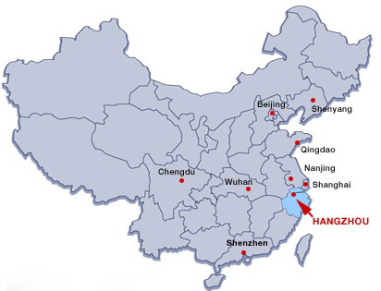


Complementary muon-spin relaxation and neutron scattering studies of heavy fermion materials
Michael Smidman
Center for Correlated Matter and School of Physics
Zhejiang University, China

Slide 2

ISIS
Adrian Hillier
Devashibhai Adroja
Pascal Manuel
Fabio Orlandi
Christian Balz
Matthias Gutmann
PSI
Toni Shiroka
Shams Sohel Islam
TRIUMF
Gerald Morris
Bassam Hitti
Acknowledgements
Zhejiang University
Jinyu Wu
Zhaoyang Shan
Jianwei Shu
Chun Han
Yanan Zhang
Dajun Su
Jiawen Zhang
Yongjun Zhang (Hubei Normal)
Bin Shen (Nanjing University)
Zhentao Wang
Yu Liu
Chao Cao
Yu Song
Frank Steglich
Huiqiu Yuan
CSNS
Wu Xie

Slide 3
Outline
Introduction
Magnetic order of quantum critical ferromagnet CeRh₆Ge₄
(3) Non-collinear ferromagnetism in pressure-induced superconductor Ce₅CoGe₂
(4) Complex magnetic order in candidate spin-triplet superconductor CeSb₂

Slide 4
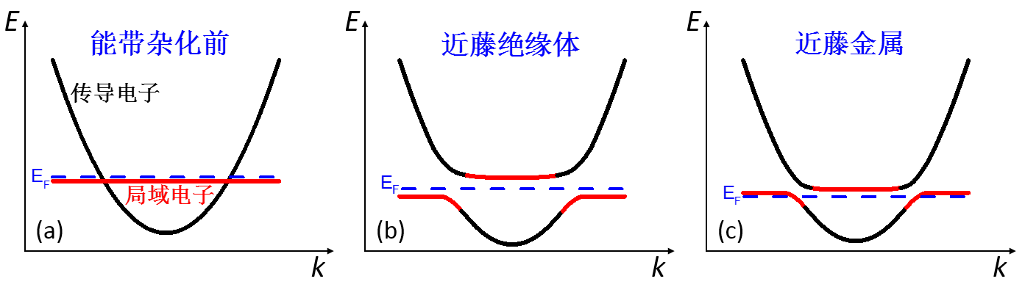
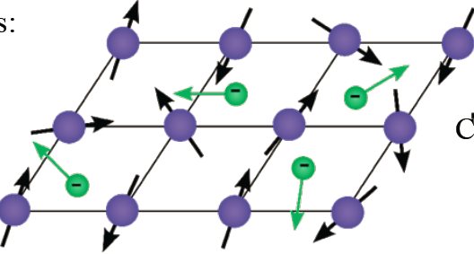
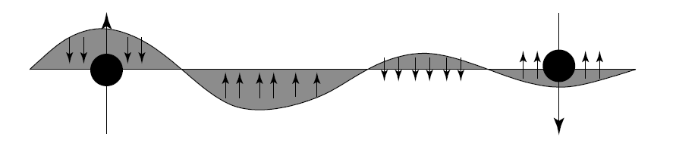
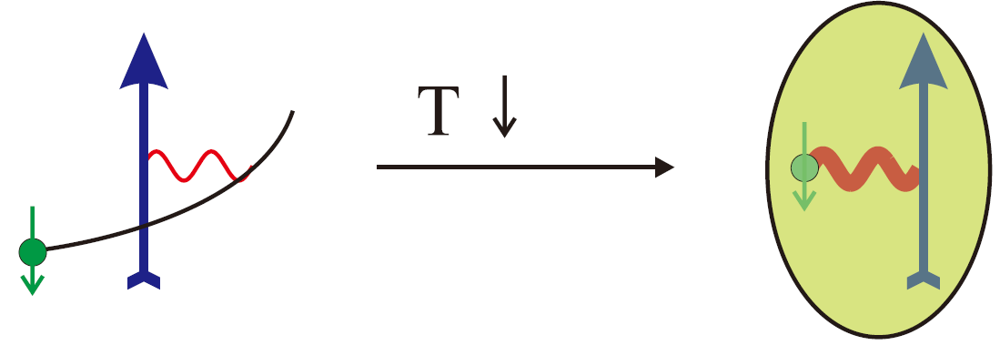
Quantum phase transitions in f-electron compounds
Kondo lattice: Regular arrangement of atoms with partially filled 4f/5f electron shells + conduction electrons
Heavy fermions: Charge carriers have large effective masses
RKKY interaction
Magnetic exchange
➔ Long-range magnetic order
Kondo effect
Hybridization between f- and conduction electrons
➔ Non-magnetic singlet ground state (“quenches” f-electron moment)
Tunable competition between RKKY and Kondo interactions

Slide 5
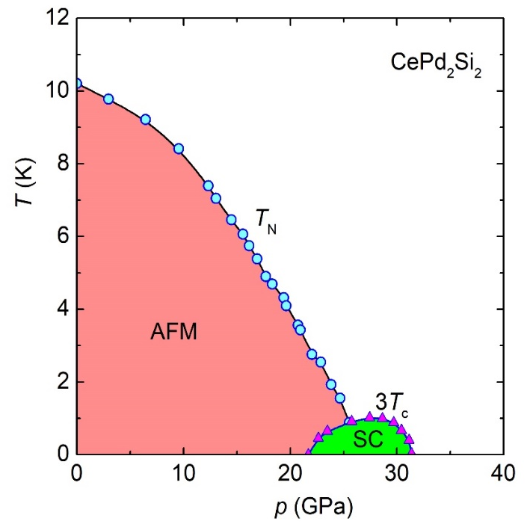
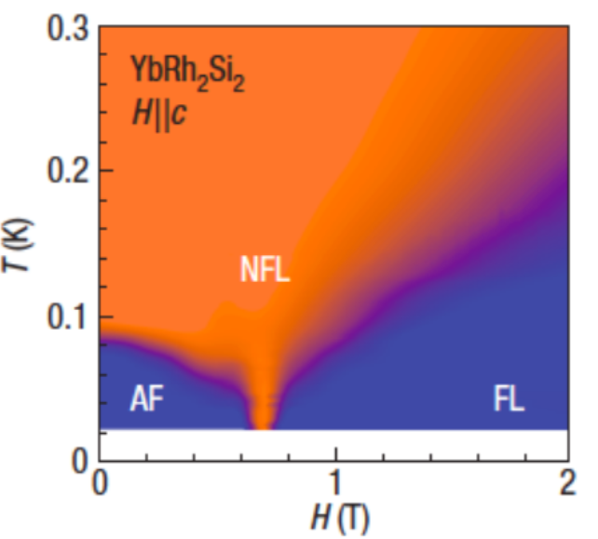
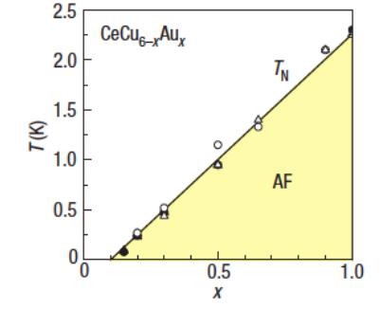
Quantum criticality
Pressure
Magnetic fields
Doping
M. D. Mathur et al., Nature (1998)
J. Custer et al., Nature (2003)
A. Schroeder et al., Nature (2000)
Tune a 2nd order transition to T = 0 by non-thermal control parameters
➔ Quantum critical point
Governed by quantum not thermal fluctuations
Novel phases of matter, e.g. strange metals, nematicity, unconventional superconductivity

Slide 6
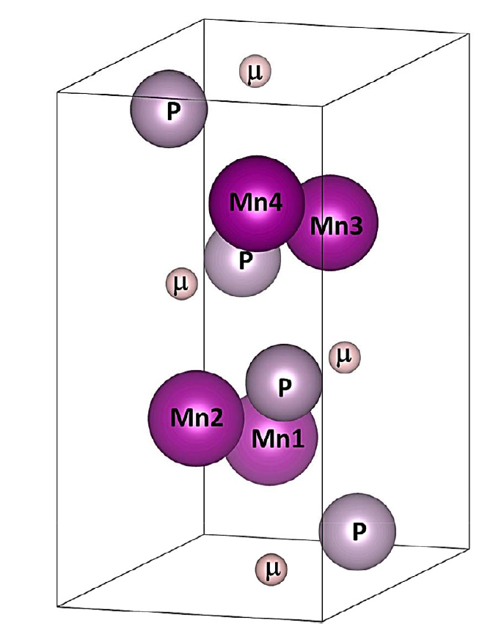
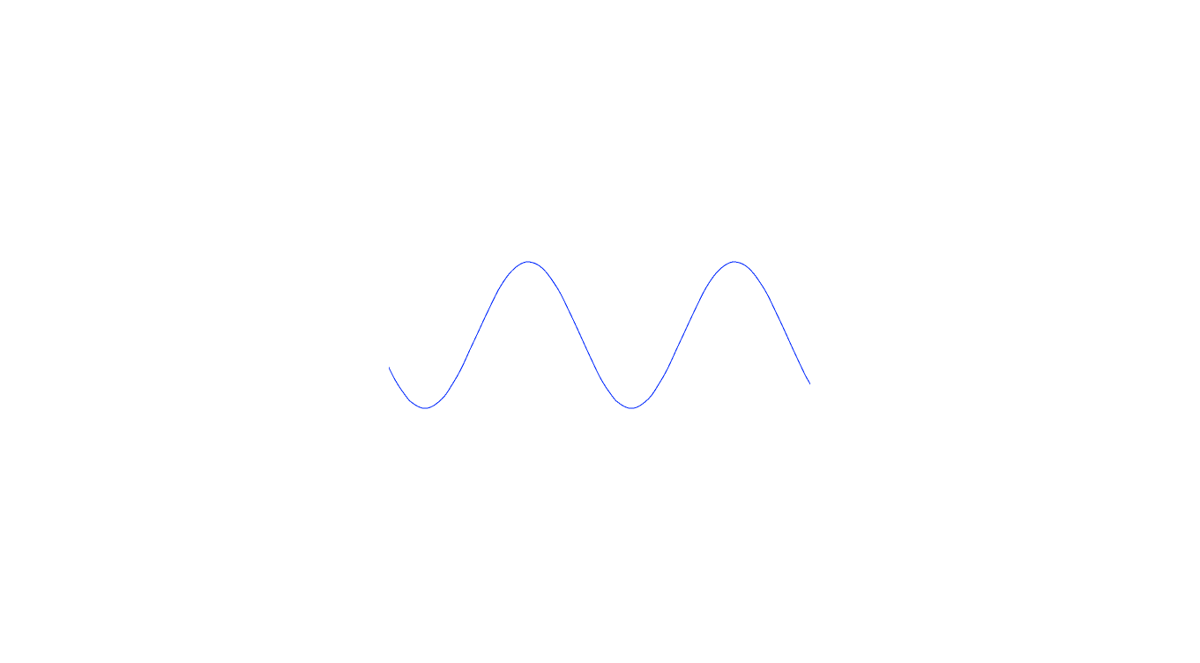

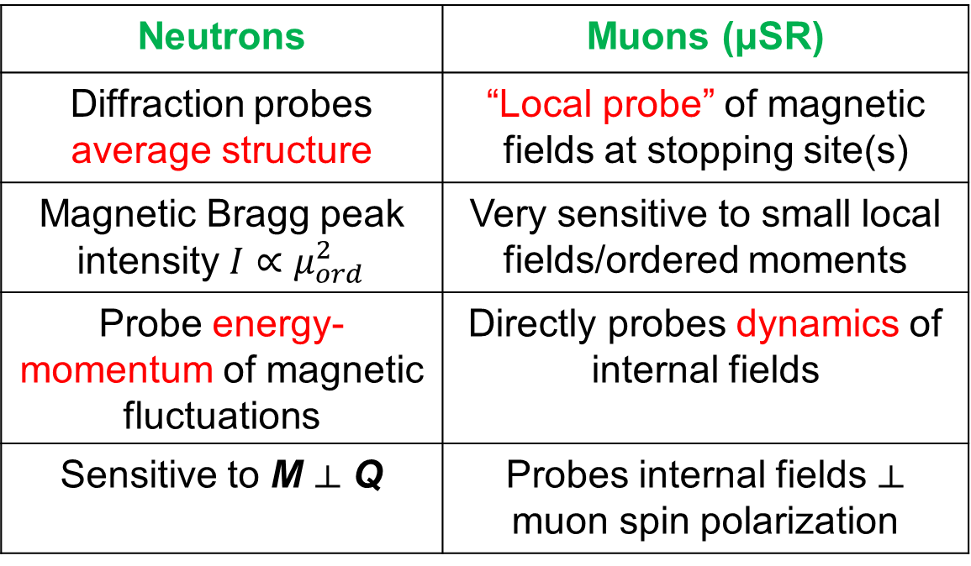
Neutrons + muons: “Complementary”magnetic probes
Neutrons | Muons (μSR)
Diffraction probes average structure | “Local probe” of magnetic fields at stopping site(s)
Magnetic Bragg peak intensity $I∝μ_{ord}^{2}$ | Very sensitive to small local fields/ordered moments
Probe energy-momentum of magnetic fluctuations | Directly probes dynamics of internal fields
Sensitive to M ⟂ Q | Probes internal fields ⟂ muon spin polarization
Diffraction probes |F_{hkl}|² => cannot determine ‘global phase’
φ = π/4
$$M_{j}= M_{0}cos(k.R_{j}+φ)$$
φ = 0
μSR can sometimes distinguish between different magnetic structures with identical or similar diffraction patterns

Slide 7
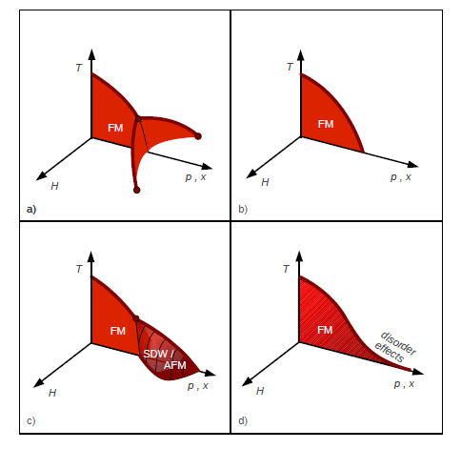
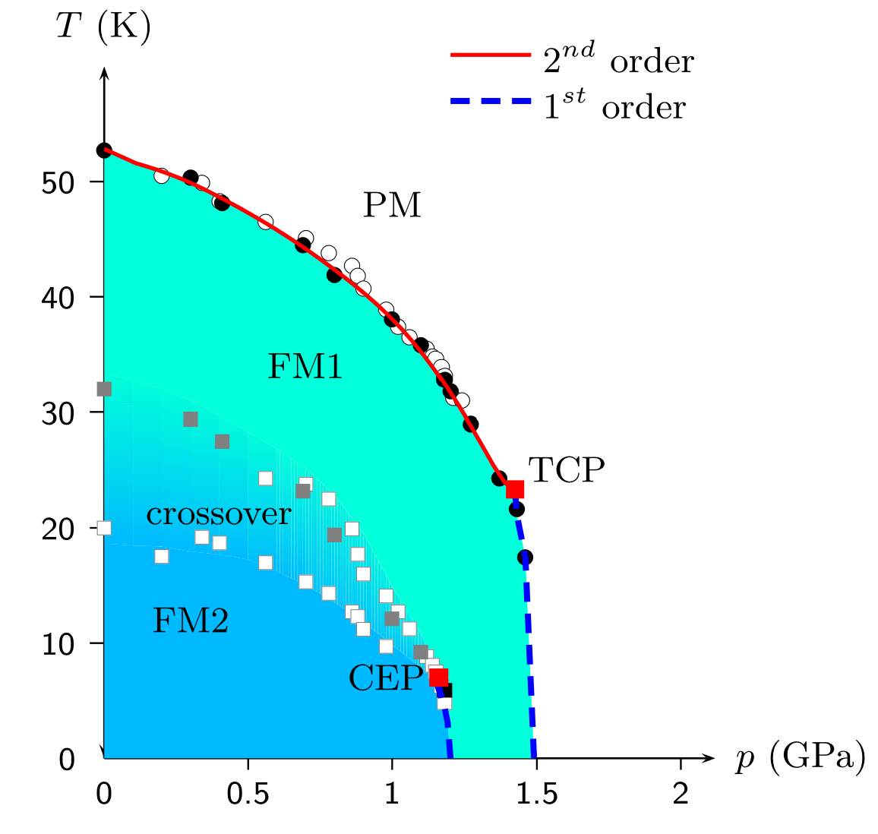
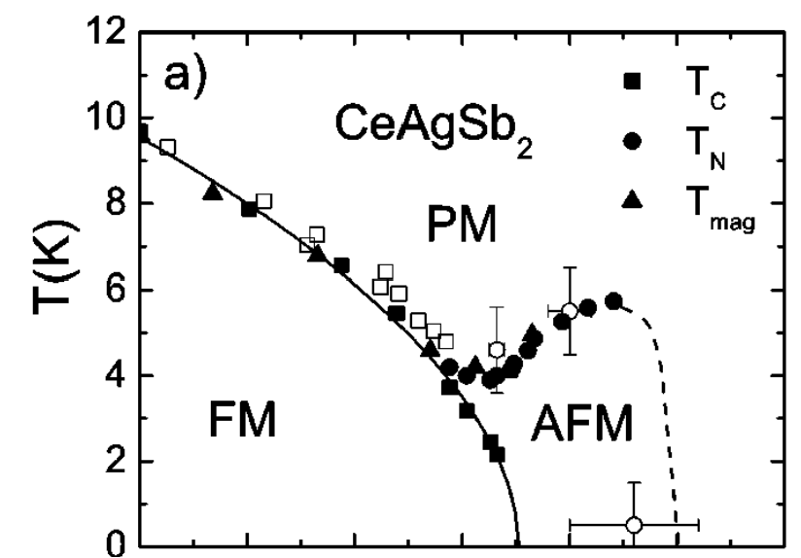
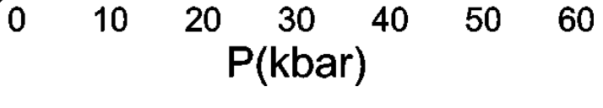
Ferromagnetic quantum criticality?
UGe₂, ZrZn₂, CoS₂…
URu_{2-x}Re_{x}Si₂, Ni_{x}Pd_{1-x}…
(Disorder)
UGe₂
CeAgSb₂, Nb_{1-y}Fe_{2+y}…
Ni_{1-x}V_{x}, CePd_{1-x}Rh_{x}…
V. Taufor et al. PRL (2010)
V. A. Sidorov et al. PRB (2003)
M. Brando et al., Rev Mod Phys. (2015)
Ferromagnetic quantum critical points not generally observed
Theoretically predicted to be prohibited in clean ferromagnetic systems
[D. Belitz et al. PRL (1999)]

Slide 8
Outline
Introduction
Magnetic order of quantum critical ferromagnet CeRh₆Ge₄
(3) Non-collinear ferromagnetism in pressure-induced superconductor Ce₅CoGe₂
(4) Complex magnetic order in candidate spin-triplet superconductor CeSb₂

Slide 9
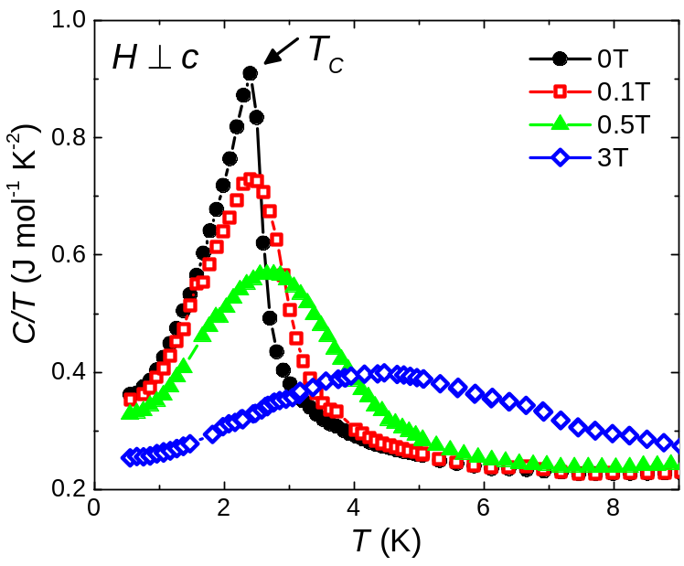
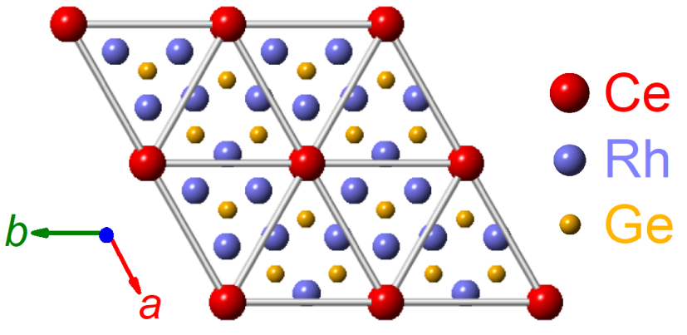
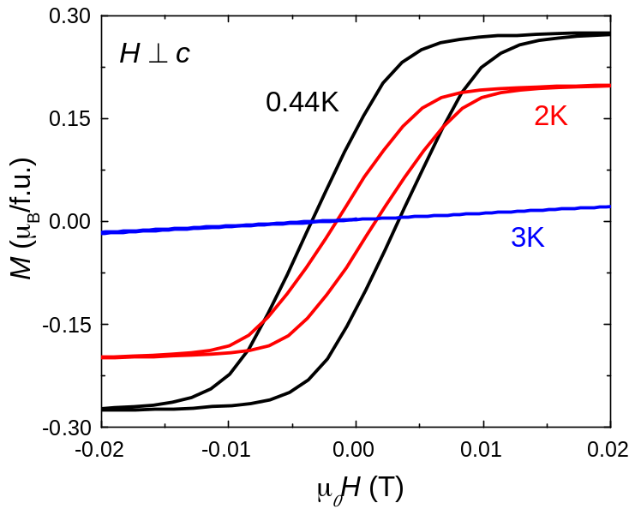
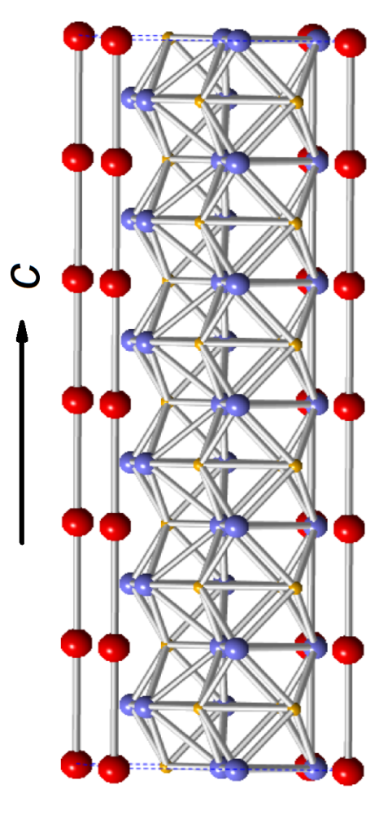
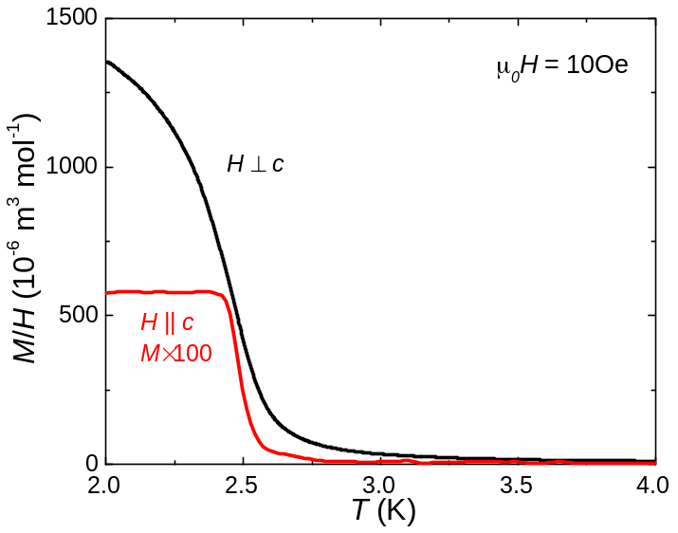
CeRh₆Ge₄: Clean stoichiometric Kondo ferromagnet
Triangular lattice of quasi-1D Ce chains
Ferromagnetic transition T_{C} = 2.5 K
ab-plane ordering of reduced Ce-moments
E. Matsuoka et al JPSJ (2015)
B. Shen et al., Nature 579, 51 (2020)

Slide 10
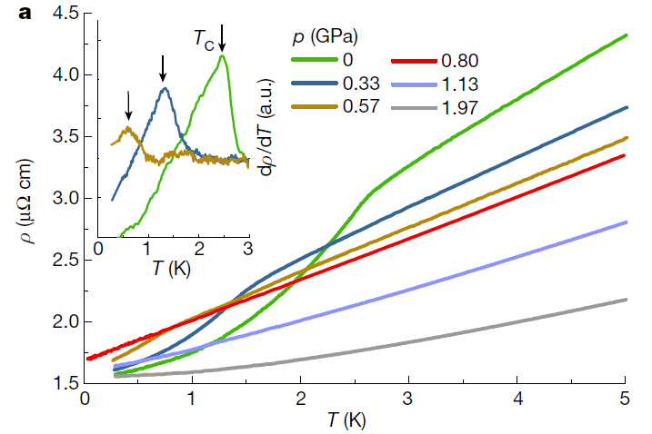
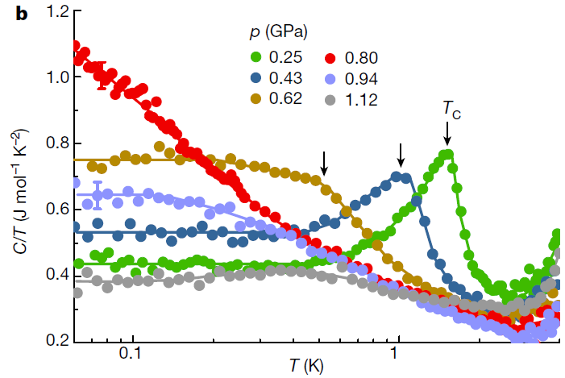
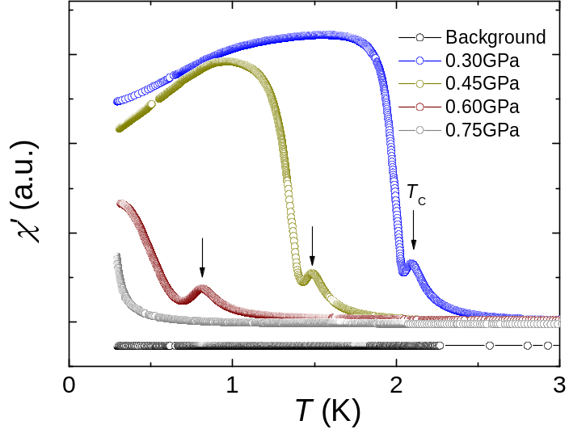
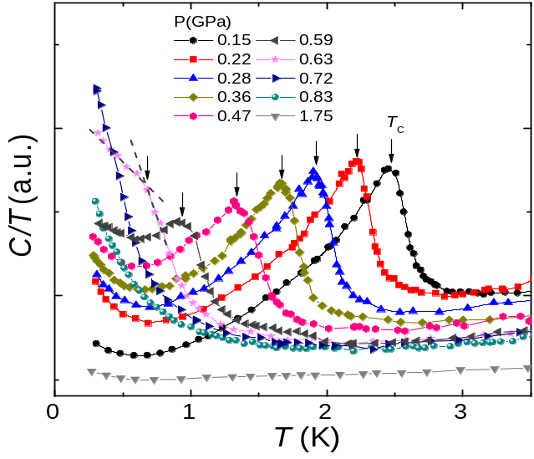
Ferromagnetic quantum critical point in CeRh₆Ge₄
Resistivity
Heat capacity
ac susceptibility
ac heat capacity
Ferromagnetic quantum critical point at p_{c} = 0.8 GPa
B. Shen et al., Nature 579, 51 (2020)

Slide 11
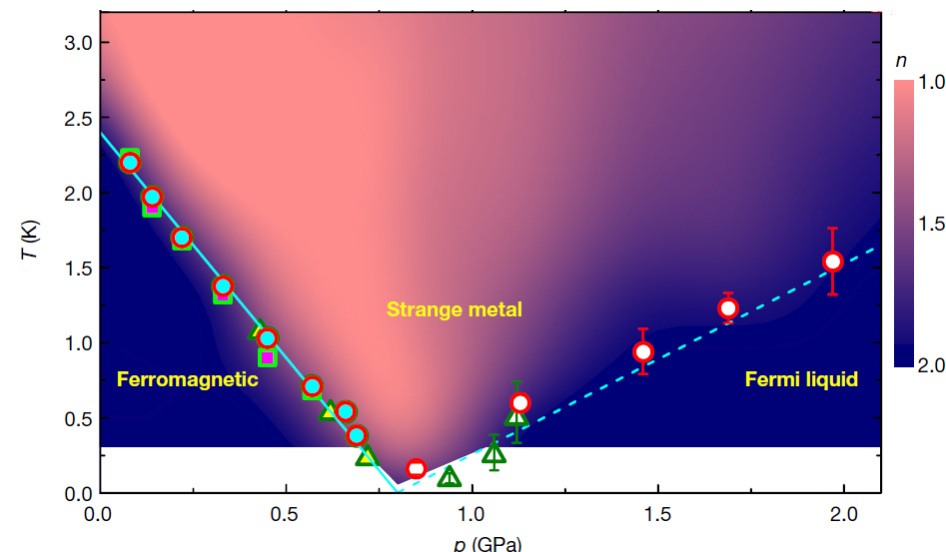

Ferromagnetic quantum critical point in CeRh₆Ge₄
B. Shen et al., Nature 579, 51 (2020)
Microscopic nature of magnetic order in CeRh₆Ge₄?

Slide 12
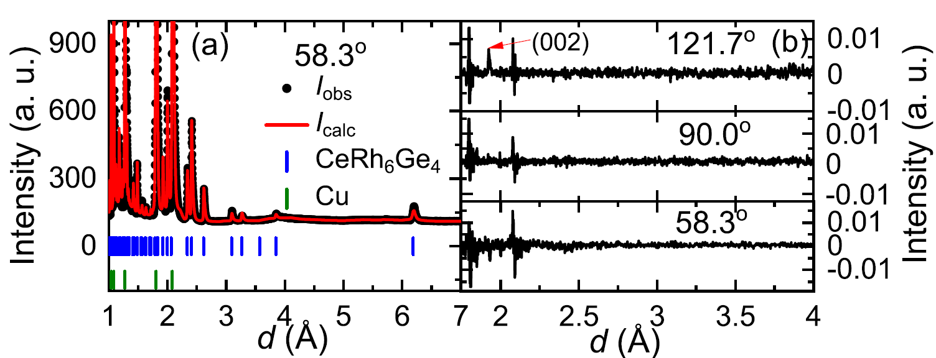
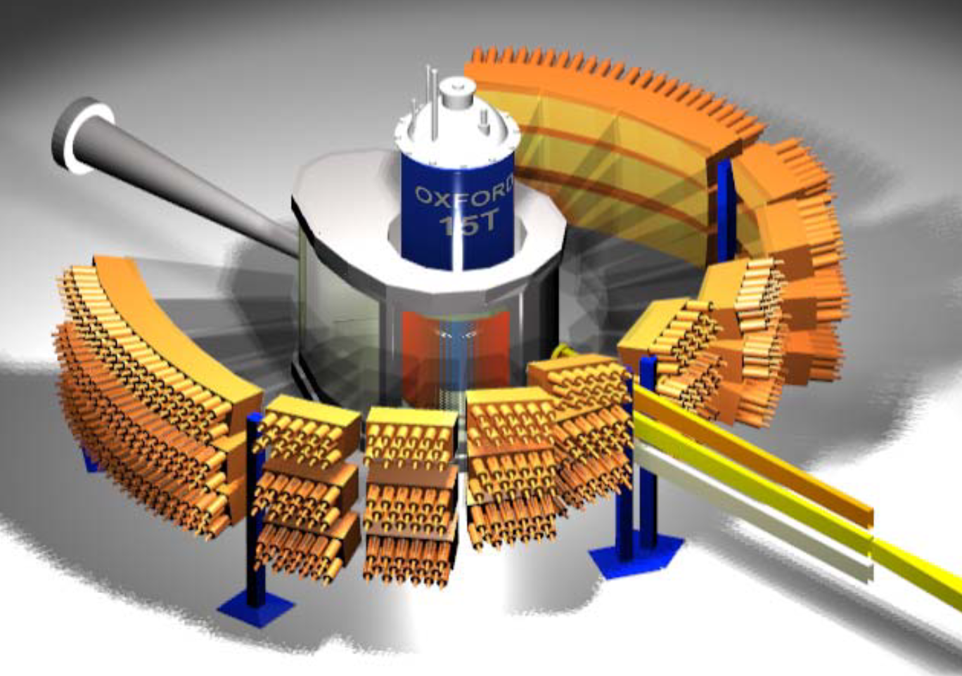
CeRh₆Ge₄: Powder neutron diffraction
Powder neutron diffraction @WISH (ISIS)
J. W. Shu et al. Phys. Rev. B 104, L140411 (2021)
Subtract 4 K data from 0.4 K => no systematic magnetic Bragg peaks

Slide 13
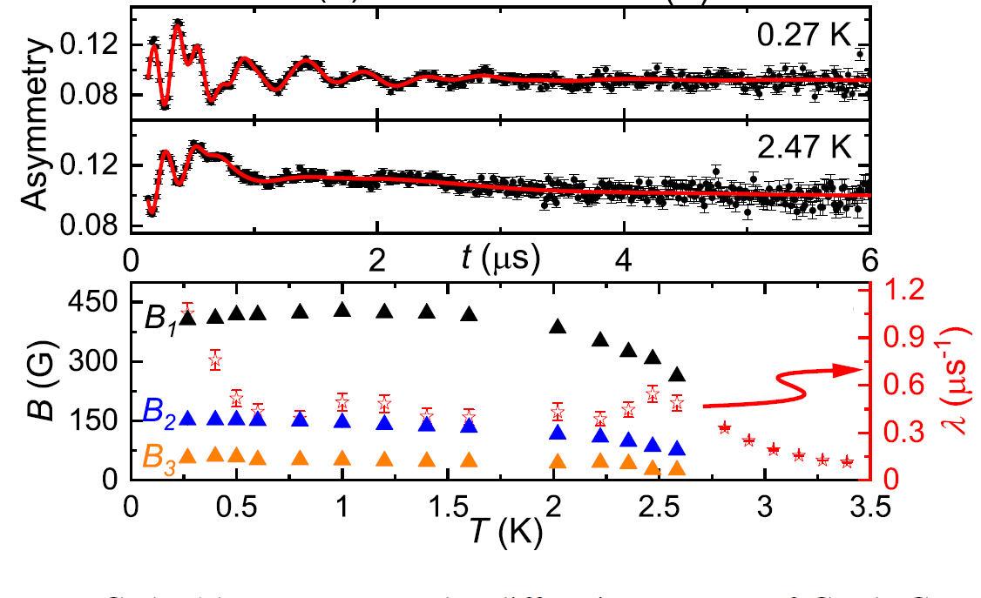

CeRh₆Ge₄: Muon-spin relaxation
μSR@MuSR (ISIS)
Coherent oscillations in ZF- μSR
=> Long range magnetic order
3 oscillation frequencies (internal fields)
J. W. Shu et al. Phys. Rev. B 104, L140411 (2021)

Slide 14
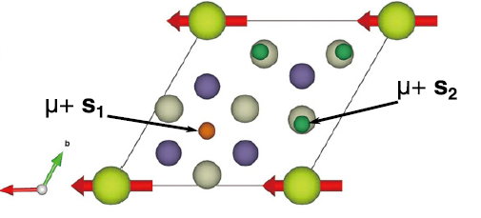
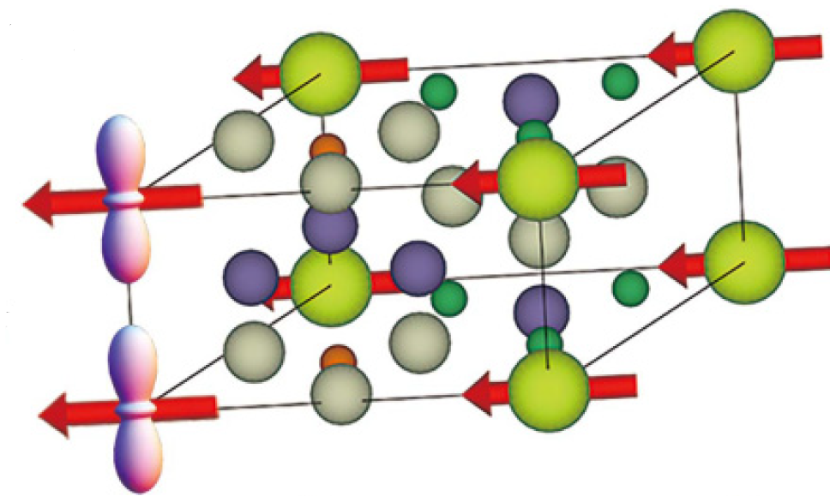
CeRh₆Ge₄: μSR
μSR@MuSR (ISIS)
Two inequivalent muon stopping sites
Ferromagnetic order along a-axis
=> Two local fields associated with site s₂
Calculated local fields (FM order, 0.24 μ_{B}/Ce)
s₁: 87 G
s₂: 152 G, 364 G
Fitted values
56 G, 151 G, 405 G
All consistent with small moment in-plane ferromagnetic order (~0.15-0.3μ_{B}/Ce)
J. W. Shu et al. Phys. Rev. B 104, L140411 (2021)

Slide 15
Outline
Introduction
Magnetic order of quantum critical ferromagnet CeRh₆Ge₄
(3) Non-collinear ferromagnetism in pressure-induced superconductor Ce₅CoGe₂
(4) Complex magnetic order in candidate spin-triplet superconductor CeSb₂

Slide 16
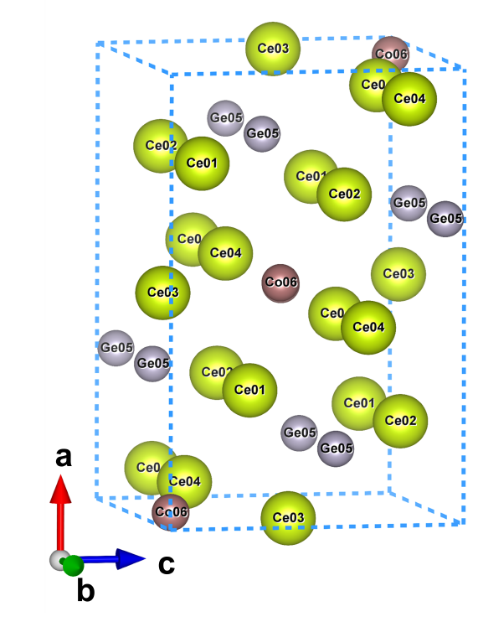
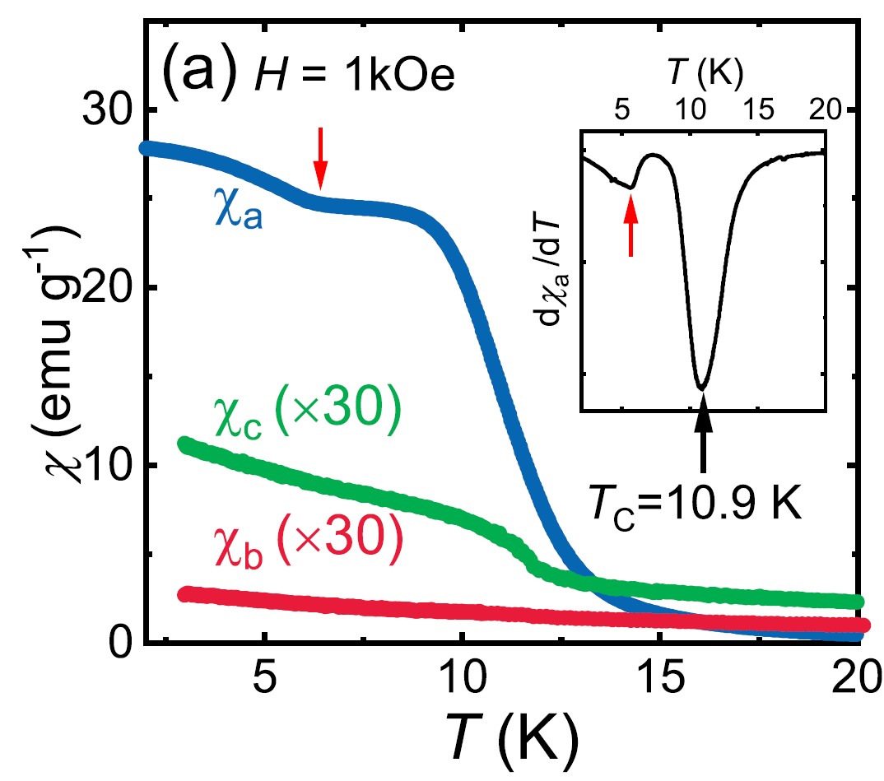
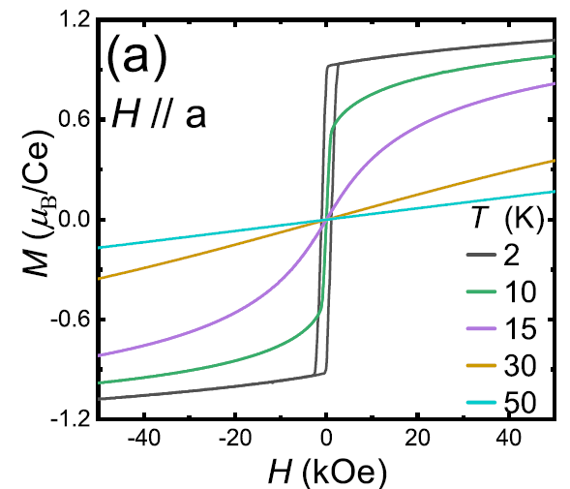
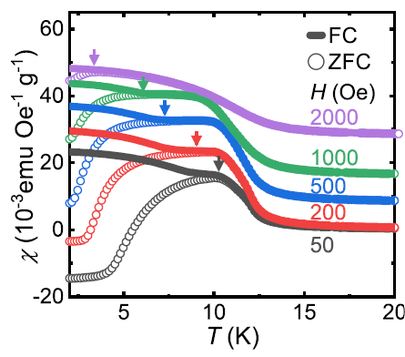
Ferromagnetic Kondo lattice Ce₅CoGe₂
Orthorhombic crystal structure (Pnma):
4 inequivalent Ce-sites
Ferromagnetic transition at T_{C} = 10.9 K with easy a-axis
Spin glass behavior with freezing temperature T_{f} = T_{C}
D. J. Sun et al. Phys. Rev. B 110, 144432 (2024)

Slide 17
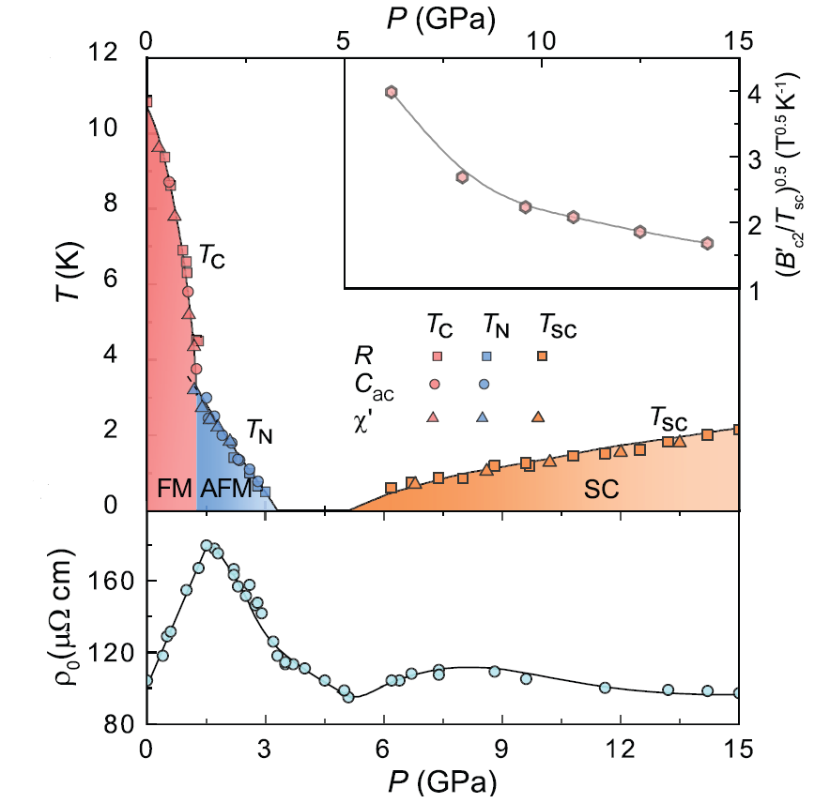
New scenario for unconventional superconductivity in correlated systems?
T_{C} decreases under pressure
Above 1.2 GPa, new magnetic transition with distinct field response
Change from ferromagnetic to antiferromagnetic ground state
Magnetic order suppressed to zero temperature quantum critical point at 3.2 GPa
Superconductivity appears well above the QCP at 6.2 GPa (T_{c} ~ 0.5 K), shifts to higher temperature with pressure (2 K at 15 GPa)
Distinct scenario for superconductivity in correlated ferromagnets
Y. N. Zhang et al. National Science Review 13, nwag119 (2026)

Slide 18
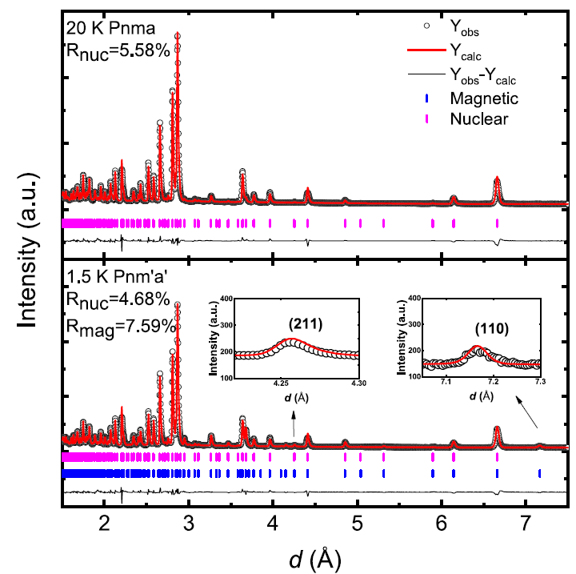
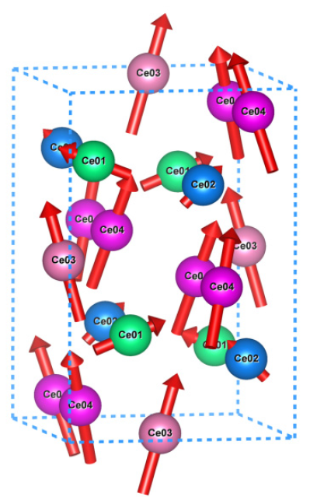
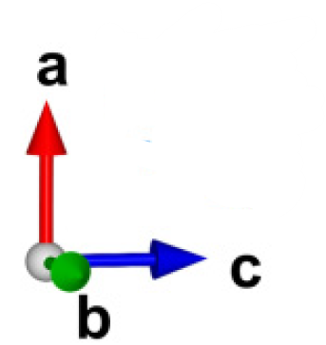
Canted ferromagnetism in Ce₅CoGe₂ at ambient pressure
Ambient pressure powder neutron diffraction:
k=0 ferromagnetic structure with magnetization along a-axis
Cannot refine with collinear FM structure: magnetic (110) peak demonstrates symmetry allowed c-axis component
Non-collinear ferromagnetic structure with net magnetization along a-axis
J. Y. Wu et al. Phys. Rev. B 113, 134431 (2026)

Slide 19
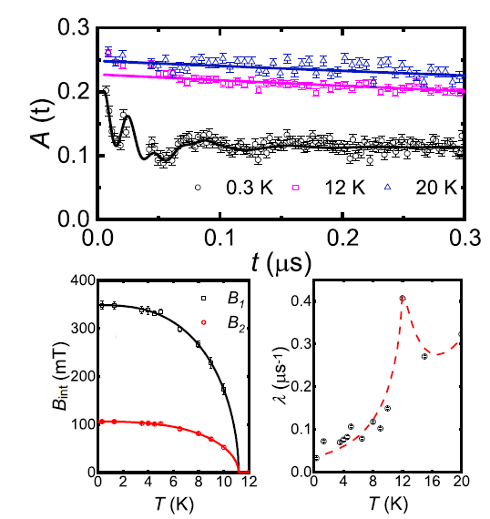
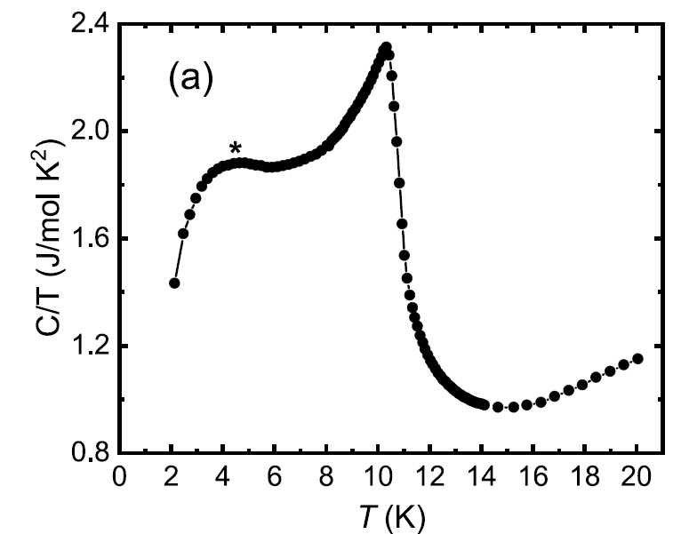
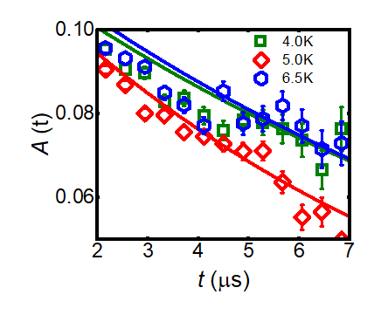

μSR on Ce₅CoGe₂
μSR@VMS (PSI)
Coherent oscillations with no evidence for change of magnetic structure with temperature
Weak increase in exponential relaxation rate λ + broad hump in C/T =>
Slowing down of fluctuations in magnetic phase? Incipient antiferromagnetic fluctuations in ferromagnetic state?
J. Y. Wu et al. Phys. Rev. B 113, 134431 (2026)

Slide 20
Outline
Introduction
Magnetic order of quantum critical ferromagnet CeRh₆Ge₄
(3) Non-collinear ferromagnetism in pressure-induced superconductor Ce₅CoGe₂
(4) Complex magnetic order in candidate spin-triplet superconductor CeSb₂

Slide 21
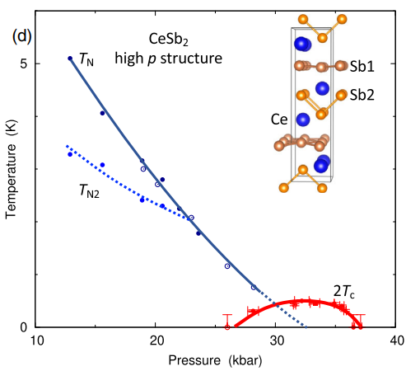
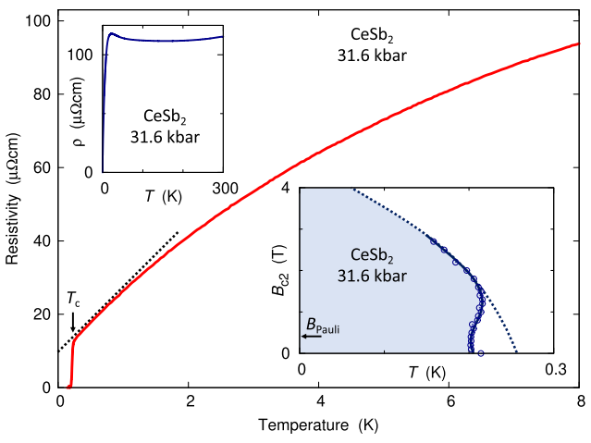
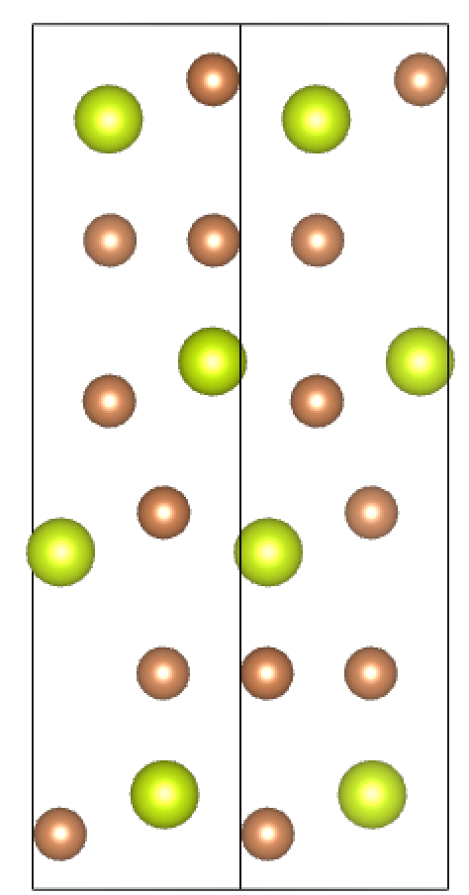
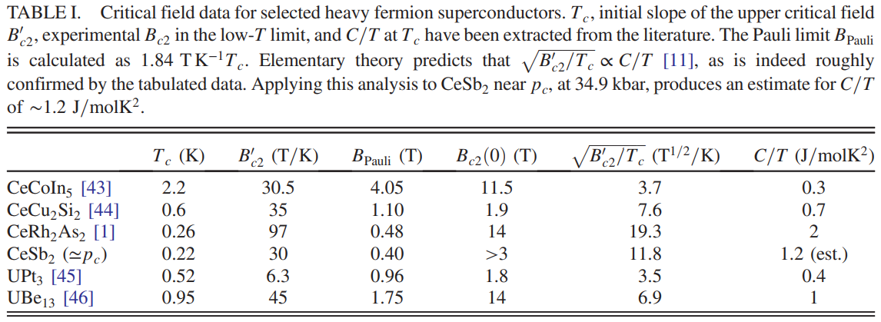
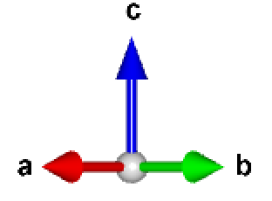
Candidate spin-triplet superconductor CeSb₂
Layered orthorhombic structure:
4 nearly square Ce-layers/unit cell
(2 bilayers)
(a = 6.28 Å, b = 6.13 Å)
Heavy-fermion superconductivity under pressure: SC dome at QCP?
H_{c2} (T) greatly exceeds the Pauli limit + inverted ‘S’-shape:
Spin triplet?
Sb
Ce
4.0 Å
5.1 Å
Squire et al. PRL 131, 026001 (2023)

Slide 22
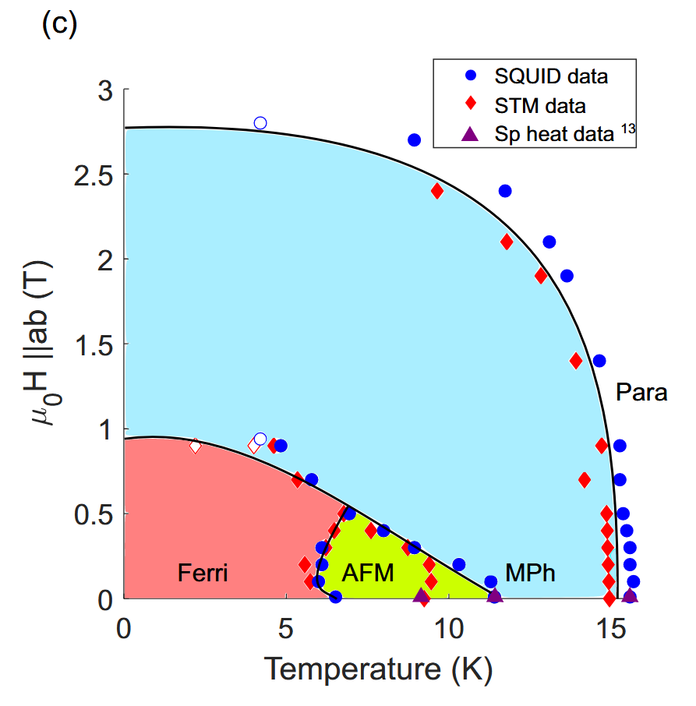
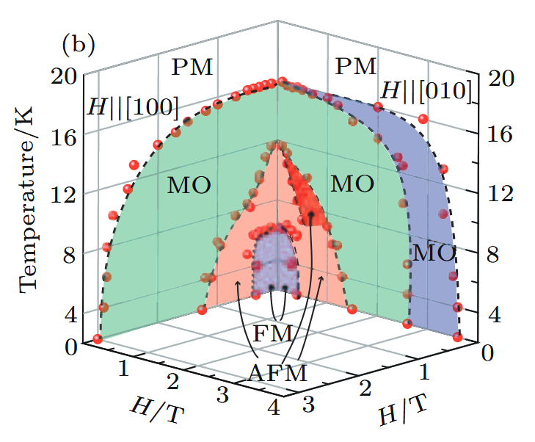
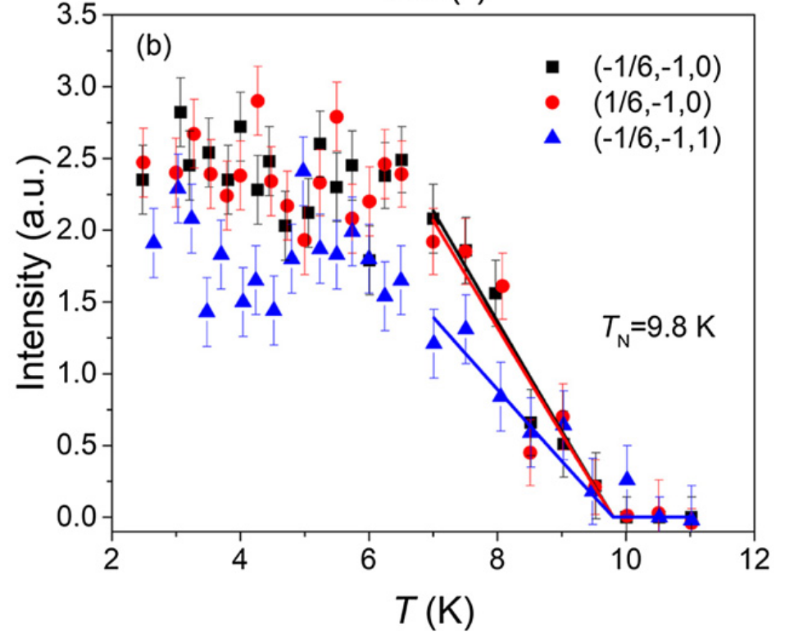
Candidate spin-triplet superconductor CeSb₂
Ambient pressure: Multiple magnetic phases with AFM and FM components below T_{N} = 16 K
Neutron diffraction: Commensurate AFM propagation vector (±1/6, -1, 0) below ~ 10 K
Trainer et al. PRB 104, 205134 (2021)
Zhang et al. Chin. Phys. B 26, 067102 (2017)
Liu et al. JPCM 32 405605 (2020)

Slide 23
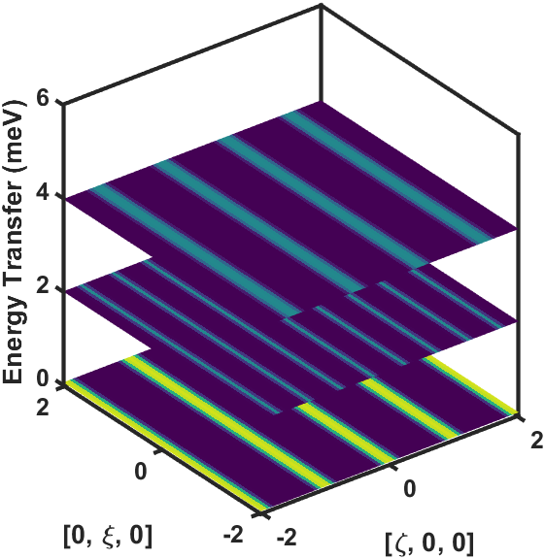







Inelastic neutron scattering measurements of CeSb₂
Inelastic neutron scattering @LET (ISIS)
Out-of plane excitations
In-plane excitations
Z. Y. Shan et al. Phys. Rev. Lett. 134, 116704 (2025)
“Rod-like” excitations in [HL] and [HK] planes: No long-range propagation of spin-waves (magnons) along c* axis and along on one in-plane direction (with twinning)
Spin-waves stem from integer Bragg positions:
Direct evidence for quasi-1D ferromagnetic excitations

Slide 24









Ferromagnetic spin ladder model
Data well described by a ferromagnetic spin ladder model with weak coupling between ladders
What about the magnetic structures?
$J_{2d}$ = -0.1 meV
$δ$ = 1.2
$J_{b}$ = -2.2 meV
$J_{d}$ = -1.8 meV
$J_{1d}$ = -1.4 meV
Z. Y. Shan et al. Phys. Rev. Lett. 134, 116704 (2025)

Slide 25



Magnetic order of CeSb₂
Neutron diffraction @SXD (ISIS), SIKA (ANSTO), TREND (CSNS)…
(Unpublished)
Multiple magnetic propagation vectors with different temperature dependences:
No magnetic Bragg peaks above 11 K, but magnetic order below T_{N} = 16 K?

Slide 26


Magnetic order of CeSb₂
μSR@LAMPF (TRIUMF)
Trainer et al. PRB 104, 205134 (2021)
(Unpublished)
Coherent oscillations below 16 K: Long range magnetic order below T_{N} = 16 K
Temperature dependence of internal fields consistent with previously observed transitions with small changes in internal fields

Slide 27

Magnetic order of CeSb₂
μSR@LAMPF (TRIUMF)
(Unpublished)
Calculated internal fields for pure ferromagnetic model: Site 1 => 296 mT, Site 2 => 196 mT
Fitted values: B₂(0) = 204 mT, B₃(0) = 248 mT, B₄(0) = 256 mT
Besides B₁, local fields dominated by ferromagnetic spin ladders

Slide 28
Summary
Neutron scattering and muon-spin relaxation are powerful complementary tools for probing magnetic structure and dynamics in heavy fermions and other correlated materials
Muon-spin relaxation is particularly useful for probing weak magnetic order often found in proximity to quantum phase transitions and novel quantum phases of matter
D. J. Sun et al. Phys. Rev. B 110, 144432 (2024)
Y. N. Zhang et al. National Science Review 13, nwag119 (2026)
J. Y. Wu et al. Phys. Rev. B 113, 134431 (2026)
Z. Y. Shan et al. Phys. Rev. Lett. 134, 116704 (2025)
B. Shen et al., Nature 579, 51 (2020)
J. W. Shu et al. Phys. Rev. B 104, L140411 (2021)

