Slide 1
Towards a Long Strip AC-LGAD Detector for the CEPC Outer Silicon Tracker
Mei Zhao（IHEP,CAS）
On be half of CEPC OTK group
2026-7-31

Slide 2
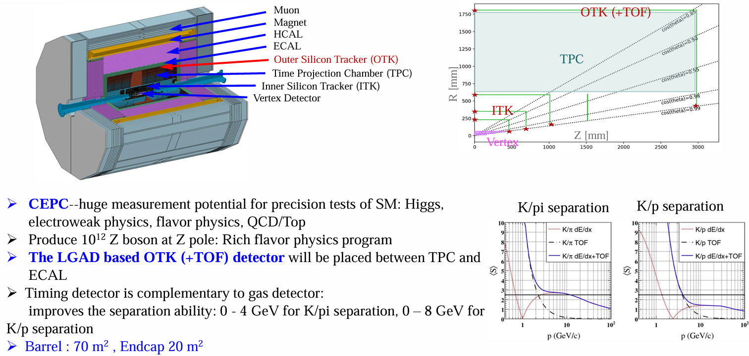
CEPC Outer Silicon Tracker
Notes:
for instance, CEPC experiment, the LGAD based OTK detector will be placed between TPC and Ecal, the timing information from the detector will improve the separation ability for in 0-4GeV K/pi and in 0-8 GeV K/p.
And the total area is Extremely large. Since for $D tracker system in the collider, spatial resolution along the bending direction is more crucial, AC-LGAD sensors with strip-shaped readout electrodes is good, it can reduce the number of readout channels while maintaining the …
The requirement of CEPC for the timing layer is that spatial resolution less than 10um, along the bending direction,,,Timing resolution less than 50ps. The strip length is 2-4 cm, quite long.
The development of this project will significantly contribute to the detector technology for such collider experiment.

Slide 3
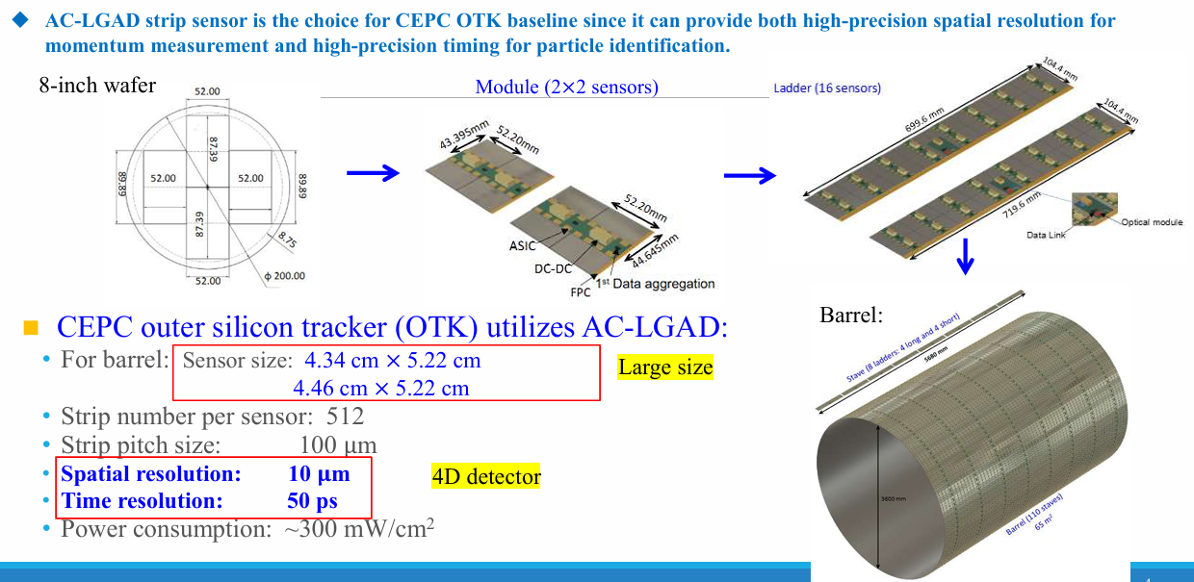
CEPC Outer silicon tracker
For 4D tracker system in these colliders, AC-LGAD sensor with strip-shaped readout electrodes reduce the number of readout channels while maintaining spatial resolution along the bending direction.

Slide 4
Towards a long strip AC-LGAD detecteor
AC-LGAD sensor
Read out ASIC
LGAD+ASIC test
LGAD Beam Telescope
Mechanical Design and Fabrication R&D

Slide 5
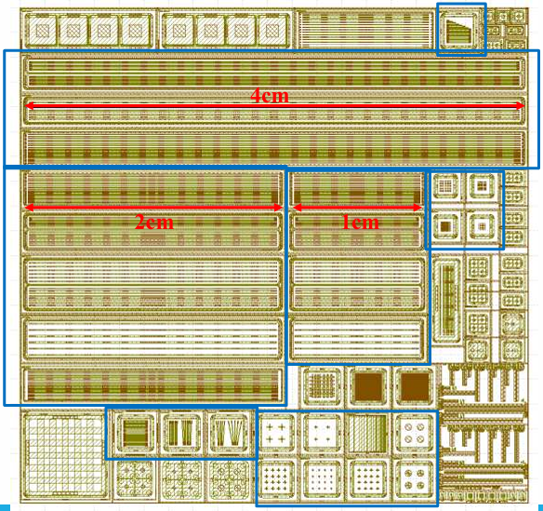
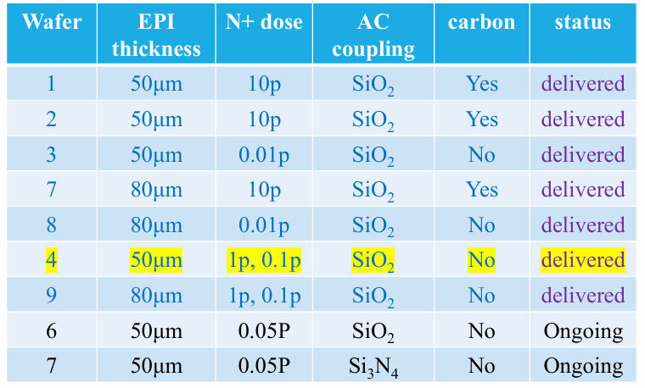
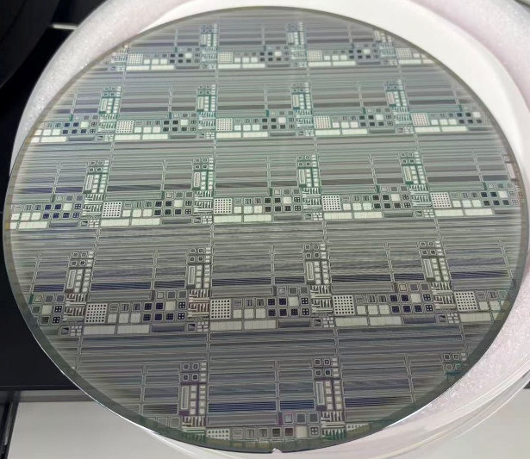
AC-LGAD sensor R&D
AC-LGAD with long strip been submitted for fabrication in April 2025
➢ Strip lengths: 1 cm, 2 cm, and 4 cm
➢ Strip pitch sizes: 100 µm, 200 µm, and 500 µm
➢ Electrode widths: 25 µm, 50 µm, and 100 µm
➢ Isolated structure design and EPI thickness (50 µm, 80 µm) to reduce sensor capacitance
➢ Process design optimization: N+ doping concentration
Testing has been done on wafer 1, wafer3, wafer 4.
I-V, C-V, spatial and timing performance using Beta and laser system

Slide 6
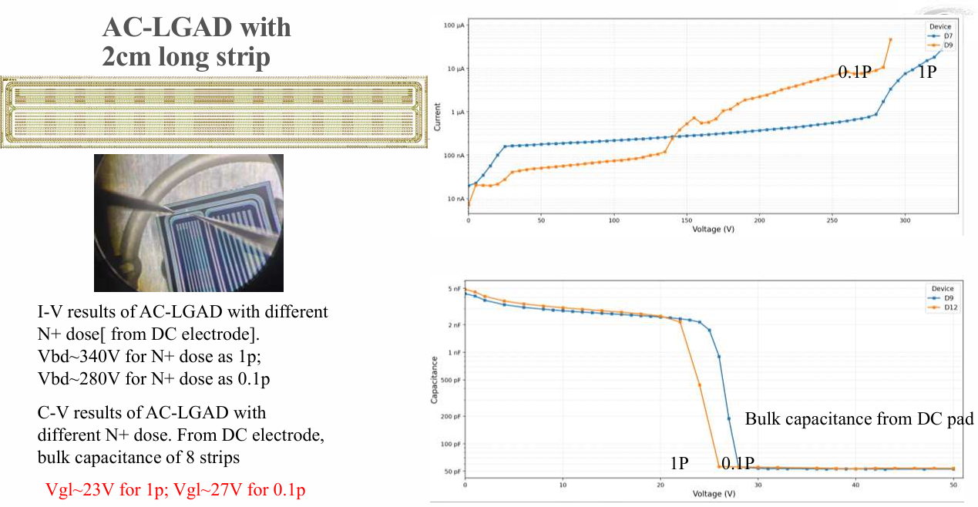
AC-LGAD sensor R&D

Slide 7
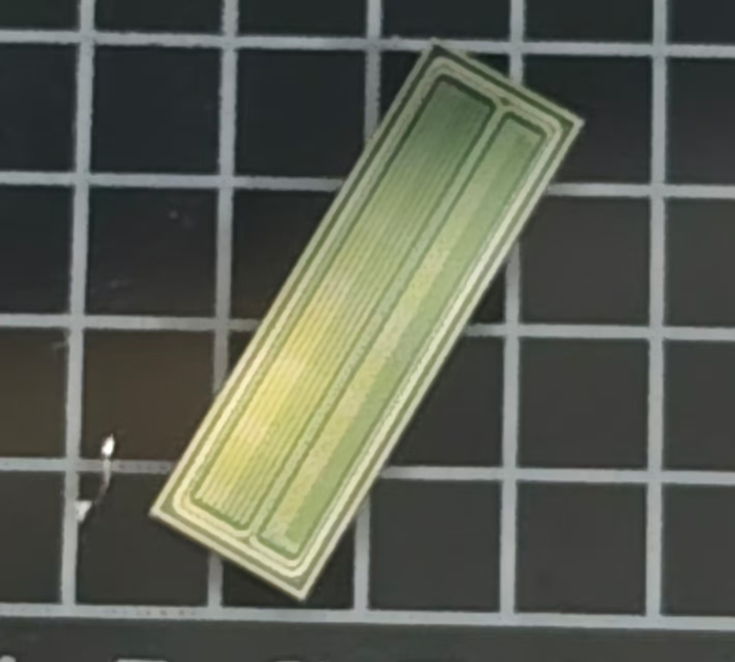
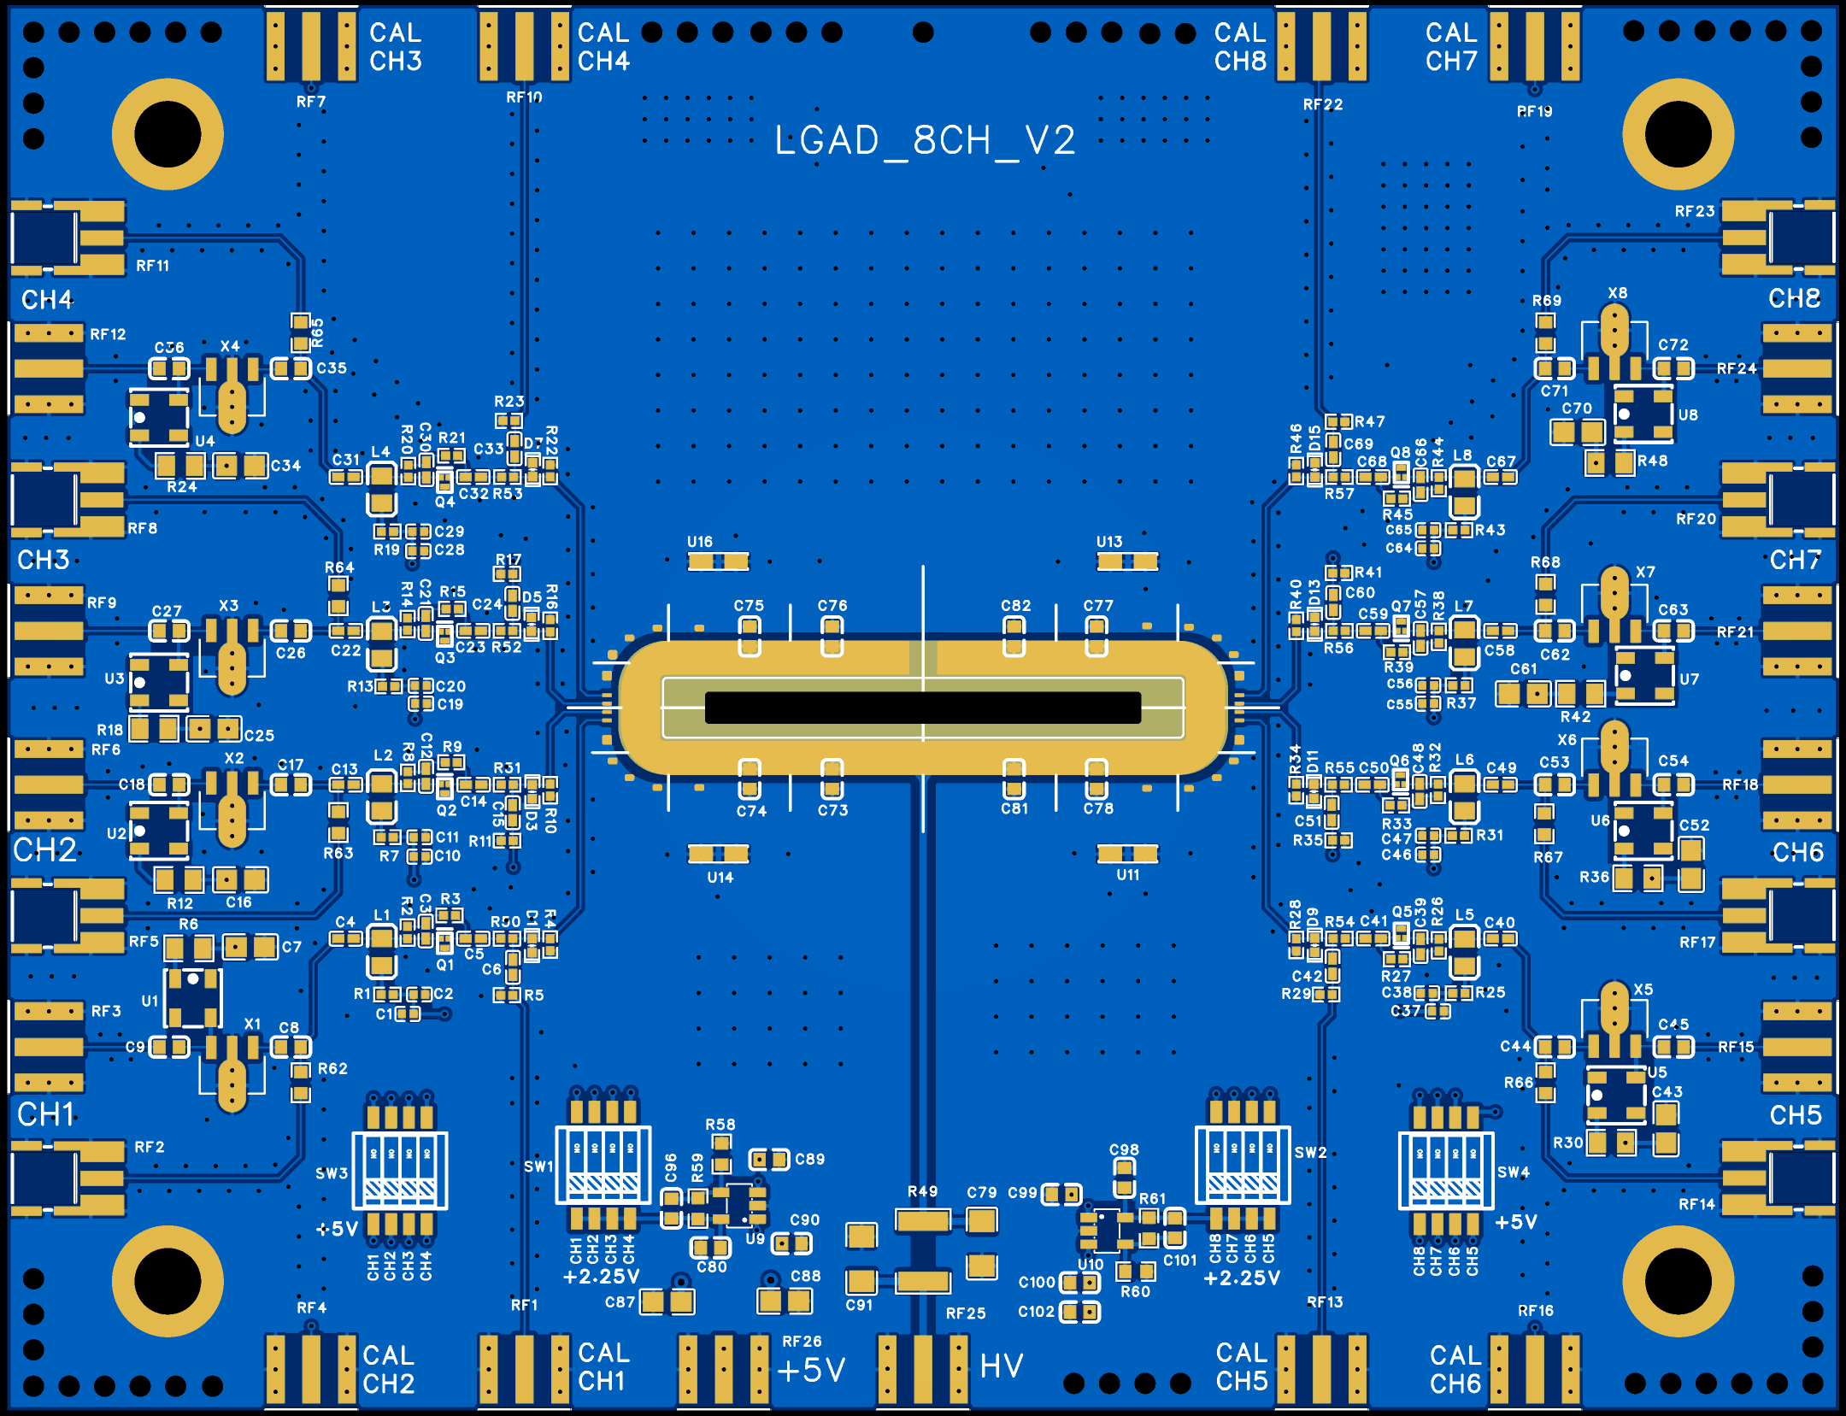
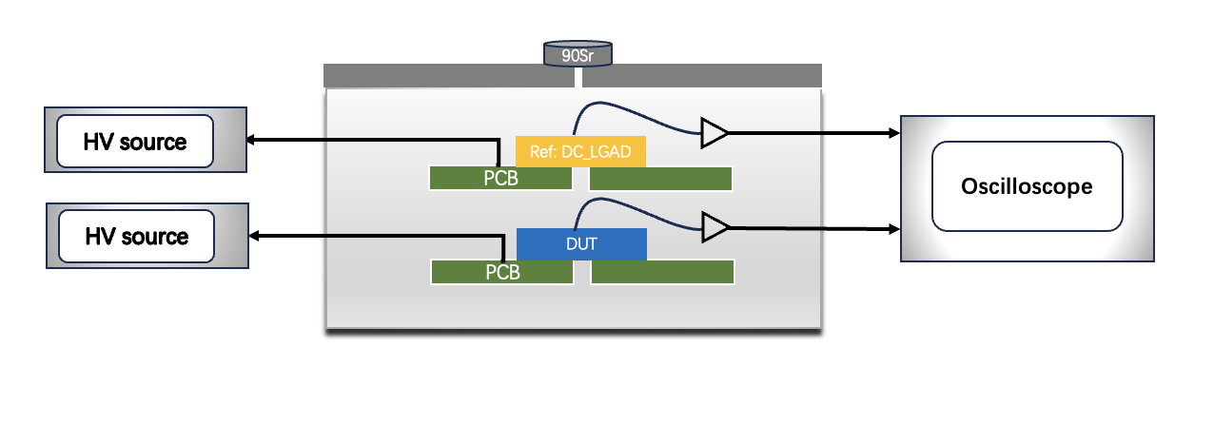
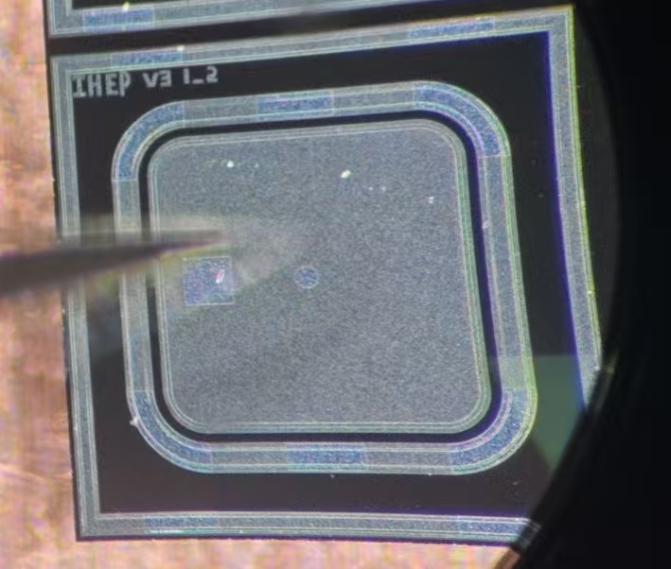
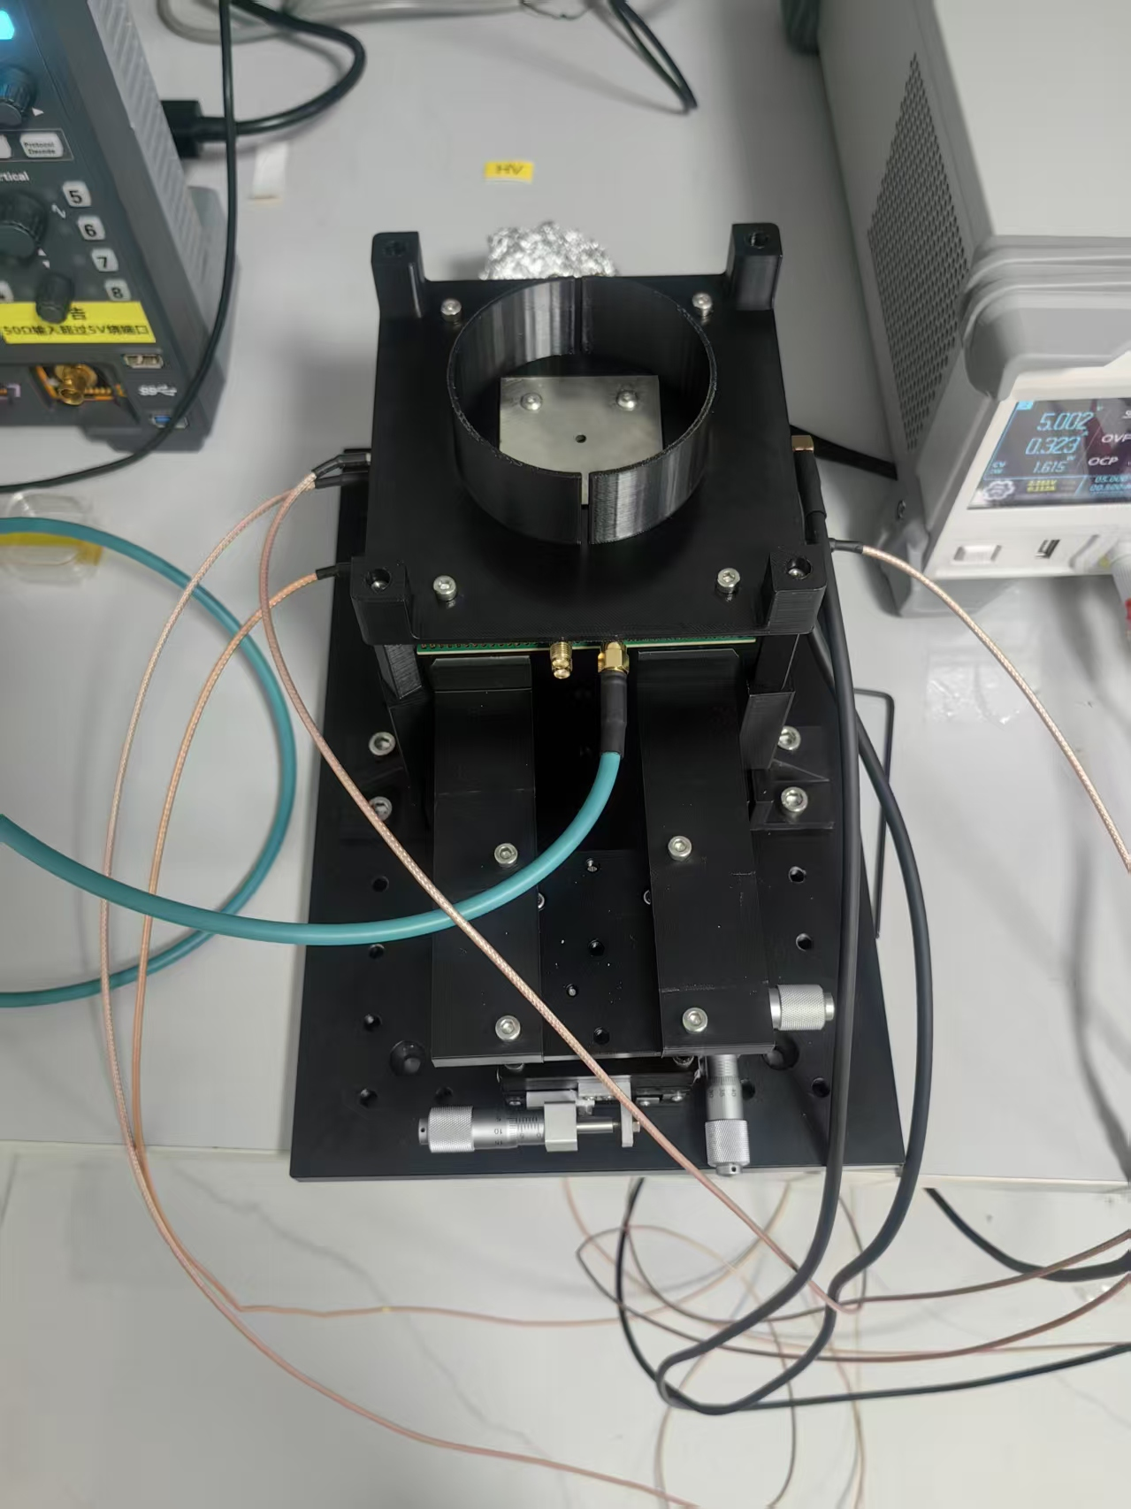
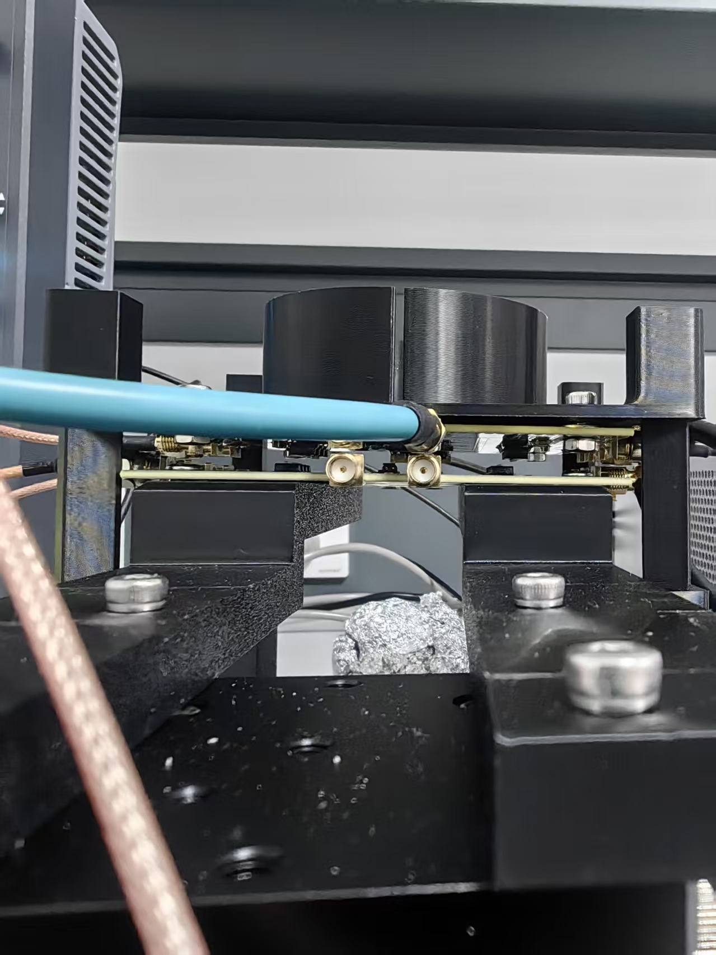
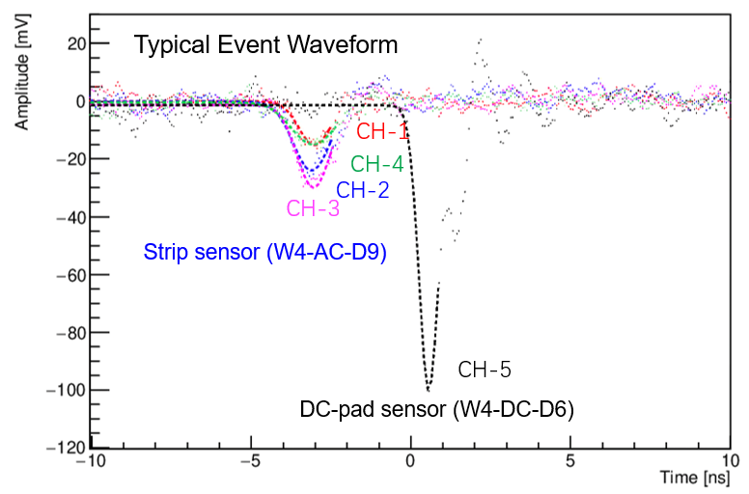
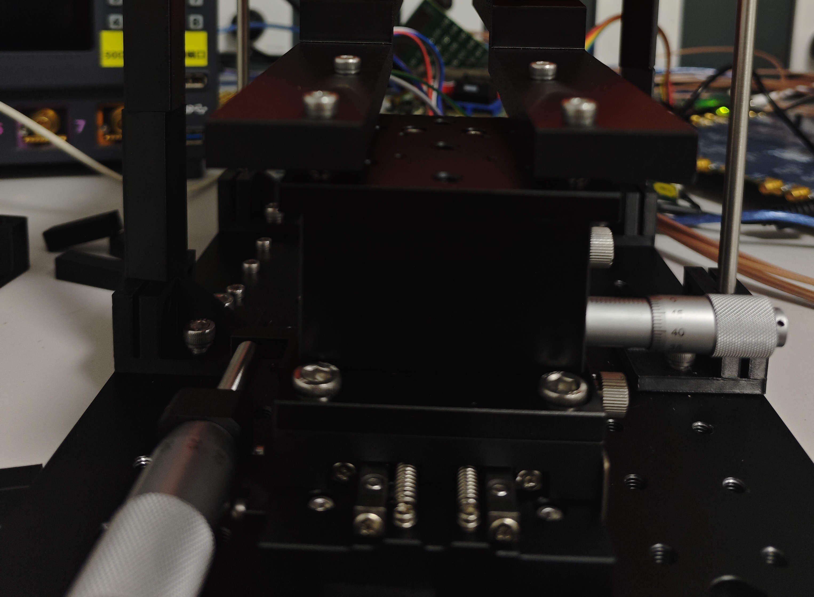
AC-LGAD sensor R&D
Beta test setup
BUT strip sensor with strip length as 2 cm
Strip Sensor
DC Sensor
DC-pad sensor (W4-DC-D6)
Time resolution 36 ps
Readout board for sensors

Slide 8
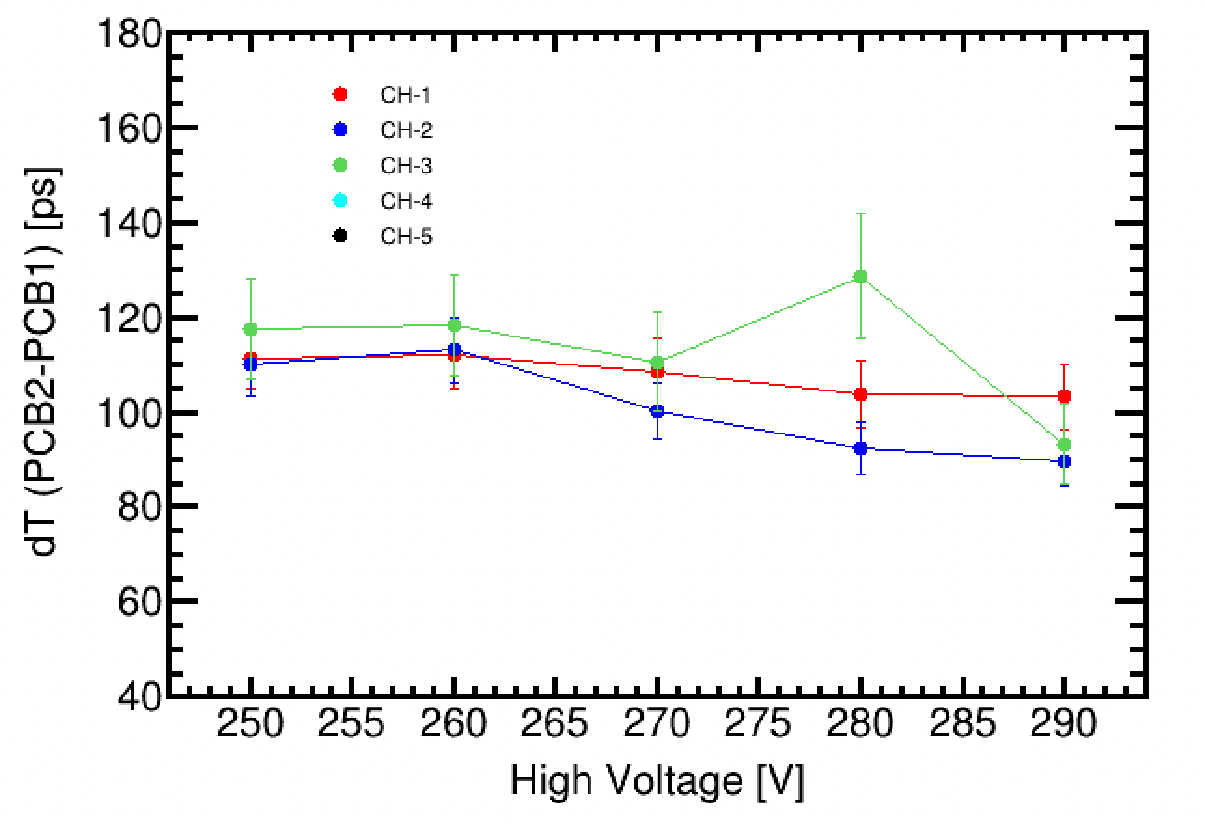
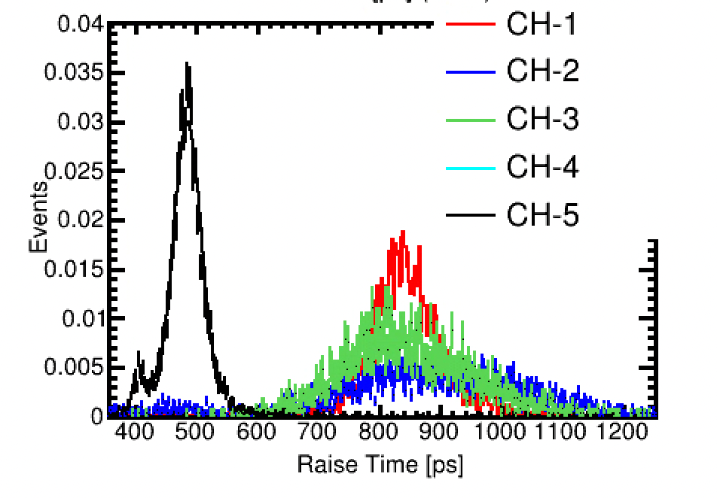
Strip Sensor Time Resolution (Beta Source)
DUT strip sensor (W4-AC-D9, 2 cm)
CH-1
CH-2
CH-3
CH-4
CH-3
CH-1
Raise Time
CH-2
Strip Sensor Time Resolution:
√ (90-*90-36*36)~83 ps
(DC, W4-DC-D6)
The signal rise time of strip sensors is substantially longer than that of pad sensors.
The strip sensor (W4-AC-D9: 2 cm, 100 μm pitch, 50 μm electrode width) achieved a time resolution of ~83 ps.
8

Slide 9
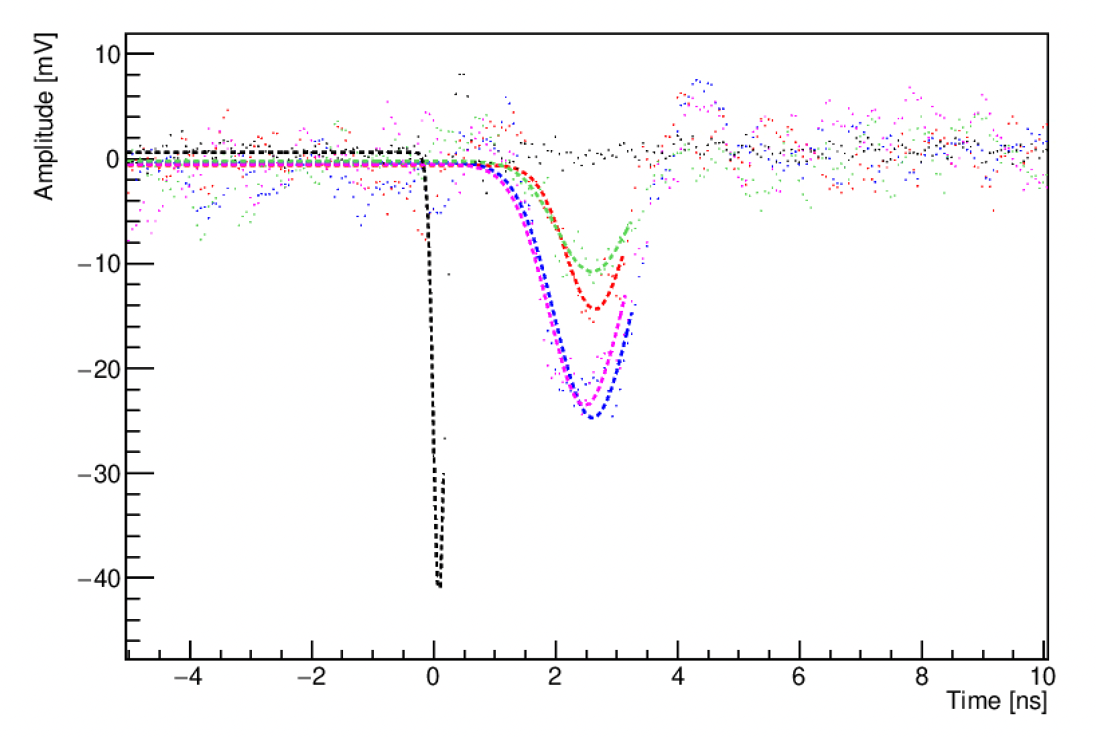
Laser TCT Sensor Characterization
Laser
Typical Event Waveform (0.02% laser intensity)
50%
Polarization-maintaining beam splitter
50%
Attenuator and focusing system
CH-4
CH-1
LGAD or
LGAD+LATRIC
Photodiode (PD)
CH-3
PD
CH-2
Timing resolution 1.2 ps
PCB
Strip Sensor (W4-AC-D9)
Trigger
CH-5
Oscilloscope
DUT sensor
Laser scanning
CH-1
CH-2
Data analysis
CH-3
CH-4

Slide 10
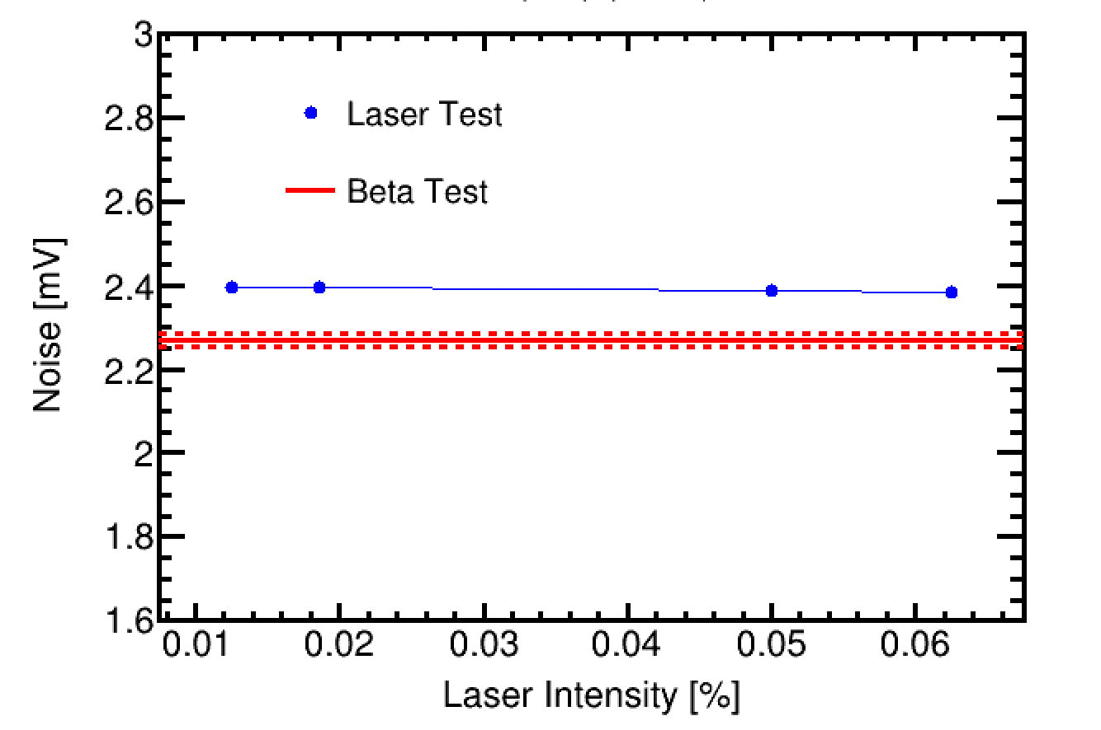
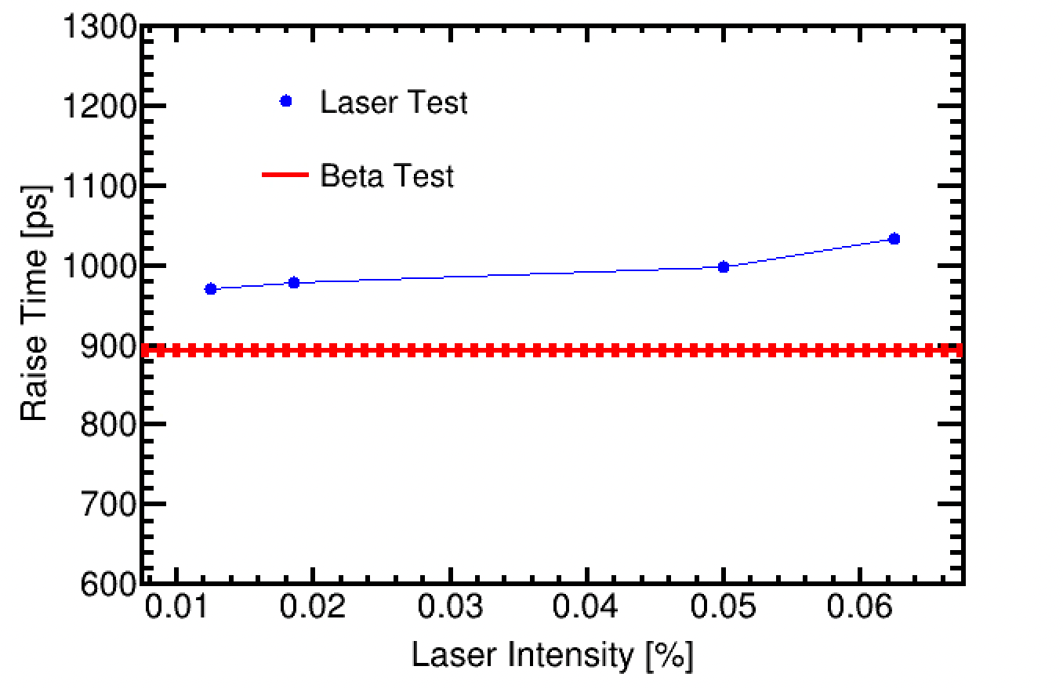
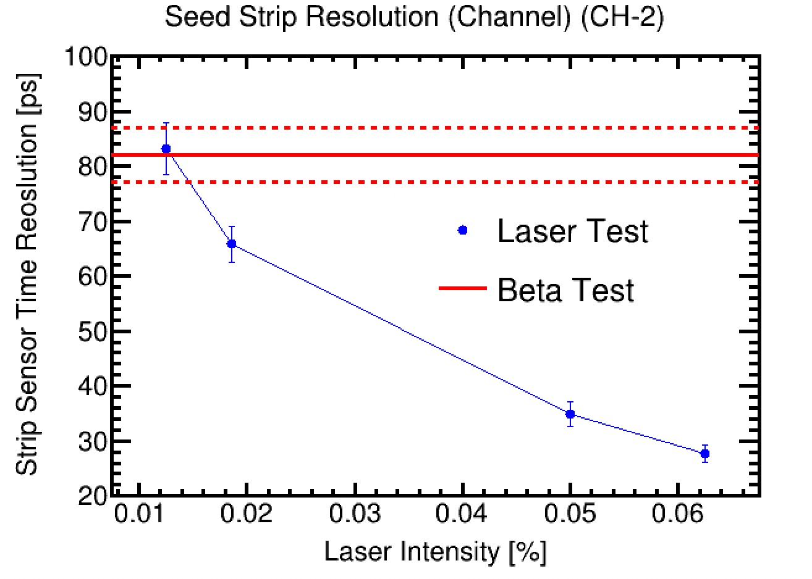
Strip Sensor Time Resolution (Laser Source)
Strip sensor (W4-AC-D9, 2 cm)
CH-1
The tuned laser emulates the MIP amplitude, noise, and rise time well.
CH-2
CH-3
CH-4
Time resolution
Noise
Pulse Raise Time
Laer-Beta agreement within 5%
Laser-Beta agreement within 7%
Laser 20% better than Beta
The time resolution of the strip sensor (W4-AC-D9, 2 cm) obtained from the laser test is ~65 ps, which is 20% better than the beta test (~80 ps), as Landau fluctuations in $dE/dx$ are absent in the laser measurements.

Slide 11
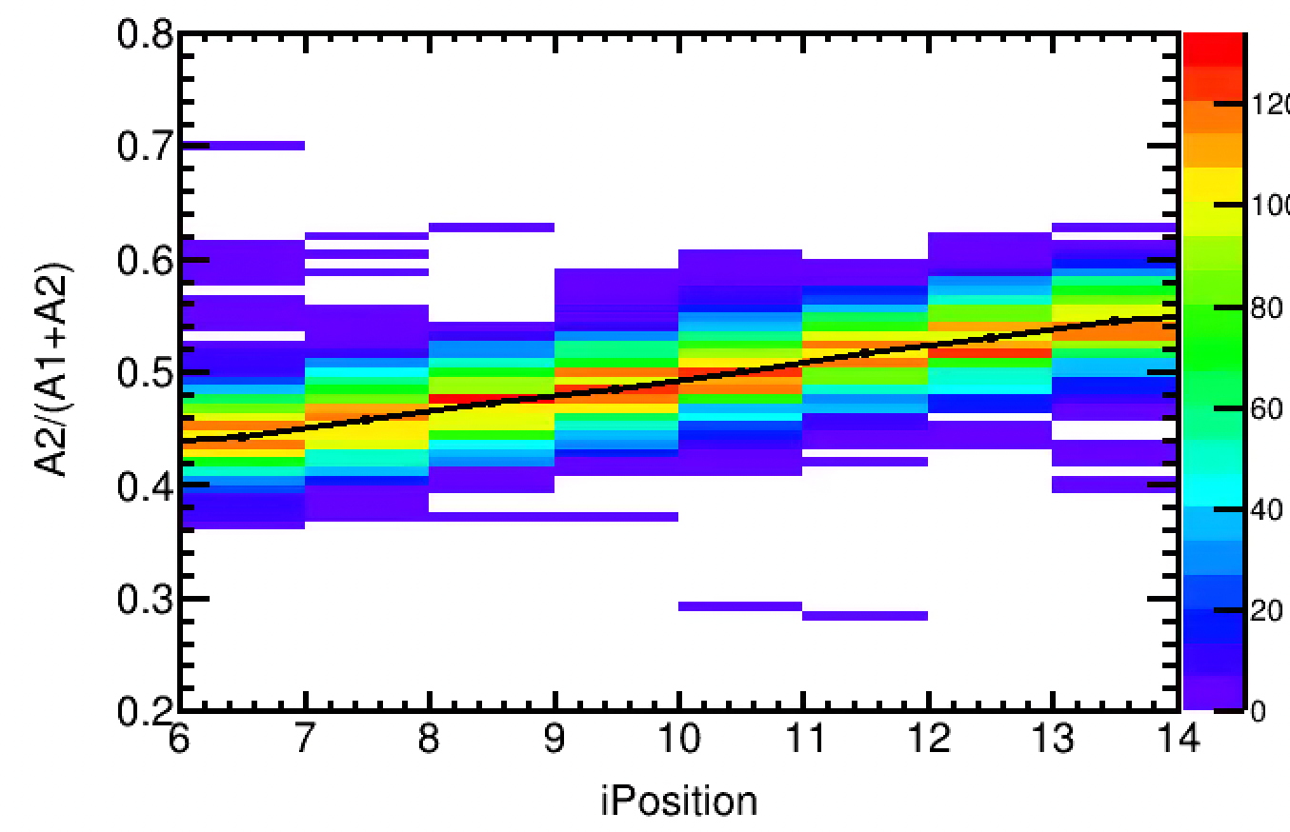
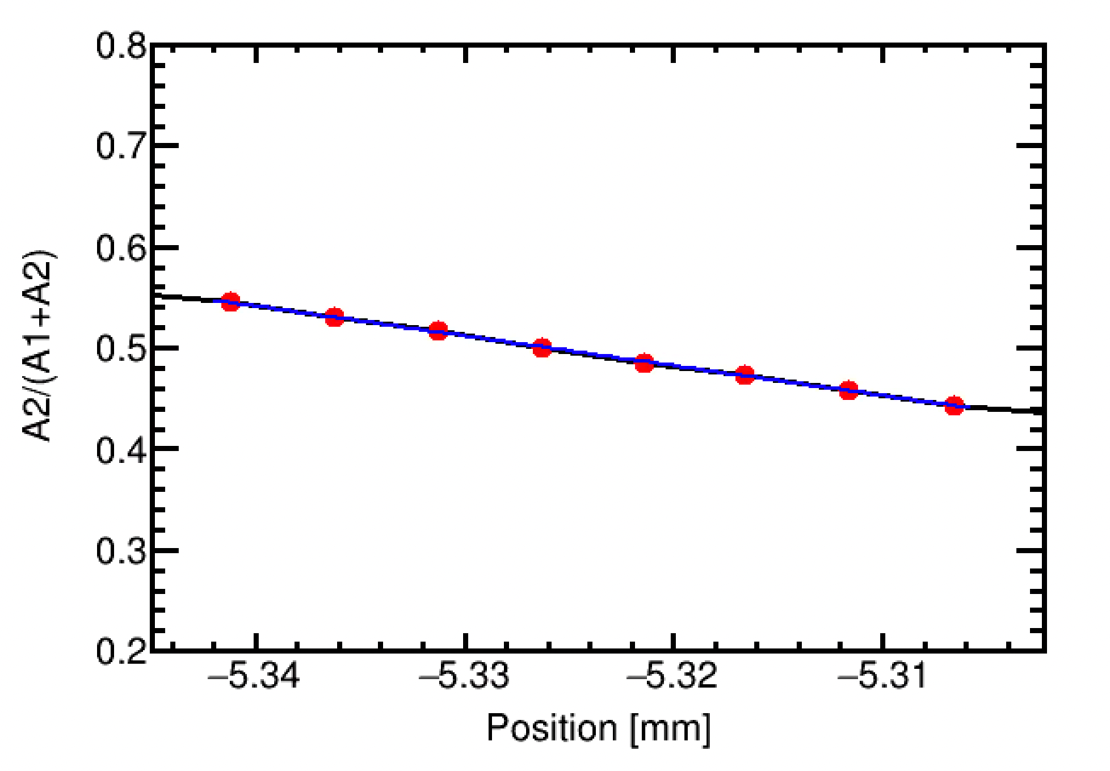
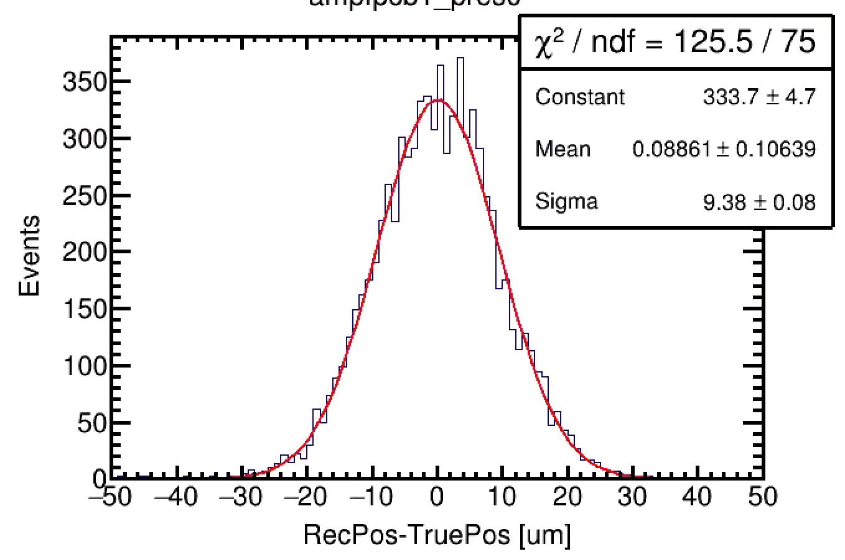
Strip Sensor Spatial Resolution
MIP-Equivalent Laser (0.02% Intensity)
A₂ and A₁ are the waveform amplitudes of the seed (maximum amplitude) strip and the second strip, respectively.
Events
A1/(A2+A2) at 8 scanning positions
A1/(A2+A2) as a function of position
Strip sensor (W4-AC-D9, 2 cm):
Open window of 50 μm between 2 stirps
Laser scanning
Spatial Resolution
The latest tape-out optimized n⁺ strip sensor (W4-AC-D9: 2 cm, pitch 100 μm, 50 μm electrode width, and n⁺ dose = 0.1 p) achieved a spatial resolution of 9.4 μm.
CH-3
CH-1
CH-4
CH-2

Slide 12
Towards a long strip AC-LGAD detecteor
AC-LGAD sensor R&D
Read out ASIC
LGAD+ASIC test
LGAD Beam Telescope
Mechanical Design and Fabrication R&D

Slide 13
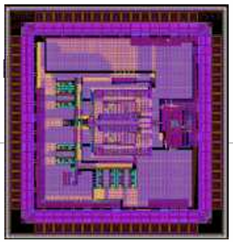
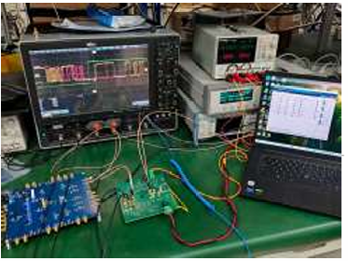
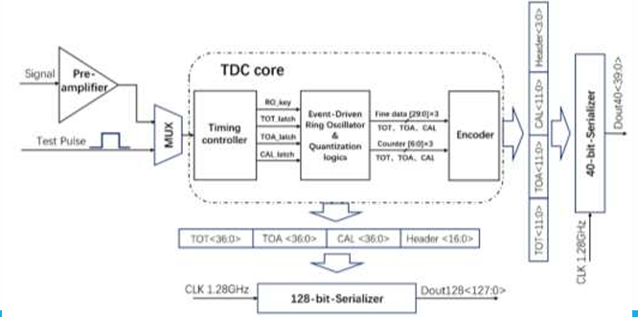
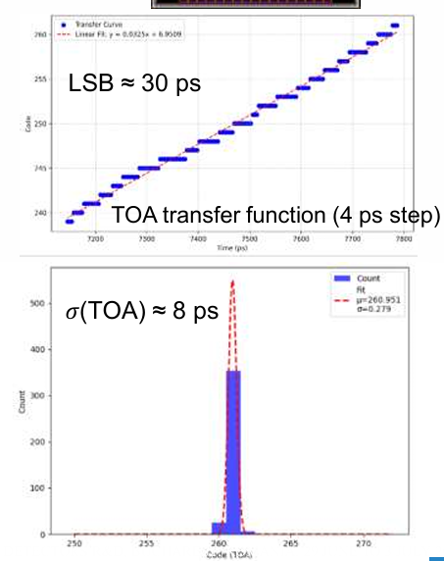
Read out ASIC
The first LGAD readout ASIC prototype, LATRIC-V0, submitted for tape-out in April, was delivered in August 2025
The ASIC integrates a pre-amplifier, a discriminator, a TDC, and a serializer for data output. o
The LSB is 29.8 ps, meeting the 30 ps design goal.
TDC power consumption is 0.1 mA (1.2 V) @ 0.5 MTPS (Mega-Trigger Per Second), 0.3 mA @ 1 MTPS, and 0.5 mA @ 2 MTPS.

Slide 14
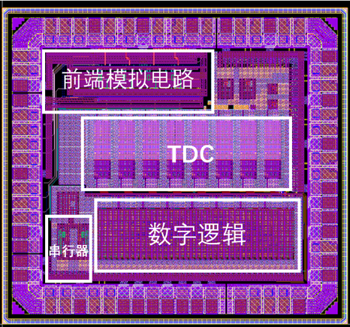
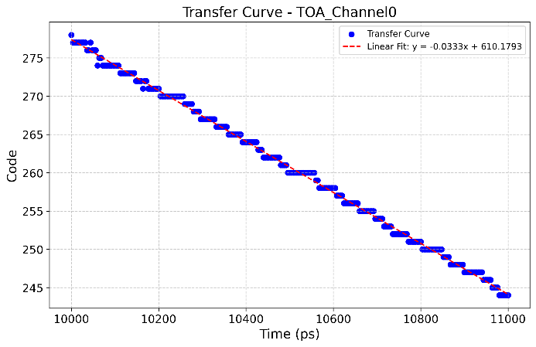
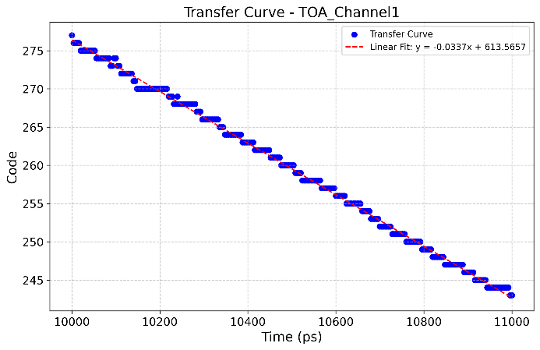
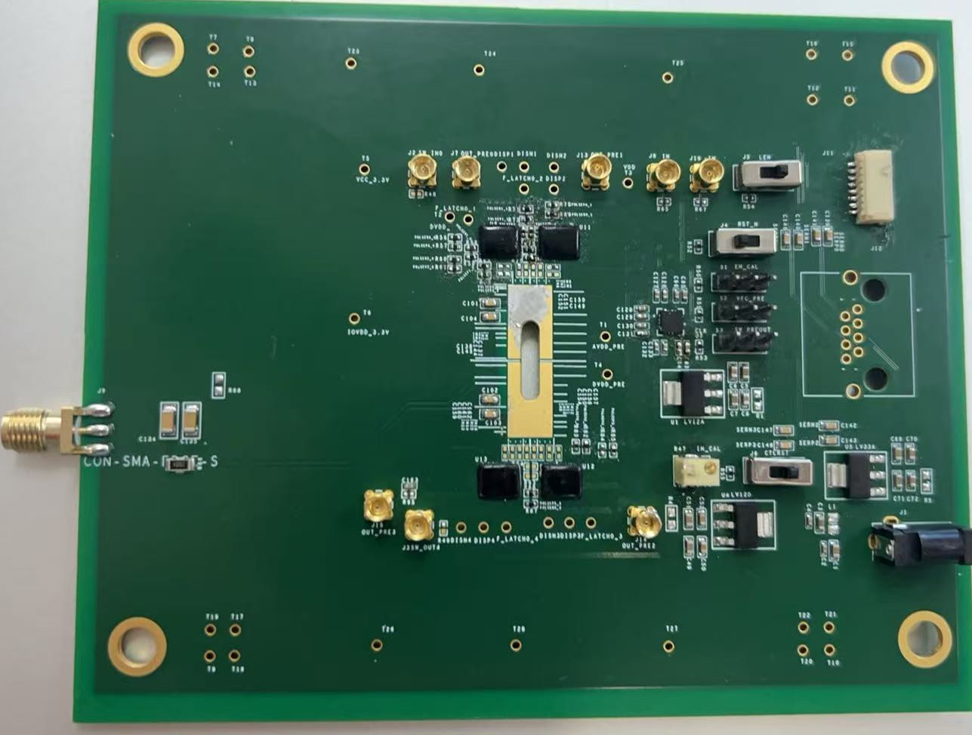

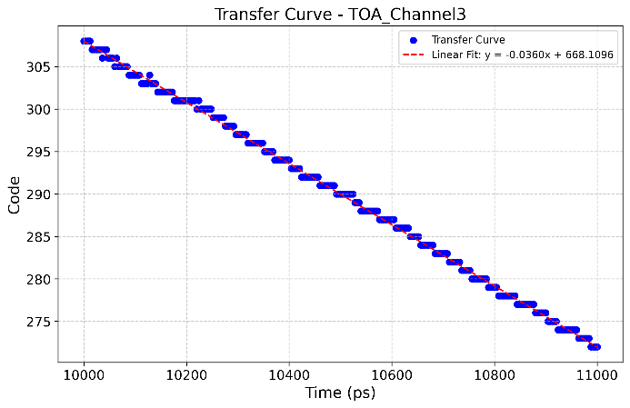
Readout ASIC
  The second version readout ASIC, LATRIC1, adopts an 8-channel was designed and submitted for tape-out in October 2025.
  The channel pitch is 100 μm. Four channels integrate the analog front-end and TDC. The other four channels consist of TDCs connected to differential pulse receivers.
  Performance optimizations include:
  An enhanced analog front-end with increased preamplifier gain to improve the signal-to-noise ratio.
  Refined encoder logic. Addition of an event builder and timestamp functionality, etc.
  LATRIC1 layout
LATRIC1 measured TDC LSB After ASIC Return in March 2026
CH0 LSB ≈ 29.80 ps
CH1 LSB ≈ 29.44 ps
LATRIC
LGAD
LATRIC
CH2 LSB ≈ 27.09 ps
CH3 LSB ≈ 27.58 ps
The latest designed LATRIC1-Sensor Integration Test Board

Slide 15
Towards a long strip AC-LGAD detecteor
AC-LGAD sensor R&D
Read out ASIC
LGAD+ASIC test
LGAD Beam Telescope
Mechanical Design and Fabrication R&D

Slide 16
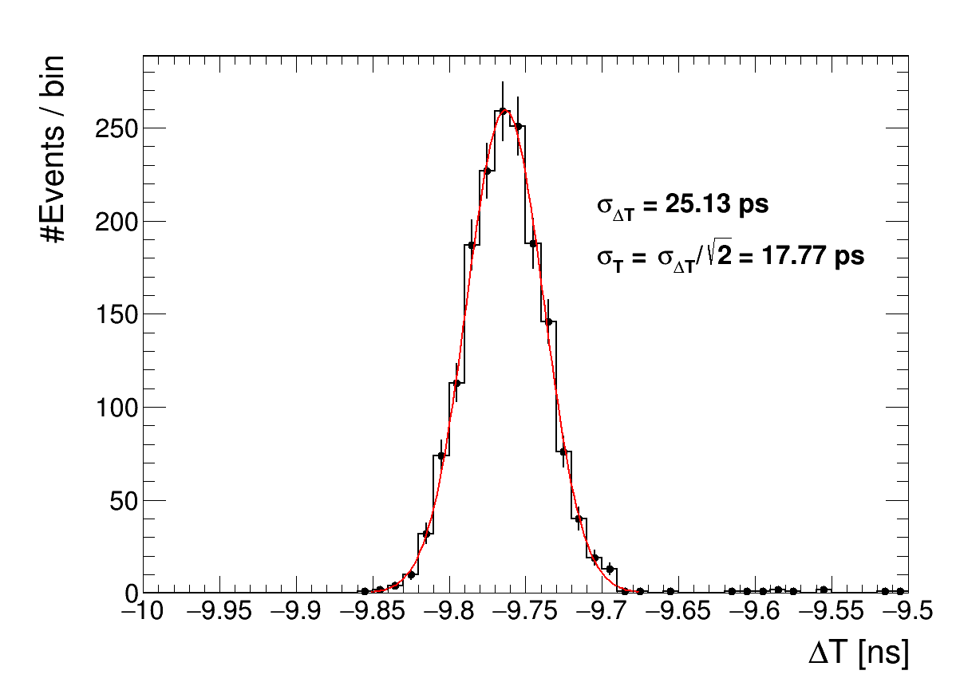
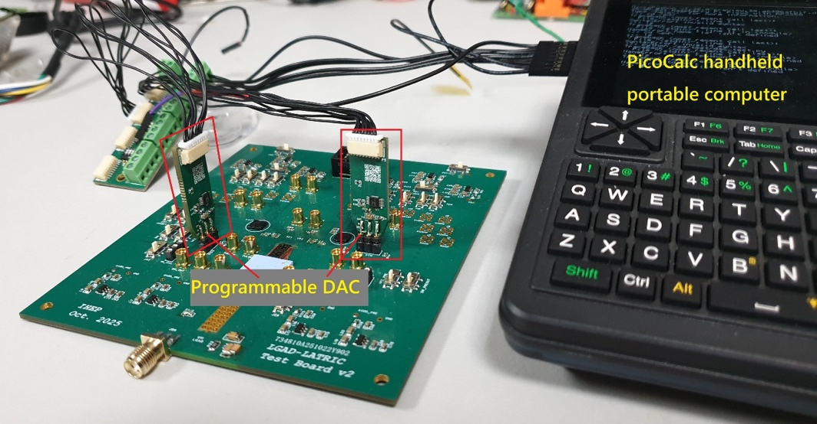
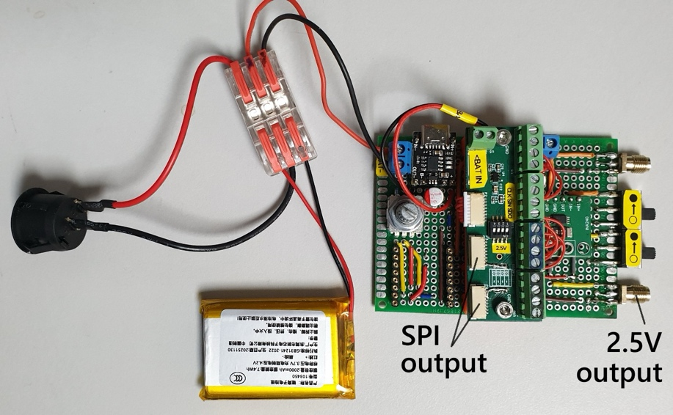
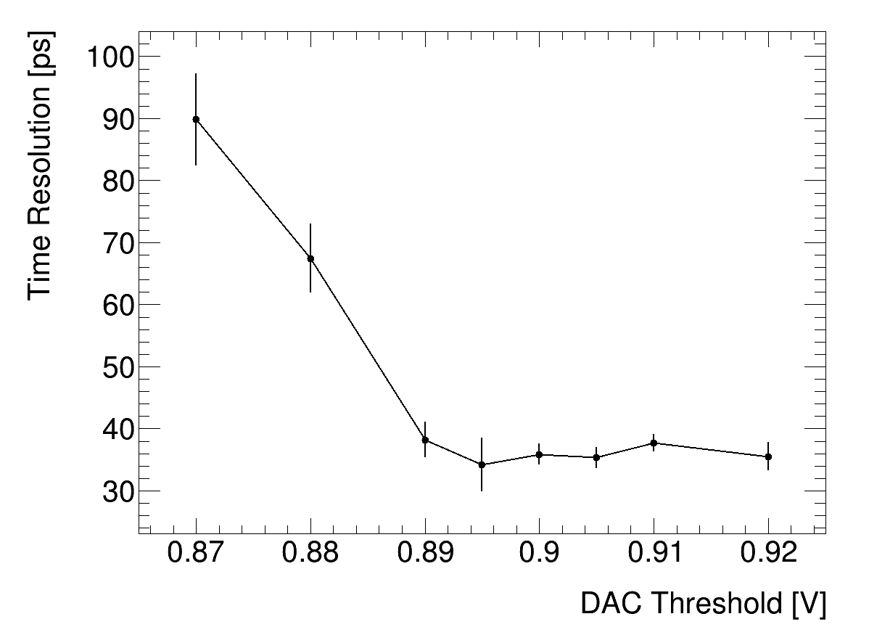
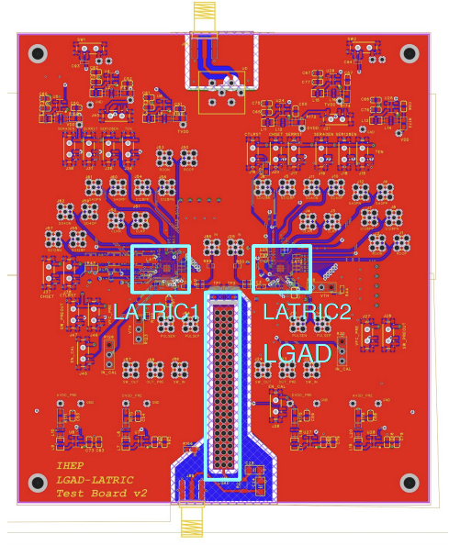
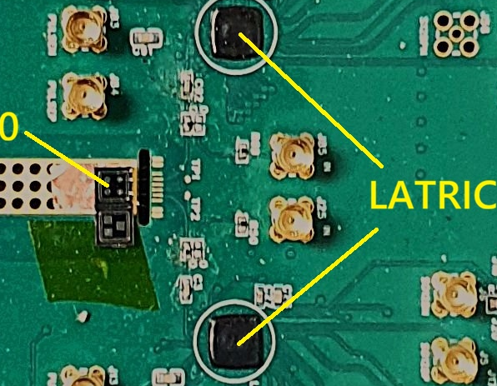
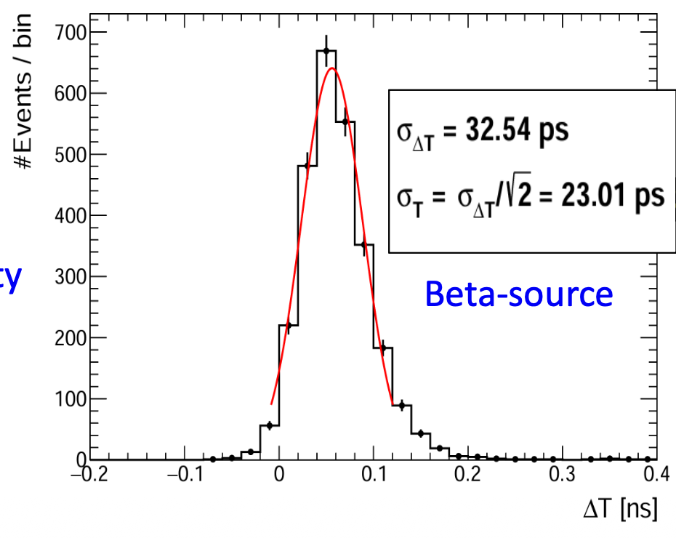
LATRIC0 (Single Channel) and Sensor Combined Test
Developed DAC Controller “PicoCalc”
Isolated Remote SPI Module (RSM) for DAC Control
Time difference measured with two LATRIC0 chips
A time resolution of 18 ps was measured for the combined LGAD+LATRIC at 100% laser intensity.
AC-LGAD (Pixel 2.5mm*2.5mm)
Sensor–LATRIC0 Integrated Test Board
A time resolution of 23 ps was measured for the combined LGAD+LATRIC at Beta source system
At MIP-equivalent laser intensity, the time resolution improves with increasing threshold and stabilizes at about 36 ps in the 0.89–0.92 V range.

Slide 17
Towards a long strip AC-LGAD detecteor
AC-LGAD sensor
Read out ASIC
LGAD+ASIC test
LGAD Beam Telescope
Mechanical Design and Fabrication R&D

Slide 18
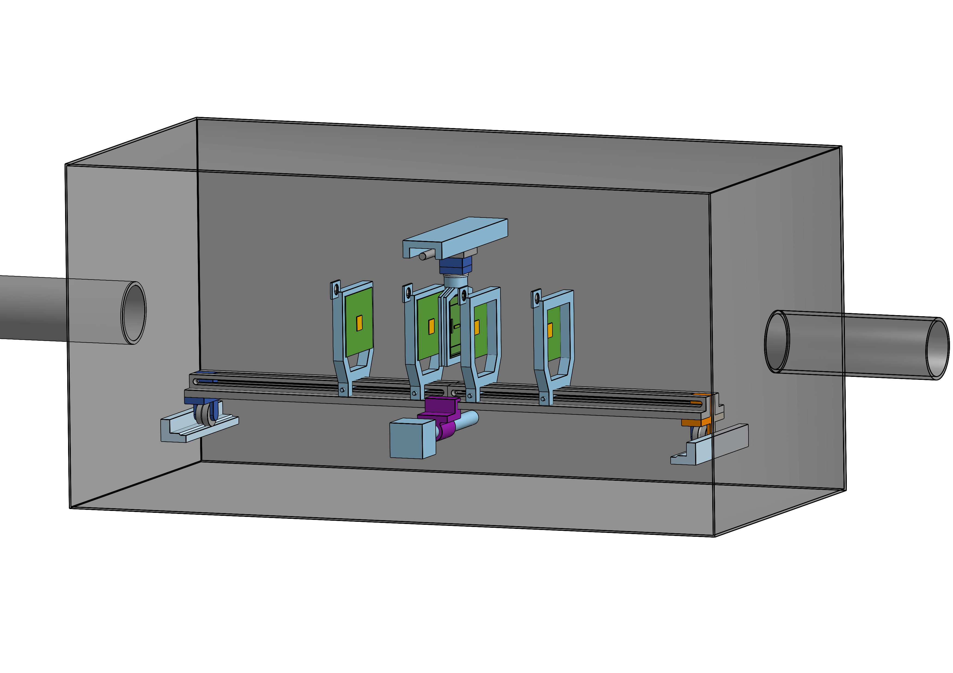
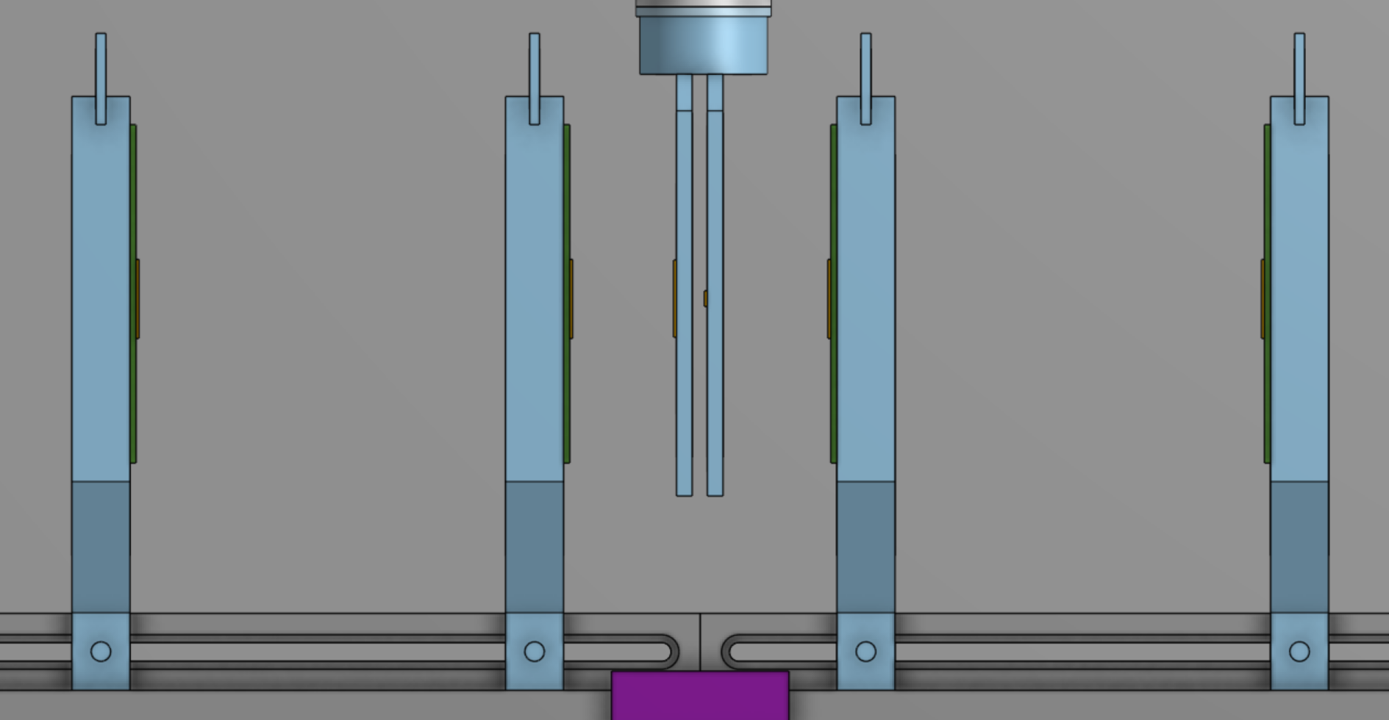
Development of the Beam Telescope
A test beam campaign for the next sensor/ASIC validation is planned.
The beam telescope design is currently ongoing, with completion planned within 1–2 months.
The vacuum valve box is also also under design, and the beam tests are planned to be carried out in China (could be at the PWFA facility at IHEP).
Vacuum box
y
X,Y, y-rotation
0.5m ~ 1m
z
Laser alignment
x
Adjustable distance, kept as small as possible to minimize scattering.
Remote adjustment of the position is required.
1m ~ 1.5m
0.5m ~ 1m

Slide 19
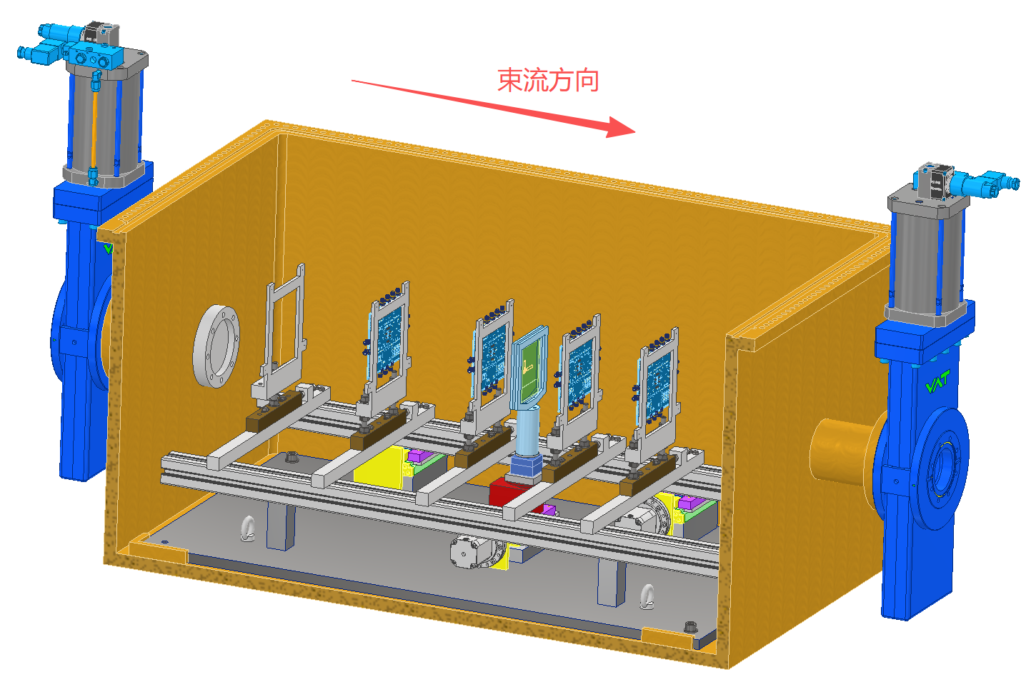
LGAD Beam Telescope
Beam Direction
Box
Sensor DUT moving stage
Beam window
Vacuum valve
Locating pin
Lifting mechanism
Base plate
(liftable together with motion system)
Horizontal translation stage

Slide 20
Towards a long strip AC-LGAD detecteor
AC-LGAD sensor
Read out ASIC
LGAD+ASIC test
LGAD Beam Telescope
Mechanical Design and Fabrication R&D

Slide 21
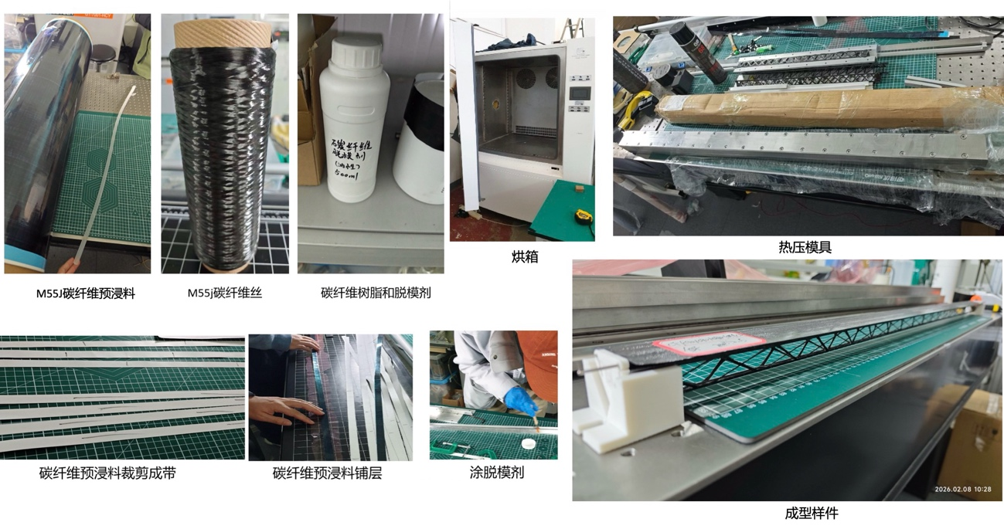
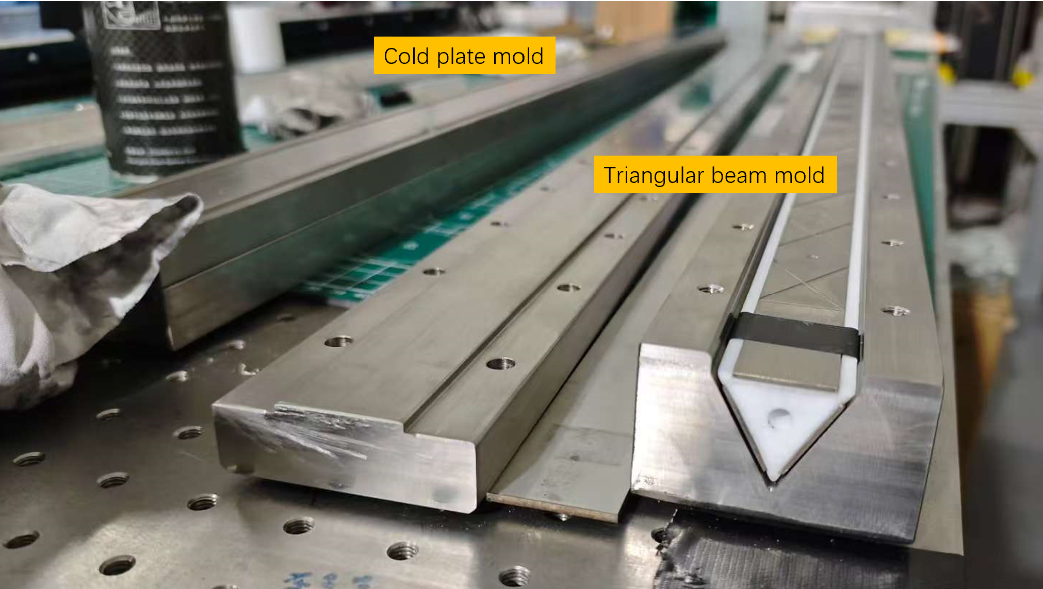
Mechanical Design and Fabrication R&D
Research on lightweight carbon-fiber composite structural design, advanced manufacturing processes, thermal management, and cooling integration.
Aims to promote the engineering application of lightweight composite materials and related technologies in semiconductor detectors, providing critical technical support for the development of particle tracking detectors.
Silicon tracker require low material budget and minimal deformation (single layer < 1% X₀, deformation at the micrometer level).
设计加工的碳纤维热压磨具
烘箱
M55J预浸料
M55J碳纤维丝
碳纤维树脂和脱模剂
碳纤维预浸料裁剪带
碳纤维预浸料铺层
涂脱模剂
Latest engineering prototypes designed and fabricated by the team
成型样样件

Slide 22
Summary
CEPC outer tracker system requires high timing and spatial resolution for PID
Towards CEPC Outer tracker, R&D of AC-LGAD sensor, readout ASIC, combined test is ongoing; Meanwhile, beam test preparation and Mechanical Design and Fabrication R&D also are ongoing
Results:
2cm strip AC-LGAD Sensor: spatial resolution~9.4um, time resolution~80ps
ASIC: LSB~30ps
Next:
AC-LGAD with isolation struction will be taped out to improve its timing performance
8-channel ASIC+sensor test and multi-channel ASIC tape-out
Beam test
Mechanical fabrication

