Slide 1
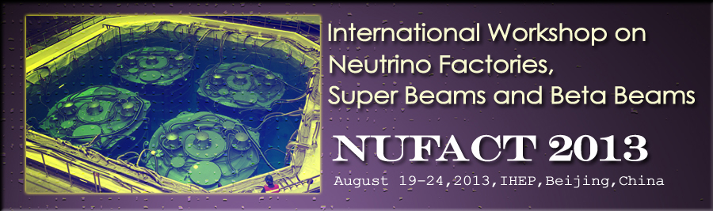
Performance on CPiV and MH of long-term accelerator projects

Slide 2
Acknowledgements:
R. Bayes, P. Coloma … and …
  All my colleagues in EUROnu, IDS-NF, MAP/MASS, T2HK, LBNE, LBNO, nuSTORM, …

Slide 3
Contents:
Motivation
Options for the future
ICFA Neutrino Panel
Conclusions

Slide 4
Motivation
Performance on CPiV and MH of long-term accelerator projects:

Slide 5
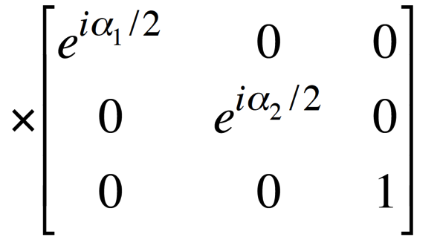
Standard Neutrino Model:
Three mass states
linked to three
flavour states via
unitary mixing
matrix;
Additional, sterile, states conceivable:
  Would imply:
    3-neutrino mixing matrix not unitary
Notes:
The Double Chooz collaboration, by measuring the "disappearance" of electron antineutrinos, presents hints for oscillation also involving the third angle with the following value: sin^2(2theta_13) = 0.085 +/- 0.051. The probability given by preliminary results that there is no oscillation is only 7.9%.

Slide 6
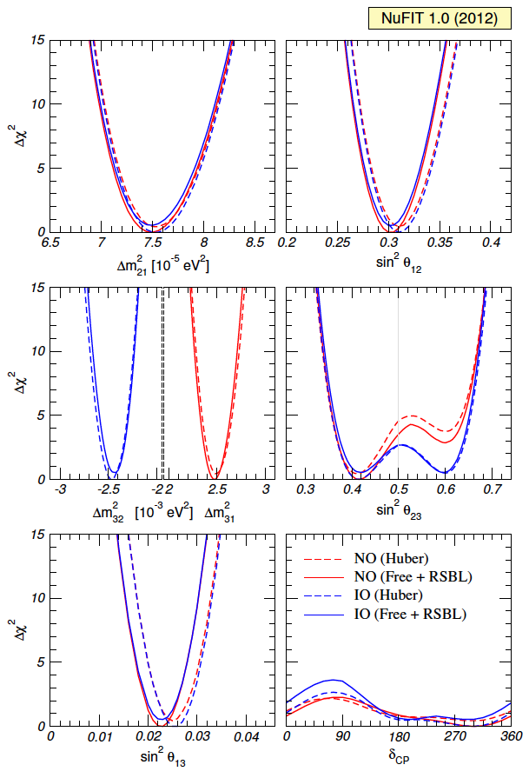
Standard Neutrino Model:
Exciting new data!
  Discovery of leptonic
  CP-violation is possible
Good knowledge of:
  θ₁₂, θ₁₃, |θ₂₃-45°|, Δm²₂₁,
  |Δm²₃₁|
Need to determine:
  sign(Δm²₃₁), sign(θ₂₃-45°)
Essentially no knowledge of:
  δ
Increases motivation for precision determination of the parameters and search for “non-standard effects”
Notes:
The Double Chooz collaboration, by measuring the "disappearance" of electron antineutrinos, presents hints for oscillation also involving the third angle with the following value: sin^2(2theta_13) = 0.085 +/- 0.051. The probability given by preliminary results that there is no oscillation is only 7.9%.

Slide 7
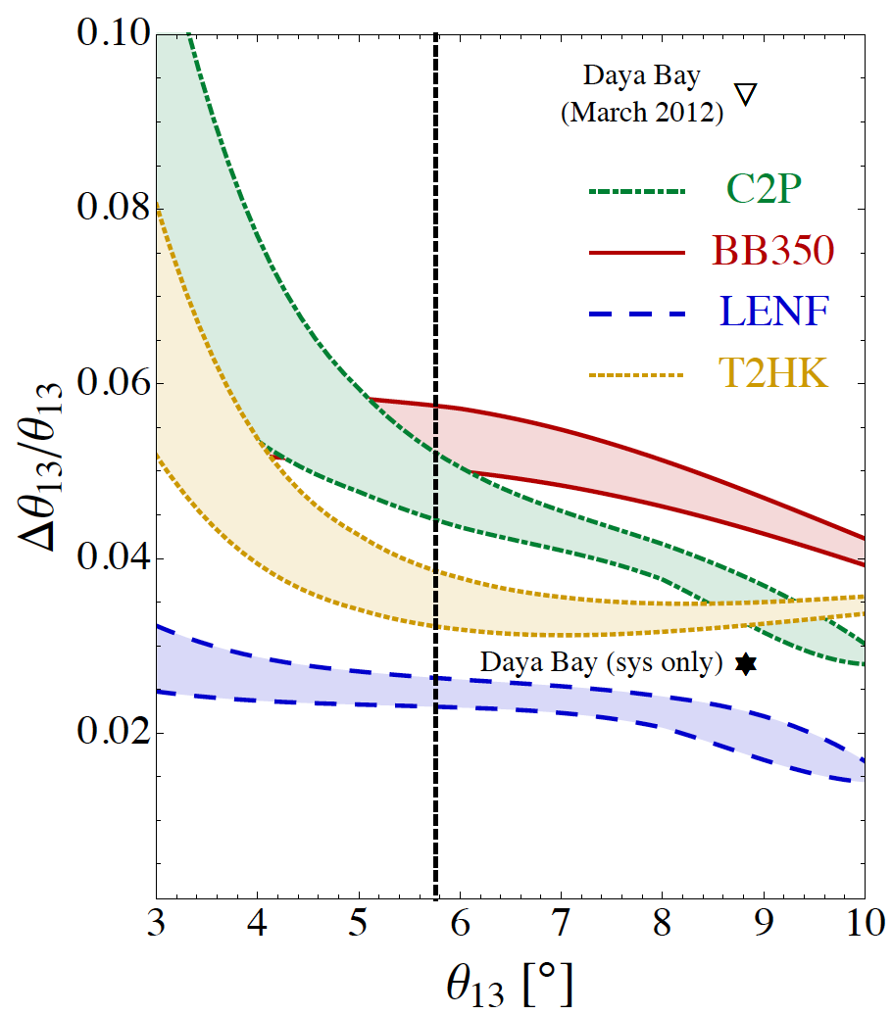
The SνM measurement programme:
Looking beyond MINOS, T2K,
NOνA, DChooz, Daya Bay, Reno, …
  θ₁₃ will be very well known
Therefore future programme
must:
  Complete the “Standard
  Neutrino Model” (SνM):
    Determine the mass hierarchy
    Search for (and discover?) leptonic
    CP-invariance violation
  Establish the SνM as the correct
  description of nature:
    Determine precisely the degree to which θ₂₃ differs from π/4
    Determine θ₁₃ precisely
    Determine θ₁₂ precisely
  Search for deviations from the SνM:
    Test the unitarity of the neutrino mixing matrix
    Search for sterile neutrinos, non-standard interactions, …
arXiv:1203.5651
Notes:
Peroration:
Goals of the presentation:
Show sensitivity and precision of the beta beam and neutrino factoru
Show maturity of R&D
Demonstrate that there are short-term contributions, especially nuSTORM

Slide 8
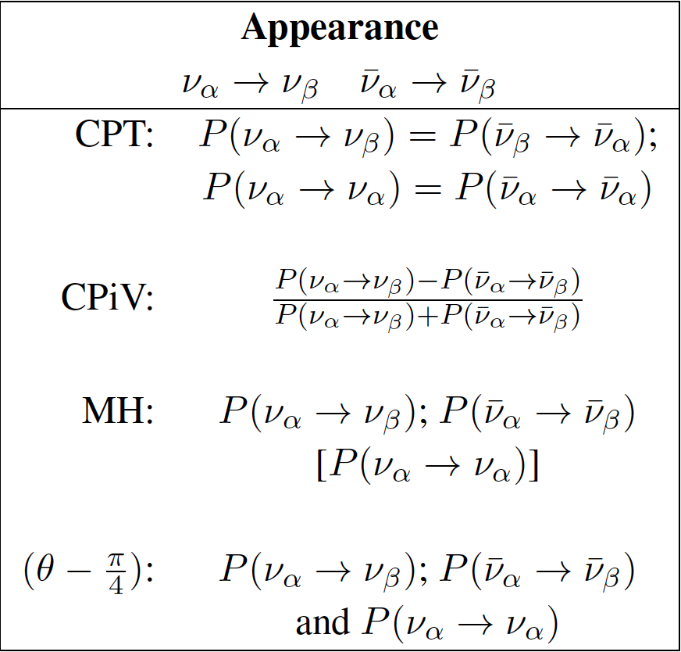
The SνM measurement programme:
Looking beyond MINOS, T2K,
NOνA, DChooz, Daya Bay, Reno, …
  θ₁₃ will be very well known
Therefore future programme
must:
  Complete the “Standard
  Neutrino Model” (SνM):
    Determine the mass hierarchy
    Search for (and discover?) leptonic
    CP-invariance violation
  Establish the SνM as the correct
  description of nature:
    Determine precisely the degree to which θ₂₃ differs from π/4
    Determine θ₁₃ precisely
    Determine θ₁₂ precisely
  Search for deviations from the SνM:
    Test the unitarity of the neutrino mixing matrix
    Search for sterile neutrinos, non-standard interactions, …
arXiv:1203.5651
Notes:
Peroration:
Goals of the presentation:
Show sensitivity and precision of the beta beam and neutrino factoru
Show maturity of R&D
Demonstrate that there are short-term contributions, especially nuSTORM

Slide 9
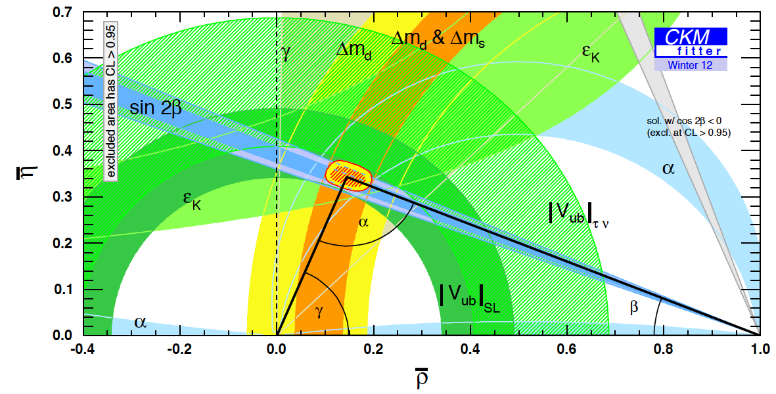
The case for precision:
What determines the goal for sensitivity and precision?
  Sensitivity:
    Definitive discovery!
      Must have sensitivity of “~5σ”
      To resolve the LSND/miniBooNE “suite of anomalies” may set the bar higher!
  Precision:
    Field presently led by experiment;
      Too many, or too few, theories;
    Goal to determine parameters with a precision comparable to that with which the quark-mixing parameters are known
PDG
Notes:
Peroration:
Goals of the presentation:
Show sensitivity and precision of the beta beam and neutrino factory
Show maturity of R&D
Demonstrate that there are short-term contributions, especially nSTORM

Slide 10
Options for the future
Performance on CPiV and MH of long-term accelerator projects:

Slide 11
Reactor and decay at rest:

Slide 12
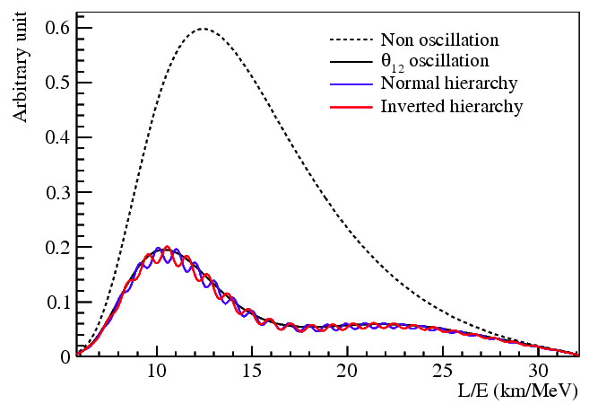
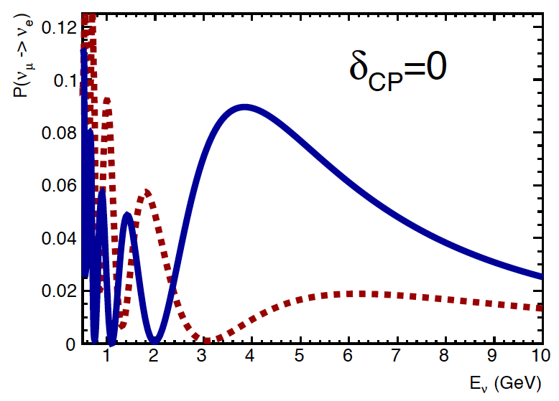
Mass hierarchy:
Two options:
  Exploit L/E spectrum:
    Juno (Daya Bay II), Reno 50:
      Liquid scintillator detector
      at ~50 km
      Requires exquisite energy resolution
  Exploit matter effect:
    Electron-neutrino charged current interactions in the earth receive additional “charge-exchange” contribution
    Leads to a modification of the oscillation probability for long (~1000 km) baselines
Phys.Rev.D78:111103,2008
CERN-SPSC-2012-021;
SPSC-EOI-007

Slide 13
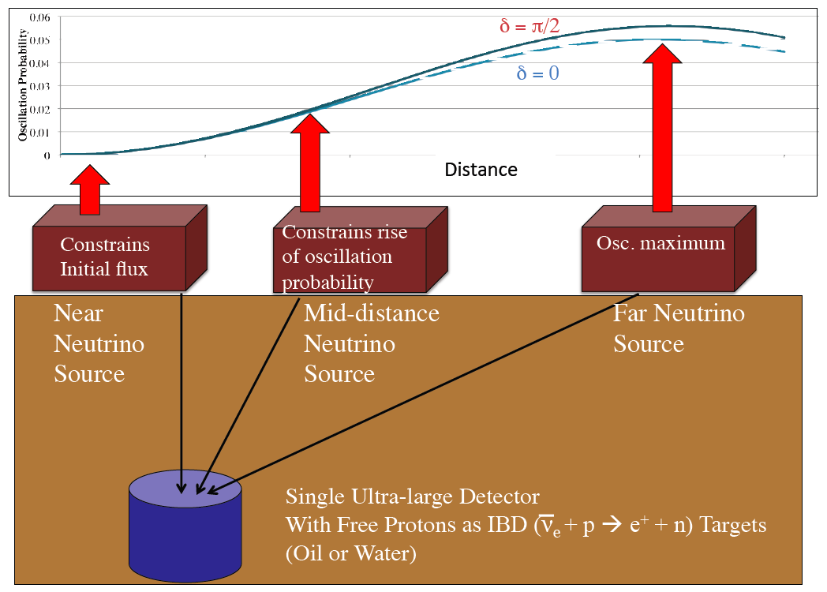
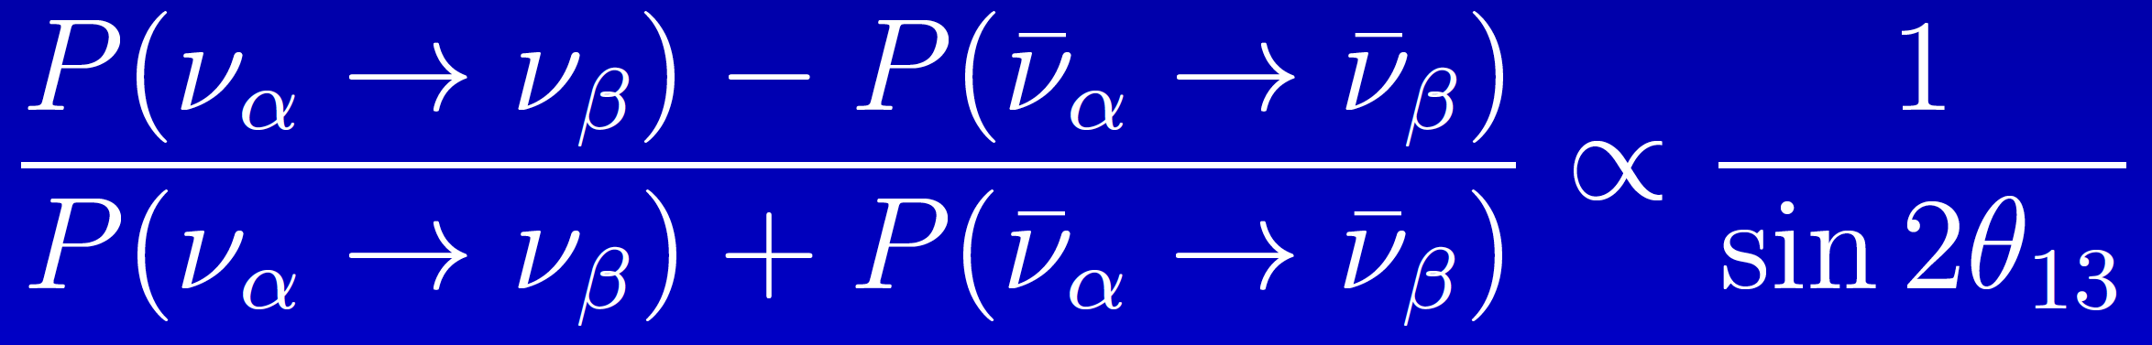
CPiV:
Two options:
  Exploit L/E spectrum:
    DAEδALUS:
      Pion/muon decay at rest
      ν_{μ} ➔ ν_{e}
      No “matter effect contamination”
      Measurement of δ—assumes SνM
  Measure asymmetry:
    Large θ₁₃ makes discovery conceivable, but:
      Places premium on the control of systematic uncertainties
Phys.Rev.D78:111103,2008
Shaevitz
CERN-SPSC-2012-021;
SPSC-EOI-007

Slide 14
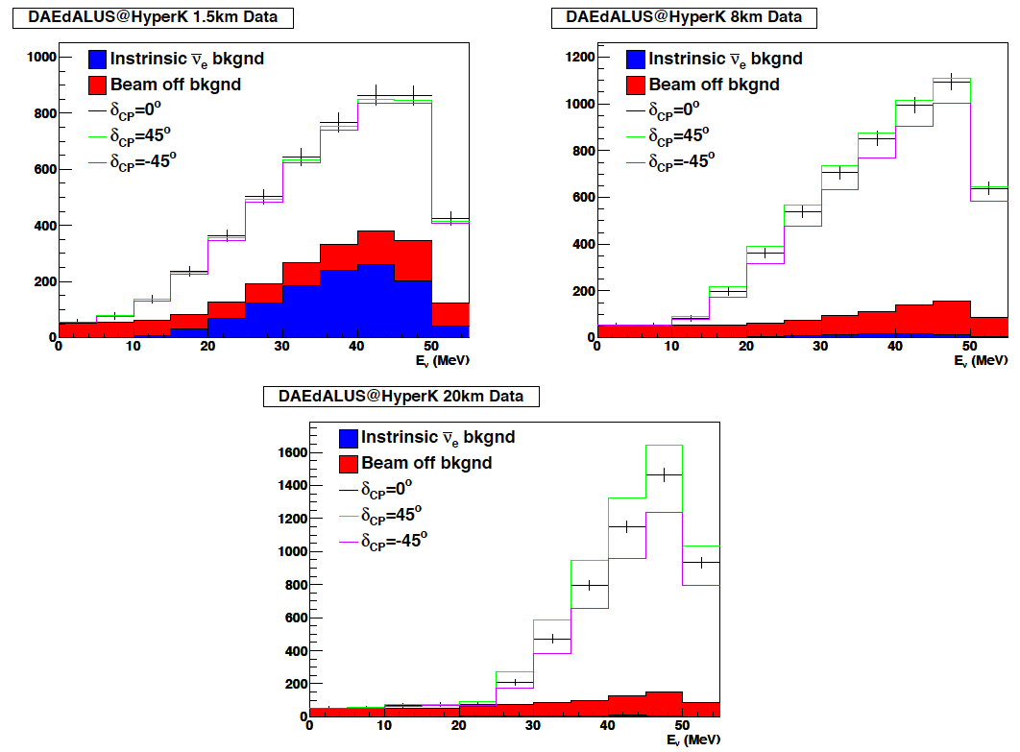
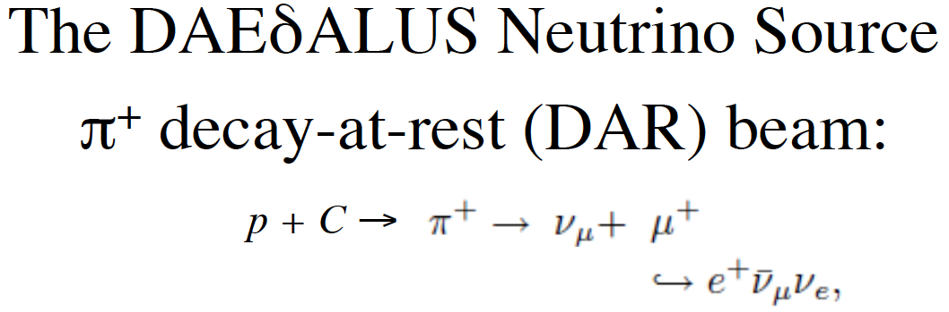
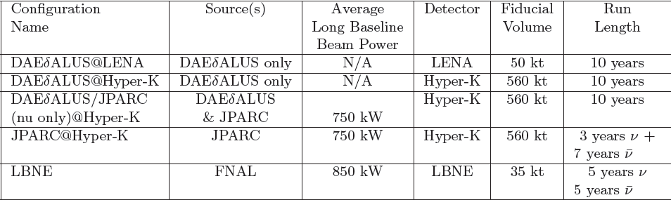
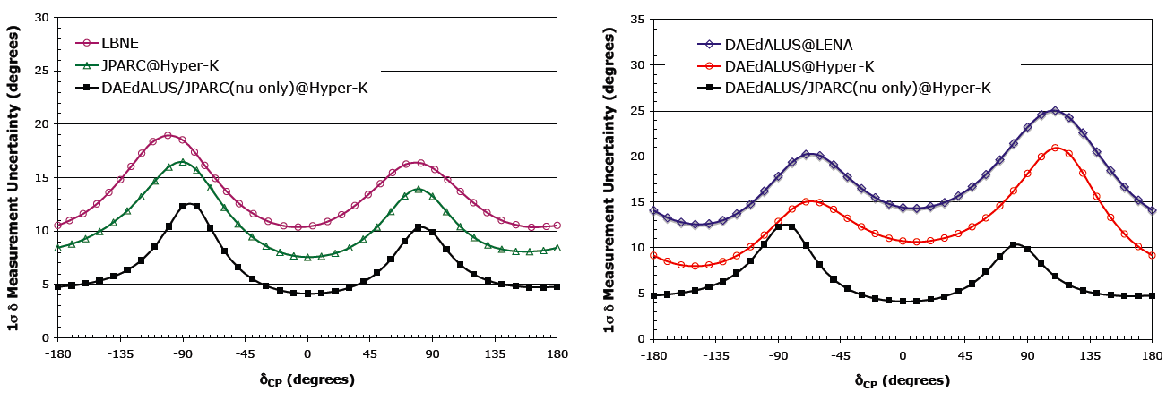
1307.6465
1307.2949
1006.0260v1
D⁺ cyclotrons:
  1 MW (1.5 km); 2 MW (8 km); 5 MW (20 km)

Slide 15
Long-baseline, accelerator based:

Slide 16
Option thumbnails:
Conventional super-beams:
  Wide-band, long baseline: e.g. LBNE, LBNO, [Protvino]
    <E_{μ}> ~ 2—3 GeV; matched to LAr or Fe calorimeter;
    Long-baseline allows observation of first and second maximum
    Near detector exploited to reduce systematic errors
  Narrow-band, short baseline: e.g. T2HK, SPL, [ESS]
    <E_{μ}> ~ 0.5 GeV; matched to H₂0 Cherenkov;
    Short-baseline allows observation of first maximum
    Near detector exploited to reduce systematic errors
Beta-beam, short baseline: e.g. CERN γ=100;
  <E_{μ}> ~ 0.5 GeV; matched to H₂0 Cherenkov;
  Short-baseline allows observation of first maximum
  Requires short-baseline super-beam to deliver competitive performance
Neutrino Factory: e.g. IDS-NF E_{μ}=10 GeV, NuMax(+) E_{μ}=5 GeV;
  Uniquely well known flux (flavour content and energy spectrum);
  Baseline 1300—2500 km
  Requires a magnetised detector
  Identified by EUROnu as the facility for the high-precision programme

Slide 17
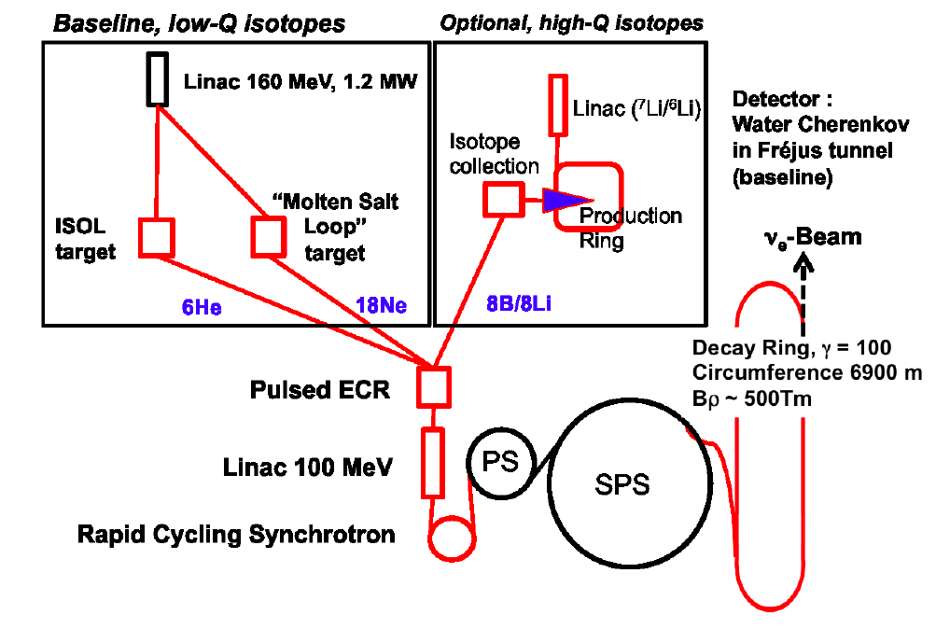
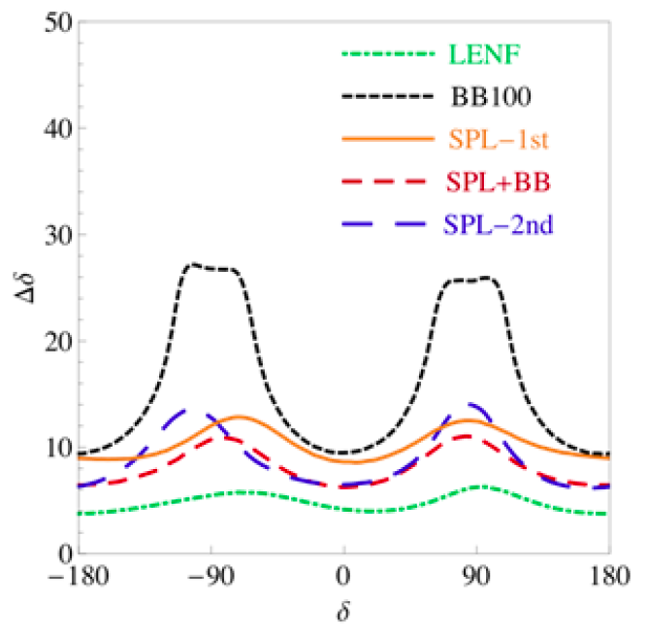
Beta-beam:
10.1103/PhysRevSTAB.16.021002
Advantage:
  Pure ν_{e} beam
Disadvantages:
  Ion beams have high rigidity:
    Practically limited to low neutrino energy
  To obtain competitive sensitivity require high-power super-beam
EUROnu conclusions:
  Given the superior performance of the Neutrino Factory and the cost of a combined beta-beam and super-beam complex and (if implemened at CERN) the disruption to the LHC programme;
    Staged implementation of the Neutrino Factory identified as the preferred option

Slide 18
Super-beams: T2HK, LBNO, LBNE

Slide 19
MH and CPiV at LBL experiments:
0.3 GeV
~1.2 GeV
~1.7 GeV
Mass hierarchy and CPiV modulate oscillation probability:
  Need to measure as a function of L/E [measure E spectrum]
MH sensitivity grows with L [matter effect]
CPiV modulation grows with L/E [but, measure E spectrum]

Slide 20
MH and CPiV at LBL experiments:
290 km:
  Relatively small matter effect:
    Need MH to achieve CPiV sensitivity;
    CPiV measurement relatively unpolluted by matter effect
1300 km:
  Optimum choice for combined MH and CPiV sensitivity if sensitivity relies on first oscillation maximum
2300 km:
  Strong matter effect gives excellent MH sensitivity
  CPiV sensitivity at first maximum smaller than 1300 km, but, strong CPiV sensitivity at 2nd maximum
1110.6249, 1307.7335

Slide 21
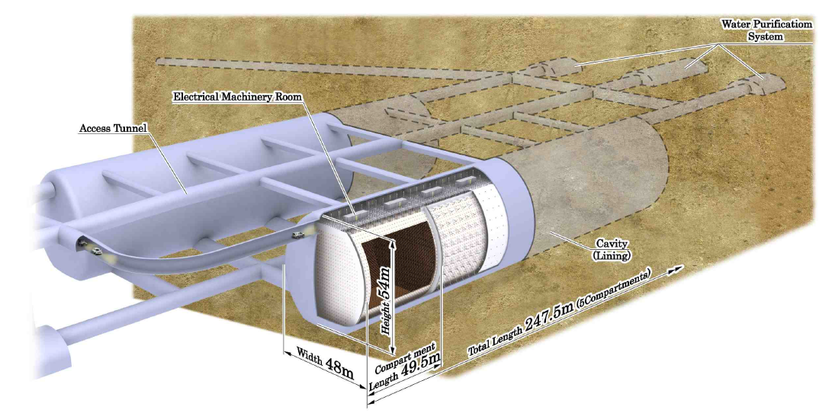
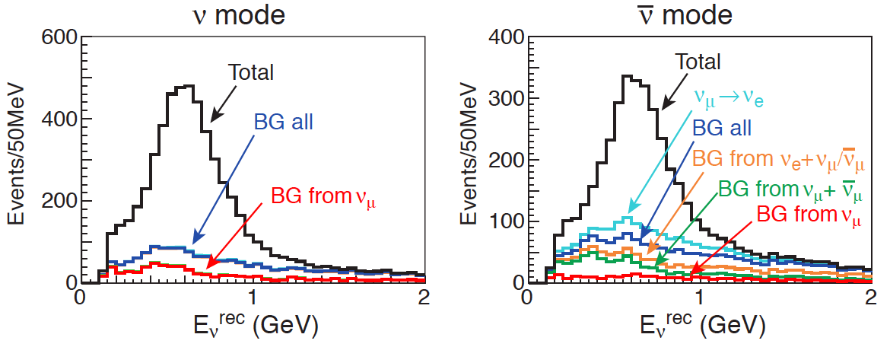
T2 Hyper-Kamiokande:
arXiv:1109.3262
Source:
  JPARC neutrino beam:
  upgrade path to 1.66 MW
Detector: water Cherenkov
  Fiducial mass: 560 kTonne
  Site:
    2.5° off axis;
    Baseline ~290 km
0.3 GeV

Slide 22
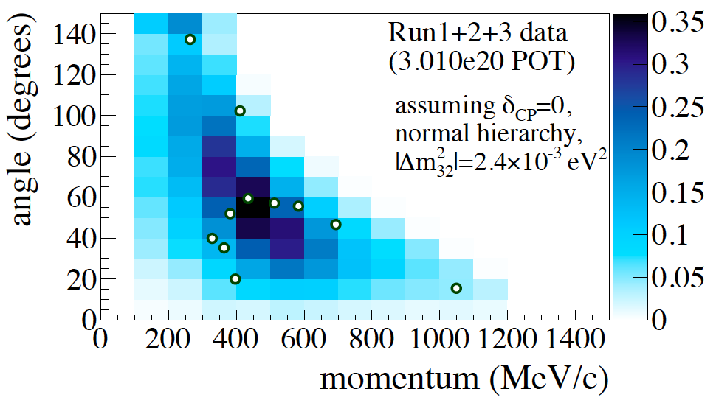
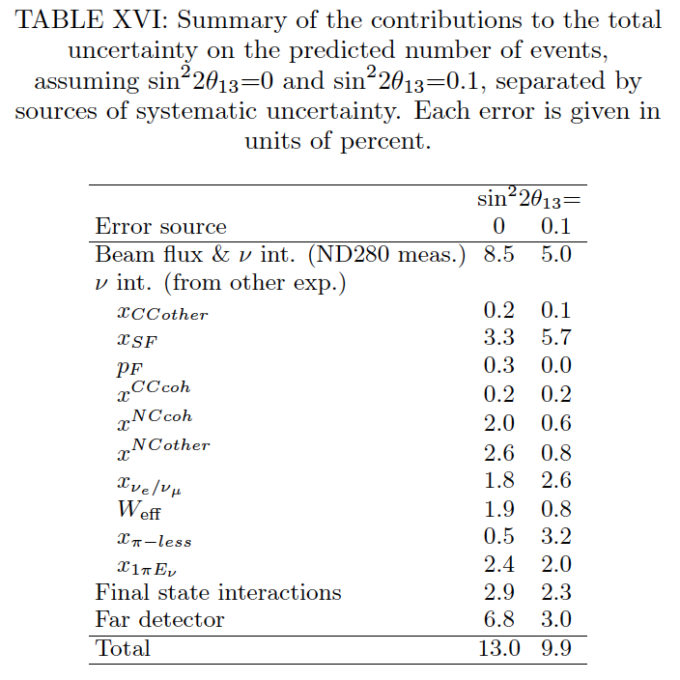
T2K: evidence for ν_{μ}➔ν_{e}; the state of the art:
arXiv:1304.0841
EPS 2013
3.0%
7.4%
Statistics:
  Sample: 11 events
Systematics:
  Flux/cross section: 5% [using CCQE and 1pi from ND280]
  Neutrino-nucleus scattering: 7.4%
  Final state interactions: 2.3%
7.5%
28 events
3%
7.5%
Notes:
Hi Ken,
The update numbers of T2K in summer 2013 are
Flux/cross section (in situ): 3.0%
Neutrino-nucleus scattering: 7.5%
Final state interactions: 2.3%
So, you can see. The in situ sys error is within 5% or smaller.
In the uncertainty of the Neutrino-nucleus scattering, the largest one is due to Spectra-Function while we use the relativistic Fermi Gas model. Once we update our neutrino interaction model, we expect to reduce this uncertainty.
Enjoy China!
Tsuyoshi

Slide 23
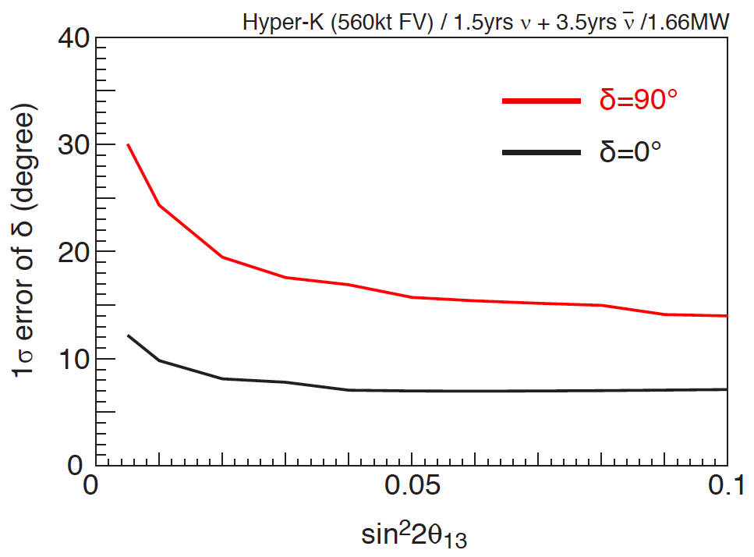
T2 Hyper-Kamiokande:
arXiv:1109.3262
Systematic uncertainties:
  Signal: 5%
  νμ induced background: 5%
  νe induced background: 5%
  Relative neutrino/anti-neutrino normalisation: 5%

Slide 24
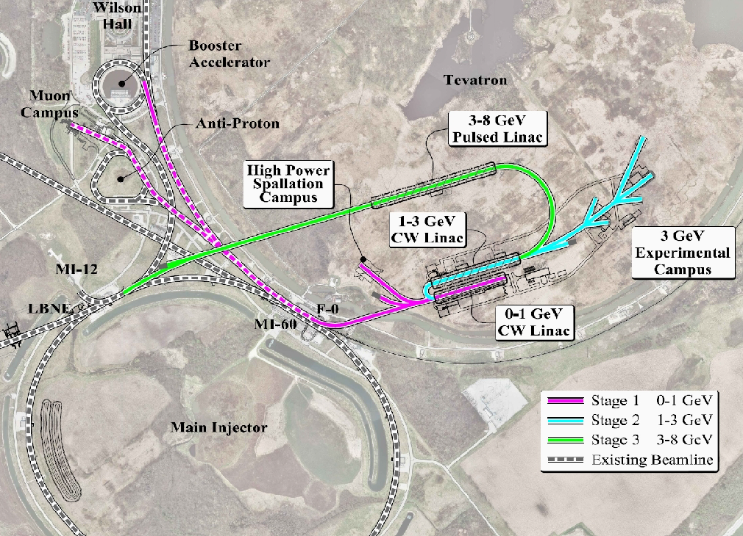
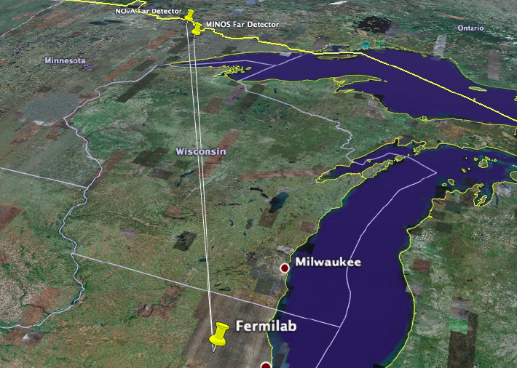
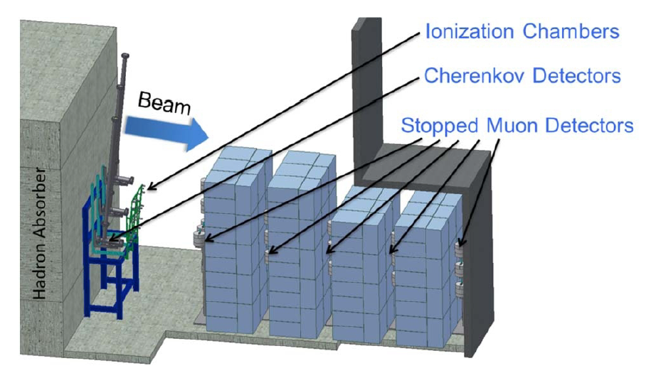
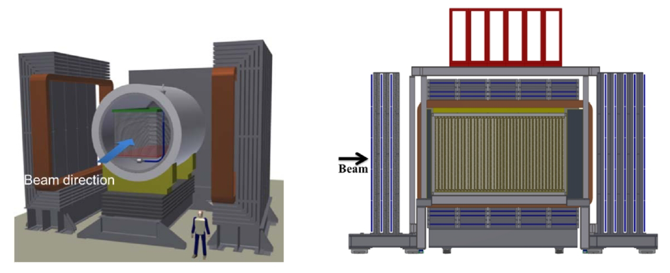
Long-Baseline Neutrino Experiment:
1110.6249, 1307.7335
Near detector options:
  HiResMnu
  Lar TPC

Slide 25
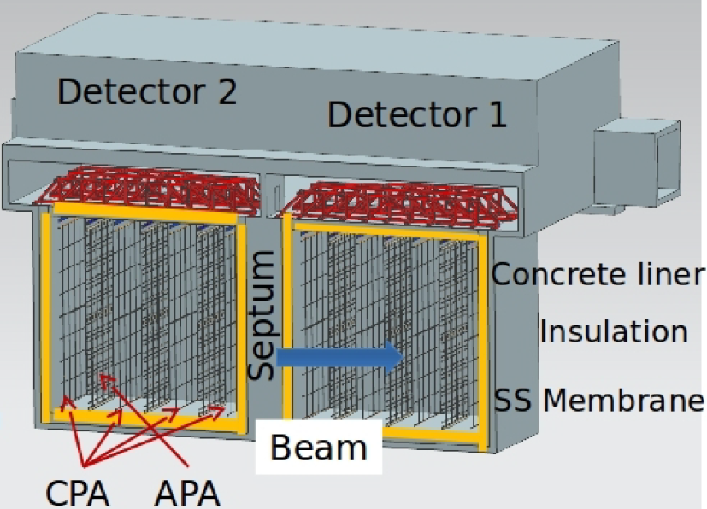
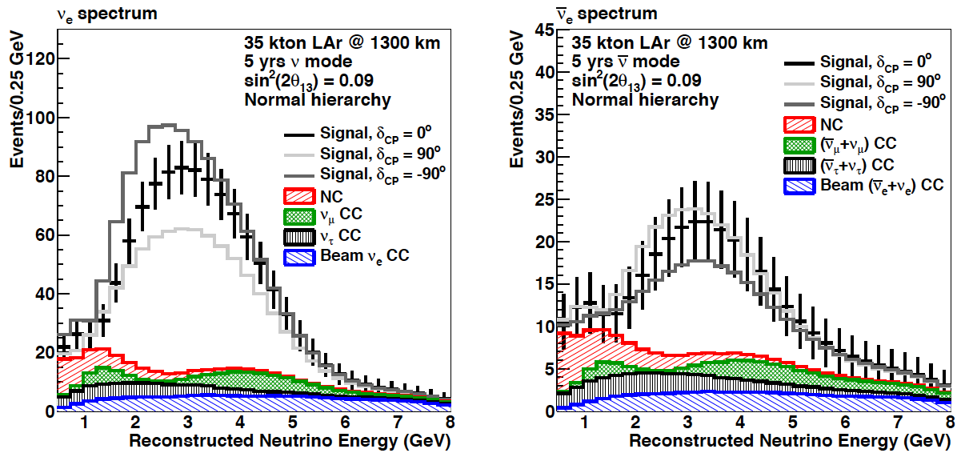
Long-Baseline Neutrino Experiment:
Source:
  FNAL MI: 700 kW
  Project X: 2.3 MW [upgrade]
Detector: LAr TPC
  Fiducial mass: 10 kTonne
    Upgrade to 34 kTonne
  Site: SURF
    On axis; upgrade u/g 4850 ft
    Baseline 1300 km
~1.2 GeV
arXiv:1307.7335

Slide 26
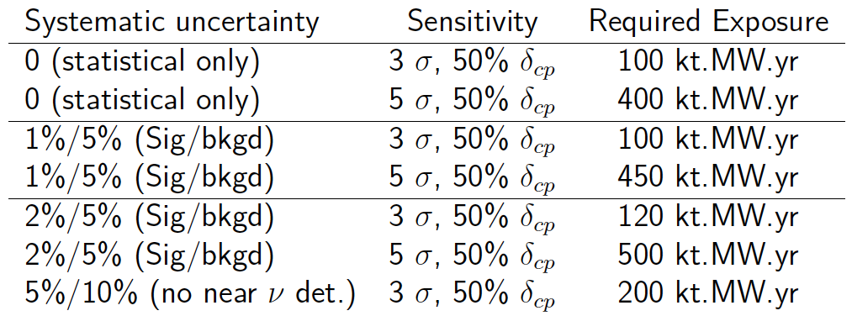
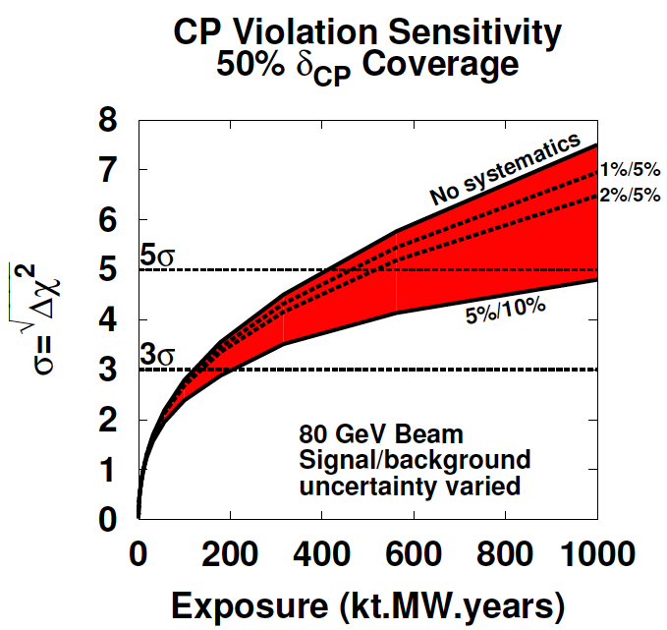
Long-Baseline Neutrino Experiment:
Systematic uncertainties:
  Signal: 1%
  Background: 5%
arXiv:1307.7335

Slide 27
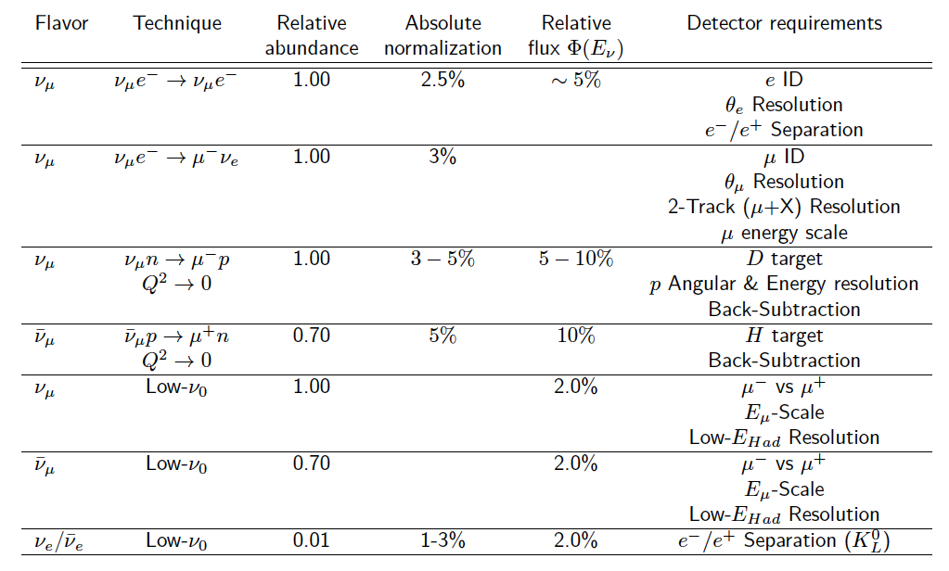
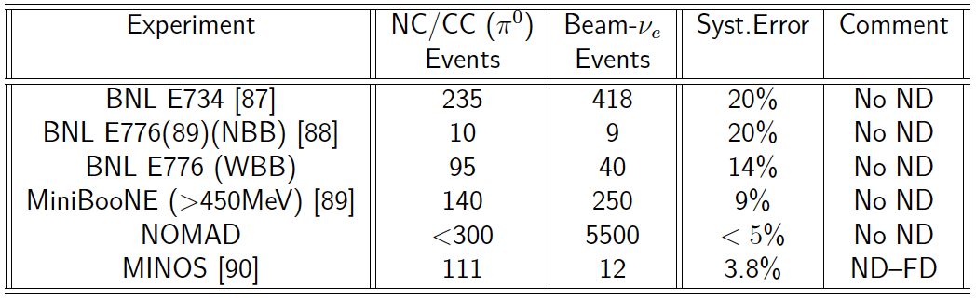
Controlling systematics: near detector:
High-resolution near detector and detailed programme of measurement essential to meet specified systematic uncertainties
Effects such as nuclear/final-state interactions must also be controlled at the %-level
arXiv:1307.7335

Slide 28
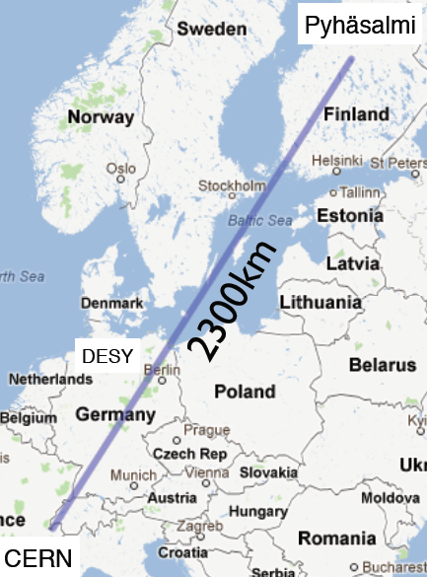
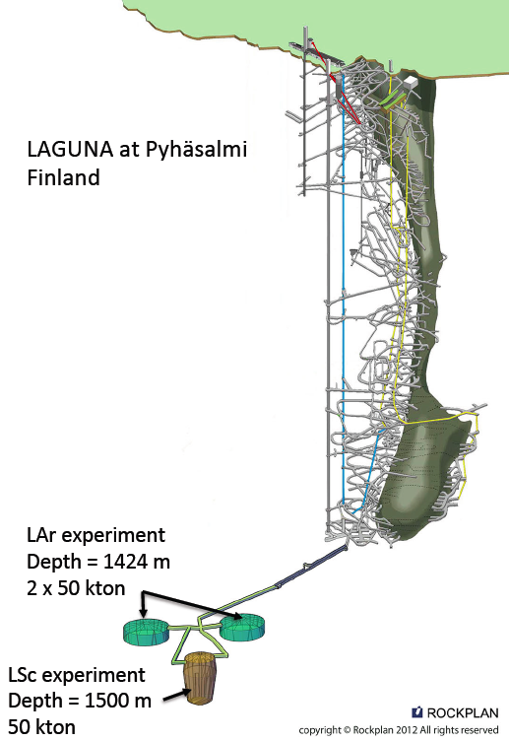
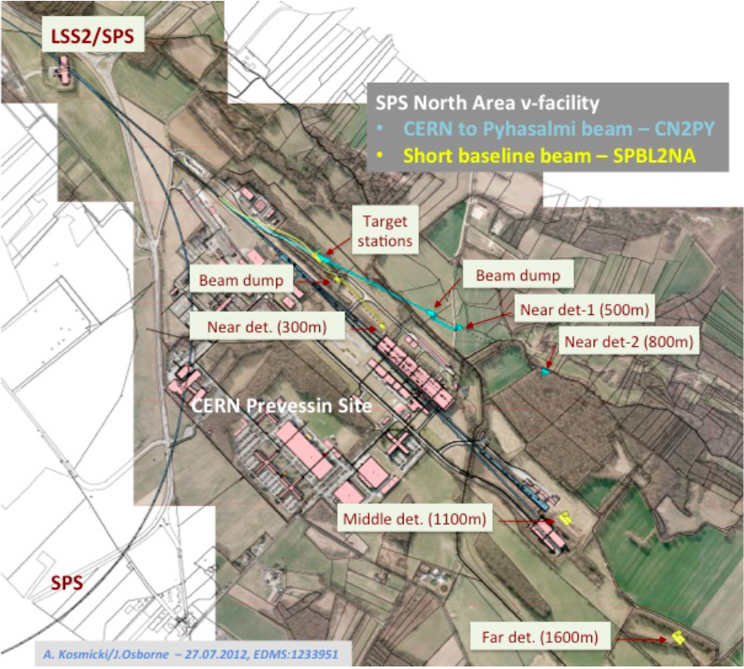
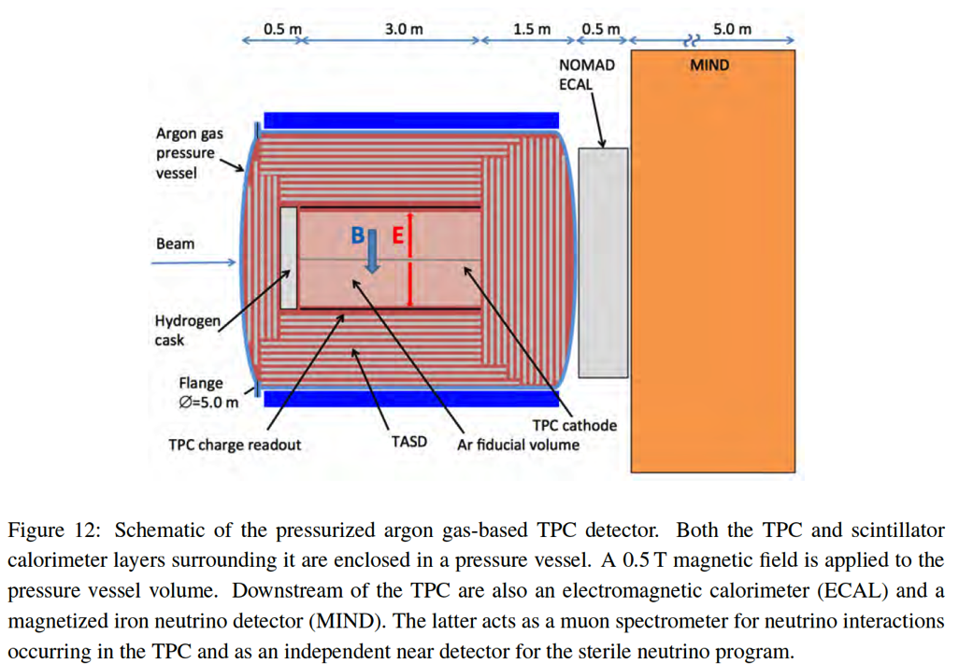
Long-Baseline Neutrino Observatory:
CERN-SPSC-2012-021;
SPSC-EOI-007
Source:
  CERN SPS: 700 kW
  PS 2: 2 MW [possible upgrade]
Detector: LAr TPC + MIND
  LAr fiducial mass: 20 kTonne
  MIND fiducial mass: 25 kTonne
  Site: Phyasalmi, Finland
    On axis
    Baseline 2300 km
Suite of detectors:
  High-pressure Ar + MIND
  L-scintillator

Slide 29
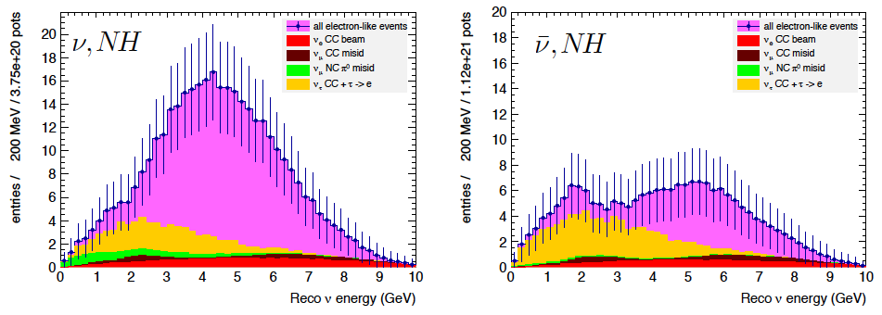
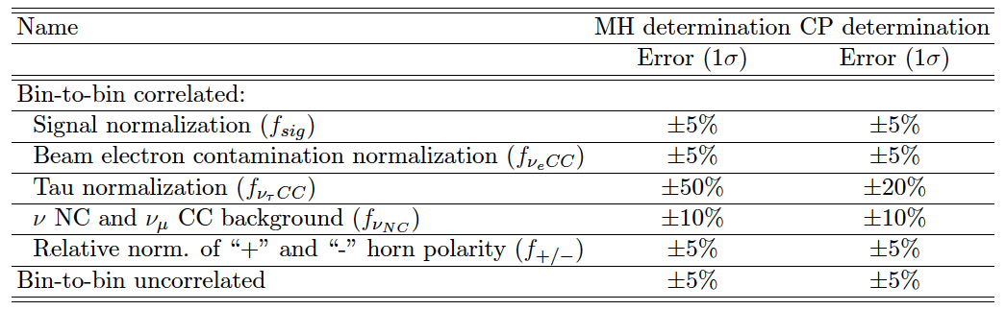
LBNO:
CERN-SPSC-2012-021;
SPSC-EOI-007
~1.7 GeV
Limited sensitivity to second oscillation maximum
Correlated and uncorrelated systematic uncertainties considered:
  Signal: 5%
  Background: 5% [but see table]

Slide 30
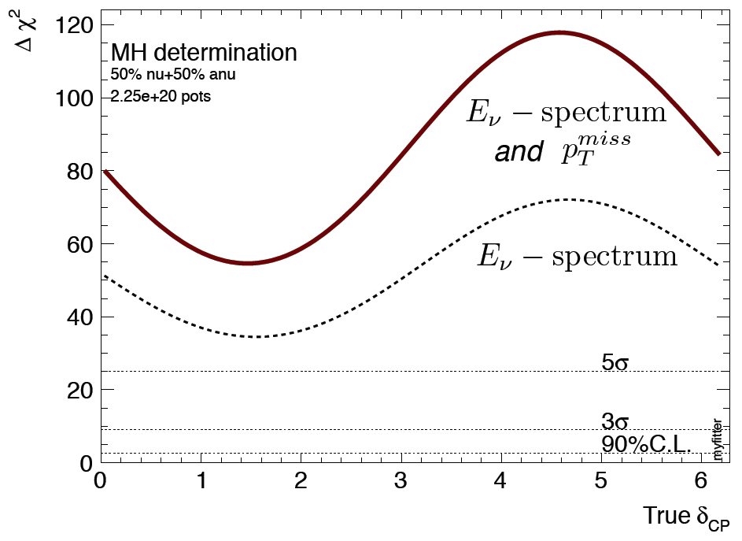
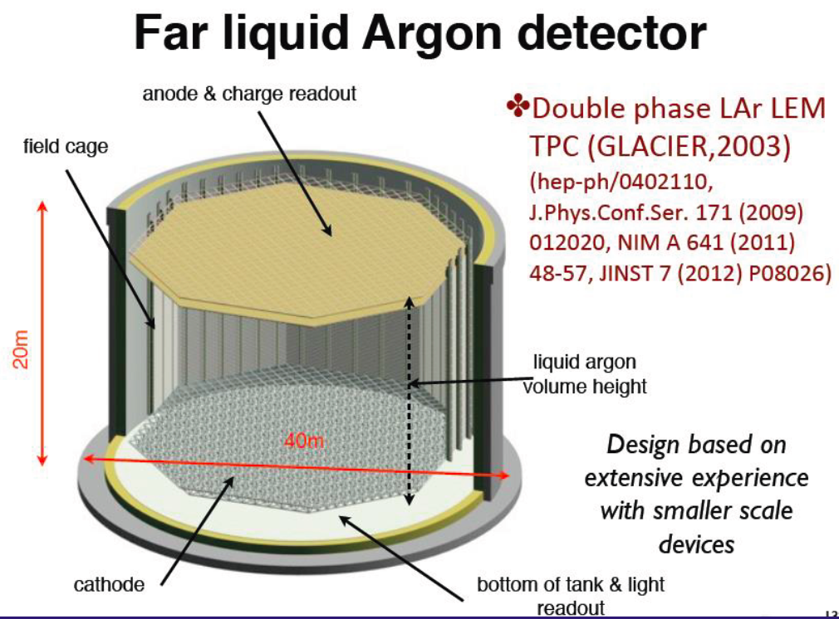
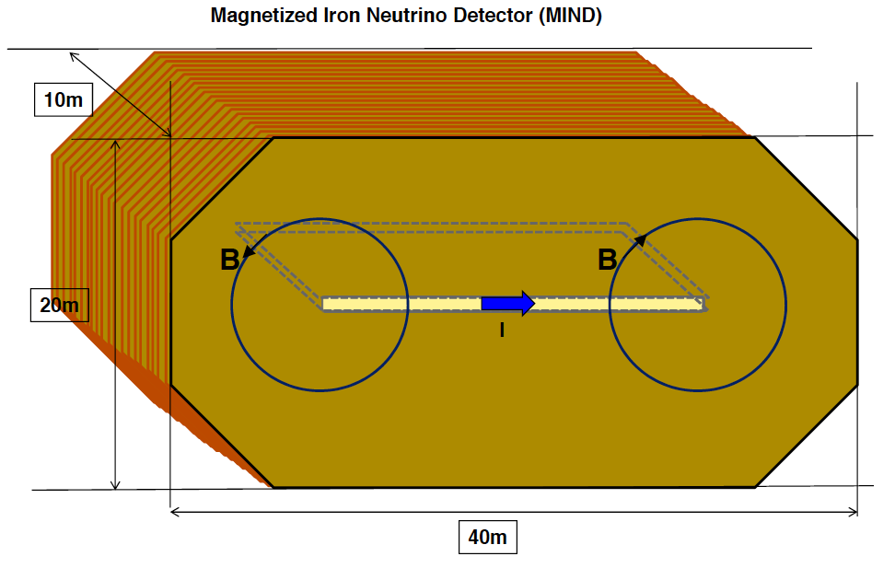
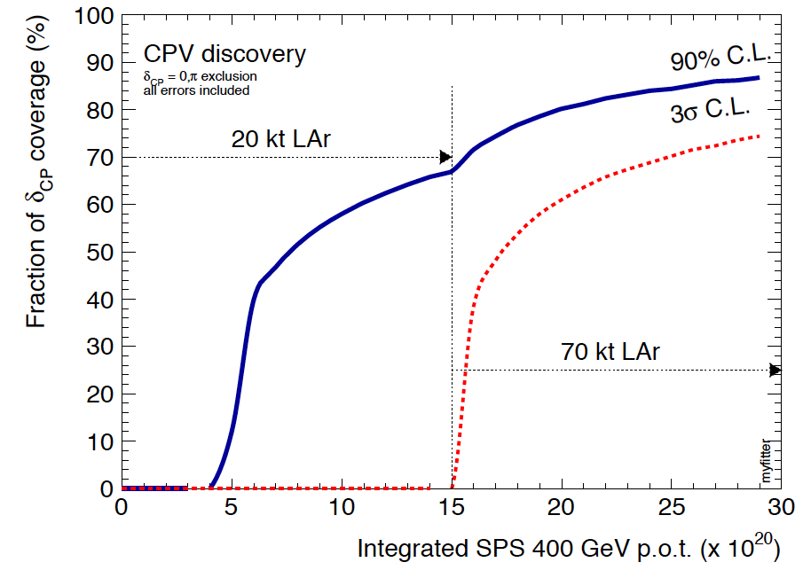
LBNO:
CERN-SPSC-2012-021;
SPSC-EOI-007
CERN-SPSC-2012-021;
SPSC-EOI-007
Benefit of long baseline clearly visible in excellent MH reach:
  Study of matter effect in neutrino propagation
CPiV reach competitive with LBNE

Slide 31
Neutrinos from stored muon beams

Slide 32
Effect of systematic uncertainties:

Slide 33
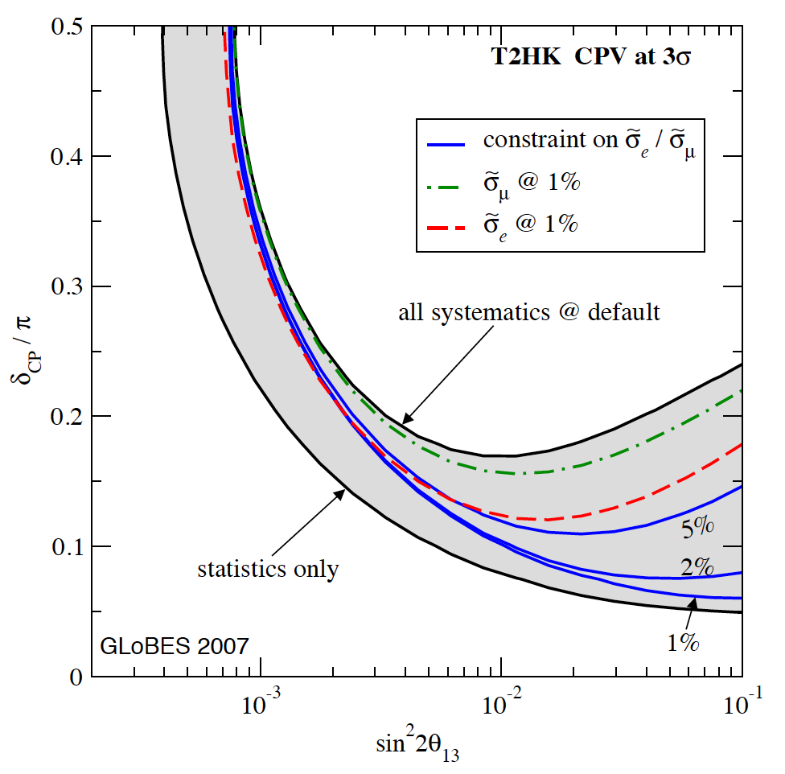
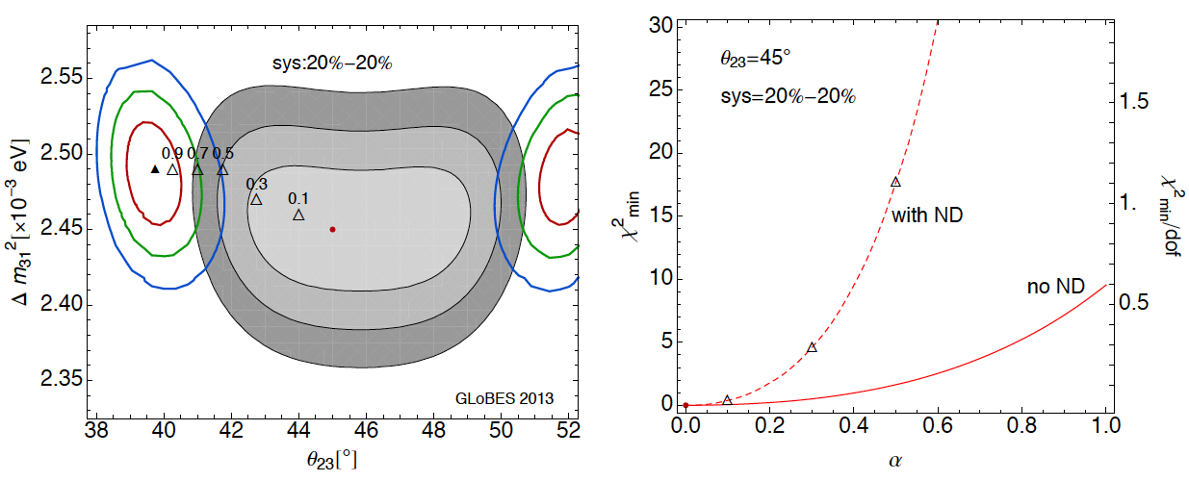
Limiting systematics in the LBL programme:
NBB + H2O Cherenkov:
  Clearly limited by cross section uncertainties
WBB + LAr TPC:
  Critical point: ν_{e} appearance in ν_{μ} beam:
    Convolution of flux × cross section × nucl. effect
    Precision limited by deconvolution
1307.1243
Coloma, Huber
Nuclear
effects

Slide 34
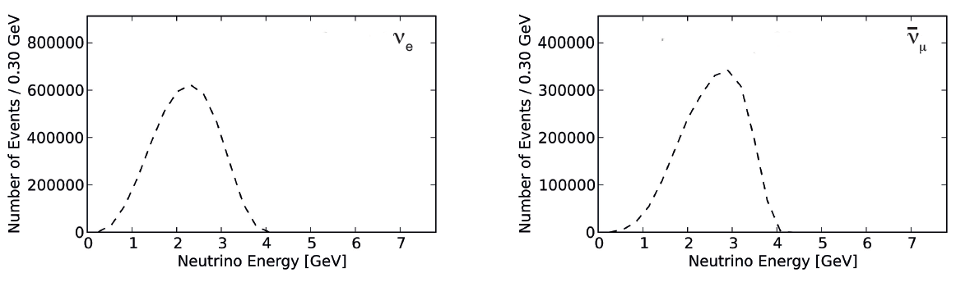
nuSTORM and cross section measurement:
LOI to FNAL PAC: 1206.0294;
EoI to CERN: CERN-SPSC-2013-015, SPSC-EOI-009,1305.1419;
Proposal to FNAL PAC, May 2013
nuSTORM event rate is large:
  Statistical precision high:
    Can measure double-differential cross sections

Slide 35
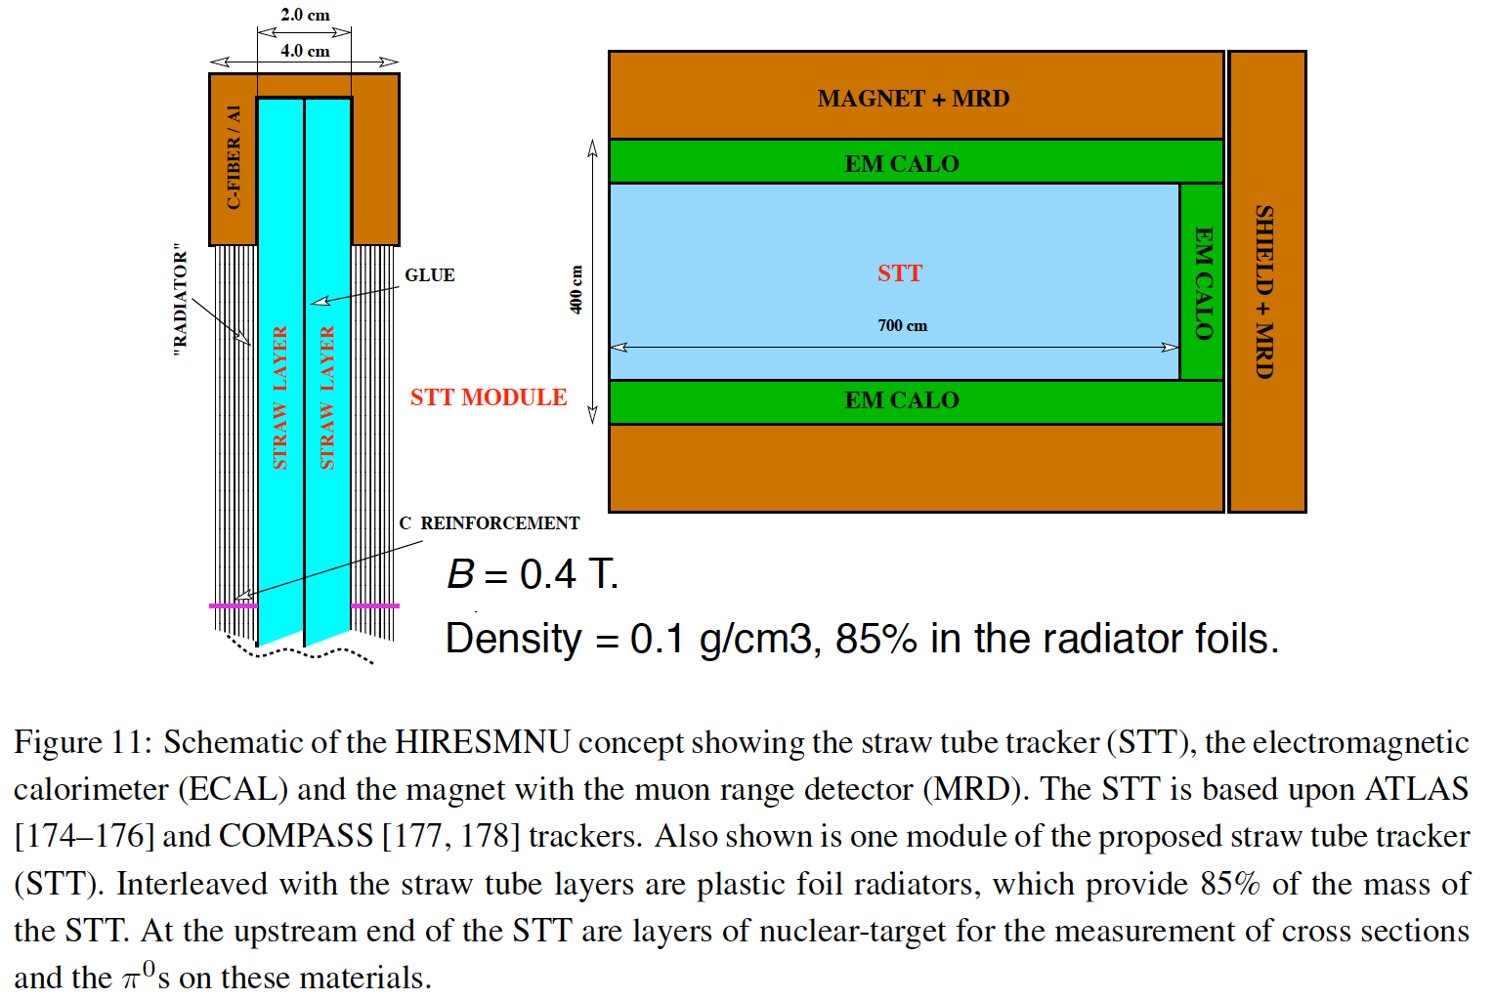
Detector options:
Staged approach possible:
  Initial measurements could exploit existing detector:
    If at FNAL Minerva, Mini/MicroBOONE are candidates
  Possible exploitation of LAr detector developed for LAGUNA or ICARUS/NESSiE etc.
  Implementation of one or more dedicated detectors to make definitive measurements
Generic study of nuSTORM to evaluate performance …

Slide 36
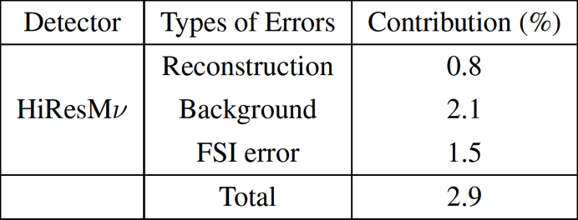
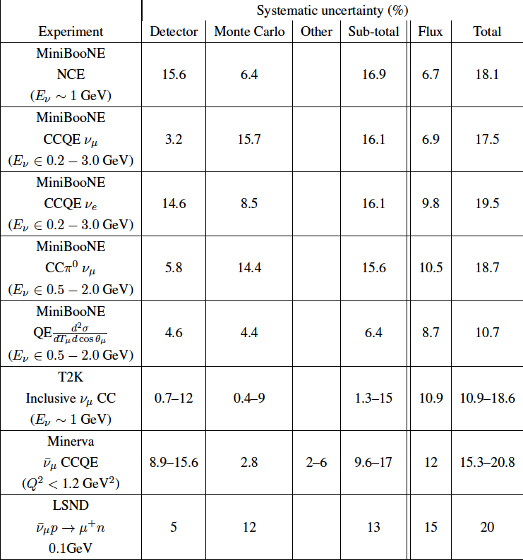
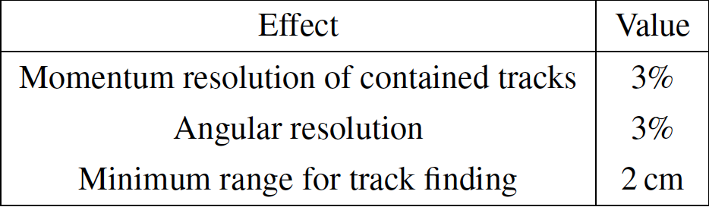
Cross section measurement performance:
Existing experiments:
  Sets the goal
Performance of HiResMnu:
Assumed performance of generic detector for evaluation of precision of cross section measurement:
Flux uncertainty varied:
  1% nuSTORM specification
  10% typical of conventional beams for comparison

Slide 37
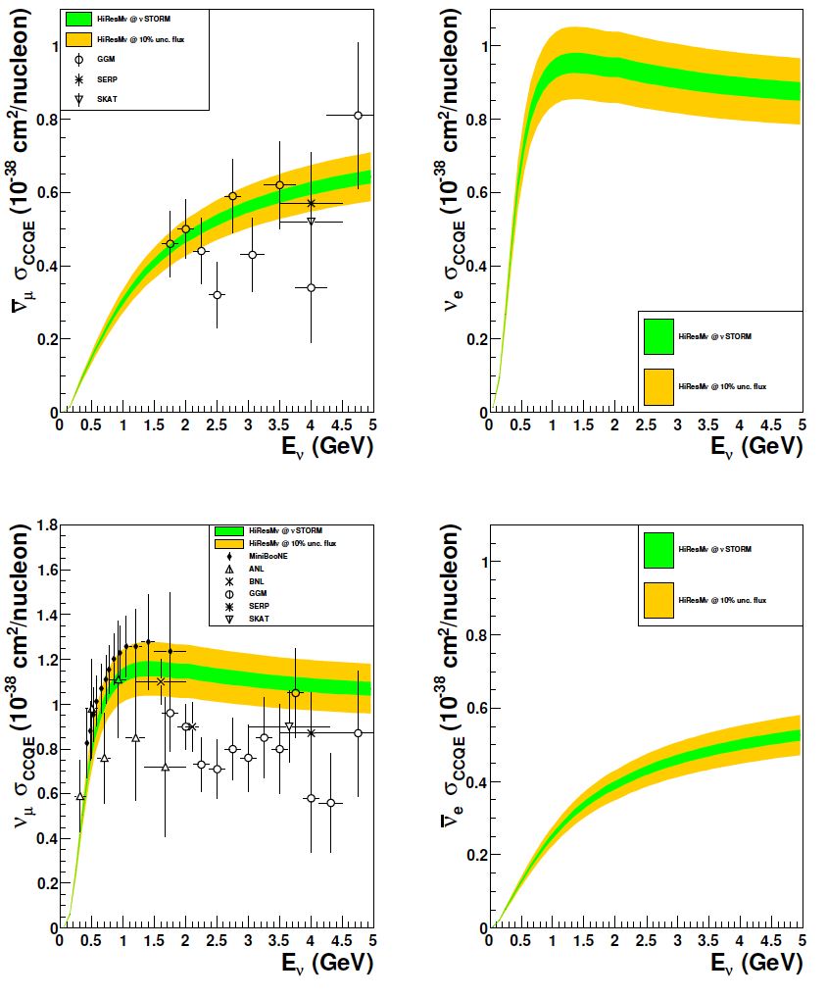
CCQE cross section measurement:
Systematic uncertainties for CCQE measurement at nuSTORM:
  Six-fold improvement in systematic uncertainty compared with “state of the art”
  Electron-neutrino cross section measurement unique

Slide 38
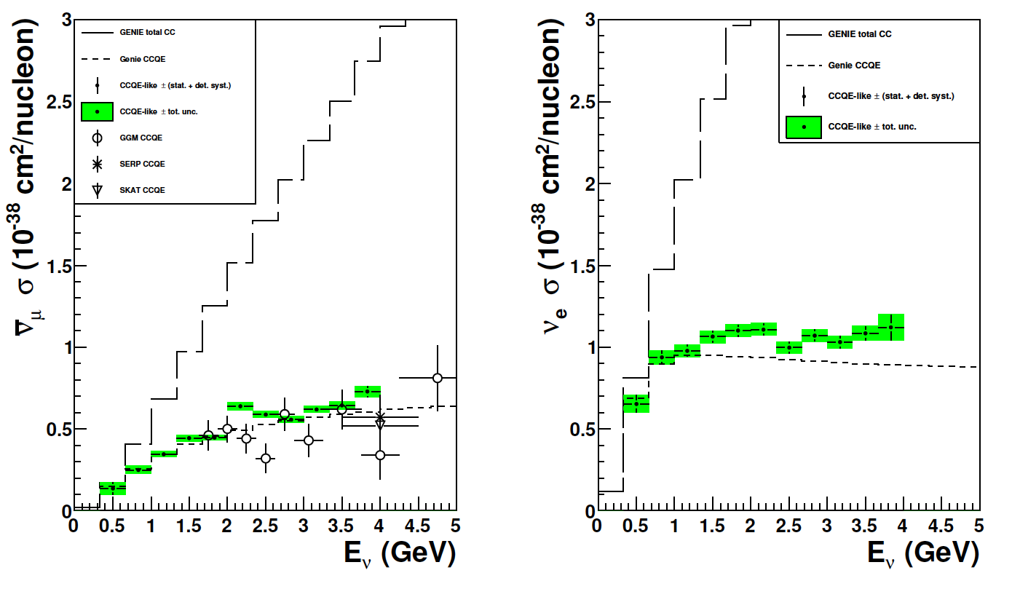
CCQE cross section measurement:
Simulation of “generic detector”:
  Muon-neutrino CCQE cross section measurement substantially improves “state of the art”
  Electron-neutrino CCQE measurement unique
  Evaluation of other channels has begun

Slide 39
Neutrino Factory:
arXiv:1112.2853
Optimise discovery potential for CP and MH:
  Requirements:
    Large ν_{e} (ν_{e}) flux
      Detailed study of
      sub-leading effects
Unique:
    (Large) high-energy
    ν_{e} (ν_{e}) flux
      Optimise event rate at
      fixed L/E
      Optimise MH sensitivity
      Optimise CP sensitivity

Slide 40

Neutrino Factory:
arXiv:1112.2853
Two approaches:
  Optimise L and E to match detector threshold
    IDS-NF approach:
      1.4% signal
      20% background

Slide 41

Neutrino Factory:
arXiv:1112.2853; 1308.0494v1
Two approaches:
  Optimise L and E to match detector threshold
    IDS-NF approach:
  Exploit LAr detector sited 1300 km from FNAL
    MAP/MASS approach:

Slide 42
Neutrino Factory:
Bayes, Coloma
IDS-NF
NuMAX

Slide 43
ICFA Neutrino Panel
Performance on CPiV and MH of long-term accelerator projects:

Slide 44

http://www.fnal.gov/directorate/icfa/neutrino_panel.html
Top page only at the moment. Site will go “live” Monday 26Aug13.

Slide 45




Slide 46



Slide 47
Conclusions
Performance on CPiV and MH of long-term accelerator projects:

Slide 48
Conclusions:
The combination of NB and WB super-beams have the potential to:
  Determine the mass hierarchy; and
  Make a first sweep of the CP parameter space
Substantial contribution to first scientific imperative:
  To complete the Standard Neutrino Model (SνM)
To establish the SνM as the correct description of nature requires:
  Development of a capability to produce large, high-energy data sets; and
  To control systematic uncertainties
    This requires a dedicated programme
An incremental programme can be (has been) articulated:
  Scientific imperative: develop three-pronged programme:
    Deliver critical oscillation measurements through super-beam programme;
    Establish systematic-uncertainty control programme
      Including measurement of ν_{e}N cross sections at nuSTORM
    Develop capability required to implement the Neutrino Factory
      Including MICE, the critical system demonstration for ionization cooling
  To realise this fantastic programme seems likely to require international coordination

