Slide 1
Post-Acceleration Study for Neutrino Super-beam at CSNS
Presenter：Yang Wu
McMaster University
Work conducted at IHEP

Slide 2
Contents
Introduction
Design goals
Overall design considerations
Scheme I
Scheme II
Comparison
Summary

Slide 3
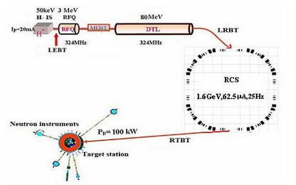
Introduction
CSNS (China Spallation Neutron Source) is a multi-disciplinary research facility
CSNS accelerator complex consists of:
80MeV H⁻ Linac
1.6Gev proton rapid cycling synchrotron(RCS)
Beam transport lines
Notes:
Mainly for matter structure studies using neutron scattering techniques

Slide 4
Introduction cont’d
 | CSNS I | CSNS II
Beam Power (kW) | 100 | 500
Proton energy (GeV) | 1.6 | 1.6
Repetition rate (Hz) | 25 | 25
Protons per pulse (10¹³) | 1.56 | 7.8
RCS circumference (m) | 227.92 | 227.92
Linac energy (MeV) | 80 | 250
Linac peak current (mA) | 20 | 40
Linac RF frequency (MHz) | 324 | 324
The post-acceleration scheme studies are based on the CSNS II accelerator

Slide 5
Design goals
To extend CSNS to a super-beam facility which could be used for neutrino oscillation studies by adding a post-acceleration complex
To minimized the influence to CSNS applications, 10% of the RCS beam is used for post-acceleration.
To be competitive, the proton driver is to have an energy of 128GeV and beam power of 4MW.

Slide 6
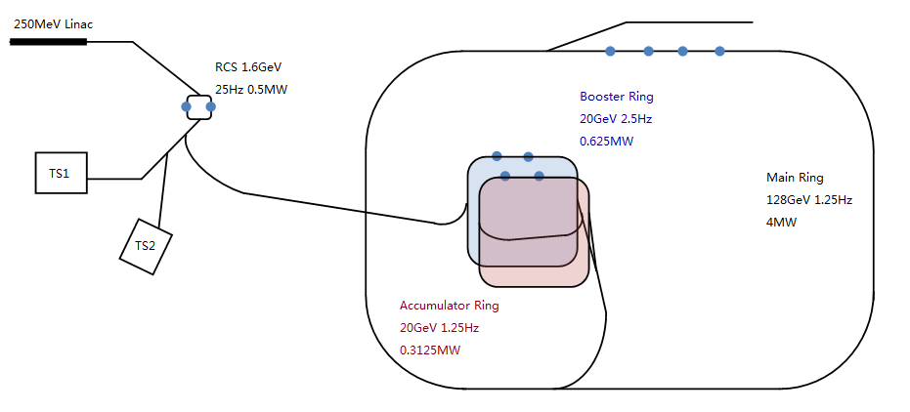
Overall design considerations
Two-step acceleration:
Using accumulator ring
Reducing the repetition rate of the MR
Satisfying the limitation of the ramping rate of SC-magnets.
Booster
1.6GeV-20GeV
Main Ring
20GeV-128GeV
Accumulator
20GeV
Booster and Accumulator are sharing the same tunnel
Notes:
Frequency:2.5Hz

Slide 7
Scheme I: Post-acceleration scheme with RT-magnets in the Main Ring
RCS
1pulse 2bunches
Booster
1 pulse 2 bunches
Main Ring
2 pulses 4 bunches
Accumulator
1 pulse 2 bunches

Slide 8
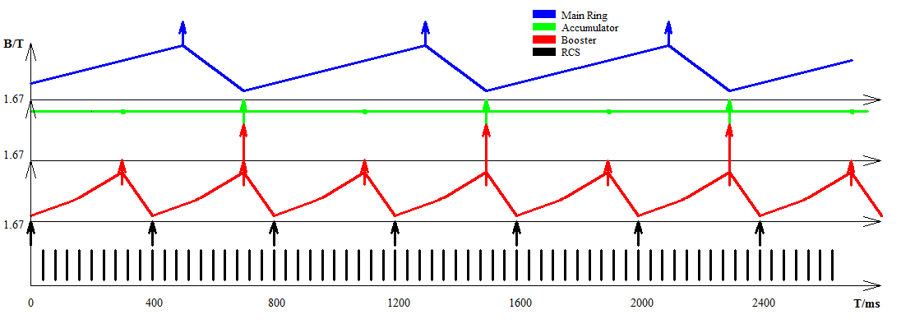
Scheme I: Post-acceleration scheme with RT-magnets in the Main Ring
25Hz 2.5Hz 1.25Hz 1.25Hz

Slide 9
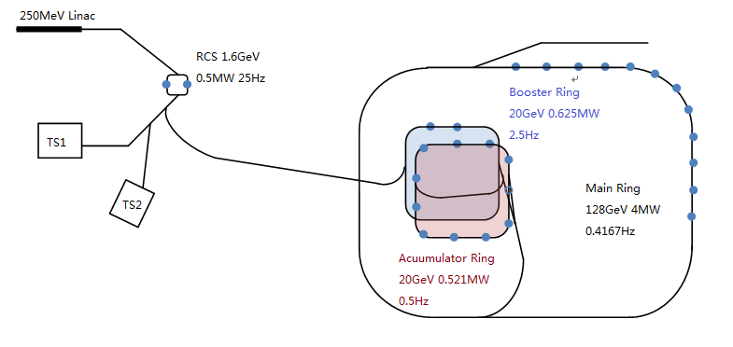
Scheme II: Post-acceleration scheme with SC-magnets in the Main Ring
Booster
1 pulse 2 bunches
Main Ring
6 pulses 12 bunches
Accumulator
5 pulses 10 bunches
Superconducting magnet Smaller Main Ring

Slide 10
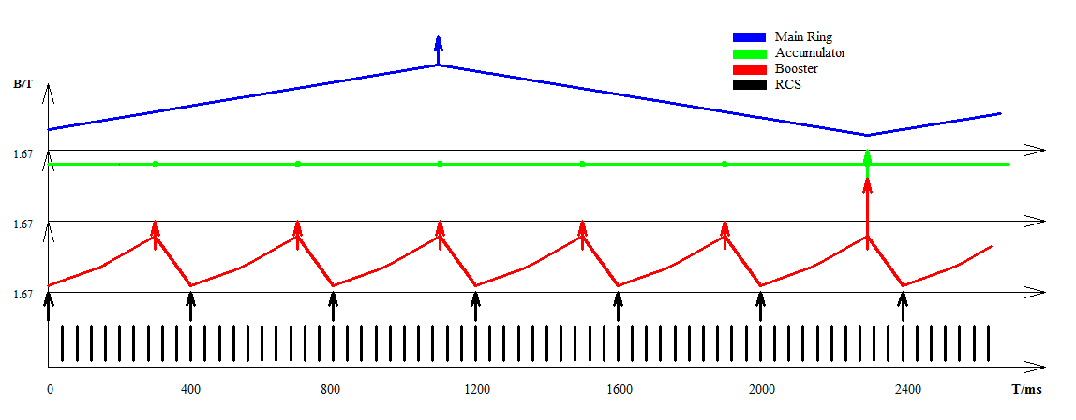
Scheme II: Post-acceleration scheme with SC-magnets in the Main Ring
25Hz 2.5Hz 0.4167Hz 0.4167Hz

Slide 11
Comparison: Booster Ring
BOOSTER parameters | Scheme I (RT-MR) | Scheme II (SC-MR)
Circumference (m） | 1025.64 | 1253.56
Dipole field（T） | 0.1446-1.3437 | 0.1183-1.0994
Dipole ramping rate during rising period (T/s) | 3.0746- 4.9194 | 2.5156-4.0250
Curvature radius (m) | 54.41 | 66.50
RF Voltage (kV） | 343.16 | 419.38
Number of ferrite cavities (or MA cavities) | 16 (8) | 20 (10)
RF harmonics | 9 | 11
No scheme shows evident advantages
Circumference: Accumulator Ring
Four more RF cavities: Circumference → RF voltage
Notes:
The circumference of the booster in the SC0MR scheme is 1.2 times as long as the one in the RT-MR scheme. This is mainly due to that the AR is longer in order to accumulate more pulses and the Booster is sharing the tunnel with the AR

Slide 12
Comparison: Main Ring
MAIN RING parameters | Scheme I (RT-MR) | Scheme II (SC-MR)
Circumference (m） | 4558.40 | 3418.8
Repetition rate (Hz) | 1.25 | 0.4166
RF Voltage (kV） | 3131.4 | 1174.3
Dipole field (T) | 0.2519-1.4820 | 0.3400-2.0000
Dipole ramping rate during rising period (T/s) | 3.0753 | 1.3833
Curvature radius (m) | 290.20 | 215.04
Number of ferrite cavities (or MA cavities) | 143 (71) | 54 (27)
RF harmonics | 40 | 30
SC-MR scheme has obvious advantages
Circumference, dipole ramping rate and RF voltage

Slide 13
Summary
A post-acceleration system for CSNS Neutrino Superbeam has been studied, with two slightly different schemes.
Both schemes exploit only 10% of CSNS/RCS beam.
The scheme with SC magnets in the MR is favored due to lower construction and operational cost.
With the beam energy of 128 GeV and beam power of 4 MW, CSNS superbeam will be very competitive in long-baseline neutrino physics.

Slide 14
Thank you for attention!

