Slide 1
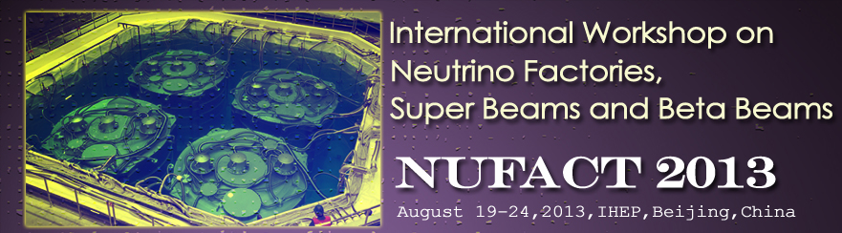


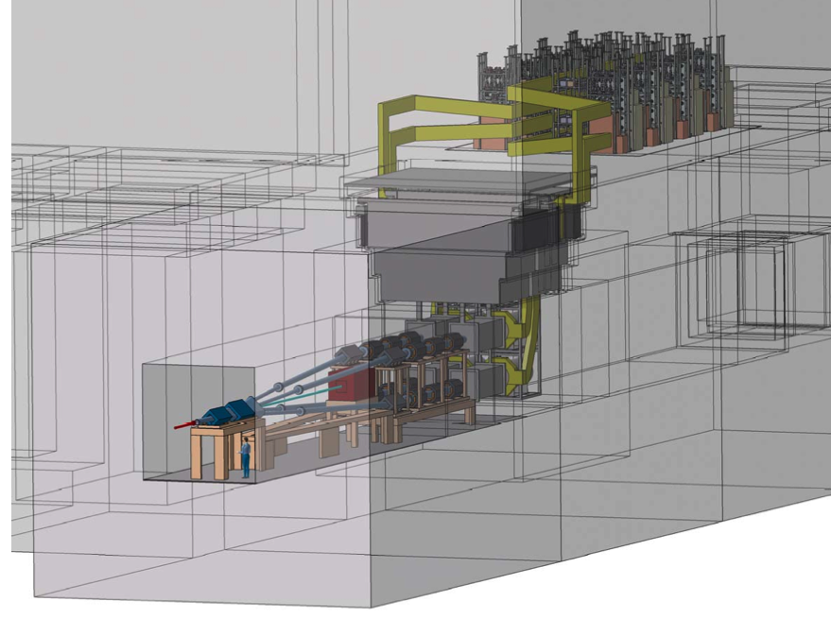
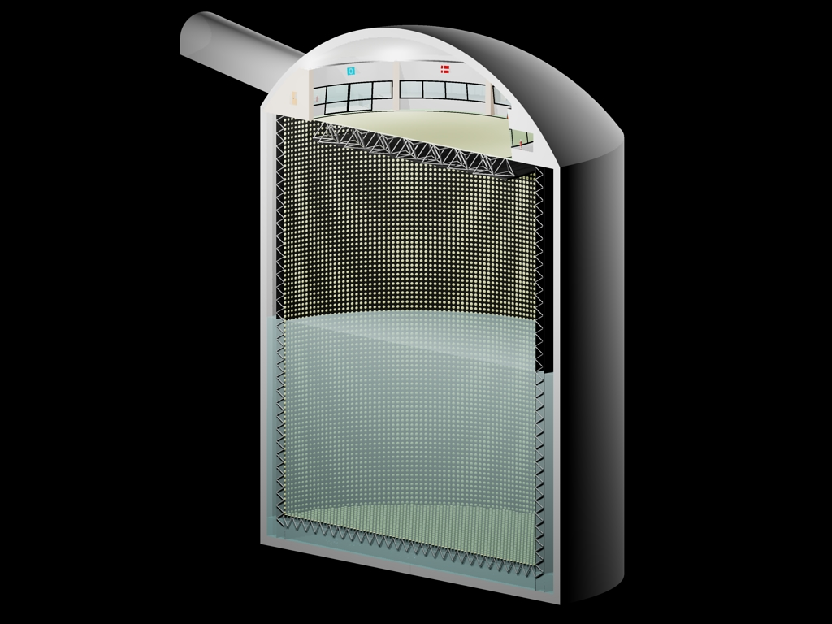
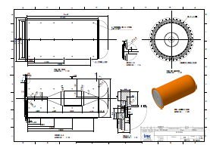
Target station and optimization studies for ESS Super Beam
E. Baussan, M. Dracos, N. Vassilopoulos IPHC/CNRS

Slide 2
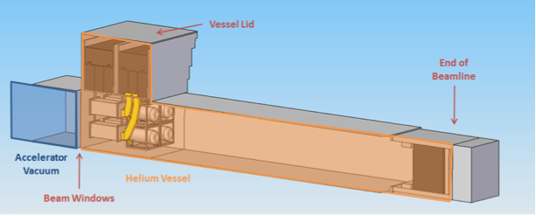
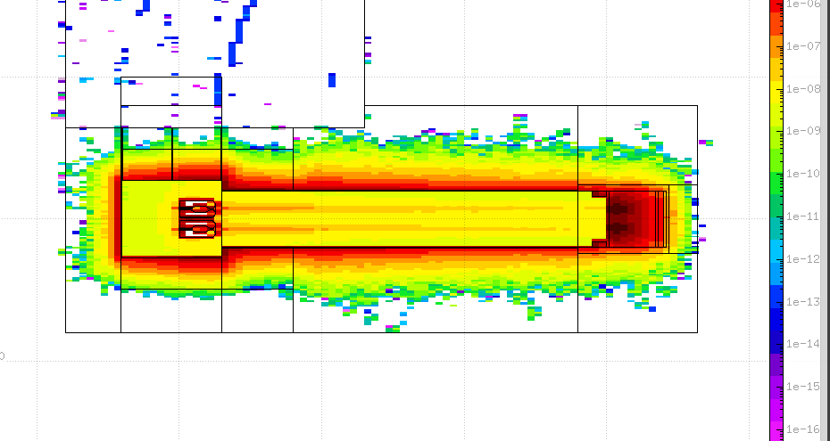
layout
Target station description
Target
Horn
Studies on physics potential (sys. errors 5 % signal, 10% background, mass hierarchy assumed not known )
Proton beam energy
Horn’s current
Target and decay tunnel length
also
Particle yield
Perfect focusing vs horn’s focusing vs no focusing
Energy deposition, radiation (neutrons), muons (near detector location)
Thanks to
Chris Densham and his team for the target studies et
Enrique Fernandez for the globes calculations and his input on results

Slide 3
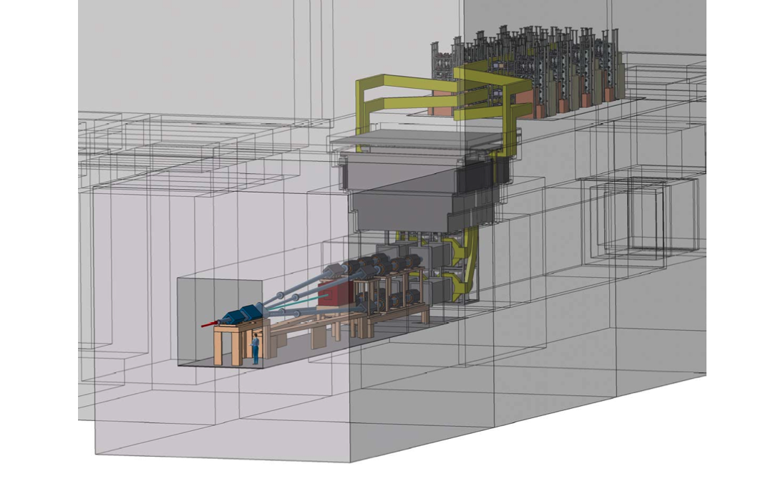
ESS Super beam layout
(adopted from SPL Super Beam - EUROnu)
PSU
Concrete surrounding shielding (8 m)
Iron (2.2 m) and concrete (3.7 m) shielding
Beam dump
Decay tunnel
He vessel (25 m)
Concrete surrounding shielding) (8 m)
4-targets/horns
Vessel (He)
Switching yard to four proton beams or accumulator rings

Slide 4
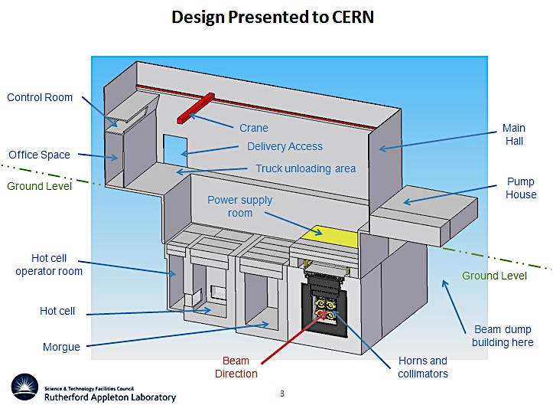
Super beam Four-horn/target station

Slide 5
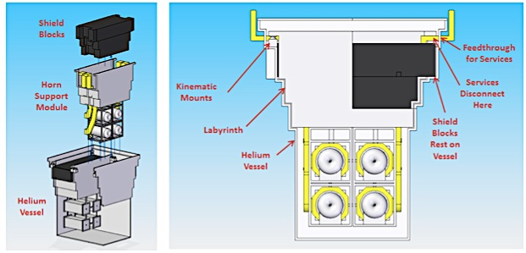

He vessels

Slide 6
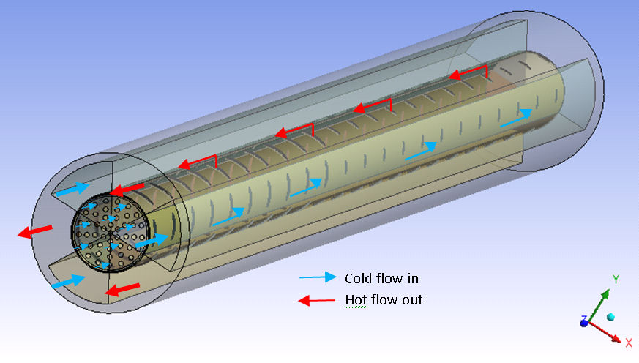
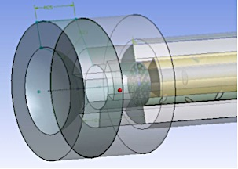
Target: packed bed
Large surface area for heat transfer
Coolant able to access areas with
highest energy deposition
Potential heat removal rates at the hundreds of kW level
Pressurised cooling gas required at high power levels
Minimal stresses
Tests of such a target are planned using the
HiRadMat high intensity proton irradiation facility at CERN
Full study in EUROnu.org, arXiv:1212.0732 (SPL super beam)
Titanium alloy cannister containing packed bed of titanium or beryllium spheres
Cannister perforated with elliptical holes graded in size along length
Beam window, Be is a candidate
Pressure stresses can be dealt by having a hemispherical window design
Separation from target station coolant

Slide 7
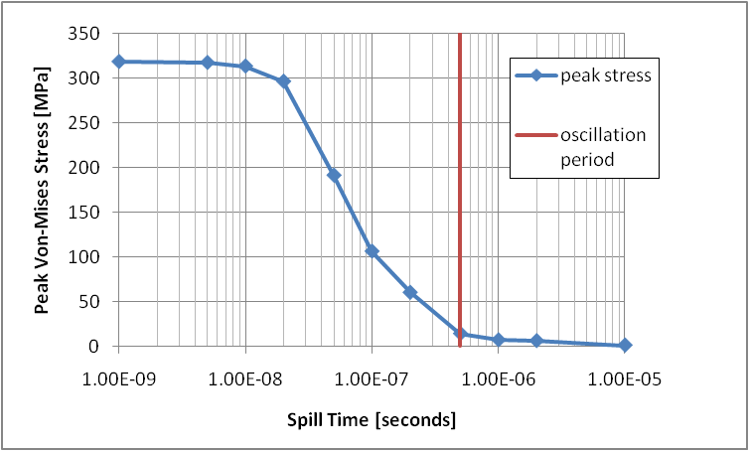
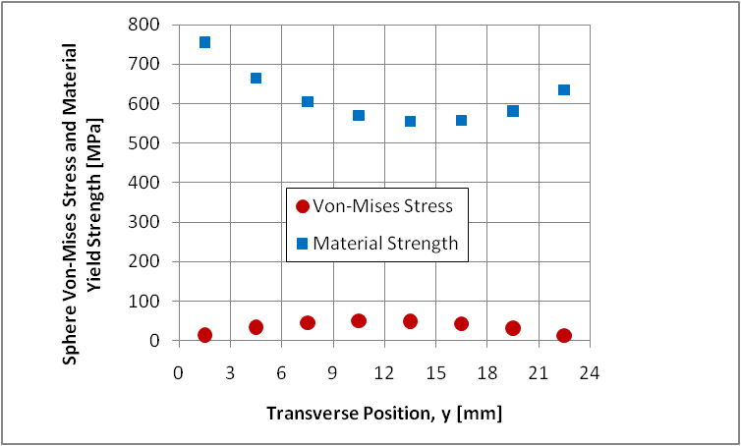
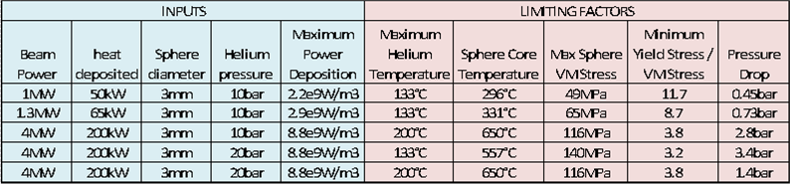
Stresses for the Packed bed target
EUROnu example, 24mm diameter cannister packed with 3mm Ti6Al4V spheres
Quasi thermal and Inertial dynamic stress components
ideally spill time > oscillation period

Slide 8
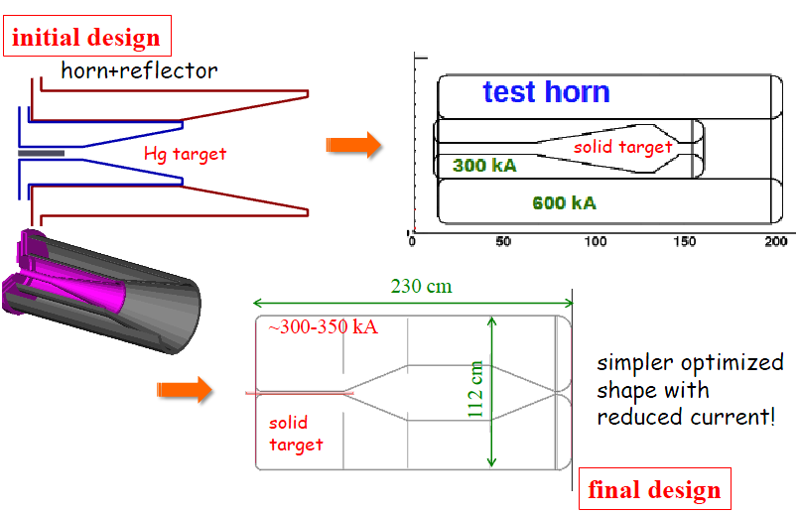
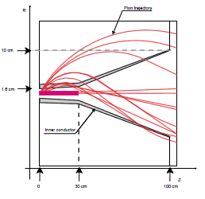
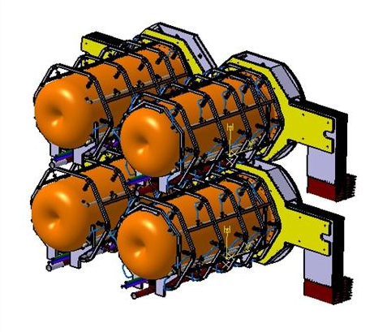
Horn evolution
details in WP2 notes @ http://www.euronu.org/
evolution of the horn shape after many studies:
triangle shape (van der Meer) with target inside the horn : in general best configuration for low energy beam
triangle with target integrated to the inner conductor : very good physics results but high energy deposition and stresses on the conductors
forward-closed shape with target integrated to the inner conductor : best physics results, best rejection of wrong sign mesons but high energy deposition and stresses
forward-closed shape with no-integrated target:
best compromise between physics and reliability
4-horn/target system to accommodate the MW power scale

Slide 9
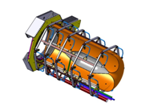
Horn studies
horn structure
  Al 6061 T6 alloy good trade off between mechanical strength, resistance to corrosion, electrical conductivity and cost
  horn thickness as small as possible: best physics, limit energy deposition from secondary particles but thick enough to sustain dynamic stress
horn stress and deformation
  static mechanical model, thermal dilatation
  magnetic pressure pulse, dynamic displacement
  Horn lifetime at least 1 year from fatigue analysis (30 – 60 MPa max stress depending on HTCs)
  60 water jets for cooling
Full study in EUROnu,
arXiv:1212.0732

Slide 10
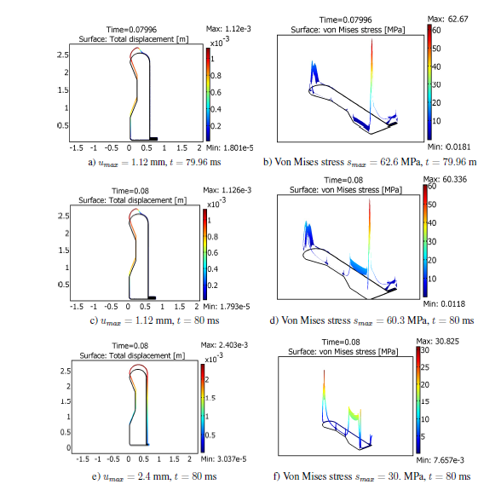
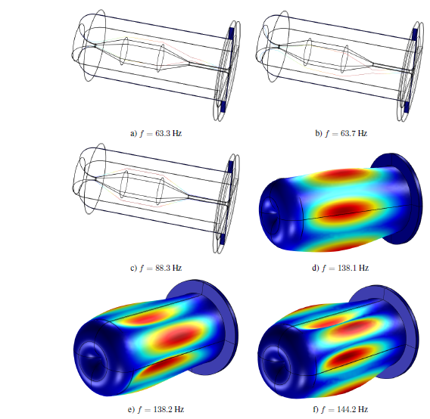
Stress due to thermal dilatation and magnetic pressure for 350 kA @ 12.5 Hz
displacements and stress plots just
before and on the peak
  stress on the corner and convex region
  stress on the upstream inner due to pulse
  uniform temperature minimizes stress, max = 30 MPa
t= 79.6 ms
  S_{max} = 60 MPa
modal analysis, eigenfrequencies
f = {63.3, 63.7, 88.3, 138.1, 138.2, 144.2} Hz
u_{max} = 1.12 mm
t= 80 ms
T_{Al-max}= 60 ⁰C,
inner
  S_{max} = 30 MPa
u_{max} = 2.4 mm
t= 80 ms
outer
T_{Al-uniform}= 60 ⁰C
peak magnetic field each T=80ms (4-horns operation)

Slide 11
Are the adopted SPL Super Beam parameters fit well the ESS case ?
Parameter | SPL | ESS
Power (MW) | 4 | 5
E_{p+} (GeV) | 4.5 | 2, 2.5
Baseline (km) | 130 | 365, 540
Target | Packed-bed | Packed-bed
Target length (cm) | 78 | 53-78
Target radii (cm) | 1.5 | 1.5
Horn | Forward closed | Forward closed
Horn current (kA) | 350 @ 12.5 Hz | 350 @ 14 Hz
# of horns/targets | 4 | 4
Tunnel length (m) | 25 | 15-25
Tunnel radii (m) | 2 | 2
Exposure (years) | 2 ν + 8 anti-ν | 2 ν + 8 anti-ν

Slide 12
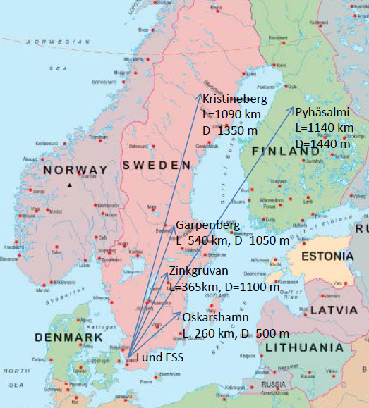
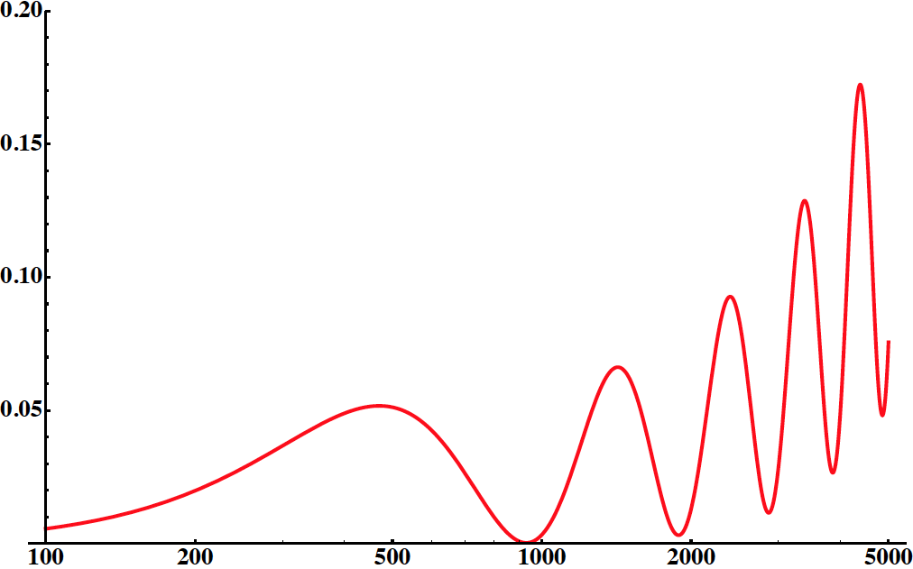
Reminder: collection of possible detector locations in Sweden
Many mines (active or not) are available
What is the optimal position for CPV?
MH might be discovered at 5σ with including atmospheric ν
Dm²_{sun}=7.6x10⁻⁵ eV²
Dm²_{atm}=2.4x10⁻³ eV²
q₂₃=44.4°
q₁₂=34.4°
q₁₃=9.3°
d_{CP}=0
E~290 MeV
P(ν_{μ}− ν_{e})
L/E (km/GeV)

Slide 13
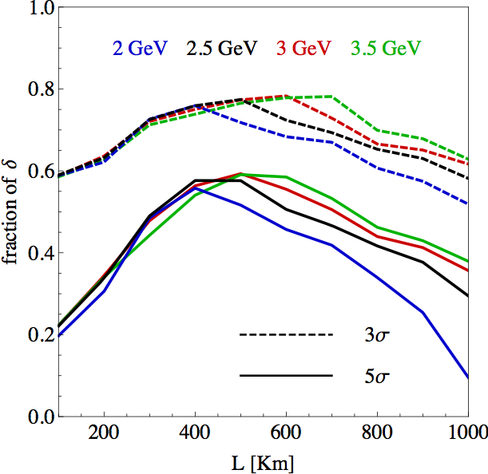
are our candidate baselines good enough?
Yes

Slide 14
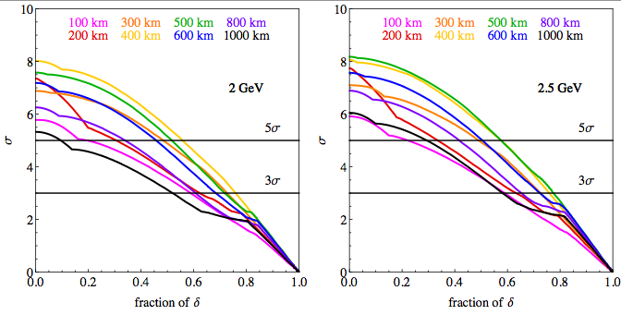
Very good baselines for the following mines :
Zinkgruvan at 365 km
Garpenberg at 540 km
Site studies under way

Slide 15
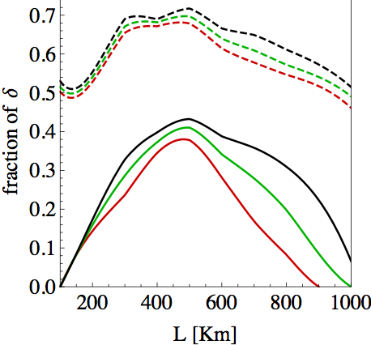
Horn Current ?
450 kA
350 kA
540 km
3σ
300 kA
365 km
5σ
The larger the better (B~I/r)
350 kA baseline
PSU study: Arxiv:1304.7111
Very good fit to 365 and 540 km baselines
lower p.o.t. per year for this study
– not to compare with main results

Slide 16
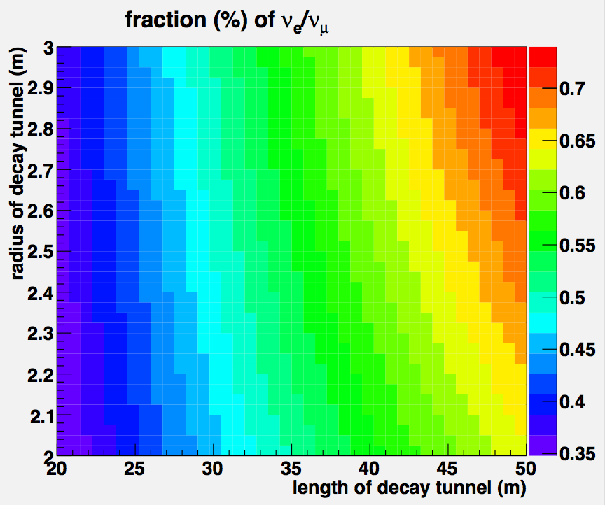
ν_{e} contamination, for detected neutrinos
current situation
ν_{e} contamination increases with respect to DT length, radii
Lower than 1 %
@ L = 25 m, 50 % of π⁺ s decay

Slide 17
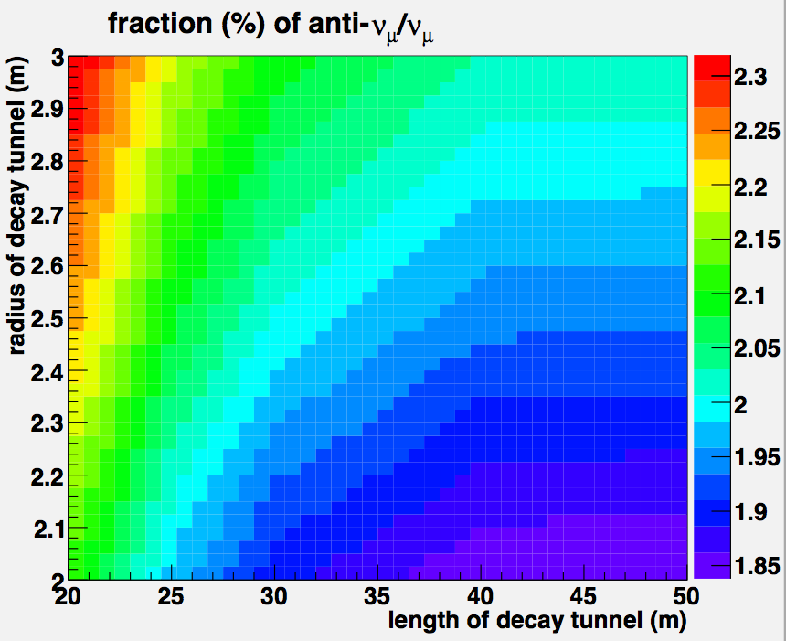
anti-ν_{μ} contamination for detected neutrinos
current situation
anti-ν_{μ} contamination decreases with respect to DT length

Slide 18
is the increased ν_{e} contamination more significant than the increased flux ?
try the following tunnel parameters:
Length (m) | Radius (m) | % of decayed π⁺
25 (baseline) | 2 (low-limit for 4-horns) | 50
50 | 2 | 72
100 | 2 | 92

Slide 19
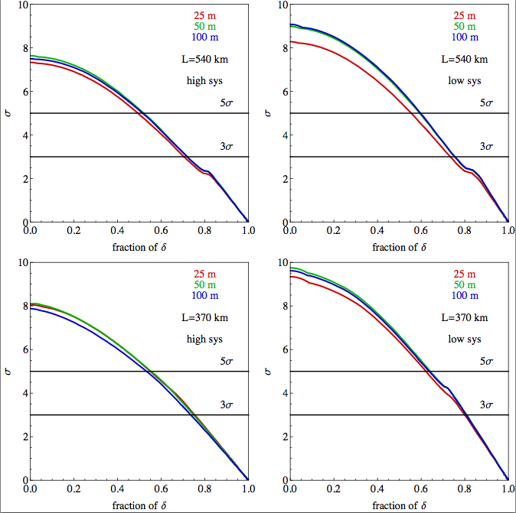
tunnel length
No significant increase in physics performance by using lengthier decay tunnel

Slide 20
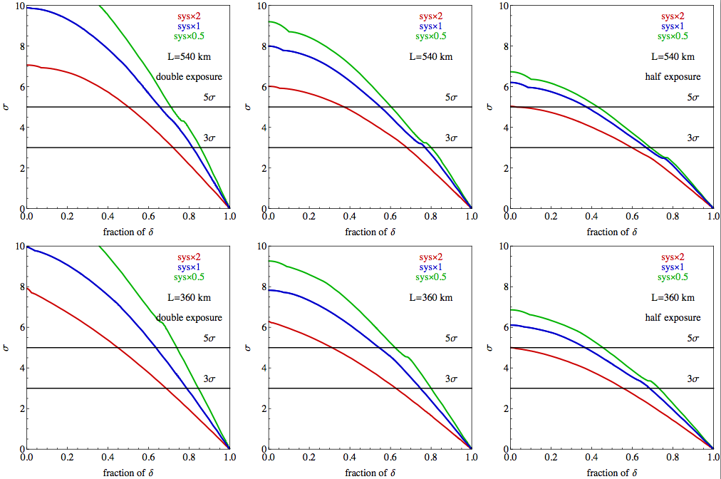
Systematics, time vs physics
time x 2
Baseline
time x 0.5

Slide 21
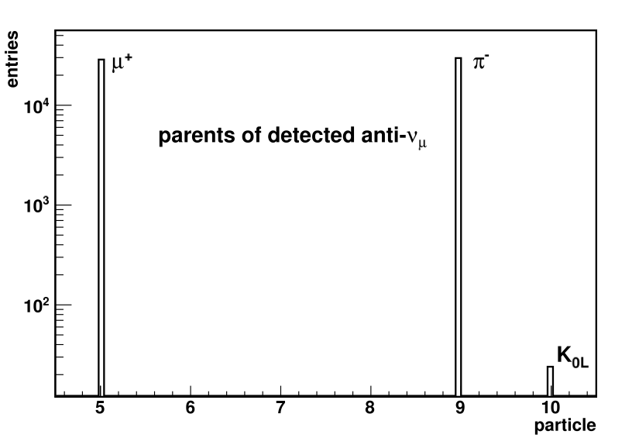
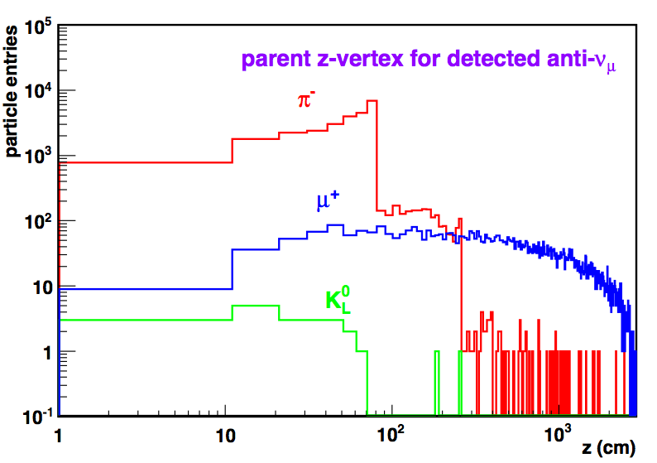
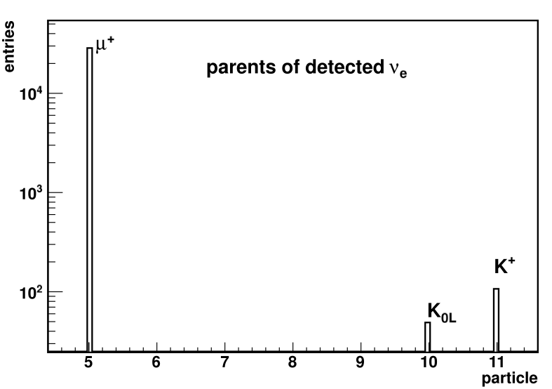
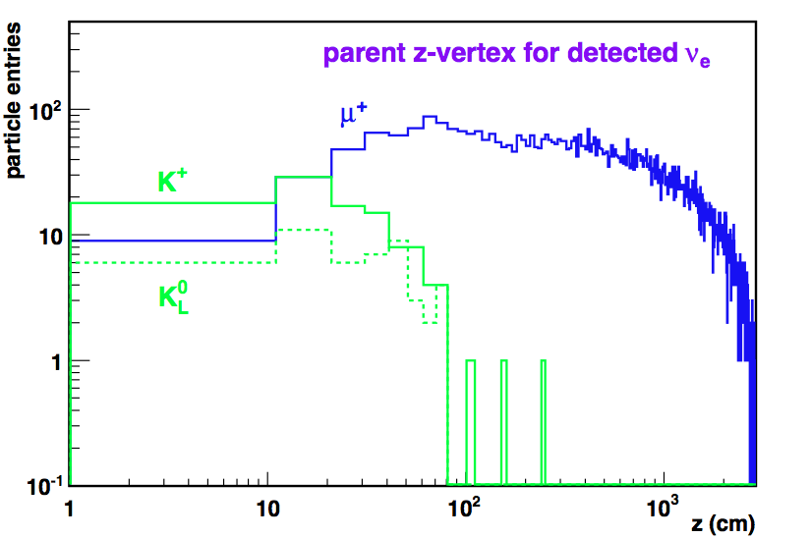
Can we use a smaller target and decay tunnel ?
not-defocused wrong signπs

Slide 22
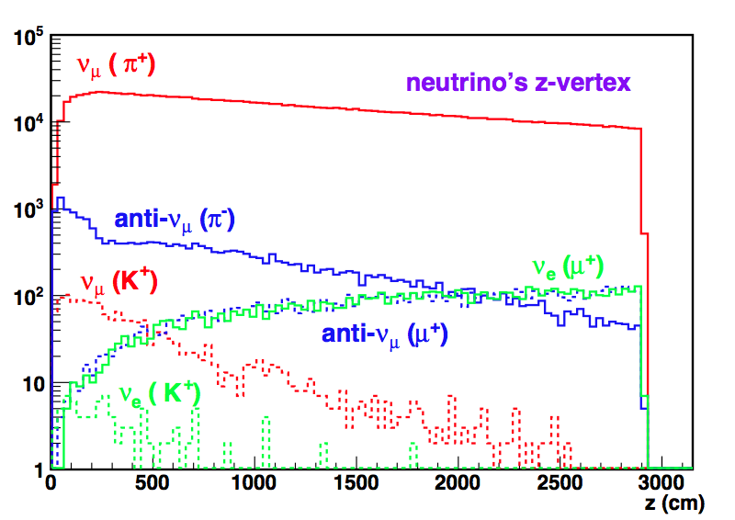
Can we use a smaller target and decay tunnel ?
detected
for neutrino beam

Slide 23
Particle production at target
Particles per p⁺ for baseline ESS target parameters and also for different radii, lengths
SPL is shown for comparison (fluka 2013)
ESS Ti packed-bed
particles/p⁺ | π⁺ | π⁻ | n
r_{1.25} | 0.27 | 0.17 | 4.4
r_{1.50}, L₇₈ (baseline) | 0.29 | 0.17 | 4.8
r_{1.50}, L₆₃ | 0.28 | 0.17 | 4.5
r_{1.50}, L₅₃ | 0.26 | 0.16 | 4.3
r_{2.00} | 0.30 | 0.18 | 5.3
SPL | 0.67 | 0.52 | 6.6
For a year there are 2.8 more protons in ESS than SPL

Slide 24
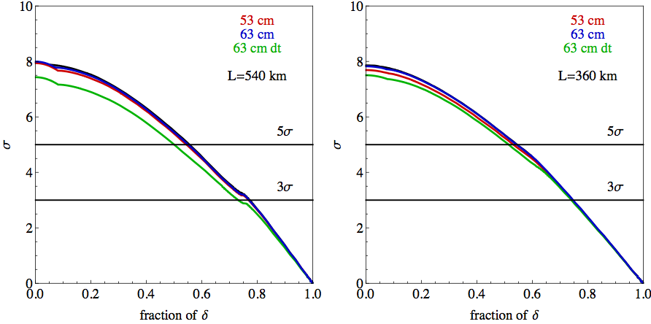
target length
the target size and decay tunnel length could be reduced at no-cost
Less irradiation
Smaller civil-engineering cost

Slide 25
Perfect focusing studies is the horn focusing well ?
Examine the quality of focusing
Compare neutrino fluxes or events of perfect focus and no focus with the specified optics
Application depends on the focusing optics and particle production for low, medium and high energy beams
Method: focus parallel (P_{T}=0, P_{Z}=P) in respect to the beam axis all charged particles at the exit of target with a given acceptance limit
Comparison between ESS and CNGS beams

Slide 26
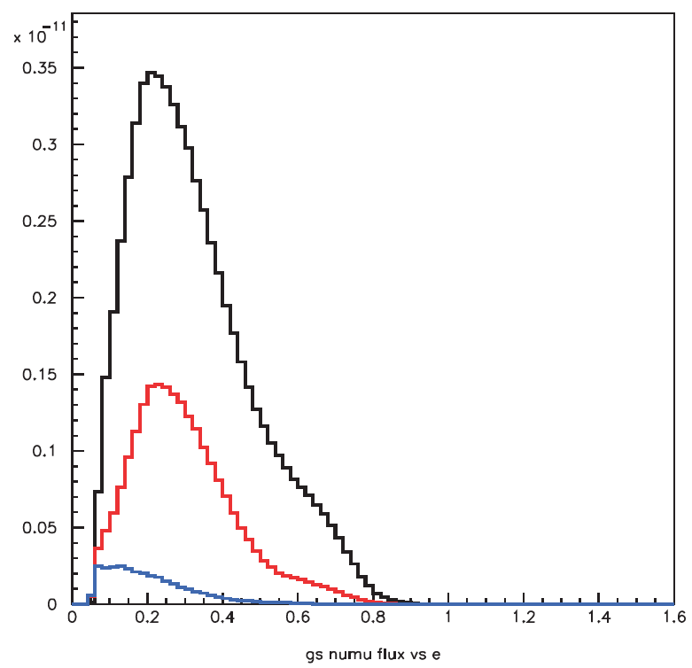
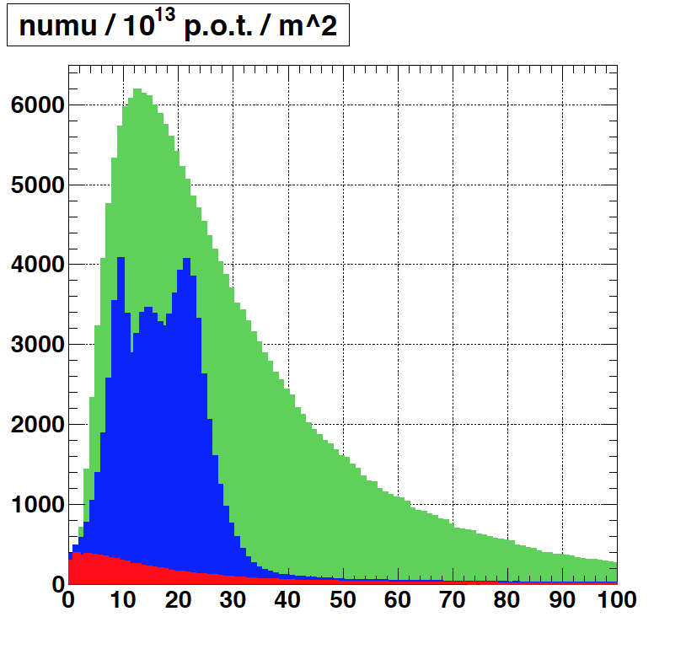
pf vs nf vs focus
ESS, no reflector
CNGS, 1 horn + 1 reflector
perfect focusing
pf with 22 mrad
acceptance
with 1500 mrad acceptance
present focusing
no focusing

Slide 27
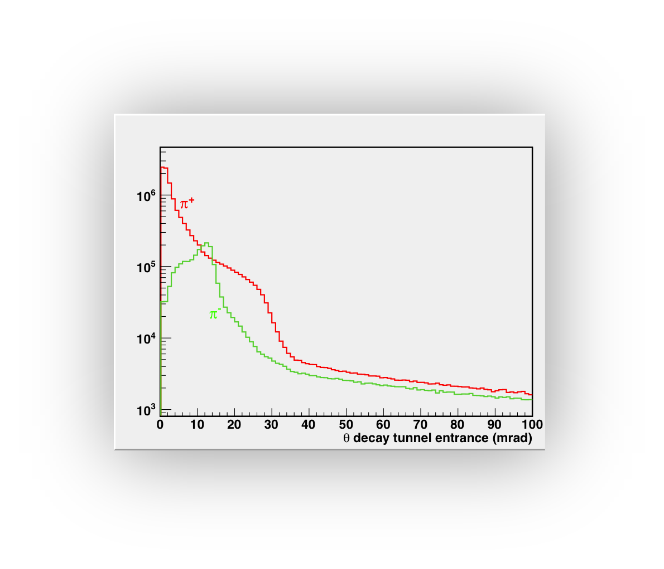
focusing-defocusing effect of the optics π⁺, π⁻ at the entrance of decay tunnel
ESS: good focusing effect, large θs and wider acceptance range @ production
CNGS
ESS
CNGS: Stronger focusing effect due to higher beam energy, lower θs
and acceptance @ production
100 (mrad)

Slide 28
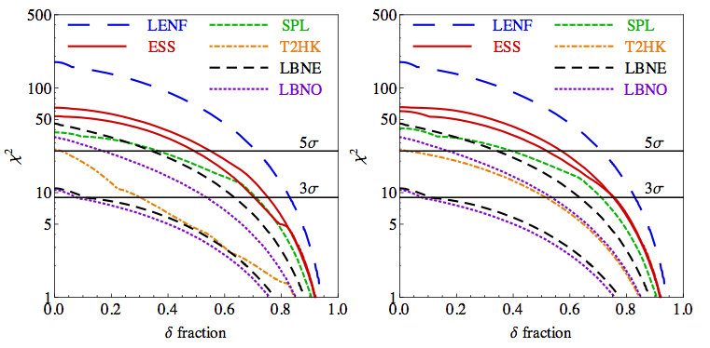
ESS with adopted parameters offers the best physics after LENF
Normal
Mass Hierarchy discovered
Unknown
Mass Hierarchy
LENF, Low Energy Neutrino factory (2000 m, 100 kt MIND, 4 MW)
SPL Super Beam, CERN to Frejus (120 km, 500 kt WC, 4 MW)
ESS Super Beam (540 km, 365 km 500 kt WC, 5 MW)
LBNO, CERN to Pyhasalmi (SPS, 2300km, 20 kt, 100 kt LAr, 0.8 MW )
T2HK Japan Super Beam Project(300 km, 560 kt WC, 1.6 MW)
LBNE USA long Baseline (1300 km, 10 kt, 33 kt LAr, 0.8 MW, 2.3 MW)

Slide 29
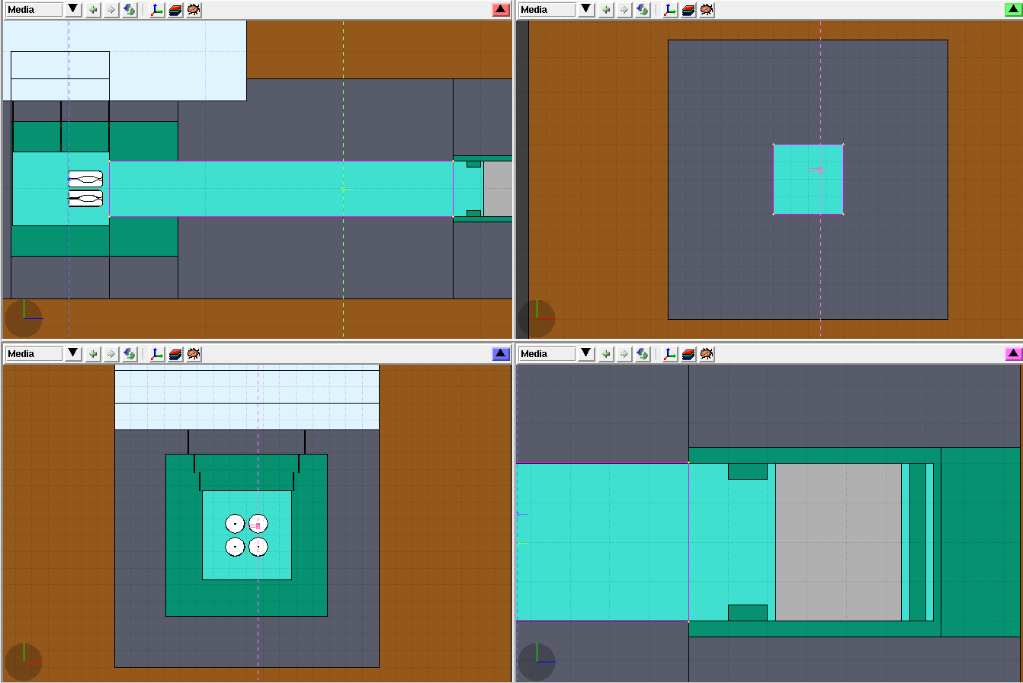
simulation layout for radiation fluka, flair gui/analysis iron-shields, concrete, molasse, He
decay tube
superbeam
beam dump
horn/target gallery

Slide 30
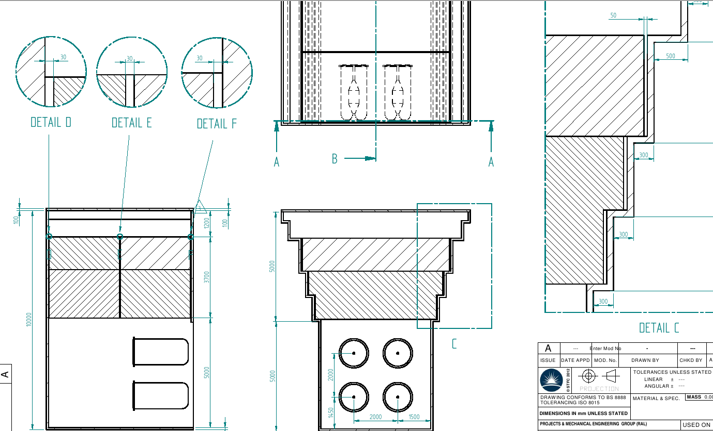
horn/target gallery
geometry for horn/target gallery – including holes:
transversal 3 cm see-through holes –
to see the effect
5 cm longitudinal holes

Slide 31
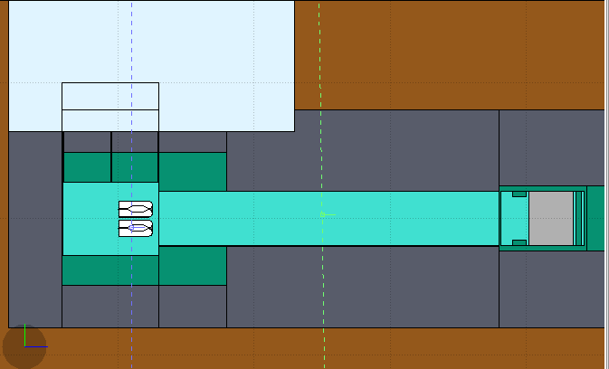
ESS/SPL power distribution iron, concrete, molasse, He
beam dump
graphite = 950/778 kW
iron = 195/229 kW
surr. concrete= 4/4 kW
kW/cm³
P tot = 4.2 / 3.4 MW
horns/target gallery
iron = 613/437 kW
horn = 50/ 32 kW
target = 168/ 85 kW
decay tunnel
iron vessel = 424/390 kW
upstream iron = 670/610 kW
surr. concrete = 467/485 kW

Slide 32
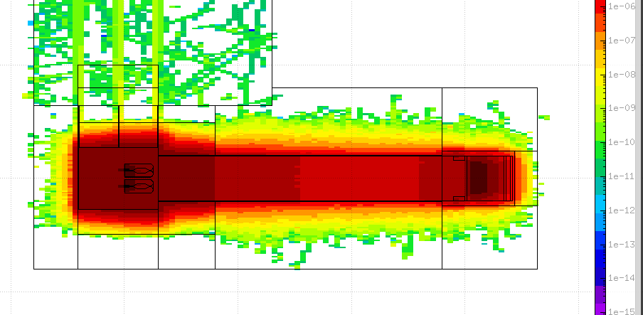
ESS neutron flux iron, concrete, molasse, He
SPL shielding achieves 10 μSv/h above target and horn, for ESS might be sufficient
On-going studies
neutron/cm²/p⁺

Slide 33
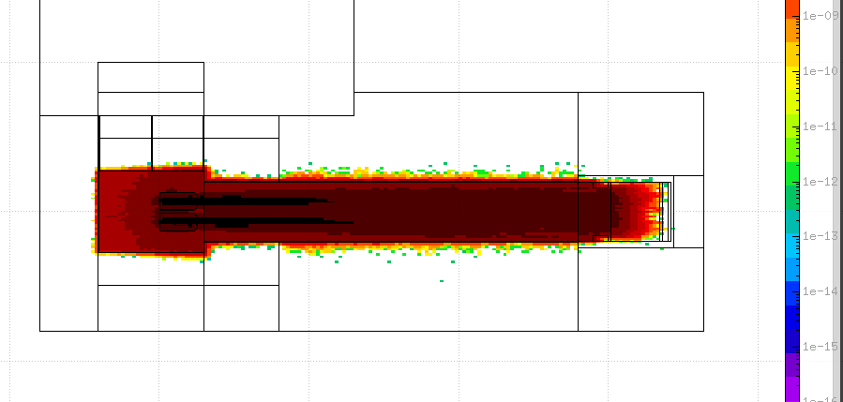
ESS muon flux iron, concrete, molasse, He
Preliminary, needs more stats
Near detector could be placed few 10ths
of meters after the bump dump gallery
μ⁺/cm²/p⁺

Slide 34
summary
ESS has the best physics performance after LENF with adopted SPL’s secondary beam parameters
Additional irradiation due to higher power and less proton energy for ESS looks manageable
Studies on going
Thanks

Slide 35
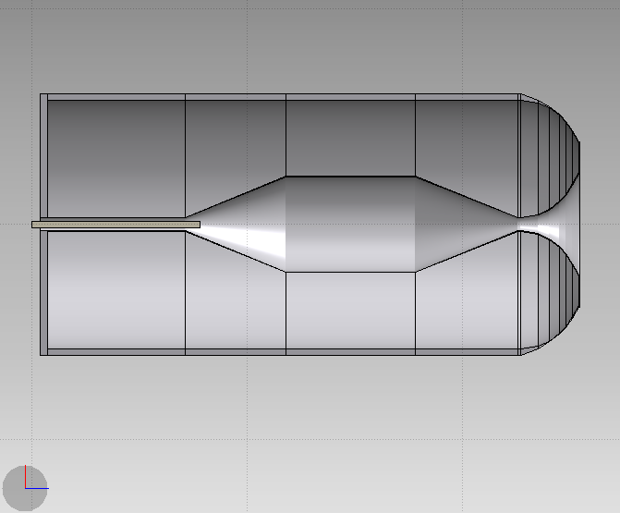
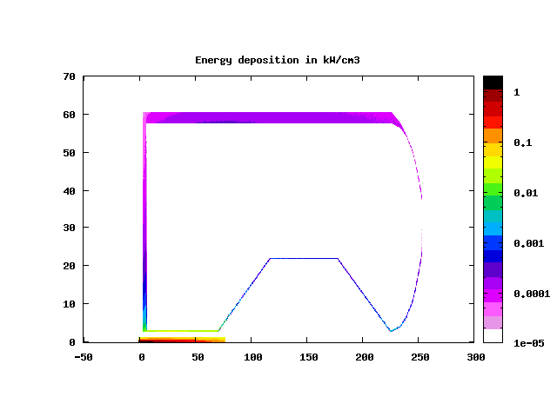
Energy Deposition from secondary particles
@1.3 MW @SPL
target Ti=65%d_{Ti} , R_{Ti}=1.5cm
36kW, t=30mm
8.6kW, t=35mm
1.7kW
2.4kW
1.3kW
2.5kW
9.5kW
radial profile of power density kW/cm³
P_{tg} = 105kW
P_{h} = 62kW
max

Slide 36
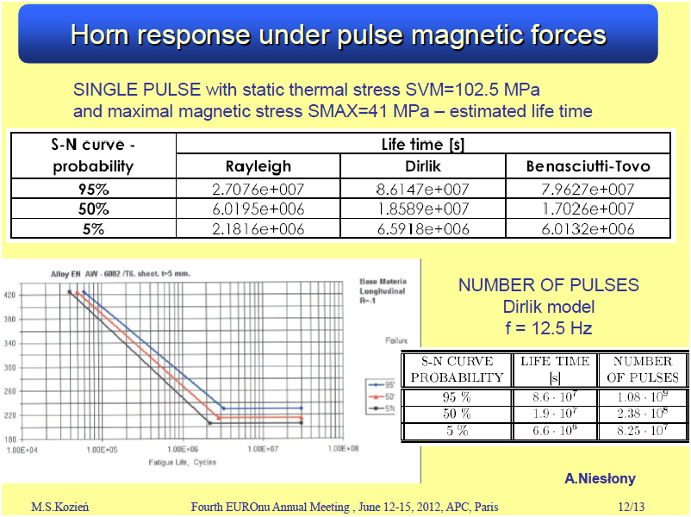
horn lifetime
lower than 60 MPa expected
highly conservative
1.25 10⁸ pulses = 200 days = 1 year

Slide 37
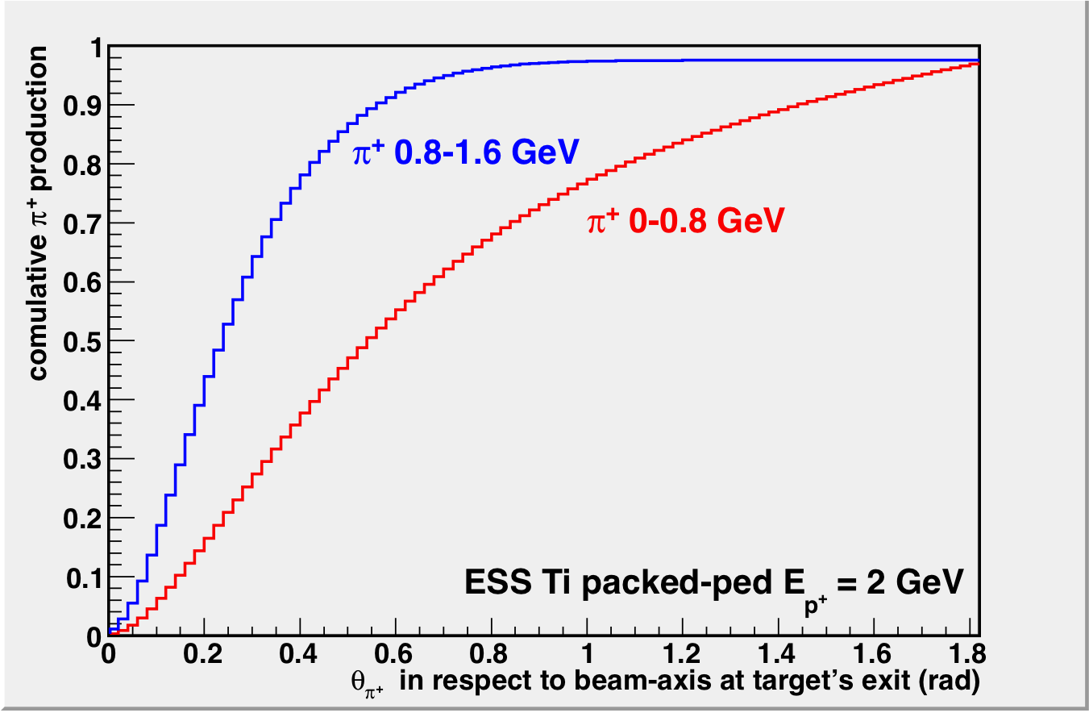
Cumulative pion production at target

Slide 38
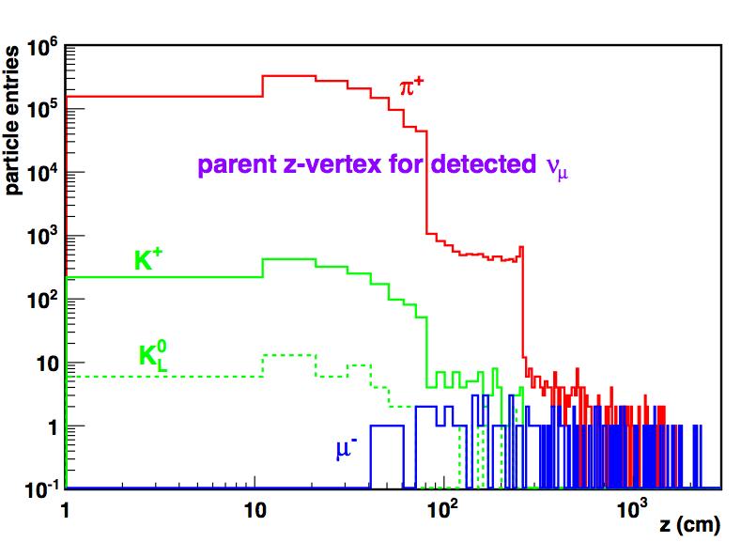

Slide 39
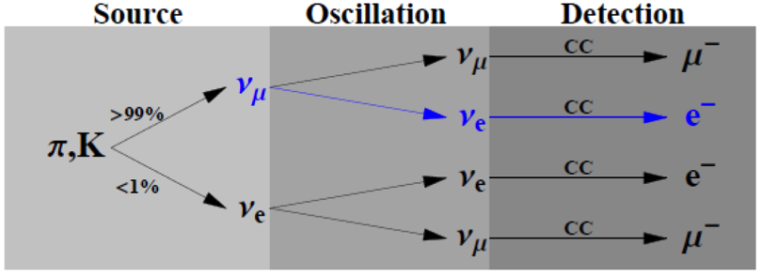
Reminder: ESS neutrino super beam
Based on ESS arXiv:1212.5058, EUROnu WP2 for SPL super beam, WP5 for MEMPHYS studies, Phys. Rev. ST Accel. Beams 16, 061001 (2013)
ESS Linac, (2.5 (2) GeV, 5 MW, modified for 50 Hz super beam)
PSU
Proton driver
beam dump
Accumulator
ring
Magnetic
horn capture
(collector)
decay tunnel
p
four horns/targets
station
Beam switchyard or
Four accumulators
Target
hadrons
ν_{μ}
decay tunnel
~ 290 MeV ν_{μ} beam to far MEMPHYS
water Cherenkov detector
~400 – 500 km

Slide 40



Slide 41

SPL: Activation in molasse
molasse @ CERN
concrete
preliminary
study set up:
packed Ti target, 65%d_{Ti}
4MW beam, 4horns, 200days of irradiation
minimum activation leads to minimum water contamination
²² Na and tritium could represent a hazard by contaminating the ground water
Activity distribution
CERN annual activity constraints in molasse (0.3mSv/year for the public through water) |  | Super Beam
²² Na | 4.2 x 10¹¹ Bq | ~10⁸ Bq
tritium | 3.1 x 10¹⁵ Bq | ~10⁸ Bq
Activation lower than CERN’s limits

Slide 42



Radiation Studies for horn/target gallery
prompt dose rates vs. concrete depth above shielding
10 μSv
iron collimator for power supply area
power distributions @ 4 MW

