Slide 1
Future Atmospheric Neutrino Experiments
Naba K Mondal
Tata Institute of Fundamental Research
Mumbai 400005, India

Slide 2
Brief History
Atmospheric neutrino experiments study neutrinos produced by cosmic ray interactions in the atmosphere.
First observed at Kolar Gold Fields (KGF), India and East Rand Proprietary Mine, South Africa in 1964.
During 1980s, massive underground detectors to search for proton decay studied atmospheric neutrinos as the major source of background.
In 1988, Kamiokande Experiment observed the deficit of atmospheric muon neutrinos compared to Monte Carlo prediction. Similar results were reported by the IMB experiment followed by Soudan-2 & MACRO.
In mid 1990s , Kamiokande data showed that the deficit of μ - like events depended on zenith angle.
In 1998, Super-K-experiment concluded that atmospheric neutrino data gave evidence for μ neutrino oscillation.
Atmospheric neutrino experiments have been contributing substantially in our understanding of neutrino masses and mixing angles.

Slide 3
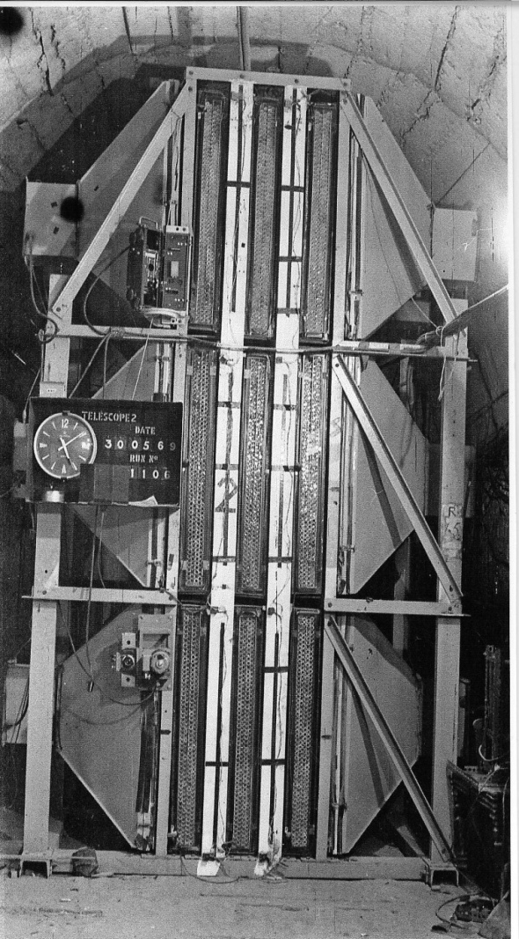
Detection of atmospheric
neutrino at Kolar Gold Field in 1965
The announcement of the discovery
of neutrino oscillation at Neutrino 98
by T. Kajita

Slide 4
Current status from Super-K

Slide 5
Atmospheric Neutrino Flux
Honda et al, ICRC 2013

Slide 6
Most important questions in neutrino physics today
Neutrino mass ordering – Mass Hierarchy
Is θ₂₃ maximal ? - Octant ambiguity.
CP violation in neutrino sector.
Non Standard interactions.
Violation of fundamental symmetries.
Study of atmospheric neutrinos have enormous potential
to answer these questions

Slide 7
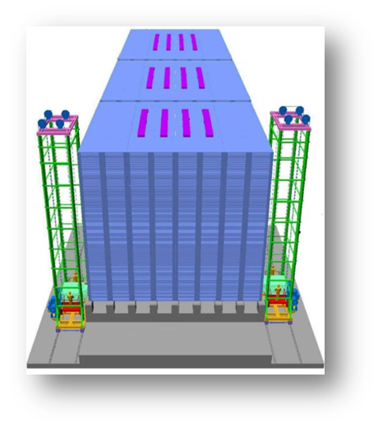
Upcoming Atmospheric Neutrino Detectors
ICAL@INO
PINGU
HYPER-K
All large long baseline neutrino detectors located underground
will also contribute to atmospheric neutrino physics

Slide 8
Oscillation probabilities of Atmospheric Neutrinos
Solar term
θ₁₃ resonance term
Interference term
r : ν_{μ}/ν_{e} flux ratio
P₂ : ν_{e} --> ν_{μ,τ} transition probability
R₂ , I₂ : Oscillation amplitudes for CP even and CP odd terms
For antineutrinos : P_{2,} R₂ , I₂ obtained by replacing matter potential V by -V

Slide 9
Plot equal probabilities of oscillation for energies and angles.

Slide 10
ν_{μ}◊ ν_{μ} and ν_{e}→ ν_{μ} oscillation in matter
Assuming Δm²₂₁ = 0

Slide 11
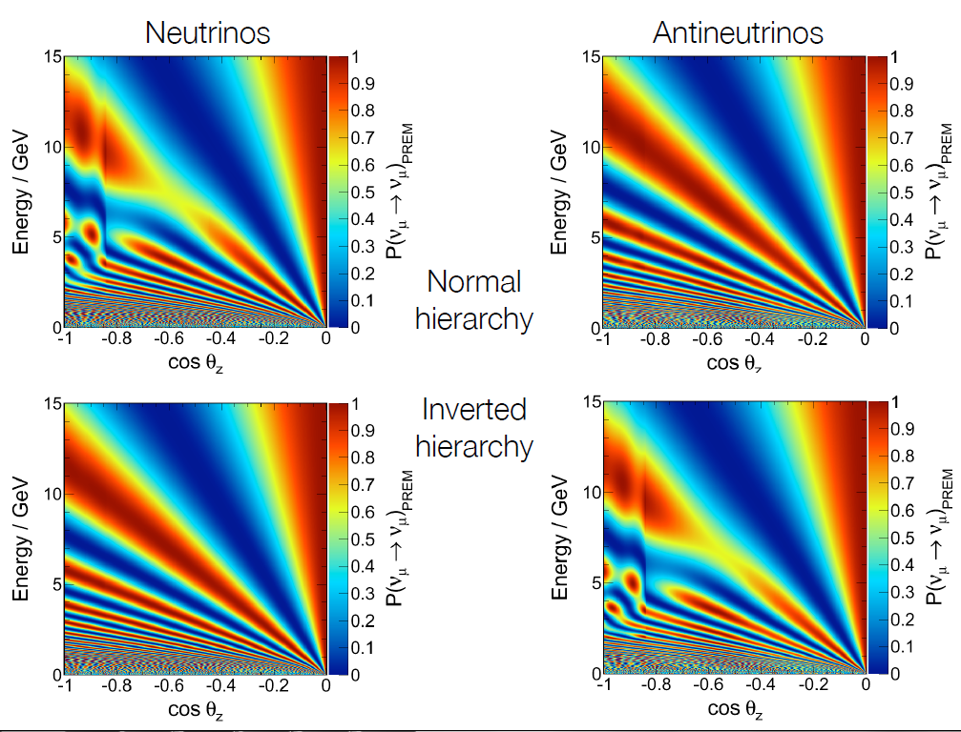
Atmospheric Neutrino Oscillation in Matter

Slide 14
INO

Slide 15
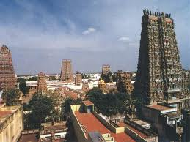
Madurai –the nearest major city
INO site is located 115 km west of the temple city
Madurai in the Theni district of Tamil Nadu close to
the border the between Tamil Nadu & Kerala.
Madurai has an international airport.

Slide 16
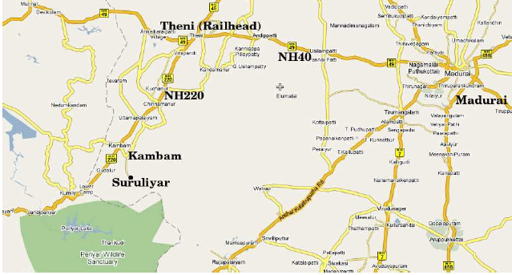
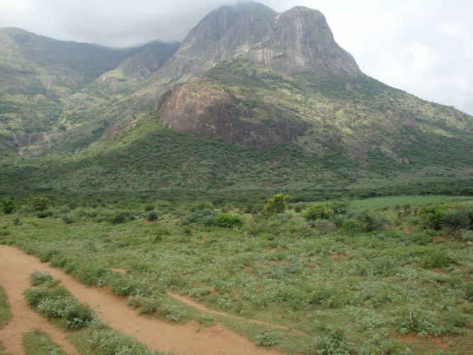
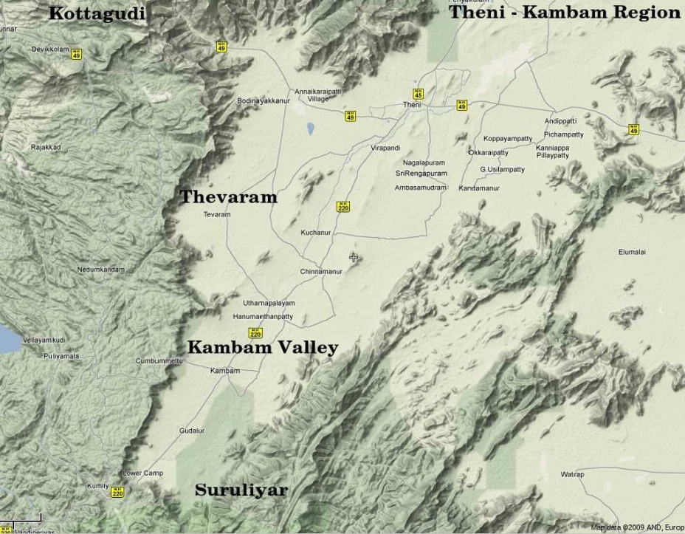
INO site : Bodi West Hills
Contact us:
9⁰ 58’ N, 77⁰ 16’ E
Pottipuram Village
Theni District
Tamil Nadu State

Slide 17
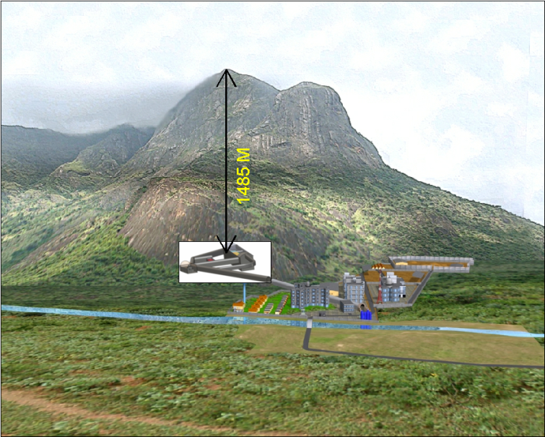
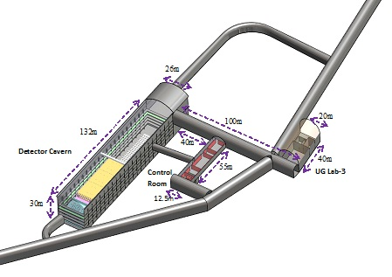
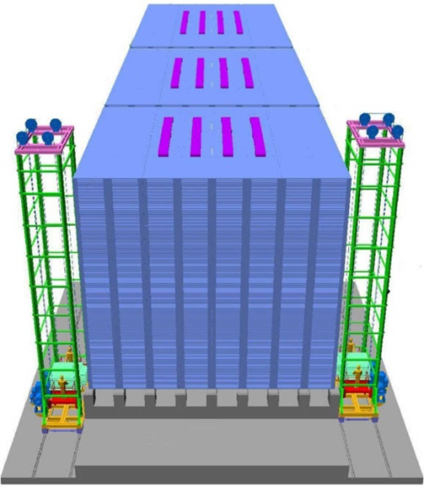
Underground complex
INO Facilities at Pottipuram
50 kton ICAL Neutrino Detector

Slide 18
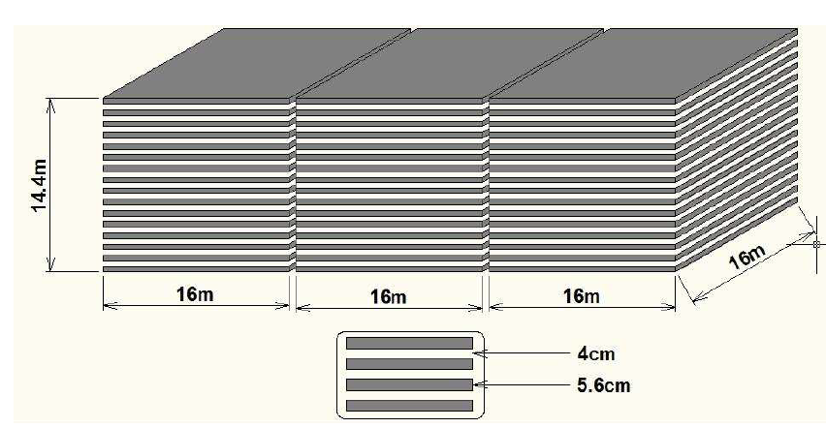
INO-ICAL Detector

Slide 19
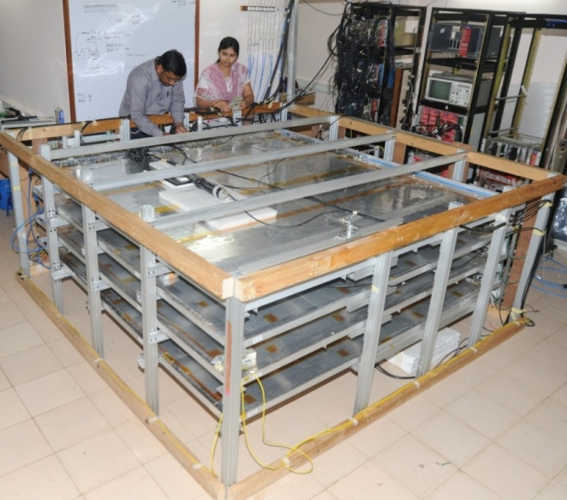
2m x 2m glass RPC test stand

Slide 20
Simulation Framework
Neutrino Event Generation
ν_{a}+ X -> A + B + ...
Generates particles that result from a random interaction of a neutrino with matter using theoretical models .
Output:
i) Reaction Channel
ii) Vertex Information
Iii) Energy & Momentum of all Particles
NUANCE
Event Simulation
A + B + ... through RPCs + Mag.Field
Simulate propagation of particles through the detector (RPCs + Magnetic Field)
Output:
i) x,y,z,t of the particles at their interaction point in detector
ii) Energy deposited
iii) Momentum information
GEANT
Event Digitisation
(x,y,z,t) of A + B + ... + noise + detector efficiency
Add detector efficiency and noise to the hits
Output:
i) Digitised output of the previous stage (simulation)
Event Reconstruction
(E,p) of ν + X = (E,p) of A + B + ...
Fit the tracks of A + B + ... to get their energy and
momentum.
Output:
i) Energy & Momentum of the
initial neutrino

Slide 21
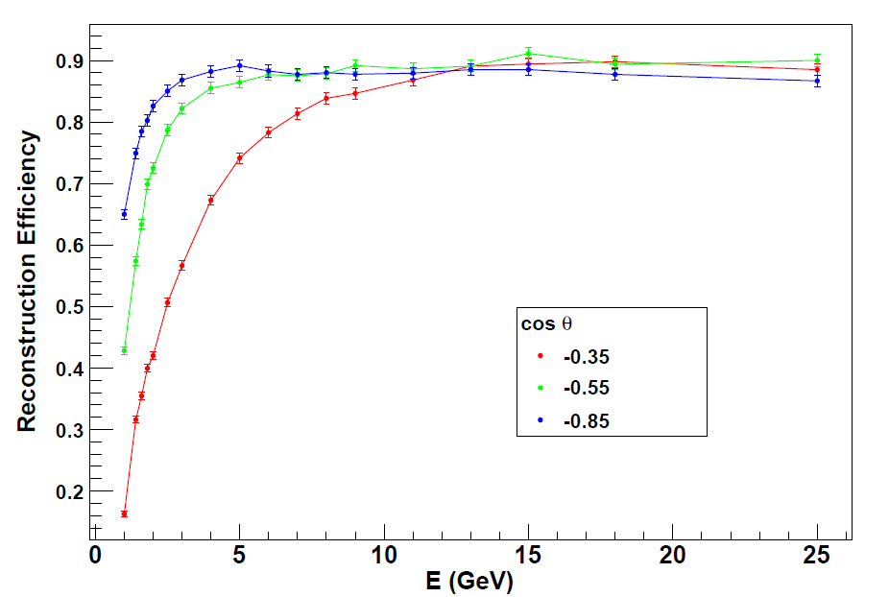
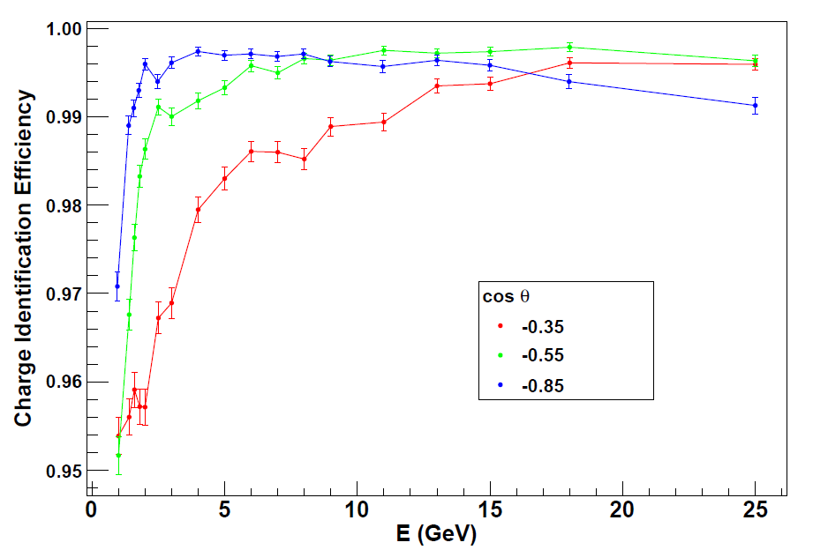
Detector Performances: Muon efficiencies

Slide 22
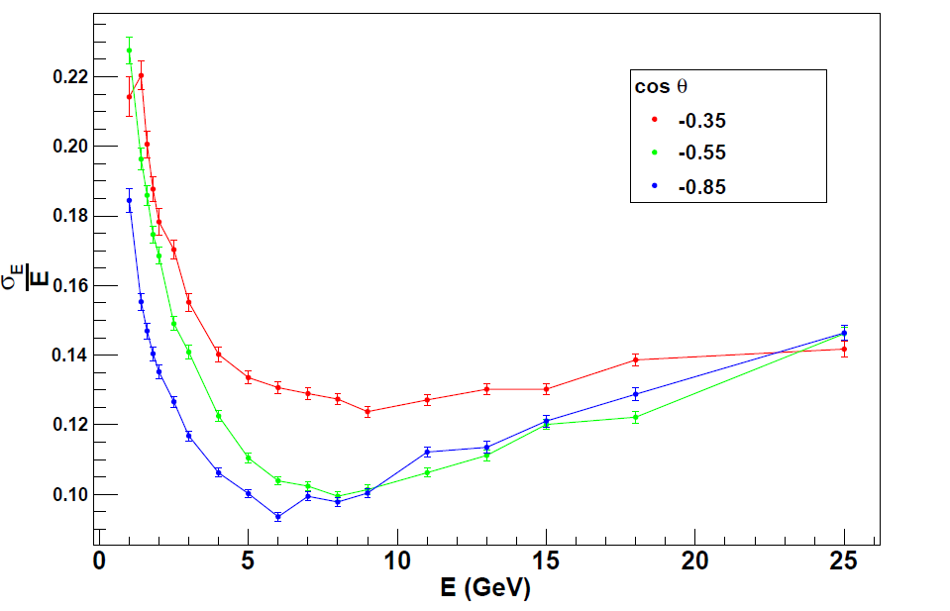
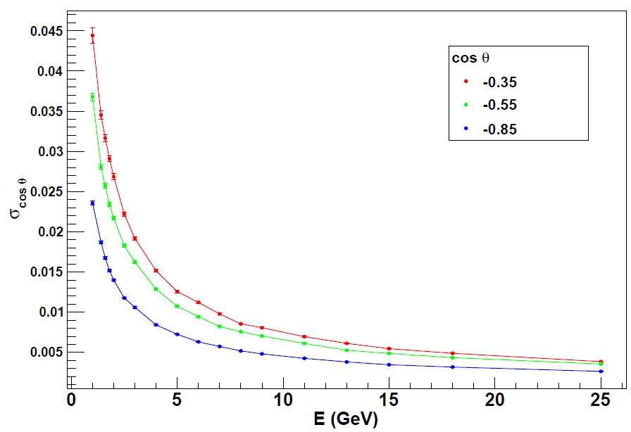
Detector performances: muon momentum resolutions

Slide 23
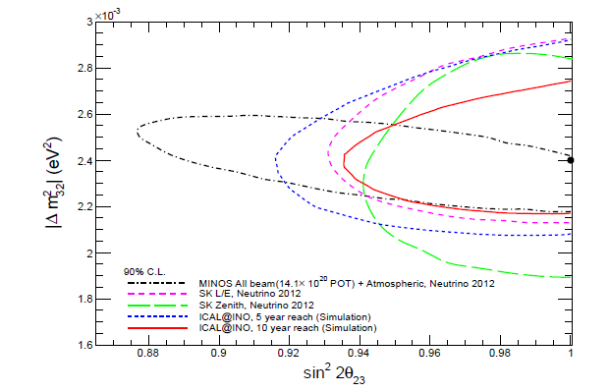
Atmospheric Parameters with INO ICAL
Thakore et al, INO collaboration, JHEP 1305, 058 (2013), arXiv: 1303.2534

Slide 24
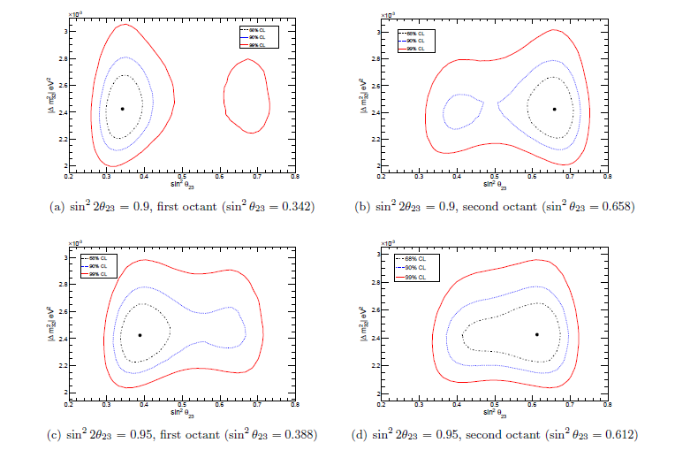
Octant sensitivity
Thakore et al, INO collaboration,
JHEP 1305, 058 (2013)arXiv: 1303.2534

Slide 25
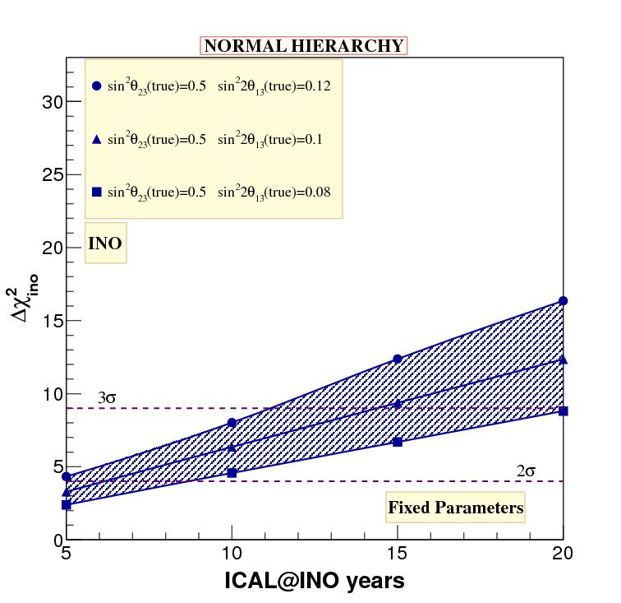
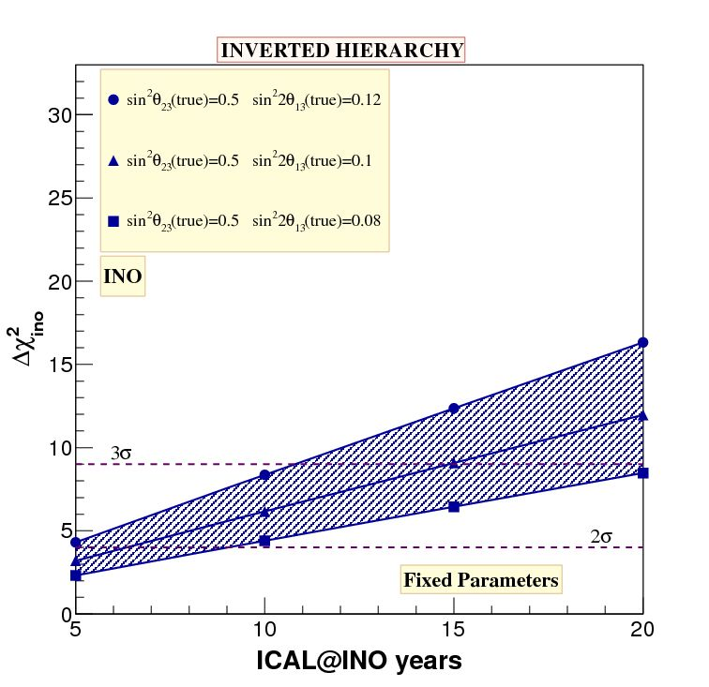
Mass hierarchy with INO-ICAL
Mass hierarchy sensitivity with INO-ICAL data only using fixed
Parameters - Sin² 2θ₁₃ = 0.12, 0.1, 0.08 and sin²θ₂₃ = 0.5.
A. Ghosh et. al. INO collaboration, JHEP, 1304, 009 (2013), arXiv: 1212.1305

Slide 26
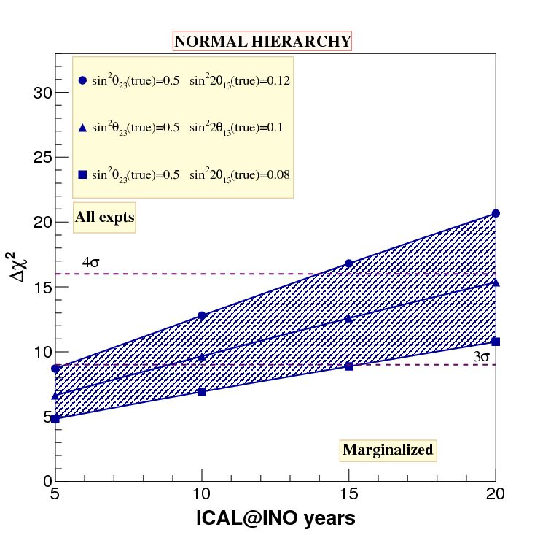
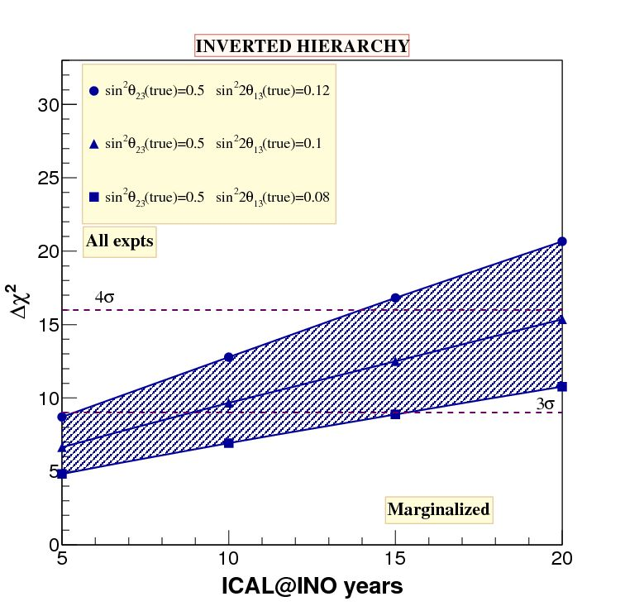
Mass hierarchy with INO-ICAL combined with accelerator & reactor experiments
A combined analysis of all experiments including ICAL@INO
as well ΝΟνΑ, T2K, Double Chooz, RENO and Daya Bay experiments
A. Ghosh et. al. INO collaboration, JHEP, 1304, 009 (2013), arXiv: 1212.1305

Slide 27
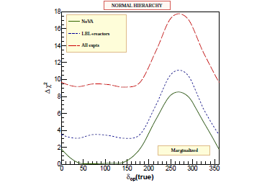
Impact of δ_{CP} on mass hierarchy
Sin²θ₂₃=0.5
Sin²2θ₁₃=0.1
Fully marginalised
A. Ghosh et. al. INO collaboration, JHEP, 1304, 009 (2013), arXiv: 1212.1305

Slide 30
Current Status
Pre-project activities started with an initial grant of ~ 10 Million dollar
Site infrastructure development
Development of INO centre at Madurai
Inter-Institutional Centre for High Energy Physics ( IICHEP)
Construction of an engineering prototype module
Detector R & D is now complete.
DPR for Detector & DAQ system is ready
Will start industrial production of RPCs soon.
Full project approved by Indian Atomic Energy Commission . Waiting for clearance from PM’s cabinet committee to start construction.

Slide 31
PINGU

Slide 32
Precision IceCube Next Generation Upgrade (PINGU)
Targeting 40 additional strings of 60-100 Digital Optical Modules each, deployed in the DeepCore volume.
• 20-25 m string spacing (cf. 125 m for IceCube, 73 m
for DeepCore)
• Precise geometry under study
• Systematics will be better
understood with additional
in situ calibration devices
Cost and technical issues well
understood from IceCube experience.
• Start-up costs of $8M – $12M.
• ~$1.25M per string.

Slide 33
PINGU Energy Range
A preliminary event selection
based on DeepCore analysis.
• 23,000 muon neutrinos per
year after oscillations.
• Oscillation signature is the
disappearance of 12,000
events per year.
Sufficient to measure neutrino
mass hierarchy via matter
effects in the 5-20 GeV range
Without direct ν_{μ} –ν_{μ}̅
Discrimination.
• Exploit asymmetries in
cross sections and kinematics.

Slide 34
Analysis Technique
Method outlined in Akhmedov, Razzaque, Smirnov- arXiv: 1205.7071
Bin, sum and subtract one hierarchy from the other
i = cos (zenith)
J = Energy
V^{eff} = Effective Volume
It works because:

Slide 35
PINGU- Experimental Signature of Mass Hierarchy
Idealized case with no
Background, perfect flavor
ID, 100% signal efficiency
Different assumed resolutions
Smear the signature but do
not eliminate it.

Slide 36
PINGU Hierarchy Sensitivity
Sensitivity depends on final detector scope, assumed analysis efficiency, detector resolution, etc.
• Caveat: not all systematics
included in each study
Even with pessimistic
assumptions, 3σ
determination expected
(median) with 2 years’
data.
• 5σ in 2-4 more years
Working now to refine details and extend systematic studies
arXiv:1306.5846

Slide 37
HYPER-K

Slide 41
Variation of event rate in Hyper-K (10 Yrs)
The difference is larger for larger Sin²θ₂₃ because resonance term is proportional to Sin²θ_{23.}
Can be used to study mass hierarchy sensitivity

Slide 42
Hierarchy sensitivity, 10 years of Atmospheric data
Normal Hierarchy
Thickness of the band corresponds to uncertainty induced from δ_{CP} .
Weakest sensitivity overall in the tail of the first octant.

Slide 43
Octant sensitivity, 10 years of Atmospheric data
θ₁₃ is fixed : sin²2θ₁₃ = 0.098
Thickness of the band corresponds to the uncertainty from δ_{CP}
Best value of δ_{CP} = 40 degrees.
Worst value of δ_{CP} = 140 (260) degrees, for 1st (2nd ) octant

Slide 44
CP-Violation Sensitivity - Exclusion of sinδ_{cp}=0
θ₁₃ is fixed : sin²2θ₁₃ = 0.099
Thickness of lines is from uncertainty in θ₂₃
Sensitivity to CP-violation is limited under both hierarchy assumptions.
The addition of this information to the beam data does not make much of an impact.

Slide 45
Hyper-K Status
Hyper-K has been recommended by Japanese HEP community and CR community.
Submitted the proposal to the Science Council of Japan in March 2013.
Hyper-K (far detector) construction and operation cost.
J-PARC operation w/ ~1MW and a near detector construction in the same package.
About 200 projects will be pre-selected. 25~30 projects will be selected as important large projects → ”SCJ Mater plan of large scale research projects”
This results will be important inputs to “Roadmap of large scale research projects” to be released by MEXT in 2015.
Proposal of Hyper-K R&D (photo-sensor, prototypical detector etc.) has been approved in July 2013 ($1.7M/5year, 2013~2017).

Slide 46
Concluding remarks
Atmospheric neutrino experiments have contributed substantially in our understanding of neutrino masses and mixing angles.
New set of Atmospheric Neutrino Experiments going to play important role in determining the neutrino mass ordering.
Need to combine results from Accelerator/ reactor based experiments for complete understanding of neutrino oscillation parameters.

Slide 47
Acknowledgement
Sandhya Choubey, Anushree Ghosh, Tarak Thakore & Amol Dighe – INO Collaboration
Dong Cowen, Tyce DeYoung, Ken Clark – PINGU collaboration
Takaaki Kajita, Masato Shiozawa – Hyper-K Collaboration
Thank You

